Slide 1


Better together?
An overview of terrestrial weather standards
Edmund Henley & Anna Milan
24 Oct 2025
Many thanks to many for input
For discussion part of session:
note WIS2.0 & CF representatives are kindly joining this session!
@MetOfficeSpace
Notes:
Terrestrial weather have well-established standards for data discovery, data transport, and data use. Common standards across all the relevant coupled spheres of terrestrial weather (cryosphere, hydrosphere, biosphere, geosphere, and atmosphere) greatly facilitate the exchange and use of model and observation data, and underpin the improvements in forecasting skill over time achieved by terrestrial weather. In this presentation we will provide a brief overview of the new WMO Information System 2.0 (WIS2.0) used for data discovery and exchange – including explorations for space weather purposes – and the CF conventions which facilitate data use, by standardising on variable names, coordinate reference frames, and units. This to facilitate comparisons with space weather equivalents, and to help discuss where opportunities for common approaches or compatibility may lie.

Slide 2
Motivation for session: let’s talk!
Why discuss space weather standards, R&O? Why now?
Various “R2O incubators” and operational centres are increasingly developing / deploying more space weather models, and integrating more observations
CCMC, ESA; SWPC, Met Office, SIDC, KNMI, …
As we scale out, the relative immaturity of standards in space weather – compared to terrestrial weather – is starting to hurt in various areas:
Sun-mud coupled models: linking subcomponent models, swapping out models
Verification (validation): easily comparing models and observations
Data assimilation: easily integrating observations into models
At small scale (few models / obs sources), can cope: use bespoke I/O, workarounds in code
At larger scale, without effort on standards, it’s harder to advance, and add value à la terrestrial
Within CGMS, am exploring options for standardising data & metadata for space weather observations from operational satellites (Henley, 2024; Monham 2024; Henley & Andries, 2025).
But not working in a vacuum: ISTP etc prior art – and 15 standards misgivings. Let’s talk…

Slide 3
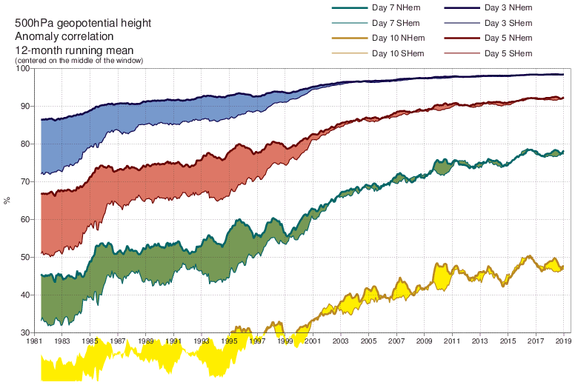


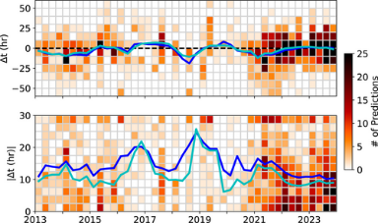
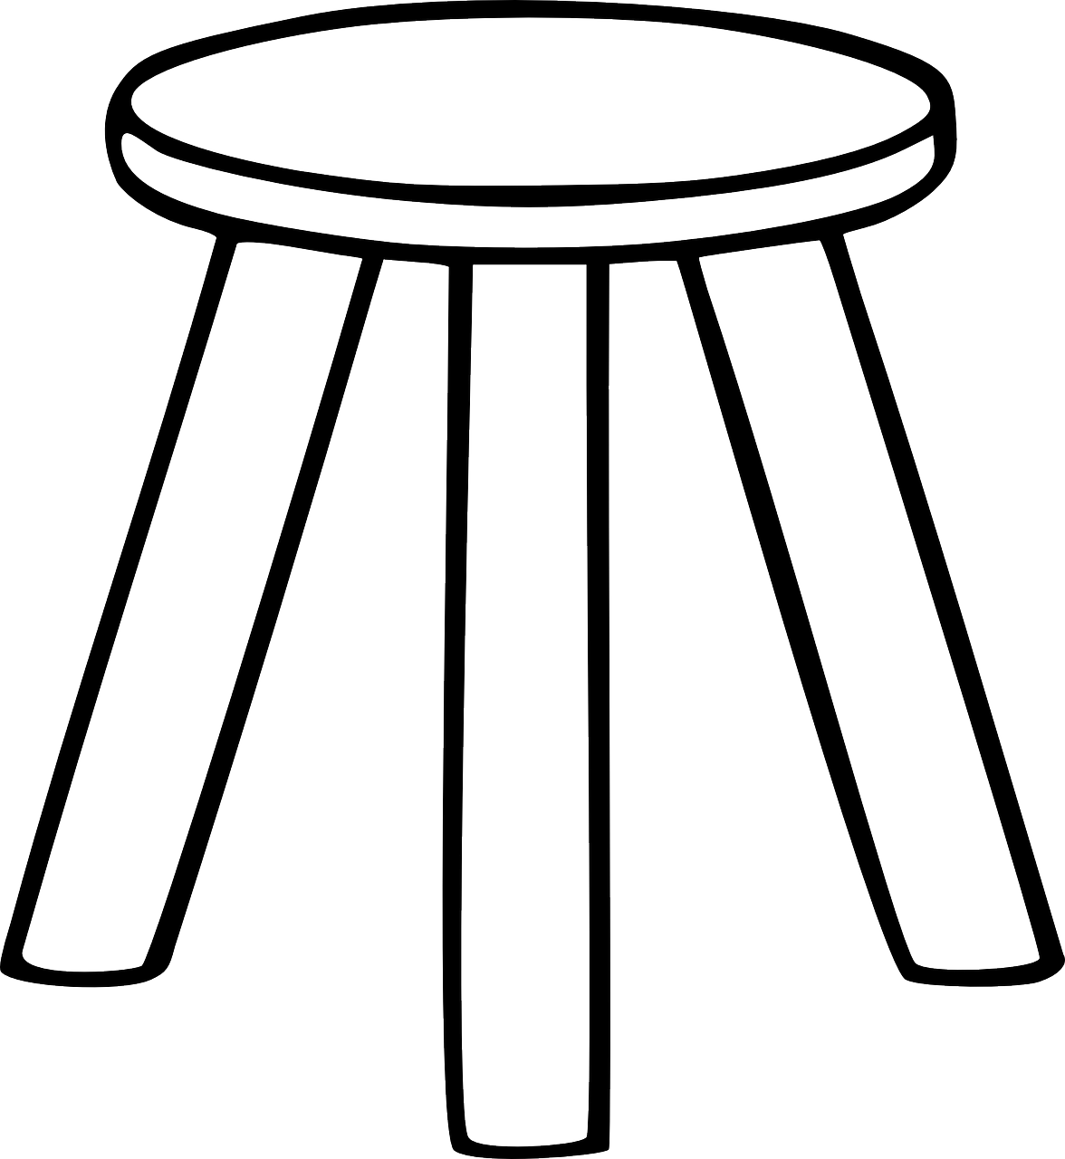


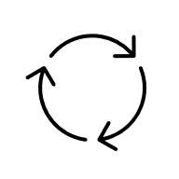


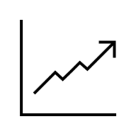
Process & progress: terrestrial / space
Standards: oil for TxWx ratchet & progress; lacking in SpWx
TxWx forecast improvements over time
Gained ~1 day lead time per decade
“Quiet revolution” of Bauer+ 2013
SpWx: unable to show equivalent progress
Skill metric: 500 hPa geopotential height anomaly correlation, 12M running mean
Riley+ 2018: “there is no evidence that the [coronal mass ejection] forecasts have become more accurate during this interval [2013 – mid-2018]”
Northern hemisphere
Better forecasts →
Continuous improvement ratchet rests on 3 legs
Same in Kay+ 2024 update. And big effort to get insight without underpinning monitoring & standards
Forecasts:
3 days ahead
Southern
Legs: better
* observing system
* models
* data assimilation
5 days ahead
7 days ahead
Drives more investment
Improves forecasts
1981
Time →
£$€
2019
ECMWF

Slide 4
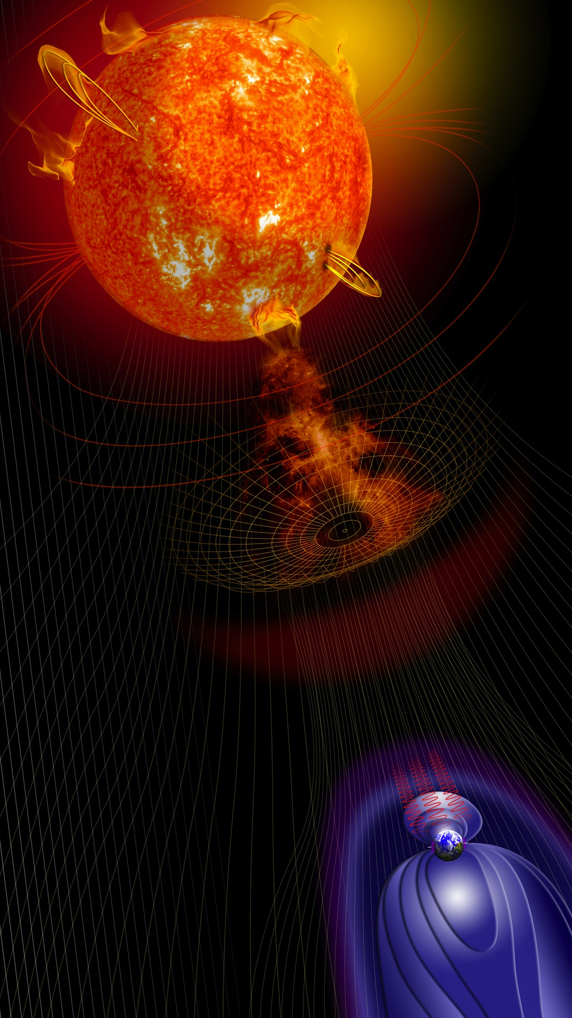


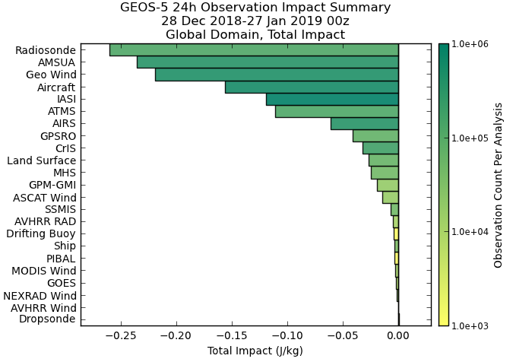

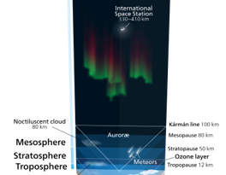






Characteristics: terrestrial / space
SpWx reliance on research affects landscape; both heterogeneous
Operational support inversion
SpWx operations must straddle ~all sun-mud spheres, be timely (NRT) & robust. Uses operational observations (e.g. GOES), some NRT research (e.g. STEREO)
SpWx research: focus on deep understanding, specific spheres, uses many non-NRT obs (funding hard)
Standards
& tools
NASA GSFC
Sun
Terrestrial
Space
Heliosphere
Magnetosphere
Radiation belts
Plasmasphere
Space weather Standards: none/lots
CRS: lots; no WKT
Tools: very bespoke
Weather balloons
Kelvinsong
Models, observations, standards efforts, …
Satellite
Exosphere
Thermosphere
Ionosphere
Ships
Standardsopause
Pain/waste if straddle
TxWx operations assimilate observations from many NRT operational sources, multiple spheres, and can quantify how each improves forecasts. Helps keep observing system funded
Mesosphere
Stratosphere
Troposphere
Terrestrial Standards: CF
CRS: GEO; WKT
Tools: flexible
External partners
Hydrosphere
Cryosphere
Biosphere
Easier if space weather ops can reuse well-supported infrastructure
NASA, 2019

Slide 5
Equivalences: terrestrial / space
Rough sketch of EH’s (mis?)understanding
What’s used for… | Terrestrial | Space
Discoverability | WIS2.0: WCMP2 | SPASE
Dissemination: access / transport | WIS2.0: APIs | HAPI
In-file metadata | CF / operations-oriented BUFR4 (obs), GRIB2 (models) | ISTP

Slide 6
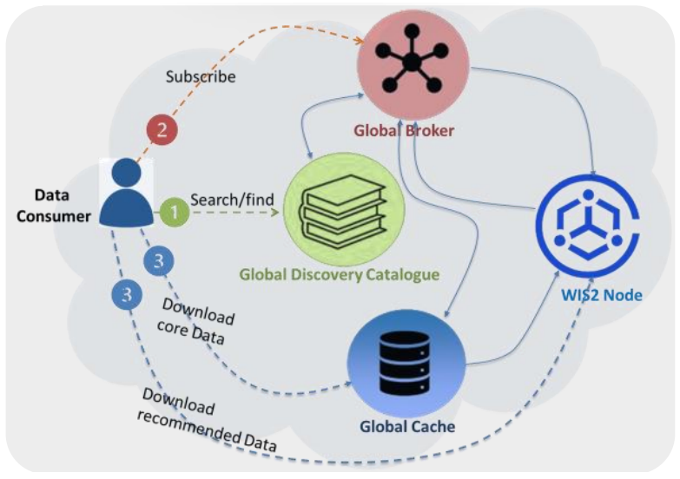




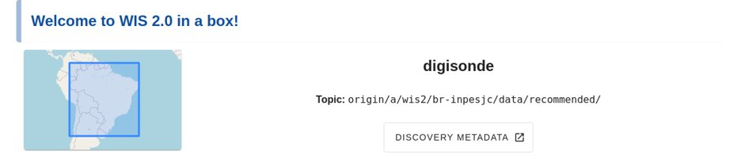
Discoverability & transport
WIS2.0 & WMO Core Metadata Profile 2.0 (WCMP2)
Useful talks at WMO 5th meeting of expert team on space weather on:
WMO’s global, well-supported WIS2.0 system
for data discovery & dissemination: Giraud 2024
Underpinning WCMP2 & WIGOS metadata: Kralidis 2024
search engines
WCMP2
«publish»
Global
Discovery
Catalogue
«index»
JSON
WIS2.0 pilot for ionosonde data exchange: Costa 2024

Slide 7

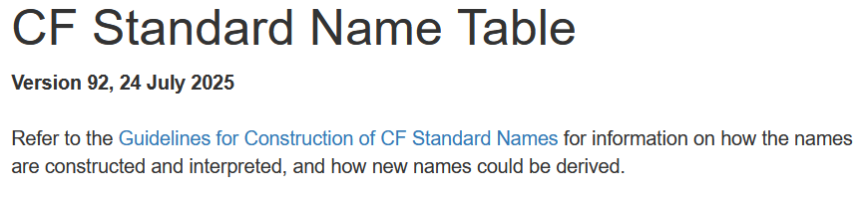
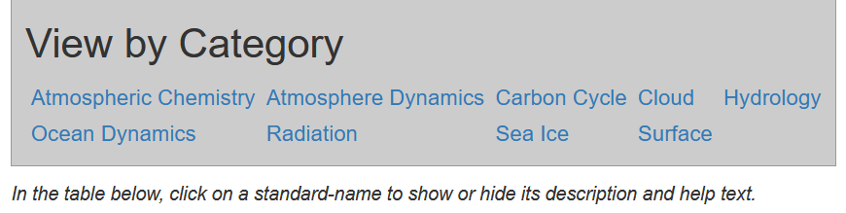
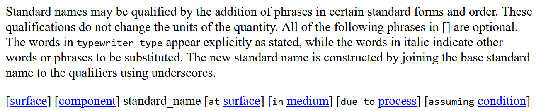
CF: variables
CF: cfconventions.org
Active community,
won AGU 2024 Open
Science Recognition Prize
Rich ecosystem of netCDF / CF tools:
cfchecker, nco, panoply, iris, (geo)xarray, …
cfconventions.org/…/cf-standard-name-table.html
standard_name attribute lets downstream libraries identify if var_A & var_B represent same quantity.
So can know if var_A - var_B is legal – and if so, what the quantity of the result is
See also: 3.3 Standard names
$ ncdump -h A1B_north_america.nc # TxWx: standard_name 😊
...
float air_temperature(time, latitude, longitude) ;
air_temperature:standard_name = "air_temperature" ;
...
// global attributes:
:Conventions = "CF-1.5" ;
$ ncdump -h OR_SEIS*_G19_*.nc # SpWx: no standard_name 😞
...
float H5MinuteDifferentialFluxes(report_number, energy) ;
...
H5MinuteDifferentialFluxes:long_name = "Hydrogen (H) differential flux for each energy band" ;
...
Guidelines for Construction of CF Standard Names: Qualifications
See also: CF FAQs: standard names

Slide 8

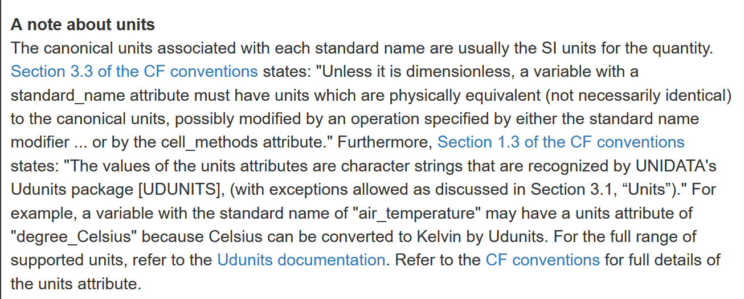
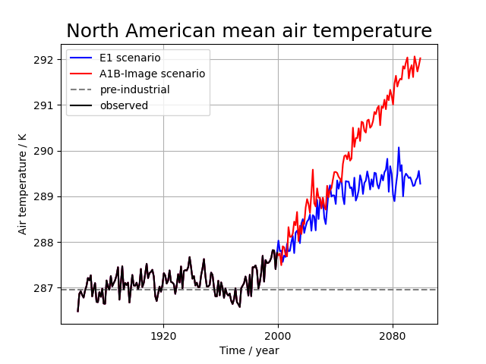
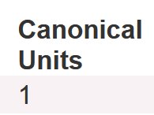
CF: units
Example libraries which underpin / get leveraged:
UDUNITS
cf-units
cfconventions.org/…/cf-standard-name-table.html
units lets downstream libraries identify the units for a data source. Also allows SI-aware updating of units if manipulating the data.
See also: 3.1 Units
$ ncdump -h A1B_north_america.nc # TxWx: units 😊
...
float air_temperature(time, latitude, longitude) ;
air_temperature:units = "K" ;
...
$ ncdump -h OR_SEIS*_G19_*.nc # SpWx: units 😊
...
float H5MinuteDifferentialFluxes(report_number, energy) ;
...
H5MinuteDifferentialFluxes:units =
"cm-2 sr-1 s-1 (MeV nuc-1)-1" ;
...
iris example:
automagic axis units
See also other iris examples on unit conversion:
multi-phenomena
derived temperature
1
year
kg m-3
kg m-2

Slide 9

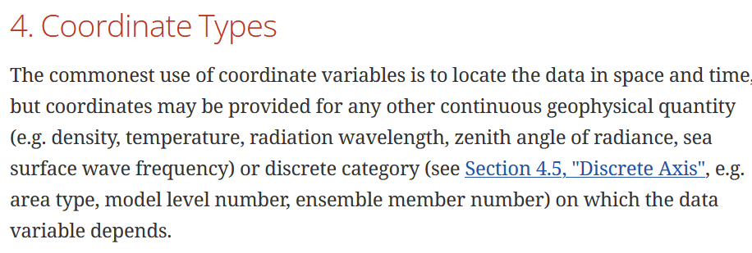
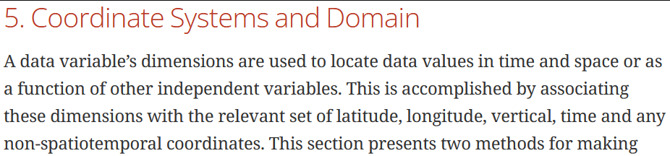
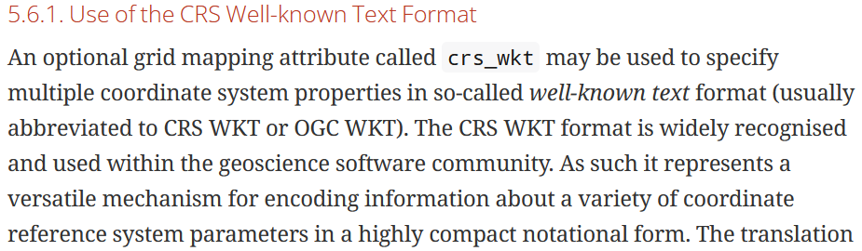
CF: coordinate reference frames
Standardised CRS metadata a key enabler to leverage powerful transformation libraries like PROJ
cfconventions.org/…/cf-conventions.html
Default coordinate reference system (CRS) assumed is GEO. However can use the grid_mapping metadata to specify other coordinate reference frames – e.g. rotated poles, or well-known-text descriptions of CRSs
$ ncdump -h rotated_pole.nc # TxWx: grid mapping 😊
...
air_pressure_at_sea_level:grid_mapping = "rot_lat_lon" ;
...
int rot_lat_lon ;
rot_lat_lon:grid_mapping_name = "rot_lat_lon" ;
rot_lat_lon:longitude_of_prime_meridian = 0. ;
rot_lat_lon:semi_major_axis = 6371229. ;
rot_lat_lon:semi_minor_axis = 6371229. ;
rot_lat_lon:grid_north_pole_latitude = 37.5 ;
rot_lat_lon:grid_north_pole_longitude = 177.5 ;
rot_lat_lon:north_pole_grid_longitude = 0. ;
$ # crs_wkt example from the CF docs 😊
...
float data(latitude, longitude) ;
data:grid_mapping = "crs: latitude, longitude" ;
...
int crs ;
...
crs:crs_wkt =
GEODCRS["WGS 84",
DATUM["World Geodetic System 1984", ELLIPSOID["WGS 84",6378137,298.257223563, ...

Slide 10
Questions

Slide 11
WMO references
WIS 2.0 Overview (webpage)
Manual on the WMO Information System (WMO-No. 1060), Volume II – WMO Information System 2.0
  WMO Core Metadata Profile (WCMP2)
Guide to WMO Information System (WMO-No. 1061),
Volume II – WMO Information System 2.0 (PDF)
Manual on Codes (WMO-No. 306), Volume I.2 (PDF)
  GRIB2 and BUFR4 standards
  WMO CF-Extensions

