Slide 1




COALITION FOR ADVANCING RESEARCH ASSESSMENT
Title of the event
PRESENTER
October 2025
Notes:
For technical issues, feel free to contact Secretariat in the chat

Slide 2

An urgent need to reform existing ways of assessing research
Assessment processes relying predominantly on journal- and publication-based metrics can be a hurdle to the recognition of diverse contributions and may negatively affect the quality and impact of research.
They also contribute to an unhealthy research culture and an unaffordable publication system.

Slide 3

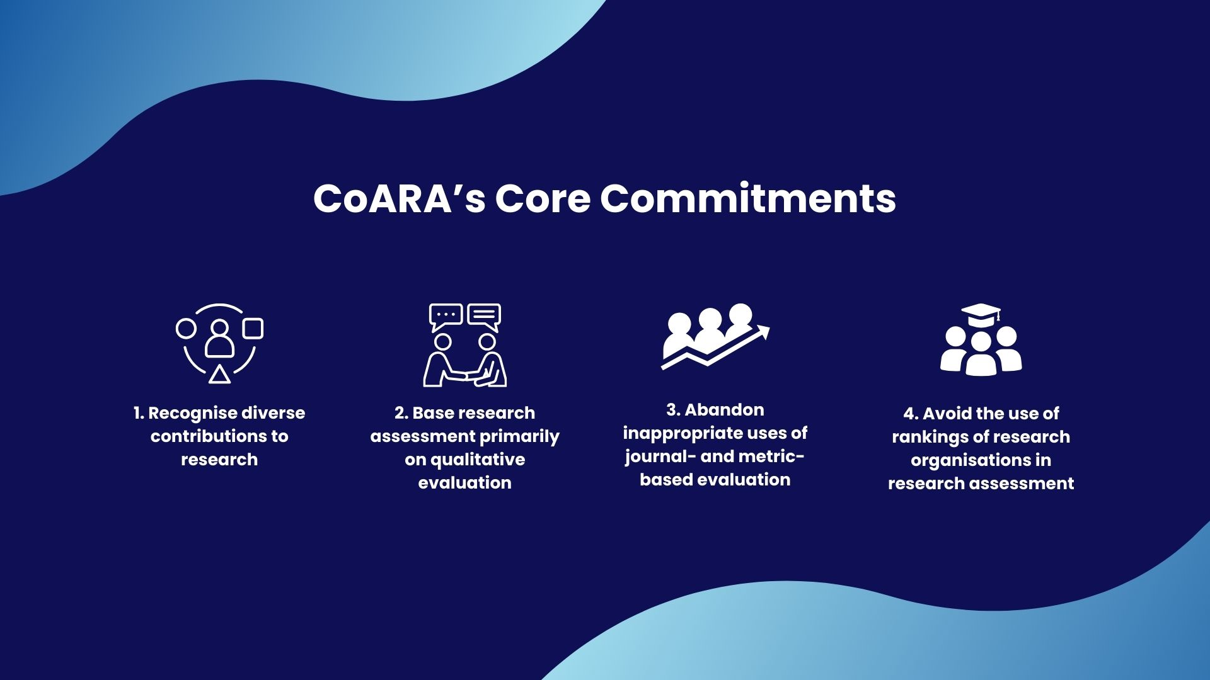

Vision and mission
Vision
In line with the Agreement, CoARA’s vision is that the assessment of research, researchers and research organisations recognises the diverse outputs, practices and activities that maximise the quality and impact of research.
Mission
Enable systemic reform of research assessment on the basis of common principles and commitments within an agreed timeframe, as set in the Agreement on Reforming Research Assessment. ​Through exchange of information and mutual learning between all those willing to improve research assessment practices.​
​

Slide 4


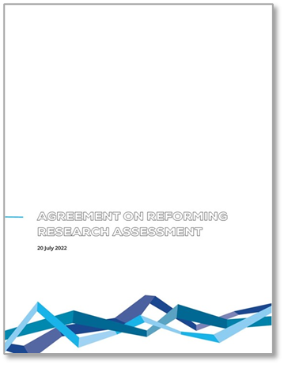




CoARA: a shared direction and harmonised lines of action
Brings together all actor groups relevant to the reform, acting as a coalition of doers
889 signatories
773 members
Implement the ARRA commitment within an agreed time frame and share progress
Signatories of the Agreement on Reforming Research Assessment (ARRA) do not only advocate for change, they also commit to actively drive reform in research assessment.
3rd birthday
Early impact, policy changes on EU. National, institutional levels
Notes:
Agreement: a collective effort
Don’t know whether you heard about CoARA :D
Why COARA (notes where), also to add that the largest

Slide 5




4 core commitments
1
2
3
4
Recognise the diversity of contributions to, and careers in, research, in accordance with the needs and the nature of the research
Base research assessment primarily on qualitative evaluation for which peer-review is central, supported by responsible use of quantitative indicators
Abandon the inappropriate uses in research assessment of journal- and publication-based metrics
Avoid the use of rankings of research organisations in research assessment

Slide 6

Supporting commitments
Commit resources to reforming research assessment as is needed to achieve the organisational changes committed to.
Review and develop research assessment criteria, tools and processes.
Raise awareness of research assessment reform and provide transparent communication, guidance, and training on assessment criteria and processes as well as their use.
Exchange practices and experiences to enable mutual learning within and beyond the Coalition.
Communicate progress made on adherence to the Principles and implementation of the Commitments.
Evaluate practices, criteria and tools based on solid evidence and the state-of-the-art in research on research, and make data openly available for evidence gathering and research.
Notes:
Supportive commitments: Three commitments to pilot and enable the move towards new criteria, tools ​
and processes for research assessment​
- Three commitments to facilitate mutual learning, communicate progress ​
and ensure that new approaches are evidence-informed

Slide 7

CoARA: From Agreement to Action

Slide 8


From Agreement to action
The Agreement
The Agreement on Reforming Research Assessment sets a shared direction for changes in assessment practices for research, researchers and research performing organisations.
Overarching goal
Maximise the quality and impact of research by setting a common direction
Scope
The Agreement includes the principles, commitments and timeframe for reforms and lays out the principles for a Coalition of organisations willing to work together in implementing the changes.

Slide 9




Timeline
Agreement includes touch-base points in years 1 and 5 after signature to communicate progress, based on self-assessment
By Year 1
By Year 5
Signatories share how their organisation has started the process of reviewing or developing criteria, tools and processes.
Signatories have regularly demonstrated progress towards reviewing, developing and evaluating criteria, tools and processes that fulfil the core commitments.
The Agreement is only the starting point!
Changes to be developed ​and implemented by the Coalition

Slide 10







Who can sign the Agreement?
The Agreement is open for signature to organisations from across the world.
Public or private research funding organisations and their associations
Universities, and their associations
National/regional authorities or agencies that implement some form of research assessment and their associations
Research centres, research infrastructures, and their associations
Other relevant non-for-profit organisations involved with research assessment,
and associations.
Academies, learned societies, and their associations, and associations of researchers

Slide 11
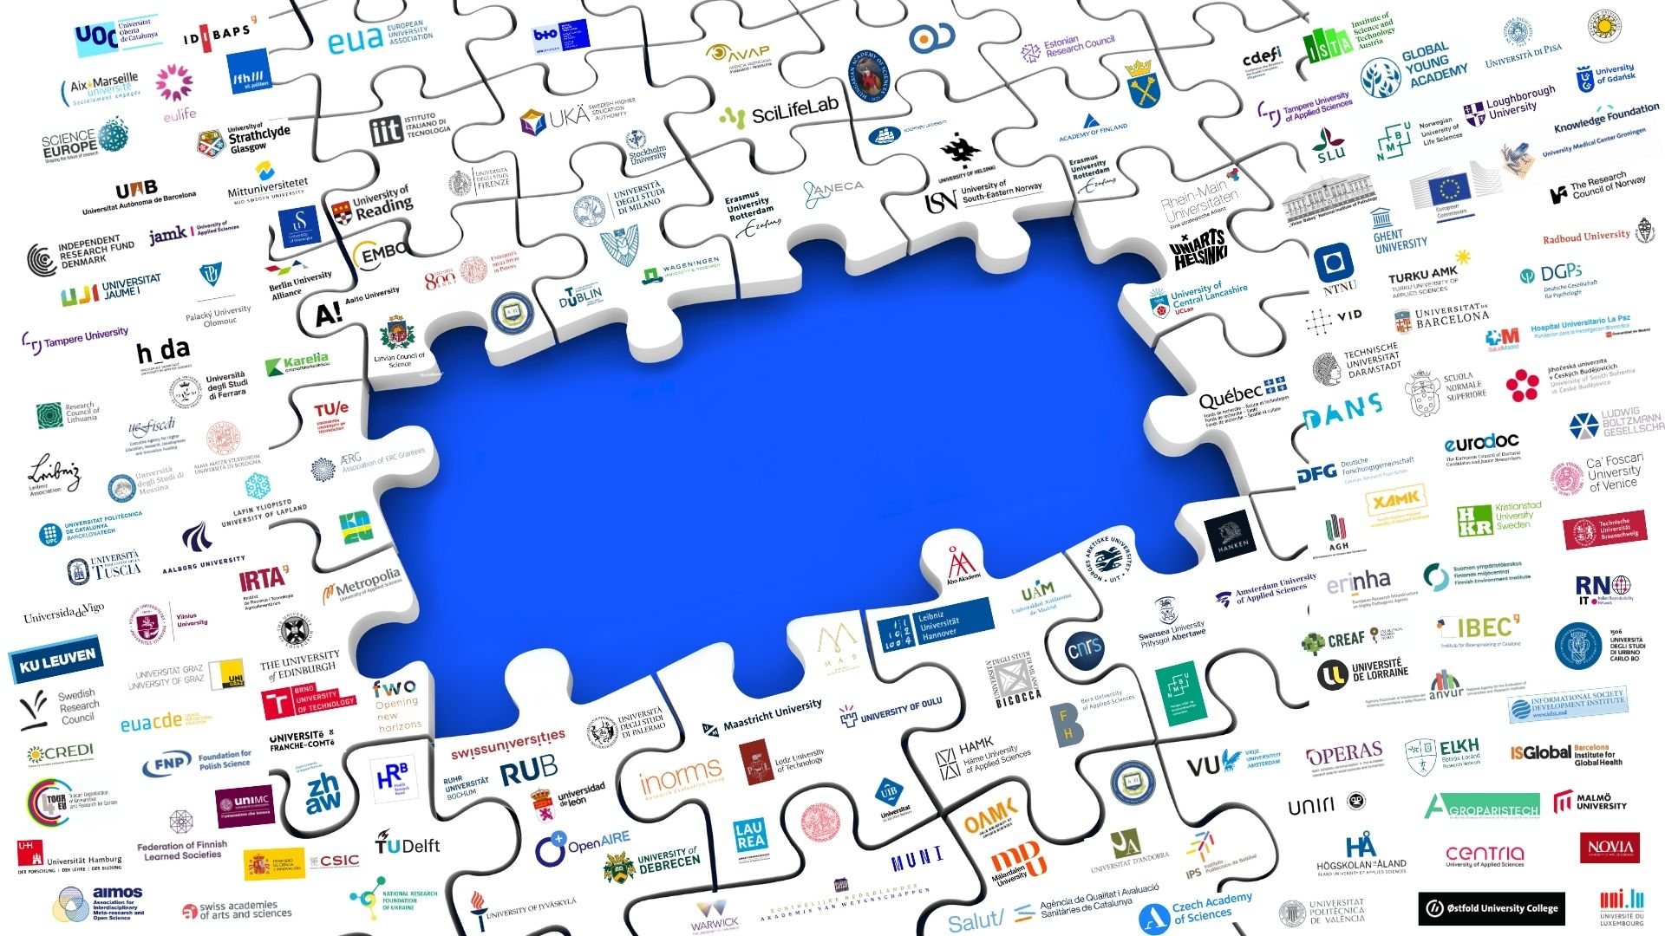
Action Plans: building blocks for advancing the reform
Action Plans play a vital role in fulfilling the core commitments of the CoARA Agreement, helping signatories and members outline key milestones for implementing research assessment reform
Upon signing the Agreement, organisations commit to developing an Action Plan within one year
Action Plans:
building blocks for reform

Slide 12









Signatory vs. Membership
Optional membership
SIGNATORY
MEMBER
ENDORSE PUBLICLY
ACHIEVE
CHANGE
JOIN THE COMMUNITIES
HAVE A VOICE
NETWORK AND LEARN
Publicly signal the need and your willingness to reform the current ways of research assessment
Realise change in your organisation by implementing the 10 CoARA commitments
through an action plan developed within your organisation
Benefit from communities of practice; propose and join Working Groups and National Chapters
Shape CoARA’s strategy by participating in governance and decision-making
Interact and share best practices with the CoARA network of members
As a signatory you can level up to membership any time. There are no membership fees.

Slide 13



CoARA Governing Bodies
General Assembly of Members:
All Members
Represents all members of the Coalition. The highest-level decision-making body.
Steering Board
Elected
Responsible for oversight, success, strategy, business plan and sustainability of the Coalition
CoARA Secretariat
Facilitates daily operations, nurtures communities around CoARA, and coordinates CoARA Boost project.

Slide 14
CoARA Membership

Slide 15
CoARA membership per organisation type
As of October 17th, 2025
In descending order of total share:
779 member organisations
895 signatories
[17 October 2025]

Slide 16
CoARA membership per country
As of October 17th, 2025
Membership total:
779
# of countries*:
58
(17 October 2025)
Number of members
*excl. pan-European and global organisations

Slide 17
CoARA membership: international outreach goals
As of October 17th, 2025
Countries strongest presence:
Spain (85), Italy (72), Poland (55), France (54)
>35 members
20-35 members
15-19 members
5-14 members
<5 members
Total nb of Members: 779 (17/10/2025)

Slide 18
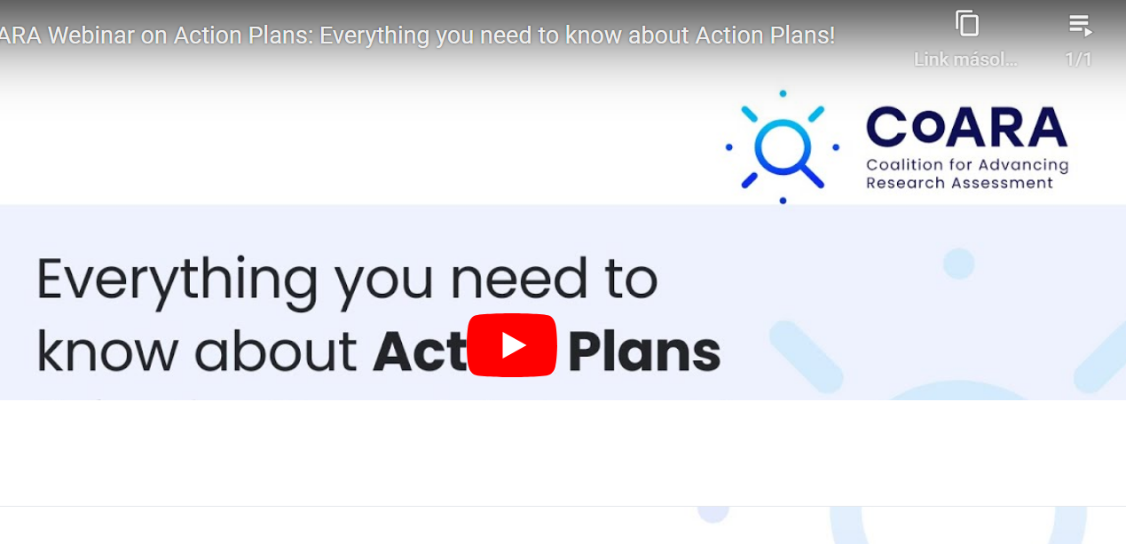
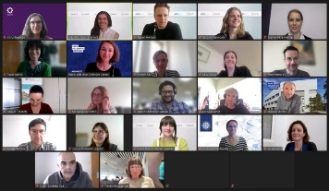



CoARA in action: paving the way for systemic change
Commitments reflected in Action Plans
Established corpus
Webinar and other support mechanisms
National level discourse
Active Working Groups (WGs)
Consultations and events
First outputs
Regular updates via the website and newsletter
16 National Chapters
Local implementation communities
Liaising with ministries, outreach work, support to action plans
Growing number of National Chapters (NCs)
Cascade Funding Beneficiaries
Grants for institutions to implement the ARRA
80+ applications for 25 projects funded (Call 1)
130+ applications for 28 projects funded (Call 2)
CoARA Events
Online and hybrid
Call for hosting events for CoARA members
Notes:
Speaking of implementation paths, let's have a look at them, at a glance: we see a steadily growing corpus of action plans, busy working groups and National Chapters, cascade funding program to catalyse institutional change, and the possibility to co-host CoARA events, to create spaces for discssion around central coara matters and overall, to keep the reform as aligned as possible, but as diverse as necessary. I will bring you closer to these activities in a second but first let’s have a look at the growth of the coalition.

Slide 19
CoARA Communities: Working Groups and National Chapters

Slide 20




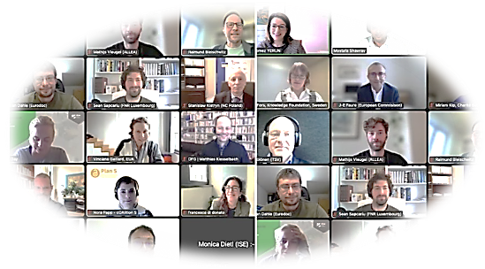









Overview of the CoARA Working Groups
Reforming Academic Career Assessment
Multilingualism and Language Biases in Research Assessment
Towards Open Infrastructure for Responsible Research Assessment
Recognizing and Rewarding Peer Review
Global Framework for Research Evaluation in the Social Sciences and Humanities (SSH)
Experiments in Assessment – Idea Generation, Co-Creation, and Piloting
Responsible Metrics and Indicators
Improving Practices in the Assessment of Research Proposals
Towards Transformation, Transdisciplinarity, Applied/Practice-Based Research, and Impacts
1st WGs Co-Chair meeting
17 November 2023
Ethics and Research Integrity Policy in Responsible Research Assessment for Data and Artificial Intelligence
Early-and-Mid-Career Researchers (EMCRs) – Assessment and Research Culture
TIER – Towards an Inclusive Evaluation of Research
Supporting the Alignment of Research Assessment Systems with CoARA in Biomedical Disciplines Through Administrative Reforms and Governance
Notes:
Based on a bottom-up approach with members’ voluntary involvement, Working Groups operate as ’communities of practice’, providing mutual learning and collaboration on specific thematic areas.

Slide 21
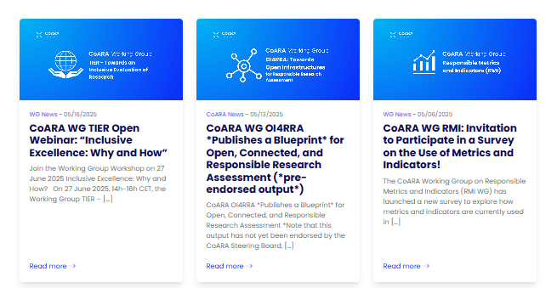
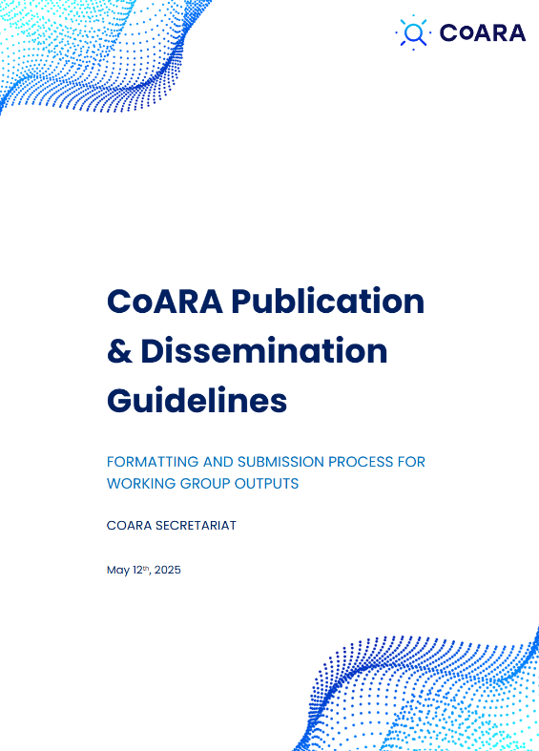
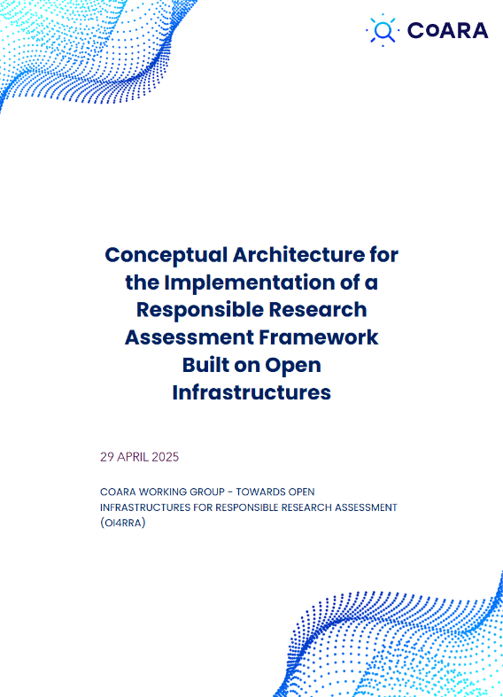

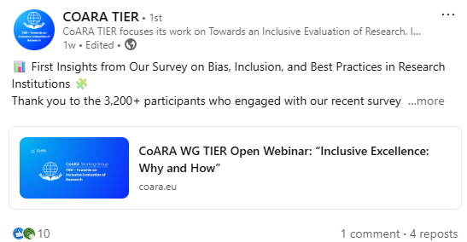


Working Group highlights
1st wave of WGs are nearing the end of their operations, early outputs
WG Publication and Dissemination Guidelines on Zenodo
Outputs Endorsement framework
Surveys, workshops, reports
See a progress overview here: CoARA Boost D4.3: First progress report of WGs, including (Co-) Chairs Forum
Find pre-endorsed outputs in the CoARA Working Group Zenodo community: CoARA Working Groups
Events, outputs resources… available on the CoARA website
Upcoming event:

Slide 22

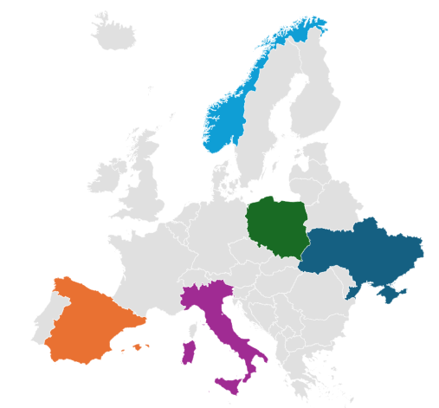

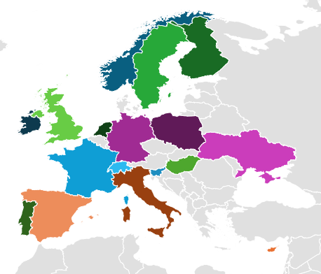
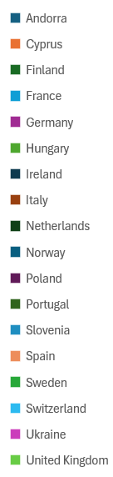
National Chapters are central for a coherent and diverse CoARA
National Chapters in 2023
National Chapters in 2025
r

Slide 23
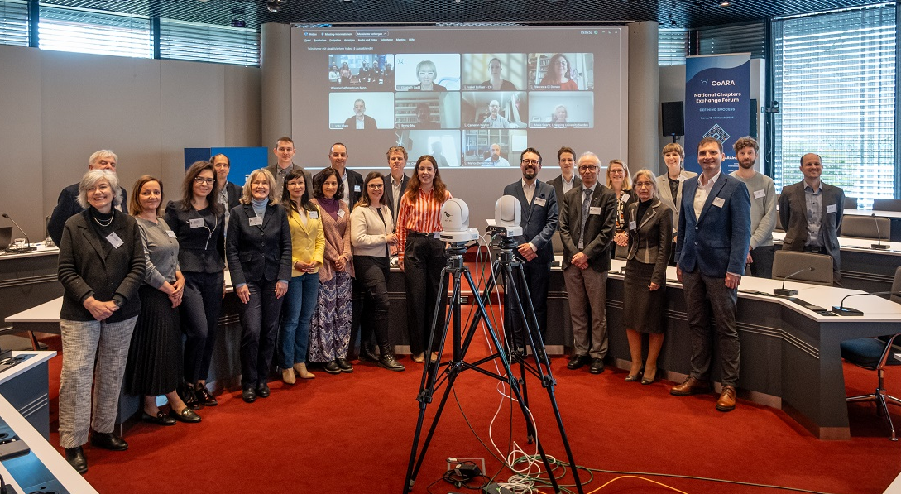

National Chapters are central for a coherent and diverse CoARA
2nd National Chapters Exchange Forum: “Defining Success,” at the DFG headquarters in Bonn, Germany on 13-14 March 2025
Support framework to and a multidimensional typology of National Chapters under definition
Overview of NCs available on Zenodo: Overview of the CoARA National Chapters - printable booklet
Video interviews with the NC Co-Chairs, available on the CoARA Youtube channel
Upcoming:
3rd National Chapters Exchange Forum: March 2026 in Spain, co-organised by CSIC

Slide 24
Supporting CoARA: Boost Project and Cascade Funding, funded by the European Union

Slide 25









CoARA Boost Partners
ESF
European Science Foundation
France
Coordinator
ALLEA
All European Association
Germany
CNRS
Centre National de la Recherche Scientifique
France
MCAA
Marie Curie Alumni Association
Belgium
Science Europe
Belgium
ANVUR
Agenzia Nazionale di Valutazione del Sistema Universitario e della Ricerca
Italy
CRAC-Vitae
Careers Research and Advisory Center
United Kingdom
HUN-REN
Hungarian Research Network
Hungary
YERUN
Young European Research Universities Network
Belgium

Slide 26




CoARA Boost Objectives
Strengthen CoARA’s operational capacity
Provide infrastructure, resources, and coordination to support CoARA’s growing activities and ambitions.
Catalyse the reform and institutional change
Advance knowledge development, policy evolution, and transformation of research assessment.
Enable knowledge sharing
Facilitate the collection, exchange, and synthesis of information among CoARA members and beyond.
Expand and empower membership
Grow the Coalition’s reach within Europe and internationally, engaging new actors and building momentum.
Notes:
As oretty much reflected in WOs. Strengthen CoARA’s Operational Capacity
– Provide infrastructure, resources, and coordination to support CoARA’s growing activities and ambitions.
Catalyse Reform and Institutional Change
– Advance knowledge development, policy evolution, and transformation of research assessment practices.
Enable Knowledge Sharing
– Facilitate the collection, exchange, and synthesis of information among CoARA members and beyond.
Expand and Empower Membership
– Grow the Coalition’s reach within Europe and internationally, engaging new actors and building momentum.

Slide 27
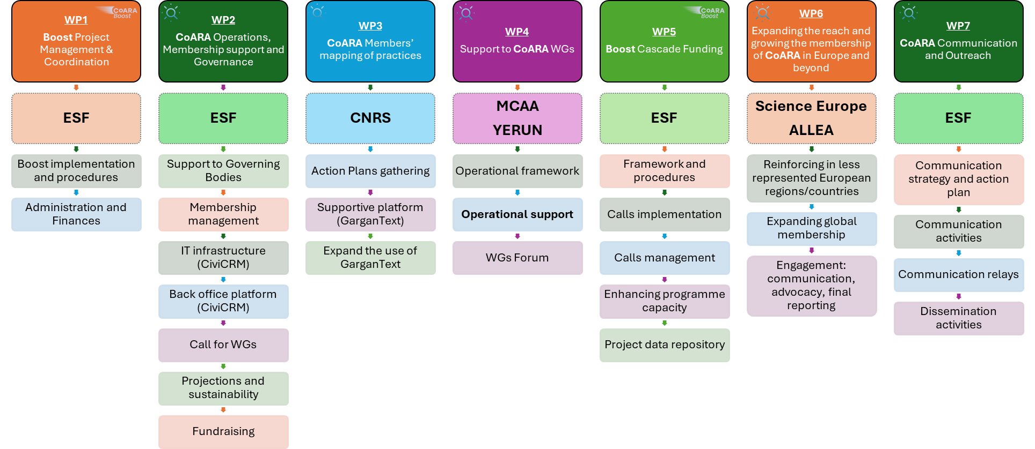
CoARA Boost Project overview

Slide 28
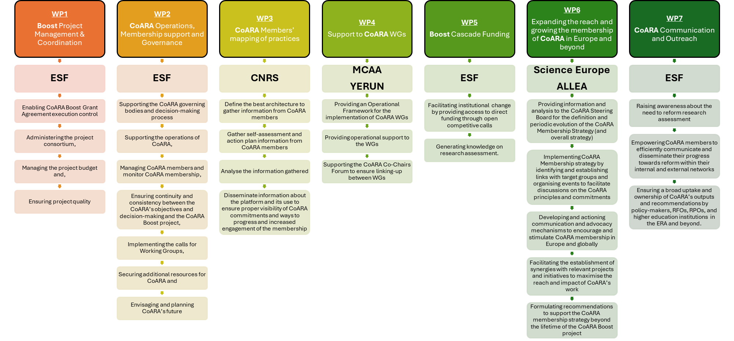
CoARA Boost WPs’ objectives

Slide 29








The big picture
PLAN
MEANS
GOALS
Membership Growth
WP2 - CoARA Operations, Membership support and Governance
Membership management
WG calls
Governance of CoARA
Support to members and actor groups
Action
plans
WP3 – Members’ mapping of practices
Collection
Analysis
Database of action plans
Activity areas
Working Groups (WGs)
WP4 – Support to CoARA Working Groups
Operational framework for WGs
WGs Co-Chair Forum
Global Outreach
WP6 - Expanding the reach of CoARA
F2F and online CoARA events
Outreach
WP7 - Communication
Strengthening the implementation of the Agreement
WP1 - Project Management
Podcasts
Webinars
Policy briefs
WP5 – Cascade Funding
2.75 m€ to RRA projects

Slide 30
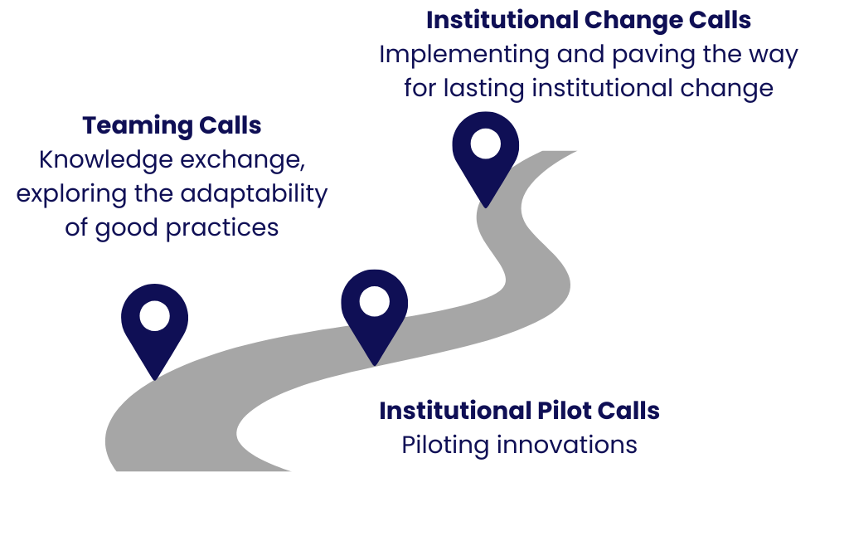


Cascade Funding: facilitating institutional change
Diverse starting points!
Support for organisations to carry out concrete, tangible changes in research assessment in relevant institutions
To implement the ARRA commitments
To exchange, pilot, and implement new practices, processes and tools
Notes:
To further support implementation
Objective, emphasize again that the call targets institutional change
Timeline, status of applications received
Highlight the recording and documentation of the info session last week

Slide 31



Cascade Funding: types of projects
Teaming Projects
    Transfer and adaptation of experience and practices from a more advanced/experienced organisation to one or more less experienced ones. Benefit from existing knowledge and enhance capacity building
    Up to 40 k€
Institutional Pilot Projects
    These provide the means to test and try new assessment approaches, procedures, and frameworks in the context of a well-defined and well-specified initiative (e.g., a pilot competitive call in a university)
    Up to 30 k€
Institutional Change Projects
    Provide the means to accelerate change in procedures and processes in an organisation
    Up to 60 k€

Slide 32
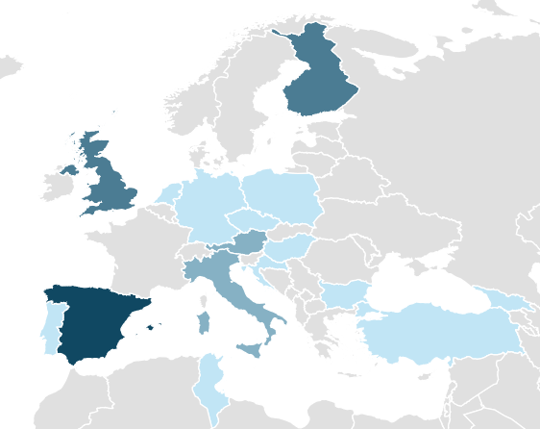
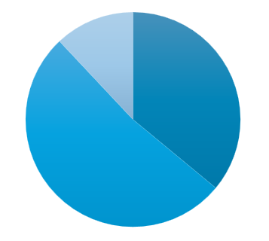
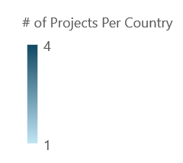
Cascade Funding Call 1: facilitating institutional changes
Apply by
26 June!
24 projects were selected for the 1st round of Cascade Funding, with projects that started between December 2024 and January 2025
A huge thank you to the dedicated reviewers! Without your efforts, this milestone would have not been possible!
Read more about the selected projects here
Geographical Diversity of Projects Per Country:
Types of Projects Selected:
Finland
3
Teaming Projects
9 Institutional Change Projects
United Kingdom
Netherlands
Germany
Poland
Czechia
Austria
13
Institutional Pilot Projects
Hungary
Spain
Croatia
Italy
Bulgaria
Portugal
Georgia
Türkiye
Tunisia

Slide 33
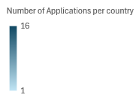
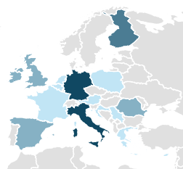

Cascade Funding Call 2: facilitating institutional changes
28 projects were selected for the 2nd round of Cascade Funding, with projects expected to start in September 2025.
A huge thank you to the dedicated reviewers! Without your efforts, this milestone would have not been possible!
Read more about the selected projects here
Types of Projects Selected:
Geographical Diversity of Projects Per Country:
Projects per country
Finland
Ireland
Netherlands
Belgium
United Kingdom
Germany
Poland
France
Austria
Romania
Italy
Croatia
Serbia
Spain
Greece
Cyprus

Slide 34
Cascade Funding Calls 2: topical insights
Scope of interests of the selected projects
Core commitments addressed by the selected projects

Slide 35
CoARA’s Impact to Date

Slide 36

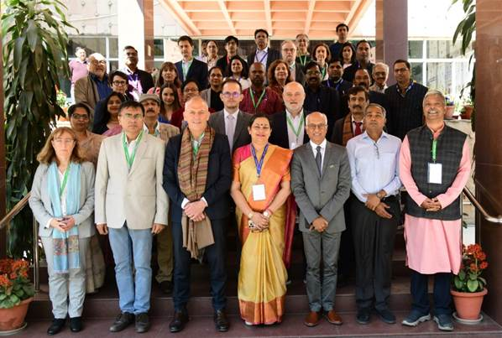
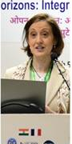


CoARA global outreach
Linking policy priorities:
CoARA Steering Board Member, Luciana Balboa, discusses inclusive research assessment reform.
Hyderabad, India. June 2025.
Indo-French Seminar in Delhi, India March 2025
Lidia Borrell-Damián (Science Europe) presenting links between CoARA and Open Science

Slide 37
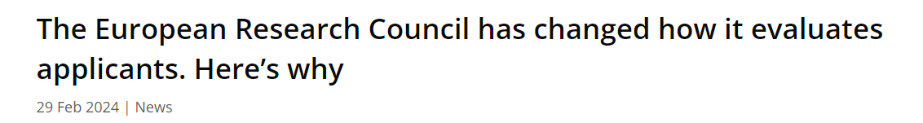
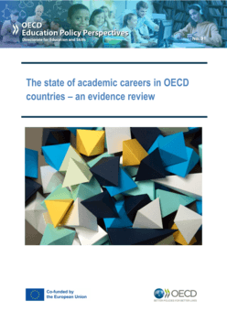


Early Impact on European and National Policies
An increasing number of policy documents refer to CoARA, at the EU and international levels
160+ documents indexed by the Overton database refer to CoARA in documents from 20+ countries and 15 gov. organisations.
Notes:
It cannot be emphasized enough how much All the different activities and actor groups (NCs, WGS) contribute to the impact of CoARA. Even as early around the 2nd anniversary of publishing the ARRA, we see some early impact that is worth showcasing.
Looking at the impact (ARRA and) CoARA has on the national and international research policy landscape, we are proud to see an explicit reference of CoARA in the UK REF Initial Guidance and the recent change in ERC's new evaluation criteria which can even be considered as an instance of implementation of CoARA These, we believe, are significant stept to recognise diverse career paths and out the weight away from prestige-based indicators.
To better understand/to gain insight on the gravity of the policy discourse around CoARA, recently we checked mentions of CoARA (simple keyword search, manual quality checks) in Overton, a database indexing policy document worldwide, and we found 160+ documents with explicit mentions of CoARA, from more than 20 countries and 15 governmental sources, including the Gov. Of Japan and the Gov. of Uruguay.

Slide 38
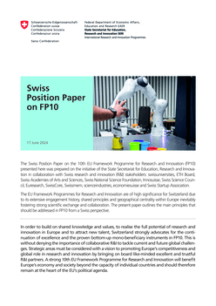
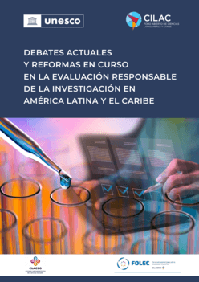
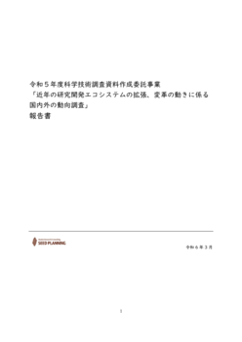
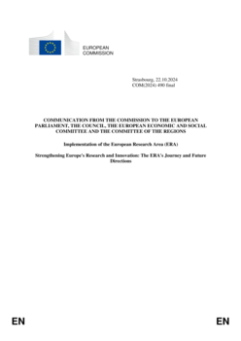
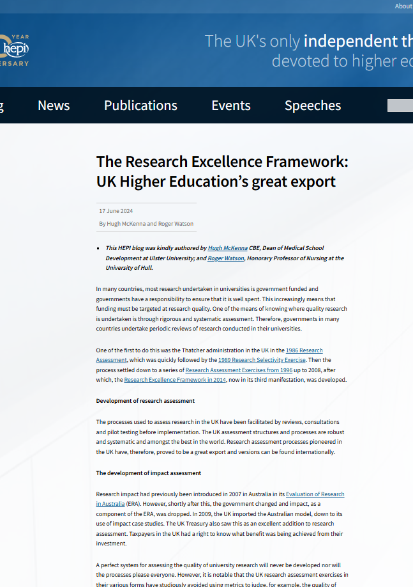
CoARA in recently published policy documents (highlights)
OECD - source
Swiss Position Paper- source
UNESCO - source
Market Research & Consulting - source
European Commission - source
HEPI - source
Rich pool of reflections on CoARA in policy documents globally
Notes:
To finish with, we keep an eye on the early impact CoARA has on the national and international research policy landscape. You can see here a small snapshot, really tjust a small token of the gravity of the policy discourse around CoARA, policy documents where CoARA has been discussed from all corners of the world, from left to right: (to add just the titles of reports here and country)

Slide 39
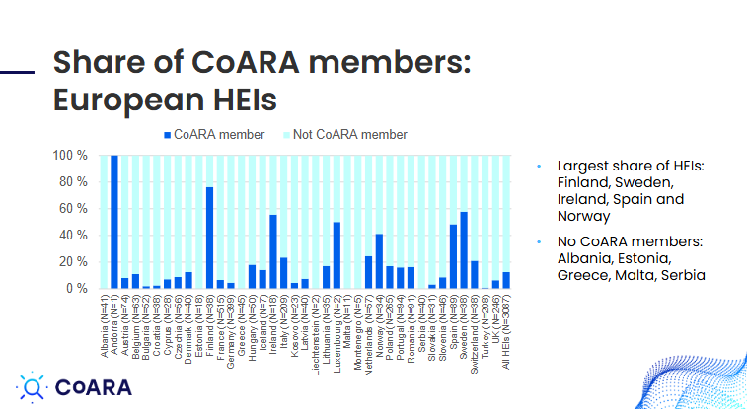
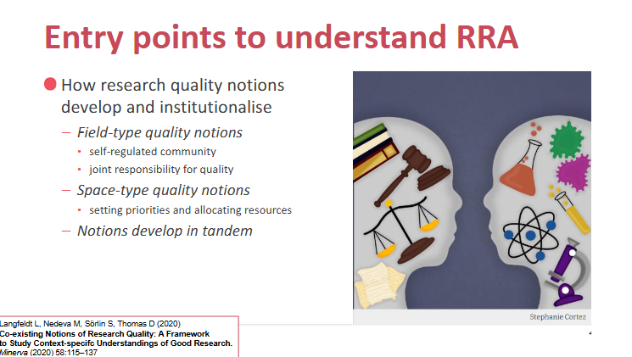
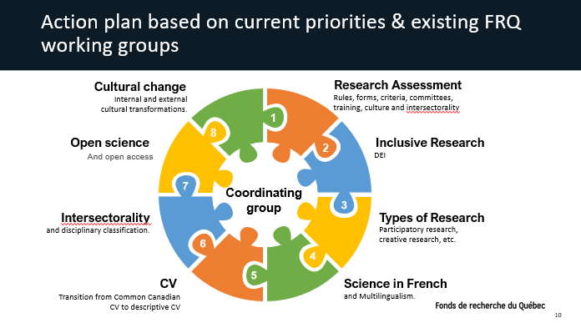
Impact – further contexts
CoARA’s Impact in National and European Contexts:
  Uptake of CoARA across the Higher Education Institutions in Europe — presented by Janne Pölönen (Federation of Finnish Learned Societies)
    Click here for the Uptake of CoARA in Higher Education in Europe presentation.
  Accompanying research on CoARA in the Norwegian research system — presented by Prof. Liv Langfeldt (NIFU)
    Click here for the NyEval presentation.
Global Perspectives on Research Assessment:
  The Implementation of the Fonds de recherche du Quebec (FRQ)’s Action Plan — presented by Prof. Rémi Quirion (FRQ)
    Click here for the recording of the presentation.
    Click here for the Powerpoint presentation.
The European Research Council (ERC)’s research assessment reform journey
  The ERC’s research assessment reform journey — presented by Dr. Angela Wittelsberger (ERC) on the evaluation of research proposals and the understanding of excellence
    Click here for the ERC presentation.

Slide 40
Upcoming in 2025 and Beyond

Slide 41
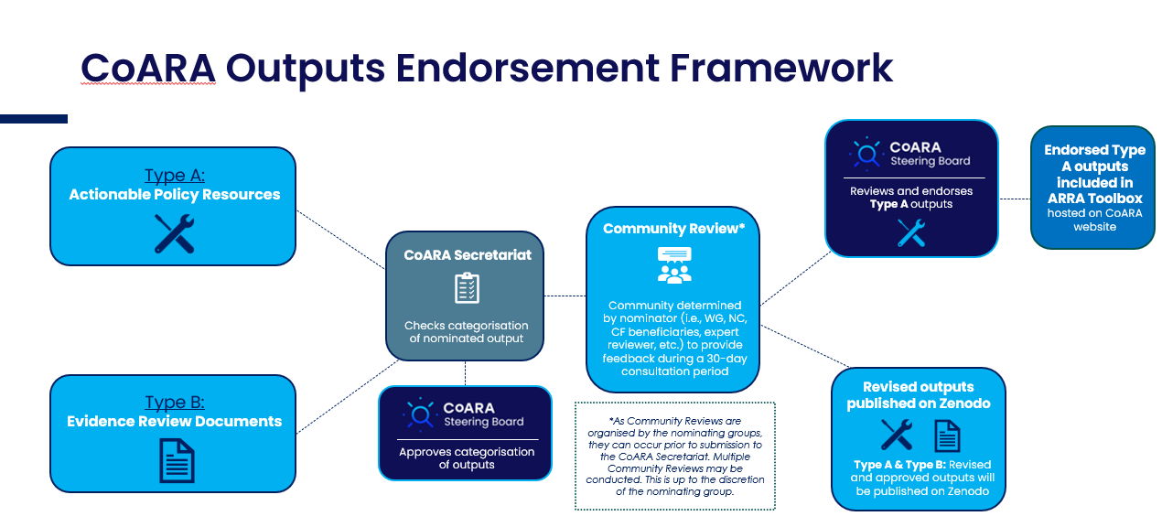
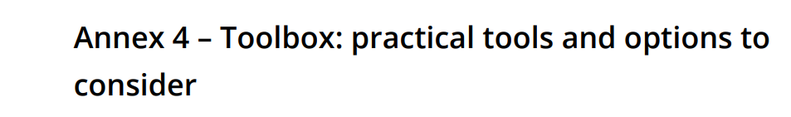



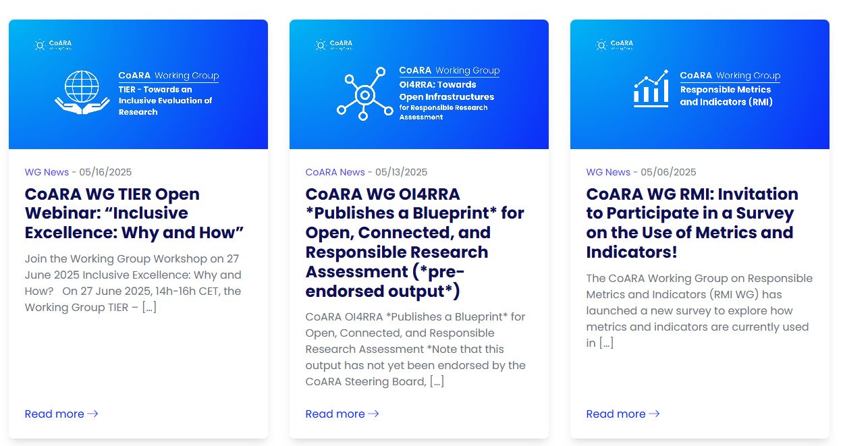
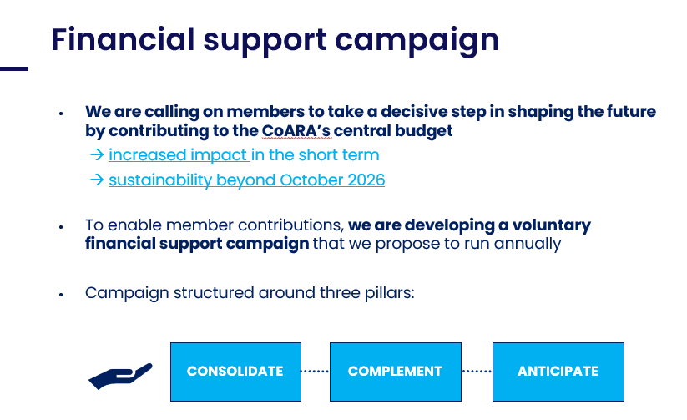
Strategic priorities for 2025
CoARA Outputs Endorsement Framework – implementation started
Building consensus over collectively endorsed resources
Overview of WGs' outcomes
Up for approval by the GA
Releasing the first enhanced version of the CoARA Toolbox
Collection of CoARA-endorsed outputs
Clear versioning and endorsement information
Maintaining responsiveness and enhanced support for CoARA members
New website to improve connectivity
Webinars and events
Enhance community ownership
Build capacity for increased support to NCs, CoARA events, enhanced dissemination, etc.
Targets co-defined by the GA
Voluntary sponsorship campaign

Slide 42
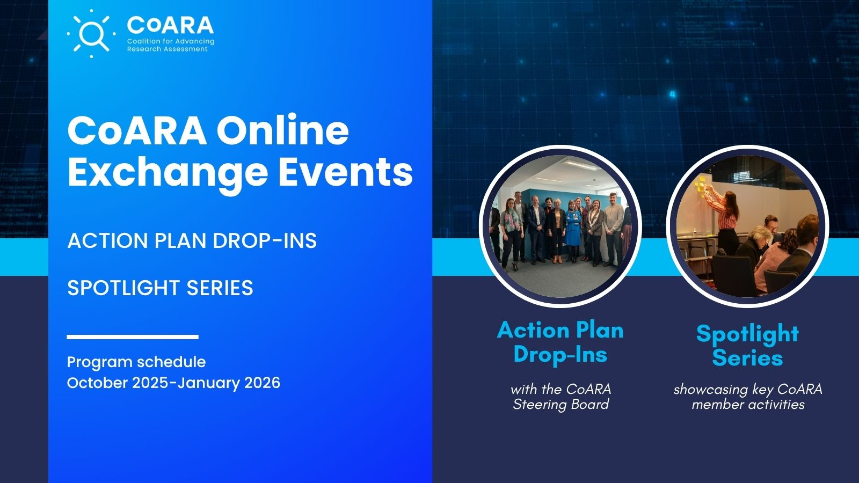
Upcoming events: online exchange series
To further enhance mutual exchange across the coalition and with an aim to provide more inclusive peer exchange mechanisms, CoARA has launched a series of online exchange events.
The first events will focus on two dedicated series: Action Plan Drop-In sessions and a CoARA Spotlight series.
  Action Plan Drop-In Sessions: Monthly online sessions on the 3rd Friday of each month for informal discussions with CoARA Steering Board members to discuss all things related to Action Plan development.
  CoARA Spotlight Series: Presentations featuring key spotlights from CoARA members driving research assessment.
Click here for the program schedule

Slide 43
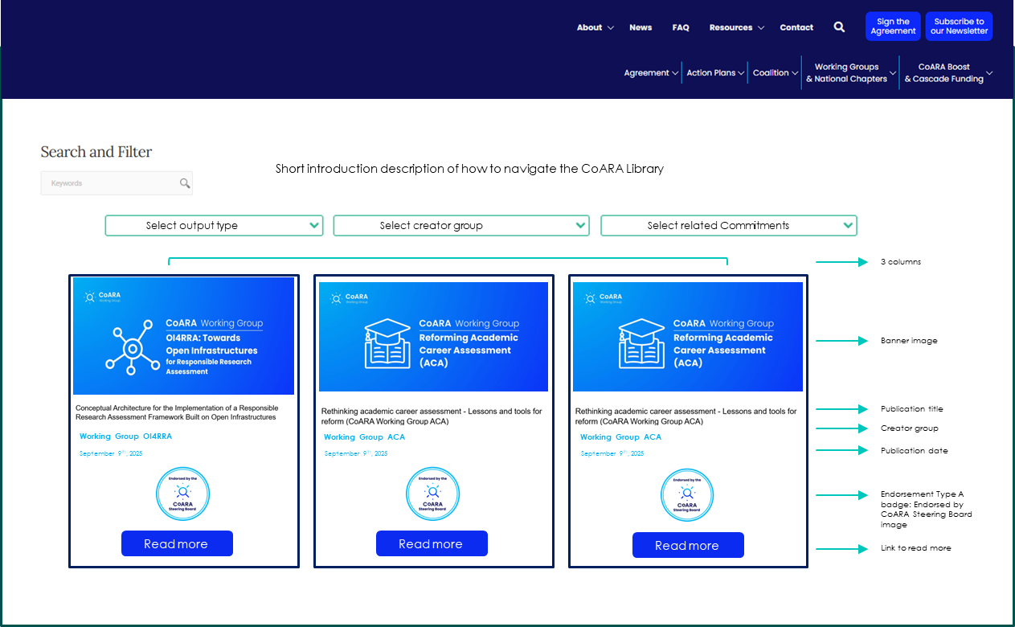
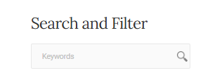
Upcoming in December 2025: CoARA Library
Details on filter categories
CoARA Library currently in development, with an expected launch in December 2025
Streamline resources endorsed by the CoARA community and/or the Steering Board, to be hosted on www.coara.org
Searchable database to make endorsed tools for implementation readily accessible to the coalition
Output type:
CoARA Toolbox
Contextual Support Documents
Creator group:
Working Group
National Chapter
Cascade Funding Projects
3rd Party
Related Commitments*:
  1. Diverse contributions
  2. Qualitative evaluation
  3. Avoid metric-based evaluation
  4. Avoid use of rankings
  5. Commit resources to RRA
  6. RA criteria, tools, and processes
  7. Raise awareness of RRA
  8. Mutual learning
  9. Communicate progress
  10. Accessible data & RoR
To be hosted on the new coara.org website CoARA Library with outputs linked via Zenodo

Slide 44
CoARA Communications Tools

Slide 45
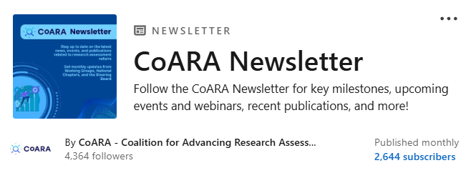


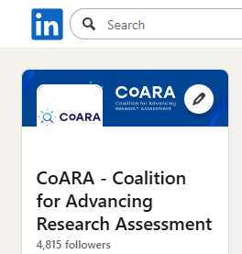


Communication toolkit
Key dissemination channels:
Advocacy materials on the coara.org website
  CoARA support badge
  Zoom backgrounds for webinars and CoARA online events
  Generic presentations with CoARA branding
  National Chapters printable booklet
Dissemination channels to streamline activities and amplify your messages
  CoARA Newsletter: bi-monthly distribution with 2.5k+ subscribers to date
  CoARA LinkedIn: 4.3k+ followers to date to amplify your activities and keep you up to date on all coalition-related news
  CoARA News blog: spotlight upcoming activities, publications, or events
  CoARA Youtube channel: hosting webinars and helpful resources for coalition members
  CoARA transitions to Bluesky → follow us!
Streamlining activities across the coalition
2.5k+
newsletter subscribers to date
Facilitating connectivity across the growing coalition
4.7k followers on LinkedIn to date
2.3k followers gained in the past year
  Contact communication@coara.org for inquiries and dissemination requests
Notes:
Just go though highlighting resources listed here

Slide 46
Notes:
For technical issues, feel free to contact Secretariat in the chat

