Slide 1



Boosting environmental awareness in opera creation
Alessandro Roveri, Teatro Comunale di Modena
Claudio Allocchio, GARR

Slide 2
Summary
The Butterfly Project
What the project is about, who the partners are
What actions have been taken for sustainability
How technology (LoLa and NRENs) was used (artists perspective)
Results related to sustainability
Connections and LoLa technology in the Butterfly Project
Three locations - three types of support and solutions
What’s next?
Future perspectives and developments

Slide 3
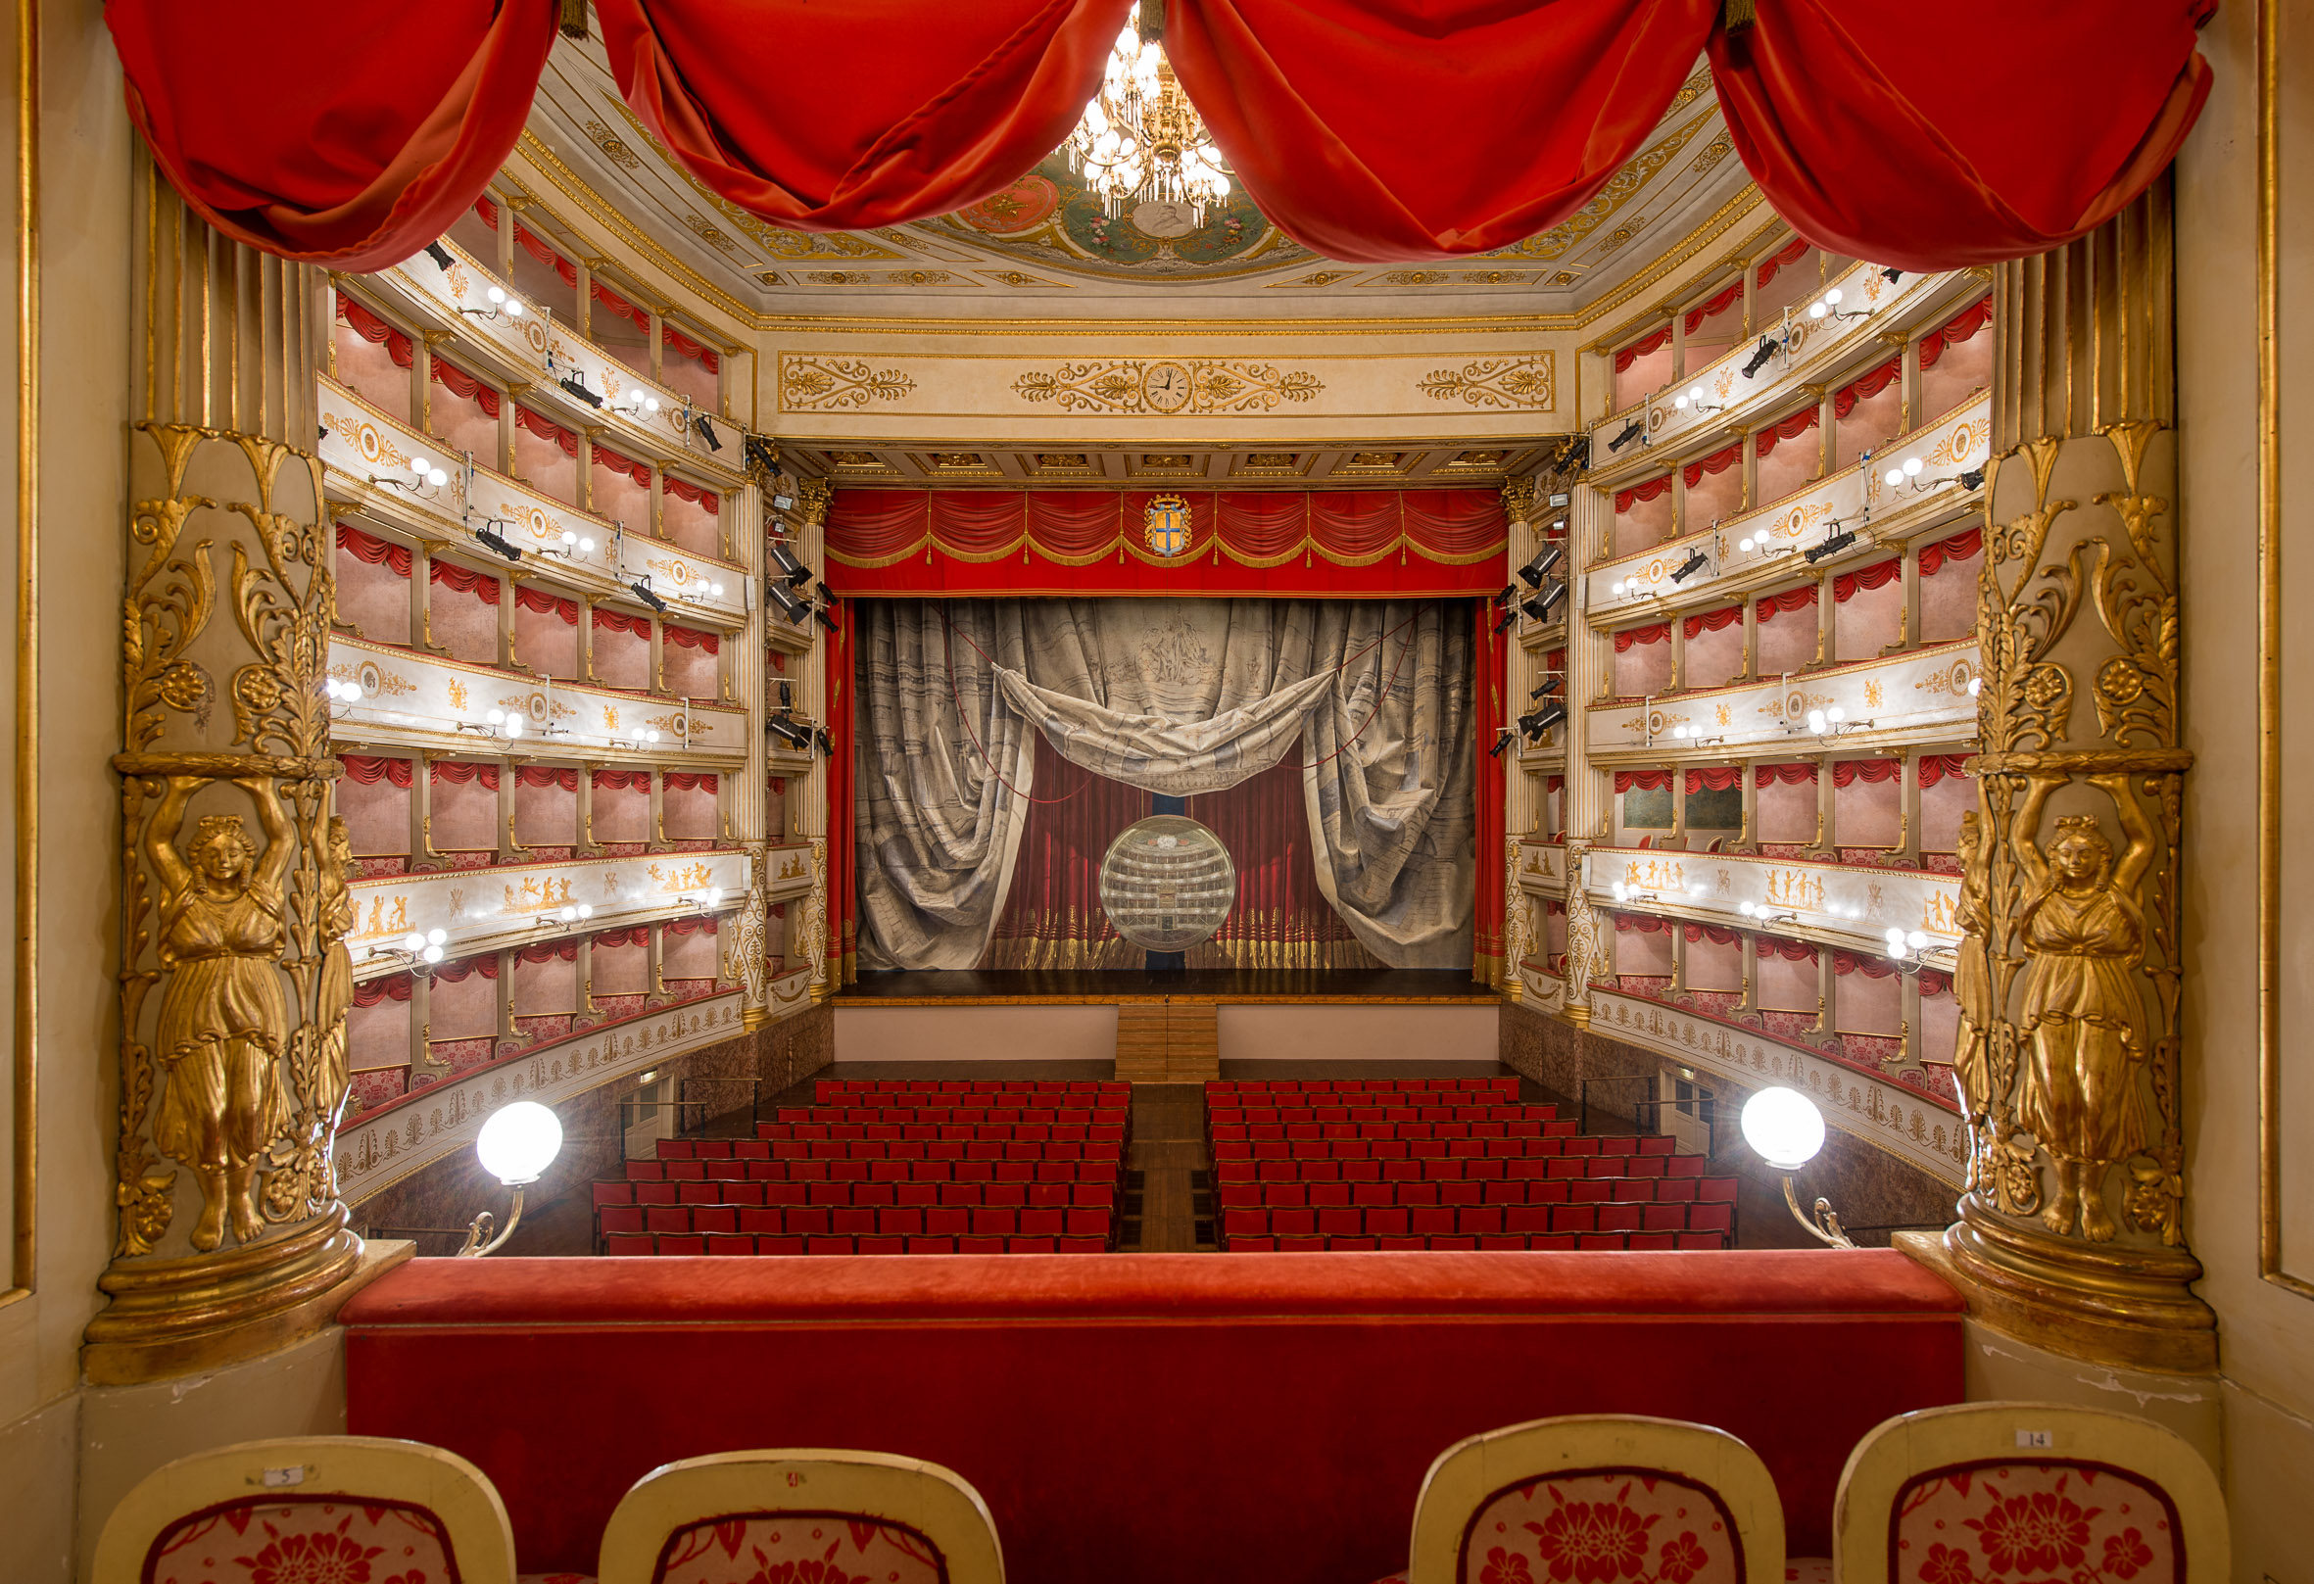

Slide 4
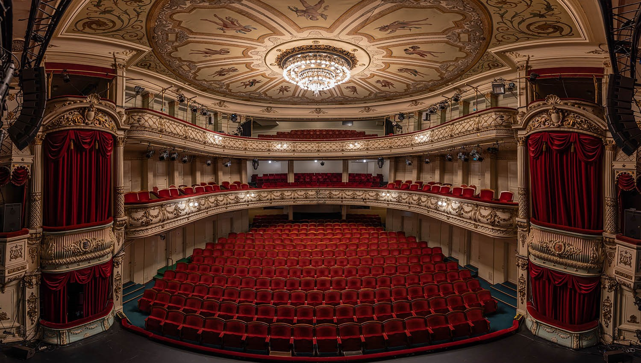

Slide 5
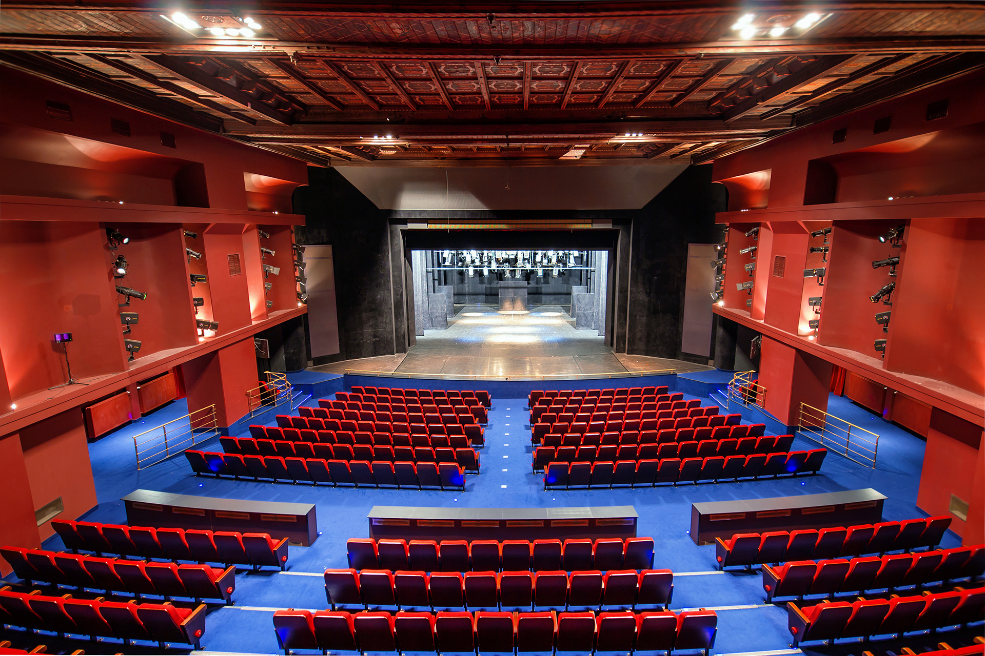

Slide 6


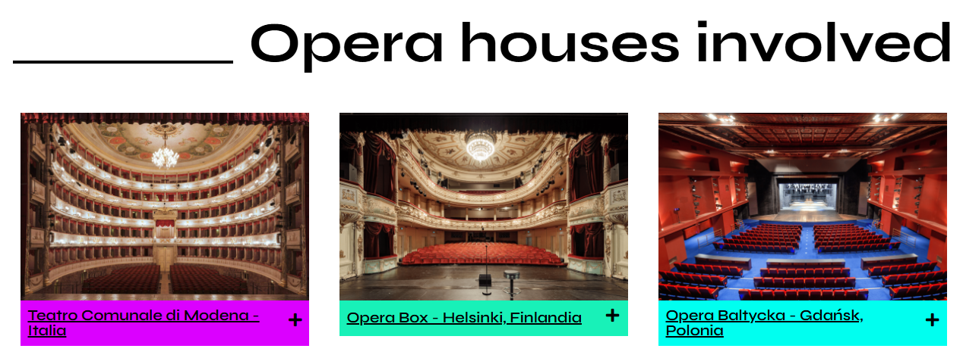
PROJECT PARTNERS

Slide 7


ASSOCIATED PARTNERS

Slide 8
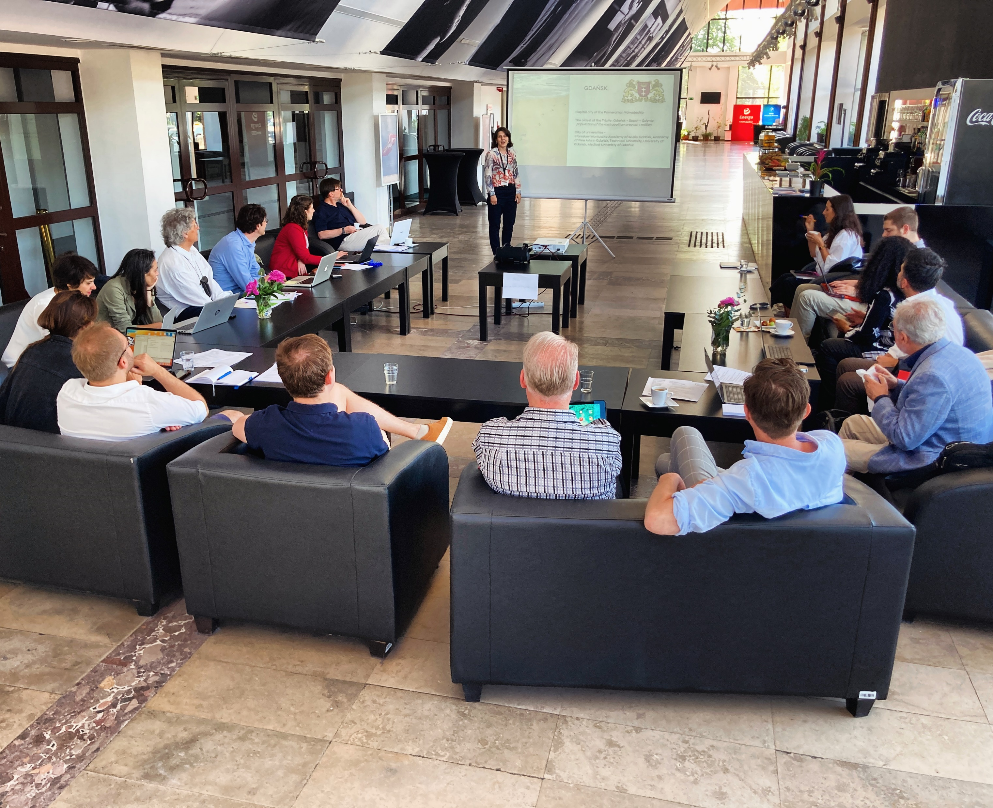
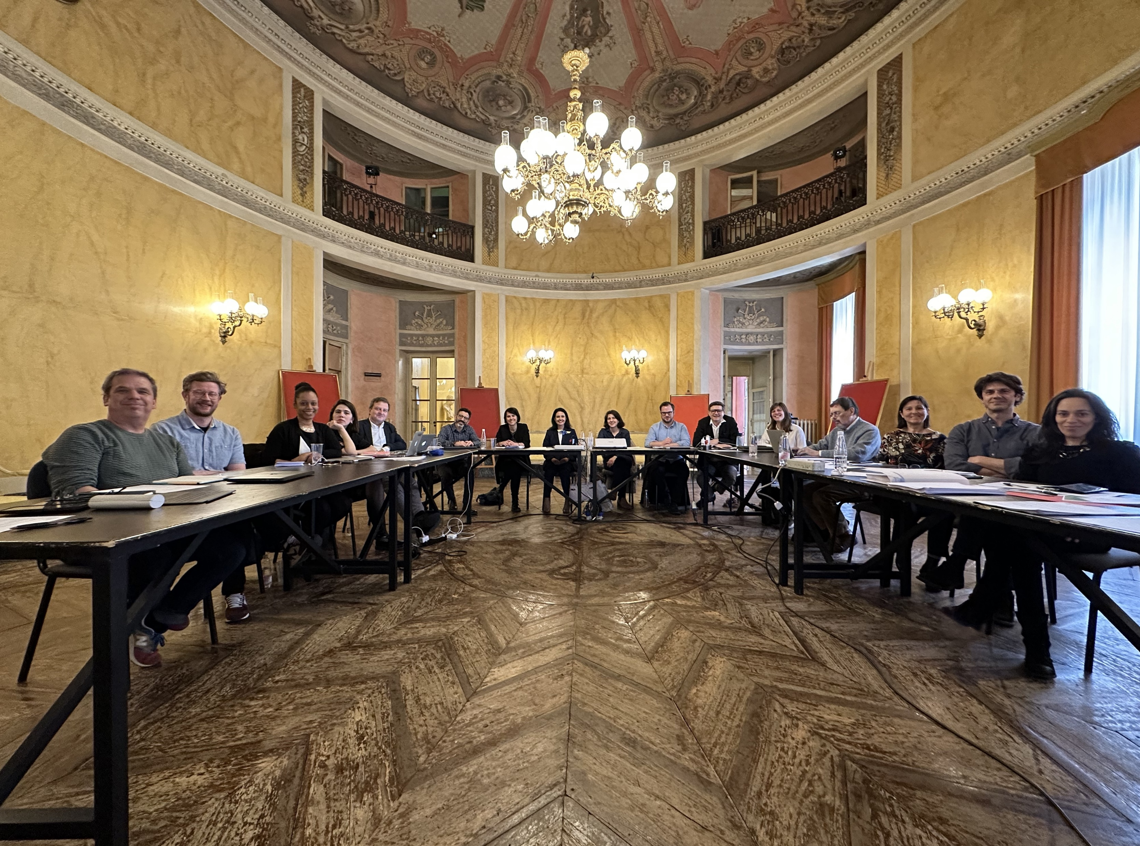

Slide 9
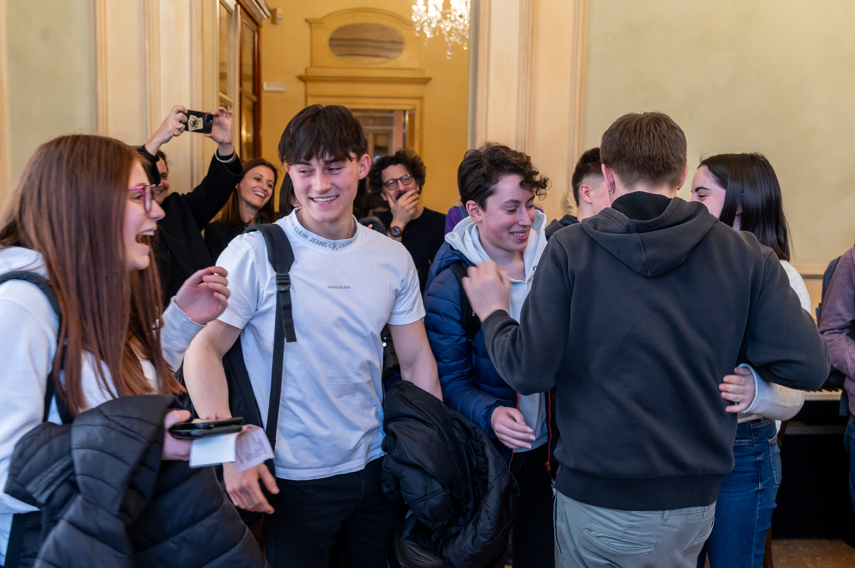
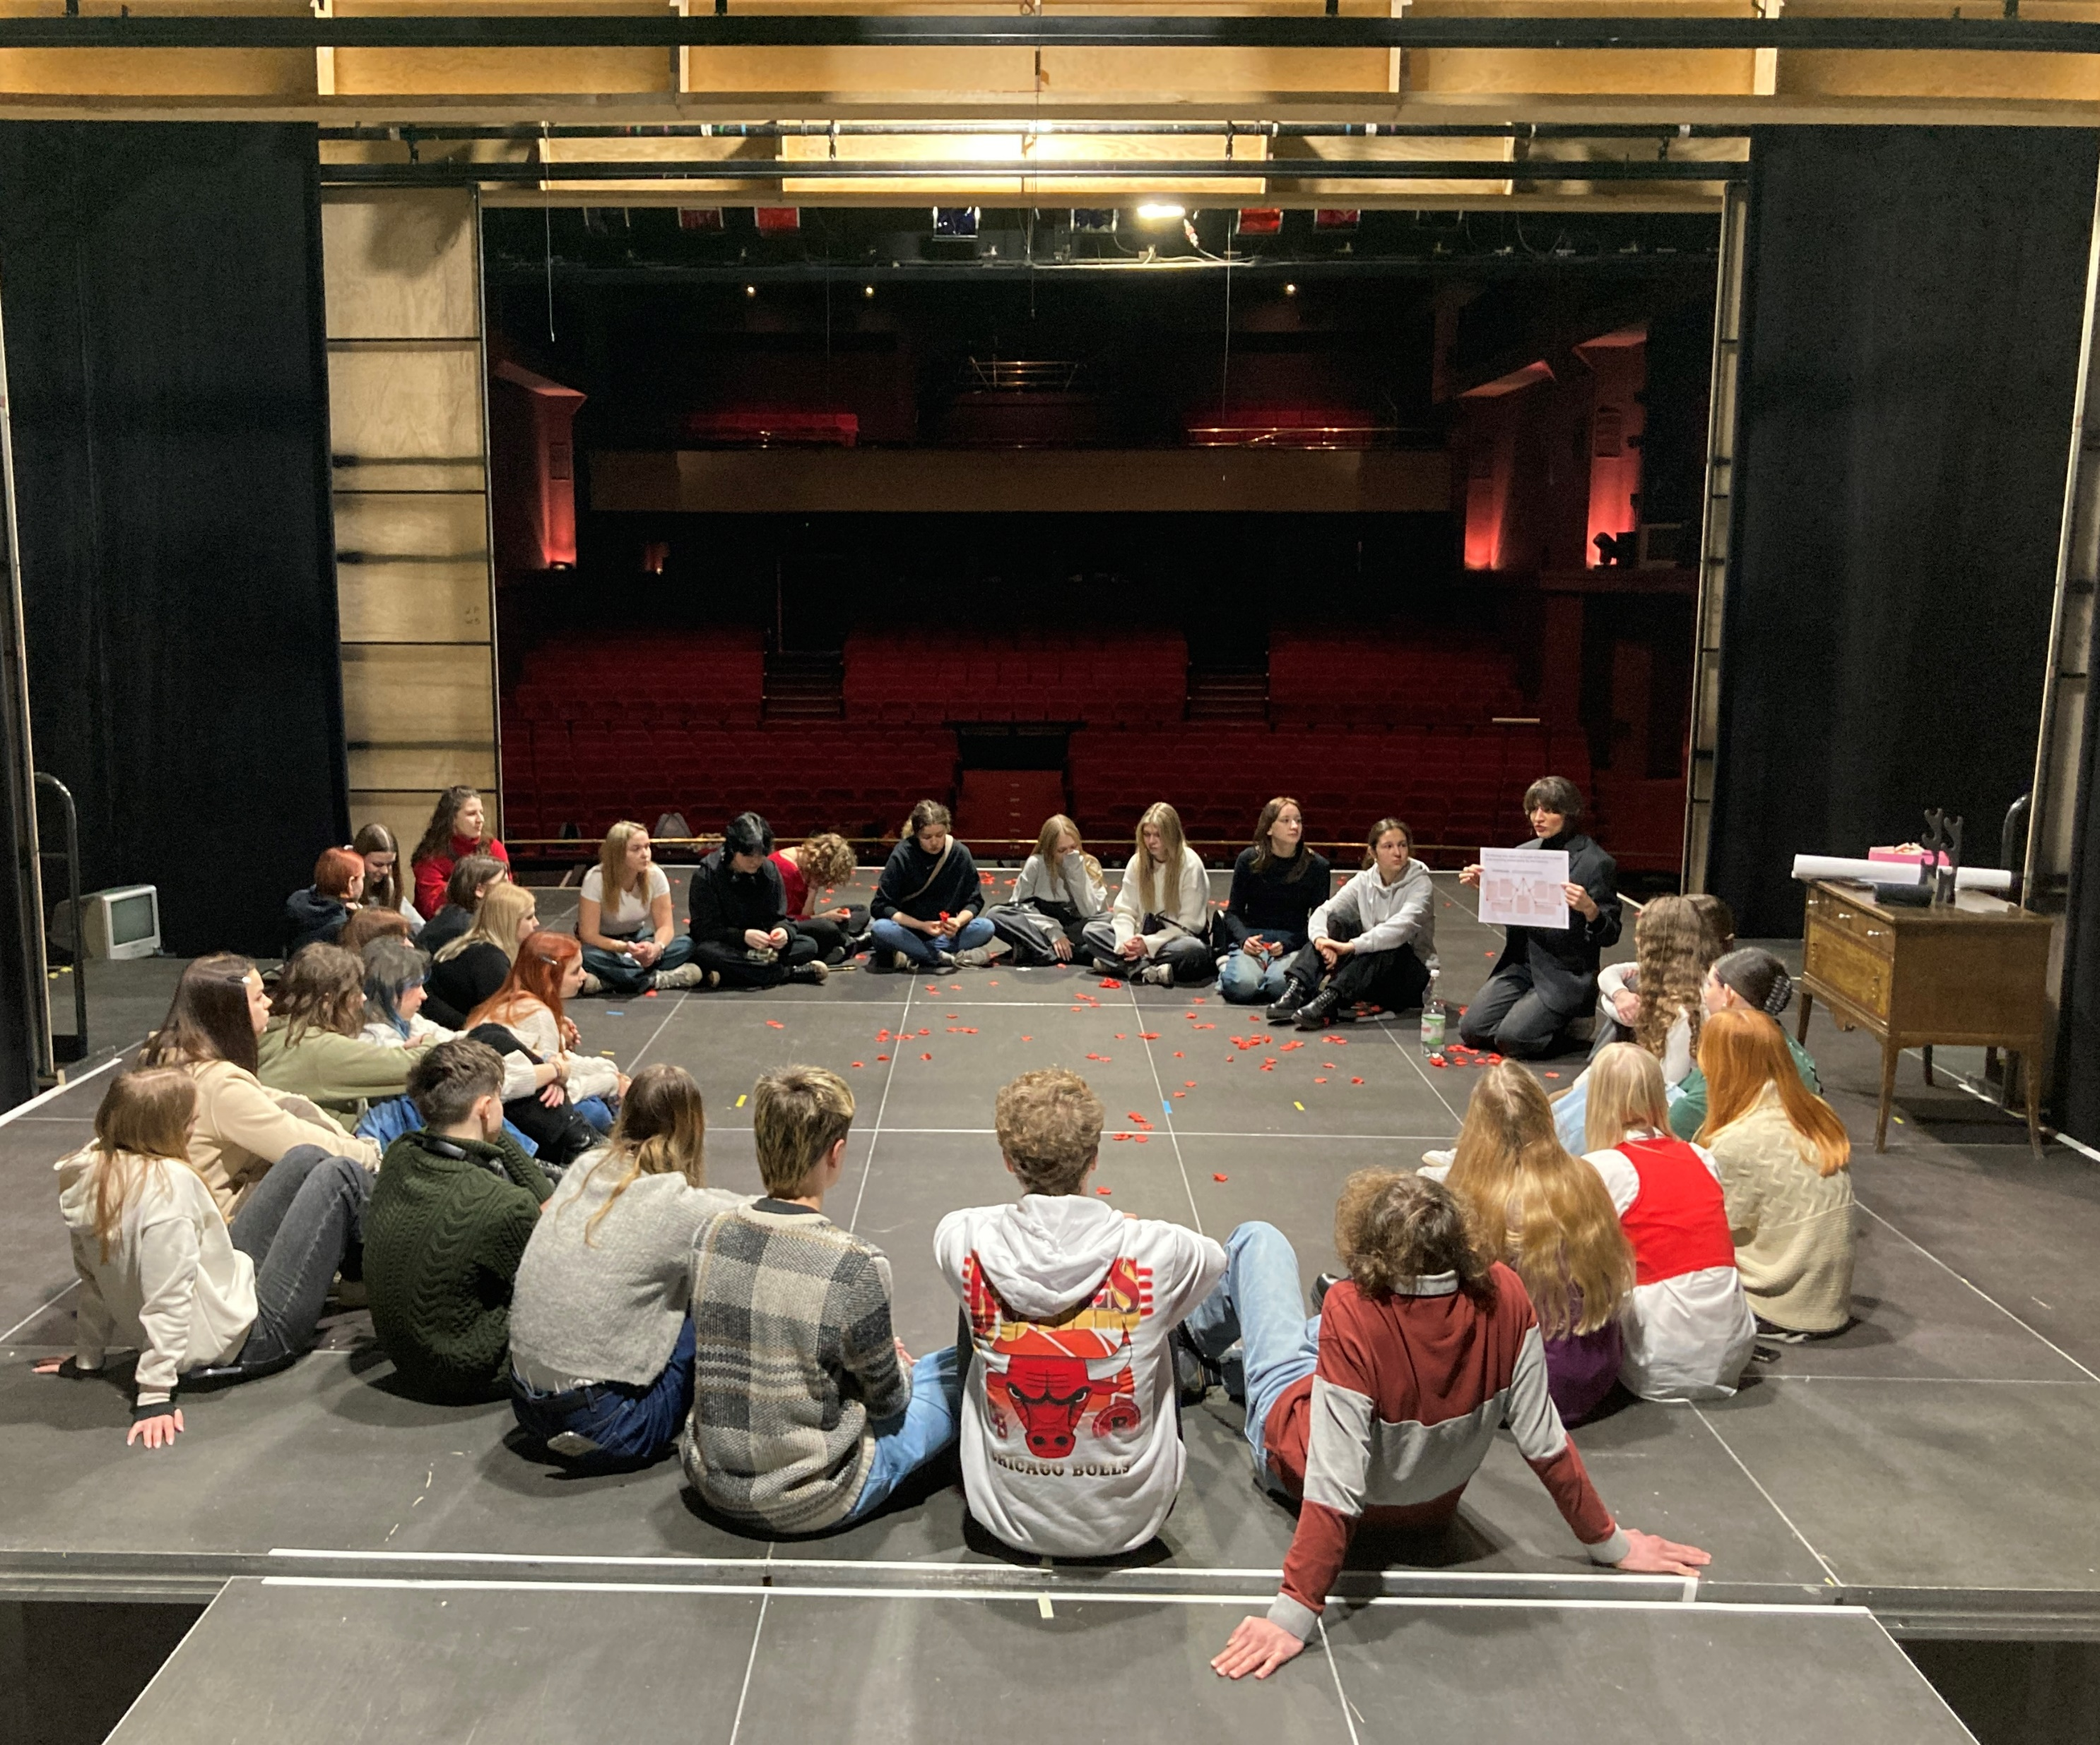
SCHOOL PROJECT

Slide 10
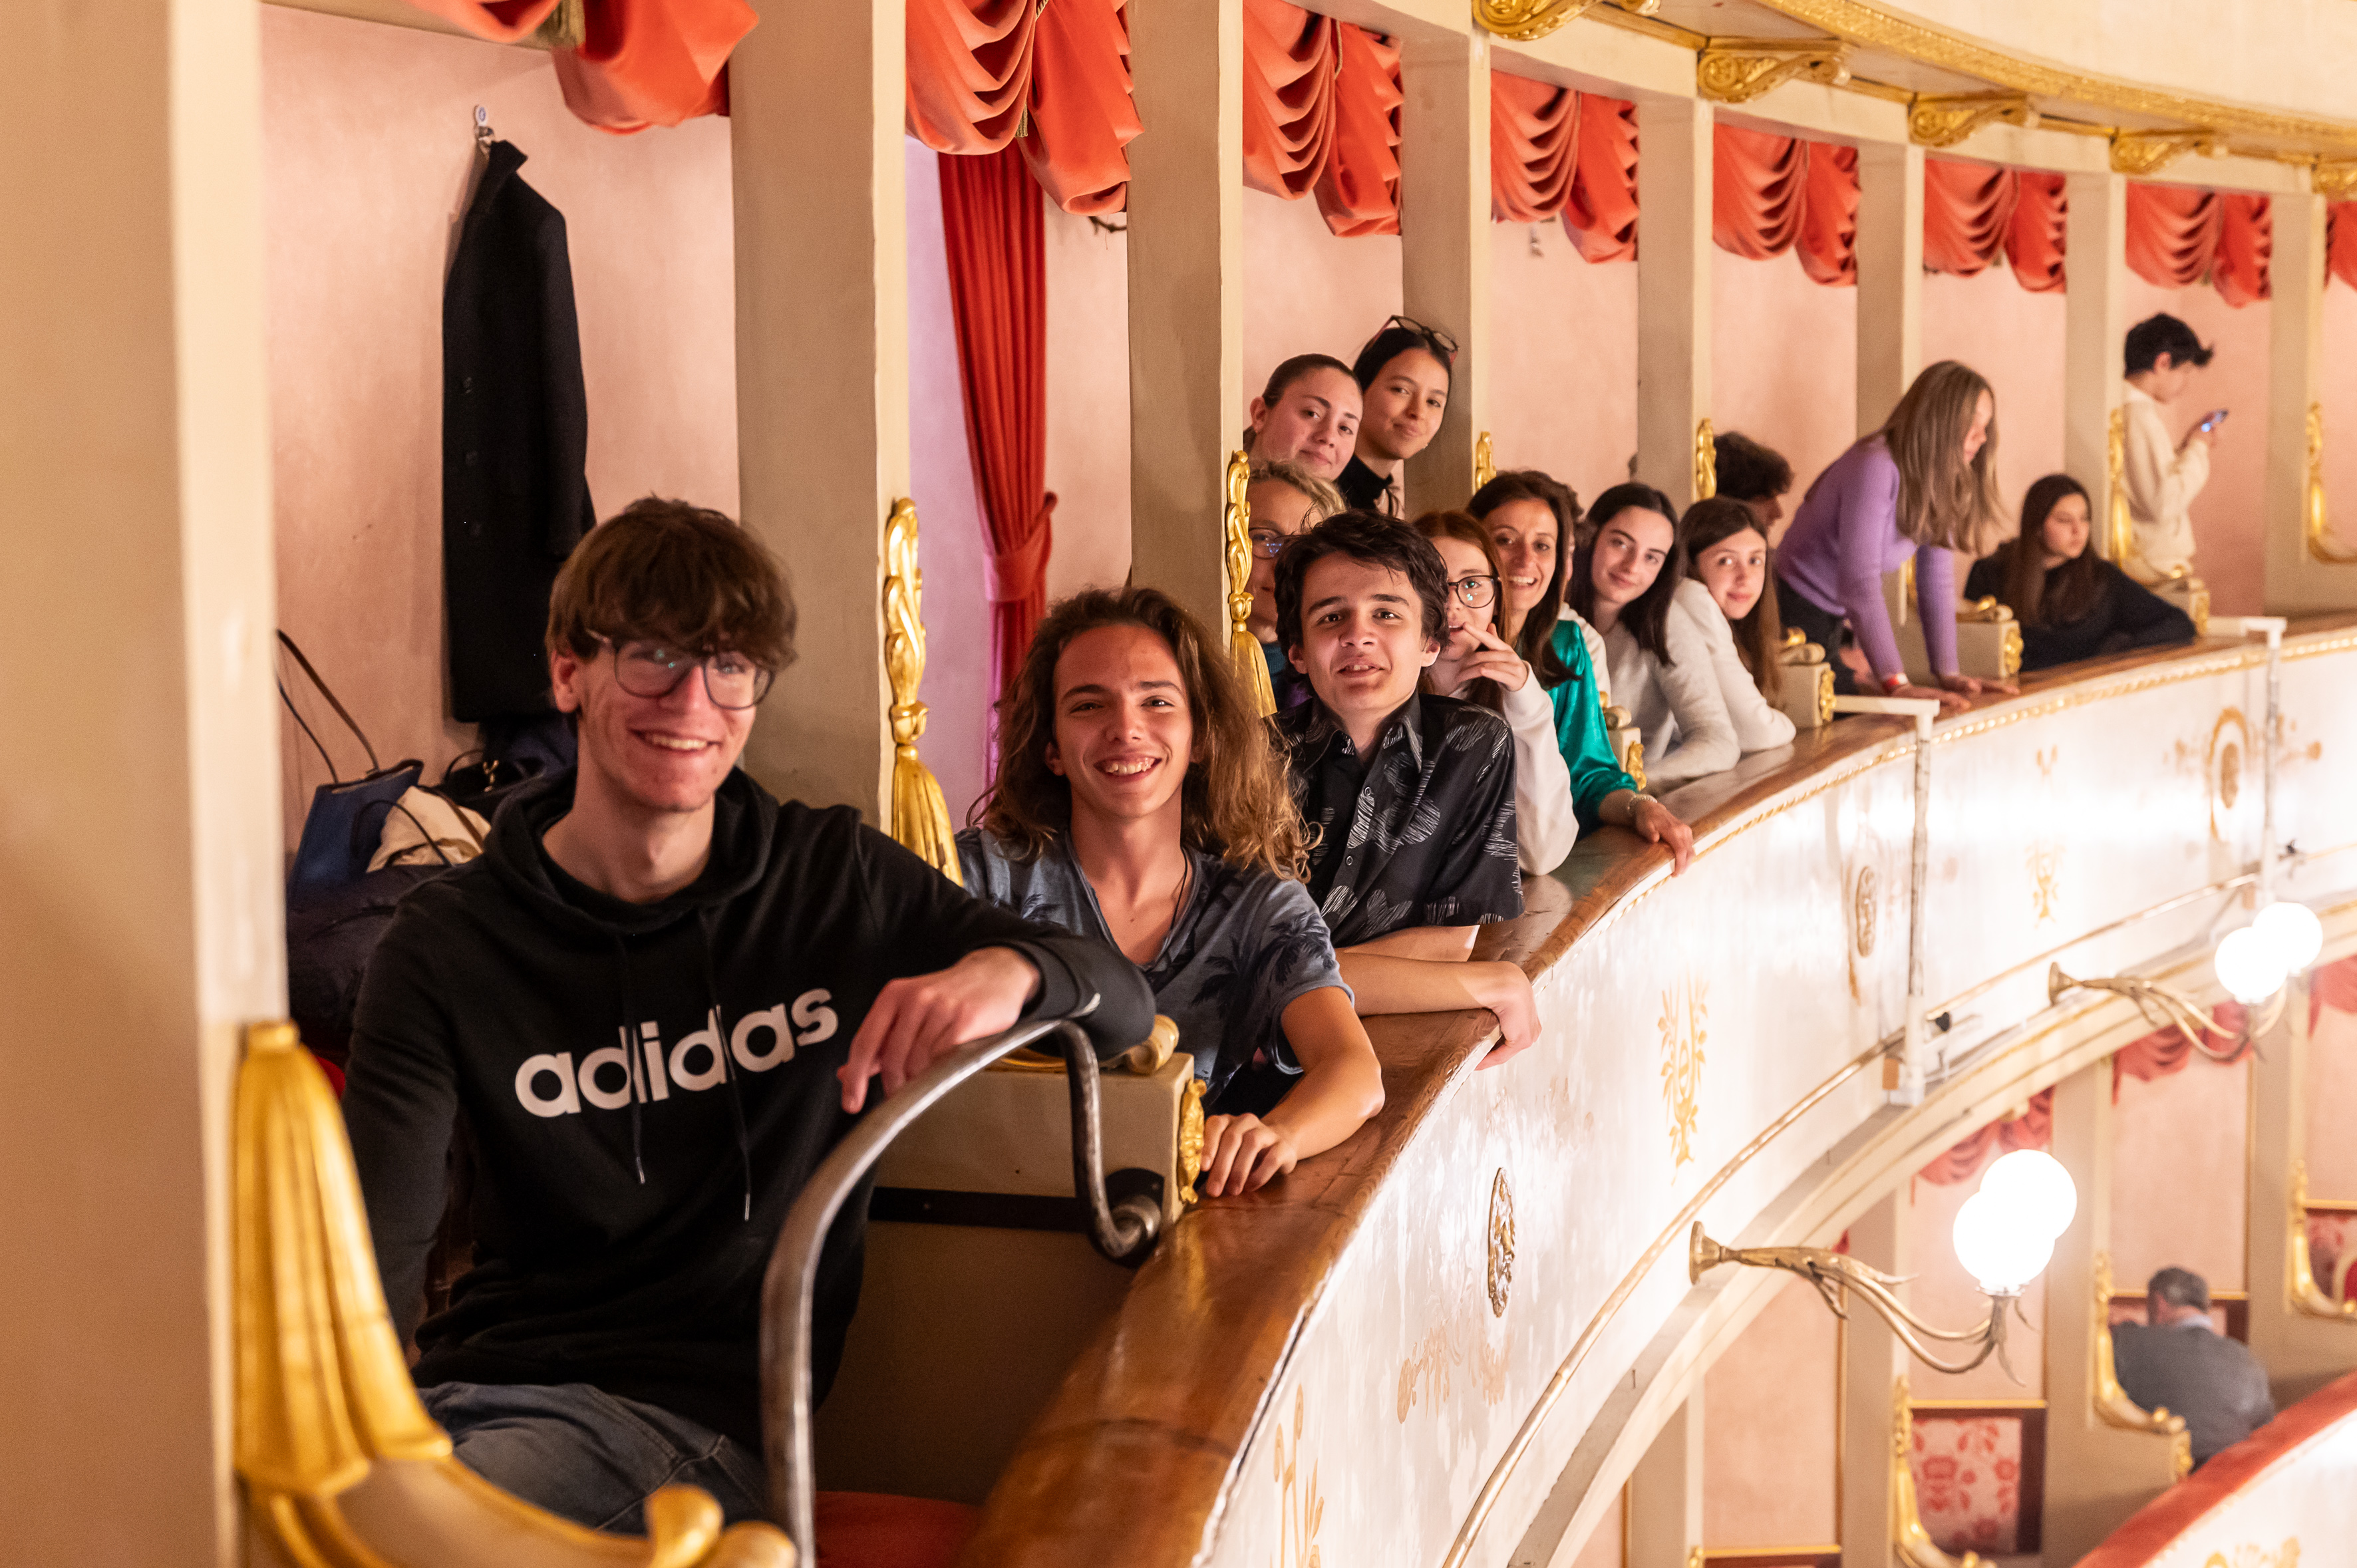
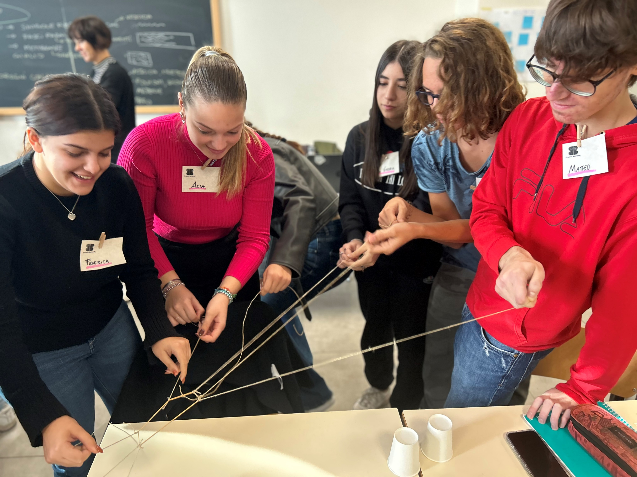

Slide 11
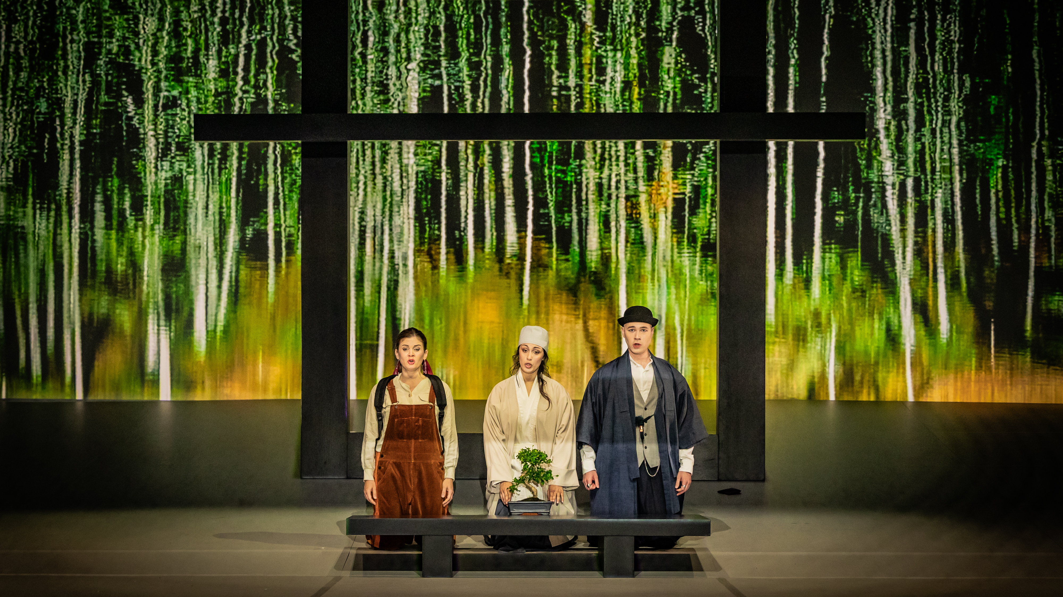

Slide 12
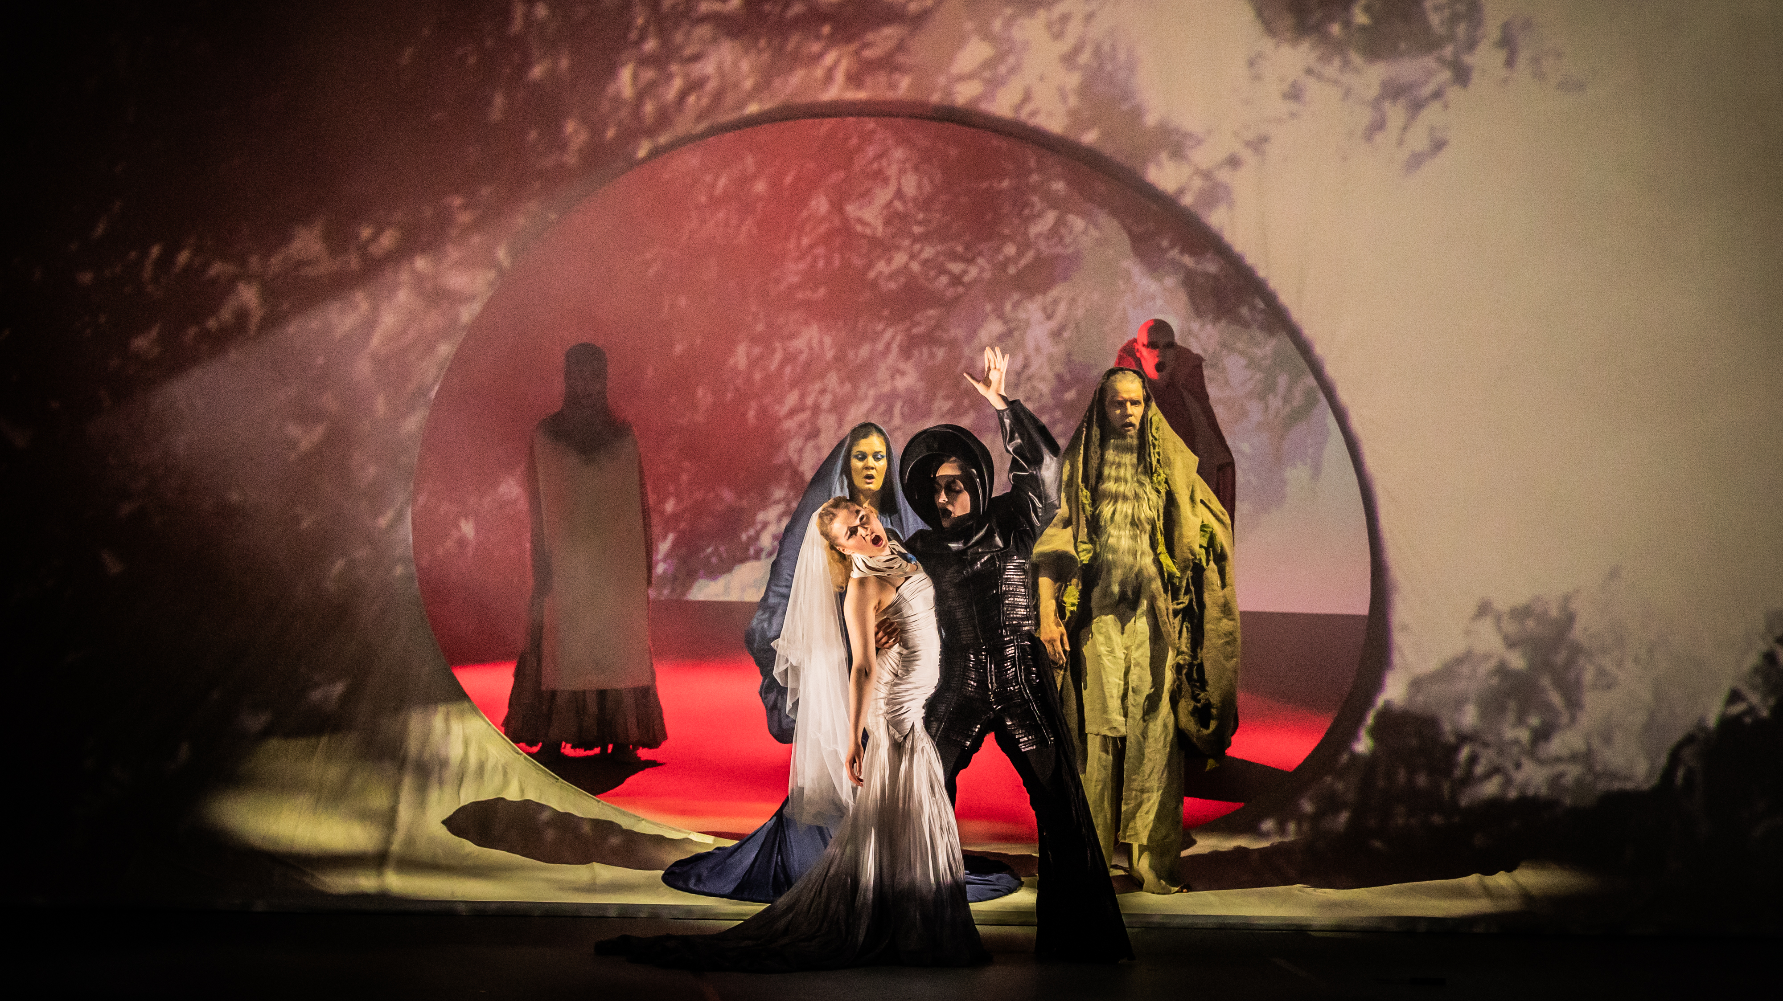

Slide 13
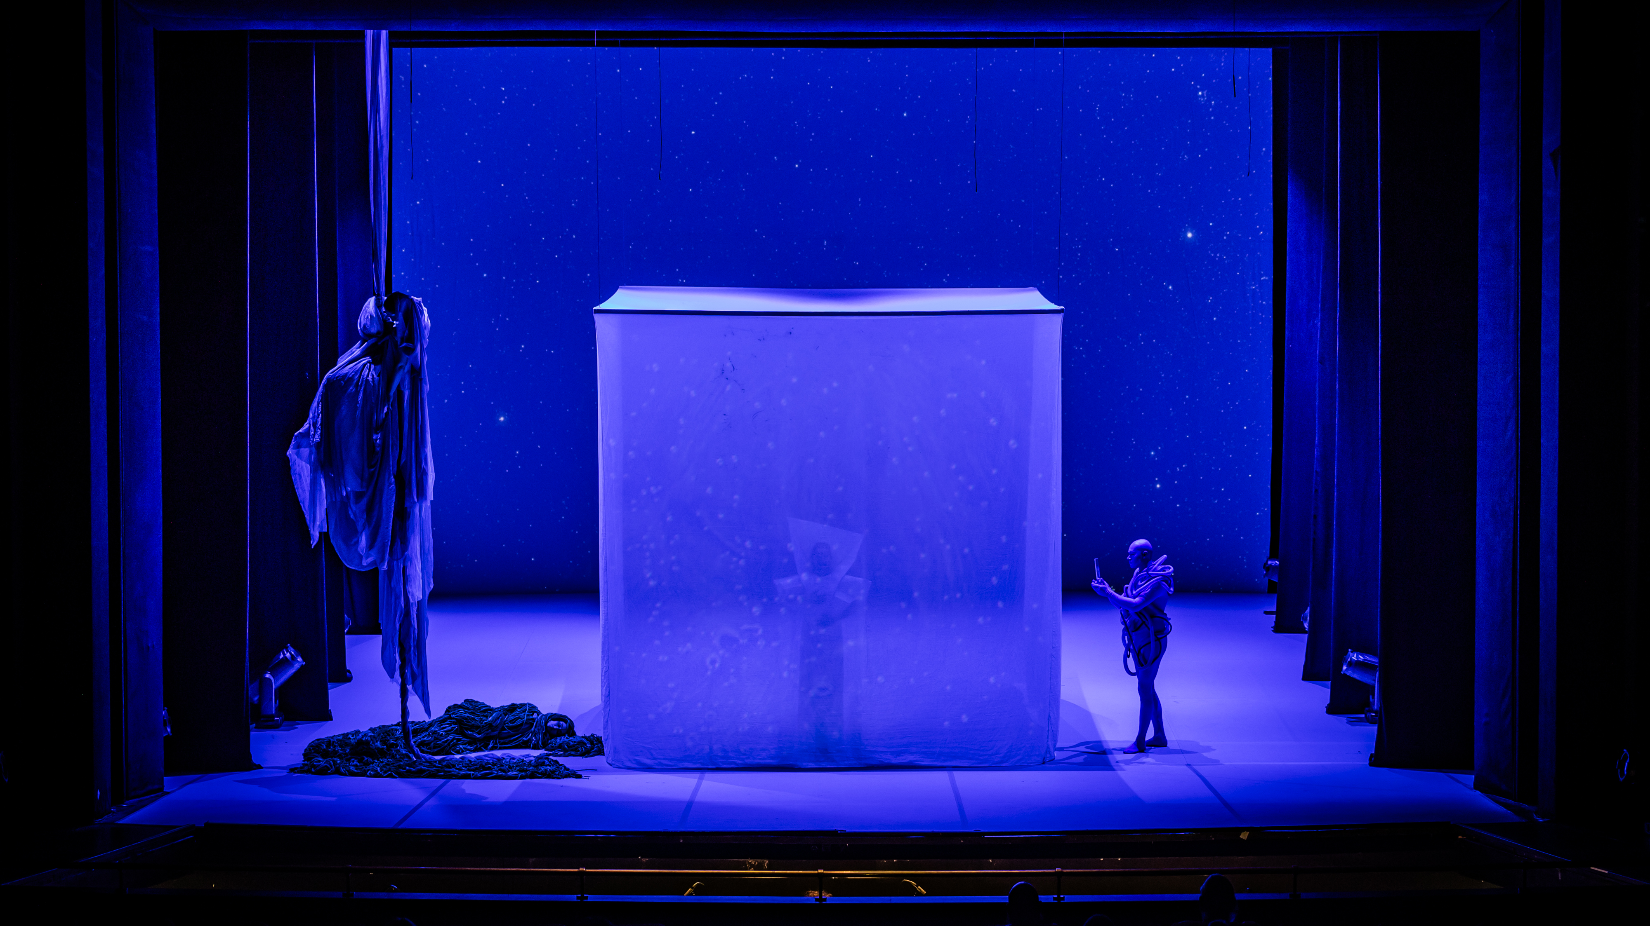

Slide 14
Sustainability tools and initiatives
Julie’s Bicycle – The Creative Climate Tools (CC Tools)
LOLA, remote rehearsals, GARR Conservatory of Trieste
Travels WeCity (Bike to Theatre)
Sustainability in opera staging and production:
Costumes: Extensive research on eco-friendly materials (not synthetic, but more sustainable options like cotton, silk, etc.). Compact and lightweight to travel in suitcases, as material weight is crucial.
Minimalist set design: Compensated by immersive video scenography to avoid transportation. Sets are not transported (using existing structures and props from different theaters).
Limited travel: Fewer people moving (no choir, small ensemble, cast)

Slide 15
Comparison between the two versions of the opera Butterfly
 | Carbon footprint of the Butterfly project - sustainable scenario [tons of CO2 _{equivalent} ] | Carbon footprint of the Butterfly project - unsustainable scenario [tons of CO2 _{equivalent} ]
Energy consumption | 0.44 | 0.44
Public travel | 0.97 | 4
Project materials | 2 | 14
Transport of scenography | 0.05 | 0.76
Artists' movements | 20 | 37
Total emissions | 11.46 | 56.20
Comparison of carbon footprint results from the two versions of the work Butterfly

Slide 16
LoLa’s contribution to sustainability
The savings in terms of CO2 made possible by remote rehearsals LoLa were calculated, compared with the emissions that would have been produced by traveling to carry out rehearsals in person in Modena. The measurement tool estimated a carbon footprint of 7.54 tons of CO2 equivalent saved.

Slide 17
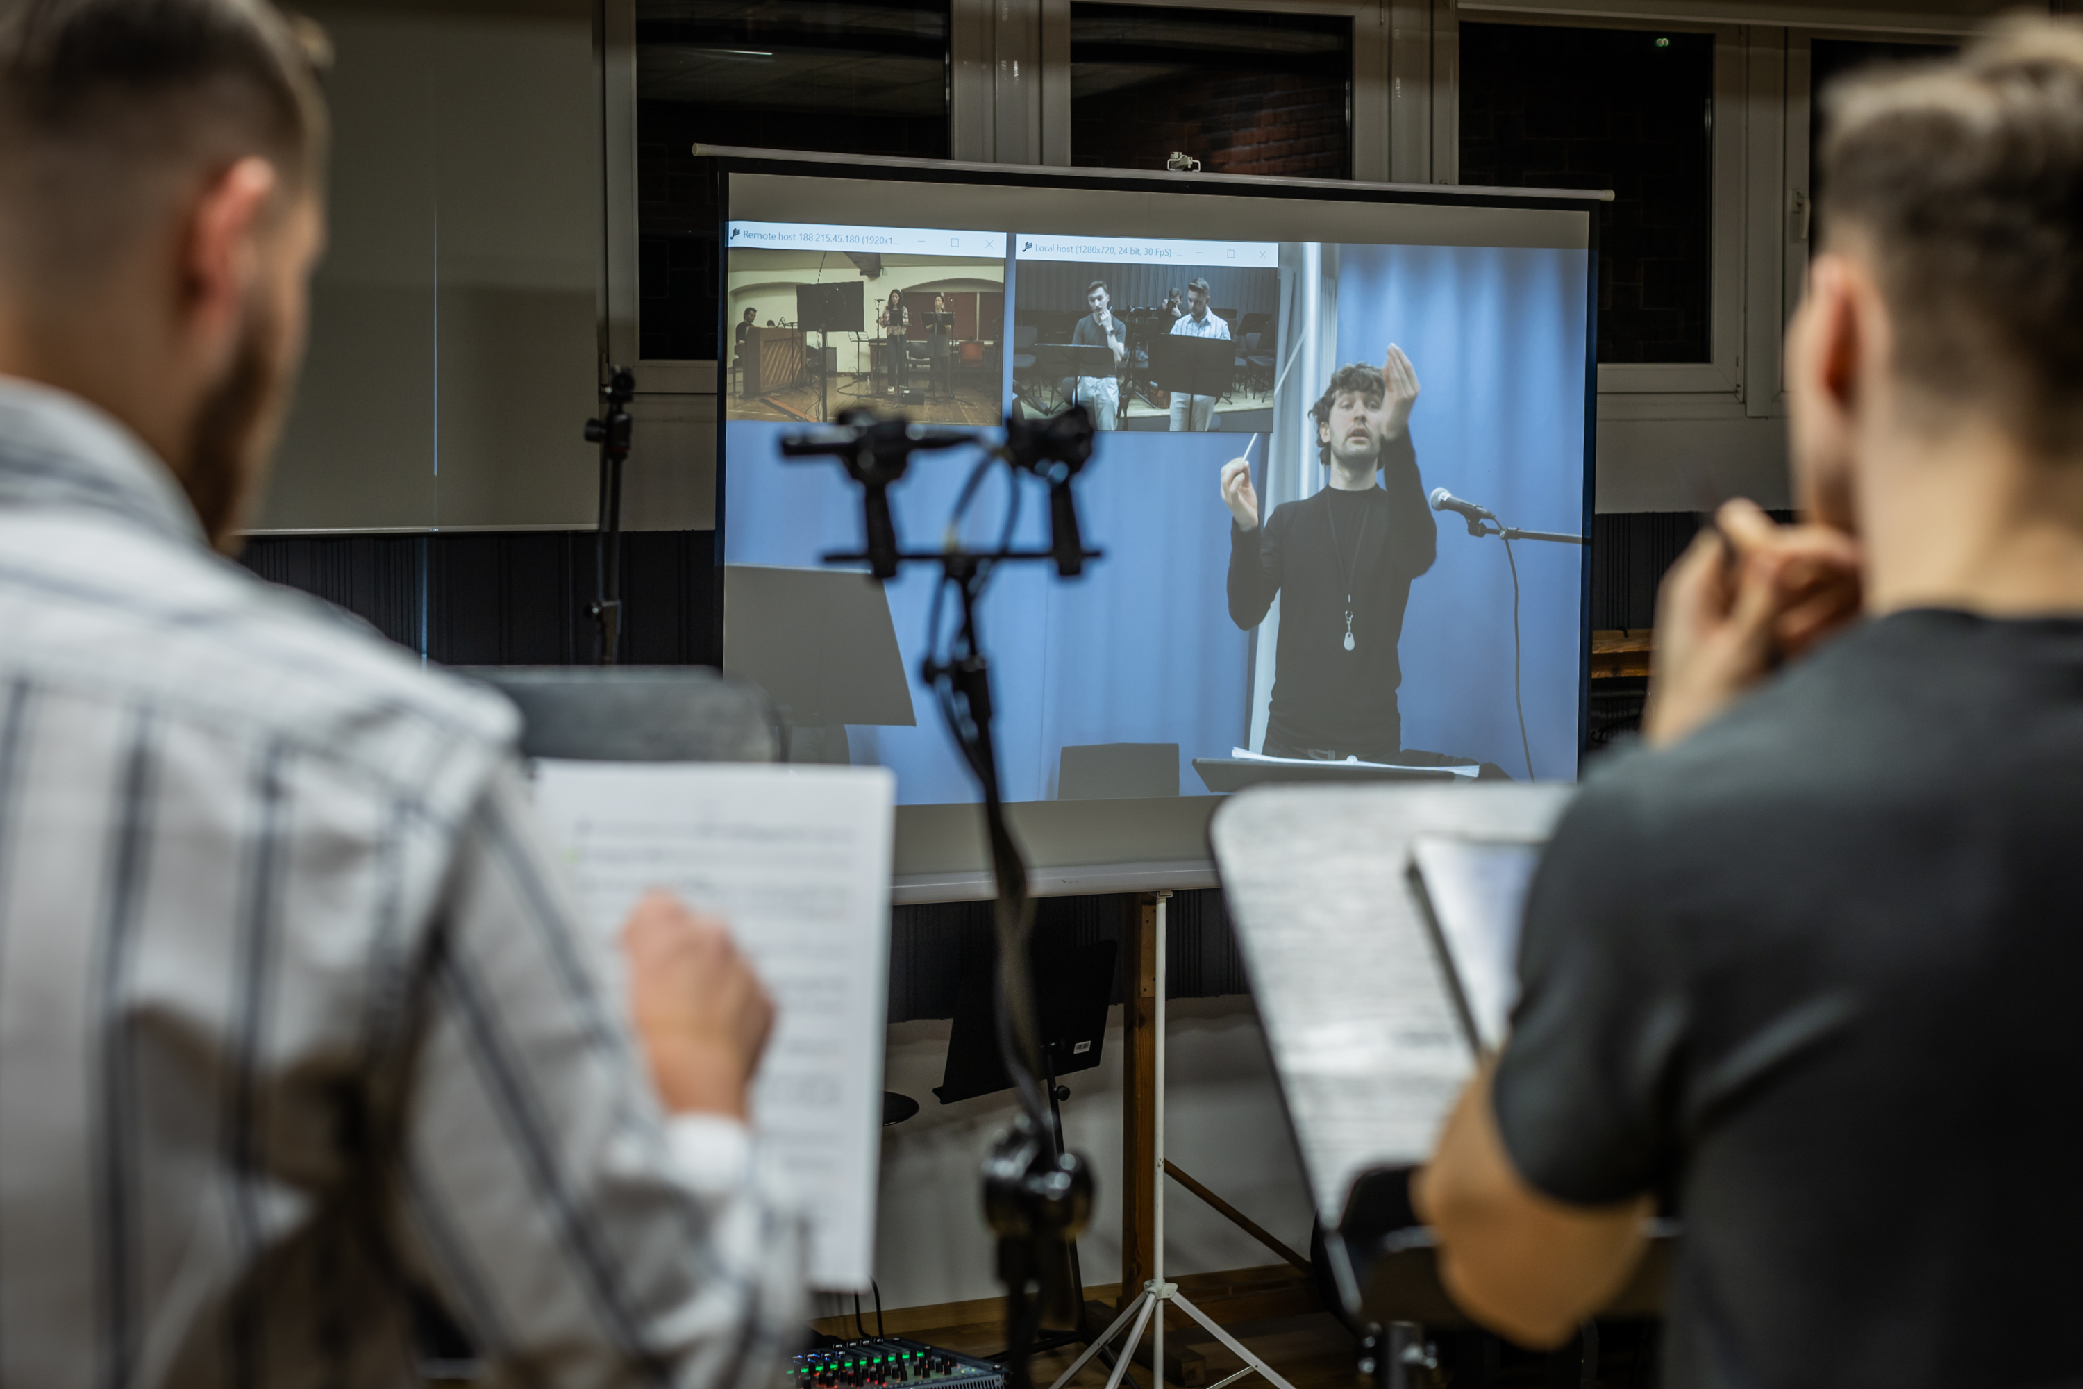
Connections and LoLa technology in the Butterfly Project

Slide 18
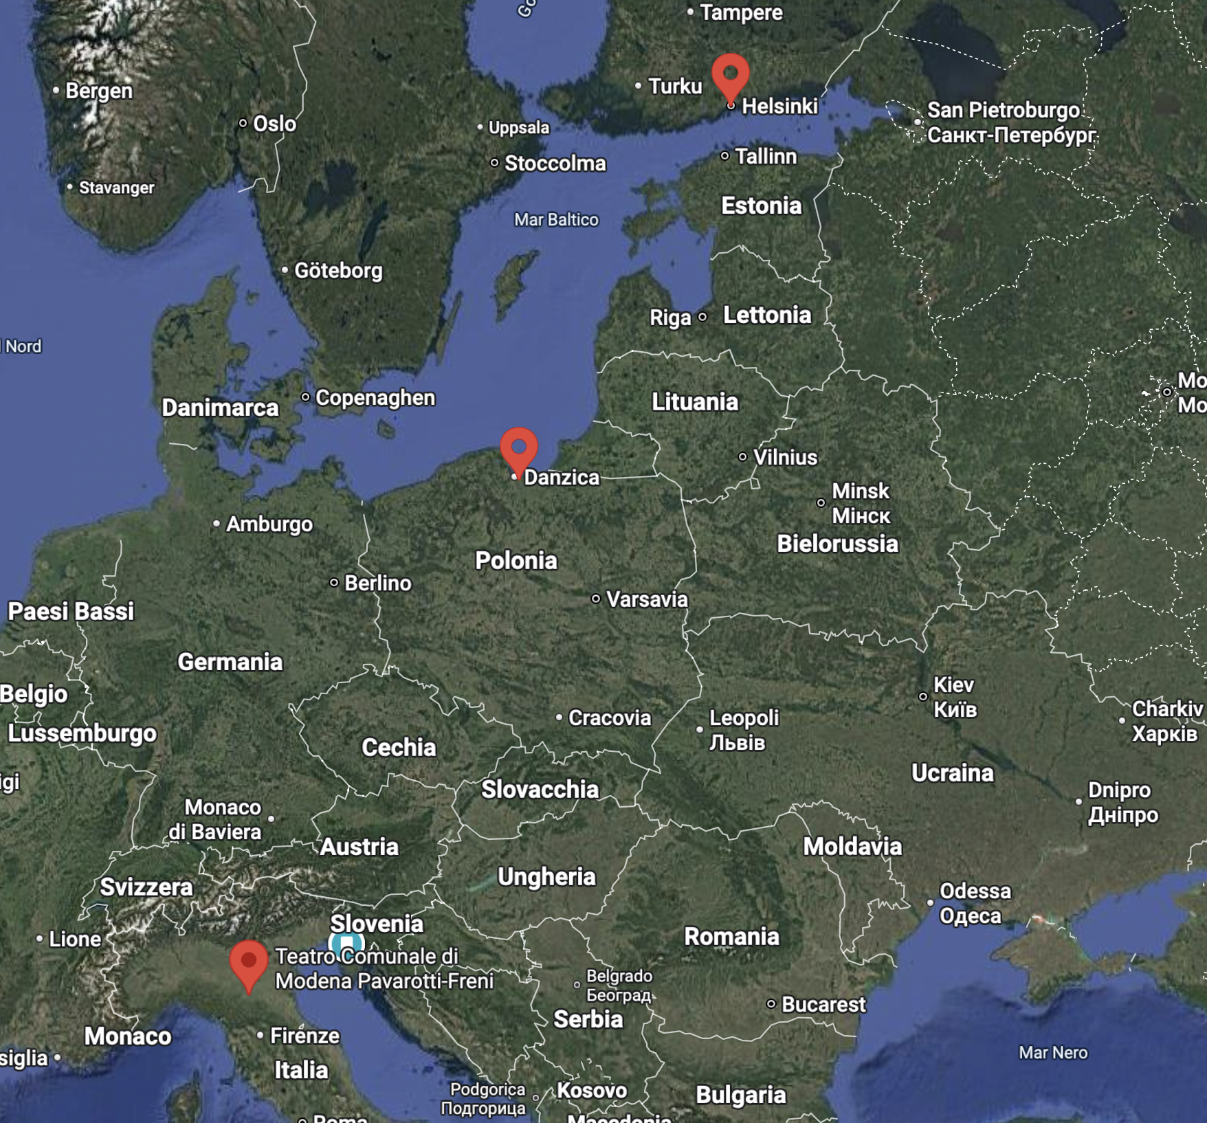

Slide 19
LoLa - Three types of solution / support
Modena: procure and learn, and have technology for the future
Gdansk: the local NREN (PCSS) provides full service on demand
Helsinki: just use what is already in daily use

Slide 20
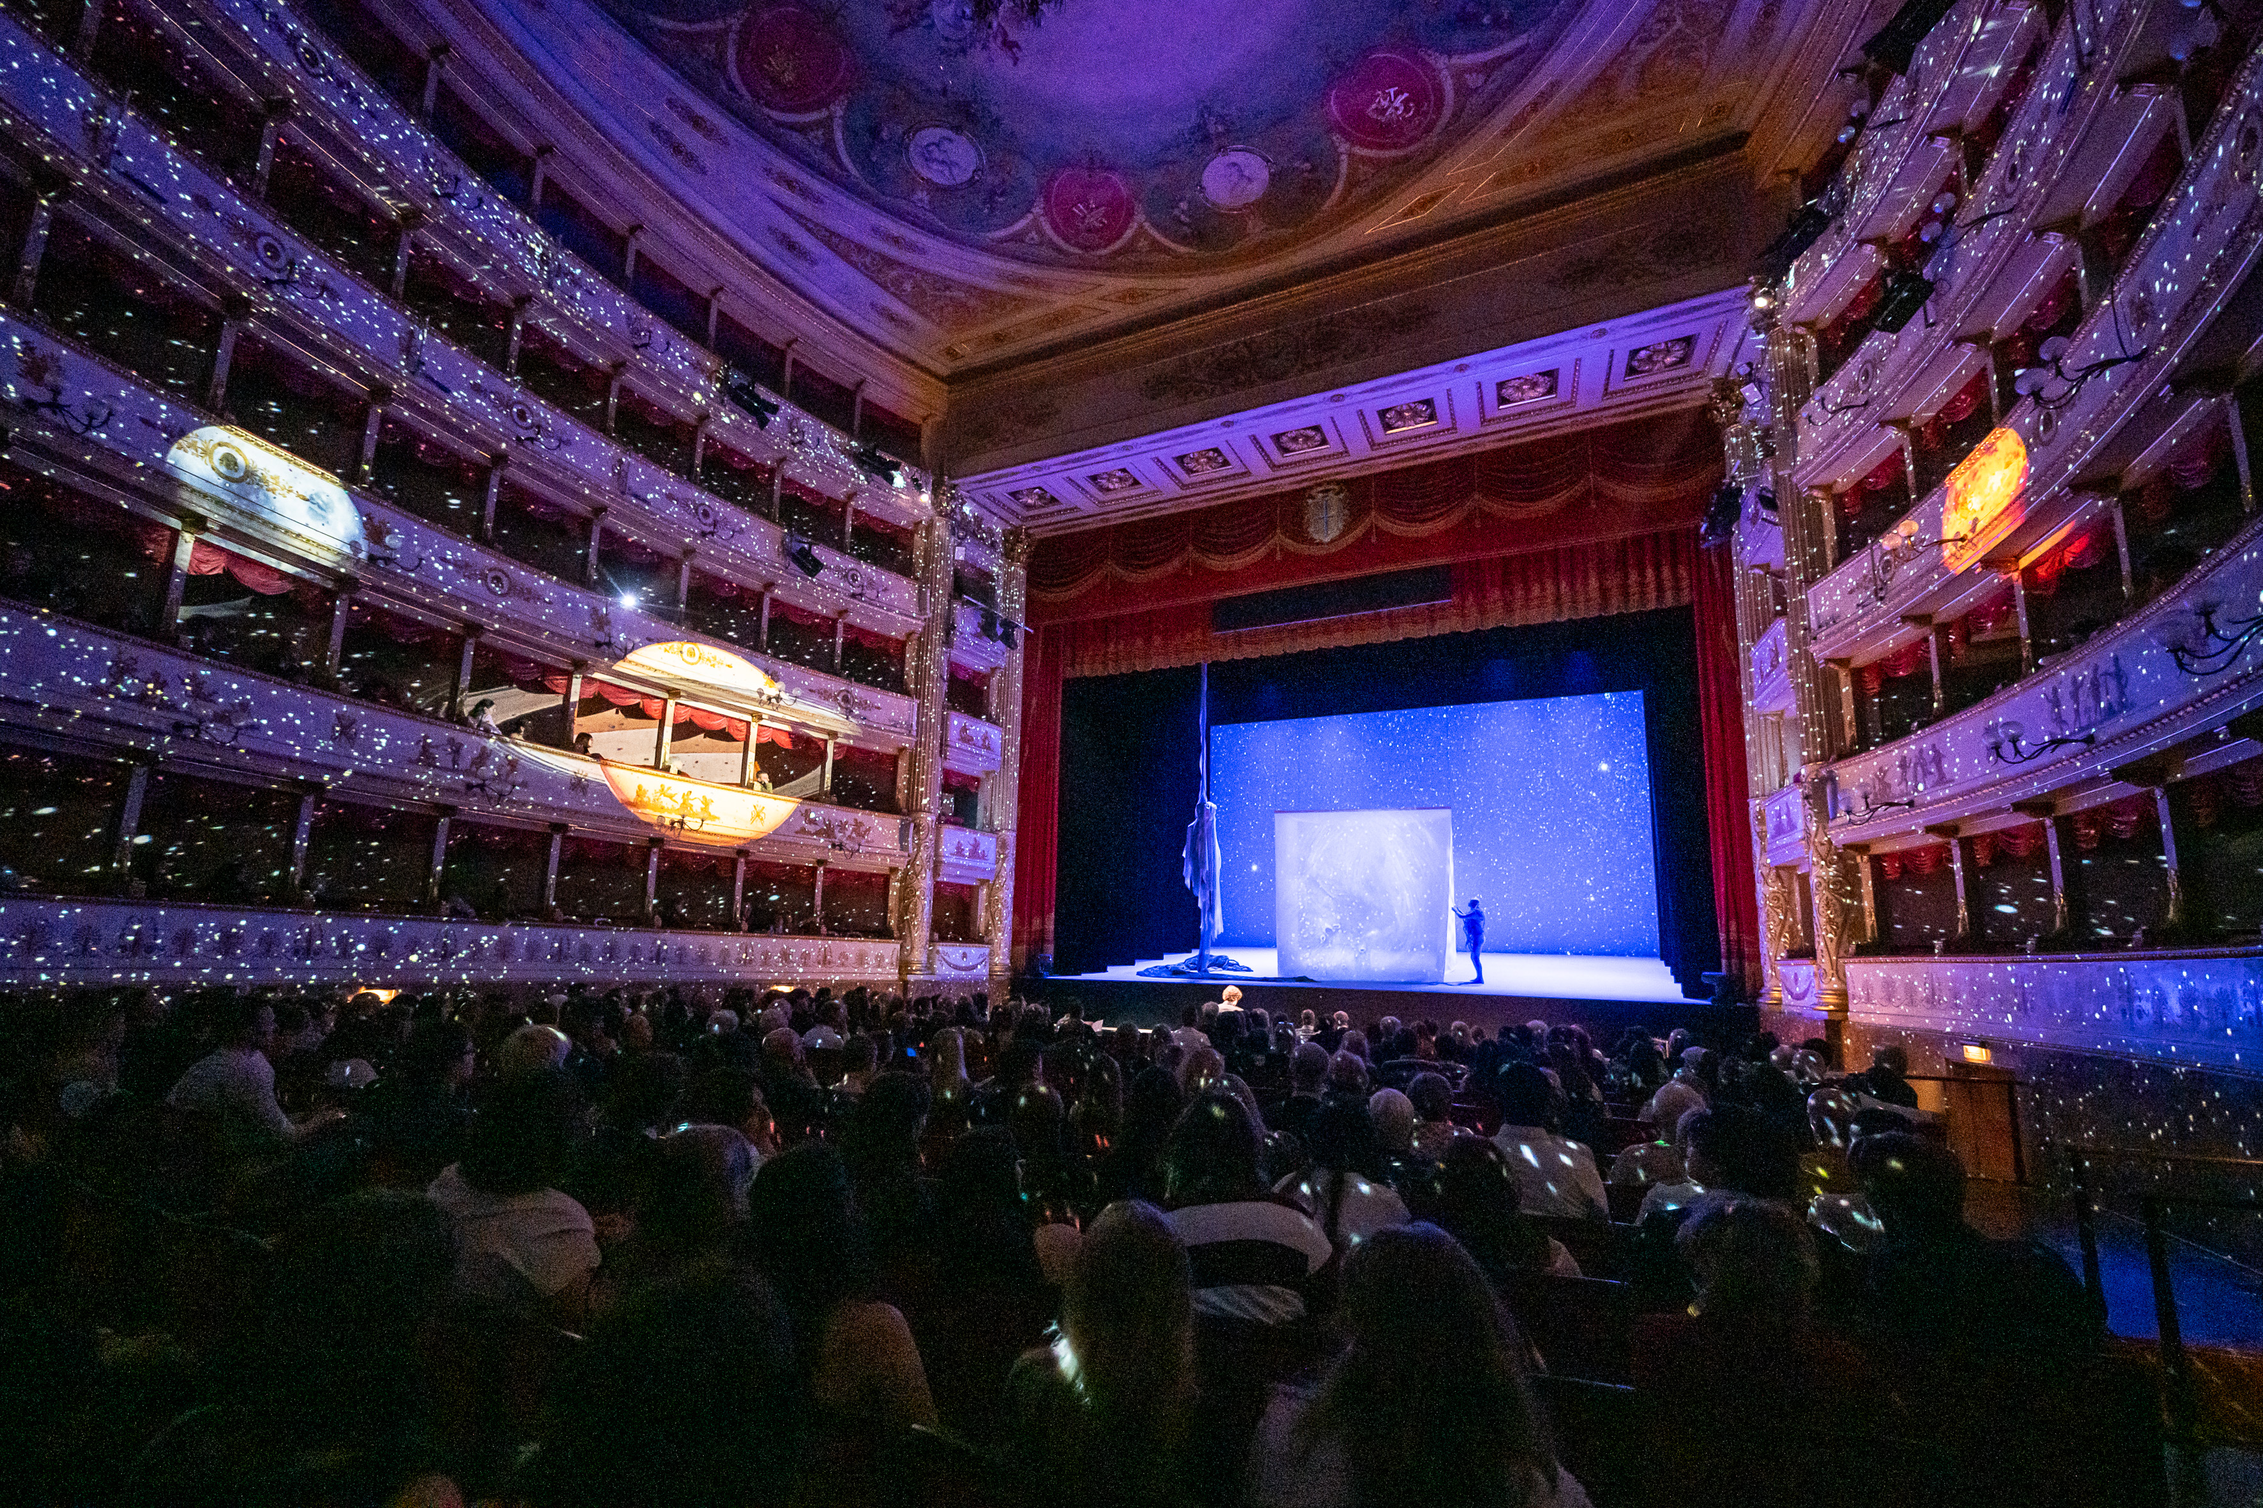
What’s next?
Future perspectives and developments

Slide 21
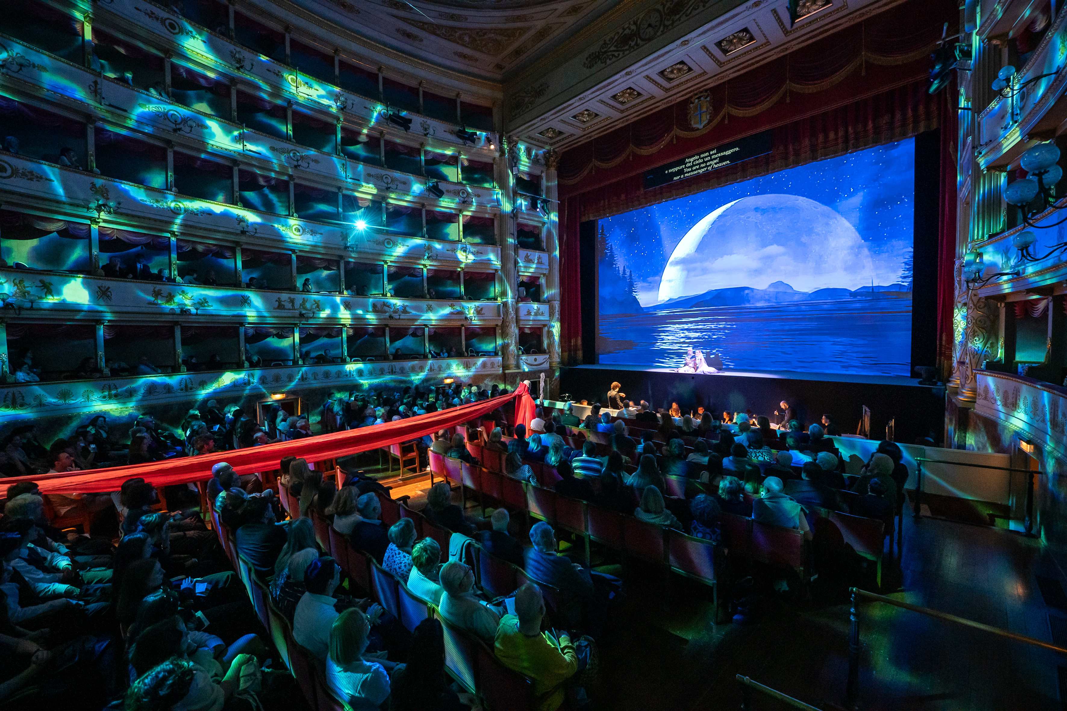
Enjoy the full show…
https://garr.tv/w/cb3NCcUxPdwgiQBAbwsw4Z

