Slide 1

Evaluation of the immunotoxicity of PFAS with New Approach Methodologies
Maxim Carlier, Theo Verboom, Brendan van der Haar, Laura Cuijpers, Peter Cenijn, Lisa Baumann, Wilbert Bitter, Majorie van Duursen, Timo Hamers

Slide 2
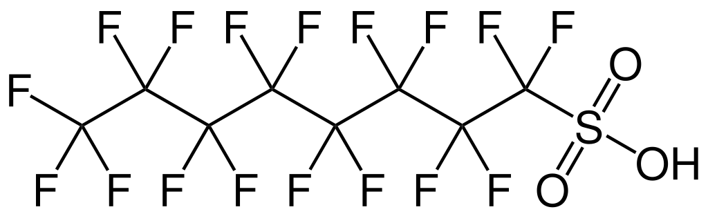
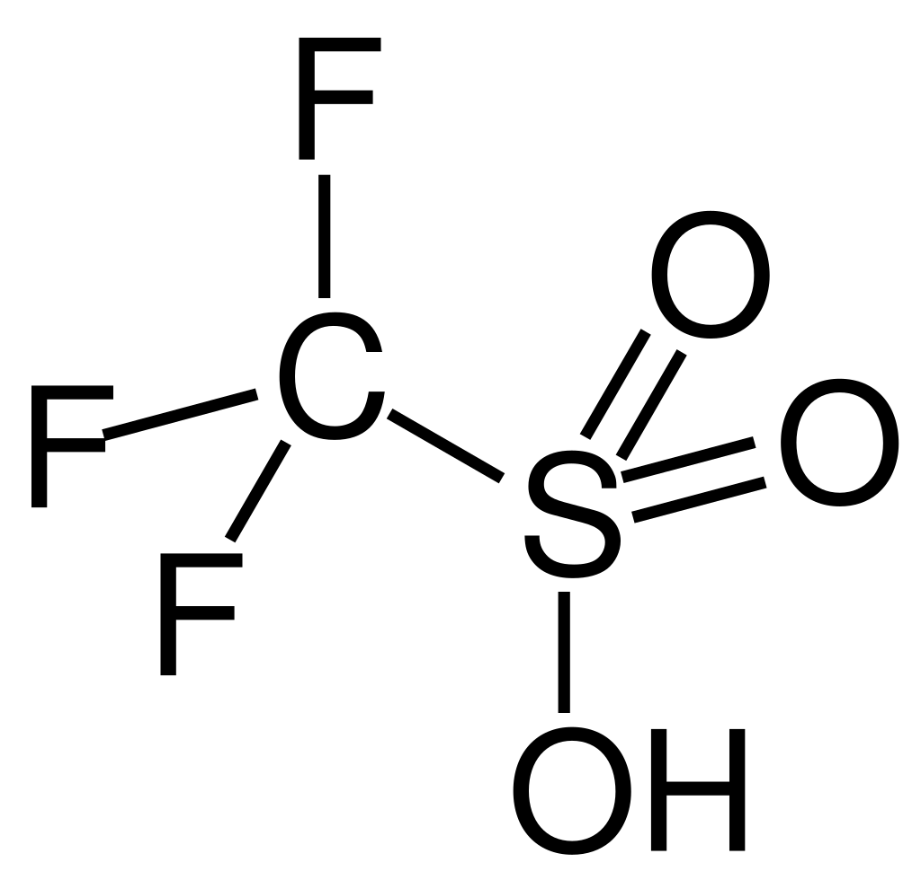
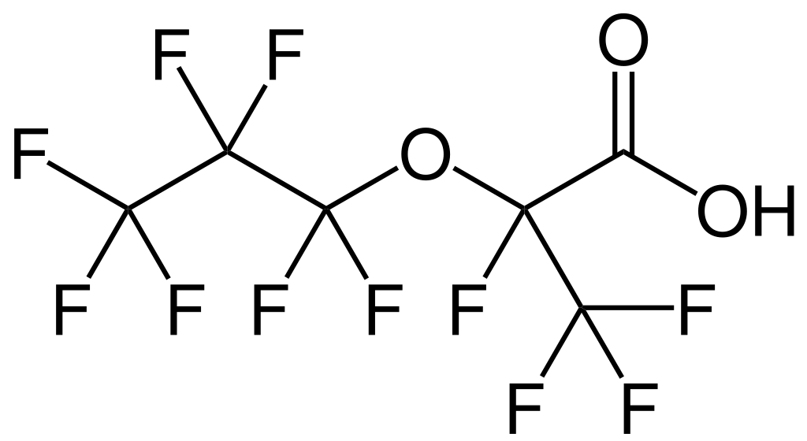
PFAS and immunotoxicity
Per- and polyfluoroalkyl substances (PFAS) have water, grease and dirt repellent properties
PFAS are used in clothing, food packaging, lubricants, among other things
Highly exposed children show lower antibody titers after vaccination
Perfluorooctanesulfonic acid (PFOS)
Trifluoromethanesulfonic acid (TFMSA)
GenX

Slide 3
Immunotoxicity tests
1) challenge zebrafish embryo with fluorescent protein-expressing pathogen → measure bacterial load
Only effects innate immune system
2) human macrophages differentiated from THP-1 cells. Measure cytokine release with co-exposure to lipopolysaccharide.

Slide 4
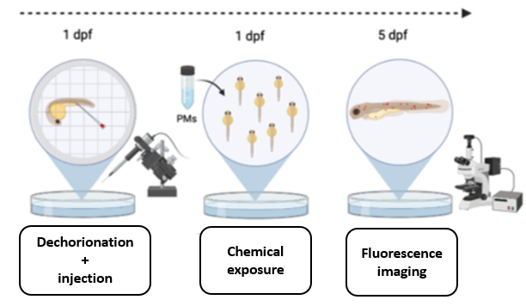
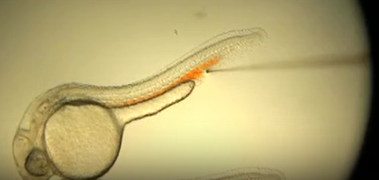
Methods
1 day after fertilization: dechorionation and injection with fluorescent Mycobacterium marinum
After injection: Exposure to the test compound
5 days after fertilization: Fluorescence microscopy.
Benard et al. (2012) Journal of visualized experiments: JoVE, (61), 3781.

Slide 5
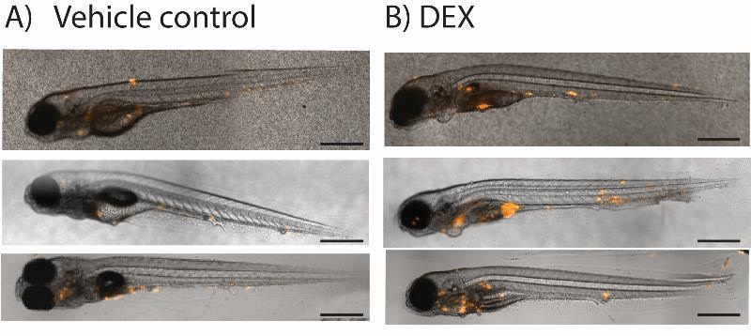
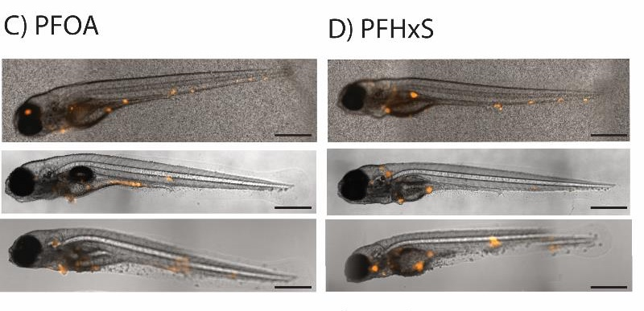
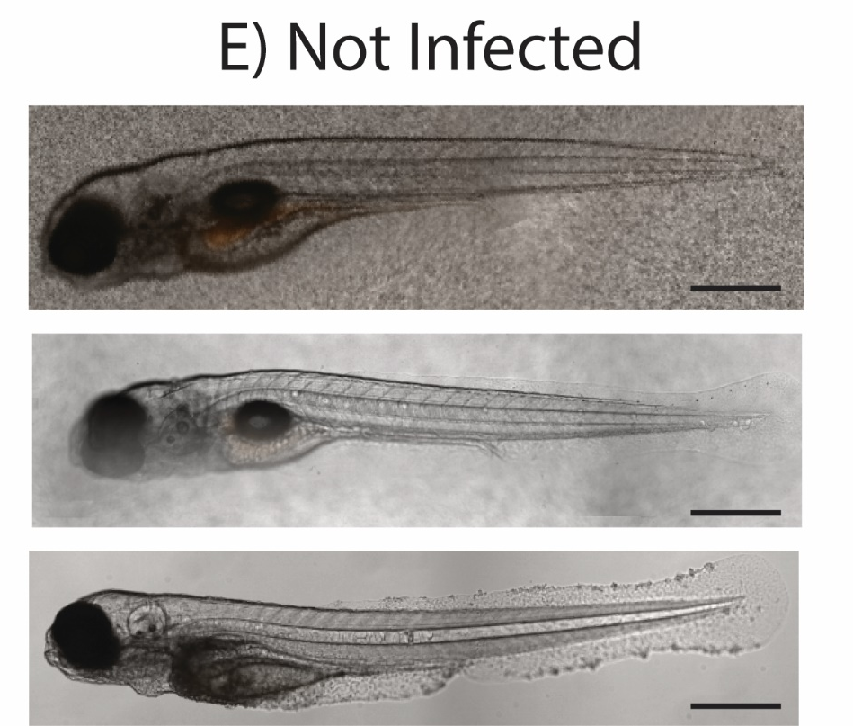
Results
Dexamethasone was established as positive control
Infection spread over the whole body
Non-infected embryos showed no background fluorescence
Carlier et al. (2025). Toxicol Appl Pharmacol, 117484.

Slide 6
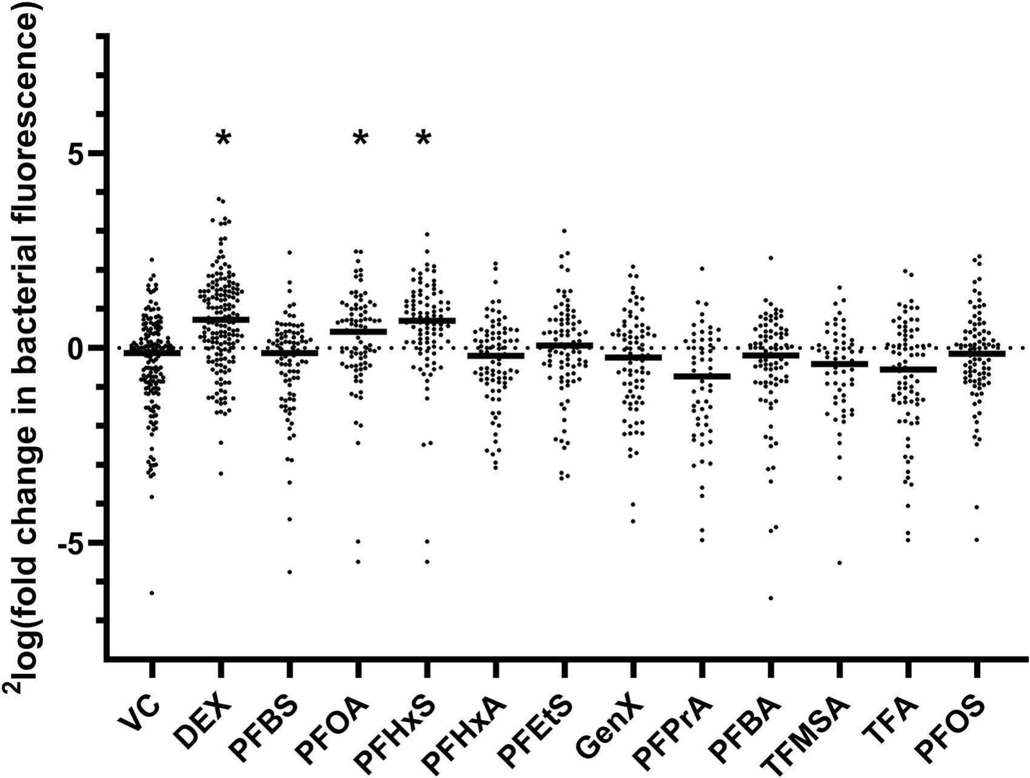





Results

Slide 7
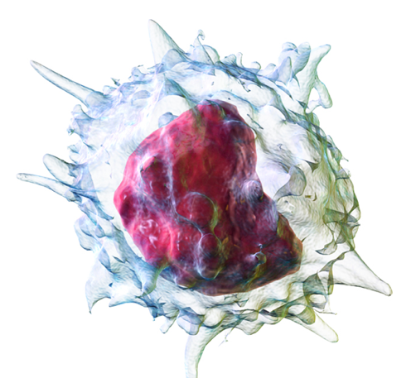

THP-1 immunosuppression assay
Human acute monocytic leukemia cell line (THP-1)
Differentiation to macrophages
Exposure to PFAS (48 hours)
Induction with LPS (3 hours)
Secretion of pro-inflammatory cytokine TNF-alpha

Slide 8
Results

Slide 9
Conclusion
PFHxS and PFOA → higher bacterial load in zebrafish embryos
PFHxS and PFOS → Decreased secretion of TNF-alfa after induction with LPS
secretion of pro-inflammatory cytokines → ability of zebrafish embryos to fight off infections.
Both assays indicate that some PFAS can induce immunosuppression

Slide 10
