Slide 1
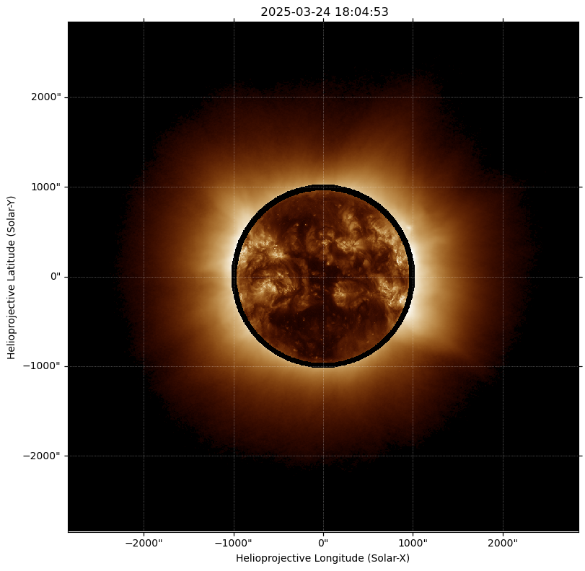
Accessing MLSO data programmatically
Michael Galloy
NSF NCAR/High Altitude Observatory/Mauna Loa Solar Observatory (MLSO)
Retrieve UCoMP and K-Cor data programmatically. Limited to active instruments currently – will expand to other data in the future.
Much more convenient for longitudinal studies (1 image a day for Carrington Rotation), queries that need to be automated
Python, IDL, and command-line clients available.
Docs: https://mlso-api-client.readthedocs.io
Repo: https://github.com/NCAR/mlso-api-client

