Slide 1
Research Software Quality Kit (RSQKit)
Shoaib Sufi
University of Manchester
CoSeC Staff Celebration Day
16th October 2025
This project has received funding from the European Union’s Horizon Europe Programme under GA 101129744 — EVERSE — HORIZON-INFRA-2023-EOSC-01-02

Slide 2

























What is EVERSE
Aims
  EVERSE aims to create a framework for research software and code excellence
  Collaboratively designed and championed by research communities
  Building a European Network of Research Software Quality
  Moving towards / setting the foundations for a Virtual Institute for Research Software Excellence
Goals
  Contribute to making research software a first-class citizen of the scientific process
  Enabling the people who contribute to research software to get credit for their efforts
Partners:
Driver clusters & infrastructures:

Slide 3
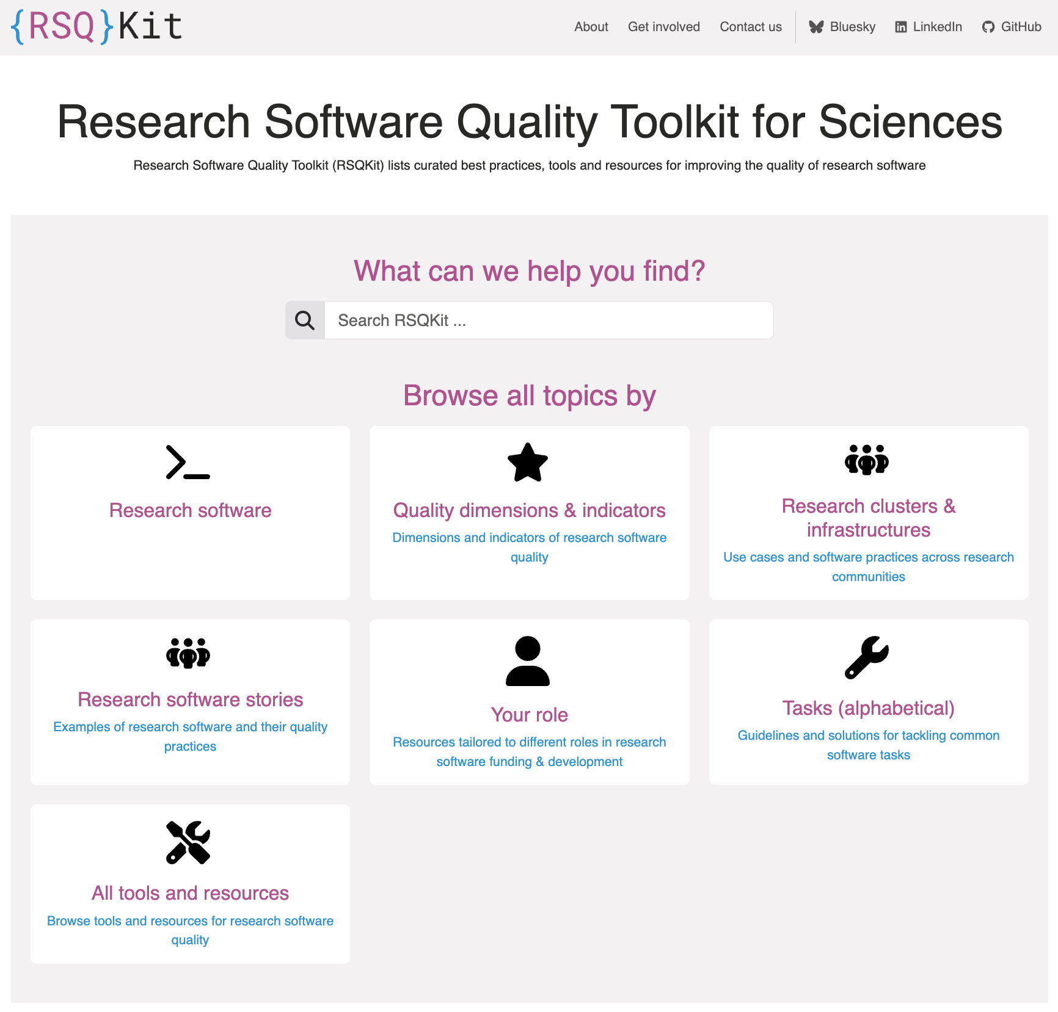



What is RSQKit
https://everse.software/RSQKit/
The Research Software Quality Kit:
Task driven guide – how to improve you research software quality (RSQ)
Tools related to improving RSQ
Training related to improving RSQ
Exemplars of good practice – Research Software Stories
Roles involved in research software
Research clusters and Infrastructures that make & use research software
A model for understanding the research software process for different types of research software
A product of
Inspired by

Slide 4
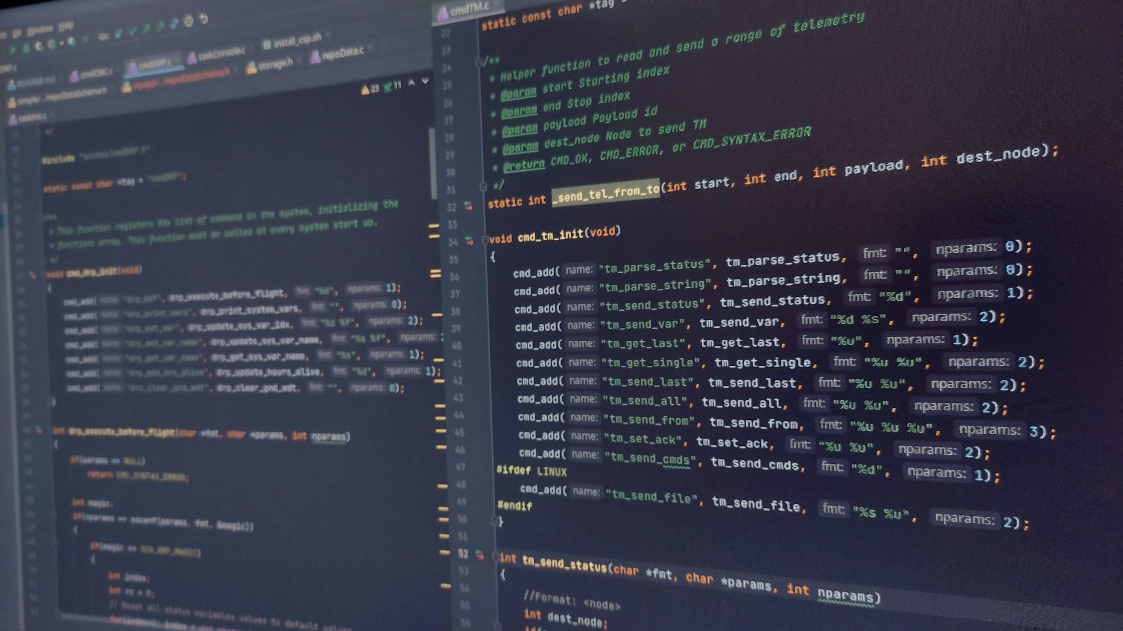
Audience
Researchers who code
Research software engineers
Those training research software skills
Those managing and/or procuring funding for project with a software component
Those running research infrastructures using software
Those developing software related policy at organisations and in projects
unsplash.com/photos/black-flat-screen-computer-monitor-MmYtZoZ8ET4

Slide 5
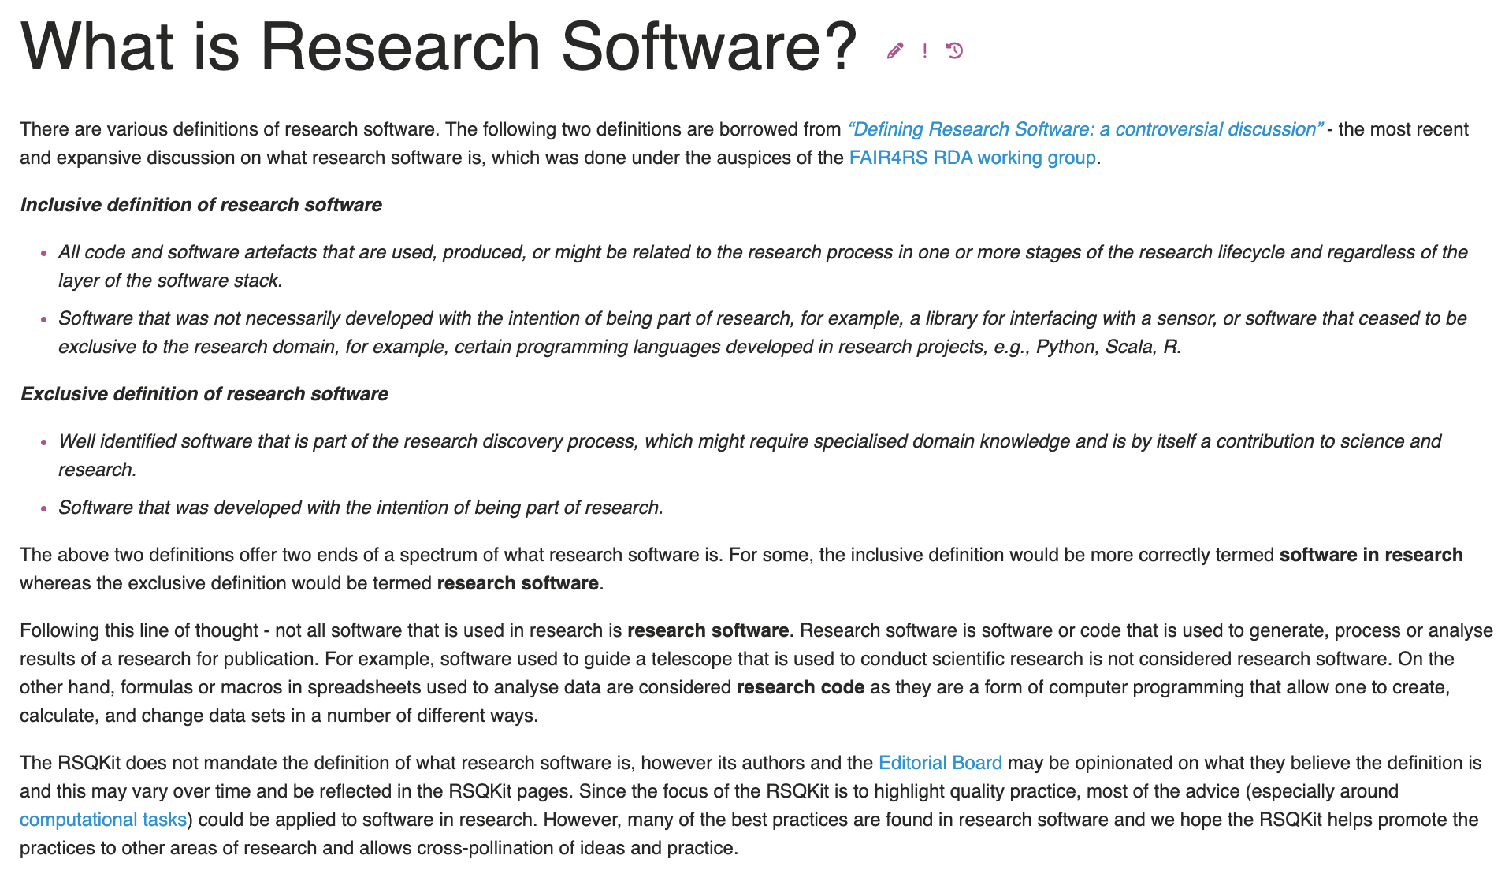
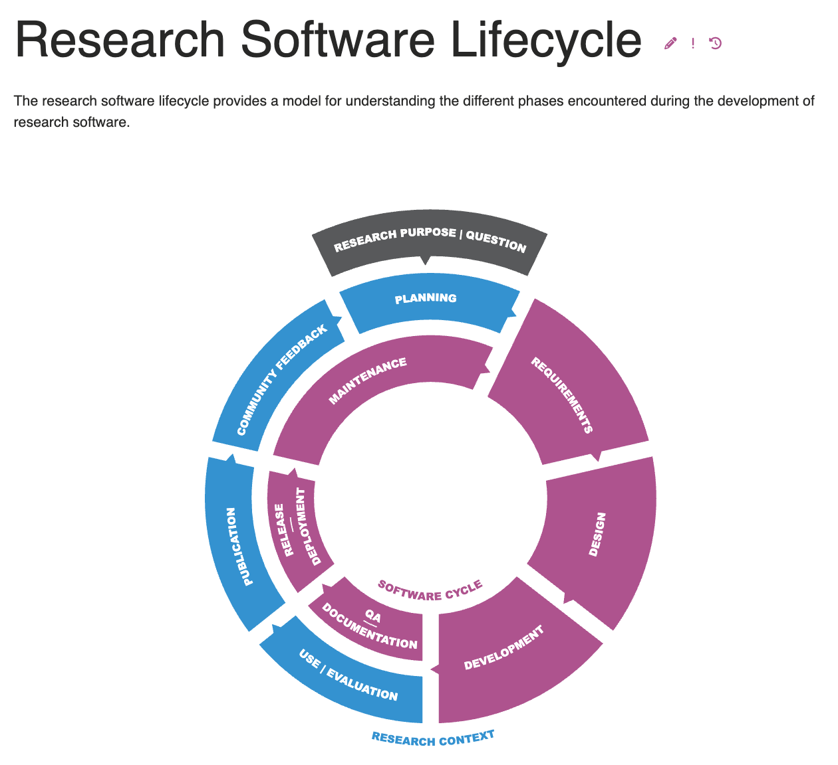
Definitions and Frame of Reference

Slide 6
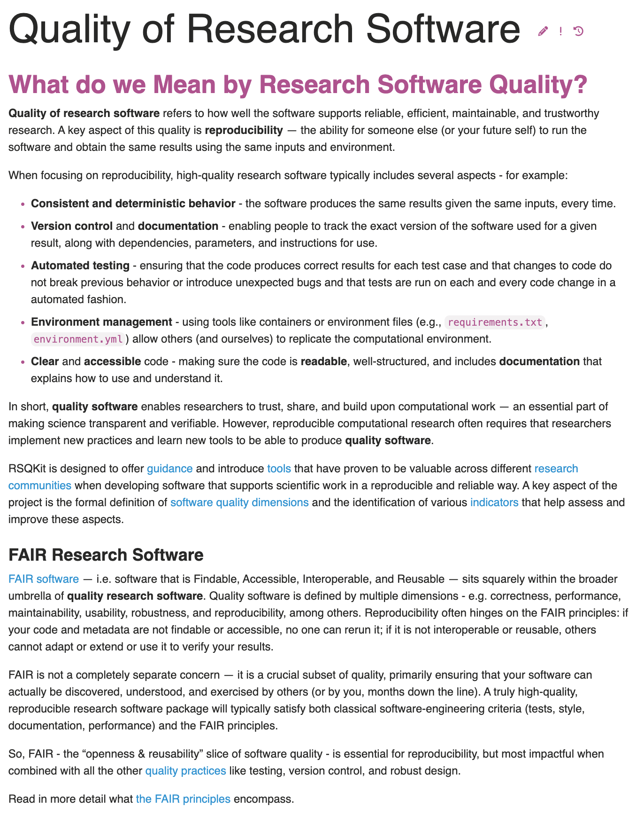
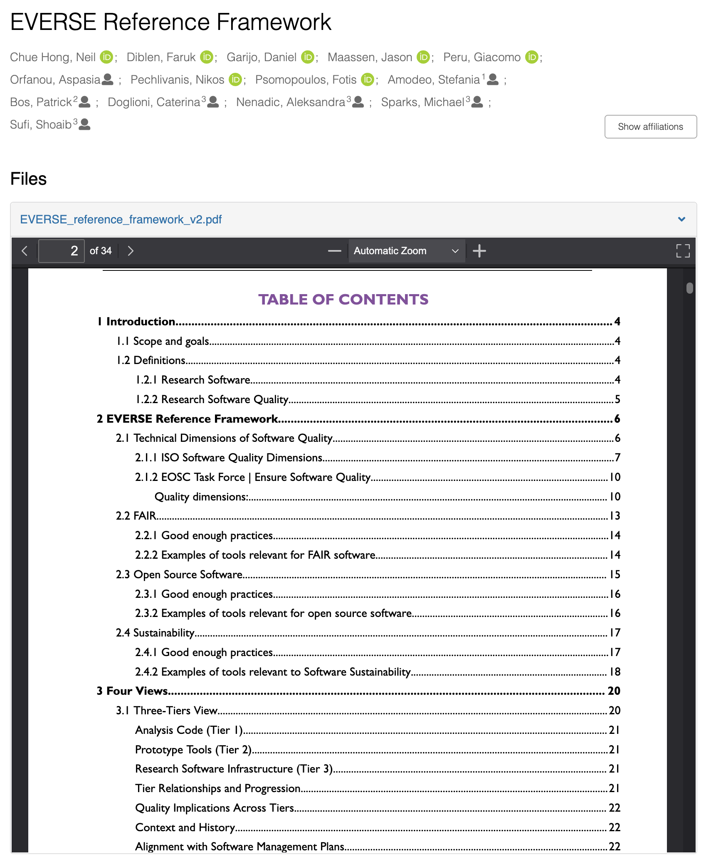
Definitions and Frame of Reference 2
https://zenodo.org/records/15856368
Version 2 published in July 2025

Slide 7
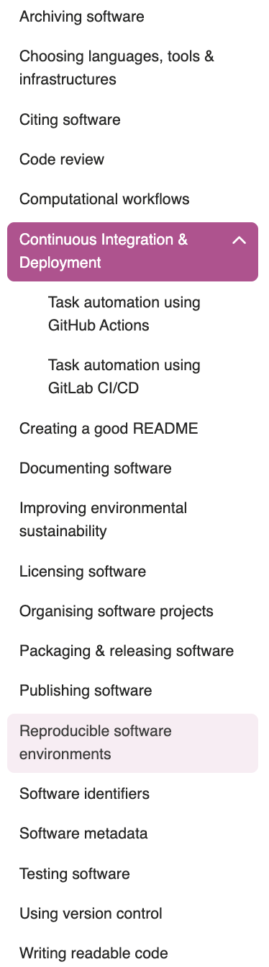
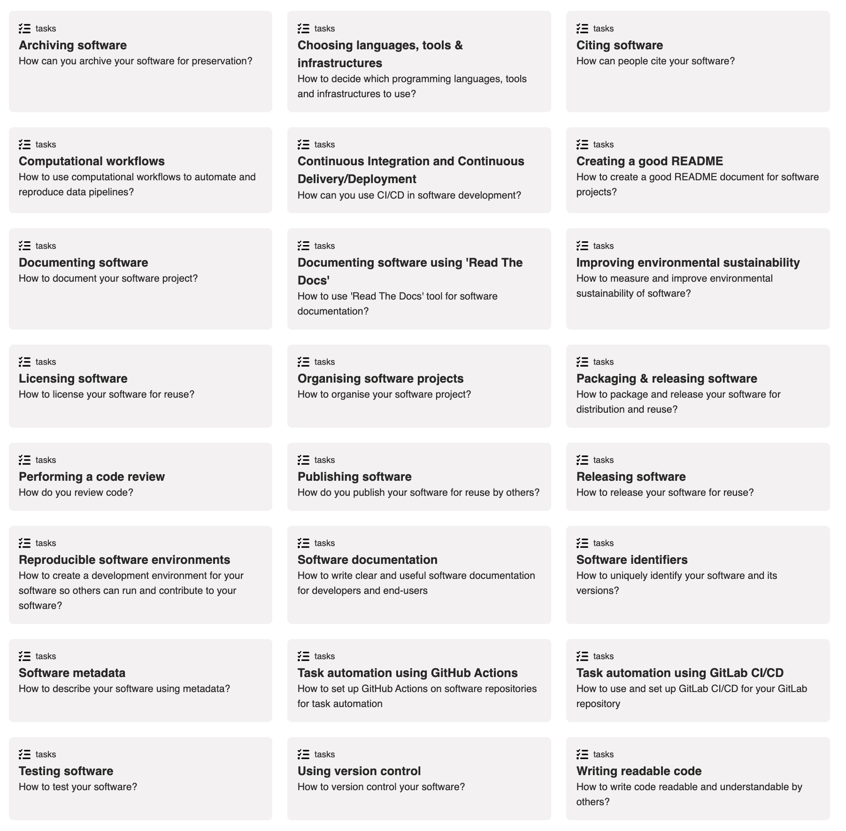
Tasks
Common software tasks that improve quality
Quality of practices vs quality of product
https://everse.software/RSQKit/tasks

Slide 8
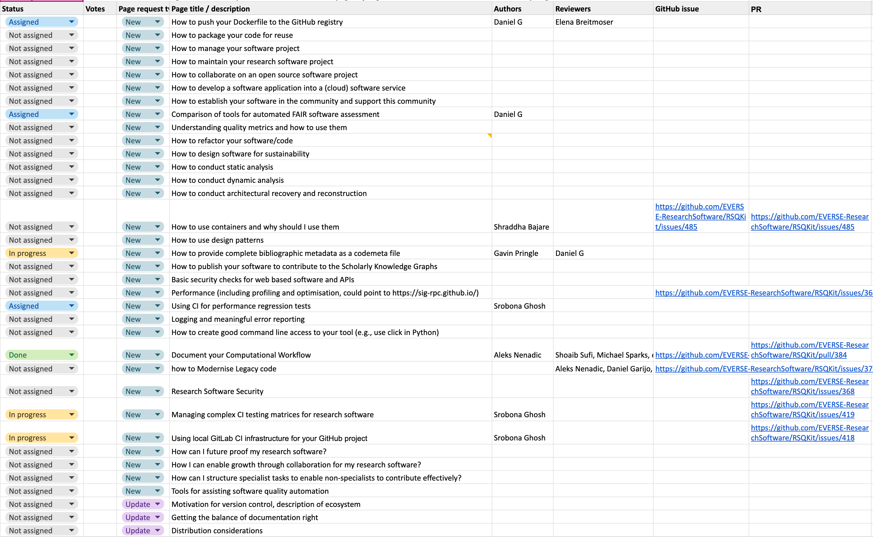
Write, review or suggest a task page!
GitHub Issue
Google Sheet

Slide 9
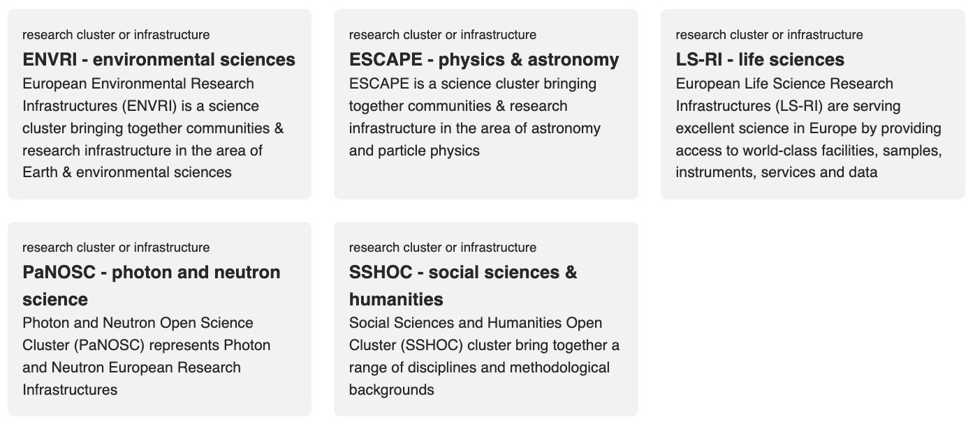

Research Clusters & Infrastructures
Collection of projects and infrastructures
Develop and make a lot of use of software to enable progress
could be added as a Research Cluster/Infrastructure

Slide 10
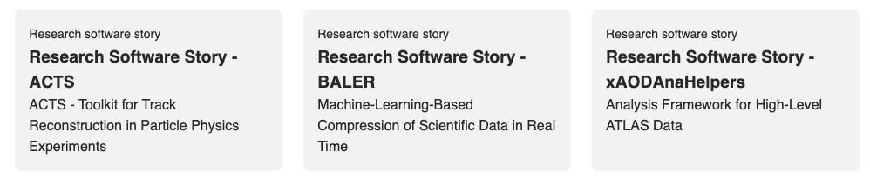
Research Software Stories
A good story covers the ….
Problem
User community
Architecture
Libraries and systems
Software quality practices
Developer community
Tools used
FAIR & Open aspects
Documentation
Sustainability
References
Advertisement
Onboarding
Software quality example

Slide 11
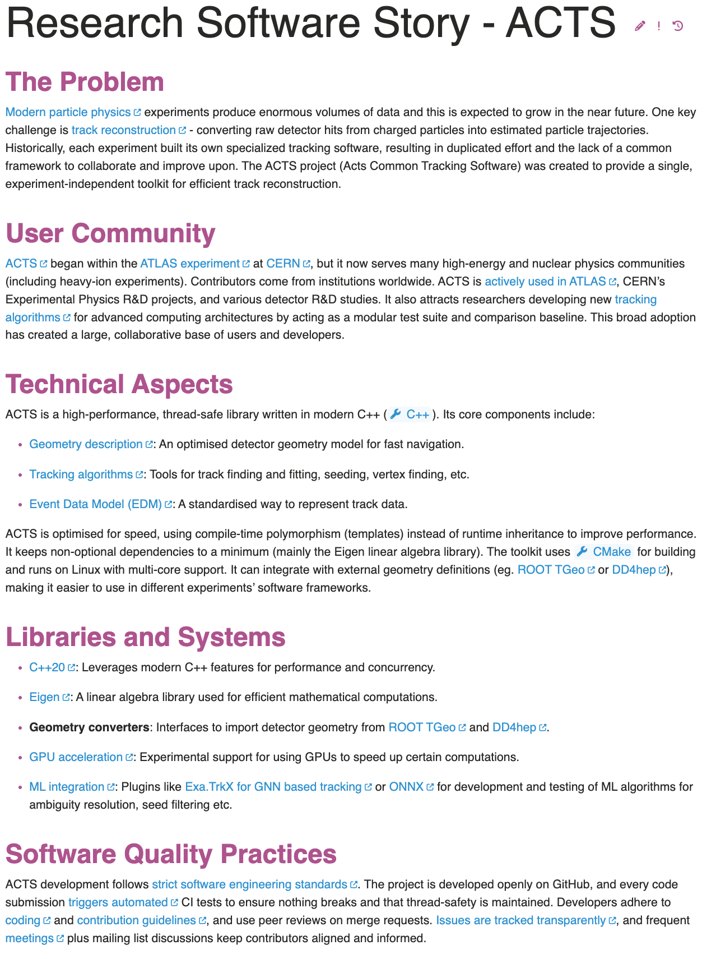
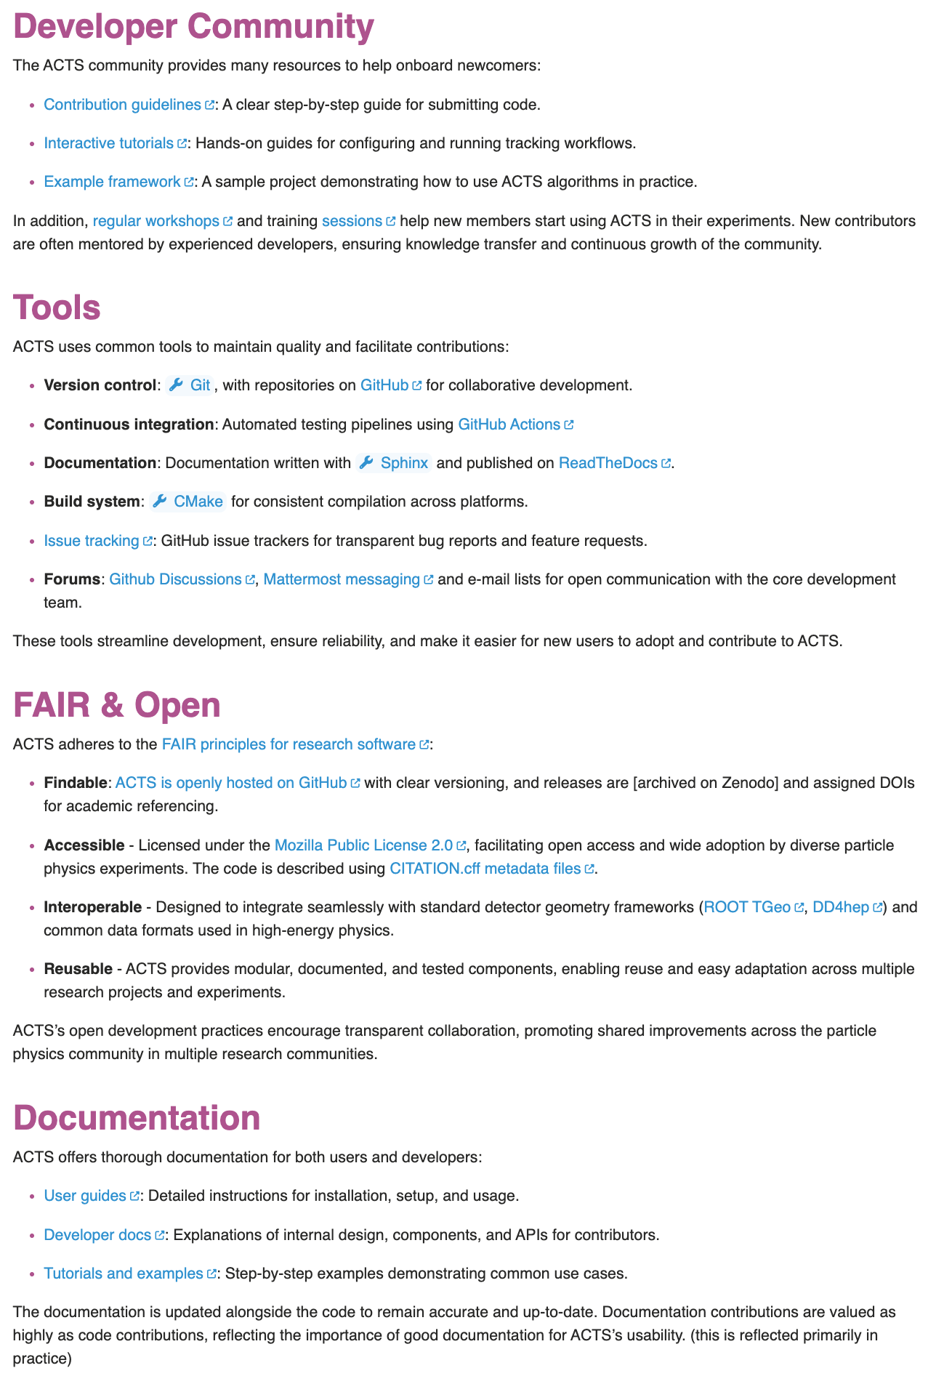
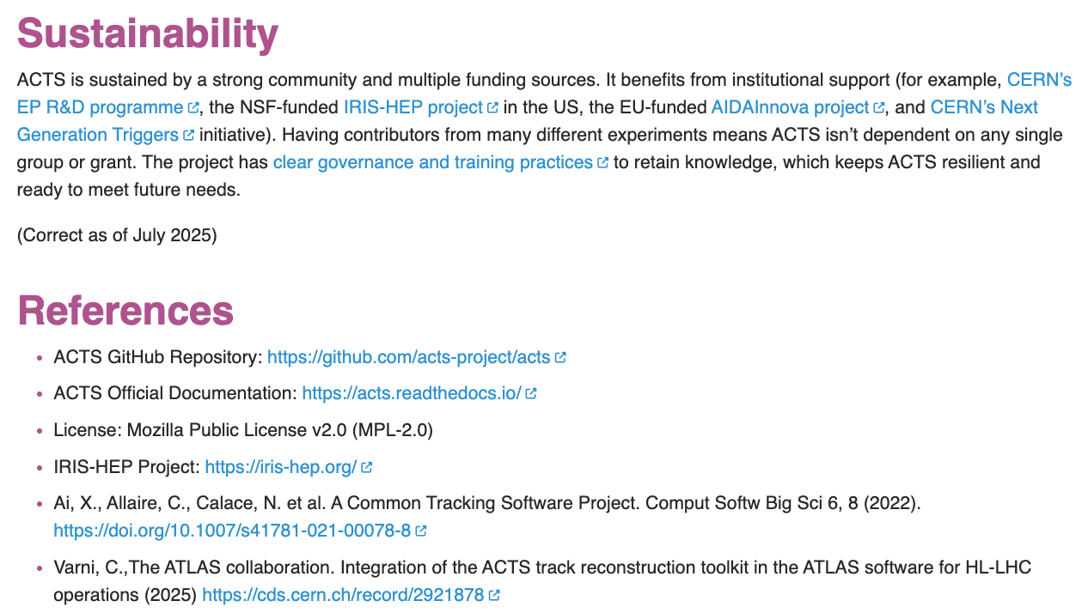
ACTS – A Research Software Story
https://everse.software/RSQKit/acts_research_software_story

Slide 12
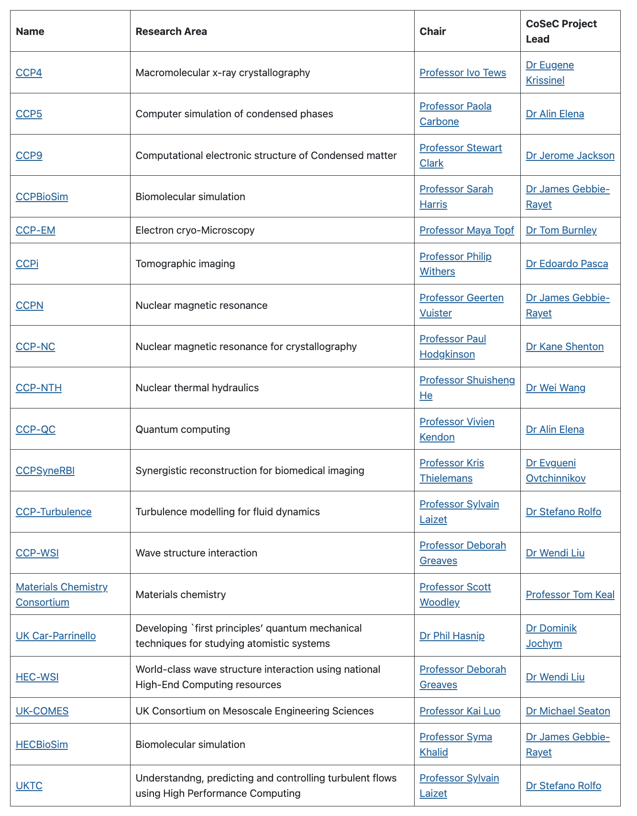






















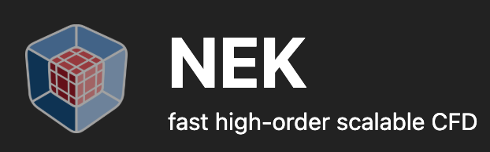

Many Stories in CoSeC
Some are collections and would be a new type of story
Not all are owned by the CCP but used/approved/contributed to
Not all software for each CCP is listed – just some – there is a lot of research software here!
Great to see:
DL_*
…
Lots and lots of research software!
www.cosec.ac.uk/communities/current-ccps-and-hecs/
Notes:
For collections – could be things like minimum requirements to be included – minimum requirements around quality.

Slide 13
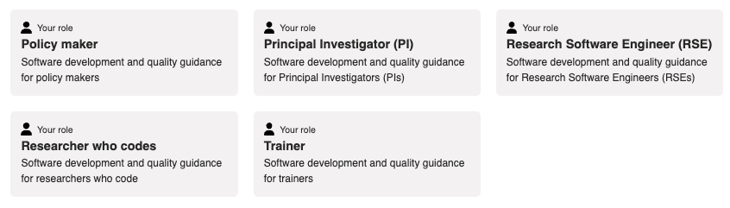
Research Software Roles
Software quality
Responsibilities
Challenges
Tasks
Further guidance
PI: Software Management
PI: Establishing a software team
PI: Responsible for reproducibility
PI: Incorporating FAIR
PI: Ethical, environmental and legal
PI: Promoting openness and reuse

Slide 14
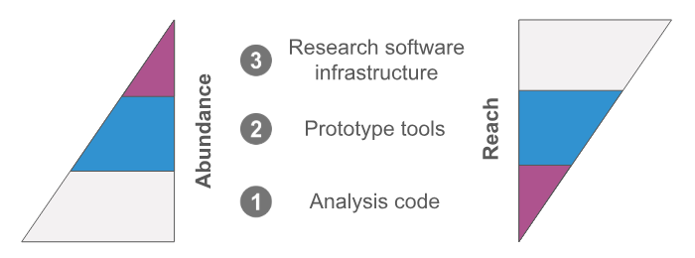
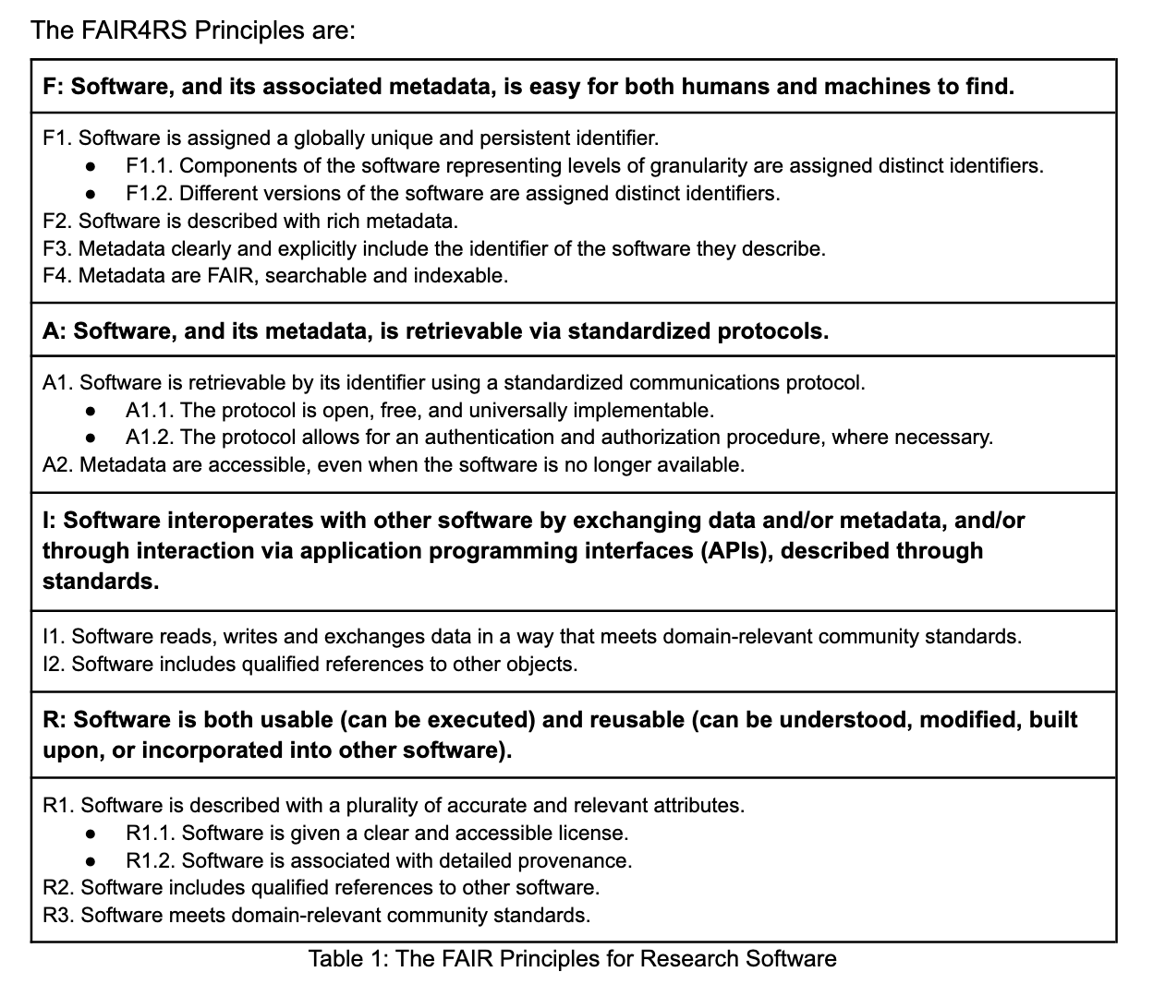
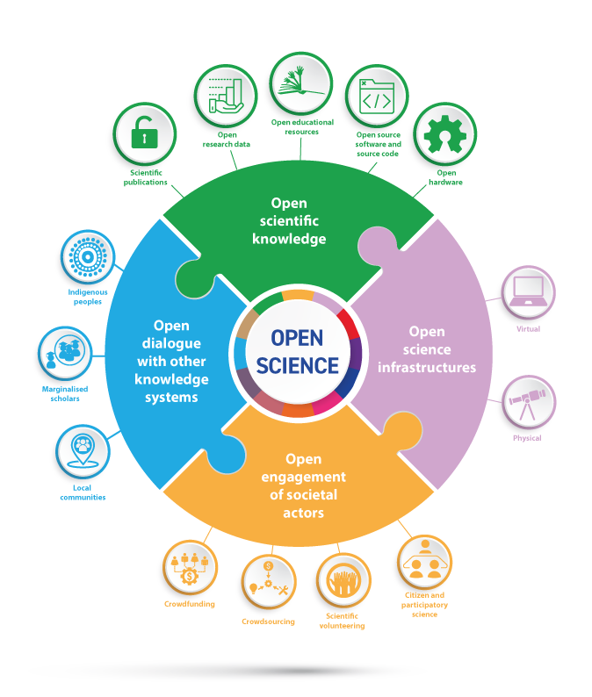
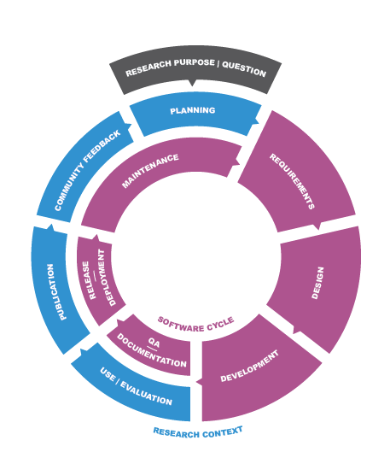
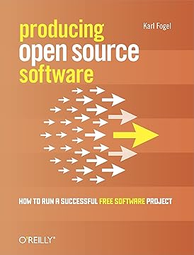


The landscape and drivers
Landscaping
The three tier model
FAIR Research Software
Open Science/Research
Attitudes
Gaps
Incentives
Funding
Policies
Community
Community Development & Metrics
The research software life cycle
By UNESCO.org - Understanding open science (p:6)

Slide 15
RSQKit Architecture
(linkage and automagic)
RSQKit
Scope
From ETT (Elixir Toolkit Theme) - https://elixir-belgium.github.io/elixir-toolkit-theme/
  Tasks to Tools
  Tools to further information
  Task & Tool linkage to training registry (limited to TeSS)
  Related pages
RSQKit additions (the ++) - Future work
  Extending the training registries that are supported
  Presenting the link between dimensions & indicators with tasks and tools
  Connecting roles with tasks
Research Clusters & Infrastructures
Resources
(tool websites, references, tutorials, existing guidance)
Definitions
Research Software Stories
Training registries
Roles
Contributors
EVERSE: Training
EVERSE: TechRadar
Tasks
Institutions
EVERSE: Indicators
Tools
Dimensions & indicators
Work in progress / planning
Data
Content
External
EVERSE

Slide 16
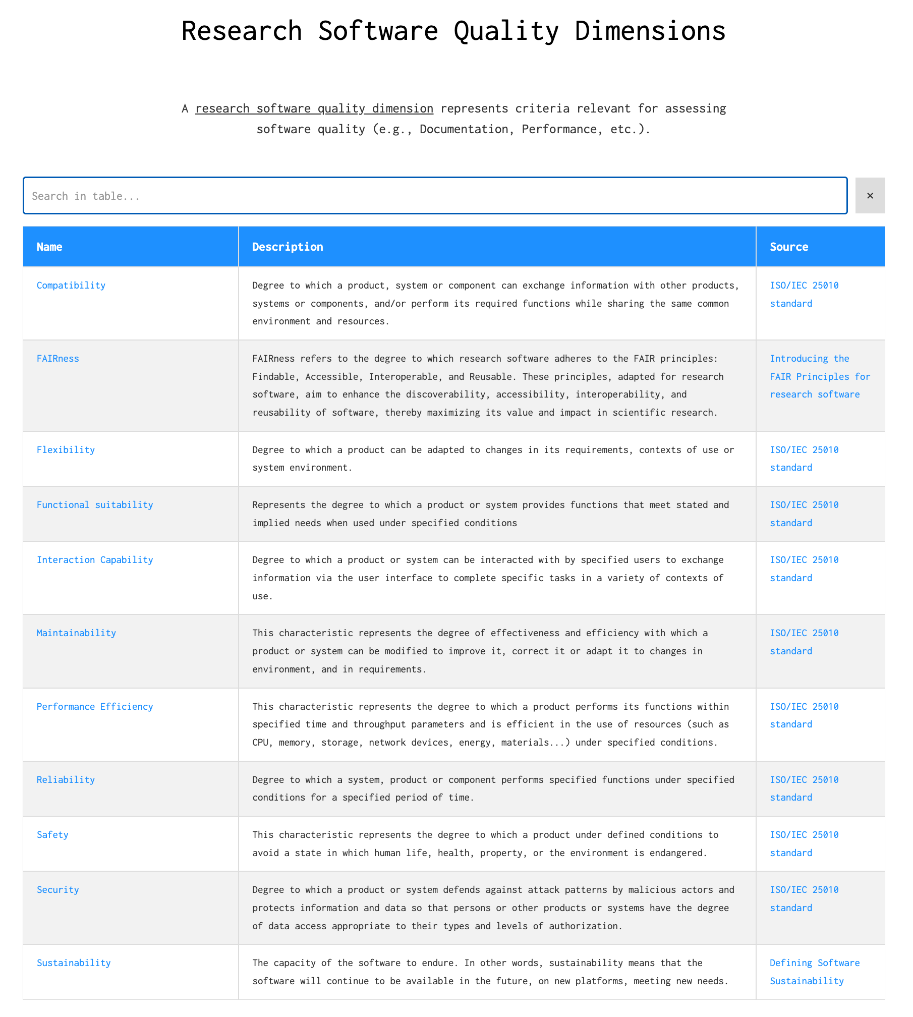
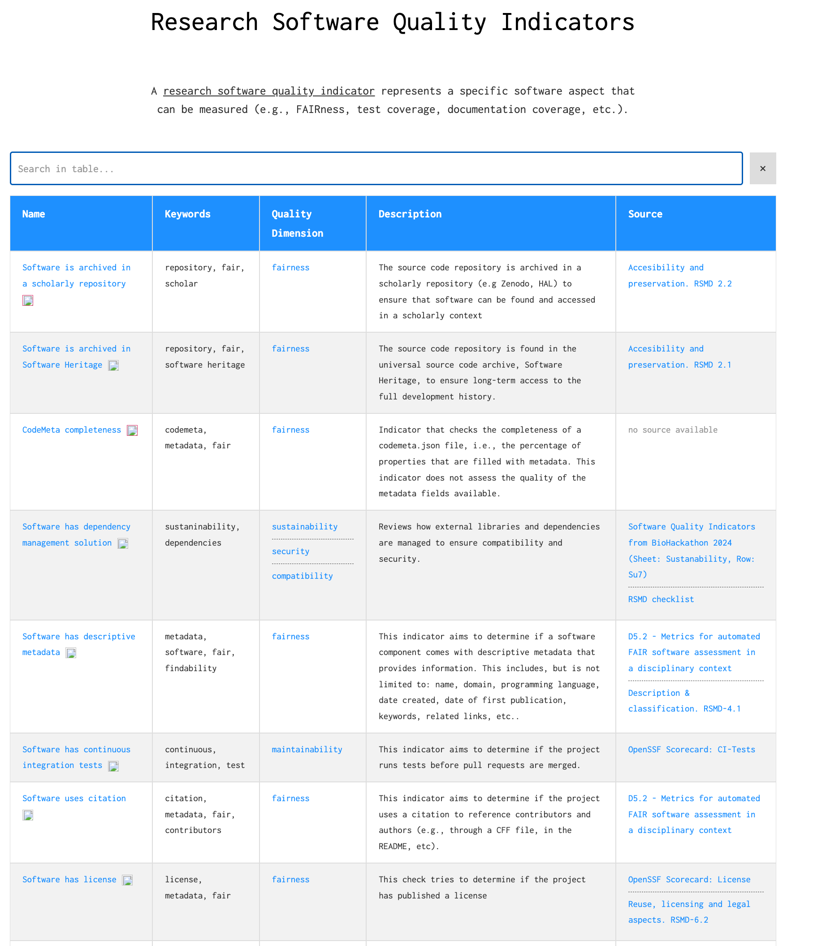
Dimensions & Indicators
everse.software/indicators/website/indicators.html
  Which software quality dimensions / categories
  Which software quality indicators are these associated with
  What do these apply to
    Best practices
    Tools
    Training
    Assessment pipelines
More being added actively ….
Fairly stable list

Slide 17

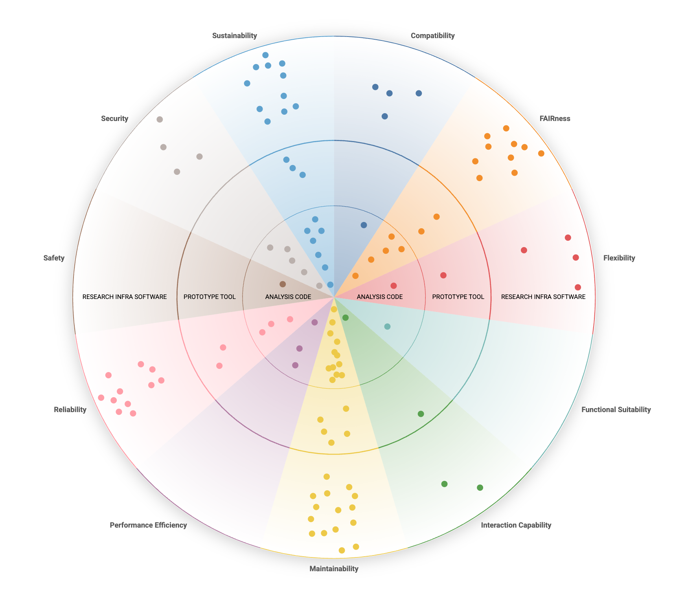
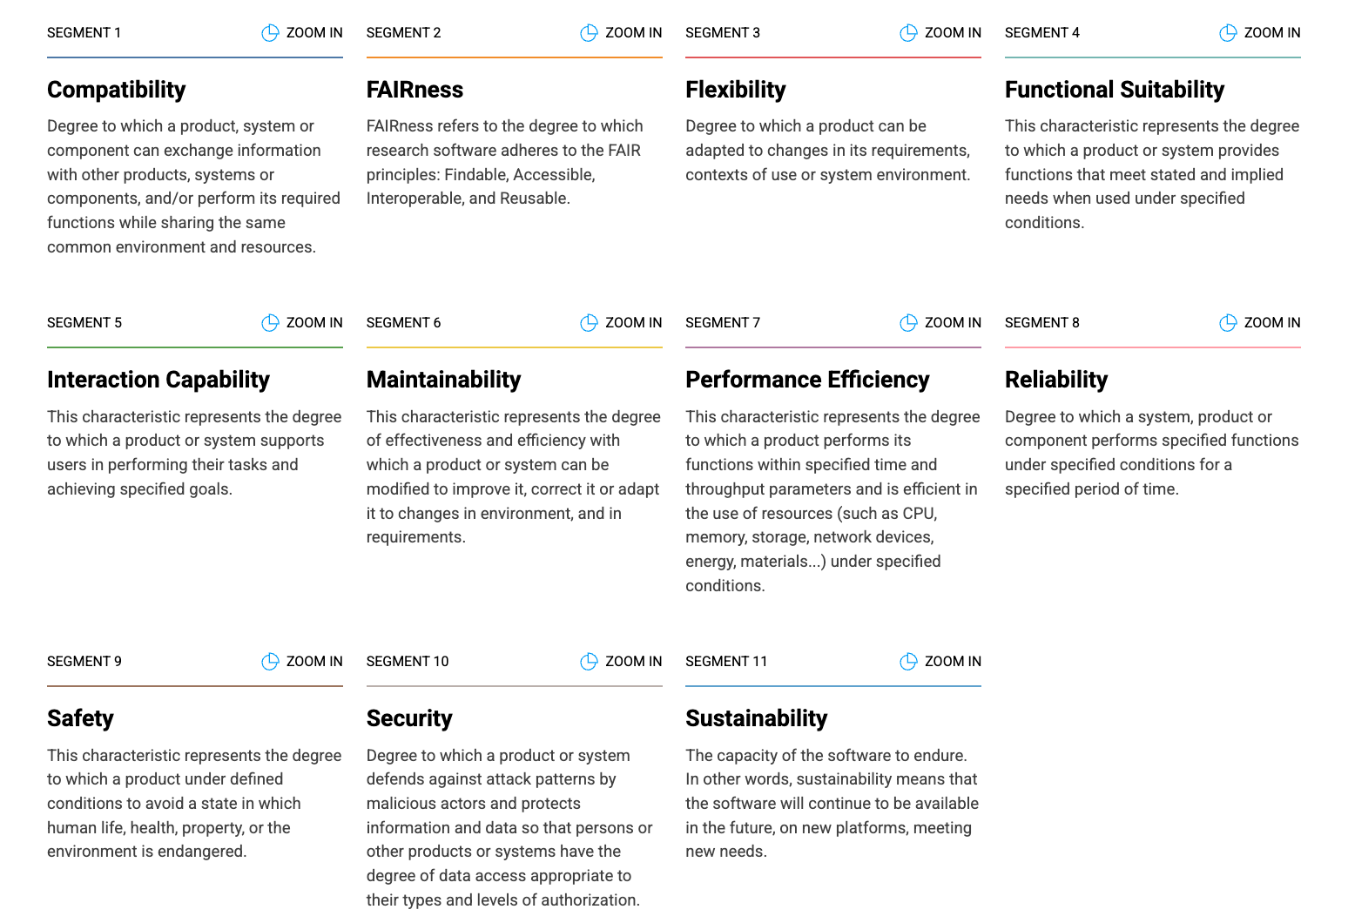
Tools
everse.software/TechRadar
The TechRadar
  When to use what tools and facets to help improve software quality

Slide 18
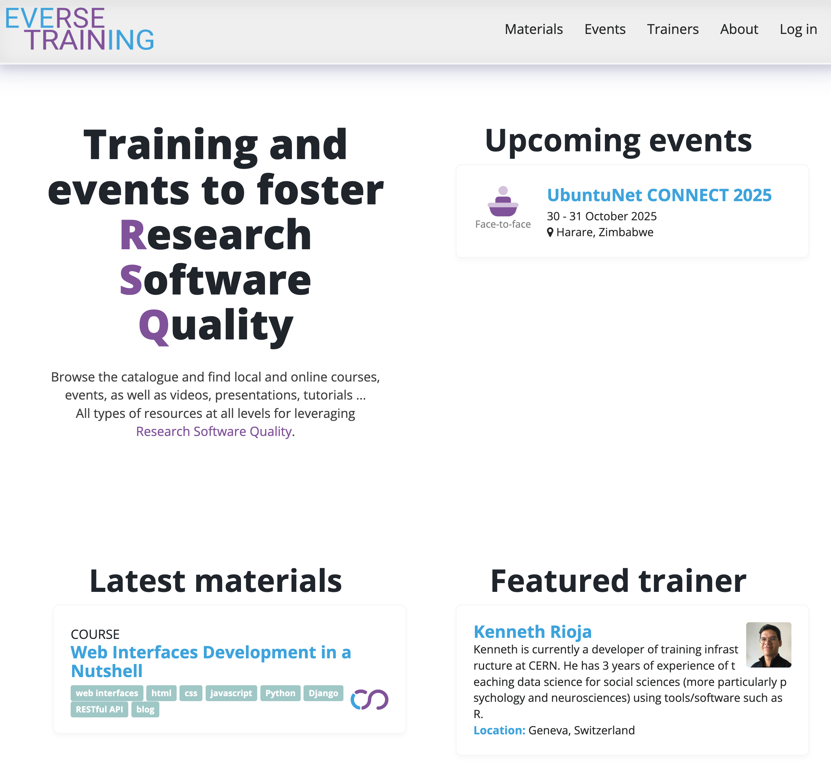
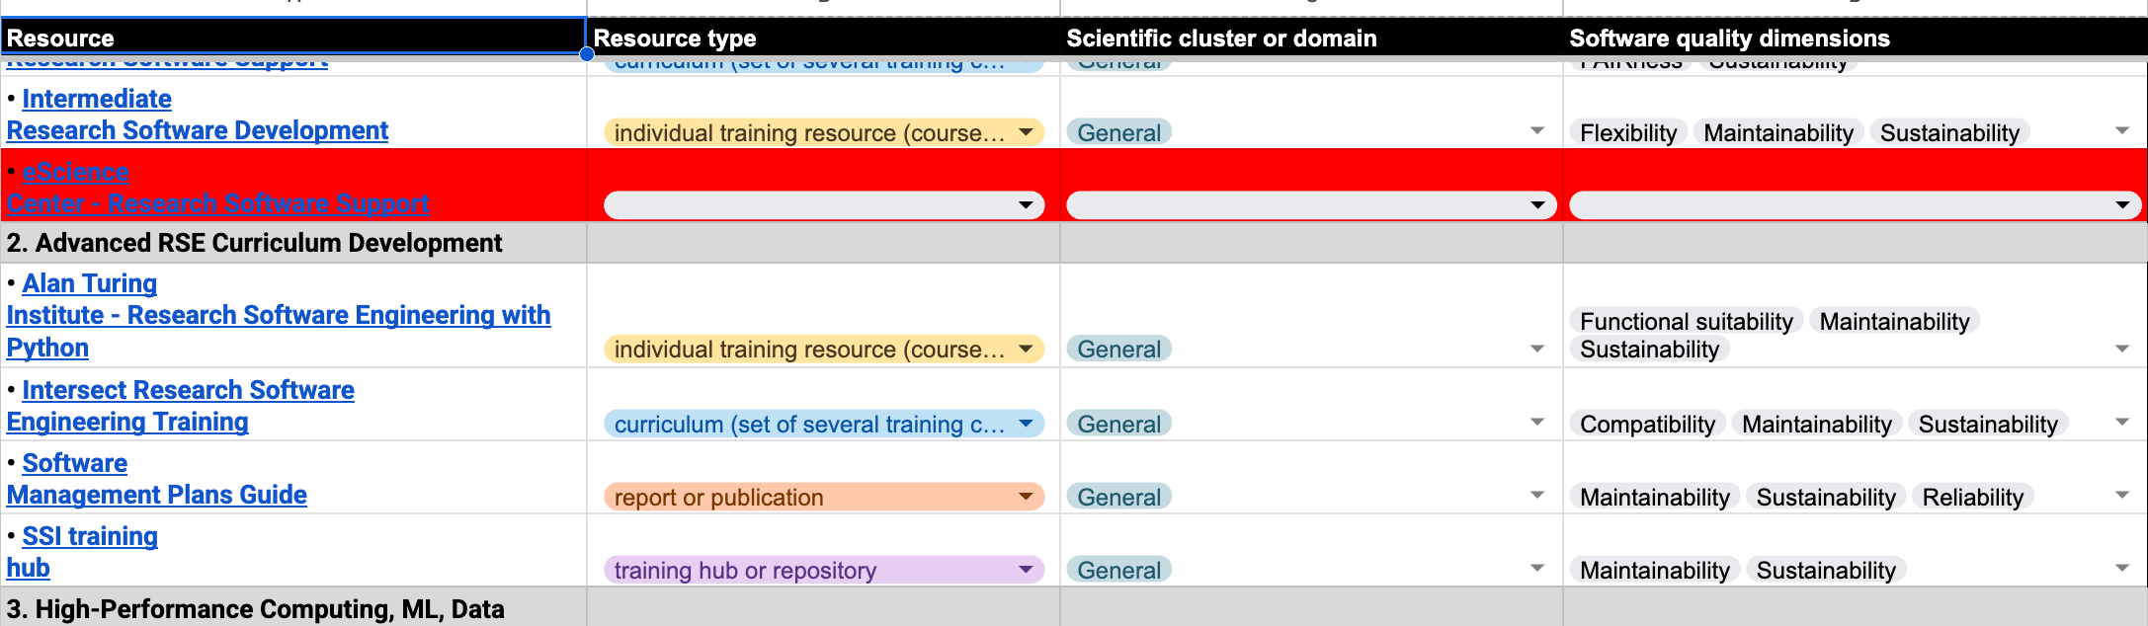
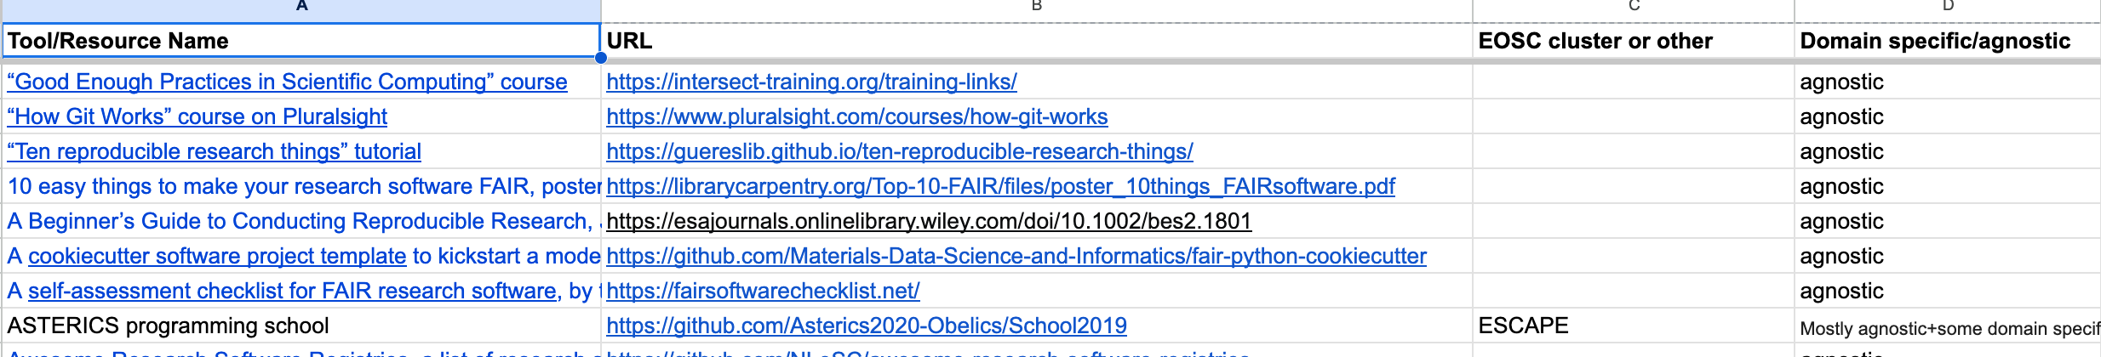
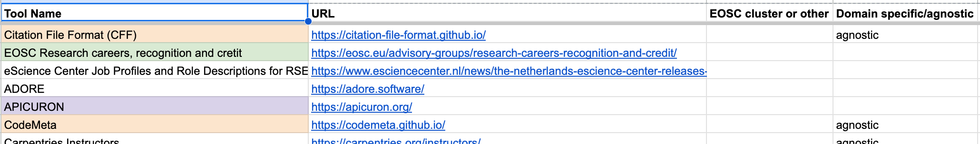
Training &Careers
Training
Training registries and repositories
  27 identified
Training materials and curricula
  92 identified
Recognition
Standard & platforms supporting recognition
  Over 25 identified
https://github.com/EVERSE-ResearchSoftware/training
https://everse-training.app.cern.ch/
- EVERSE Training registry

Slide 19
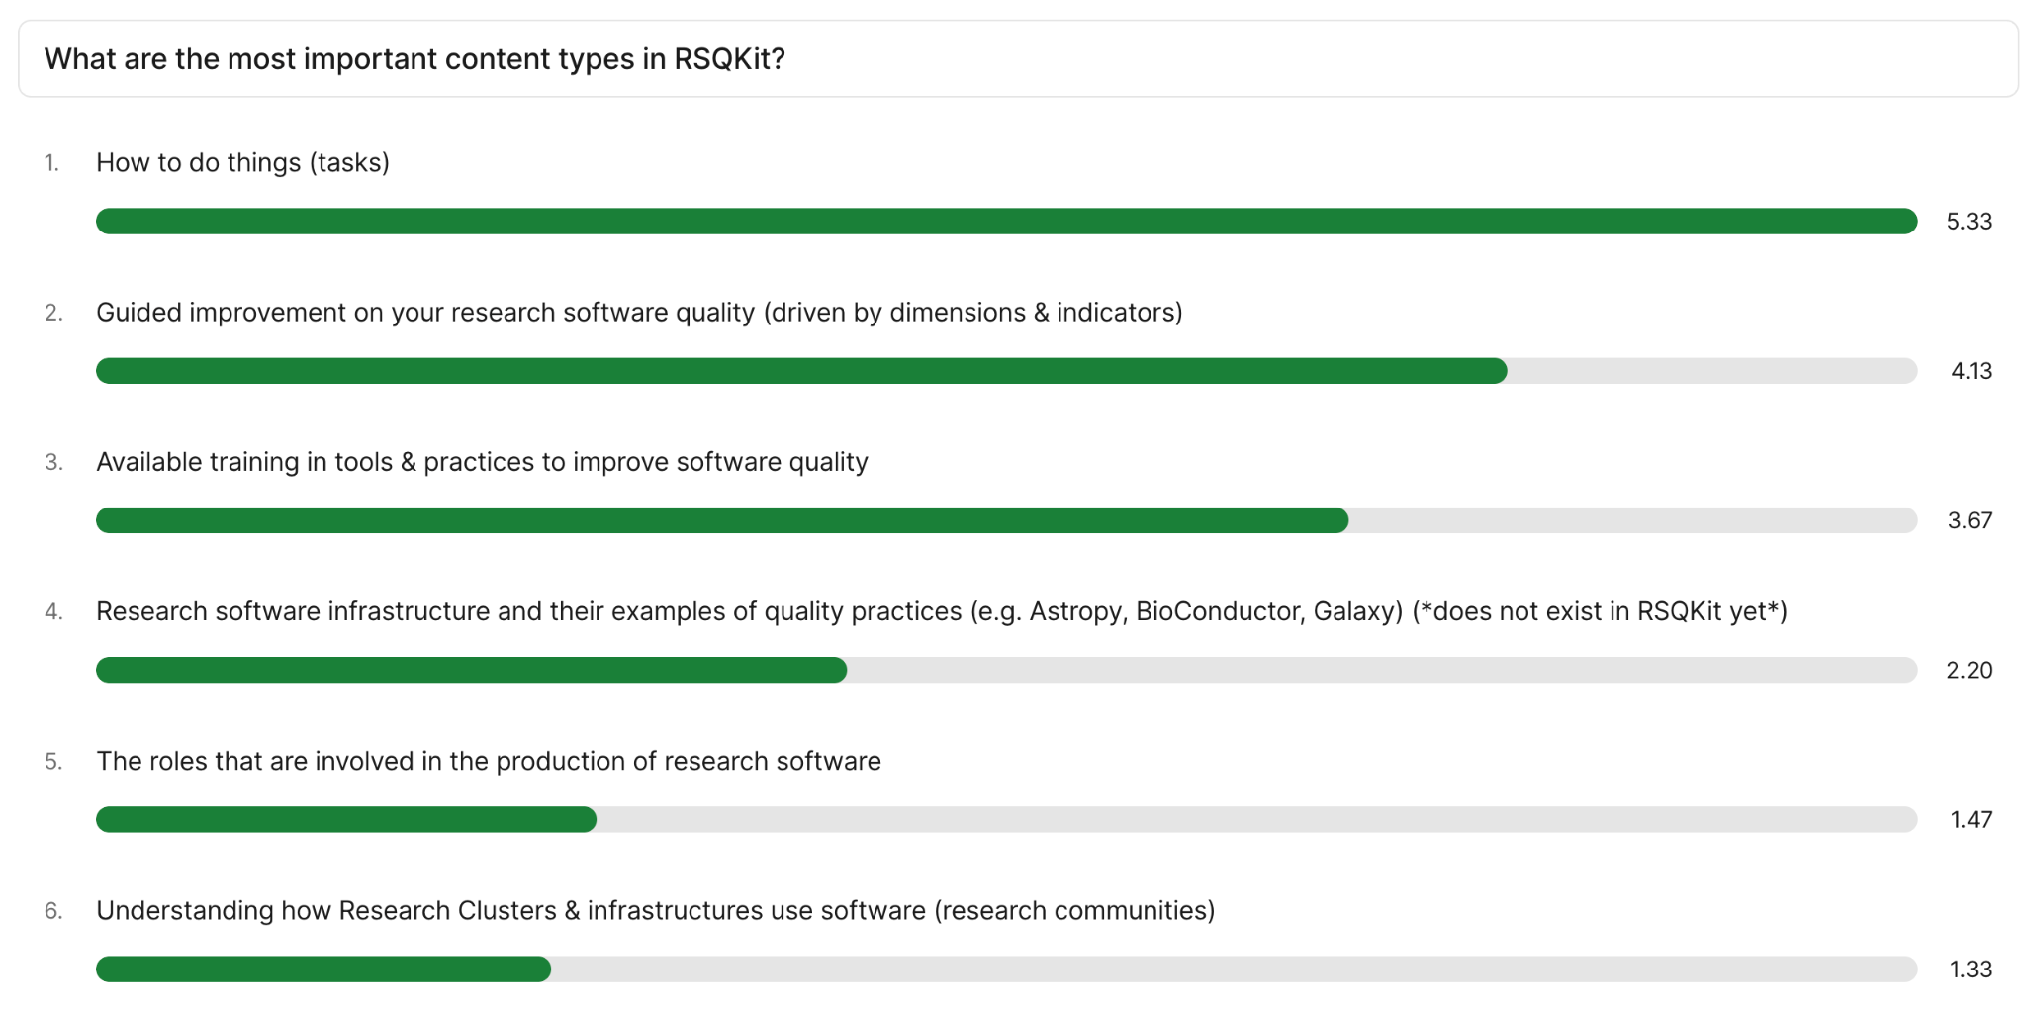






Capturing Best Practices: capturing latent knowledge
What best practices
Asking about priorities
Introductions & contentathons at community events
Surveying the EVERSE team
Prioritising
Commissioning content
everse.software/network/

Slide 20
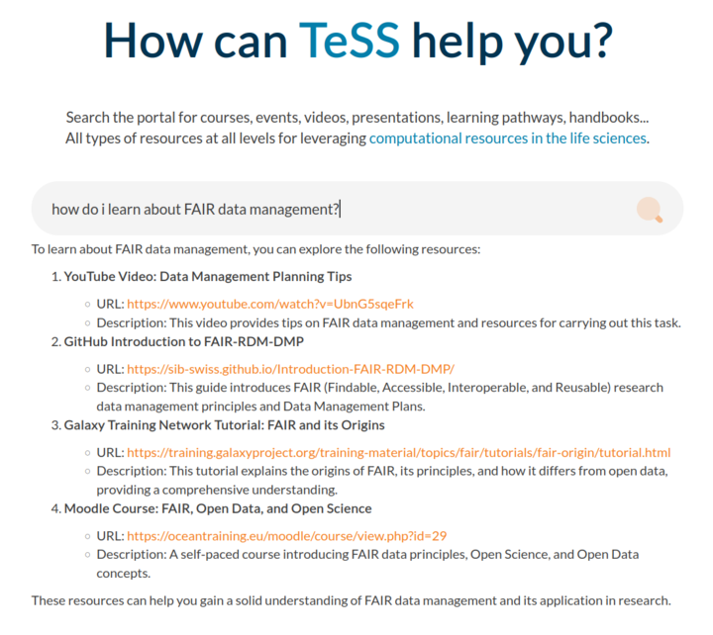
Chatbots and AI
RSQKit Chatbot – early work
https://github.com/EVERSE-ResearchSoftware/RSQKit-chatbot
Links + 1 for RAG
TeSS Chatbot – early work
Creating on the fly learning pathways

Slide 21






Open for Connection / Comment / Contributions
EVERSE Network
RSQKit Guidelines
RSQKit editorial board
Contributor Agreement
How to Contribute
What to Contribute
What Not to Contribute
Contributor Responsibilities
Acknowledgement of Contributions
Ownership of Content
Meets weekly
rsqkit@lists.certh.gr
everse.software/network/
contact@everse.software
everse.software/RSQKit/contribution_guidelines
github.com/EVERSE-ResearchSoftware
www.youtube.com/channel/UCHMrK3NFTwTAB2t8Sbt7sVA
www.linkedin.com/company/eosc-everse/
fosstodon.org/@eosc_everse
bsky.app/profile/eosc-everse.bsky.social
zenodo.org/communities/everse

Slide 22
Reproducible analytics & infrastructure depends upon – technical factors and human factors.
The technical factors include quality software that is resilient and produced in a sustainable way.
The human factors include sustaining the workforce that produces the software with the right recognition and reward where software is a first-class citizen of research
EVERSE aims to explore and document the factors to create a community enriched resource (RSQKit) which serves the research software community

Slide 23
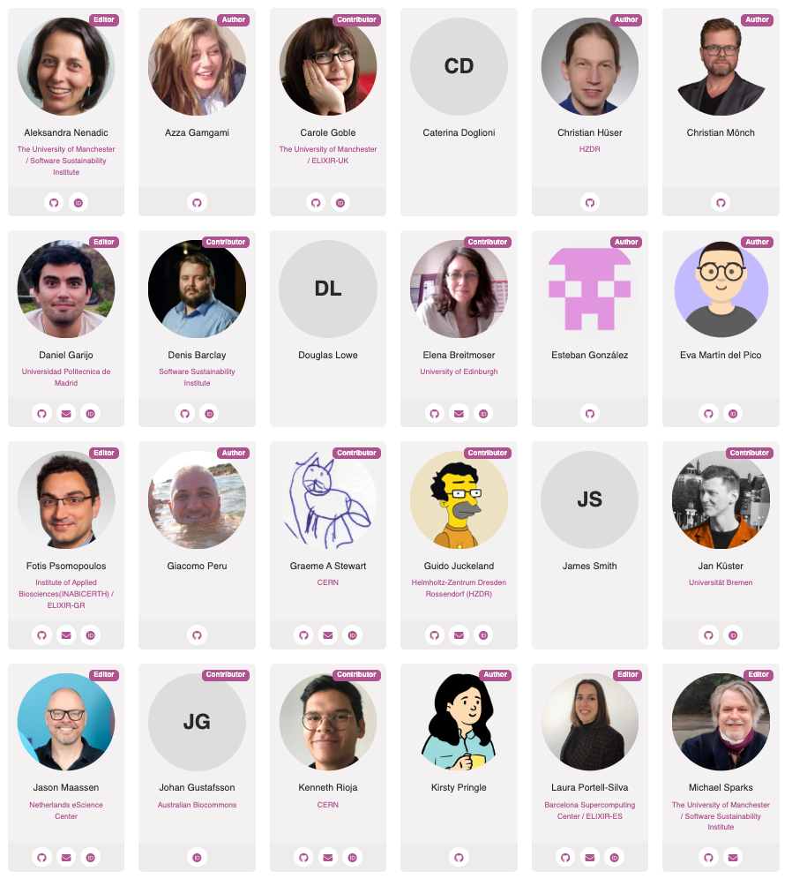
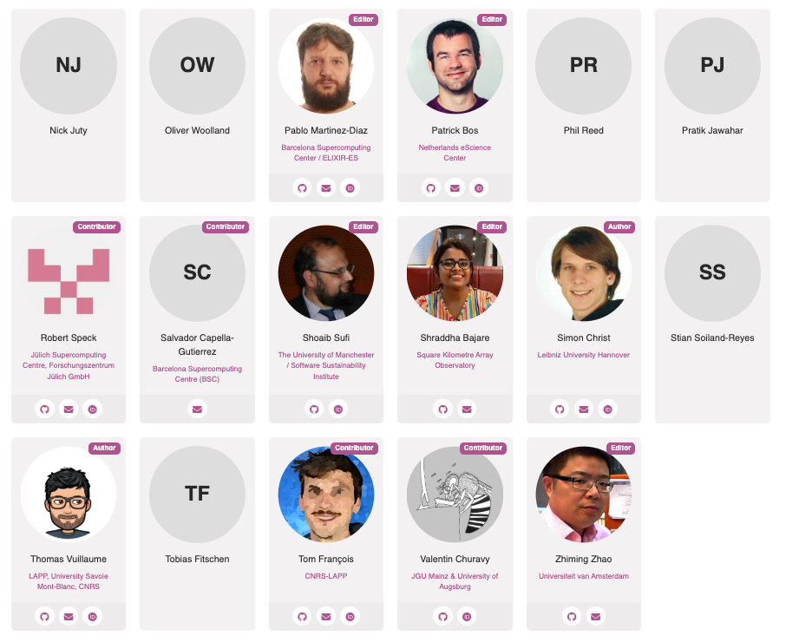
Thank you – Any Questions?
RSQKit - all contributing authors and editors

