Slide 1





Anonymization and privacy management in social science data archives: the Slovenian case
Session 6H: 8-Embracing Open Science: Methodological and Epistemological Challenges in Research Infrastructures for the Social Sciences 1/2
Sonja Bezjak, Slovenian Social Science Data Archives
23rd September 2025
THE RC33 11th INTERNATIONAL CONFERENCE ON SOCIAL SCIENCE METHODOLOGY

Slide 2
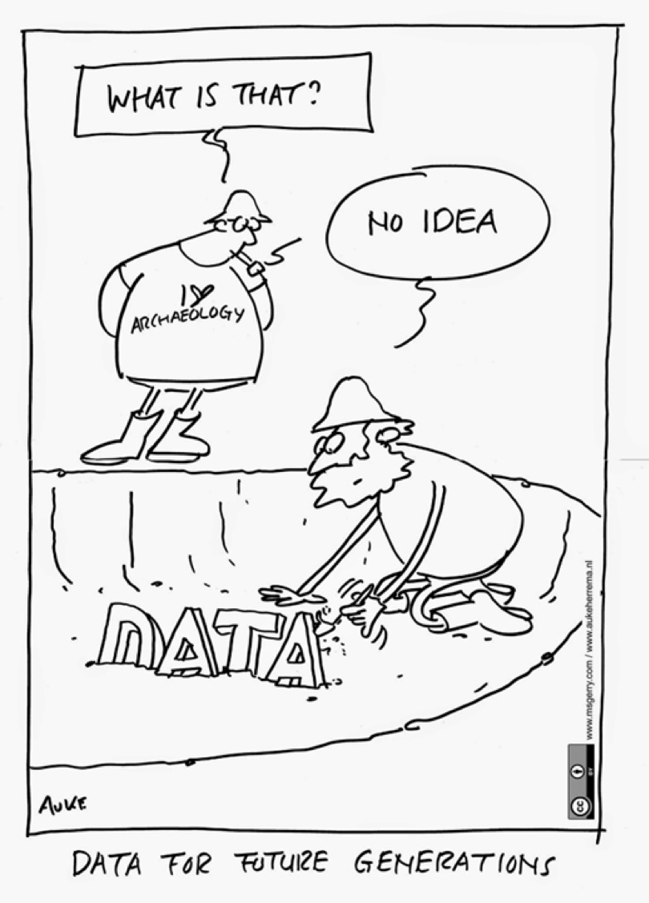
Content
CESSDA: international context
Slovenian Social Science Data Archives
  Data processing and archiving procedures
  Quality assessment and classification of curation
  Risk assessment for the disclosure of personal data
Cases: the MiCREATE and DEAGENCY projects
Conclusions and recommendations

Slide 3
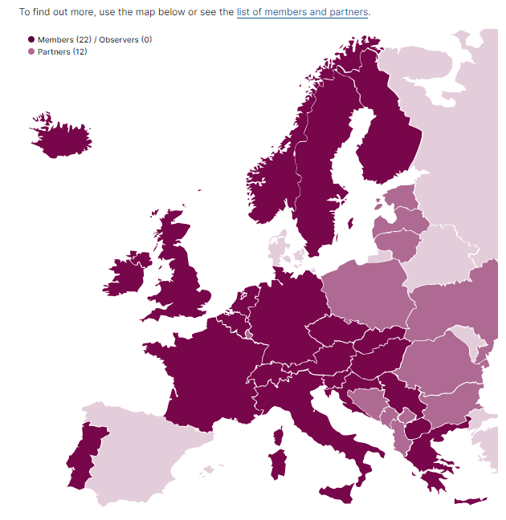
Consortium of European Social Science Data Archives
In Europe, national social science data archives began to emerge in the 1970s.
“CESSDA … brings together social science data archives across Europe, with the aim of promoting the results of social science research and supporting national and international research and cooperation.“ (https://www.cessda.eu/About)
CESSDA Tools: aiming to make data FAIR
ELSST Thesaurus, Vocabulary Service, European Question Bank…
https://www.cessda.eu/About/Consortium

Slide 4

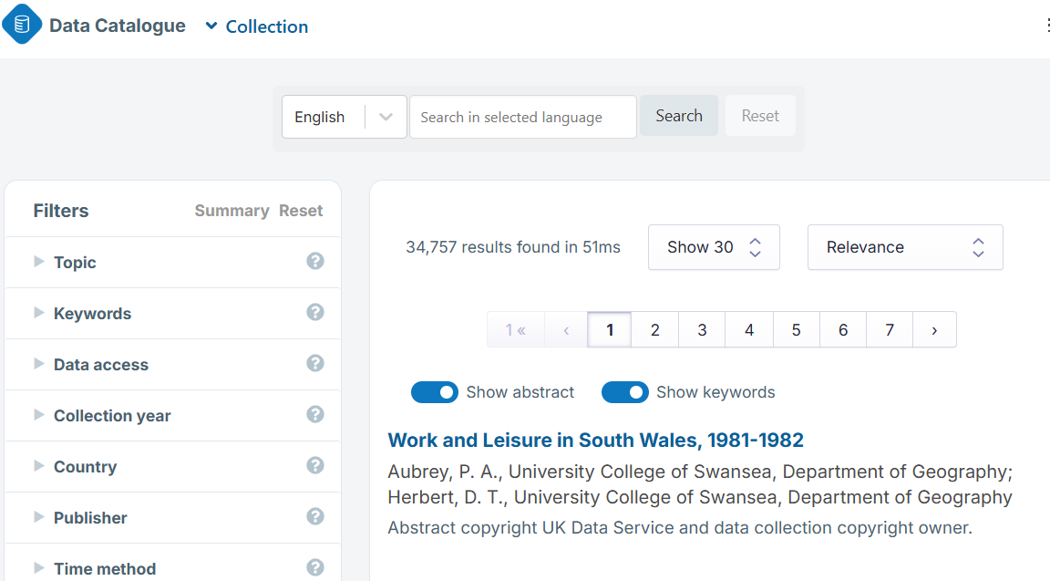
Social science data findable in data catalogues
Metadata of more than 34.000 data collections held by SPs
Metadata in English and/or local languages
Quanti and Quali-data, Mixed-modes data
Crossectional, Longitudinal
New, recent & historical data
https://datacatalogue.cessda.eu/

Slide 5

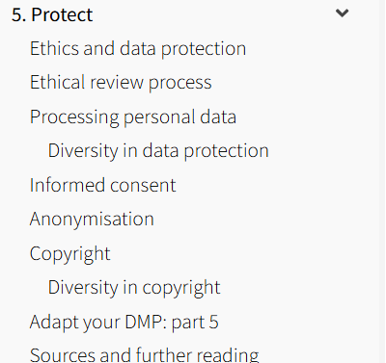
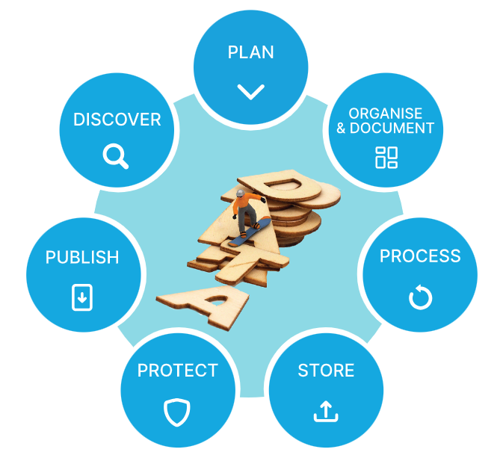
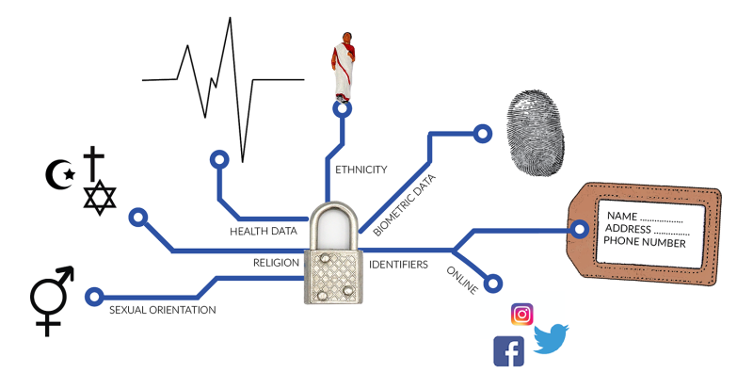
Trainings for Data Management Planning
Online guide for social scientists helping
them to publish their data and make them FAIR
CESSDA Training Team (2017 - 2022). CESSDA Data Management Expert Guide. Bergen, Norway: CESSDA ERIC. Retrieved from https://dmeg.cessda.eu/

Slide 6
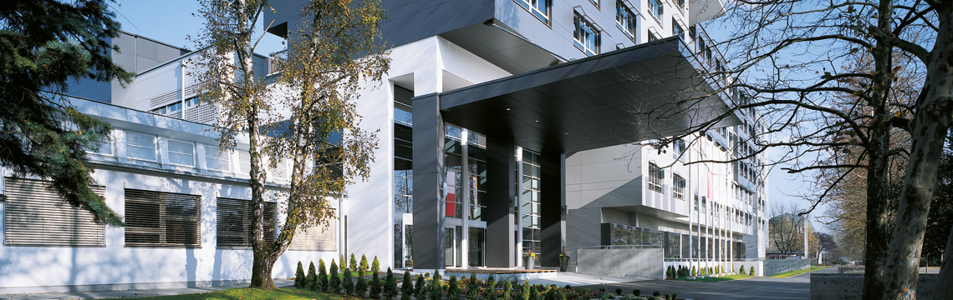
Slovenian Social Science Data Archives
→ ADP for Arhiv družboslovnih podatkov
Faculty of Social Sciences, University of Ljubljana
🗓️ Established: 1997
📌 Role: National data center for social sciences
🔒 Trustworthy repository: Core Trust Seal certificate (since 2018)
🌐 Membership: CESSDA ERIC Consortium of European Social Science Data Archives
🤝 Collaboration: National and international projects
🔗 Website: www.adp.fdv.uni-lj.si
https://www.adp.fdv.uni-lj.si/

Slide 7
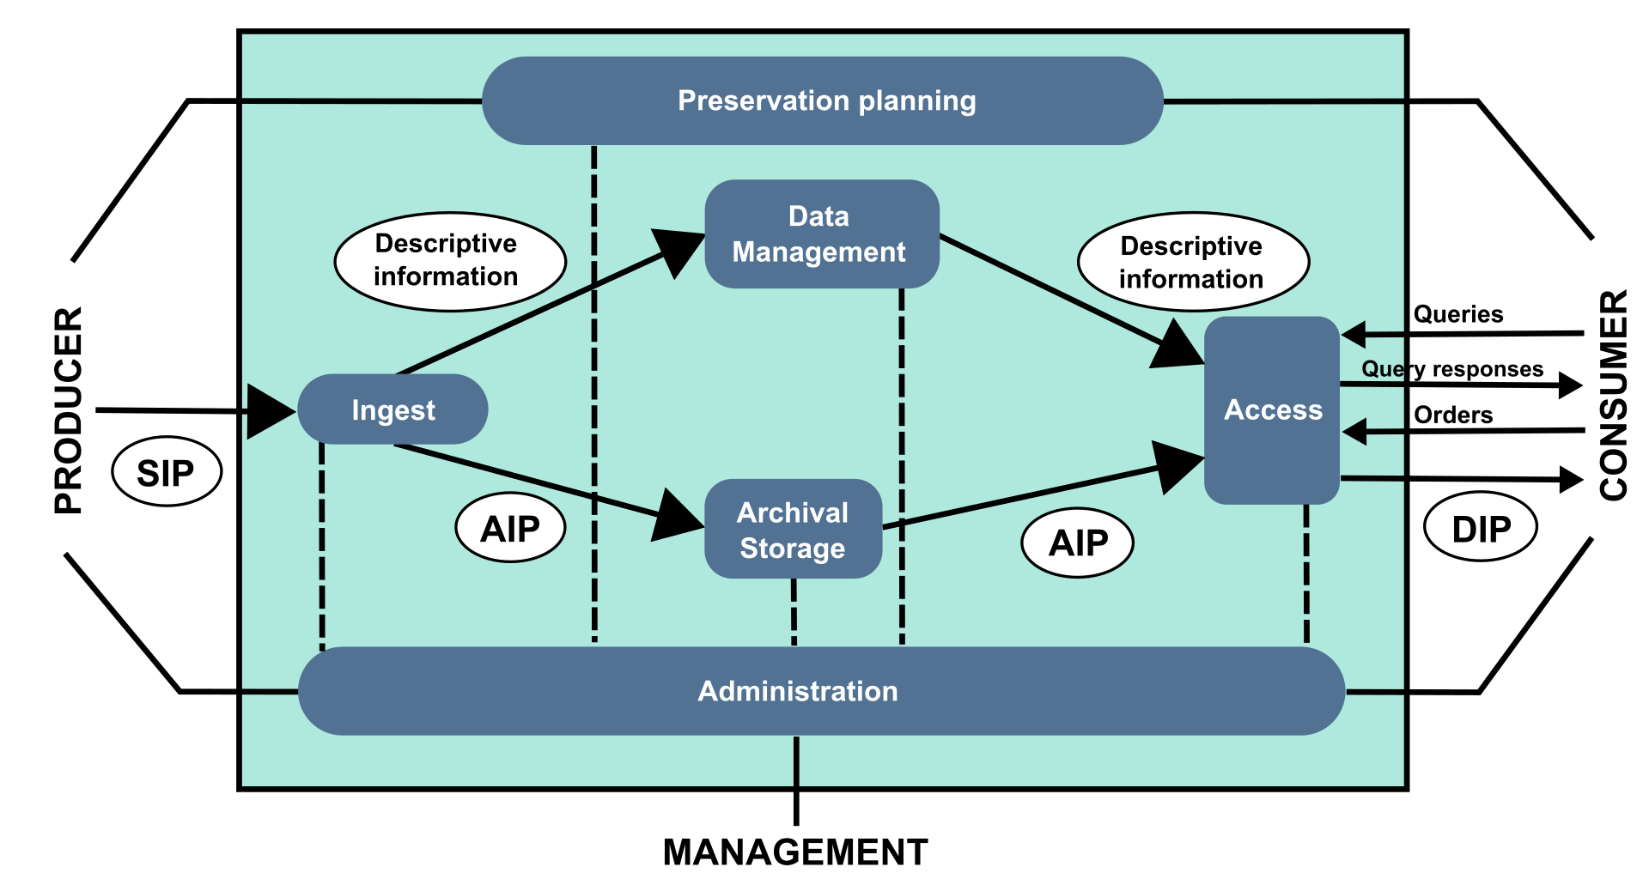
ADP‘s mission
The mission of ADP is to ensure long-term services for the acquisition, preservation, and access to high-quality research data.
ADP preserves data relevant to social science analyses, with a focus on issues related to Slovenian society or significant for it, regardless of geographical boundaries. (https://www.adp.fdv.uni-lj.si/en/mission/)
Open Archival Information System

Slide 8
Data Publication in ADP
In Slovenian ADP catalogue there are around 800 data publications.
… „publication in a data repository with fully documented data, which are provided with bibliographic information and a persistent identifier and are subject to quality control.“ (Glossary of Open Science in Slovenian, Slovar odprte znanosti).
„As open as possible as closed as necessary“ principle →
Different regimes of access:
1. Access without registration
2. Access with registration (Public Use Files)
3. Limited Access
- Scientific Use Files
- Secure Use Files

Slide 9

Data processing and archiving procedures in ADP
Pre-submission meeting – Review legal basis, data cleaning, documentation.
Metadata, Data and Documentation upload to DataVerse – Initial review by data archivist.
Detailed quality & eligibility check – Data archivist + acquisition manager.
CESSDA Training Team (2025). CESSDA Data Archiving Guide version 4.5. Bergen, Norway: CESSDA ERIC.

Slide 10

Quality assessment and classification of curation in ADP
Research Assessment by digital archivist and acquisition manager
      - Quality Assessment (Curation Assessment Tool) – Criteria:
      Quality of documentation, Reusability potential, Open access compliance, Legal & ethical standards…
Curation regime proposed to ADP‘s Research Acquisition Committee
  - Long-term curation: higher rated studies
  - Short-term curation: smaller, narrow projects
Final decision taken by Research Acquisition Committee
CESSDA Training Team (2025). CESSDA Data Archiving Guide version 4.5. Bergen, Norway: CESSDA ERIC.

Slide 11
Risk assessment for the disclosure of personal data
ADP provides additional support to reduce a risk of dislosing personal data.
Quantitative Data
Qualitative Data (mainly textual)
Check the frequency of sensitive variables (e.g., gender, ethnicity, number of children)
Create cross-tabulations to assess risk of indirect identification
Check ~10% of material for direct/indirect identifiers
Coordinate additional data cleaning with authors if needed

Slide 12
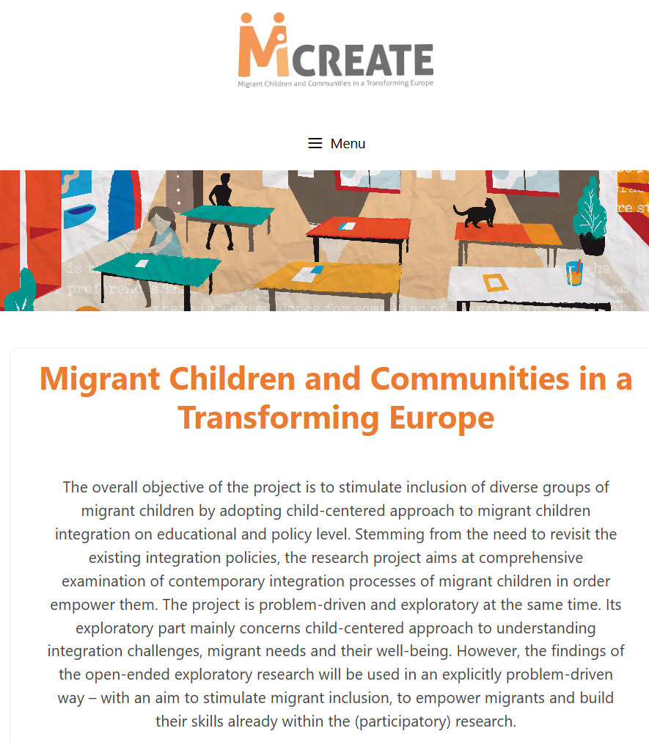
Project Features & Data Sensitivity
MiCREATE (2019–2022)
Focus: migrant children’s life experiences
Led by ZRS Koper – Institute for Social Studies (Slovenia)
15 partners from 12 countries
Methods: interviews, surveys, focus groups
Highly sensitive personal data; full anonymisation often impossible due to narrative content
https://www.micreate.eu/

Slide 13
Project Features & Data Sensitivity
MiCREATE (2019–2022)
Initial DMP drafted by using CESSDA DMEG, ADP provided consultations
Planned central deposit at ADP, later shifted to national data archives due to language diversity & risk complexity (data collected out of EU)
Slovenian partner submitted 3 studies to ADP, each with different protection level
Individual risk assessments for 3 datasets:
MICREE – Full anonymisation not possible → SUF (restricted access only for scientific use)
MICRES – Well anonymised; minor edits only
MICREO – Additional checks on demographic & school data → some open-ended responses removed

Slide 14
MICREATE DATA PUBLICATIONS
Sedmak, M., Gornik, B., Medarić, Z., Dežan, L., Zadel, M. and Bajt, V. (2022). MiCREATE – Migrant Children and Communities in a Transforming Europe, 2019: Interviews with experts [Data file]. Ljubljana: University of Ljubljana, Slovenian Social Science Data Archives. ADP - IDNo: MICREE19. https://doi.org/10.17898/ADP_MICREE19_V1
Sedmak, M., Gornik, B., Medarić, Z., Dežan, L. and Zadel, M. (2022). MiCREATE – Migrant Children and Communities in a Transforming Europe, 2021: Survey among pupils and students [Data file]. Ljubljana: University of Ljubljana, Slovenian Social Science Data Archives. ADP - IDNo: MICREO21. https://doi.org/10.17898/ADP_MICREO21_V1
Sedmak, M., Gornik, B., Medarić, Z., Dežan, L. and Zadel, M. (2022). MiCREATE - Migrant Children and Communities in a Transforming Europe, 2019: Interviews with primary and secondary school employees [Data file]. Ljubljana: University of Ljubljana, Slovenian Social Science Data Archives. ADP - IDNo: MICRES19. https://doi.org/10.17898/ADP_MICRES19_V1

Slide 15
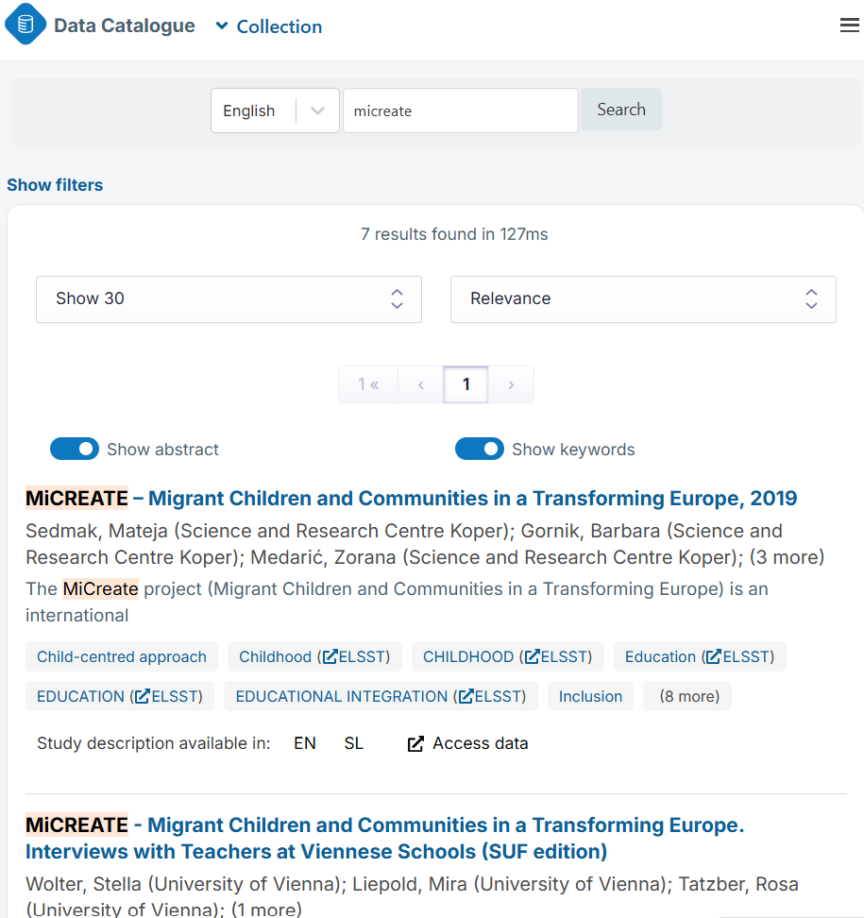
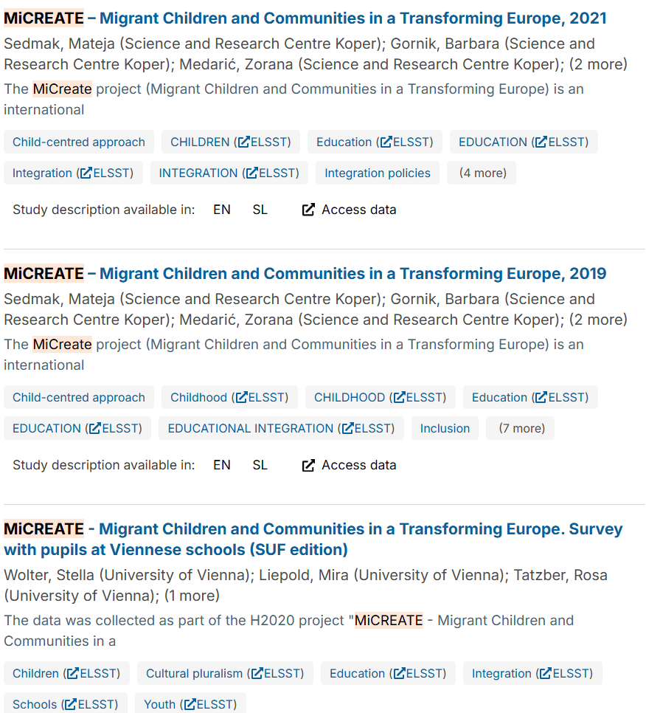
MICREATE DATA PUBLICATIONS

Slide 16
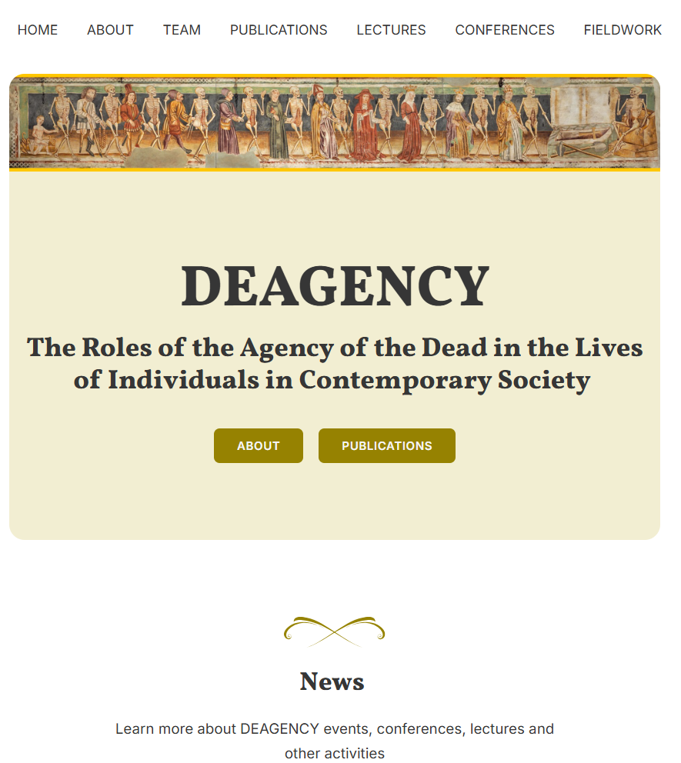
Project Features & Data Sensitivity
DEAGENCY (2023–2028)
Ongoing ERC project in Slovenia, Bosnia & Herzegovina, Slovakia, Hungary
Led by University of Ljubljana, Faculty of Arts
Focus: role of the dead in the lives of the living
Methods: interviews, videos, photos, diaries
Strong identity protection needed due to personal and sensitive nature of data
https://erc-deagency.eu/

Slide 17
Project Features & Data Sensitivity
DEAGENCY (2023–2028)
ADP consulted during proposal writing,
Planned protection measures & archiving in line with open science
Consultations during research data life-cycle
Challenge: data repositories in selected countries do not provide service for sensitive data
Decision taken: all research data to be archived at ADP
Additional activity: external experts invited to assess qualitative data in different languages

Slide 18
Conclusions and Recommendations
Early data management planning – Involve data experts in project proposal or early planning phase for alignment of objectives, ethics, and open access.
Domain specific repositories – choose domain specific repositories, usually they provide expert support or can help you to find right solutions
Expert risk assessment – search for help at the ethics committee, DPOs, domain specific repositories, essential for vulnerable groups or complex methods (e.g., ethnography).

Slide 19




Thank you
University of Ljubljana
Faculty of Social Sciences
Kardeljeva ploščad 5
1000 Ljubljana
Slovenia
www.adp.fdv.uni-lj.si
sonja.bezjak@fdv.uni-lj.si
Arhiv.Druzboslovnih.Podatkov
@ArhivPodatkov

