Slide 1
Open Access, Preprints, and Peer Review in the Open
Building Excellence in Peer Review
Africa Bioethics Network (ABN) and the African Journal of Bioethics (AJB)
Daniela Saderi (PREreview) AND Roseline Dzekem DINE (Review and Curate Network)
2 October 2025
This presentation is licensed under a CC BY 4.0 license unless otherwise specified

Slide 2
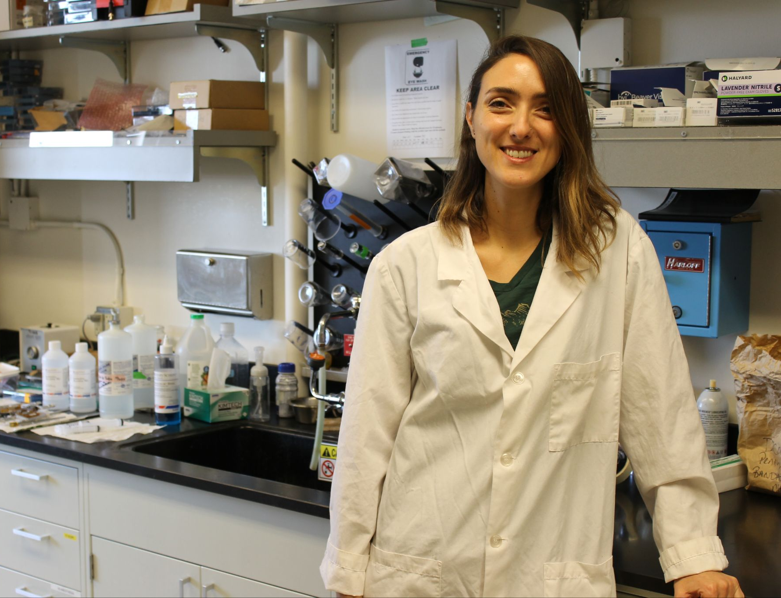
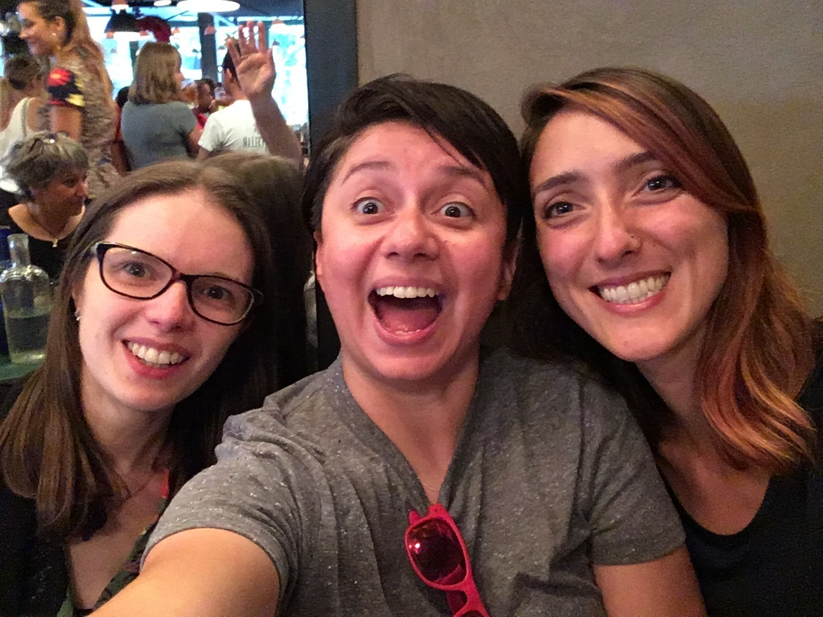
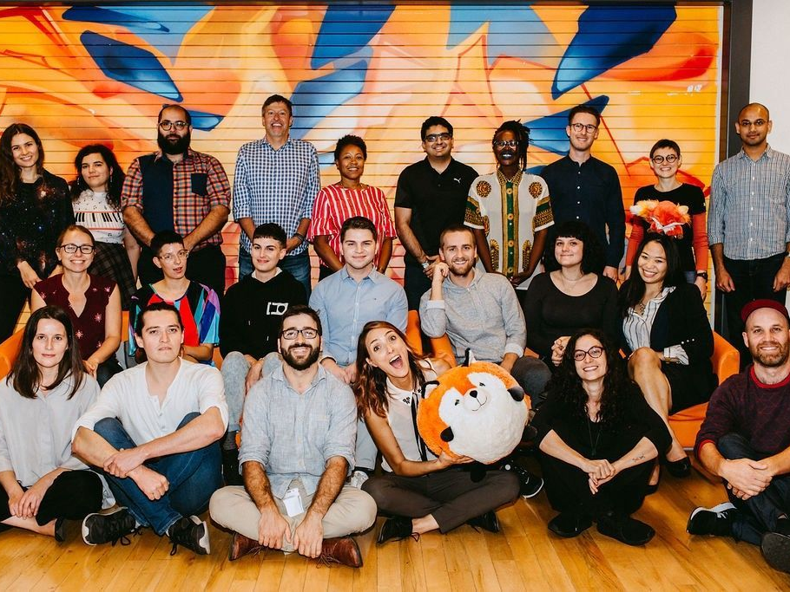


Hi, I’m Daniela
Neuroscientist
Mozillian
PREreview Co-founder and Executive Director
Wife and mom of 2

Slide 3


Hi, I’m Roseline
PREreview Champion 2025
Founder of the Review and Curate Network (RCN)
Club lead for the RCN PREreview Club
Notes:
Pass over to Roseline

Slide 4
Overview
What is Open Science? What is Open Access?
What are Preprints? Benefits and challenges.
Where can one find and submit preprints?
What is Open Preprint Review?
About PREreview and the Review and Curate Network and how to engage.

Slide 5
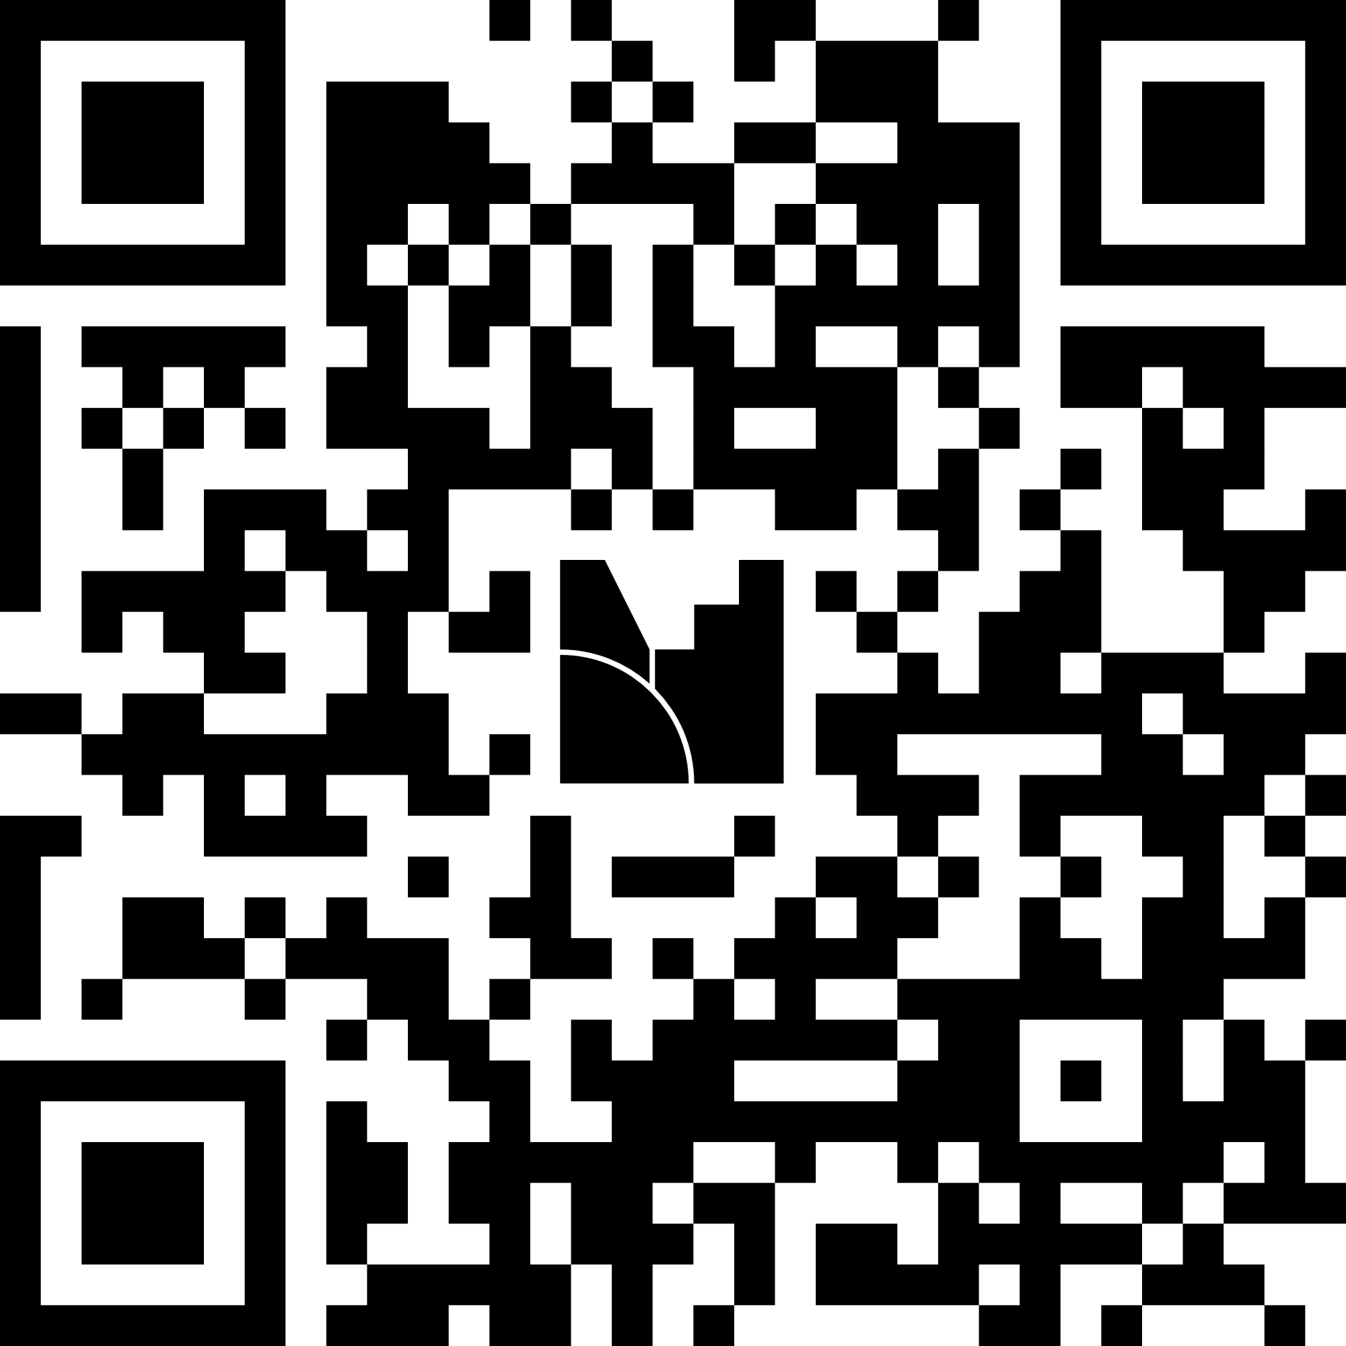
Please be ready to use Mentimeter to interact with us throughout the presentation when prompted by facilitators.
If using Mentimeter is not an option for you, please feel free to type in the Zoom chat.
https://www.menti.com/alheo8635fx4

Slide 6
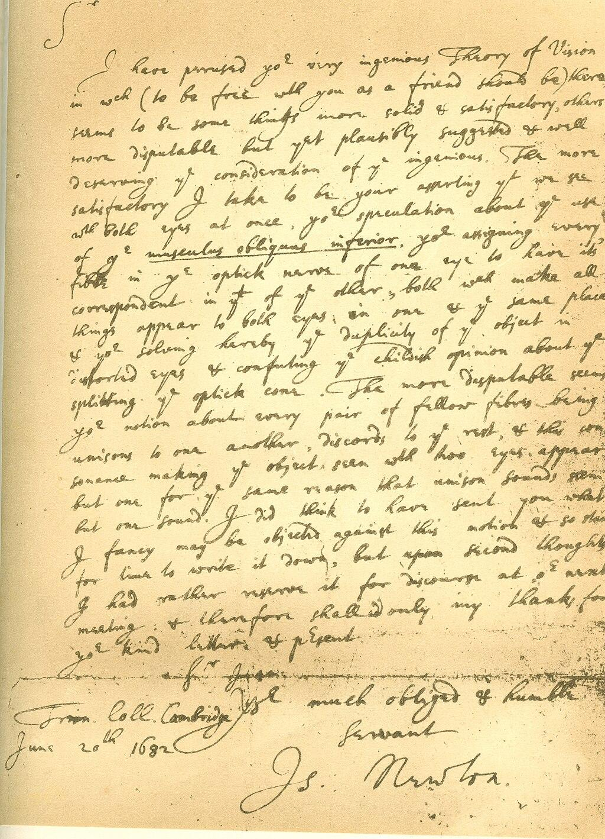
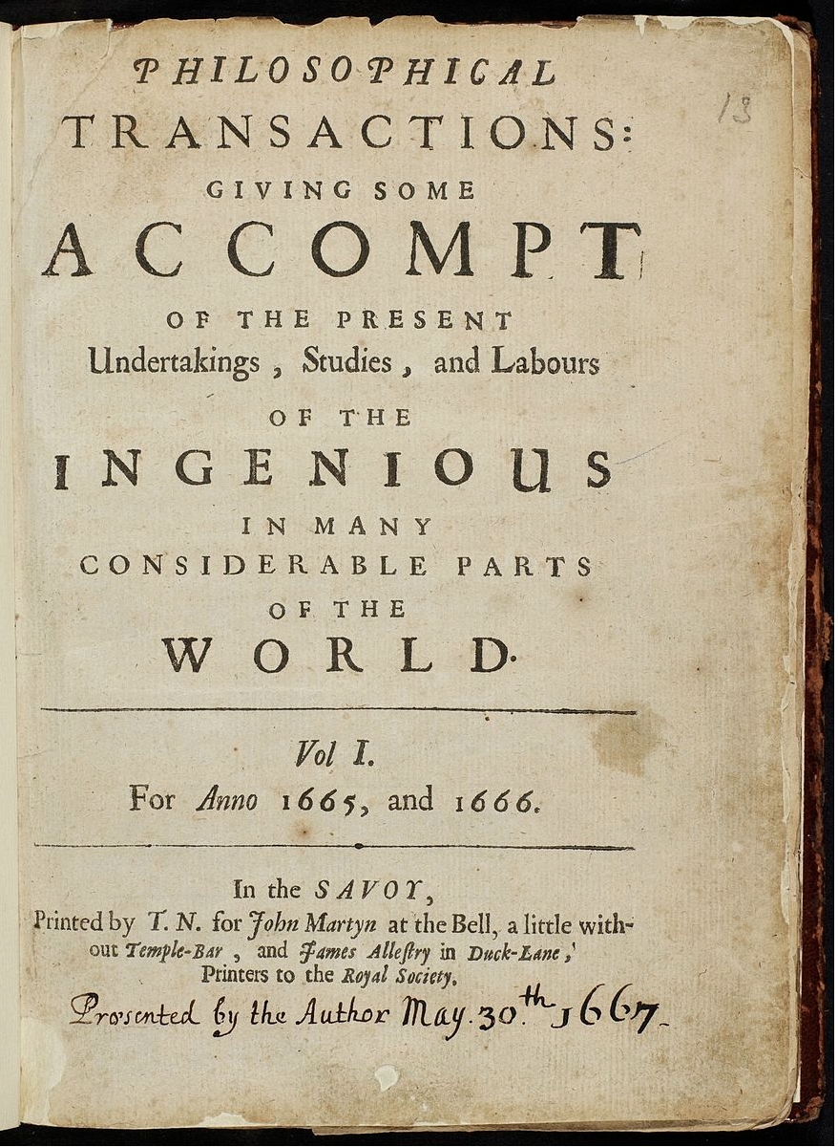


When, where, and how do we share our research?
Title page to volume 1 of Philosophical Transactions
Source: Philosophical Transactions
Royalty free image modified from: https://www.pickpik.com/magazines-journals-reading-stack-document-business-130212
"Seated Woman with Blog, after Picasso" by Mike Licht, NotionsCapital.com is licensed under CC BY 2.0.
Isaac Newton's letter to Dr. William Briggs, June 20th 1682 CC BY-SA 3.0
Oral Traditions* & Letters
(Ancient Times–1600s)
Scientific Societies & Journals (1600s–1800s)
Print & Institutionalization
(1800s–1900s)
Digital & Open Science (1990s–Present)
Why do we share our research?
Notes:
Notes: [CLICK] Throughout history, scholars have shared their discoveries in different ways, evolving alongside technological and cultural shifts:
[CLICK] Oral Traditions & Letters (Ancient Times–1600s) – Early scholars shared knowledge through oral teachings, letters, and private correspondences (e.g.,Isaac Newton exchanged ideas with William Briggs via private letters). There is a star next to Oral traditions as we want to go back to this point in the next slide.
[CLICK] Scientific Societies & Journals (1600s–1800s) – The formation of societies like the Royal Society of London (1660) and Académie des Sciences (1666) led to the first scientific journals, such as Philosophical Transactions (1665), formalizing peer communication.
[CLICK] Print & Institutionalization (1800s–1900s) – Scientific publishing expanded, with institutions and universities reinforcing journal-based dissemination with peer review becoming a standard practice.
[CLICK] Digital & Open Science (1990s–Present) – The internet revolutionized access, allowing, at least from a technical point of you, for much easier and faster ways to disseminate research outputs.
So the “when”, “where”, and “how” we share research has changed through history. But the question we want to ask is [CLICK] Why do we share research? What is the number one motivator that pushes us to share knowledge? Before we get to this first activity however, we want to raise an important point.

Slide 7
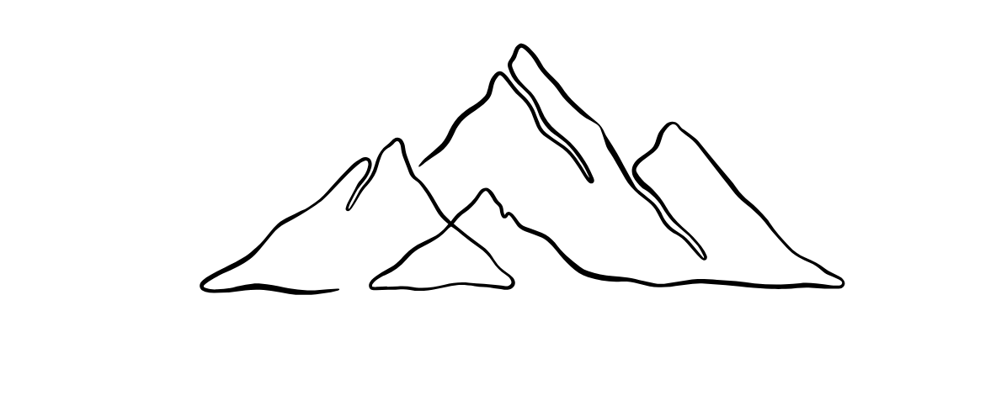
Multiple ways of knowing
In recent years, many scholars have become aware of the large body of information known as Traditional Knowledge (TK), Indigenous Knowledge (IK), or Traditional Ecological Knowledge (TEK), amongst other terms. These knowledge systems, developed over countless generations, are based on individual and collectively learned experiences and explanations of the world, verified by elders, and conveyed and guided experiential learning, and by oral traditions and other means of record keeping.
—George Nicholas After Thousands of Years, Western Science Is Slowly Catching Up to Indigenous Knowledge; emphasis added
Notes:
Notes:…and we welcome and want to hold space for anyone to bring such experience and expertise into our shared work throughout this group.

Slide 8
Reflecting on the why
Why do you want to share your research? What motivates you to share knowledge?
https://www.menti.com/alheo8635fx4
Or go to Menti.com and type this code 3251 5951

Slide 9
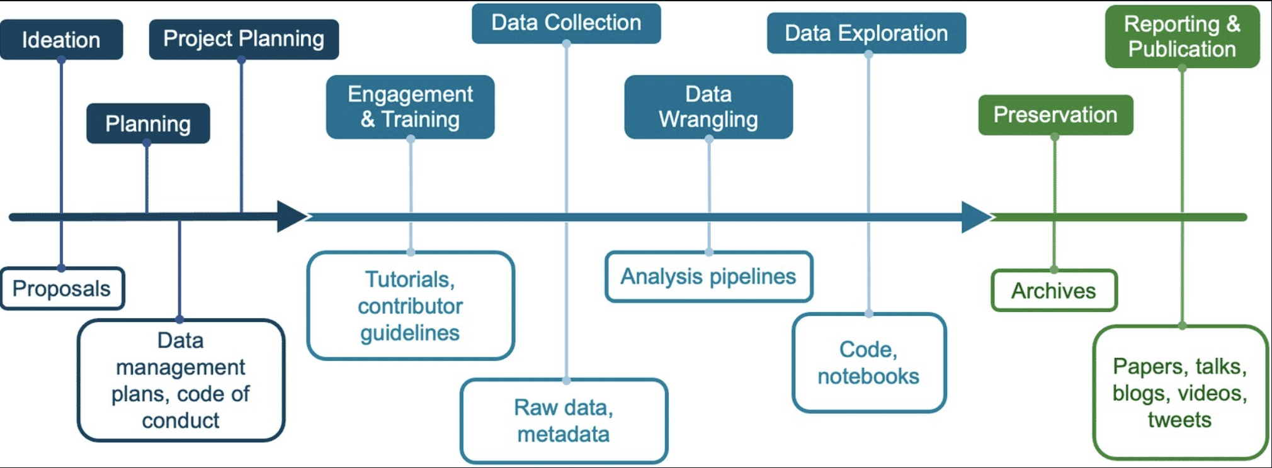
The research “cycle”
Module 5, Lesson 4 of NASA TOPS Open Science 101, 2023-12-06 (v 1.0.0) - CC BY 4.0
Zenodo 10.5281/zenodo.10161527
Notes:
Notes: So continuing thinking about the research cycle, obviously a lot happens before we get to sharing the final product as it were If we think about how research is produced, there are a lot of steps involved and at numerous stages of the journey there is information sharing with different parties. Such as proposals, planning documents, data and code..

Slide 10

The research “cycle”
Module 5, Lesson 4 of NASA TOPS Open Science 101, 2023-12-06 (v 1.0.0) - CC BY 4.0
Zenodo 10.5281/zenodo.10161527
Notes:
Notes: However, traditionally we don’t see many of these outputs or have a clear idea of what is involved in the whole process, even the final paper is often hidden behind a paywall.. There are lots of initiatives nowadays promoting the sharing of some of these outputs like data and methodologies, which not only helps to build a fuller picture and understanding of the research process, but can help people get feedback at earlier stages and also helps with reproducibility, ensuring that this information is publicly available.

Slide 11
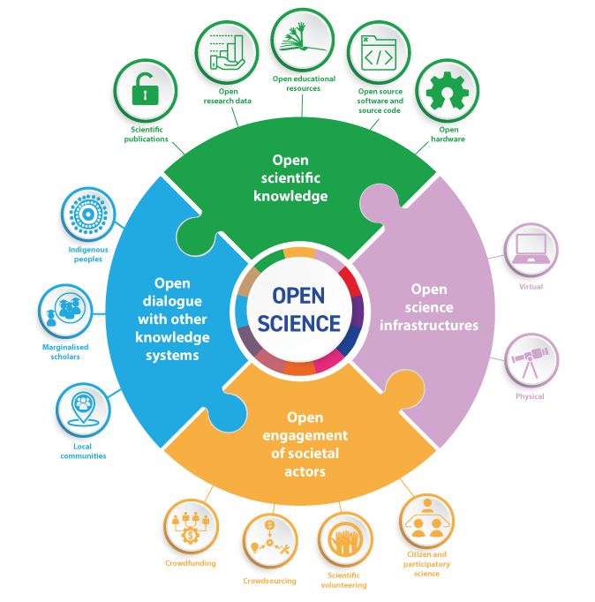
By UNESCO.org - Understanding open science (p:6) following UNESCO Recommendation on Open Science. CC BY-SA 4.0, https://commons.wikimedia.org/w/index.php?curid=130456946

Slide 12

What is
By open access to this literature, we mean its free availability on the public internet, permitting any users to read, download, copy, distribu­te, print, search, or link to the full texts of these articles, crawl them for indexing, pass them as data to software, or use them for any other lawful purpose, without financial, legal, or technical barriers other than those inseparable from gaining access to the internet itself. The only constraint on reproduction and distribution, and the only role for copyright in this domain, should be to give authors control over the integrity of their work and the right to be properly acknowledged and cited.
—Budapest Open Access Initiative Declaration, 2002; emphasis added
Notes:
The Berlin Declaration on Open Access to Knowledge in the Sciences and Humanities (2003) requires that, to qualify as open access, a contribution must not only be usable free of charge, but also users must be permitted "to copy, use, distribute, transmit and display the work publicly and to make and distribute derivative works in any digital medium for any responsible purpose, subject to proper attribution." (Berlin Declaration on Open Access to Knowledge in the Sciences and Humanities, 2003).

Slide 13
What is
The Berlin Declaration on Open Access to Knowledge in the Sciences and Humanities requires that, to qualify as open access, a contribution must not only be usable free of charge, but also users must be permitted "to copy, use, distribute, transmit and display the work publicly and to make and distribute derivative works in any digital medium for any responsible purpose, subject to proper attribution.”
—Berlin Declaration on Open Access to Knowledge in the Sciences and Humanities, 2003; emphasis added

Slide 14
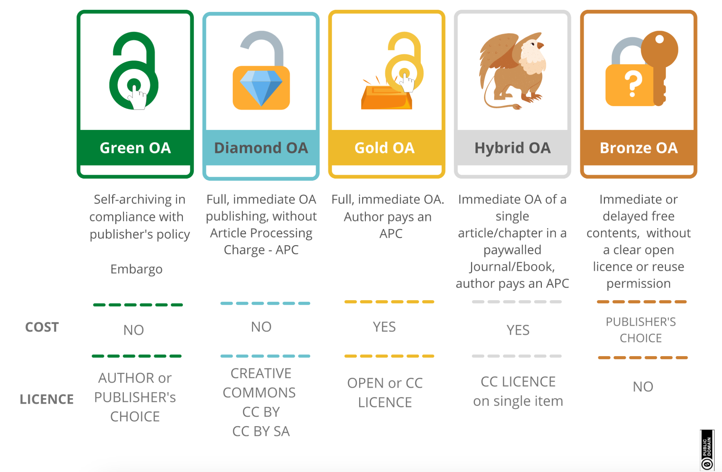
Open Access is implemented in different ways
Source: https://bibliotecadigitale.cab.unipd.it/en/digital-library/about-publishing/open-access
Notes:
Green Open Access Though publishing in a subscription journal or a monograph is accessible at a cost, it is also possible to publish an open version of the same work.
Self-archiving (or Green OA) is one of the strategies for making scientific production open. It consists of uploading documents, in the version permitted by the publisher or by the license previously chosen, in an Open Access institutional or disciplinary/thematic archive, without additional costs for the author.
The versions allowed for Green OA republication, which vary concerning the policies of the individual publishers, are the pre-print or submitted version (not referenced, author's manuscript - AM), the post-print or accepted version (= after peer review, without editorial layout, also called Author's Accepted Manuscript - AAM) and, to a much lesser extent, the editorial version (Version of Record - VoR).
Often an embargo period is required by publishers (usually for postprint and editorial versions), before being able to make the contribution open; the expiring date of embargos can be indicated at the moment of submission to the institutional archive.
The Green OA contribution can be accompanied by an open license, chosen by the authors or defined by the policies of the publisher.
Tools to verify publishers' policies and look for Green OA versions of research documents:
Sherpa Romeo: the platform that collects information on the self-archiving policies of publishers and journals
ShareYourPapers: a tool with which authors can check which versions of their document can be shared with open access
Unpaywall, Dissemin and Open Access Button: to find Green Open Access contents available in preprint, postprint and institutional servers
Gold Open Access
The work is made available immediately by the academic publisher in a completely Open Access journal or collection or book, upon payment of a fee called APC (Article Processing Charge).
Generally, the copyright is maintained by the authors or by the scientific societies who edit the journal/monograph, which is published with a license that allows different levels of reuse.
Facilities may be provided for authors on the payment of the APC.
Diamond Open Access
Immediate Open Access publication without paying an APC fee. Copyright can be maintained by the author and the open licenses allow for sharing and reuse (generally Creative Commons licenses are applied). The Directory of OA Journals (DOAJ) makes it easy to locate Diamond non-profit academic journals.
A subgroup of these journals is called Platinum Open Access: the license applied to contributions (published OA without APC) is the only Creative Commons CC-BY, which allows the widest use of the published content.
Hybrid Open Access
Also defined with trade names such as open choice or open select, hybrid open access occurs when a contribution is published in a subscription journal (or in a paid miscellany) but becomes immediately available for free on the Publisher's website upon payment of the APC. The open contribution is accompanied by an open reuse license (generally Creative Commons).
Particular attention must be paid by the authors to the license that accompanies the hybrid Open content so that it can be republished on platforms other than that of the publisher.
The Hybrid OA model implies the phenomenon of increasing costs to read and publish, the so-called double-dipping, dealt with by research and academic institutions through the subscription of transformative publish & read contracts.
Bronze Open Access
When the published contribution is, immediately or after a certain period, available for free on the publisher's website, without the presence of an open license or a transparent declaration of the rights of authors and re-users. This determines its unclear status from the point of view of intellectual property and the related reuse of published content, although payment by the authors of an APC is sometimes required.
Source: https://bibliotecadigitale.cab.unipd.it/en/digital-library/about-publishing/open-access

Slide 15
Open Access is implemented in different ways
Source: https://bibliotecadigitale.cab.unipd.it/en/digital-library/about-publishing/open-access
Notes:
Green Open Access Though publishing in a subscription journal or a monograph is accessible at a cost, it is also possible to publish an open version of the same work.
Self-archiving (or Green OA) is one of the strategies for making scientific production open. It consists of uploading documents, in the version permitted by the publisher or by the license previously chosen, in an Open Access institutional or disciplinary/thematic archive, without additional costs for the author.
The versions allowed for Green OA republication, which vary concerning the policies of the individual publishers, are the pre-print or submitted version (not referenced, author's manuscript - AM), the post-print or accepted version (= after peer review, without editorial layout, also called Author's Accepted Manuscript - AAM) and, to a much lesser extent, the editorial version (Version of Record - VoR).
Often an embargo period is required by publishers (usually for postprint and editorial versions), before being able to make the contribution open; the expiring date of embargos can be indicated at the moment of submission to the institutional archive.
The Green OA contribution can be accompanied by an open license, chosen by the authors or defined by the policies of the publisher.
Tools to verify publishers' policies and look for Green OA versions of research documents:
Sherpa Romeo: the platform that collects information on the self-archiving policies of publishers and journals
ShareYourPapers: a tool with which authors can check which versions of their document can be shared with open access
Unpaywall, Dissemin and Open Access Button: to find Green Open Access contents available in preprint, postprint and institutional servers
Gold Open Access
The work is made available immediately by the academic publisher in a completely Open Access journal or collection or book, upon payment of a fee called APC (Article Processing Charge).

Slide 16
Useful Tools to detect Open Access policy in journals
The Directory of Open Access Journals (DOAJ) is a website that hosts a community-curated list of open access journals
Via the Open Policy Finder (formerly SHERPA/RoMEO and SHERPA/Juliet) anyone can access information on self-archiving policies of publishers, journals, and funders
ShareYourPapers (OA.Works) is a tool with which authors can check which versions of their document can be shared open access
Unpaywall, Dissemin (shutting down on Jan 1, 2025) and Open Access Button tools to help authors and readers find Green Open Access routes/contents available in preprint, postprint, and institutional servers
The Journal Checker Tool is a tool provided by Plan S to verify journals against the open requirements requested by funders

Slide 17
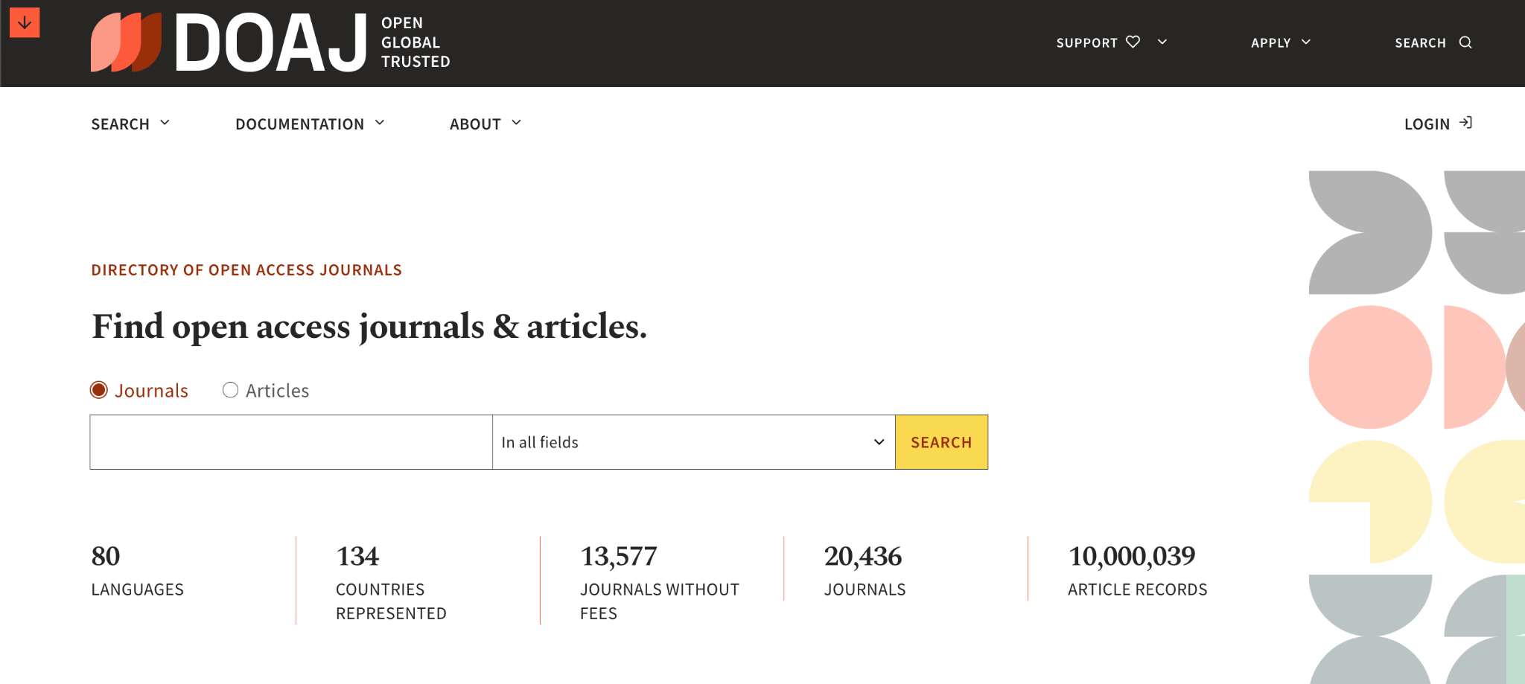
Is the journal I want to publish Open Access?
https://doaj.org
Notes:
“The Directory of Open Access Journals (DOAJ) is a website that hosts a community-curated list of open access journals, maintained by Infrastructure Services for Open Access (IS4OA). It was launched in 2003 with 300 open access journals.” - Wikipedia

Slide 18
Learning about Open Access Policy specific to a journal
**We are not doing this today but this is something you can try on your own**
Navigate to the DOAJ website.
Type in the name of one of the following journals in the search box, and then click on the yellow "SEARCH" button.
  Pan-African Journal of Health and Environmental Science (https://doaj.org/toc/2789-620X)
  Global Bioethics (https://doaj.org/toc/1591-7398)
  South African Journal of Bioethics and Law (https://doaj.org/toc/1999-7639)
The search results may show more than one match. Select the desired journal within the search results by clicking on the journal name. What do you notice?
Notes:
This is an example of a site that you can use to determine if a journal’s policy is consistent with how you wish to publish your open access results. Journal policies should always be reviewed and considered during the early planning phase of your project and well before submitting your manuscript for publication.

Slide 19
What is a Preprint?
A preprint is a scientific manuscript that is uploaded by the authors to a public server. The preprint contains data and methods, but has not yet undergone journal-organized peer review.
—Modified from ASAPbio Preprint FAQ section
Notes:
Notes: Preprints are one of the things changing this hidden system, can anyone give us a definition?
This definition we have found has been modified from the ASAPbio Preprint FAQ section and we feel it captures it quite well ‘A preprint is a scientific manuscript that is uploaded by the authors to a public server. The preprint contains data and methods, but has not yet undergone journal-organized peer review.’
(Launch poll - What level of knowledge about preprints do researchers have in your community?')
Preprints are often the authors’ final version of a manuscript and are shared online free of charge. If shared on an independent specialized scholarly repository, accepted manuscripts will be licensed (usually with CC-BY), assigned with a digital object identifier (DOI) and indexed in a scholarly digital database — thereby establishing priority of discovery for the author and making the work citable and at the same time discoverable. This form of archiving is known as Green Open Access.

Slide 20
Who has read a preprint? 🖐️

Slide 21
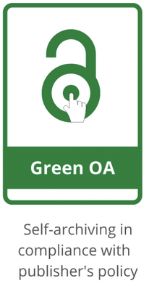
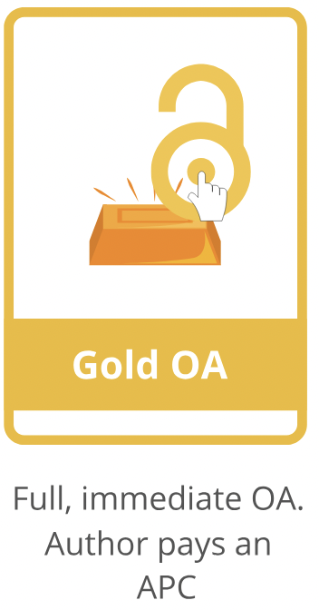
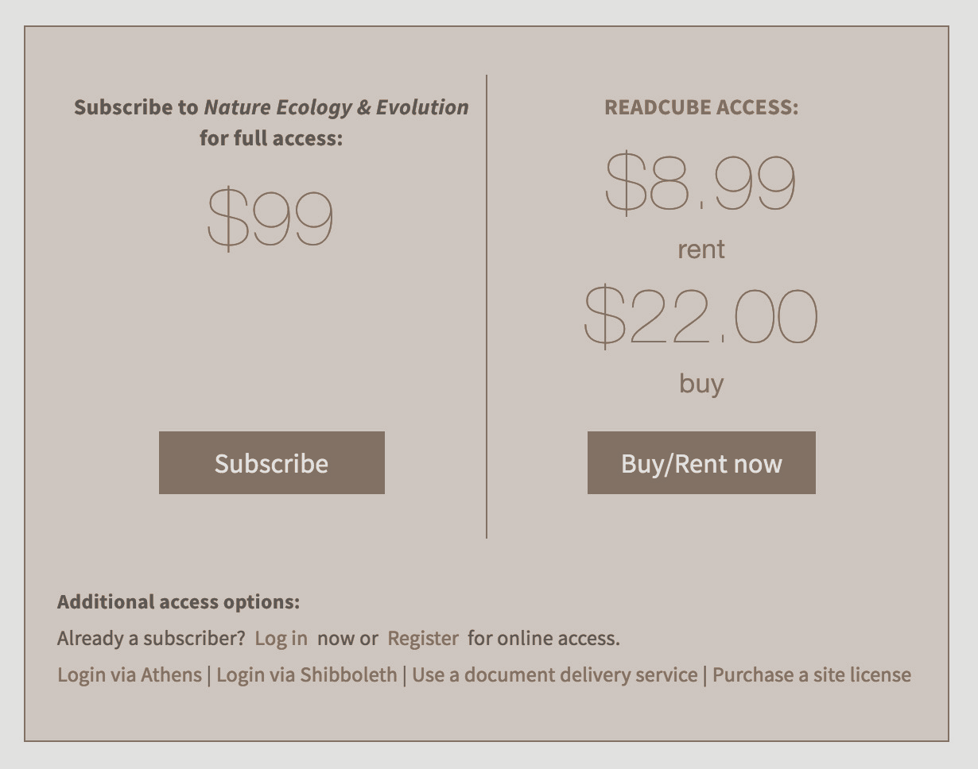









Preprints vs. traditional journal publication
Preprint server
Peer reviewed paper
<48 hrs screening process
Months to years
Public
Private
Journal 1
Journal 2
Journal 3
Submit
Manuscript
Peer Review
Revise
Revise
Slide modified from original by Jessica Polka, ASAPbio (CC BY 4.0)
Emojis by Mozilla (CC BY 4.0)
Notes:
This slide is meant to illustrate the traditional peer review process carried out by a journal (bottom) which for most journals happen in the dark, outside of the public eye. As you may well know, the manuscript is submitted by the authors to a journal, it goes through peer review, successfully or unsuccessfully, often for multiple rounds, and it’s not before several months to years that the manuscript reaches the public. (CLICK) Preprints allow for early sharing of the research output, and all happens in the open. (CLICK again to enable next animation). Preprints also open up the doors to constructive community feedback at a point in time in which changes can still be made.

Slide 22
Who has read a preprint? 🖐️
Who has published a preprint? 🖐️

Slide 23
Benefits
Common concerns
Free to publish and free to read
Fear of being scooped
Greater visibility and reach of the work
Incompatibility with journal policy
Claim priority on their work
(aka scoop protection)
Low reliability and credibility
Increased citations
(permanent citable, versionable records)
Lack of peer review
Opportunity for early feedback
It takes too long
Ni, R., & Waltman, L. (2024). To preprint or not to preprint: A global researcher survey.
Journal of the Association for Information Science and Technology, 75(6), 749–766. https://doi.org/10.1002/asi.24880
Proof of productivity
Notes:
Ni, R., & Waltman, L. (2024). To preprint or not to preprint: A global researcher survey. Journal of the Association for Information Science and Technology, 75(6), 749–766. https://doi.org/10.1002/asi.24880
“Journal policies for posting and citing preprints vary across disciplines. Klebel et al. (2020) found that 91% of the journals in the life sciences and earth sciences allow preprinting, while this is the case for only 45% of the journals in the humanities. In a survey carried out by ASAPbio (2020), it was observed that concerns about preprinting were stronger among respondents who had never posted a preprint than among those who did have experience with preprinting.

Slide 24
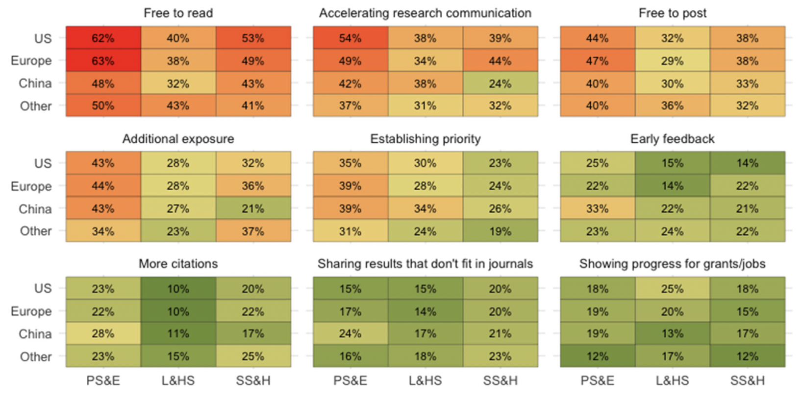
Attitudes towards benefits of posting preprints
Ni, R., & Waltman, L. (2024). To preprint or not to preprint: A global researcher survey. Journal of the Association for Information Science and Technology, 75(6), 749–766. https://doi.org/10.1002/asi.24880 Global survey of attitudes towards preprints (n=3506)
Notes:
Ni and Waltman “present the results of a global online survey of authors of research papers asking them about their familiarity with preprinting and their experience with reading and posting preprints. Survey participants were also asked to share their views on the benefits of preprinting, concerns about preprinting, and ways in which preprinting can be promoted.”
In total, survey responses were received from 114 countries/regions. 3506 completed responses to our survey
Choices: “not at all beneficial,” “somewhat beneficial,” “very beneficial,” and “do not know.”

Slide 25
What do you see as the main benefits
of posting preprints?
Answer with one word at the time on Menti (we are making a word cloud)
or use the Zoom chat to answer

Slide 26
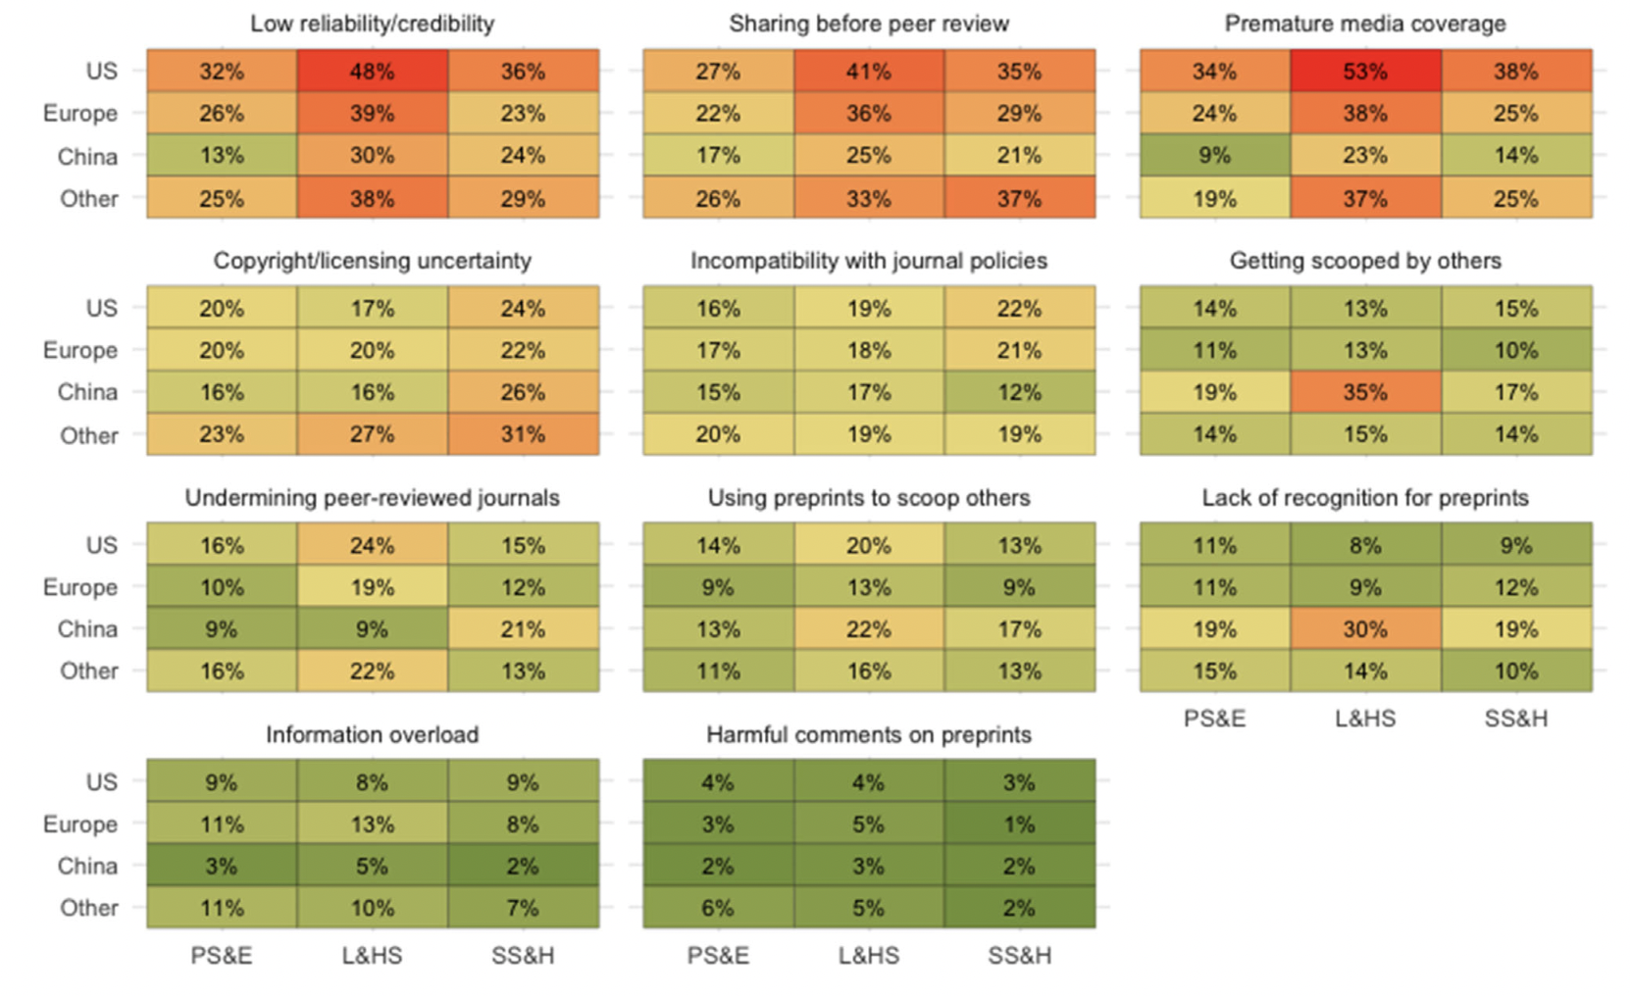
Attitudes towards concerns of posting preprints
Ni, R., & Waltman, L. (2024). To preprint or not to preprint: A global researcher survey. Journal of the Association for Information Science and Technology, 75(6), 749–766. https://doi.org/10.1002/asi.24880 Global survey of attitudes towards preprints (n=3506)
Notes:
Ni and Waltman “present the results of a global online survey of authors of research papers asking them about their familiarity with preprinting and their experience with reading and posting preprints. Survey participants were also asked to share their views on the benefits of preprinting, concerns about preprinting, and ways in which preprinting can be promoted.”
In total, survey responses were received from 114 countries/regions. 3506 completed responses to our survey
Choices: “not at all beneficial,” “somewhat beneficial,” “very beneficial,” and “do not know.”

Slide 27
What do you see as the main concerns
of posting preprints?
Answer with one word at the time on Menti (we are making a word cloud)
or use the Zoom chat to answer

Slide 28
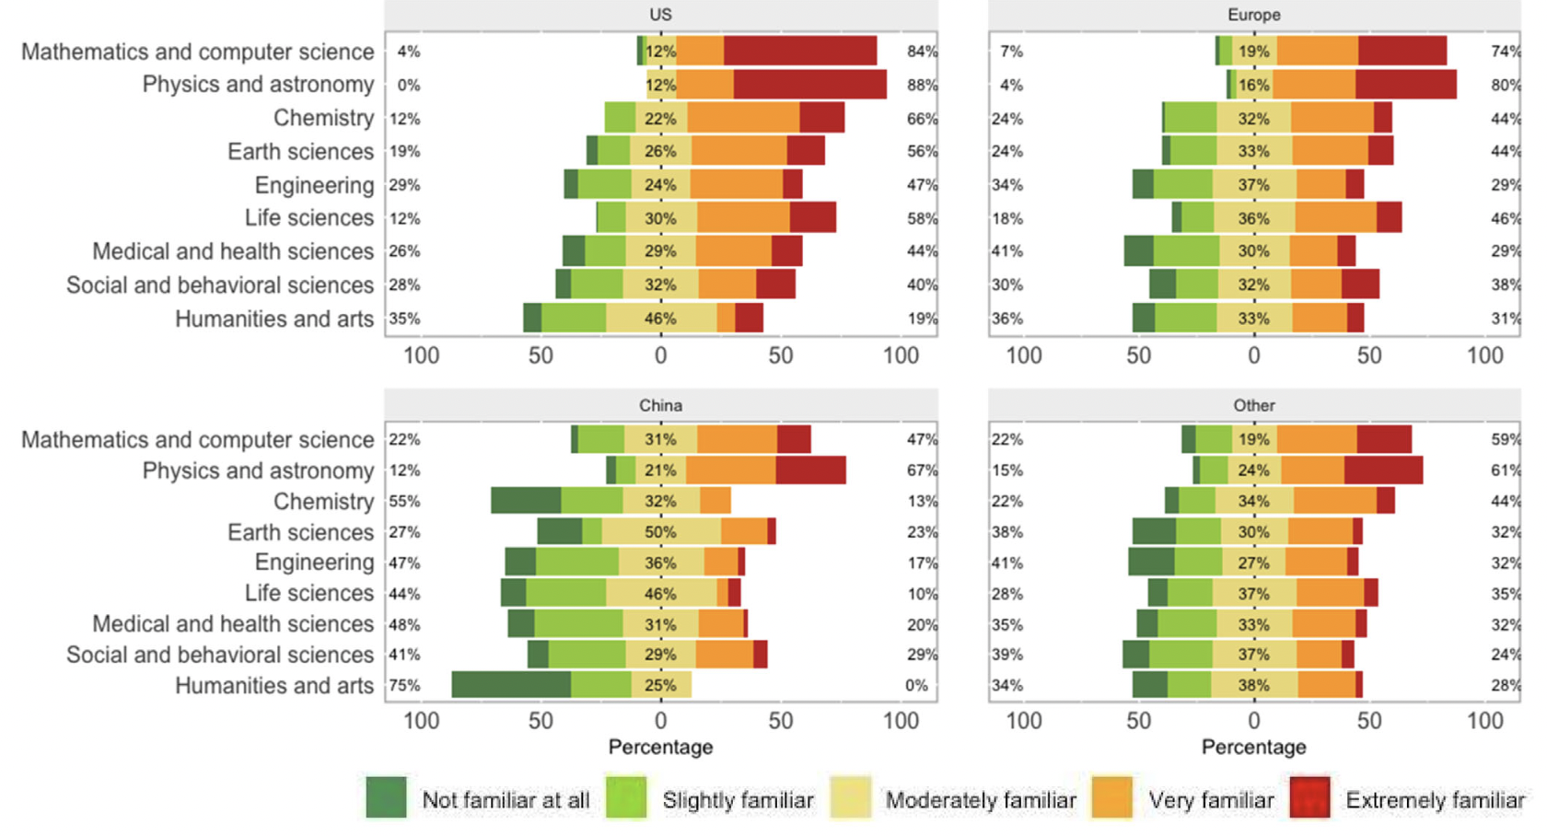
Familiarity with preprinting
Ni, R., & Waltman, L. (2024). To preprint or not to preprint: A global researcher survey. Journal of the Association for Information Science and Technology, 75(6), 749–766. https://doi.org/10.1002/asi.24880 Global survey of attitudes towards preprints (n=3506)
Notes:
Ni and Waltman “present the results of a global online survey of authors of research papers asking them about their familiarity with preprinting and their experience with reading and posting preprints. Survey participants were also asked to share their views on the benefits of preprinting, concerns about preprinting, and ways in which preprinting can be promoted.”
In total, survey responses were received from 114 countries/regions. 3506 completed responses to our survey
Choices: “not at all beneficial,” “somewhat beneficial,” “very beneficial,” and “do not know.”

Slide 29
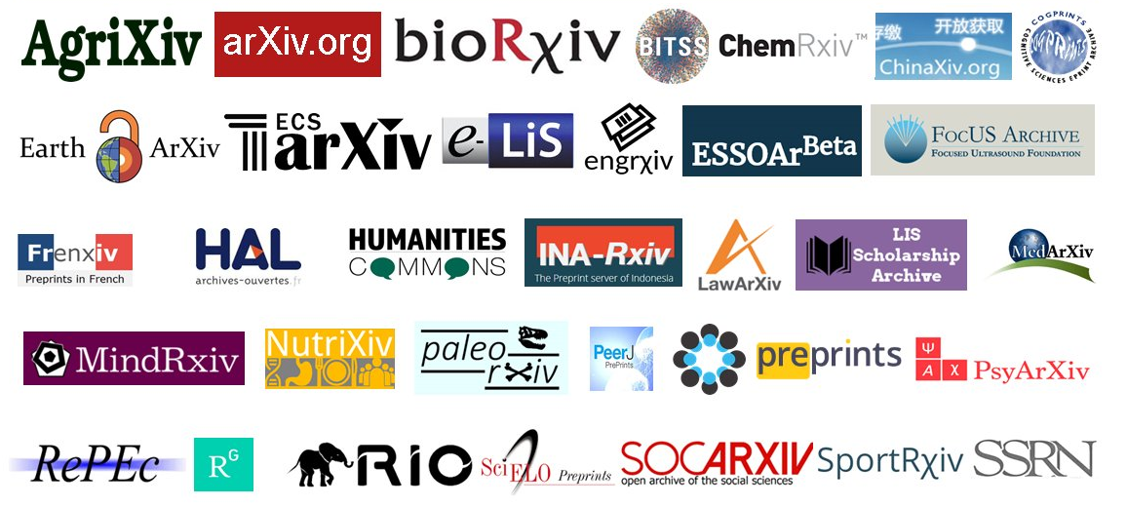



Finding a preprint server that that best suits your needs
There are 50+ preprint servers available
  Some only accept full manuscripts, others take different types of outputs and/or postprints (papers accepted for publication at a journal)
  Server characteristics are cataloged in the ASAPbio Preprint Server Directory
General-purpose repositories: Zenodo, Figshare
Consider visibility, funder recommendations, and features like preservation & indexing

Slide 30
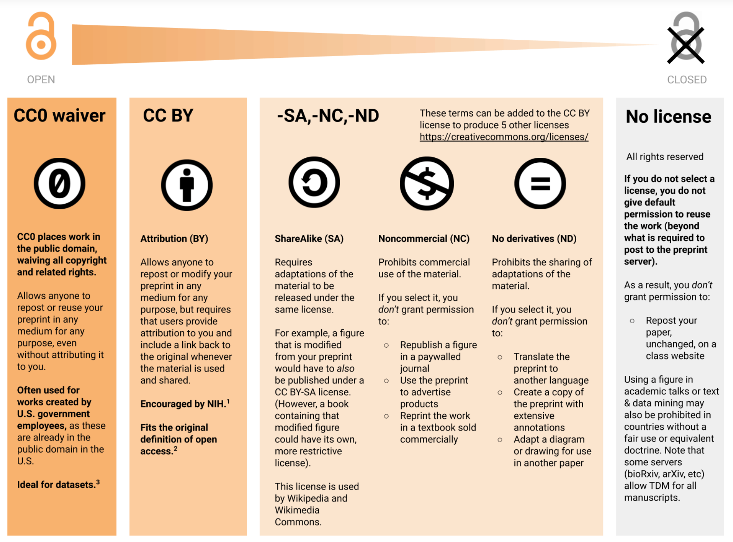
Finding the preprint server that works for you
Check journal policies on when and where preprints may be posted
  Open Journal Policy Finder
  Journal website
Choose a licence
Check out the ASAPbio Preprint Resource Center for more guidance around what preprints are, how to post them, and more.
Licensing diagram – v2019-08-04 https://asapbio.org/licensing-faq - CC BY 4.0

Slide 31
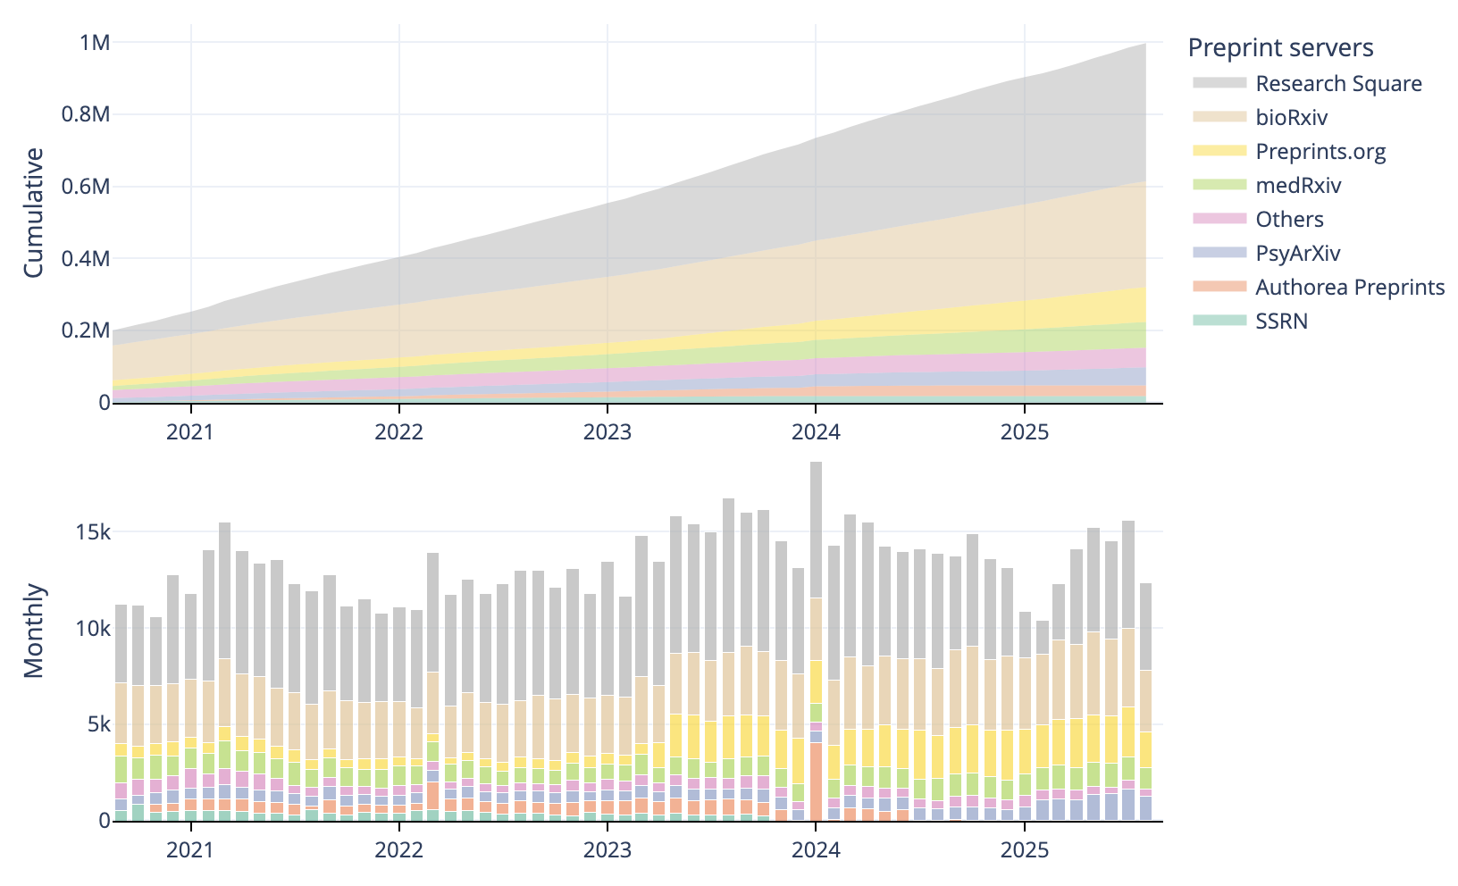
Growing number of preprints published every year
Preprint adoption varies across scientific disciplines and geographical regions.
Rzayeva, N., Pinfield, S., & Waltman, L. (2025, April 30). Adoption of Preprinting Across Scientific Disciplines and Geographical Regions (1991-2023). https://doi.org/10.31235/osf.io/xdwc4_v2
Source: Sciety website https://sciety.org/about
Notes:
Notes: The number of preprints published has increased substantially over the 5 years, a big increase was seen for example during the COVID pandemic as it was so vitally important to get research on the topic out as quick as possible and so the value of preprints was suddenly recognised more widely. As preprints become more widely used and accepted, they raise the possibility of rethinking the peer-review process. Preprints are enabling new forms of peer review that have the potential to be more thorough, inclusive, and collegial than traditional journal peer review, and to thus fundamentally shift the culture of peer review toward constructive collaboration.

Slide 32
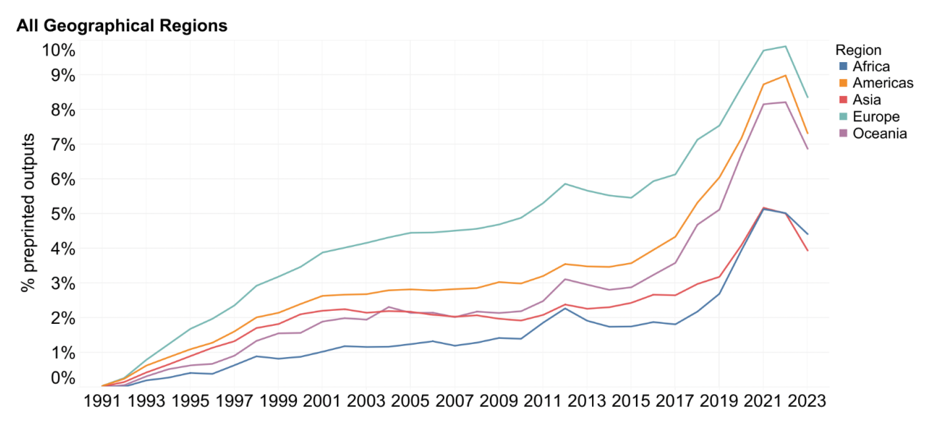
Preprint adoption across geographical regions...
Rzayeva, N., Pinfield, S., & Waltman, L. (2025, April 30). Adoption of Preprinting Across Scientific Disciplines and Geographical Regions (1991-2023). https://doi.org/10.31235/osf.io/xdwc4_v2

Slide 33
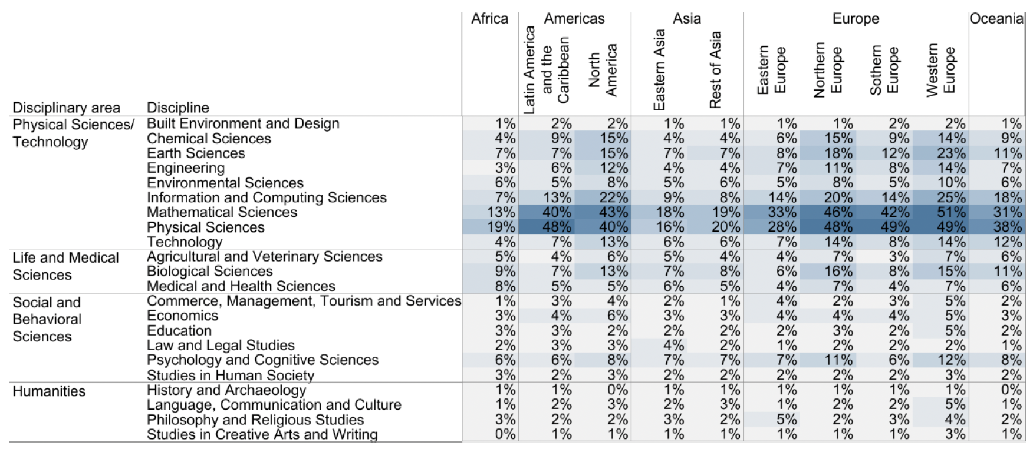
Preprint adoption across geographical regions and discipline
Rzayeva, N., Pinfield, S., & Waltman, L. (2025, April 30). Adoption of Preprinting Across Scientific Disciplines and Geographical Regions (1991-2023). https://doi.org/10.31235/osf.io/xdwc4_v2

Slide 34
The Gates Foundation 2025 Open Access Policy Refresh
Require preprint posting
Discontinue support for Article Processing Charges (APCs)
Support new Open Access business models and infrastructure
Making research publicly available on submission to
a journal (before any peer review), while ensuring authors retain their intellectual property rights
Dismantling inequities caused by APCs, which makes Open Access publishing an option only
for the most well-funded, well-connected researchers
Fostering an Open Access publishing ecosystem that shows promise for equity in scholarly publishing, by channeling funding into new technology and systems that ease the compliance burden to grantees
Modified from presentation by Ashley Farley, CSE 2024 Meeting

Slide 35








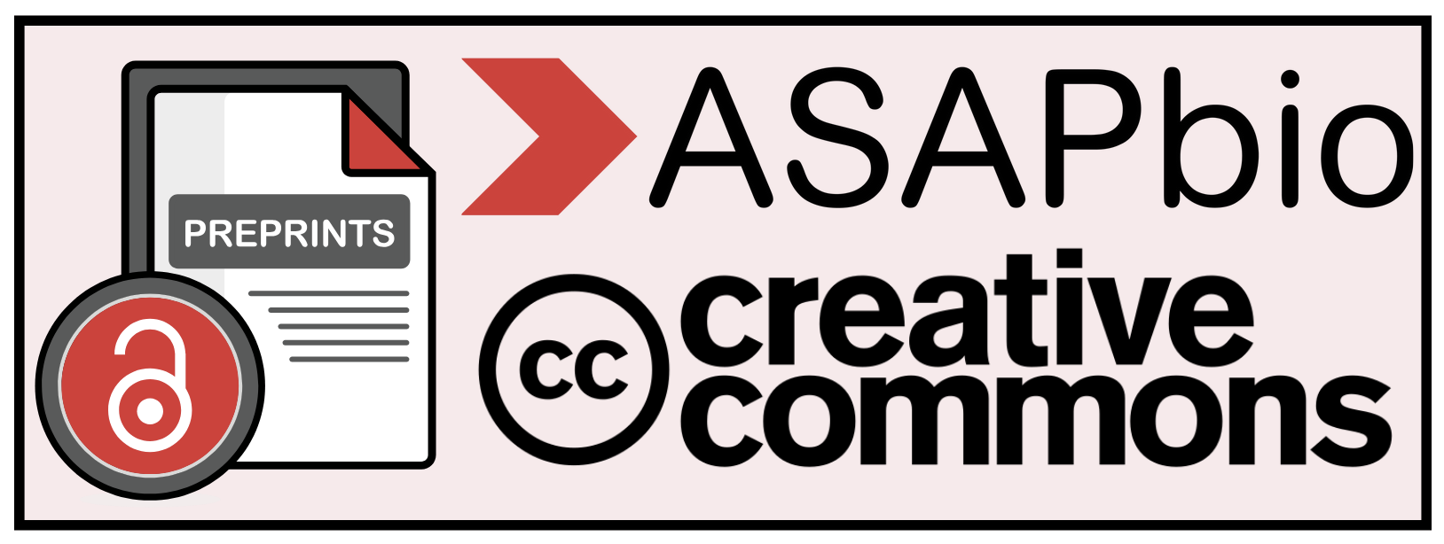
More and more funders are recognizing the value of preprints
and more…
https://asapbio.org/preprint-policy-framework
Notes:
From ASAPbio website (https://asapbio.org/preprint-policy-framework): “ASAPbio in partnership with Creative Commons has engaged with research funders, including members of the Open Research Funders Group, to further policy alignment toward a standard Preprint Policy Framework. As of July 2025, the Gates Foundation and Aligning Science Across Parkinson’s (ASAP) identify this Preprint Policy Framework as a model framework, and are committed to promoting the use of preprints and their open licenses in policy and practice. CZI has also signaled alignment.

Slide 36



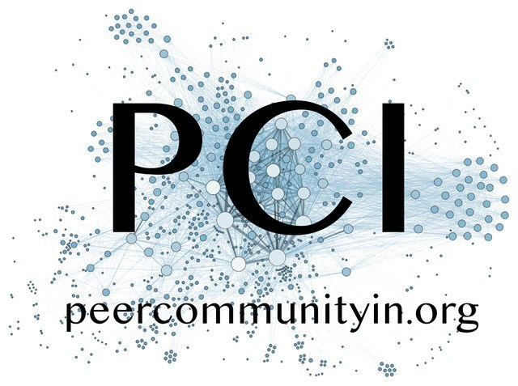

Preprints pave the way for community feedback
Preprint server
Peer reviewed paper
<48 hrs screening process
Constructive community feedback, ideas, discussion
Months to years
Public
Private
Journal 1
Journal 2
Journal 3
Submit
Manuscript
Peer Review
Revise
Revise
Slide modified from original by Jessica Polka, ASAPbio (CC BY 4.0)
Emojis by Mozilla (CC BY 4.0)

Slide 37
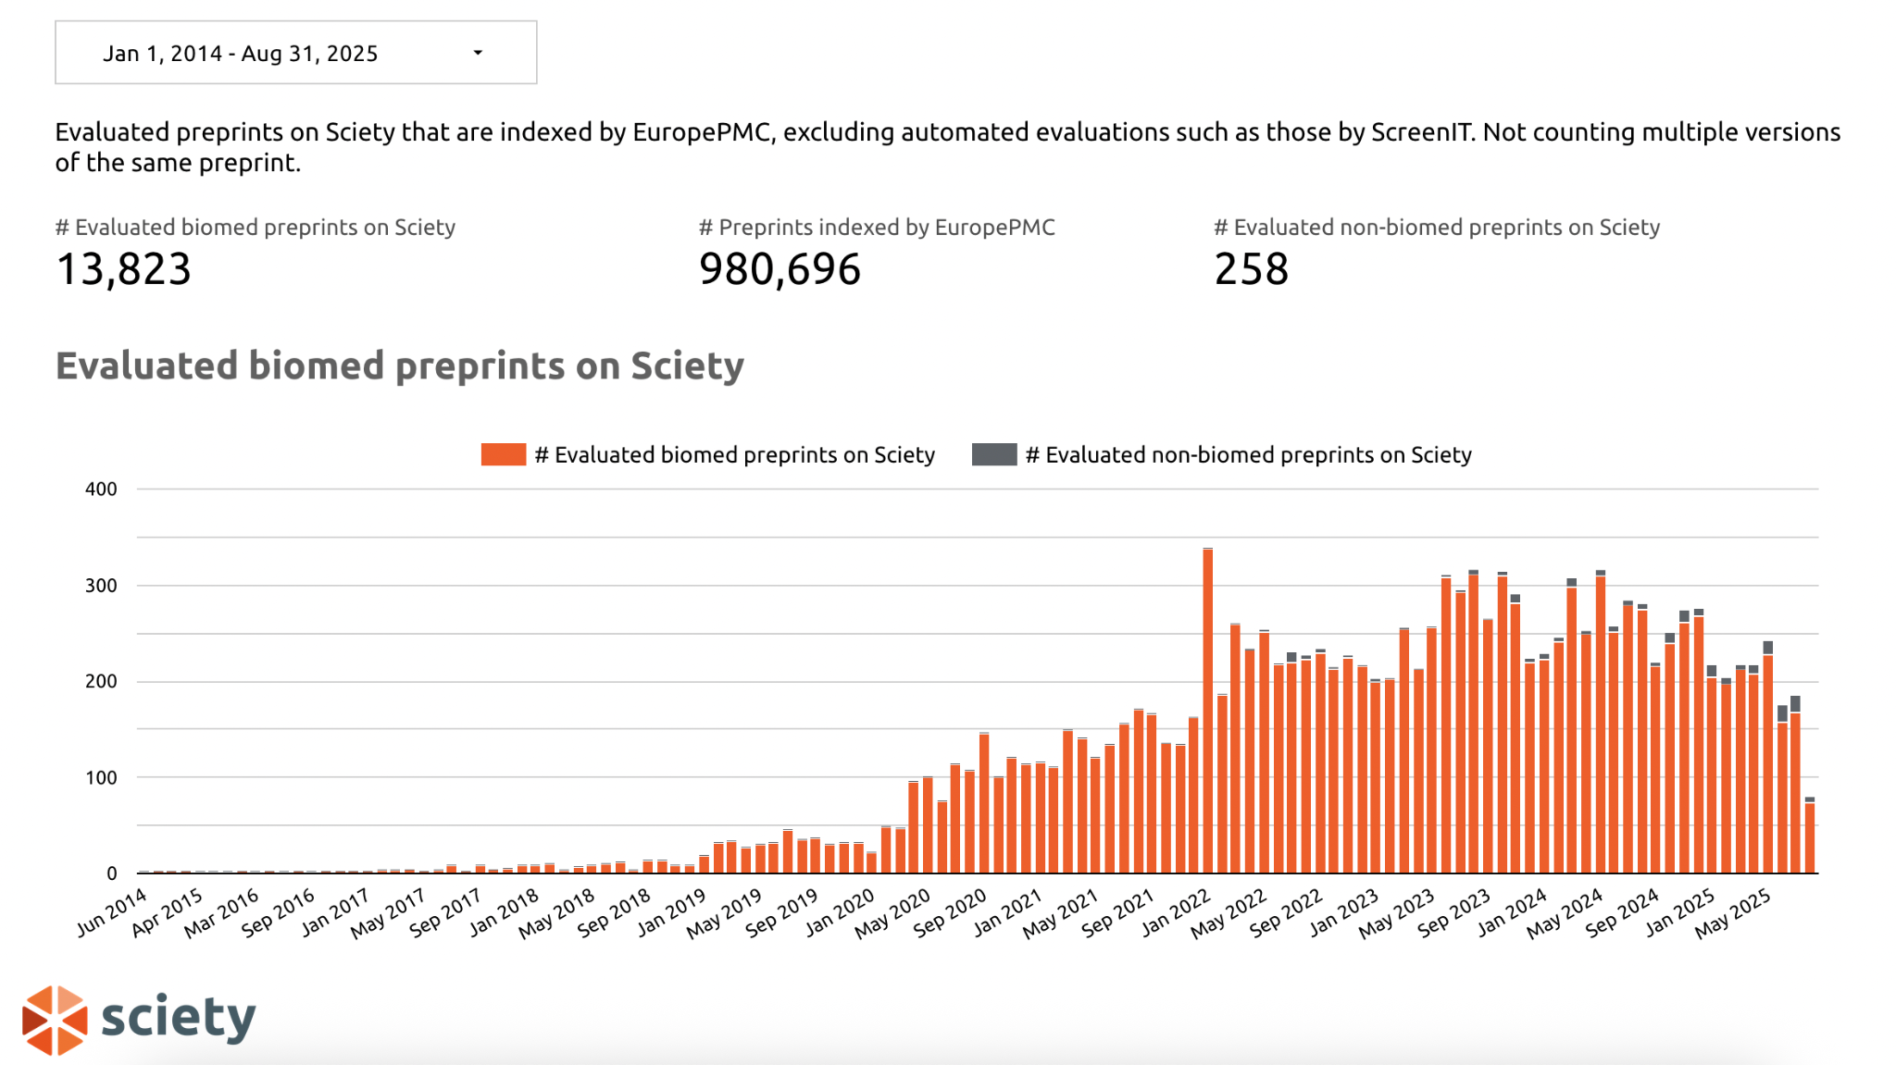
Preprint review adoption is also growing
Notes:
Notes: Traditionally preprints at the beginning were not peer reviewed, they were for early sharing of outputs before publication in a journal with a peer review system, but now people have realised that if we have open availability of the research which can then also enable the early feedback on research at a time when improvements can be made. Also not all preprints go on to be submitted at a journal and peer reviewed at that stage.
This figure represents Preprints evaluated per month on Sciety, excluding reviews conducted by automated tools (ScreenIT) and reviews by journals posted after publication of the journal version (source data available [20]).
This chart includes data from the following services, regardless of which server the preprints they evaluate have been posted to: eLife, Review Commons, Arcadia Science, preLights, Rapid Reviews, PREreview, NCRC, Peer Community In (Evolutionary Biology, Ecology, Zoology, Animal Science, Neuroscience, Paleontology, Archaeology), PeerRef, Biophysics Colab, ASAPbio (and ASAPbio-SciELO) crowd review, Life Science Editors (including Foundation), and The Unjournal. Data have been collected and provided by Sciety. Reviews posted to comment sections of preprint servers are not included, and depending on the policies of individual services, some of the evaluations included in this chart may not meet our definition of preprint review.

Slide 38
Who has read a preprint? 🖐️
Who has published a preprint? 🖐️
Who has reviewed/commented on a preprint? 🖐️

Slide 39

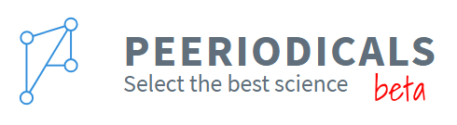


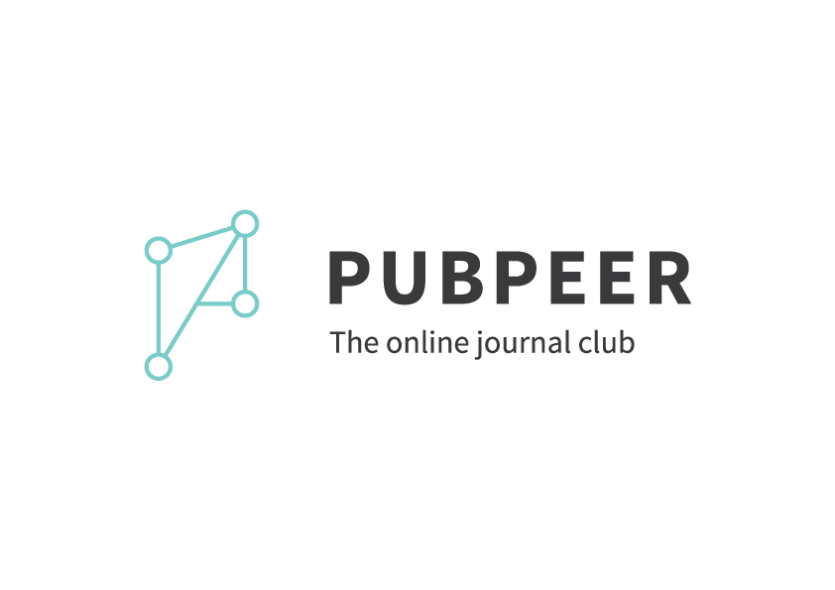





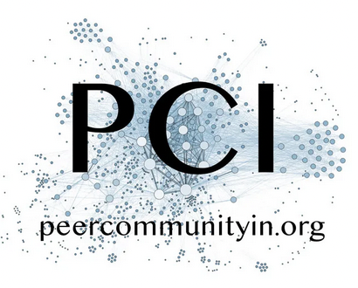


Preprint peer review platforms
Preprint feedback initiatives
Comments on preprint servers
Social media posts
Minimalist or freeform
Journal-like
Over 35 platforms reviewing preprints
Modified with permission from ASAPbio slide

Slide 40
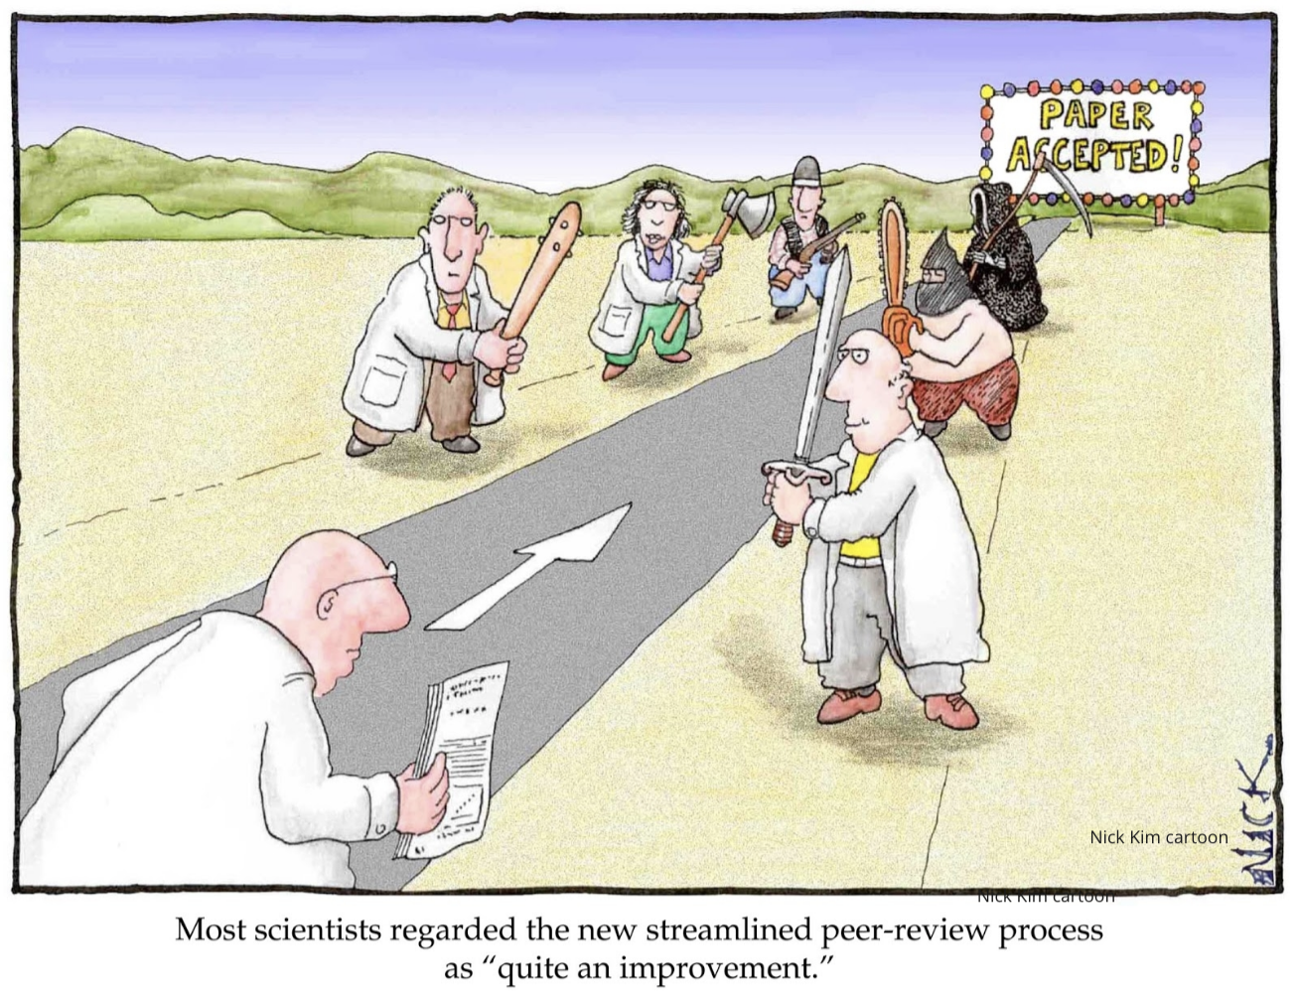
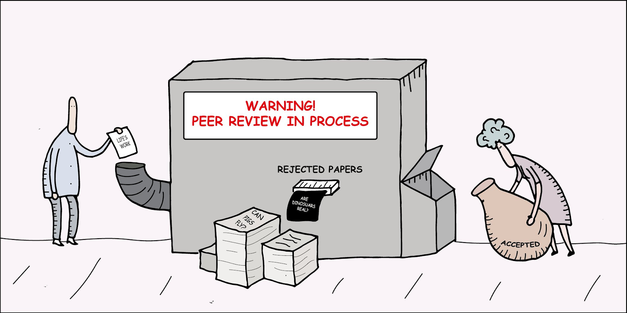
What is Peer Review?
Peer review is the evaluation of work by one or more people with similar competencies as the producers of the work. It functions as a form of self-regulation by qualified members of a profession within the relevant field.
—Wikipedia
https://twitter.com/digitalsci/status/781860071831642113

Slide 41
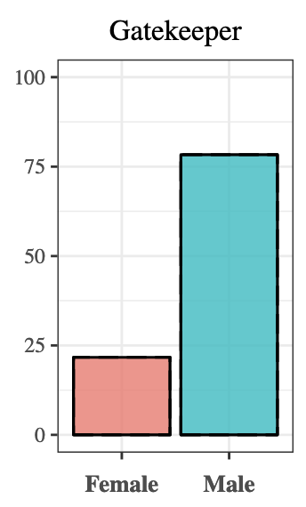
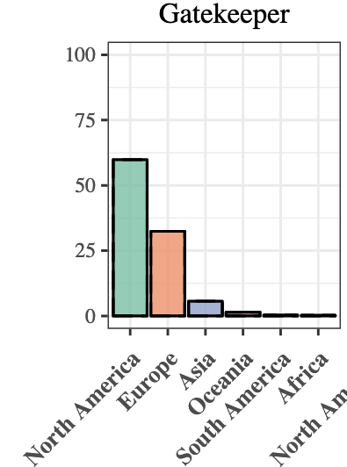
Who are the “experts”? Mostly male, mostly North American
“Gatekeeper” = Senior Editors, Reviewing Editors, and peer reviewers (~8,000 total) at elife 2012-2017
75% of gatekeepers were men
60% of gatekeepers were from North America, 32% from Europe, 5.7% from Asia, <2% from South America, Oceania, and Africa.
Murray et al., 2019 (bioRxiv) https://doi.org/10.1101/400515
Notes:
Data around the diversity of peer reviewers is scarce, but there are a few studies that have looked at gender and geographical representation of peer review gatekeepers—in this 2019 study from of senior editors, reviewing editors and peer reviewers at the journal eLife. The authors reported an overrepresentation of male gatekeepers (mostly peer reviewers as they were 7,000 out of the total 8,000) and over 90% of these gatekeepers were living in North America or Europe with only just over 5% from Asia and under 2% from South America, Oceania, and Africa.

Slide 42
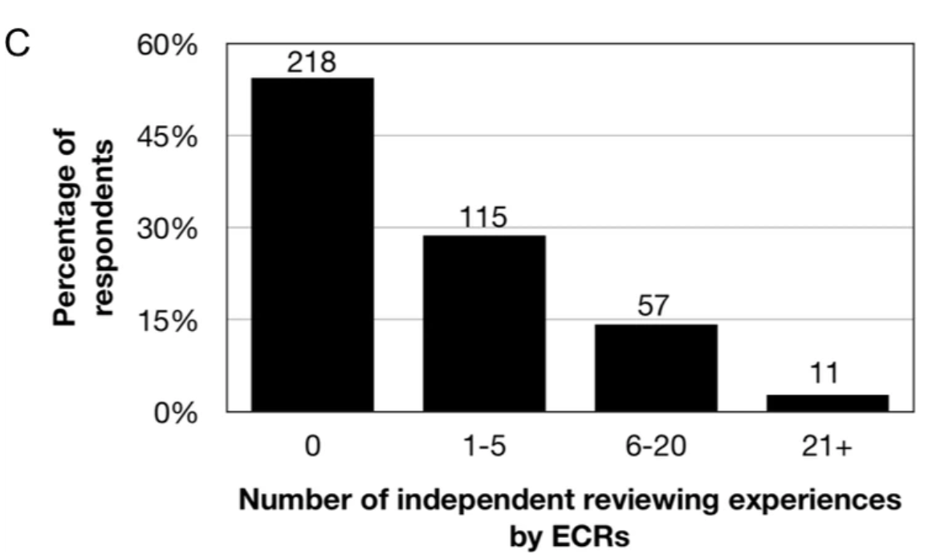
Who are acknowledged as “experts”? Not ECRs
Survey responses 498 over a month-long data collection period in September, 2018
About half of the respondents (64% Post-docs) had never done an independent review
But…
Gary S McDowell et al., 2019 (eLife) https://doi.org/10.7554/eLife.48425
Notes:
Notes: In this study McDowell and colleagues surveyed 498 ECRs (defined as “anyone engaged in research who is not recognized as an independent leader of a research group, including: undergraduate, graduate, and postdoctoral researchers; junior research assistants”) and found that about half of them had never engaged in independent peer review. However…(next slide)

Slide 43
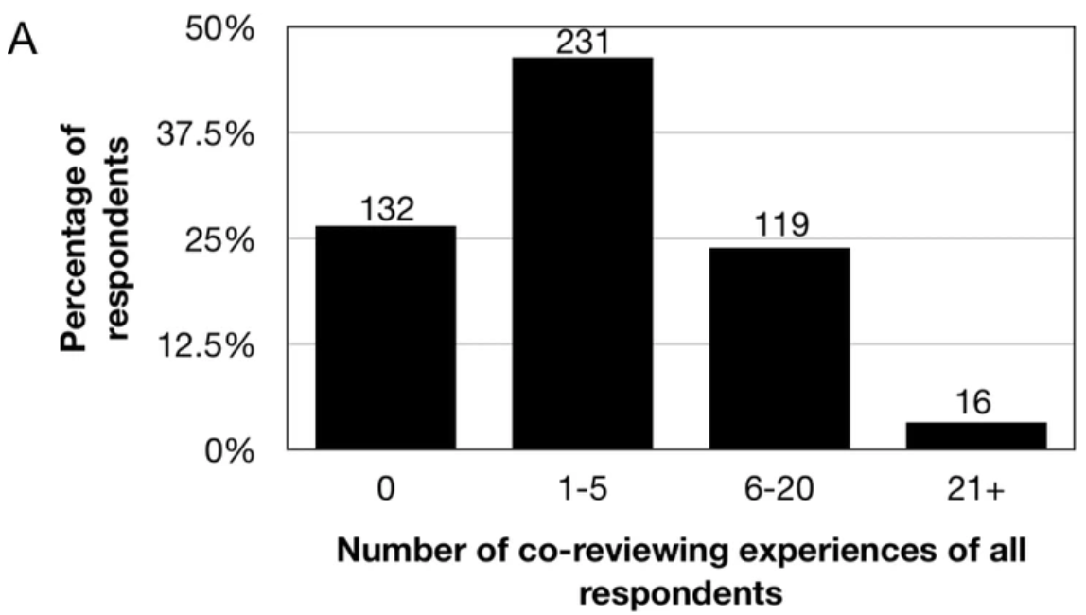
Who are acknowledged as “experts”? Not ECRs
Survey responses 498 over a month-long data collection period in September, 2018
About half of the respondents (64% Post-docs) had never done an independent review
But… more experienced reviewing as co-reviewers, activity that was rarely recognized (“ghostwriting”)
Gary S McDowell et al., 2019 (eLife) https://doi.org/10.7554/eLife.48425
Notes:
Notes: …several experienced peer reviewing as co-reviewers (defined as someone who has “contributed ideas and/or text to a peer review report when one is not the invited reviewer) although without always being recognized. The authors define the process of co-reviewing without recognition as “ghostwriting”. 46% folks who co-reviewed report to know they have not been recognized and 32% don’t know.
Even if these are not comprehensive data around global peer review practices, we can deduces that who is called to be an “expert”, someone with enough experience to be a peer reviewer may be part of an homogeneous group of people which is not at all representative of the diversity of researchers whose work is evaluated.

Slide 44
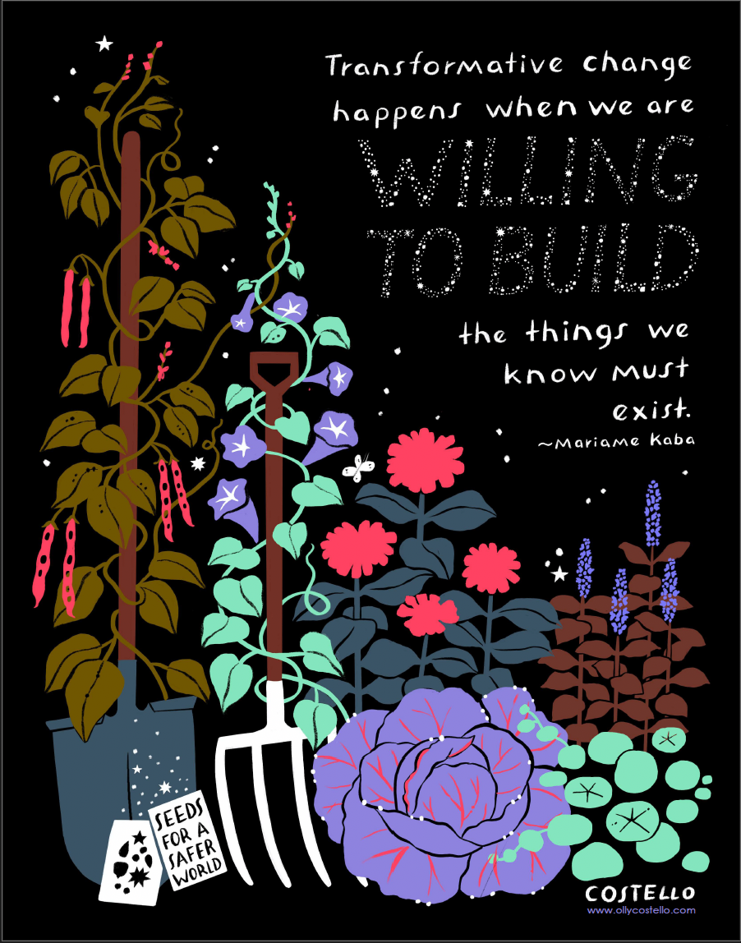
At PREreview we envision a world where knowledge flows freely and equitably, unbound by systemic barriers or entrenched hierarchies.
We envision a future where scholarly ecosystems center collective care, fairness, and innovation—rooted in the belief that true progress emerges from the margins and flourishes through community.

Slide 45




PREreview is a preprint review platform, a resource center, a convener
Peer review training programs to train researchers and experts on constructive, socially-conscious peer-review practices
Open platform where anyone with an ORCID iD can share open, constructive feedback to preprints and be recognized for their contributions
Community engagement with experts around via collaborative Live Reviews of preprints, PREreview Clubs, and an annual Champions Program.
prereview.org

Slide 46
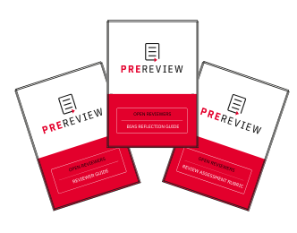
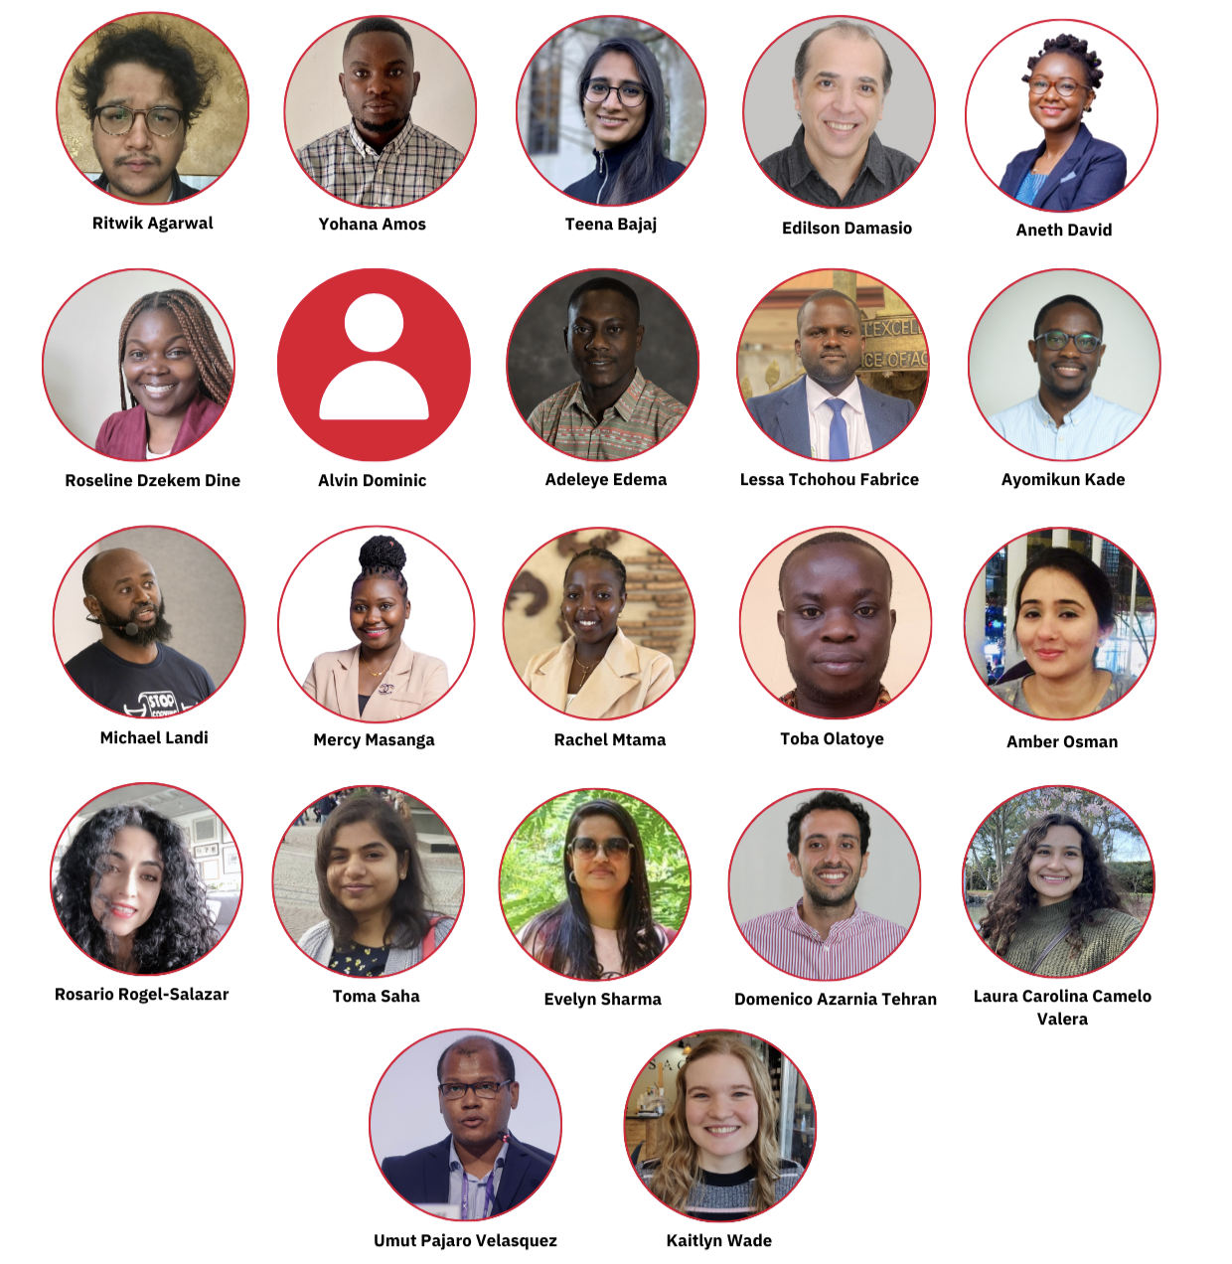






Open Reviewers training and resources
prereview.org/resources
PREreview Champions 2025

Slide 47

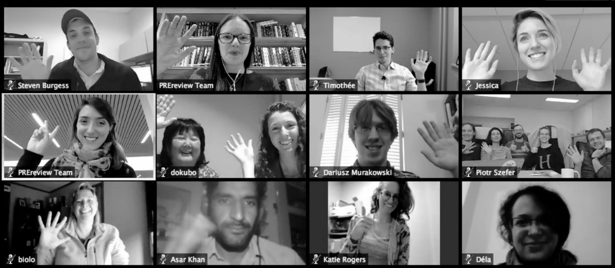

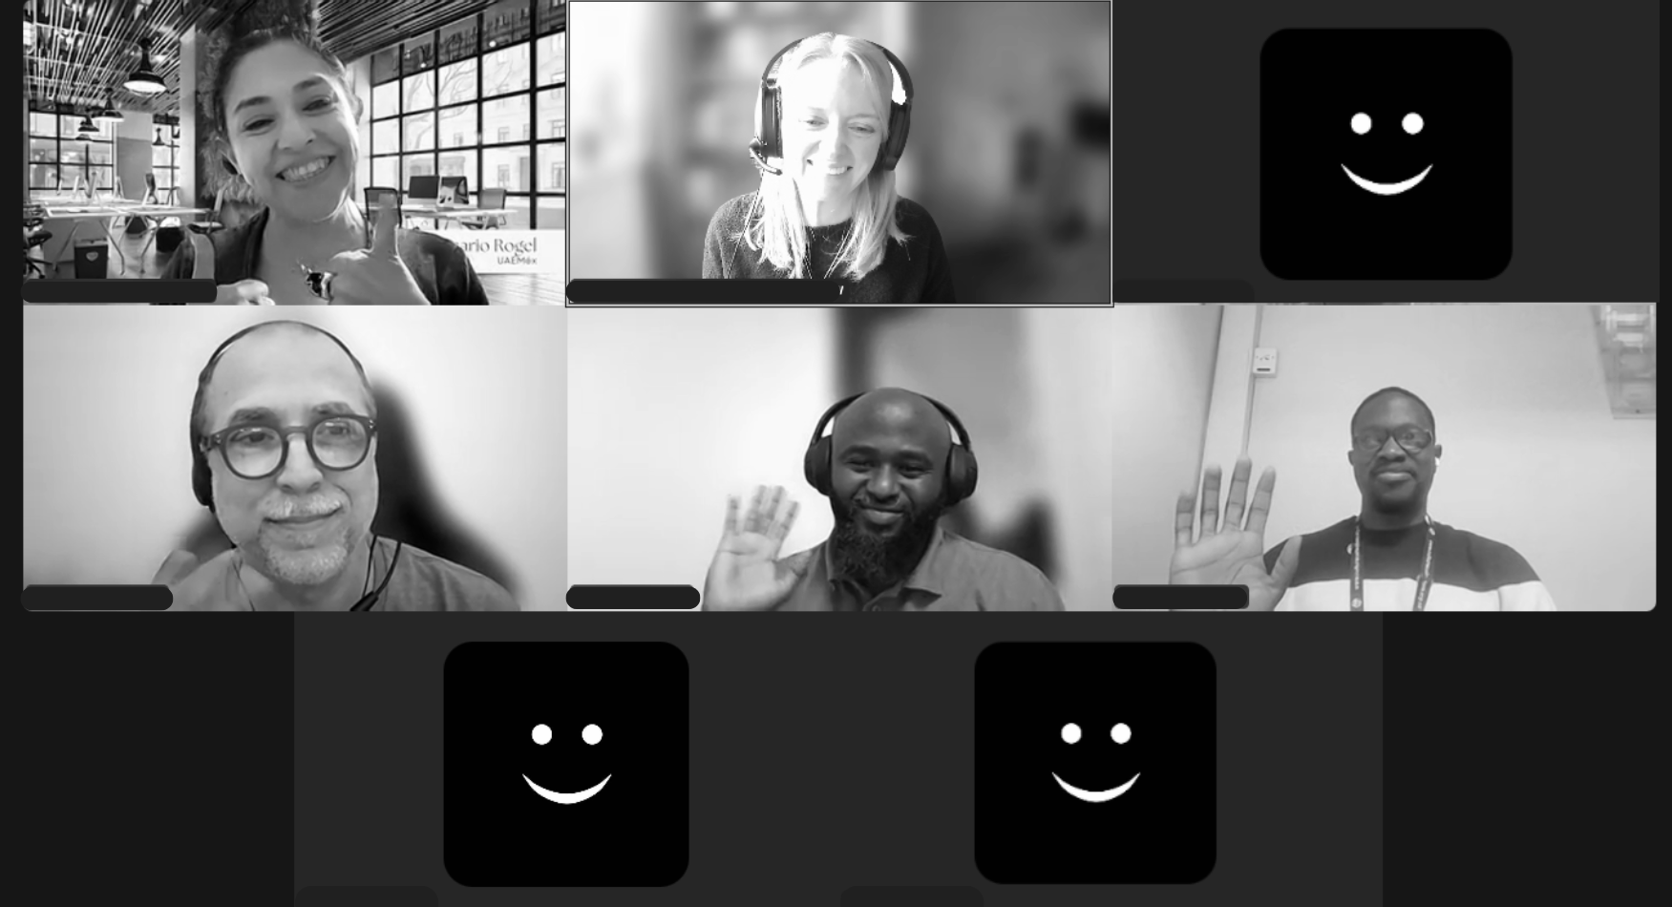

Collaborative and interactive peer review

Slide 48








Interoperable preprint review platform
30+ preprint
servers

Slide 49
Fostering Openness in Science with the Review and Curate Network (RCN)
The traditional means of publication and communication of science (journal publication, conferences, symposiums, and dissemination meetings) were initially introduced in the UK and France and have been embraced widely, however, not evenly, across the world.
In 2018, global North countries produced an average of >35,000 scientific and technical journal articles per country while global South countries produced an average of 9700, or 4000 if China and India are excluded (World Bank, 2020).
Global South researchers (excluding China and India) author less than 2% of the top 1% most-cited articles globally.
Source: Albanna, B., Handl, J. & Heeks, R. Publication outperformance among global South researchers: An analysis of individual-level and publication-level predictors of positive deviance. Scientometrics 126, 8375–8431 (2021). https://doi.org/10.1007/s11192-021-04128-1
Notes:
Sources: 1. https://dppd.medium.com/global-south-researchers-succeeding-against-the-odds-how-are-they-different-9a63589b792
2. https://ncses.nsf.gov/pubs/nsb20206/publication-output-by-region-country-or-economy/#utm_source
3. https://link.springer.com/article/10.1007/s11192-021-04128-1

Slide 50
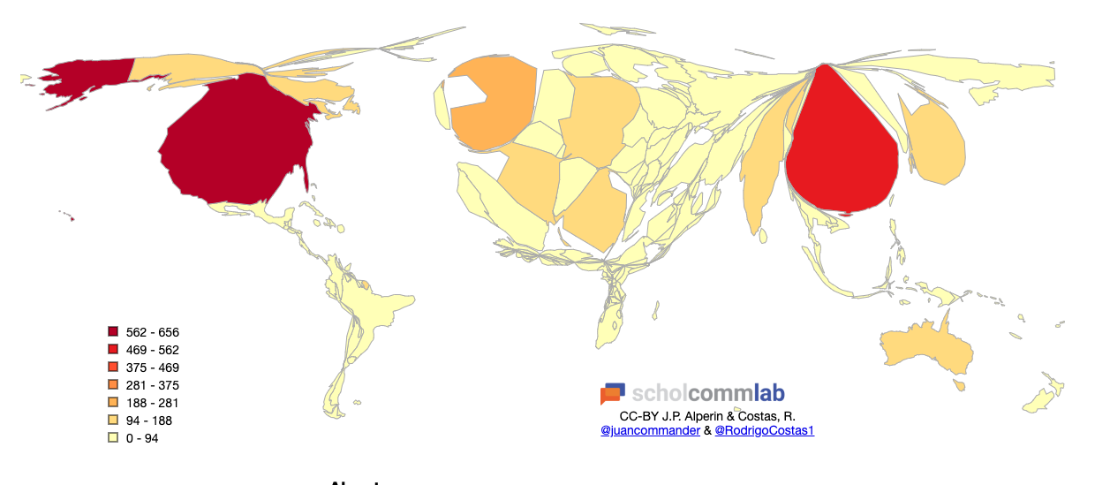
Unrepresentative gatekeeping leads to unrepresentative publishing
Global map scaled for publications by Juan Pablo Alperin (Simon Fraser University) and Rodrigo Costas (Centre for Science and Technology Studies) as part of a larger research collaboration to study the production and readership by countries, and over time. Data about publications by country was sourced from Scopus in 2017.
Notes:
When the gatekeepers of the global research system—do not reflect the diversity of the researchers they oversee, significant biases can emerge. As a result, valuable research may be overlooked or dismissed. When these biases shape the criteria for what is considered valid or high-quality science, it can skew the entire body of knowledge, limiting the scope of what gets recognized as legitimate science. Ultimately, this systemic imbalance can stifle innovation, reduce inclusivity, and hinder the advancement of global knowledge. This map developed by Juan Pablo Alperin (Simon Fraser University) and Rodrigo Costas (Centre for Science and Technology Studies) shows the world as scaled by publications in Scopus per country. Here you can see a big disparity in what is counted as legitimate scientific knowledge coming from the Global North compared to the Global South.

Slide 51
Fostering Openness in Science with the Review and Curate Network (RCN)
Factors leading to these disparities include:
  Limited diamond Open Access journals in Africa
  A lack of skills in Open Science and Science communication skills among African researchers.
  The skew of international journal publication towards English.
  Biases against Southern researchers in terms of receiving research grants and by reviewers of traditional journals rejecting papers from institutions in the Global South.

Slide 52
RCN’s Model for Resilient and Inclusive Research Communication
The Review and Curate Network was created to help speed up sound and open scientific communication in the Global South through open peer review, collaboration, webinar series, open science training among others.
RCN was created in April 2024 through a community seed grant provided by non-profit organization ASAPbio.
RNC aims to contribute to narrowing the scientific communication gap in the Global South through the use of a combination of platforms such as PREreview and the AFRI repository.
Notes:
Therefore, we discuss how preprint review can be leveraged to serve as a strategy to advance scientific communication, education, and promote inclusion in the Global South. Using an open model, we work with preprint repositories such as AfricArXiv to identify preprints to be reviewed.

Slide 53
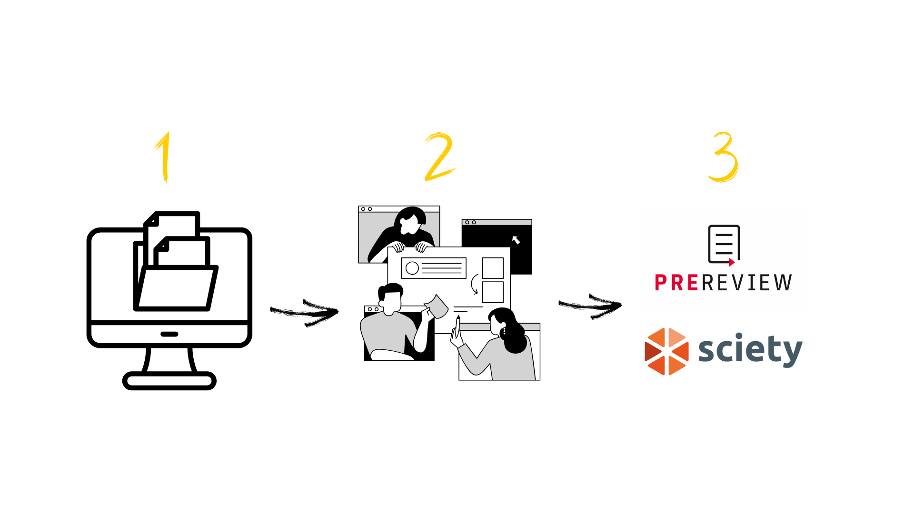
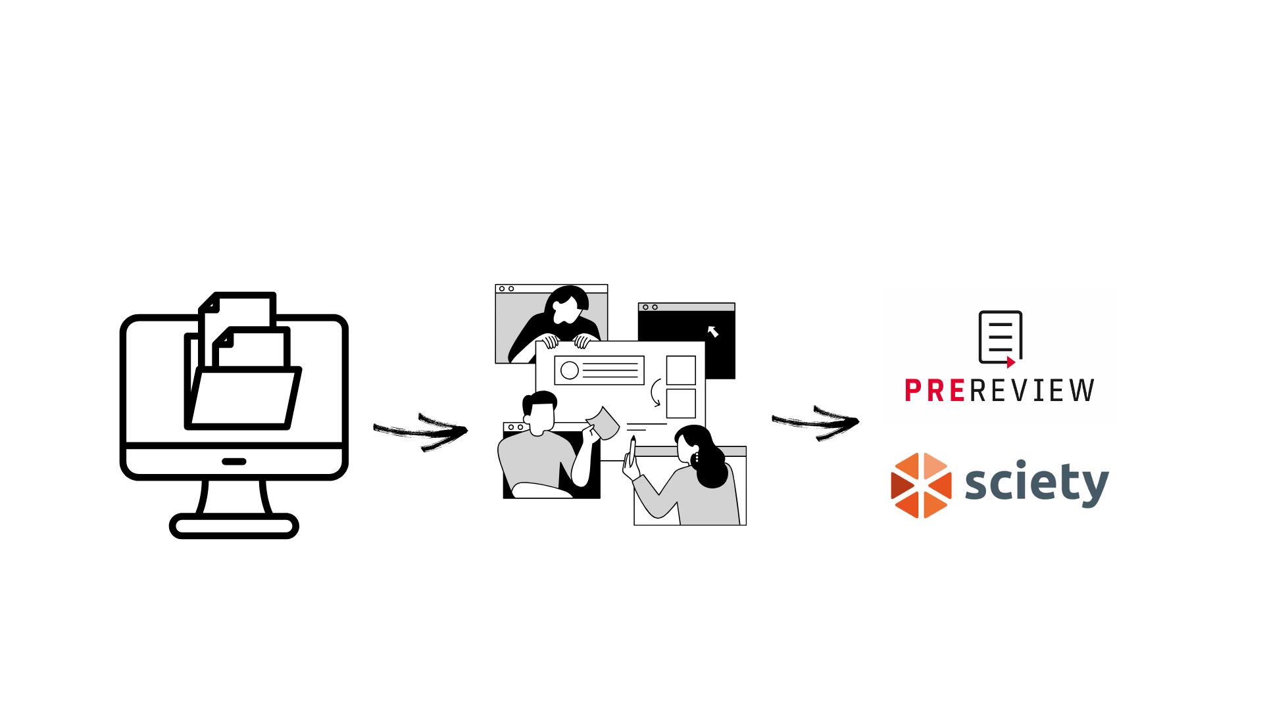
How it works: The Open Model
RCN works with preprint repositories such as AfricArXiv to identify preprints to be reviewed.
Participants evaluate and comment on preprints collaboratively using an open digital platform.
Review outputs are published on PREreview and Sciety, ensuring discoverability and recognition.
Notes:
This process aligns with the principles of Open Science by enhancing transparency, accelerating feedback loops, and increasing participation from underrepresented regions.
It also serves as a scalable model for integrating real-world research engagement into curricula, supporting both equity in education and resilience in research ecosystems.

Slide 54
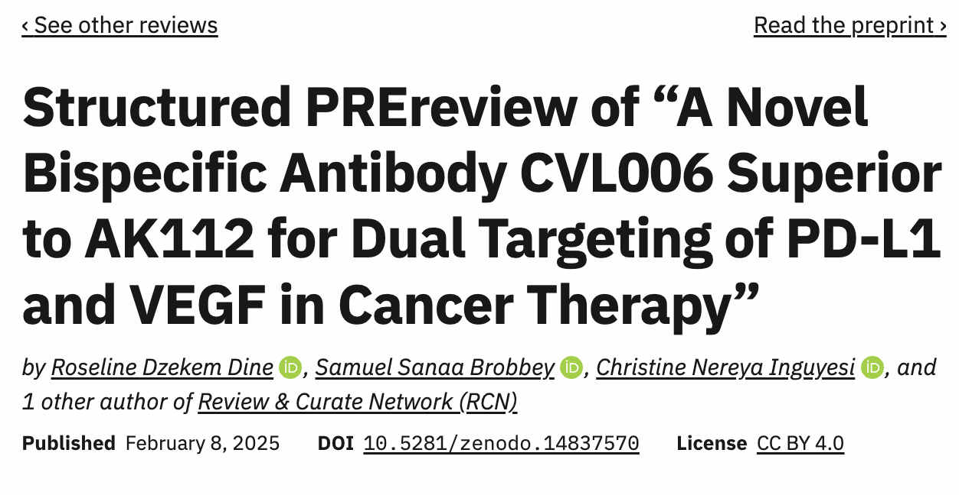
The published review is discoverable and creditable
Reviews are added to the PREreview Club page
Review Authors have the option to sign the review with their public ORCID profile or their unique PREreview pseudonym
The reviews are assigned a CC BY 4.0 License retained by the Review Authors and a DOI via DataCite
Notes:
The published review is discoverable and creditable:
- Review Authors have the option to sign the review with their public ORCID profile, building recognition and a profile as a reviewer, or with their unique PREreview pseudonym which is automatically assigned to them at the point of creating an account.
Reviews are added to the RCN PREreview Club page.
All reviews are assigned a CC By 4.0 license and a DOI via Datacite, ensuring persistent discoverability.

Slide 55
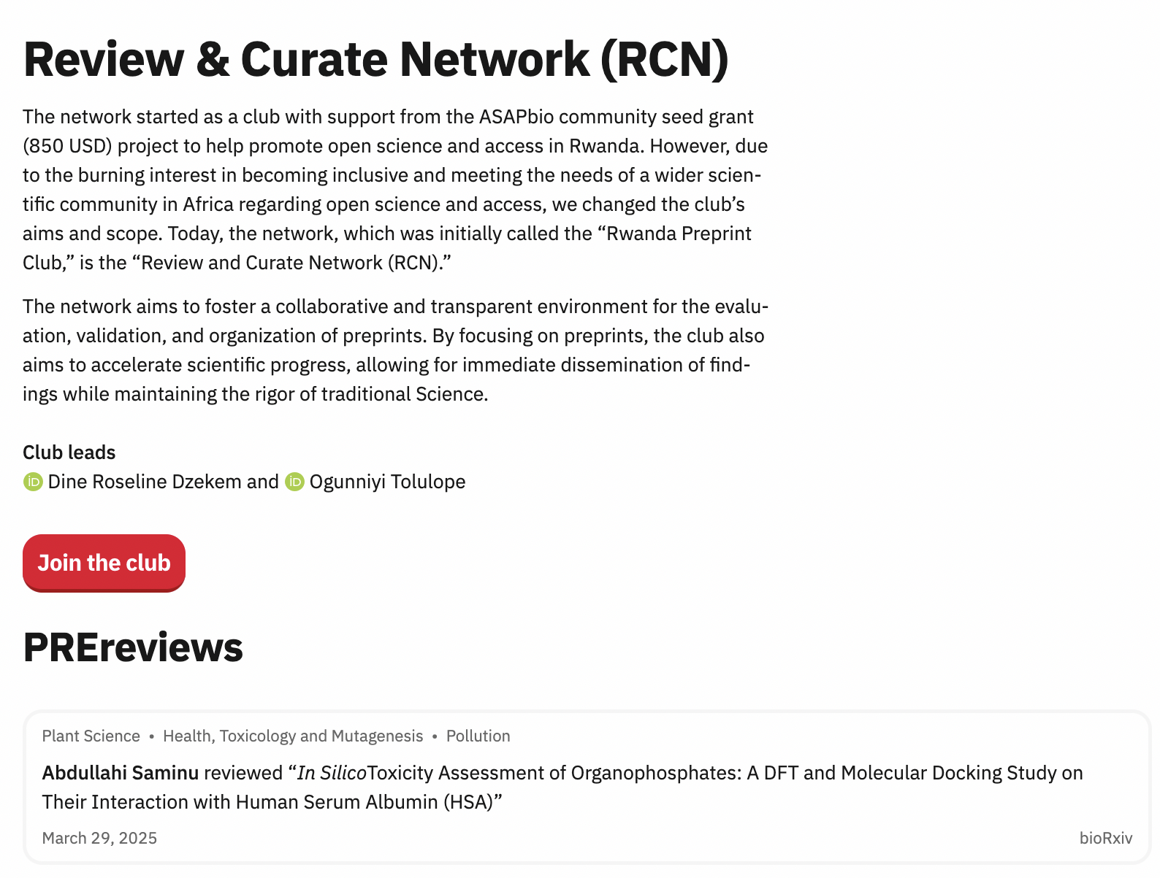
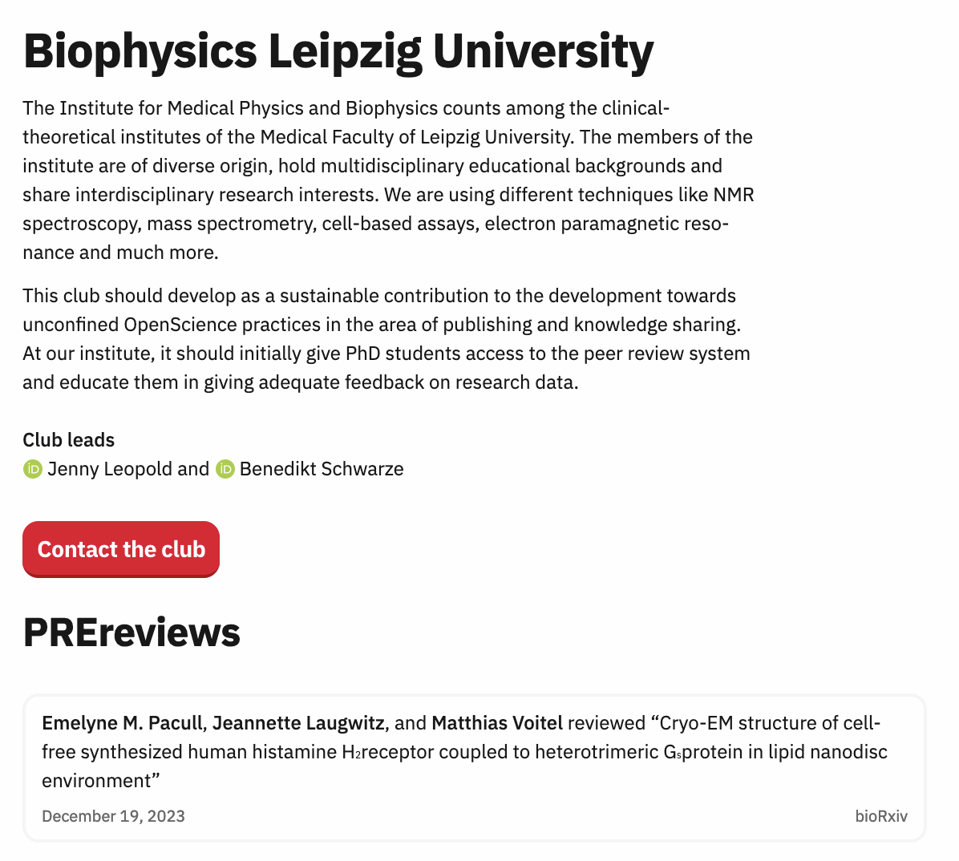
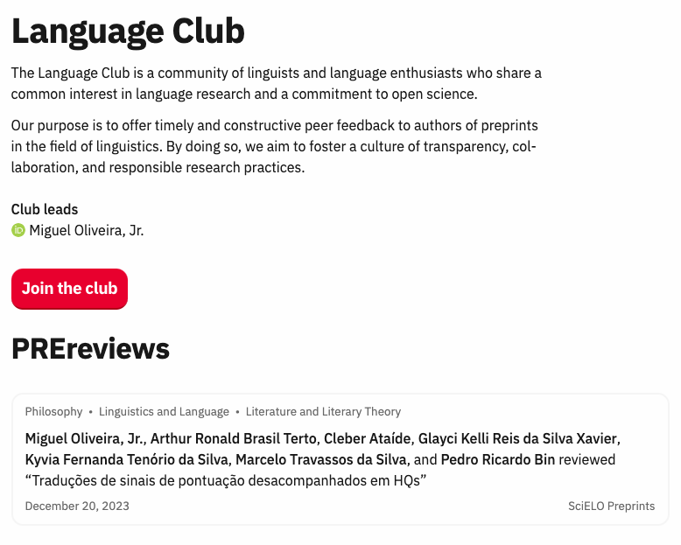
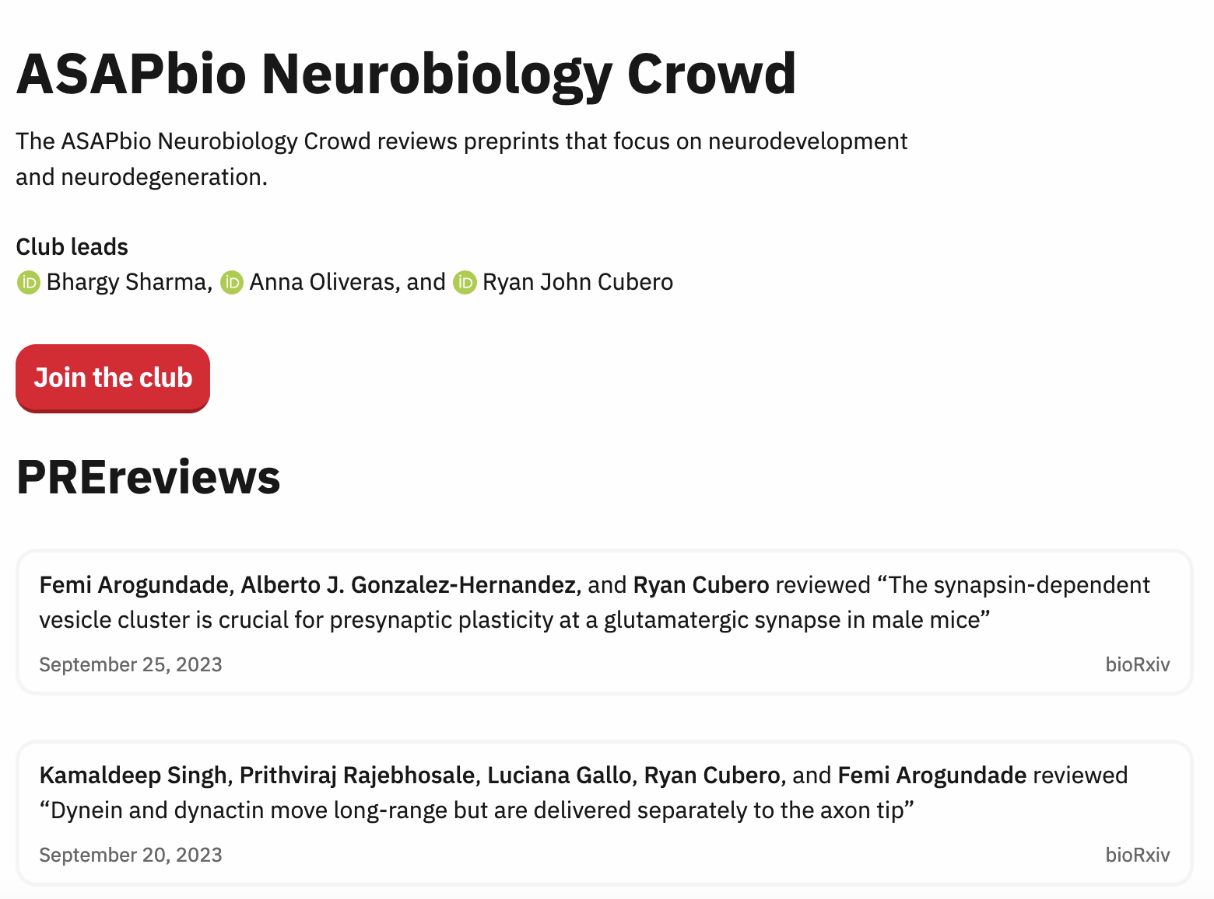
39+ PREreview Clubs

Slide 56



Let’s post a “test preprint review” together
In your browser navigate to https://sandbox.prereview.org
Click on the big red button that says
Paste the doi or the url of the preprint you want to review (e.g., https://doi.org/10.1101/2025.07.30.25332426)
Verify that it’s the right preprint you want to review by checking the title and the abstract, then click
Sign in with your ORCID. If you don’t have an ORCID record, let’s make one here https://orcid.org/register
Choose how you’d like to write your review and click

Slide 57

Let’s post a “test preprint review” together
7. If we selected the option “I’ve already written the review”, then we’ll see that we ask to declare the use of genAI to come up with the review. Click “no” for this test.
8. Paste the review in the text box and check formatting. We’ll simply write “test”.
9. Then you have the option to sign your review with your public name linked to your ORCID record or your PREreview unique pseudonym.
10. Did we review this preprint together or alone? Let’s press alone for this test.
11. Then we ask about competing interests. Let’s declare none for this test.
12. We need to read and agree to the PREreview Code of Conduct
13. Check everything looks good and click

Slide 58
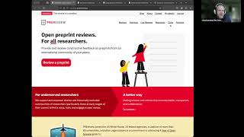
PREreview Demo
bit.ly/PREreview-workflow-demo
Notes:
Link to video: https://bit.ly/Structured-PREreview-Demo (for people to review again later if they so wish)

Slide 59
What can you as an expert do to engage preprint review?
Create an account on PREreview.org, using your ORCID iD, and fill in your profile
Visit your "My Details" page and click on "Connect ORCID profile." to allow PREreview.org to share your public review activity with ORCID
Start reviewing! Choose between copy/pasting in your review, filling out a basic template, or following our Structured Review prompts
Wanna review together? Join the Review and Curate Network Club or start your own (prereview.org/clubs)
Look into PREreview Open Reviewers training for your organization or join our next community workshop (prereview.org/trainings)
Try out the review publishing and request workflow without actually publishing anything via our Sandbox (https://sandbox.prereview.org)
Notes:
Calls to action

Slide 60
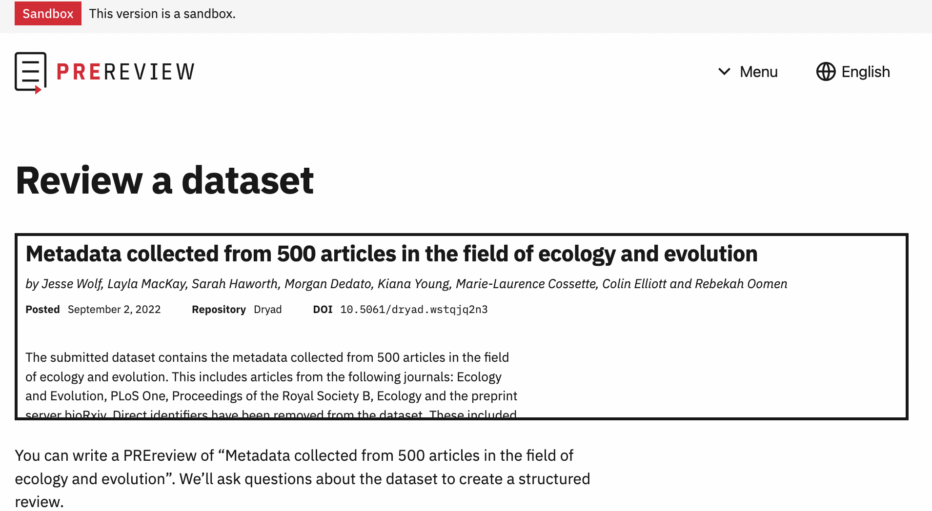
Coming soon… dataset review on PREreview.org

Slide 61



Join us!
https://bit.ly/RCN-WhatsApp
bit.ly/PREreview-newsletter
bit.ly/PREreview-Slack

Slide 62
Thank you!
daniela@prereview.org
dineroselinedzekem@gmail.com

