Slide 1





Introducing Oxford’s digital transformation
Critical and Responsible AI Integration for Undergraduates: A case study from the Teaching and Learning Exploratory Fund
Kelly Webb-Davies Dr Rachel Quarrell
Lead Business Technologist (EdTech) Science course lead, Astrophoria Foundation Year
AI Competency Centre Department of Chemistry
AIEOU Collaborator Conference
16th of September 2025
© University of Oxford 2025

Slide 2

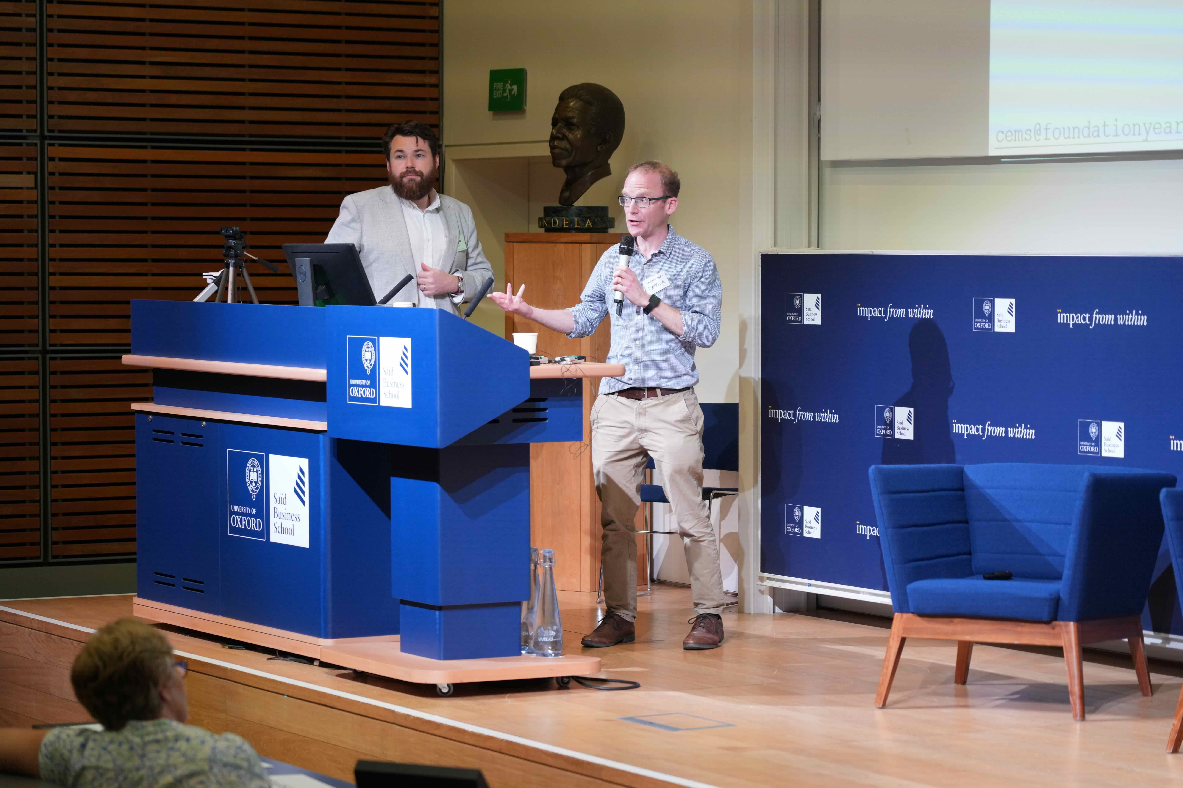
Teaching and Learning Exploratory Fund
Goal: Explore how AI could be used for T&L ethically and reflecting the Russell Group principles
Rapid rise of AI – opportunities for experimentation
12 projects supported
Expertise from AI Competency Centre and Centre for Teaching and Learning
Projects begun in Michaelmas ’24, completed by Trinity ’25
Knowledge Exchange forum July ‘25
Photo: Yining (Evelyn) Tang
© University of Oxford 2025

Slide 3
Case Study: AI for Learning Project
Goal:
Teach students (n=5) and tutors (n=6) subject leads (n=4) to use ChatGPT Edu as an active learning tool, not a crutch
Methods:
Students and tutors given ChatGPT Edu licences
Training workshops
Tutors testing ChatGPT Edu in their field and evaluating accuracy
AI Playbook created as a guide for students
GPT hackathon with tutors to explore applications
© University of Oxford 2025

Slide 4
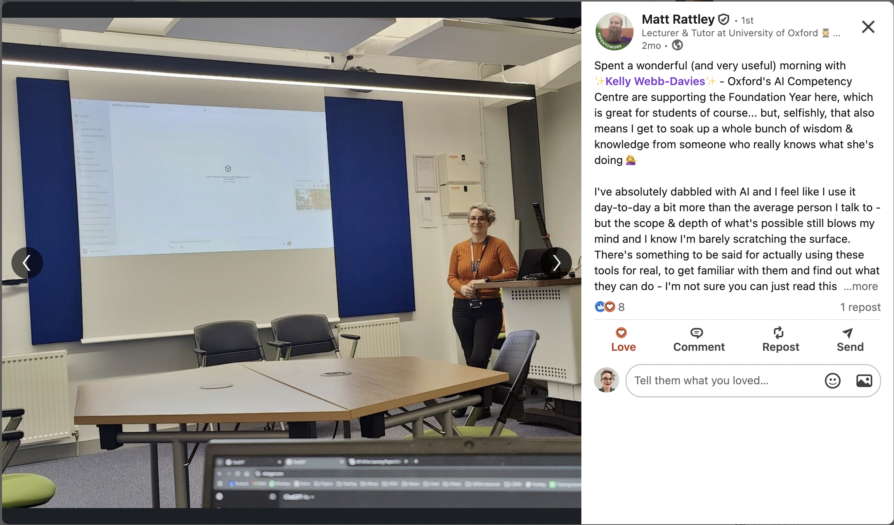
Introducing Oxford’s digital transformation
Photo: Matt Rattley
© University of Oxford 2025

Slide 5
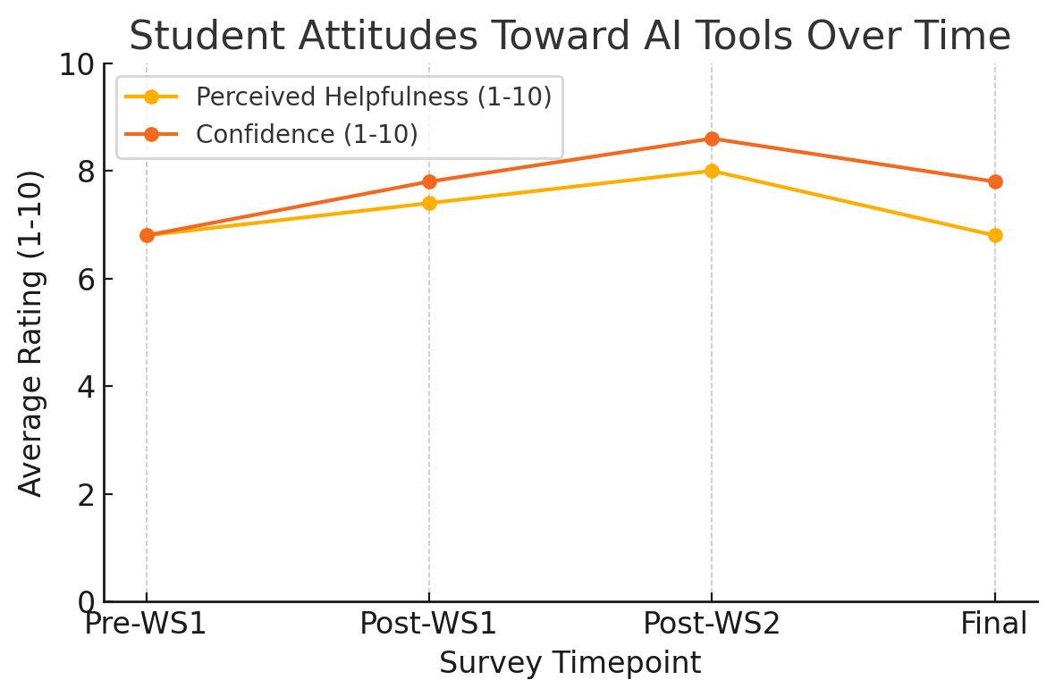
Student Experience
Confidence and perceived usefulness rose with training then fell after experience using tools
Also used for revision, project brainstorming, emotional support
Mixed feedback
All students would want the licence if it was offered again.
  “ChatGPT acts as the painkiller and quite often bypasses the learning process.”
  “It gaslights me into thinking the wrong answer is correct.”
  “It felt a lot more fun that just revision… feels a lot more like having a conversation.”
  “Overall it was really great. It really helped with revision for these exams.”
© University of Oxford 2025

Slide 6
Tutor Experience
Tutors also received training which they employed to test the accuracy of ChatGPT Edu and design learning use cases for students.
Concerns: maths errors, diagram limitations, risk of over-helping students.
Produced a guidance documents for students.
  Example prompts
  Examples of mistakes
  Academic integrity and best practices
Hackathon – tutors created custom GPTs with guardrails.
© University of Oxford 2025

Slide 7
Lessons Learned
Students will (and are) using AI – universities must equip them for critical, thoughtful use.
Hands on experience with AI tools + training encourages critical approach.
Test and evaluate the tools in your subject area.
Benefits in collaboration and experimentation with new technology.
  Two-way process with AI experts
Data protection: enterprise-protected workspace important for students to upload course materials
© University of Oxford 2025

