Slide 1


Holding Fear, Honouring Hope
From Professional Anxiety to Agency in the AI Era
Noosha Mehdian, UBC & UCW
September 16, 2025

Slide 2
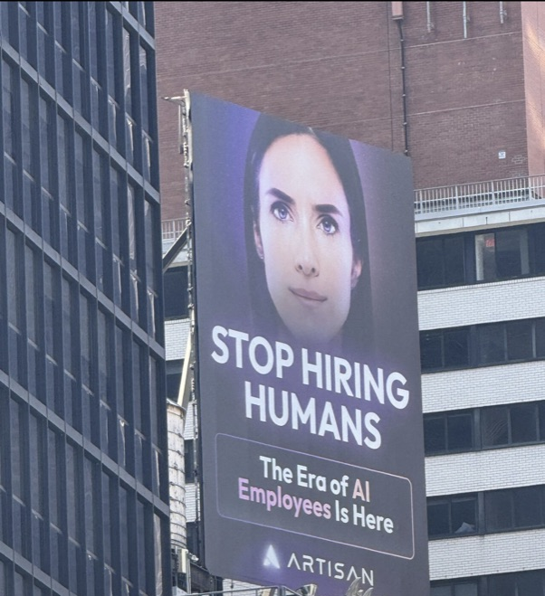
The Unspoken Conversation
"I spent years training to be an educator.
But now AI can do all of these things 24/7. So what makes me irreplaceable?”

Slide 3
Identity Dissolution
Technical
AI provides personalized tutoring and instant feedback
Relational
Eclipse of I-Thou relationships fundamental to education
Existential
Contested visions: market efficiency vs. human development

Slide 4
The Social Fabric Evidence
AI Hyper-Personalization
Individual Optimization
VS.
Human Collective Learning
Social fabric of transformation
Meaning-making through dialogue

Slide 5
What AI Cannot Replace
Epistemic Agency:
The human capacity to seek truth, not just process patterns
Critical Evaluation:
Teaching students to synthesize, take responsibility for knowledge
Collective Meaning-Making: Creating moments where learning becomes transformation
Moral Reasoning:
Helping students become not just knowledgeable, but wise

Slide 6
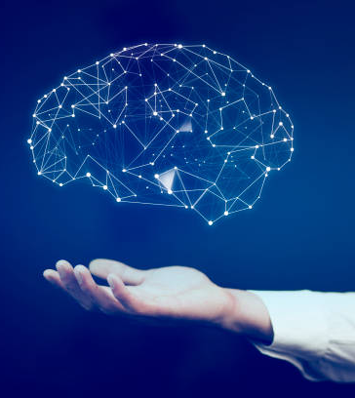
Critical Hope: Beyond Optimism
Acknowledge Reality
Face the truths of automation
Choose Agency
Act toward transformative possibility despite uncertainty
Shape Narrative
Reclaim power to imagine and alternatives
Ask "How do we design human-AI collaboration that preserves education's essential purposes?"

Slide 7
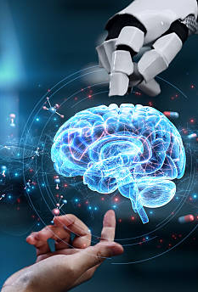
The Solution
Learning experiences that amplify rather than replace human capacities
Students
Teachers
AI
Triadic
Intelligence

Slide 8
Educators: Not Redundant, But Reimagined
Curators of learning experiences that matter
Critics of algorithmic bias and technological determinism
Collaborators in human-AI partnerships that preserve what's sacred
Cultivators of classroom cultures where students feel brave enough to ask transformative questions
anxiety about AI is a compass pointing toward values.

Slide 9

The Resolution
AI Handles
Individual, transactional support
Humans Create
Collective transformation

Slide 10

We need to tend to our fear with Critical Hope.

Slide 11
References
Aerts, C. (2025). Challenging hyper-personalization: Towards (re-)socializing learning in human-to-human-to-machine dialogue. In UNESCO, AI and the future of education: Disruptions, dilemmas and directions (p. 59). UNESCO Publishing.
Buber, M. (1970). I and Thou (W. Kaufmann, Trans.). New York: Charles Scribner's Sons.
Chai, C.S., Wu, J.Y., & Chiu, T.K.F. (2025). "Keeping the primary goals of education in the AI era."
Deimann, M. & Farrow, R. (2025). Contested imaginaries: Reclaiming higher education in the age of AI. In UNESCO, AI and the future of education: Disruptions, dilemmas and directions (p. 46). UNESCO Publishing.
Freeman, K., Carr, S., Phillips, B., Noya, F., & Nestel, D. (2022). From clinician to educator: a scoping review of professional identity and the influence of impostor phenomenon. The Asia Pacific Scholar, 7(1), 21-32.
Freire, P. (1992). Pedagogy of Hope: Reliving Pedagogy of the Oppressed (1992, English trans. 1994).
He, M. (2023). The influence of cultural identity education on students' positive psychology. HTS Teologiese Studies / Theological Studies.
Lo, N. and To, B. (2023). To learn or not to learn: perceptions towards continuing professional development and self-identity among English language teachers during the COVID-19 pandemic. SN Computer Science, 4(3).
Mehdian, N. (2025, April 6). Not Redundant, But Reimagined: Educators, AI, and the Power of Critical Hope. https://aieou.web.ox.ac.uk/article/not-redundant-reimagined

