Slide 1
Federation in a Trusted Research Environment
Ross Stiven, Aridhia

Slide 2

Overview
The Aridhia DRE​
Product Management – a personal history​
Aridhia and data federation – a company history​
PHEMS ​
The challenges of federation
Solutions – Federation in a TRE
Our data federation workflow
The future?

Slide 3
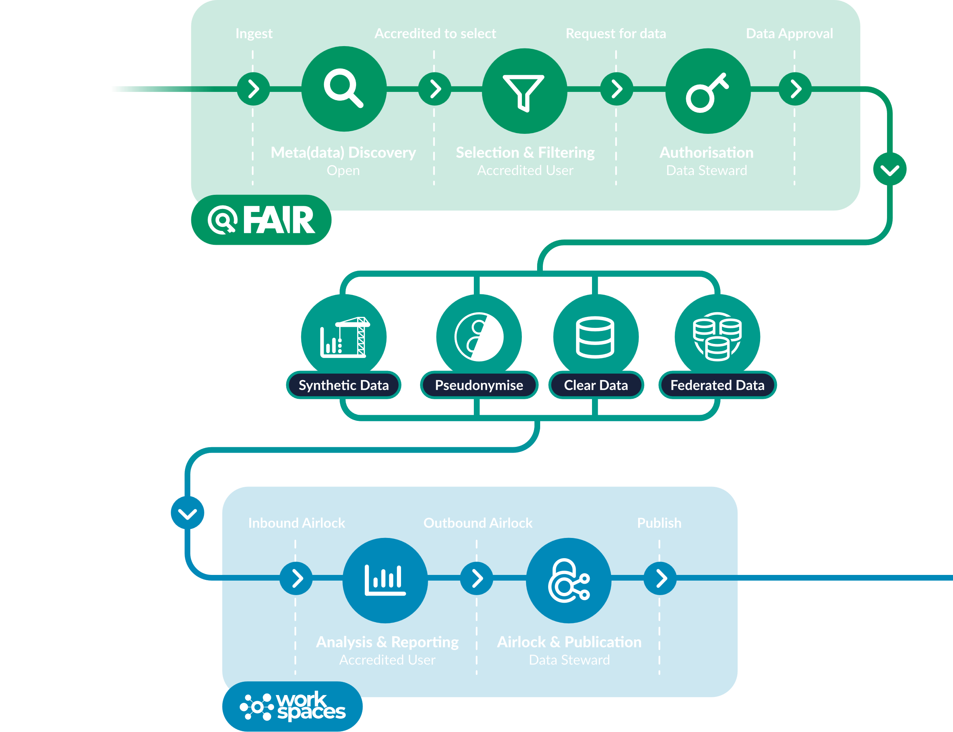

Slide 4


Slide 5
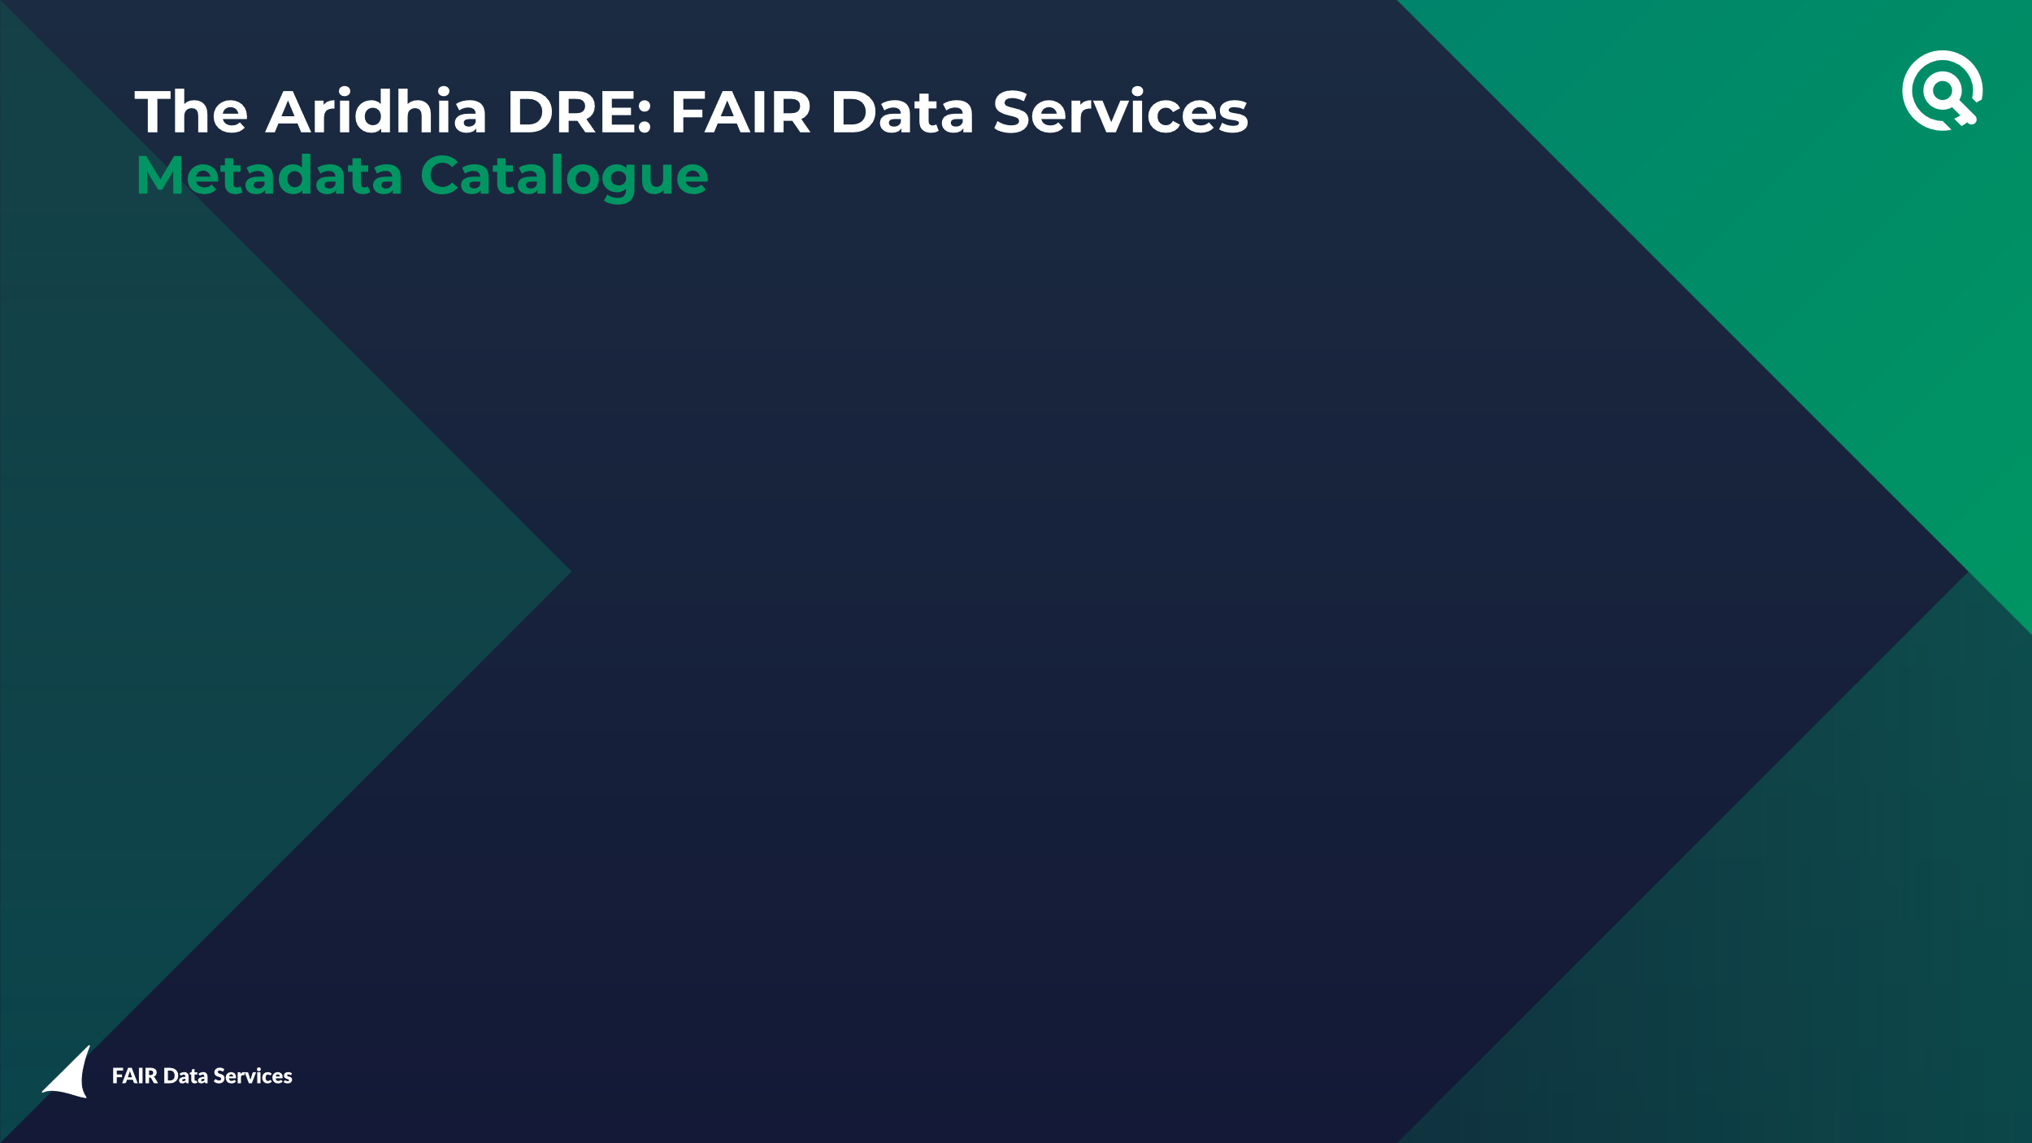

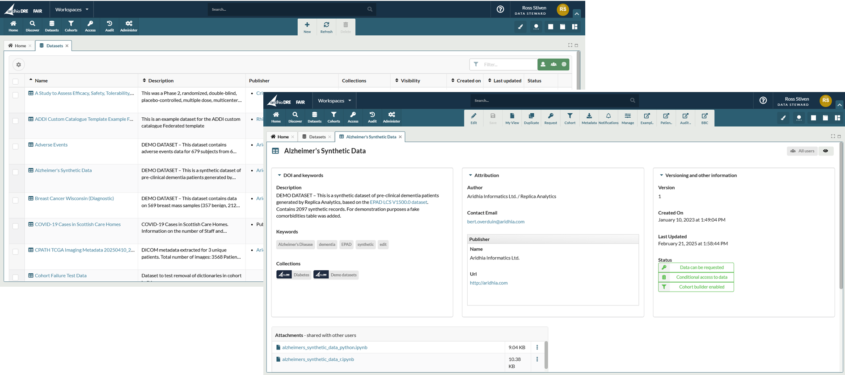

Slide 6


Slide 7
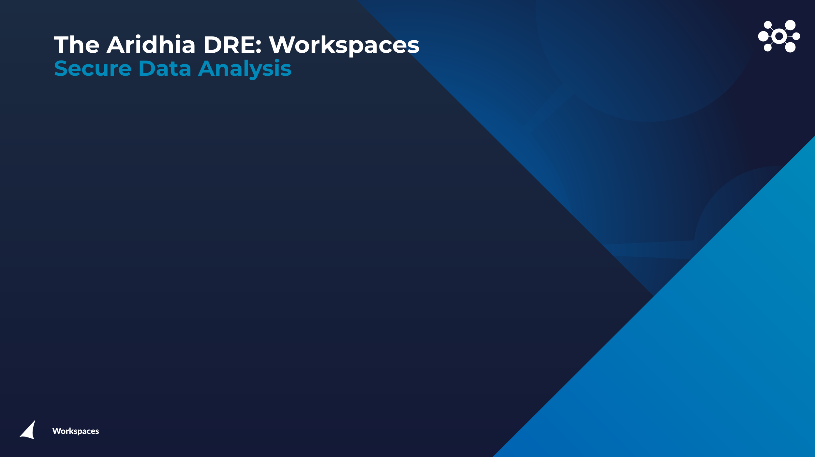
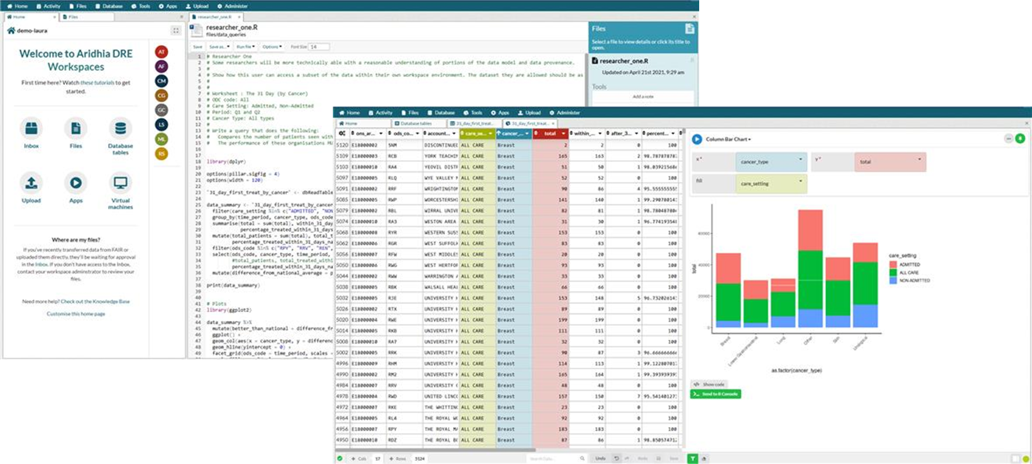

Slide 8
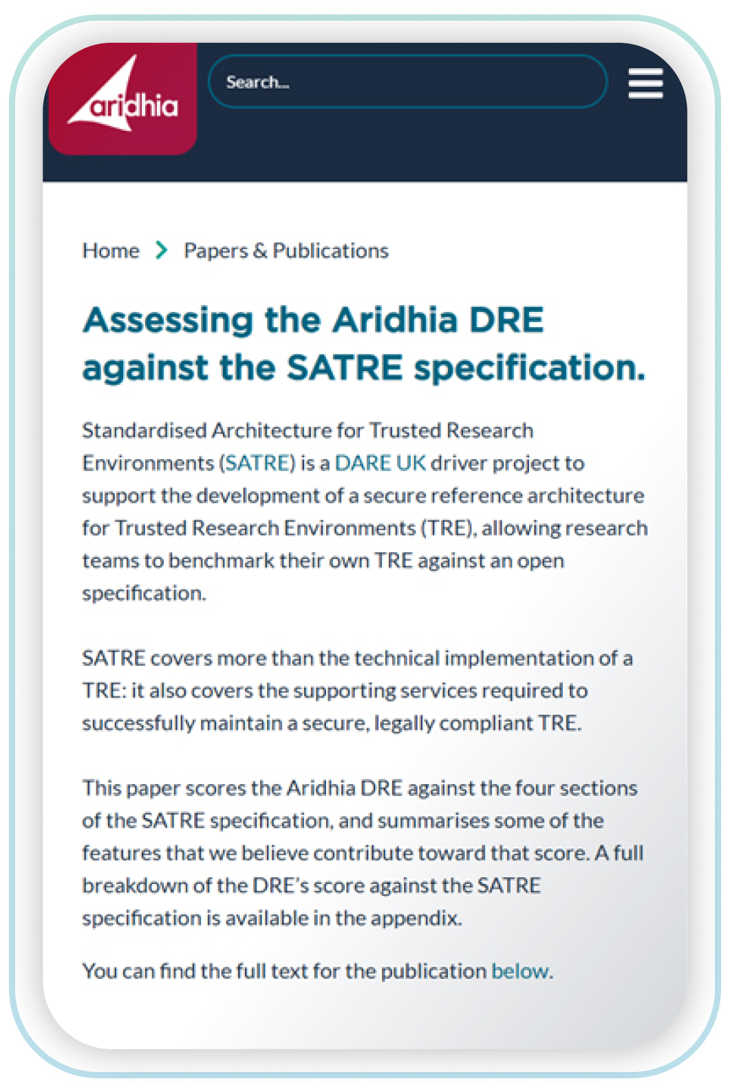
SATRE
The first commercial TRE provider to use SATRE
We scored the DRE against SATRE in 2024 and rescored in 2025, this is documented in a whitepaper available from our website:
https://www.aridhia.com/assessing-the-aridhia-dre-against-the-satre-specification/
However, we believe that federation should become part of the specification:
https://medium.com/@aridhia/beyond-satre-the-future-of-trusted-research-environments-c6f052f0a055

Slide 9
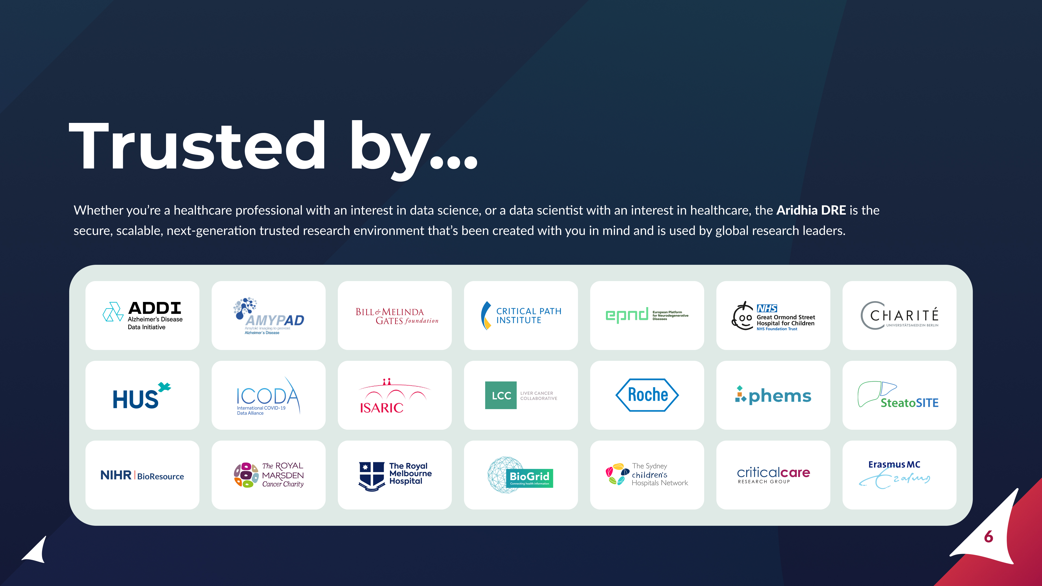

Slide 10
Product
Management
A personal history

Slide 11
What is a product manager?
And what do they do?
The Product [manager] is accountable for maximizing the value of the product resulting from the work of the Scrum Team. How this is done may vary widely across organizations, Scrum Teams, and individuals.
The Product [manager] is one person, not a committee. The Product [manager] may represent the needs of many stakeholders in the Product Backlog. Those wanting to change the Product Backlog can do so by trying to convince the Product [manager].
Taken from the Scrum Guide
https://scrumguides.org/scrum-guide.html#product-owner

Slide 12

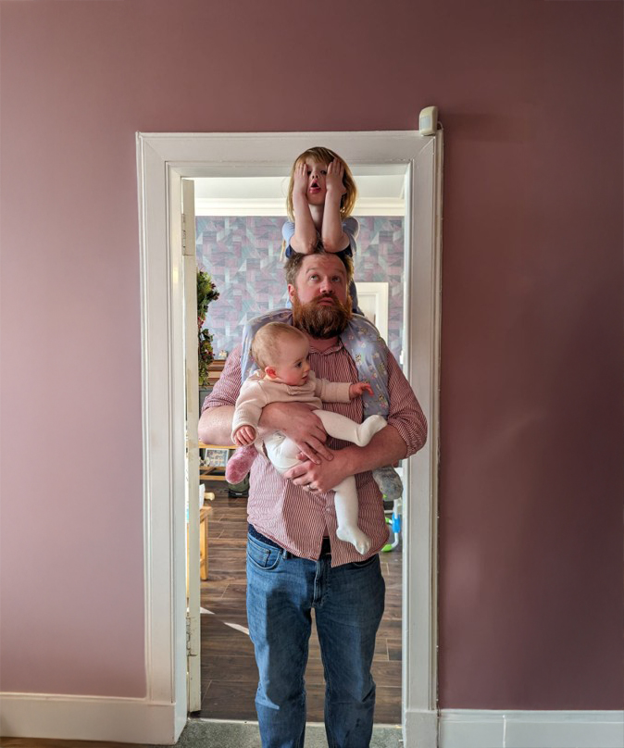
How did I become a product manager?
I started my professional life as a data analyst, looking at computer network traffic
I became a part time product owner in this role
I was not very good at it…

Slide 13
Why I was not a good product owner
And how I got better
Three reasons I was a bad product owner:
I didn’t know anything about software development
I didn’t care about the opinion of other people
I wasn’t interested in 95% of users
How did I get better? I spent some time working in eCommerce:
You cannot write off 19 out of 20 users in that environment
You need to meet the users where they are

Slide 14
This is not eCommerce
To be 100% clear
There is a balance to be struck between the needs of expert and novice users, but we still want federated data analysis to be adopted as widely as possible.
In this context the Product Manager has one key job:
Understand user problems and then identify solutions to those problems.

Slide 15
Two categories of problem
Technical
The technology you need doesn’t exist, isn’t mature, or hasn’t been used in your domain
Adoption
The technology exists and is mature, but users can’t or won’t use it

Slide 16





Our federation problems are not technical
There are many available frameworks

Slide 17
Aridhia & Data Federation
A company history

Slide 18
Previous Federation
Projects
An overview
ICODA
ADDI and the FDSA
RMH and Vantage6
PHEMS

Slide 19
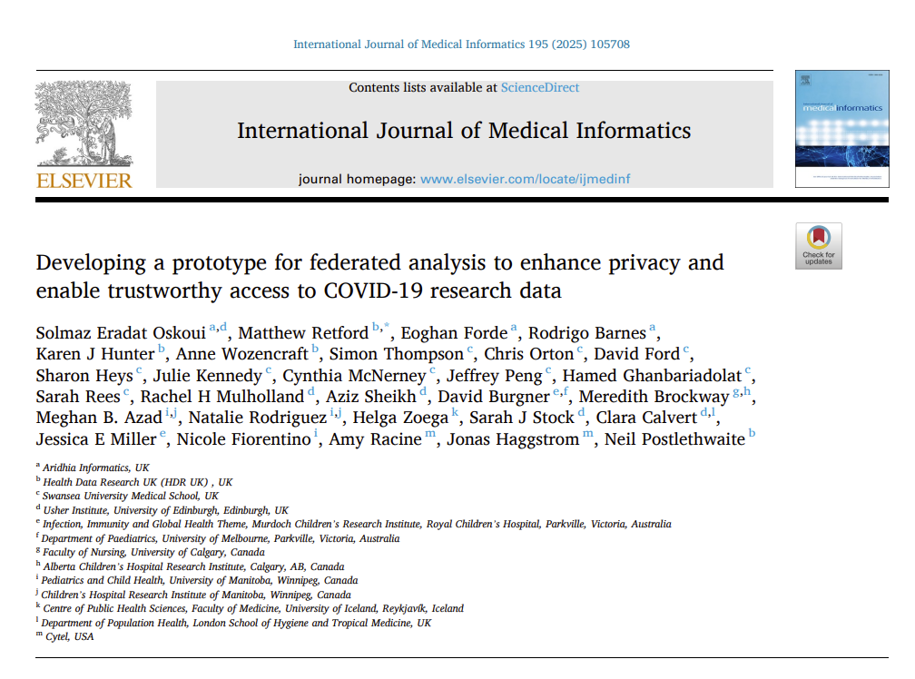
ICODA
Aridhia was a partner in the International Covid-19 Data Alliance
A successful multi-national collaboration bringing together academia and industry
The paper opposite was published this year detailing the project and its outcomes:
https://doi.org/10.1016/j.ijmedinf.2024.105708

Slide 20
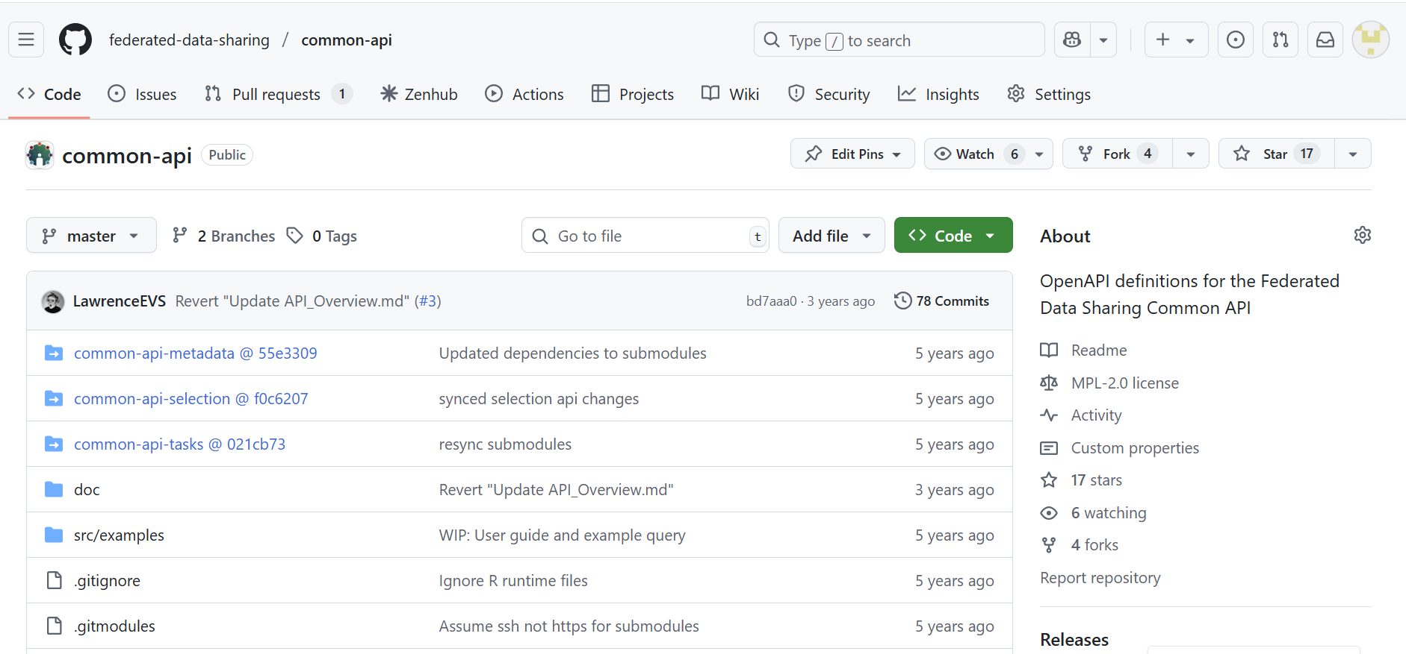
ICODA: Common API
Beyond the scientific impact the most important outcome was the Common API
An open-source specification for a federated data sharing API
https://github.com/federated-data-sharing/common-api

Slide 21



ADDI and RMH
ADDI and the FDSA:
ADDI are one of our longest standing customers, the Aridhia DRE is the backbone of their AD Workbench
They developed the FDSA, a data federation project based on the common API. Deployed versions of this can be easily integrated with the DRE
RMH and Vantage6:
RMH are participants in DigiCore a Europe-wide oncology data project.
They are using a DRE workspace to host their Vantage6 node.

Slide 22
PHEMS
The Paediatric Health Data Space

Slide 23
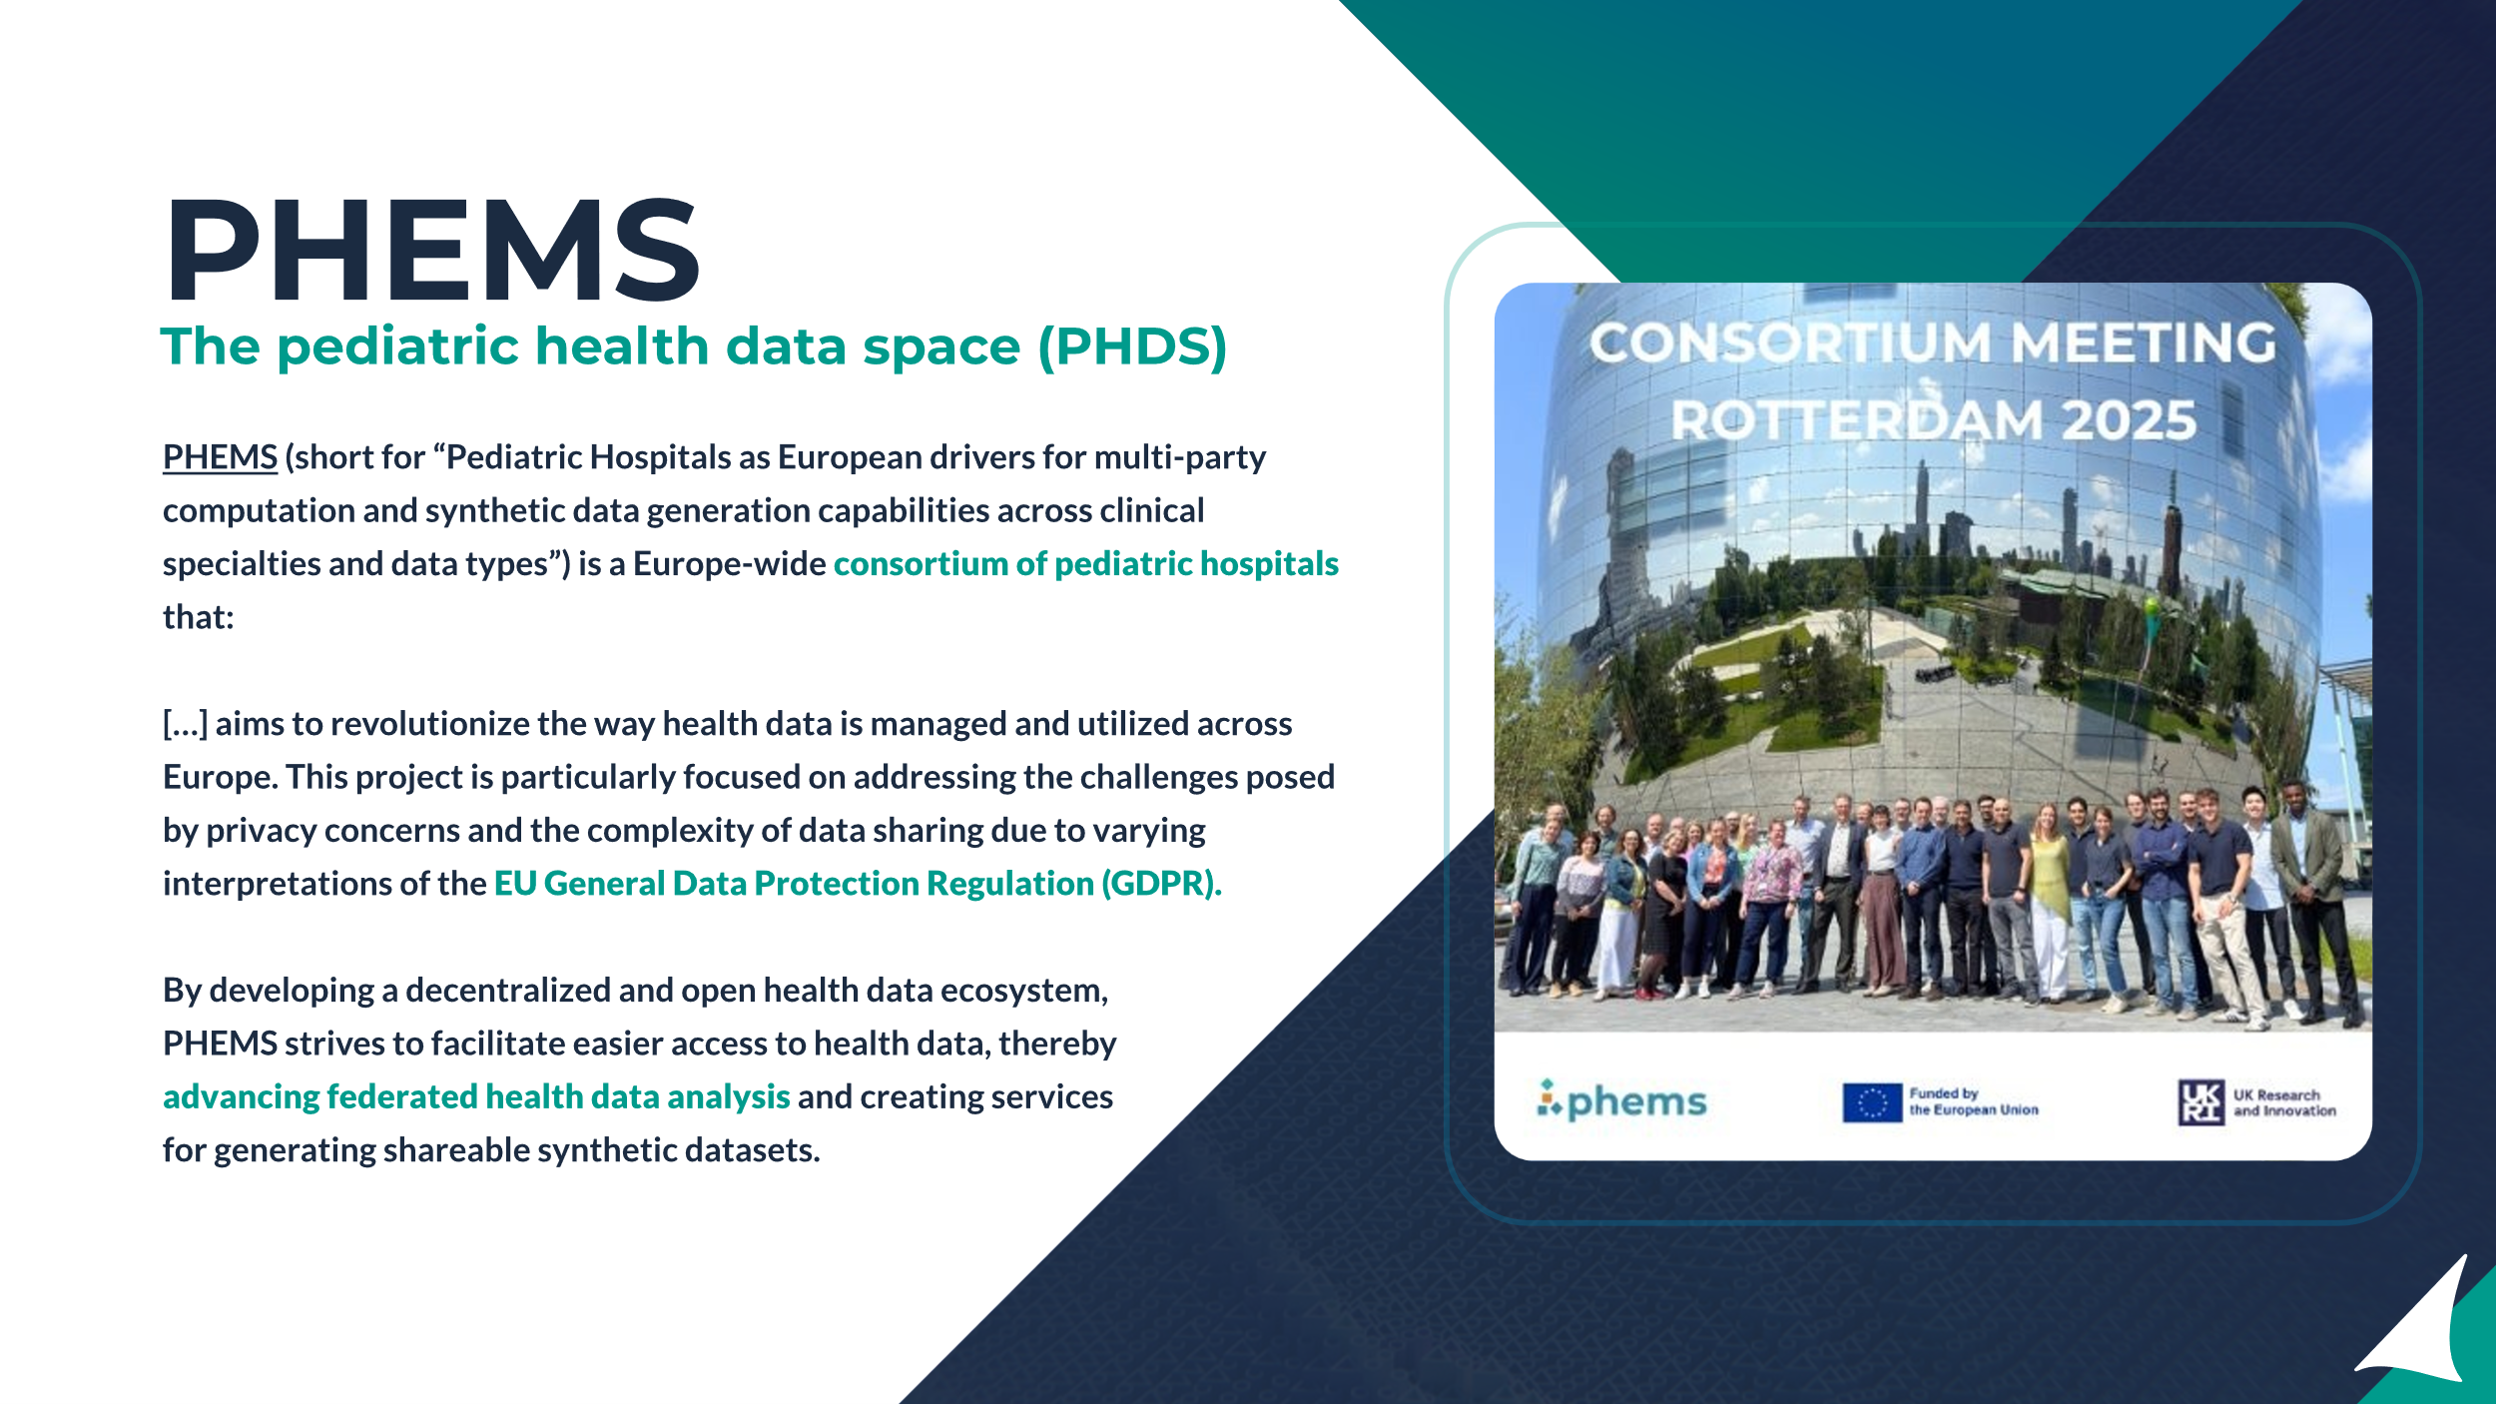

Slide 24

PHEMS federated use cases
1
2
Federated
Analysis
Federated
Learning
Hospitals in the PHEMS network to share benchmarking data for clinical outcomes​.
The first version of this is now live.
Hospitals in the PHEMS network pool their data to train machine learning (ML) models. ​
Further design and development work is required to meet this use case.

Slide 25
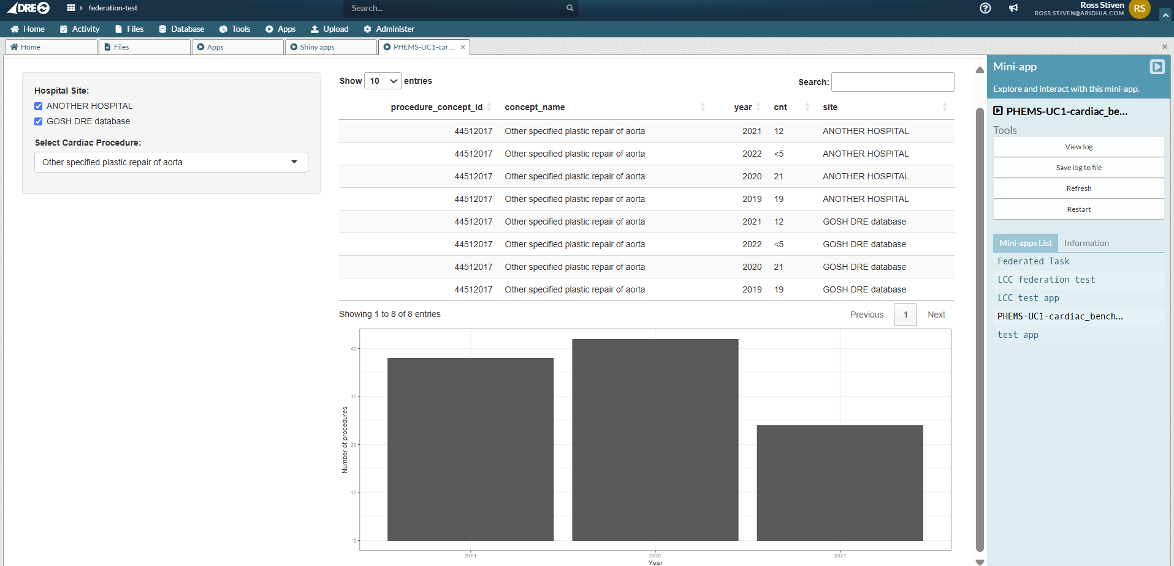
PHEMS Use Case 1
Hosted in the DRE

Slide 26
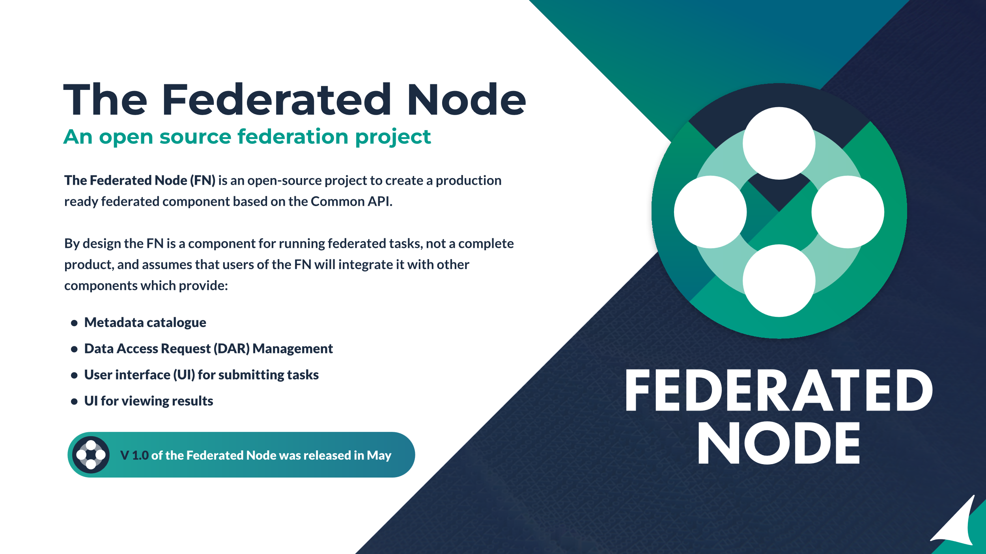

Slide 27
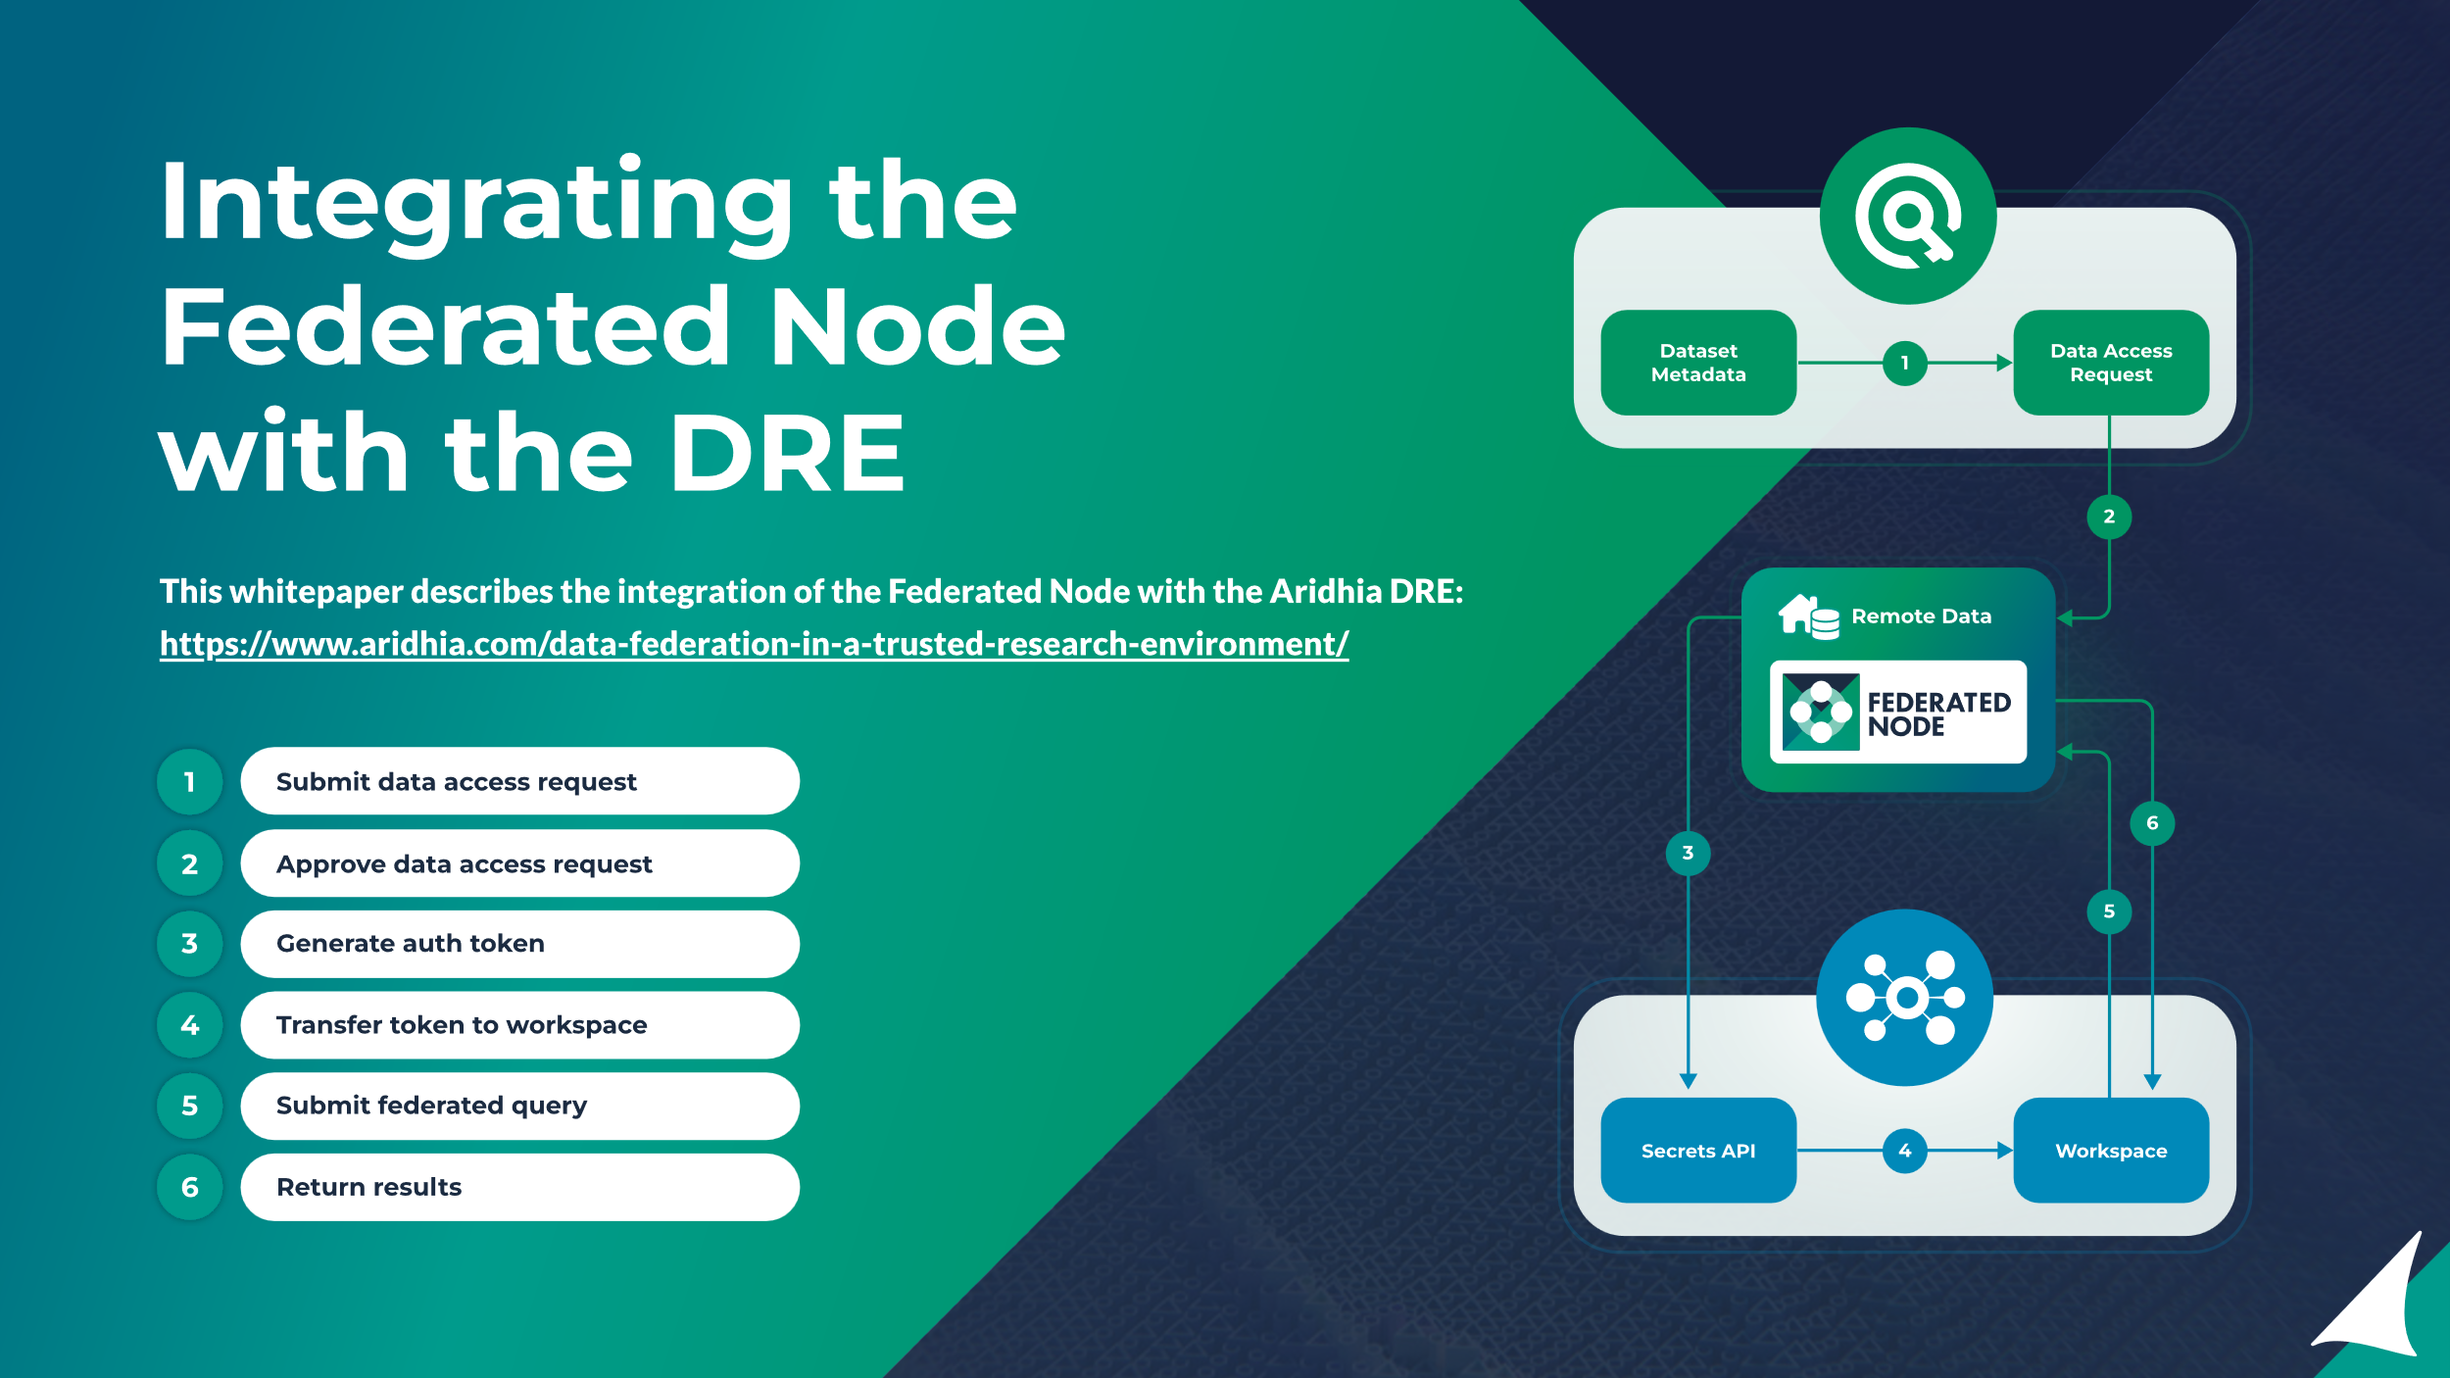

Slide 28
The Challenges of Federation

Slide 29
The Challenges of Data Federation
Four problems
Skills
Capacity
Trust and Security
Bureaucracy

Slide 30
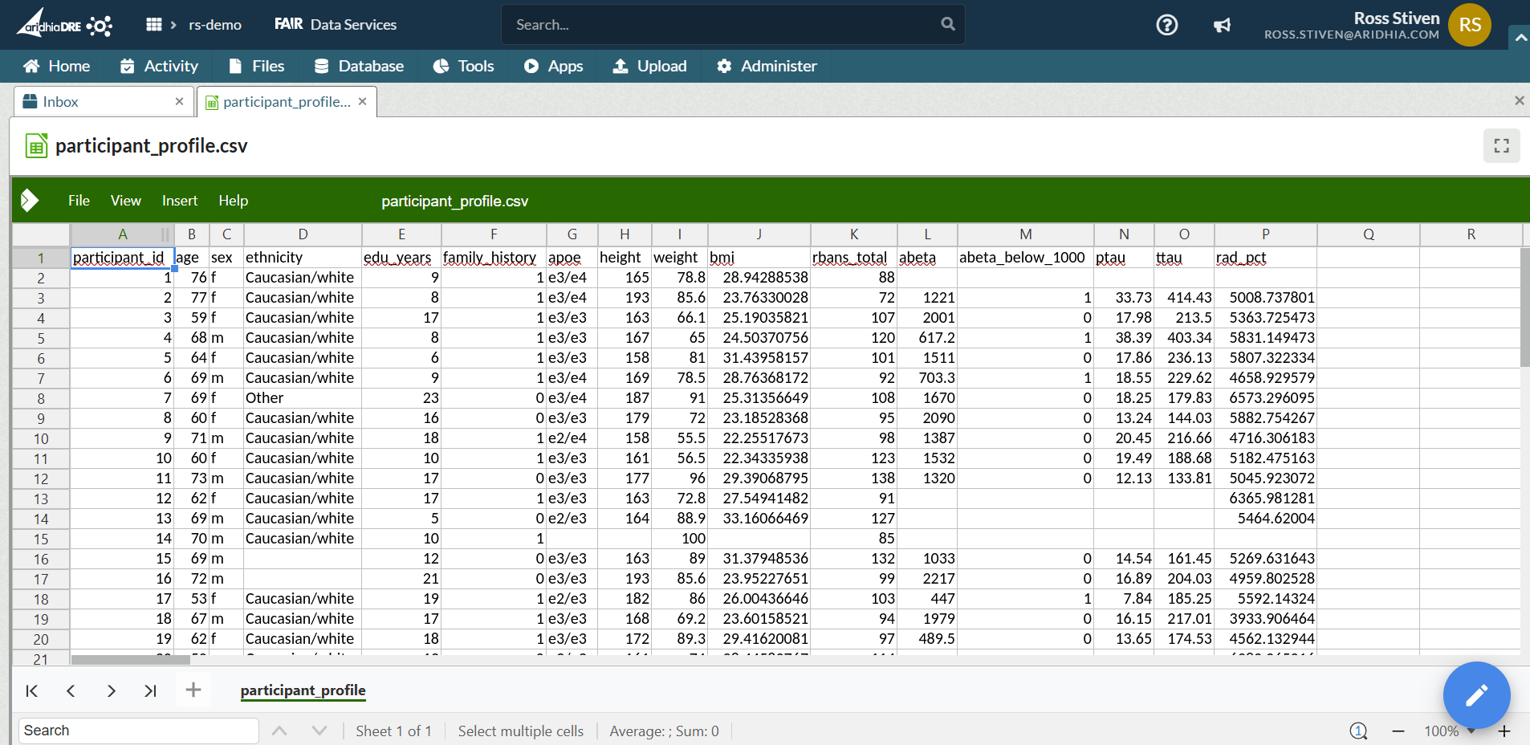
Skills

Slide 31
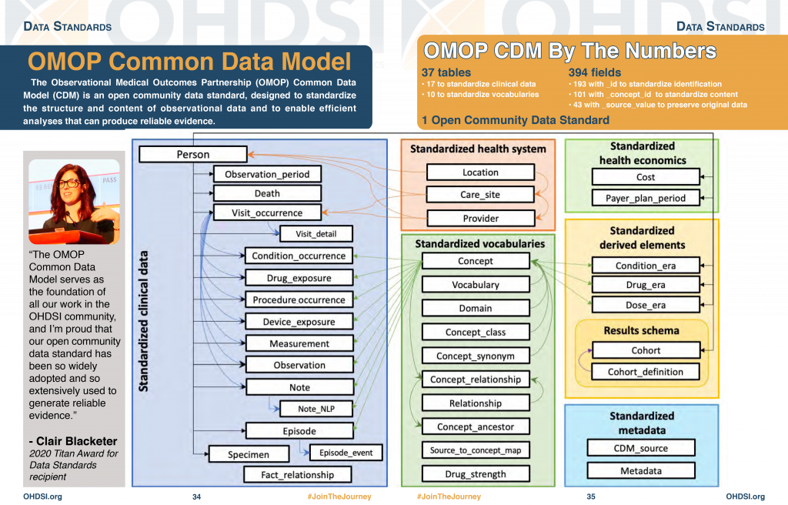
Capacity

Slide 32
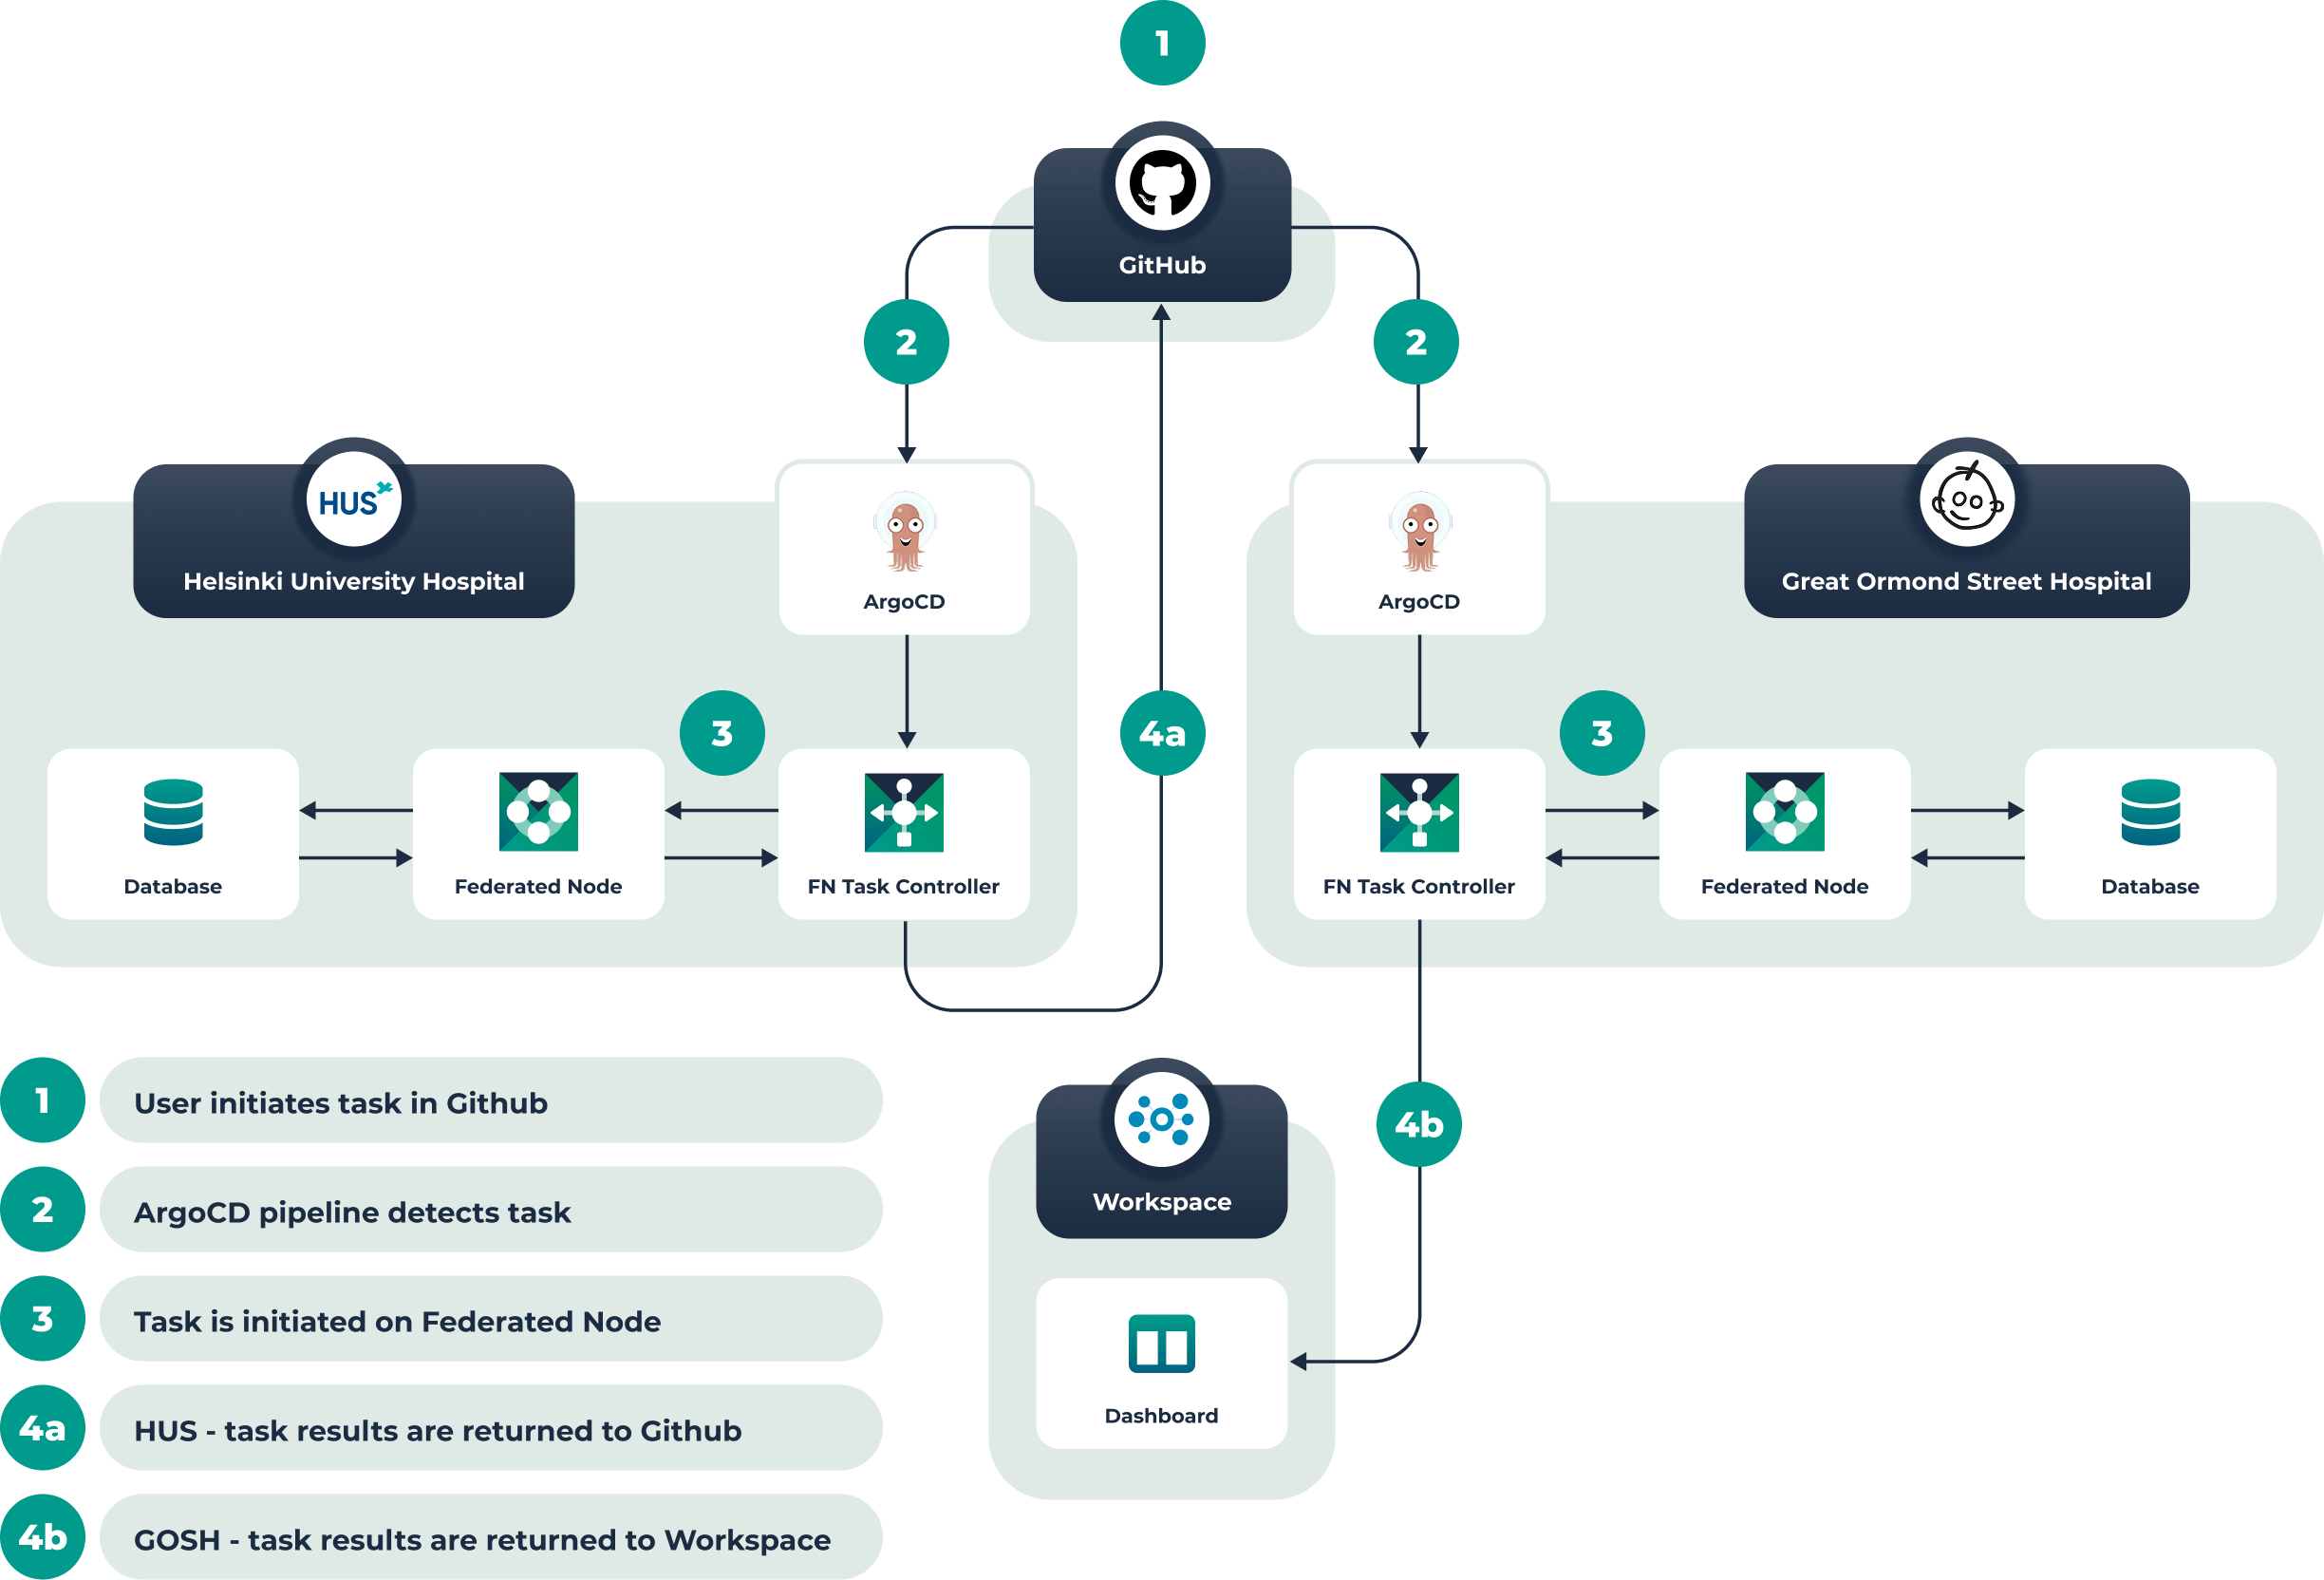
Trust and Security
The PHEMS MVP Network
The core PHEMS network has three main components:
• A central GitHub organisation which is used to manage the analytical code and initiate tasks
• Federated Nodes deployed to participating hospitals, in this case GOSH and HUS
• A workspace for delivering the results provided by Aridhia

Slide 33
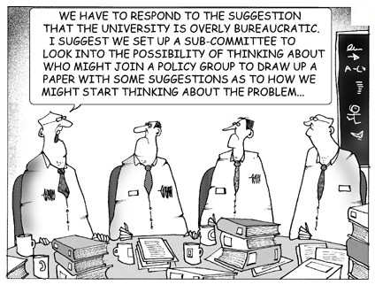
Bureaucracy
Data sharing permission
Infrastructure set up

Slide 34
Summarising the challenges of data federation
Four problems redux
Skills
some proportion of the target user base lacks the skills to adopt data federation
Capacity
our target users do not have the capacity to quickly meet all the pre-requisites for successful federation, with data harmonisation a particular bottleneck
Trust and Security
lack of trust between partner organisations, and a consequent difficulty agreeing on acceptable levels of security
Bureaucracy
the slow grind of providing appropriate infrastructure and making data available

Slide 35
Federation in a TRE
Providing a solution

Slide 36
Solutions
Fixing our four problems
Skills
lowering barriers to entry with low and no code workflows with generative AI assistance
Capacity
providing data owners with a secure environment and appropriate tooling for data harmonisation
Trust and Security
open standards and independent accreditation
Bureaucracy
comparing the experience of the PHEMS partners

Slide 37




AI Assistance
I’M SORRY ROSS.
I’M AFRAID I CAN’T DO THAT.

Slide 38





AIRA: The DRE AI Framework
Integrating Gen AI in the analytical workflow
The AIRA framework allows workspace owners to deploy their own offline LLM or SLM models into their workspace to assist with their data analysis
Users can use these to generate code by providing natural language prompts:
“Write me an r script that will generate a box plot using the variables family history and years of education”

Slide 39
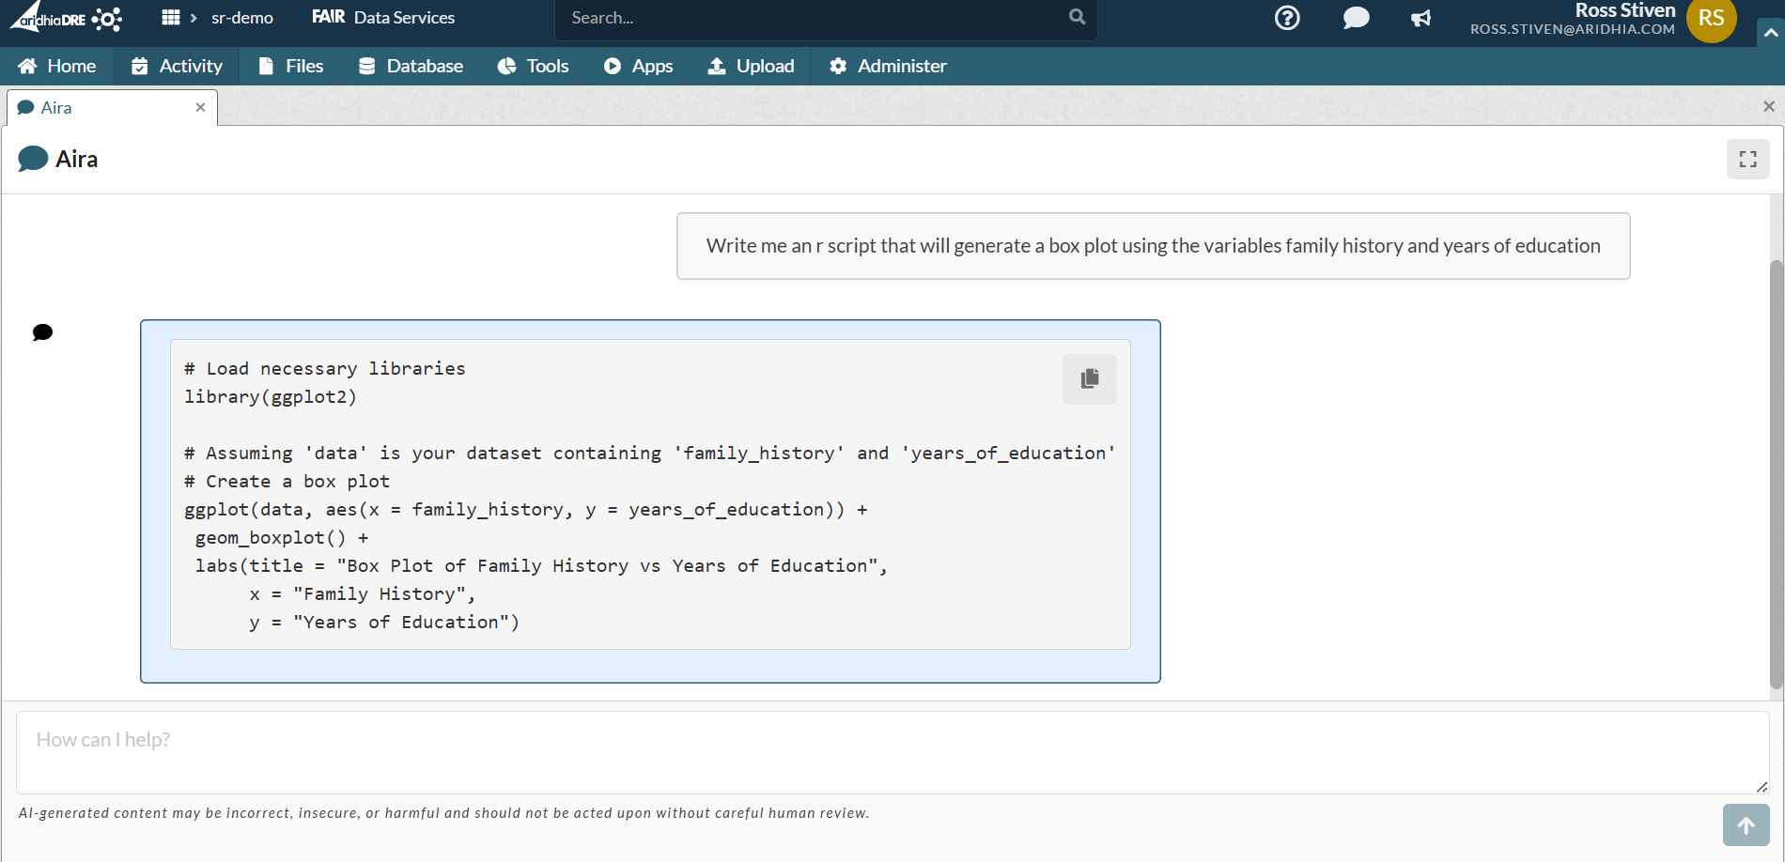
AIRA: The DRE AI Framework

Slide 40
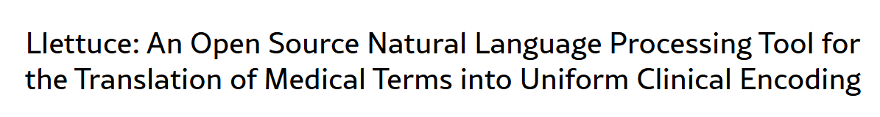


Capacity
We cannot solve this problem directly.
But we can ease the burden by providing secure curation workspaces with appropriate tooling.

Slide 41
Trust and Security
Open Standards and Independent Accreditation
The job of an information security team is not to provide detailed technical assessments of software.
It is to create high-level frameworks for their assessment, these depend on recognised open standards and trusted independent accreditors.

Slide 42




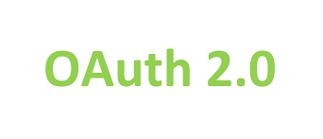


Trust and Security
Open Standards and components

Slide 43




Trust and Security
Independent Accreditation
Corporate InfoSec teams regard these as the gold standard.
Aridhia spends more than two thousand hours a year maintaining its accreditations. This does not include time spent managing the SDLC which is a necessary component of achieving accreditation.
An open-source software project cannot be accredited like this…
…but it can be integrated with a TRE which is.

Slide 44
Bureaucracy
A PHEMS Case Study
PHEMS has four founding partners, they are all using discrete infrastructure to join the network.
Two partners are doing this through their central IT teams.
The other two are not...

Slide 45
Bureaucracy
GOSH and PHEMS
GOSH are one of the founding partners of PHEMS.
They are also long-term users of the DRE.
Their data team has delegated authority to deploy tooling and data within their DRE.
Once the data was harmonised this allowed them to stand up their Federated Node and associated data in a few hours.

Slide 46
A Federated
TRE
Our current workflow

Slide 47
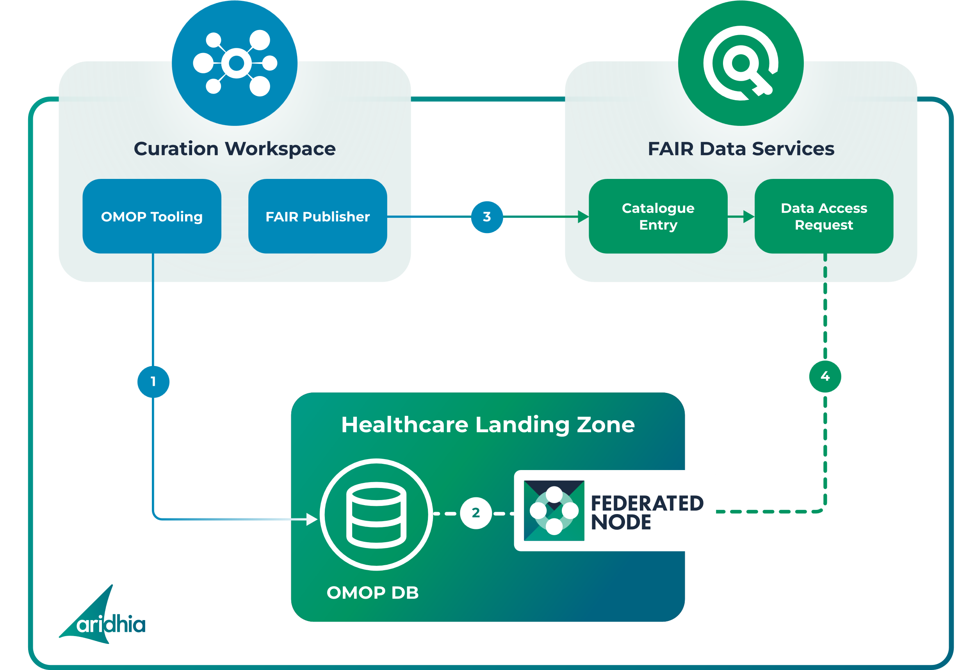
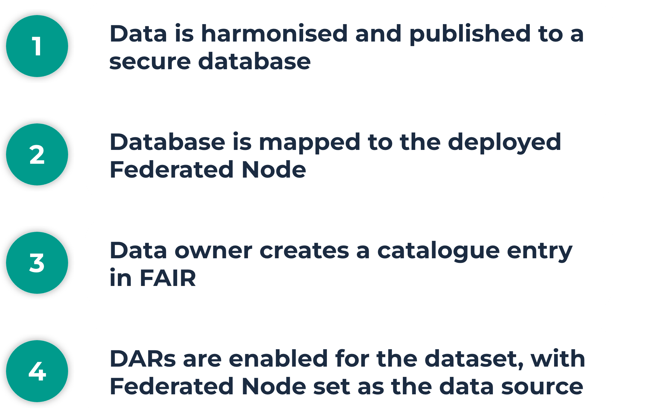
Data Owners
Harmonising data and making it available
Data Owners
Harmonising data & making it available

Slide 48
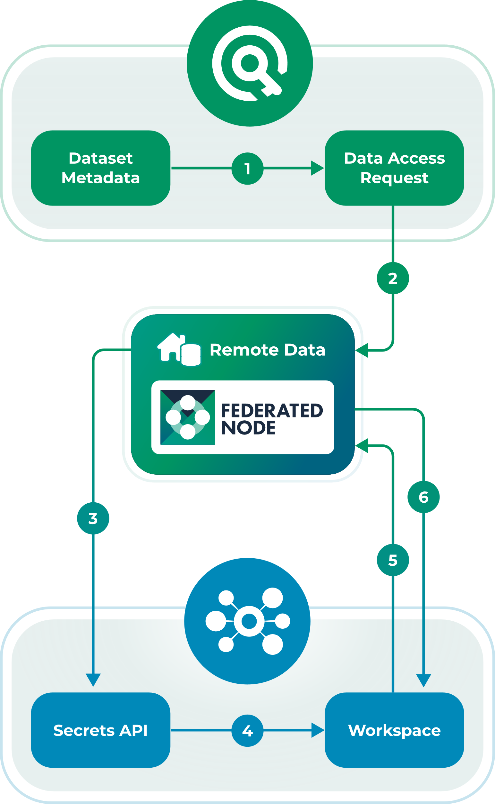
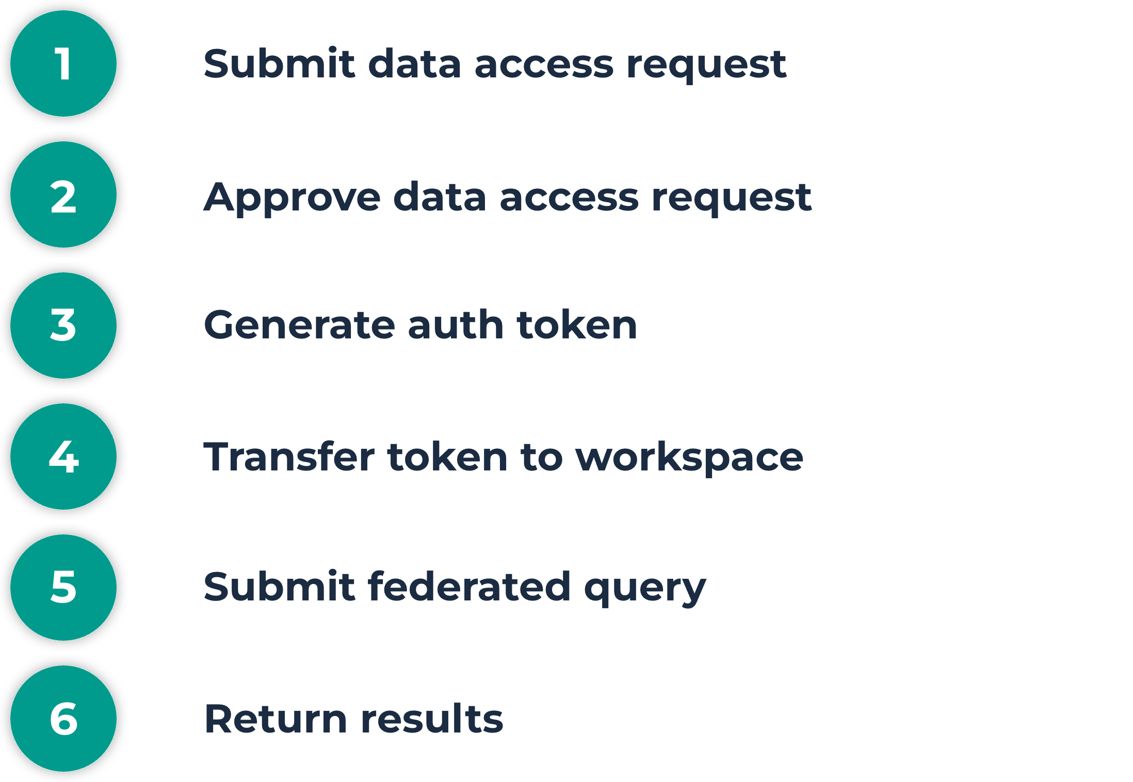
Reuse existing FN diagram for requests etc
Data Analysts
Requesting data and running queries

Slide 49
What’s Next?
Future developments

Slide 50
Upcoming Federation Projects
Further development of the Federated Node
Introducing a machine learning capability to the FN. This is primarily driven by our involvement in PHEMS and enabling their second use case
DRE as an aggregation point for federated ML
Explore running this in the opposite direction with a Federated ML framework, running the central server in a workspace which controls externally hosted nodes.
The GA4GH Task Execution Service
We’re involved in a DARE UK project to test running the GA4GH TES in secure workspaces. The success or failure of this will probably determine the feasibility of the previous task.
Federated AI…

Slide 51
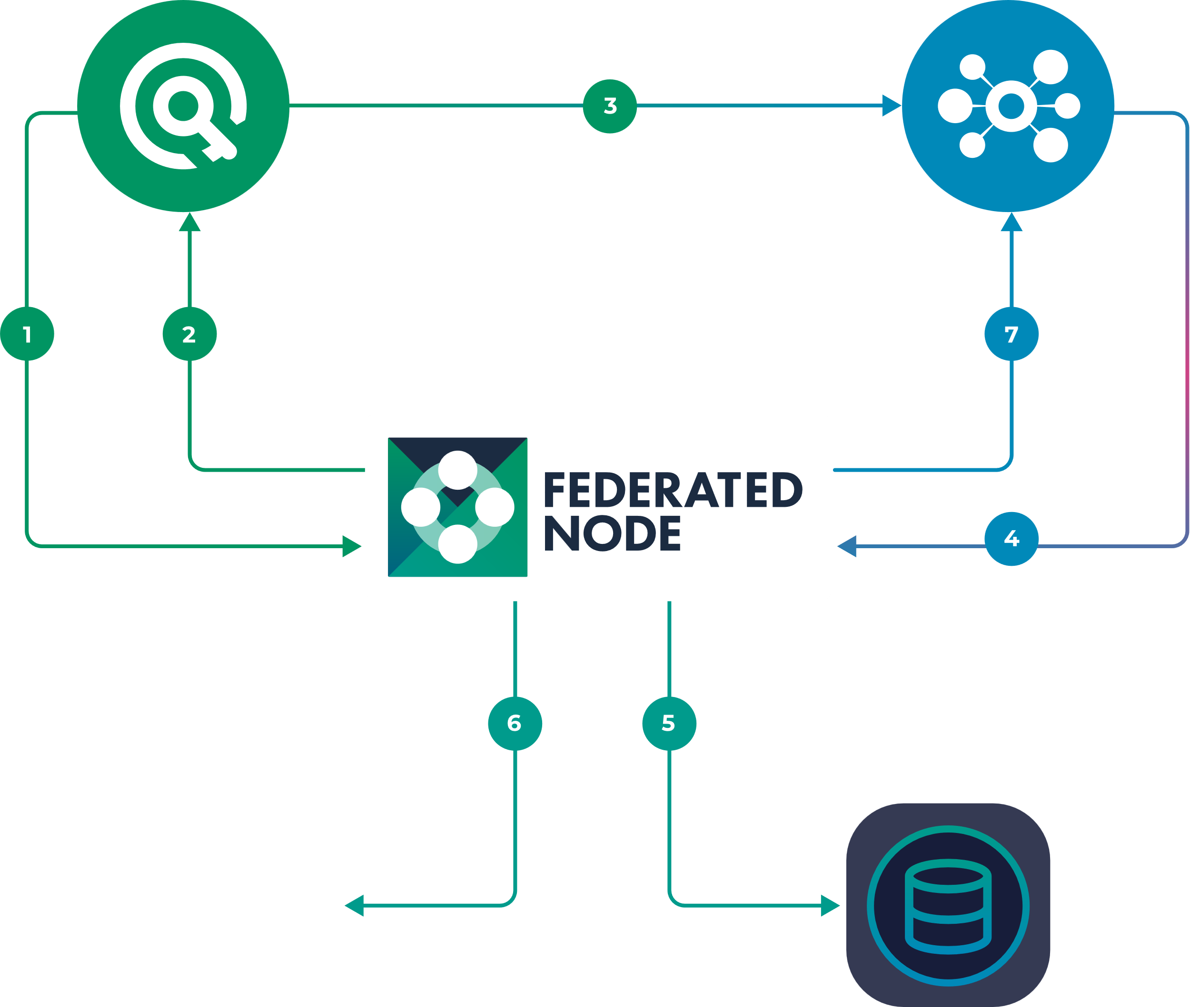
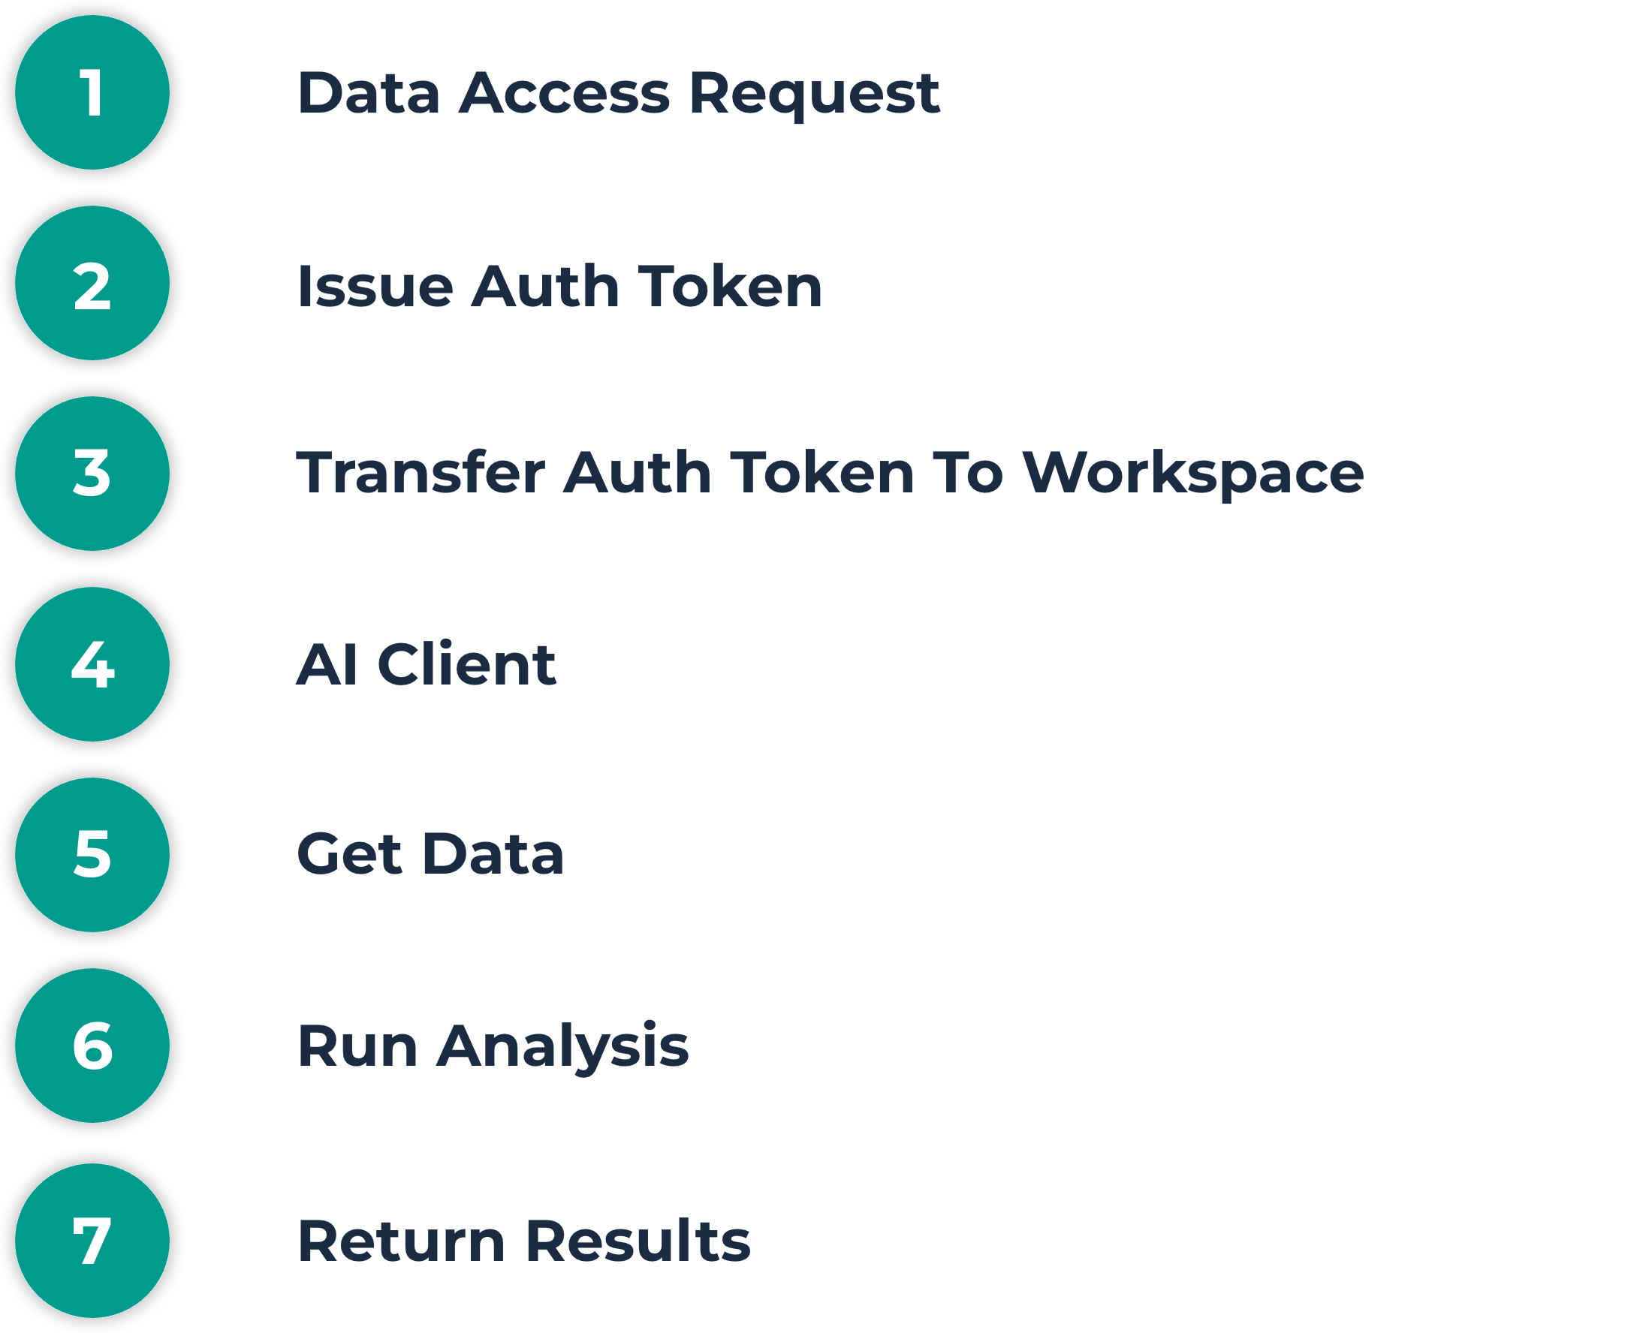

Deploying AI with a Federated Node
FAIR
Workspaces
Prompt to AI Client:
“Give me a scatterplot for dataset A with column1 as x-axis and column 2 as y-axis”
AI Server
Dataset

Slide 52
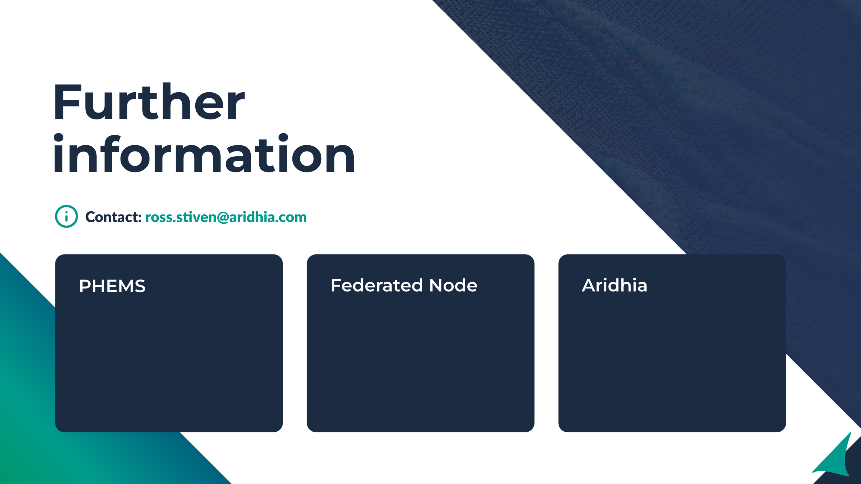
https://phems.eu/
https://www.youtube.com/@PHEMS_EUProject
https://github.com/Aridhia-Open-Source/PHEMS_federated_node
https://www.aridhia.com/data-federation/
https://www.aridhia.com/data-federation-in-a-trusted-research-environment/

Slide 53

www.aridhia.com | info@aridhia.com

