Slide 1



Enriching textual data from digital libraries
Boris Lehečka, lehecka@mzk.cz, boris@daliboris.cz
TEI Conference 2025
16–19 Septemper 2025, Krakau
The paper was funded by the Institutional support for long term conceptual development of a research organization (The Moravian Library) by the Czech Ministry of Culture.

Slide 2
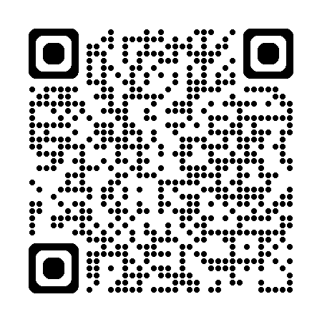
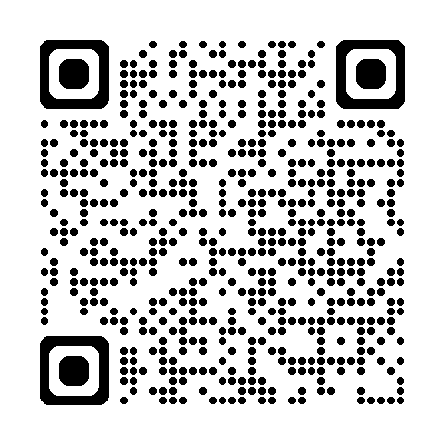
Presentation
PowerPoint
https://bit.ly/tei-2025-demo
PDF
https://bit.ly/tei-2025-demo-PDF

Slide 3
Outline
TEI from digital libraries using server tools
  Kramerius+
  enrichement workflow
  DL4DH Feeder
TEI from digital libraries on desktop
  Libri augmentati
  Docker version

Slide 4
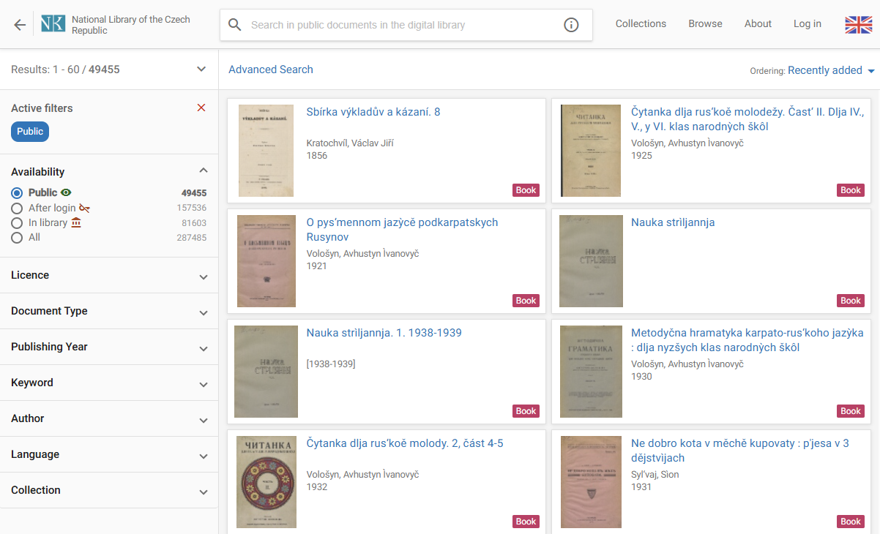
National Library of the Czech Republic, https://www.digitalniknihovna.cz/nkp/search

Slide 5
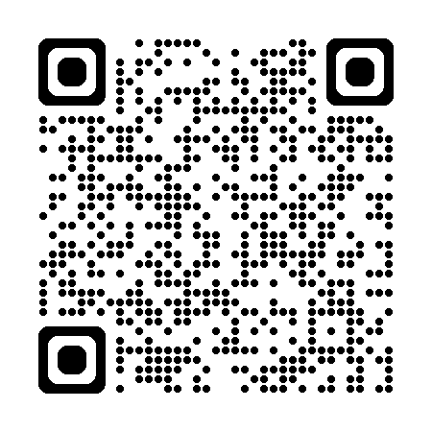
DL4DH Feeder
graphical interface for working with enriched data from digital library
  https://github.com/LIBCAS/DL4DH-Feeder

Slide 6
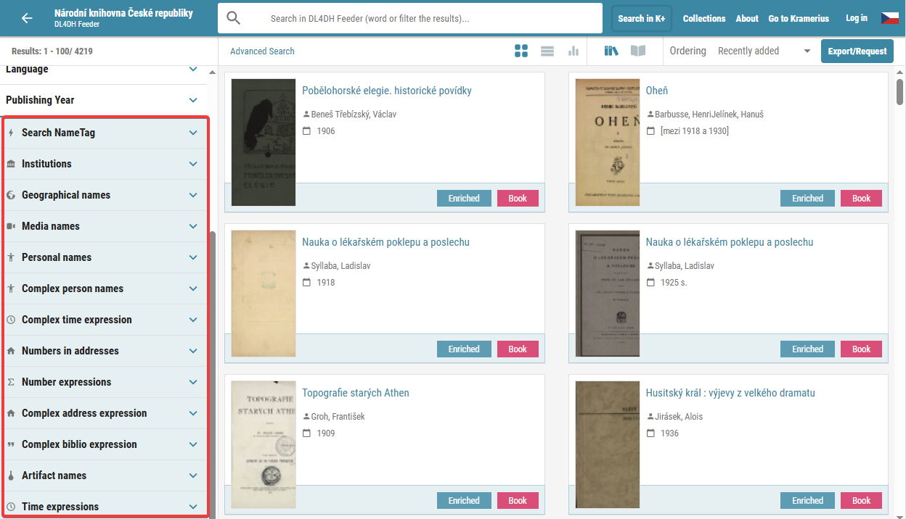
DL4DH Feeder, https://feeder.nkp.cz/search

Slide 7
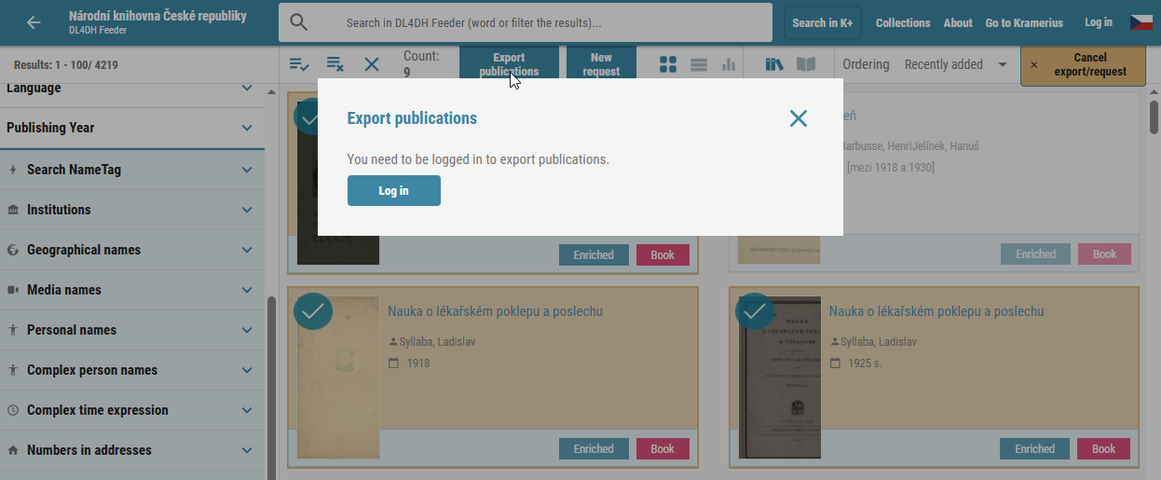
Export book(s), but only after logging in

Slide 8
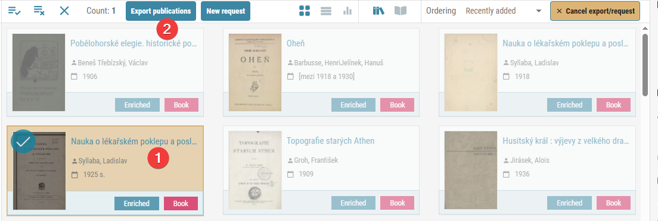
Select book(s) for export

Slide 9
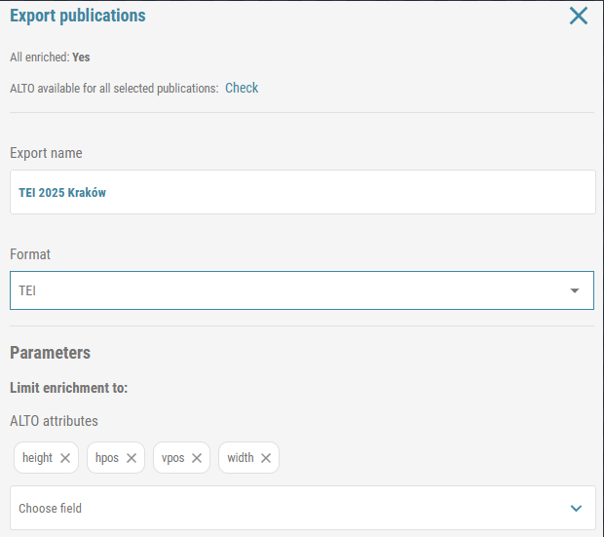
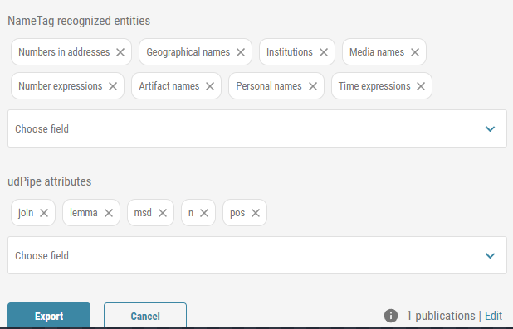
Export to TEI, choose parameters

Slide 10

Export request confirmation

Slide 11
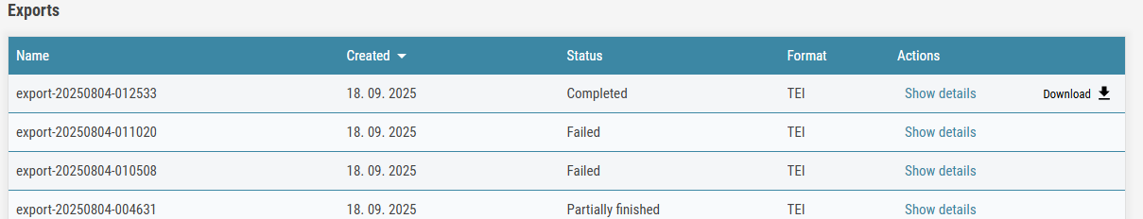
List of export requests

Slide 12
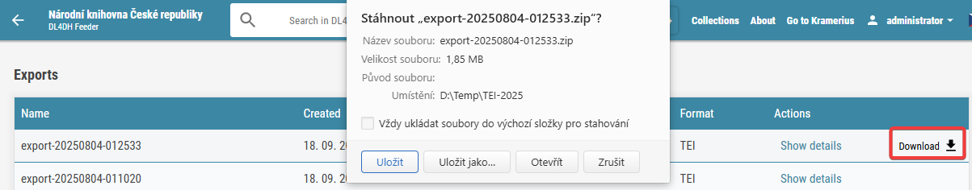
Donwload book(s) in TEI

Slide 13
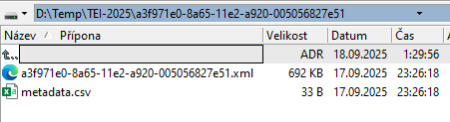
Content of the ZIP file

Slide 14
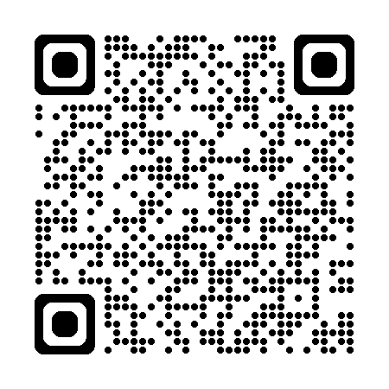
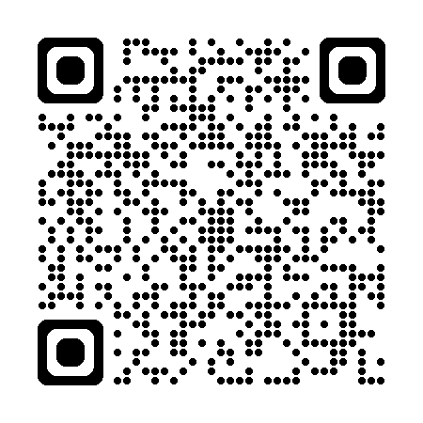
Kramerius+, DL4DH TEI Converter
web application for enrichement administration
  enrichement
    NLP processing of the text
    lemmatization, morphosyntactic analysis, NER (named entity recognition)
  publication of enriched data (for users)
  processing enrichement requests (by users)
  https://github.com/LIBCAS/DL4DH-Kramerius-plus
DL4DH TEI Converter
  https://github.com/LIBCAS/DL4DH-TEI-Converter
  converts enriched data (server version connected with Kramerius instance)

Slide 15
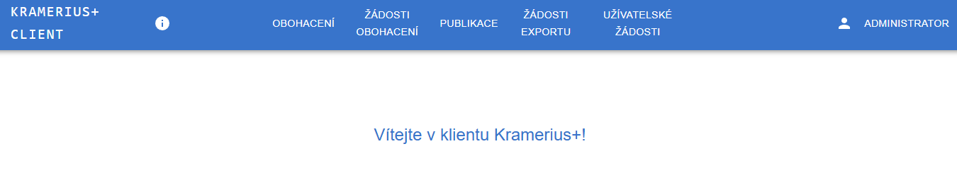
Kramerius+: enrichement administration

Slide 16
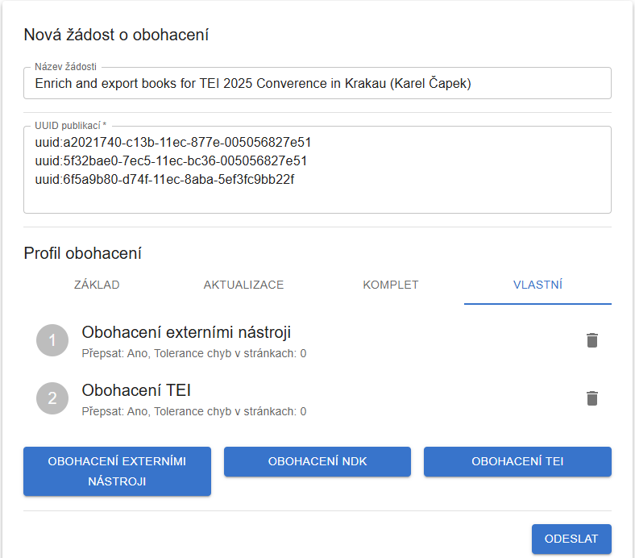
Create enrichement and export to TEI resquest

Slide 17
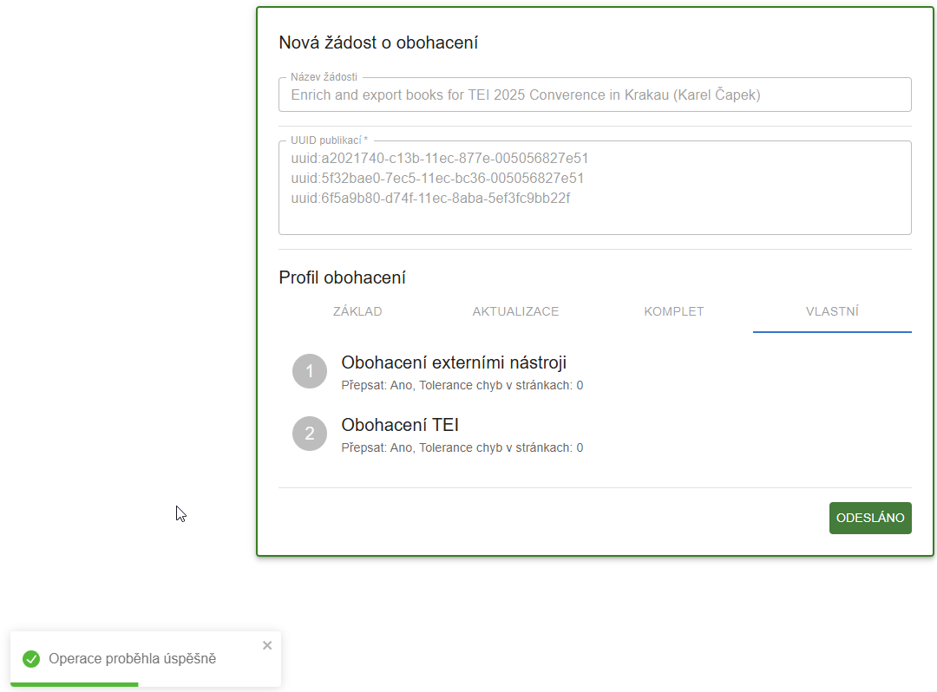
Request created

Slide 18
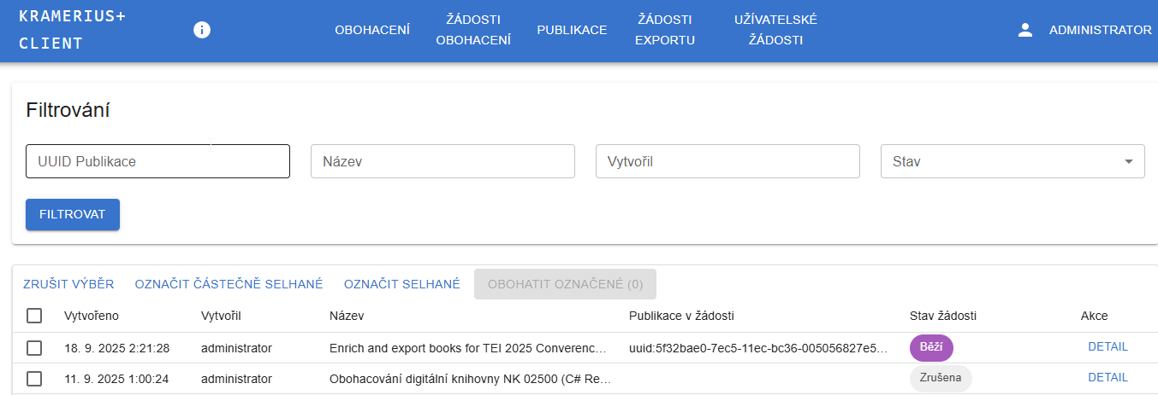
Existing requests

Slide 19
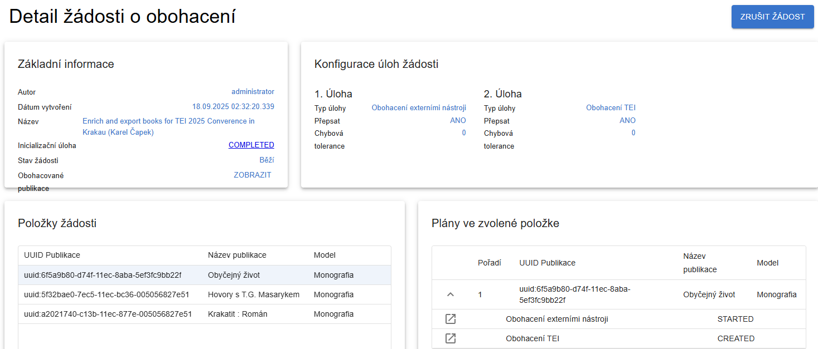
Request details

Slide 20
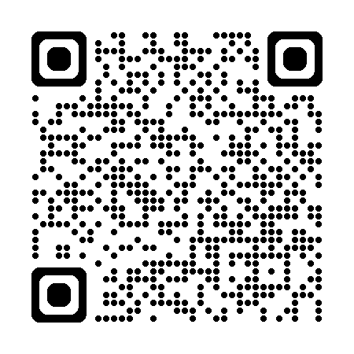
Libri augmentati
grabs (meta)data from digital library
enriches text using external services
converts all to TEI
programmed in XProc 3.0 (https://xproc.org)
https://github.com/moravianlibrary/libri-augmentati
Docker image available
  https://hub.docker.com/r/daliboris/libri-augmentati

Slide 21
Run Docker image
docker run -it --rm --volume D:\TEI-2025\Libri-augmentati:/data daliboris/libri-augmentati:latest
  -it = interactive mode
  --rm = remove Docker container after exit
  D:\TEI-2025\Libri-augmentati = path on my computer where I want store enriched data
  /data = path in Docker container where enriched data will be stored (can't be changed)
  daliboris/libri-augmentati:latest = identifier of the Docker image with Libri augmentati application

Slide 22
Use Libri augmentati
use following prompt
  Morgana.sh -config=/config/config.xml /la/run/client.xpl -option:library-code=mzk -option:api-version=7 -option:output-directory=/data/tei-conference -option:document-resources="MODS DC FOXML" -option:page-resources="ALTO TEXT FOXML DC MODS IMAGE" -option:document-id=uuid:de87a0e0-643b-11ea-a744-005056827e51 -option:nickname=postural-defects -indent-errors

Slide 23
Explanation of parameters
Morgana.sh
  main script that runs XProc pipeline
-config=/config/config.xml
  base configuration used by MorganaXProc-IIIse engine
/la/run/client.xpl
  main pipeline for request processing
-option:library-code=mzk
  abbreviation of digital library where publications are stored
-option:api-version=7
  version of Kramerius (API) used by digital library

Slide 24
Explanation of parameters – cont.
-option:output-directory=/data/tei-conference
  where final data and reports are stored (should be in /data/ directory)
-option:document-resources="MODS DC FOXML"
  which metadata for the entire document should be downloaded
-option:page-resources="ALTO TEXT FOXML DC MODS IMAGE"
  which metadata for individual pages should be downloaded
-option:document-id=uuid:de87a0e0-643b-11ea-a744-005056827e51
  identifier of the digital book to be downloaded
-option:nickname=postural-defects
  nick name for the book (report and directory with this name will be created)

Slide 25
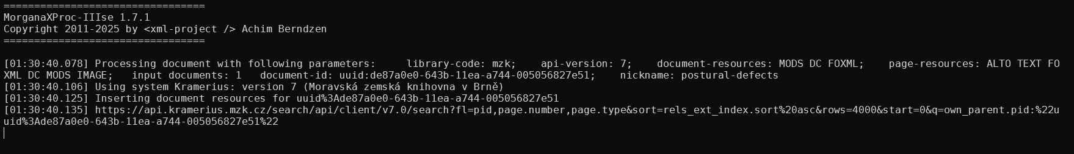
Request processing

Slide 26
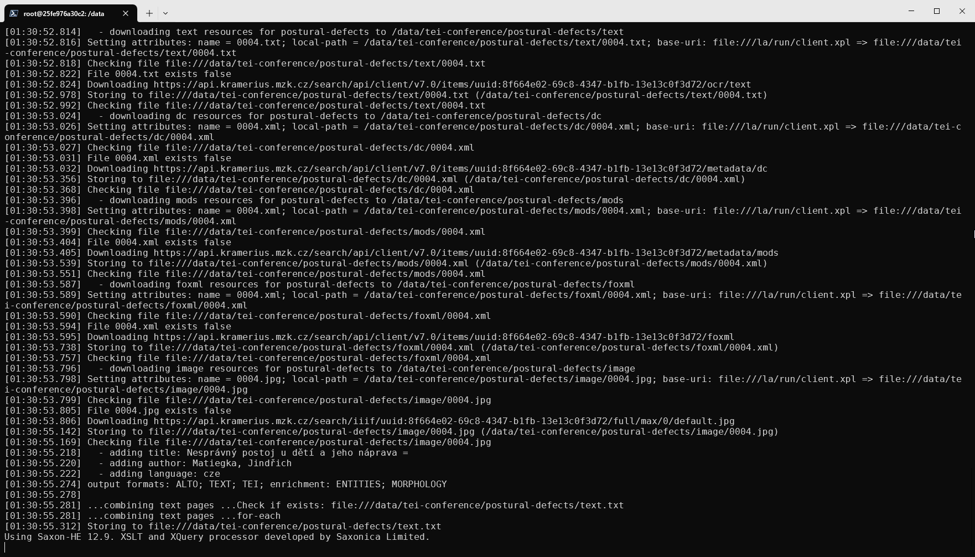

Slide 27
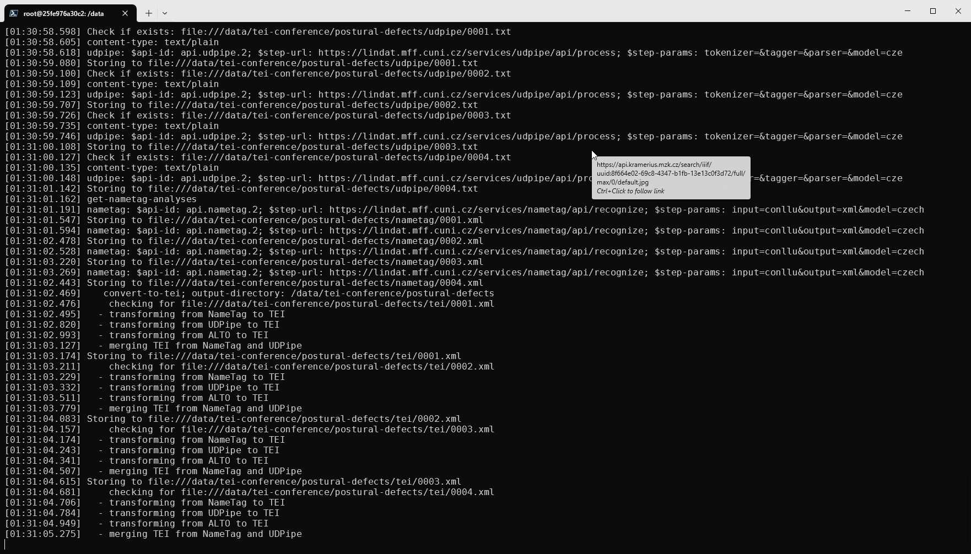

Slide 28
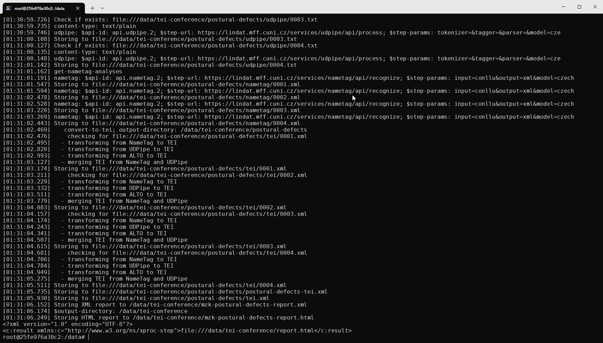

Slide 29
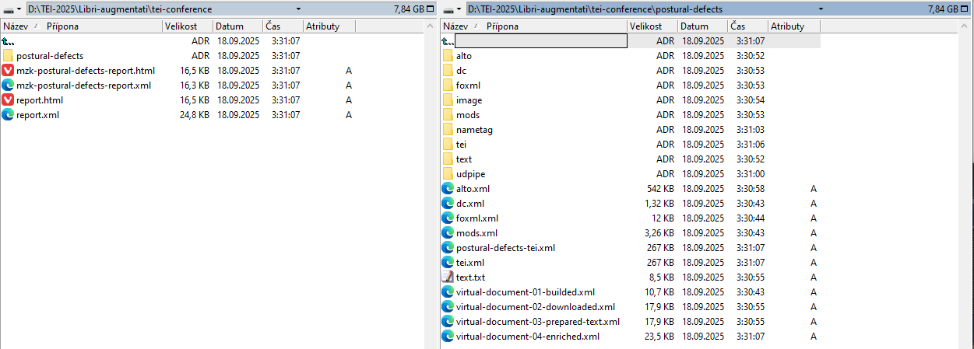
Results (in main directory and subdirectories)

Slide 30
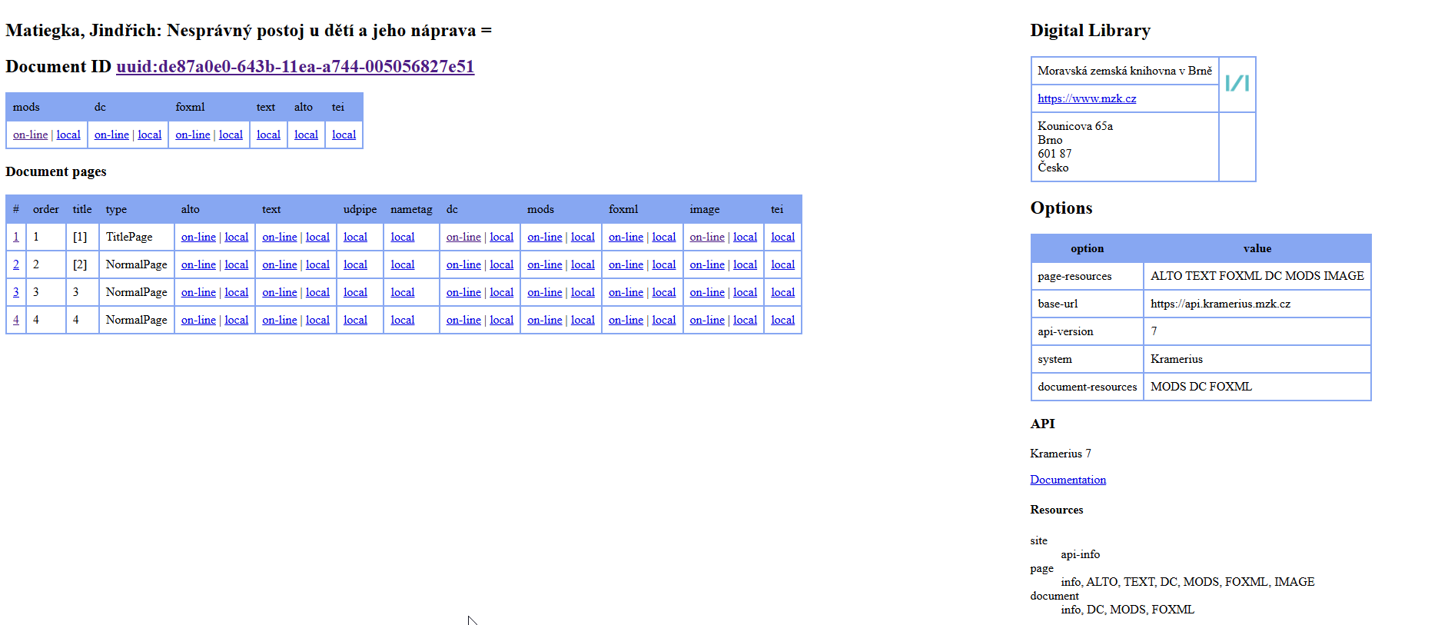
Report

Slide 31
Thank you!
Boris Lehečka
  lehecka@mzk.cz, boris@daliboris.cz
  Moravian Library
  Freelancer

