Slide 1
RSQKit (WP2/TF1)
Shoaib Sufi (UNIMAN, UK)
Aleksandra Nenadic (UNIMAN, UK)
Patrick Bos (Netherlands eScience Center, NLeSC)
General Assembly Meeting
19-21 March 2025,Barcelona,Spain
This project has received funding from the European Union’s Horizon Europe Programme under GA 101129744 — EVERSE — HORIZON-INFRA-2023-EOSC-01-02

Slide 2
Part 1
Thu 20th March 2025 - 9:30 -11:00 Session #1 (16 pax): RSQkit update. Integration with other WPs (3,4,5), feedback & contentathon (Part 1)
RSQKit’s place in EVERSE
Demo
Update on progress
Understanding RSQKit architecture
Integration with different WP’s
Feedback session

Slide 3
RSQKit: Its place in EVERSE
To do / future
WP1 - Outreach
WP2 - Best practices
WP4 - Pilots & Drivers
Task 2.1
Landscape Analysis
Task 1.1 & 1.2 & 1.3
EVERSE Network & Science Communities & Other Orgs & Industry
Task 4.1
Software assessment in Science clusters
Promotion, Participation & use
?
WP3 - Tools and services
Task 4.2
Showcase of good practices in the pilots
Task 2.2 & TF1
RSQKit
Examples of use
Task 3.1
Technology watch: tools
Tools
Links to training
?
Task 5.1
Curate training resources
Task 3.2
Metadata & indicators
Task 2.3
Dimensions & Indicators
Dimensions & indicators
Links to
Informs
Task 5.2
Recognition framework for research software people
Task 3.3
Dashboard
WP5 - Training & credit
Task 5.3
Establish an RSQ training activity
WP6 - project oversight
Showing connections into & around RSQKit - not all connections in the project
Notes:
RSQKit serves as the central repository of knowledge and best practices for research software quality, and WP5 is the work package responsible for creating the educational resources that will help the research community understand and implement these best practices, with direct links and references to the information contained within the RSQKit.

Slide 4
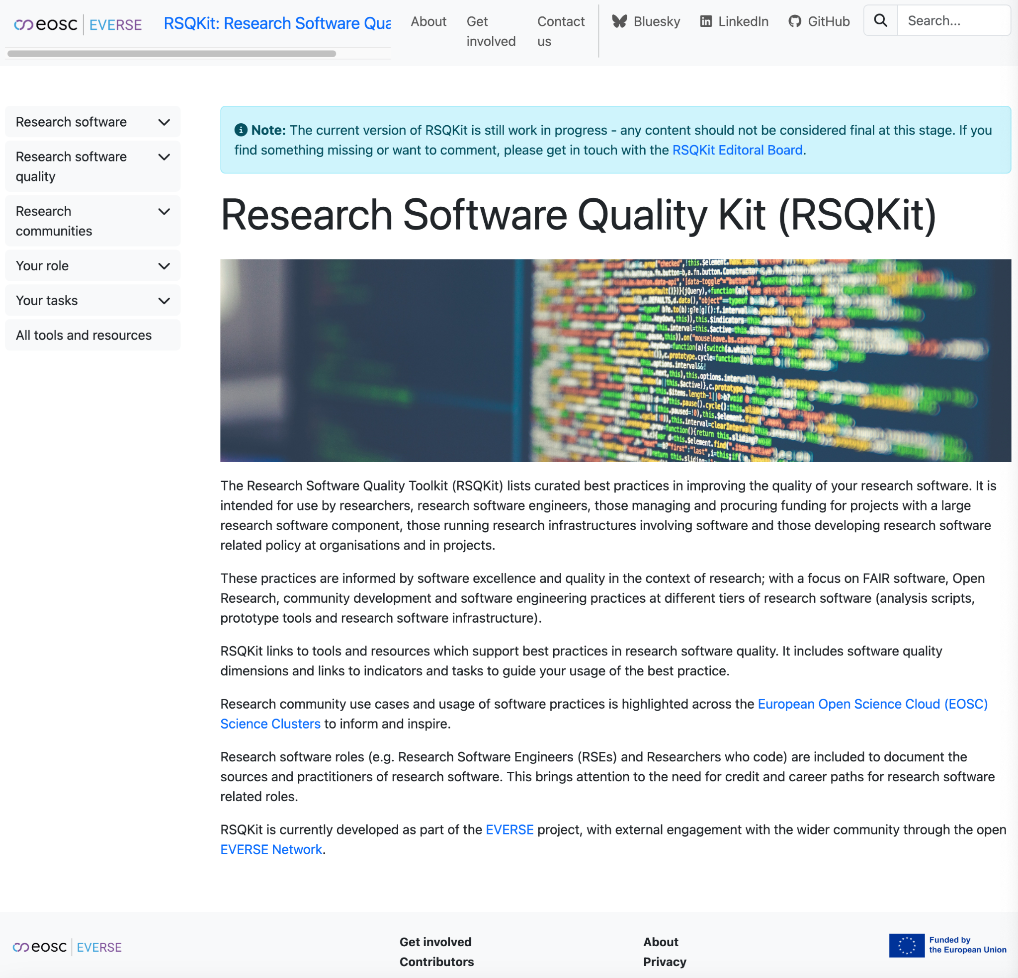
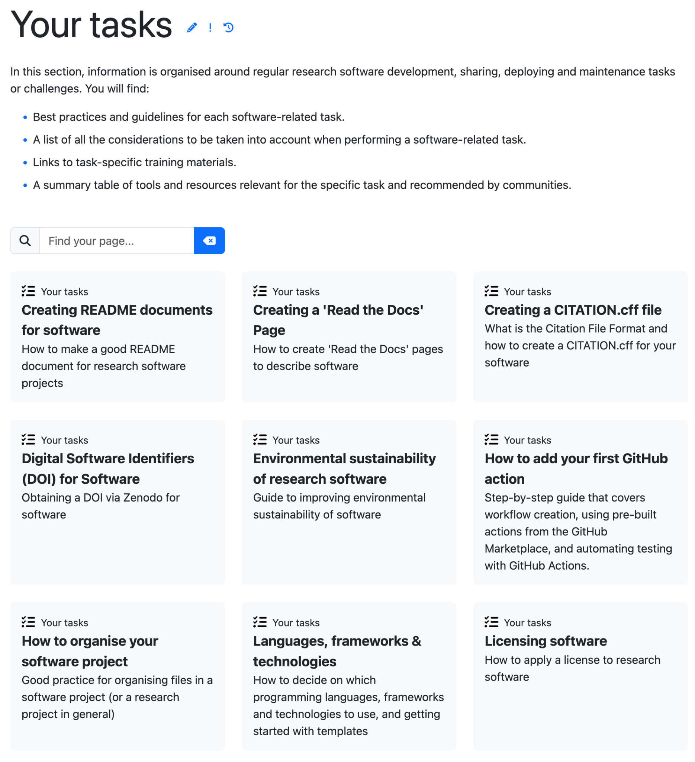
Demo: RSQKit
https://everse.software/RSQKit/
Notes:
In demo - talk what is there atm, can mention what will be there in the future - but that will be covered later in the slides

Slide 5
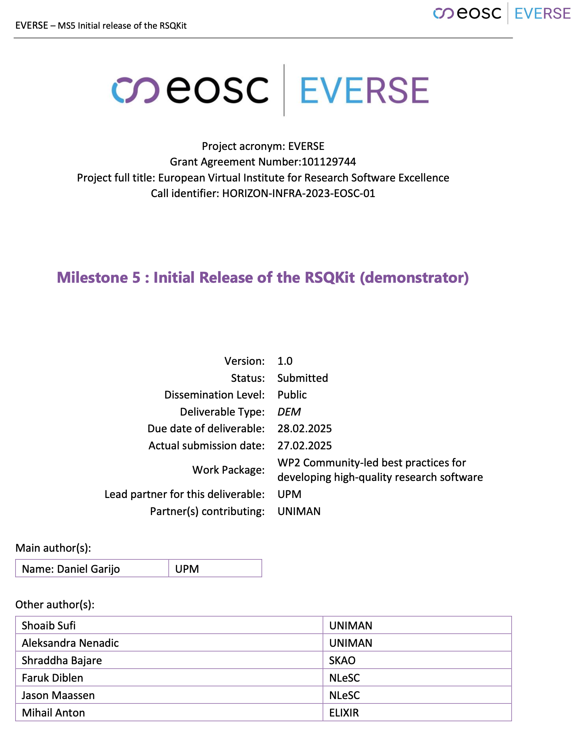
MS5, end of Feb 2025 (M12)- Initial Release of RSQKit
MS5_WP2_Initial Release of the RSQKit - https://zenodo.org/records/14978845
Setting up the infrastructure for RSQKit
  Based on - ETT - https://elixir-belgium.github.io/elixir-toolkit-theme/
Structuring of RSQKit
  Inspired by - RDMkit - https://rdmkit.elixir-europe.org/
Establishing the Editorial Board
  Meeting weekly - https://everse.software/RSQKit/contribution_guidelines
  Infrastructure, content checks, planning and integrations (Training/WP5)
Content
  Common tasks for research software quality from research software experts (in or related to the project)
  Topics identified & prioritised from wider engagement with project members
Allowing wider contributions
  Guidelines - https://everse.software/RSQKit/contribution_guidelines
  Templates (specifically tasks, communities)

Slide 6
The ‘Zen’ of RSQKit (ETT++): linkage & automagic
RSQKit
Scope
Research Communities
From ETT (Elixir Toolkit Theme)
  Tasks to Tools
  Tools to further information
  Task & Tool linkage to training registry (limited to TeSS)
  Related pages
RSQKit additions (the ++) - Future work
  Extending the training registries that are supported
  Presenting the link between dimensions & indicators with tasks and tools in a meaningful way
    Pathways?
  Connecting roles with tasks
Resources
(tool websites, references, tutorials, existing guidance)
Definitions
Research Software Communities
Roles
Contributors
Tasks
Institutions
Training registries
Tools
Dimensions & indicators
Work in progress / planning
Data
Content
External

Slide 7
RSQKit connection with WP1: EVERSE Network
Done (2025)
RSQKit featured in EVERSE Network Launch - 18th Feb 2025
RSQKit session at deRSE25 - 25th Feb 2025
  18 tickets
  9 pull requests
Upcoming
ELIXIR STEERS presentation series - RSQKit - 24th April
Planned
CW25 workshop proposal submitted - 13-15th May 2025
EVERSE Network webinar series - April/May ?
Future
Will become a feature of events
  Raise awareness & use
  Open for for input & contributions
  Contentathon’s / Hacks
  Editorial Board happy to support
Messaging (what we learnt so far)
  Clarity on what RSQKit is and who it is for should be available early on to set the scene
  More templates for different pages
    Comments and content on
      Pages (task, research stories, software communities)
      Resources (tools, training)
  Engagement levels can vary
What events or other opportunities are there to promote RSQKit ?
Does WP1 have any requirements for RSQKit? (e.g. to make it easier to promote)

Slide 8
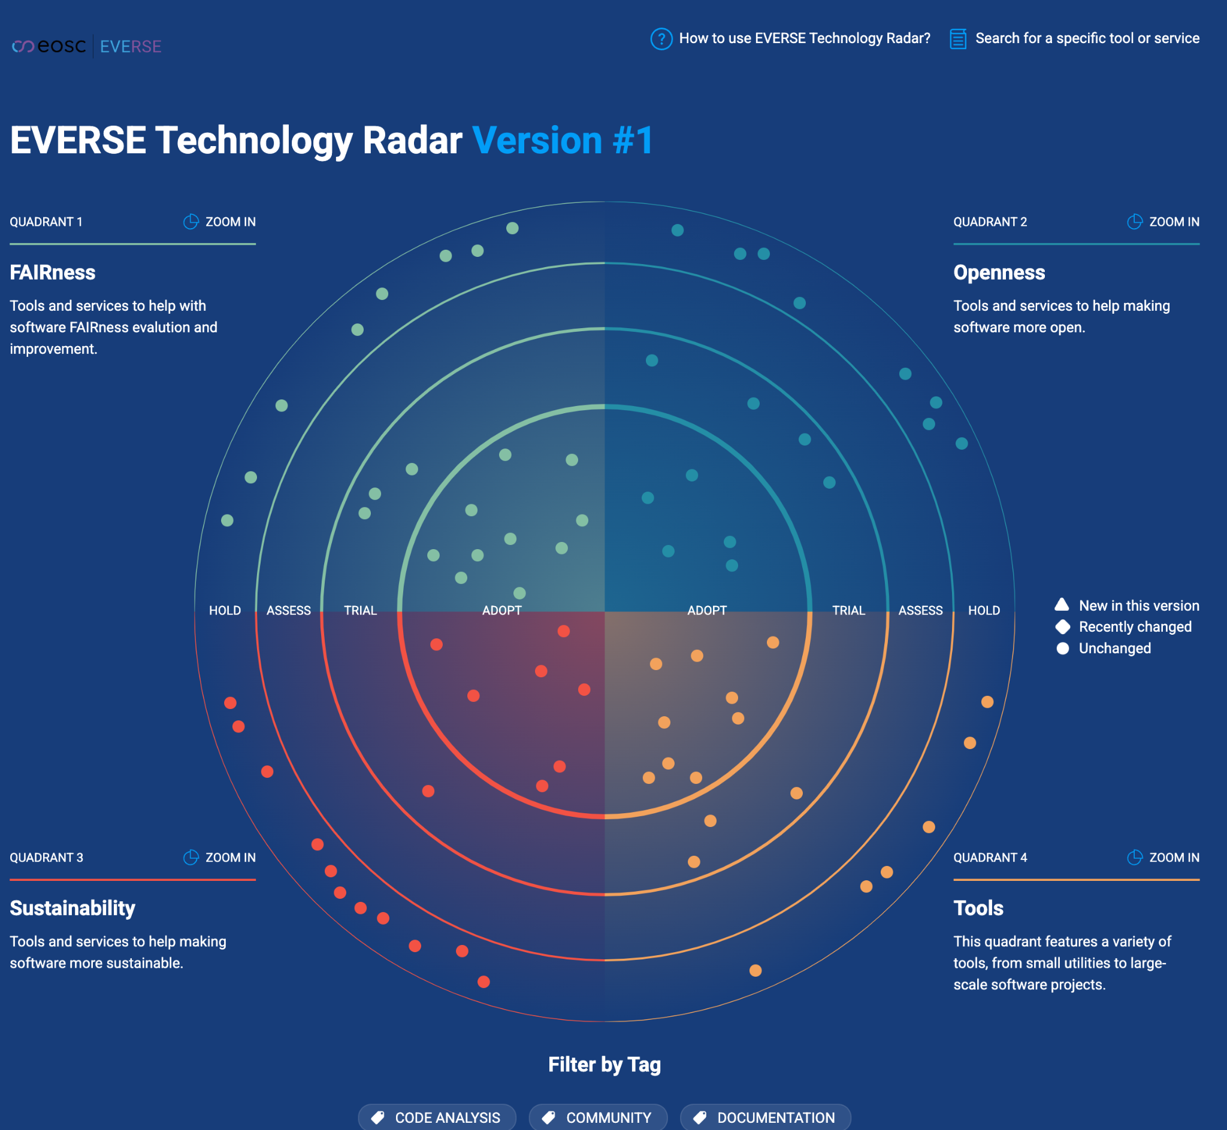
RSQKit: Progress, integration requirements and next steps - WP2&WP3
Software metadata schemas
Metadata & Dimensions & Indicators
2.3 & 3.2
Dashboard
First version of the software metadata schemas for tools, indicators and dimensions has been released
  Tools: https://w3id.org/everse/rs
  Indicators: https://w3id.org/everse/rsqi
  Dimensions: https://w3id.org/everse/rsqd/
Technology radar follows the schemas and (many) tools are mentioned in RSQKit
  Tools use the dimensions used in D3.1
Dashboard will receive indicators, defined according the common schemas released
Next steps:
Link dimensions and indicators in RSQKit
Integration of Radar into RSQKit
RSQKit
Needs discussion
?
Survey & other ouputs
Radar (to integrate into RSQKit)
EVERSE WP3 workshop - "Evaluating Tools and Services to improve the quality of research software" (10th Feb 25)
EVERSE workshop on Software Quality Assessment pipelines - Life Science (task 3.2) (14th Feb)

Slide 9













RSQKit: Integration and next steps - WP4
Research Communities
Research Stories
Research Software Communities
Research Clusters
Research Infrastructures
Future focus/work
Communities within research who are producing generic & domain specific software, libraries and catalogues
Lots of amazing software quality practices being used
Many of these are software as infrastructure
Future focus/work
How software is being used in research clusters & infrastructures
Covering analysis scripts, prototype tools and software infrastructure.

Slide 10
RSQKit: Integration and next steps - WP5
Collection of training resources
Registration of resources
Surfacing in RSQKit
e.g. https://github.com/EVERSE-ResearchSoftware/training or in a (EVERSE) TeSS instance or mTeSS-X
TeSS (which instance)
Task & Tools
Careers & Roles
mTeSS-X (OSCARS)
Competencies toolkit
Job families (Netherlands eScience Centre & UCL)
Roles

Slide 11
Aside: Resync with TF2 - Reference Framework
Not just about RSQKit
Many of the work packages have gone deeper and have findings
The Reference Framework needs to be updated to reflect this

Slide 12

Feedback session
10 minutes to have a look through RSQKit (if people need more time do say - we can max at 15 mins)
Then we will run a sli.do to gather feedback
Sli.do questions:
What are the most
important content types in RSQKit
Where would you like to see more connections/interlinking within RSQKit?
What did you find useful in RSQKit?
What did you expect to find in RSQKit but didn't?
Would you recommend the RSQKit, and if so, for whom?
How would you like to be more involved in RSQKit?
Notes:
(Q&A section is open)

Slide 13
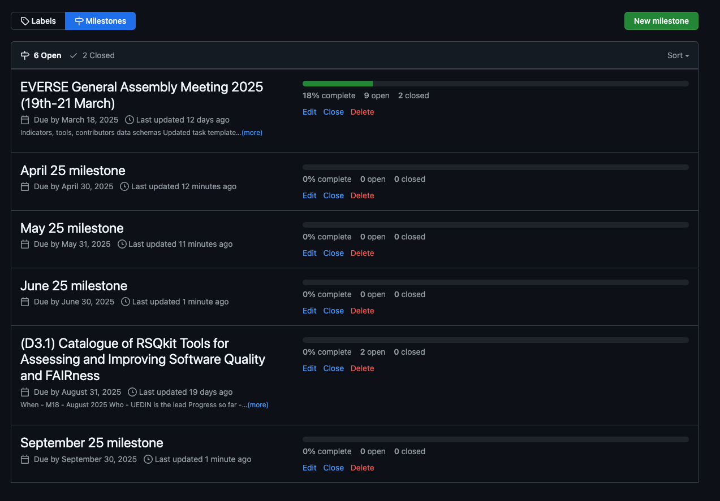
RSQKit: next 6 months draft (April - Sept 25)
Editorial board plant to have Monthly sprints (April - Sept 25)
Areas of work
    Additional prioritised task pages content
    Expand Editorial Board - with ESCAPE member (and others?)
    Marking up task pages content with indicators and dimensions
    Call out for research software communities
    Outreach - ELIXIR STEERS presentation, CW25, EVERSE Network
    Additional templates:
    Roles
    Research clusters & Infrastructures
    Research software stories
    Research software communities
  Integration conversation with WP3 around tools (D3.2 due August 2025)
    Tools marked up with indicators & dimensions
    Connected to task pages
    New pages identified from this task
  Additional roles around software usage
  Updating contribution guidelines - a consistent voice and approach to existing materials
  Task page review
    What was in the proposal - some further work needed on Workflows
    What has been suggested
  Refresh the layout based on additional content that has been added
    web design work to align the theme with the main everse.software website
General
  Contributions from outreach events needs follow up and post work to make these valuable contributions/ideas ‘productised’
    Follow up (GA, deRSE tickets)
https://github.com/EVERSE-ResearchSoftware/RSQKit/milestones

Slide 14
Part 2
Thu 20th March 2025 - 11:30 - 13:00 Session #1 (16 pax): RSQkit update. Integration with other WPs (3,4,5), feedback & contentathon (Part 2)
*-athon (*: Content, Integration, Review etc)

Slide 15
Session 2: Contentathon
If you were not in Session 1
  Covered the architecture & progress on RSQKit
  Demo of RSQKit
  We collected feedback on RSQKit
    <show results of that>
  The next 6 months plans
  Discussions along the way
    <highlights>
    <what to work on>
<how we will facilitate>
  <group formation>
<what we will do as follow up>
Session 2 agenda if you were not in Session 1
  Intro - 10-15 mins
  Hack / Contentathon - 1 hour to 1 hours 10 mins
  Close - 10-15 mins

Slide 16

Session 2: What could be worked on
Lots of options!
Careers & Roles
Research Communities
4
Integration with WPs
General review
1
2
3
Could you work on a template
RSE (first version exists)
Researchers who code (there is an existing PR - could you comment on that)
Policy makers
PIs
Managers
Trainers
Landscape survey
Tools survey
Indicators work (might be after the GA)
Radar integration discussions
Structure & organisation
Filling out the Research Communities that exist (we have a template)
Suggest a science story - about one piece of software and its use
Landing pages
Ease of finding things
Suggestions in tickets
Suggesting tools
Suggesting existing best practices
Suggesting what is missing
Reviewing content
Suggesting related standards, training and communities of practice and best practice guides
Requirements for Integration with other repositories/registries
Task pages
5
Other
6
Writing content on research software quality topics
https://github.com/EVERSE-ResearchSoftware/RSQKit/issues/224
List of previously collected and prioritised task topics
Add to the discussion if ticket already exists
Create a new ticket for a topic
Other ideas - open to suggestions
Editorial board members are here to help facilitate
https://unsplash.com/photos/a-street-sign-on-a-pole-bylXfUFJylU

Slide 17
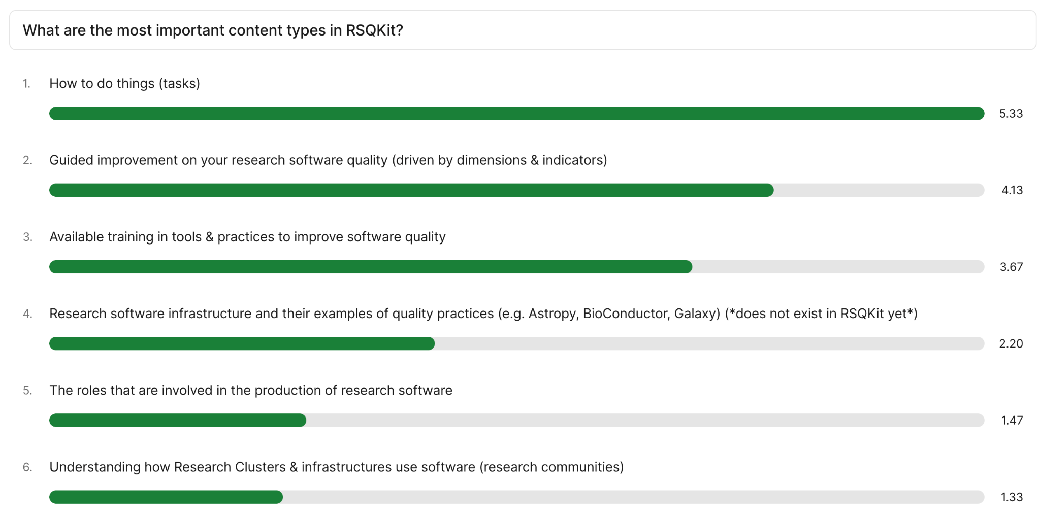

Slide 18
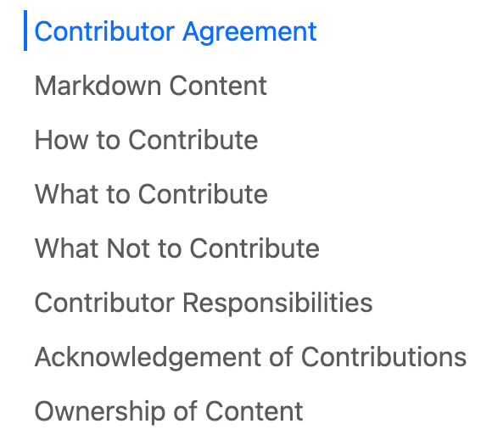
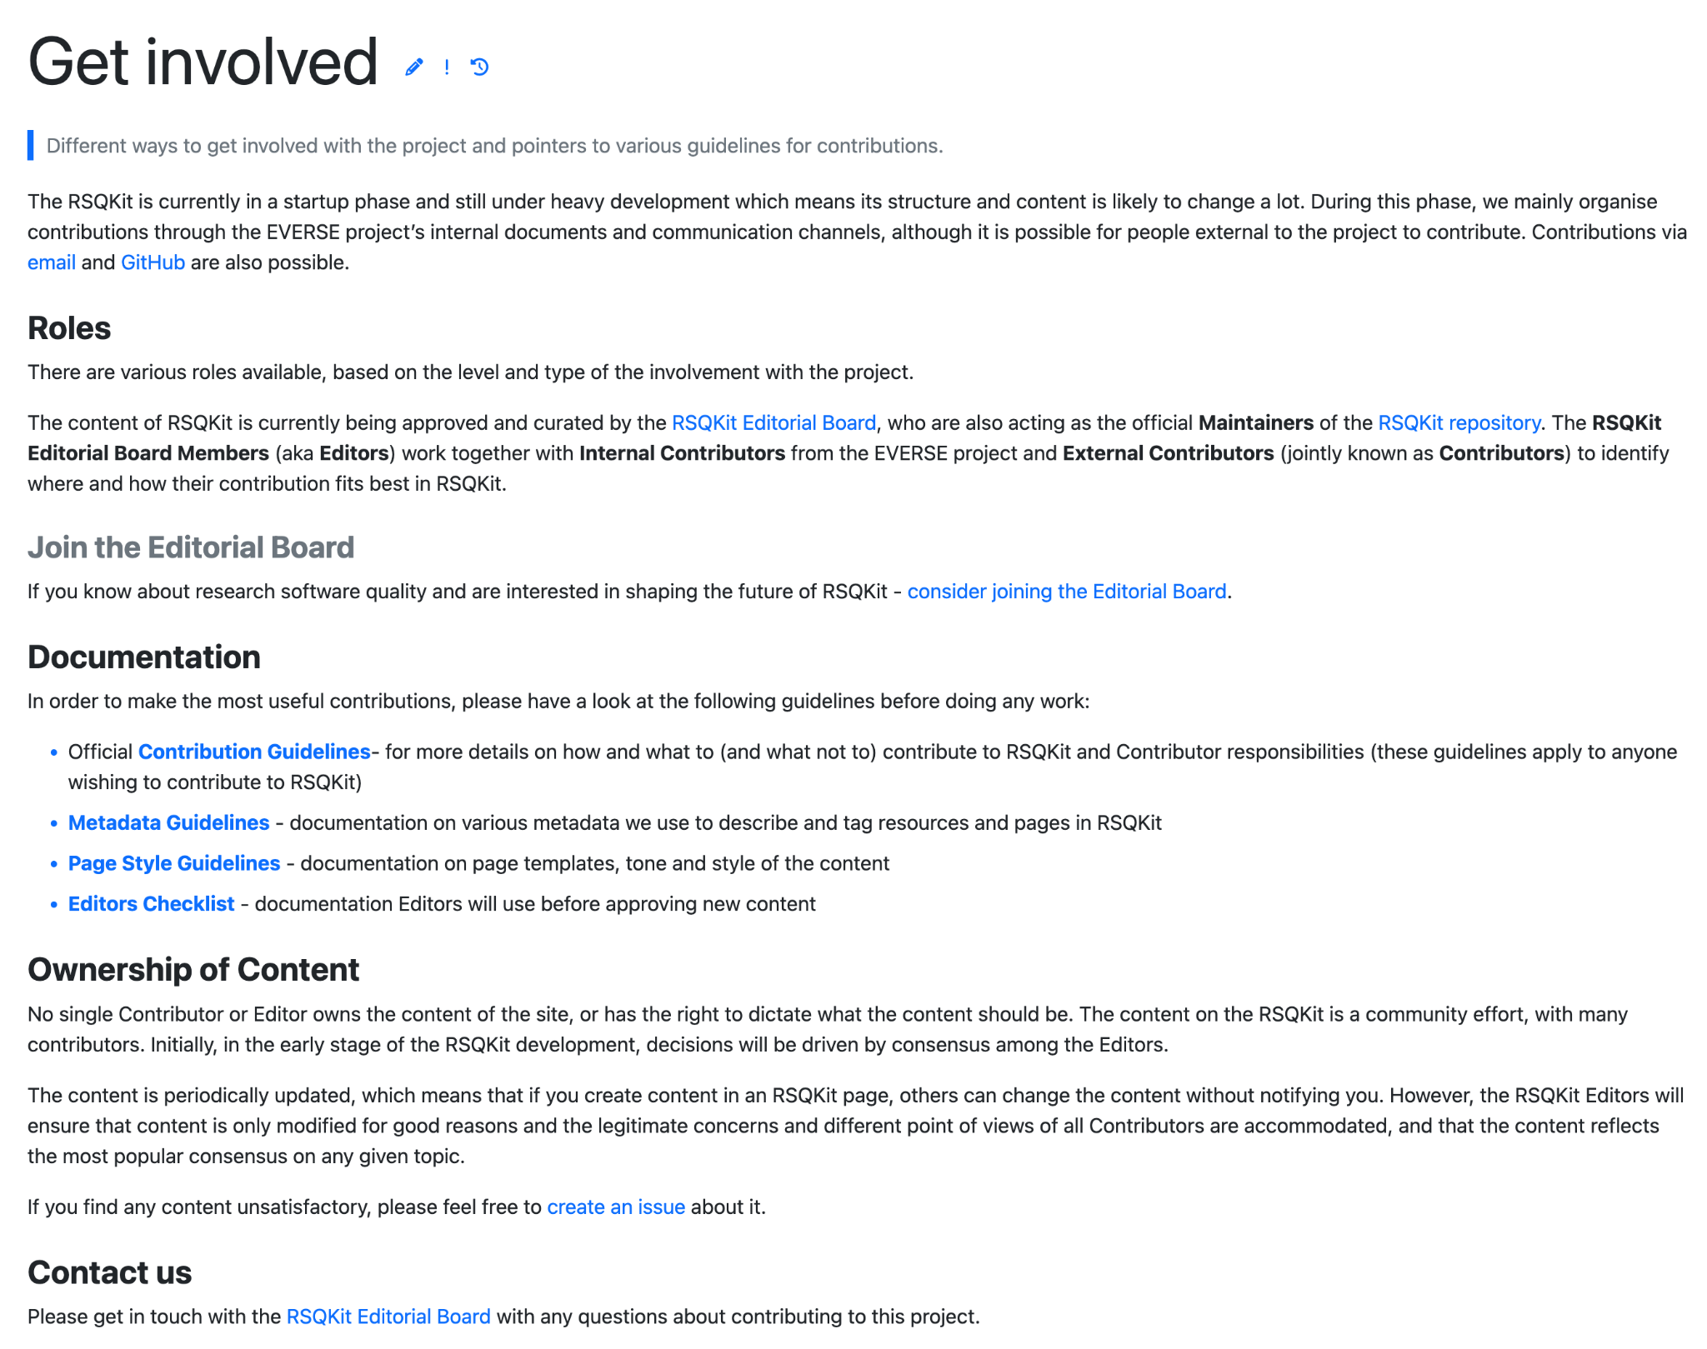
Guidelines
https://everse.software/RSQKit/get_involved
https://everse.software/RSQKit/contribution_guidelines

Slide 19
Contentathon / Hack session
Finish at 12.45pm
Can form groups
Say what you are planning to work on (in the document/in mattermost)
Can work alone
Editorial members here
If we are less in number majority can do something plenary but feel free to do something in a small group or as an individual
We will keep an eye on the Zoom chat & Mattermost channel
  RSQKit@EVERSE GA 2025 - https://mattermost.hzdr.de/everse/channels/rsqkiteverse-ga-2025

Slide 20

Contentathon close
Overview of what’s been worked on
What happens now
  Follow up with tickets and PRs
  Working on the feedback
  Plan will adjust with other sessions taking place at the GA
Ways to interact
  WP2 meeting - status
  TF1 meetings - governance & raising integration issues
  Editorial Board - work on infrastructure, review, content requests, integration and structure/policy
    A working group - if interested - we have weekly meetings - expect work - tickets/PR’s etc : )
    https://everse.software/RSQKit/editorial_board
    Contact - rsqkit@lists.certh.gr
Great to have follow up conversations/design chat at the GA
https://unsplash.com/photos/white-and-orange-open-led-signage-turned-on-FQgI8AD-BSg

Slide 21
Thank you!
RSQKit has rules for putting things in
We are not trying to stop you from working
We need to talk about integration
Contact details:
Mattermost
Editorial Board - rsqkit@lists.certh.gr
This project has received funding from the European Union’s Horizon Europe Programme under GA 101129744 — EVERSE — HORIZON-INFRA-2023-EOSC-01-02

