Slide 1
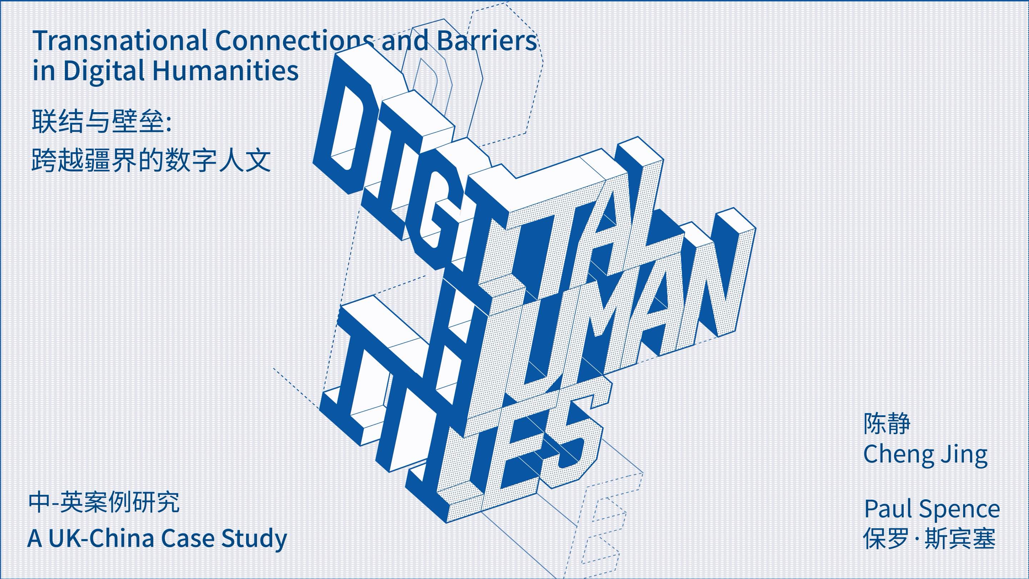
https://zenodo.org/records/16035797

Slide 2

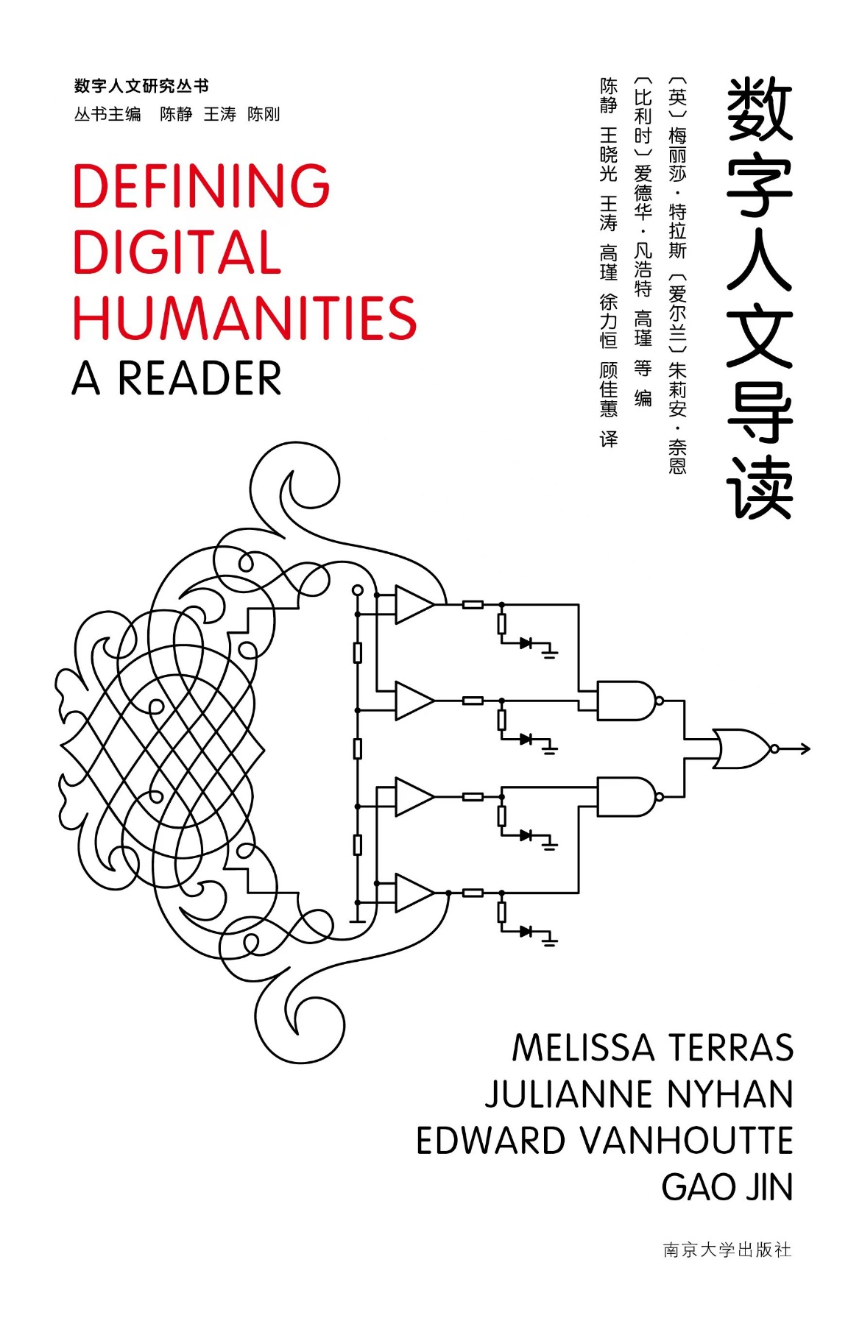

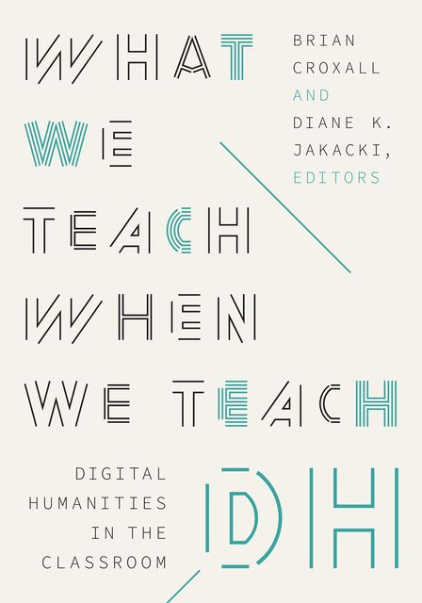
BACKGROUND – CHEN JING
Transnational connections and barriers in DH: a UK-Chinese case study
History of Digital Humanities (DH)
Digital Humanities and Knowledge Production
Digital Humanities Pedagogy
Digital Humanities Infrastructure

Slide 3
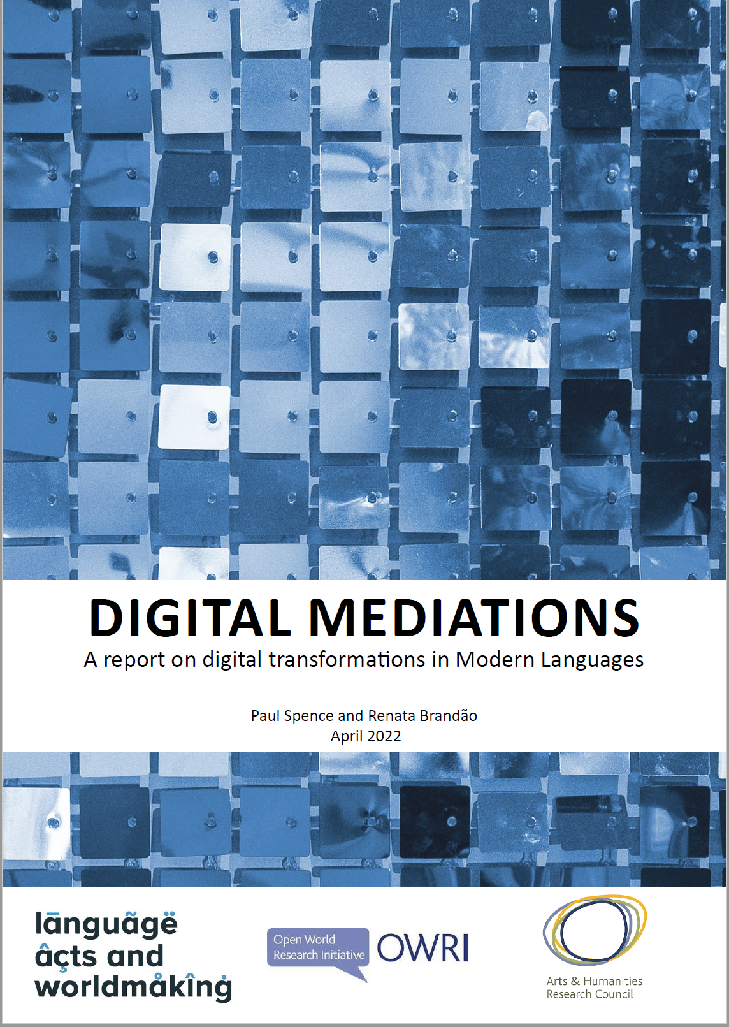
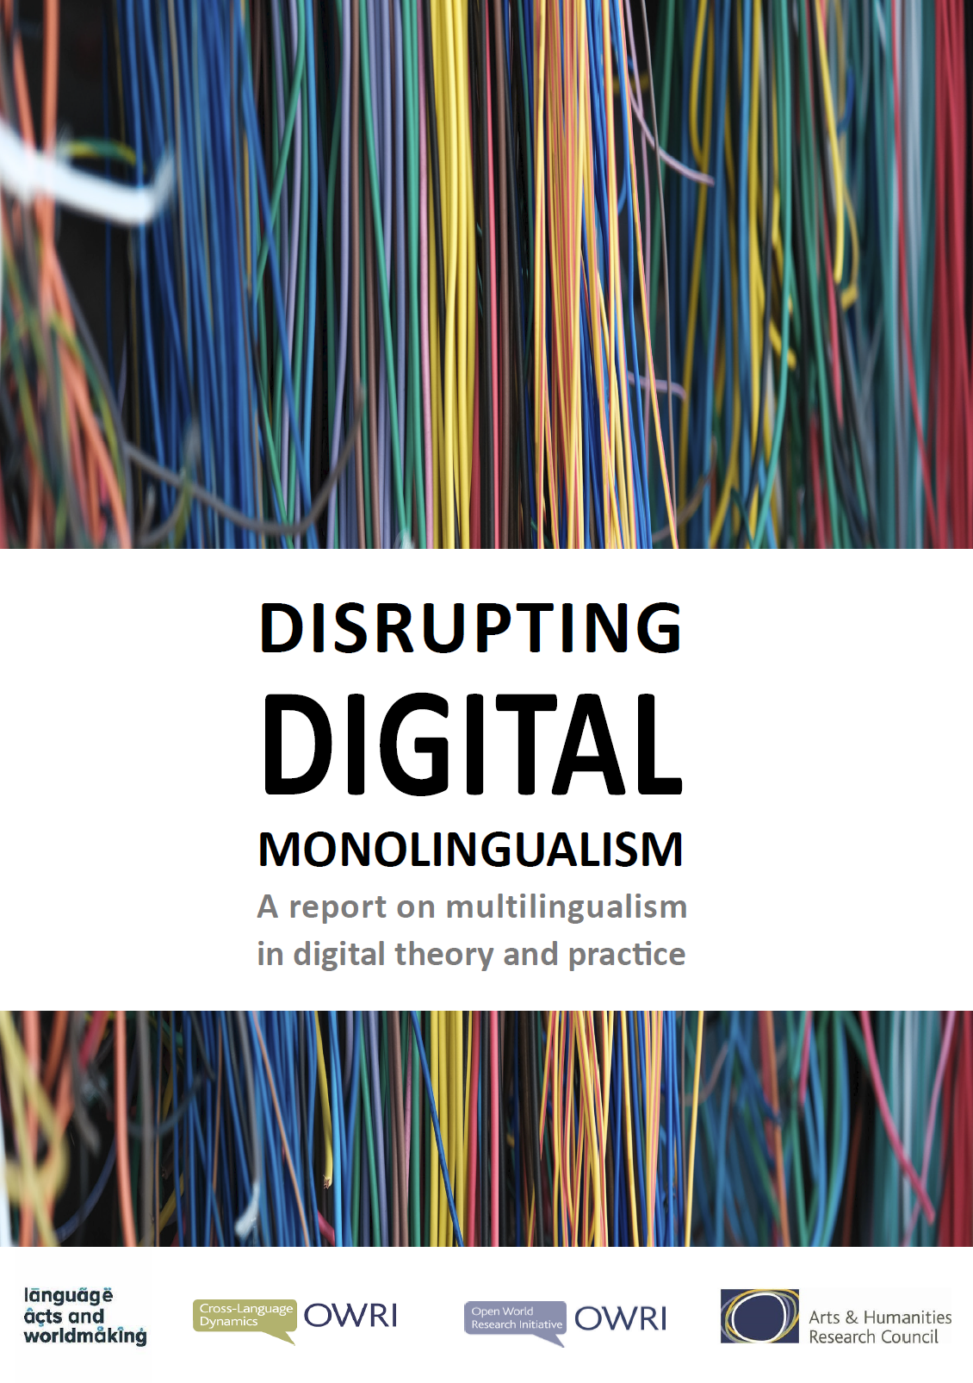
BACKGROUND – PAUL SPENCE
Transnational connections and barriers in DH: a UK-Chinese case study
Global diversity in DH
2016-2019 Global diversity in digital humanities, & Mexican study
Digital Modern Languages
(Language Acts & Worldmaking project)
2019-2022 Digital transformations in Modern Languages
Digital Multilingualism/Multilingual DH
2022-now Disrupting Digital Monolingualism
2022-now DH and low resourced languages
Global diversity in DH infrastructures
Local/regional focus
2024-now DH infrastructures in Spain/Latin America (chapter pending)
2024 UK-China study (with Chen Jing)

Slide 4
OUR STUDY, METHODS
Transnational connections and barriers in DH: a UK-Chinese case study
A bi-national study comparing attitudes towards digital humanities in China and the UK.
45 in-depth interviews with academics, funders, policymakers, and professionals across the cultural and technological sectors.
The interviews explored:
  Local conditions shaping DH knowledge production
  Their connection to transnational dynamics in DH

Slide 5
AREAS COVERED
GENERAL FINDINGS
Infrastructure
Professionalisation and institutional structures
Current state of DH as a field
Funding
Evaluating digital humanities research
Teaching and training
THE COMPUTATIONAL TURN
  Computational humanities
  Data and collections at scale
  AI and DH
KNOWLEDGE PRODUCTION AND OUTCOMES
DH and knowledge production
COLLABORATIONS BEYOND ACADEMIA
Collaborations with the GLAM sector
Collaborations beyond academia/with commercial sector
RELATIONSHIPS AND COLLABORATION
Primary countries of collaboration
Nature and types of collaboration
Barriers and challenges to collaboration
Reflections on global DH structures and equity
Geopolitical influence on collaborative dynamics
GLOBAL VISIBILITY
Perceived visibility on the global stage
Language and communication
CONCLUSIONS / RECOMMENDATIONS
General
For Researchers
For GLAM institutions
For Funders
For University administrators
COLLABORATION CHINA–UK
Context
Challenges
Opportunities

Slide 6
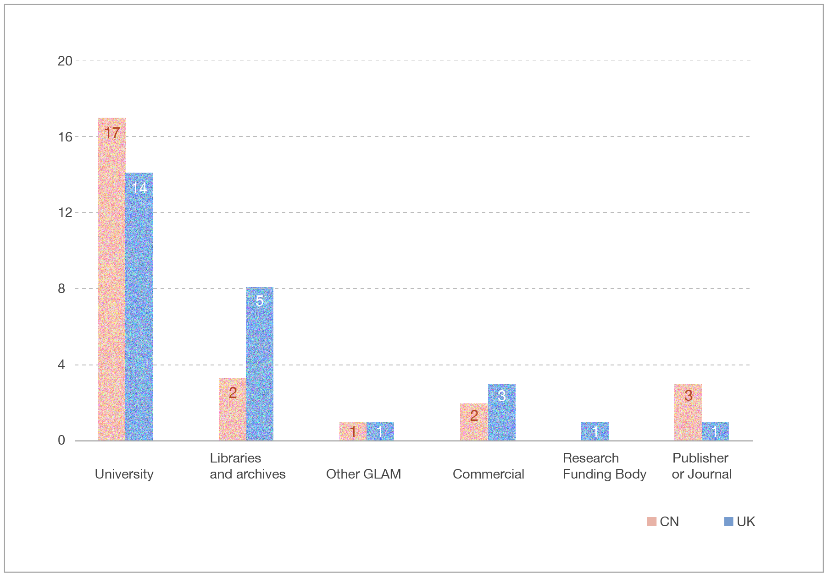
INSTITUTION AND JOB TITLE
Transnational connections and barriers in DH: a UK-Chinese case study

Slide 7
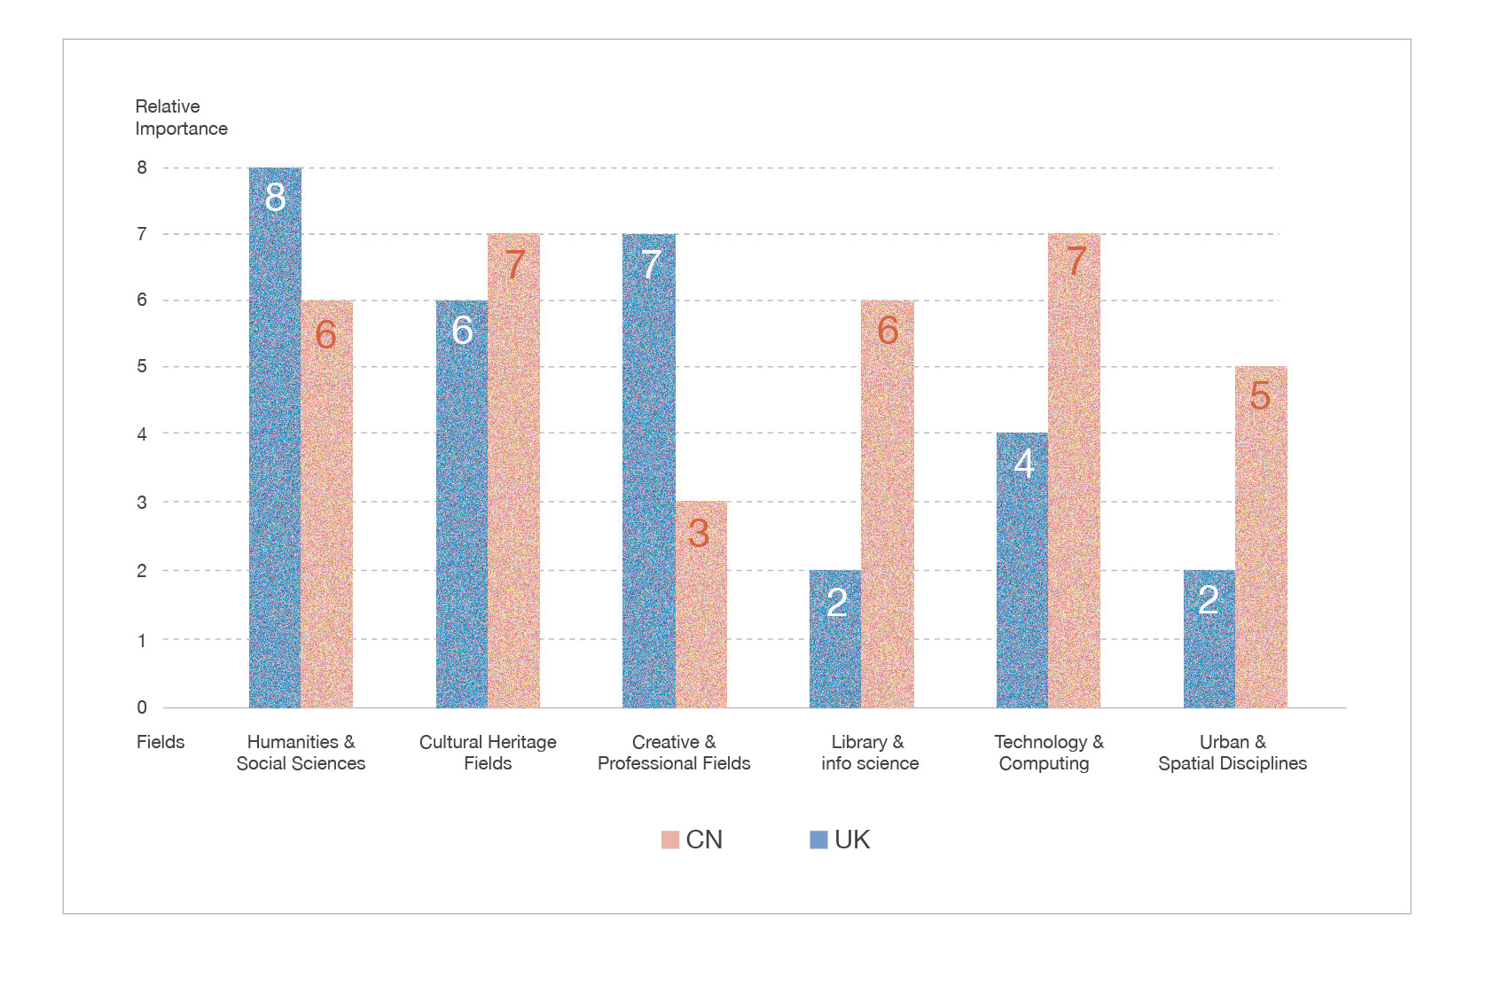
DISCIPLINARY BACKGROUNDS
Transnational connections and barriers in DH: a UK-Chinese case study

Slide 8
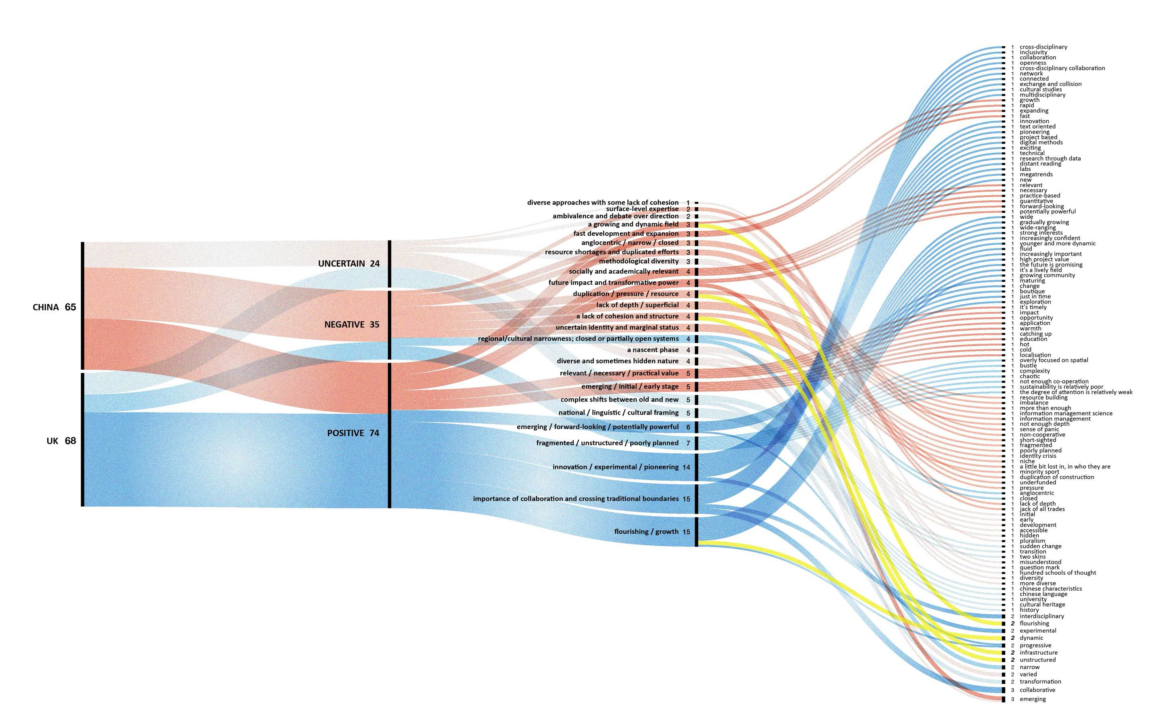
THREE WORDS
Transnational connections and barriers in DH: a UK-Chinese case study

Slide 9
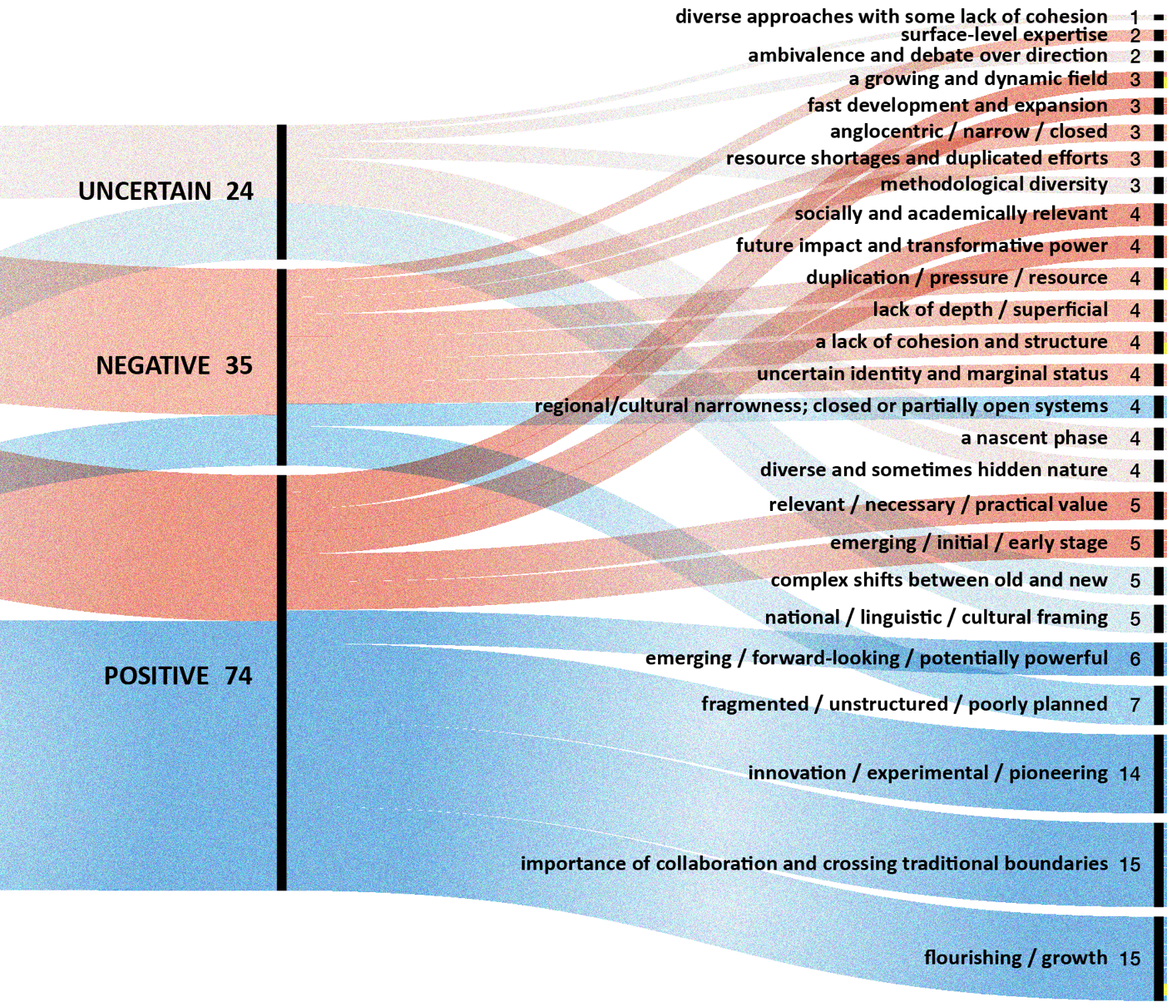
THREE WORDS
Transnational connections and barriers in DH: a UK-Chinese case study

Slide 10
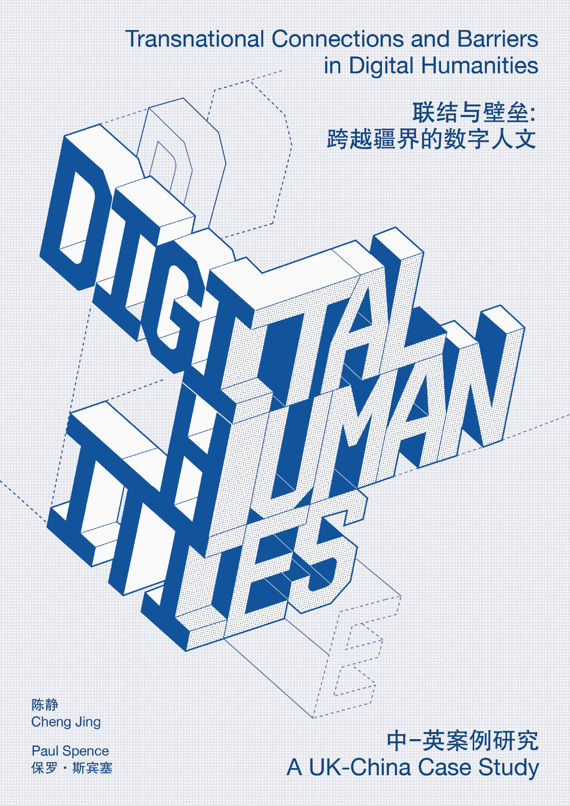
OUR FOCUS TODAY
Transnational connections and barriers in DH: a UK-Chinese case study
  (1) new knowledge production;
  (2) professional structures;
  (3) global visibility;
  (4) international collaboration.
https://zenodo.org/uploads/16035797

Slide 11
NEW KNOWLEDGEMENT PRODUCTION
Transnational connections and barriers in DH: a UK-Chinese case study
DH allowed them to generate new methods of analysis, new kinds of data/research object, new kinds of research question, new forms of collaboration and new forms of rethinking the humanities.
UK scholars more often foreground epistemological disruption; Chinese scholars highlight epistemological systematization and integration.
While UK scholars often foreground critical reflexivity, methodological pluralism, and public engagement; Chinese scholars emphasise infrastructure, cultural continuity, and national-scale applications.
Chinese responses focus more on disseminating authoritative cultural knowledge to a broad, often educationally-focused, public
“I think we need to try and start talking about digital humanities in the context of big challenges.”

Slide 12
RELATIONSHIP TO GLAM
Transnational connections and barriers in DH: a UK-Chinese case study
GLAM institutions in China play a significant role in digital humanities. They not only provide foundational data resources for digitization but have also established some high-profile digital humanities projects.
“I think the impact has been more significant..….we can apply some of the theories and methodologies of digital humanities, including some of the technologies it promotes, to the development and creation of our digital products, which can make our road more solid and effective.”
In the UK, a series of factors has contributed to an environment of growing confidence in the use of digital technology in cross-stakeholder cultural heritage research.
x

Slide 13
RELATIONSHIP TO COMMERCIAL SECTOR
Transnational connections and barriers in DH: a UK-Chinese case study
The relationship between DH researchers and the commercial sector is complex.
There is sometimes some “suspicion towards commercial partners”.
DH should “plant its flag a little bit more” and build stronger connections with the commercial sector, through work placements, sponsorship opportunities and fellowships for people to move the other way from industry.
There is potential for the digital humanities to have a stronger, deeper and more multi-layered relationship with the commercial sector.
The danger here is that this may blur the line between scholarship and commercial innovation, sometimes diluting academic priorities or creating reputational risks.

Slide 14

PROFESSIONAL STRUCTURE: UK
Transnational connections and barriers in DH: a UK-Chinese case study
The respondents identify UK’s “long history of DH centres and departments” as a factor which has given the field greater visibility in the UK – because it has cemented the notion that digital humanities is doing serious and meaningful academic research – and which has helped it to achieve stronger institutional support.
Most UK interviewees feel that their institutions are generally supportive of the digital humanities, even if they do not always understand it well: “they kind of know that they want something digital, but they don’t really understand what that is”.
But – there is a structural divide between a minority of institutions with relatively well-resourced departments or centres who have been able to achieve “a certain critical mass”, and who can therefore sustain DH profiles and activity, and a majority of universities or other institutions where work in DH is more tenuous.

Slide 15

PROFESSIONAL STRUCTURE: CHINA
Transnational connections and barriers in DH: a UK-Chinese case study
Chinese scholars, meanwhile, describe a landscape where digital humanities centres and labs are proliferating, but often “just [as] a name”, with uncertain effectiveness: “after the establishment of some digital humanities centres, I am not particularly sure whether they are actually running and playing a role […] to a large extent”.
There is a strong emphasis on the need for “labs” and “infrastructure”, with the ideal being “a lab where all the resources can be accessed directly”, supporting both hardware and data needs.
Yet, the reality is that most organizations are “still dominated by research organisations” and “virtual institutions”, and some wish that organizations were “more visionary and ambitious”.

Slide 16
CAREER TRAJECTORIES IN DH
Transnational connections and barriers in DH: a UK-Chinese case study
In the UK, the situation is more nuanced, and scholars following the formal ‘academic’ pathway find themselves at a significant advantage over those on ‘non-academic’ contracts.
A number of interviewees in both countries gave the opinion that entry into the field often happens by chance rather than by design. Some UK scholars argue that practitioners “fall into” DH through exposure to digital tools.
Digital humanities roles are most commonly found within academic departments rather than in libraries, which contrasts with the US model, “The UK is different from the US in that I think still most DH roles are based in academic departments. So ‘lecturer in something with DH’ is probably the most common presentation”. […]

Slide 17
CAREER TRAJECTORIES IN DH
Transnational connections and barriers in DH: a UK-Chinese case study
In China, the lack of defined career trajectories presents a major hurdle to the professionalization of Digital Humanities.
Chinese digital humanities roles are still emerging and are often tied to existing positions in libraries, museums, or traditional humanities faculties. There is a strong sense of uncertainty about what constitutes a digital humanities job.
The job market for digital humanities in China is described as experimental and uncertain, with few dedicated roles in industry

Slide 18
PROFESSIONAL STRUCTURE
Transnational connections and barriers in DH: a UK-Chinese case study
UK scholars worry about hidden work and the need to “actively build” networks
“institutional obstacles”
“there has not really been a pure, full-fledged collaboration”
“the openness of data is very difficult”
There is pride in being “one of the most open and inclusive and participatory research cultures”
more individually driven but also shaped by hierarchy and collective organization.

Slide 19
VISIBILITY IN THE FIELD 1
Transnational connections and barriers in DH: a UK-Chinese case study
The UK DH community benefits from structural advantages like language dominance and a historical foundation in the field but still has work to do in establishing a collective identity and introducing sustained inclusivity.
In contrast, the Chinese DH community faces significant external and internal barriers—from language and cultural differences to institutional fragmentation—but shows signs of growth and increasing global awareness.
“I think it is not enough. The main thing is that we don't publish enough English articles, especially not enough influential English articles. This may be mainly a problem of teachers' writing, because it seems that most history scholars don't pay
much attention to the writing of these overseas journals”.

Slide 20
VISIBILITY IN THE FIELD 2
Transnational connections and barriers in DH: a UK-Chinese case study
The dominant barriers include language differences, insufficient presence in English-language publications, and minimal representation in international DH institutions.
Chinese DH is often seen as isolated within a “local area network” and importance of developing a uniquely Chinese DH voice rather than simply conforming to Western standards.
Language barriers are a significant challenge for both sides.
In the UK, very few DH researchers have the level of proficiency in the Chinese language to communicate effectively at the level required to undertake serious research and UK scholars note that most collaborations currently rely on Chinese researchers’ proficiency in English.

Slide 21
INCENTIVES AND OBSTACLES TO COLLABORATION
Transnational connections and barriers in DH: a UK-Chinese case study
Chinese researchers are often more aware of Western scholarship than vice versa.
They feel disconnected from China’s culture of knowledge production due to a lack of opportunities for researchers in both countries to interact, collaborate and learn from each other.
There has not been the same kind of “calibration of topics and areas of interest” that has occurred with European partners
“We talk about the digital world, but it’s digital worlds [plural] - we don't all have access to the same infrastructure and data”.

Slide 22
CONCLUSIONS
Transnational connections and barriers in DH: a UK-Chinese case study
Our report aimed to explore comparative frameworks and dialogic mechanisms that enable truly equal engagement across different DH communities. But we also wished to provide grounded, comparative, empirical insights to inform future policy and strategy.
It concludes with strategic recommendations for funders, researchers, universities, and the Galleries, Libraries, Archives and Museums (GLAM) sector to strengthen transnational collaboration, build inclusive infrastructures, support emerging professionals, and foster mutual understanding across the UK and China in the digital humanities.

Slide 23
OUR PROPOSALS
Transnational connections and barriers in DH: a UK-Chinese case study
  General
    Respondents identify a lack of opportunities to interact with people from the other country, arrange open ideation/hackathon events around common historical or cultural topics with invited participants from other humanities disciplines, GLAM sector and policy organisations.
  DH researchers
    Greater “calibration of topics and areas of interest” or Open showcases of DH research in virtual workshops
  GLAM institutions
    Design interactive competitions to stimulate the innovative use and comparison of GLAM data in both countries.
  Funders
    Seed funding for exploratory networking programmes around specific research topics
  University administrators
    Joint summer schools involving …
  Teachers and programme convenors
    A need to pay attention to the international classroom. Masters’ programmes in the UK have a high proportion of international students, and yet this is largely an untapped resource in the classroom – we can give these voices more agency in curriculum design.

Slide 24
CONTACTS/ACKNOWLEDGEMENTS
Transnational connections and barriers in DH: a UK-Chinese case study
Download our report: https://zenodo.org/records/16035797
Contact:
  Chen Jing (cjchen@nju.edu.cn)
  Nanjing University, China
  Paul Spence (paul.spence@kcl.ac.uk)
  King's College London, United Kingdom
We would like to acknowledge the generous support of the UKCHA Collaborative Research Award in the Humanities for Scholars from China to Visit the UK, coordinated by the University of Exeter, and the grant from the Chinese Scholarship Council, both of which made it possible for us to design and carry out this research project.

