Slide 1
"From open code to open contributions": exploring open source culture in academia
Arielle Bennett
DOI: 10.5281/zenodo.17084292

Slide 2
Some links!
HackMD for shared notes: https://hackmd.io/@Arielle-Bennett/rsecon25-os-workshop
Link to access Miro board: https://miro.com/app/board/uXjVJVnzLw4=/?share_link_id=96880408379
Password: codecontributions

Slide 3
Agenda
Ice Breakers + Intros
Open Source Reflections
Open Source Barriers
BREAK
Learning from existing practices
Practical interventions

Slide 4
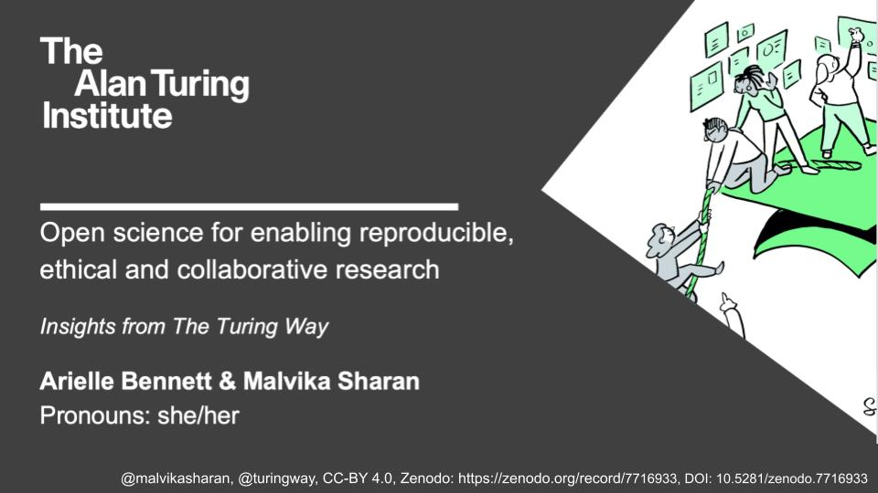
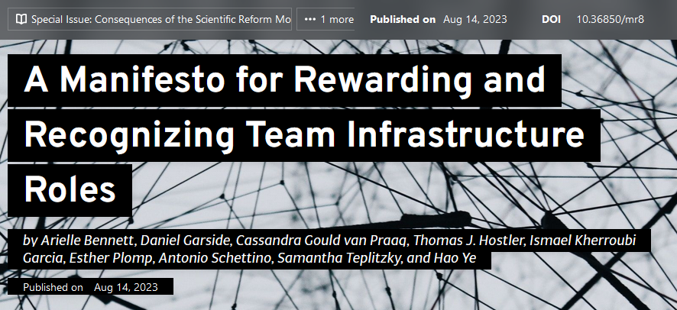
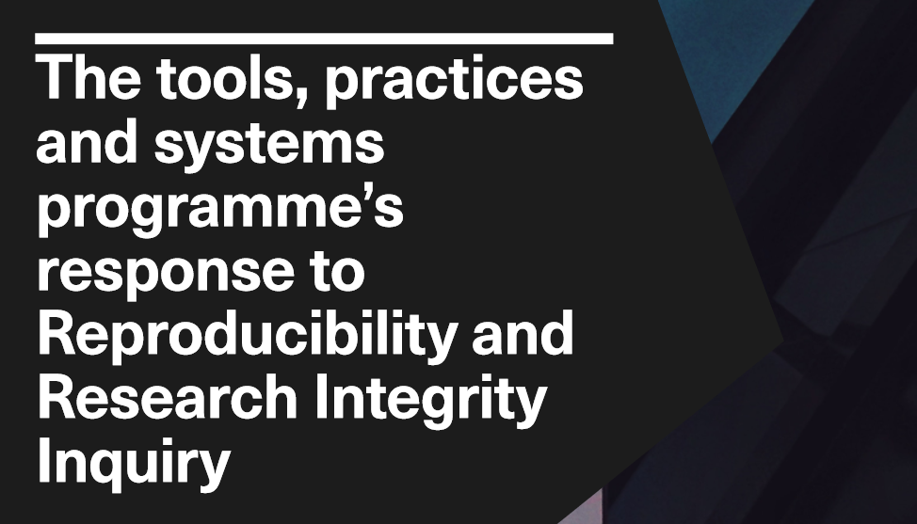
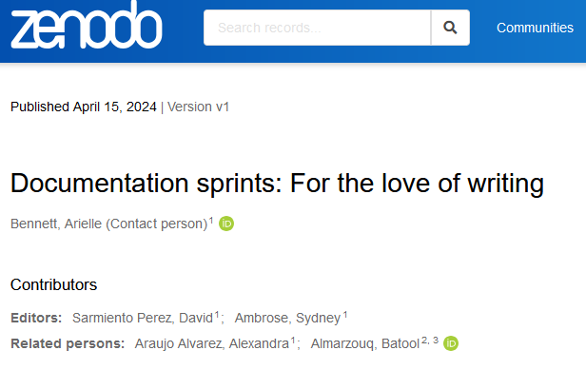
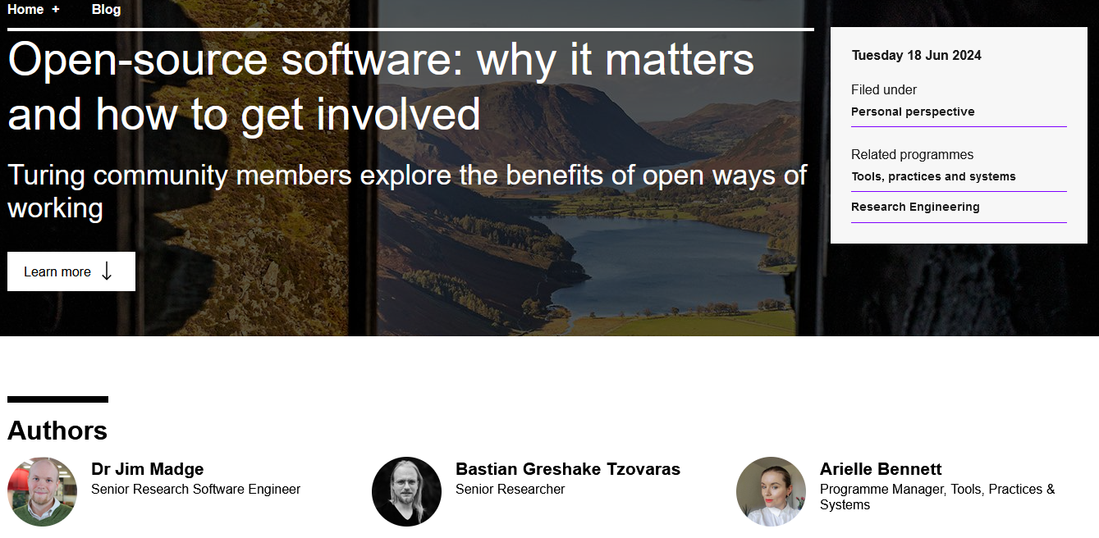
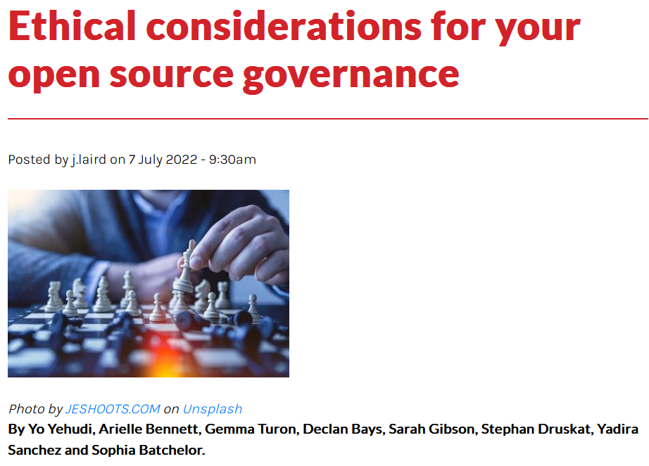
Arielle Bennett
Senior Researcher in Open Source Practices at The Alan Turing Institute
The Turing Way contributor - Research Infrastructure Roles, Activism, Book Dash
Center for Scientific Collaboration & Community Engagement Fellow 2019
SSI Fellow in 2025!
Notes:
I'm Arielle Bennett, currently senior researcher in open source practices at The Alan Turing Institute. I work alongside the research community managers, and research application managers, and RSEs to support open source tools, and practices at the Institute. I've been a long time supporter of and contributor to open source projects, as part of my

Slide 5
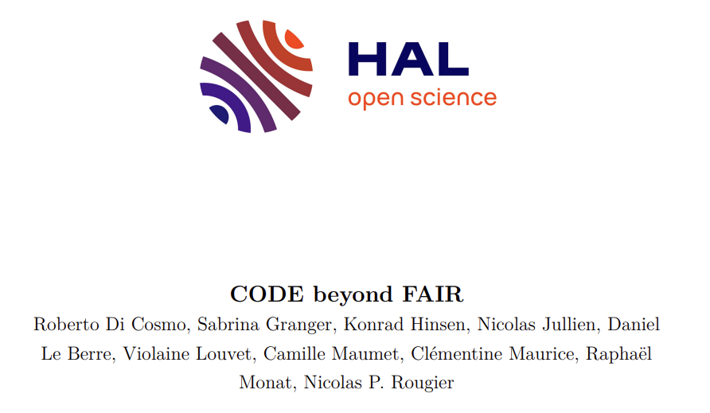
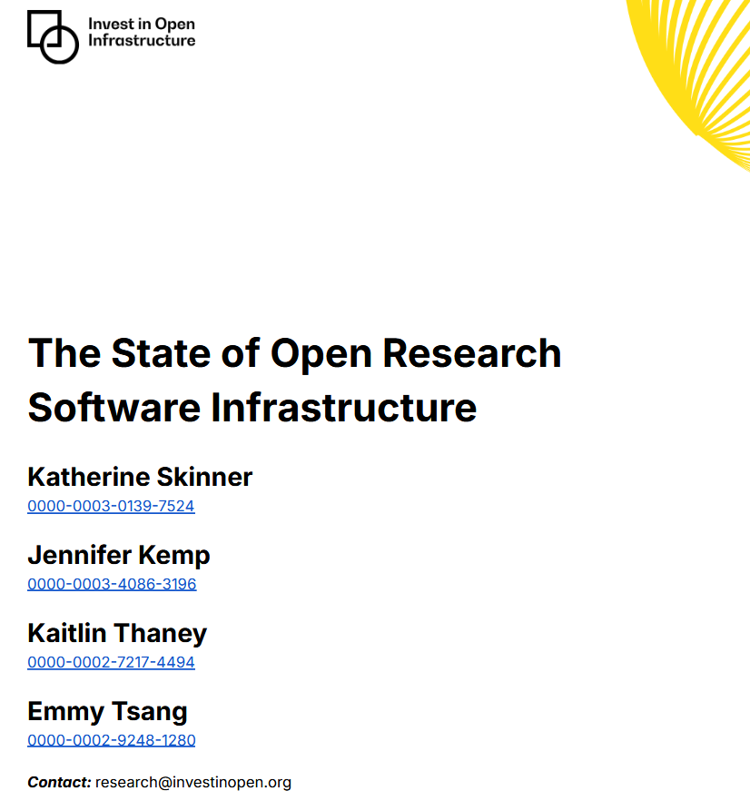
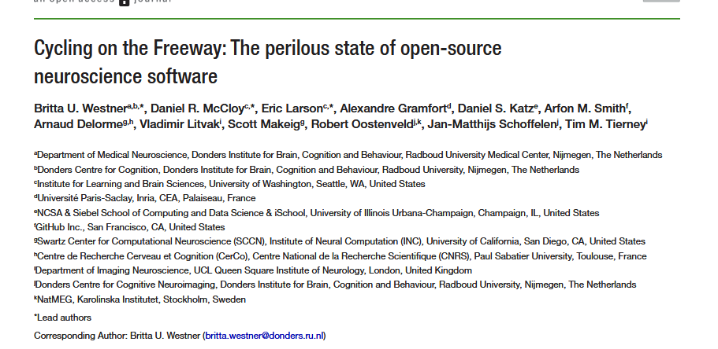
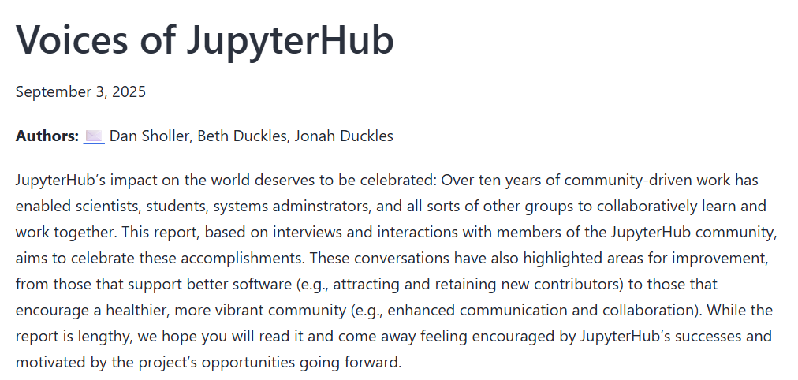
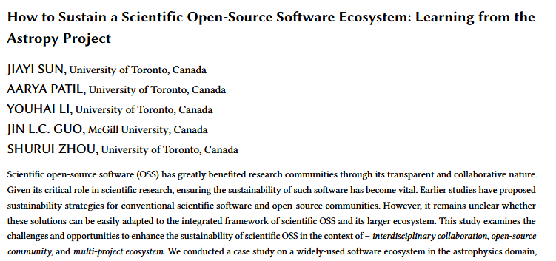
From open code to open contributions: SSI Fellowship
Notes:
As we've heard in several sessions already today, although there is a strong tradition of supporting open source scientific software across academia, even projects used by thousands or even millions of researchers across the globe still face challenges with maintenance, funding, security, contributor burnout and more. Academic open source is not immune to the challenges faced by the FOSS ecosystem more broadly, but I believe it also has a few unique barriers of it's own, and the solutions

Slide 6
From open code to open contributions: SSI Fellowship
Understand perceptions of, and barriers to, contributing to open source scientific projects from researchers, RSEs and other research professionals, with the aim of developing and influencing practical solutions to support the ecosystem
Survey - 150+ responses to date
This workshop
Focus groups - autumn 2025
Scientific publication
Policy paper + submissions to UKRI
Pilot design to support open source projects at HEIs
Notes:
Submissions to UKRI as part of their ongoing consultation on a unified software policy

Slide 7
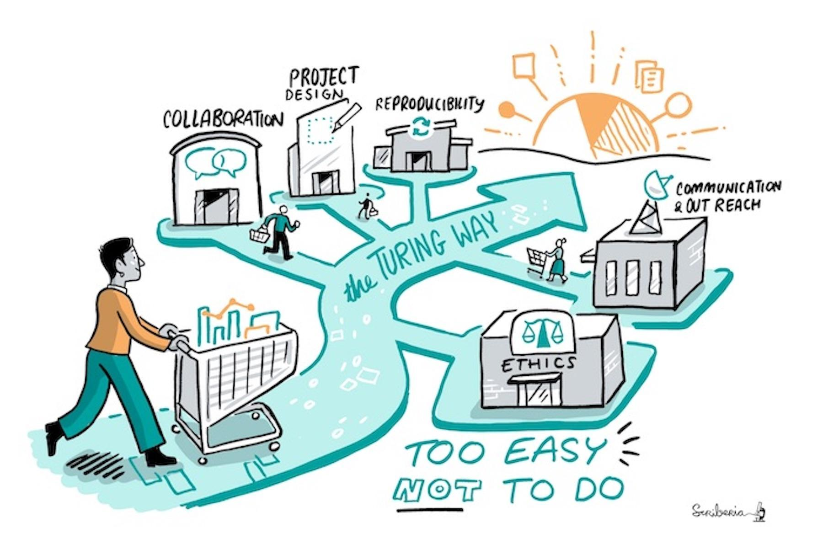

The Turing Way
An open science project and community-driven handbook on data science and research practices.
CC-BY 4.0 Image by Scriberia for The Turing Way

Slide 8
The Turing Way
An open science project and community-driven handbook on data science and research practices.
We involve and support a diverse community to make data science and research reproducible, ethical, and collaborative for everyone.
CC-BY 4.0 Image by Scriberia for The Turing Way

Slide 9
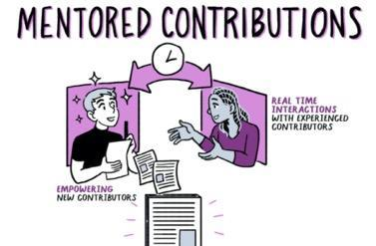
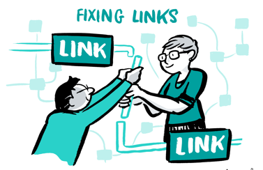
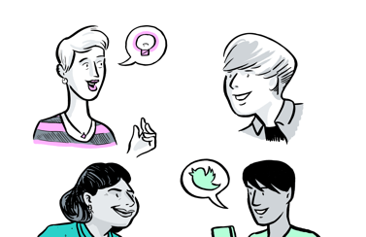
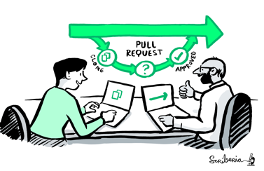
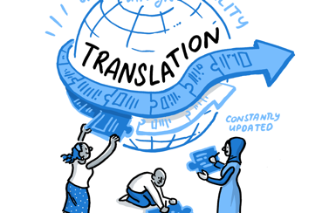
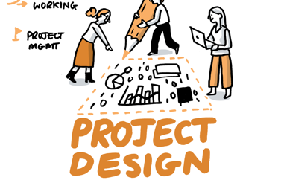
Many pathways for contributions
Develop
Maintain & improve
Share resources
Informal Collaboration
Global efforts
Formal Projects
Notes:
We define pathways for collaboration that always require multiple people to support each other. For example, people are invited to develop and share resources through mentored contributions, We also create opportunities for people to maintain and improve resources which could be as simple as fixing a broken link or a bug, or creating new resources of their interest. Contributors are also those who share
these resources, review and update the existing chapters and translate them in languages that ensure accessibility for a wider community. Finally, we encourage everyone to share best practices by highlighting their work.

Slide 10
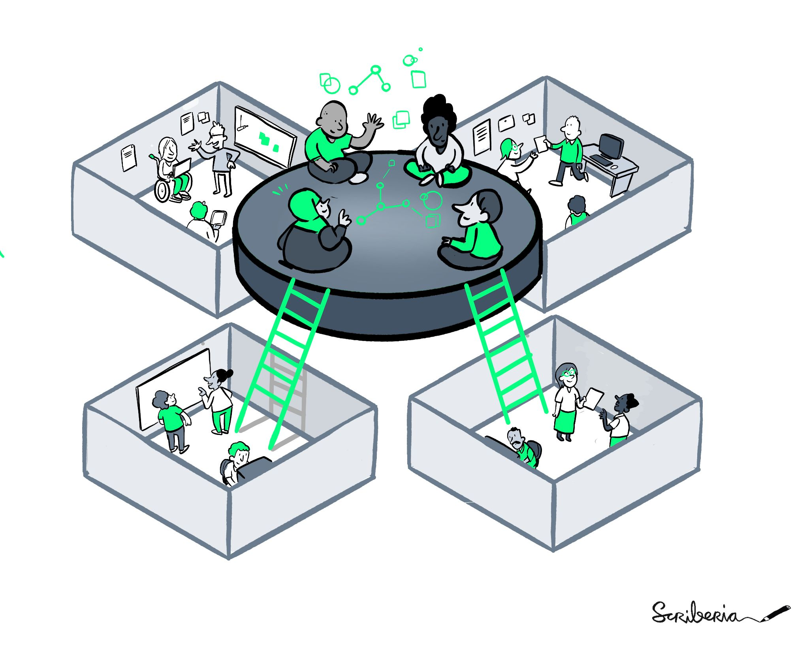
Come hang out!
Sign up to our newsletter
Join our Collaboration Cafes - 1st & 3rd Wednesday of the month, 15:00 - 17:00 UK time
Join our Slack
All this and more here: the-turing-way.start.page

Slide 11
Agenda
Ice Breakers + Intros
Open Source Reflections
Open Source Barriers
BREAK
Learning from existing practices
Practical interventions

Slide 12
Icebreaker
Introduce yourselves
Answer the question "Open source is like..."
Add it to Miro!
Workshop attendees will be acknowledged in publications and reports

Slide 13
Agenda
Ice Breakers + Intros
Open Source Reflections
Open Source Barriers
BREAK
Learning from existing practices
Practical interventions

Slide 14
Open source reflections (30 mins)
Quiet reflection on the following questions (add these to the HackMD or the Miro board if you want):
1. What was your first meaningful open source contribution?
2. What motivated you to contribute?
3. What surprised you, or was unexpected about the process?
4. What barriers did you encounter?
5. How was your contribution recognised?
6. How did this shape your subsequent engagement with open source?
Discuss with your groups and note common themes
Choose someone to report back

Slide 15
Agenda
Ice Breakers + Intros
Open Source Reflections
Open Source Barriers
BREAK
Learning from existing practices
Practical interventions

Slide 16
Open source barriers (30 mins)
In groups: discuss specific barriers to open source contribution in academia, either from personal experience or observations
Add these to the Miro board or shared notes document
Categorise them:
  Technical
  Social
  Structural
  Incentives
  Other
Vote for the top 3 priority barriers across any categories
Choose someone to report back

Slide 17
Agenda
Ice Breakers + Intros
Open Source Reflections
Open Source Barriers
BREAK
Learning from existing practices
Practical interventions

Slide 18
Welcome Back!

Slide 19
Some links!
HackMD for shared notes: https://hackmd.io/@Arielle-Bennett/rsecon25-os-workshop
Link to access Miro board: https://miro.com/app/board/uXjVJVnzLw4=/?share_link_id=96880408379
Password: codecontributions

Slide 20
Agenda
Ice Breakers + Intros
Open Source Reflections
Open Source Barriers
BREAK
Learning from existing practices
Practical interventions

Slide 21
Presentations
David Perez Suarez - UCL
Markus Hauru - The Alan Turing Institute

Slide 22

Open Source Programme Office is being created at
How the

Slide 23

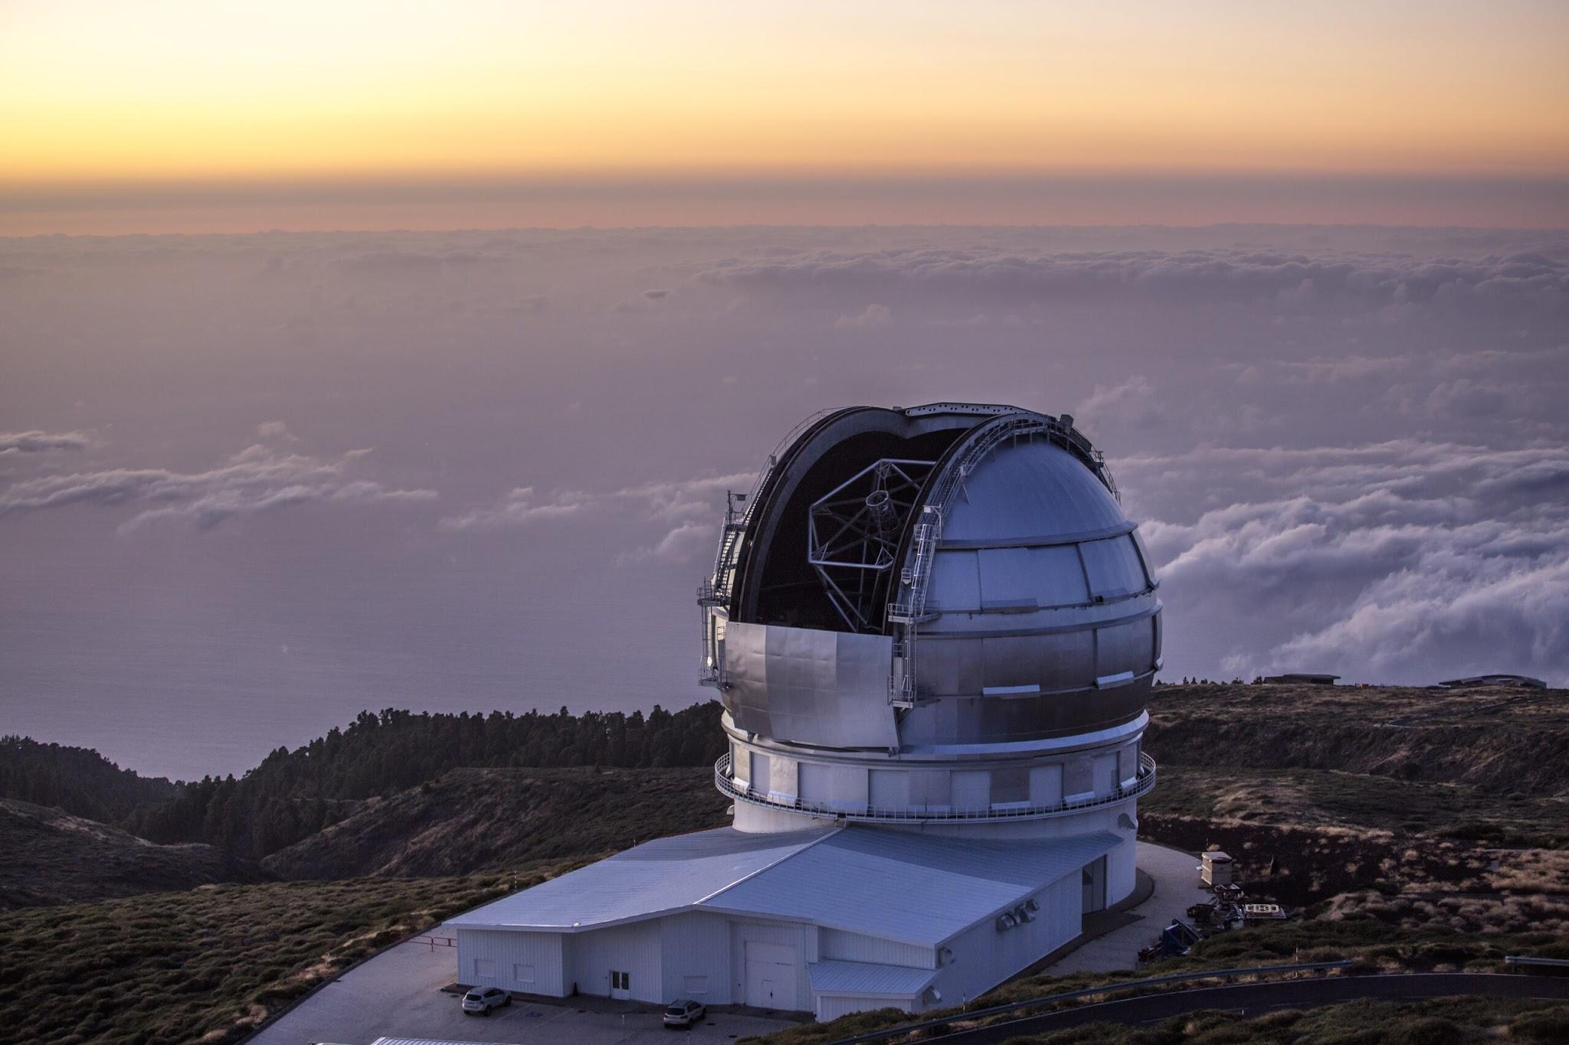





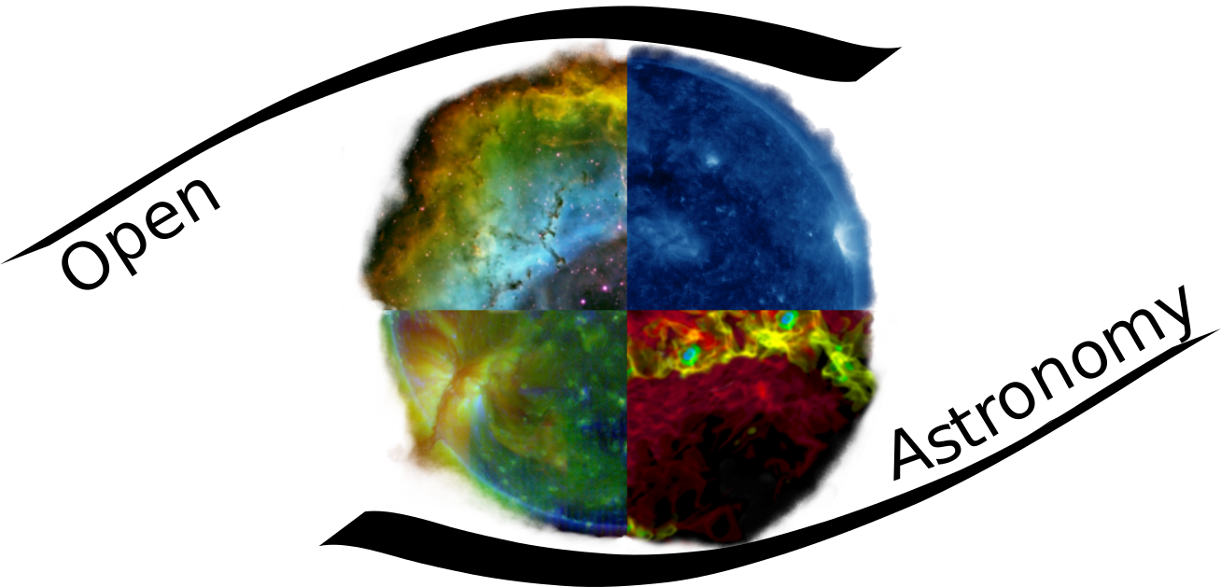








Who am I? Short biopic
🎉1st contribution (~2006)
SOCIS
Dive in code
GranTeCan (La Palma) Photo by Daniel López / IAC
77

Slide 24
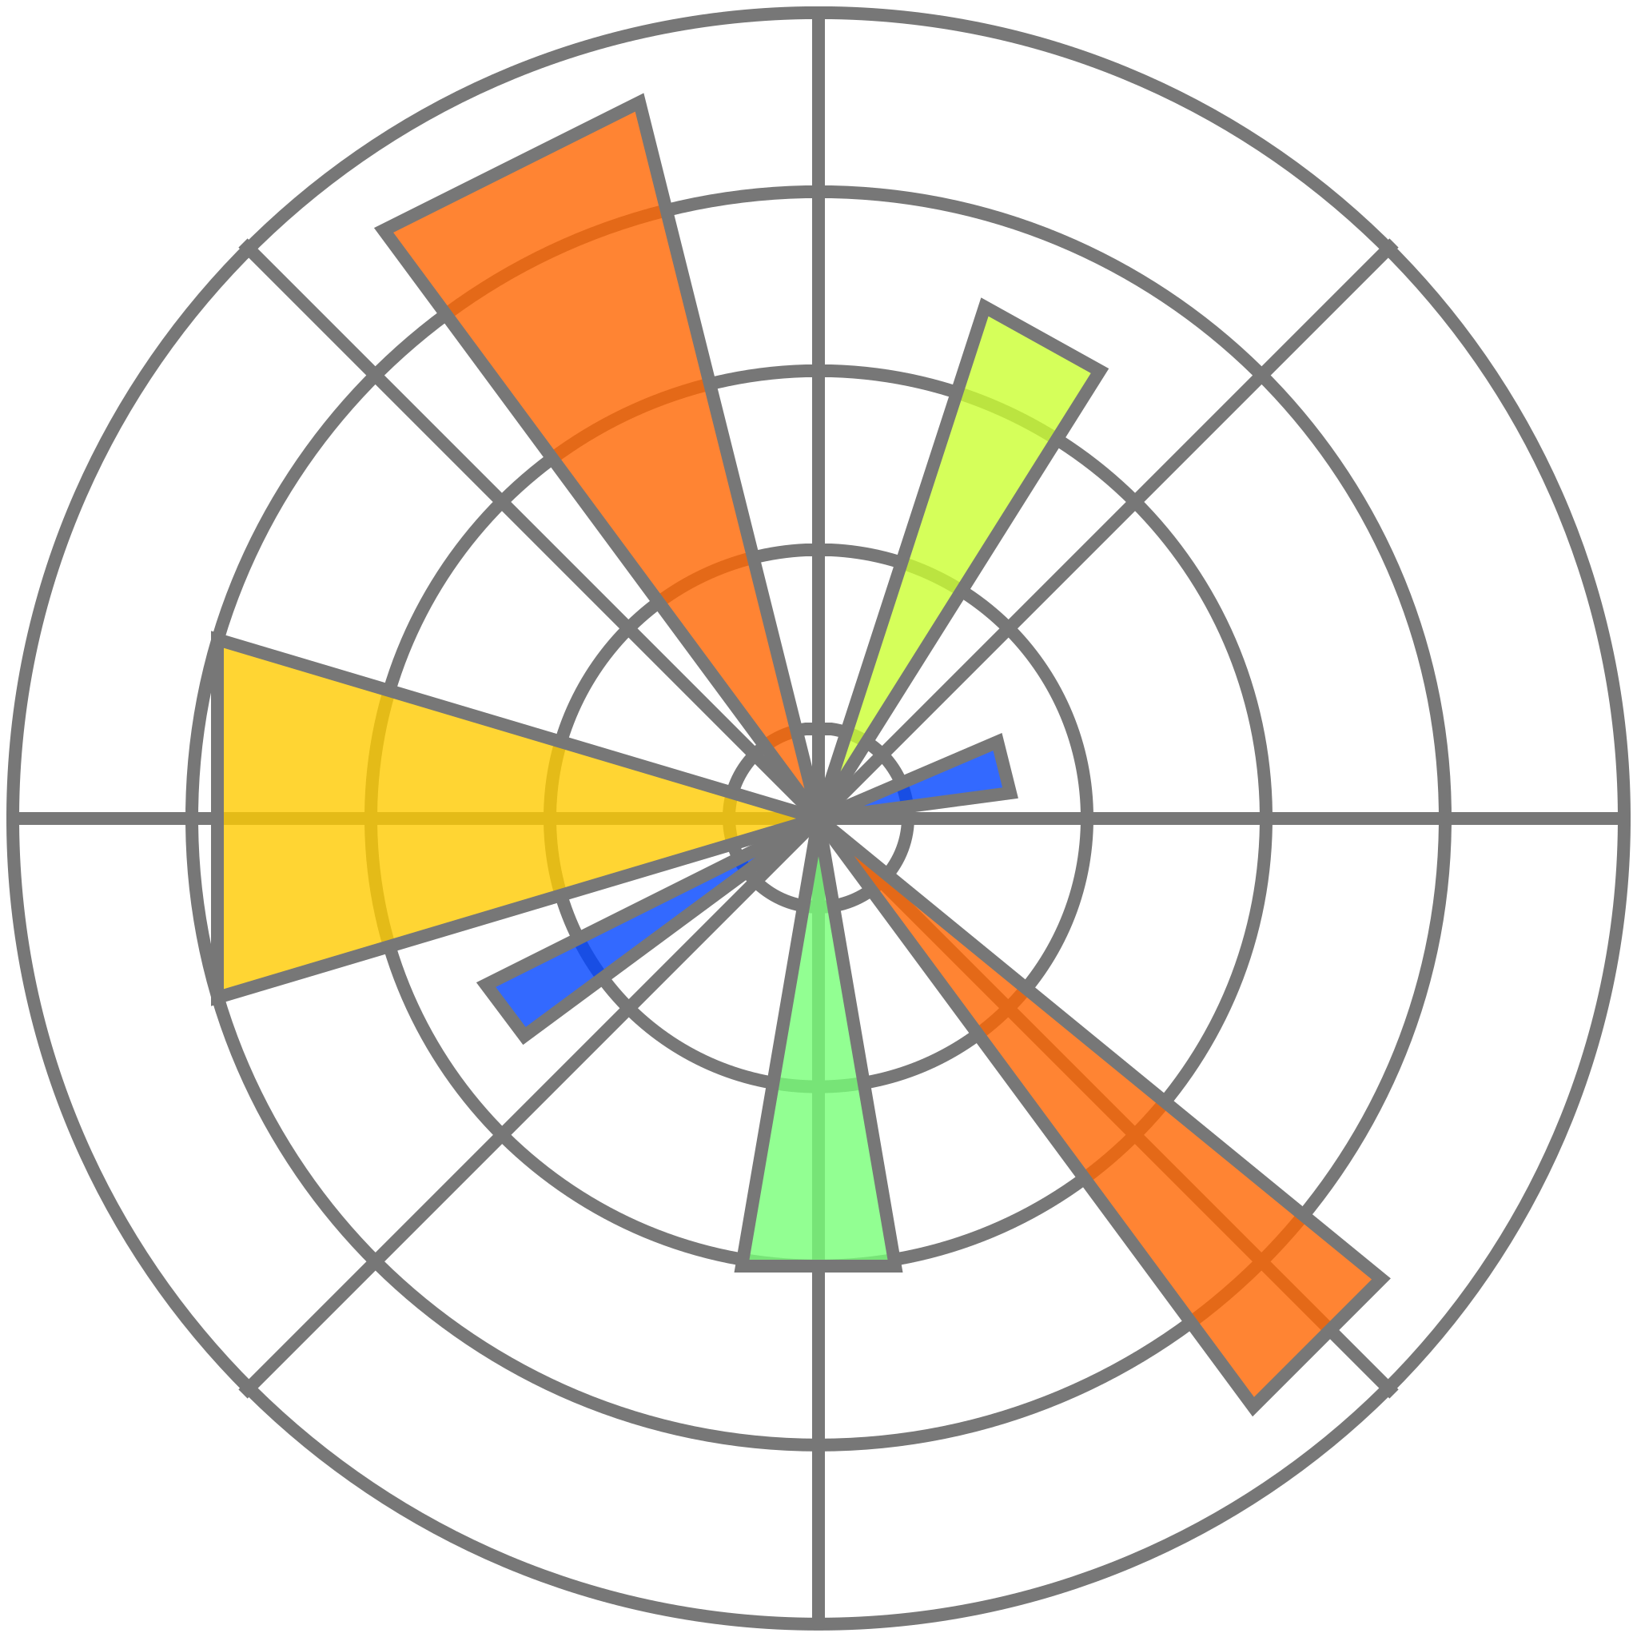



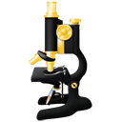




UCL's Collaborations (RSE) team
People with OSS roles before joining
Activities supported by the group
2 maintainers
1 (many) packages maintainer
Promote Open Science
1 maintainer
Problems??
1 maintainer
💰
Open Source Software Sustainability Funding (2022)
1 package maintainer
1 maintainer
👛
Open Source Toolkit research theme (2023-2024)
1 maintainer
1 maintainer
💷
Internally seed funding (2025-)
2 maintainers

Slide 25


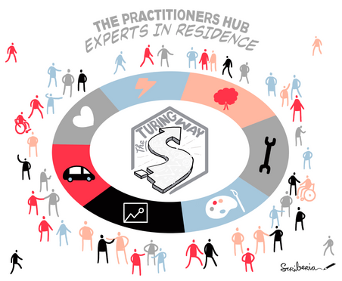











OSPO timeline (till now)
London 2021
...
Feb 2024
Jul 2024
Nov 2024
London OSS Breakfast
Sep 2024
RSECon24
2025
Notes:
Meanwhile, internally, I've been talking with people and finding allies

Slide 26
What is our Goal?
🧑‍🏫 Education
OS tool training
OS development (collaborations)
Philosophy
Mentoring
Employability
👩‍🔬 Research
Open Science
Reproducibility
Maintenance
🏛️ Infrastructure
Support OSS
Adapt/contribute
Sovereignty
📜 Policies / Collaborations 🤝
📏 Metrics
What do we create?
Where do we help?

Slide 27
Presentations
David Perez Suarez - UCL
Markus Hauru - The Alan Turing Institute

Slide 28
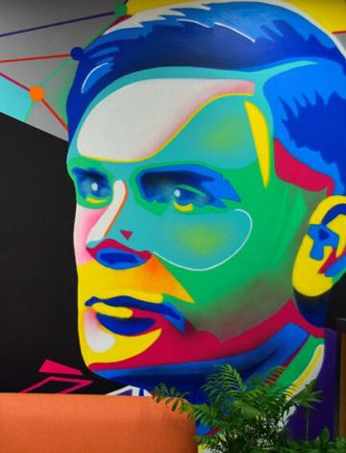
Open Source Service Area @ Alan Turing Institute
Markus Hauru
Senior Research Data Scientist
mhauru@turing.ac.uk

Slide 29
Research Engineering Group (REG) @ The Turing

Slide 30
REG and Open Source
What we do well:
Openly license most of our work
Advocate for open source in our projects
What we could do better:
Upstream contributions
Maintenance

Slide 31
REG Service Areas
5% of our time goes towards service areas:
Recruitment, communications, EDI, GitHub maintenance, etc.
And, since 2023, Open Source Service Area

Slide 32




Open Source Service Area
“We work to make REG a better open source citizen by contributing and enabling and encouraging the rest of REG and Turing to contribute to the wider open source ecosystem.”
2-3 people with 5% FTE allocations
A handful of other actives
Many people taking part in activities
Next: Things we do

Slide 33
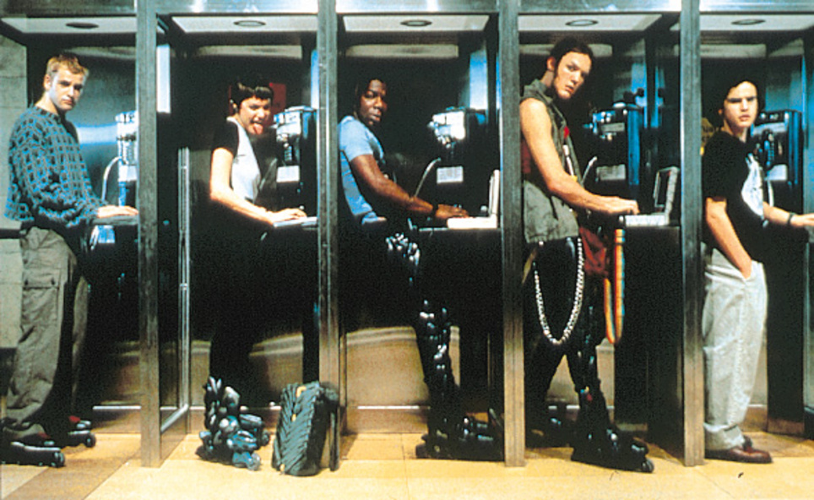
Hacksessions
A Friday afternoon, once a month, for contributing to upstream open source packages
Or other open source packages…
Typically ~5 people each month

Slide 34
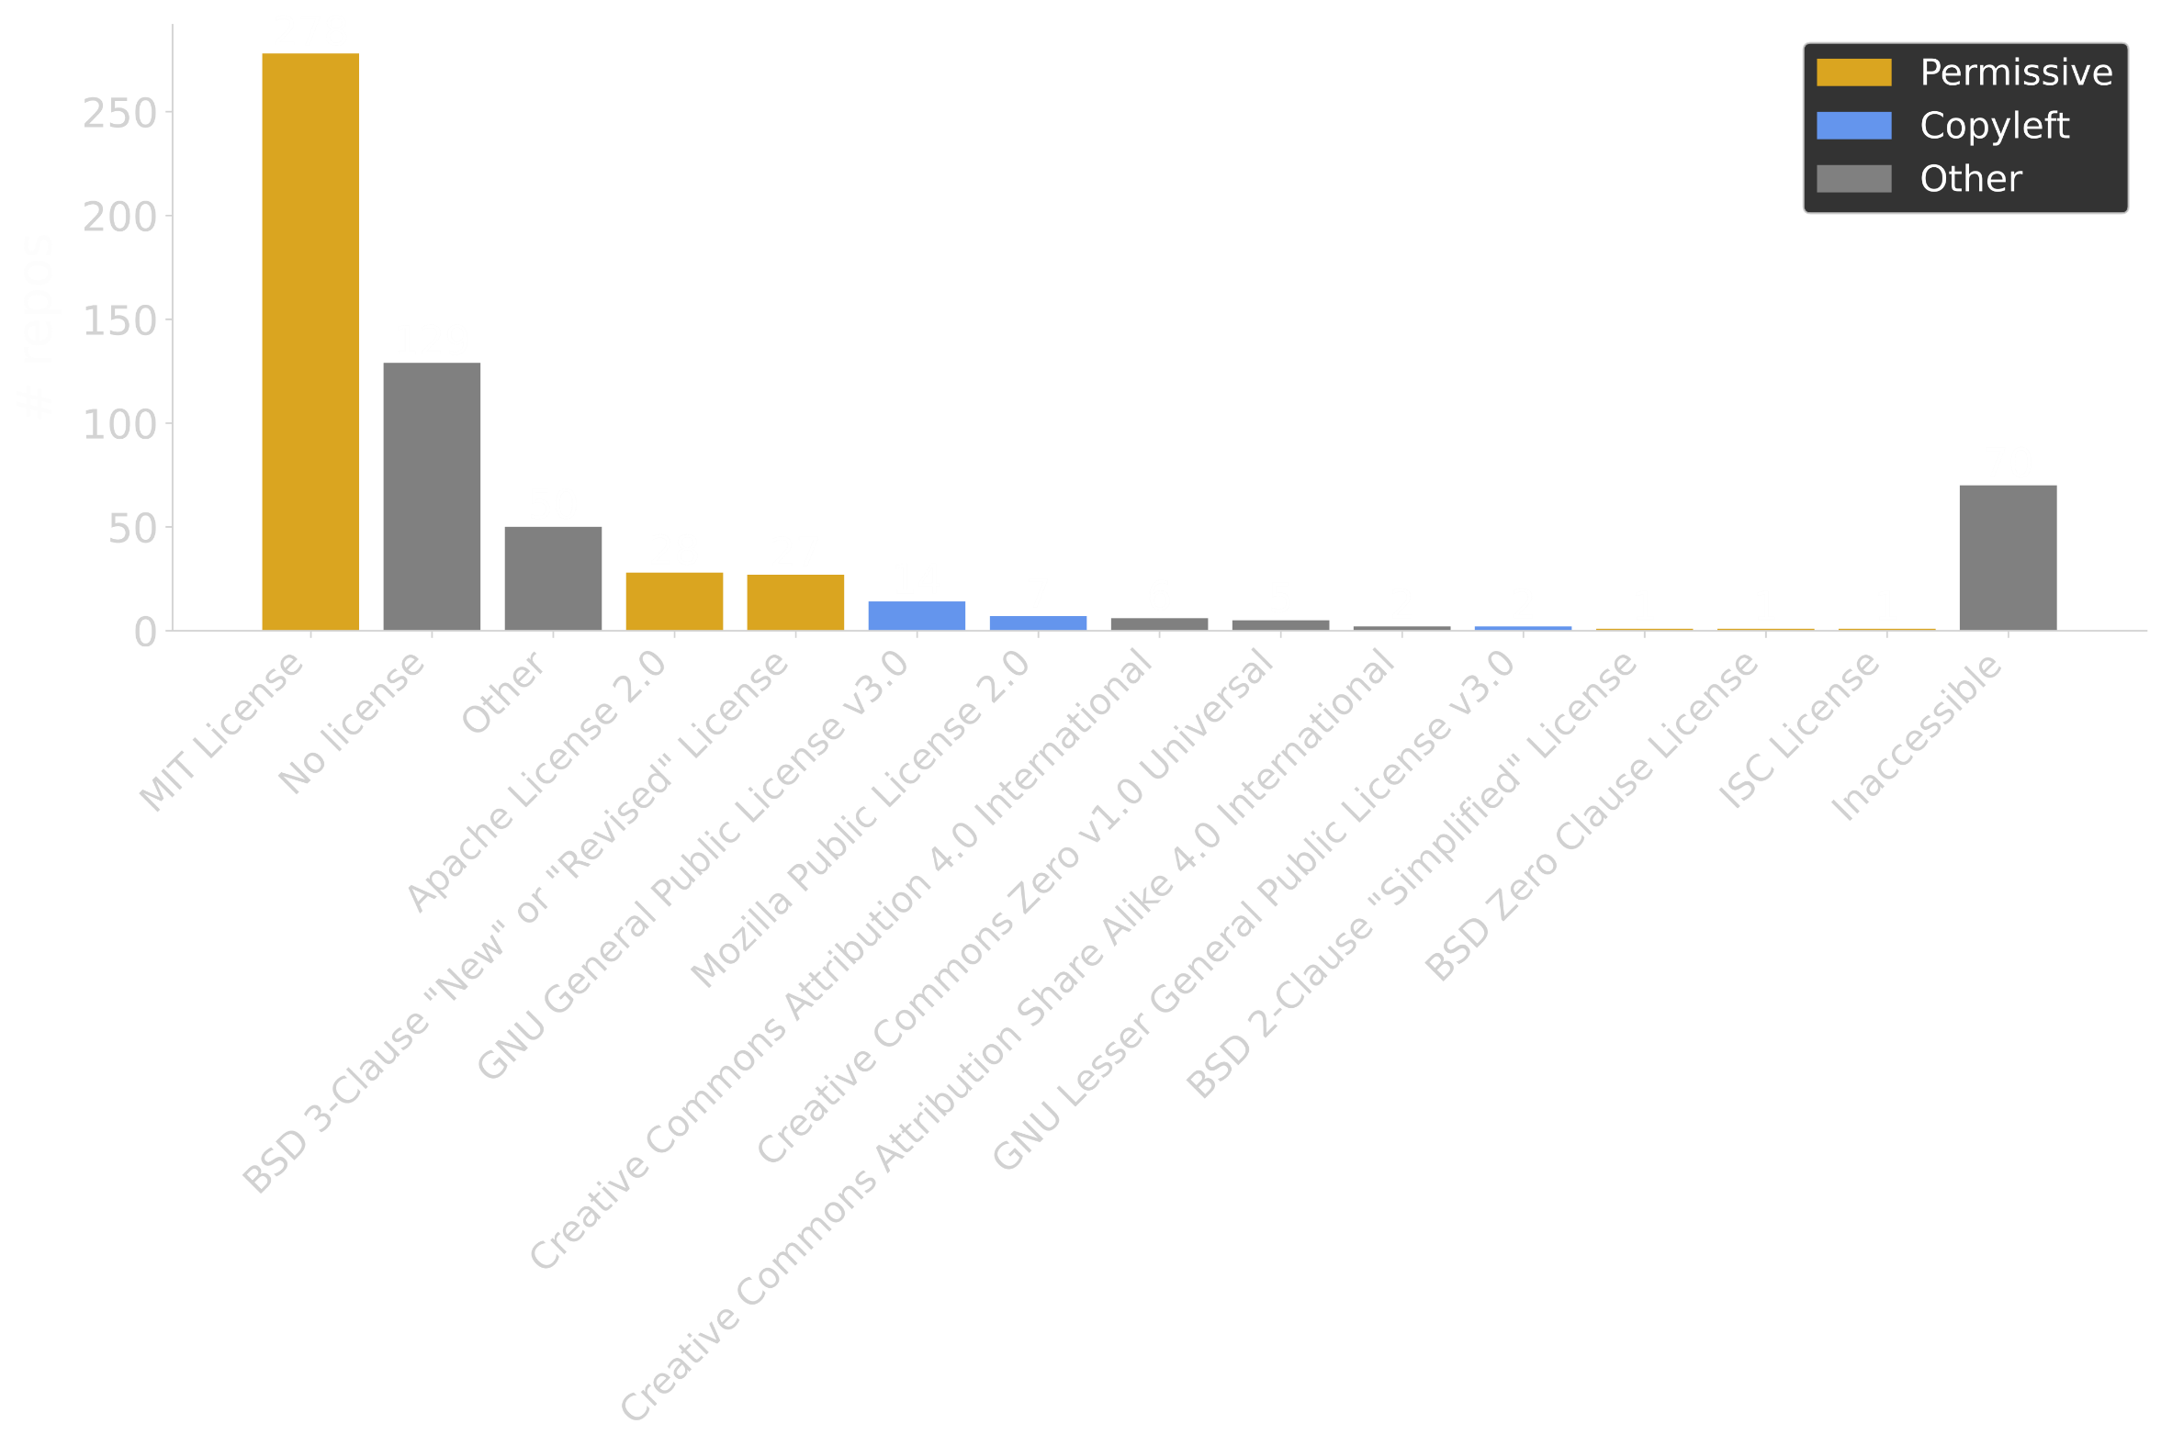

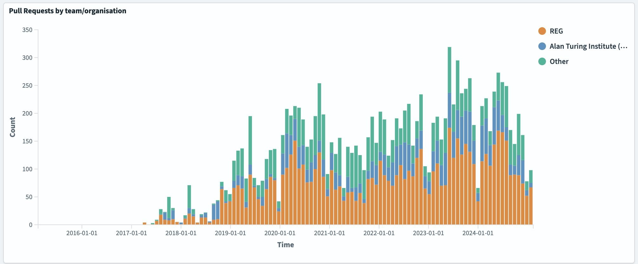

Analysing our GitHub data
How do we maintain our repos?
Who engages with them?
Deployed GrimoireLab
Considering where to go from here

Slide 35
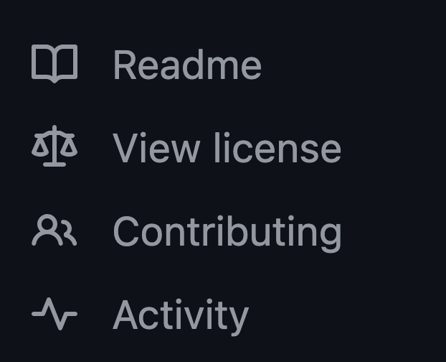

GitHub house cleaning
Finishing a drive of archiving abandoned GitHub repos of ours. There are hundreds.
Next: A drive to ensure we’ve open sourced what we can.

Slide 36
And also
FOSDEM attendance and organising
Internal and external comms: Talks, blog posts
Collaborating with Turing’s Tools, Practices & Systems and other teams
UKRI Data Policy Draft consultation
EDI/open source initiative
Having a banner to rally around helps

Slide 37
Open Source Service Area @ Alan Turing Institute
Thank you
Rosie Wood, Martin Stoffel, Markus Hauru, David Llewellyn-Jones, Jim Madge, Andy Smith, et al

Slide 38
Agenda
Ice Breakers + Intros
Open Source Reflections
Open Source Barriers
BREAK
Learning from existing practices
Practical interventions

Slide 39
Open source barriers: how to reduce, mitigate, resolve? (30 mins)
In groups: pick one of the barriers from the session before the break (can do more than one if you have time!)
Brainstorm ideas for addressing it, these could be at any scale
Consider:
  Resources
  Likely barriers
  Who should lead or be involved in the work?
  What exists already that could be scaled or adapted?
Add notes to Miro board or shared notes document
Choose someone to report back

Slide 40
Final bits…
Take the "From Code to Contributions" survey here: https://southampton.qualtrics.com/jfe/form/SV_aXYKOkmKdvzbRiu
Check out The Turing Way: the-turing-way.start.page
Look out for other opportunities to feed into focus groups, publications etc
Stay in touch ariellebennettlovell@gmail.com

Slide 41
Thank you!

