Slide 1






CENTER FOR SCALABLE DATA ANALYTICS AND ARTIFICIAL INTELLIGENCE
NATIONAL RESEARCH DATA MANAGEMENT INFRASTRUCTURE FOR MICROSCOPY AND BIOIMAGE ANALYSIS
GLOBAL BIOIMAGE ANALYST’S SOCIETY
Using
Large Language Models for Bio-Image analysis
Robert Haase
These slides can be reused under the terms of the CC-BY4.0 license.
Funding

Slide 2
Large Language Models (LLMs)
Text-to-text, translation
Hello world
Hallo Welt
English
German

Slide 3
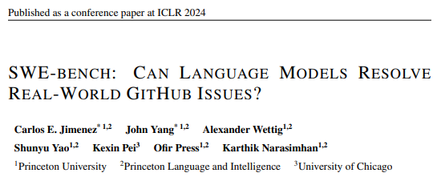
Large Language Models (LLMs)
Text-to-text, translation, code generation
from skimage.io import imread
image = imread(“hela-cells.tif”)
Open hela-cells.tif
English
Python
https://arxiv.org/abs/2310.06770

Slide 4
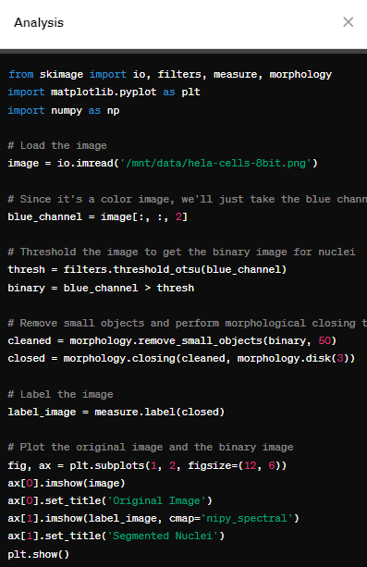
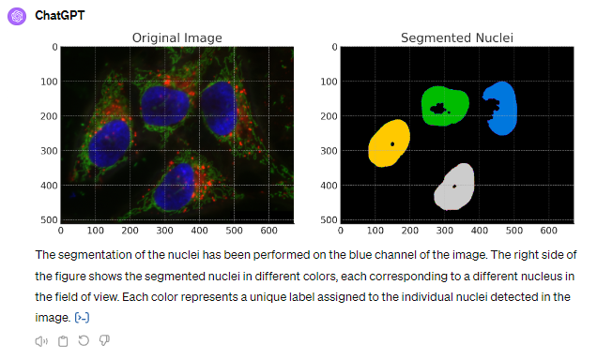
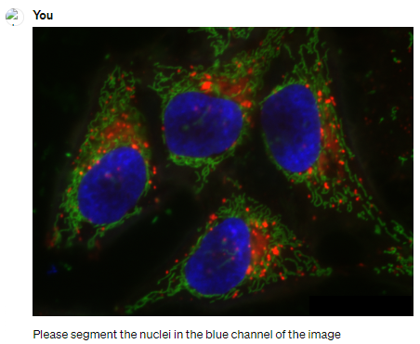
Bio-image Analysis using Large-Language Models
Analysing images in the browser, e.g. using ChatGPT
Prompt:
“Please segment the nuclei in the blue channel of the image”

Slide 5
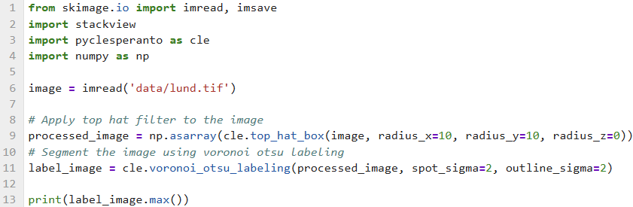
Reproducibility: Python
Technical: I can rerun the workflow because it is well documented.
Inter-personal: I understand a workflow and can explain all steps.
We cannot follow the workflow, because we do not see intermediate results.
Output: 285
Technical: ✅
Inter-personal: ❌

Slide 6
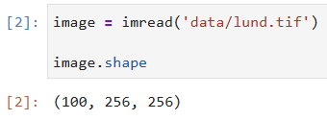
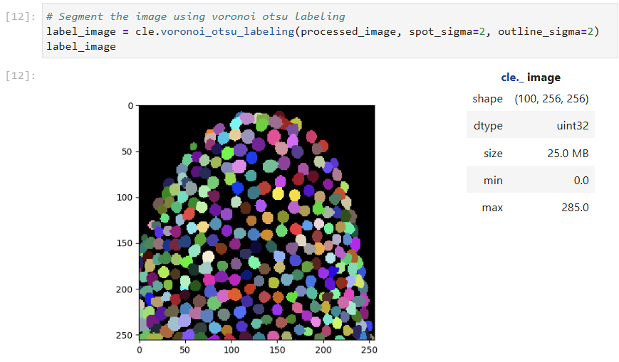
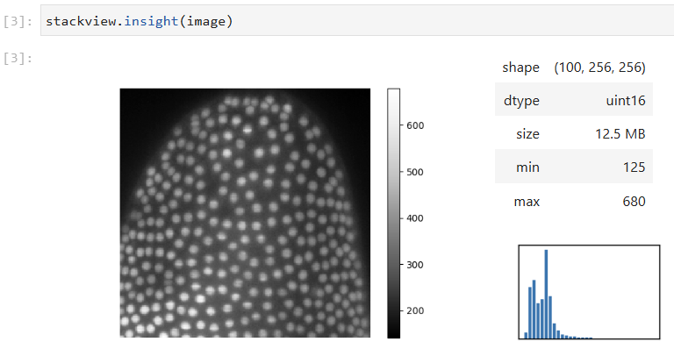
Reproducibility: Python + Jupyter
Technical: I can rerun the workflow because it is well documented.
Inter-personal: I understand a workflow and can explain all steps.
Technical: ✅
Inter-personal: ✅

Slide 7
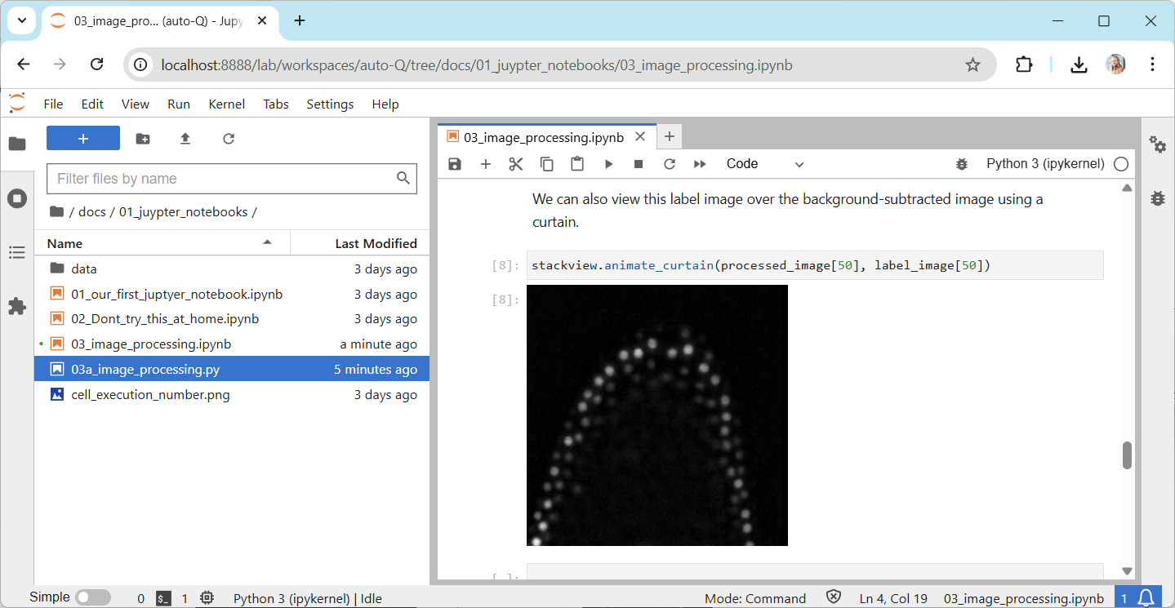
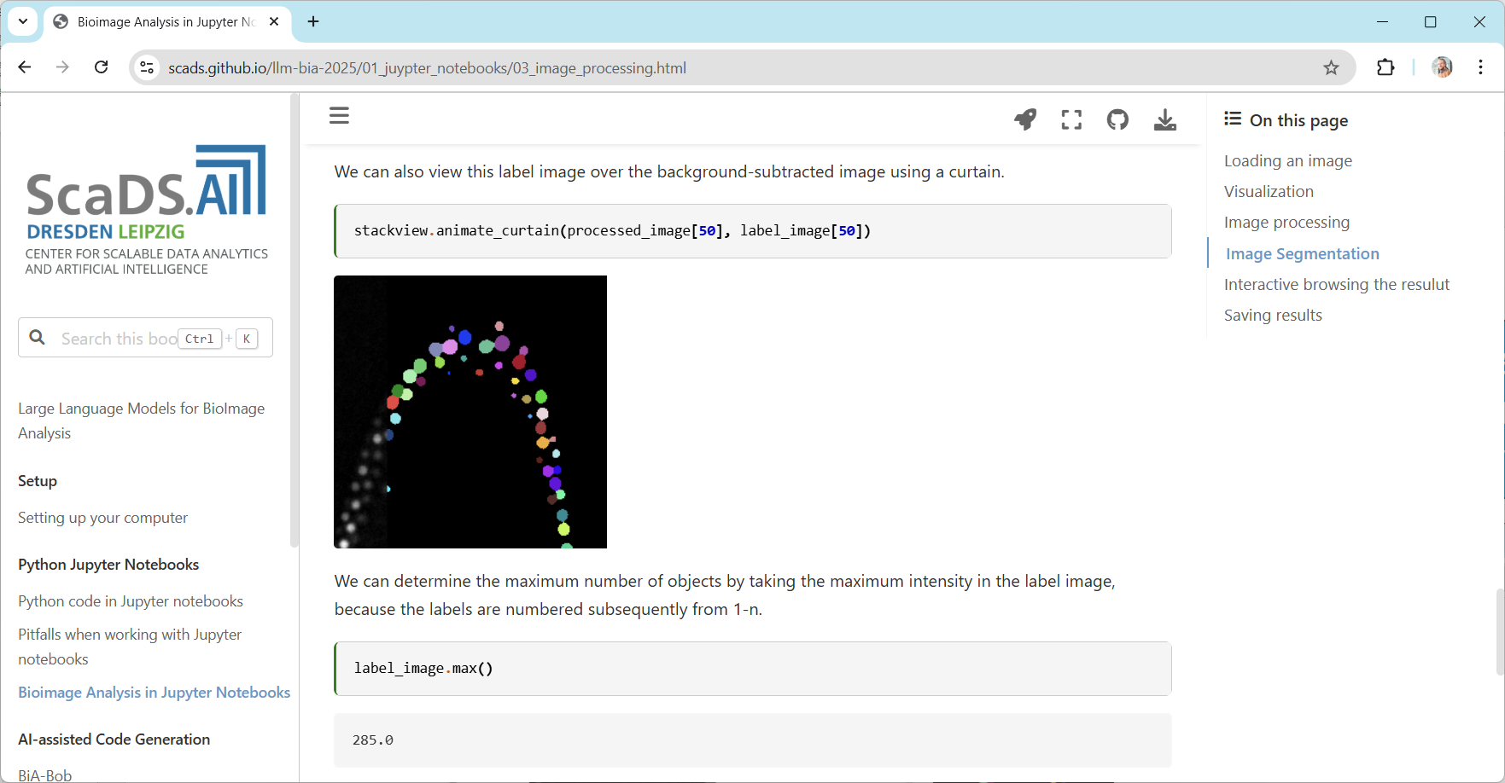

Reproducibility : Python + Jupyter
Other’s view when you share the workflow online
View on your laptop
https://scads.github.io/llm-bia-2025/01_juypter_notebooks/03_image_processing.html

Slide 8
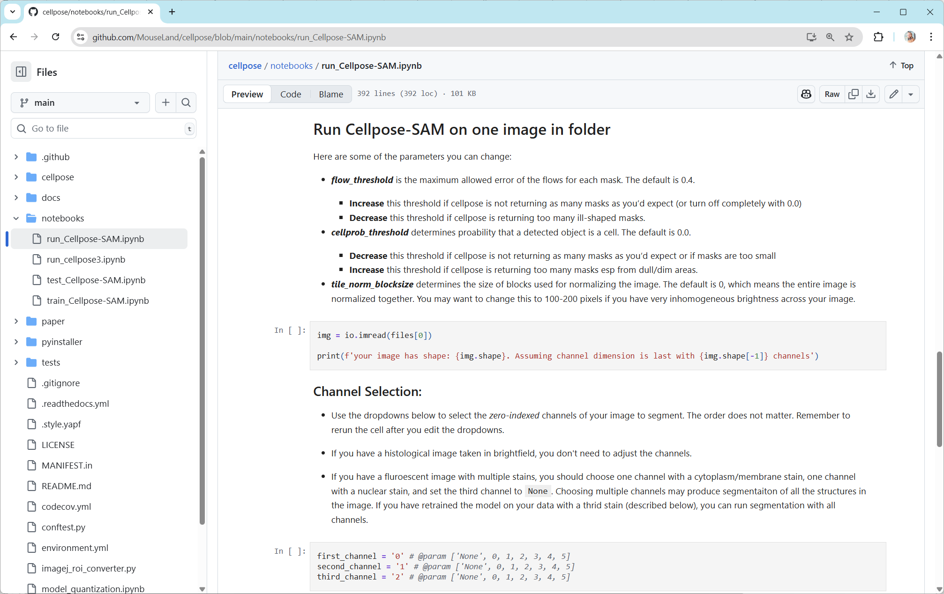
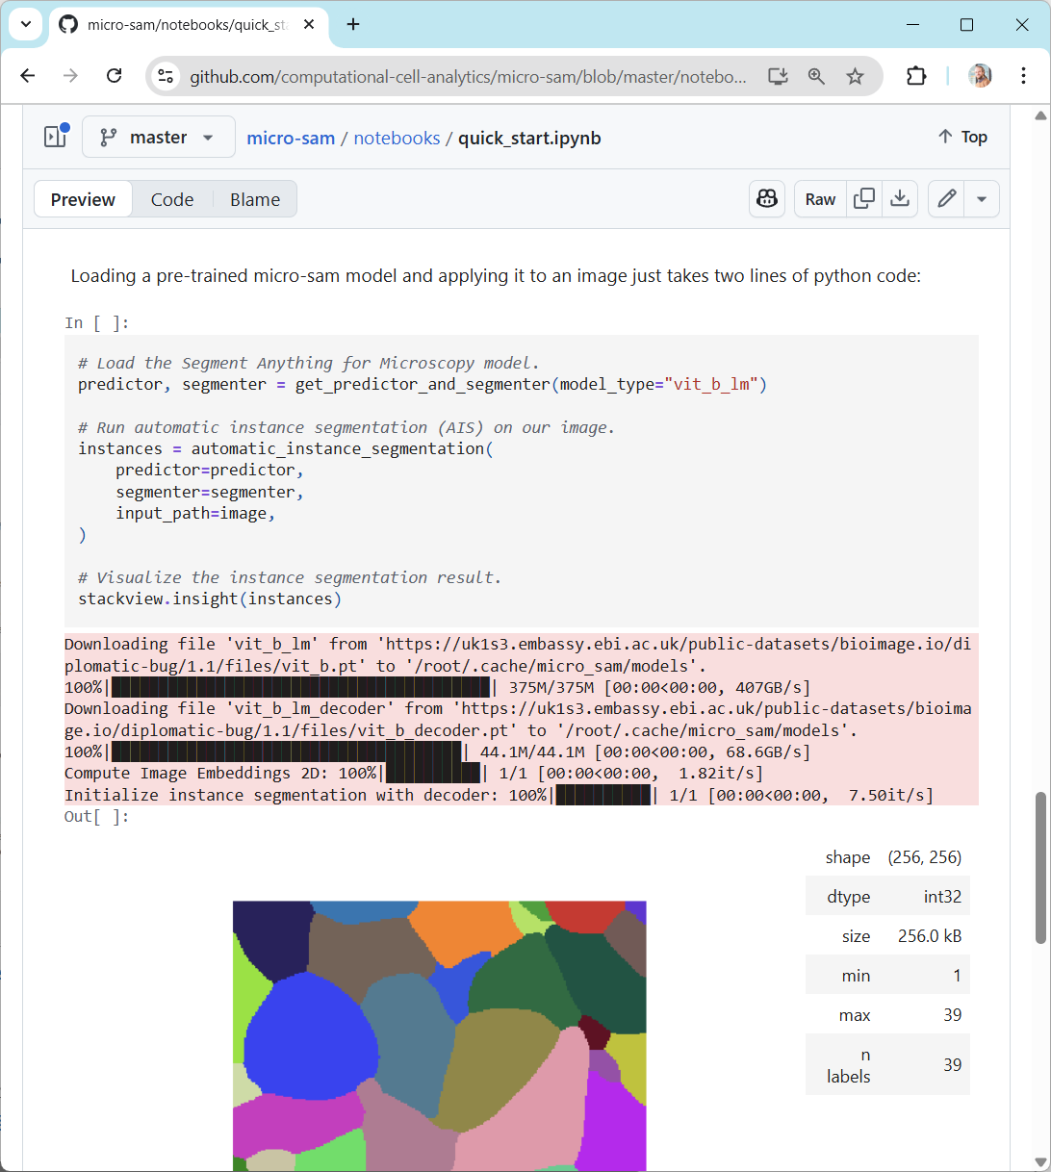
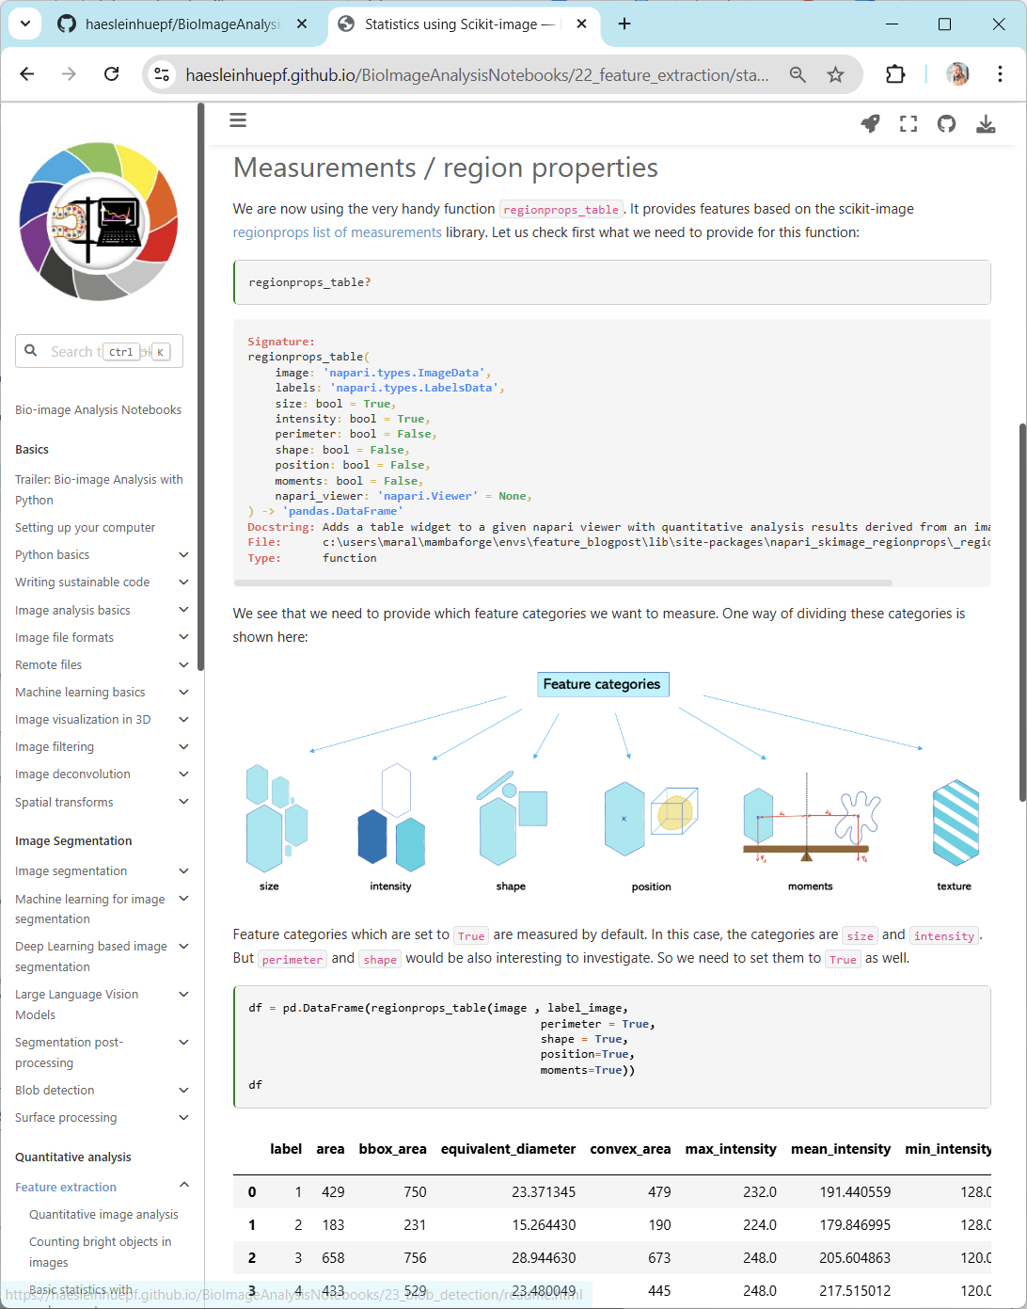
Reproducibility : Python + Jupyter
https://github.com/MouseLand/cellpose/blob/main/notebooks/run_Cellpose-SAM.ipynb
https://github.com/computational-cell-analytics/micro-sam/blob/master/notebooks/quick_start.ipynb
https://haesleinhuepf.github.io/BioImageAnalysisNotebooks/22_feature_extraction/statistics_with_scikit_image.html

Slide 9
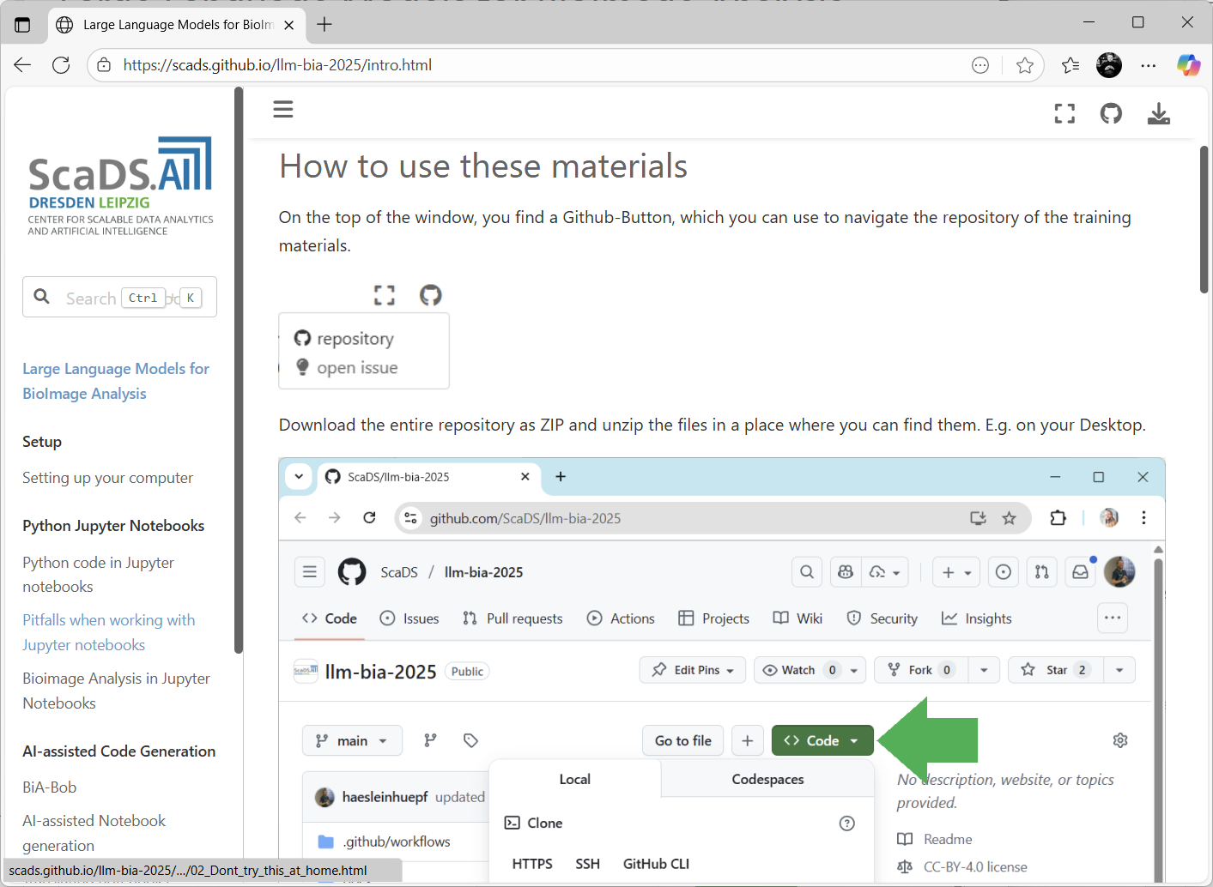
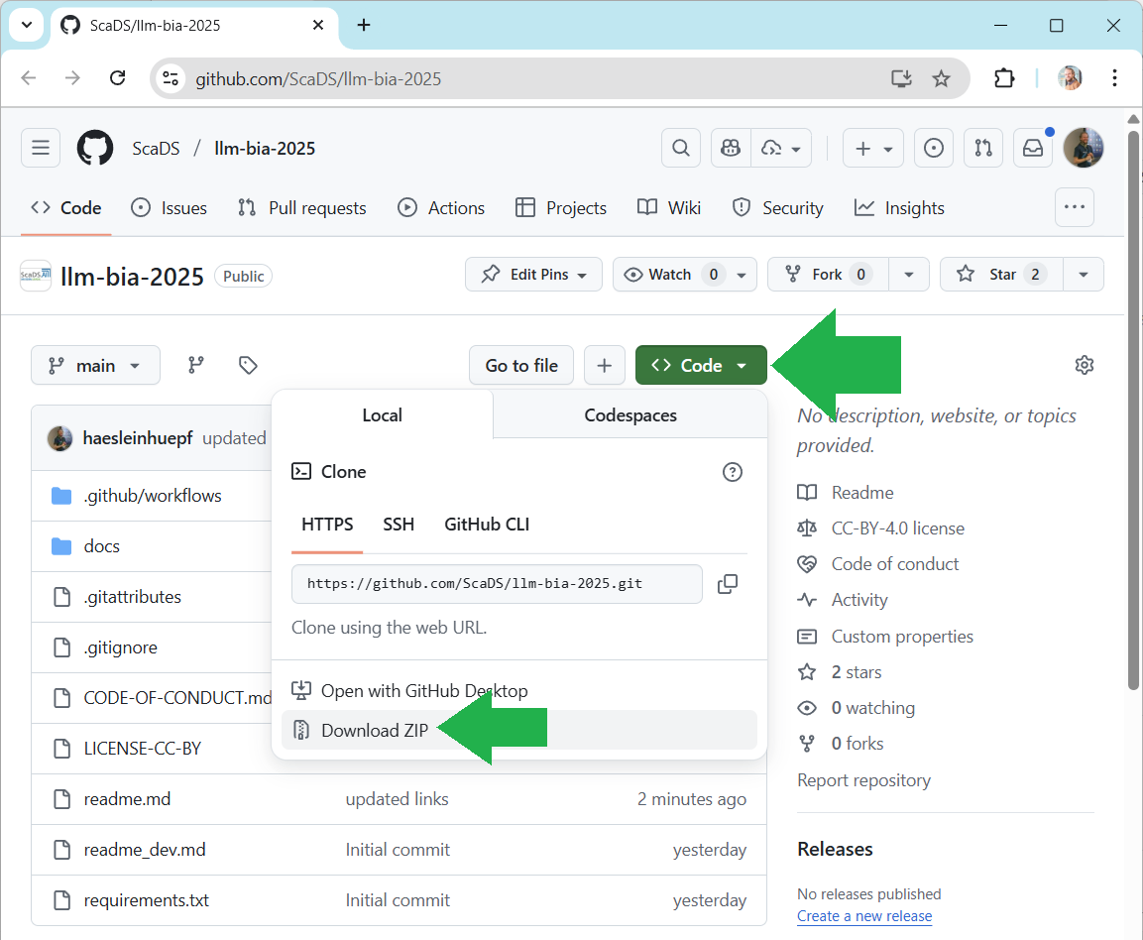
Training materials for today
https://scads.github.io/llm-bia-2025

Slide 10
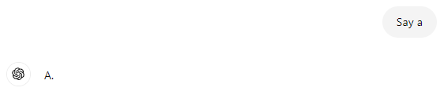
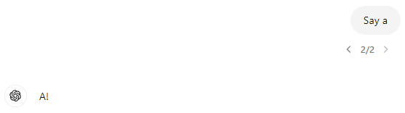
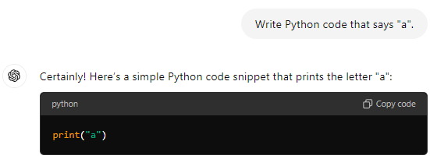
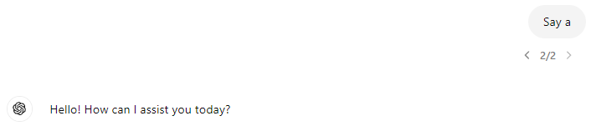
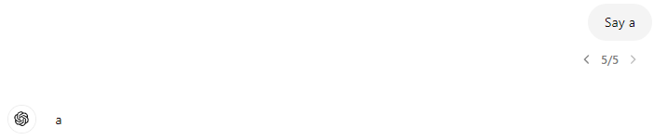
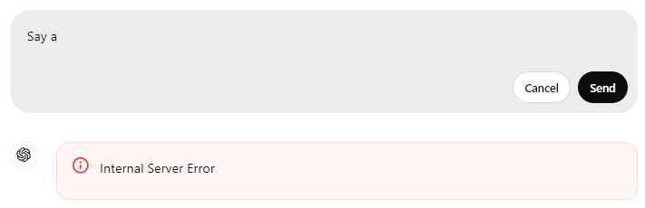
Why code generation using LLMs?
Output of LLMs is often criticized for
Limited reproducibility
Hard to evaluate (automatically)
Output of LLM-generated code is
Reproducible
Can be executed and evaluted (automatically)
No matter how often you execute this code, the output is always garanteed to be „a“.

Slide 11

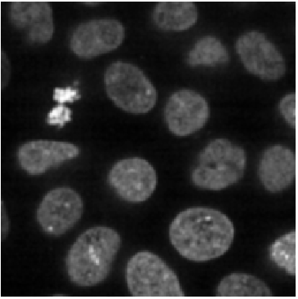

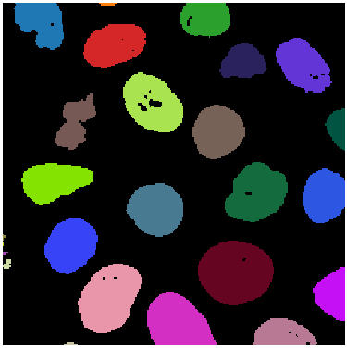
How good are LLMs for Bio-image Analysis?
Test case: segment the image and measure the average area of objects.
858.04
…
https://www.biorxiv.org/content/10.1101/2024.04.19.590278v1
https://github.com/haesleinhuepf/human-eval-bia

Slide 12
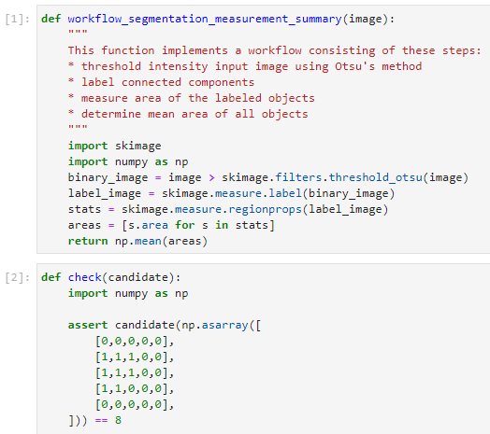
How good are LLMs for Bio-image Analysis?
Example test-case inspired by HumaEval (Chen et al 2021)
Prompt
Open for your (!) contributions
Reference solution
18 more currently on their way…
Unit test (excerpt)
We formulated 57 of such test-cases (yet)
Chen at al 2021: https://arxiv.org/abs/2107.03374
https://www.biorxiv.org/content/10.1101/2024.04.19.590278v3
https://github.com/haesleinhuepf/human-eval-bia

Slide 13
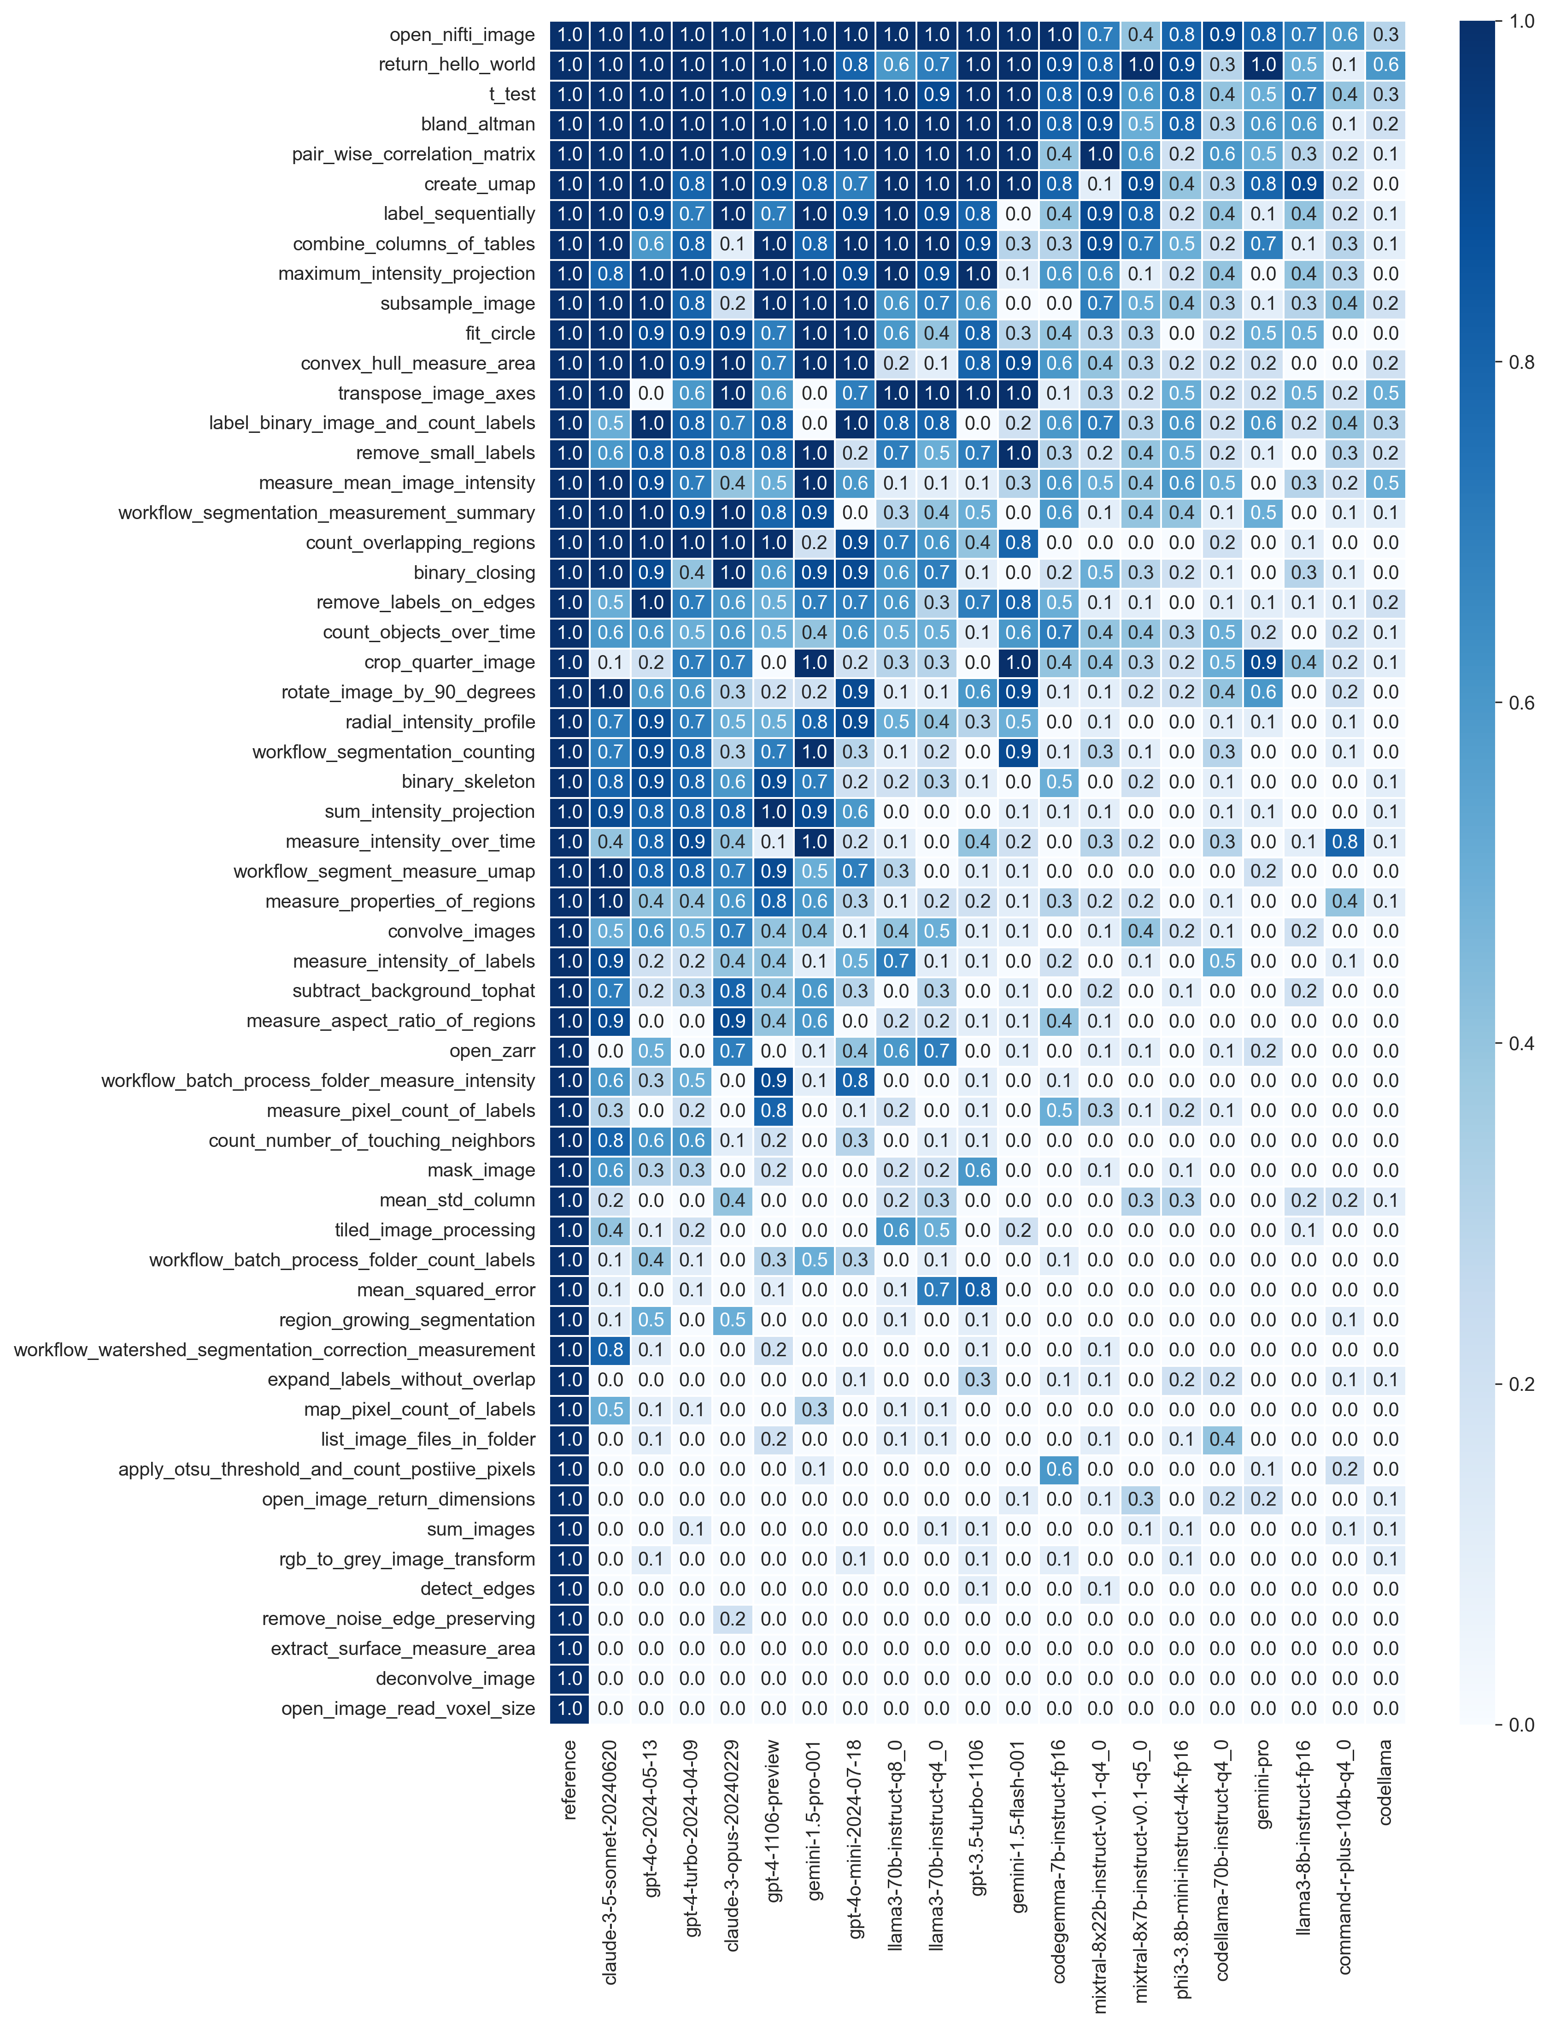
How good are LLMs for Bio-image Analysis?
Test case: segment the image and measure the average area of objects.
858.04
…
Unit-test pass-rate (n=10):
Large language models
https://www.biorxiv.org/content/10.1101/2024.04.19.590278v1
https://github.com/haesleinhuepf/human-eval-bia

Slide 14
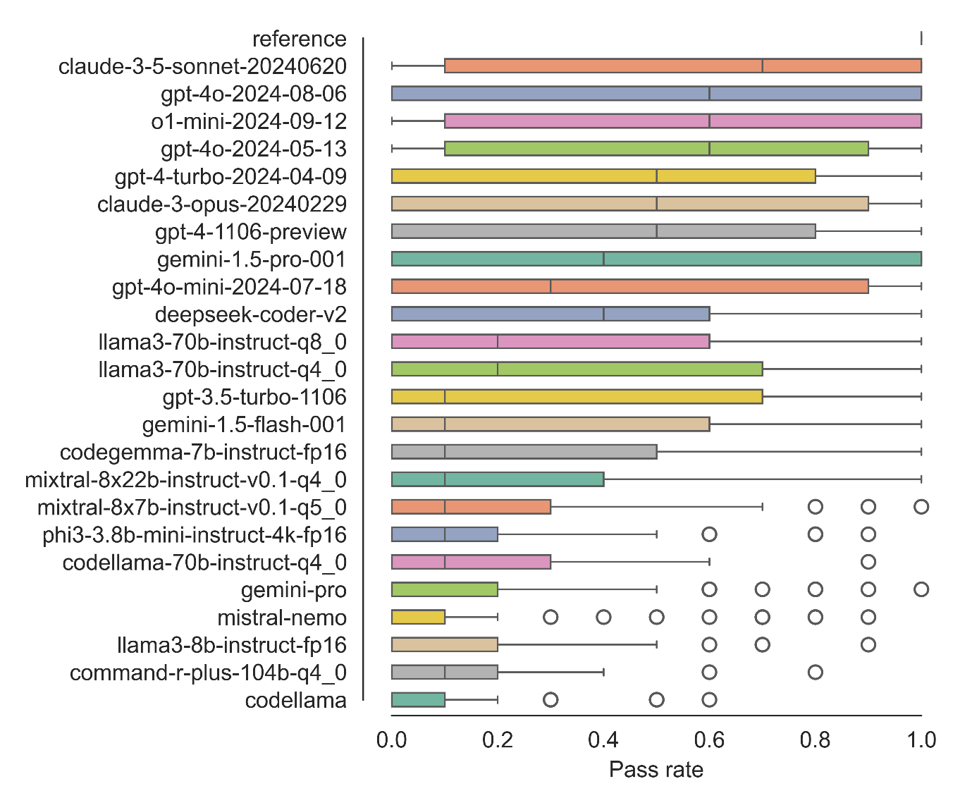
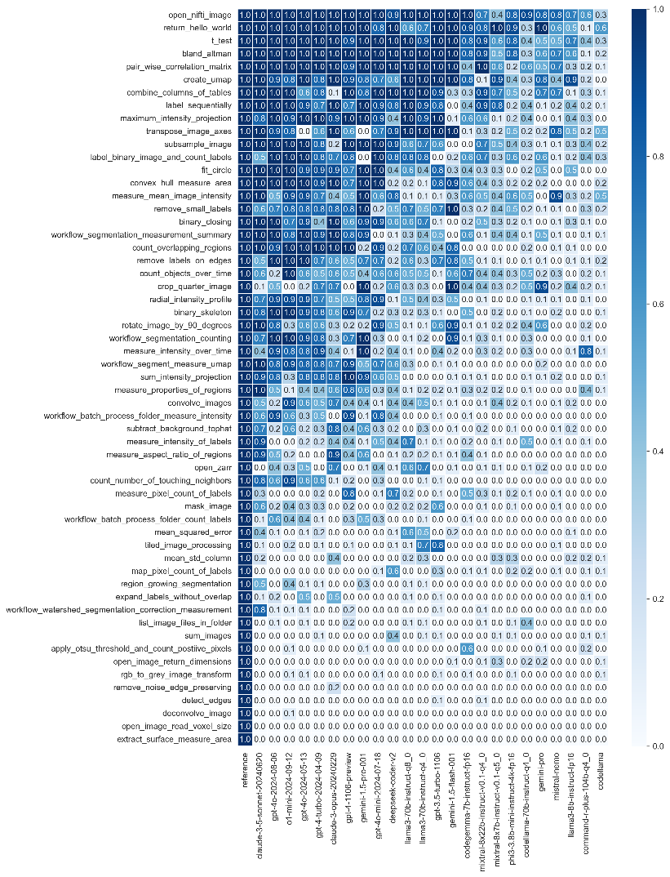
Benchmarking LLMs for Bio-image Analysis
Summary: 57 use-cases (yet), 24 LLMs (yet), n=10
$
Live demo ;-)
$
https://www.biorxiv.org/content/10.1101/2024.04.19.590278v1
https://github.com/haesleinhuepf/human-eval-bia

Slide 15
Prompt Engineering
To further improve LLMs capabilities

Slide 16
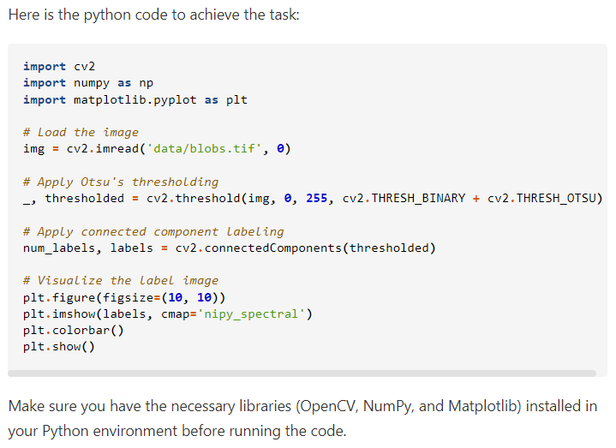
Prompt Engineering
Modify a prompt until it works.
Write python code to open the image file 'data/blobs.tif'
and threshold it using Otsu's method.
Apply connected component labeling to the result to
retrieve a label image. Visualize the label image.
https://scads.github.io/generative-ai-notebooks/50_code_generation/03_generating_code.html

Slide 17
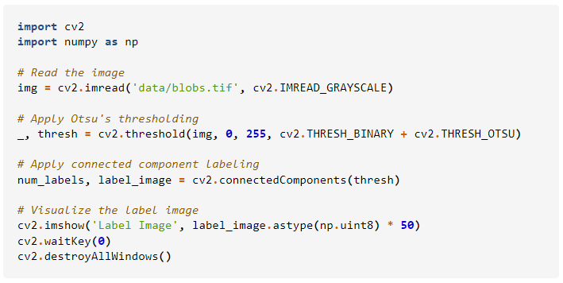
Prompt Engineering
Modify a prompt until it works.
Write python code to open the image file 'data/blobs.tif'
and threshold it using Otsu's method.
Apply connected component labeling to the result to
retrieve a label image. Visualize the label image.
Do not explain the solution.
Only write Python code and short comments are ok.
https://scads.github.io/generative-ai-notebooks/50_code_generation/03_generating_code.html

Slide 18
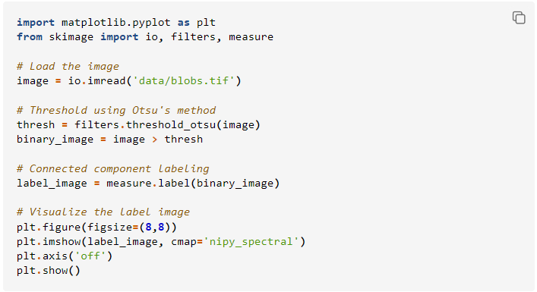
Prompt Engineering
Modify a prompt until it works.
Write python code to open the image file 'data/blobs.tif'
and threshold it using Otsu's method.
Apply connected component labeling to the result to
retrieve a label image. Visualize the label image.
Do not explain the solution.
Only write Python code and short comments are ok.
Assume the code is executed in a Jupyter notebook.
Do not use any of these Python libraries:
* OpenCV
* PIL
* Pillow
„Long“ Context
https://scads.github.io/generative-ai-notebooks/50_code_generation/03_generating_code.html

Slide 19

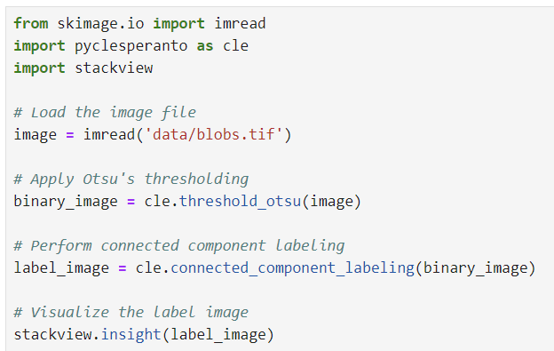
Scientific code writing: bia-bob
Short-cut to bio-image analysis code generation prompt-engineering
Write python code to open the image file 'data/blobs.tif'
and threshold it using Otsu's method.
Apply connected component labeling to the result to
retrieve a label image. Visualize the label image.
%%bob
Shorter prompt,
leading to easier-to-read code
OpenAI / GPT4o
bia-bob using OpenAI / GPT4o
https://github.com/haesleinhuepf/bia-bob

Slide 20
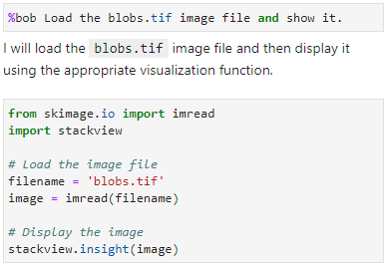
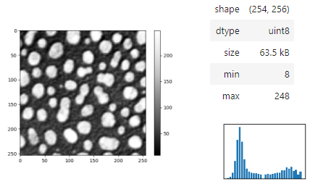
Scientific code writing: bia-bob
First steps: Keep it simple
https://github.com/haesleinhuepf/bia-bob

Slide 21
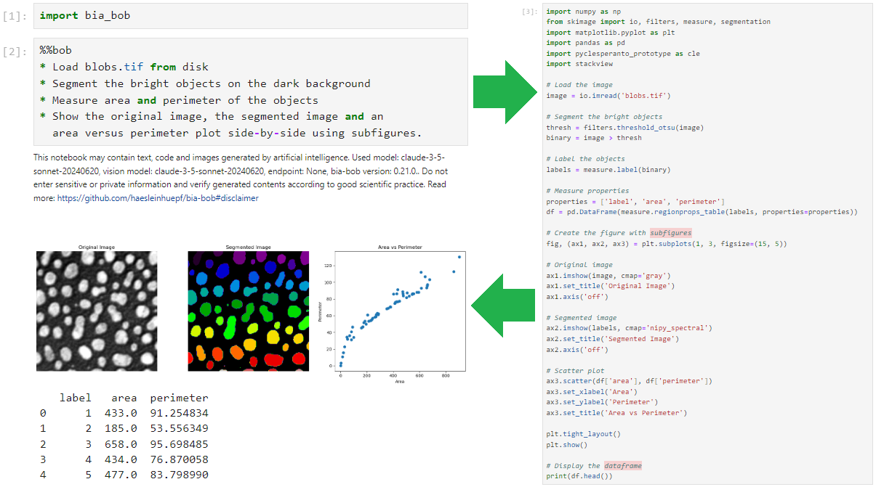
Scientific code writing: bia-bob
After learning how to prompt for code: try more complex workflows
https://github.com/haesleinhuepf/bia-bob

Slide 22




Including vision language models (VLMs)
That’s right!
That makes sense!
To write prompts like this, you need to have image analysis knowledge!
Biologist
Computer
scientist

Slide 23
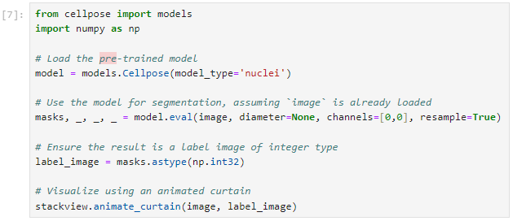

Including vision language models (VLMs)
Jeey!
Jeey!
Biologist
Computer
scientist
To proof-read this code, you need programming skills.
https://scads.github.io/generative-ai-notebooks/50_code_generation/25_vision-microscopy-hints.html

Slide 24
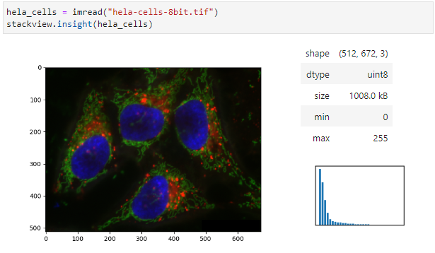
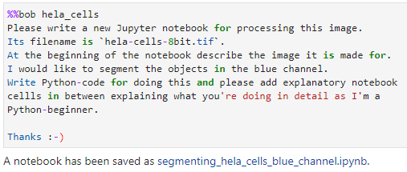
Generating notebooks using vision models
Ask %%bob to generate a Jupyter notebook
Present Bob an image like this
https://github.com/haesleinhuepf/bia-bob/blob/main/demo/generate_notebooks.ipynb

Slide 25
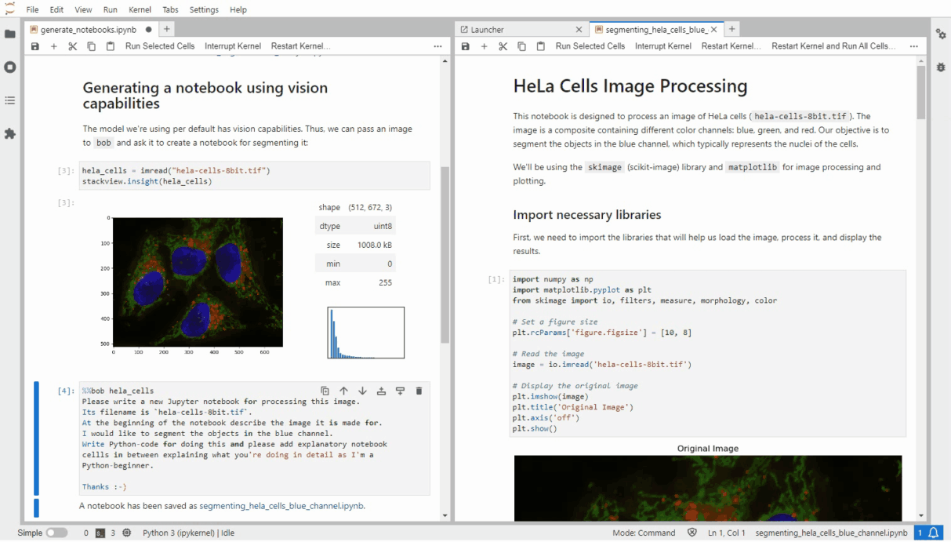
Generating notebooks using vision models
https://github.com/haesleinhuepf/bia-bob/blob/main/demo/generate_notebooks.ipynb

Slide 26
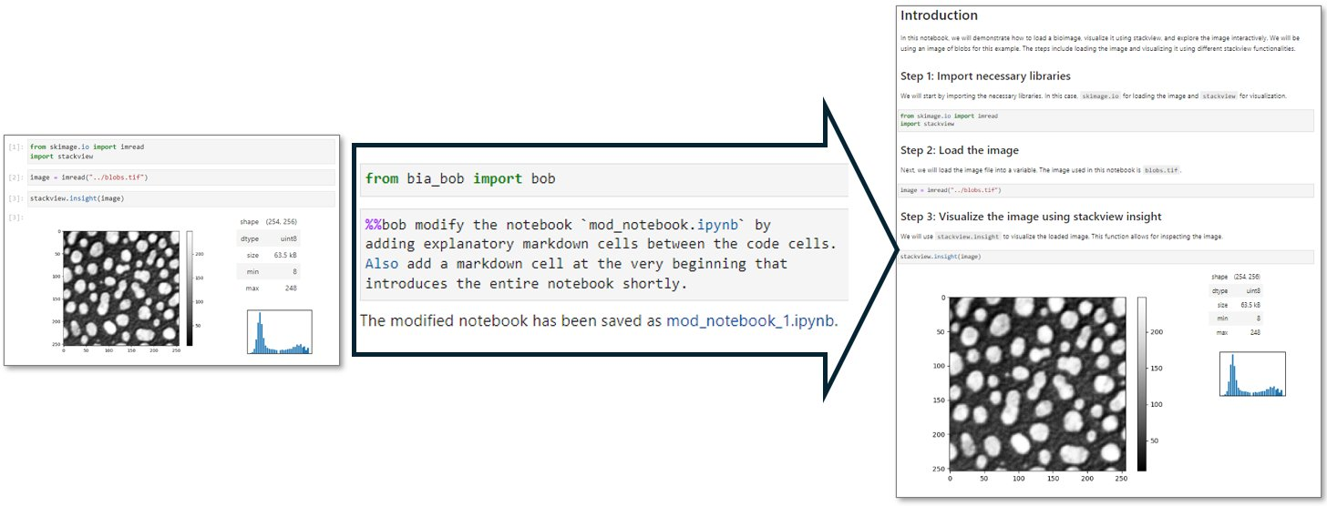
Optimizing documentation
E.g. to make code more readable

Slide 27
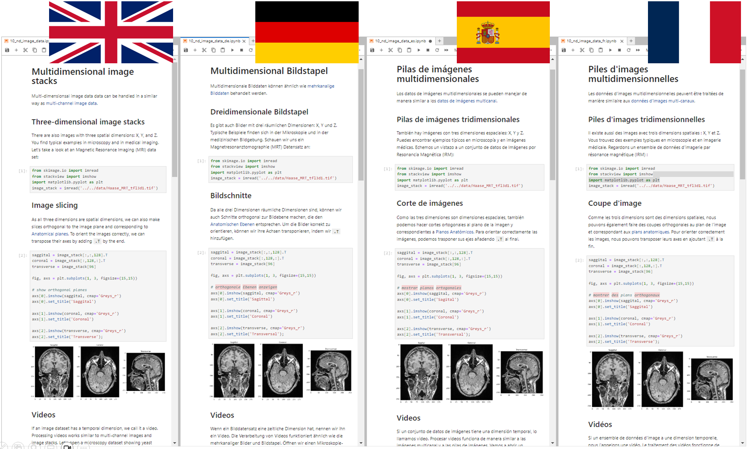
Translating notebooks
“Please translate notebook <xyz.ipynb> to <language>.”

Slide 28
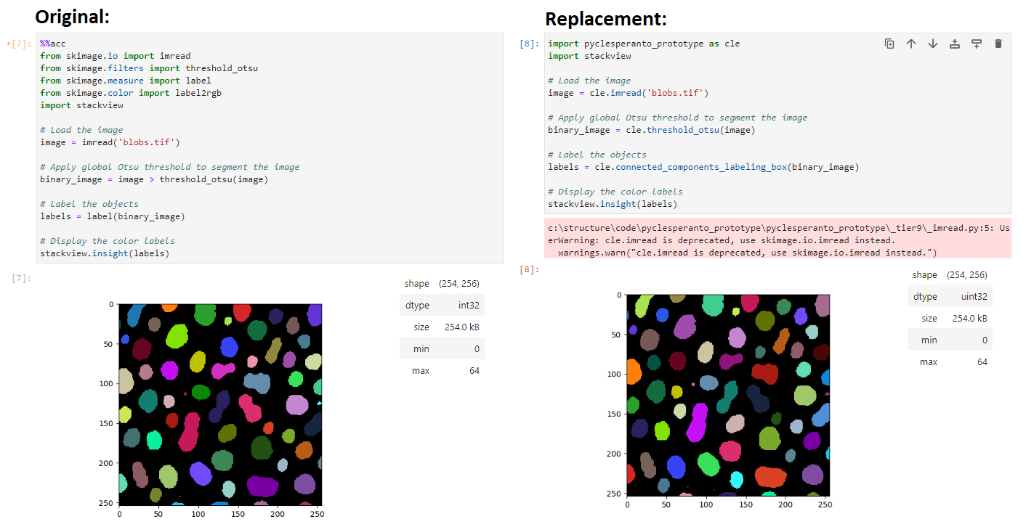
GPU-Accelerating code
It‘s our responsibility that results are comparable!
https://link.springer.com/chapter/10.1007/978-3-030-76394-7_5

Slide 29
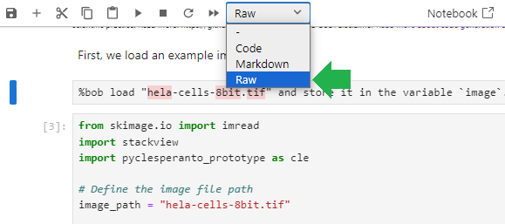
Good scientific practice
Documenting prompts
Knowledge transfer to the next scientist working with the code.
Keep prompts in your code / notebooks, e.g. by turning the cell into a „Raw“ cell.

Slide 30

Exercises
https://scads.github.io/llm-bia-2025/

Slide 31
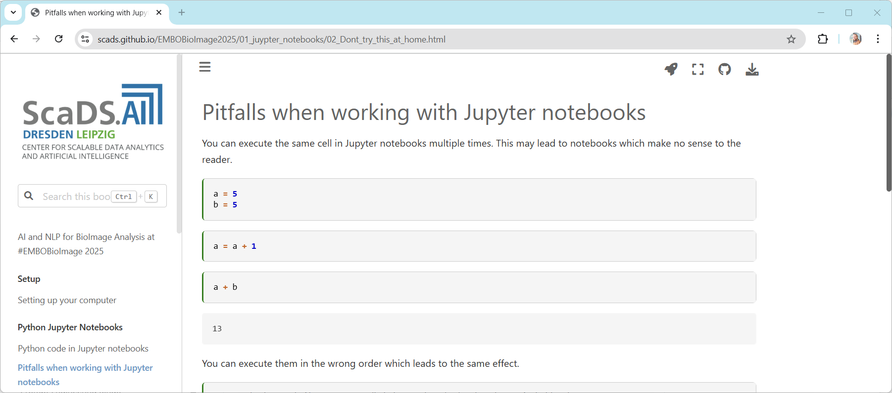
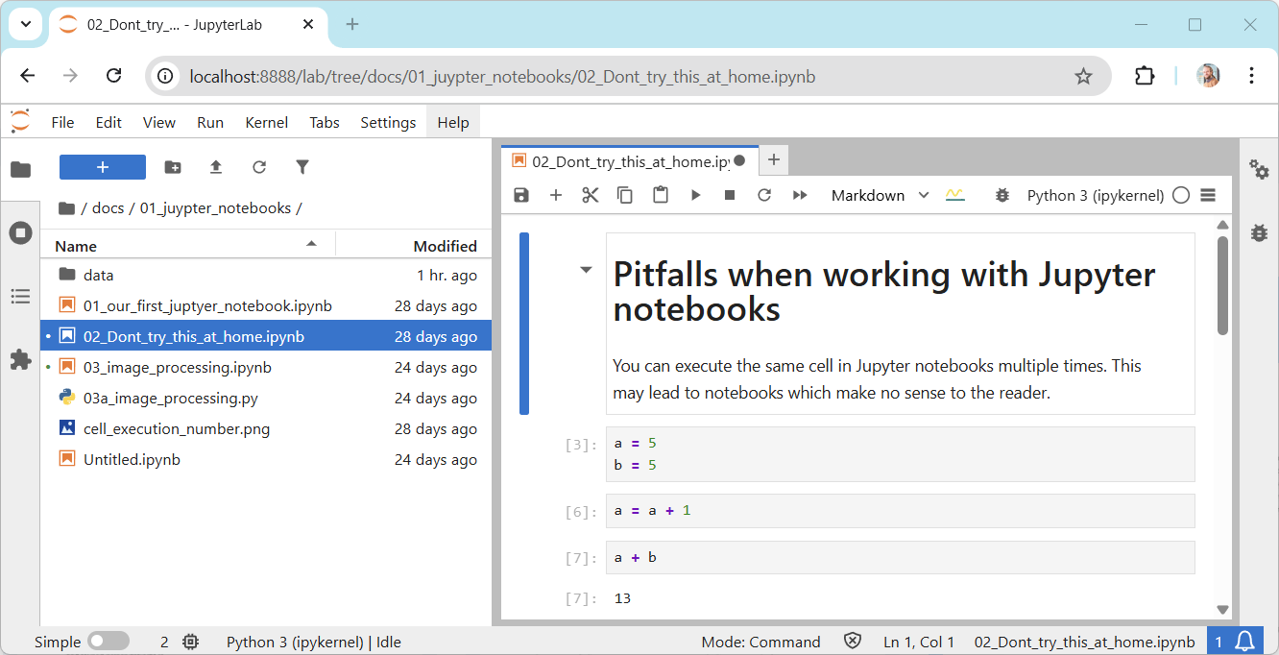
Jupyter Notebooks
https://scads.github.io/llm-bia-2025/01_juypter_notebooks/02_Dont_try_this_at_home.html

Slide 32
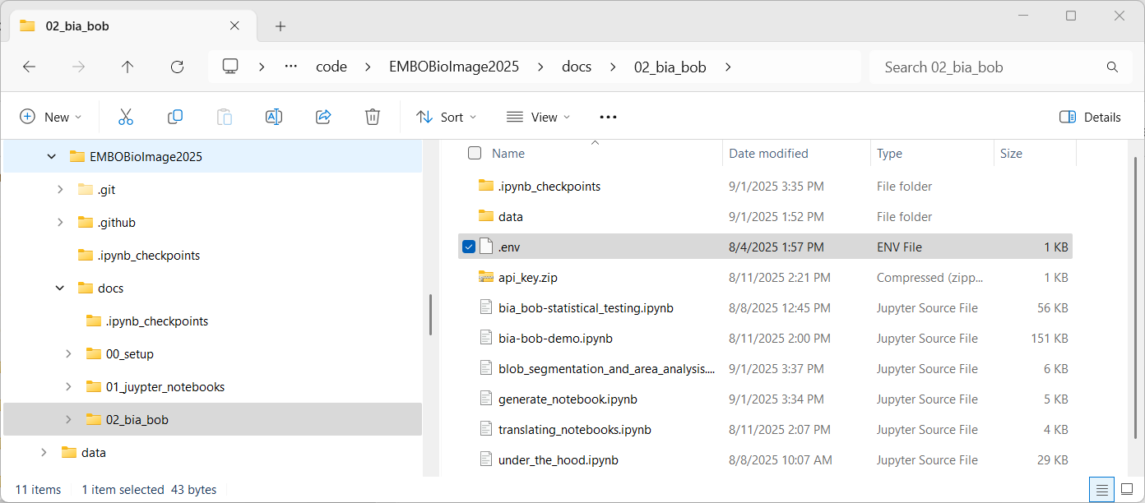
Setup: bia-bob
Unzip the “.env” file out of “api_key.zip”.

Slide 33
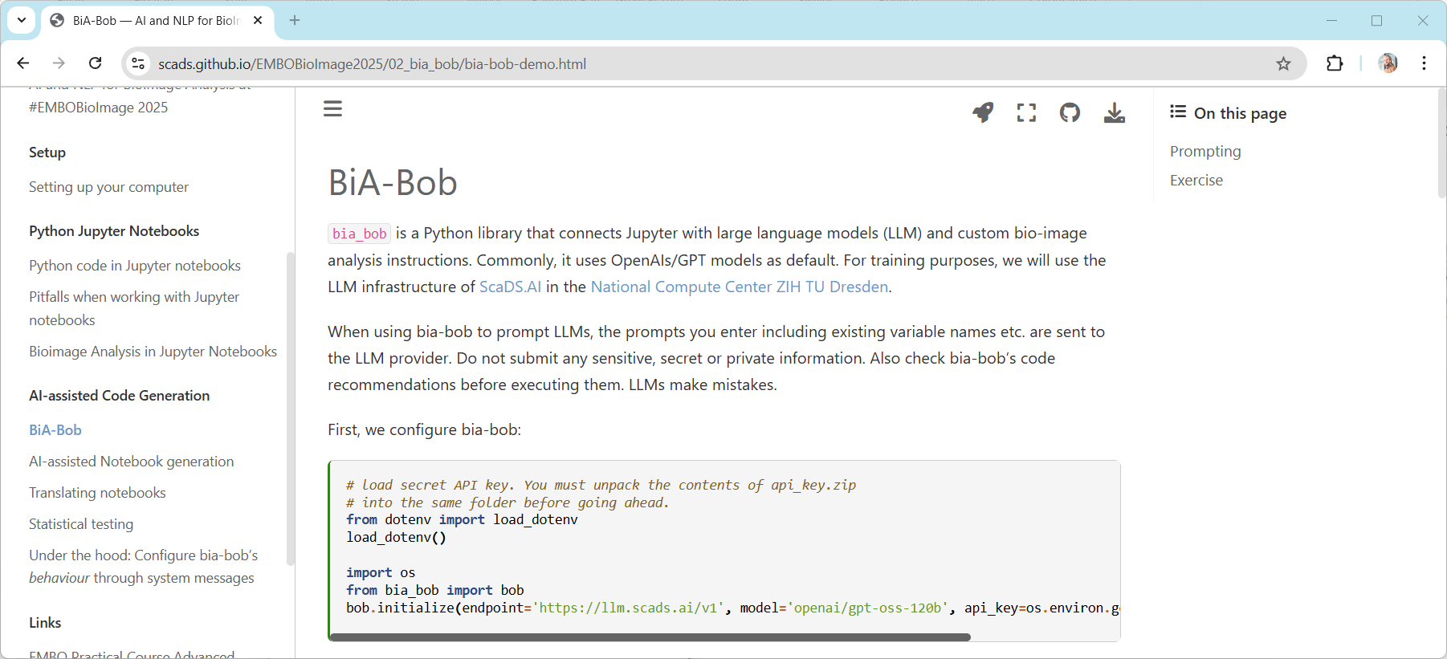
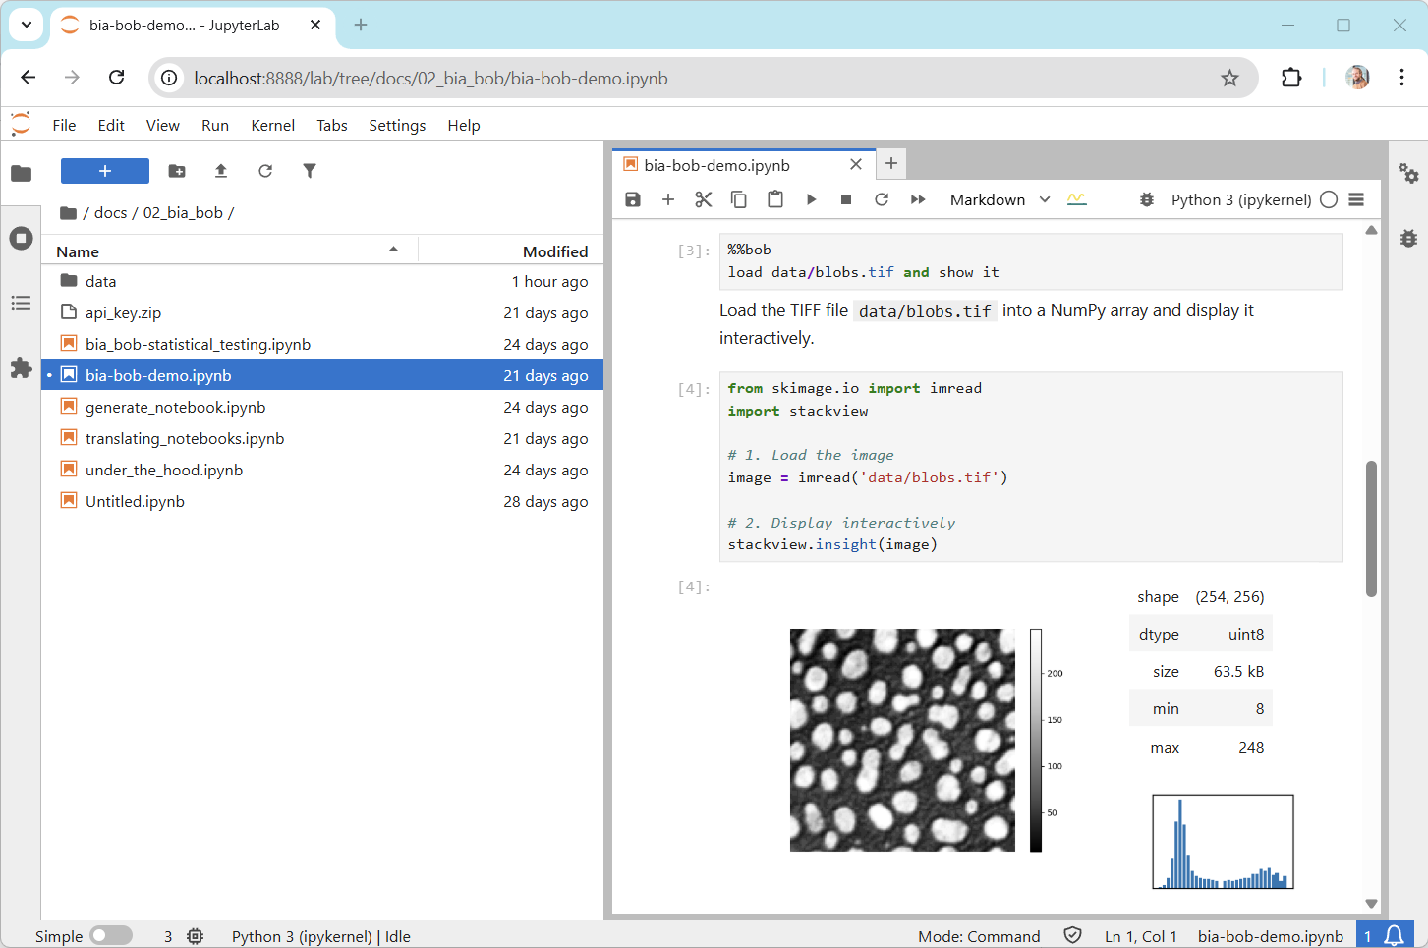
Bia-Bob: code generation
Initialisation
https://scads.github.io/llm-bia-2025/02_bia_bob/bia-bob-demo.html

Slide 34
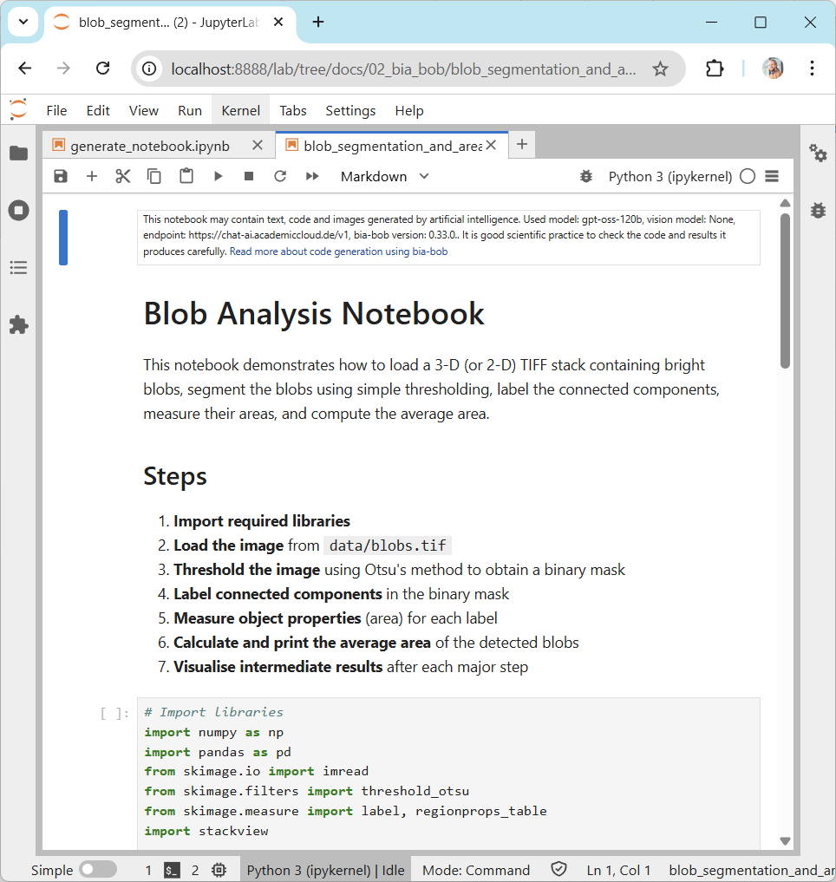
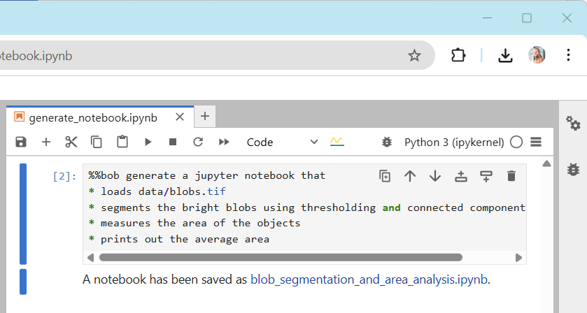
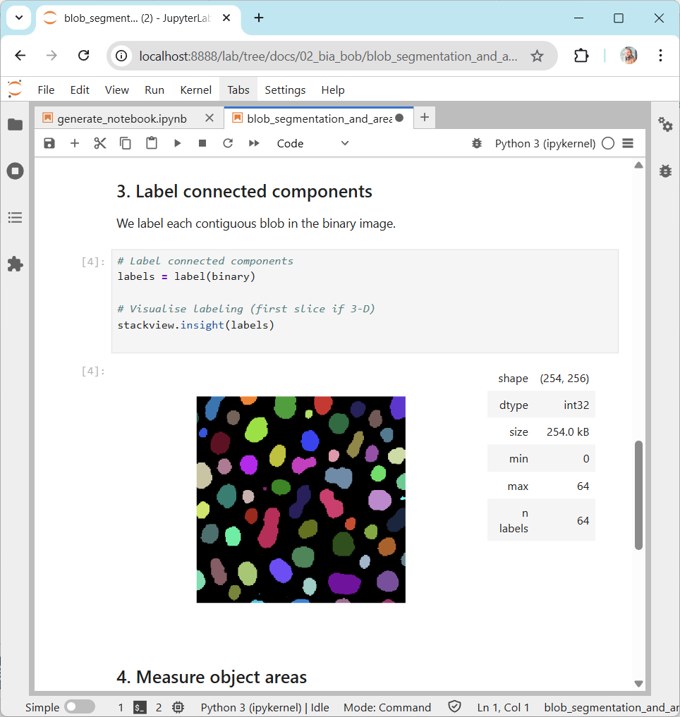

Bia-Bob: notebook generation
https://scads.github.io/llm-bia-2025/02_bia_bob/generate_notebook.html

Slide 35




Code for statistical analysis
Be careful when prompting for code and provide as many details as you can!
LLMs often provide “simple” solutions.
https://scads.github.io/embo-lsm-bia-2025/03_bia_bob/bia_bob-statistical_testing.html

Slide 36



Code for statistical analysis
Be careful when prompting for code and provide as many details as you can!
Look at your data!
https://scads.github.io/embo-lsm-bia-2025/03_bia_bob/bia_bob-statistical_testing.html

Slide 37



Code for statistical analysis
Be careful when prompting for code and provide as many details as you can!
LLMs cannot be brave scientists yet, but you can!
https://scads.github.io/embo-lsm-bia-2025/03_bia_bob/bia_bob-statistical_testing.html

Slide 38
Installation (optional!)

Slide 39
API-Keys
Application programming interface (API) keys: A modern kind of password basically invented to avoid entering username/passwords over and over again
Login using username / password
My Computer
Remote
server
Save the API key on my computer
While logged in: Obtain an API Key
Some tools
Login using API key, to use some tools only
Never share your API key with others (unless you trust them)
API key can be revoked / invalidated any time,
https://en.wikipedia.org/wiki/API_key

Slide 40



Anthropic / Claude API Key
To use claude, you need an API Key from Anthropic (usage may cost money)
3
2
1

Slide 41


OpenAI API Key
Create an OpenAI API Key (usage may cost money)
2
4
3
1
https://openai.com/index/openai-api/

Slide 42



GitHub Models API Key
Create a GitHub Models API Key (usage may cost money)
2
3
1
https://github.com/marketplace/models/
4

Slide 43

GitHub Models API Key
Free service by Github / Microsoft Azure
Create a GitHub Models API Key
2
No need to configure any rights. Just create a key with default settings.
4
3
1
https://github.com/settings/personal-access-tokens/new

Slide 44




KISSKI / GWDG API Keys
Free service by German Academics
Create an KISSKI API Key
https://services.kisski.de/services/en/service/?service=2-02-llm-service.json
https://kisski.gwdg.de/en/leistungen/2-02-llm-service/

Slide 45




Exercise: Store the API key in your environment
Enter
OPENAI_API_KEY
Or
ANTHROPIC_API_KEY
Or
GH_MODELS_API_KEY
Add the OPEN AI API Key to your environment variables
2
Key here
3
1
4
https://github.com/haesleinhuepf/bia-bob?tab=readme-ov-file#setting-api-keys

Slide 46


Setup an environment on your computer
conda env create -f https://github.com/haesleinhuepf/bia-bob/raw/main/environment.yml
conda activate bob-env
jupyter lab
Setup a new environment using a predefined set of Python image-analysis related libraries
Log in to this environment

Slide 47



Bia-bob installation on the web
https://github.com/haesleinhuepf/bia-bob?tab=readme-ov-file#installation

Slide 48


Initializing bia-bob
When you run it for the first time, and want to use …
OpenAI GPT 4omni (optional, as it’s default)
Anthropic claude
Github Models
KISSKI Models
https://github.com/haesleinhuepf/bia-bob?tab=readme-ov-file#using-openai--chatgpt-as-backend

Slide 49
LLMs are everywhere

Slide 50



LLMs are everywhere
ChatGPT
Claude
Open models
https://chatgpt.com/
https://claude.ai/
https://huggingface.co/chat/

Slide 51




LLMs are everywhere
YMIA Python Seminar Oct 14th 2024
GloBIAS Seminar Series Oct. 18th 2024
YMIA Python Seminar Oct 14th 2024
GloBIAS Seminar Series Oct. 18th 2024
Napari-chatGPT / Omega
Bioimage-io ChatBot
https://github.com/royerlab/napari-chatgpt
https://www.nature.com/articles/s41592-024-02310-w
https://bioimage.io/chat/ https://www.nature.com/articles/s41592-024-02370-y
https://gerbi-gmb.de/teams/ymia/
https://www.globias.org/activities/bia-seminar-series

Slide 52


LLMs are everywhere
Jupyter-AI
aider
https://jupyter-ai.readthedocs.io/
https://github.com/paul-gauthier/aider/

Slide 53



LLMs are everywhere
Github Copilot [Workspace]
Cursor
https://copilot-workspace.githubnext.com/
https://www.cursor.com/

Slide 54


Scientific code writing: git-bob
Integrating LLMs technology into GitHub
https://github.com/haesleinhuepf/stackview/issues/79

Slide 55


LLMs are everywhere
I have not seen any LLM that supports ImageJ Macro well.
Fiji‘s Script Editor
https://forum.image.sc/t/ai-assisted-code-generation-in-fijis-script-editor/100877/3

Slide 56
Summary & outlook
LLMs can generate code to analyze biological microscopy images
We can learn how to use them
We need to understand bio-image-analysis, no matter if we write code ourselves or if we generate code using LLMs

Slide 57




Acknowledgements
Collaborators & contributors
Christian Tischer (EMBL Heidelberg), Jean-Karim Hériché (EMBL Heidelberg), Nico Scherf (MPI CBS Leipzig), Loïc A. Royer (CZ Biohub), Elena Nicolay (UFZ Leipzig), Kevin Yamauchi (ETH Zurich / Basel), Seth Hinz, Teun A.P.M. Huijben, Jordão Bragantini (CZ Biohub San Francisco), llan Theodoro (CZ Biohub and the State University of Campinas, Brazil), Ian C. (University of British Columbia), Pradeep Rajasekhar (WEHI Australia)
BIDS Team @ ScaDS.AI / UL
Communities & platforms
Funding
Lea Kabjesz, Lea Gihlein, Mara Lampert
RH acknowledges the financial support by the Federal Ministry of Education and Research of Germany and by Sächsische Staatsministerium für Wissenschaft, Kultur und Tourismus in the programme Center of Excellence for AI-research „Center for Scalable Data Analytics and Artificial Intelligence Dresden/Leipzig“, project identification number: ScaDS.AI

