Slide 1
G-O-H*
INDIRECT HEARING SCREENING
Adaptation research towards a multilingual use: Slovak, Czech, Polish, Romanian, Croatian, Slovenian, and Italian
Gábor Olaszy, Mátyás Bartalis, BME TMiT SmartLab
* G=Gósy, O=Olaszy , H= Hearing

Slide 2
RESEARCH AND DEVELOPMENT
AT THE CROSSROADS
OF KNOWLEDGE-BASED
HUMAN-CENTRIC AND HEALTHCARE AI

Slide 3
OVERVIEW
1. THE G-O-H METHOD FOR HUNGARIAN, 1980-85
2. IDEA FOR MULTILINGUAL ADAPTATION, 2024
3. RESEARCH AND DEVELOPMENT, 2024-26
4. PLANS FOR THE FUTURE , 2026-

Slide 4
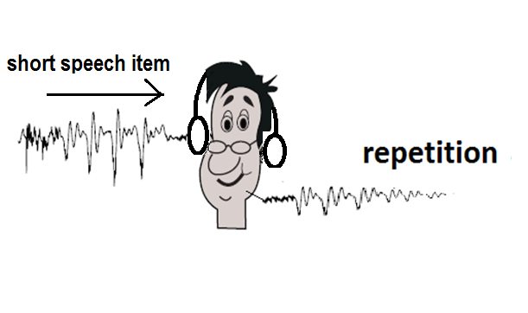
THE G-O-H HEARING SCREENING METHOD
HAS BEEN IN PRACTICE FOR 40 YEARS IN THE
HUNGARIAN NATIONAL HEALTH-SCREENING NETWORK
The method: repetition of short, synthesized speech items
The answers show whether the hearing is good or not.
It is used mainly for regular screening (6 months) of children

Slide 5
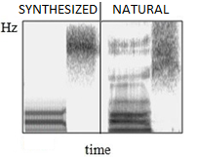
WHY SYNTHETIC SPEECH?
Less redundant than natural speech
Synthesis is done under control
Only the most important acoustic cues are built into the waveform

Slide 6
WHY IS THE REGULAR HEARING SCREENING
OF CHILDREN IMPORTANT ?
Speech comprehension is based on age-specific hearing level and appropriate speech perception processes.
If the child’s hearing is good, language acquisition develops typically.
In case of hearing impairment, language acquisition processes will develop atypically.
This can also hinder school learning.

Slide 7
WHY DO PEOPLE LIKE THIS TOOL?
It can be used in simple and everyday environments
(family, day care center, elementary school, etc.).
No special training is required to use it.
Its use is simple. It is always at hand.
Screening can be completed in 2-3 minutes.
For children it is a TOY.

Slide 8
WHAT IS THE RESULT OF THE TEST?
THE G-O-H HEARING SCREENING DOES NOT GIVE A DIAGNOSIS
The final result of the test indicates ear specific information
of 3 states as
GOOD HEARING
MILD OR TEMPORARY HEARING LOSS - consult a doctor
HEARING LOSS - consult a doctor

Slide 9
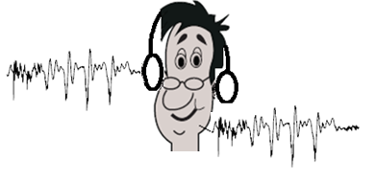
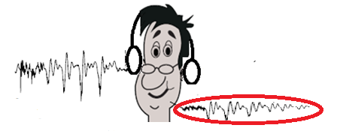
THE METHOD OF REPETITION IS BASED ON ECHOING
If the auditory system and brain processes are working well, the child will repeat the same syllable that was played to the ear through the headphones.
If there is a functional disorder at some point in the auditory and brain system (hearing impairment), the response of the child will differ from the syllable originally played

Slide 10
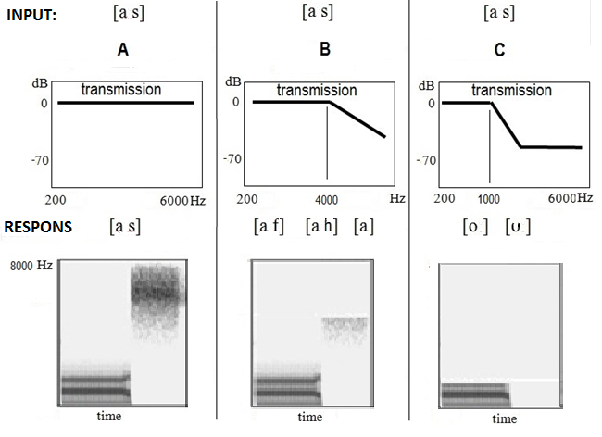

THE HEARING MECHANISM CAN BE IMITATED
BY AN ELECTRONIC FILTER

Slide 11
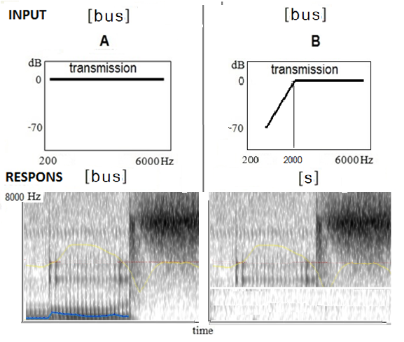
IMITATION OF A LOW FREQUENCY HEARING LOSS

Slide 12
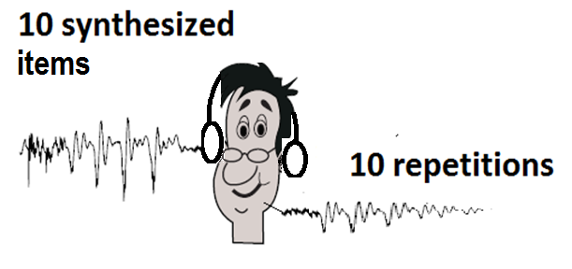
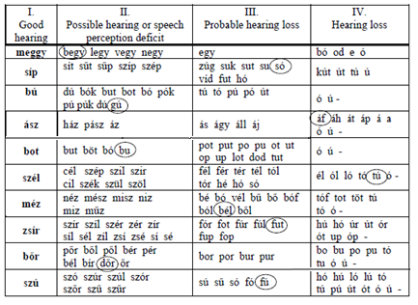
THE G-O-H SCREENING PROCEDURE
The place of examination is a quiet room
The synthesized, mostly meaningless syllables are played on 50 dB SPL to the ear
The answers are marked on the evaluation sheet manually
The complete screening of one child needs 3 minutes
Answer and evaluation sheet

Slide 13
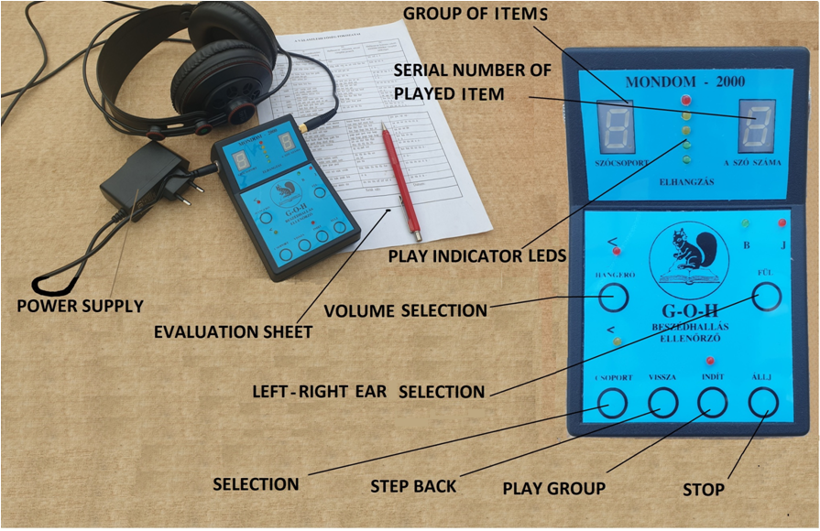
THE G-O-H HEARING SCREENING SYSTEM
IN 2000

Slide 14
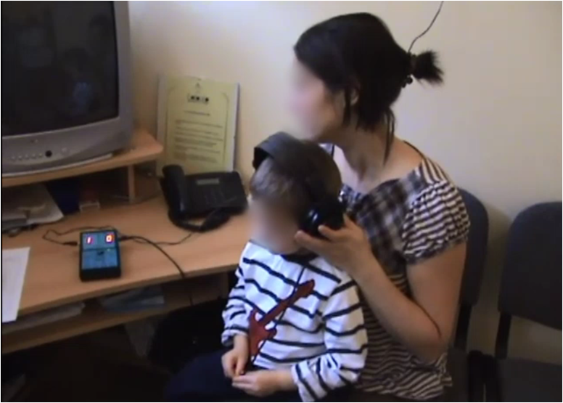
HEARING SCREENING IN A DAY CARE CENTER

Slide 15
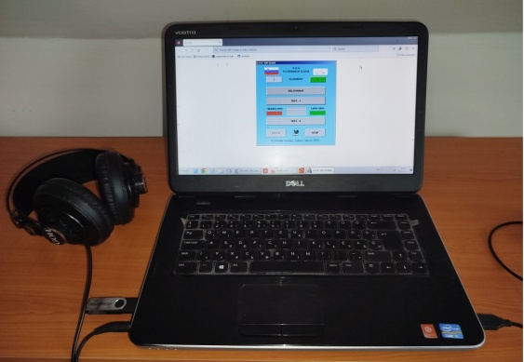
THE FULL SOFTWARE VERSION OF G-O-H
APPEARED IN 2024

Slide 16
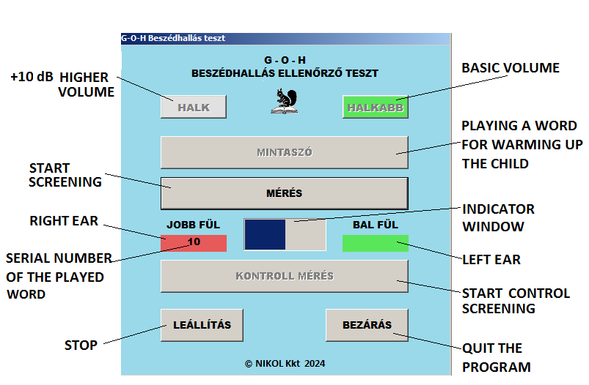
THE SCREEN OF THE SOFTWARE VERSION OF G-O-H

Slide 17
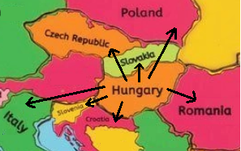
IDEA FOR MULTILINGUAL ADAPTATION
THE SOFTWARE VERSION OF THE ORIGINAL G-O-H OPENED
THE GLOBAL SPACE OF USE VIA THE INTERNET

Slide 18
HYPOTHESIS-1
If we can create monosyllabic speech sequences using the speech sounds of the Hungarian syllable library, that fit the speech sound system of other languages, then the GOH-based hearing screening procedure can be implemented for other language environments as well.
This is related to the acoustic properties of the new language.
HYPOTHESIS-2
If we can create monosyllabic speech sequences that can be associated with a clear written form in the given language, then the GOH-based hearing screening procedure can be implemented in the given language environment as well.
This is related to the writing rules of the given language.

Slide 19
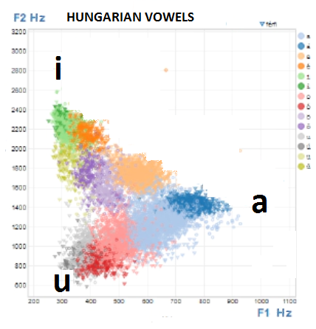
FINDING THE VOWELS THAT HAVE COMMON CHARACTERISTICS IN THE 7 LANGUAGES
Vowels

Slide 20
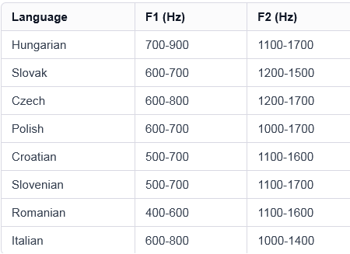
.
Vowel a

Slide 21
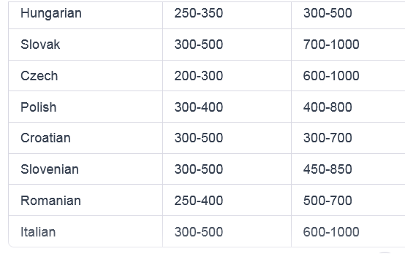
Vowel u

Slide 22
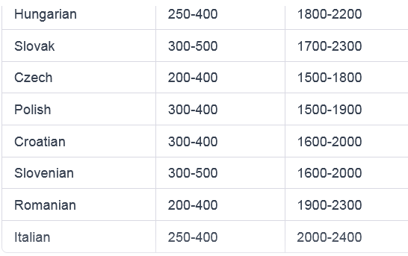
Vowel i

Slide 23
Conclusion: the synthesized Hungarian a, u, i vowels will probably be percieved with good accuracy by the foreign persons, because the acoustic distance among them is large enough.
These 3 vowels can be used in the unified syllable set.

Slide 24
FINDING THE CONSONANTS THAT HAVE COMMON CHARACTERISTICS IN THE 7 LANGUAGES
Consonants: nasals, voiceless fricatives, plosives, and the tremulant can be used to build syllables
A little manual tuning is sometimes needed in fricatives

Slide 25
SYLLABLES DEFINED FOR THE 7 LANGUAGES
ALTOGETHER THE WAVEFORMS OF 62 SYLLABLES HAVE BEEN CONSTRUCTED AND TESTED FOR THE ADAPTATION OF G-O-H HEARING SCREENING
FOR THE 7 LANGUAGES
HYPOTHESIS-1 WAS CONFIRMED

Slide 26
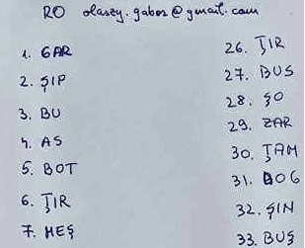
DETERMINING THE POSSIBLE WRITTEN FORMS OF THE PLAYED SYLLABLES IN THE 7 LANGUAGES
Internet based listening
tests in 7 countries
Listen to the syllable
Write what you heard
Make a photo
Send it to the developer
40 syllables/test/language
.

Slide 27
SOME ACTUAL YOUTUBE LINKS FOR NATIVE TESTERS TO LISTEN THE 40 SYLLABLES IN 5 LANGUAGES
.
.
CZ https://youtu.be/IO3592Z3kRg
HR https://youtu.be/sWl1fhCHM1k
SI https://youtu.be/q8ak6w3cdPI
RO https://youtu.be/--pLJ6XhCuc
PL https://youtu.be/P-72l1bPP-I
IT Under development

Slide 28
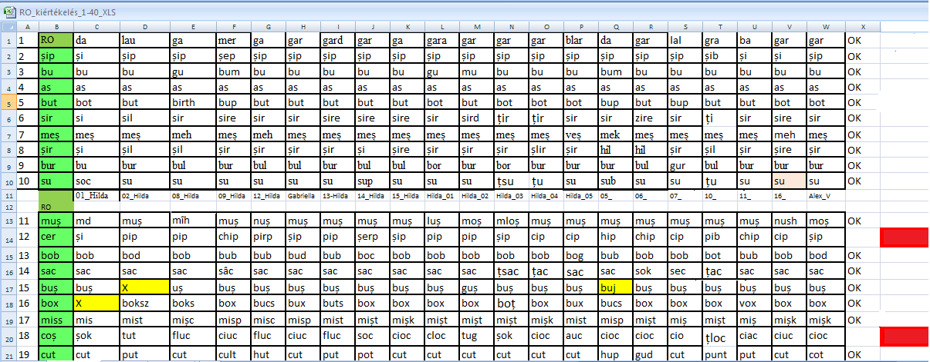
EVALUATION OF THE LISTENING TESTS
.

Slide 29
The possible written form(s) of the 62 syllables have been determined for
7 languages
.
HYPOTHESIS-2 WAS CONFIRMED

Slide 30
DETERMINING THE EVALUATION TABLES
FOR 7 LANGUAGES
.
Separate evaluation tables were defined for each of the
7 languages, based on the results of the listening tests.
We also used the experience of the previous 40 years.

Slide 31
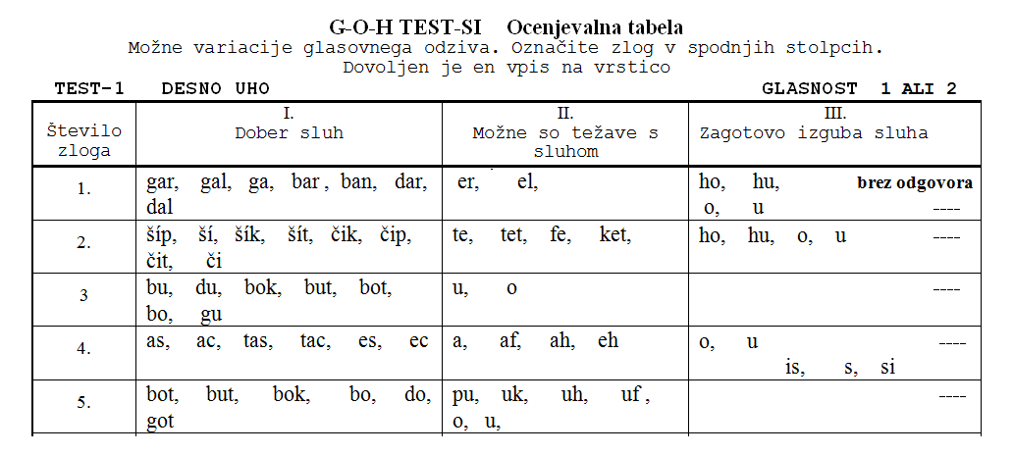
PART OF THE EVALUATION TABLE FOR SLOVENIAN
.

Slide 32
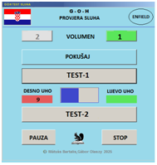
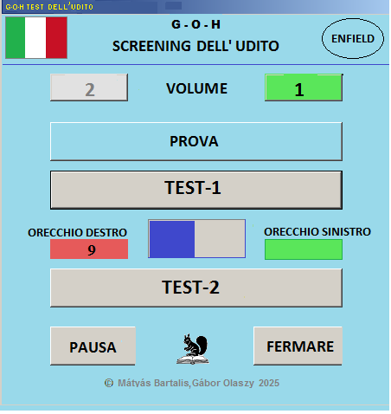
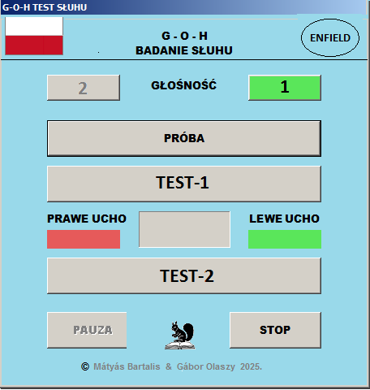
UNIFIED SOFTWARE FRAMEWORK FOR
THE LANGUAGES
.
ITALY
SLOVENIA
POLAND

Slide 33
PLANS FOR THE FUTURE
.
FREE DOWNLOADABLE SOFTWARE
FROM THE ENFIELD PLATFORM
THE PROJECT IS OPEN FOR OTHER LANGUAGES
olaszy.gabor@gmail.com

Slide 34
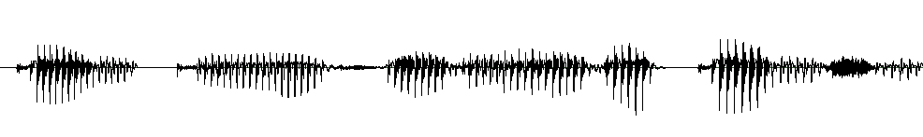
THANK YOU FOR YOUR ATTENTION
olaszy.gabor@gmail.com

