Slide 1

CC-BY 4.0

Slide 2
Pre and Post Confocal Microscopy
Lecture 12

Slide 3
Introduction to Bioimage Analysis
CC-BY 4.0

Slide 4
What is Bioimage Analysis?
Bioimage analysis is the process by which one extracts quantitative data or information from scientific images.
Notes:
What is bioimage analysis? Bioimage analysis is the process by which one extracts quantitative data or information from scientific images.

Slide 5
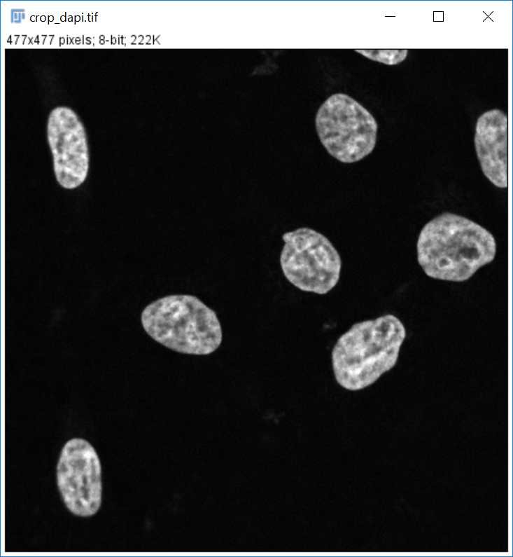
What is Bioimage Analysis?
Bioimage analysis is the process by which one extracts quantitative data or information from scientific images.
Notes:
And I want to highlight quantitative as we need to take numbers from it that will tell us something about the sample. But I would also like to emphasize on the word scientific images, as the acquisition of these images has to be clearly documented and understood for other scientists to be able to reproduce them.
[click]
Here we have an image from nuclei acquired with a fluorescence microscope. Can you write in the chat how many nuclei we see in this image? We might want to estimate intensity of the nuclei or how big they are. How can we do this? We could do it manually, for example, with some tool to draw the region for each nuclei, or use other tools to threshold intensity values and then output a table with all the measurements. Let’s check what answers we got for the nuclei count. It might have seemed simple, but we didn’t specify anywhere what we do with the nuclei touching the borders. This would have been part of a bioimage analysis protocol that we didn’t state here beforehand.

Slide 6
Why do we need bioimage analysis?
Which nucleus is brighter?
A
B
Same brightness…
Notes:
Do we always need bioimage analysis? Can we simply show images to answer our questions? We could wonder what happens with localization of some proteins for example. We see these two cells and explain that cell B has been treated with some drug. We can assume the protein moved from the nucleus to the cytoplasm, right? Which nucleus is brighter?
[click]
Oops. And these can prove to be even more complicated to estimate when the volumes are different so the signal is spread over larger volumes and gets dimmer.

Slide 7
Why do we need bioimage analysis?
Which nucleus is larger?
A
B
Same size…
Notes:
In a similar fashion, let’s say our hypothesis is that after adding some drug, a particular cell type starves, leaving more nutrients to other cells, so they shrink in size. In case B they definitely look smaller. But is it true?
[click]
After analyzing we notice it was another optical illusion. Actually this cell type remains unaffected by the drug, yet the other cells surrounding it, grow. So we might have to change our way of thinking.

Slide 8
What are the characteristics of bioimage analysis?
Quantitative
Notes:
So, what are the characteristics of bioimage analysis. The previous examples already led us to one key characteristic. It’s supposed to be quantitative. If we were to specify the intensity of each cell or the size of each of them, we would have noticed it’s the same number.

Slide 9
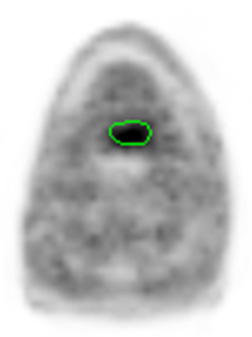
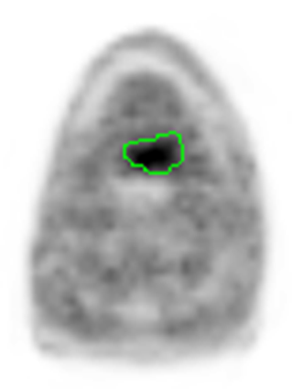
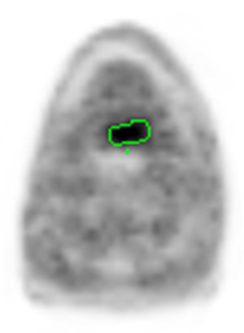
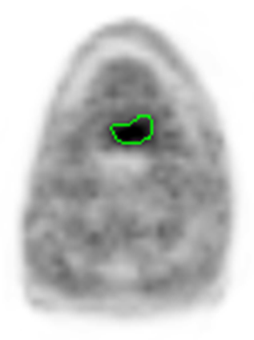
What are the characteristics of bioimage analysis?
Quantitative
Objective
Automatic Segmentation
8.2 ml
Observer 1
17.3 ml
Observer 2
7.5 ml
Observer 3
9.9 ml
Automatic Segmentation
8.2 ml
Data source: N. Abolmaali, R. Haase, Oncoray, TU Dresden
Notes:
Additionally, we want our observations to be objective.
[click]
If we ask three different observers to segment tumour outlining, they will do their best, some might be more patient than others, but we will always have a bit of variability on the gray areas.
[click]
On the other hand, if we apply the same bioimage analysis, the results are objective, it doesn’t matter who run it.

Slide 10
What are the characteristics of bioimage analysis?
Quantitative
Objective
Repeatable
Notes:
With this example we also see that bioimage analysis should be repeatable. If we start from the same raw data, we want to be able to end up with the same output, but also the raw data is not destroyed in the process so we can repeat the experiment in the same way.

Slide 11
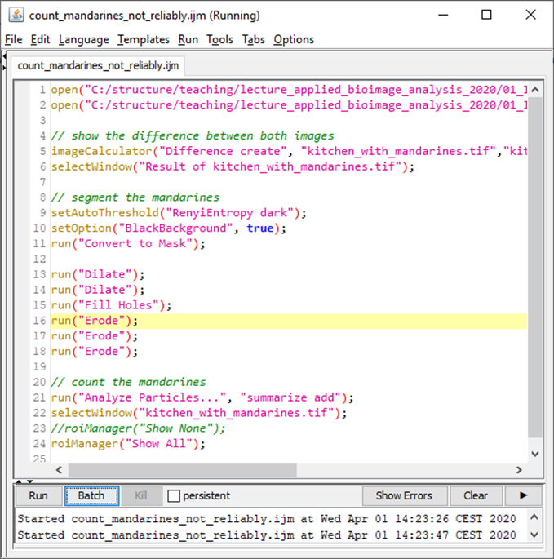
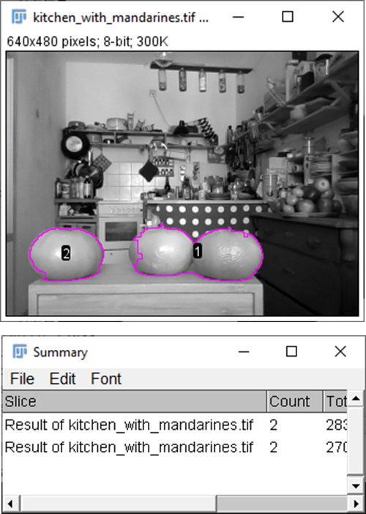
What are the characteristics of bioimage analysis?
Quantitative
Objective
Repeatable
Reproducible
Schmied et al., Nature Methods, 2024
Notes:
Next, we would like our analysis to be reproducible.
[click]
One way of doing this, is documenting what we have done. This can be done by describing in a step by step basis in materials and methods, but we can also write down a script and share it. The work linked here describes from minimal, to recommended and ideal ways to share and publish bioimage analyses, as well as images.
[click]
Something important to highlight here is that, even if the pipeline does not seem to be yielding the right result, it is still reproducible. Science has to be reproducible, and then we can discuss if we agree with the criteria used. But if I can take your analysis, reproduce it and then compare it with mine, we can start a discussion and progress. If I can’t reproduce your work, then I won’t be able to have a baseline to discuss with you, and I might even doubt of what you have done.

Slide 12
What are the characteristics of bioimage analysis?
Quantitative
Objective
Repeatable
Reproducible
Reliable
Notes:
Finally, this brings us to the last characteristic bioimage analysis ideally has, and that is that it is reliable. Although in the previous example I showed that the measurement was not perfect, when developing an image analysis we have to look for reliability and characterize and understand the limitations. We can also work on identifying where the problem lies and try to fix them. We also have to identify how accurate we need to be and what the limitations are as it is impossible to get perfect results in many cases. We will probably see a workaround for this mandarine problem later.

Slide 13
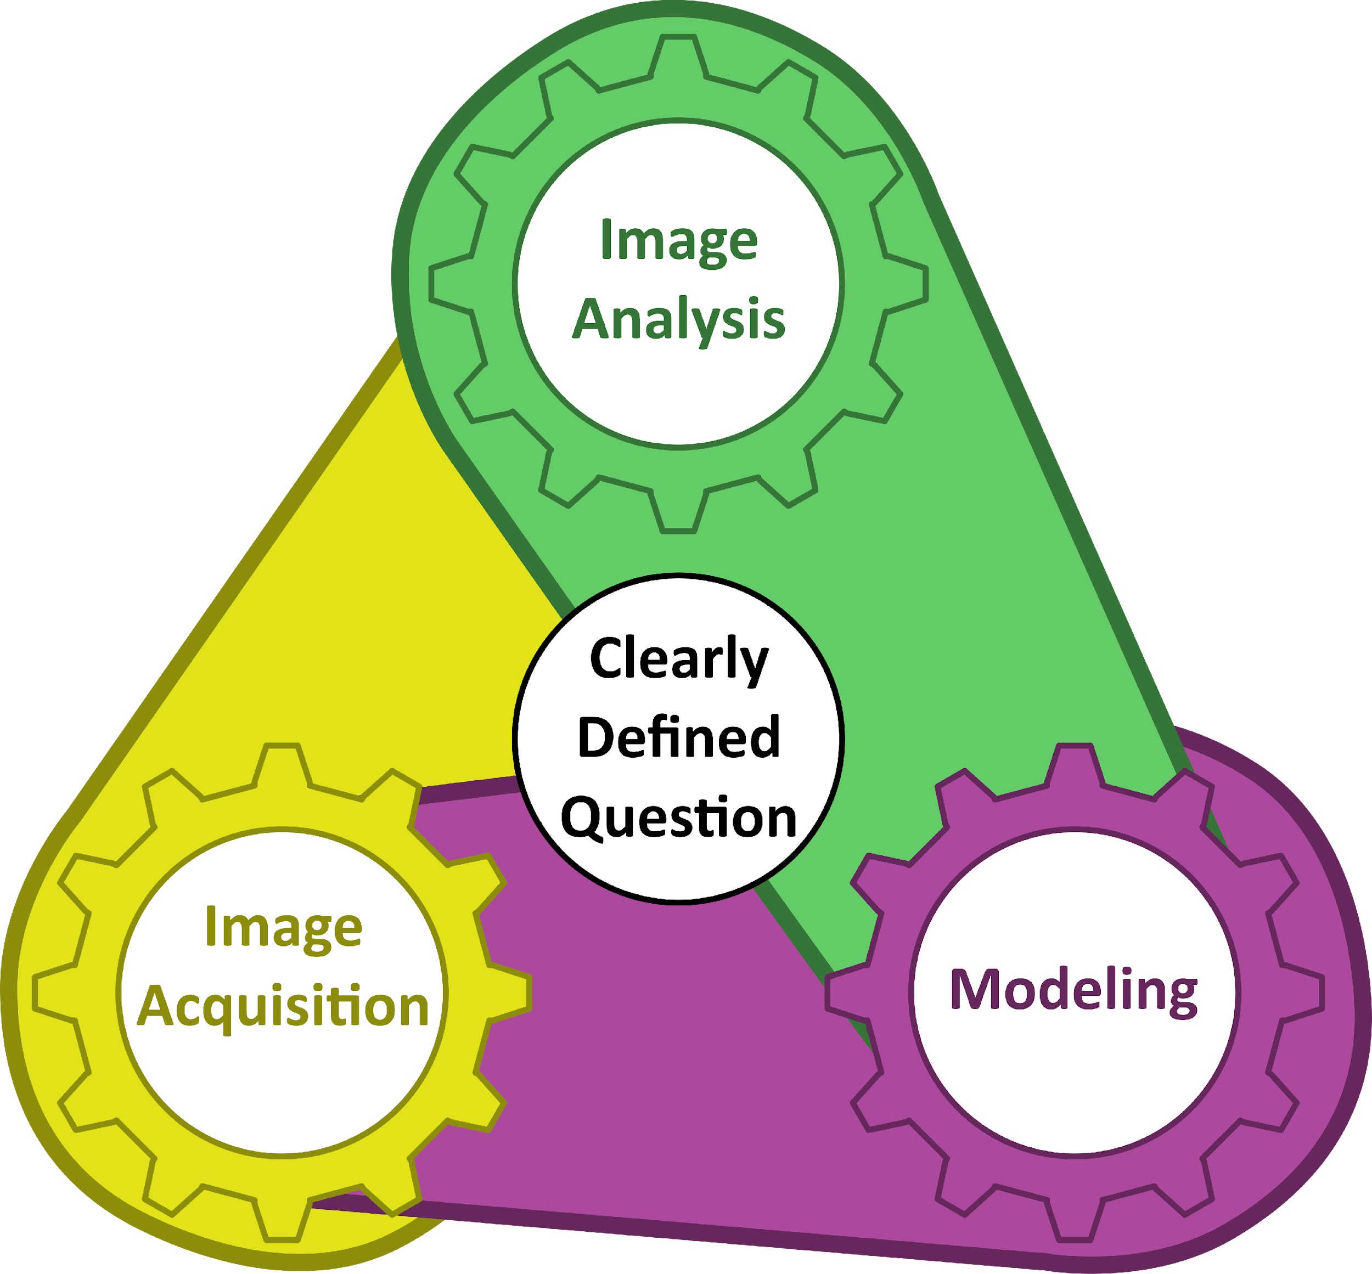




Where do we start?
What is the scientific question?
How do we analyze the images?
What should we image and how?
How does this feed back into our understanding?
The Three Gears of Bioscience Projects
Wait et al., JCS, 2020
Notes:
But where do we start? How do we know we need bioimage analysis? What will we use?
[click]
Well, what is the scientific question? We must first be clear on our question, and we have to be very specific about this. “Is this drug A better than drug B?” Is not specific enough. Does drug A inhibit growth of cell type M, while drug B lets them keep proliferating? This is better. With that we can look into the following.
[click]
After identifying the hypothesis we want to test, we should reverse engineer the quantitative information that will inform our hypothesis. This way, we know what image analysis we will have to do and what the images should contain. In this case, it would have been cell number, but it could have been size or intensity of some reporter.
[click]
We know what information has to be contained in the image so, What should we image and how? Well, we know we have to image cells of type M, some treated with drug A and some with drug B. Maybe some controls. But with this information we can already start deciding the experimental procedure, and the image acquisition.
[click]
After performing the experiments, imaging and analysis we will have quantitative results that will be fed into our statistical model, or mathematical model. This could even be a toy model, but it will reflect our understanding of the system and what is going on. Here, we should also take into account how our observations perturb the system under study.
[click]
Finally, all these gears feedback into each other and help design new experiments that are more informative. After interpreting the results from our experiment, we can find holes or missing parts of our interpretation. This will feed back into how we can improve or change the acquisition, and the following analysis. Note that there are many science projects where the clearly defined question can fuel any of these three gears, and the whole experimental design can be reverse engineered from that gear.

Slide 14
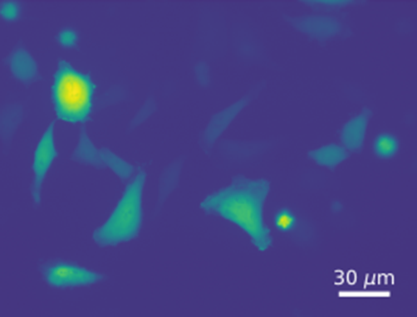
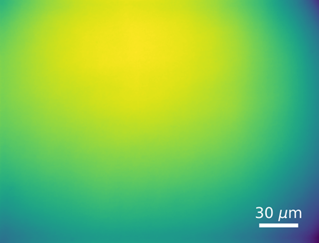

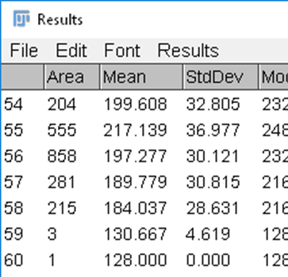
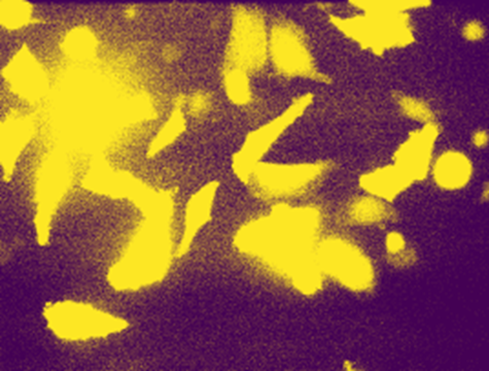
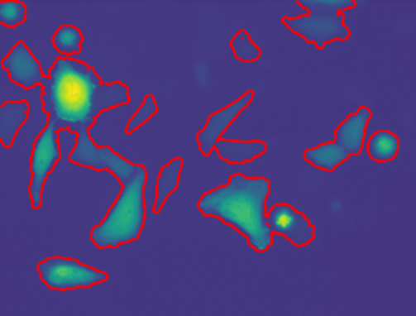
Image Analysis Workflow
Preprocessing
Segmentation
Quantification
Raw Images
File format
Image data
Metadata
Background correction
Illumination correction
Noise suppression
Semantic segmentation
Refinement
Instance segmentation
Measurements
Feature Extraction
Notes:
How is a typical image analysis workflow? We start from the raw images.
[click]
As discussed previously, we need to understand first how the digital image works, what is the file format, the image data and metadata.
[click]
The next step, is called preprocessing. It can include several steps of correction such as background correction, illumination correction or noise suppression.
[click]
Now comes the tricky part. Segmentation is partitioning or dividing the image in the regions or objects that we want to analyze. For this we have several steps such as semantic segmentation, which requires us to distinguish between foreground and background pixels.
[click]
A refinement step to clean what is called salt and pepper.
[click]
And finally, instance segmentation to separate each object of interest.
[click]
With all the objects identified, we can proceed to quantify and extract features of interest from them.

Slide 15
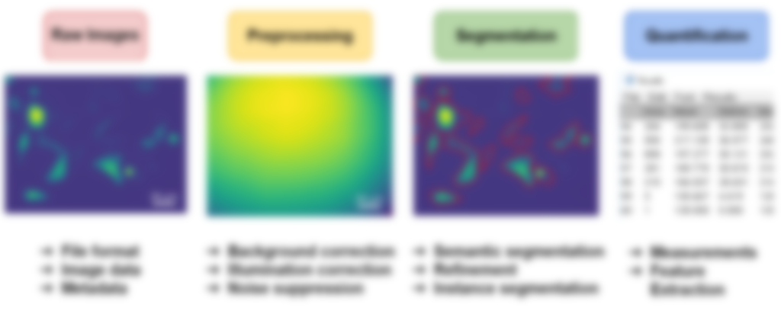
Image Analysis Workflow
Raw Images
File format
Image data
Metadata
Notes:
Let’s start by describing the raw or digital image.

Slide 16
Image Analysis Workflow
Preprocessing
Background correction
Illumination correction
Noise suppression
Notes:
Now we have raw images acquired with our microscope. Before we attempt segmenting them to find our objects of interest, we can correct for a couple things such as background or inhomogeneous illumination. Depending on the scientific question, we might not have to do all these steps. It is good practice to correct most of these and they also prove to be good examples for common image analysis algorithms.

Slide 17
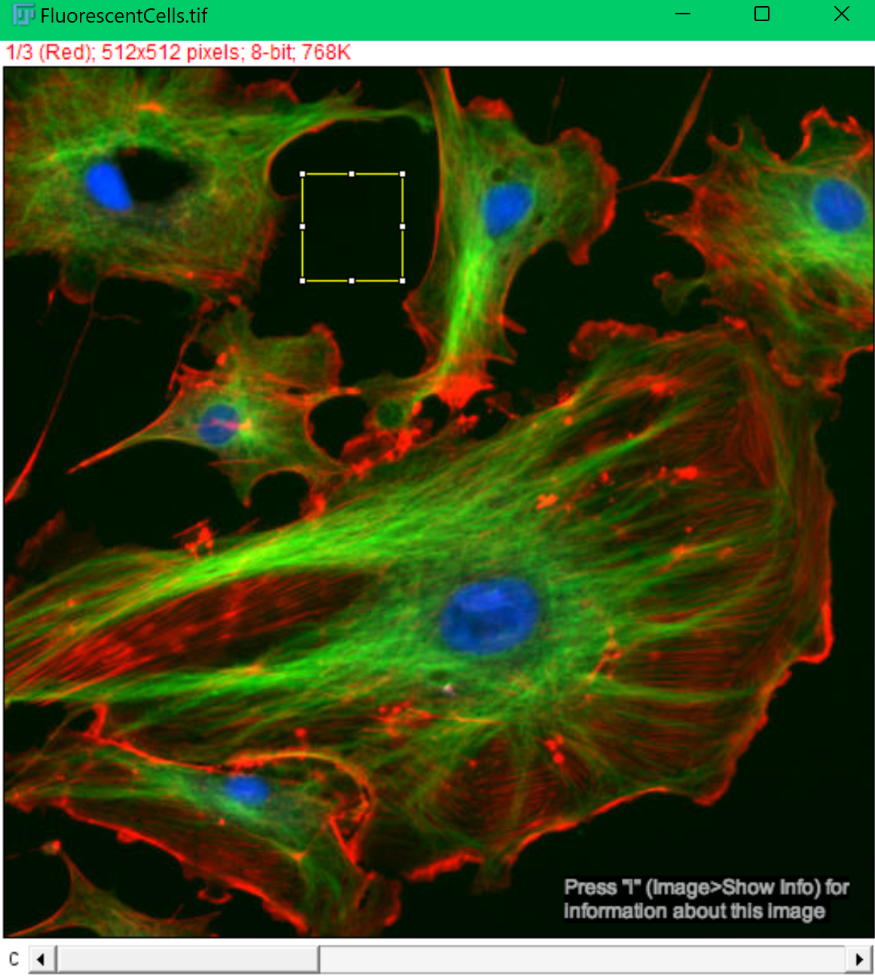
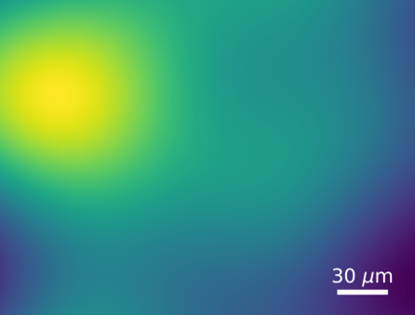
Background Subtraction
Can be Estimated from an empty region.
Can be characterized analogously.
We can apply algorithms like rolling ball.
Fluorescent Cells/ Fiji samples
Notes:
As shown previously, the dark region in images have some background signal. We have discussed several different sources for this such as dark noise, the energy required to energize a camera sensor, autofluorescence in mounting media, etc. This is not ideal and preferably not the way to go, but one could get an estimate from looking at the dark empty region in an image. Estimate the mean or median of this region and subtract that value from each pixel.
[click]
Ideally, one should characterize the background by acquiring several images with the same acquisition settings used for the sample, but without the sample. There are several ways of doing this and it also depends on the microscope and how the sample is prepared.
[click]
Finally, we could apply algorithms that get rid of background as well as some of the inhomogeneous intensity such as rolling ball algorithms.
To be able to perform any of these three, we will need a bit more about the basic operations we can perform on images.

Slide 18
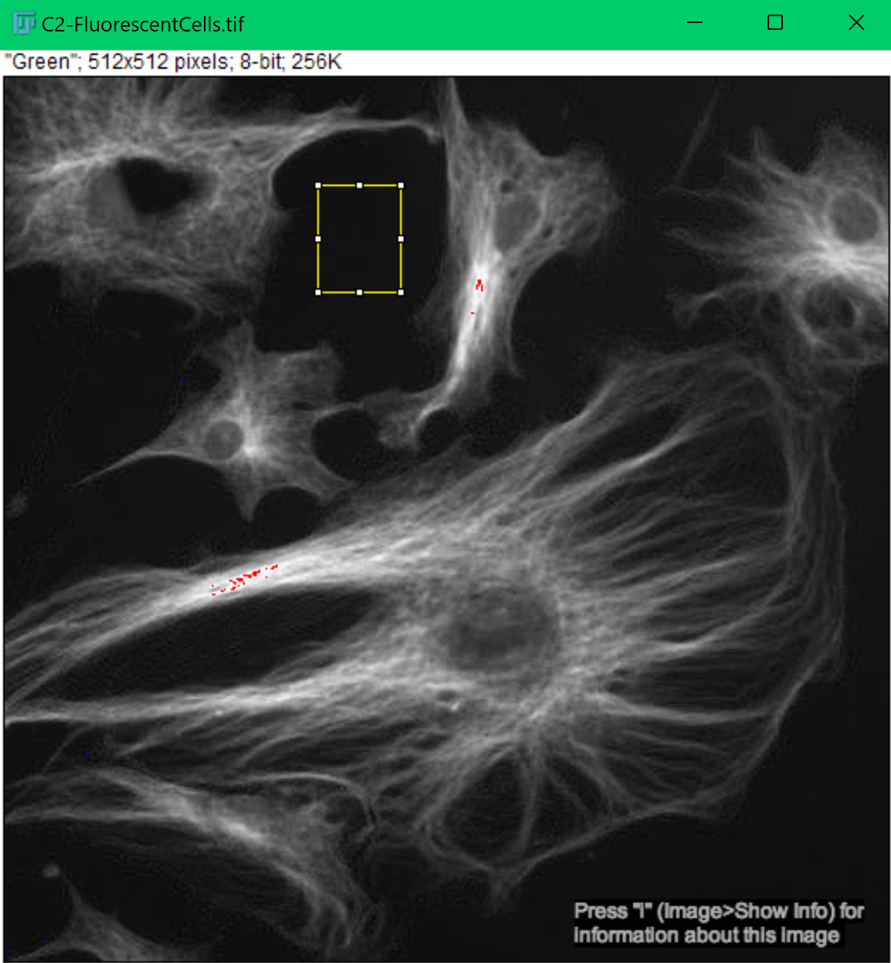
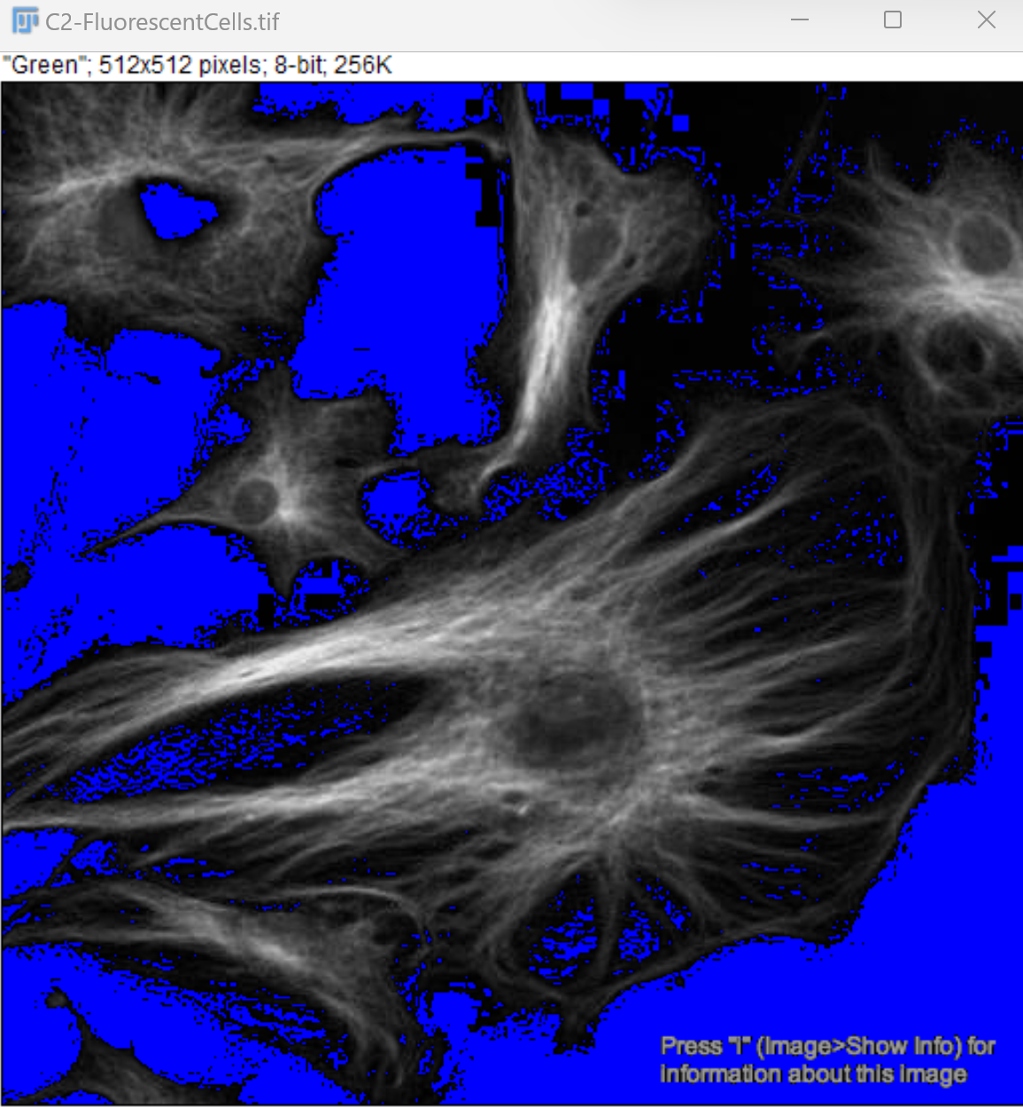
Constant value
Fluorescent Cells/ Fiji samples
Notes:
If we have an image for which we do not have any information from which it came from, we could select a small region of empty space and calculate the mean. Followingly, we can subtract that value from every pixel.
[click]
This is a quick fix, and as you can see it is not perfect nor the best, but it does part of the job.

Slide 19

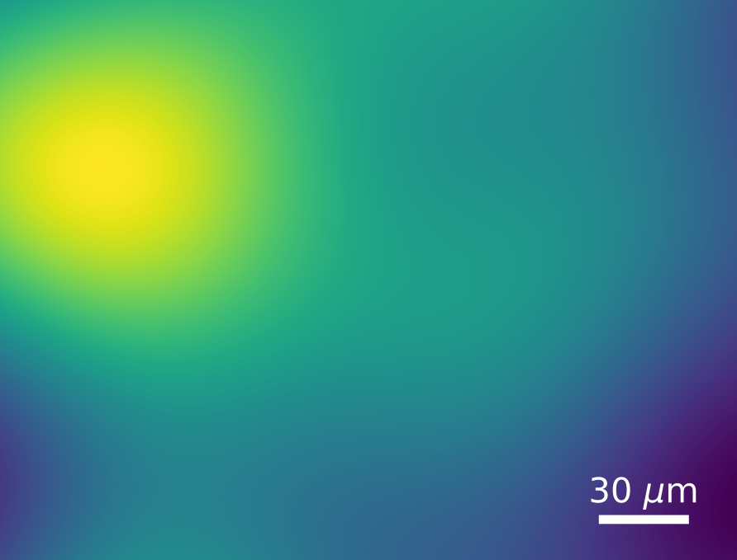
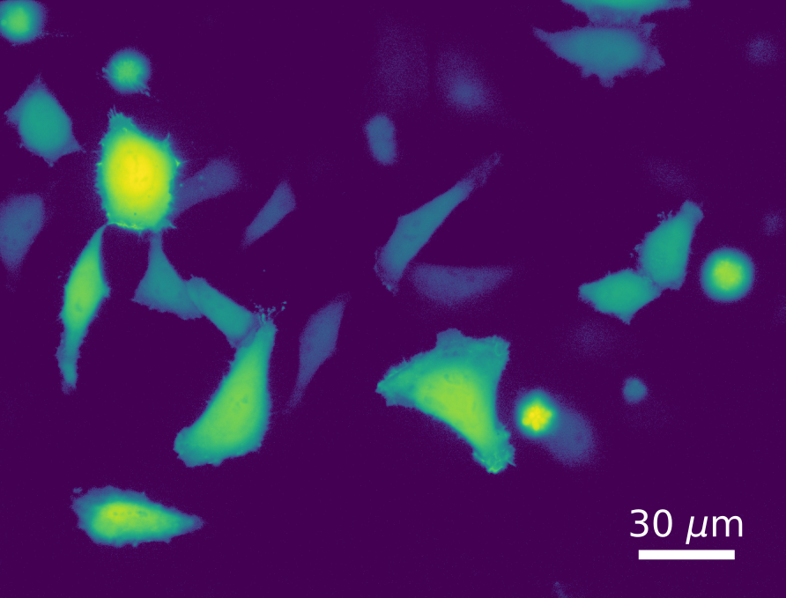
Subtracting background image
Corbat, PhD Thesis, 2021
Notes:
Here I can show you one more type of image operation. Let’s say I took several images with same acquisition settings but without the sample. This way I end up with background images. Instead of taking one image and outputting one image, this operation will take two or more images and output one single image. So the first thing we will do is take the first pixel across every image, and calculate the median, and place that values in the first place. We will do the same for the second pixel in every image, and so on.
[click]
This way we discard any noise or objects in the images and end up with a single median background image. What do you think will happen if the images do not have the same size? Can you see the limitation here?
Finally, we can subtract, pixel by pixel from the image acquired with the sample.
[click]
Et voila, here we have our background corrected image.

Slide 20
Inhomogeneous Illumination
We can characterize illumination profile with homogeneously fluorescent slide.
Acquire several images in different positions
Calculate mean per pixel (subtract background)
Divide every image by the profile
Notes:
We already talked about background correction, and another frequent issue is inhomogeneous illumination. This results in signal being higher in specific regions of the image. In a similar fashion, we can acquire several images of a homogeneous fluorescent sample or slide at several different positions. Calculate the mean or median per pixel, remember to subtract background of this image. And finally use this value to normalize every image acquired.

Slide 21
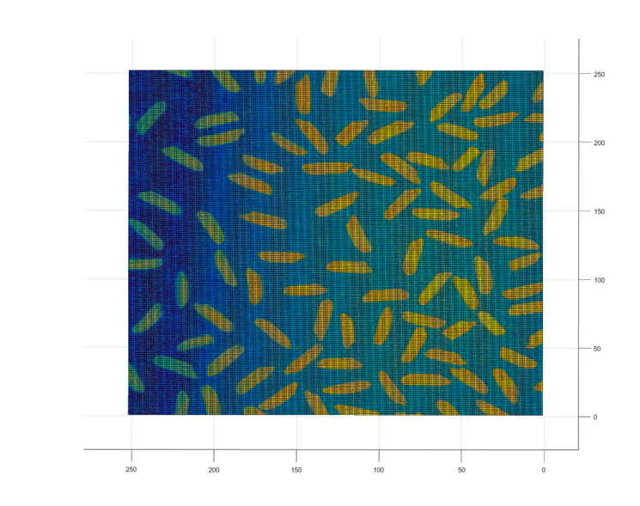
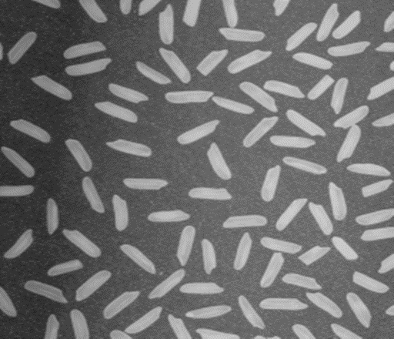
Rolling Ball
Notes:
Let’s take a look at one last algorithm. This one is quite graphical, if image analysis was not graphical enough. We have her a picture of rice on a table. We can already see a dim region and a brighter region. To the right we will encode the intensity in height of a 3D image. If we look at it from the top, it looks like we only changed the LUT. But if we flip it.

Slide 22
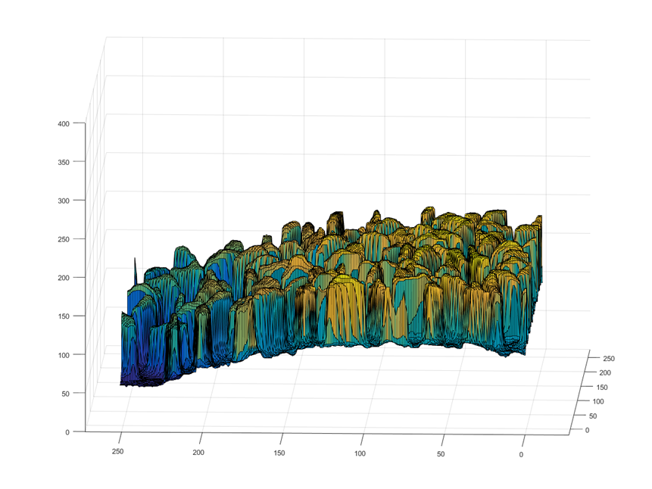
Rolling Ball
Notes:
We can appreciate how the region to the left is dimmer, or we can see that the height is lower. So, in this case background and illumination have this curvy profile.

Slide 23
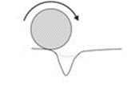
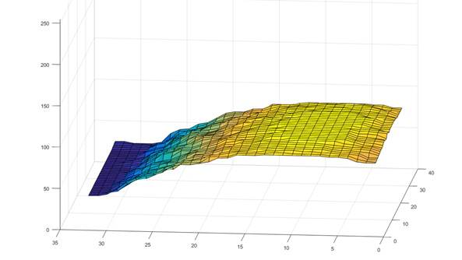

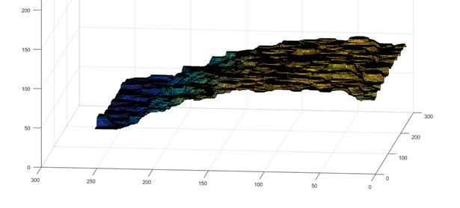
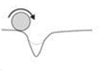
Rolling Ball
Notes:
Imagine we take a ball of diameter r which is bigger than the width of a single rice. And we will make it roll on the lower surface; you will have to imagine that we flip gravity or the image.
[click]
If we register the height of the ball at each position, we will get a curvy plane that represents this background and illumination.
[click]
Imagine now that we take a ball whose diameter is actually smaller than the rice.
[click]
While rolling it, it will fall inside of the rice, registering it’s height as well. This means that the profile will also have a bit of rugosity for each time it fell inside the rice.

Slide 24

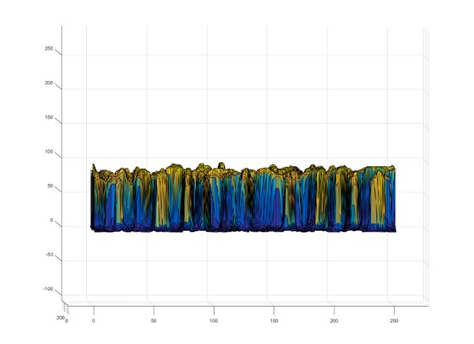

Rolling Ball
-
=
Original Image
Background
Corrected Image
Notes:
Finally, we want to subtract this background. Which one should we use? The one that came from the diameter higher that the width of rice or the one that was smaller?
[click]
Well, if we chose the one that was smaller, we will subtract part of the rice from our image. So, we will use the one that was bigger and subtract only the background and illumination profile.
[click]
This way we end up with a nicely corrected image. In FIJI, you can perform this operation by selecting Process > Subtract Background and it will let you choose the width of the ball in pixels. You can always click on Preview to see the result before applying it.

Slide 25
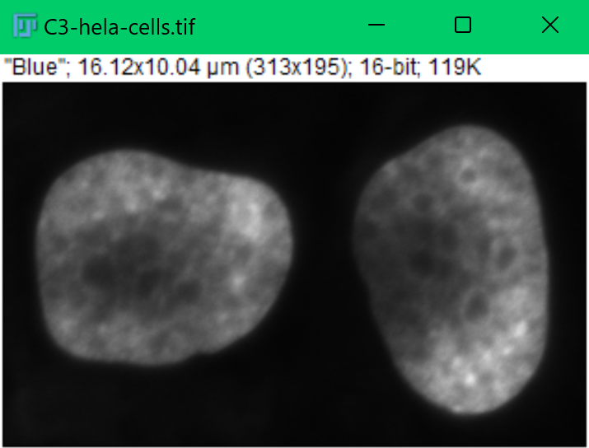
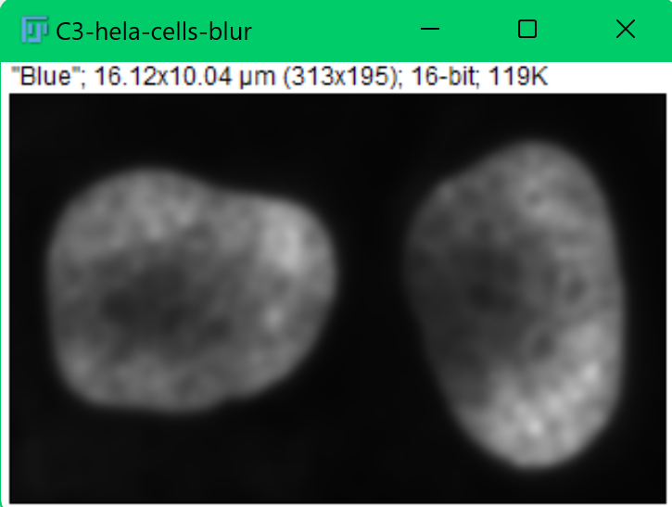
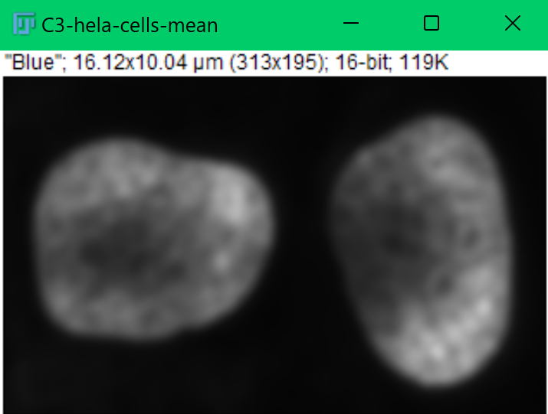
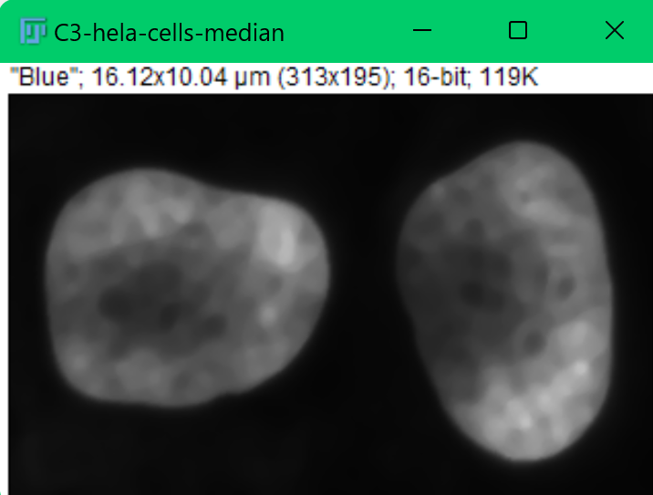
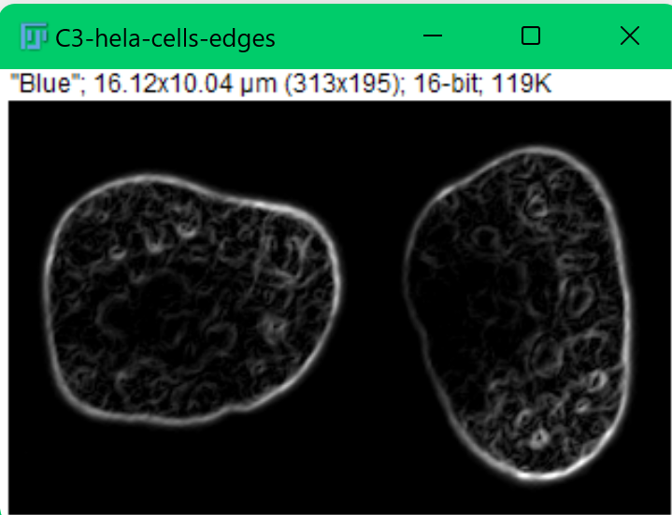
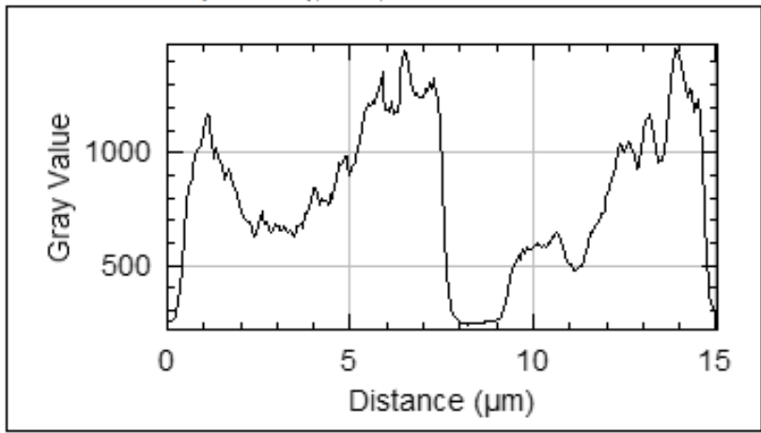
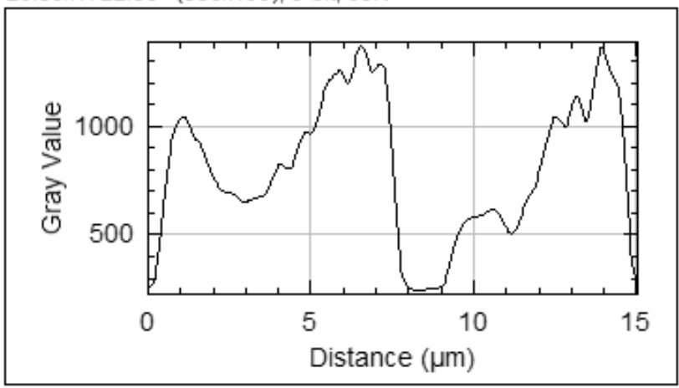
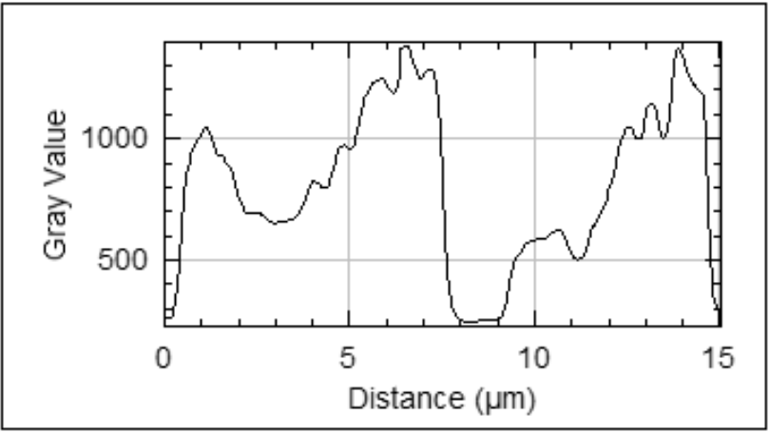

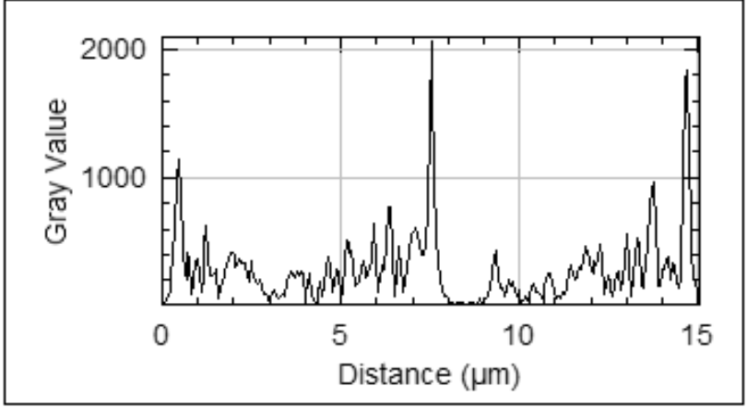
Spatial Filtering
HeLa Cells / Fiji samples
Notes:
We have been discussing about resolution and discretization of intensities and space, but there is a lot of information in the spatial distribution of the intensities. How can we exploit this to our advantage? Let’s get back to our HeLa Cells sample image. The plot you see below is the intensity profile you get by drawing a horizontal line across the middle of the image. You can see the regions that correspond to the nuclear intensity.
[click]
We could use spatial filtering to smooth the image and then suppress some of the noise due to acquisition. We lose some of the details, but this will help a lot for segmentation. We can see on the profile how the sharper details are lost.
[click]
Or we could use other types of spatial filtering to enhance edges and remove homogeneous regions. But how does this work?

Slide 26



Mean filter
+1 | +1 | +1
+1 | +1 | +1
+1 | +1 | +1
Kernel
*
X
94 100 104 119 125 136 143 153 157 158
103 104 106 98 103 119 141 155 159 160
109 136 136 123 95 78 117 149 155 160
110 130 144 149 129 78 97 151 161 158
109 137 178 167 119 78 101 185 188 161
100 143 167 134 87 85 134 216 209 172
104 123 166 161 155 160 205 229 218 181
125 131 172 179 180 208 238 237 228 200
131 148 172 175 188 228 239 238 228 206
161 169 162 163 193 228 230 237 220 199
mean ( 94, 100, 104,
103, 104, 106,
109, 136, 136) = 110
110 113 112 110 117 132 147 156
119 125 120 108 106 120 142 156
132 144 137 112 99 114 144 163
135 149 141 114 100 125 160 177
136 152 148 127 124 154 187 195
136 152 155 149 161 190 212 210
141 158 172 181 200 220 228 218
152 163 176 193 214 231 232 221
Notes:
Let’s say we have this small image here. The values for each pixel is shown in this matrix in the middle. We will use a 3 by 3 mean filter, that means we will take a 3x3 neighborhood, sum all the values of these pixels and divide by the number of pixels, which is nine. So our kernel is this small 3 by 3 matrix with all 1/9 values. We apply this to this neighborhood and then replace the value in the center pixel.

Slide 27
Mean filter
+1 | +1 | +1
+1 | +1 | +1
+1 | +1 | +1
Kernel
*
X
X
94 100 104 119 125 136 143 153 157 158
103 104 106 98 103 119 141 155 159 160
109 136 136 123 95 78 117 149 155 160
110 130 144 149 129 78 97 151 161 158
109 137 178 167 119 78 101 185 188 161
100 143 167 134 87 85 134 216 209 172
104 123 166 161 155 160 205 229 218 181
125 131 172 179 180 208 238 237 228 200
131 148 172 175 188 228 239 238 228 206
161 169 162 163 193 228 230 237 220 199
mean ( 94, 100, 104,
103, 104, 106,
109, 136, 136) = 110
mean (100, 104, 119,
104, 106, 98,
109, 136, 123) = 113
110 113 112 110 117 132 147 156
119 125 120 108 106 120 142 156
132 144 137 112 99 114 144 163
135 149 141 114 100 125 160 177
136 152 148 127 124 154 187 195
136 152 155 149 161 190 212 210
141 158 172 181 200 220 228 218
152 163 176 193 214 231 232 221
Notes:
Next, we do the same with the neighborhood surrounding the following pixel. In a way, information from surrounding pixels is used to modify each pixel. This will smooth out the image but also suppress noise.

Slide 28
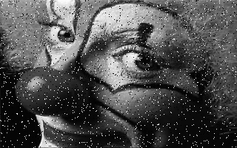





Mean vs median filter – noise reduction
Unfiltered
salt and pepper noise
Mean filtered
Median filtered
mean-filtered
median-filtered
Clown / Fiji samples
Notes:
Let’s imagine a situation where we have a camera with some hot pixels, some pixels that are noisy and have very high values. Or our sample or acquisition generates this kind of noise.
[click]
If we were to apply a mean filter as before, that very high intensity is spread out to the surrounding pixels. We could take a different approach and use median instead. This ahs the advantage that it will discard outlier values.
[click]
Imagine our image has this salt and pepper noise. See the differences between applying a mean and a median filter. The advantages of a mean filter is that it’s faster to process as it does not require sorting. The advantage of the median filter is that no new values are created in the image and it suppresses this type of noise.

Slide 29
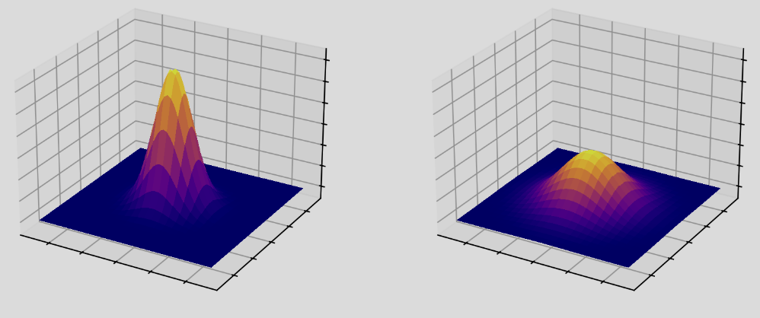


Gaussian Smoothing
Used to “blur” images and remove detail and noise
  Gaussian-shaped kernel
Computationally efficient
  Larger filters (e.g. 2D) can be implemented
  using smaller 1D filters or in Fourier space
The degree of smoothing is
given by the standard deviation σ
Size can be matched to PSF
Introduction to Bioimage Analysis
Clown/ Fiji samples
original
gaussian-filtered σ=2
Notes:
Another common filter used for smoothing images is the gaussian filter.
[click]
It’s mostly used to blur images, remove noise and consists of a gaussian shaped kernel. Here we can see a 3D projection of it.
[click]
A big advantage is that it’s computationally efficient to calculate as it can be obtained via composition of smaller filters or calculated in Fourier space.
[click]
The degree of smoothing, related to its size, is given by the standard deviation, the sigma value of the gaussian.
[click]
Another interesting feature is that you can choose sigma in such a way that it matches the point spread function of the microscope. By doing this, you can suppress noise while avoiding to lose details as only pixels coming from the same PSF are considered in a kernel.

Slide 30
Image Analysis Workflow
Segmentation
Semantic segmentation
Refinement
Instance segmentation
Notes:
Well, now is a good time to stop, take a deep breath… Should we continue? Do we have any questions about key concepts until now?
Segmentation is often the key step in image analysis. Segmentation is used to separate what is of interest from what is not, and is what makes the image easier to process downstream for quantification. It’s often the limiting step and one of the most complicated ones.

Slide 31
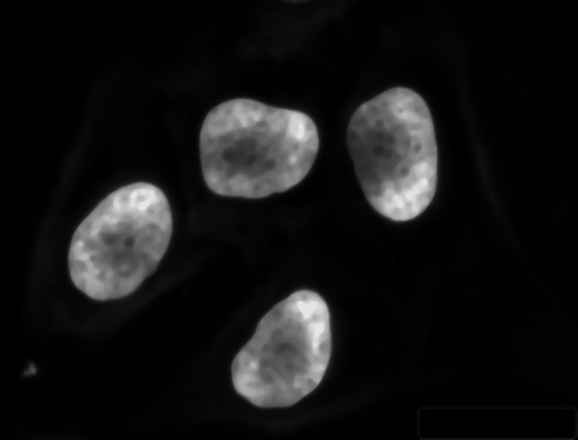
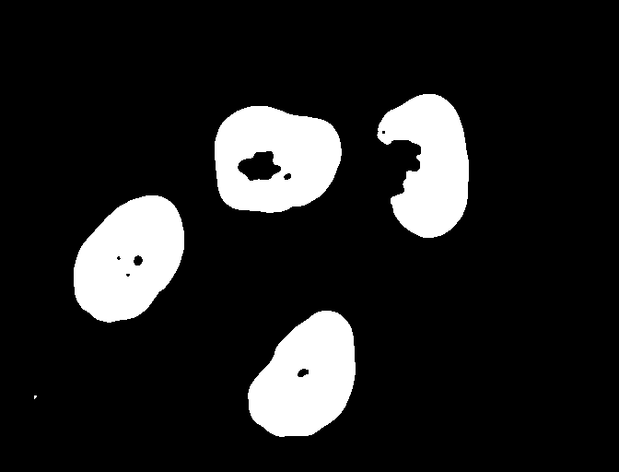
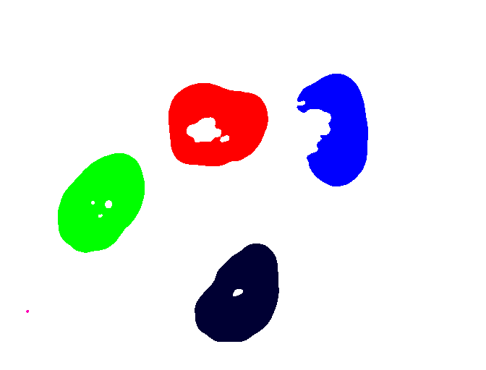
Segmentation
Separates the objects of interest from the background
Input
Semantic Segmentation
Instance Segmentation
Filtered image
Binary mask
Labeled mask
HeLa Cells / Fiji samples
Notes:
Segmentation is separating the objects of interest in an image into the ones we would like to analyze from the ones we want to ignore. We start with our filtered image and we apply a method, could be thresholding, to distinguish between pixels that belong to the foreground, pixels that belong to objects of interest, from pixels belonging to the background. This is called semantic segmentation, it distinguishes foreground from background and will generate a binary mask. Binary masks are images whose pixels take one of two values, one for background and another one for foreground. Then, you can apply other algorithms to distinguish between different objects. This is called Instance segmentation and will yield a labeled mask. In labeled masks, each instance or object is assigned a label, usually an integer, and every pixel that corresponds to that object has that same value. Pixels in background take 0, maybe all the pixels for the nuclei in green take the value 1, the pixels for the red one take value equal 2, and so on and so forth.

Slide 32

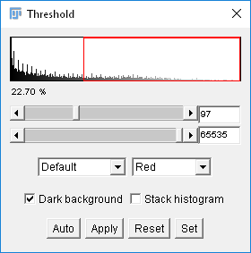
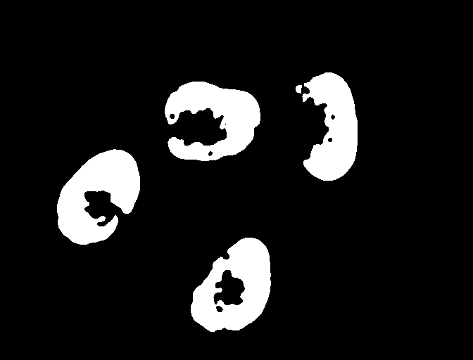
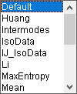

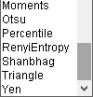
Segmentation - thresholding
Thresholding is a basic segmentation method
  Manual thresholding vs automatic thresholding.
HeLa Cells / Fiji samples
Notes:
Thresholding is one of the most common and basic segmentation methods. When the image is clean enough it works straight out of the box and saves a huge amount of work.
[click]
You might do it manually the first time to have a rough idea of how well separated are the intensity values of the foreground from the background.
[click]
Ideally, if you want to be more objective and reproducible, also if you want to be able to apply it to many images, you might look into many of the automatic thresholding algorithms like Moments,
[click]
Otsu
[click]
Each of these automatic thresholding algorithms have their own theory and usecases.

Slide 33
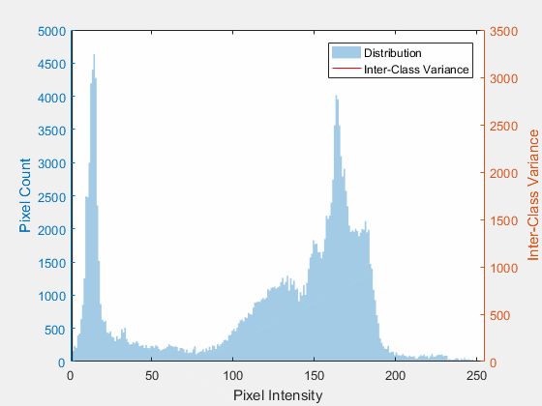
Otsu thresholding
Algorithm returns the intensity that maximizes inter-class variance between foreground and background
Lucas(CA), CC BY-SA 4.0 <https://creativecommons.org/licenses/by-sa/4.0>, via Wikimedia Commons
Notes:
Let’s take Otsu as an example as it is one of the most ubiquitous. Otsu uses looks for the intensity value that can divide the intensities into two populations such as to maximize the inter-class variance. Here the two class Otsu is shown, but it is possible to have more than two classes.

Slide 34

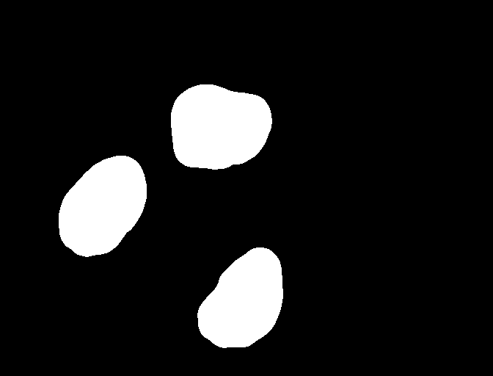
Post processing
Refinement of the binary mask
  Ex.: fill holes present in the segmented objects; filter objects by area, size or circularity; filter objects by intensity, etc.
Original binary mask
Fill holes operation
Binary mask filtered by circularity
HeLa Cells / Fiji samples
Notes:
More often than not, binary masks are not perfect after segmentation. We can already see a small positive pixel at the bottom left, some holes in the nuclei, a missing piece in the top right.
[click]
We can apply a fill holes operation, which will… well… fill holes
[click]
Followed by filtering by circularity. Most objects detected are ellipses, but the nucleus that was missing a piece was not so it got filtered. You always have to consider your scientific question to decide what to apply. If we would measure area, mean intensity or morphometry, we would like to keep the nuclei that have been well segmented. Consider as well if we are introducing any bias by filtering out nuclei with specific characteristics. On the other hand, if we wanted to count nuclei, we filtered out a nucleus that could have been counted, even if a piece was missing.

Slide 35
Connected components labelling
In order to allow the computer differentiating objects, connected components analysis (CCA) is used to mark pixels belonging to different objects with different numbers
Background pixels are marked with 0.
1
0
0
0
0
0
0
1
1
0
0
0
0
0
1
1
1
0
0
0
0
CCA
1
1
0
0
0
3
0
0
0
0
0
3
3
3
0
0
0
3
3
3
3
2
2
0
3
3
3
3
Notes:
Once we are happy with our semantic segmentation, we can proceed with an instance segmentation. Connected components analysis is one of the simplest.
[click]
Here each foreground pixel in touch with another foreground pixel will be assigned the same label. Separated components will receive different values. Background pixels will receive a 0 value. This is quite simple, and might lead to objects being clumped together when they are in touch by even a single pixel. Can we fix this somehow?

Slide 36

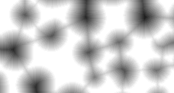
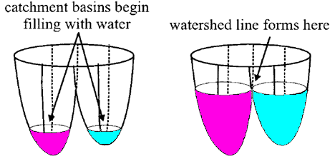
Watershed
Euclidean Distance map
Binary mask
Separated Objects
https://imagej.nih.gov/ij/images/watershed-animation.gif
Notes:
Of course! We can come up with a new algorithm called watershed. If we have our clumped objects, we can replace every pixel value by its distance to the edge. This is called an Euclidean distance map. Imagine now that the brightest pixel is the deepest point in a basin. We will fill in each basin slowly until they are almost in touch with each other. This way we can separate objects that are clumped together by a thin bridge.
[click]
This animation can help us understand how this algorithm works.
We came a very long way combining many different steps and algorithms to get this labeled image. These techniques are often called classical image analysis. They might be too many and cumbersome, but if we take enough time we can explain them, understand how each parameter work, and tweak them if needed. But there are other ways of performing segmentation.

Slide 37



Learning from data
Machine Learning
Input
Feature Extraction
Classification
Output
Artificial Intelligence
Cat
Machine Learning
E.g.: SVMs (support vector machines); decision trees; neural networks
Deep Learning
Deep Learning
Input
Feature Extraction + Classification
Output
Cat
E.g.: CNNs (Convolutional Neural Networks); RNN (Recurrent Neural Network); Autoencoders
Notes:
In the last decades, there has been an increase in methods based on deep learning. Let’s start from the more general definitions all the way to deep learning. Artificial intelligence is any technique that enables computers to mimic human intelligence. Classical image analysis could fall in this category. Machine learning is a bit more specific as it requires the algorithm to learn from data and make decisions based on patterns observed. Finally, uses artificial neural netwoks to reach conclusions. It still uses data to learn how to make decision so it is a specific case of machine learning.
[click]
Machine learning based methods start from an image and then extract features from it. These features could be obtained by applying several different spatial filters like gaussians of different sizes, edge detections and blob detections.
[click]
Following this, a decision tree or random forest, or a support vector machine could be trained with labeled data to learn how to predict something.
[click]
In deep learning, feature extraction step is included in the learning step. A neural network can be trained to learn how to extract valuable features and then predict classes.

Slide 38


Machine learning-based segmentation
Pixel-based classification
  Trainable Weka segmentation
  Ilastik
Image source: https://www.epfl.ch/labs/cvlab/software/biomedical/biomedplugins/
https://imagej.net/Trainable_Weka_Segmentation
Notes:
If we take into account that images are composed of millions of pixels, which we could label into different classes, this translates into being able to quickly generate many labeled data for training. If we draw ROIs over some pixels tagging them with different values representing different classes we can then apply machine learning to train what is called a pixel classifier. We then need to select features, or spatial filters, that add the most valuable information to determine each class. For example, if we are looking for vessel like structures, we should add edge filters of the appropriate size, if we are looking for blobs, add Laplacian of Gaussians, if its only intensity differences we care about, we have to add gaussian filters, etc. After tagging pixels and selecting features, we can train this Pixel Classifier. Its job is going to be to classify each pixel into the corresponding class. Remember that background is also a class.
[click]
In FIJI, we can use the trainable Weka segmentation for this purpose. Ilastik uses a similar methodology. And there are more.

Slide 39








Cell and nuclei segmentation
Trained model
Nuclei segmentation
Test image
Test image
Trained model
Cell segmentaiton
BioImage Model Zoo
Notes:
What about deep learning? I won’t go into the details of how to train models as this is a whole topic of a couple hours on its own, but I will visit a couple of examples that are used very often nowadays. Consider that models are often trained with a specific input and output in mind. This means that you might need one model to segment nuclei and a different one to segment cells. You can look for models in the BioImage Model Zoo repository linked in this slide. You can open a FIJI instance in the webpage, upload your image and try out the different models to see if anyone works for you. Remember that pretty pictures does not mean that the results are right, but they are a step forward. If you do not really understand, do not hesitate in asking for help.

Slide 40







Deep learning for cell/nuclei segmentation
CellPose
StarDist
Striner et al., Nat. Meth., 2021
Schmidt et al., MICCAI, 2018
Notes:
I’ll take some time to mention some deep learning models that gained a lot of popularity lately. CellPose already has a couple of version out and was trained to predict spatial gradients of diffusion of intensity or flows. It’s quite general and works very well out of the box for a lot of cases, be it nuclei segmentation, cell segmentation, both. CellPose can also be fine tuned if needed by retraining for your specific case.
Another one I would like to mention is StarDist. It works very good for nuclei or objects that are star convex, or ellipses let’s say.

Slide 41



Why do we still use classical approaches?
DL generalization problem
Lack of annotated training data or small datasets
Validation and characterization
Image analysis is not limited to cell/nuclei segmentation
Notes:
After these couple slides, Deep learning seem to be the solution to segmenteation, do we still need classical approaches?
[click]
Well, we have what is called the Deep Learning generalization problem. Although some models seem to be working for more and more modalities, we still find cases where they don’t work and need extra fine tuning.
[click]
For some cases we lack annotated training data or the datasets we have are too small or not variable enough.
[click]
Even when we manage to implement or fine tune a model, we should still validate and characterize it. We again need more data and experience to do this.
[click]
And last but not least, not every image analysis question is about cell and nuclei segmentation, there are other things as well.

Slide 42
Image Analysis Workflow
Quantification
Measurements
Feature Extraction
Notes:
Finally, we have reached the quantification step [sigh]. We finally have a labeled image where each object of interest is labeled separately. What do we do now?

Slide 43


Image quantification
Counting the number of objects of a certain type
Measure geometric properties: size and shape features, area, perimeter
  Based on a segmentation of object(s)
Study intensity features
  Based on histogram of object(s) (in multiple channels)
Study texture features
  Statistics and spatial grayscale variations
Relational/structural features
  How objects (parts of objects) relate to one another
Notes:
During the course we already discussed many of the possible quantifications we might need. Such as Counting number of objects, measuring geometric or morphometric properties, studying intensity features, texture feature or relational features. There are an infinite number and you can be creative and make your own, as long as it is well explained, tested and it makes sense for your scientific question.

Slide 44




Image quantification: 2D measurements
Shape-related measurements
Intensity-related measurements
Notes:
In FIJI you can go to Analyze > Set Measurements… and tick all the values you would like to obtain from your objects.
[click]
Some of these are shape related measurements like [click] circularity [click] roundness [click] aspect ratio [click] ellipcity. Some are very similar but have key differences between them
[click]
There are also Intensity related measurements like mean, minimum, maximum, [click] integrated density.

Slide 45

The Analyze Particle tool in Fiji
Analyze / Tools / ROI Manager
Use “Add”, “Update” or “Delete” to manage the ROIs
For binary masks, use “Analyze / Analyze Particles…” to automatically add ROIs to the ROI Manager
Notes:
After selecting all the measurement you would like to acquire, you can go to Analyze > Tools > ROI Manager. From here you can manage all the detected ROIs. By clicking on measure or on More >> multi Measure, you can get the following.

Slide 46

The Analyze Particle tool in Fiji
Results Table: calculated measures for each ROI
  Each line corresponds to a single ROI and each column to a specific measure
  Table can be saved as a .csv file
Notes:
A table where each row corresponds to each label or object found in the image, and you have all the corresponding measurements to that object in each column. This table can be saved as a csv for posterior analysis or statistics. Uff, this has been quite a journey. I hope you got an idea of how one can build an image analysis workflow. There are so many ways of developing a pipeline, steps that can be included, swapped, run twice with different parameters, Deep learning models that might simplify the question.

Slide 47





















Software Tools in the BioImage Analysis ecosystem
Open source software
Custom solutions
Icy
napari
Notes:
There is also a huge amount of tool that could be used. Here we focused mostly on ImageJ slash FIJI, but you might want to try out other tools. Some are proprietary while others are open source, some are domain specific while others are more general.

Slide 48
Where do we start?
What is the scientific question?
How do we analyze the images?
What should we image and how?
How does this feed back into our understanding?
The Three Gears of Bioscience Projects
Wait et al., JCS, 2020
Notes:
So, don’t hesitate in turning this gears a couple times. Think about your clearly defined scientific question, consider the output you need from your analysis and acquire a small sample dataset as close to what you expect will be needed. Start working on your image analysis as soon as possible. You will identify new issues with the experimental design that you can already start addressing. When you can output results from your image analysis, you can feed into your understanding of the system you are studying. Once again, as you gain a better understanding of the system, you might identify new issues to be addressed or even refinement for the experimental procedure. While running this gears you will improve experimental design or design new experiments for new questions as well. Most importantly, don’t wait too long to start turning the other gears as they feedback into each other.

Slide 49

Checklist for reproducibility
Schmied et al., Nat. Meth., 2023
Schmied et al. ,
Notes:
Remember than when publishing your image analysis pipeline, revisit the checklist to ensure that it is reproducible. As a minimum look for a tick in every checkbox corresponding to the minimal requirements, ideally, the more ticks you have, the better as it makes it easier to reproduce your analysis, and also share and let other people reproduce your analysis on their samples. As usual, you can always ask for help in forums or to your local bioimage analyst.

Slide 50






Datos de Contacto
acorbat@df.uba.ar
acorbat.github.io
@acorbat.bsky.social
Agustin Corbat
LCI Light Microscopy Course Lecture; DOI: 10.5281/zenodo.15390210
Haase, Introduction to BioImage Analysis, YouTube
Corbat, Introduction to BioImage Analysis, YouTube

Slide 51










