Slide 1
A critical look at some CMNS Models
William Collis
Billcollis (at) iscmns.org
The difficult relationship between theory and observation
1
Notes:
1

Slide 2
Purpose of Theory
Convincing Explanation
Useful Prediction
Successful theory should lead to progress, acceptance and financing of LENR!
2
Notes:
First few slides will be about systematic testing.
2

Slide 3

Background
After 30 years few (if any) models attempting to explain CMNS have achieved acceptance outside its proponents.
Few experiments set out to test models.
Many models fail to illustrate what phenomena they explain or predict.
Every model predicts residual radioactivity – but this is often ignored!
3
Notes:
First few slides will be about systematic testing.
3

Slide 4
How can we test theories?
Look for expected fuels / products.
Slow Chemical / Physical / Calorimetric methods are not sensitive and not real time.
Nuclear Measurements identify reactions: Particle tracks.
  Gamma energies / intensities / decay rates.
Isotopic anomalies. Mass spectroscopy.
4

Slide 5
Is it Cold Fusion?
Fusion implies the approach of charged particles tunneling through Coulomb barrier.
This would be most probable for the lightest nuclei of low charge (e.g. p, d, t)
By far the most probable reaction is:-
p + ²H -> γ + ³He +5.493 MeV
p+d → ³He is 14 orders of magnitude faster than d+d → ⁴He
Absence of ³He implies no Coulomb barriers!
5
Notes:
p+d → 3He is 14 orders of magnitude more likely than d+d →

Slide 6
Is there a Nuclear Active Site?
It is well established that chemical structure, temperature have little or no effect on rates of nuclear reactions.
LENR appears to continue in hot spots long after melting would destroy any structure or coherence.
Conclusion: Structures are not important.
6

Slide 7
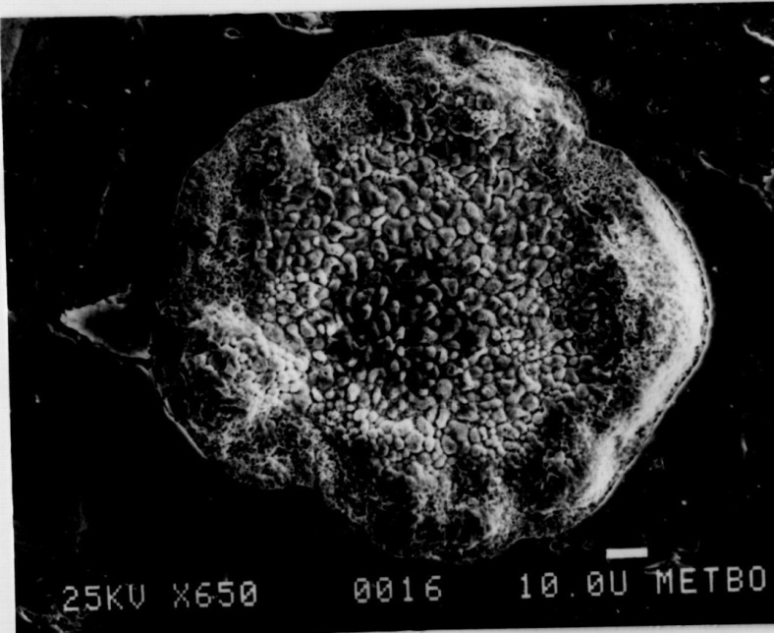
Frozen Hotspot on heat producing Nickel exposed to hydrogen.
Notes:
The granules visible are a eutectic melting at 1000 C but the Nickel was at < 400 C.

Slide 8
A simple way to weed out wrong theories.
Test models against all naturally occurring isotopes to see if they correctly predict beta radioactivity.
This is an easy theoretical test using software but almost all models fail.
8

Slide 9
Models briefly considered here…
Widom Larsen heavy electrons
Storms’ hydrotons and electron capture
Iwamura like captures of alphas
Deep Dirac Levels
Fisher’s Polyneutron theory
Bazhutov’s Erzion theory
Collis’ ENP theory
9

Slide 10
WIDOM LARSEN
Electrons are conjectured to acquire energy.
Sufficiently energetic electrons can be captured by protons to create neutrons.
Neutral neutrons can be captured without any Coulomb Barrier.
Notes:
Unobserved radioactivity predicted.

Slide 11
Problems with WIDOM LARSEN THEORY and electron capture
Energetic electrons will be captured by natural elements other than hydrogen too! Indeed these may be the only energetically possible captures if the acquired energy is less than 780 keV.
There are 65 naturally occurring isotopes which would become beta radioactive on capturing a 780 keV electron. Where are they?
Fails natural isotope interaction test.
Example: e- + ³He-> ³H -0.019 MeV
(but we might make tritium at low kinetic energy!!)

Slide 12
Storms’ Electron Captures.
Storms proposes 3 major reactions:-
d + e- + d → ⁴H → ⁴He
p + e- + d → ³H → ³He
p + e- + p → d
These weak interactions are inhibited by 20+ orders of magnitude!
12
Notes:
Many theories ignore how nuclear energy is converted into heat.
12

Slide 13
Expected Interactions
p + d → ³He
d + d → ³H + p
d + d → ³He + n
p + p → d + e+ (positron emission)
But we don’t see these expected products so Cold Fusion is not an explanation.
13
Notes:
The model requires more ad hoc parameters than the reactions it predicts.
13

Slide 14
Electron Captures.
There are no mechanisms proposed for how
BOLEPS (burst of Low Energy Photons) arise and with what energies
Nuclei approach each other
Competing strong interactions are suppressed
⁴H beta decays
Positrons are suppressed
Multi-body fusion is possible.
14
Notes:
The model requires more ad hoc parameters than the reactions it predicts.
14

Slide 15
Iwamura type multibody fusion.
⁸Be + ¹³³Cs →141Pr +2.887 MeV
with Palladium or Nickel we predict radioactivity:-
⁸Be + ¹⁰²Pd→¹¹⁰Sn +2.853 MeV
⁸Be + ¹⁰⁵Pd→¹¹³Sn +4.852 MeV
⁸Be + ⁵⁸Ni→ ⁶⁶Ge +6.321 MeV
(⁸Be is 4 deuterons).
Why aren’t radioactive products detected?
15
Notes:
15

Slide 16
Iwamura multibody fusion 2.
Predict products of ⁸Be fusion with every existing natural isotope.
Result: 70 out of 181 exothermic fusions produce beta radioactivity.
e.g^{. 40}Ca(97.0%) → ⁴⁸Cr(beta+) +12.917 MeV.
How is it possible that almost no beta radioactivity and gammas are observed?
16
Notes:
Many theories ignore how nuclear energy is converted into heat.
16

Slide 17
Meulenberg’s DDL Model for Pd/D
²H + e- +¹⁰²Pd->¹⁰⁴Ag+ e- +10.321 MeV
²H + e- +¹⁰⁴Pd->¹⁰⁶Ag+ e- +10.683 MeV
²H + e- +¹⁰⁶Pd->¹⁰⁸Ag+ e- +10.835 MeV
²H + e- +¹⁰⁸Pd->¹¹⁰Ag+ e- +11.069 MeV
²H + e- +¹¹⁰Pd->¹¹²Ag+ e- +11.388 MeV
All the above silver isotopes are beta radioactive but expected gammas are not observed! (²H+e = d#)
17
Notes:
Jean Luc may wish to comment on this!
17

Slide 18
The Q/4He ratio
It is observed that Q/4He is sometimes close to 24 MeV consistent with:
²H + ²H → ⁴He +23.847 MeV
But every CMNS model proposes that multiple reactions are occurring, so this ratio is a coincidence of no significance.

Slide 19
Fisher’s Polyneutron Model
Invokes catalytic transfer of neutrons from to natural isotopes without any Coulomb barrier.
But predicts unobserved run-away effect in heavy water:
²H + ^{A}n → ¹H + ^{A+1}n
19
Notes:
^{A}n is a polyneutron of A amu
19

Slide 20
Bazhutov’s Erzion Model
Invokes catalytic transfer of neutrons between isotopes without any Coulomb barrier (like Fisher).
But predicts beta radioactive negative Erzion which would stick close to any heavy nuclide :-
⁷Li + Э_{N} → Э⁻ + ⁸Be +9.176 MeV
The high mass of Э⁻ would cause it to bind strongly to other nuclei effectively removing it over nuclear time scales.
20
Notes:
20

Slide 21
Collis ENP Model
The ENP model borrows from the Fisher and Bazhutov models while bypassing the previously mentioned objections. It will be the subject of later presentation at this meeting. It predicts radio-activity where it is found (but this needs to be confirmed).
21
Notes:
ENP explains and predicts many phenomena.
21

Slide 22
Conclusions
All models predict residual radioactivity. Characterizing it will identify the reaction.
If expected gammas are not found, the model must be refined.
Any valid model must make more predictions than assumptions / parameters.
It is not acceptable to ignore established nuclear physics laws without very good experimental reason.
22
Notes:
ENP explains and predicts many phenomena.
22

Slide 23
Thank You!
Any comments or questions?
23
Notes:
23

