Slide 1


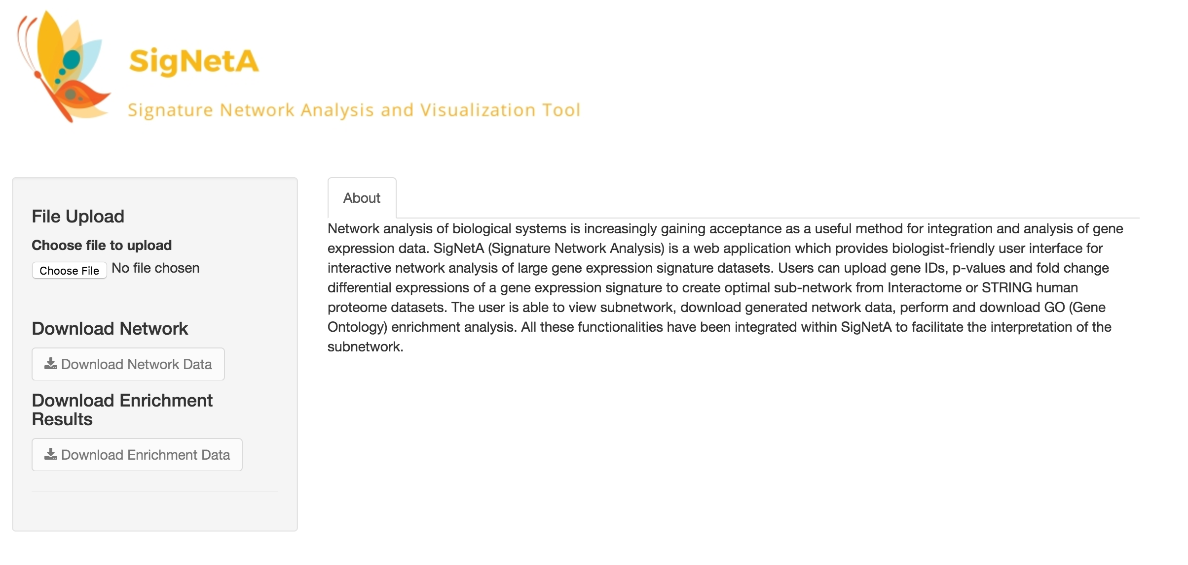
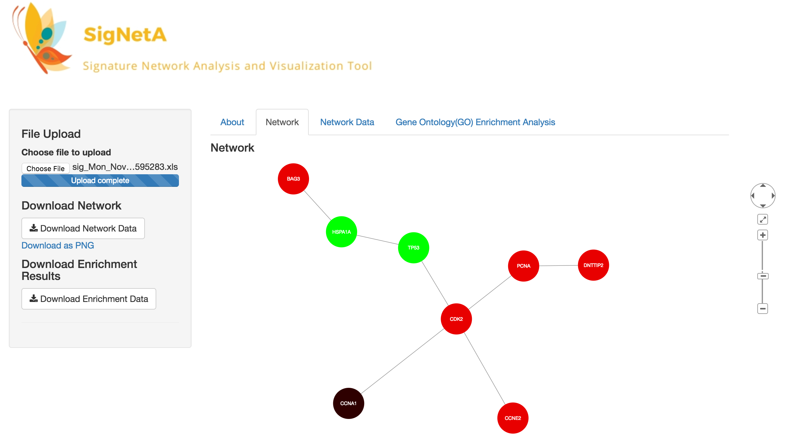
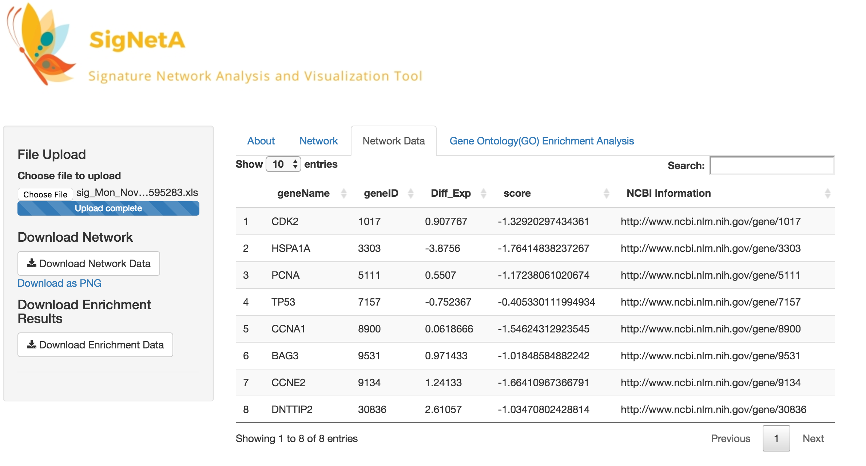
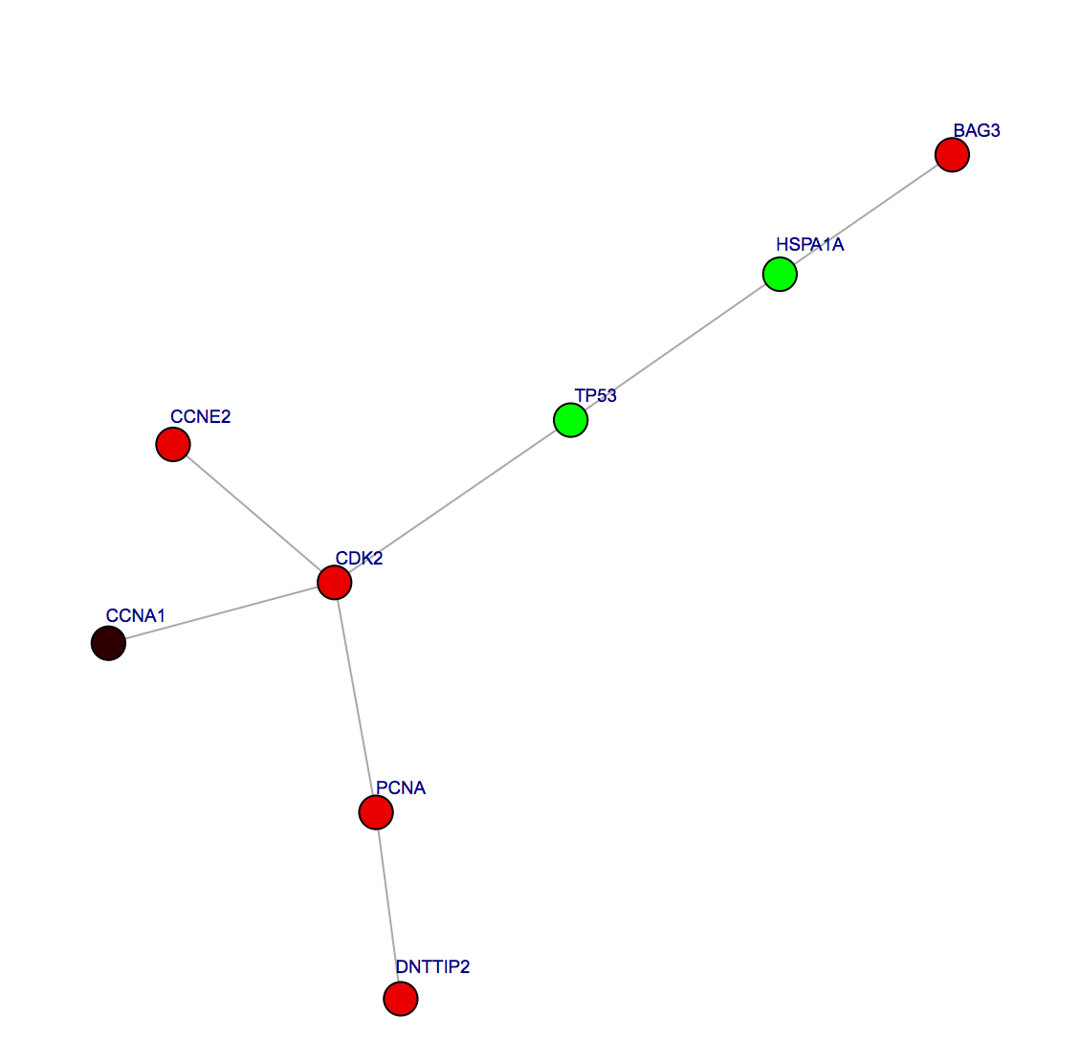
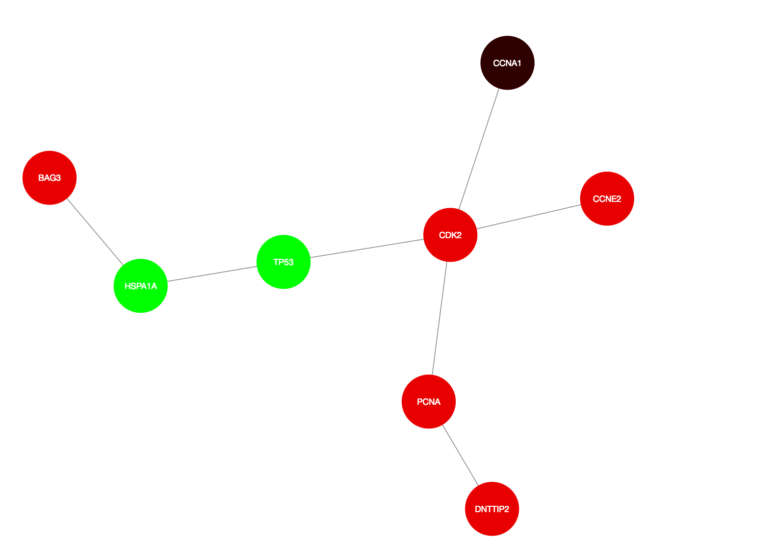
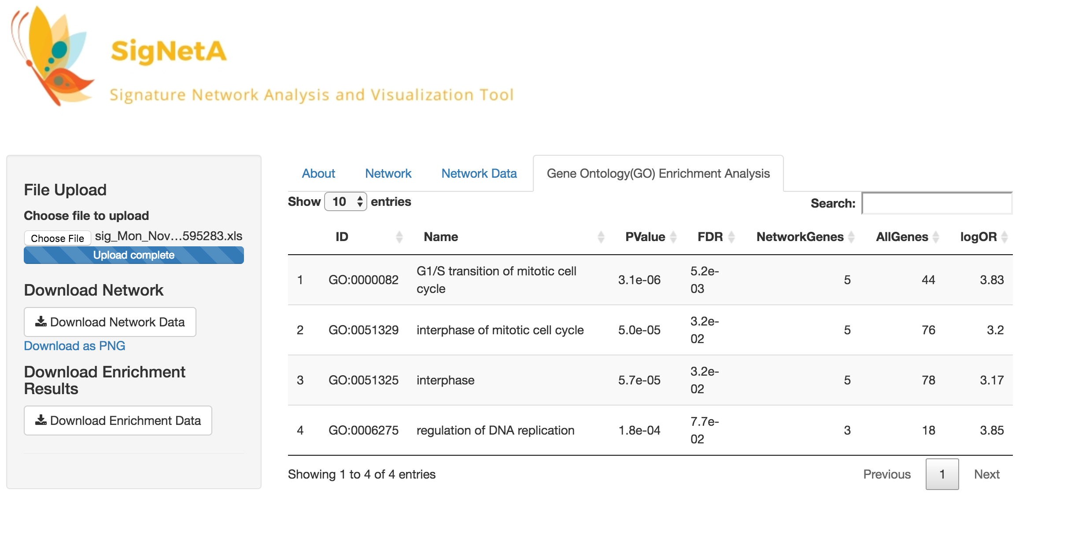
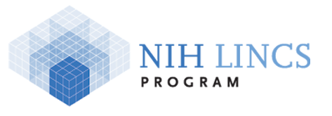


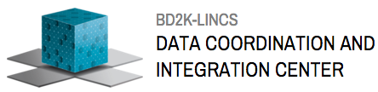
SigNetA: Web Tool for Network Analysis of Gene Expression Signatures
Rashid Saadman Karim¹, Mario Medvedovic¹
¹Laboratory for Statistical Genomics and Systems Biology, Department of Environmental Health, Division of Biostatistics and Bioinformatics, University of Cincinnati College of Medicine, Cincinnati, OH, USA
Abstract
Network analysis of biological systems is increasingly gaining acceptance as a useful method for integration and analysis of gene expression data. SigNetA (Signature Network Analysis) is a web application which provides biologist-friendly user interface for interactive network analysis of large gene expression signature datasets. Users can upload gene IDs, p-values and fold change differential expressions of a gene expression signature to create optimal subnetwork from Interactome human proteome datasets. The user is able to view subnetwork, download generated network data, perform and download GO (Gene Ontology) enrichment analysis. All these functionalities have been integrated within SigNetA to facilitate the interpretation of the subnetwork.
Example Application:
Network analysis for LINCSCP_10263 signature of perturbation of small molecules based on L1000 data for treatment Vorinostat.
Conclusion
For network analysis and visualization of large gene expression signatures, SigNetA can be used as
an independent web application for fast and efficient generation of highly significant genes and perform enrichment analysis on them. Other features that can be added are pathway nodes in the subnetwork connecting the relevant genes with the pathways based on the enrichment analysis performed and also add other protein protein interaction networks (e.g. STRING ) for research based on comparison of subnetworks which will be released in the future updated version of the the web application.
a.
Signature upload
Using the file upload option a .xls file containing gene IDs, p-values and differential expression values of LINCSCP_10263 is uploaded.
Introduction
For network analysis of biological systems existing tools (e.g Cytoscape) are used for visualizing molecular interaction networks and biological pathways and integrating these networks with annotations, gene expression profiles and other state data. These applications are desktop based and data analysis results can’t be easily shared, installation in different operating systems and maintaining version compatibility are cumbersome and they generate static networks for which exploratory data analysis becomes hard, especially for large datasets. SigNetA overcomes those limitations as it is a freely accessible web tool developed using Shiny web application framework for R and it uses r-cytoscape.js which is a HTMLWidgets package for CytoscapeJS to create interactive networks. It uses RunFastHeinz algorithm to calculate heuristically maximum subnetwork of genes from uploaded signature. Gene Ontology enrichment analysis can be performed to determine which genes in subnetwork play significant role in certain pathways.
References
Beisser D, Klau GW, Dandekar T, Mueller T and Dittrich M (2010). “BioNet: an R-package for the Functional Analysis of Biological Networks.” Bioinformatics, 26(8), pp. 1129-1130
Dittrich MT, Klau GW, Rosenwald A, Dandekar T and Mueller T (2008). “Identifying functional modules in protein-protein interaction networks: an integrated exact approach.” Bioinformatics, 24(13), pp. i223–i231.
Franz M, Lopes CT, Huck G, Dong Y, Sumer O, Bader GD(2015)." Cytoscape.js: a graph theory library for visualization and analysis” Bioinformatics (2015) 32 (2): 309-311.
R-cytoscape.js library reference: https://github.com/cytoscape/r-cytoscape.js
b. Subnetwork generation
Using the network analysis methods mentioned a highly correlated subnetwork is generated which contain CCNA1 as highly upregulated.
BAG3,PCNA,DNTTIP2,CDK2 and CCNE2 are up regulated and TP53,HSPA1A are downregulated. Network image can be downloaded using the download as PNG option.
b.
c. Subnetwork data
A data table is created for the subnetwork generated which contains information such as gene name, gene ID, differential expression, score and links to NCBI for the significant genes in the subnetwork. Network data can be downloaded using the download network button.
Overview of Network Analysis Methods
c.
a.
A gene expression signature dataset consisting of gene IDs, p-values and differential expression is uploaded.
Genes from the dataset are matched with the human PPI interactome dataset. Score each node with beta uniform mixture model on the basis of p-values. Finally RunFastHeinz algorithm is used to calculate optimal scoring subnetwork. Green and red nodes identifies genes which are down and up regulated respectively. Analysis functions used from Bionet package.
An interactive version of the subnetwork is created using r-cytoscape.js library.
GO enrichment analysis carried out using genes from subnetwork
Gene Expression Signature Upload
Links and contact information
For accessing SigNetA online, please visit http://eh3.uc.edu/apps/signeta
For further queries or if you want to send a feedback regarding the web application please send an email to karimrn@mail.uc.edu
b.
d. Gene Ontology(GO) enrichment analysis
GO enrichment analysis is performed for the genes in the subnetwork and it’s seen that 5 of the 8 genes in the subnetwork has a significant role in G1/S transition of mitotic cell cycle, interphase of mitotic cell cycle, interphase and regulation of DNA replication and 3 genes are significant in regulation of DNA replication. This data provides insights which can be used for further analysis. Enrichment analysis data can be downloaded using the download enrichment data button.
c.
d.
d.
Acknowledgements
This work has been funded by the NIH grant U54HL127624
Gene Ontology
Enrichment
Analysis

