Slide 1


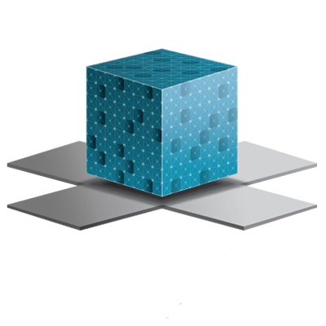
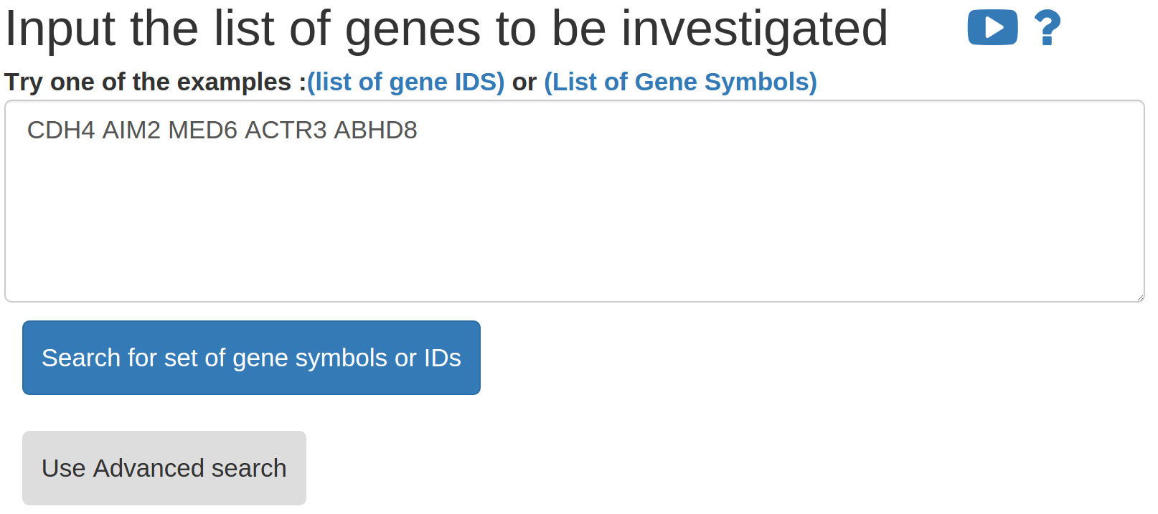
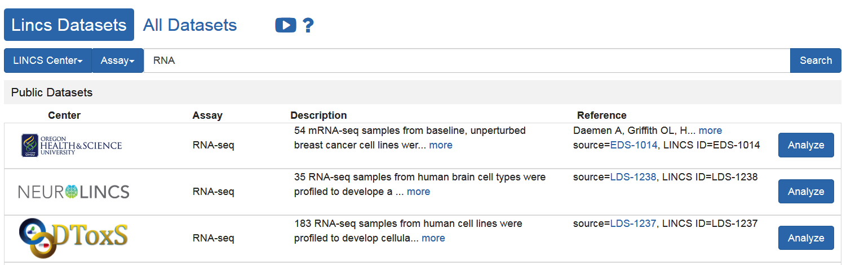
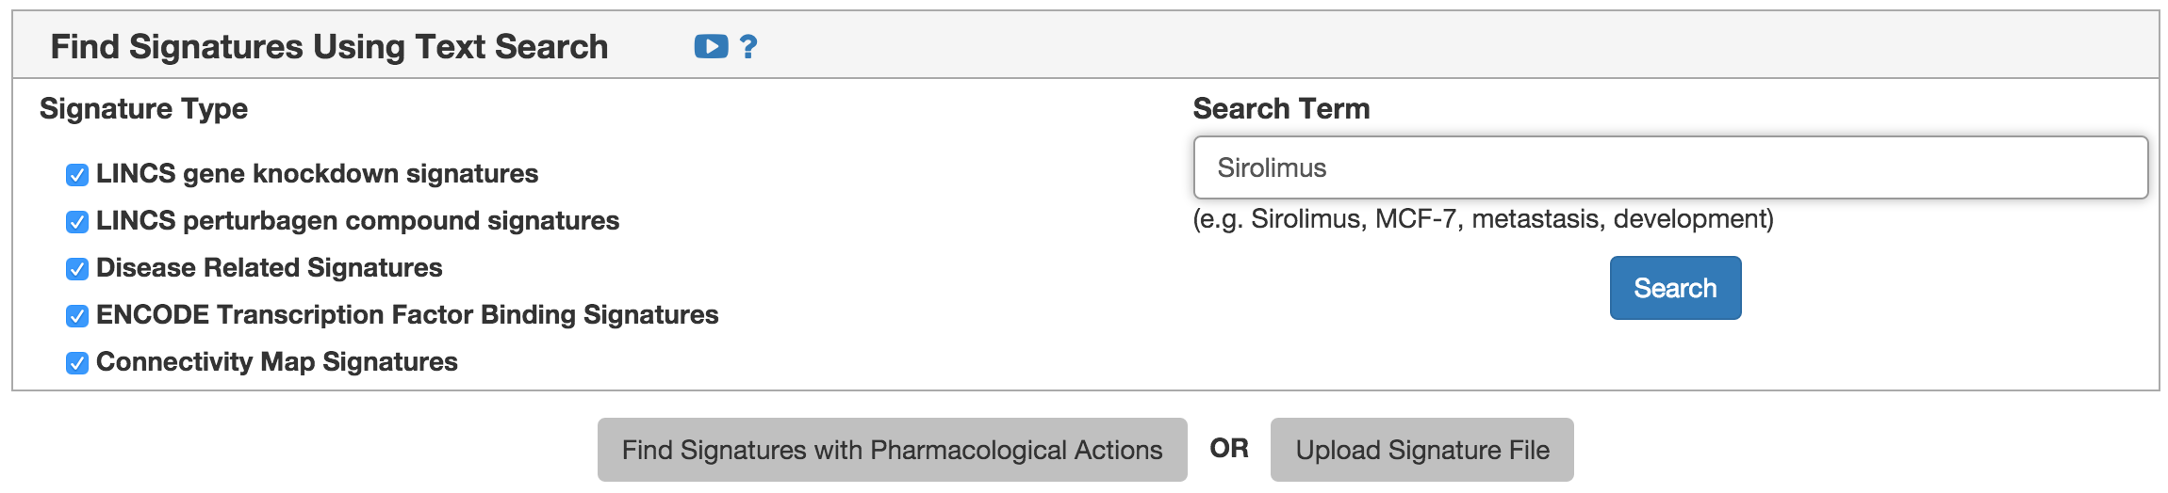
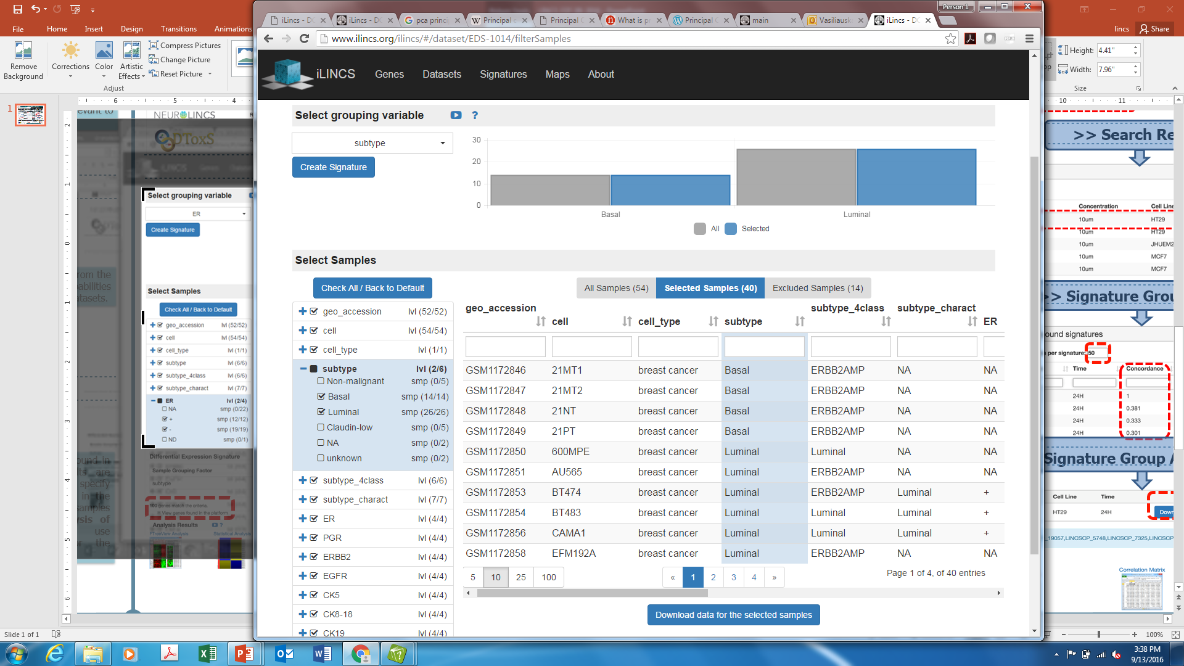
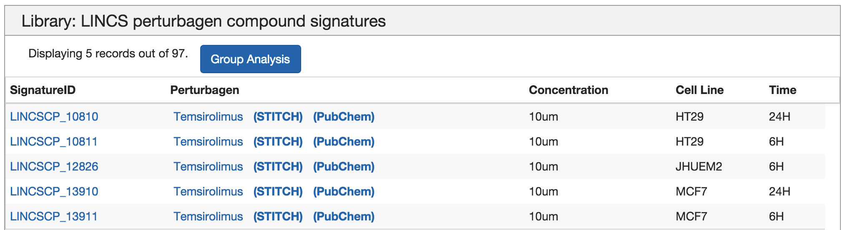
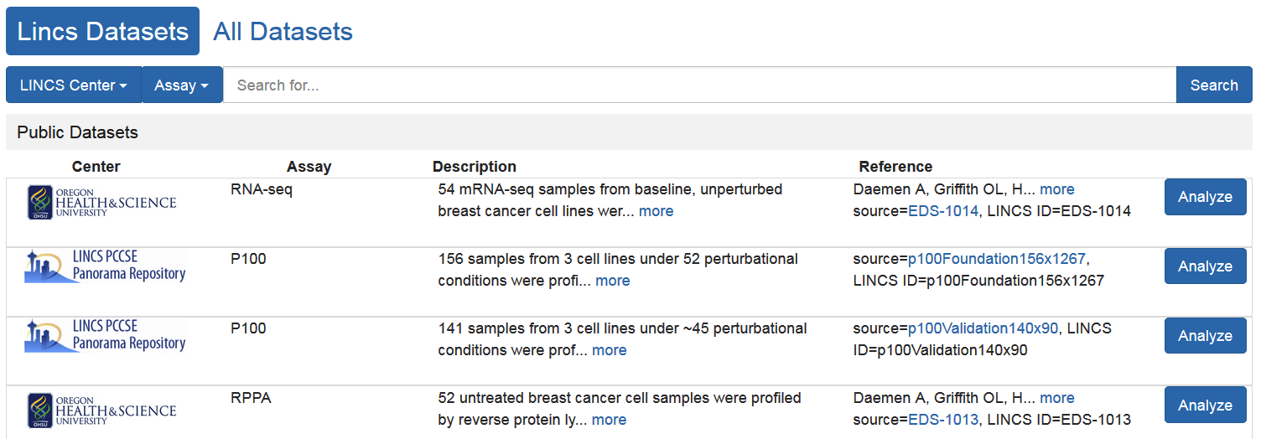
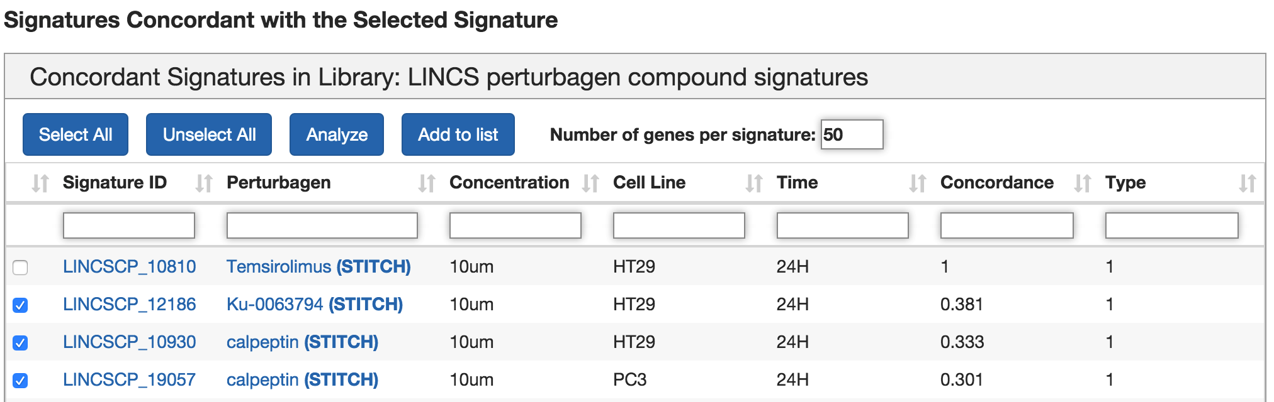
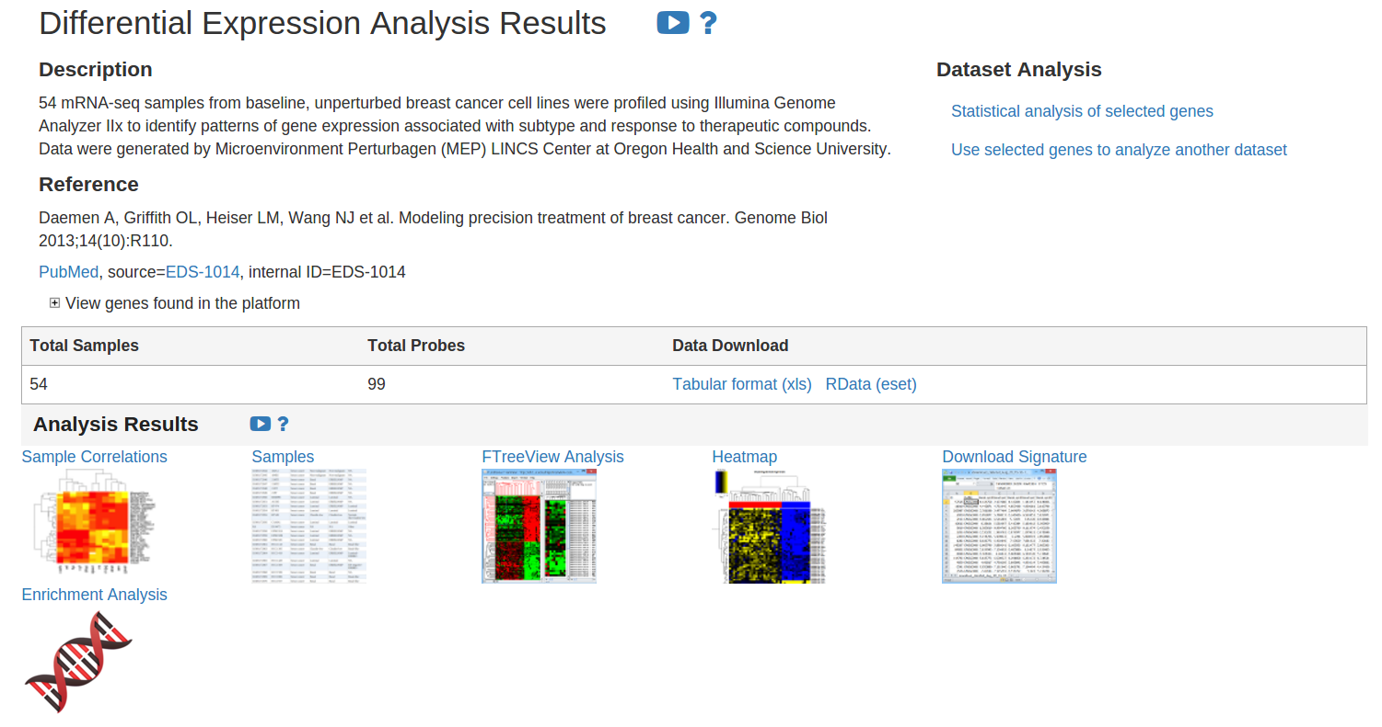
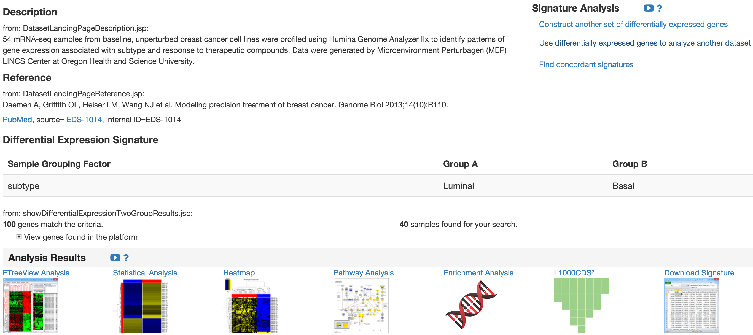
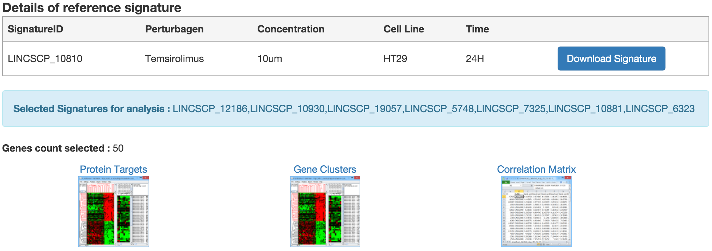
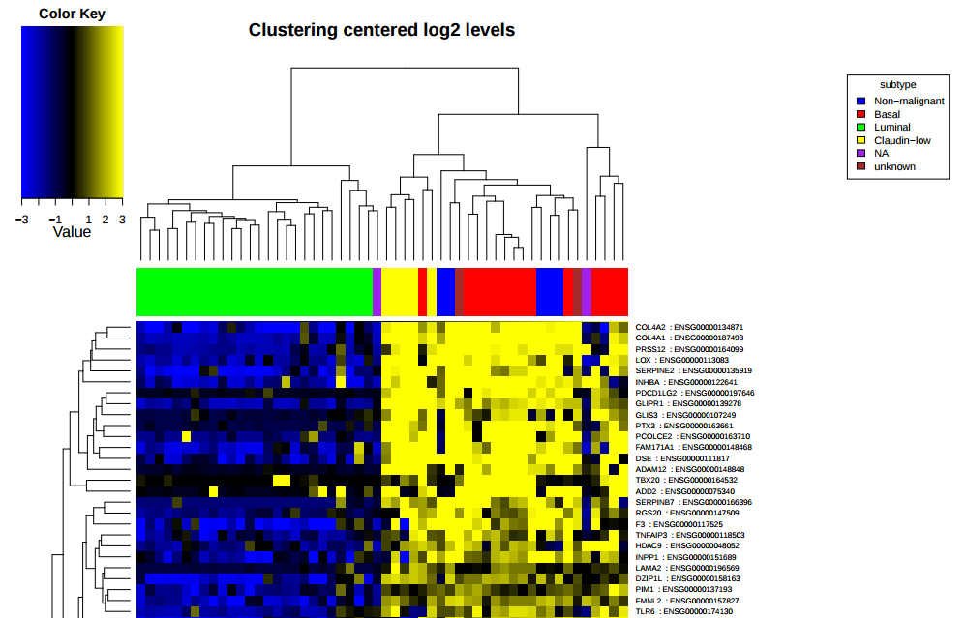
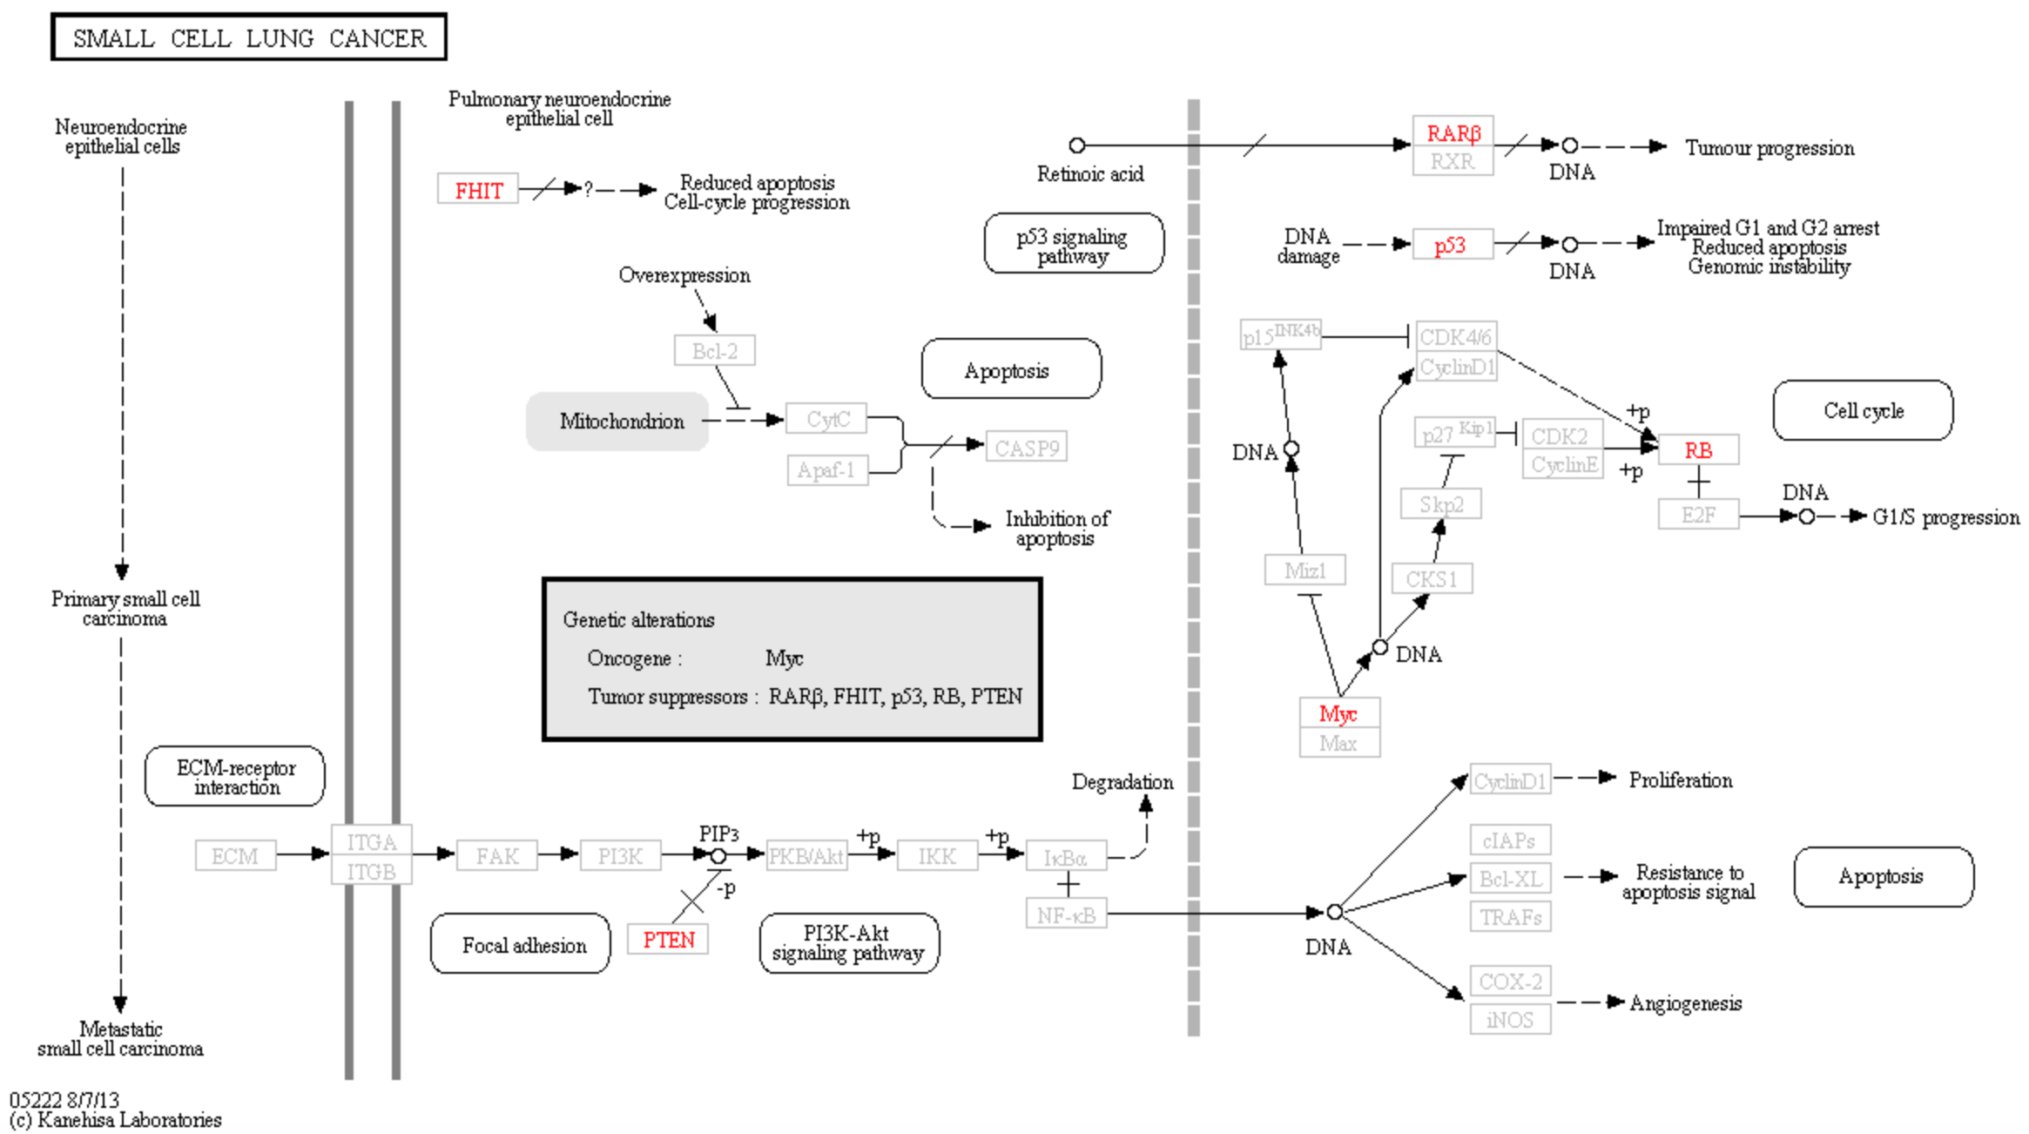
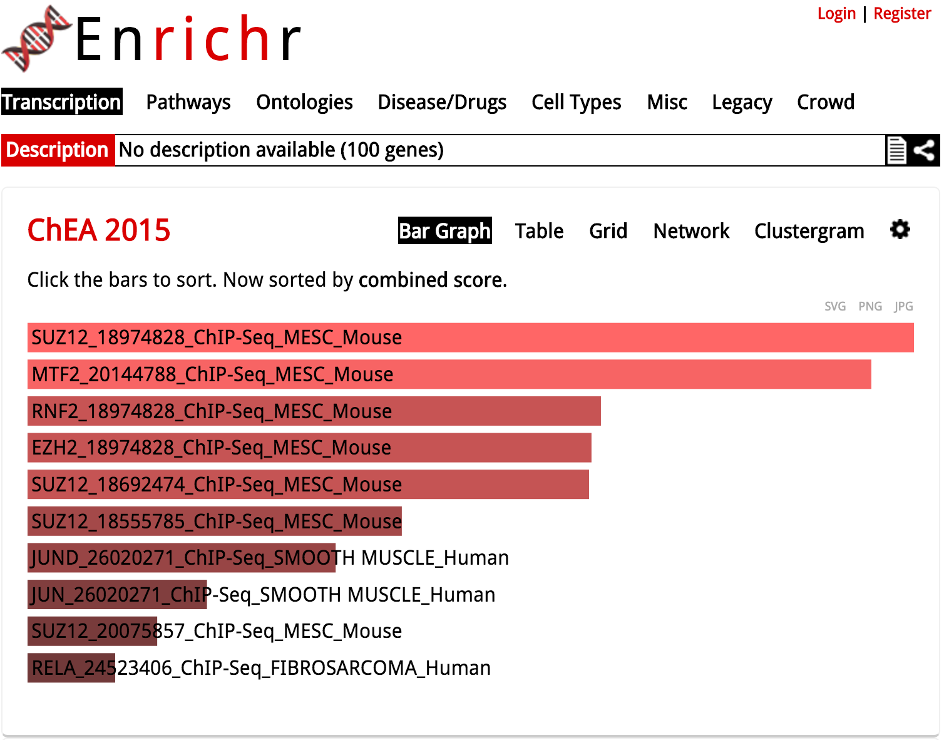
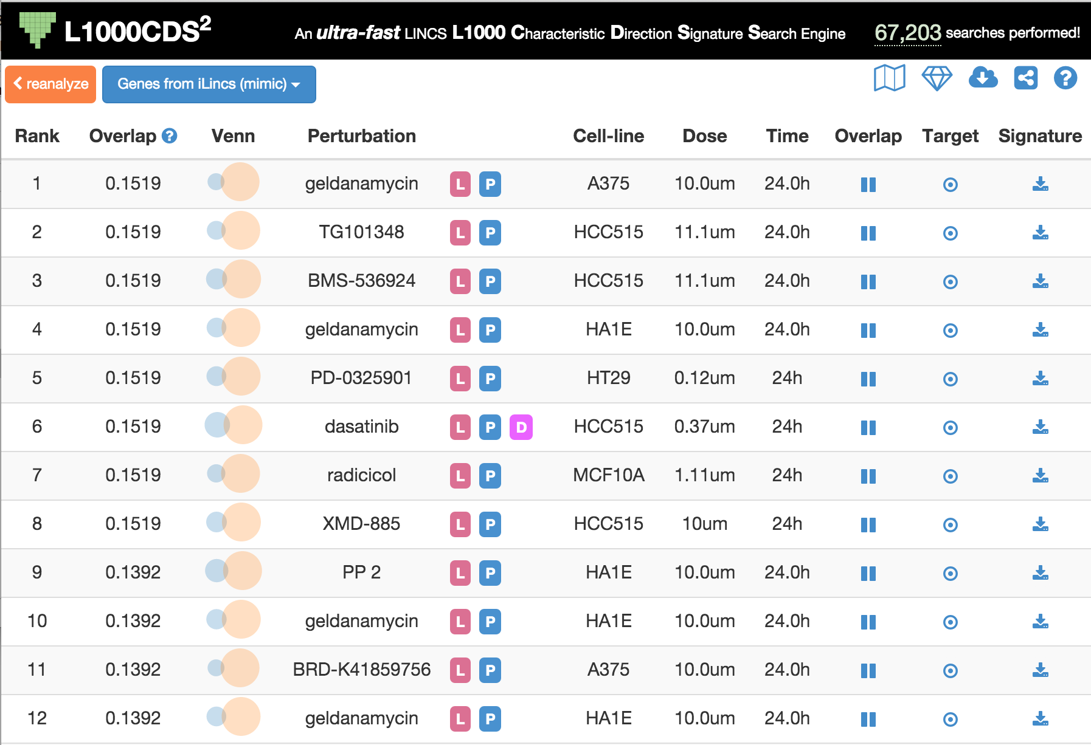
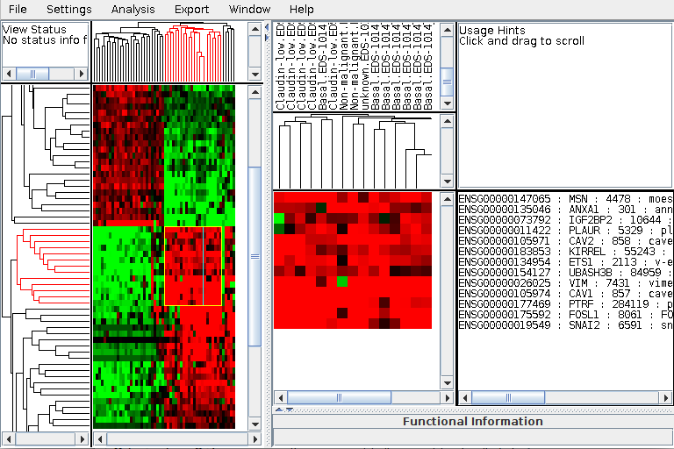


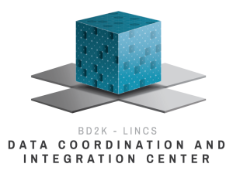
iLINCS: Web-Platform for Analysis of LINCS Data and Signatures, ilincs.org
NIH Big Data to
Knowledge (BD2K)
Marcin Pilarczyk, Mehdi Fazel Najafabadi, Naim Mahi, Prudhvi Shedimbi, Michal Kouril, Nicholas Clark, Shana White, Mark Bennett,
Wen Niu, John Reichard, Juozas Vasiliauskas, Jarek Meller, Mario Medvedovic
Laboratory for Statistical Genomics and Systems Biology, Division of Biostatistics and Bioinformatics, Department of Environmental Health, University of Cincinnati College of Medicine
iLINCS (Integrative LINCS) is an integrative web platform for analysis of LINCS data and signatures. The portal provides biologists-friendly user interfaces for analyzing transcriptomics and proteomics LINCS datasets. The portal integrates R analytical engine via several R tools for web-computing (rserve, opencpu, shiny, rgl) and DCIC developed web tools and applications (FTreeView, Enrichr) into a coherent web platform for LINCS data analysis. Users can follow several workflows which allow them to identify differentially expressed genes, proteins and phosphoproteins in LINCS datasets and use them in analysis of other LINCS and non-LINCS dataset (e.g. TCGA and GEO transcriptomic datasets), and in the analysis of LINCS L1000 signatures. In this way, the platform facilitates integrative analysis of LINCS data and signatures. The mechanistic interpretation of LINCS transcriptomic and proteomics signatures is facilitated by the enrichment analysis via Enrichr and DAVID, and by pathways analysis using the R implementation of the SPIA algorithm. The portal can be accessed freely and does not require user registration (http://ilincs.org).
iLINCS Genes
Datasets
Signatures
Maps
Paste or construct a gene list
Select a LINCS or non-Lincs dataset
Query, analyze and visualize gene/protein expression profiles for selected genes in the selected dataset
Select a dataset
Construct a signature
Functional enrichment and pathway analysis
Correlation with signature libraries
Use signature to interrogate a different dataset
Find or upload signature
Find concordant signature
Analyze expression/binding profiles of concordant signatures
Assess biological underpinning of groups of concordant signatures
Select a dataset
Construct a signature
Functional enrichment and pathway analysis
Correlation with signature libraries
GENES
Datasets
Signatures
What are my genes doing in LINCS data?
Query, analyze, and visualize gene/protein expression profiles for the selected genes in the selected dataset.
Mining LINCS datasets
Differential gene/protein analysis, functional enrichment analysis, pathway analysis, correlation with signatures libraries, use newly created signature to interrogate another dataset (LINCS or non-LINCS).
Mining and explaining perturbation signatures
Interrogate signatures similar to the signature of interest, assess biological underpinning of groups of concordant signatures.
> Select Genes
> Select Dataset
> Search for Signatures
List of genes may be inputted using gene symbols or gene IDs. They can be inputted in separate lines as well as separated with other characters, such as space, tab, or comma. After submitting a list, it can be refined to match ones which are relevant to the query.
Users may choose among currently released LINCS datasets. Select datasets may be available for certain authorized personnel. Aside from LINCS datasets, there are more than 3000 others (e.g., TCGA, GEO, CGH) available to be analyzed.
Besides Search Term, iLincs provides a vast list of Pharmacological Actions to choose from as well as an option to upload a signature file, to be compared to selected signature libraries
>> Search Results
>> Select Datasets to Analyze
>> Create a Signature
Users may download a signature of interest from the results table and can also perform Group Analysis of all concordant signatures.
Create a Differential Expression Signature using inclusion/exclusion criteria and sample grouping for the sample selection. For creating a signature, only two groups must be selected. However, the users are able to select additional criteria to focus on particular subsets.
Datasets may be chosen directly from the list or using iLincs search capabilities across LINCS and non-LINCS datasets.
>>> Signature Group Analysis
Define the number of differentially expressed genes from each signature to use for the Signature Group Analysis.
>>> Results of Differential Expression Analysis
>>> Differential Expression Signature
If any of submitted genes are found in the dataset, preliminary results are shown for all samples. To further specify a particular subset of samples in the inquiry, narrow down the list of samples by selecting Statistical analysis of selected genes and use inclusion/exclusion criteria for the sample selection.
A signature is generated using the top 100 differentially expressed genes, but may be revised by using Construct another set… according to a P value and a differential expression value cut off.
Use differentially expressed genes… allows users to analyze another dataset with the extracted list of genes, whereas Find concordant signatures allows users to perform Signature Group Analysis.
>>>> Signature Group Analysis Results
Signatures from the libraries may be Downloaded for further analysis.
Visualizing Analysis Results
L1000CDS²
L1000CDS² is a LINCS L1000 characteristic direction signature search engine. It enables users to find consensus L1000 small molecule signatures that match user input signatures.
Functional TreeView
FTreeView allows users to interactively view cluster analysis results of microarray data. An extracted gene list may be exported to a file or passed to NCBI or DAVID.
Heatmap
Heatmaps illustrate differential expression values between certain genes and samples, which are clustered according to chosen data properties.
Signaling Pathway Impact Analysis
SPIA uses the information from a list of differentially expressed genes and their log-fold changes in order to identify biological pathways most relevant to the condition under the study.
Enrichr
Enrichr is a web-based enrichment analysis tool providing various types of visualization summaries of collective functions of gene lists.
DATA COORDINATION AND INTEGRATION CENTER FOR LINCS-BD2K
This work has been funded by the LINCS-BD2K grant U54HL127624.

