Slide 1




Giddy Gods and Happy Heroes
Detecting Character-Emotions in Fanfiction about Greek Myth with Vector Space Models
Julia Neugarten, Radboud University, Nijmegen, the Netherlands
Thijs Meijerink, independent researcher
Digital Humanities 2025

Slide 2
Introduction
Aim: detecting character-emotion in fanfiction about Greek myth
Why?
  Fanfiction often revolves around “emotional landscapes of reading” (Samutina 2016)
  Fanfiction benefits from distant reading (lots and lots of born-digital data)
  Fanfiction lets fans relate emotionally to the mythological past
  Digital methods like sentiment analysis (SA) have only been applied to a limited extent
    Aspect-based sentiment analysis of fanfiction comments using machine learning (Neugarten et al. 2024)
    Calculating sentiment arcs for fanfiction texts (Jacobsen et al. 2024)

Slide 3

Fanfiction (about Greek Myth)
Fanfiction: stories written by and for fans, inspired by existing stories, published online, usually for free (Neugarten 2021)
Often transformative
Is it transformative of culturally dominant discourses about emotion?
MythFic corpus: 5.154 works of fanfiction from Archive of Our Own (± 28 million words)
Fandom: Ancient Greek Religion & Lore
Language: English

Slide 4
Research Questions
What are the associations between fictional characters in fanfiction about Greek myth, and emotions?
Do character-emotion associations differ between character genders?
  men versus women
Do character-emotion associations differ between genres?
  angst (sad stories) versus fluff (happy stories)

Slide 5
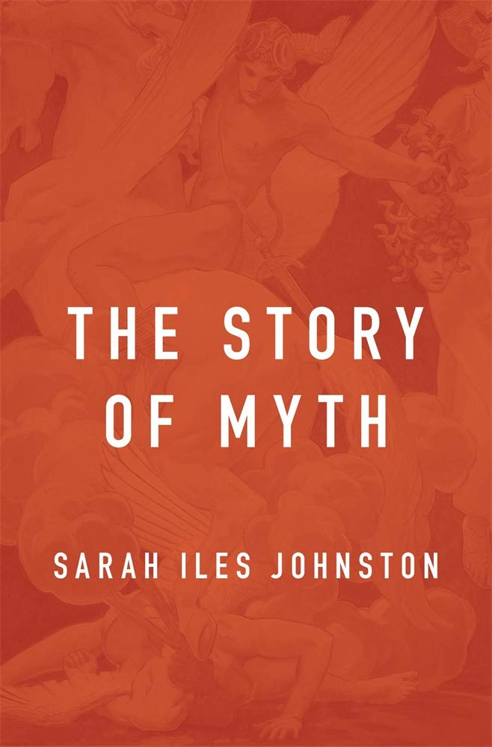
Character
Characters from Greek myth are accretive:
“when [a reader] encounters the character in different instantiations, his or her concept of the character gradually accrues traits from some or all of these instantiations” (27, 2018).
So: character/emotion associations may exist on a large scale, across texts.

Slide 6
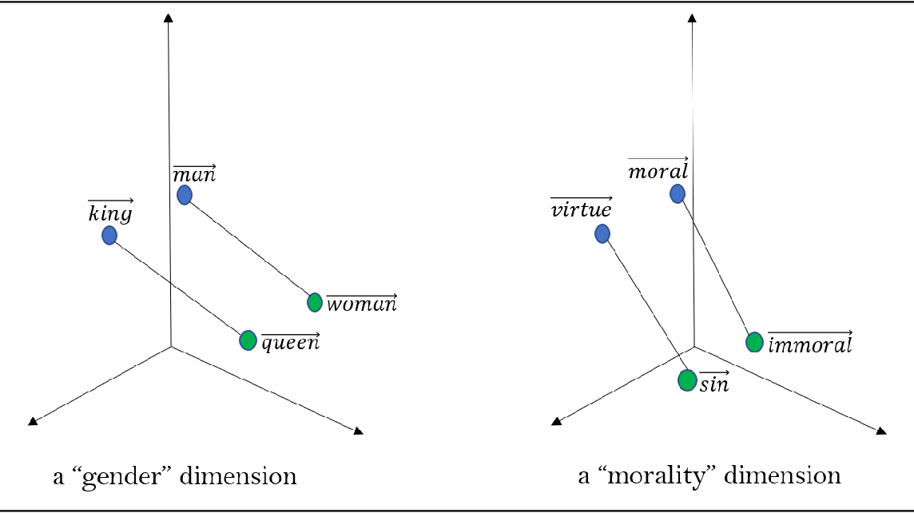
Method: Vector-Space Models
Based on SentiArt (Jacobs 2018, 2019)
6 ‘basic’ emotions (Ekman 1992)
Sadness
Fear
Anger
Surprise
Joy
Disgust
Trained on the MythFic corpus
Spearman’s ρ of ~0.58 validated on the WordSim-353 word similarity benchmark
Image by Arseniev-Koehler (2021)

Slide 7
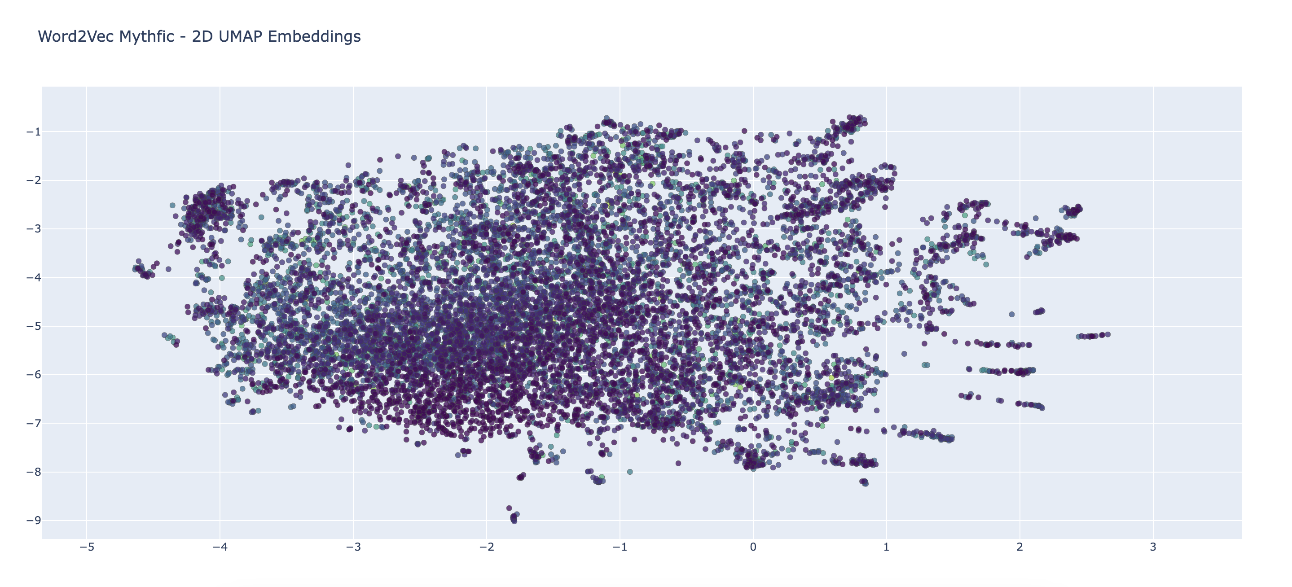

Slide 8
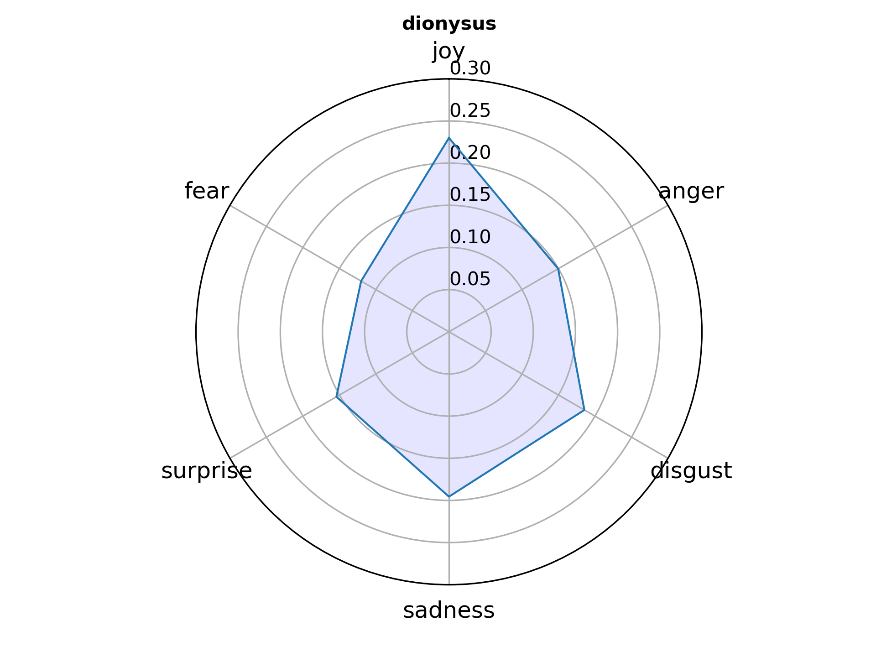

Slide 9
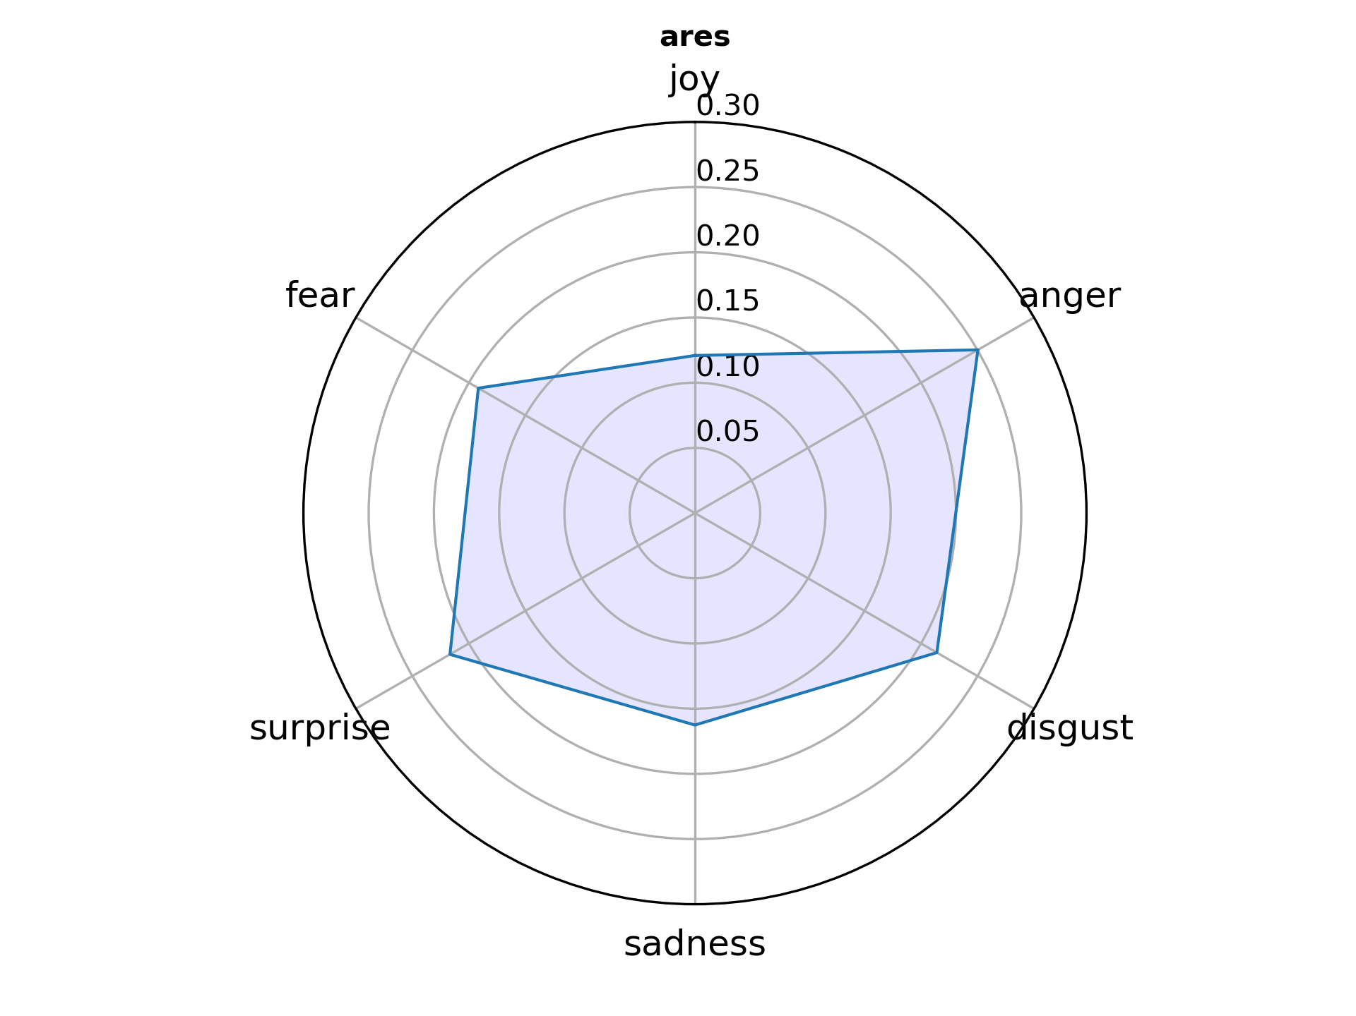

Slide 10
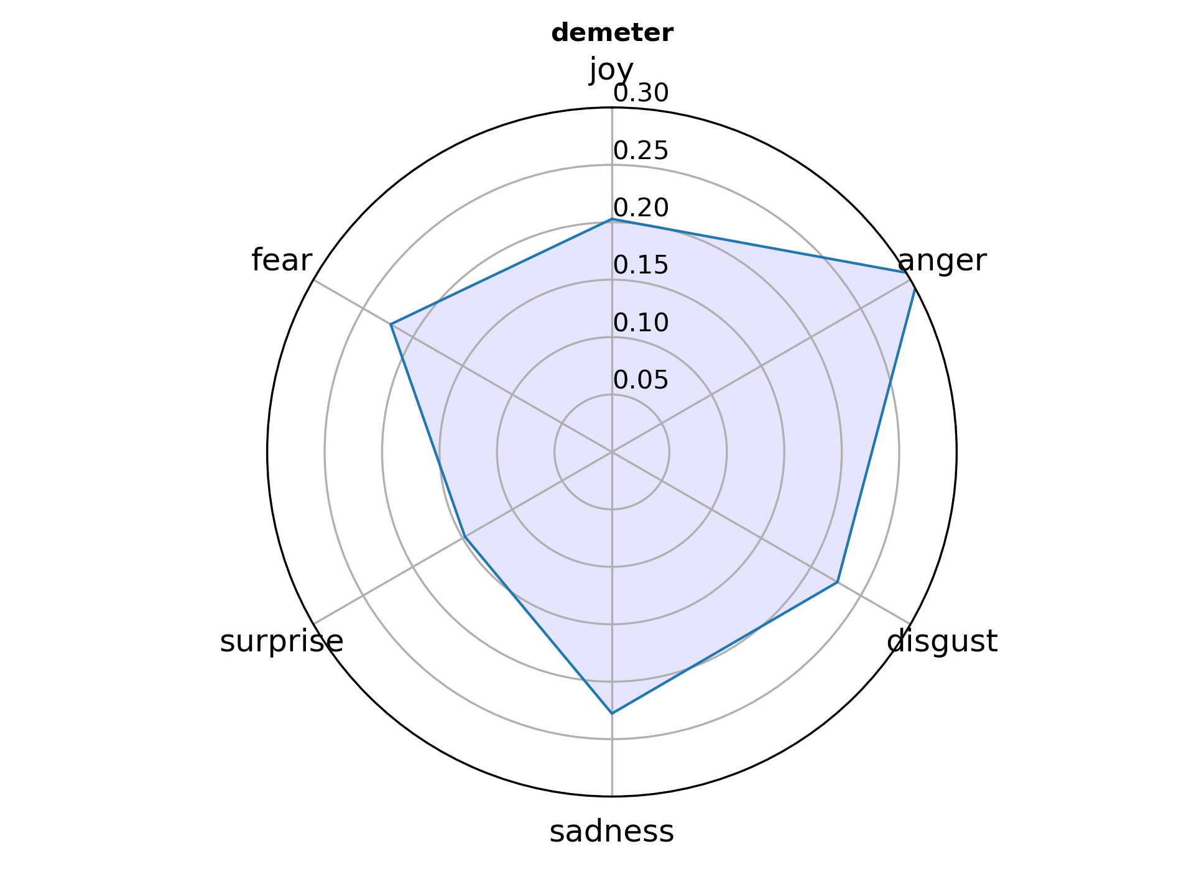

Slide 11
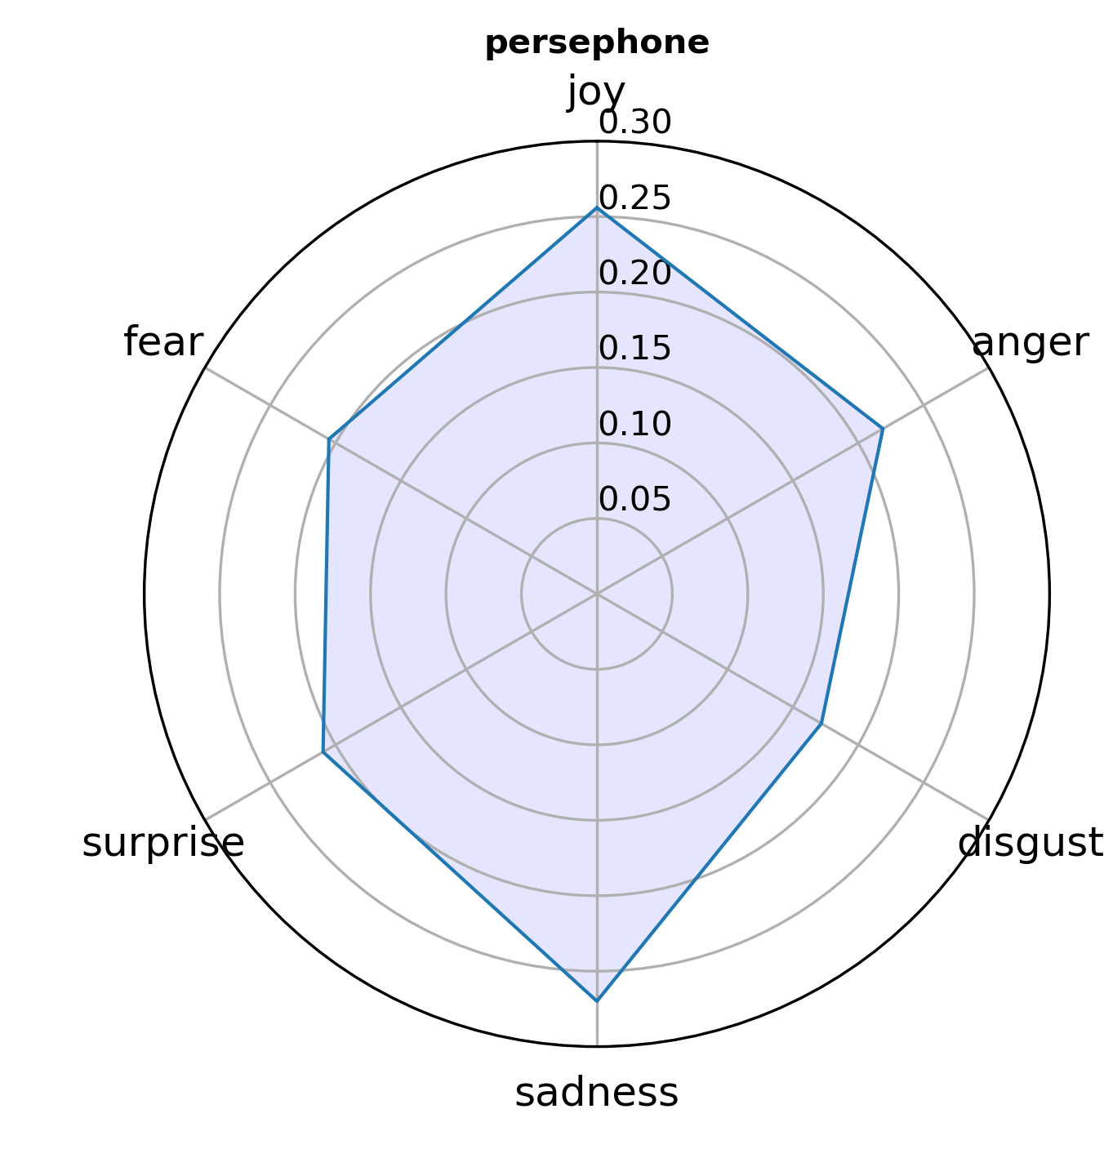
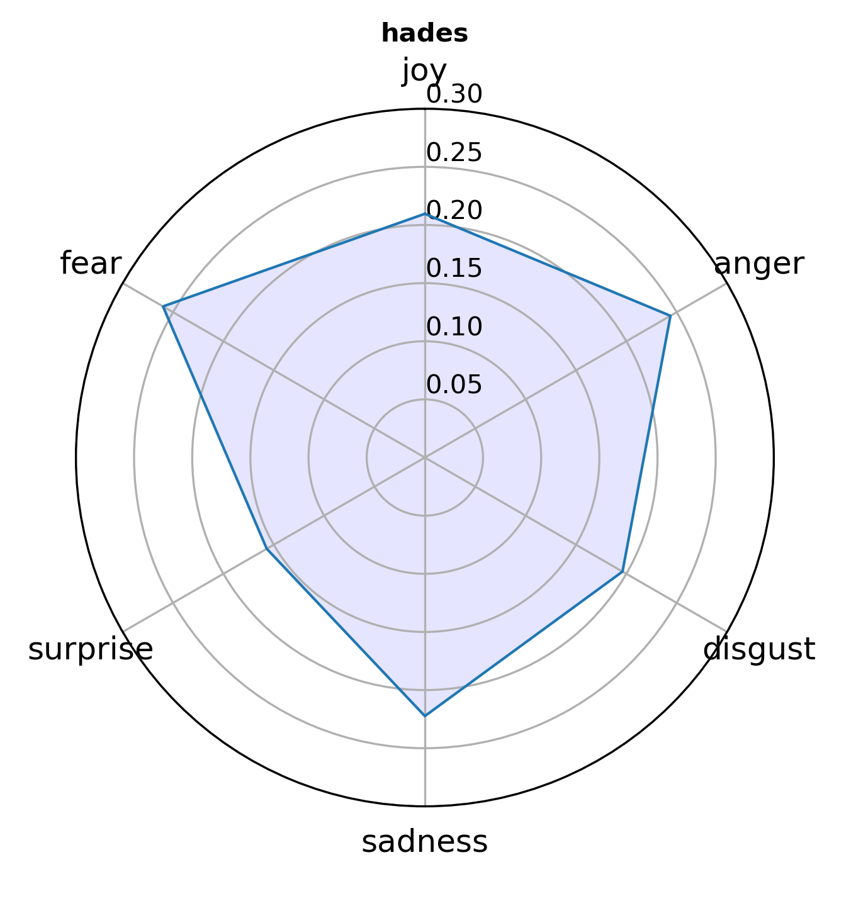

Slide 12
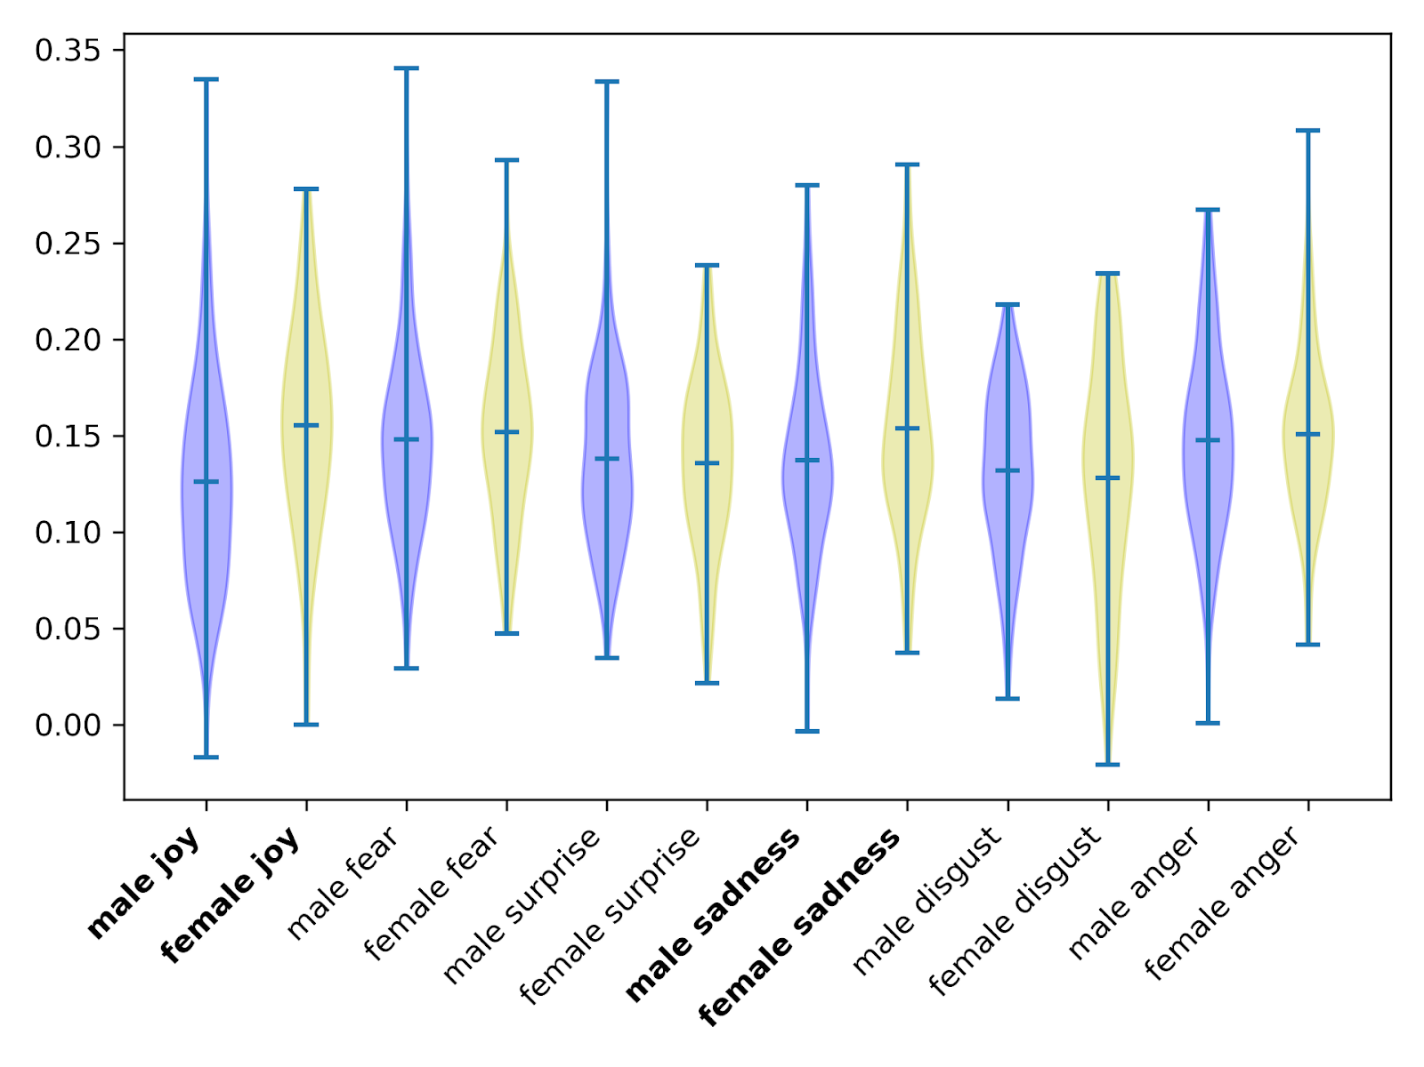
Gender
227 characters
133 men
94 women
Significant differences (p<0.05) for joy and sadness

Slide 13
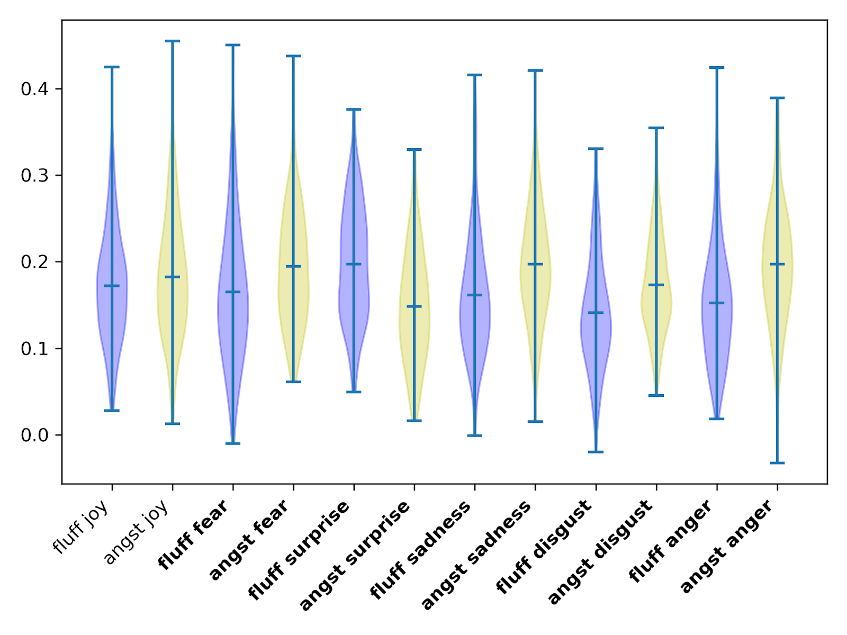
Genre
Characters plotted separately for angst and fluff
Significant differences (p<0.05) for all emotions except joy

Slide 14
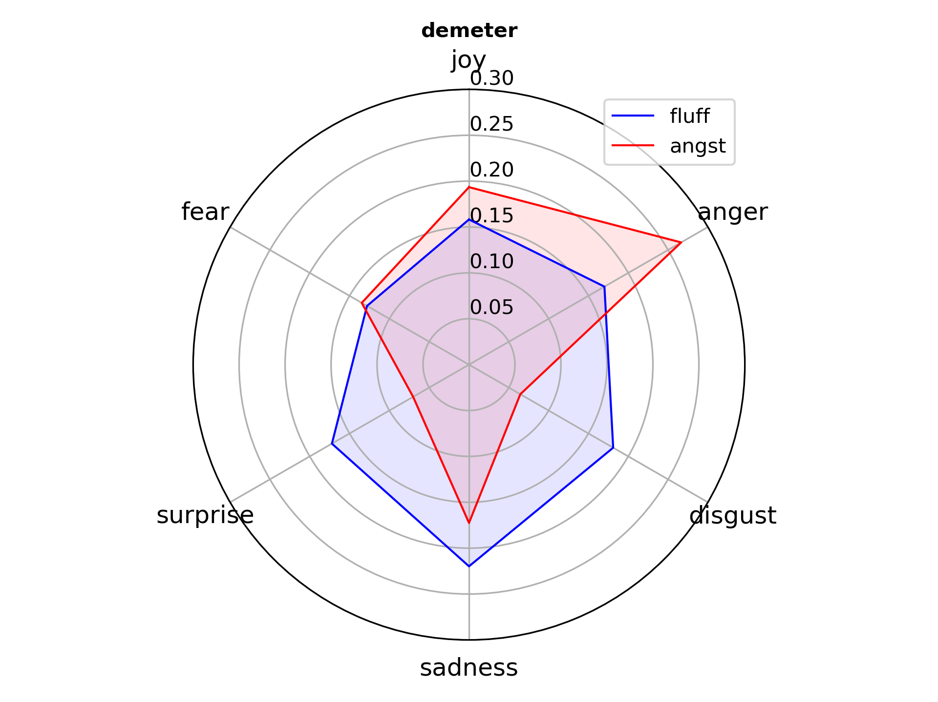

Slide 15
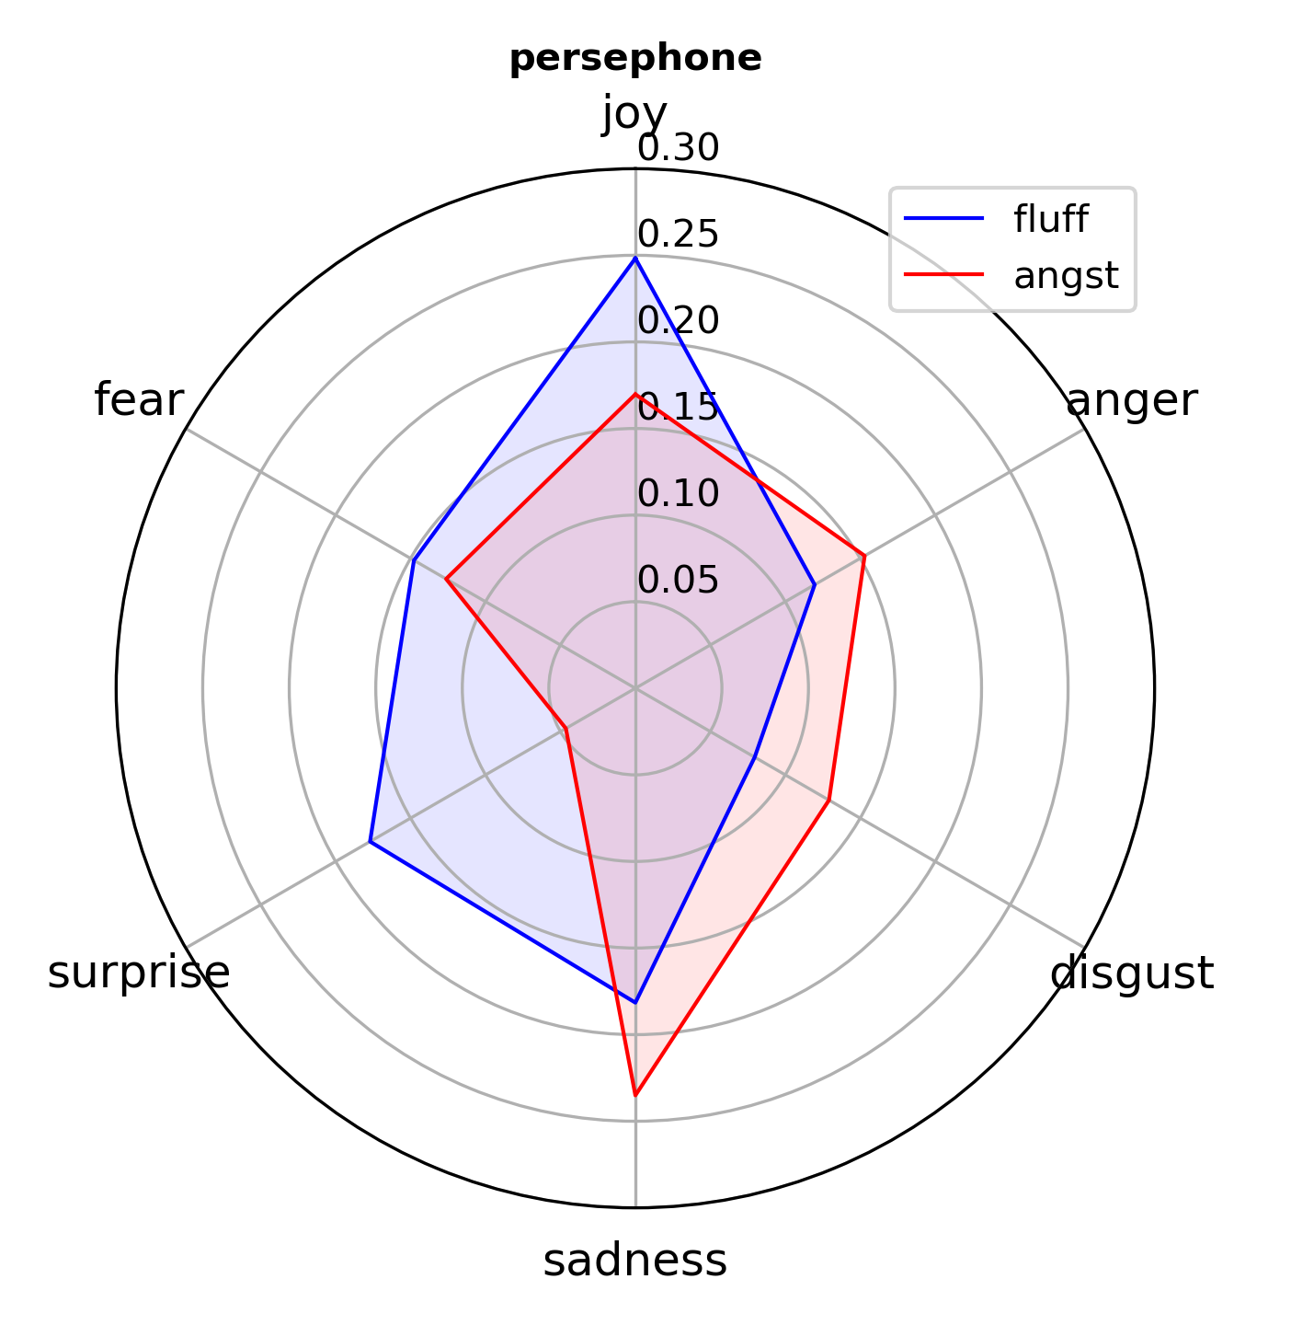
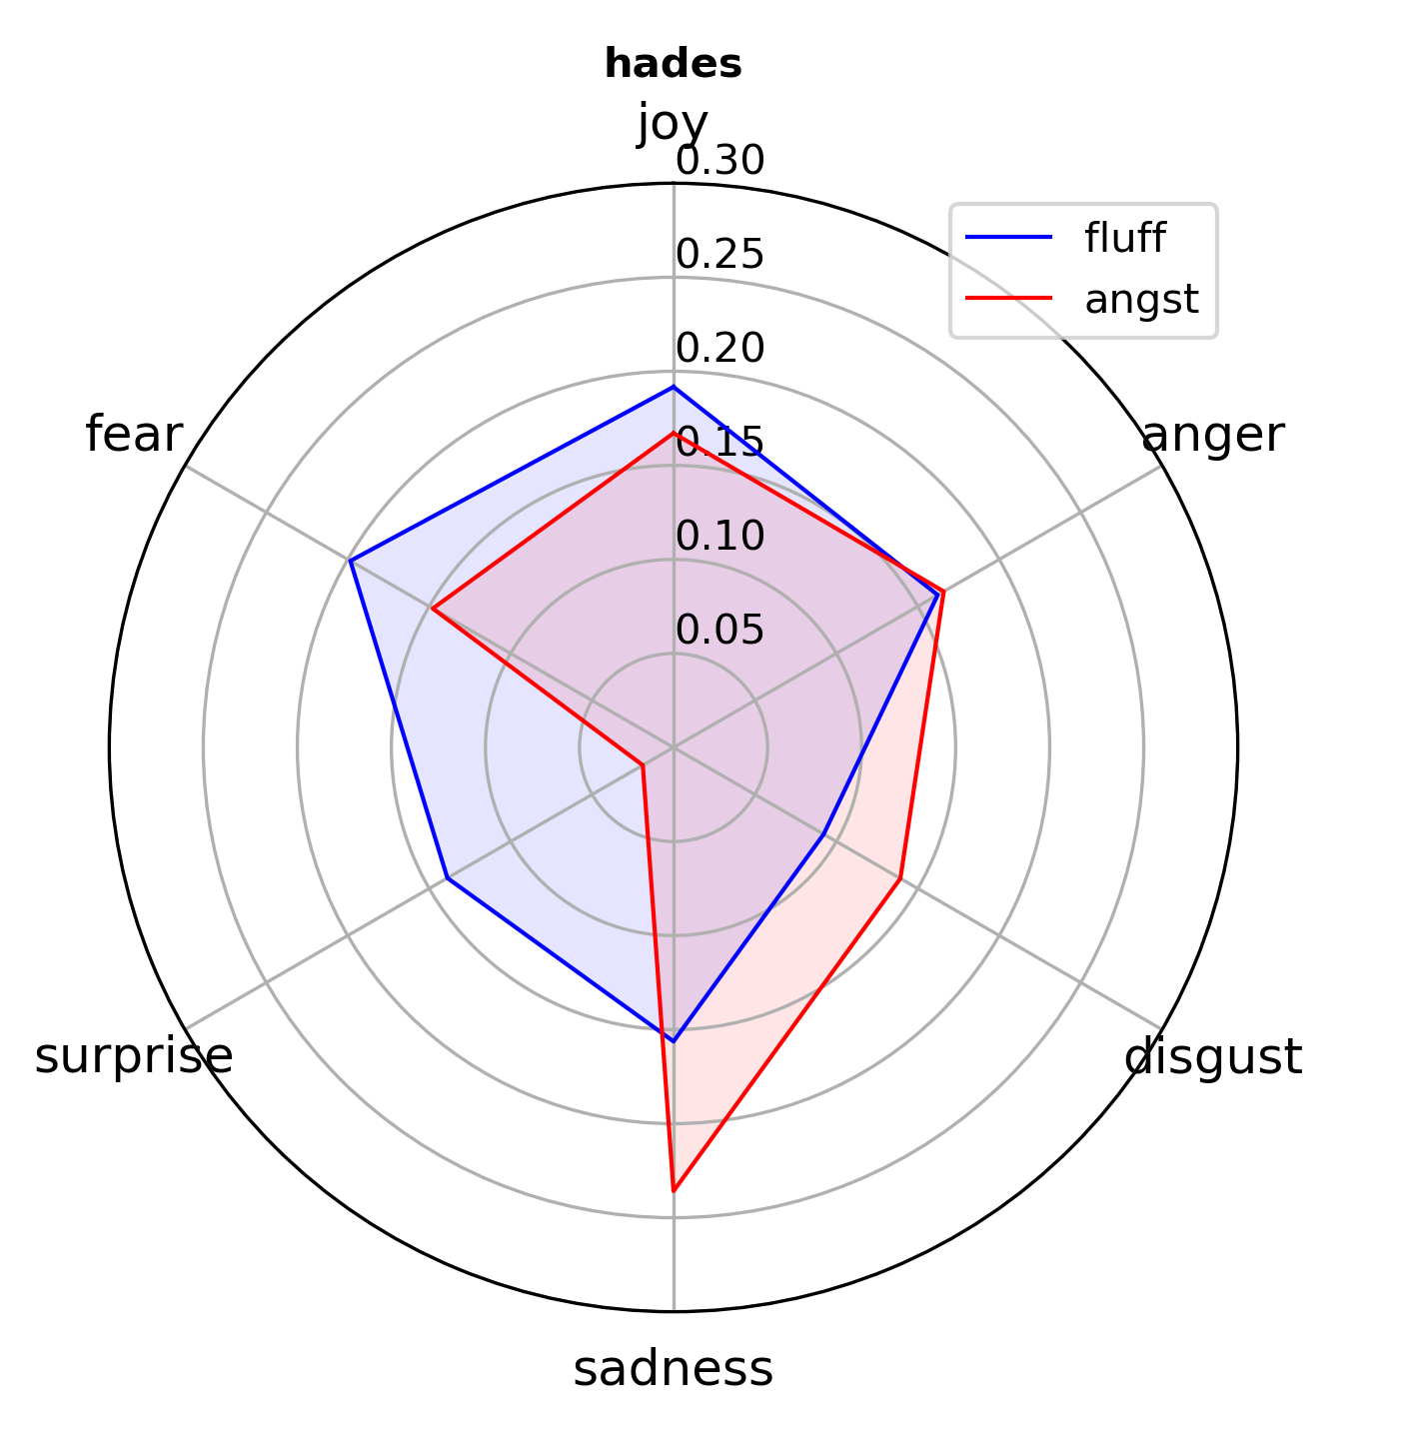

Slide 16
Discussion & Conclusion
Issue: Directionality of emotion
Character-differences based on protagonist-status or romantic status
Resonance of Classical canon
Women as more joyful and more sad, so less stoic?
Angst confirmed as the genre of negative emotions: anger, fear, disgust, sadness

Slide 17




Contact Us!
julia.neugarten@ru.nl
@julianeugarten.bsky.social
https://github.com/th555/myth2vec_public

Slide 18

Questions?

Slide 19
References
Arseniev-Koehler, Alina. Theoretical Foundations and Limits of Word Embeddings: What Types of Meaning Can They Capture? July 2021, https://doi.org/10.31235/osf.io/vrwk3.
Ekman, Paul. “Are There Basic Emotions?” Psychological Review, vol. 99, no. 3, 1992, pp. 550–53, https://doi.org/10.1037/0033-295X.99.3.550.
Jacobs, Arthur M. (2018): “The Gutenberg English Poetry Corpus: Exemplary Quantitative Narrative Analyses”, in: Frontiers in Digital Humanities 5. DOI: 10.3389/fdigh.2018.00005.
Jacobs, Arthur M. (2019): “Sentiment Analysis for Words and Fiction Characters From the Perspective of Computational (Neuro-)Poetics”, in: Frontiers in Robotics and AI 6. DOI: 10.3389/frobt.2019.00053.
Jacobsen, Mia, et al. “Patterns of Quality: Comparing Reader Reception Across Fanfiction and Commercially Published Literature.” CHR2024, pp. 718–39, https://ceur-ws.org/Vol-3834/paper106.pdf.
Neugarten, Julia, et al. “Catching Feelings: Aspect-Based Sentiment Analysis for Fanfiction Comments about Greek Myth.” CHR2024, pp. 217–31, https://ceur-ws.org/Vol-3834/paper23.pdf.
Neugarten, Julia, and Roel Smeets. MythFic Metadata: Exploring Gendered Violence in Fanfiction about Greek Mythology. Radboud University, 28 Apr. 2023. https://doi.org/10.34973/2MYE-8468.
Neugarten, Julia. “Brittle: Re-Thinking Narratives of Disordered Eating through Fanfiction.” Frame: Journal of Literary Studies, vol. 34, no. 2, 2021, https://www.frameliteraryjournal.com/34-2-writing-the-mind/34-2-julia-neugarten/.
Samutina, Natalia. “Emotional Landscapes of Reading: Fan Fiction in the Context of Contemporary Reading Practices.” International Journal of Cultural Studies, vol. 20, no. 3, 2016, pp. 253–69. https://doi.org/10.1177/1367877916628238.

