Slide 1



Managing Open Source Projects: Standards and Collaboration Tools
Sebastián Ayala Ruano
MoNA/DSP meeting
July 17, 2025
  Slides: https://doi.org/10.5281/zenodo.15985179
Designed by The Turing Way project and Scriberia

Slide 2

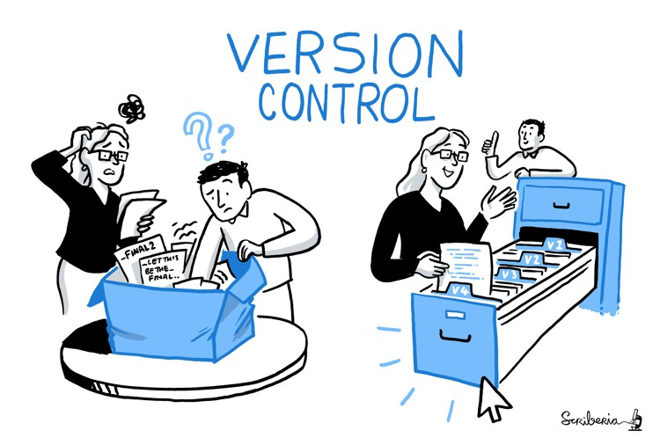
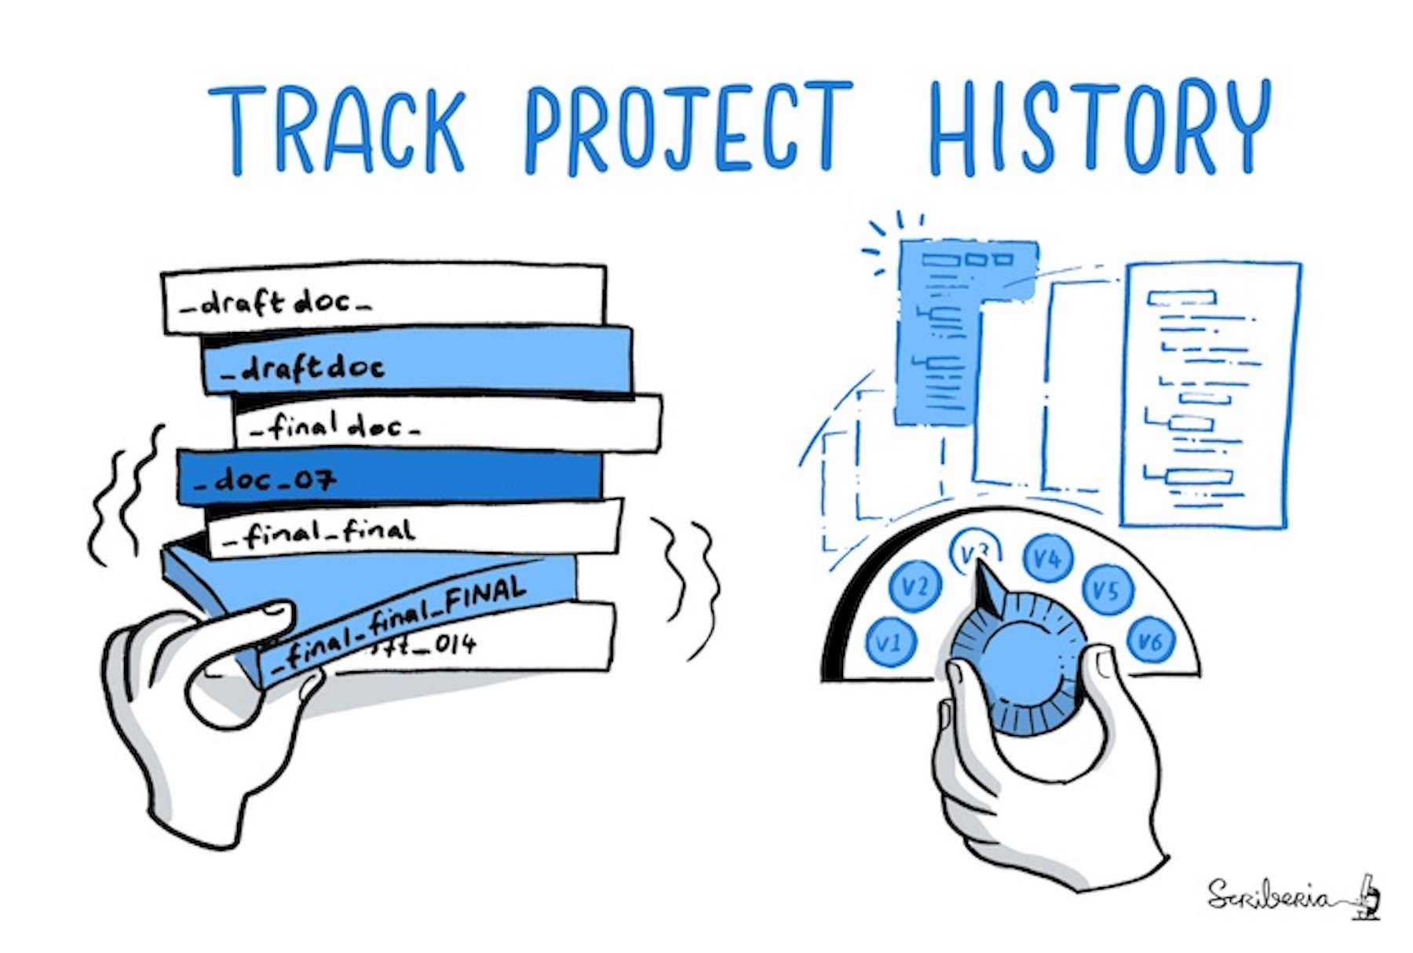

What can GitHub do?
Hosts repositories online and store files
Provides web interface for version control
Supports collaborative work
Designed by The Turing Way project and Scriberia
1

Slide 3
What can GitHub do?
Hosts repositories online and store files
Provides web interface for version control
Supports collaborative work
Helps manage projects in the same place as your work
Designed by The Turing Way project and Scriberia
1

Slide 4
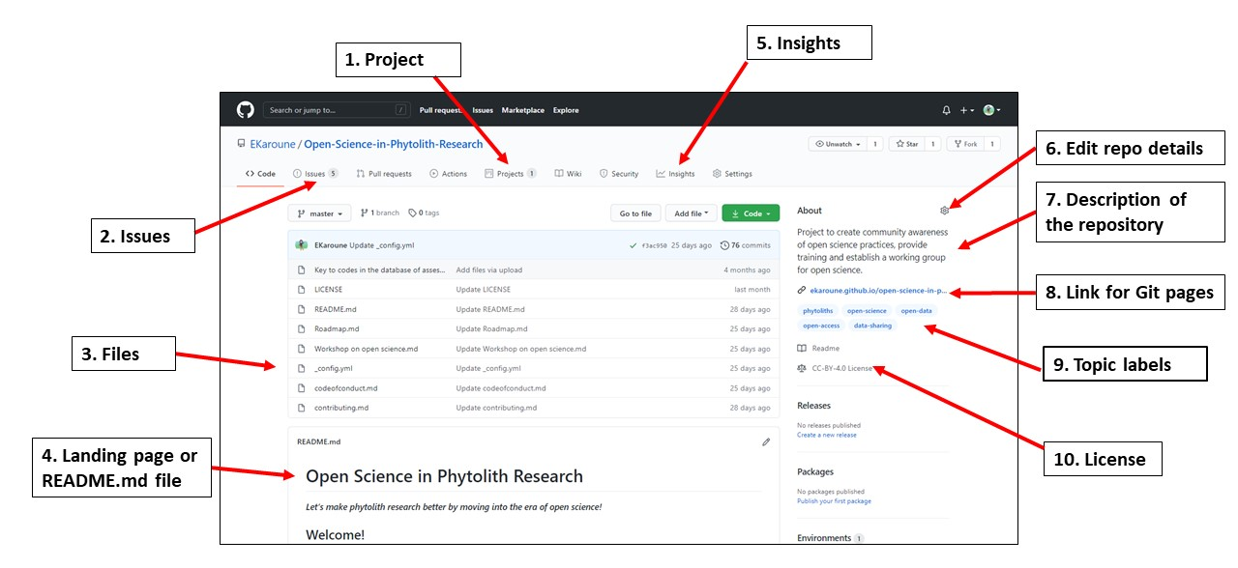
GitHub repository features
CC BY The Turing Way project
2

Slide 5
How GitHub populates “Projects”?
Repositories form the basis for documentation
Issues form the basis for task management
Project Boards form the basis for project management
Organizations host repositories and can support multiple Project Boards
3

Slide 6
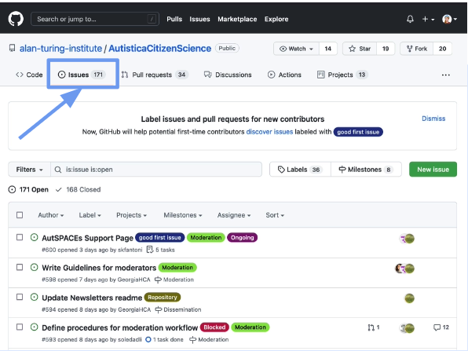
Issues = Tasks
Summary of what the task is, what it relates to, and who can help
Issues can be tagged with appropriate labels
Examples: pandas and The Turing Way
4

Slide 7
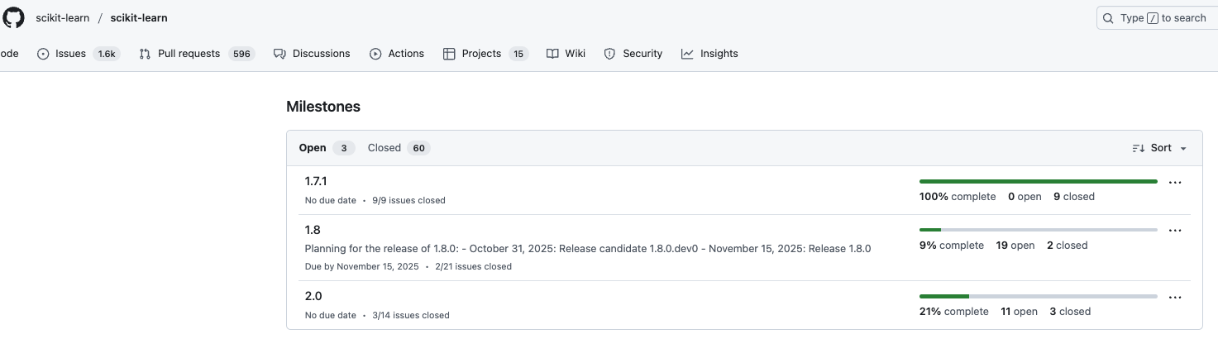
Milestones = mini projects
Set of issues for a sprint, project stage, or version
It is possible to add due dates
Examples: scikit-learn and open-life-science
5

Slide 8
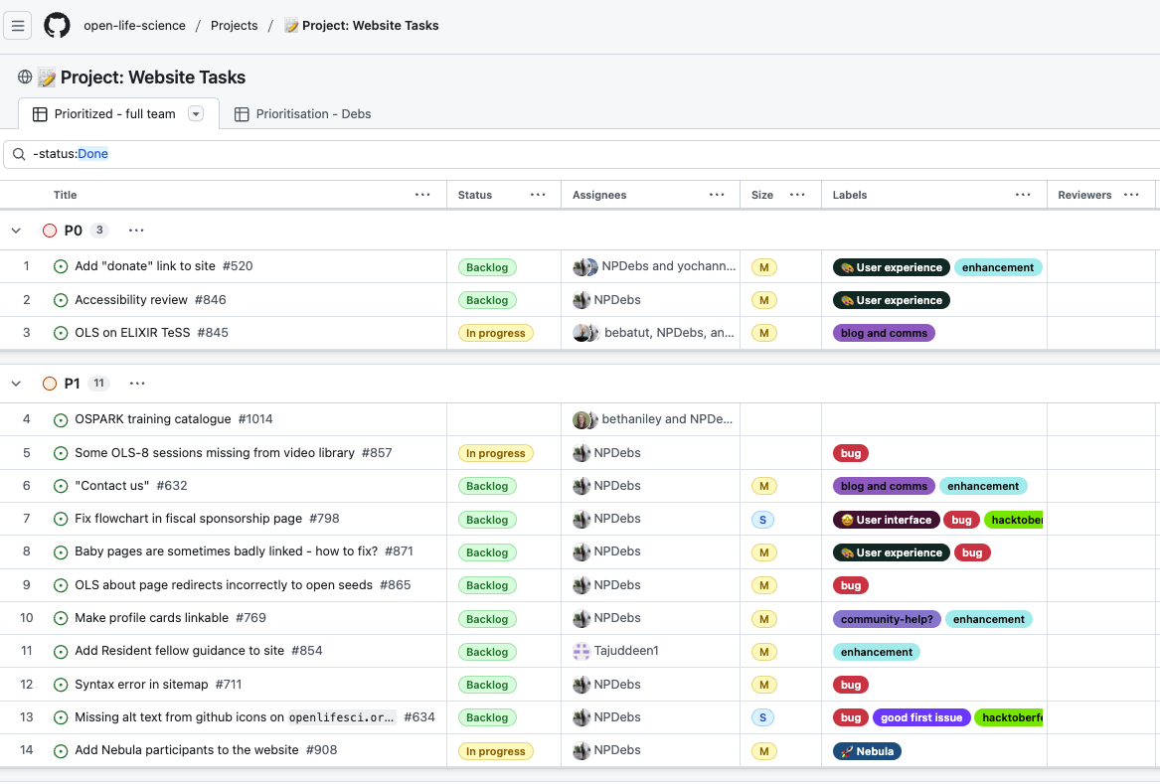
Project Boards - List
Populated with tasks (issues)
Structure boards using labels, keywords and fields, grouping, slicing (pivot tables), and more (check the GitHub Docs)
Examples: open-life-science and the-carpentries
6

Slide 9
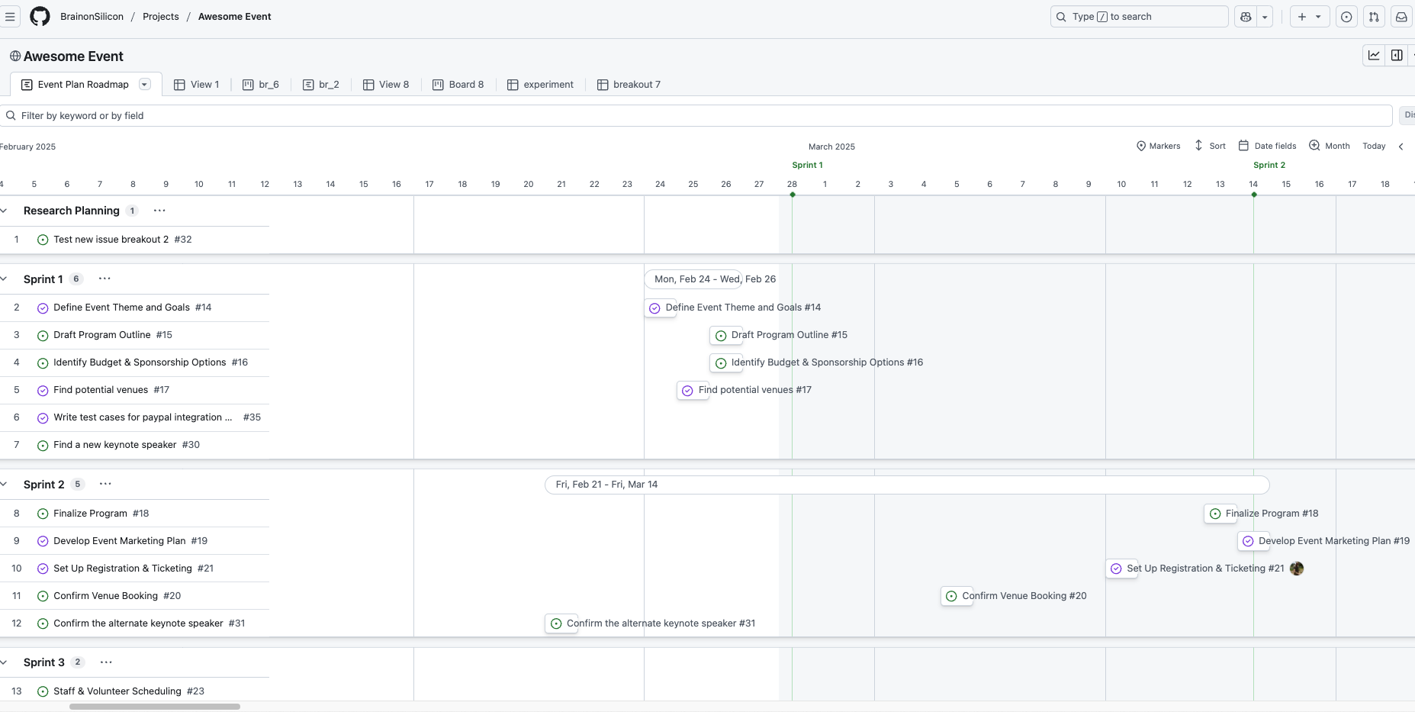
Project Boards - Roadmap
Populated with tasks (issues)
Structure boards using labels, keywords and fields, grouping, slicing (pivot tables), and more (check the GitHub Docs)
Example: BrainonSilicon
7

Slide 10
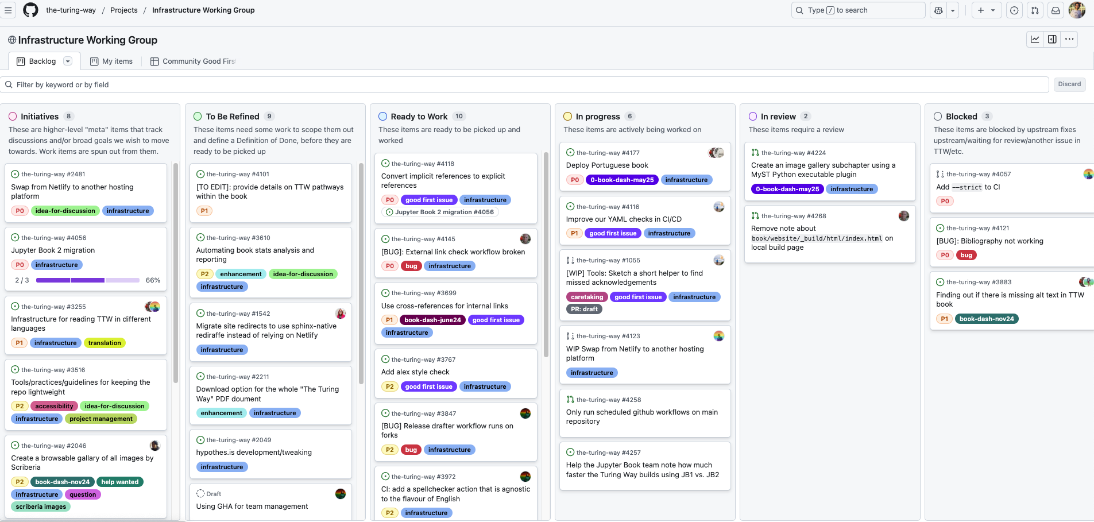
Project Boards - Kanban
Populated with tasks (issues)
Structure boards using labels, keywords and fields, grouping, slicing (pivot tables), and more (check the GitHub Docs)
Examples: the-turing-way and nf-core
8

Slide 11
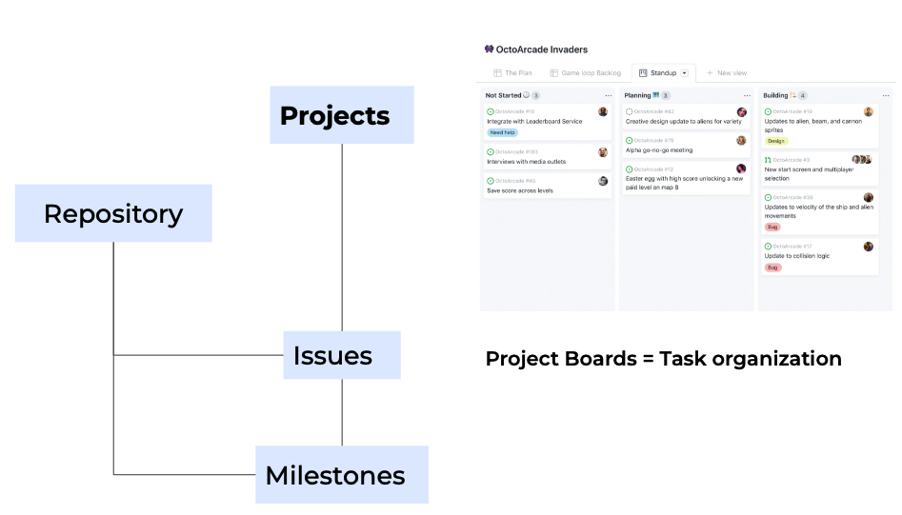
Recap
9

Slide 12
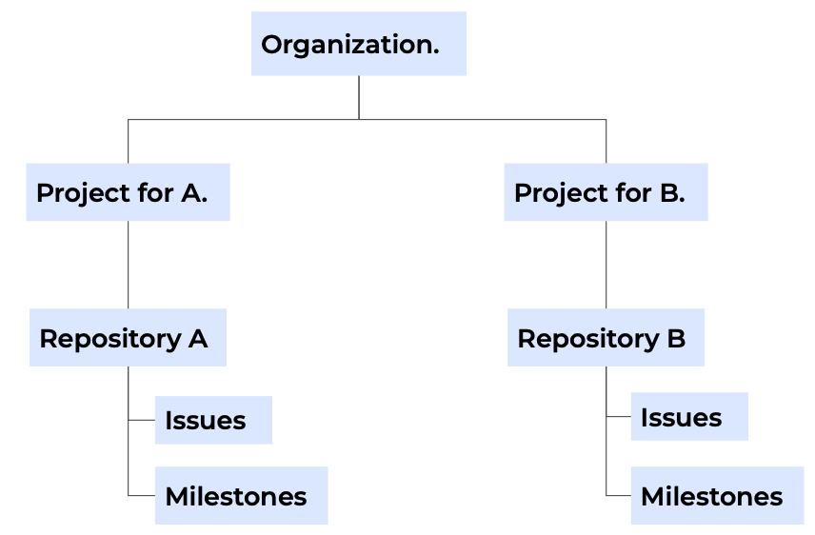
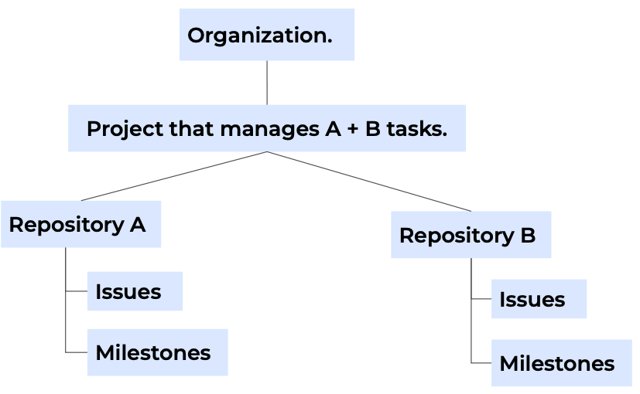
Project structures
10

Slide 13
Useful files in a GitHub repository
├ docs
├ src
├ README.md
├ LICENSE.md
├ CITATION.cff
├ CONTRIBUTING.md
├ CODE_OF_CONDUCT.md
├ …

Slide 14
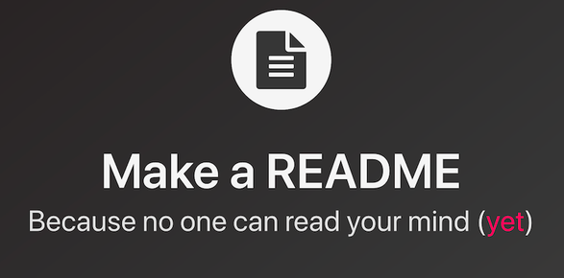
README
First stop for visitors – file located in the root directory, all caps, in markdown (.md)
Importance – sets expectations about how much support there is
Desirable information to include:
* What you're doing, for who, and why
* How to get started
* Where to find key resources
A README is not the only or comprehensive documentation of your project
CC BY UBC Library Research Commons
11
Notes:
A README is not the only or comprehensive documentation of your project

Slide 15
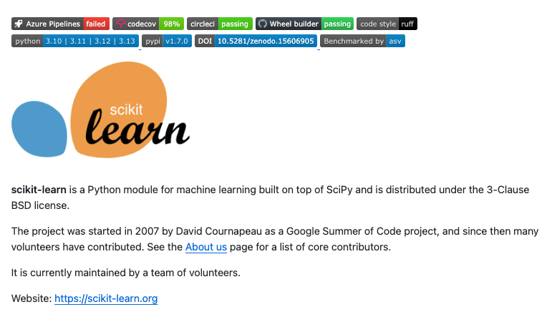
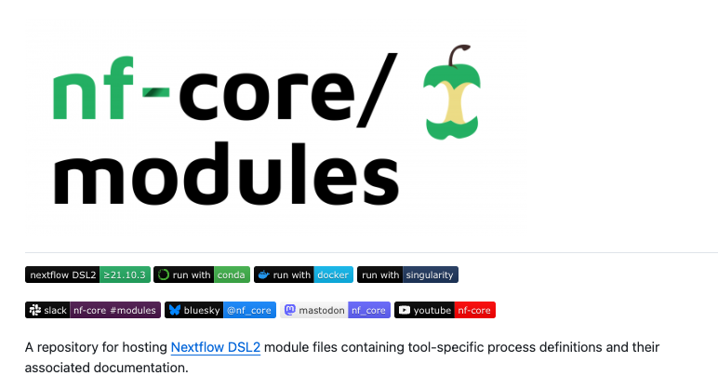
README for software
Start with a logo or picture, short description, and relevant badges
Examples: scikit-learn and nf-core
12
Notes:
A README is not the only or comprehensive documentation of your project

Slide 16
README for software – relevant badges
GitHub Actions: Indicates the status of your GitHub Actions workflows
Release: Indicates the latest version of the software
License: Shows what license your project is under
Tests: Indicates the state of your tests according to an yml file.
Read the Docs: Indicates the status of the project's documentation build on Read the Docs
….
More info: https://github.com/badges/awesome-badges
![example workflow](https://github.com/github/docs/actions/workflows/main.yml/badge.svg)
![GitHub release (latest by date)](https://img.shields.io/github/v/release/user/repo)
![GitHub](https://img.shields.io/github/license/user/repo)
![OSTests](https://github.com/owner/repository/actions/workflows/os-tests.yml/badge.svg)
[![DocumentationStatus](https://readthedocs.org/projects/name/badge/?version=latest)](https://name.readthedocs.io/?badge=latest)
13
Notes:
Read the Docs: Indicates the status of the project's documentation build on Read the Docs

Slide 17
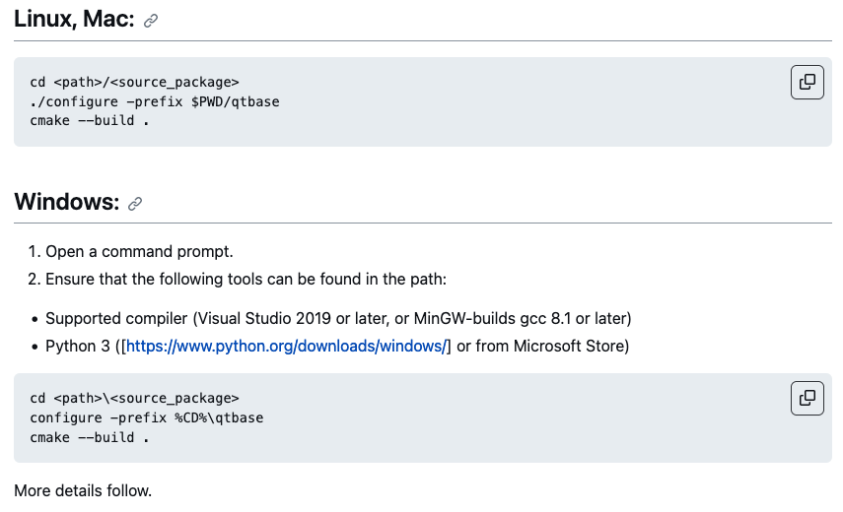
README for software
Add installation instructions
* List requirements and if there’s any extra step into acquiring them
* List installations for the different OSs, containers, or other methods
* Include developer installation
* If the instructions are too large, link to a docs page
14
Notes:
If the instructions are too large, link to a docs page

Slide 18
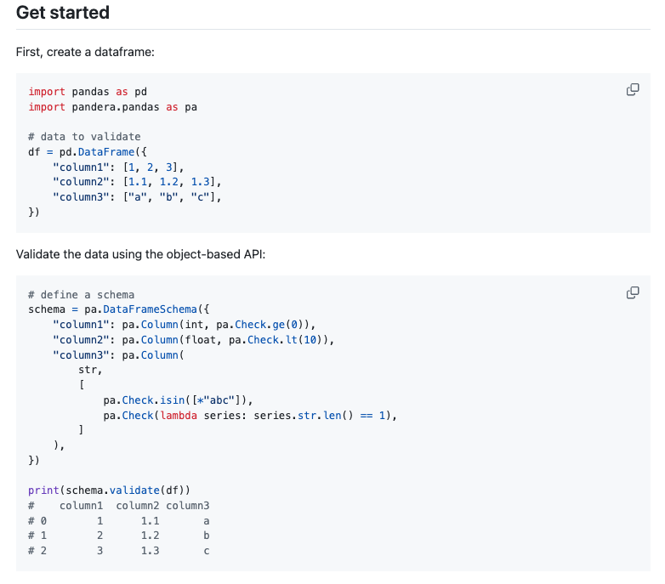
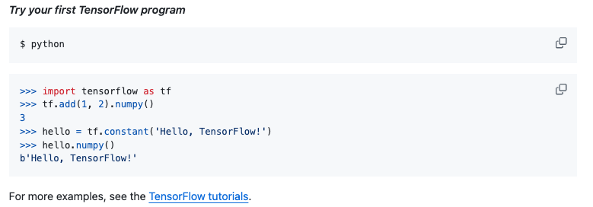
README for software
Add execution instructions
* How to run/import your software into a project
* Simple example
15
Notes:
how to run/import your software into a project

Slide 19
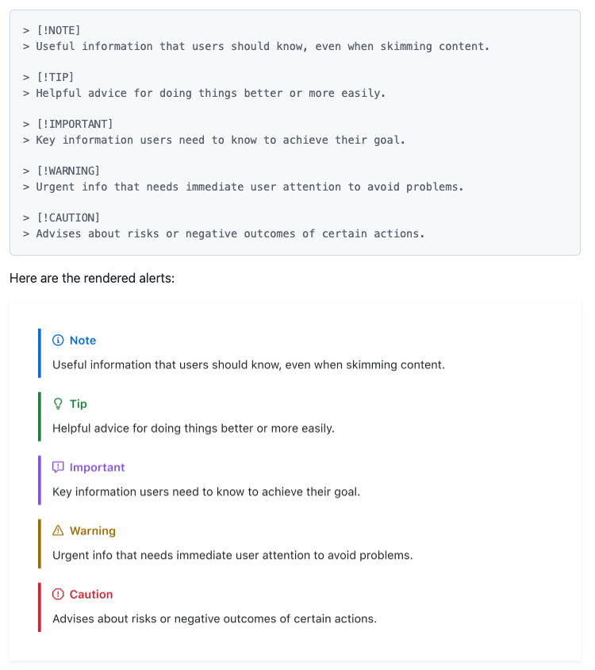
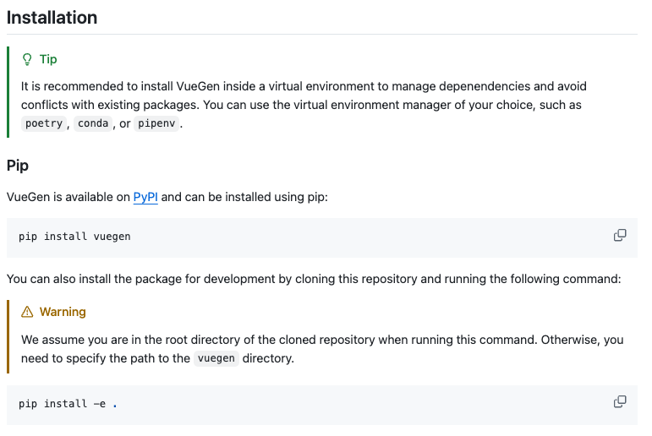
README
Use GitHub-style admonitions/alerts - emphasize critical information
16
Notes:
emphasize critical information

Slide 20
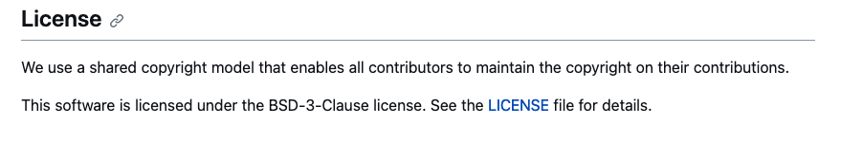
README
Add sections with brief descriptions for license, contributing, and code of conduct, and link to the files in the repository
Extra
  * Documentation
  * Deployment
  * Acknowledgements
  * Citation
  * Contact
17
Notes:
Acknowledgements

Slide 21
README examples and useful links
The Turing Way README
Alexwlchan READMEs for Open Science
Purple Booth’s README Template
Standard README - style specification
PaperBadger - project README
Thoughtbot’s Blog on How to Write a Good README
Matias Singer’s curated List of Awesome READMES
The Open Leadership Framework README http://mzl.la/olf
Markdown Cheatsheet Github
Emoji reference Emojipedia
18

Slide 22
Useful files in a GitHub repository
├ docs
├ src
├ README.md
├ LICENSE.md
├ CITATION.cff
├ CONTRIBUTING.md
├ CODE_OF_CONDUCT.md
├ …

Slide 23



Open Source Licenses
Sharing something on the internet or GitHub does NOT automatically allow others to use it
Sharing work with a license does NOT give away your copyright—you can still publish, sell, etc
Use
Anyone can use the work for any purpose
Modify
Anyone can modify the work
Share
Anyone can redistribute both the original and modified work to anyone else with the same license
“Open source software is software that can be freely used, modified, and shared (in both modified and unmodified form) by anyone. “
- GitHub Glossary, Open Source
19
Notes:
So all in all, Licenses help clarify for who and for what purpose the work can be used, how the work can or cannot be modified, and how the work and derivatives of the work can be shared. In truly open licenses, anyone can use the work for any purpose, and modify it however they want, and redistribute the work or its derivatives however they want with the same license.

Slide 24
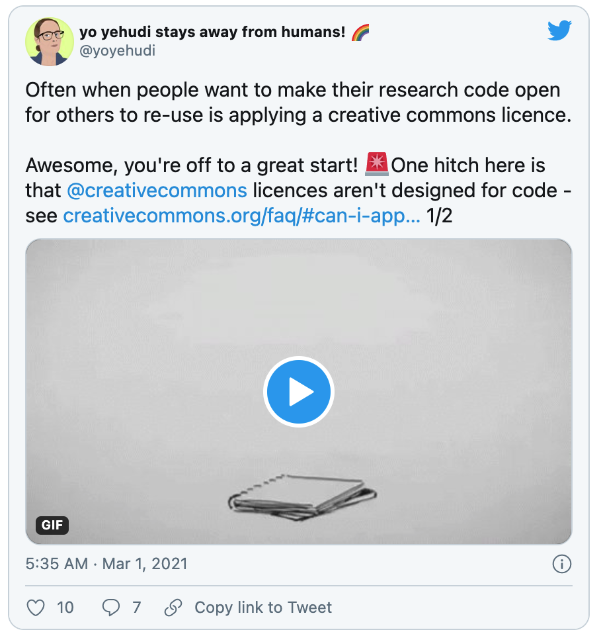
Open Source Licenses
data
≠
code
≠
creative works
(e.g. writing or images)
They require different licenses!
20
Notes:
Not all licenses can be applied to all types of works. There are licenses that are appropriate for data and creative works (mostly the Creative Commons licenses) and also licenses that are special for code. You can’t use a software code license for digital art.s.

Slide 25
Copyleft and Derivative Works
Non-copyleft
(permissive, non-reciprocal)
Open licenses that do not require derivative works to shared with the same license.
Copyleft
(reciprocal, aka ‘viral’)
Open licenses that require all derivative works to be shared with the same license.
Examples:
CC BY
MIT, BSD, APL-2.0
Examples:
CC BY-SA
GPLv3, MPL-2.0
21
Notes:
Then there are copyleft licenses that concern derivative of works. In non-copyleft licenses that are open, the person using the your work does not have to share derivative works under the same license. This pertains to CC BY for non-code works, and MIT, or BSD for code.
In copyleft licenses, derivative works must be shared with the same copyleft license. The common ones here are CC-BY-SA and GPLv3.

Slide 26




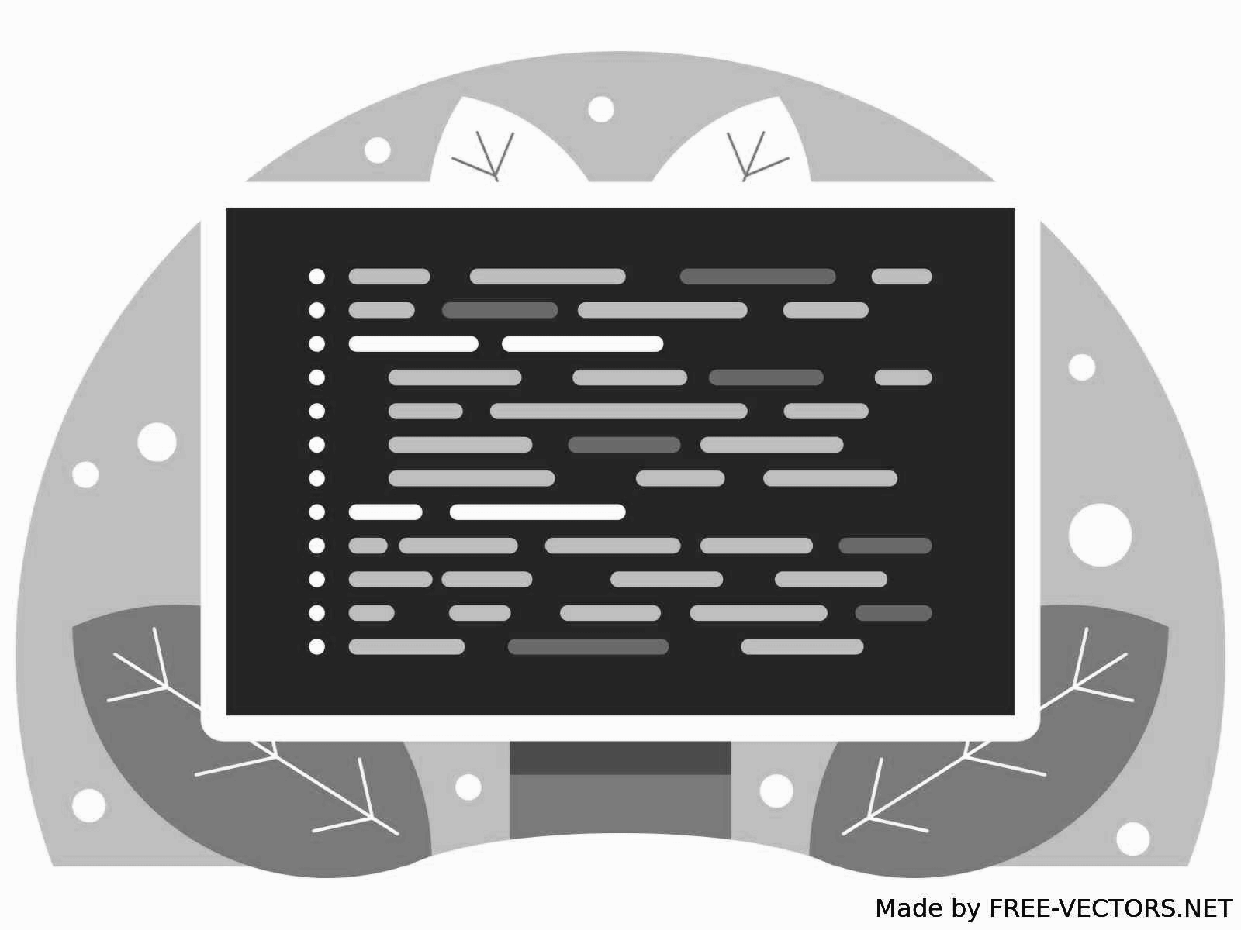

Patent Clause in Open Source Licenses
With Patent clause: MPL-2.0, APL-2.0, GPLv3
No Patent clause: MIT, BSD
Alice
Granted
Bob
22
Notes:
An open copyright license with a patent-granting clause is one that, in addition to copyright, also licenses any patents held by the licensor and that is embodied in the licensed code. Popular licenses with patent-granting clauses include Apache2, GPLv3, or Mozilla Public License.
In these cases with these licenses, Bob can use that code without fear that Alice will sue him for patent infringement.
Each open source license has different features for different considerations. Just because an open license does not have a patent clause, doesn’t mean it is any lesser or better than any other open license.
Every situation is unique, every community engaging with the work has their own standards, so you should choose the license that fits your individual circumstance the best. This also goes for non-code licenses.

Slide 27
Summary
Software (choosealicense.com)
Content (creativecommons.org): CC0, CC BY, CC BY-SA
Data: CC0
 | non-copyleft | copyleft
No patent clause | BSD, MIT
Patent snapback | APL- 2.0 | GPLv3, MPL-2.0
 | non-copyleft | copyleft
No attribution | CC0
Attribution | CC BY | CC BY-SA
23
Notes:
There are tools to help you choose a license based on your situation. It should be worth noting that a project may have different components of data, code, and content and thus can have a mixture of different kinds of licenses.

Slide 28
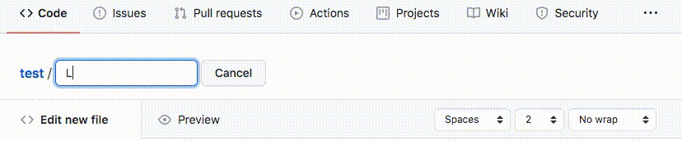
How to Apply a License
Place the full text of the license in a file (usually named LICENSE) in the root directory
You can include multiple licenses (e.g., one for software, one of content) as long as you are explicit about which license applies to which parts of your work. You can do this in the License section in your README
24
Notes:
Place the full text of the license in a text file (usually named LICENSE) in the root directory.
You can include multiple licenses (e.g., one for software, one of content) as long as you are explicit about which license applies to which parts of your work. You can do this in the License section in your README.

Slide 29
More info about Open Source Licenses
The Open Source Definition (10 Criteria) | opensource.org
Legal Matters | producingoss.com
Forge Your Future with Open Source | fossforge.com
Open Source Guide | opensource.guide
Basics of Open Source Licensing | Open Source Archetypes
Commons:Licensing | Wikimedia Commons
25
Notes:
The Open Source Definition (10 Criteria) | opensource.org
Legal Matters | producingoss.com
Forge Your Future with Open Source | fossforge.com
Open Source Guide | opensource.guide
Basics of Open Source Licensing | Open Source Archetypes
Commons:Licensing | Wikimedia Commons

Slide 30
Useful files in a GitHub repository
├ docs
├ src
├ README.md
├ LICENSE.md
├ CITATION.cff
├ CONTRIBUTING.md
├ CODE_OF_CONDUCT.md
├ …

Slide 31
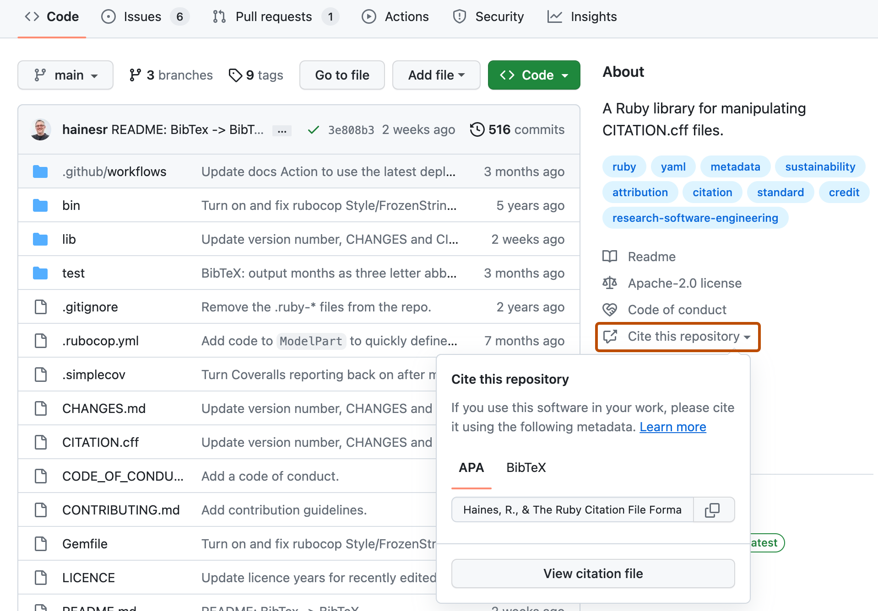
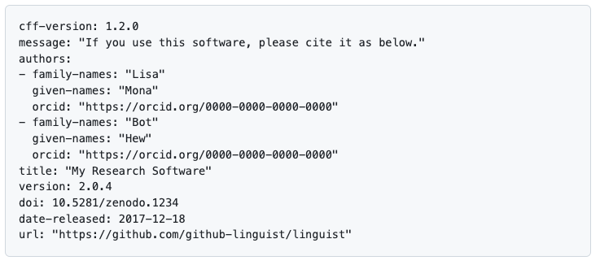
Citation file
You can add a CITATION.cff file to the root of a repository to let others know how you would like them to cite your work.
This file is plain text with human- and machine-readable citation information
It is possible to link to different resources like articles, books, data, etc
More info on the GitHub Docs and RubyCFF Project
26

Slide 32
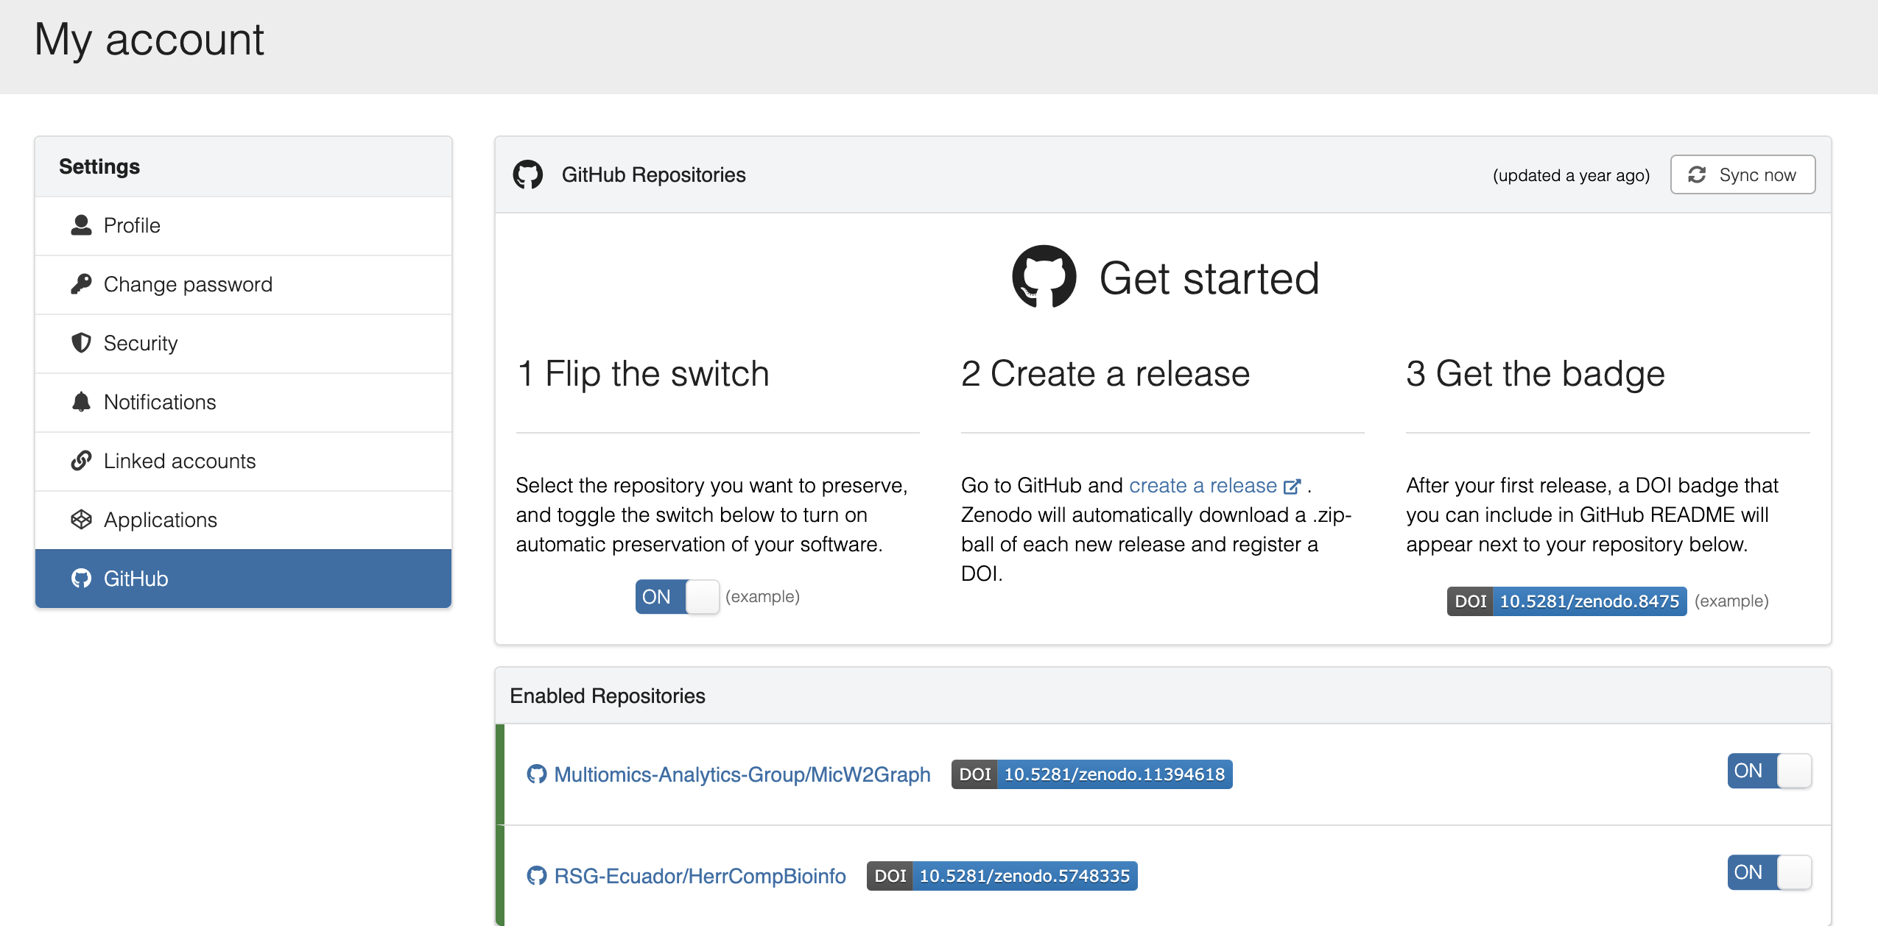
Making your code citable
Zenodo: open digital archive built by CERN and OpenAIRE, enabling researchers to share and preserve research outputs
Zenodo archives your repository and issues a new DOI each time you create a new GitHub release. Check GitHub Docs for more info
Example: The Turing Way
27
Notes:
Zenodo allows you to easily (and automatically, once you’ve set it up and linked it to your repository) create version-specific and tool-concept level digital object identifiers (DOIs). This makes it easier for you and your users to cite your software, including the version used in a workflow, with unique DOIs

Slide 33
Useful files in a GitHub repository
├ docs
├ src
├ README.md
├ LICENSE.md
├ CITATION.cff
├ CONTRIBUTING.md
├ CODE_OF_CONDUCT.md
├ …

Slide 34
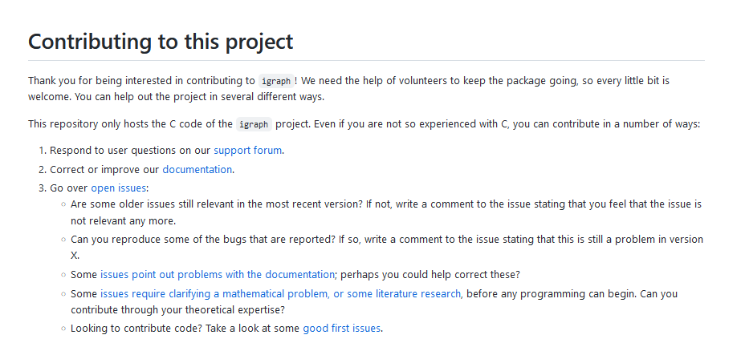
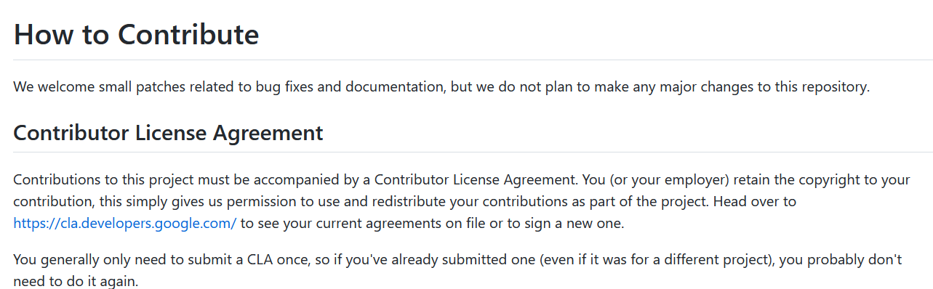
Contributing guidelines
How people collaborate to the project? Coding, documentation, tutorials, design, …
Importance: structure contributions, set guidelines, ensure standard style, improve efficiency, and involve new people
Make technical hidden rules about how to contribute to the project, clear: how to send a PR, how to create a branch and to which branch it should be submitted, how to open an issue, a PR must always have an issue?, how to ask questions
Examples: igraph and AlphaFold
28
Notes:
make technical hidden rules about how to contribute to the project, clear: how to send a PR, how to create a branch and to which branch it should be submitted, how to open an issue, a PR must always have an issue?, how to ask questions

Slide 35
Repositories of Open Source Projects
Open Source Friday
First Timers Only
CodeTriage
24 Pull Requests
Up For Grabs
First Contributions
SourceSort
29

Slide 36
Useful files in a GitHub repository
├ docs
├ src
├ README.md
├ LICENSE.md
├ CITATION.cff
├ CONTRIBUTING.md
├ CODE_OF_CONDUCT.md
├ …

Slide 37
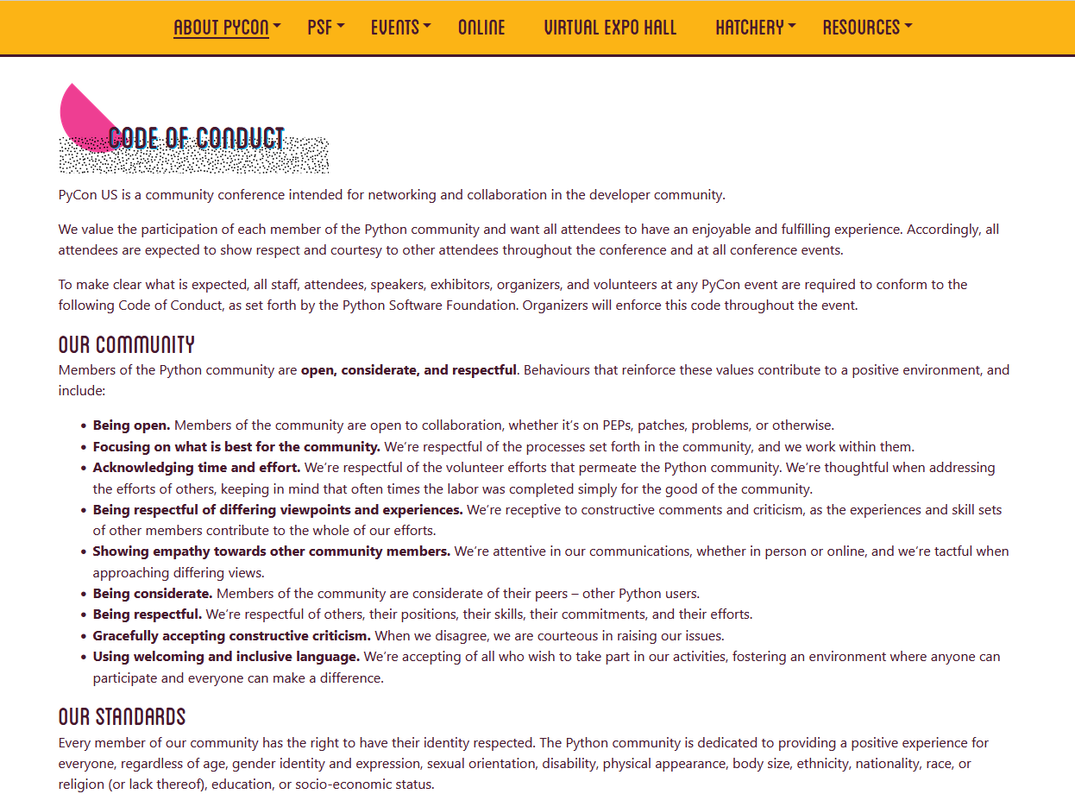
Code of Conduct
A set of rules outlining the social norms, rules, & responsibilities of an individual project, party or organization
Why to add a CoC?
* Sets clear expectations on your community members
* Tells contributors that you care about your community
* Invites people to your project
Examples: PyCon conference and
The Carpentries
30
Notes:
The Carpentries CoC

Slide 38
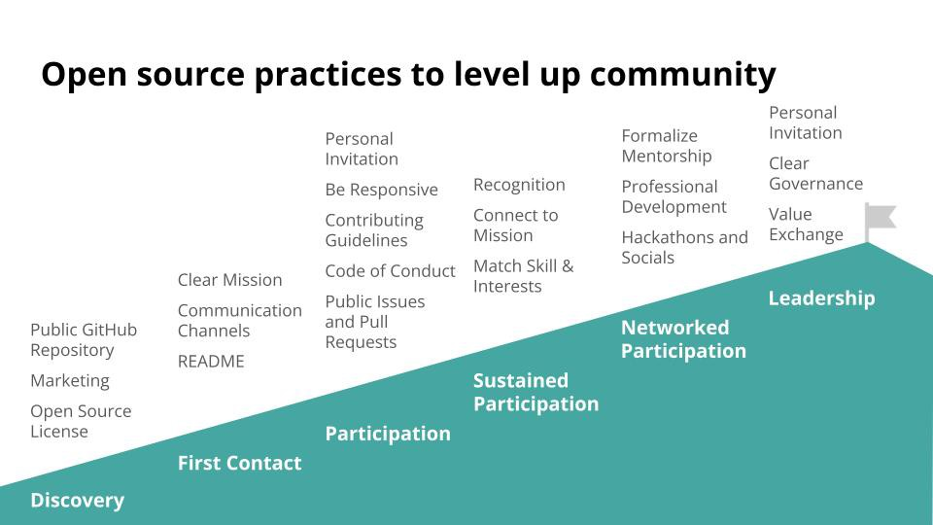
Mountain of Engagement
CC BY Abby Cabunoc Mayes
31
Notes:
CC BY Abby Cabunoc Mayes

Slide 39
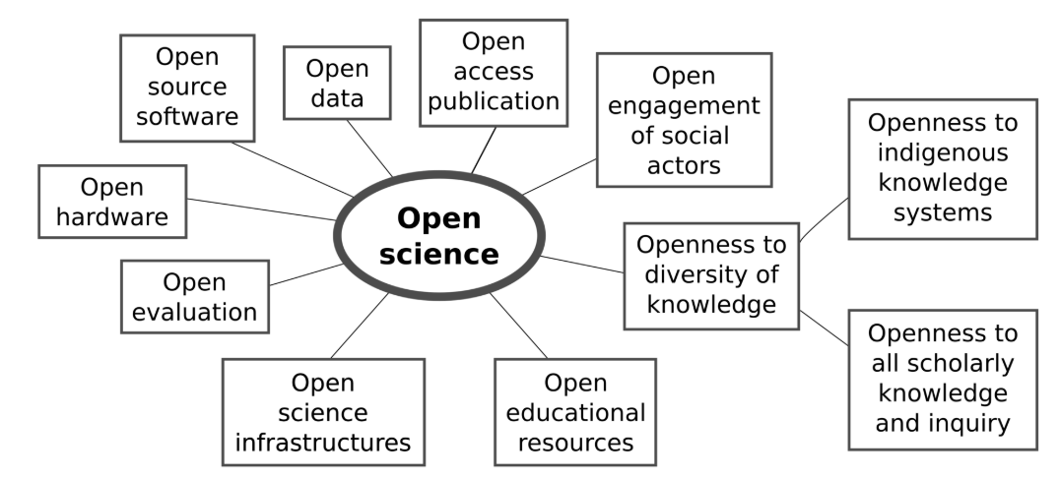
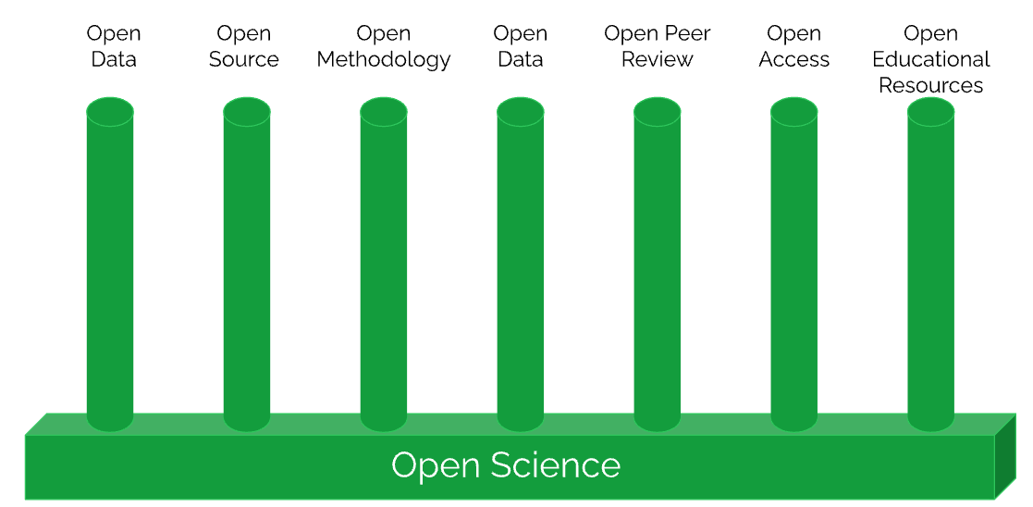
Going further – Open Science
CC BY Robbietan Morrison
32
Notes:
CC BY Abby Cabunoc Mayes

Slide 40

Thanks!
Sophia Batchelor – Project Management with GitHub workshop (Byte-sized RSE series, UNIVERSE-HPC project)
Alexander Martinez Mendez, Mariana Meireles, Malvika Sharan, Yo Yehudi, and other contributors for slides of the Open Life Science Program
The Turing Way
  Slides: https://doi.org/10.5281/zenodo.15985179

