Slide 1
DCC Spring Training Days – Session 9
From researcher to repository and back again
Valentijn Gilissen – Data Processing Team Leader / Preservation Officer / Data Steward
Deborah Thorpe – Senior Research Data Management Specialist
08/07/2025

Slide 2


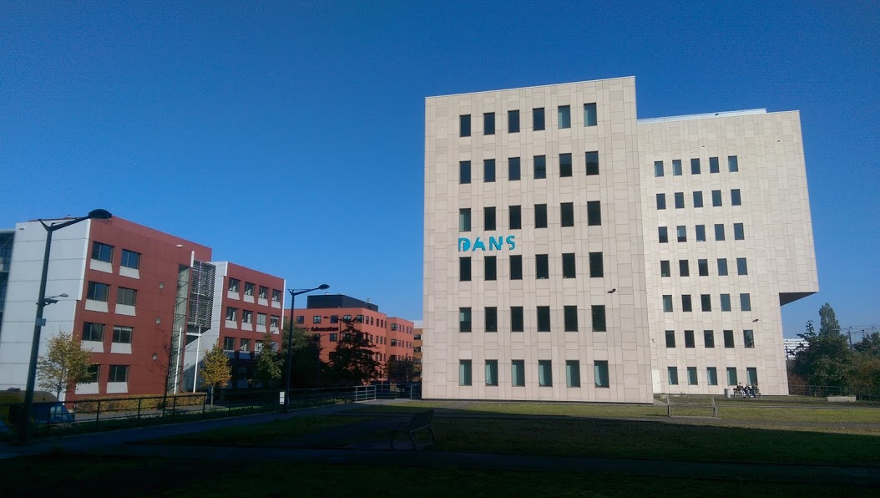



Data Archiving and Networked Services
https://dans.knaw.nl
Mission: promote and provide permanent access to digital research resources
First predecessor dates back to 1964 (Steinmetz Foundation), Historical Data Archive 1989
Institute of Dutch Academy and Research Funding Organisation (KNAW & NWO) since 2005

Slide 3

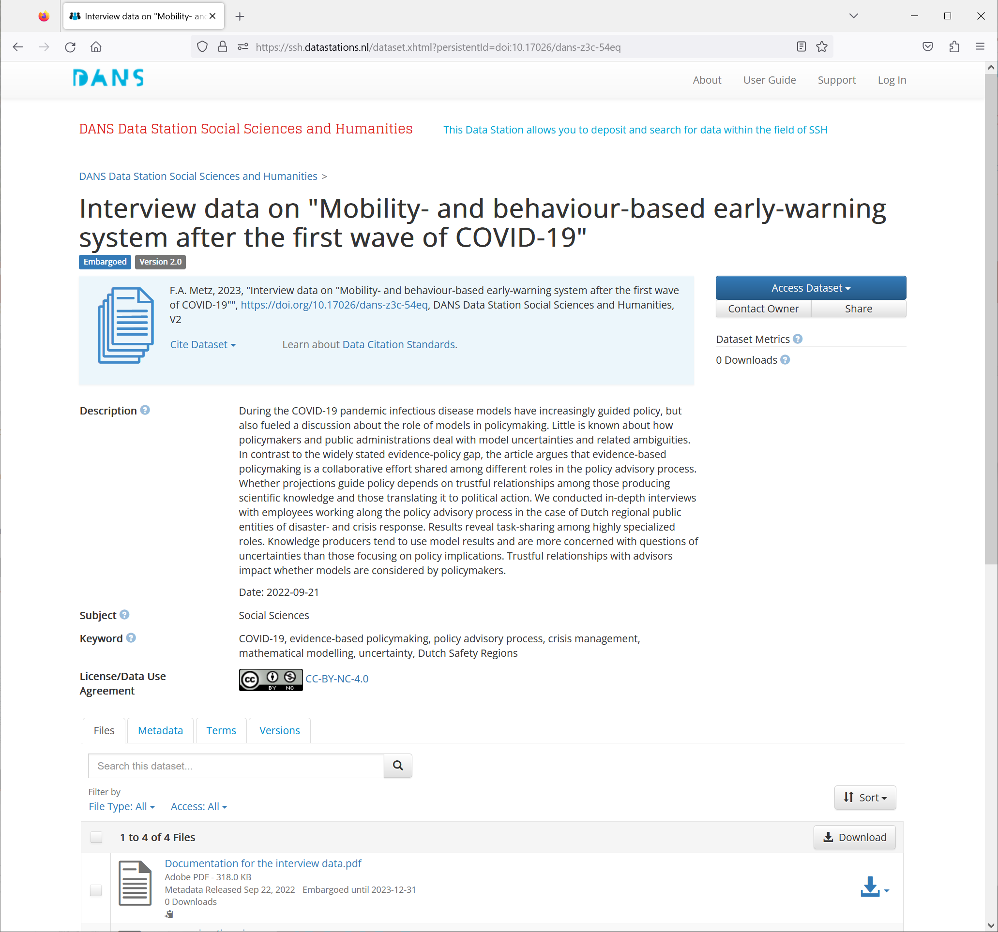
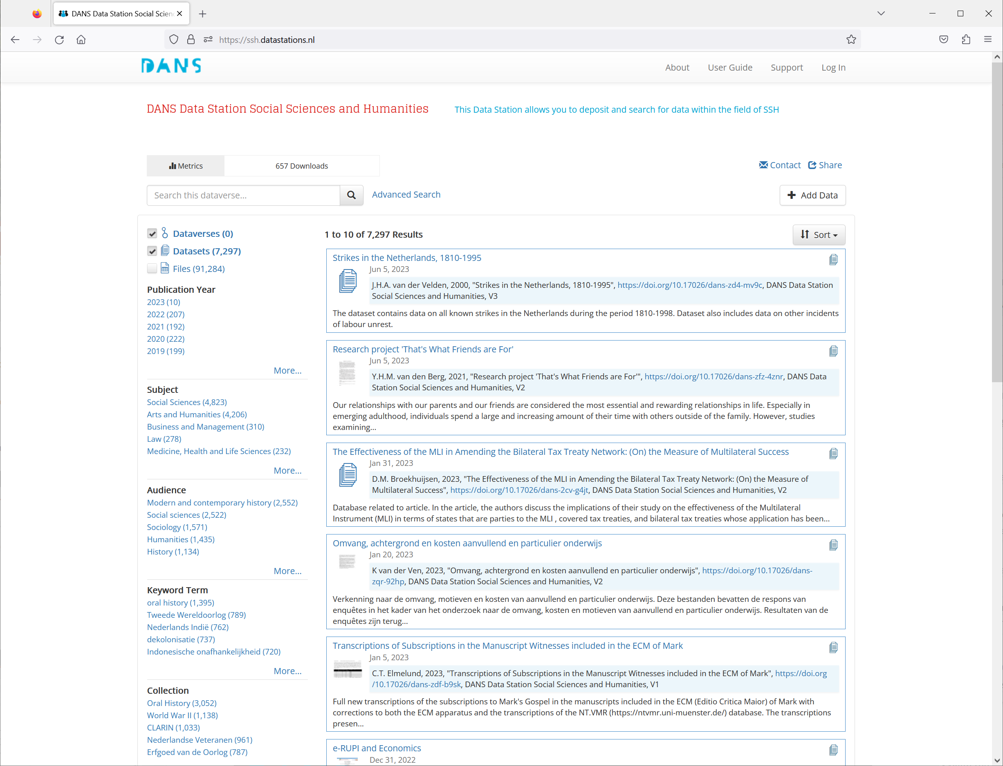
DANS Data Stations

Slide 4
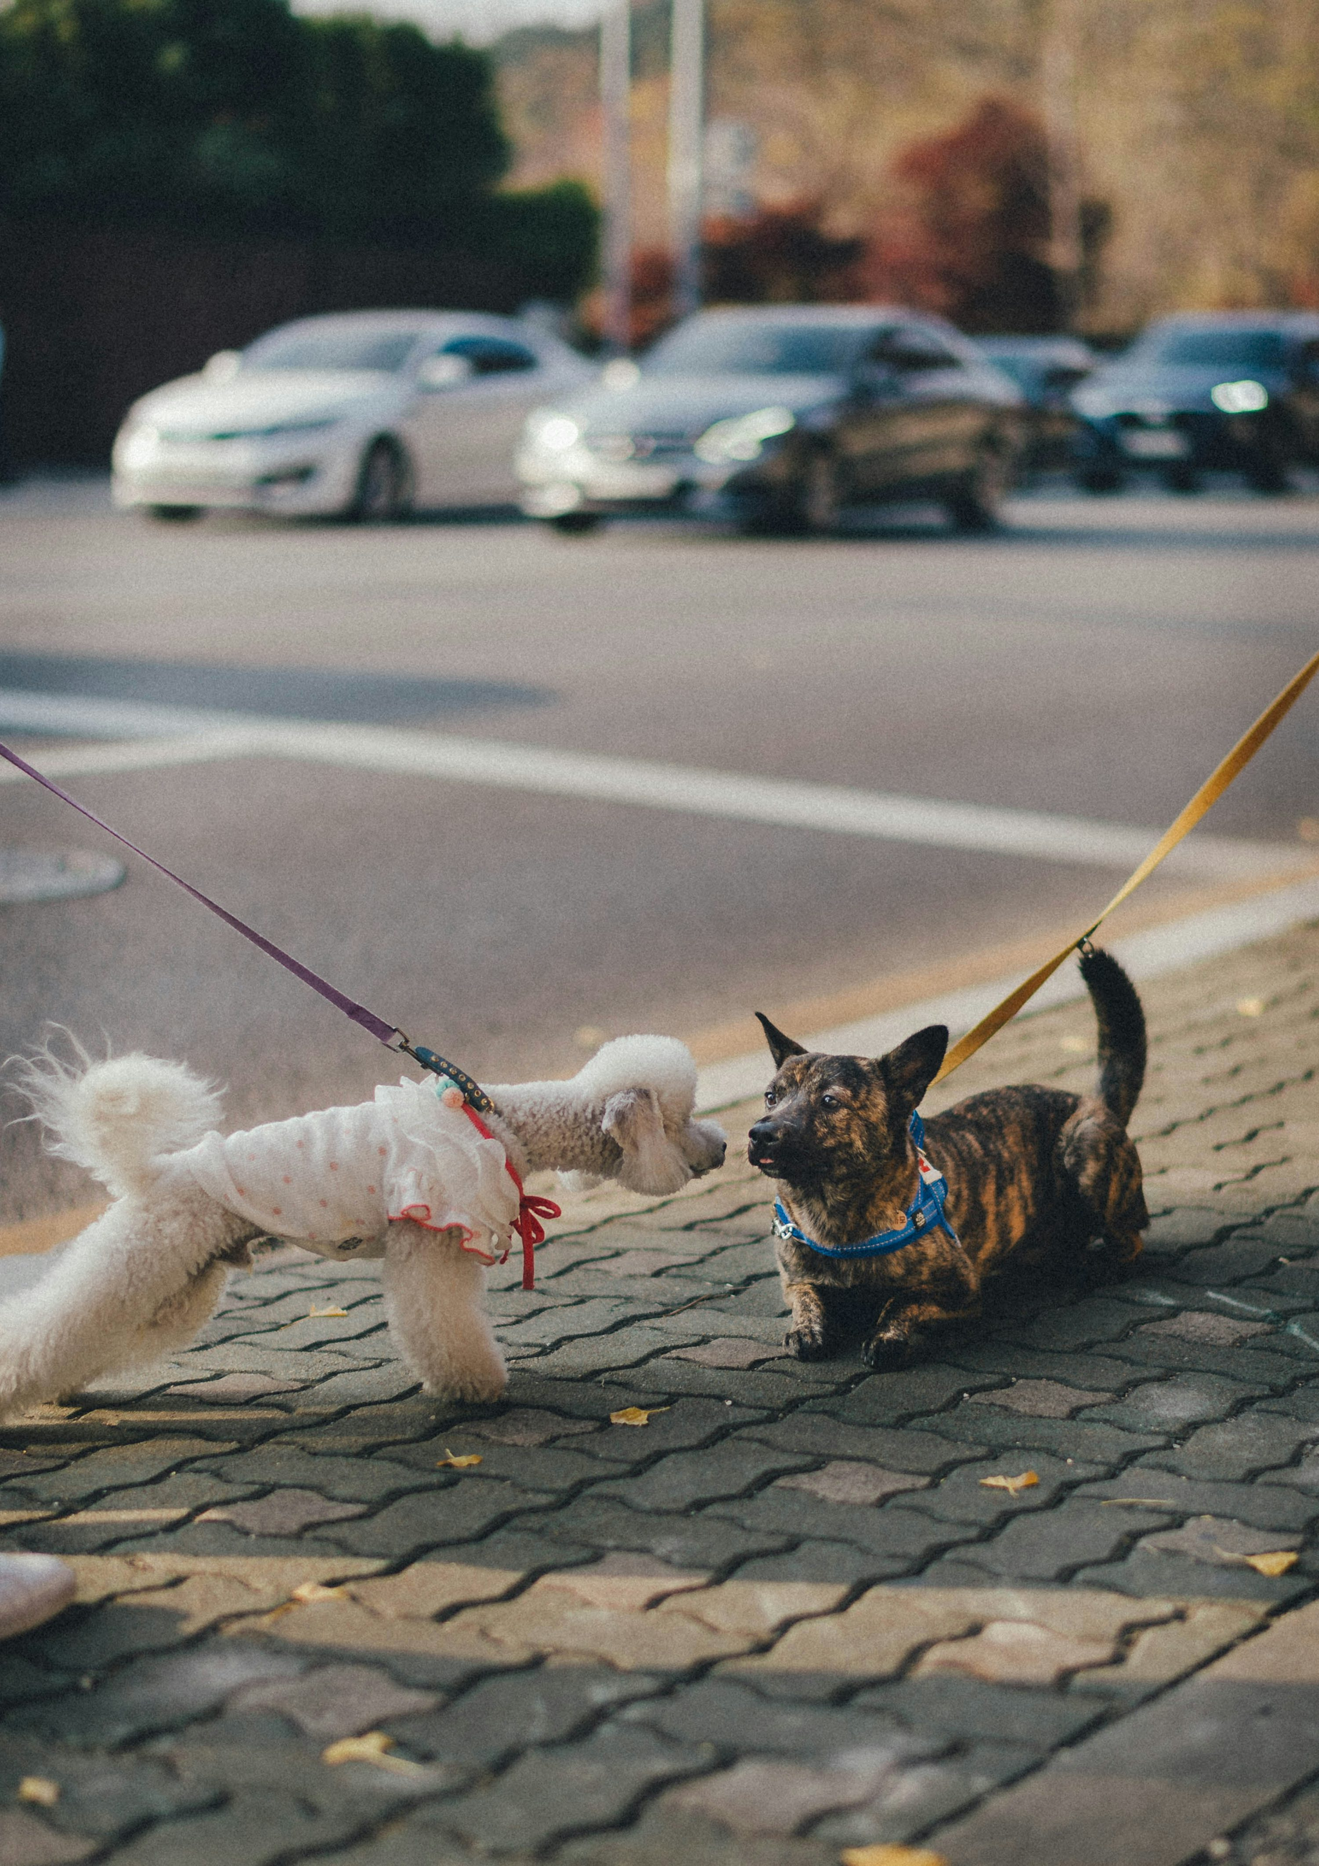
Introduce yourselves
Your name
Your role
What types of data do you collect / curate / advise / specialise in?
Photo by Bundo Kim on Unsplash

Slide 5
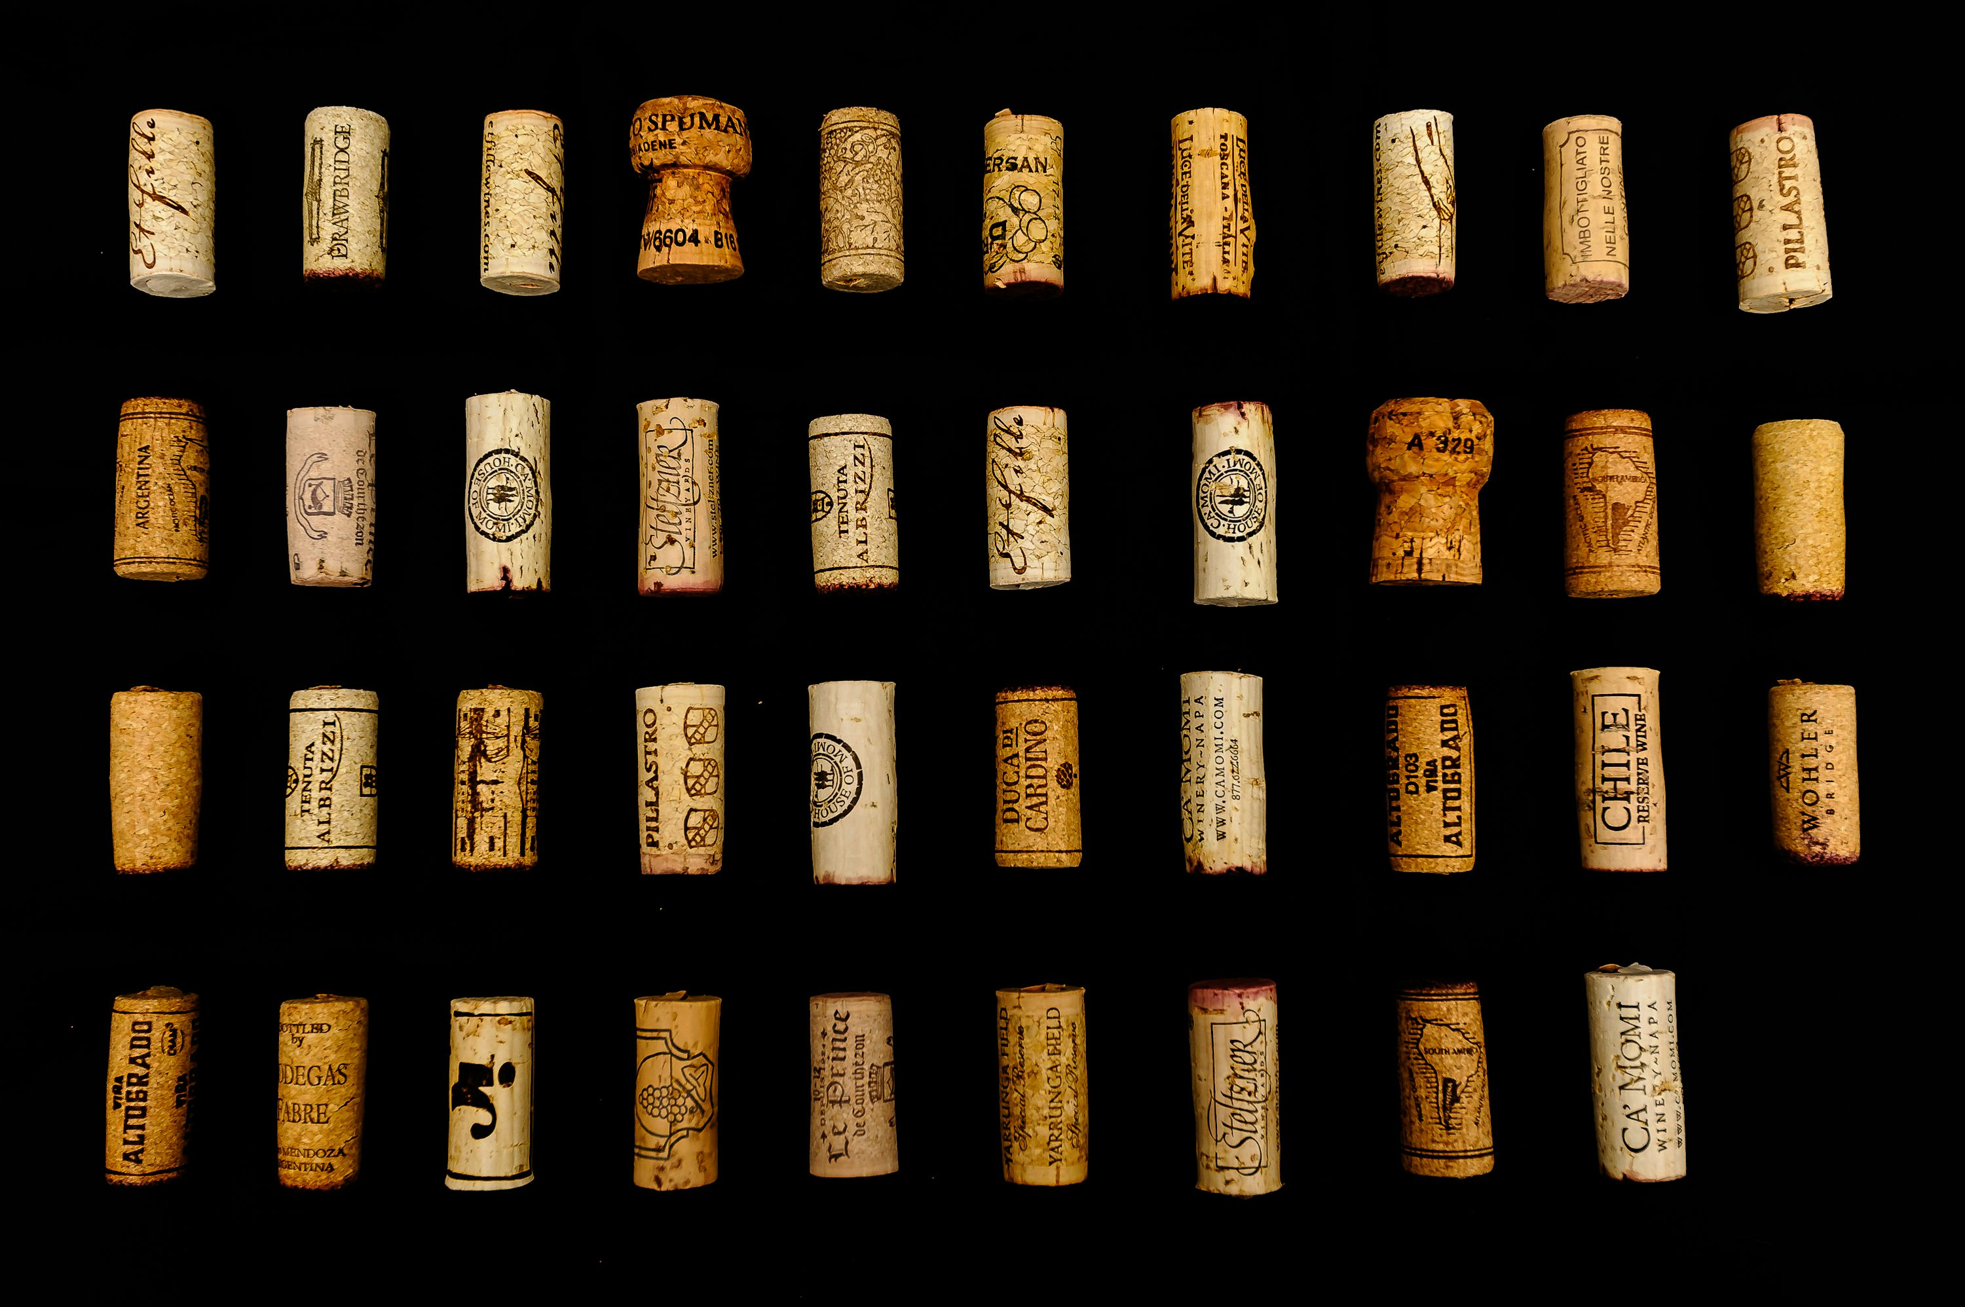
Do you / have you ever collected something?
How did you / do you organise this collection?
Any challenges with this?
5 minutes
Photo by Ning Shi on Unsplash

Slide 6



Personal data – awareness of rules and regulations
Personal data – pseudonymisation/anonymisation
Selecting a repository
File names – anonymisation
Repository certification
Restricting file access
Providing dataset metadata
Choosing a licence for reuse
Discipline-specific requirements
Selection of relevant data files
Choosing file formats
File formats policy
File format conversions
Selection of relevant datasets
Data authenticity
Data citation
Organising data in folders
Documenting data: codebooks/instructions
Data provenance

Slide 7
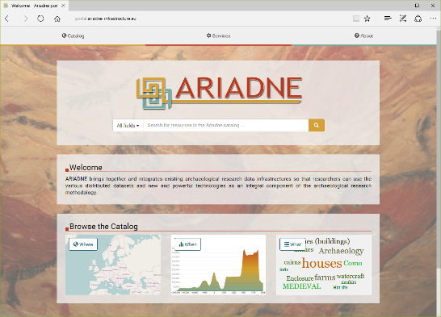
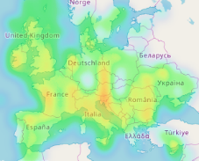
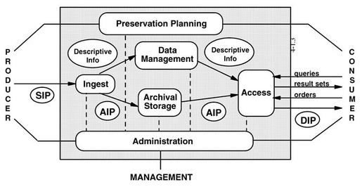

The magic(?) box of the repository
ARIADNE-portal:
http://portal.ariadne-infrastructure.eu/
Front-office
Machine to Machine
SWORD
OAI-PMH
PRODUCER
CONSUMER
Persistent Identifier Citation

Slide 8
Think, Pair, Share!
We will give you a discussion topic. Think for 5 minutes about your answer to the question.
Compare and combine your answer with the person next to you for 5 minutes
We will discuss as a larger group for 5 minutes

Slide 9
Think, Pair, Share!
How do you handle personal data?
What can a repository do to support the archiving of this? What does the researcher need to do / be aware of?

Slide 10
Licences and options
The User will act in accordance with the Netherlands Code of Conduct for Research Integrity, the GDPR and other applicable laws and regulations.
The User will always cite the dataset in the research results they publish, in whatever form, when it has been used in the research.
For distribution or disclosure of the entire dataset or of substantial parts thereof, the User must first request permission from the holder of the rights to the dataset.
pseudonymisation/anonymisation
The User will always be responsible for the processing of personal data made available within the meaning of the GDPR and any other relevant privacy legislation, as well as for complying with any conditions set by the depositor.
Restricted access
Embargo

Slide 11
Open Access licences
CC0-1.0 is a licence with which the copyright of the dataset is given up, putting the dataset in the public domain. A user may copy, change or distribute the dataset without notification. Formal attribution is not required, but this is of course still common practice in science.
With CC-BY-4.0 the copyright of the dataset remains with the rightsholder, but the user can share and change the dataset. This licence requires attribution and the user has to state if they have changed the dataset.
With CC-BY-SA-4.0 the same rules apply as for CC-BY-4.0, but in addition the user has to distribute the dataset they have reused under the same licence as the original (CC BY-SA 4.0).
With CC-BY-NC-4.0 the same rules apply as for CC-BY-4.0, but the dataset may not be used for commercial purposes.
With CC-BY-ND-4.0 the same rules apply as for CC-BY-4.0, but the user is not allowed to distribute the dataset if they have changed or extended the dataset.
The licences CC-BY-NC-ND-4.0 and CC-BY-NC-SA-4.0 are a combination of the aforementioned licences.

Slide 12
Your ideas: What metadata fields should be mandatory (most important for data reuasability)?

Slide 13
Metadata
Title
Subtitle
Alternative Title
Alternative URL
Other Identifier
Author
Point of Contact
Description
Subject
Keyword
Notes
Language
Producer
Production Date
Production Location
Contributor
Funding Information
Distributor
Distribution date
Depositor
Time Period
Date of Collection
Data Type
Series
Software
Data Sources
SSH
Keyword Getty AAT
Keyword ELSST
Topic Classification CESSDA
Universe
Frequency
Sampling Procedure
Characteristics of Data Collection Situation
Actions to Minimize Losses
Weighting
Response Rate
Archaeology
Archis ID
Report (ABR)
Methods of Recovery (ABR)
Subject (ABR)
Artefact (ABR)
Temporal (ABR)
Keyword Getty AAT
Rights Holder
Personal Data in Dataset?
Language Of Metadata
Temporal Coverage
Spatial Point
Spatial Box
Spatial Coverage
Audience
Collection
Relation or Related Material

Slide 14
Metadata
Title
Subtitle
Alternative Title
Alternative URL
Other Identifier
Author
Point of Contact
Description
Subject
Keyword
Notes
Language
Producer
Production Date
Production Location
Contributor
Funding Information
Distributor
Distribution date
Depositor
Time Period
Date of Collection
Data Type
Series
Software
Data Sources
SSH
Keyword Getty AAT
Keyword ELSST
Topic Classification CESSDA
Universe
Frequency
Sampling Procedure
Characteristics of Data Collection Situation
Actions to Minimize Losses
Weighting
Response Rate
Archaeology
Archis ID
Report (ABR)
Methods of Recovery (ABR)
Subject (ABR)
Artefact (ABR)
Temporal (ABR)
Keyword Getty AAT
Rights Holder
Personal Data in Dataset?
Language Of Metadata
Temporal Coverage
Spatial Point
Spatial Box
Spatial Coverage
Audience
Collection
Relation or Related Material

Slide 15
Your ideas: Do you think anything is missing? Would there be any additional mandatory fields that you would include?

Slide 16
Think, Pair, Share!
We will give you a question. Think for 5 minutes about your answer to the question.
Compare and combine your answer with the person next to you for 5 minutes
We will discuss as a larger group for 5 minutes

Slide 17
Think, Pair, Share!
What role should a data supporter have in creating discovery metadata for a researcher’s dataset?

Slide 18


Slide 19
Dataset curation
Validation - DANS evaluates deposits on suitability for the Designated Community for the Data Station. DANS reserves the right to reject deposits submitted for evaluation if such datasets do not meet the criteria for acceptance.
Submission Package - DANS always retains a copy of the data exactly as submitted by the depositor.
Initial Version - The submitted data and curated metadata become the first version of a submitted dataset and form the basis for any preservation copies made of the dataset.
Enhancements - DANS may make changes to the metadata and add conversion files to align them with community expectations, increase FAIR quality, and improve the long-term sustainability of the dataset. Changes to the data, and any changes to the metadata after the initial published version, will result in a new version of the dataset.
Publication - If the dataset meets all criteria and after completion of the curatorial review, DANS will publish the dataset on behalf of the depositor and provide it with a persistent identifier (PID).

Slide 20
Dataset curation
Conform Data Stations Policy; DANS Selection Policy; Data Processing Manual
Inventorise deposit
Basic curation
Check if the dataset is valid and complete
Check metadata, edit/modify where necessary
Check for privacy sensitive data
Publish dataset
Enhanced curation
Migrate files to Preferred Formats
Modify directory structure
Make a new version

Slide 21
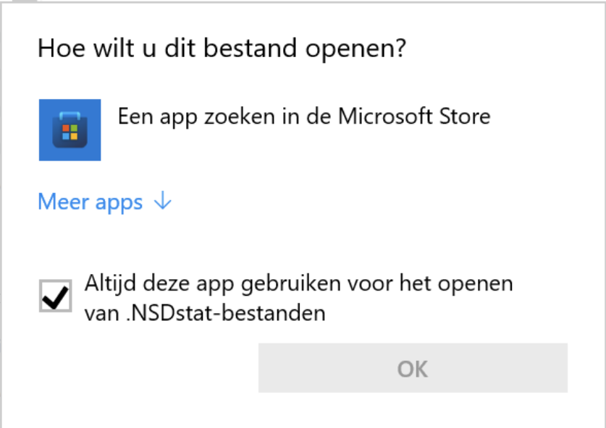
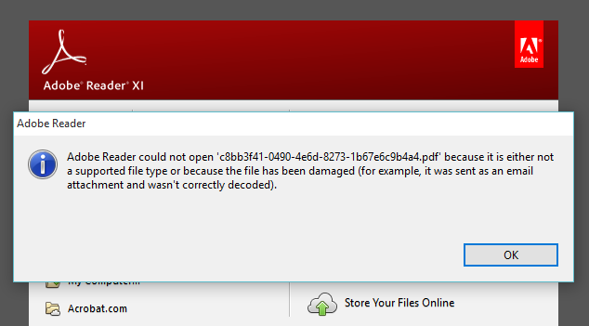
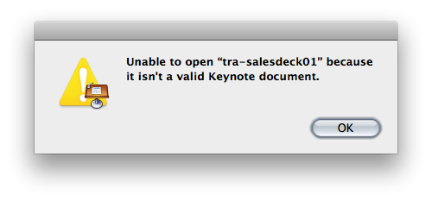
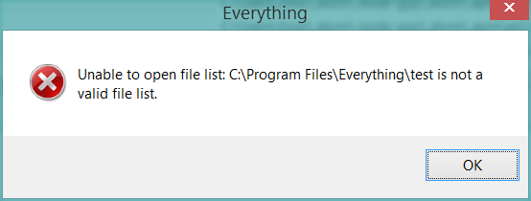
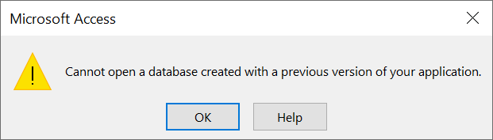
File formats

Slide 22
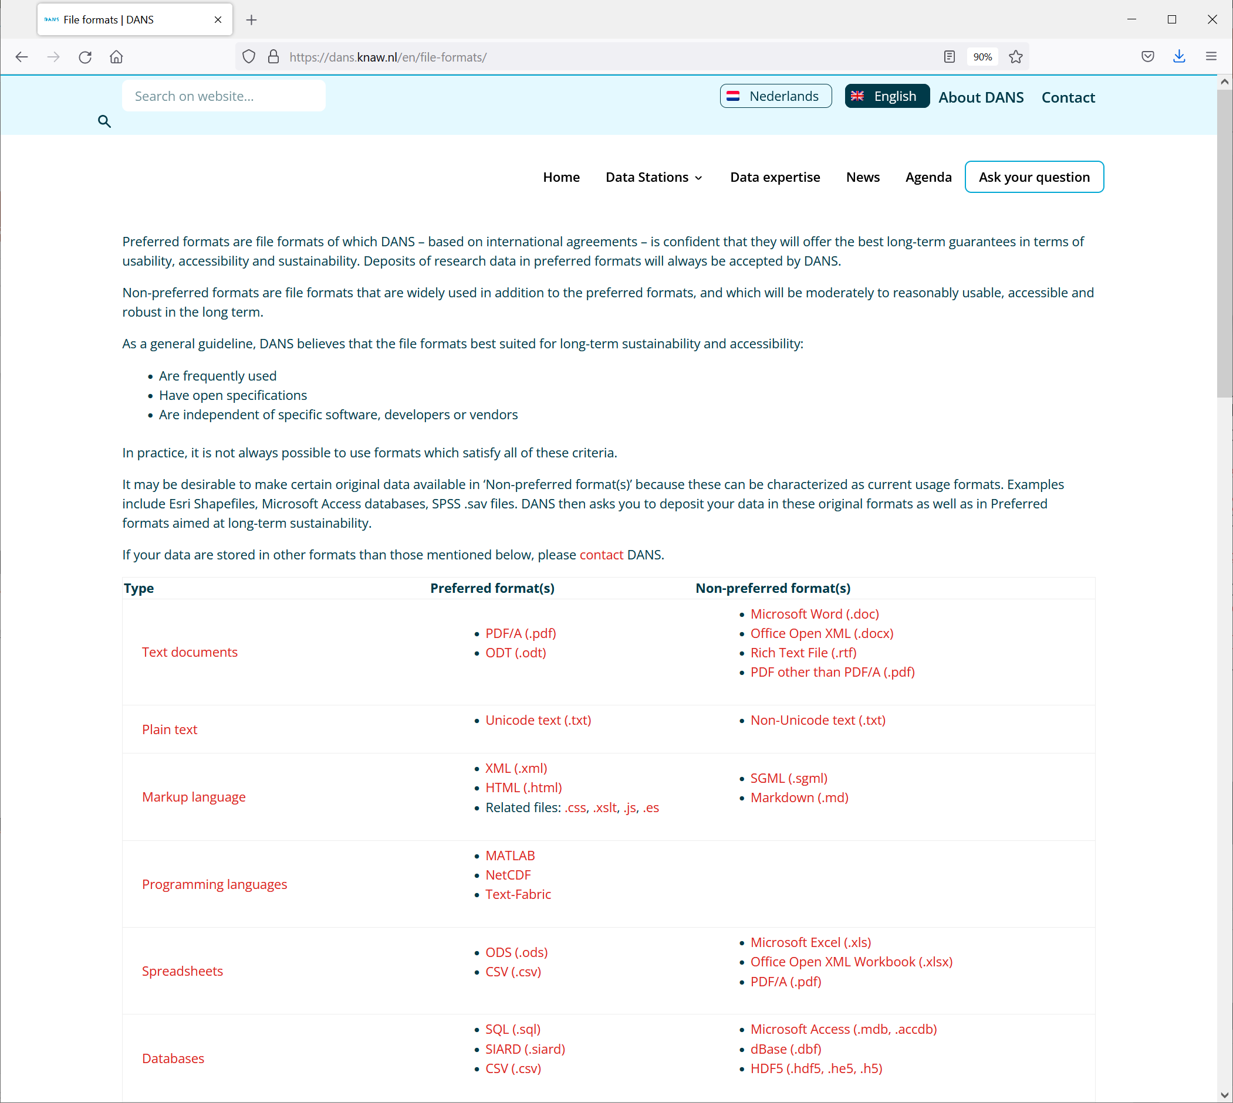
Preferred Formats
As a general guideline, DANS believes that the formats best suited for long-term sustainability and accessibility:
are frequently used
have open specification
are independent of specific software, developers or vendors
In practice, it is not always possible to use formats which meet all the ideal characteristics of a preferred format.
https://dans.knaw.nl/en/file-formats

Slide 23
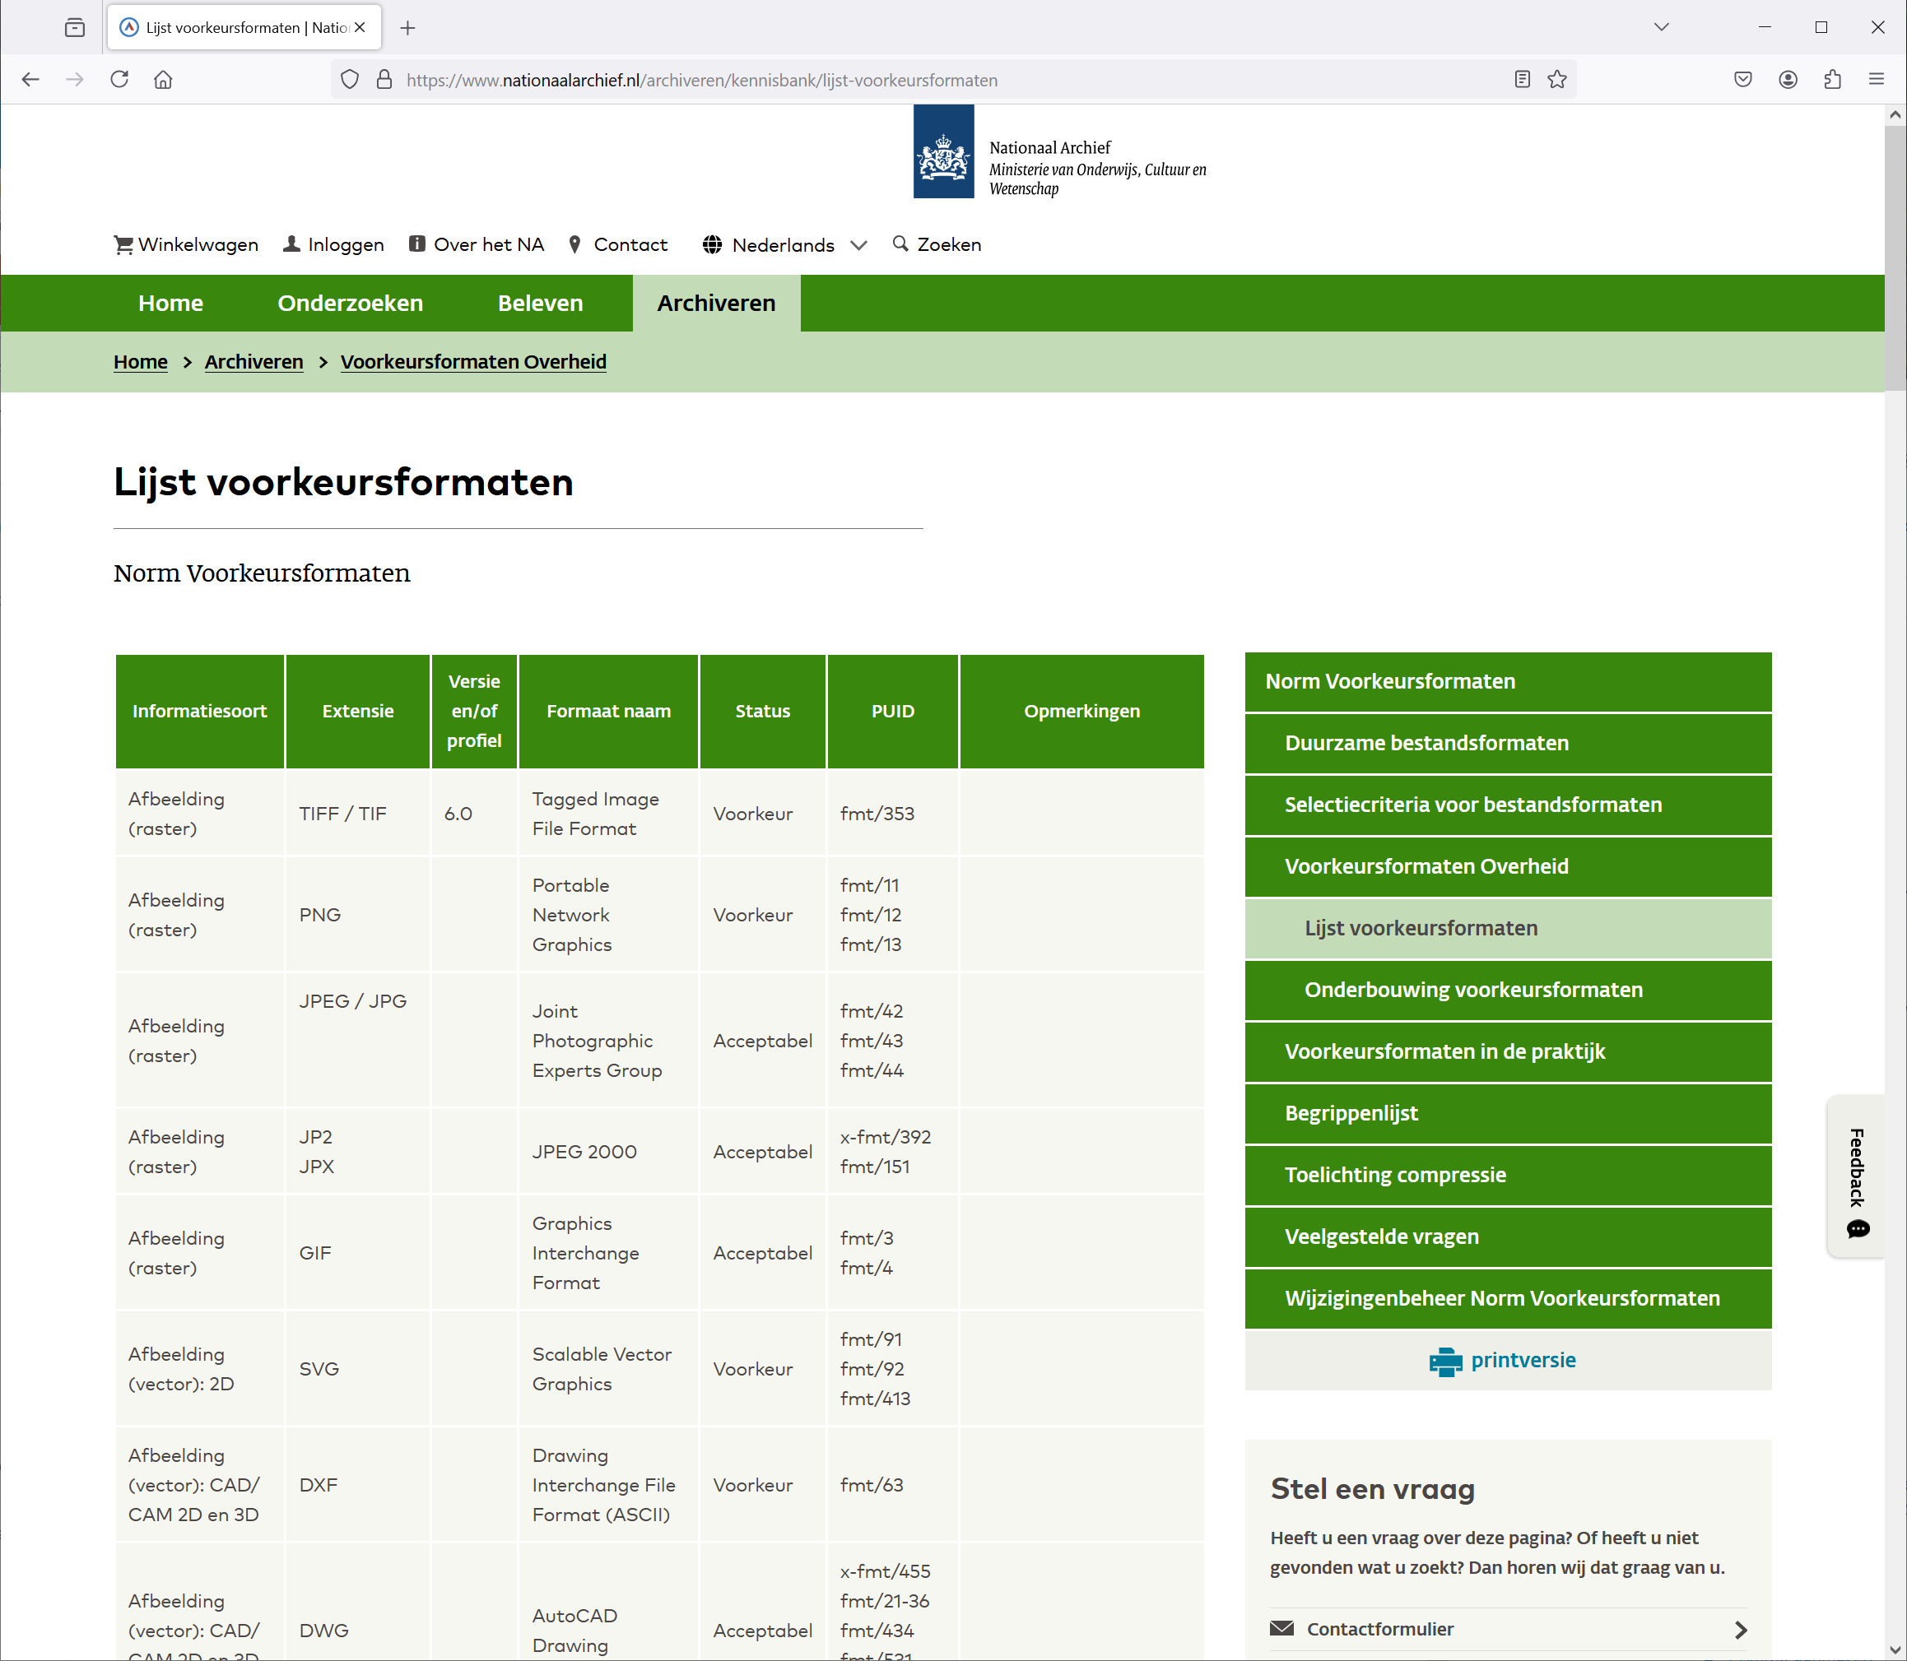

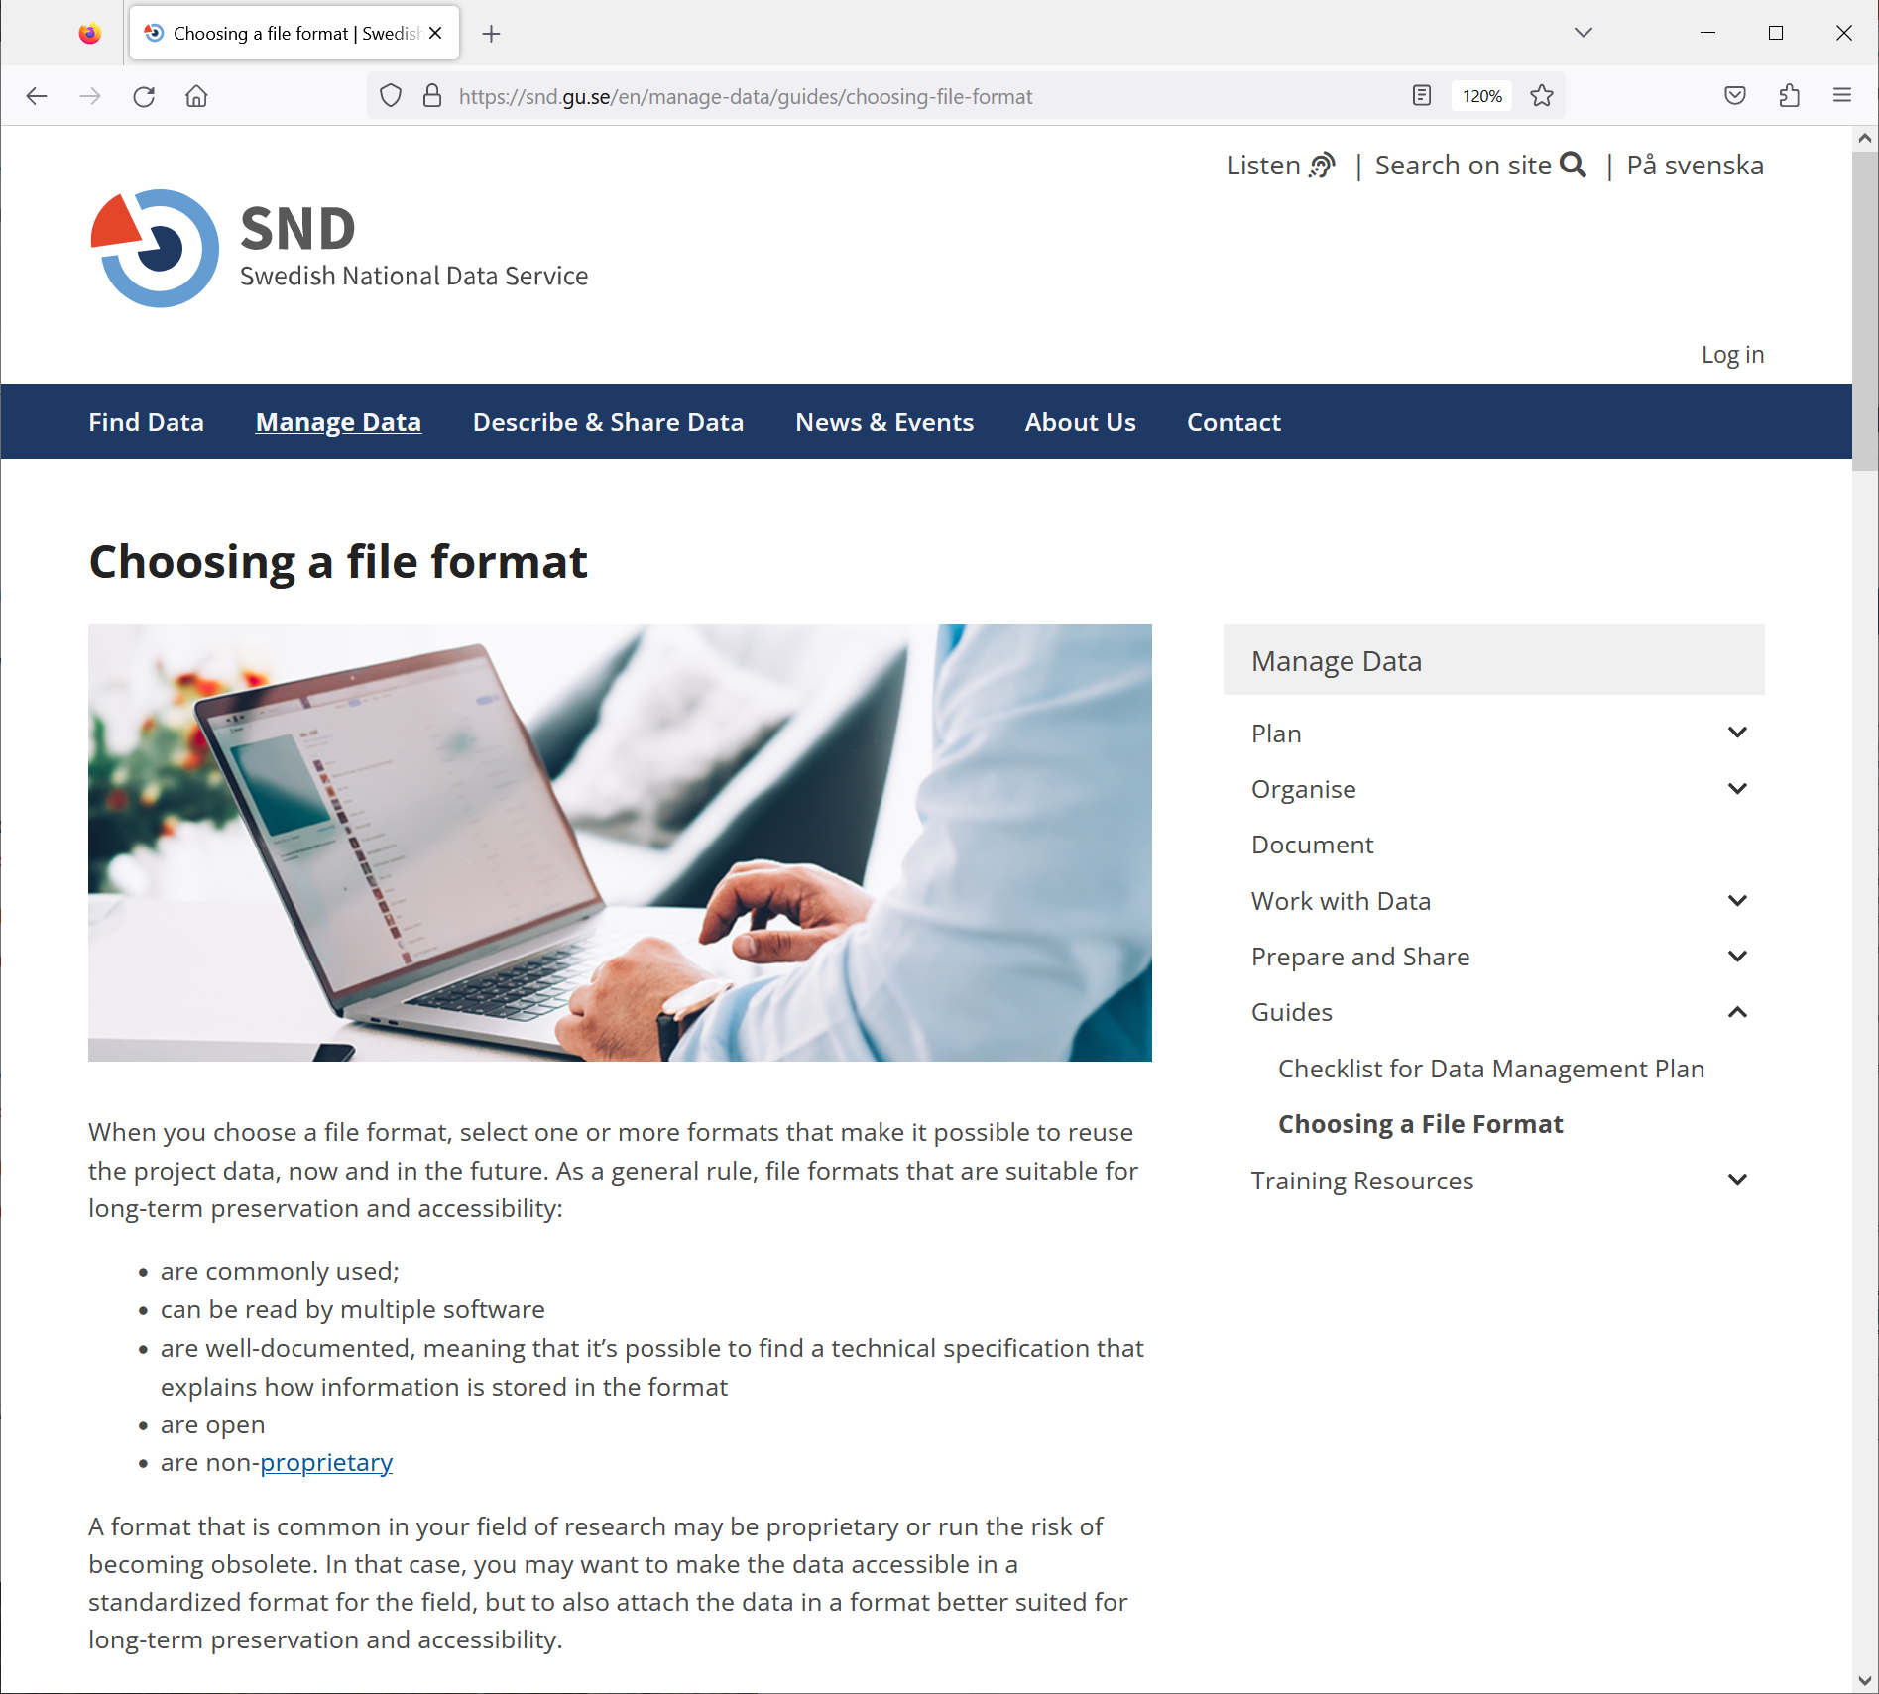
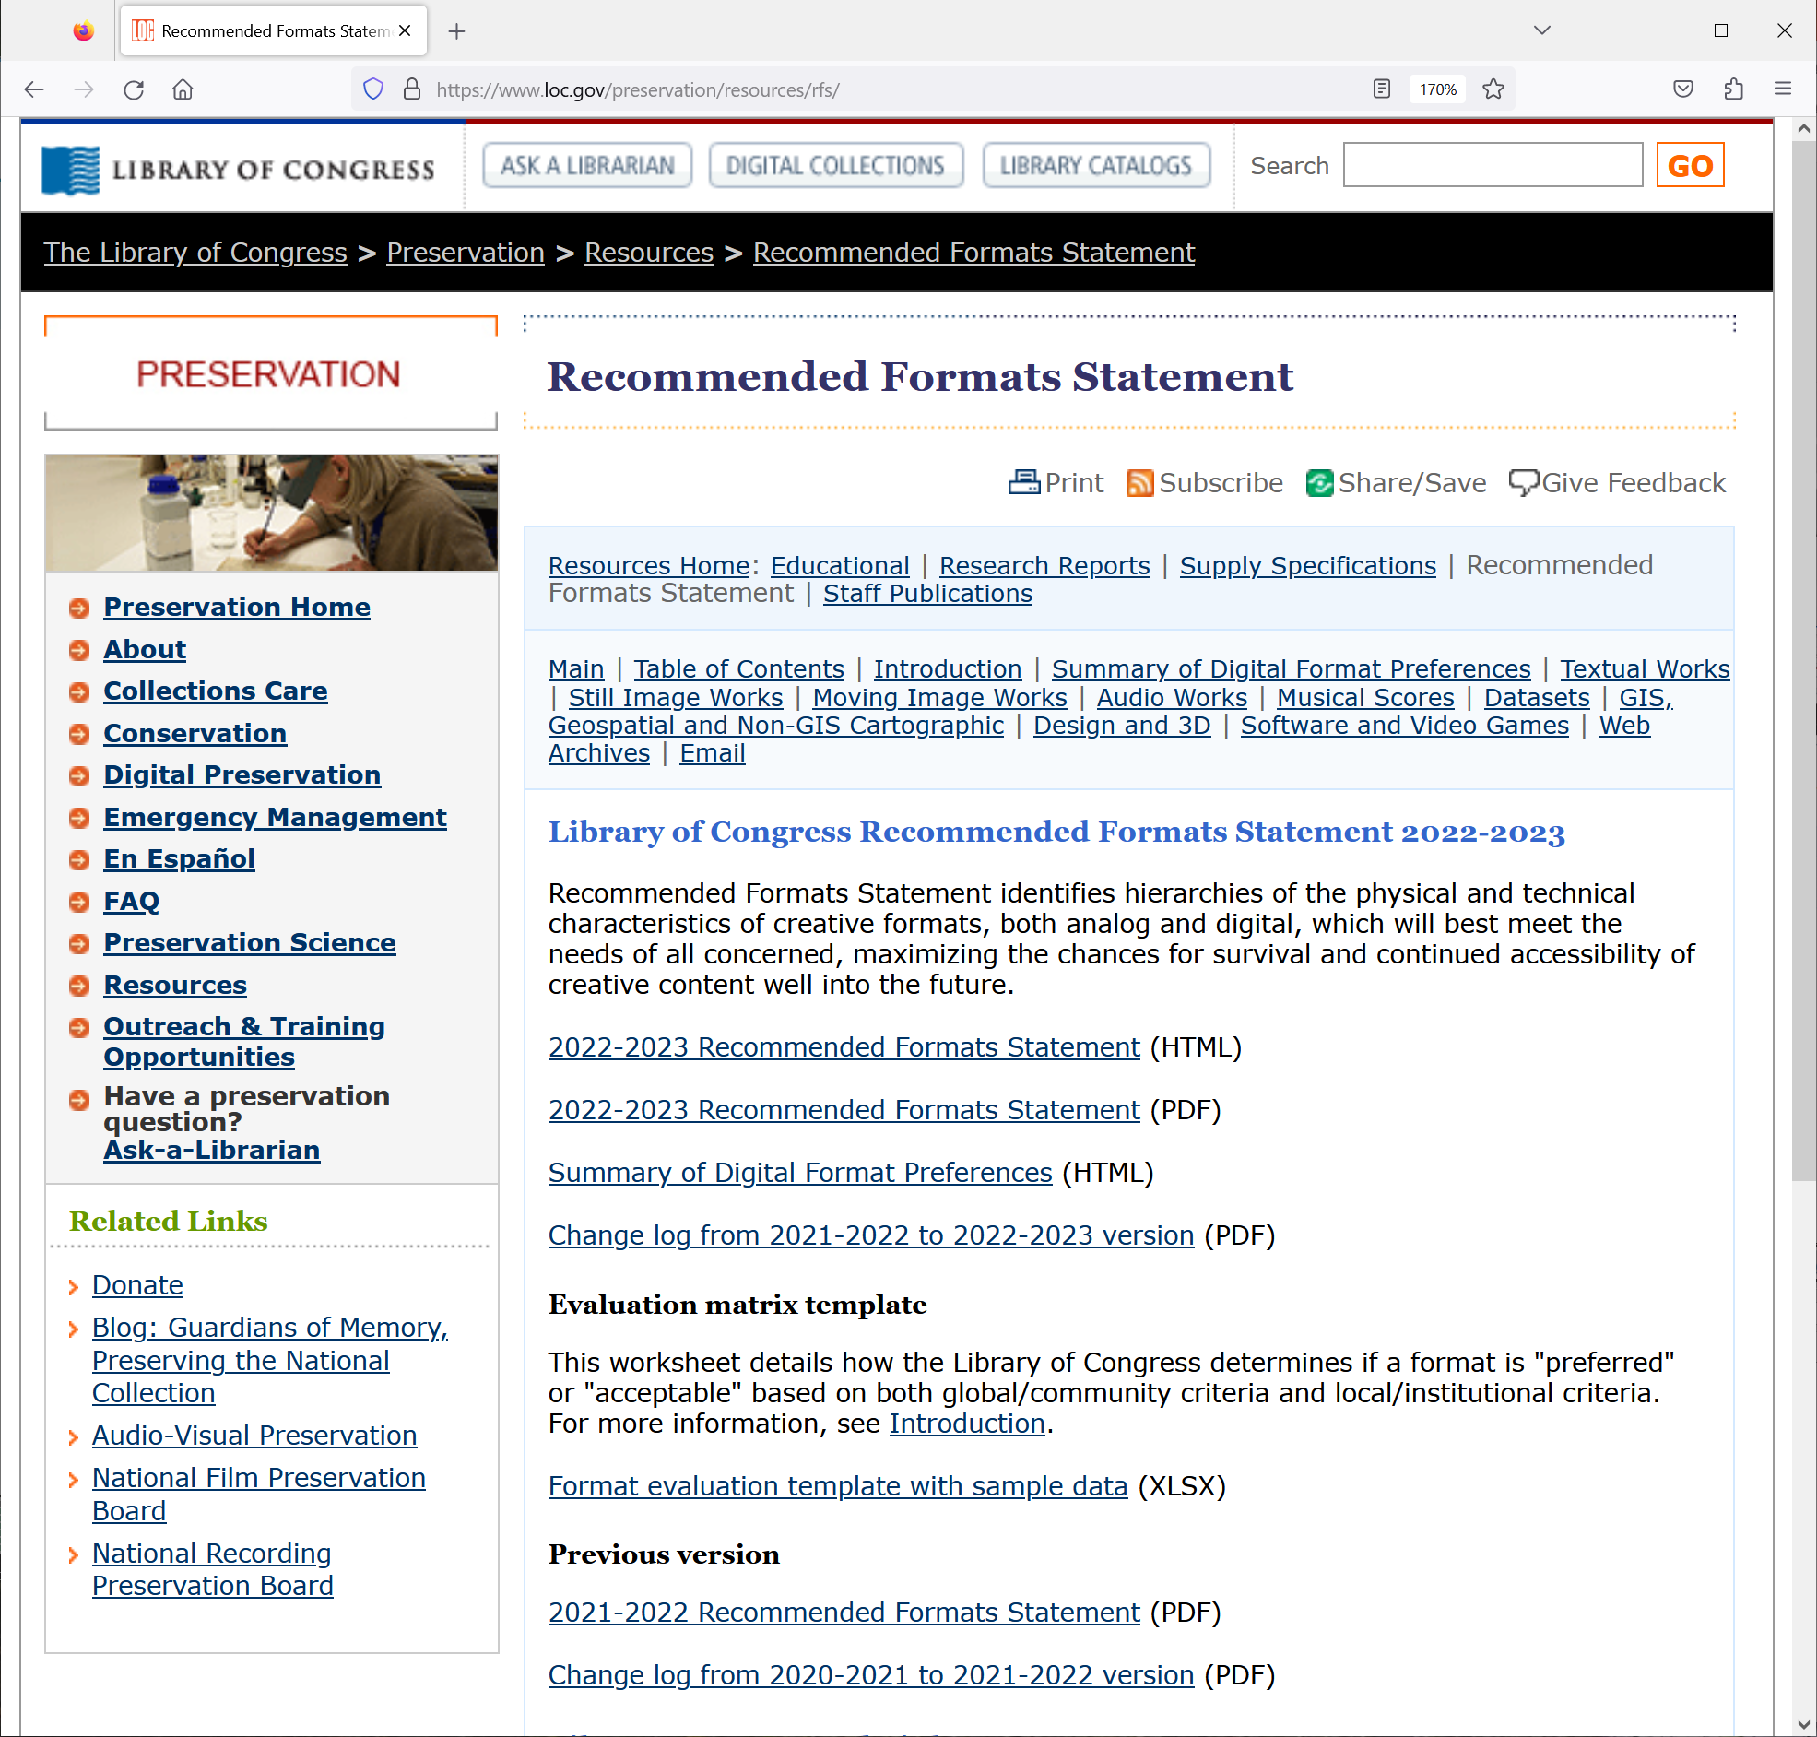

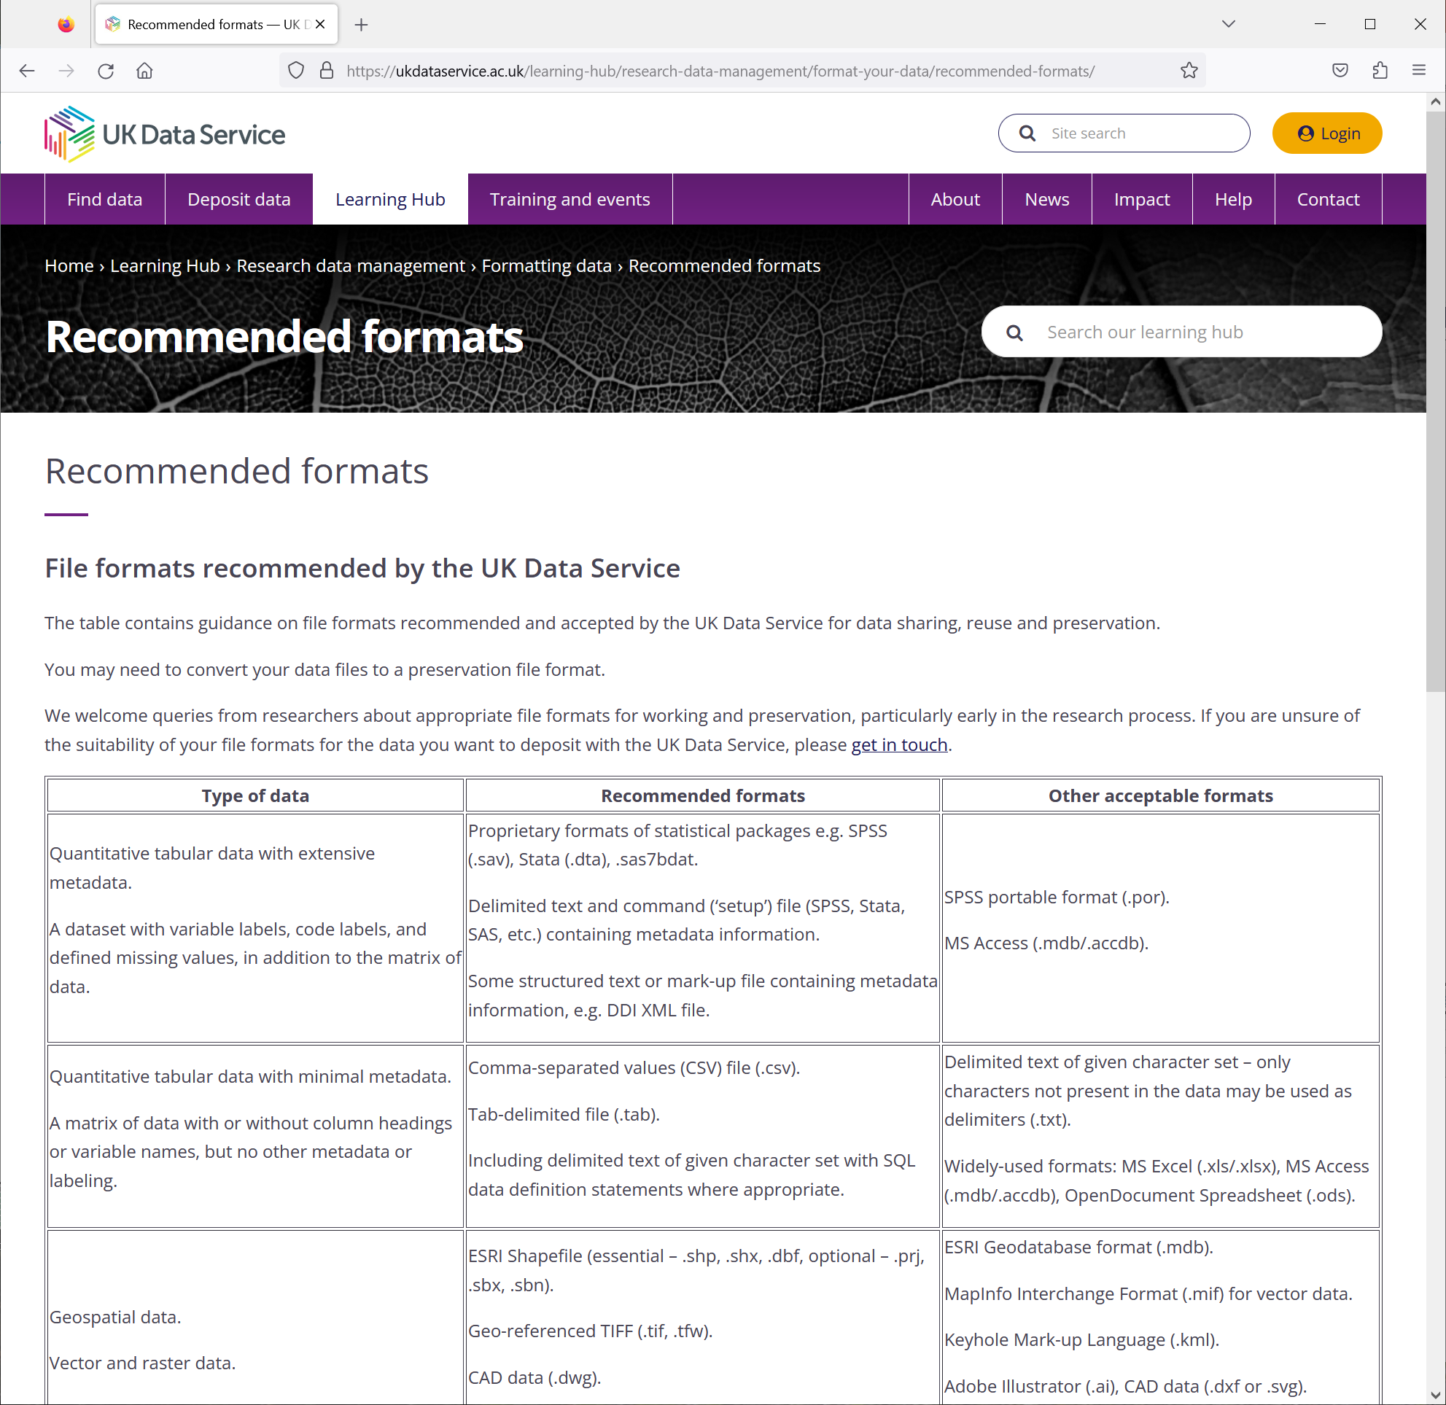
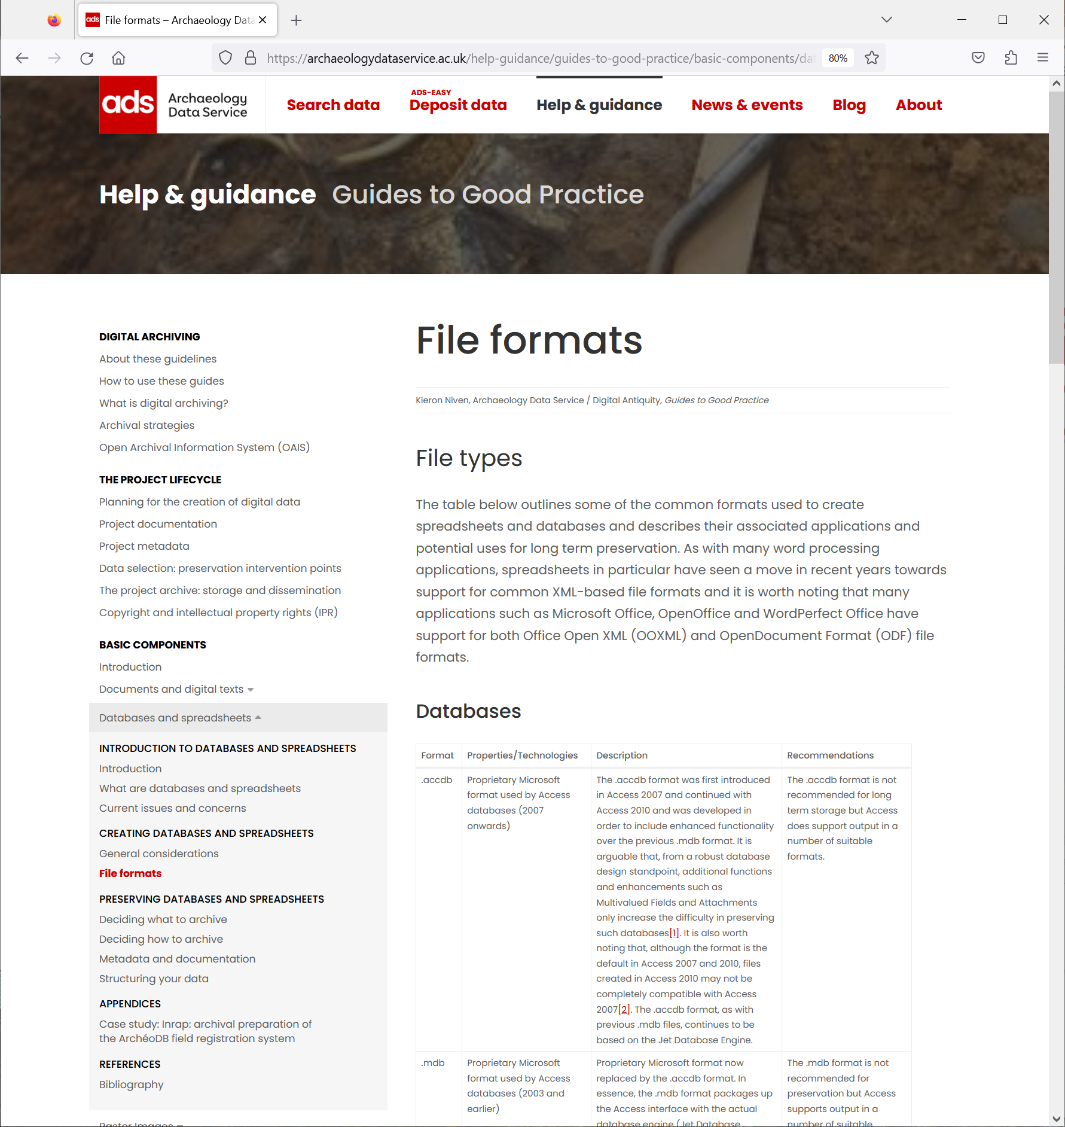
Preferred Formats

Slide 24
Valentijn’s manifesto/DANS’ positition
Formats can still be in danger of falling into disuse and becoming unsupported.* Long-term preservation should aim to make use of robust file formats
If it is not possible to obtain ‘preferred formats’, non-preferred formats should still be accepted, although less long-term guarantees can be given
When formats are converted/migrated, the original data should be preserved as well
Certain non-preferred formats can be made available as current usage formats
A policy with ‘non-acceptable formats’ risks receiving incomplete or lower-quality data. A policy with ‘acceptable formats’ risks a lack of effort towards sustainability
Emulation may offer helpful solutions, but relying on emulation may simply shift preservation concerns from formats to software
File format strategies need to be informed by expert input from data users and communities
*See: https://openpreservation.org/blogs/monitoring-disappearing-file-formats-4-dans/
and https://doi.org/10.5281/zenodo.15123699

Slide 25
Do you agree with Valentijn's manifesto?
What remaining questions do you have on file formats?

Slide 26
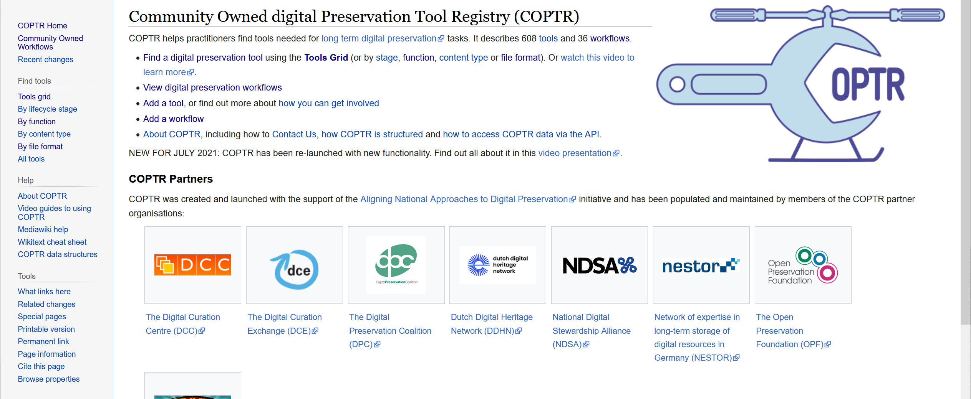
Tools and services
https://coptr.digipres.org

Slide 27
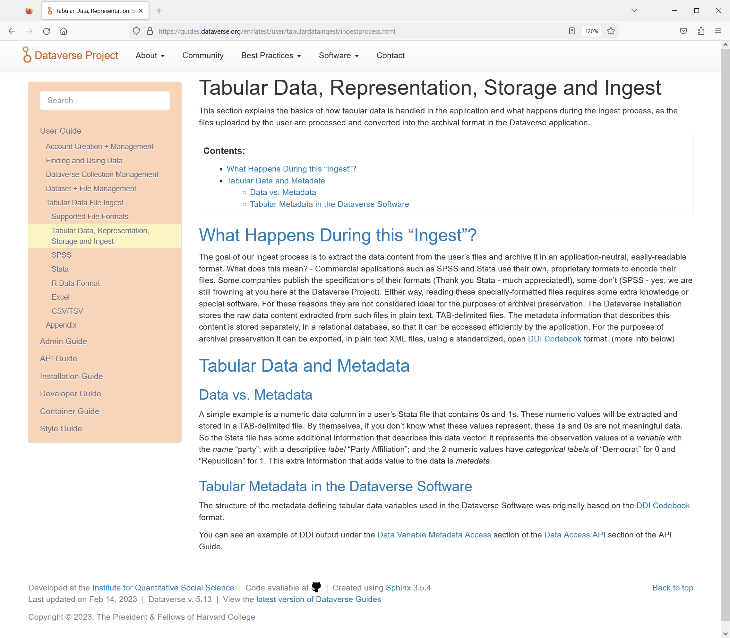
Tools and services
The goal of our ingest process is to extract the data content from the user’s files and archive it in an application-neutral, easily-readable format.
The Dataverse installation stores the raw data content extracted from such files in plain text, TAB-delimited files. The metadata information that describes this content is stored separately, in a relational database, so that it can be accessed efficiently by the application. For the purposes of archival preservation it can be exported, in plain text XML files, using a standardized, open DDI Codebook format.

Slide 28

OpenRefine?
Data is often very messy. OpenRefine provides a set of tools to allow you to identify and amend the messy data.
It is similar to spreadsheet applications
However … all actions are easily reversed in OpenRefine.
If you save your work it will be to a new file. OpenRefine always uses a copy of your data and does not modify your original dataset.
See: Data Carpentries Open Refine Training: https://datacarpentry.github.io/openrefine-socialsci/index.html

Slide 29
Do you know of other tools and services to share with the group?

Slide 30
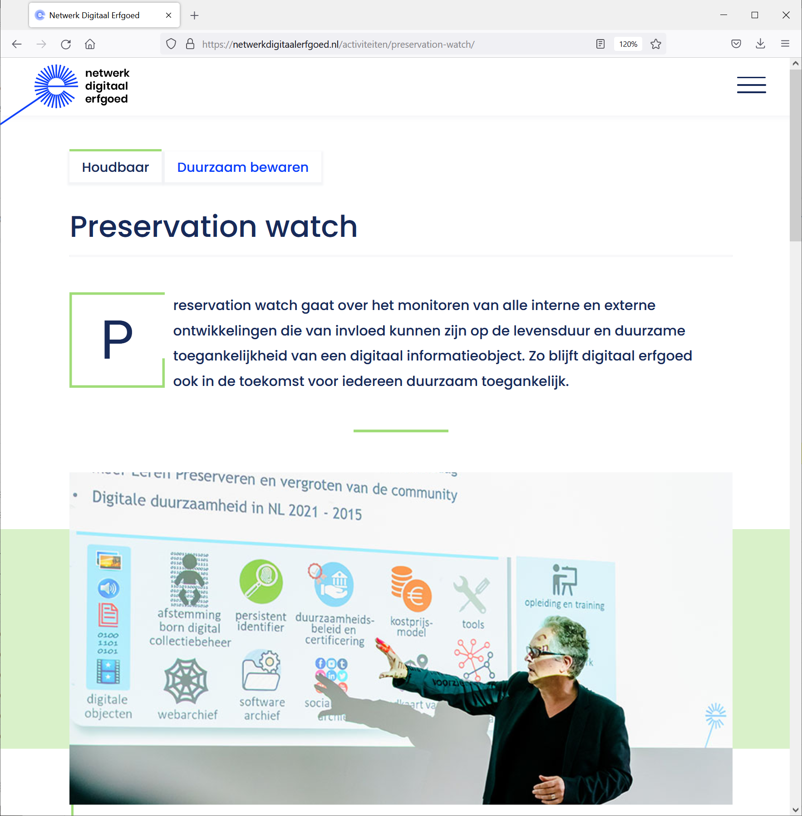

Digital Heritage Network
Dutch Digital Heritage Network KNAW Humanities Cluster (includes DANS) National Library of the Netherlands National Archive Netherlands Institute for Sound and Vision Het Nieuwe Instituut Netherlands Cultural Heritage Agency Preservation Watch Netherlands Institute for Sound and Vision DANS EYE Filmmuseum National Library of the Netherlands LIMA National Archive RHC Eindhoven Amsterdam City Archives The Utrecht Archives

Slide 31
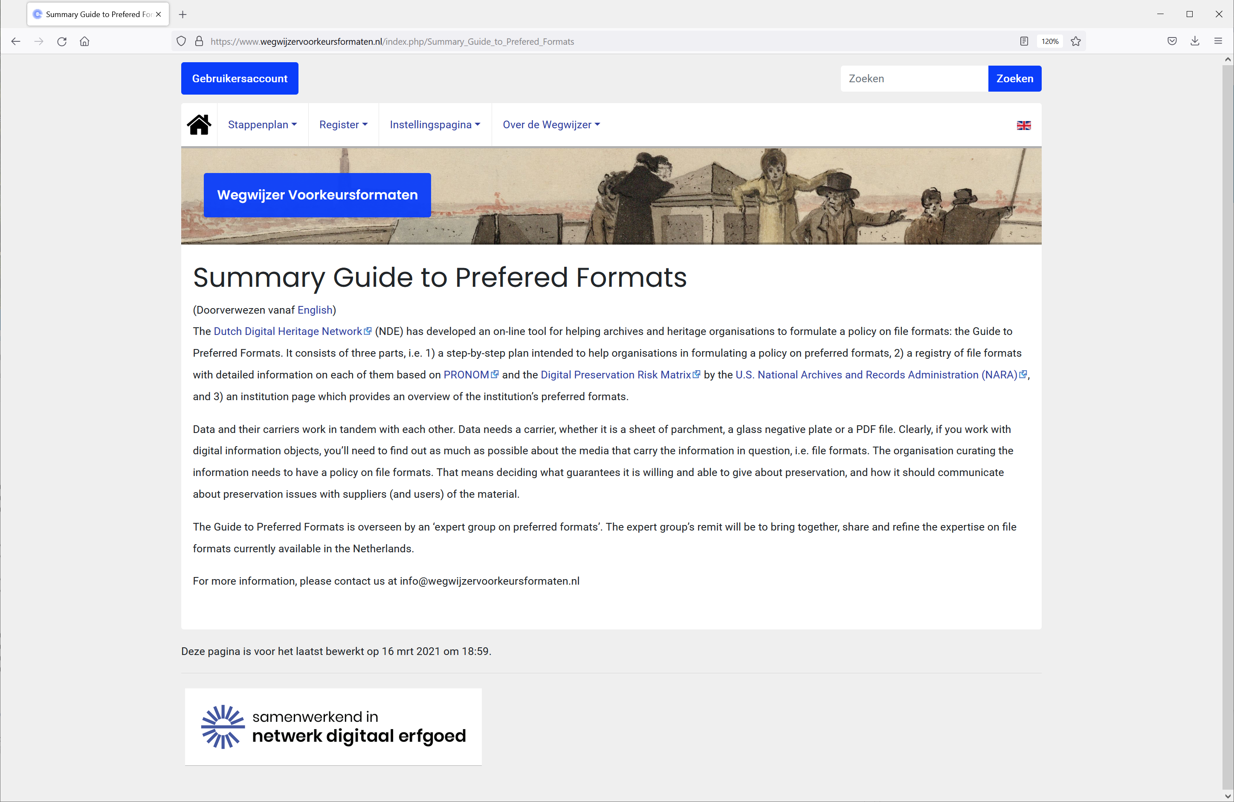
Wegwijzer Voorkeursformaten
www.wegwijzervoorkeursformaten.nl
Stappenplan Interactive step-by-step module to help institutions create their own file formats policies through comparisons with other policies, via available information and wighing importance Register Register of file formats with information derived from international sources: PRONOM; Wikidata; Library of Congress; NARA; COPTR Instellingspagina Institution pages with overviews derived from the step-by-step plans and the register

Slide 33
Open Access metadata
Trustworthy repository
A
Standardised exchange protocols
Codebooks
Persistent Identifiers
Embargo when needed
Open Access when possible
Clear folder structure
F
Access and licence information
Licence
Clear names for files and folders
Data citation
Authenticity
Persistent Author Identifiers
Provenance
R
Metadata in scheme
Version control
Preferred formats
Workflows
Support metadata mapping
Common file formats
Data standards
Vocabularies
I
APIs
PARTHENOS, Hollander, H., Morselli, F., Uiterwaal, F., Admiraal, F., Trippel, T., & Di Giorgio, S. (2019). PARTHENOS Guidelines to FAIRify data management and make data reusable. Zenodo. https://doi.org/10.5281/zenodo.2668478

Slide 34
Quick-fire PostIt notes: Take-home messages
Take a PostIt note
Answer the following questions on a PostIt and put it up on the sheet
What have you learned in this workshop that you can take into your daily work?

Slide 35
Quick-fire PostIt notes: Take-home messages
Take a PostIt note
Answer the following questions on a PostIt and put it up on Sheet 3:
What do you still need to know / learn?

Slide 36



Thank you!
More information
Visit our website www.dans.knaw.nl
And follow us online
Mastodon @DANS_knaw_nwo
LinkedIn @DANS
X @DANS_knaw_nwo

