Slide 1


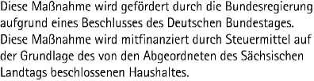
CENTER FOR SCALABLE DATA ANALYTICS AND
ARTIFICIAL INTELLIGENCE
Deep Learning for Bio-image Analysis
Robert Haase
Funded by
These slides and the related training materials can be reused under the terms of the CC-BY 4.0 license.

Slide 2
Exam Bio-image Data Science
Day: July 15th 2025
Time: 9:15
Room: S 202
Schillerstraße 6
04109 Leipzig

Slide 3




Quiz
Supervised machine learning requires…
A human supervisor
Labeled
data
A binary image
Dimensionality reduction

Slide 4
Quiz
An embedding is …
Result of dimensionality reduction
N-dimensional space
Result of clustering
Result of model training

Slide 5
CENTER FOR SCALABLE DATA ANALYTICS AND
ARTIFICIAL INTELLIGENCE
Deep Learning Basics
Robert Haase
Funded by
These slides and the related training materials can be reused under the terms of the CC-BY 4.0 license.

Slide 6
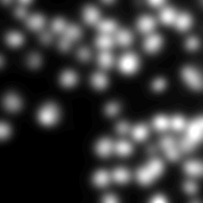
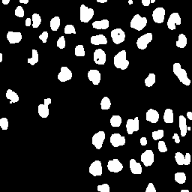
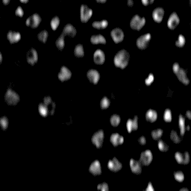
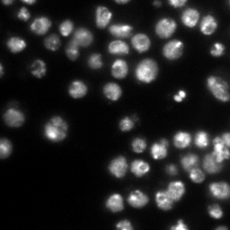
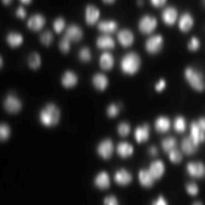
Machine learning for image analysis
In classical machine learning, we typically select features for training our classifier
?
Image data source: BBBC038v1, available from the Broad Bioimage Benchmark Collection (Caicedo et al., Nature Methods, 2019].
Convolutions

Slide 7
Outlook: Deep learning for image analysis
In deep learning, this selection becomes part of the black box
_ ?
Image data source: BBBC038v1, available from the Broad Bioimage Benchmark Collection (Caicedo et al., Nature Methods, 2019].
Convolutional neural networks

Slide 8
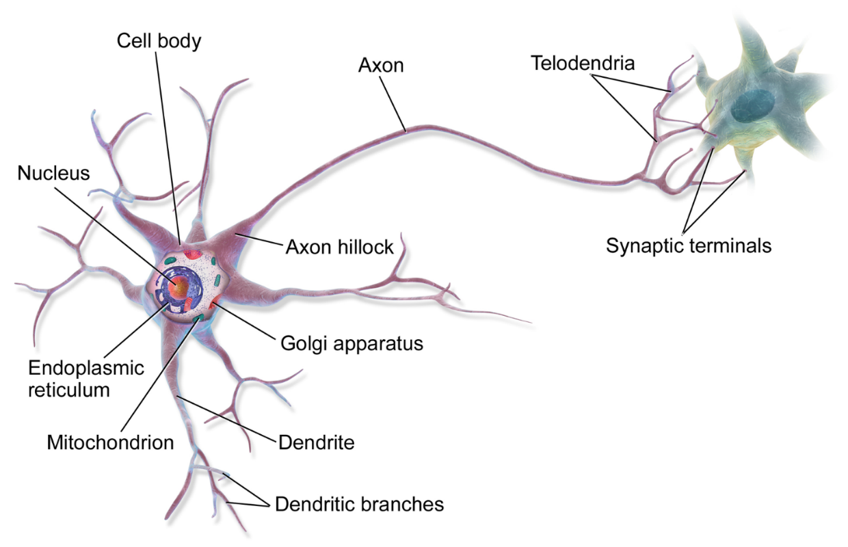

Neural networks
How biologists see neurons
How computer scientists see neurons
“perceptron”
Bias
b
Activation function
x₁
w₁
x₂
w₂
f
Output
Inputs
$$Σ$$
y
x₃
w₃
Weights
$$y=f\left(w | | 1x_{1}+w_{2}x_{2}+w_{3}x_{3}+b\right)$$
Neuron image source: https://commons.wikimedia.org/wiki/File:Blausen_0657_MultipolarNeuron.png
Licensed CC-BY 3.0 by BruceBlaus

Slide 9
Neural Networks
Early form: “Multilayer Perceptron”
fully connected class of feedforward artificial neural network
If there are many hidden layers, we speak of a deep neural network
Input layer
Hidden layer(s)
Output layer
https://en.wikipedia.org/wiki/Multilayer_perceptron

Slide 10
Convolutional neural networks
Layer types
Fully connected layer

Slide 11
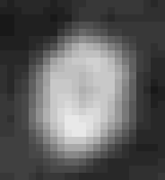

Convolutional neural networks
Layer types
Fully connected layer
Convolutional layer
Field of view

Slide 12
Convolutional neural networks
Layer types
Pooling layer
(“Max pool”, “Average pool”)
Fully connected layer
Convolutional layer
3 | 15 | 1 | 13
9 | 7 | 0 | 10
11 | 5 | 5 | 3
1 | 8 | 9 | 6
Max pooling
15 | 13
11 | 9

Slide 13
Activation functions
Introduction of non-linearity and activation functions enabled what we call deep-learning today.
Bias
b
Activation function
x₁
w₁
Output
Inputs
x₂
w₂
$$Σ$$
f
y
$y=$ ${{f(w}_{1}x}_{1}+w_{2}x_{2}+w_{3}x_{3}+b)$
x₃
w₃
Weights
Linear
Non-linear

Slide 14
Convolutional neural networks
Assuming we had no activation functions in the network,
layers can be reduced by eliminating brackets!
x₁
x₂
x₃
$$y=w_{5}\left(w_{1}x_{1}+w_{2}x_{2}\right)+w_{6}\left(w_{3}x_{2}+w_{4}x_{3}\right)$$
w₁
w₂
w₄
w₃
$$y={w_{5}w}_{1}x_{1}+{w_{5}w}_{2}x_{2}+w_{6}w_{3}x_{2}+{w_{6}w}_{4}x_{3}$$
x₁
x₂
x₃
$$y={w_{5}w}_{1}x_{1}+$$
w₆
v₁
v₂
v₃
w₅
$$v_{1}=w_{5}w_{1}$$
$$v_{2}=w_{5}w_{2}+w_{6}w_{3}$$
y
$$v_{3}=w_{6}w_{4}$$
$$y=v_{1}x_{1}+v_{2}x_{2}+v_{3}x_{3}$$
y

Slide 15
Activation functions
Introduction of non-linearity and activation functions enabled what we call deep-learning today.
Bias
b
Activation function
x₁
w₁
Output
Inputs
x₂
w₂
$$Σ$$
f
y
$y=$ ${{f(w}_{1}x}_{1}+w_{2}x_{2}+w_{3}x_{3}+b)$
x₃
w₃
Weights
Linear
Non-linear

Slide 16
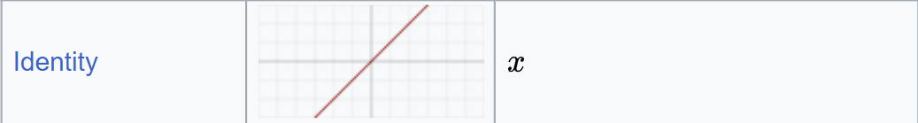
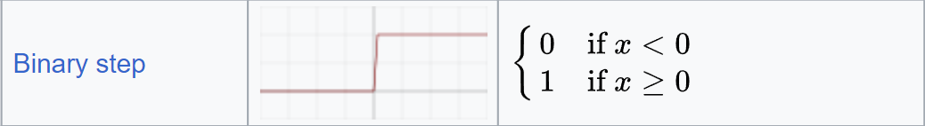
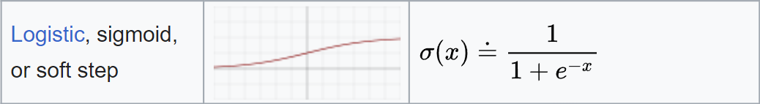
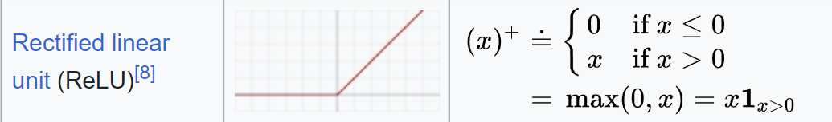
Activation functions
Introduction of non-linearity and activation functions enabled what we call deep-learning today.
Bias
b
Activation function
x₁
w₁
Output
Inputs
x₂
w₂
$$Σ$$
f
y
x₃
w₃
Weights
Linear
Non-linear
Source: https://en.wikipedia.org/wiki/Activation_function Licensed CC-BY-SA 4.0 by Laughsinthestocks

Slide 17



Learning: Back propagation
Input x
Step 0: Initialize the network randomly (weights, bias)
Step 1: Forward pass the input through the network, get an initial prediction
Step 2: Compare the output with the ground truth, compute the error (loss function)
  The loss function can be freely defined.
  Example: mean squared error
Step 3: Update weights
Ground truth
Prediction
Loss

Slide 18
Learning: Back propagation
Input x
Updating weights:
  Set output to the error (per-parameter gradient)
  Backward-pass: add/subtract gradients from weights, to push the network towards giving the right answer.
Execute the same procedure for next sample
Execute the same for multiple epochs
Ground truth
Prediction
Loss

Slide 19
Training NNs: Batch size & epochs
Data
Problem:
Assume you have 10¹⁰ samples and attempt to train for 1000 epochs
-> 10¹³ backprop steps required.
epoch 1

Slide 20
Training NNs: Batch size & epochs
Data
Batch size
Data
Problem:
Assume you have 10¹⁰ samples and attempt to train for 1000 epochs
-> 10¹³ backprop. steps required.
Solution:
Draw n=1000 random samples from the training data to train for one epoch.
Next epoch: different n samples.
-> 10⁶ backprop. steps required.
Data
Data
epoch 1

Slide 21
Training NNs: Batch size & epochs
Data
Batch size
Data
Problem:
Assume you have 10¹⁰ samples and attempt to train for 1000 epochs
-> 10¹³ backprop steps required.
Solution:
Draw n=1000 random samples from the training data to train for one epoch.
Next epoch: different n samples.
-> 10⁶ backprop steps required.
Data
Data
epoch 2

Slide 22
Training NNs: Drop-out
Drop-out: deactivating individual neurons during training
Helps with over-fitting, because the network cannot rely on individual neurons by chance being well trained, while others remain randomly initialized
Example: drop-out-rate: 30%
epoch 1

Slide 23
Training NNs: Drop-out
Drop-out: deactivating individual neurons during training
Helps with over-fitting, because the network cannot rely on individual neurons by chance being well trained, while others remain randomly initialized
Example: drop-out-rate: 30%
epoch 2

Slide 24
Model validation
Train dataset (e.g. 80% of the data)
Used for training directly
Validation dataset (10% of the data)
After every epoch, determine if model still generalizes
Test dataset (10% of the data)
Final evaluation after training is finished (once)
Underfitting
A trained model that is not even able to properly process the data it was trained on
Overfitting
A model that is able to process data it was trained on well
It processes other data poorly
Underfitting
Overfitting
Loss (lower is better)
Training duration (epochs)
https://towardsdatascience.com/how-to-split-data-into-three-sets-train-validation-and-test-and-why-e50d22d3e54c

Slide 25
CENTER FOR SCALABLE DATA ANALYTICS AND
ARTIFICIAL INTELLIGENCE
Explainable Deep Learning
Robert Haase
Funded by
These slides and the related training materials can be reused under the terms of the CC-BY 4.0 license.

Slide 26
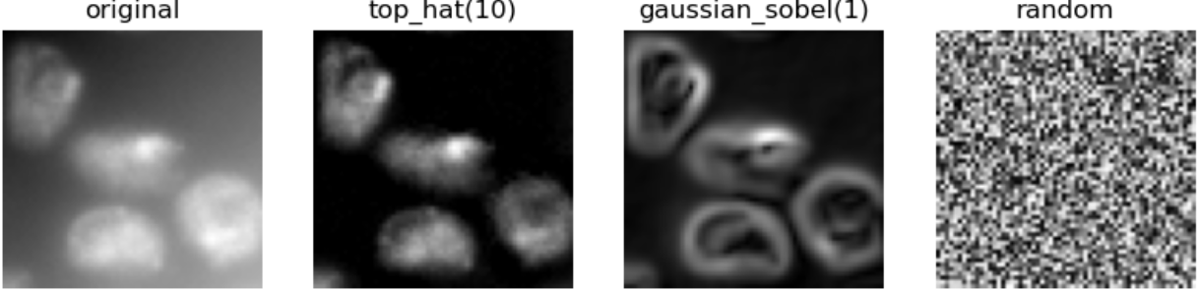

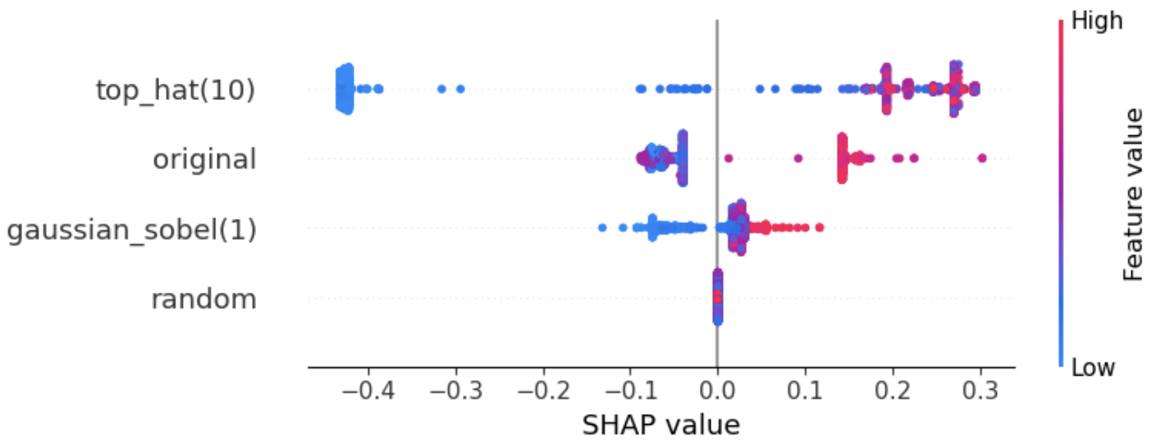
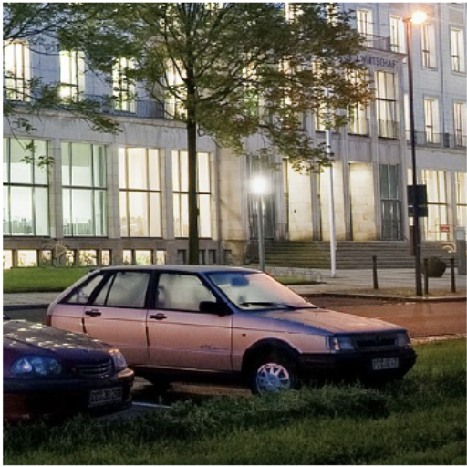
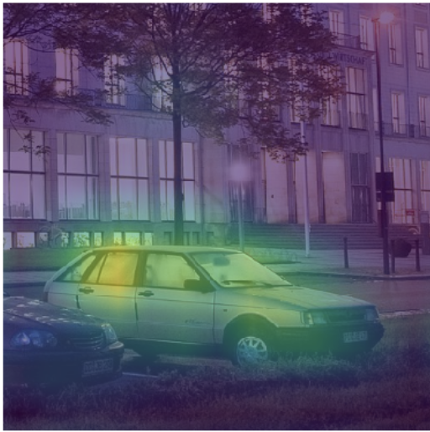
Interpretability of Deep-Learning algorithms
Visualization of intermediate results and their influence on results
Model-agnostic methods
Example: Shapley’s Additive exPlanations (SHAP)
Modell-specific Methods
Example : Gradient Class Activation Maps (Grad-CAM)
“beach wagon”
https://haesleinhuepf.github.io/xai/30_shap/pixel_classifier.html https://haesleinhuepf.github.io/xai/60_grad-cam/classification_resnet.html
Image source: Cropped from HTW Dresden (Fotograf: Peter Sebb) licensed CC BY-SA 3.0, https://commons.wikimedia.org/w/index.php?curid=15652763

Slide 27
Gradient Class-Activation Maps (Grad-CAM)
Works only with NN algorithms that first process input data with convolutional layers. (model-specific)
Independent of right half of the NN (model-agnostic)
Visualizes intermediate results to make decision-making in the AI system interpretable
Image-classification
conv.
…
conv.
Image-description
convolutional
convolutional
Image-segmentation
Image source: Cropped from HTW Dresden (Photographer: Peter Sebb) licensed CC BY-SA 3.0, https://commons.wikimedia.org/w/index.php?curid=15652763
https://www.youtube.com/watch?app=desktop&v=Y8mSngdQb9Q&t=559s

Slide 28
Gradient Class-Activation Maps (Grad-CAM)
Is applied to existing network ; no modification of the architecture necessary (post-hoc method).
Input image
Convolutional layers of a DNN such as ResNet
Output: a vector of probabilities.
conv.
0.7
Beach wagon
goldfish
palace
conv.
convolutional
0.1
convolutional
0.1
Image source: Cropped from HTW Dresden (Fotograf: Peter Sebb) licensed CC BY-SA 3.0, https://commons.wikimedia.org/w/index.php?curid=15652763

Slide 29
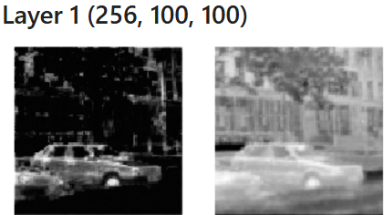
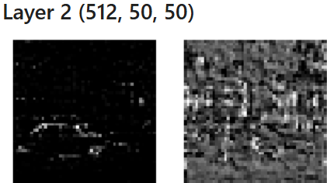
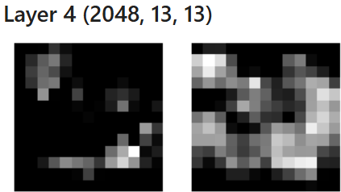
Gradient Class-Activation Maps (Grad-CAM)
Applied to existing network; no adaptation of the architecture necessary (post-hoc method).
“2028 feature images with each 13x13 pixels”
“embedding”
400x400
conv.
Beach wagon
goldfish
palace
conv.
convulutional
convulutional
Image source: Cropped from HTW Dresden (Fotograf: Peter Sebb) licensed CC BY-SA 3.0, https://commons.wikimedia.org/w/index.php?curid=15652763

Slide 30
Quiz
“aspect ratio” is what kind of feature?
Feature image
Image feature
Object feature
Feature
object

Slide 31
Gradient Class-Activation Maps (Grad-CAM)
Applied to existing network; no adaptation of the architecture necessary (post-hoc method).
None of these images directly says anything about image content. There is no feature image “Beach wagon”
400x400
conv.
Beach wagon
goldfish
palace
conv.
convolutional
convolutional
Grad-CAM happens here
Image source: Cropped from HTW Dresden (Fotograf: Peter Sebb) licensed CC BY-SA 3.0, https://commons.wikimedia.org/w/index.php?curid=15652763

Slide 32
Gradient Class-Activation Maps (Grad-CAM)
Back-propagation of a perfect classification (1,0,0) gives us gradients (weight changes) to improve the classification.
features
gradients
vector of probabilities
0.1
0.2
1
0.1
0
0.5
0
Back-propagation
These gradients tell us, how weights would need to be adjusted to produce the desired classification

Slide 33
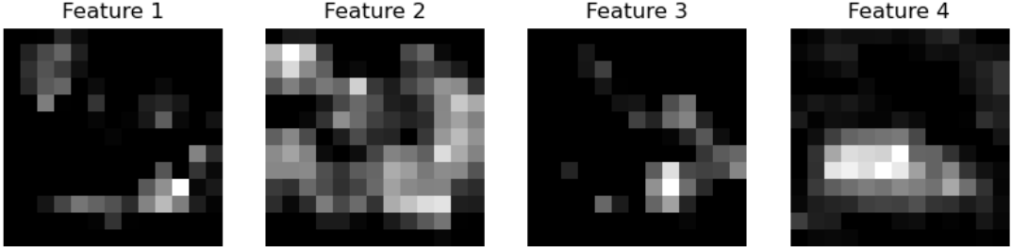
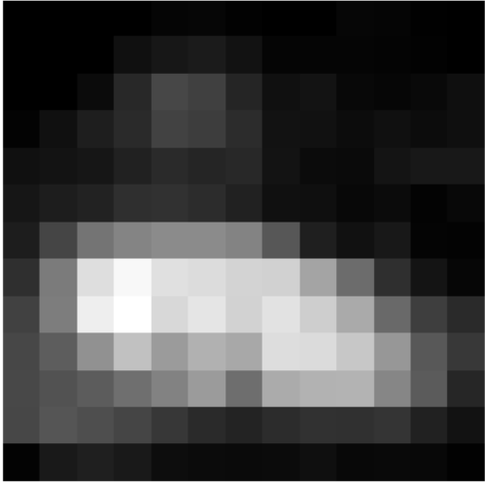
Gradient Class-Activation Maps (Grad-CAM)
Back-propagation of a perfect classification (1,0,0) gives us gradients (weight changes) to improve the classification.
From Inference
Features
Gradients
Vector of probabilities
0.1
0.2
1
0.1
0
0.5
From Backprop.
Feature map * Gradient
0
Maximum- projection
Image source: Cropped from HTW Dresden (Photographer: Peter Sebb) licensed CC BY-SA 3.0, https://commons.wikimedia.org/w/index.php?curid=15652763

Slide 34
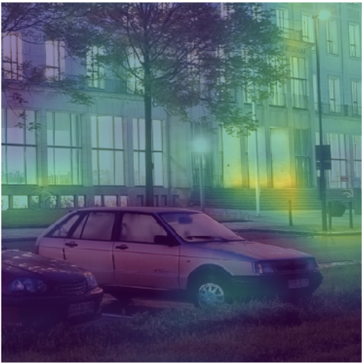
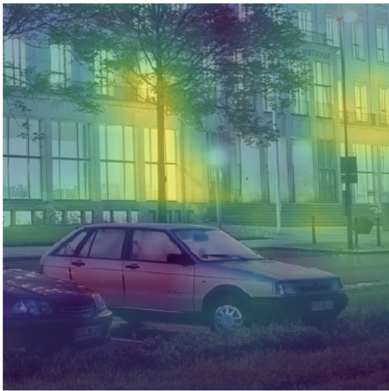
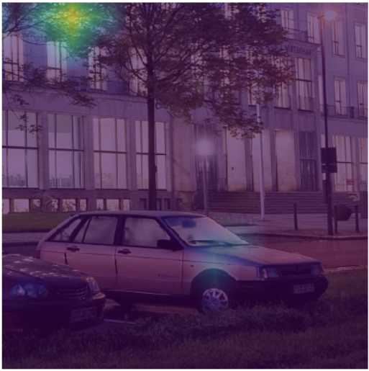
Gradient Class-Activation Maps (Grad-CAM)
Back-propagation of a perfect classification (1,0,0) gives us gradients (weight changes) to improve the classification.
This also works with other possible classifications, e.g. (0,1,0).
“beach waggon”
“palace”
“flagpole”
“great white shark”
Image source: Cropped from HTW Dresden (Fotograf: Peter Sebb) licensed CC BY-SA 3.0, https://commons.wikimedia.org/w/index.php?curid=15652763

Slide 35
CENTER FOR SCALABLE DATA ANALYTICS AND
ARTIFICIAL INTELLIGENCE
Deep Learning for Microscopy Image Processing
Robert Haase
Funded by
These slides and the related training materials can be reused under the terms of the CC-BY 4.0 license.

Slide 36
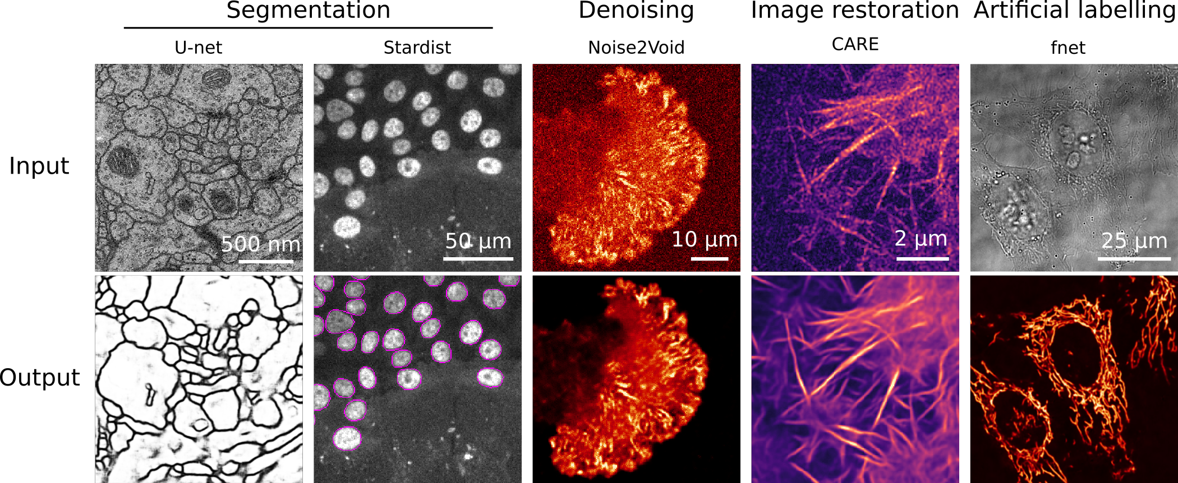
Deep Learning for Microscopy
MIT License
Copyright (c) 2020 Quantitative Imaging and Nanobiophysics Group
Permission is hereby granted, free of charge, to any person obtaining a copy
of this software and associated documentation files (the "Software"), to deal
in the Software without restriction, including without limitation the rights
to use, copy, modify, merge, publish, distribute, sublicense, and/or sell
copies of the Software, and to permit persons to whom the Software is
furnished to do so, subject to the following conditions:
The above copyright notice and this permission notice shall be included in all
copies or substantial portions of the Software.
THE SOFTWARE IS PROVIDED "AS IS", WITHOUT WARRANTY OF ANY KIND, EXPRESS OR
IMPLIED, INCLUDING BUT NOT LIMITED TO THE WARRANTIES OF MERCHANTABILITY,
FITNESS FOR A PARTICULAR PURPOSE AND NONINFRINGEMENT. IN NO EVENT SHALL THE
AUTHORS OR COPYRIGHT HOLDERS BE LIABLE FOR ANY CLAIM, DAMAGES OR OTHER
LIABILITY, WHETHER IN AN ACTION OF CONTRACT, TORT OR OTHERWISE, ARISING FROM,
OUT OF OR IN CONNECTION WITH THE SOFTWARE OR THE USE OR OTHER DEALINGS IN THE
SOFTWARE.
Source: Ricardo Henriques lab, https://github.com/HenriquesLab/ZeroCostDL4Mic/blob/master/Wiki_files/FigureS2.png license: MIT

Slide 37
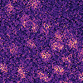
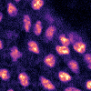
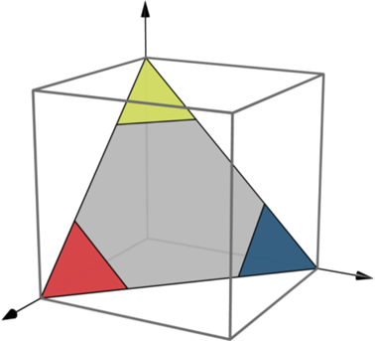
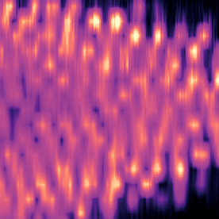
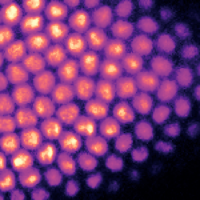
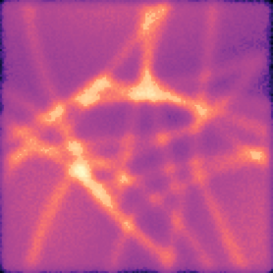
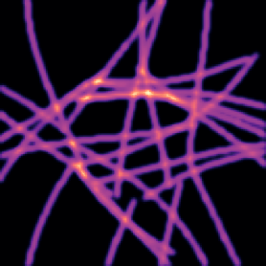
Trade-offs in live-cell imaging
Light exposure
Light Exposure
Speed
Speed
Spatial resolution
Spatial Resolution
Slide adapted from / courtesy of
Martin Weigert, TU Dresden

Slide 38
Traditional architecture: Encoder-Decoder Networks
„Auto-encoder“, „Variational Auto-Encoder“, „U-Net“
Encoder
Decoder
Skip-connections (optional)
Input
Output
Input:
noisy image
“Bottleneck”, “Embedding”,
“Latent space”
Input:
denoised image
Images demonstrating noise2void, cropped from https://github.com/HenriquesLab/ZeroCostDL4Mic/blob/master/Wiki_files/FigureS2.png license: MIT

Slide 39
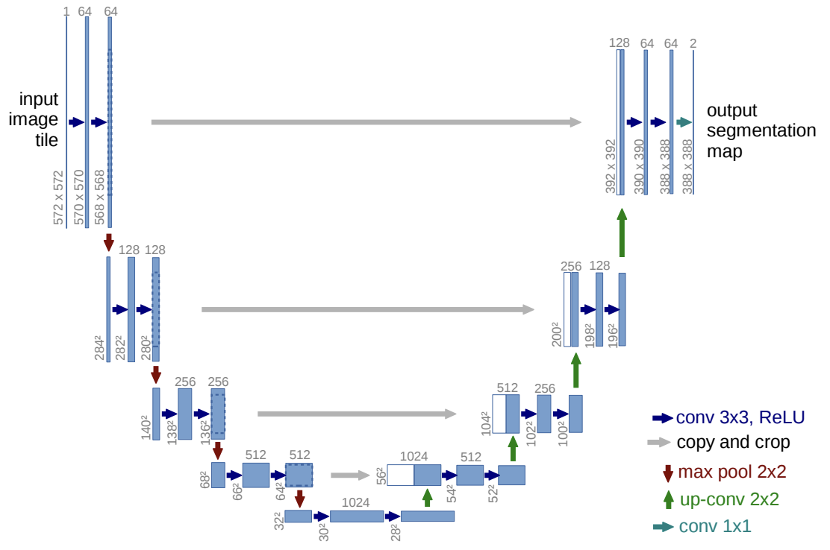
Traditional architecture: Encoder-Decoder Networks
U-Net
“Embedding”
Figure source: Ronneberger et al 2015
https://arxiv.org/pdf/1505.04597

Slide 40
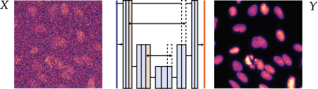
Image denoising: CARE
BSD 3-Clause License
Copyright (c) 2018-2024, Uwe Schmidt, Martin Weigert
All rights reserved.
Redistribution and use in source and binary forms, with or without
modification, are permitted provided that the following conditions are met:
* Redistributions of source code must retain the above copyright notice, this
list of conditions and the following disclaimer.
* Redistributions in binary form must reproduce the above copyright notice,
this list of conditions and the following disclaimer in the documentation
and/or other materials provided with the distribution.
* Neither the name of the copyright holder nor the names of its
contributors may be used to endorse or promote products derived from
this software without specific prior written permission.
THIS SOFTWARE IS PROVIDED BY THE COPYRIGHT HOLDERS AND CONTRIBUTORS "AS IS"
AND ANY EXPRESS OR IMPLIED WARRANTIES, INCLUDING, BUT NOT LIMITED TO, THE
IMPLIED WARRANTIES OF MERCHANTABILITY AND FITNESS FOR A PARTICULAR PURPOSE ARE
DISCLAIMED. IN NO EVENT SHALL THE COPYRIGHT HOLDER OR CONTRIBUTORS BE LIABLE
FOR ANY DIRECT, INDIRECT, INCIDENTAL, SPECIAL, EXEMPLARY, OR CONSEQUENTIAL
DAMAGES (INCLUDING, BUT NOT LIMITED TO, PROCUREMENT OF SUBSTITUTE GOODS OR
SERVICES; LOSS OF USE, DATA, OR PROFITS; OR BUSINESS INTERRUPTION) HOWEVER
CAUSED AND ON ANY THEORY OF LIABILITY, WHETHER IN CONTRACT, STRICT LIABILITY,
OR TORT (INCLUDING NEGLIGENCE OR OTHERWISE) ARISING IN ANY WAY OUT OF THE USE
OF THIS SOFTWARE, EVEN IF ADVISED OF THE POSSIBILITY OF SUCH DAMAGE.
Content aware image restoration (CARE)
Image acquisition of pairs of images: A high-quality and a low-quality image.
Problem: shot noise, biology moves!
Pair of images required!
Source: https://github.com/CSBDeep/CSBDeep/blob/main/examples/denoising2D/2_training.ipynb, License: BSD3

Slide 41
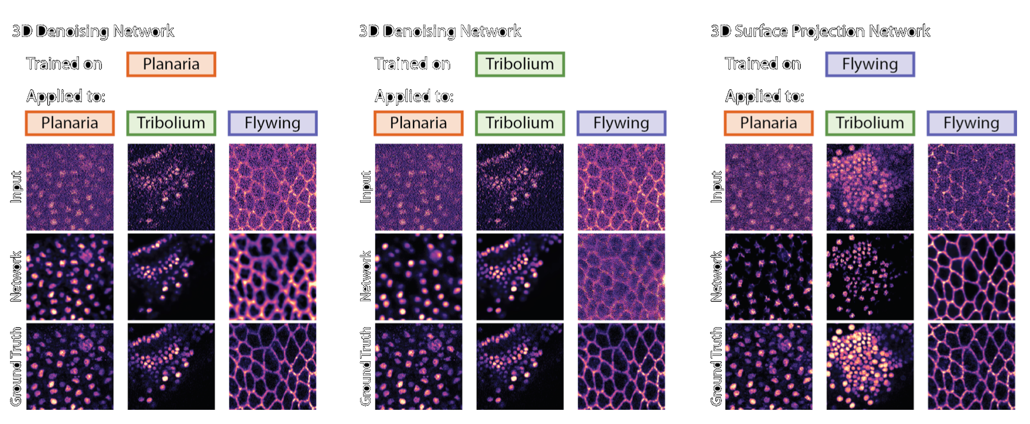
Image denoising: CARE
Important to use on the same conditions/structures/staining that the networks were trained on!
Trained on:
Applied to:
Trained on:
Applied to:
Input
Input
Prediction
Prediction
Ground truth
Ground truth
Slide adapted from: Martin Weigert, EPFL Lausanne

Slide 42
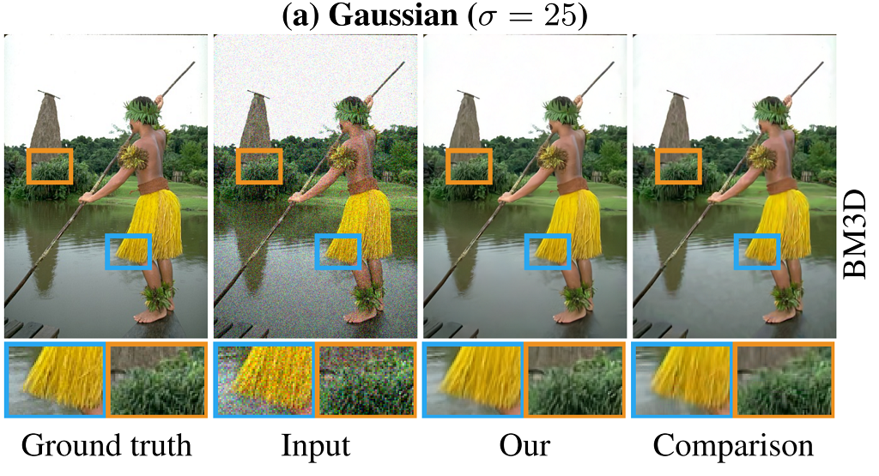
Noise2noise
Added noise with gaussian distriibution
noise2noise
BM3D
Source: Noise2Noise: Learning Image Restoration without Clean Data
Jaakko Lehtinen, Jacob Munkberg, Jon Hasselgren, Samuli Laine, Tero Karras, Miika Aittala, Timo Aila
https://arxiv.org/abs/1803.04189
https://github.com/NVlabs/noise2noise License: CC-BY-NC 4.0

Slide 43
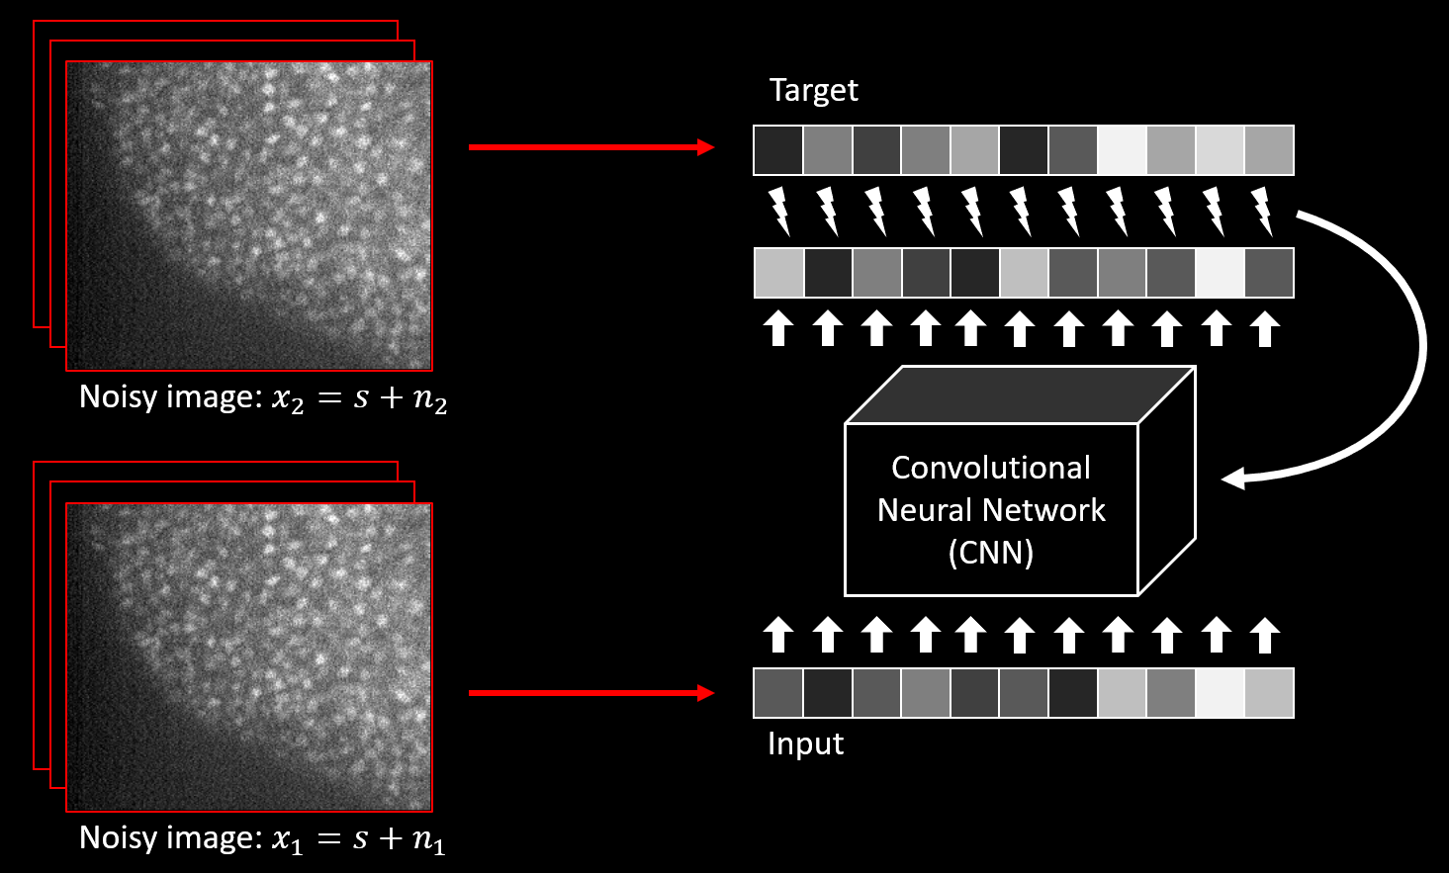
Noise2noise
by Nvidia (Lehtinen 2018) https://arxiv.org/pdf/1803.04189.pdf
Slide adapted from Alexander Krull (MPI CBG, now at U. Birmingham)

Slide 44
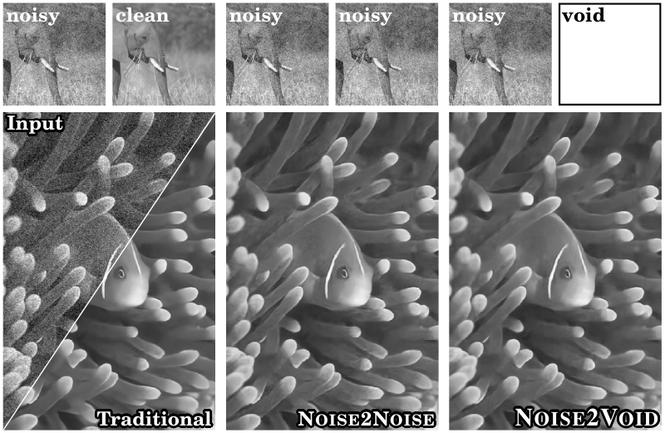
Noise2void
Image denoising without image pairs
Source: A.Krull et al.
https://arxiv.org/pdf/1811.10980

Slide 45
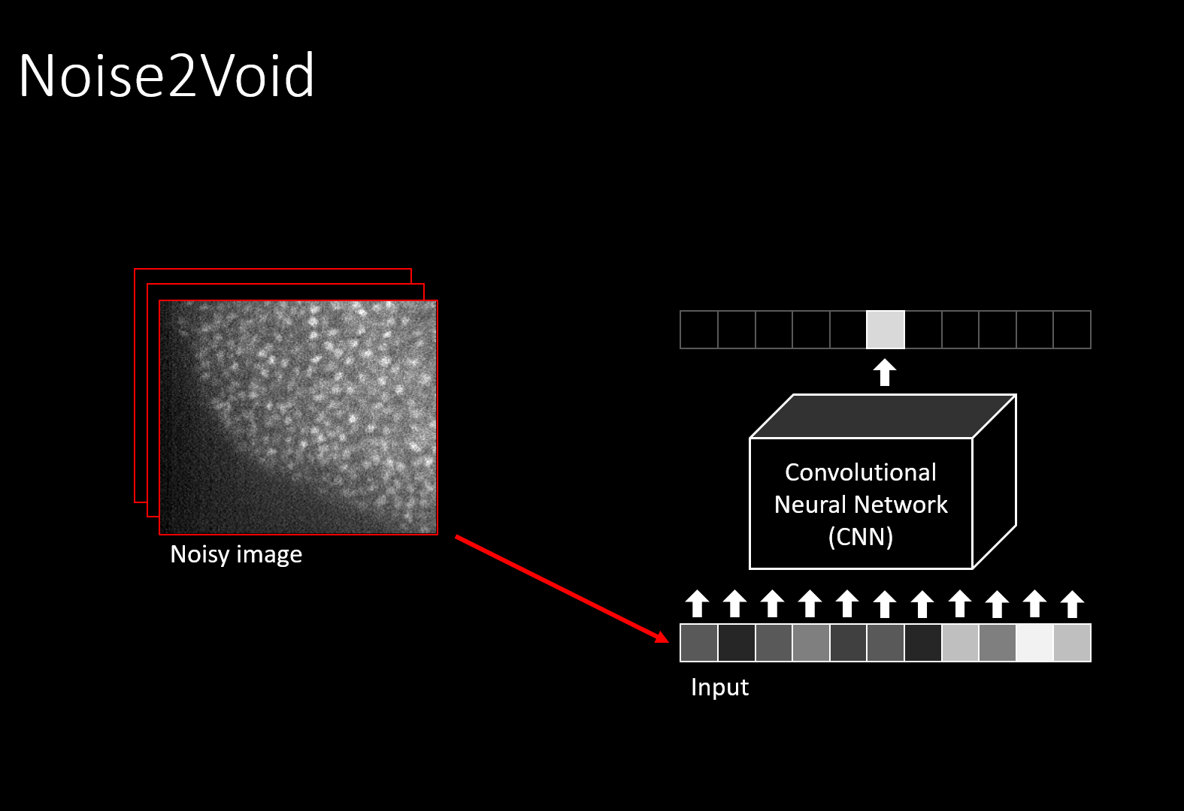
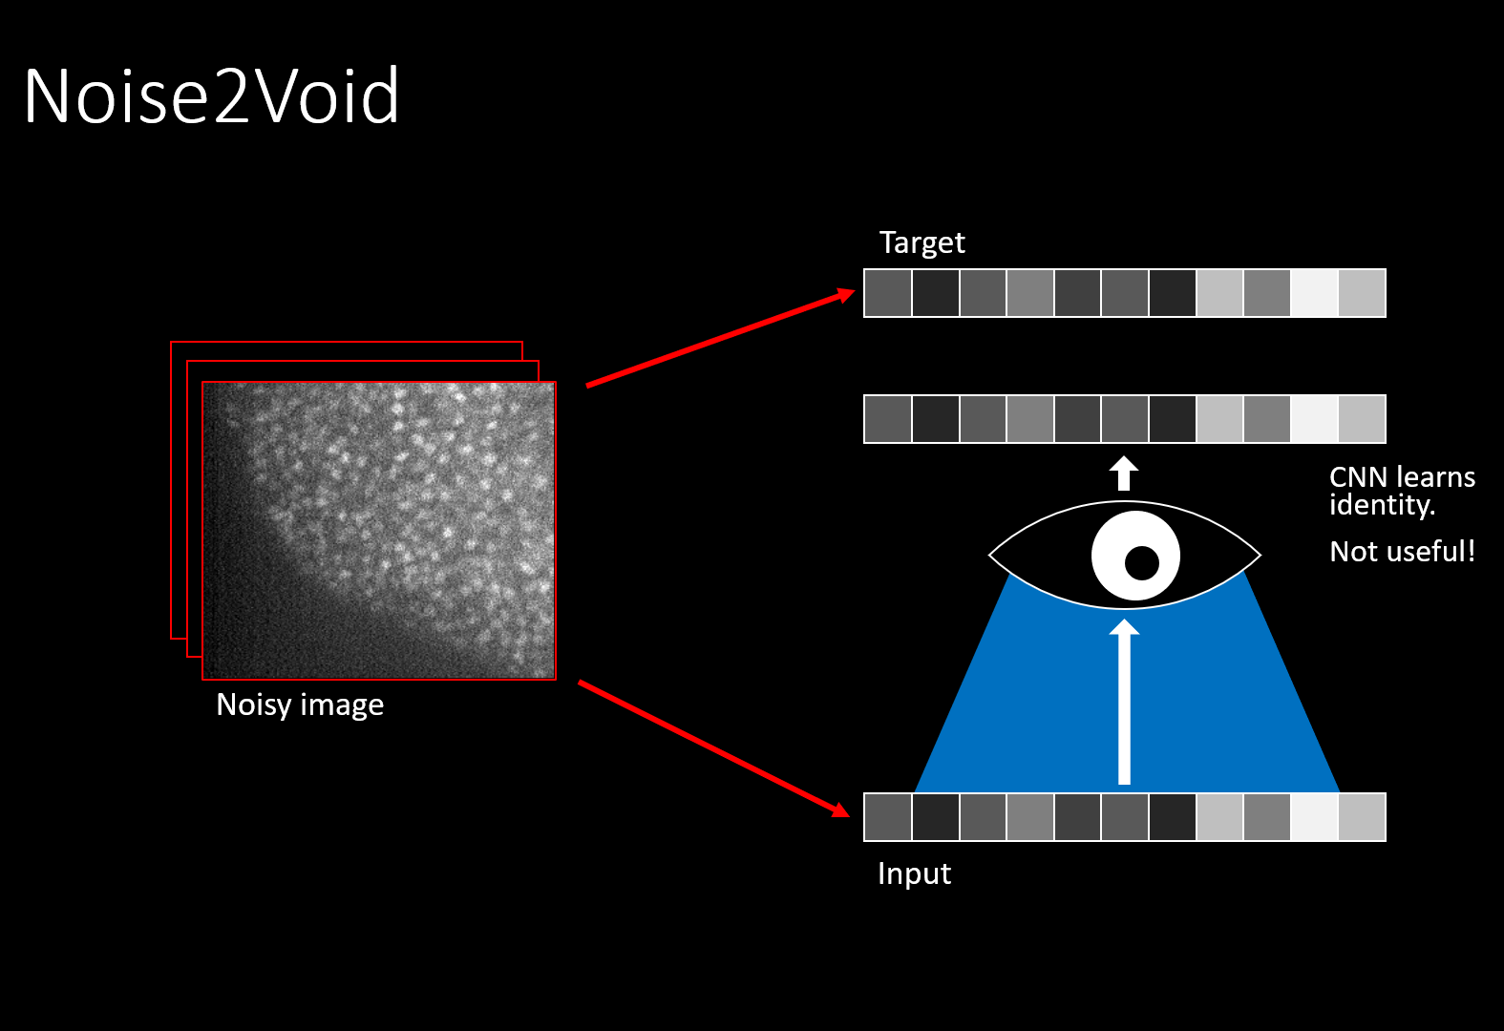
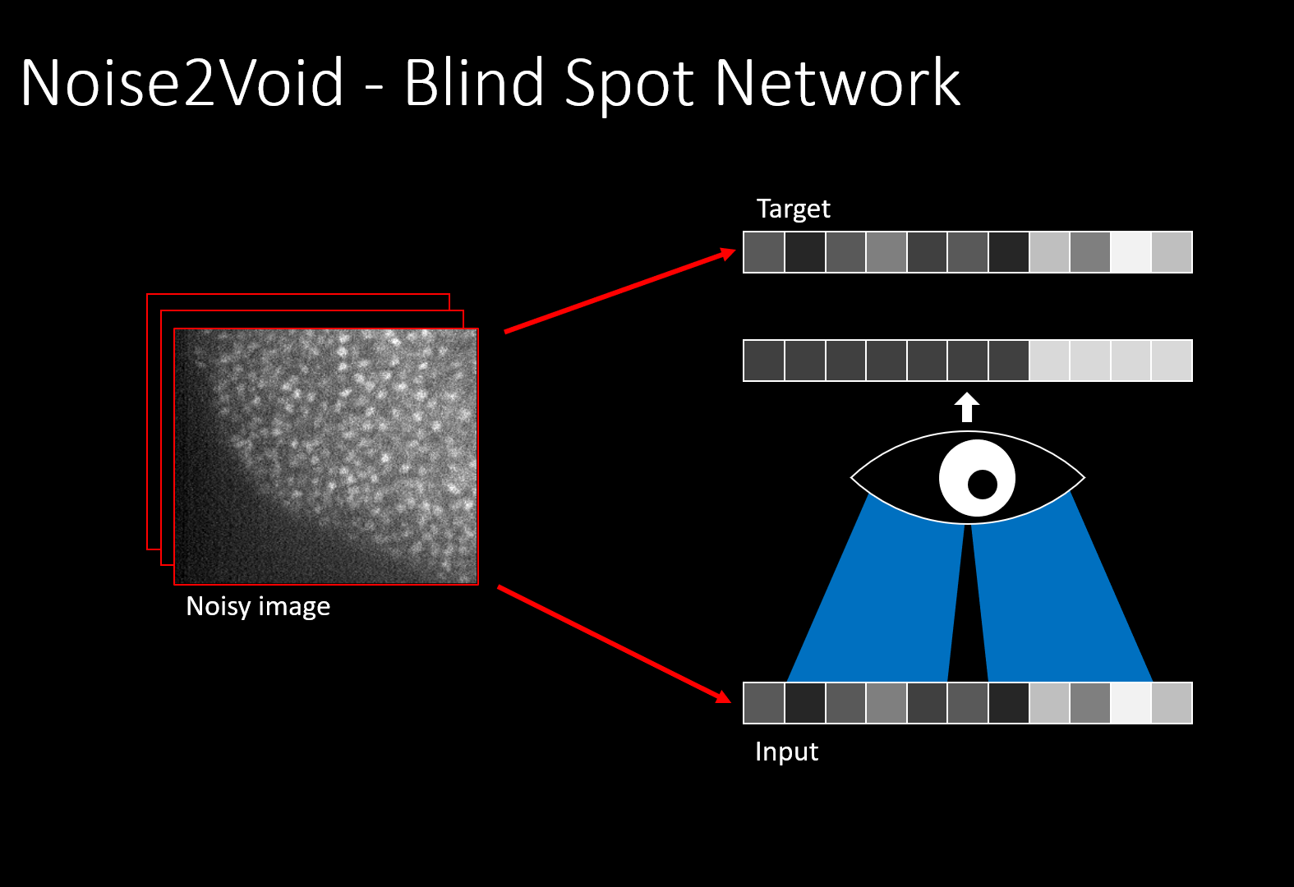
Noise2void
Noise2void: Krull et al (2019)
https://arxiv.org/abs/1811.10980
Noise2self: Batson and Royer (2019)
https://arxiv.org/abs/1901.11365
Slide adapted from Alexander Krull (MPI CBG, now at U. Birmingham)

Slide 46
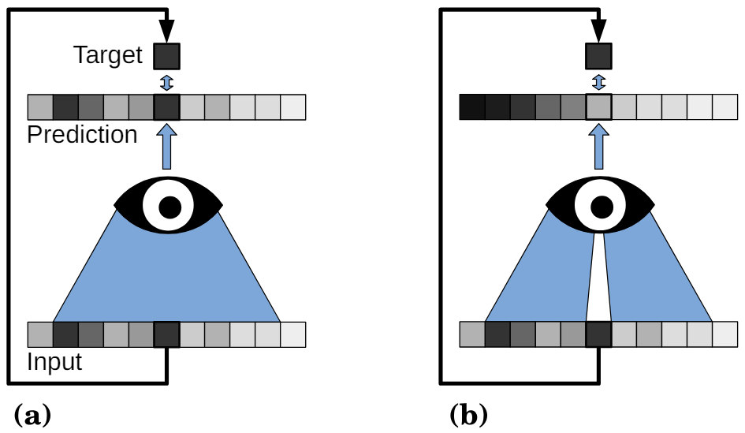
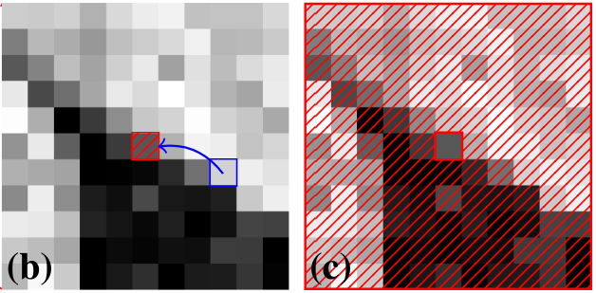
Noise2void
„Blind-spot-network“
Source: A.Krull et al.
https://arxiv.org/pdf/1811.10980

Slide 47
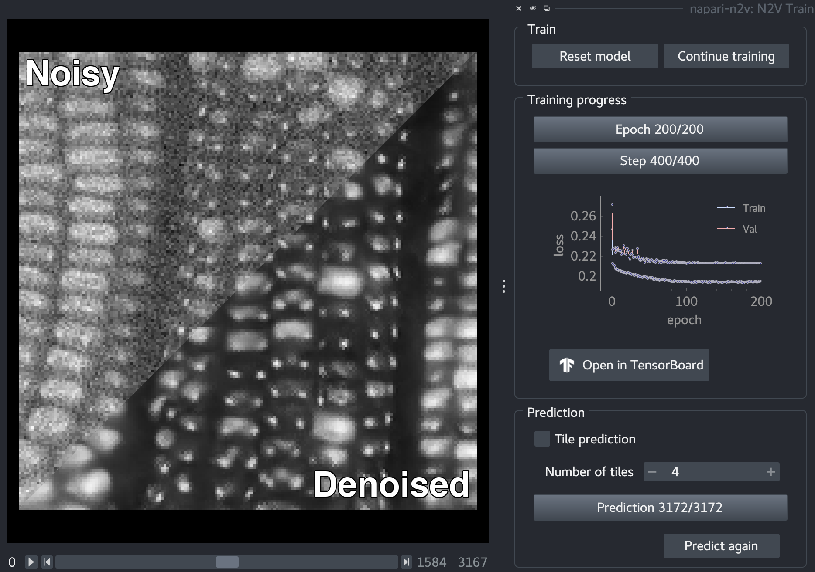
Noise2void
Napari-plugin
Copyright (c) 2022, Juglab
All rights reserved.
Redistribution and use in source and binary forms, with or without
modification, are permitted provided that the following conditions are met:
* Redistributions of source code must retain the above copyright notice, this
list of conditions and the following disclaimer.
* Redistributions in binary form must reproduce the above copyright notice,
this list of conditions and the following disclaimer in the documentation
and/or other materials provided with the distribution.
* Neither the name of napari-n2v nor the names of its
contributors may be used to endorse or promote products derived from
this software without specific prior written permission.
THIS SOFTWARE IS PROVIDED BY THE COPYRIGHT HOLDERS AND CONTRIBUTORS "AS IS"
AND ANY EXPRESS OR IMPLIED WARRANTIES, INCLUDING, BUT NOT LIMITED TO, THE
IMPLIED WARRANTIES OF MERCHANTABILITY AND FITNESS FOR A PARTICULAR PURPOSE ARE
DISCLAIMED. IN NO EVENT SHALL THE COPYRIGHT HOLDER OR CONTRIBUTORS BE LIABLE
FOR ANY DIRECT, INDIRECT, INCIDENTAL, SPECIAL, EXEMPLARY, OR CONSEQUENTIAL
DAMAGES (INCLUDING, BUT NOT LIMITED TO, PROCUREMENT OF SUBSTITUTE GOODS OR
SERVICES; LOSS OF USE, DATA, OR PROFITS; OR BUSINESS INTERRUPTION) HOWEVER
CAUSED AND ON ANY THEORY OF LIABILITY, WHETHER IN CONTRACT, STRICT LIABILITY,
OR TORT (INCLUDING NEGLIGENCE OR OTHERWISE) ARISING IN ANY WAY OUT OF THE USE
OF THIS SOFTWARE, EVEN IF ADVISED OF THE POSSIBILITY OF SUCH DAMAGE.
Source: https://github.com/juglab/napari-n2v
License: BSD-3

Slide 48
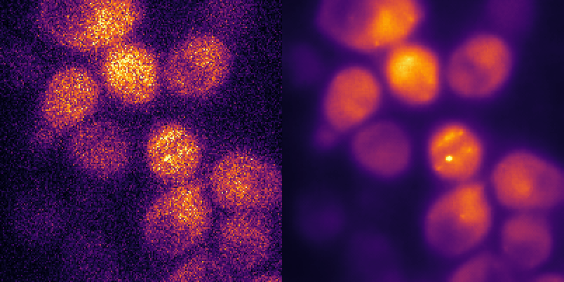
Image denoising
Noise2Void
Data by Stephanie Heinrich
Slide adapted from: Alexander Krull, MPI CBG

Slide 49
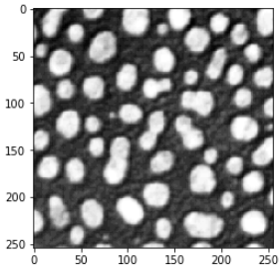
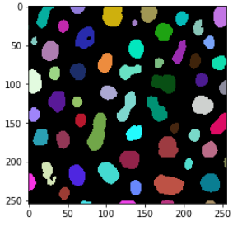
DL-based image segmentation
Quiz: Is it possible to train a neural network that performs this operation directly? Why yes? Why no?
?
Intensity image
Label image

Slide 50
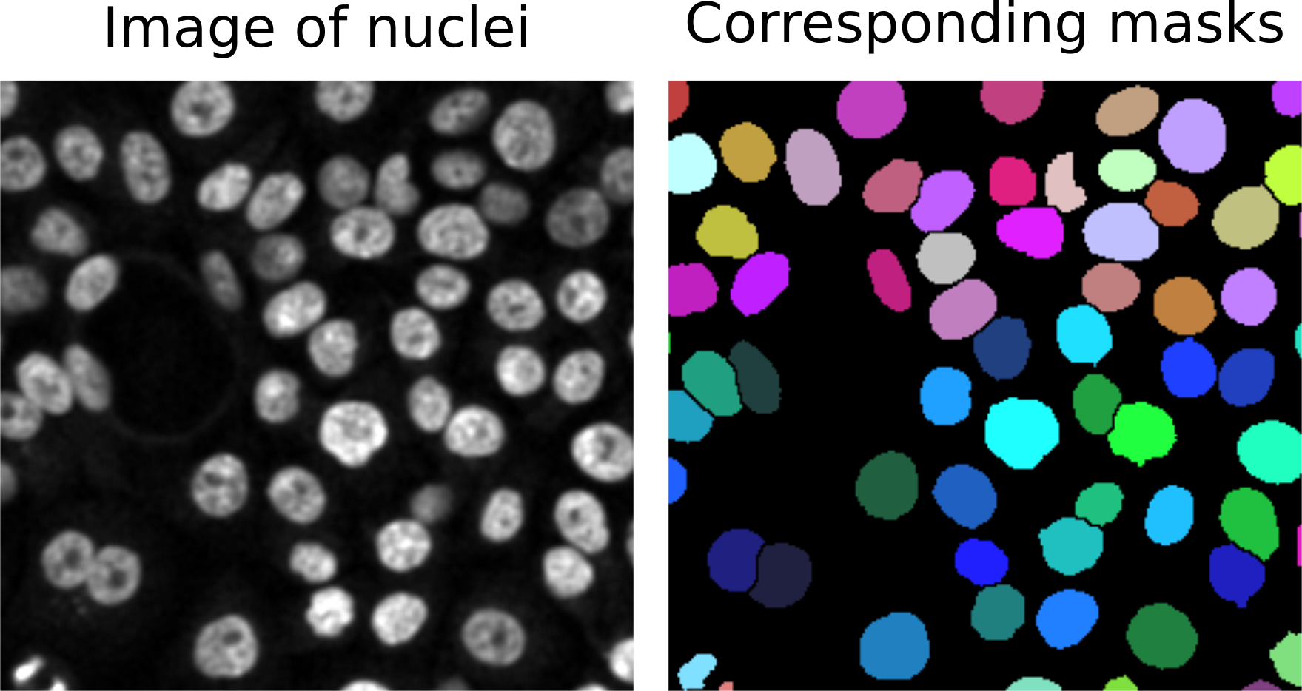
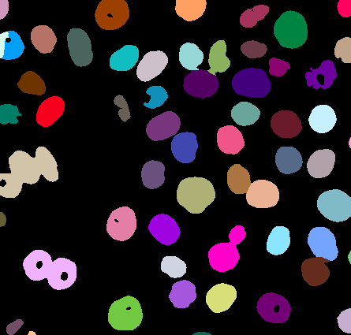
StarDist: Nuclei segmentation
Advanced algorithms are necessary when nuclei become too dense.
Input image
Voronoi-Otsu-Labeling
StarDist (DL-based)
Source: Cropped from Ricardo Henriques lab, https://github.com/HenriquesLab/ZeroCostDL4Mic/blob/master/Wiki_files/Stardist_nuclei_masks.png license: MIT

Slide 51
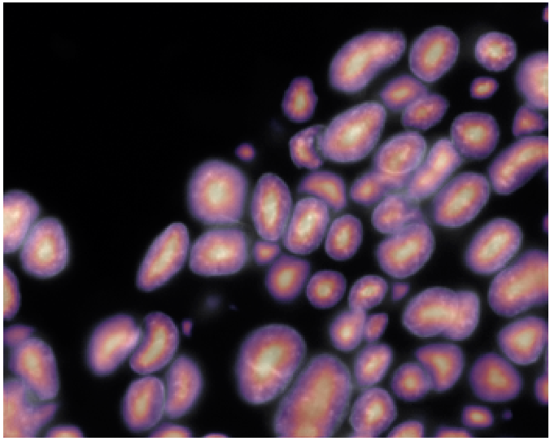





StarDist
Class. Image proc.
Deep learning
Prediction of probable object centers + polygon outlines
Non-maximum-suppression of less likely polygons
Object probabilities
Input
Ground truth
Directional distance maps (32x)
Slide adapted from: Martin Weigert, EPFL Lausanne and from https://github.com/stardist/stardist (license: BSD3)

Slide 52
StarDist
Prediction of probable object centers + polygon outlines
Non-maximum-suppression of less likely polygons
Final segmentation: polygons
Object probabilities
Local maxima
Polygon candidates
Directional distance maps
Label image
Slide adapted from: Martin Weigert, EPFL Lausanne and from https://github.com/stardist/stardist (license: BSD3)

Slide 53
StarDist: Limitations
Star-convex shapes!
Good for nuclei, bad for cells.

Slide 54
Quiz
Which shape features may be compromised
if we use StarDist for segmentation? Why?

Slide 55



StarDist: Python
Initialize model / download pretrained model
Apply model
Normalize intensity to range [0, 1]
Quiz: Many DL-based segmentation algorithms perform a normalization before processing the image. Why?

Slide 56


StarDist: Business model
Serving clinical sicentists using software based on open-source code
https://katana-labs.com/paikon-diagnostics/

Slide 57

CellPose
Processing more diverse datasets and object shapes
Source: Cropped from Stringer et al (2020) licensed CC-BY-NC 4.0 https://www.biorxiv.org/content/10.1101/2020.02.02.931238v2.full

Slide 58

CellPose: Training
Compute „flow fields“ from images
using classical image processing during training
using neural networks during prediction
Classical Image processing
Source: Cropped from Stringer et al (2020) licensed CC-BY-NC 4.0 https://www.biorxiv.org/content/10.1101/2020.02.02.931238v2.full

Slide 59

CellPose: Prediction
Deep learning
Class. Image proc.
Cell/Nuclei –segmentation based on flow-fields
Technically similar to Watershed, but with a deep-learning based “flow field” image
Image source: Modified from Stringer et al (2020) licensed CC-BY-NC 4.0
https://www.biorxiv.org/content/10.1101/2020.02.02.931238v2.full

Slide 60

CellPose
Image style is a parameter determined before prediction to guide segmentation.
Source: Modified from Stringer et al (2020) licensed CC-BY-NC 4.0
https://www.biorxiv.org/content/10.1101/2020.02.02.931238v2.full

Slide 61

Cellpose 3D
Source: Modified from Stringer et al (2020) licensed CC-BY-NC 4.0
https://www.biorxiv.org/content/10.1101/2020.02.02.931238v2.full

Slide 62

Cellpose in Python
Initialize a pretrained model
List available models

Slide 63


Cellpose in Python

Slide 64

Cellpose 2
Train your own model
https://www.nature.com/articles/s41592-022-01663-4

Slide 65

Cellpose 3
Cellpose 3 includes denoising and deblurring, to improve image segmenation quality
Source: Modified from Stringer & Pachitariu (2024) licensed CC-BY-NC 4.0
https://www.biorxiv.org/content/10.1101/2024.02.10.579780v2.article-info

Slide 66

A short excursion…
Published 1 year ago:
“The T1 algorithms achieved a median F1 score of 89.7% (IQR 36.7–82.4%), surpassing the KIT-GE, Cellpose-pretrain, Cellpose-scratch, Omnipose-pretrain and Omnipose-scratch by 49.9%, 24.4%, 35.4%, 58.9% and 48.7%, respectively.”
Claim to outperform current state of the art.
Ma, J., Xie, R., Ayyadhury, S. et al. The multimodality cell segmentation challenge: toward universal solutions. Nat Methods (2024). https://doi.org/10.1038/s41592-024-02233-6

Slide 67

A short excursion…
“However my initial testing of the winning entry mediar 8 reveals errors (which are typical without tuning) when applied to recent data posted here 6 for which cellpose produced a (subjectively) good result.”
Brian Northan et al.
https://forum.image.sc/t/thoughts-on-the-latest-sota-segmentation-algorithms/94106

Slide 68

A short excursion…
Published 11 days later:
(by the CellPose authors)
“Impairment One. Cellpose was trained and tested on grayscale images while the other methods were trained on the full multi-channel data…”
Stringer & Pachitariu, bioRxiv, 2024
https://www.biorxiv.org/content/10.1101/2024.04.06.587952v1

Slide 69
A short excursion…
Published 11 days later:
(by the CellPose authors)
“Impairment Two. Cellpose was trained with images rescaled so that cells have an average diameter of 30 pixels (which is the default), but tested with unresized images in which cells have diameters up to 400 pixels.”
Stringer & Pachitariu, bioRxiv, 2024
https://www.biorxiv.org/content/10.1101/2024.04.06.587952v1

Slide 70
A short excursion…
Published 11 days later:
(by the CellPose authors)
“Impairment Three. The training set for Cellpose included only the challenge images, while the top performing methods used additional datasets.”
Stringer & Pachitariu, bioRxiv, 2024
https://www.biorxiv.org/content/10.1101/2024.04.06.587952v1

Slide 71
A short excursion…
Published 11 days later:
(by the CellPose authors)
“Impairment Four. Cellpose was run without testtime augmentations (TTA). The Cellpose framework makes it easy to augment images at test time and we described this in the original study [3].”
Stringer & Pachitariu, bioRxiv, 2024
https://www.biorxiv.org/content/10.1101/2024.04.06.587952v1

Slide 72
A short excursion…
Published 11 days later:
(by the CellPose authors)
“In fact, Mediar directly copied our codebase for implementing the Cellpose framework without modification[…] Ma et al [1] does not dwell on this similarity between Mediar and Cellpose. Instead, they emphasize the novelty of using a transformer architecture”
Stringer & Pachitariu, bioRxiv, 2024
https://www.biorxiv.org/content/10.1101/2024.04.06.587952v1

Slide 73

A short excursion…
Professional discussion about Copyright:
https://github.com/Lee-Gihun/MEDIAR/issues/17

Slide 74

Segment Anything Model
New approach to DL-based image segmentation involving prompts
Source: https://github.com/facebookresearch/segment-anything License: Apache 2

Slide 75

Segment Anything Model
New approach to DL-based image segmentation involving prompts
Source: https://github.com/facebookresearch/segment-anything License: Apache 2

Slide 76

Segment Anything Model
New approach to DL-based image segmentation involving prompts
Source: https://arxiv.org/pdf/2304.02643

Slide 77


Segment Anything Model
Trained on mostly natural images
Source: https://arxiv.org/pdf/2304.02643 https://bbbc.broadinstitute.org/BBBC038

Slide 78
Segment Anything Model
Downsides:
Original code did not contain the procedure for iterative training
Instance segmentation not ideal (watershed-based implementation added in micro-sam)
Fine-tuning for microscopy data seems necessary

Slide 79




Segment Anything Model for Microscopy
Popping up napari plugins, some within 24h after SAM was published
https://github.com/hiroalchem/napari-SAM4IS https://github.com/royerlab/napari-segment-anything https://github.com/MIC-DKFZ/napari-sam https://github.com/computational-cell-analytics/micro-sam

Slide 80

Segment Anything Model for Microscopy
Micro-sam
Source: Archit et al (2023) licensed CC-BY 4.0
https://www.biorxiv.org/content/10.1101/2023.08.21.554208v1.article-info
https://github.com/computational-cell-analytics/micro-sam

Slide 81
Segment Anything Model for Microscopy
Real-world scenario: human-in-the-loop
Pretrained Microscopy SAM
„Personalized“ Microscopy SAM
Retraining / fine-tuning
Yes
Result good?
Big data?
New microscopy data
Automatic Segmentation
No
Interactive correction
Yes
No
Done! 🎉
Figures modified from slides by C. Pape, licensed CC-BY 4.0
https://zenodo.org/records/11265038

Slide 82

Segment Anything Model for Microscopy
Source: Archit et al (2023) licensed CC-BY 4.0
https://www.biorxiv.org/content/10.1101/2023.08.21.554208v1.article-info

Slide 83




Segment Anything Model for Microscopy
In Python
https://github.com/ScaDS/BIDS-lecture-2025/blob/main/07b_dl_segmentation/micro-sam.ipynb
https://computational-cell-analytics.github.io/micro-sam/micro_sam.html#choosing-a-model

Slide 84



CellPose-SAM
Recent combination of CellPose + Segment Anyting Model (May 1st 2025)
Source: Modified from Pachitariu et al. (2025), licensed CC-BY-NC 4.0
https://www.biorxiv.org/content/10.1101/2025.04.28.651001v1

Slide 85


CellPose-SAM: Model fine-tuning
Model fine-tuning to make it a microscopy-specific image processing model
Based on publicly available benchmark data (Grand Challenges etc.)

Slide 86









CellPose SAM in Python
“Foundation model”

Slide 87
Quiz: What could we do to deal with such artifacts at the image border?

Slide 88
Summary: Deep Learning for Bio-image Analysis
[Convolutional] Neural Networks is a decade old technology that enabled breakthroughs recently.
  Image Denoising
  Image Segmentation
Common scheme: Smart algorithms for processing input/output of neural networks + standard NN architectures
  Image in, instance segmentation out
Training these models is
  computationally expensive,
  needs large amounts of training data images / full annotations
  (single images, sparse annotations),
  requires a certain level of [python] expertise
If Voronoi-Otsu-Labeling does the job, don’t dive into deep learning!

Slide 89
CENTER FOR SCALABLE DATA ANALYTICS AND
ARTIFICIAL INTELLIGENCE
Exercises
Robert Haase
Funded by
These slides and the related training materials can be reused under the terms of the CC-BY 4.0 license.

Slide 90



Exercises
Make noise2void, stardist, cellpose, micro-sam and cellpose-sam work.
Hint: This may screw up
your conda environment.
In case of weird errors:
Don‘t panic
Recreate you environment
Install the thing you want to use,
preferably using conda.
Creating conda environments is not a big deal, just like grabbing a spoon before eating soup.

