Slide 1
Microscopy Image Processing
Robert Haase
Reusing materials from Mauricio Rocha Martins (Norden lab, MPI CBG); Dominic Waithe (Oxford University); Alex Bird, Dan White (MPI CBG), Marcelo Leomil Zoccoler, TU Dresden

Slide 2




Recap quiz
We write good documentation to enable others to re-do our experiment. This is good for …
Repeatability
Reproducibility
Replicability
Reliability

Slide 3
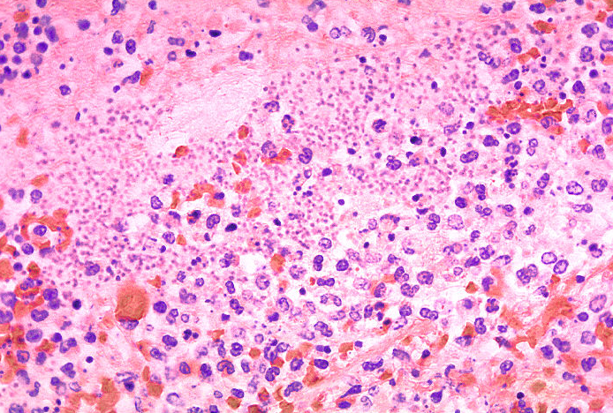
Recap quiz
This image is from a …
Transmitted light microscope
Fluorescence microscope
Electron microscope

Slide 4
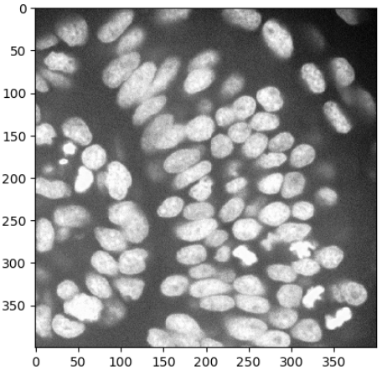
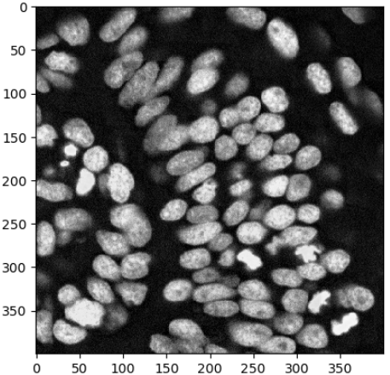
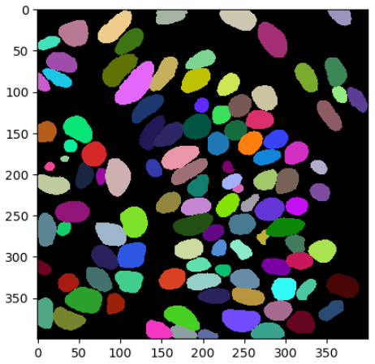
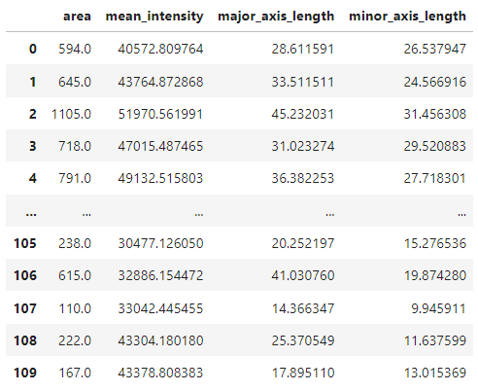
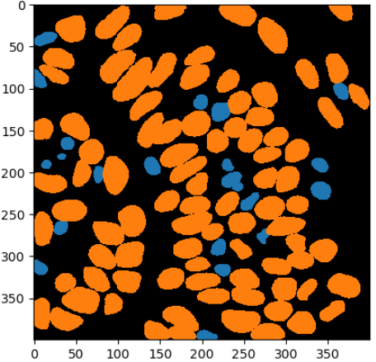
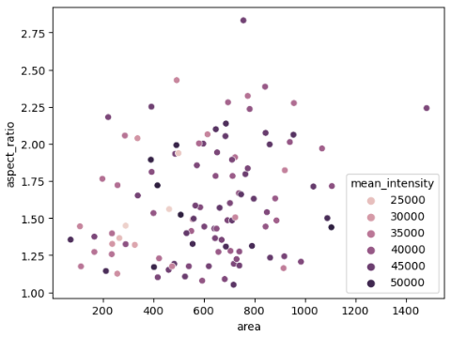
Lecture overview: Bio-image Analysis
Image Data Analysis workflows
Goal: Quantify observations, substantiate conclusions with numbers
Plotting
Visualization
Image filtering
Image segmentation
Feature extraction
Object classification
Image filtering

Slide 5
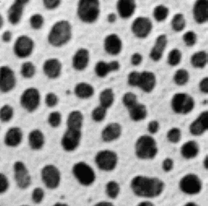

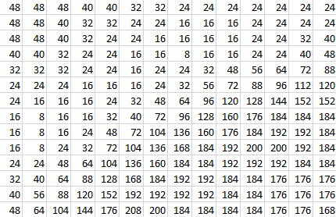
Images and pixels
An image is just a matrix of numbers: pixels: “picture element”
The edges between pixels are an artefact of the imaging / digitization. They are not real!
0
255

Slide 6
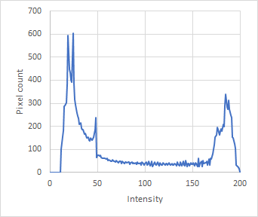
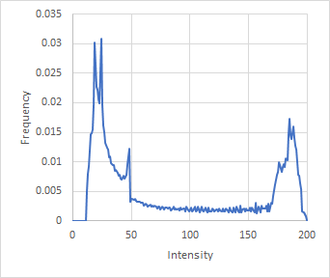
Histograms
A histogram shows the probability distribution of pixel intensities.
The probability of a pixel having a certain intensity can be measured by counting pixels and calculating the frequency of the given intensity.
Whenever you see a histogram, try to imagine the lookup-table on the X-axis

Slide 7
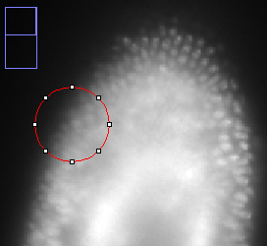
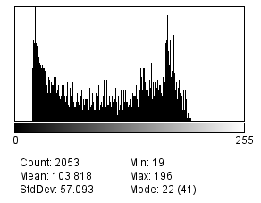
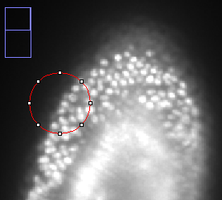
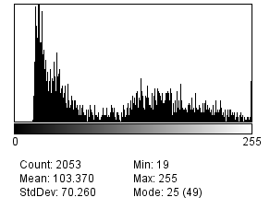
Histograms
Histograms are summaries of images
Tell stories, e.g. about image quality

Slide 8
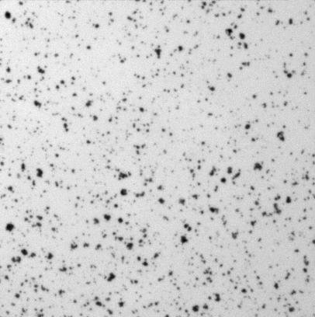

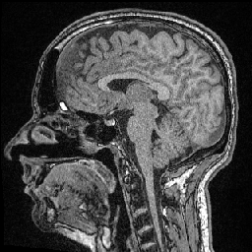
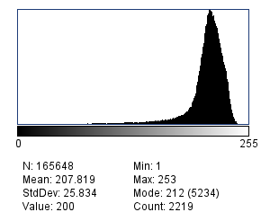
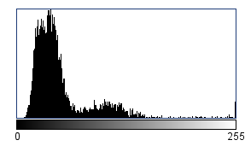
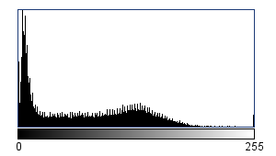
Histograms
To which image does this histogram belong to?

Slide 9
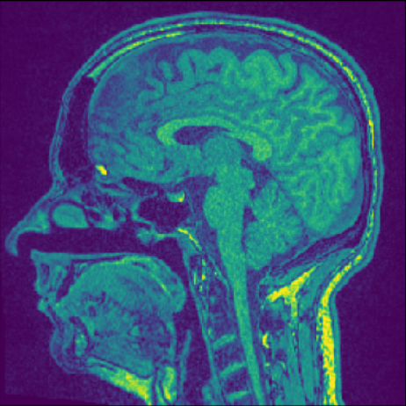
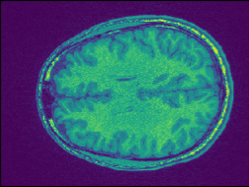
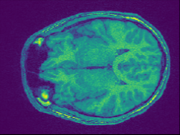
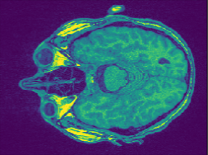
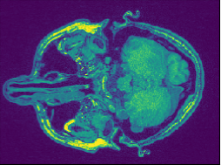




Image stacks and voxels
3-dimensional images consisting of voxels
“Image stack”
Often anisotropic (not equally large in all directions)
$$l_{z}$$
$$l_{y}$$
$$l_{x}$$
$$l_{x}=l_{y}≠l_{z}$$

Slide 10
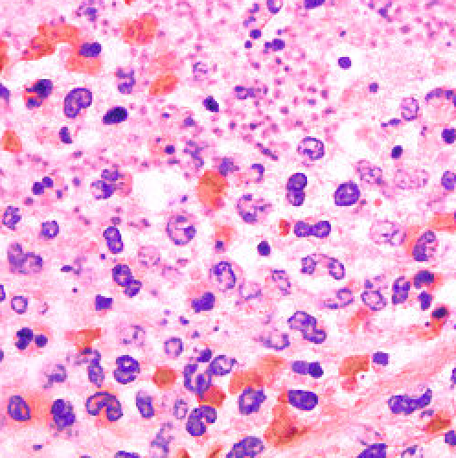
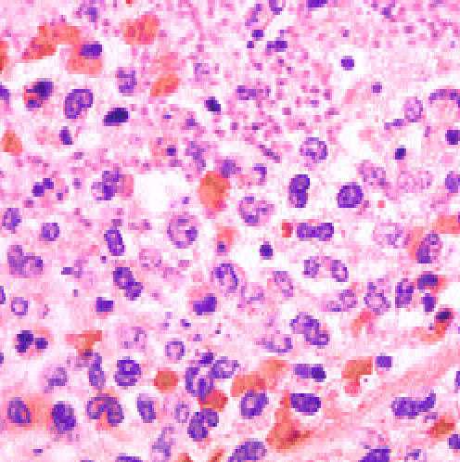
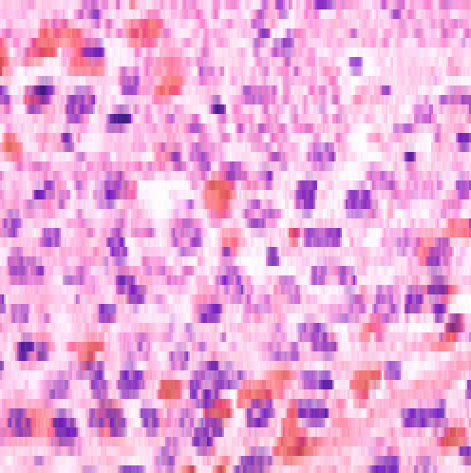
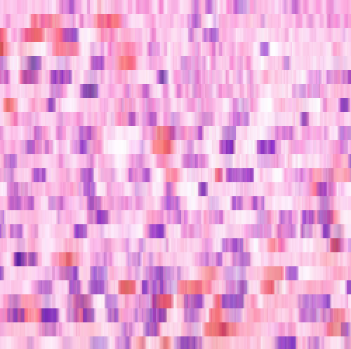
Anisotropy
Voxel size has immediate impact on image quality and thus, on processing / analysis results.
1:1
250 x 250
1:2
250 x 125
1:5
250 x 50
1:10
250 x 25
Image source: cropped from
https://de.m.wikipedia.org/wiki/Datei:Histo_Lungenpest.jpg

Slide 11
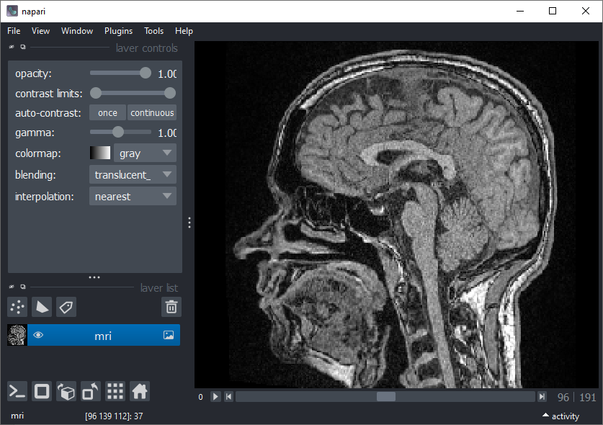

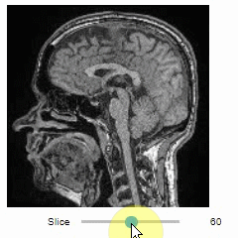
3D Image visualization
Interactive tools available
https://napari.org/
https://github.com/haesleinhuepf/stackview

Slide 12
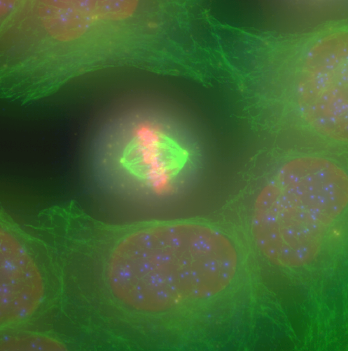
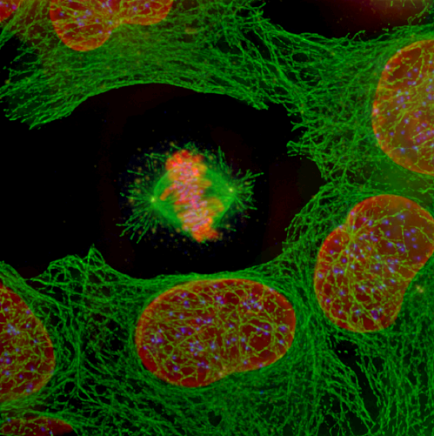
Filters
An image processing filter is an operation on an image.
It consumes an image and produces a new image out of it.
There is no “best” filter. Which filter fits your needs, depends on the context.
Filters do not do magic. They can not make things visible which are not in the image.
Application examples
Noise-reduction
Artefact-removal
Contrast enhancement
Correct uneven illumination
Filter
Image source: Alex Bird / Dan White MPI CBG

Slide 13
Quiz
What is noise?

Slide 14
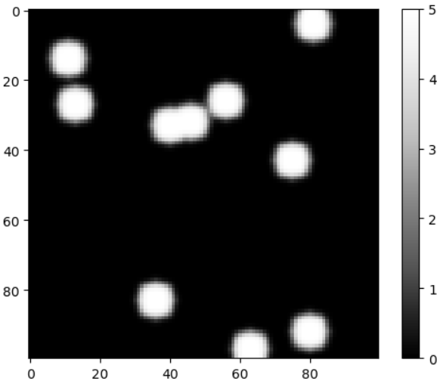
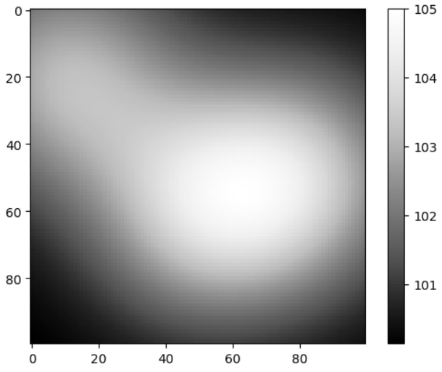
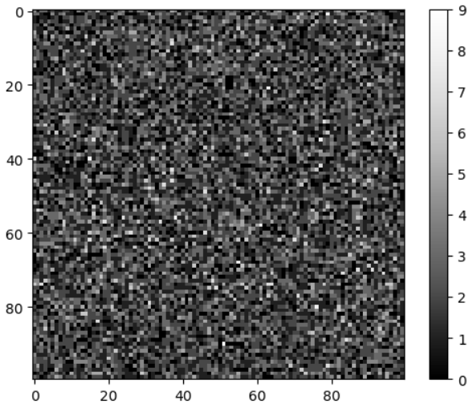
Effects harming image quality
“nuclei”
“background”
“noise”
Aberrations, defocus
Motion blur
Light from objects behind and in front of the scene (out-of-focus light)
Dirt on the object slide
Camera offset
Shot noise (arriving photons in the camera from the scene)
Dark noise (electrons made from photons)
Read-out-noise (electronics)
https://github.com/BiAPoL/Bio-image_Analysis_with_Python/blob/49a787514a367829c3e0e1832f6cc533e96d549f/03_image_processing/simulated_dataset.ipynb

Slide 15
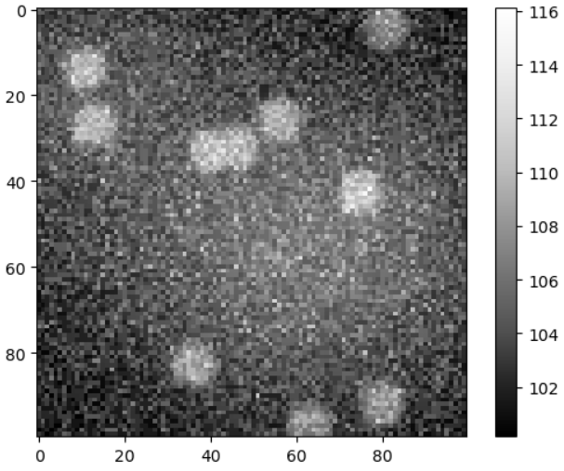
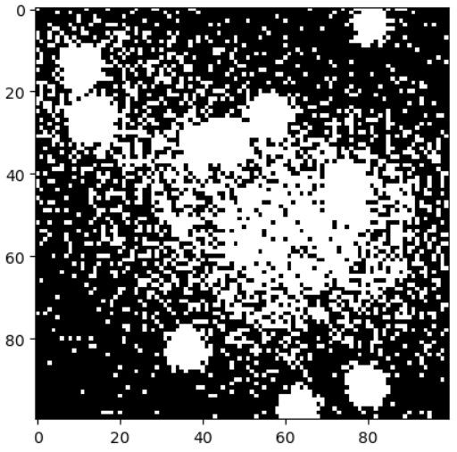
Effects harming image quality
“nuclei”
“background”
“noise”
Segmentation
https://github.com/BiAPoL/Bio-image_Analysis_with_Python/blob/49a787514a367829c3e0e1832f6cc533e96d549f/03_image_processing/simulated_dataset.ipynb

Slide 16


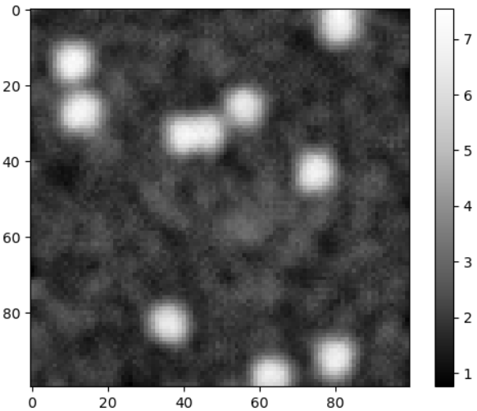
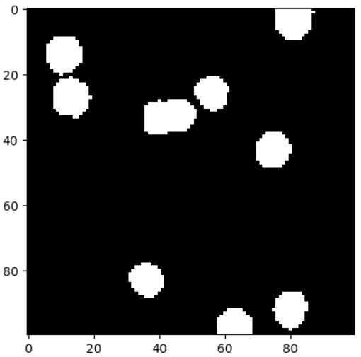
Image filtering
We need to remove the noise to help the computer interpreting the image
Oh no! I see thousands of tiny white objects!
Segmentation
Filtering
Ok, it’s just 9 objects.
Segmentation

Slide 17

Image filtering
Attempt to invert / “undo” processes disturbing image quality
?

Slide 18
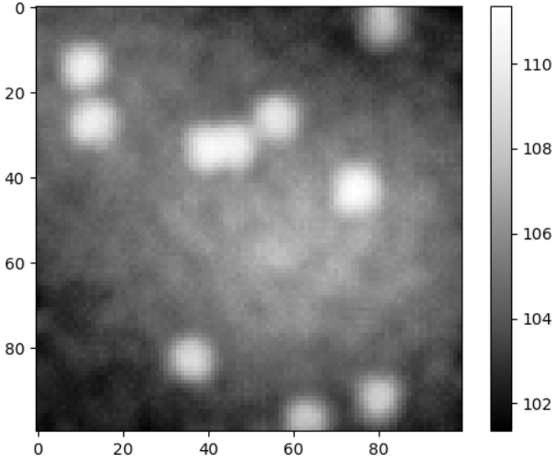
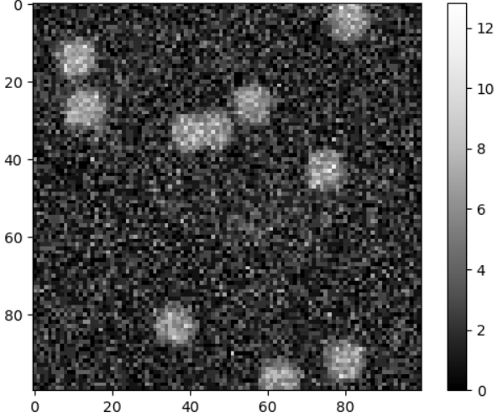
Image filtering
Attempt to invert / “undo” processes disturbing image quality
Low-pass filter: Allows low frequencies to pass
Denoise
͌
Denoise
Remove background
Band-pass filter: Allows a specific range of frequencies to pass
High-pass filter: Allows high frequencies to pass
https://github.com/BiAPoL/Bio-image_Analysis_with_Python/blob/49a787514a367829c3e0e1832f6cc533e96d549f/03_image_processing/simulated_dataset.ipynb

Slide 19
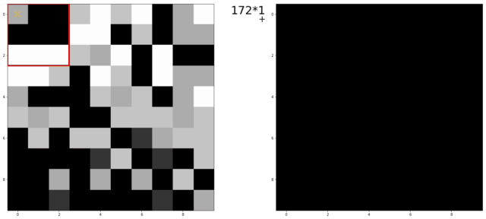
Linear filters
Linear filters compute each pixel value with a weighted linear combination of surrounding pixels
Filter kernels are matrices describing a linear filter
This multiplication of surrounding pixels according to a matrix is called convolution
1/9 | 1/9 | 1/9
1/9 | 1/9 | 1/9
1/9 | 1/9 | 1/9
Mean filter, 3x3 kernel:
Animation source: Dominic Waithe, Oxford University
https://github.com/dwaithe/generalMacros/tree/master/convolution_ani

Slide 20
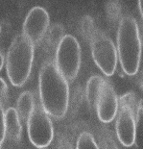
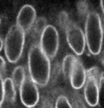
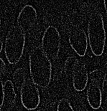
Linear filters
Terminology:
“We convolve an image with a kernel.”
Convolution operator: *
Examples
Mean
Gaussian blur
Sobel
Laplace
=
1 | 1 | 1
1 | 8 | 1
1 | 1 | 1
*
0 | -1 | 0
-1 | 4 | -1
0 | -1 | 0
=
*

Slide 21
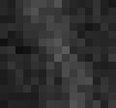
Non-linear Filters
Non-linear filters also replace pixel value inside as rolling window but using a non-linear function.
Examples: descriptive statistics filters
Minimum
Median
Maximum
Variance
Standard deviation
75 | 85 | 60
67 | 73 | 91
50 | 88 | 59
[ 50 59 60 67 73 75 85 88 91 ]
Min
Median
Max

Slide 22
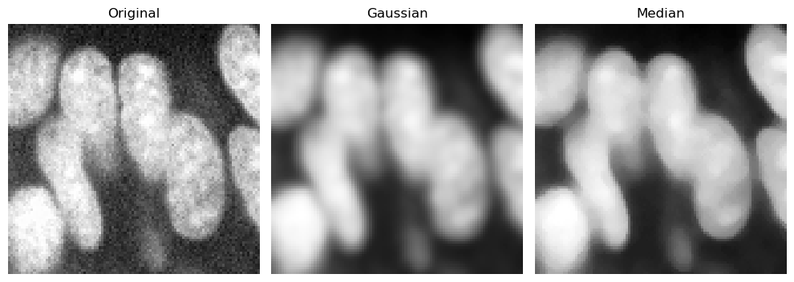
Noise removal
Gaussian filter
Median filter (computationally expensive)
Deep learning (even more expensive, but state-of-the-art)
“Edge preserving”
Image source: Mauricio Rocha Martins (Norden/Myers lab, MPI CBG)
from skimage.filters import median, gaussian
from skimage.morphology import disk
zfish_gaussian = gaussian(cropped_zfish, sigma=2, preserve_range=True)
zfish_median = median(cropped_zfish, footprint=disk(4))

Slide 23
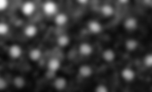

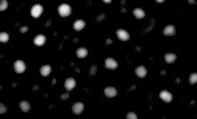

Difference-of-Gaussian (DoG)
Improve image in order to detect bright objects.
Band-pass filter
Gaussian blur (sigma = 2)
subtract
Noise reduced image
Original image
DoG-Image
“dog-2-6”
Gaussian blur (sigma = 6)
Background image

Slide 24

Difference-of-Gaussian (DoG)
Example DoG images
Original image

Slide 25









Laplace-filter
Second derivative of a Gaussian filter
Used for edge-detection and edge enhancement
Also known as the “Mexican-hat-filter”
1D
2D
Ground truth
image
1st derivative
2nd derivative

Slide 26


Laplacian-of-Gaussian (LoG)
0 | -1 | 0
-1 | 4 | -1
0 | -1 | 0
=
*
Laplace filter
Laplace filtered image
Gaussian
filter
0 | -1 | 0
-1 | 4 | -1
0 | -1 | 0
=
Laplacian of Gaussian filter
*
LoG image

Slide 27




Top-hat filter
Background subtraction
Minimum
Maximum
Subtract

Slide 28




Top-hat filter
Background subtraction
Minimum
Maximum
Subtract

Slide 29
Quiz: Noise removal
The median filter is a …
Linear filter
Median
Non-linear filter

Slide 30
Background removal
Removing background from an image is a … ?
Low-pass filter
Top-hat
High-pass filter
Image source: Mauricio Rocha Martins (Norden/Myers lab, MPI CBG)

Slide 31

Short detour: Image segmentation
Robert Haase

Slide 32

Short detour: Segmentation
Binarization, e.g. via thresholding
Very basic and yet efficient segmentation technique
Histogram based, to determine an intensity threshold above which pixels become white
Not state-of-the-art in many fields anymore
Intensity image
Binary image
?

Slide 33
Image Processing: Morphological Operations
Robert Haase
With material from
Marcelo Leomil Zoccoler, Physic of Life, TU Dresden

Slide 34




Refining masks
Binary mask images may not be perfect immediately after thresholding.
There are ways of refining them
Thresholding
Closing
Opening

Slide 35
Erosion
Erosion: Every pixel with at least one black neighbor becomes black.
Erosion

Slide 36
Dilation
Dilation: Every pixel with at least one white neighbor becomes white.
Dilation
8-connected neighborhood

Slide 37
Quiz
What would be the equivalent image processing filter you learned before? Hint: assume black=0 and white=1.
0
0
0
0
0
0
0
0
0
0
0
0
0
0
0
0
1
1
1
0
0
0
1
0
0
?
0
1
1
1
0
0
0
0
0
0
0
1
1
1
0
0
0
0
0
0
0
0
0
0
0

Slide 38
Dilation
Dilation: Every pixel with at least one white neighbor becomes white.
Dilation
Dilation
8-connected neighborhood
4-connected neighborhood

Slide 39
Opening
Erosion and dilation combined allow correcting outlines.
Separates white structures
Erases small white structures
Opening
Erosion
Dilation

Slide 40
Closing
It can connect white (high intensity) structures that are nearby
It may close small holes inside structures
Erosion and dilation combined allow correcting outlines.
Connects white structures
Closes small holes in white structures
Closing
Dilation
Erosion

Slide 41








Chaining erosion and dilation
Erosion: Set all pixels to black which have at least one black neighbor.
Erosion
Erosion
Erosion
Dilation: Set all pixels to white which have at least one white neighbor.
Dilation
Dilation
Dilation
Closing: Dilation + Erosion
Dilation
Erosion
Opening: Erosion + Dilation
Slide adapted from Haase, Lombardot, Scientific Computing Facility, MPI CBG, licensed CC BY-NC 4.0

Slide 42
Microscopy Image Processing in Python
Robert Haase

Slide 43


Working with images in python
Open images, e.g. using scikit-image
Images are just multi-dimensional arrays or “arrays of arrays”.
https://scikit-image.org/docs/0.23.x/api/skimage.io.html#skimage.io.imread

Slide 44


Loading images
Proprietary file formats, e.g. using aicsimageio or bioio
bioio is the successor of aicsimageio, but seems not to work yet
X and Y: width / height
Z: Number of images in 3D stack
T: time-points
C: channels S: scenes
https://github.com/AllenCellModeling/aicsimageio
https://bioio-devs.github.io/bioio/bioio.BioImage.html

Slide 45


Loading images
Before you can work with such images, you need to extract a numpy-array first
Select a 2D plane from a 3D image stack

Slide 46


Visualizing images
Suboptimal image display
The default colormap has been criticized many times.
https://matplotlib.org/stable/api/_as_gen/matplotlib.pyplot.imshow.html

Slide 47



Visualizing images
Disclaimer: I maintain this
Alternative: stackview
Reminder: This does not alter the image data.
https://github.com/haesleinhuepf/stackview
https://github.com/ScaDS/BIDS-lecture-2025/blob/main/02a_image_processing/02_opening_visualizing_images.ipynb

Slide 48

Visualizing images
Alternative: stackview
https://github.com/haesleinhuepf/stackview

Slide 49



Visualizing images
https://github.com/haesleinhuepf/stackview

Slide 50

Orthogonal planes
https://github.com/ScaDS/BIDS-lecture-2025/blob/main/02a_image_processing/06_inspecting_3d_images.ipynb

Slide 51



Orthogonal planes
Quiz: What does this T stand for?
https://github.com/ScaDS/BIDS-lecture-2025/blob/main/02a_image_processing/06_inspecting_3d_images.ipynb

Slide 52




Cropping and resampling images
Indexing and cropping numpy-arrays works like with python arrays.
Original image
Cropped image
Sub-sampled image
Flipped image
https://github.com/ScaDS/BIDS-lecture-2025/blob/main/02a_image_processing/05_Cropping_images.ipynb

Slide 53

Cropping and resampling images
Crop out the region you’re interested in
Interesting
Not interesting
In this case you can spare 8/9 compute time and memory for subsequent processing steps
Image data source: Nasreddin Abolmaali, TU Dresden
https://github.com/ScaDS/BIDS-lecture-2025/blob/main/02a_image_processing/05_Cropping_images.ipynb

Slide 54



Brightness, contrast, display-range
After loading data, make sure you can see the structure you’re interested in
The 95th percentile works with all images. 10000 does not.
https://github.com/ScaDS/BIDS-lecture-2025/blob/main/02a_image_processing/04_Brightness_and_Contrast.ipynb

Slide 55



Filters
… are just functions
https://scikit-image.org/

Slide 56



Filters
Use every opportunity and play with filter parameters to get an idea what they do.
https://github.com/ScaDS/BIDS-lecture-2025/blob/main/02a_image_processing/07_Image_Filters.ipynb

Slide 57


Filters
Use every opportunity and play with filter parameters to get an idea what they do.
https://github.com/haesleinhuepf/stackview#interact

Slide 58



Filters
... may be custom functions
Recommendation: Apply custom filters to super simple images to see if they do the right thing.
https://github.com/ScaDS/BIDS-lecture-2025/blob/main/02a_image_processing/07_Image_Filters.ipynb

Slide 59


Binarization / Thresholding
Turn images into binary images (most basic form of segmentation)
Basic math operation thanks to numpy
Applied to every pixel individually

Slide 60



Morphological operations
To morph objects in binary images

Slide 61


Quiz: Image processing
Which kind of operation is applied here?
?
Denoising
Background removal
Binarization
Morphological operation

Slide 62

Quiz: Image processing
Which kind of operation is applied here?
?
Denoising
Background removal
Binarization
Morphological operation

Slide 63
Exercises
Robert Haase

Slide 64

Hint: Jupyter code hints
Press SHIFT-Tab within brackets behind a function to read its documentation.

Slide 65


Exercise: image processing
Get started with loading, viewing, cropping and processing images
https://github.com/ScaDS/BIDS-lecture-2025/tree/main/02a_image_processing

Slide 66


Exercise: dependencies
There is a Jupyter Notebook which doesn’t work (anymore). Find out why.
Fix it in two ways:
A) by changing the code
B) by not changing the code
https://github.com/ScaDS/BIDS-lecture-2025/blob/main/02b_dependency_management/breaking_backwards_compatibility.ipynb

Slide 67


Material repository
Today: 9 notebooks. Invest your time wisely.
https://github.com/ScaDS/BIDS-lecture-2025

