Slide 1

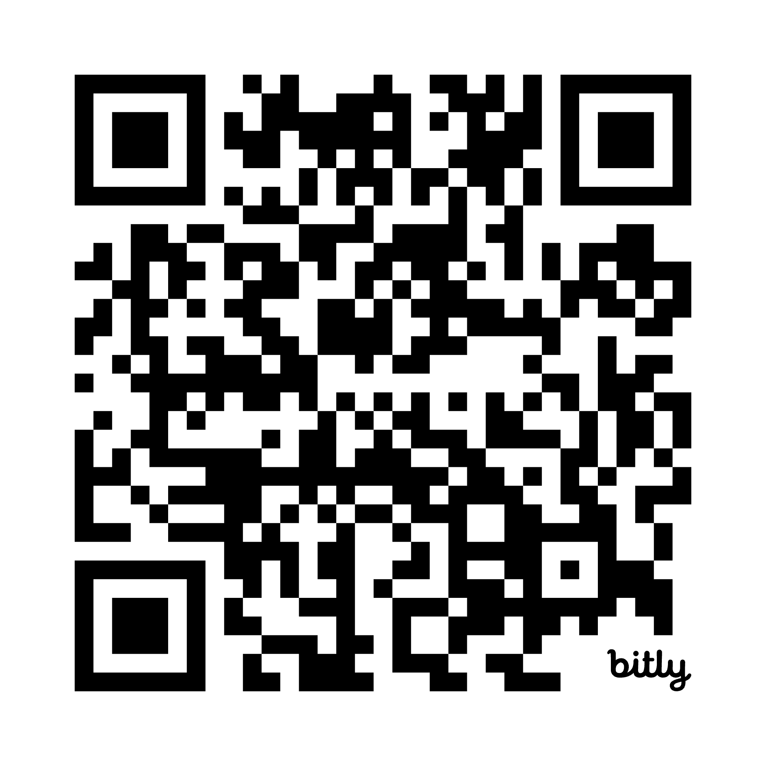
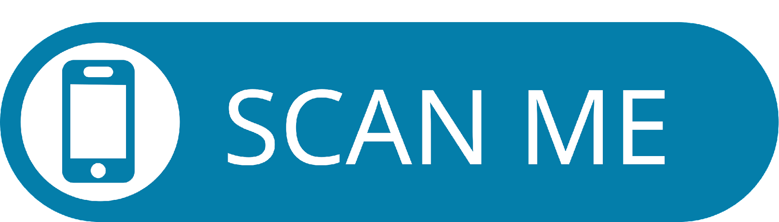
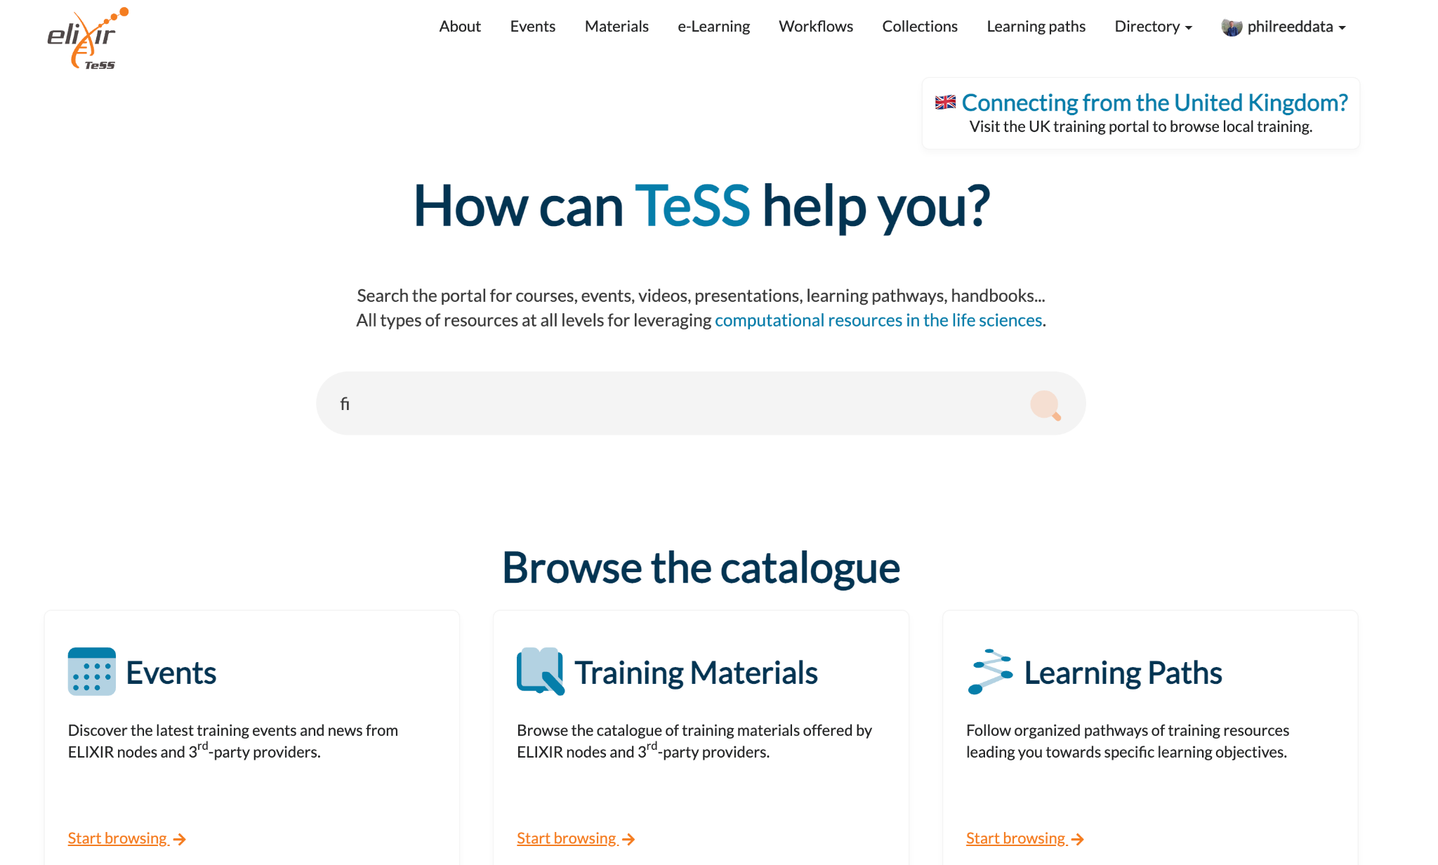

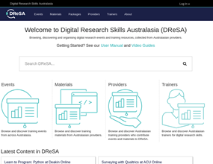
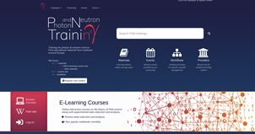

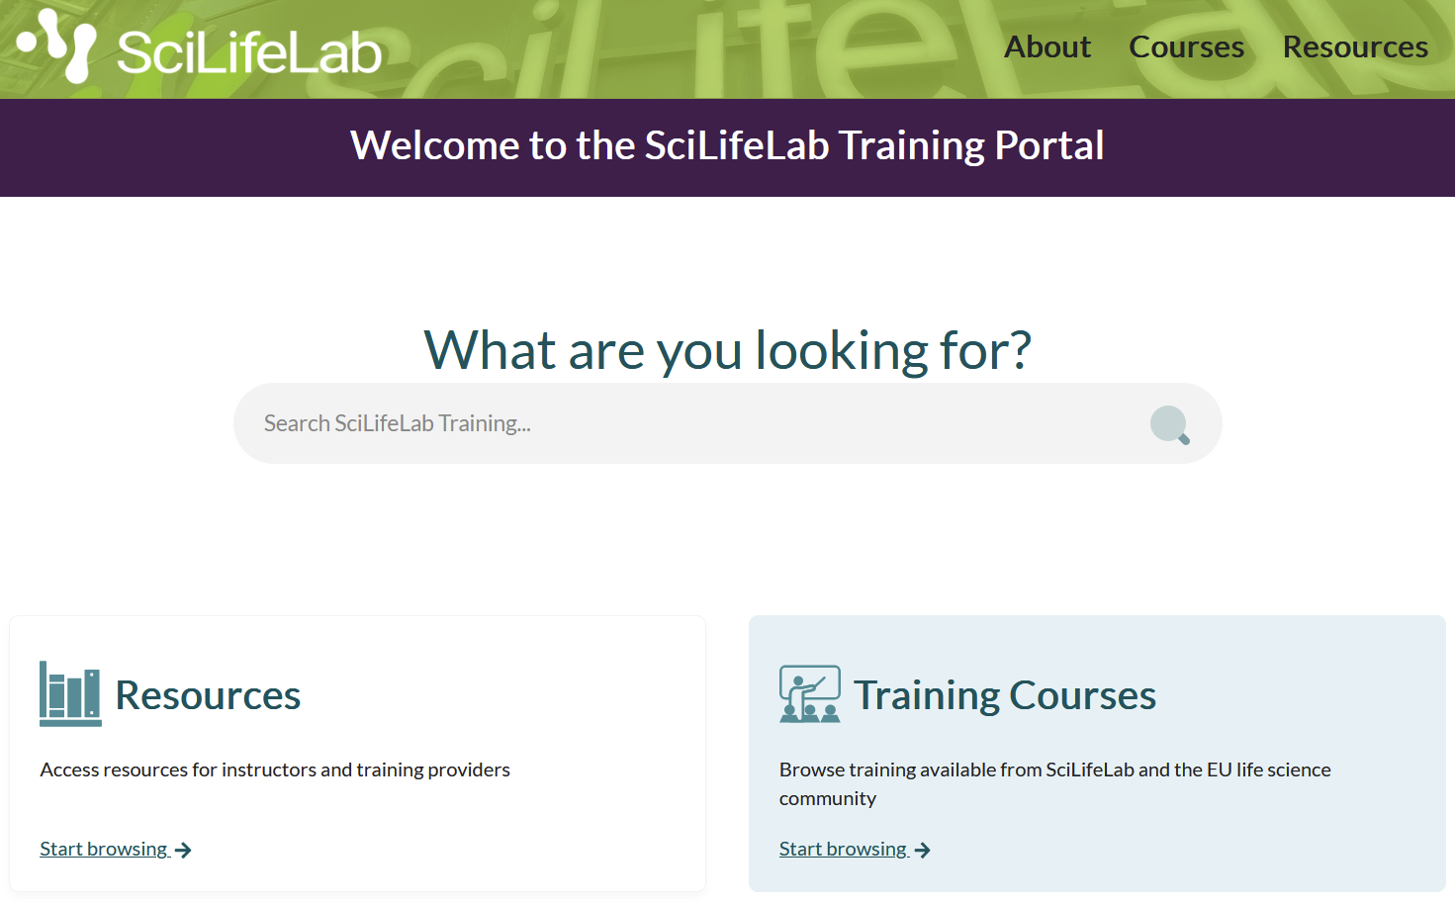
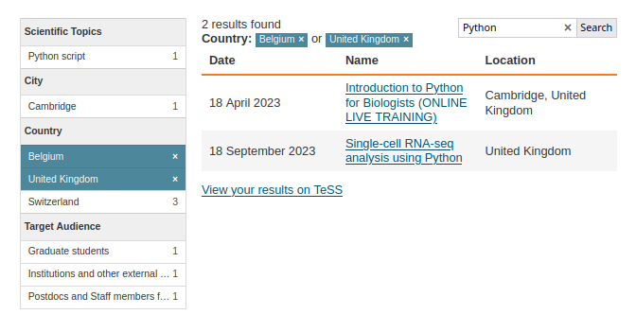


















TeSS: a federated, FAIR-aligned platform for distributed management and exchange of training resources
Phil Reed¹, Munazah Andrabi¹, Finn Bacall¹, Oliver Knodel², Martin Voigt², Kenneth Rioja³, Guido Juckeland², Carole Goble¹
A gateway, showcase and catalogue aggregating events and training materials
avg
5.5k accesses/
month
24 countries in Europe
One-stop shop for trainers and trainees to discover online information and content e.g., training materials, tutorials, online courses and events
853 events in last 12 months
>140 content providers
255 upcoming events
An added value service with curated and organised content: collections, customised training workflows, Learning Paths
14,664
past events
518 materials in last 12 months
3,473
materials
from Galaxy, SIB
Materials: Training resources in a variety of different formats, including online tutorials, videos, slides etc
Events: Face-to-face or online training opportunities that have set start and end times
Workflows: Create visually intuitive displays of different types and approaches to training, at different levels of granularity
Collections: Related training materials/events for domain of study grouped together
Learning Paths: A pathway to guide the learner through a set of learning modules to be undertaken progressively, from beginner to advanced level
Training resources are automatically discovered and registered in TeSS utilising automated scrapers and open standards e.g., Bioschemas and EDAM
Content extracted from provider sites is linked with other registries and accessed through various media
Get your Materials in TeSS
TeSS Global Usage
TeSS as a National Resource
Bioschemas
Annotate your website with Bioschemas markup to quickly and easily add your training resources to TeSS
TeSS harvests new and updated content daily, saving the need for manual form filling
The following Bioschemas profiles are supported
  Course & CourseInstance
  Training Material
TeSS is an open source, reusable software platform, and has been deployed by several other communities across the globe:
Digital Research Skills Australasia (https://dresa.org.au/)
Photon and Neutron (PaN) training (https://pan-training.eu/)
Taxila: Open science training in the Netherlands (https://taxila.nl)
SciLifeLab Sweden (https://training.scilifelab.se/)
Current scenario
23 member nodes with varied levels of engagement
Promote TeSS as a national training resource for each node
National Instances implemented by SciLifeLab (Sweden) and Taxila (Netherlands)
Future proposition
Implementing prototype of a node specific portal showcasing the node training in TeSS (UK as a test case)
Curation and tagging of existing training content
Widgets
most popular
Easily embed live TeSS content in your webpages
Useful for training providers whose content changes frequently, or who have limited control of their website
PaN
PaN + ELIXIR
ELIXIR
you?
Various styles & functionality (and extendable if needed)
Can be scoped (e.g. to only show certain providers’ content)
https://elixirtess.github.io/TeSS_widgets/
mTeSS-X: a federation of catalogues
Multi-space catalogue
Catalogues pooled into a shared TeSS instance supporting distinct community-specific “spaces”
Shared catalogue management
Exchange between catalogues
Automatic exchange of nominated content between the spaces in a TeSS hub
Done via a dedicated interface for metadata harvesting
Structured Annotation
Training materials/events can be annotated with EDAM ontology terms
Links with other tools & registries
Training can be linked to and from resources
in other registries such as bio.tools and FAIRsharing.org
Relevant training materials are linked and showcased in the RDMkit
Join the TeSS Club!
The TeSS Club is an open community that works together to continuously develop the TeSS portal and help its users
Bi-weekly Zoom meetings
Slack channel: #tess-club (elixir-europe.slack.com)
More details: https://elixirtess.github.io/about/
Affiliations
¹The University of Manchester, ²HZDR, ³CERN
Contact: tess-support@googlegroups.com
eScience Lab

