Slide 1


Title slide
Open Science Infrastructure
Laurents Sesink (Program manager Open Science)

Slide 2





        We organise collective purchasing under the best conditions
        In costs, but also in public values
        We share knowledge and coordinate collaboration
        in education, research
        and innovation
        We provide IT services
        (50+ and very diverse)
        to make IT accessible, easy and safe
        We innovate
        To make sure we are ready
        for the future
        SURF is the national ICT cooperative of Dutch education and research institutions.
        Members (100+) are all universities, universities of applied sciences, UMCs, and a lot of the research institutions

Slide 3


Services
National Supercomputer
Central purchase
National
research-netwerk
National data storage
Central Cybersecurity

Slide 4
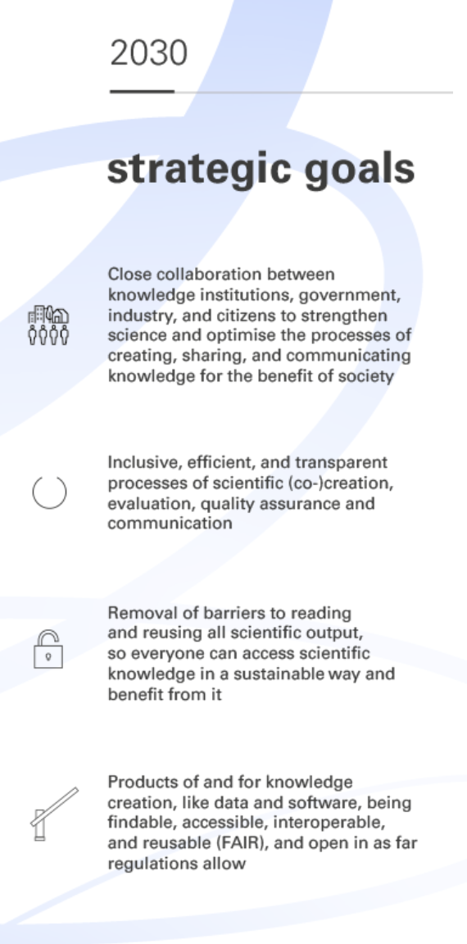

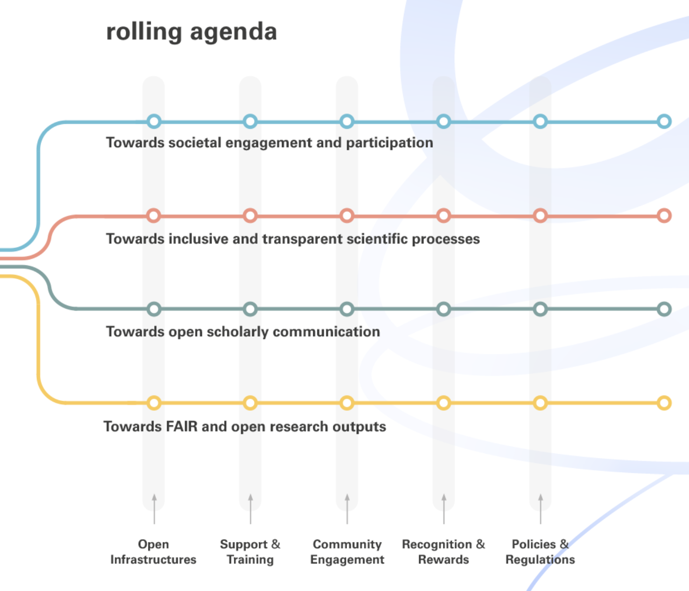
National agenda Open Science

Slide 5
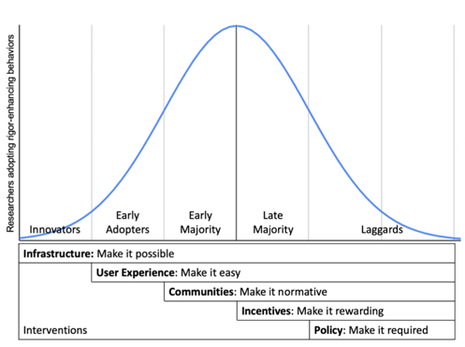
What is needed to make open science the norm
Development of better research infrastructures to enable effective open knowledge sharing
Development of better skills in research communities
Investment in communities that develop and share best practices
Development of policy and regulations
Transformation of the reward- and recognition system

Slide 6


Open Science
Open Science Communities
Reproducibility network
Data stewards
RDNL

Slide 7
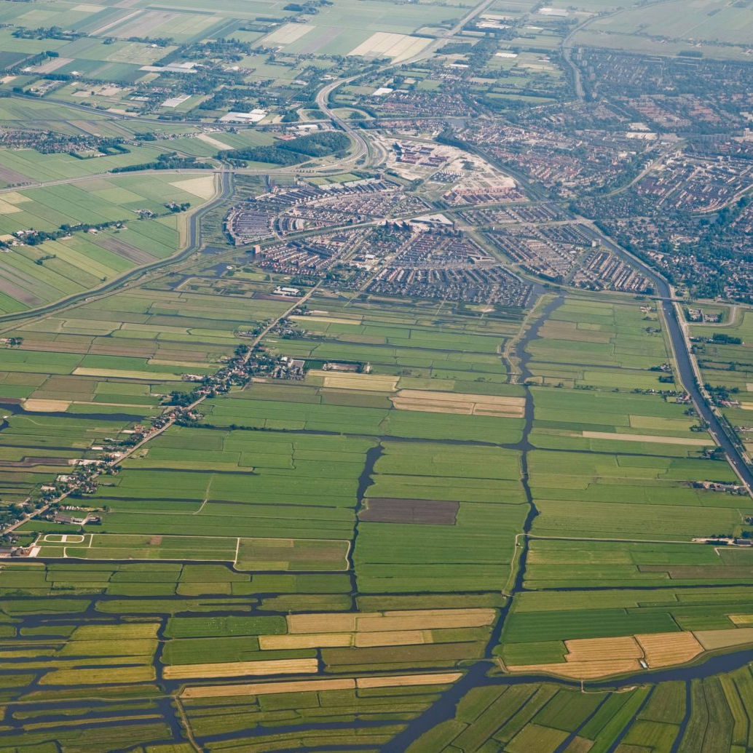
Current data landscape
“The Netherlands has a rich, but fragmented, confusing data landscape. This concerns both data services and the development and dissemination of knowledge about the care of research data. This creates risks of overlap, inefficiency and missing opportunities for connection and innovation.”
Final report Exploration and optimization of national data landscape (NPOS, 2020)

Slide 8
International programmes
EOSC
Euro-HPC
EGI
Géant
OpenScienceNL
IV-OO
Enabling Open Science
Cybersecurity
Programmes at national level
NREN
ICT execution plan / (T)DCCs
Digital Sovereignty: Opensource, Cloud, AI, Purchasing
Making the most of infrastructures
Try out, pilot and test on
local level
Reproducible research
Research graphs
Human capacity building and pooling
Data souvereignty
Sensitive data
SSI/SRAM+/EduID
2STiC/SurfNet9
SURF-SOC
800Gb/s testnetwork
Research
Network-Security-
Public Values

Slide 9
Innovation zones
  Innovation zones are clustered according to themes.
  The innovation zones are intended to solve complex problems.
  The basic principle is that complex problems are tackled through an ecosystem approach.
Enabling Open Science
Making the most of infrastructures
Cybersecurity

Slide 10
Innovation zone Enabling Open Science
FAIR Data
Reproduceerbaar onderzoeksproces
EOSC pilot node, EOSC-MO, Global Open Research Commons
PoC: Communiceer en claim een bijdrage aan onderzoek
Open Research Information
RAID
OS-Trails
Modulair Open Research Information system (hbo)
Open Research Information Agenda
Netherlands Research Portal
Open Scholarly Communication
PRC
Diamond Open Access Journals
1
2
3
Cohesion
Reproducible Workflows
Digital Commons
Federation Shared Services
Digital souvereignty

Slide 11





Supporting a reproducible research process
RO-CRATE
SURF Research Cloud

Slide 12
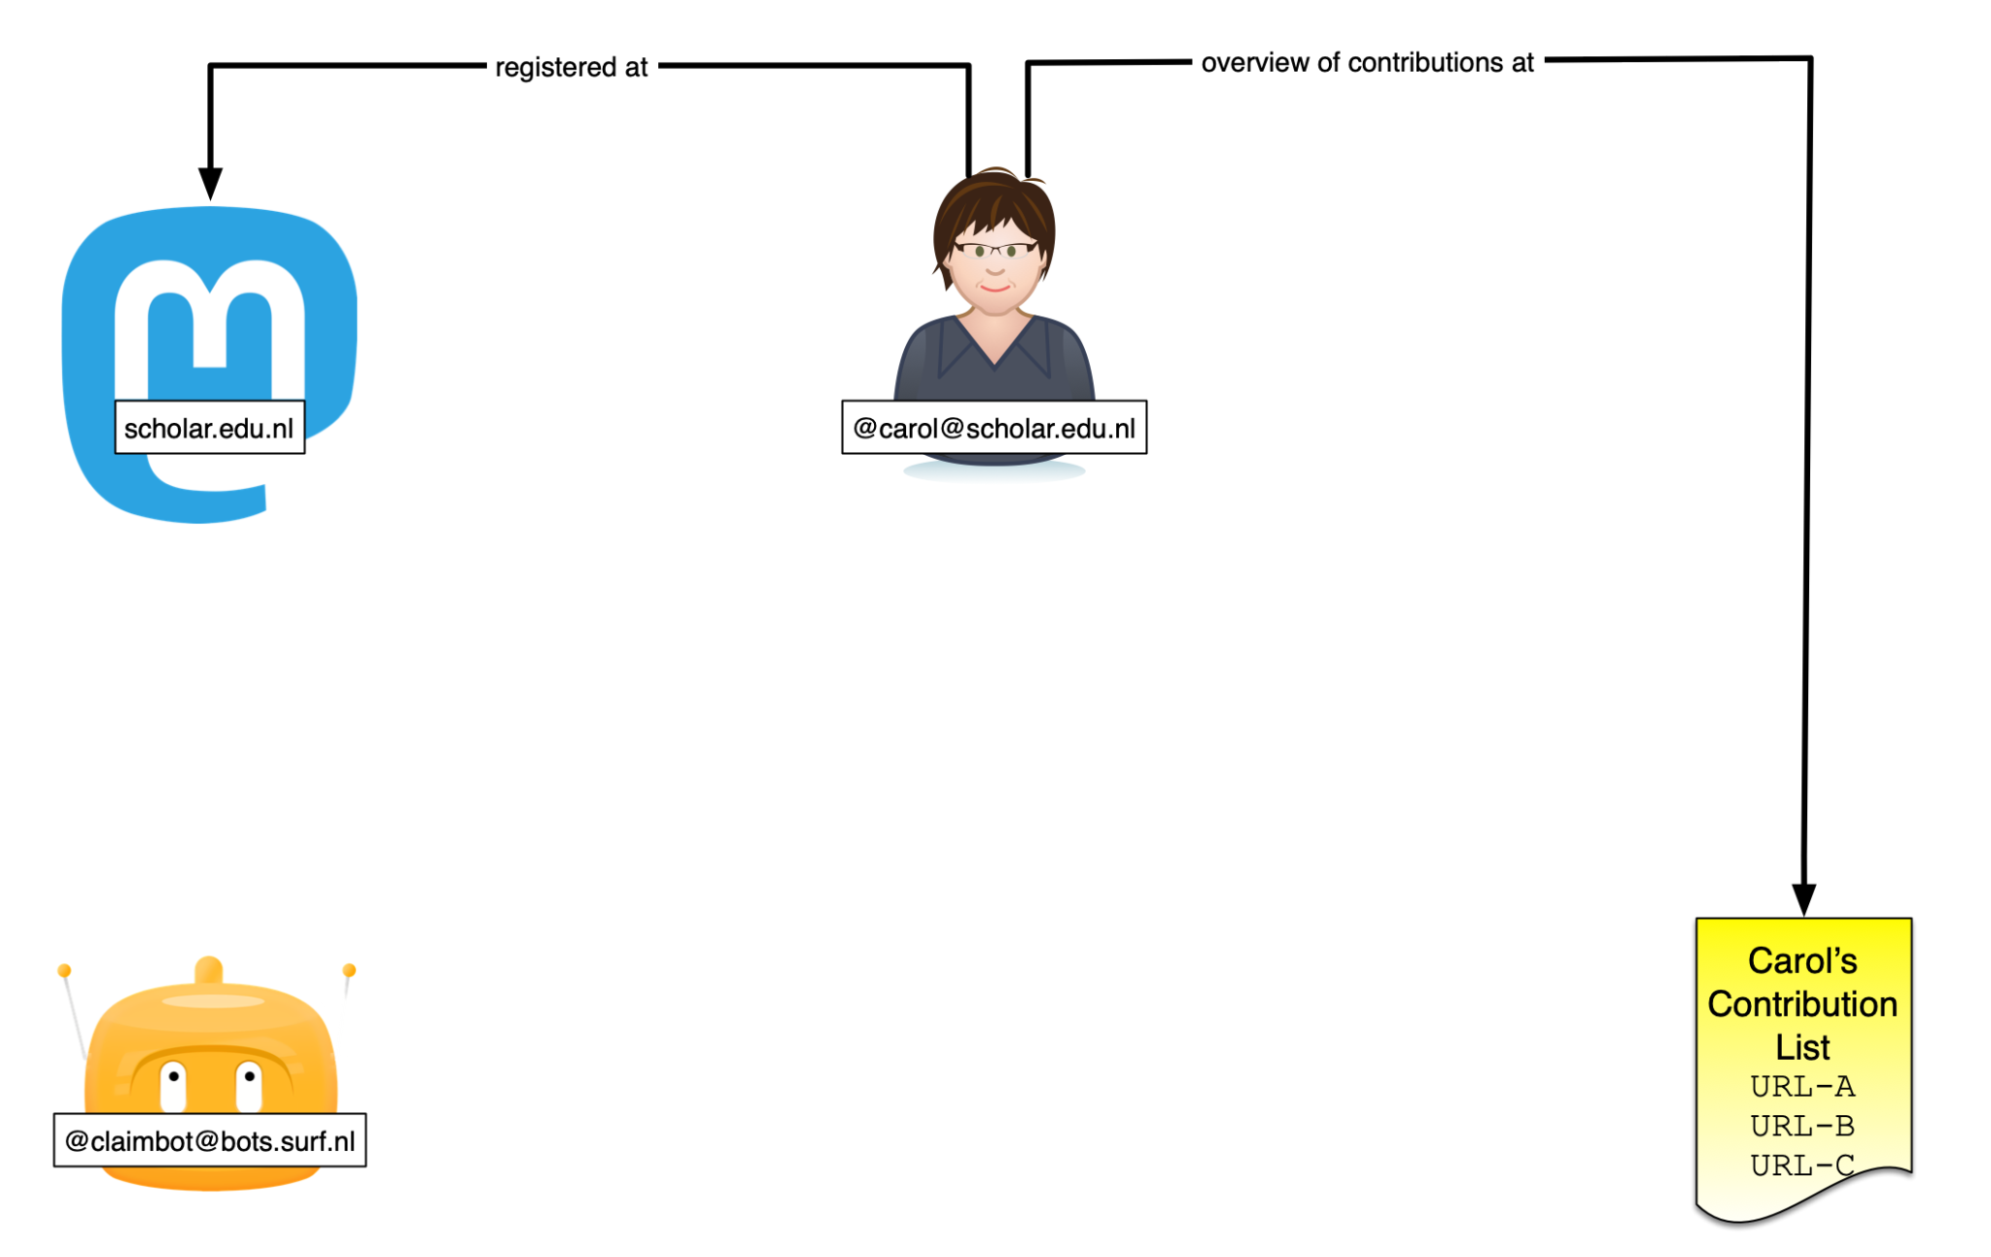




Keeping track of different types of research contributions
@dedicated website research contributions
Notes:
Patrick vanaf hier…

Slide 13
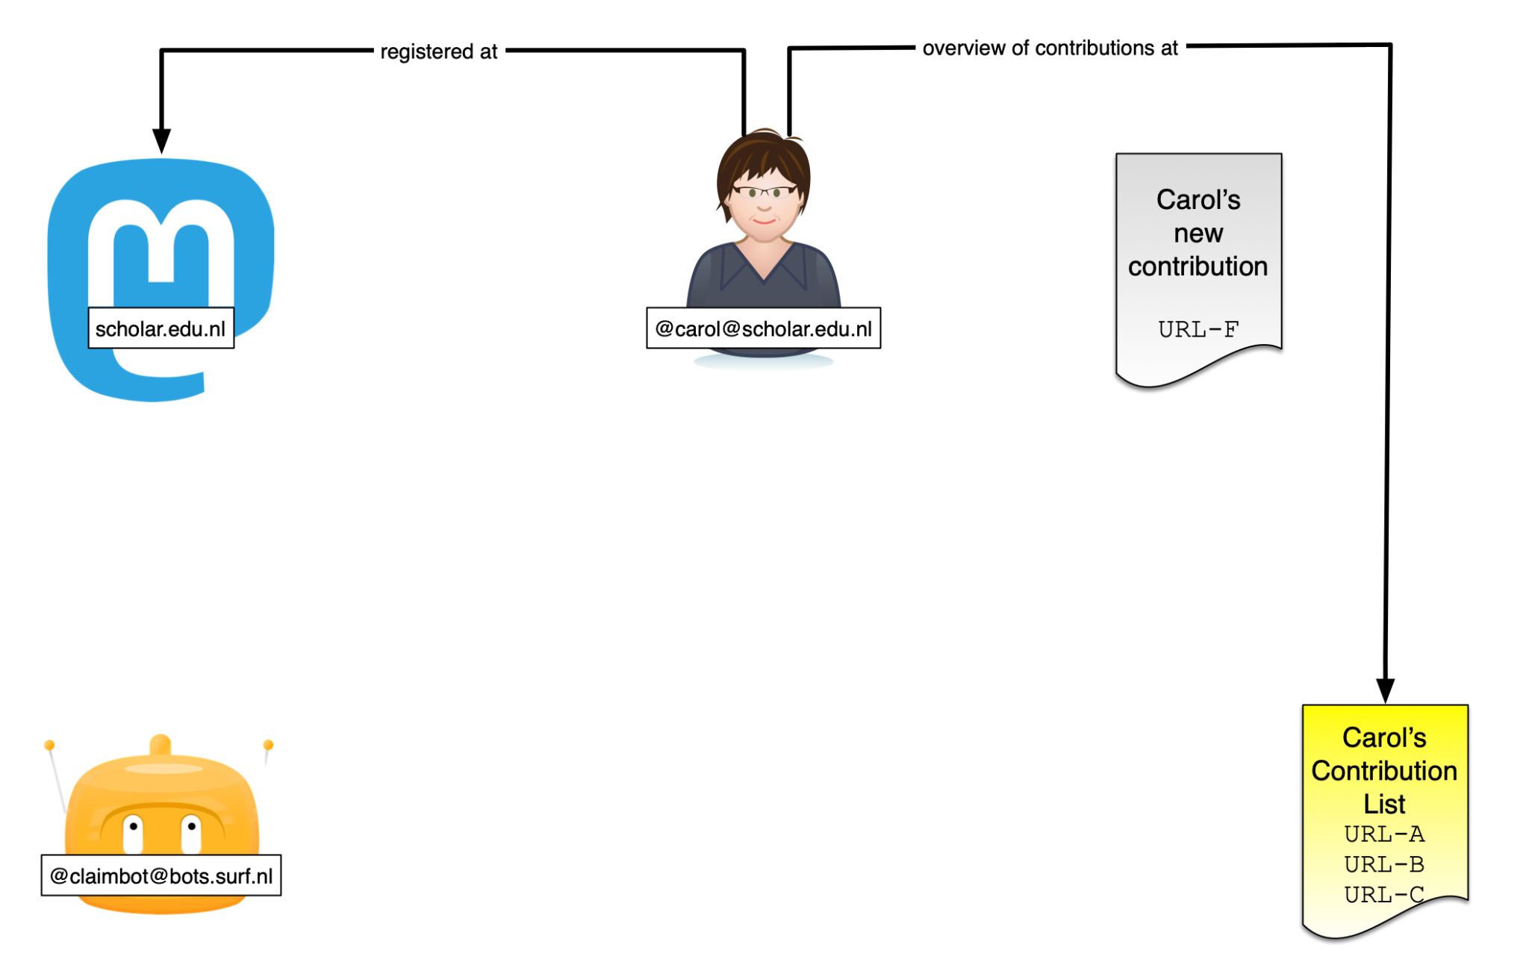

Slide 14
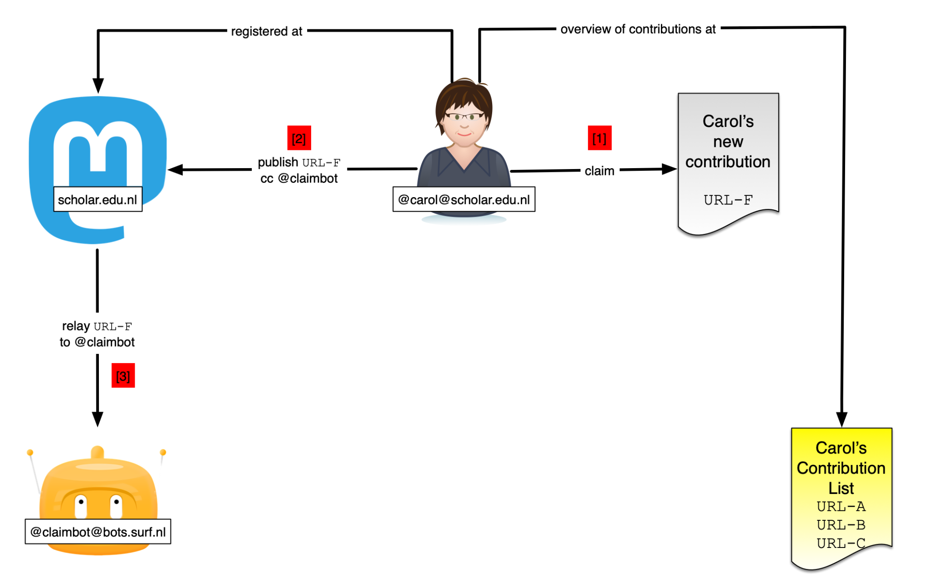

Slide 15
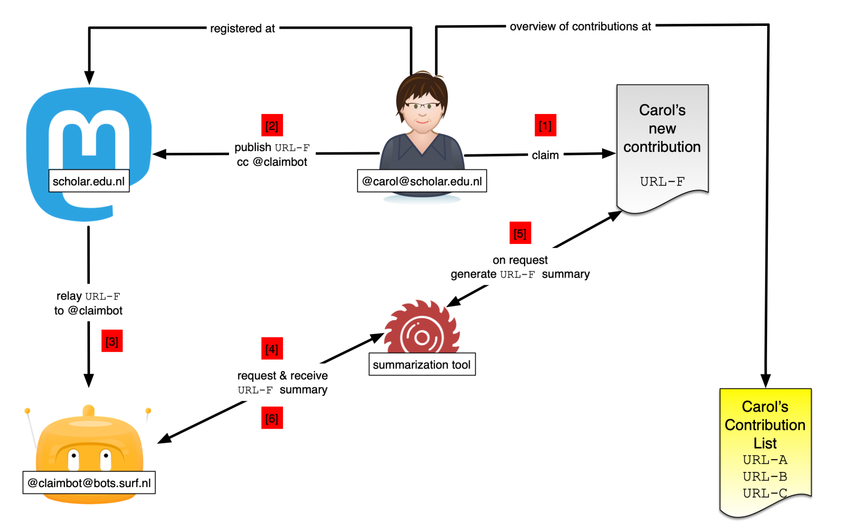

Slide 16
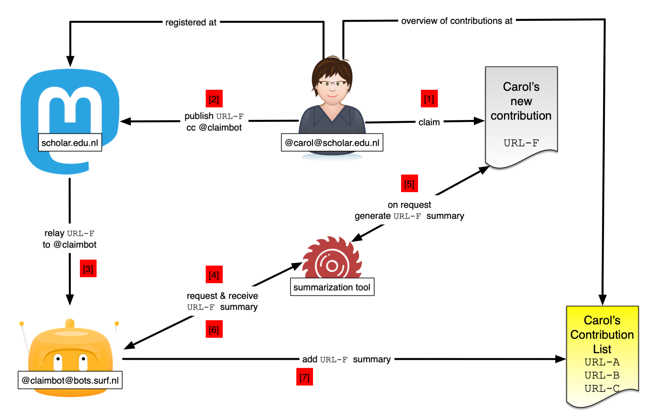
Notes:
Hier rap doorheen, niet in de details

Slide 17
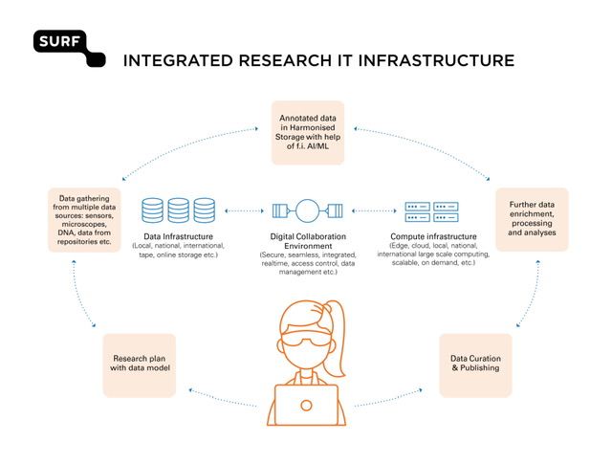
Innovation zone Optimal use of Infrastructures
Infrastructure landscape in NL is rich but fragmented. Inefficient and unclear for researchers.
How to orchestrate a national infrastructure in this rich landscape?

Slide 18
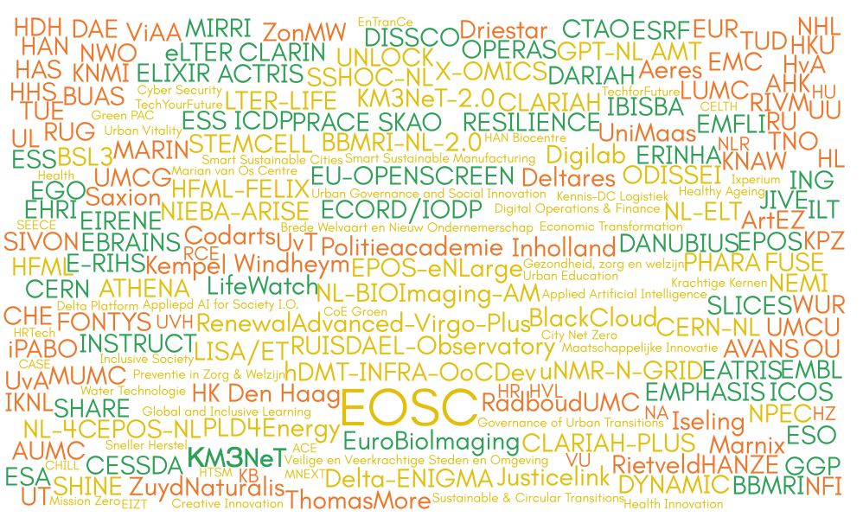
Three areas
Consortium Research Infrastructure
Institutional Research Infrastructure
European Research Infrastructure

Slide 19
How to orchestrate a national infrastructure
Institutional
Consortium
Support DCCs and Tier-2s
Research Partnerships
EOSC
Pilot Node
European
Common Language
Notes:
These are not set in stone.
Initial attempt to connect activities.

Slide 20
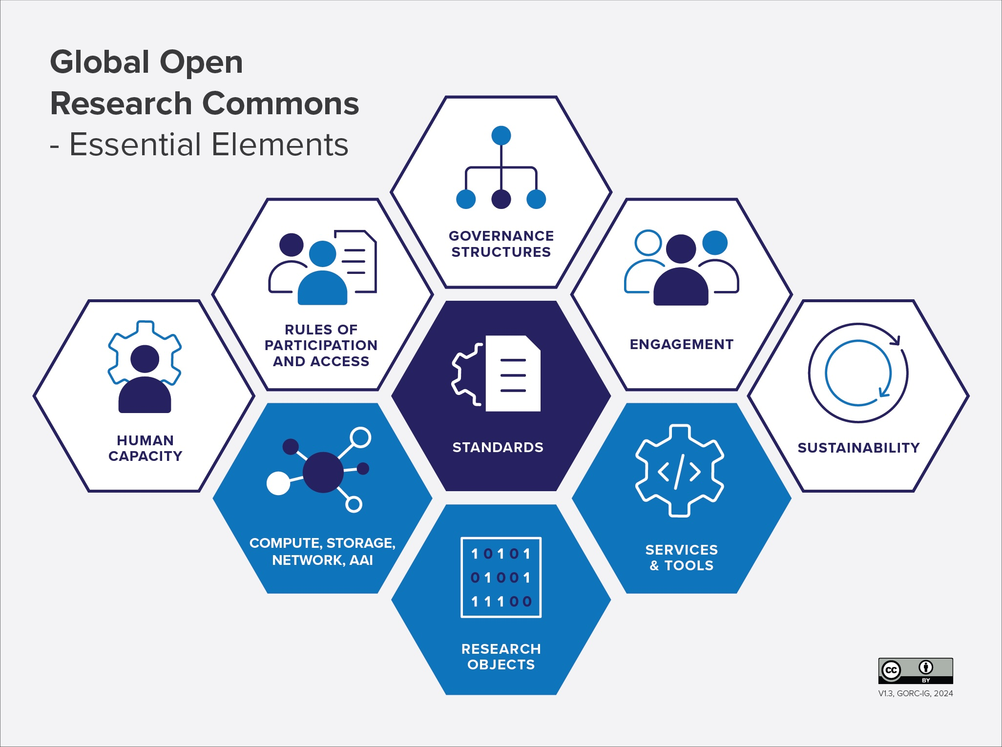
Common Language
To support the development of research commons, and work to make them interoperable.
Notes:
Developed via RDA: “While the work supports the development of individual commons, it also supports the work, necessary to make the commons interoperable. The GORC IM WG outputs provide a firm foundation for the GORC IG as it seeks to create a roadmap for commons integration.”
It

Slide 21
How to orchestrate a national infrastructure
Institutional
Consortium
Support DCCs and Tier-2s
Research Partnerships
EOSC
Pilot Node
European
Common Language
Workflow Perspective
Notes:
These are not set in stone.
Initial attempt to connect activities.

Slide 22
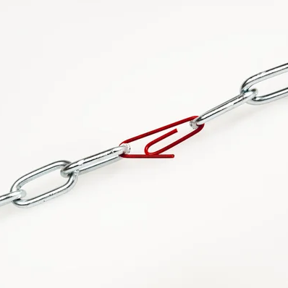
Workflow perspective
Identify researcher needs, to understand the specific needs, generic enough to facilitate.
Cover end-to-end concerns like security, scalability and reproducibility.
Identify cross-service, -institution or
-discipline challenges.

Slide 23
How to orchestrate a national infrastructure
Institutional
Consortium
Support DCCs and Tier-2s
Research Partnerships
EOSC
Pilot Node
European
Common Language
Workflow Perspective
Federation
Notes:
These are not set in stone.
Initial attempt to connect activities.

Slide 24
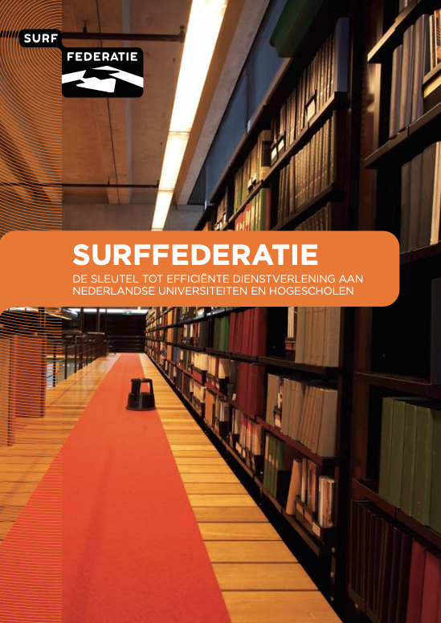

Federation
Provide seamless access to resources that are decentral, e.g.
  AAI federation
  Repository federation
  Compute federation
  Federation of Nodes
Enables us to preserve autonomy and richness
Requires technology, but also standards and agreements
Notes:
What is Federation / Why do we need/apply it for RIC?
As an institute, research group, discipline, communitty, service provider, etc., you have your own stakeholders, concerns, strategy, vision,
Example:

Slide 25
How to orchestrate a national infrastructure
Institutional
Consortium
Support DCCs and Tier-2s
Research Partnerships
EOSC
Pilot Node
European
Common Language
Workflow Perspective
Federation
Shared Services
Notes:
These are not set in stone.
Initial attempt to connect activities.

Slide 26
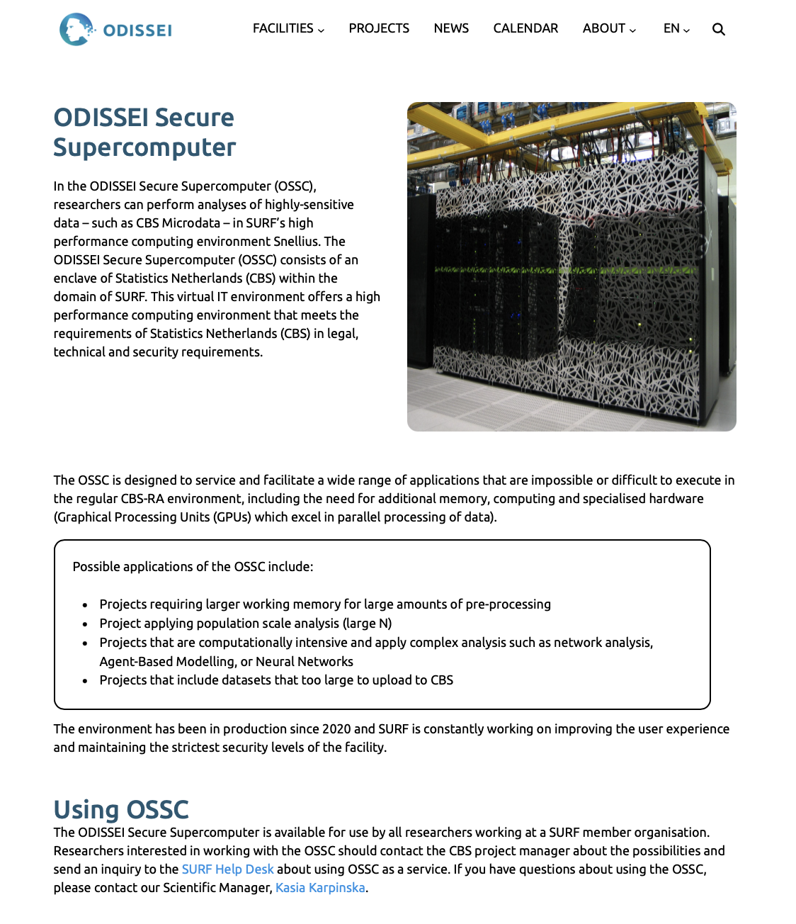
Shared Services
Generic services that can be shared by multiple consortia and institutes
To share costs for building, operating and maintaining services
Example: ODISSEI Secure Supercomputer.

Slide 27
Chapter yellow
Connecting institutional, national and European infrastructures: The EOSC

Slide 28
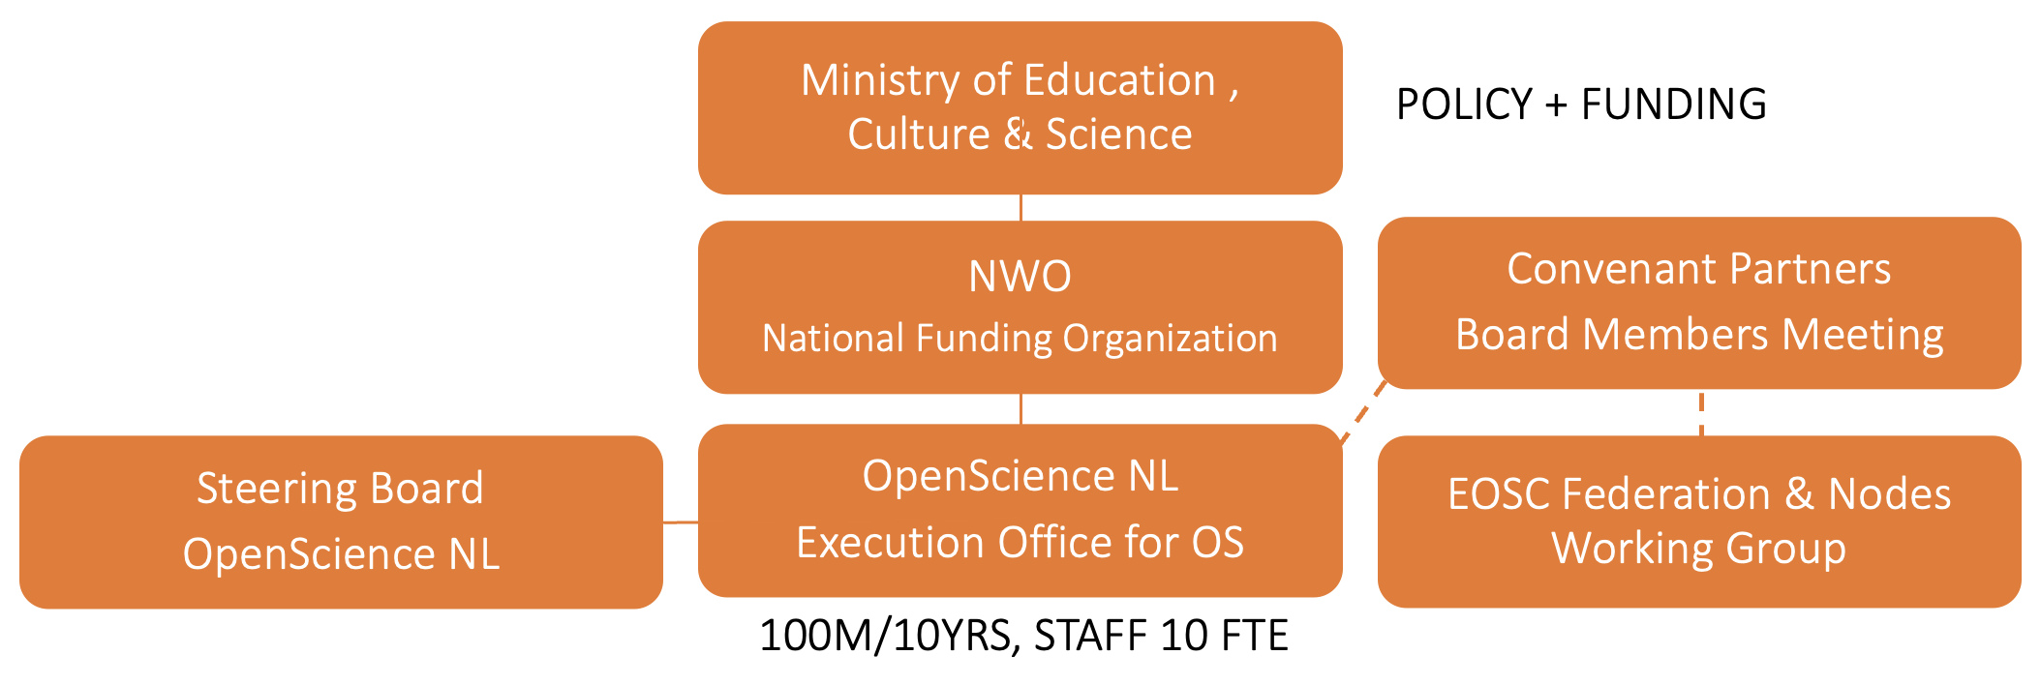
National WG EOSC nodes
Explore scenarios for defining and setting up one or more EOSC pilot node(s)
Develop a sustainable business model for the node(s)
Explore which governance model fits the preferred scenarions
Give advice to the Dutch representative(s) in the Tripartite Group
Inform the Board Members Meeting about scenarios and business model.

Slide 29
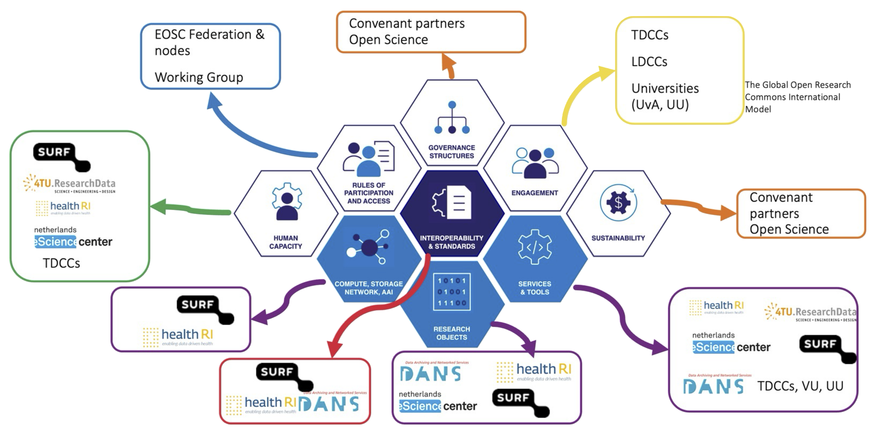
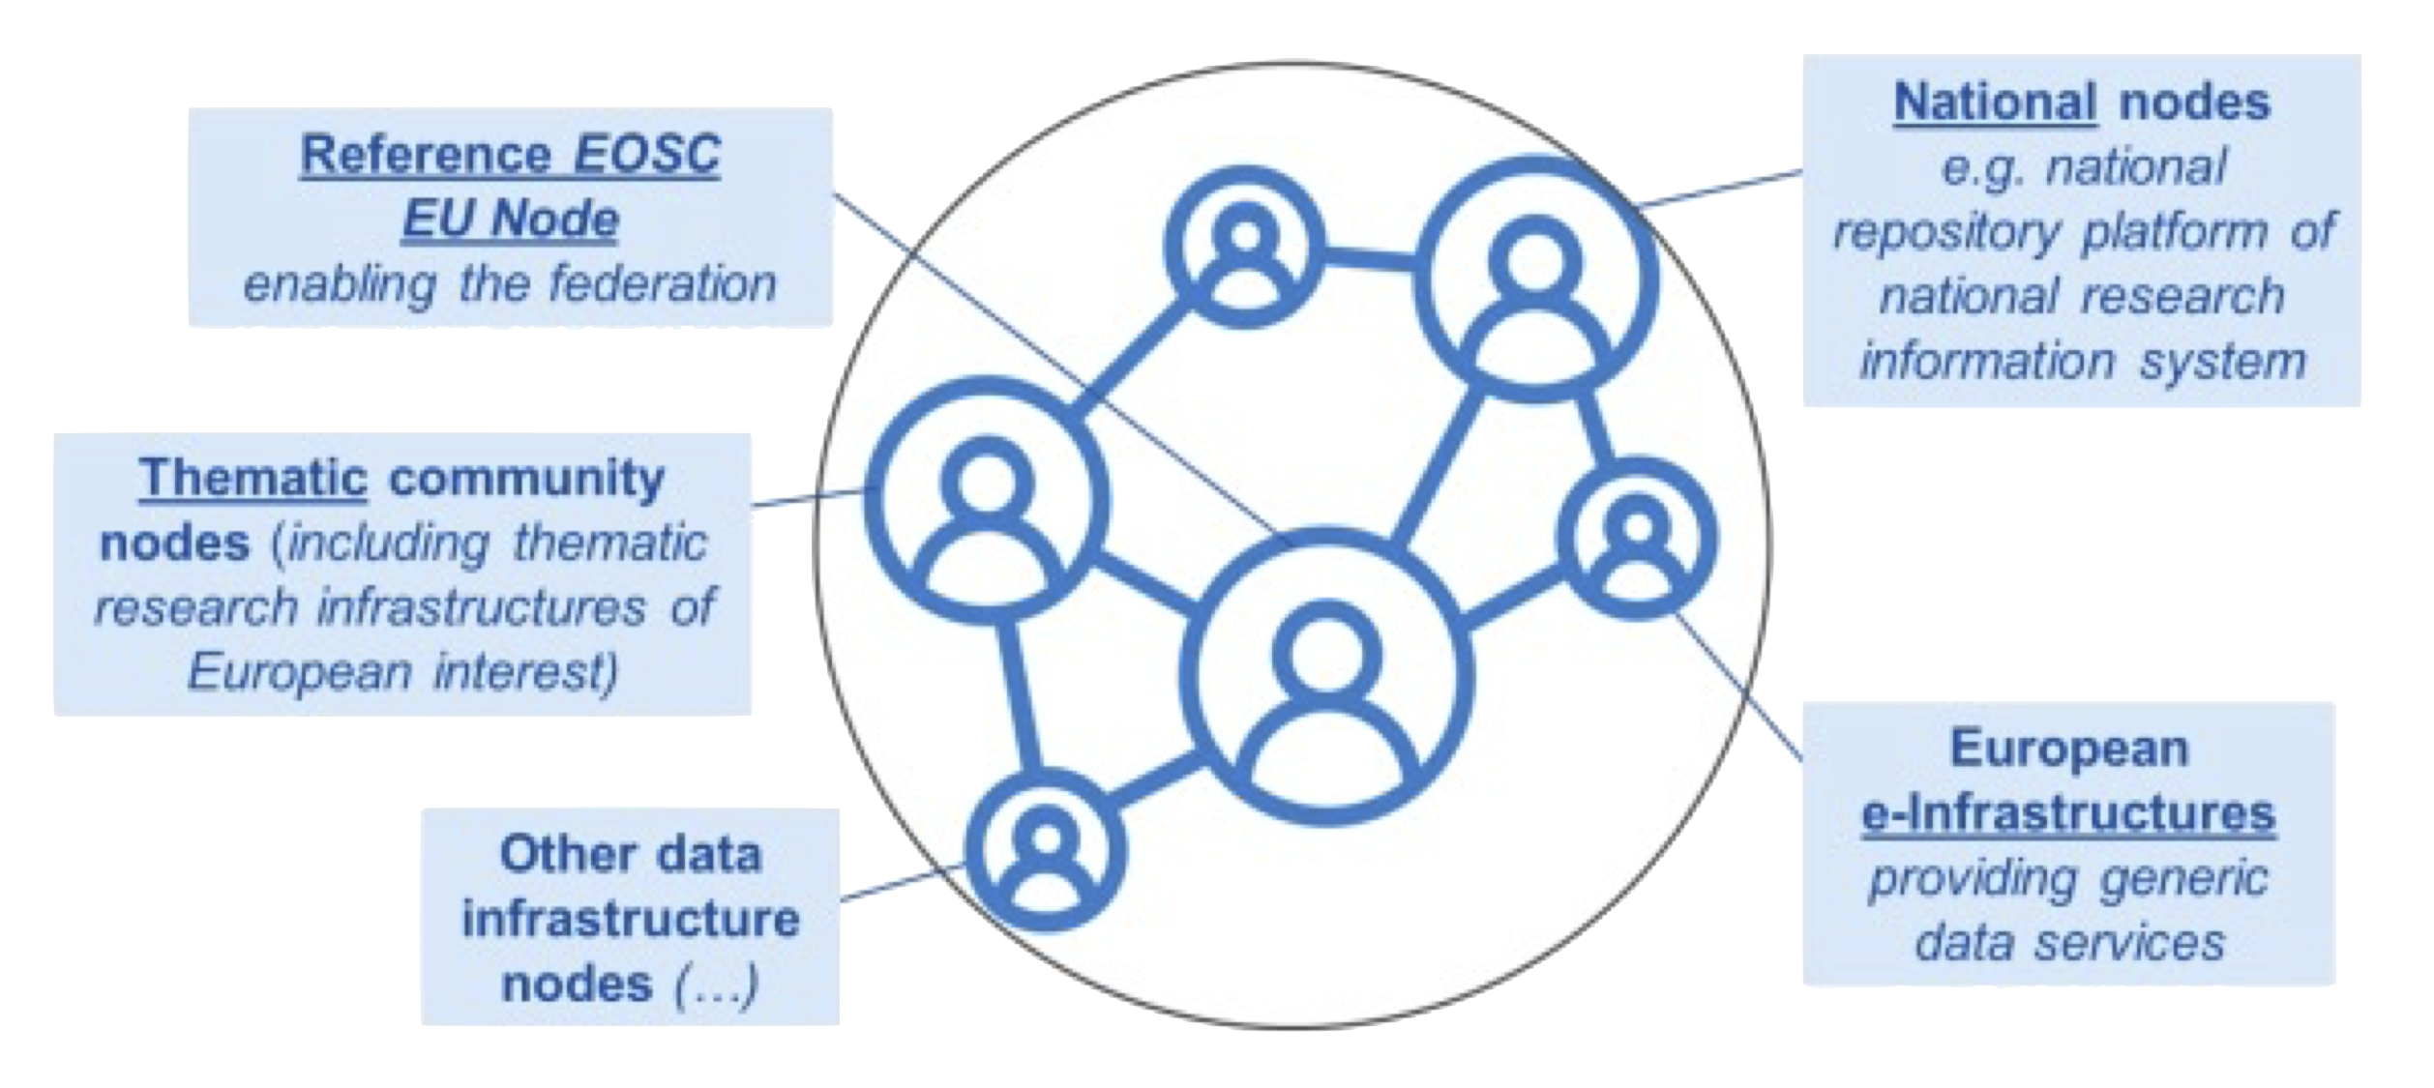
Organising the National Node
SURF Pilot Node

Slide 30
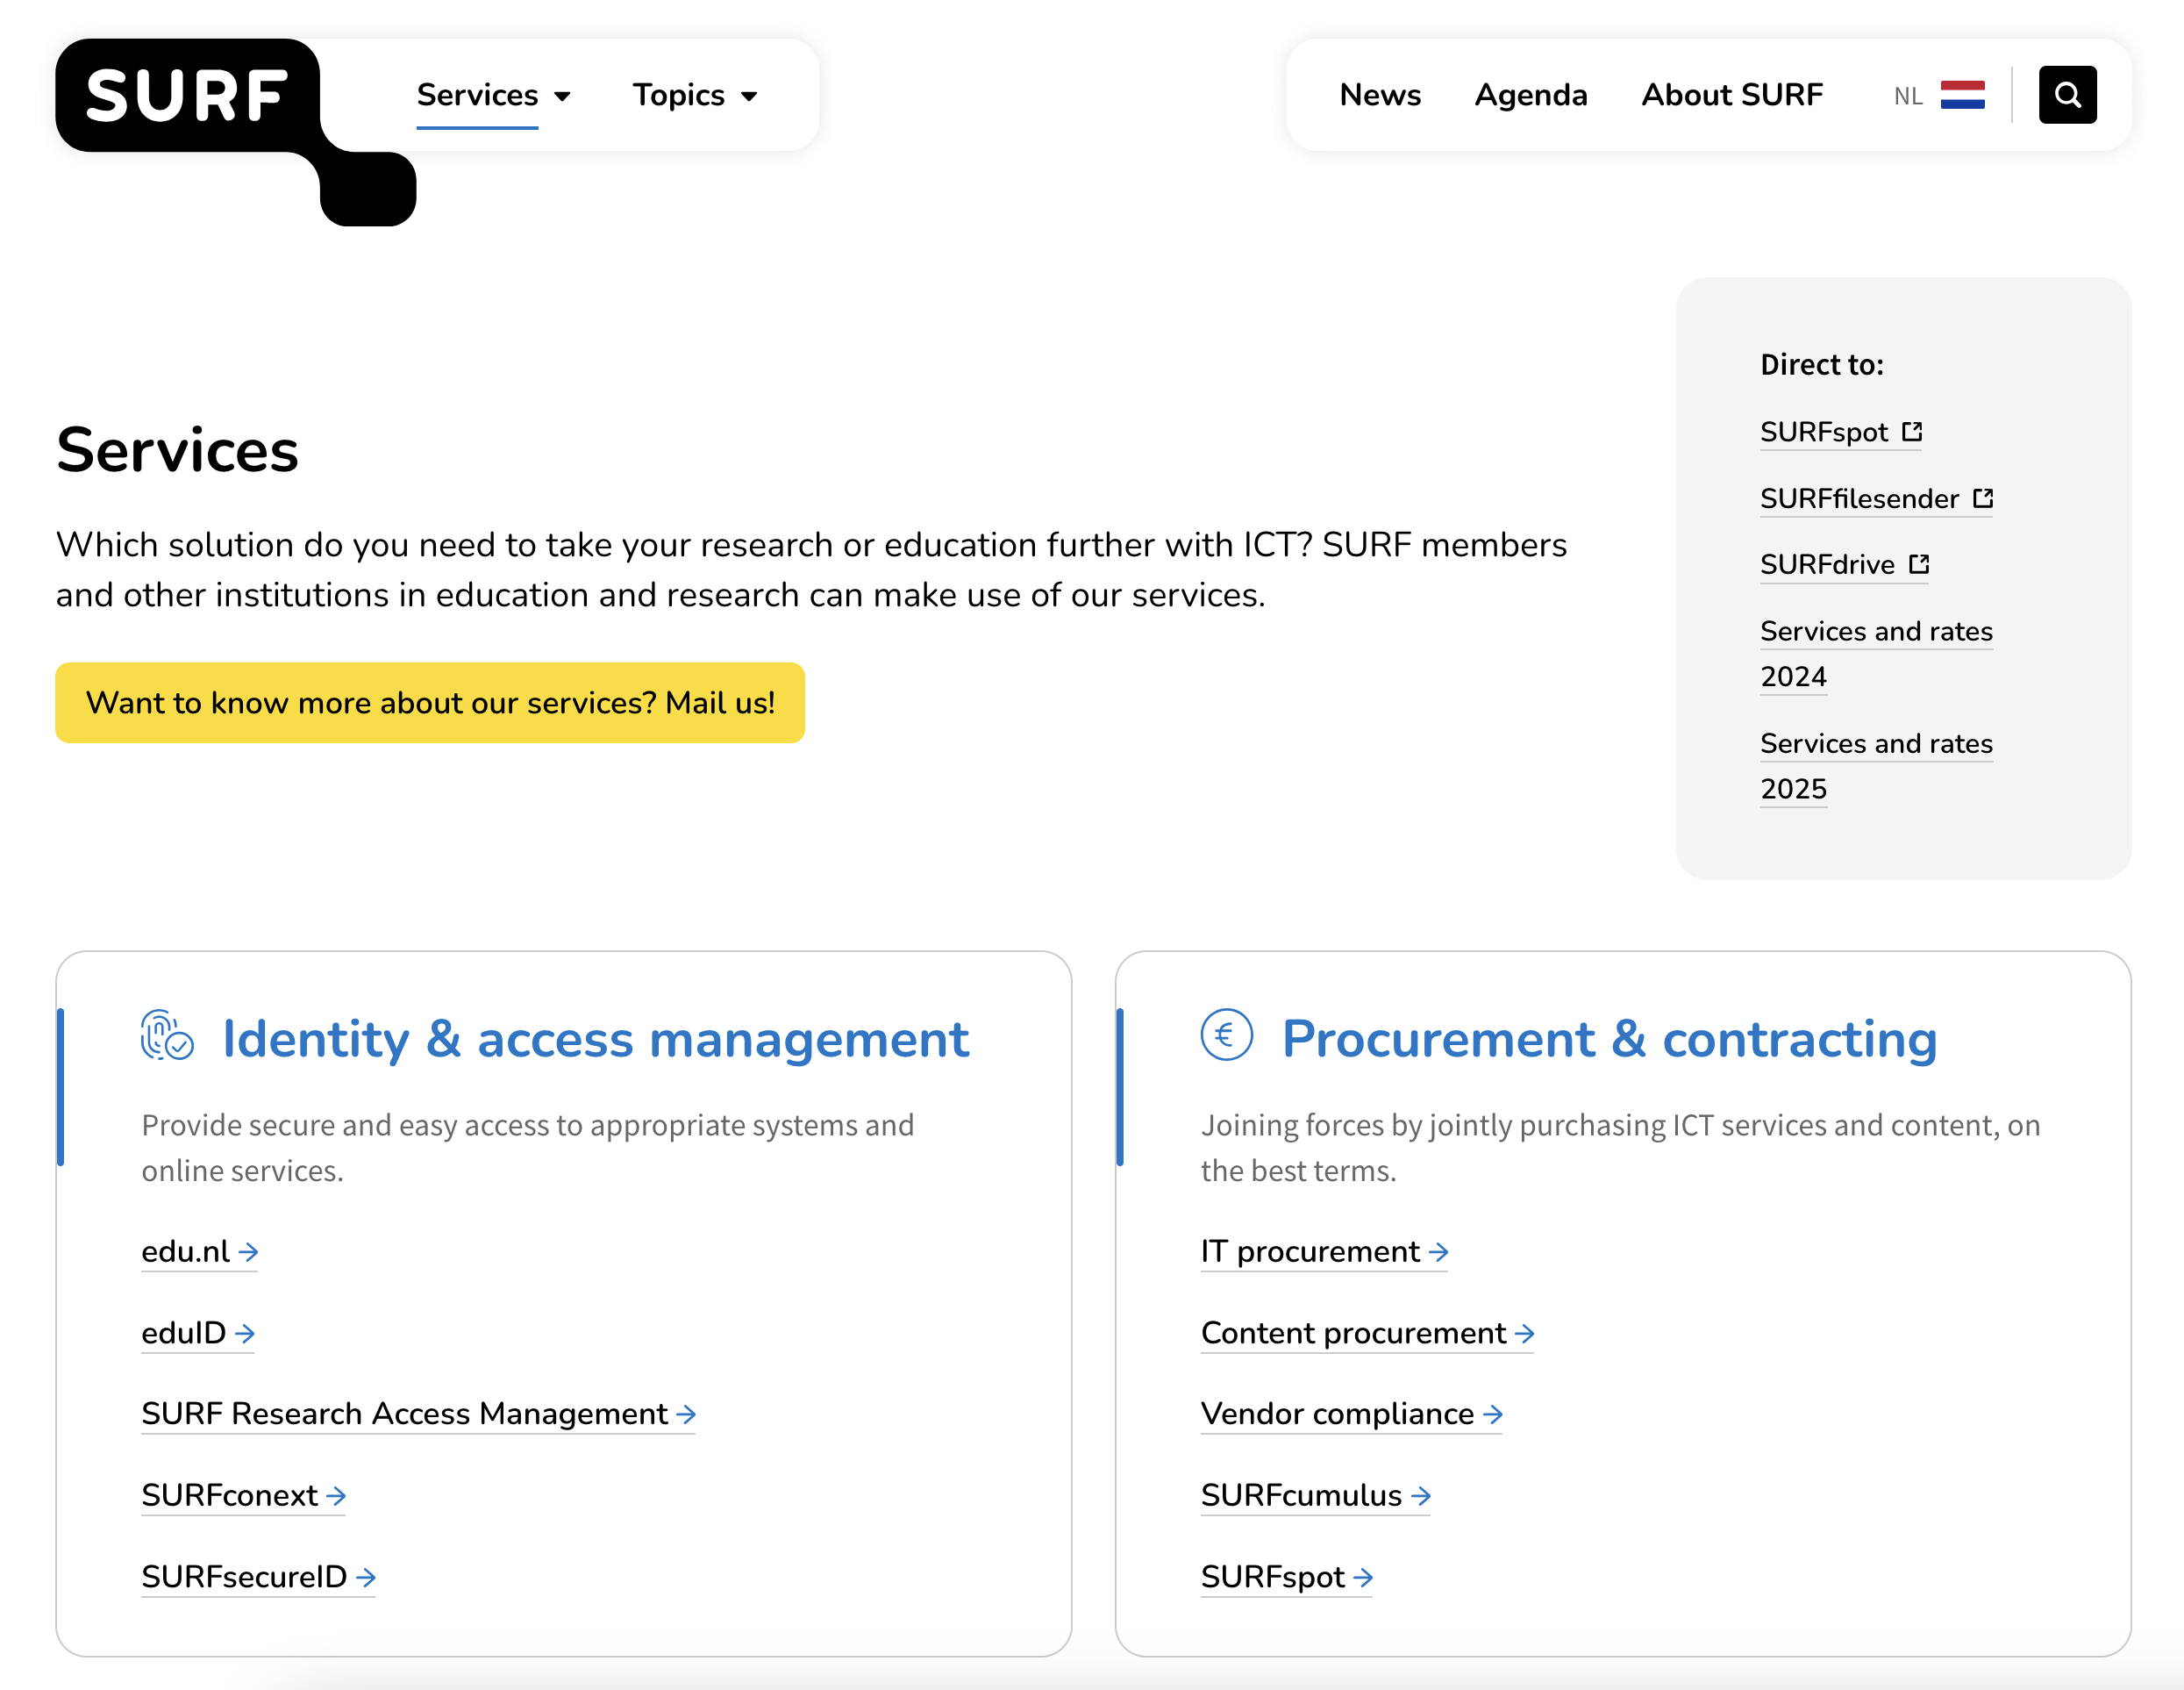
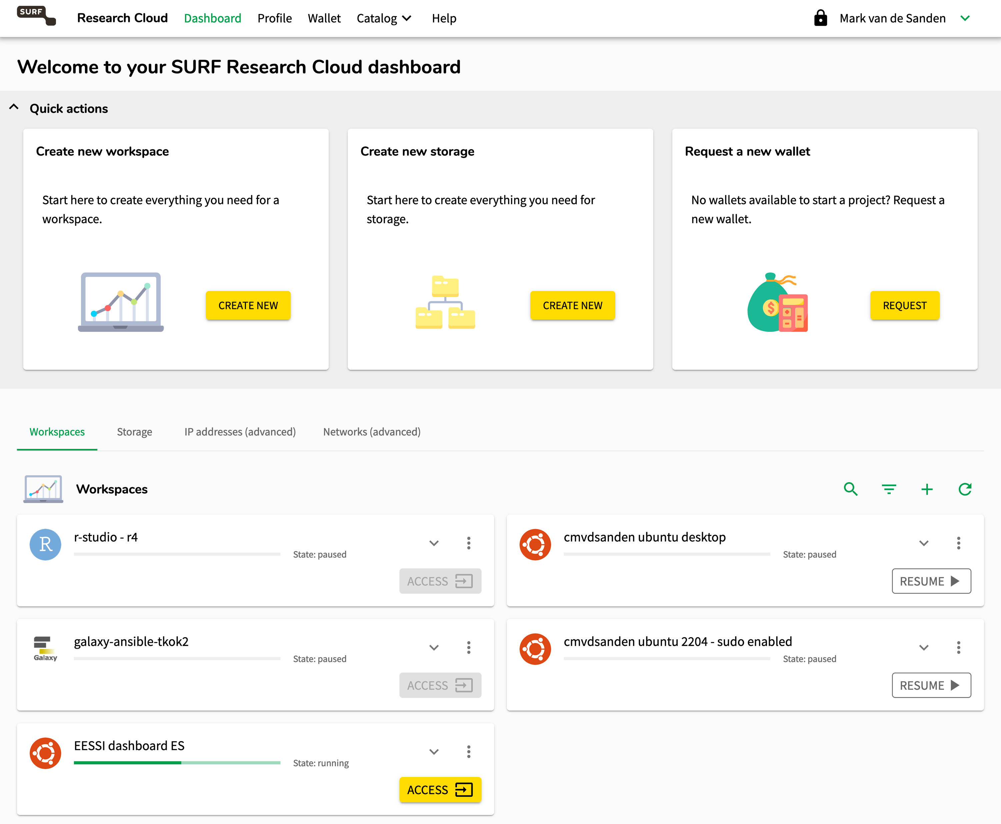
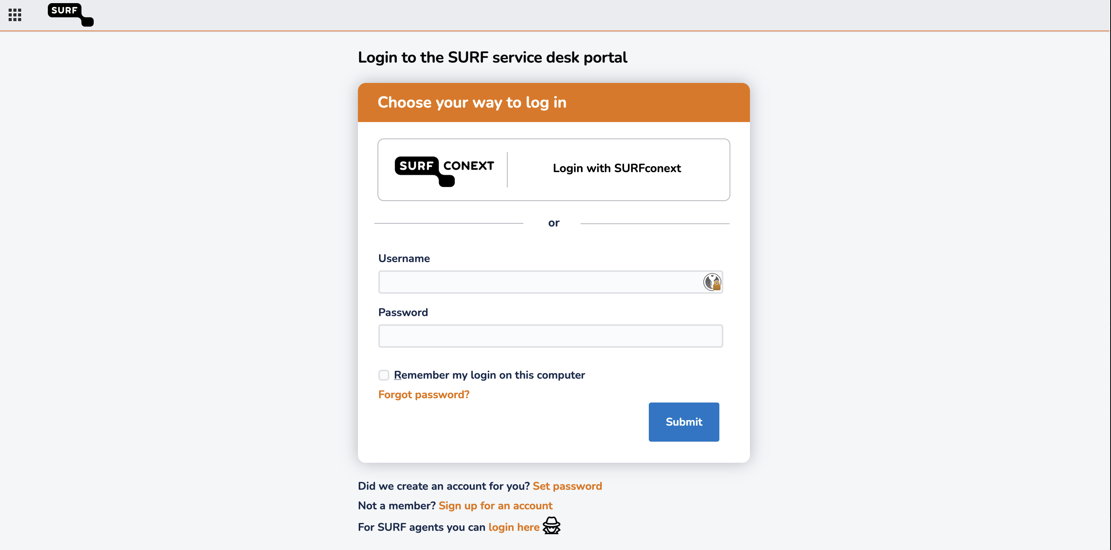
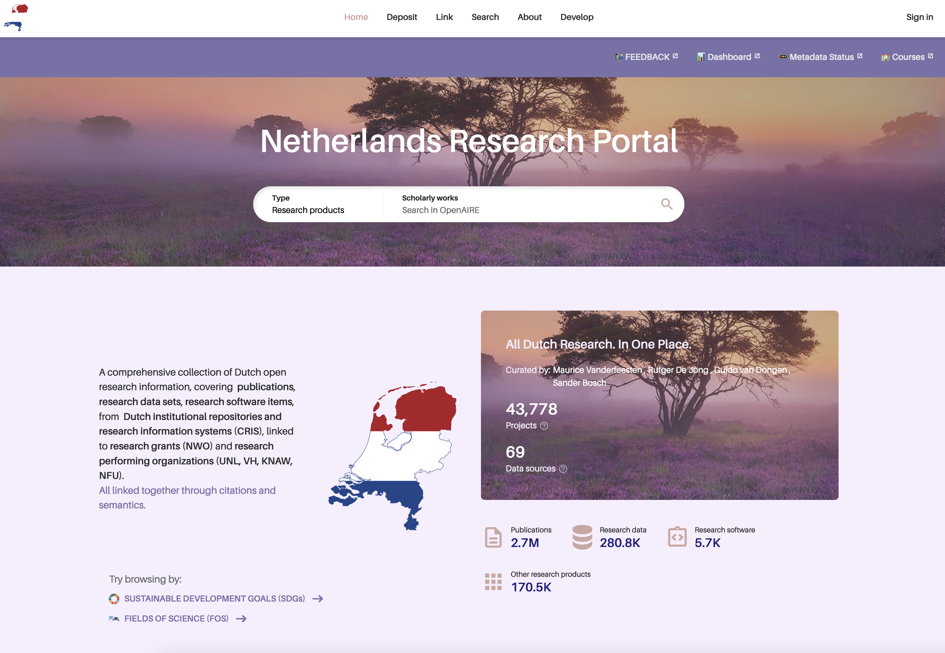
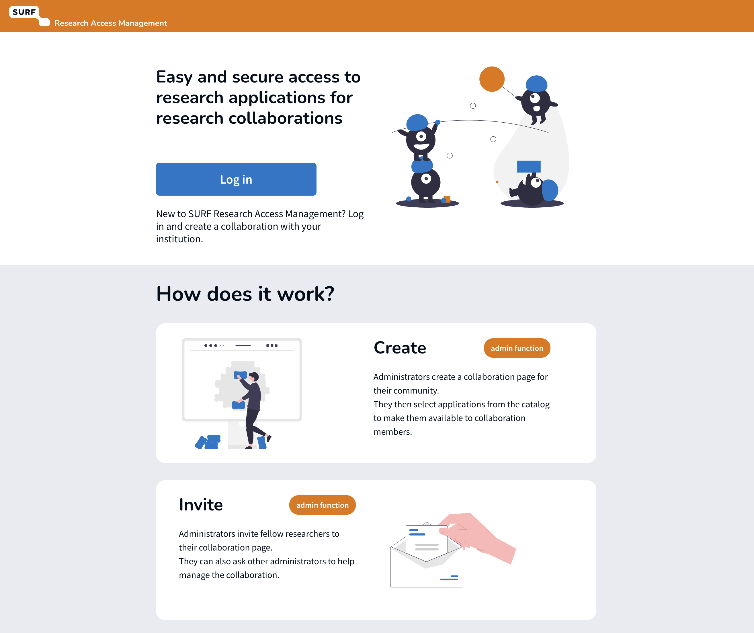
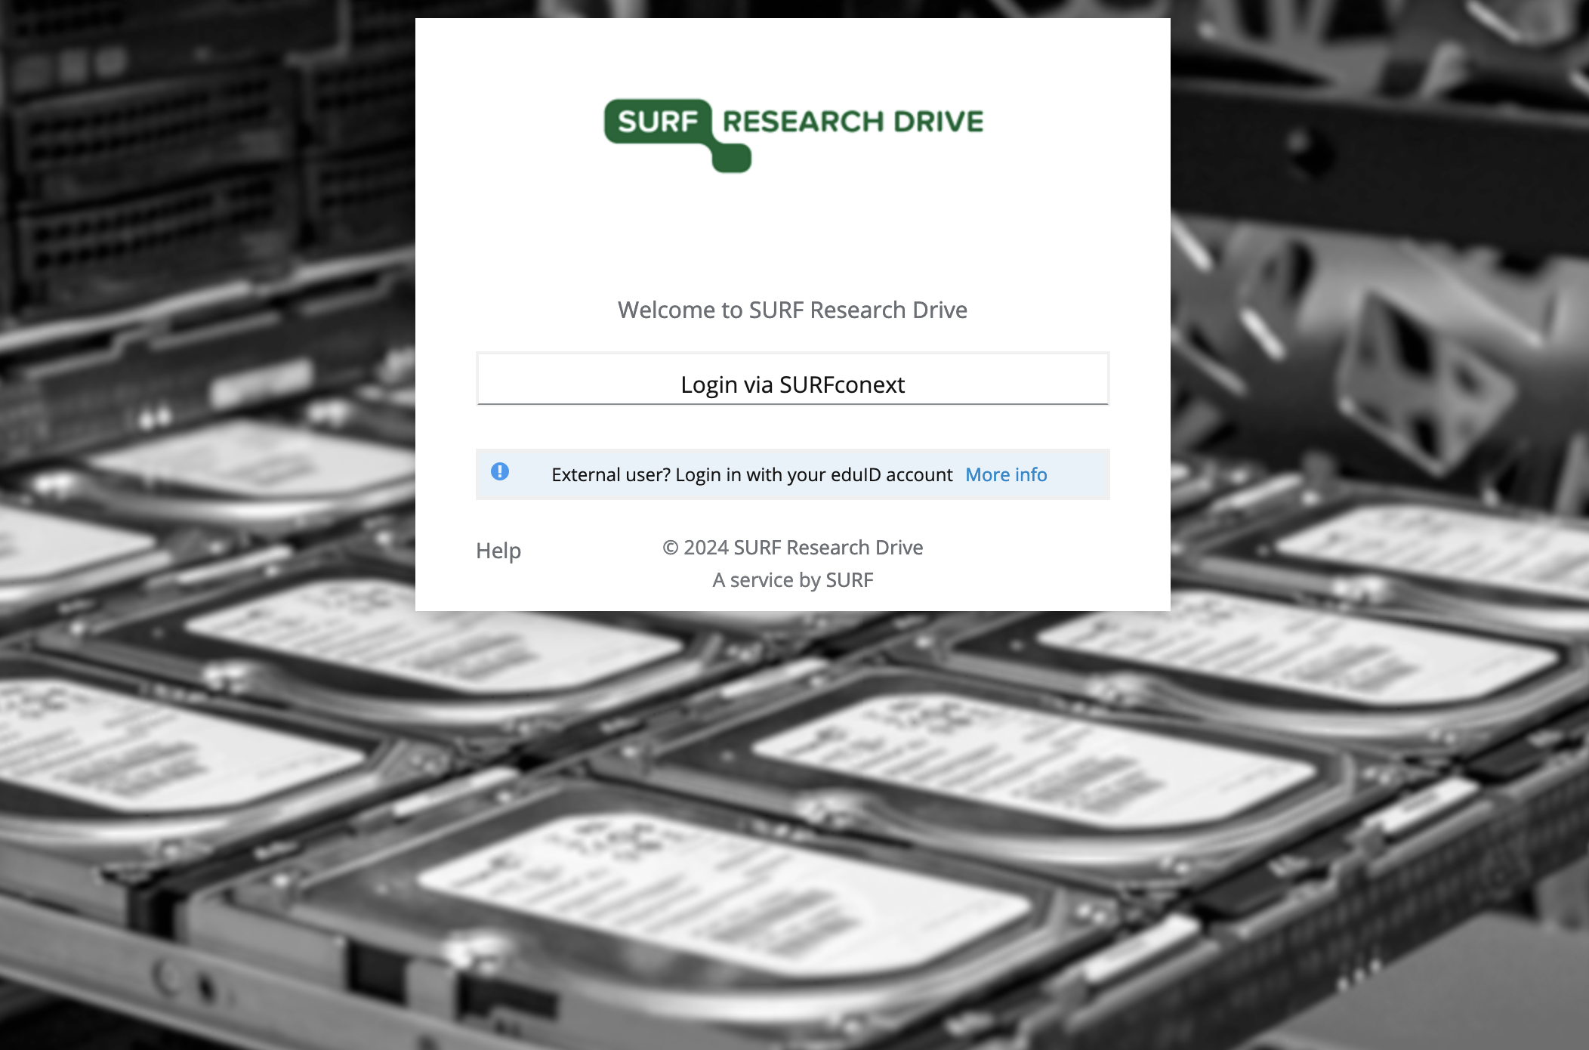
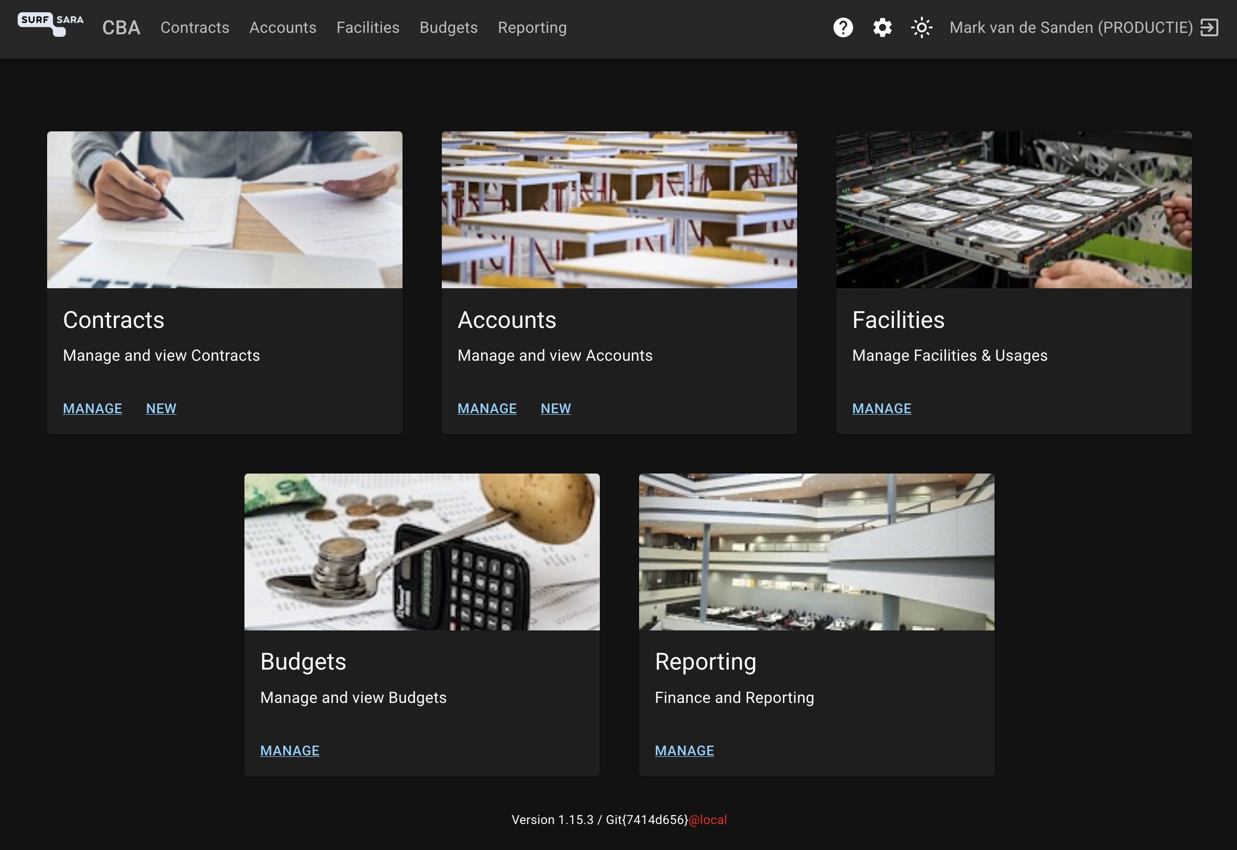

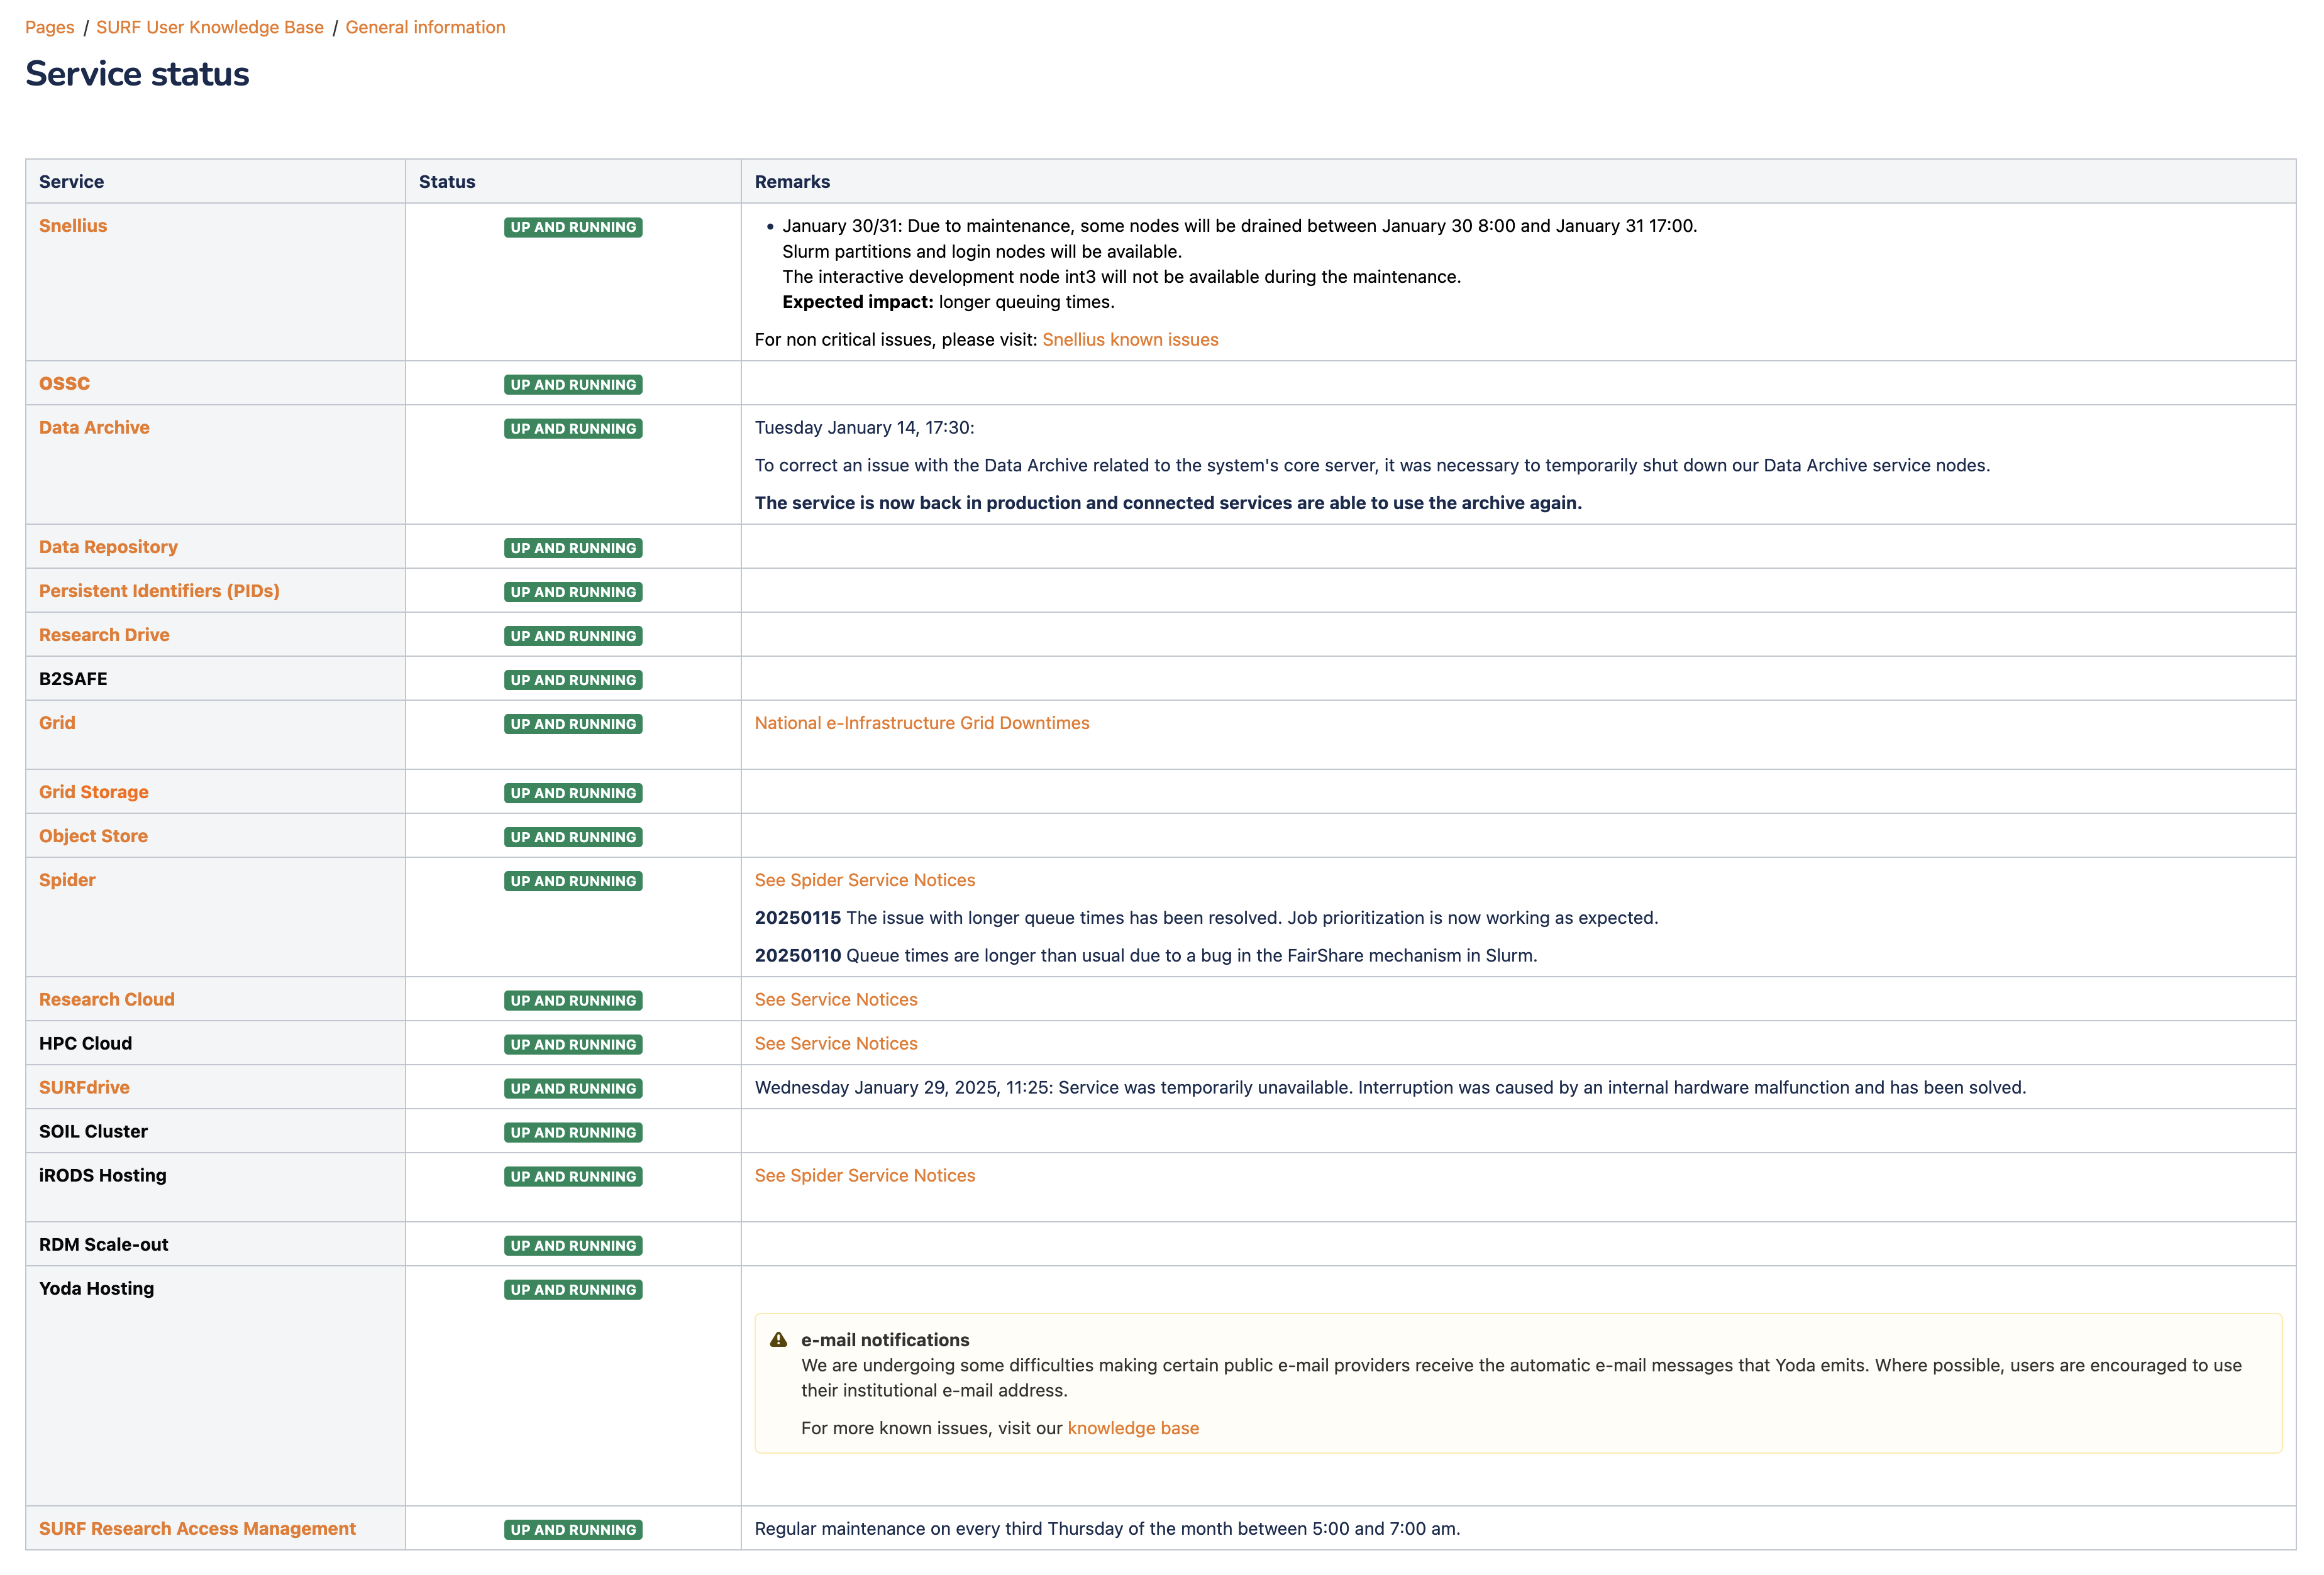
Piloting the National Node technical platform
https://www.surf.nl/en/services
(SURF Service Catalogue)
https://servicedesk.surf.nl
(Helpdesk)
https://netherlands.openaire.eu/
(Research Data Discovery)
https://portal.live.surfresearchcloud.nl/
(Cloud VMs, Containers, Jupyter Notebooks)
https://sram.surf.nl/
(Access Management)
https://researchdrive.surfsara.nl
(File Sync & Share Service)
https://cba.surfsara.nl/
(Budgeting and Usage Accounting)
https://www.taxila.nl/
(Training Materials Repository)
https://servicedesk.surf.nl/wiki/display/WIKI/Service+status
(Service Monitoring)

Slide 31
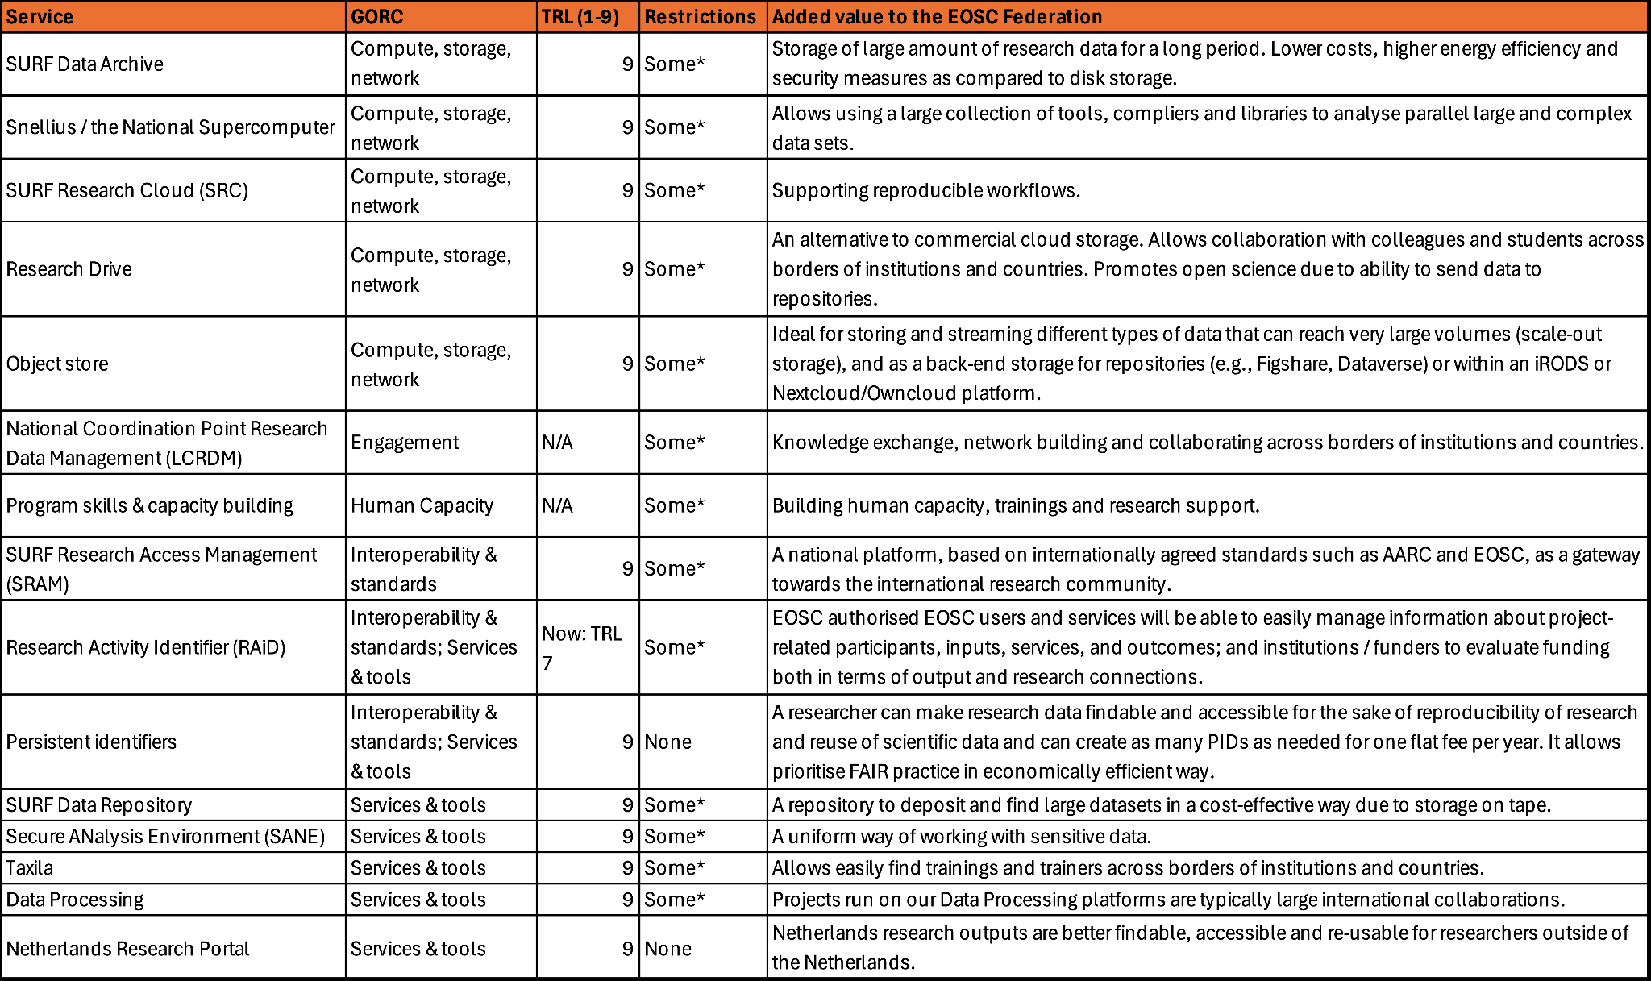





Onboarding potential services

Slide 32
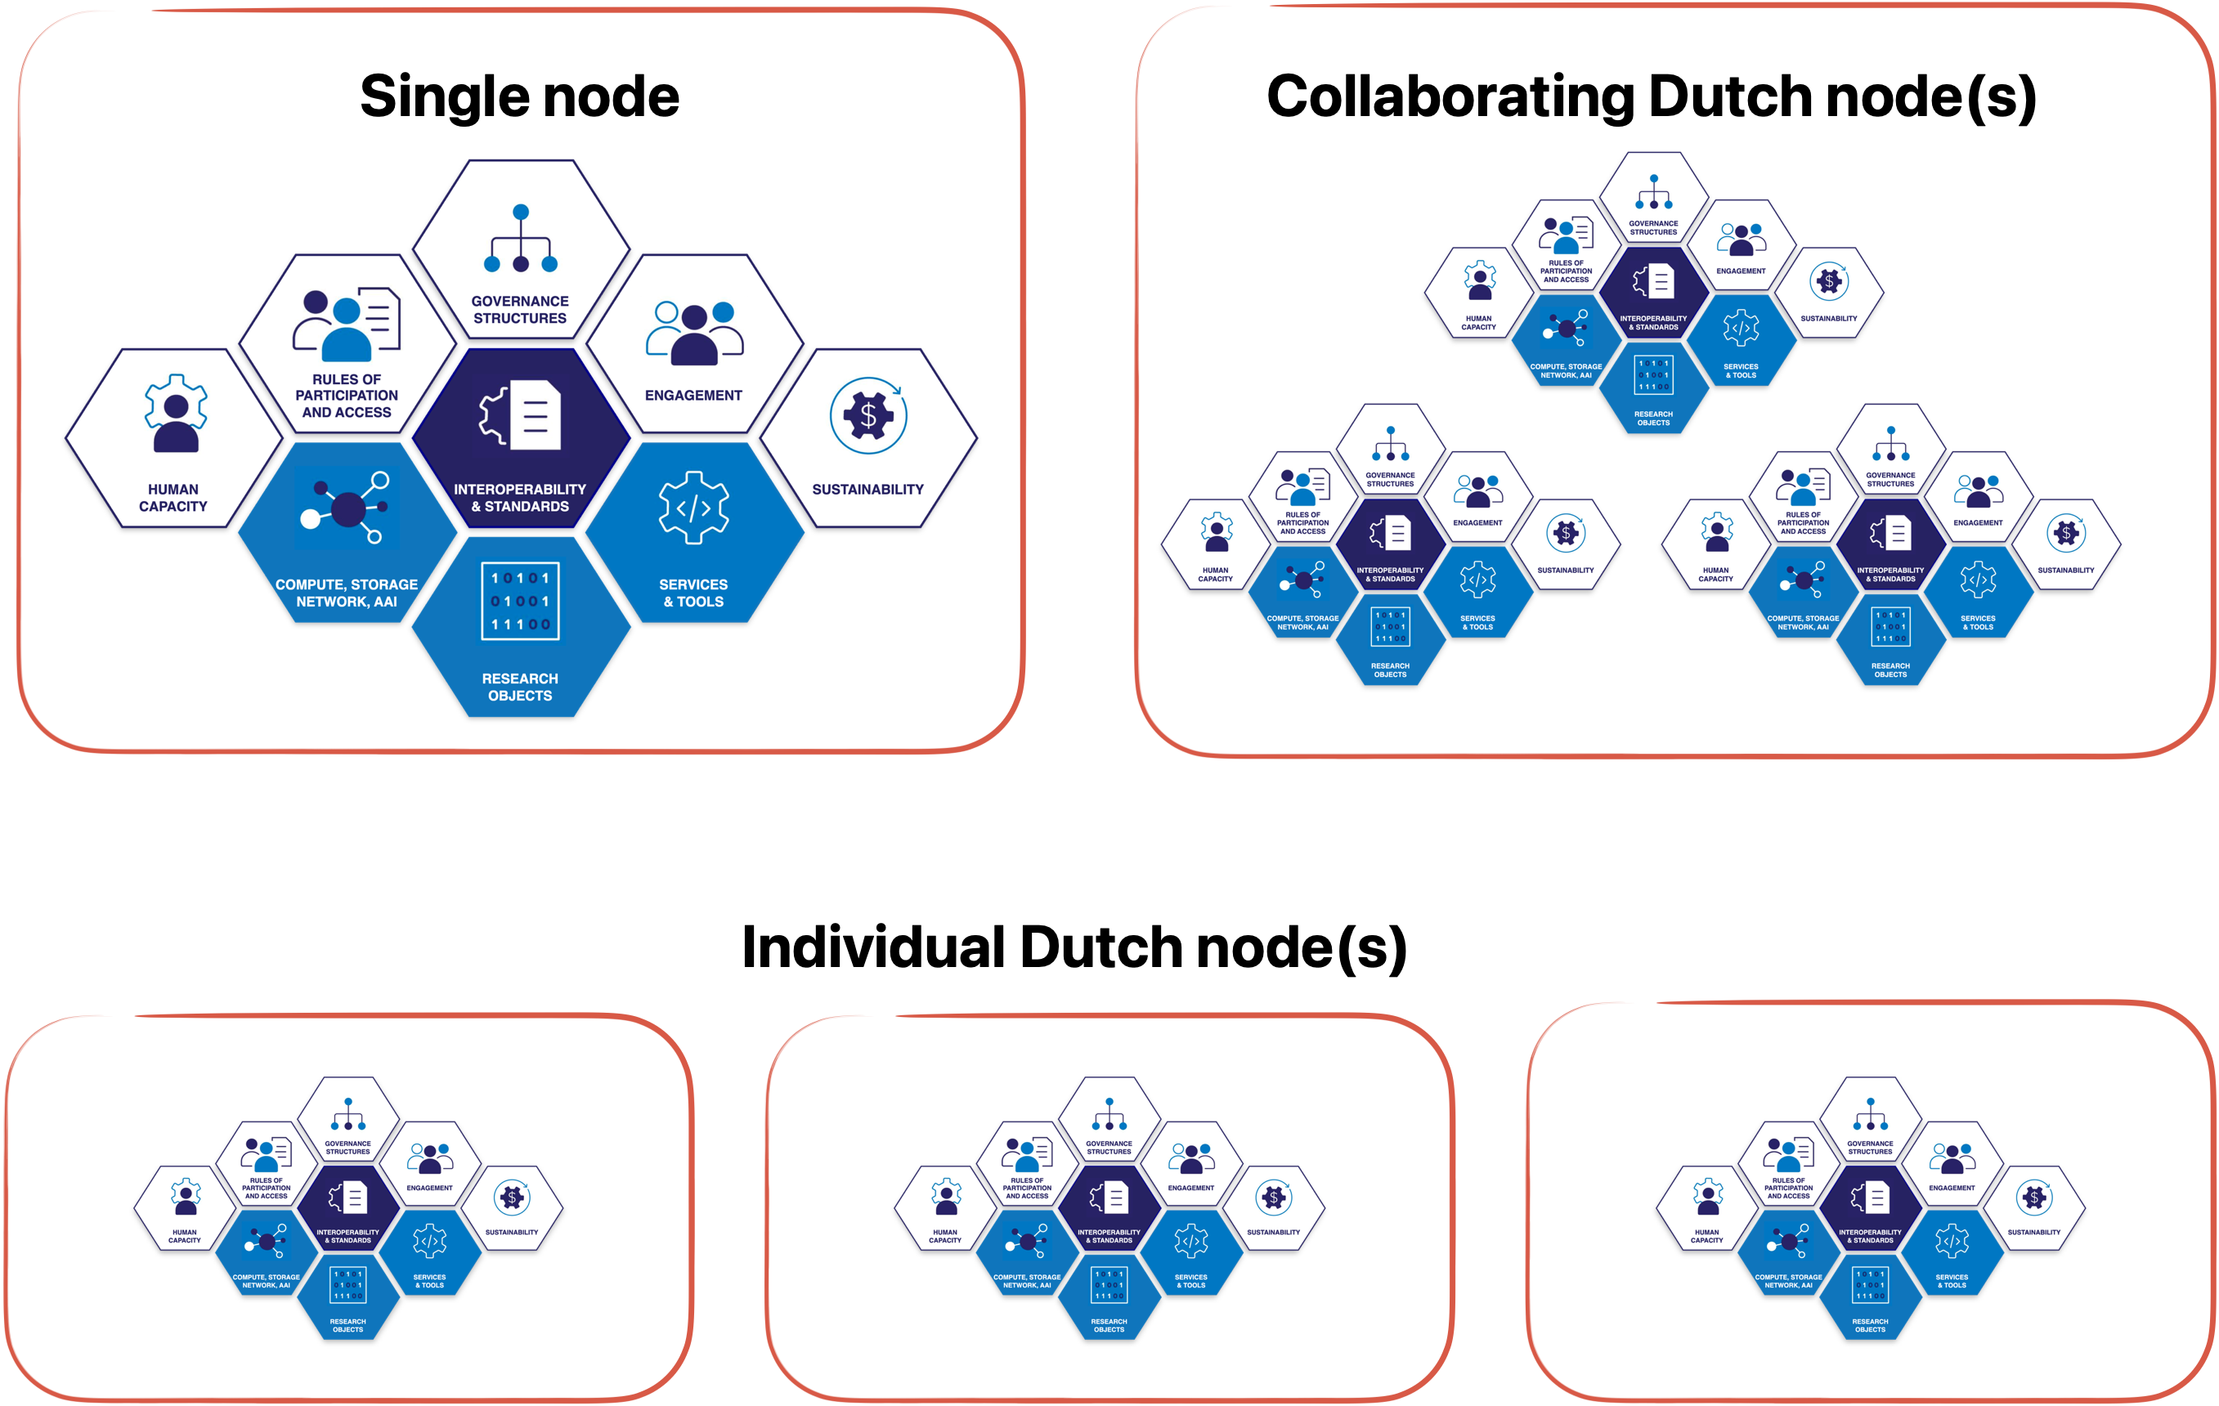
Or?

Slide 33
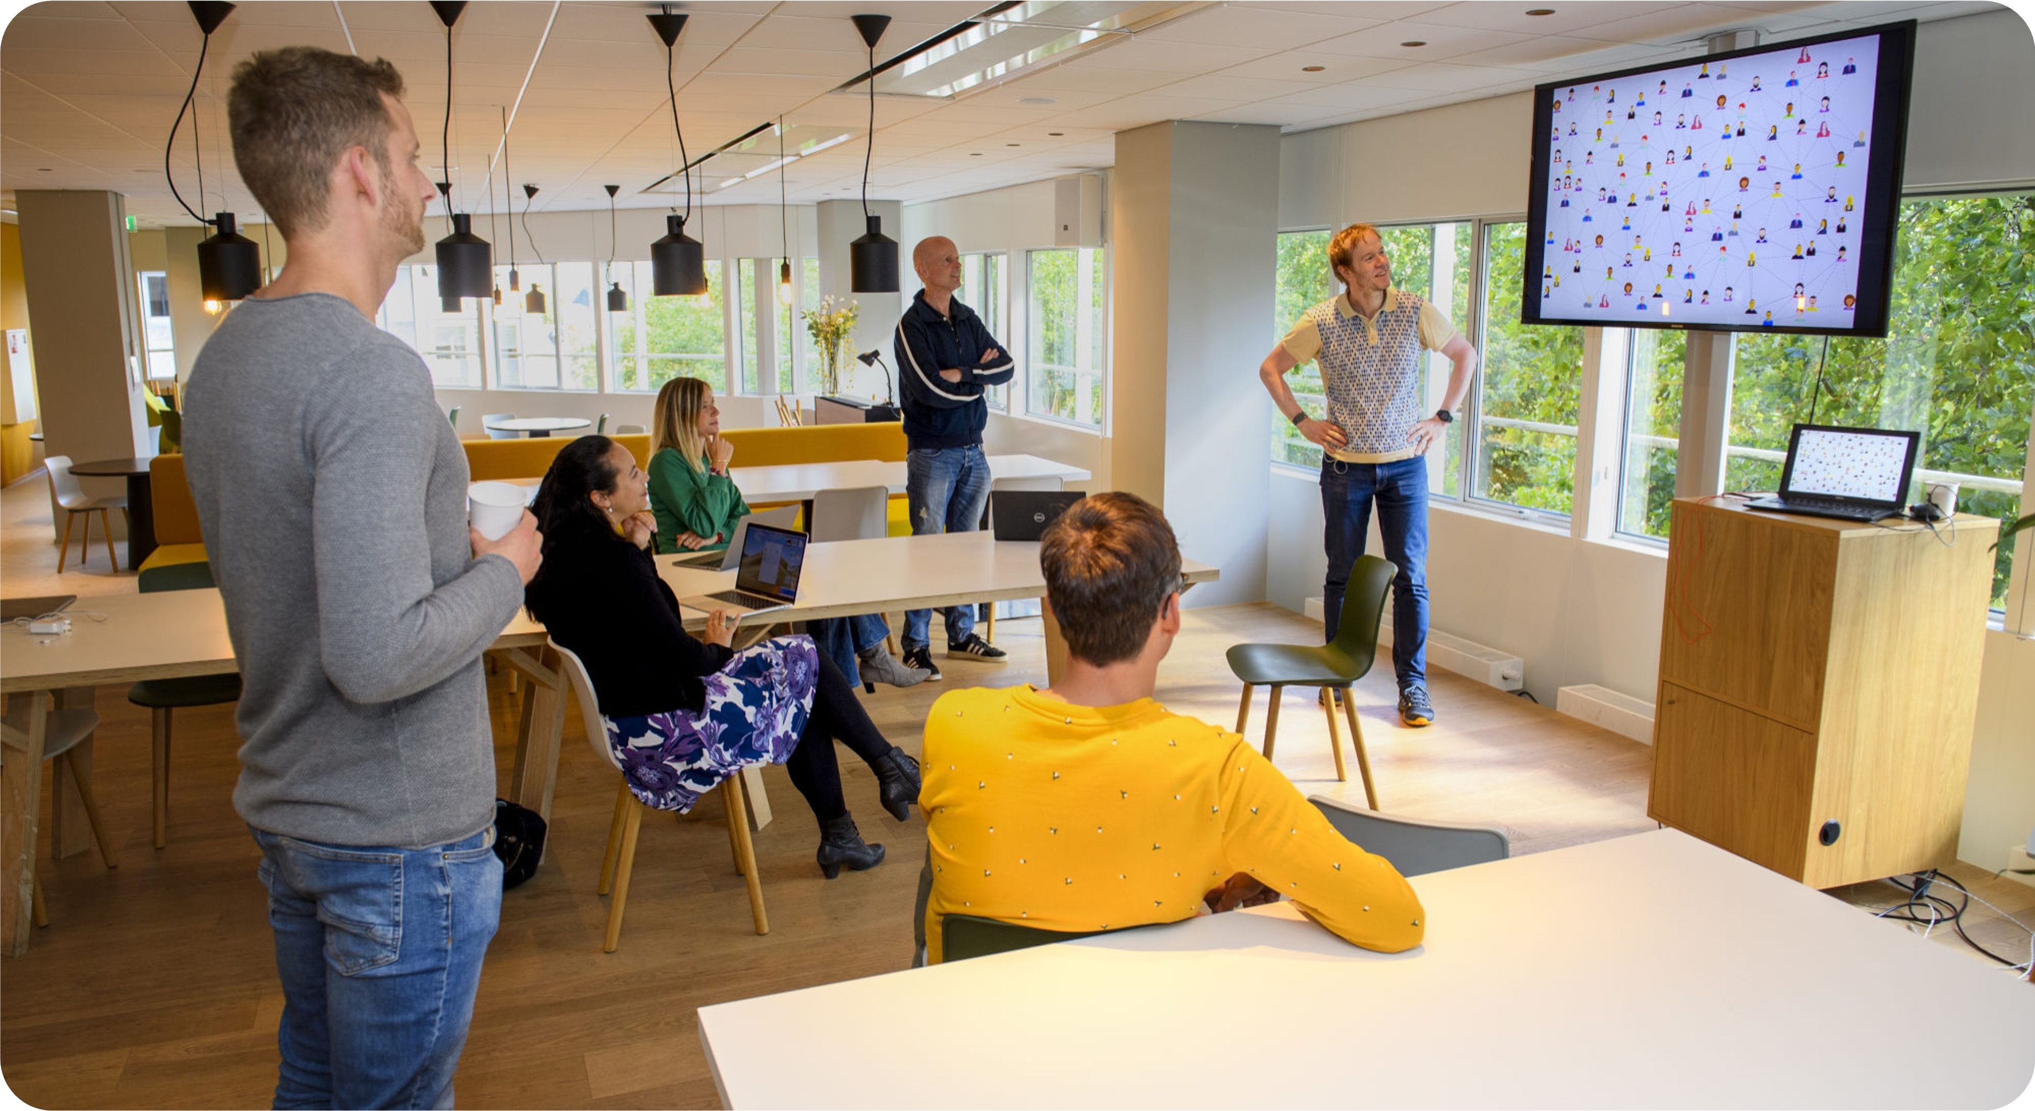
Closing slide
Thank you for your attention
www.surf.nl
Laurents.sesink@surf.nl

