Slide 1
CEI-Sphere Market Talk: Mobility
Golboo Pourabdollahian, IDC

Slide 2
Scope of Webinar
Provide snapshots of market insights on Cloud-Edge-IoT and complementary technologies
Introduce market report and Market briefs generated in the project
Agenda:
Overview of CEI-Sphere CSA
Market insights of CEI technologies in Mobility sector
Market Insights on complementary and disruptive technologies for CEI in Mobility Sector
Q&A

Slide 3
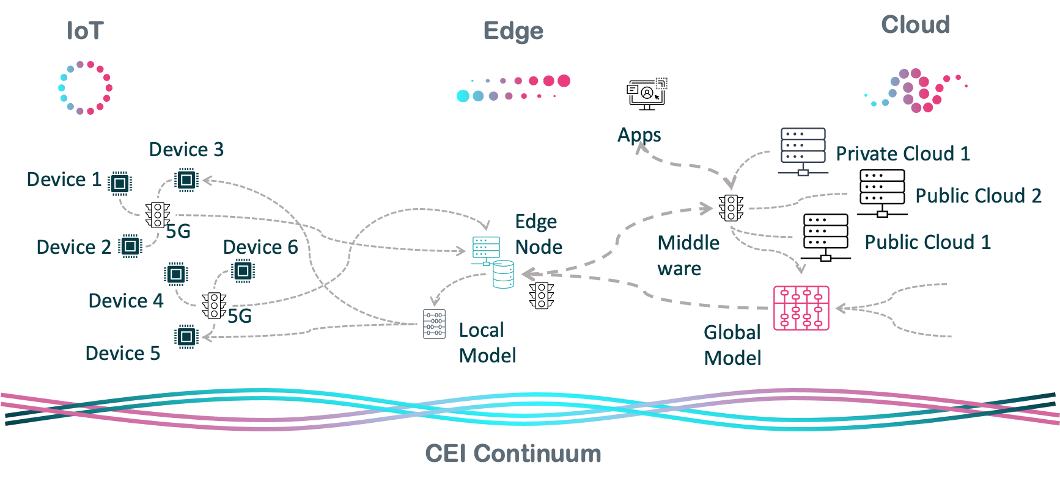
CEI Continuum
The convergence of Cloud, Edge, and IoT (CEI) creates a seamless network where data collected by IoT devices is processed, stored or analysed along the path between the edge and the cloud.
CEI computing continuum (Source: Unlock-CEI Project D4.1)

Slide 4
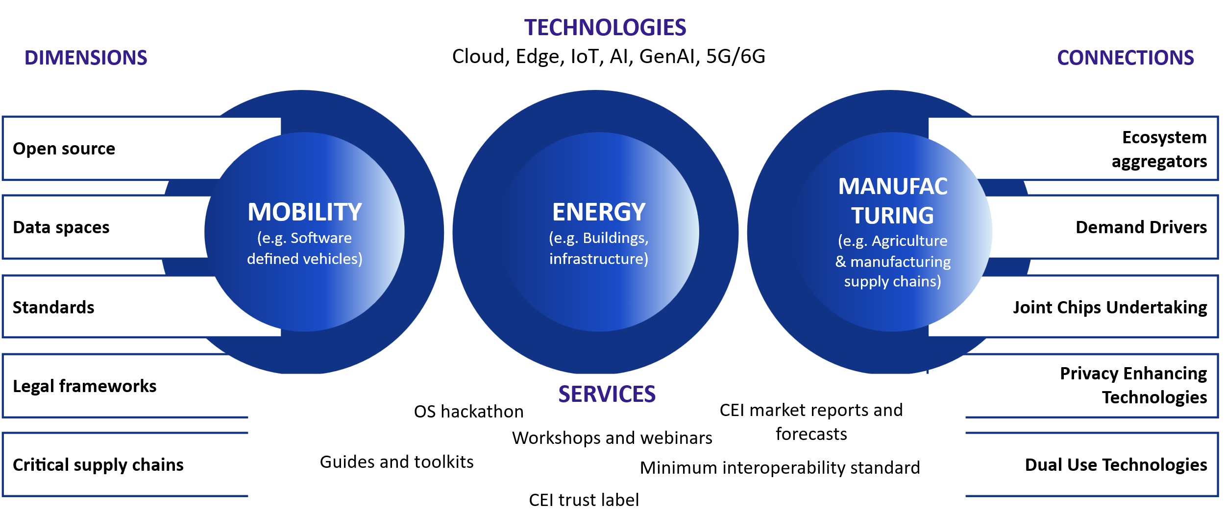









CEI-Sphere Overview
Our scope
Our ‘spheres’
Objective: Support the development of an open, interoperable, and competitive ecosystem for the Cloud-Edge-IoT Large-Scale Pilots (LSPs) through the Horizon Europe project portfolio.
Focus: Scalable, next-generation Cloud to Edge IoT solutions.
Target: Address specific demands of key European industries to enhance global competitiveness.
Key Technologies:
  Meta-OS architectures
  Decentralised intelligence
  Swarm computing
Implementation:
  Provide opportunities to regenerate the supplier base to include startups and SMEs.
  Encourage new entrants to test solutions and ensure robustness and fitness for purpose.
Project details
Start: 01/10/2024 | Duration: 30 months
Budget: €2,001,625 | More information here
The partners

Slide 5






CEI Market Analysis Report & Briefs
Extensive market report and five market briefs are available on CEI-Sphere website.
https://zenodo.org/records/15259914
https://ceisphere.eu/market-briefs

Slide 6


Join Our Upcoming CEI Market Talks

Slide 7


Slide 8


