Slide 1
Data Stewards in the Making:
Insights from our Professional Development Journey
Berckmans Jolien, Daniels Nicky, Kenens Ulrike*, Vlietinck Hanne

Slide 2








UHasselt and FRDN:
Investing together
in Data Stewards
Growth

Slide 3


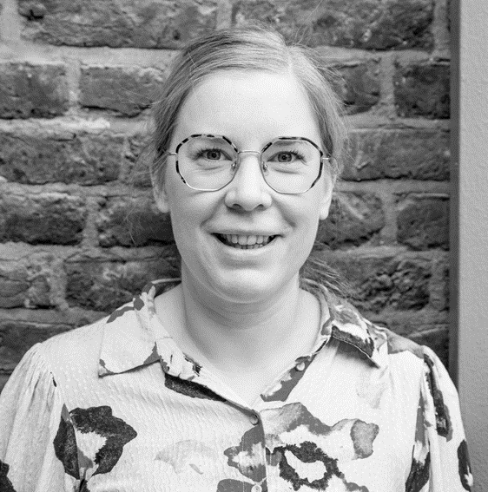

Skills 4 EOSC @ 4TU.ResearchData
Nicky Daniels Q3-4 2024

Slide 4
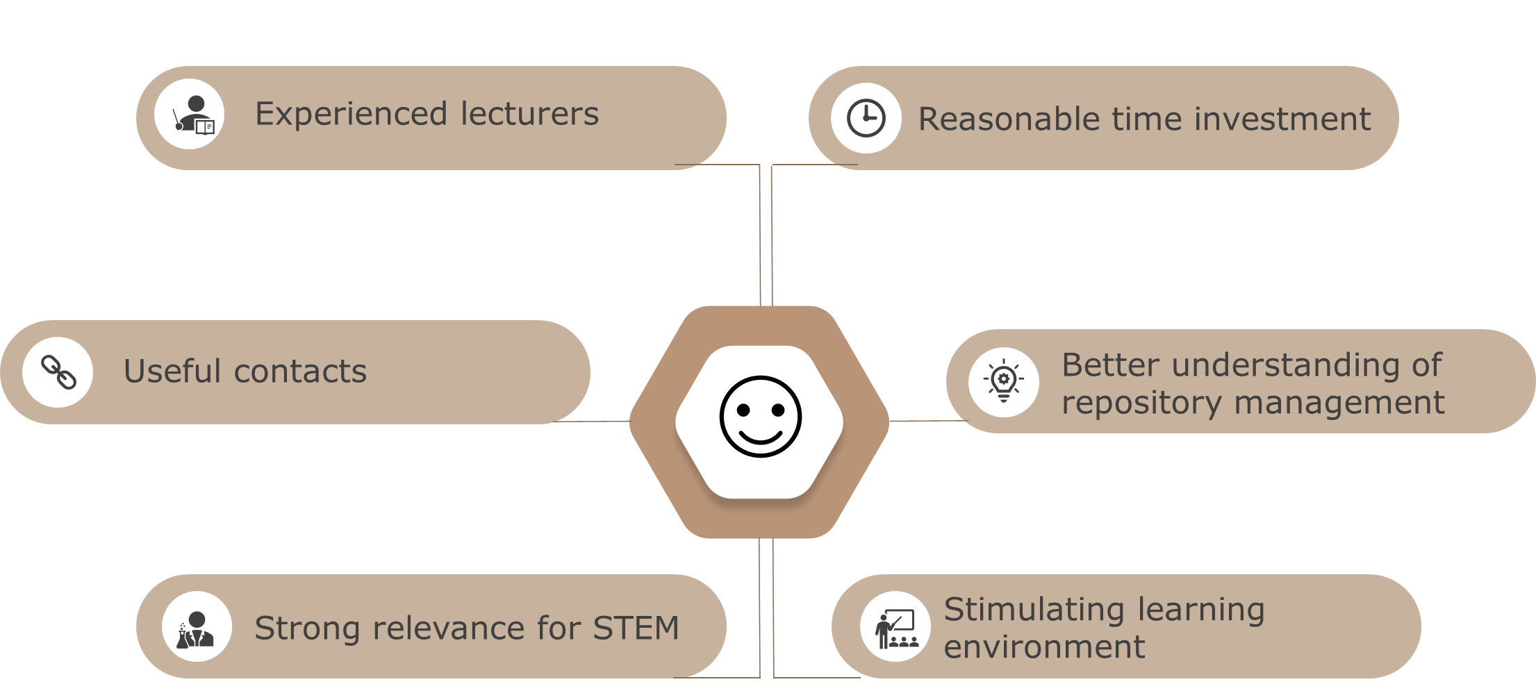
Skills 4 EOSC @ 4TU.ResearchData – key strengths

Slide 5


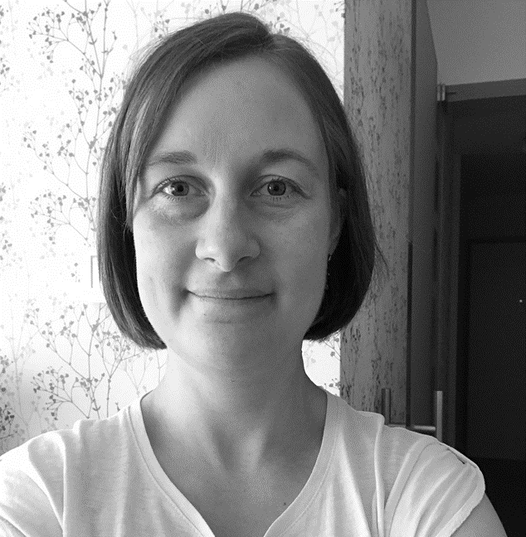
Data Steward certificate course (University Vienna)
Ulrike Kenens 2024-2025

Slide 6
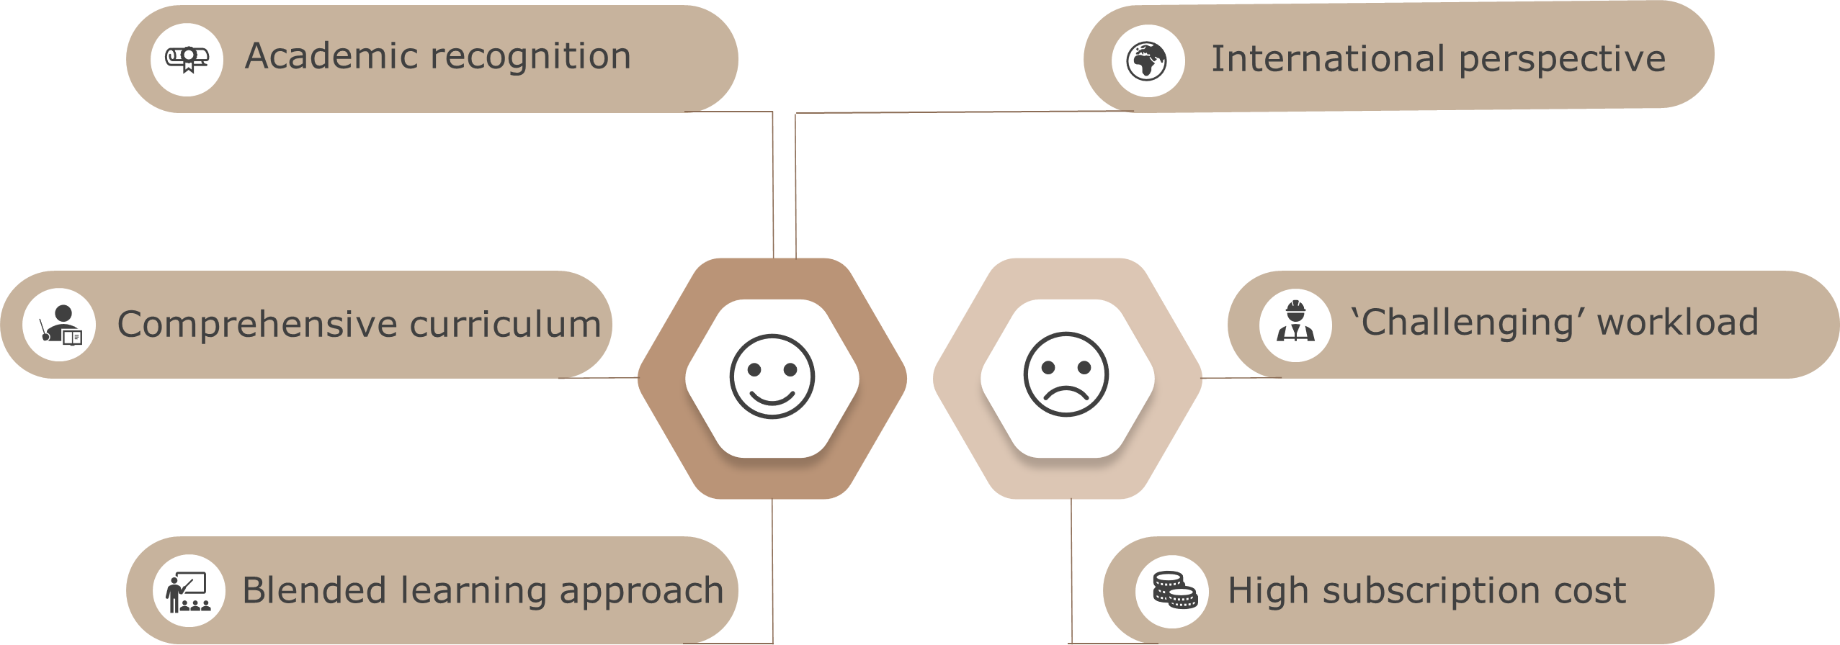
Data Steward certificate course (University Vienna) – key strengths and weaknesses

Slide 7

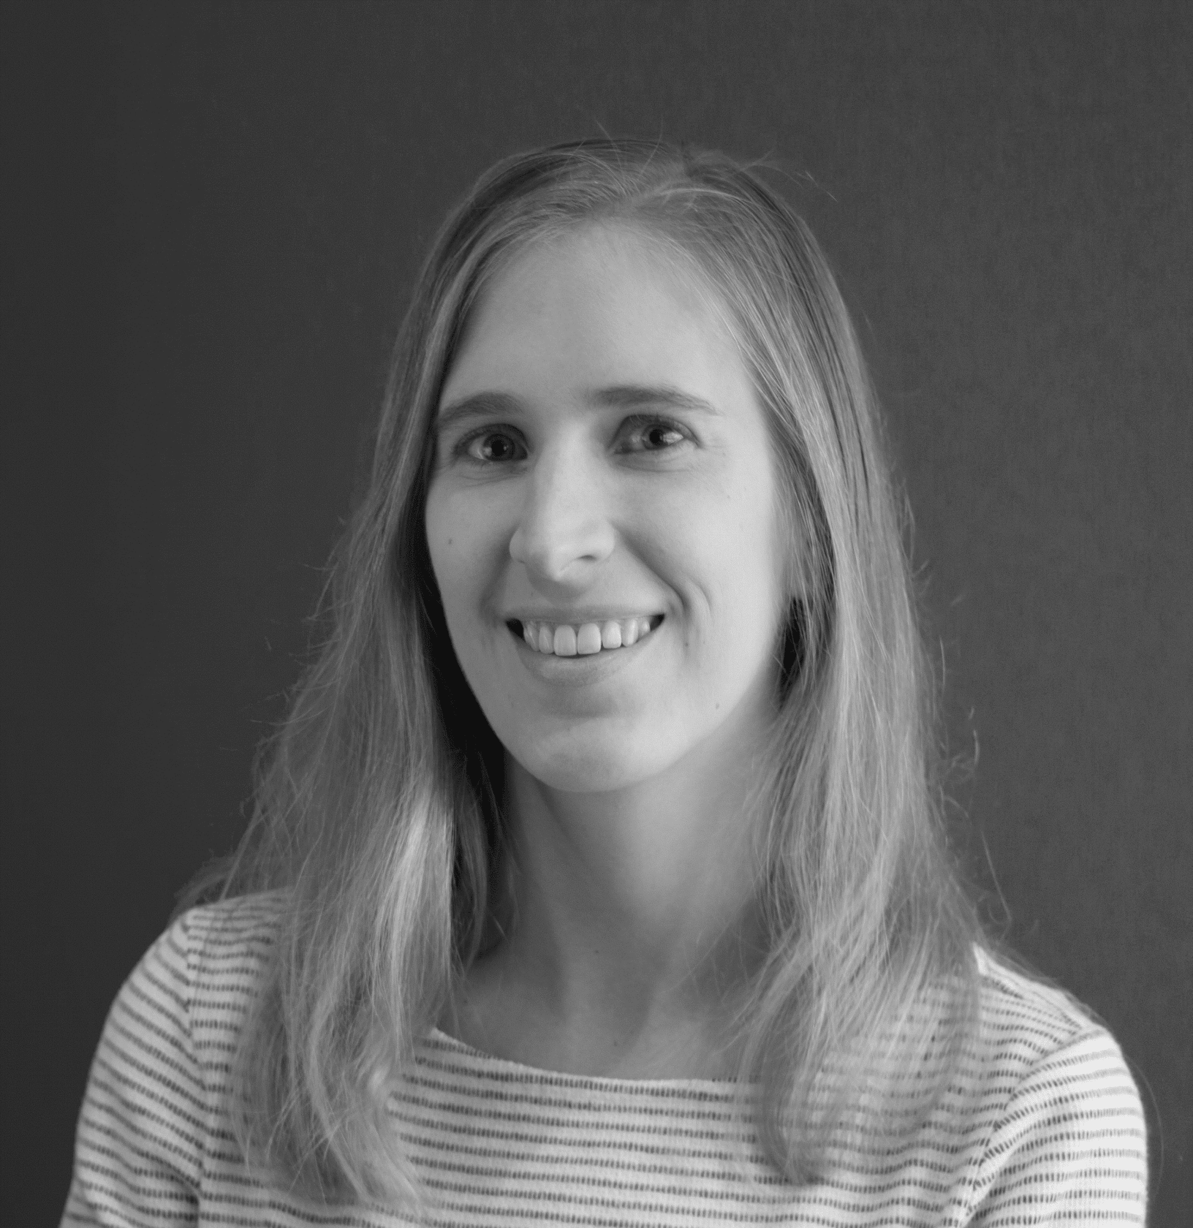
OpenAIRE Open Science train-the-trainer Bootcamp
Jolien Berckmans September 2024

Slide 8
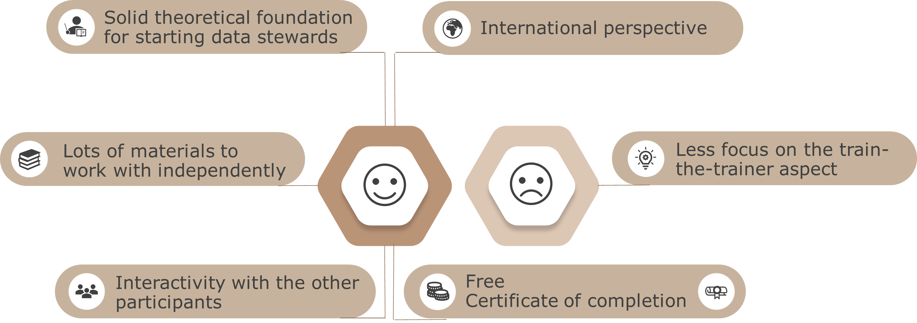
OpenAIRE Open Science train-the-trainer Bootcamp – key strengths and weaknesses

Slide 9

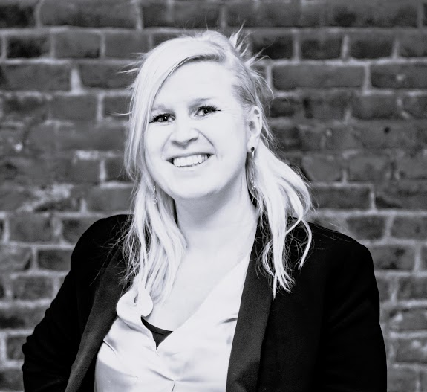
VLIR-UOS partnerships
Hanne Vlietinck 2022-ongoing

Slide 10
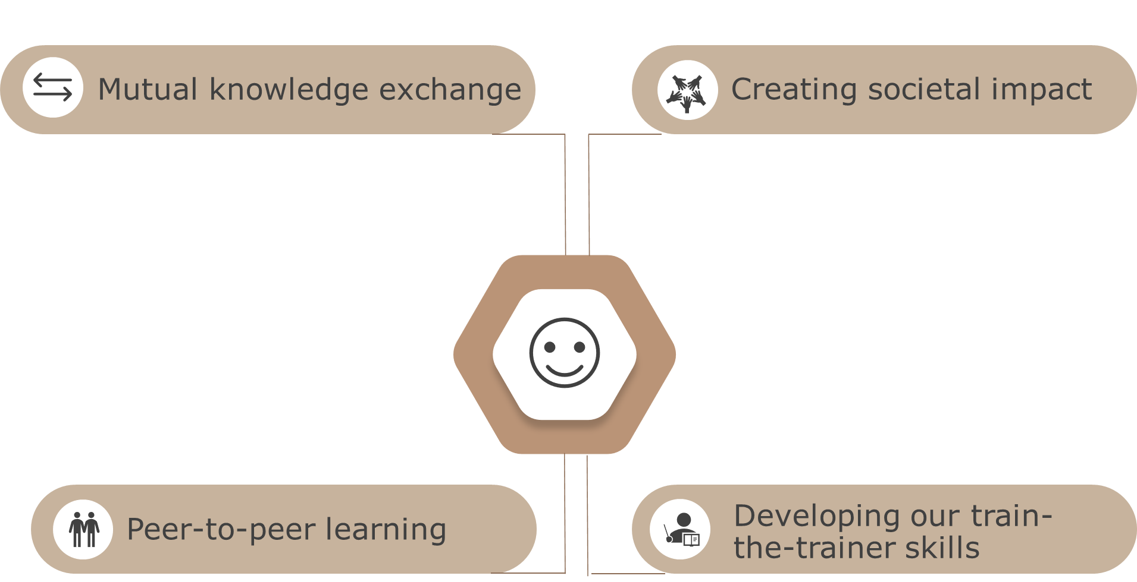
VLIR-UOS partnerships – key strengths

Slide 11

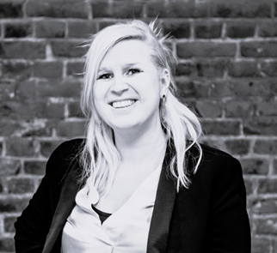
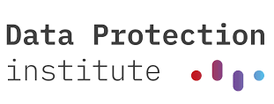
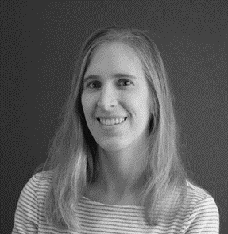

Introduction to Data Protection
All UHasselt data stewards 2024

Slide 12
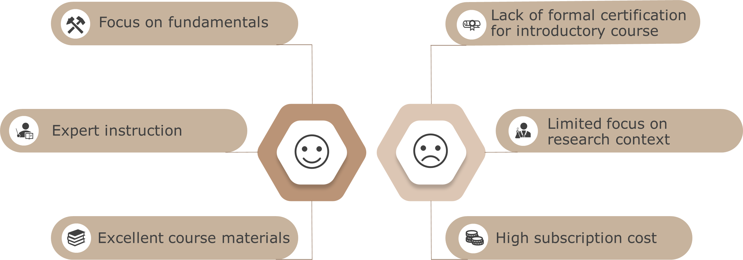
Introduction to Data Protection – key strengths and weaknesses

Slide 13

Essentials 4 Data Support
Nicky Daniels Q1 2024

Slide 14
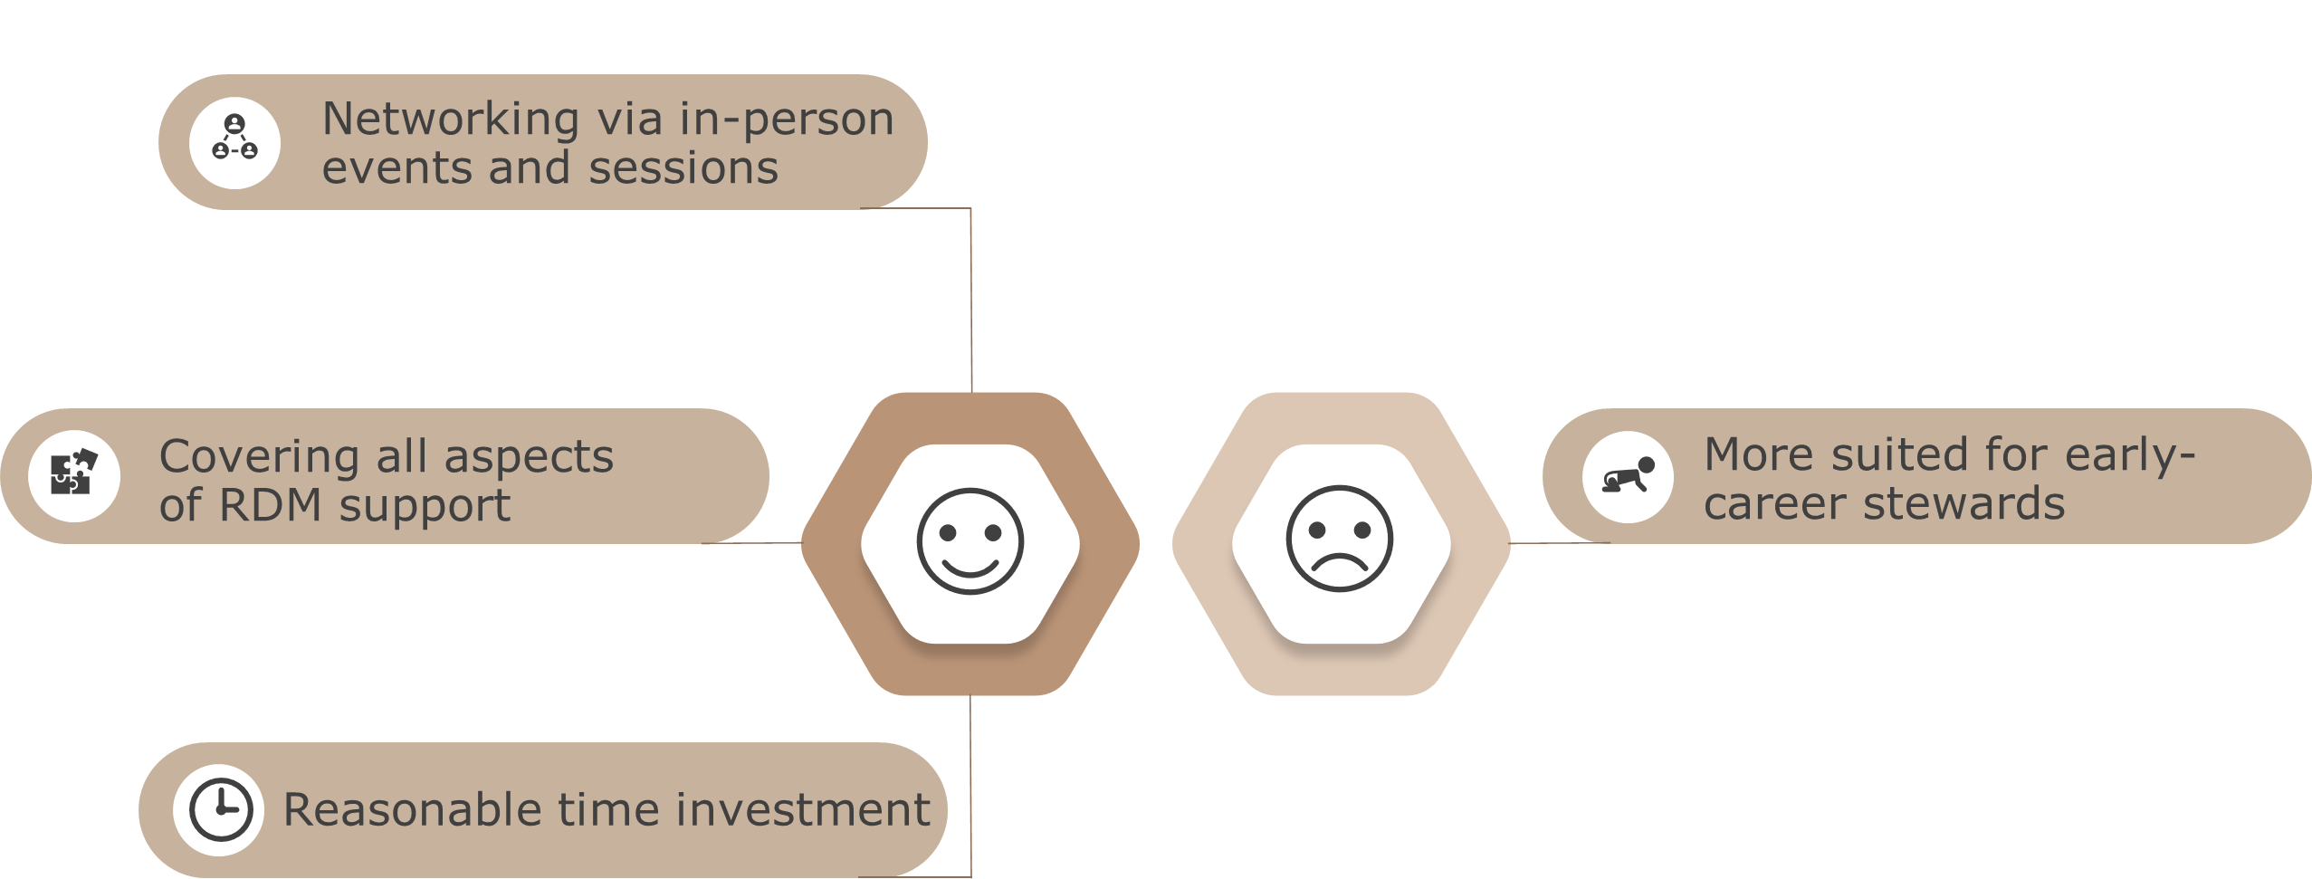
Essentials 4 Data Support – key strengths and weaknesses

Slide 15

Dedicated to continue
our professional development
journey in:
Personal data management
Software management
Open Science
Good Clinical Practice
GenAI
…

