Slide 1
Data Documentation Initiative (DDI) and Training Working Group:
Who, What, and How
DDI Training Working Group (DDI-TG)
IASSIST - June 2025
CC BY
Notes:
This presentation introduces the Data Documentation Initiative (DDI) and the training materials that have been developed by the DDI Alliance Training Working Group (TWG).
The DDI Training materials assist a variety of audiences and experience levels in understanding DDI products and implementing them in their organisation. The first version of DDI was published nearly 25 years ago, and since then there have been many dedicated DDI enthusiasts working together to promote understanding of data, metadata, and standards through the use of DDI.
DDI is an open international standard, for describing the data produced by surveys and other observational methods in the social, behavioral, economic, and health sciences. It can also be used to document and manage different stages in the research data lifecycle.
The DDI Training Working Group maintains a training library using Zenodo and YouTube, with some content available in multiple languages, such as French and Korean. These resources are freely available, to serve individuals new to and familiar with DDI. This presentation will provide some history of DDI and the DDI TWG, and guide attendees to existing and recently developed DDI resources.

Slide 2
DDI - The Data Documentation Initiative
“DDI - Data Documentation Initiative - is a metadata standard for describing research data. It provides a structured way to document datasets, improving data sharing and discoverability across disciplines.”
“Using DDI enables better data reuse, compliance with standards, and increases interoperability.”
-https://ddialliance.org/introduction-to-ddi

Slide 3


Who is the DDI Training Working Group?
Community of volunteers from around the world
The Training Working Group focuses on introducing people to DDI and enhancing their proficiency in using it. It tailors training for specific audiences, builds training expertise within the community, and maintains a library of updated materials for reuse.

Slide 4
Who is the DDI Training Working Group For?
We create content to help:
Researchers, data repositories, statistical agencies, and academic institutions widely use DDI to ensure consistent, comprehensive data documentation, enhancing data accessibility and utility.
Anyone can apply to join a working group. Each group has a leader who manages the work and reports to the governing body.

Slide 5
Some History of the DDI-TG -
Helping people with “a steep learning curve”
Began around 2015 (From the 2014-2017 Strategic Plan) - Aimed to build a community around DDI training and increase access through innovative mechanisms
“High-quality training is essential to effective use and understanding of DDI. Training should be audience-specific and provided in a variety of formats; in addition, a library of training materials should be available. This work will be undertaken in 2016–2017 by a training working group set up under the auspices of the Scientific Board.”
Goal to broaden training efforts
  Additional workshops
  A wider array of useful training materials
  Formal training courses that are widely offered
  Provide access to step by‐step instructions in getting started with the DDI using the Alliance Website
  Offer “train the trainers” to ensure a solid group of trained presenters represent the Alliance
  Offer trainings on a regular schedule and also in a flexible, customized manner

Slide 6
Brief Timeline of the DDI Training Working Group
2000
2001
2003
2007
2011
2015
2020
2021
First DDI Training at IASSIST (Amsterdam)
DDI version 1 published
DDI Alliance Est.
First DDI Training Workshop at Dagstuhl
Training identified as important goal
First TWG chair
DDI YouTube Est.
DDI Zenodo Est.
"Creating DDI Compliant Codebooks" (ppt). Bill Block, Wendy Thomas, https://doi.org/10.5281/zenodo.3823051
Started using YouTube to share recorded webinars and meetings
Started using Zenodo to share training slide decks
Amber Leahey
External review of the DDI Alliance
Notes:
First TG was: The DDI Training Committee (Amber Leahey (chair), Dan Smith, Jane Fry, Jon Johnson)
source : https://ddialliance.org/history
2000 - DDI version 1 published
2001 - First DDI Training at IASSIST (Amsterdam)
"Creating DDI Compliant Codebooks" (ppt). Bill Block, Wendy Thomas, https://doi.org/10.5281/zenodo.3823051.
2003 - DDI Alliance established
2007 - first DDI Training Workshop at Schloss Dagstuhl
2011 - external review of the Alliance identified training as an important goal - written into strategic plan for 2014-2017
2015 - Amber Leahey was the first TWG chair
2020 - Started using YouTube to share recorded webinars and meetings
2021 - Started using Zenodo to share training slide decks

Slide 7
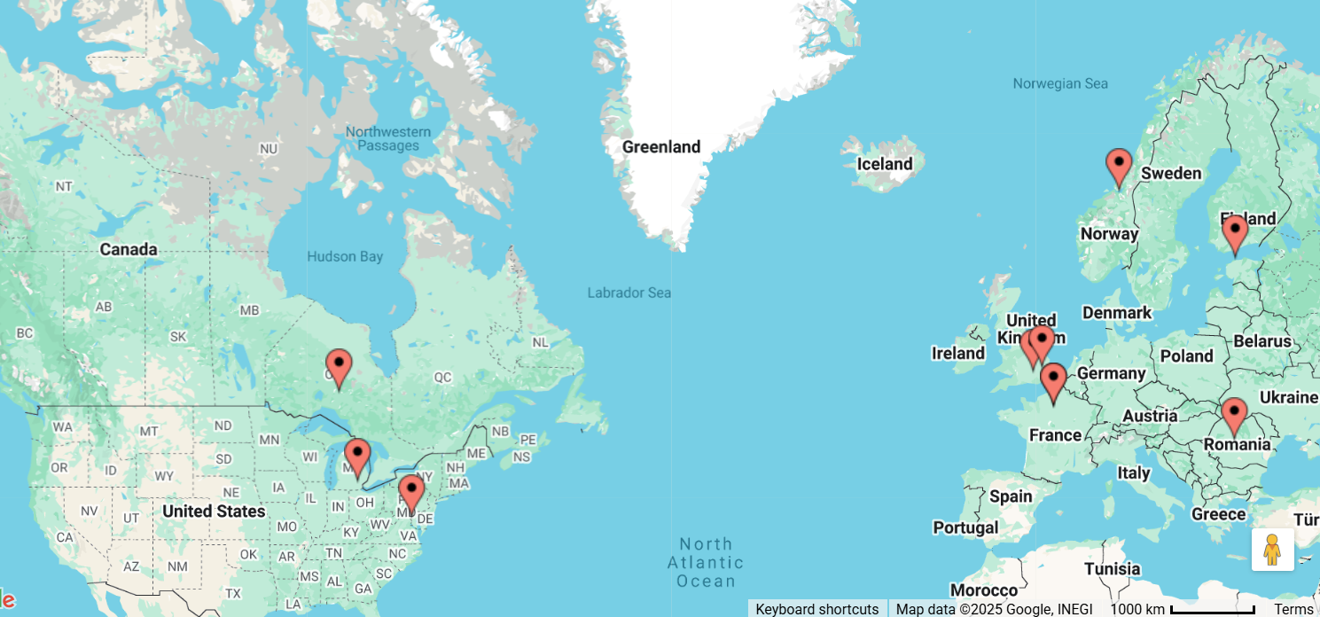
Map of Current DDI Training Working Group Members
Romania
Ontario, Canada
Paris, France
Colchester, England
Montrouge, France
Washington, DC USA
Trondheim, Norway
Ann Arbor, MI USA
London, UK
Tallinn, Estonia
Map source

Slide 8
What is the DDI Training Working Group?
The mandate of the DDI Training WG is to:
  Ensure that our goals align and build on the DDI Alliance Scientific Work Plan.
  Introduce people to DDI and improve people's competence in working with DDI.
  Promote deeper understanding of DDI’s work products by addressing specific topics.
  Gear training to specific audiences, as appropriate.
  Develop expertise within the Working Group for carrying out training.
  Maintain a training library with updated training material in languages other than English for reuse

Slide 9

The Training Working Group and Sub-Groups
TWG meets every other month
TWG chairs and sub group chairs meet monthly
Sub groups meet monthly
  Slide Deck Review Group
  Training Requests and Opportunities Group
  Webinars Group (on hold at this time)

Slide 10
What Does the DDI TG Offer?
Tangible Deliverables
Trainings by request
Slide decks for introductory trainings
Webinars
In person trainings and events
Other Benefits
Assured quality of content created
Audience-driven relevance of content created and presented
A network of DDI experts
Ongoing effort to increase and improve the network of DDI experts
Facilitates partnerships (such as with Codata)

Slide 11
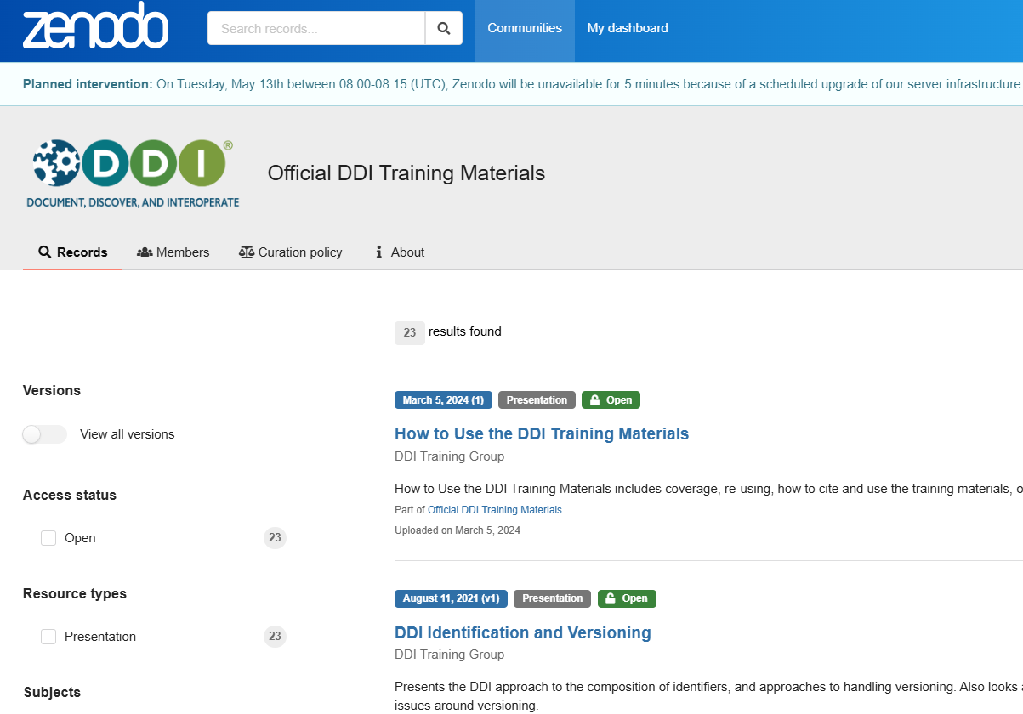
Where?
Zenodo Official DDI Training Materials

Slide 12
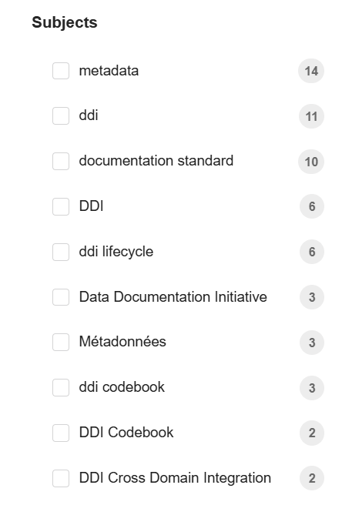
How to Use the DDI-TWG Resources
23 Zenodo resources, so far
Review slides for your own learning
Download and edit slides for your own presentations to help others with DDI and metadata
No login required
Cite using DOI
Notes:
The decks are shared in Zenodo - Zenodo is a free, open-source, general-purpose digital repository for research outputs, including data, software, and publications. It allows researchers to share and preserve their digital research objects.

Slide 13
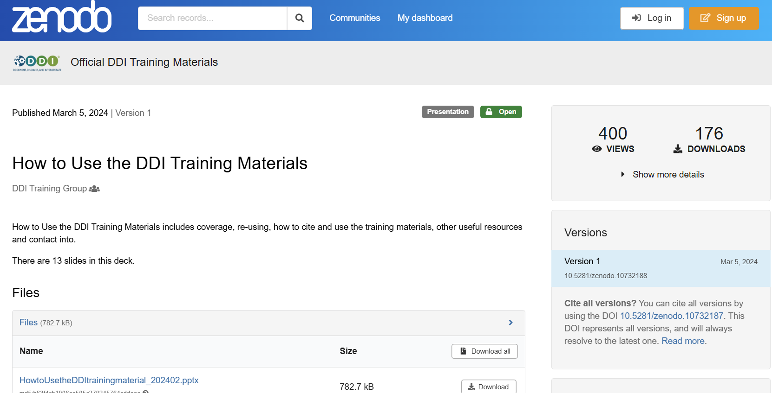
We Have a Deck on “How to Use…”

Slide 14
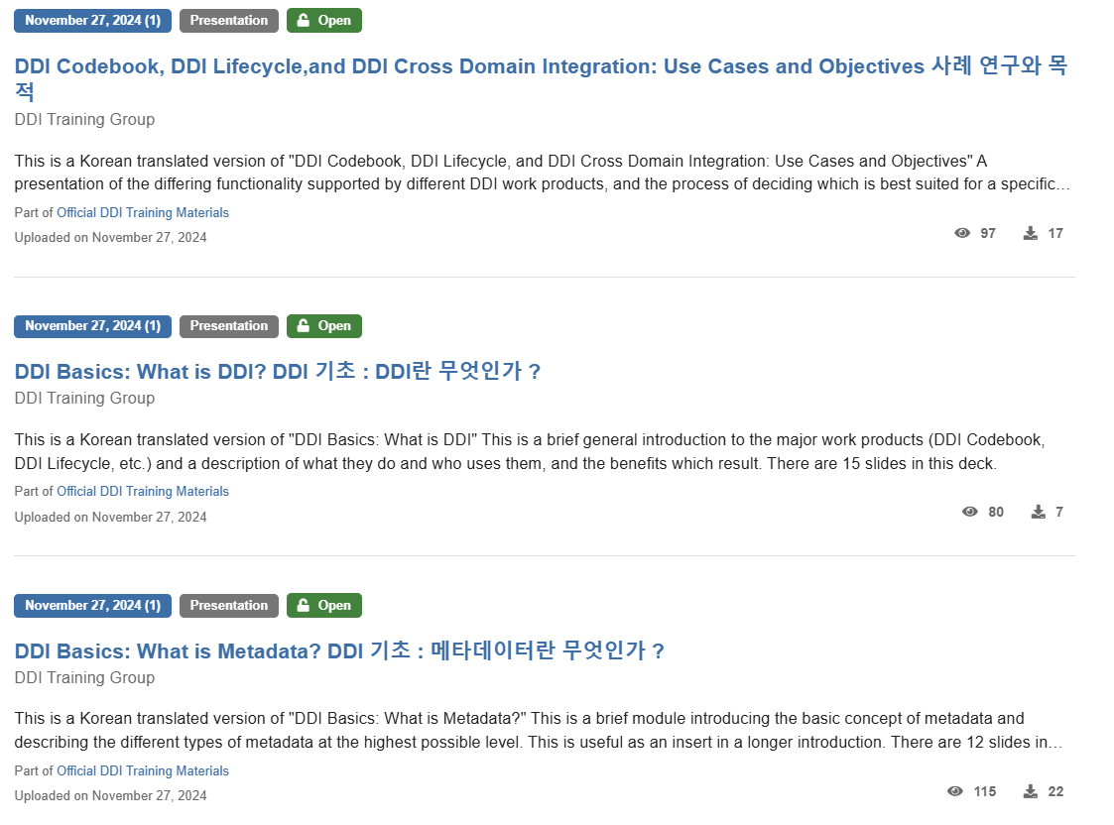
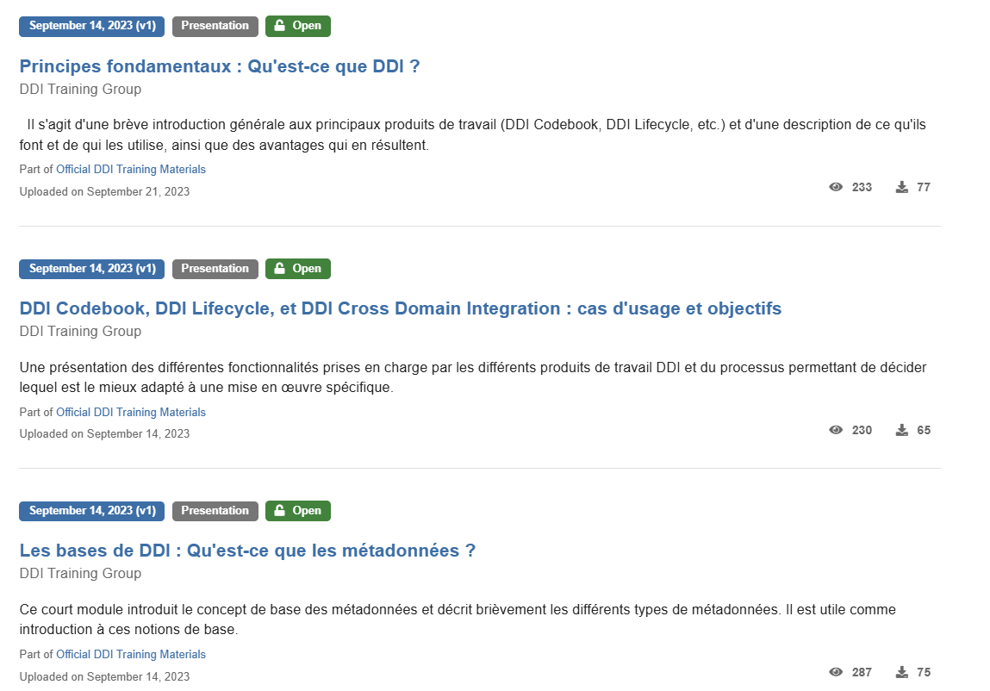
Translated DDI Resources Available

Slide 15
How are New Training Decks Added?
The slide deck topics are decided by the goals in the Strategic Mission and created by TG members sometimes from scratch, sometimes using content from past trainings or other resources.
Slide Deck Creation
TWG Open Review
Edits
Scientific Board Review
Publish to Zenodo
Existing content is searched and experts’ opinion is solicited; first draft is created
Members of the working group review the draft, proposing edits and providing comments
Edits and comments are reviewed and implemented to the draft
Draft is reviewed; additional edits may be applied following review
Final draft is loaded to the Zenodo site
Notes:
Sub-WG shares slide decks with the whole WG and the TC chairs (1 month). A submission to the TC chairs should be done as soon each deck becomes available, rather than in bulk, to shorten the review timelines.
Sub-WG makes updates to the slide decks where necessary or provides comments to feedback if not necessary.
Sub-WG decides when the slide decks are final. WG chairs make any final decisions if they cannot be resolved.
WG chairs submit the slide decks to the SB for approval.
SB checks if procedures above are followed.
SB provides sign-off before Sub-WG adds the slide decks to Zenodo for publication.

Slide 16
Share Your DDI Resources with the DDI Community
https://zenodo.org/communities/ddi-train/about
  Anyone may submit their DDI training materials to this community. The Data Documentation Initiative (DDI) is an international metadata standard for describing the data produced by surveys and other observational methods in the social, behavioral, economic, and health sciences.
To view approved training materials of the DDI Alliance, please visit the Official DDI Training Materials Zenodo community.

Slide 17
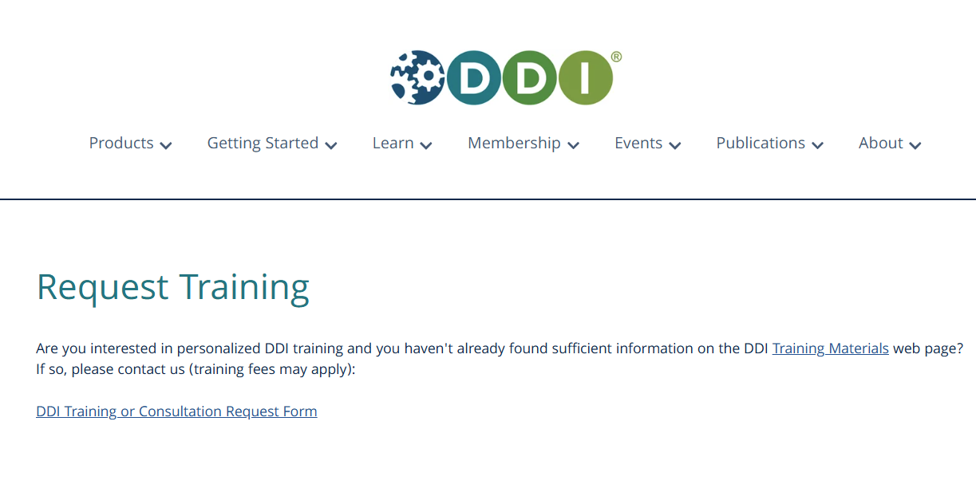
Request Help or Training
Notes:
https://ddialliance.org/request-training

Slide 18
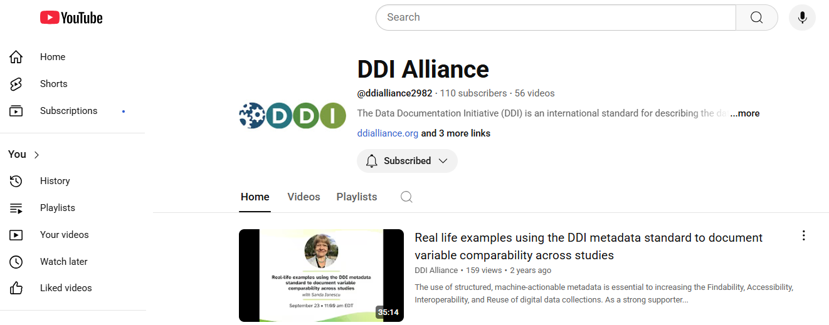
DDI Alliance YouTube - @ddialliance2982

Slide 19
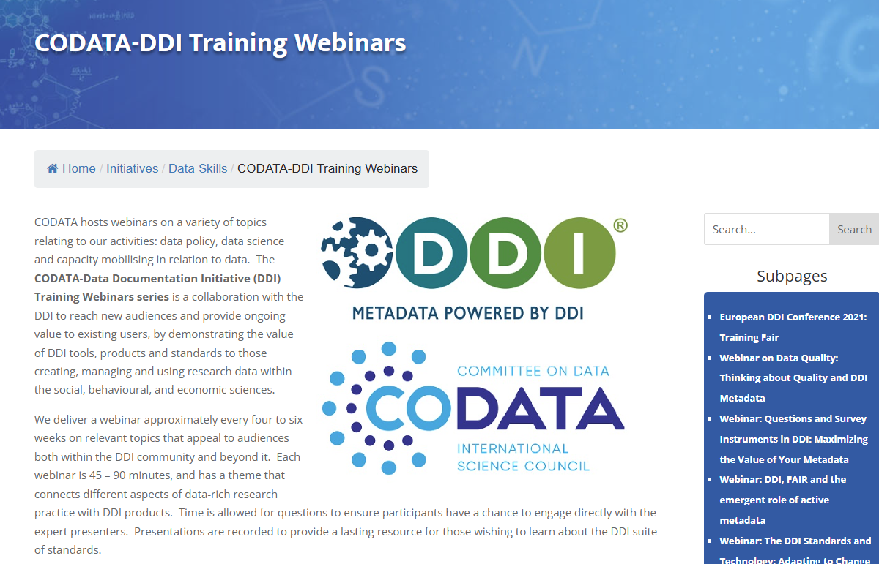
Webinars - Collaboration with CoData
Notes:
About 15 webinars recordings from 2021-2023 available. Topics include:
DDI Working Together with Other Standards
Metadata Uplift – PDF/Excel to Structured DDI Documentation
DDI Controlled Vocabularies, the CESSDA Workbench, SKOS and XKOS
Introduction to Metadata for Research Data Management: A Data Documentation Initiative (DDI) Perspective
Statistical Agencies Using DDI Metadata Standards: Promoting Transparency and Reusability of Data.
https://codata.org/initiatives/data-skills/ddi-training-webinars/

Slide 20
Want to Join us?
Be a part of the DDI Alliance!
Training Working Group (TWG) - introducing people to DDI and improving people’s competence in working with DDI.
• Networking opportunities
• Learn more about DDI
• Opportunities to conduct training
• Gain insights from others in different organizations and countries
The current Training Sub-Groups are:
• Slide Deck Review Group
• Training Requests and Opportunities Group
• Webinars Planning Group
If you are interested in joining the working group contact secretariat@ddialliance.org.
Notes:
Volunteer members of the DDI TWG meet monthly and are involved in Sub-Groups to put plans into actions.

Slide 21
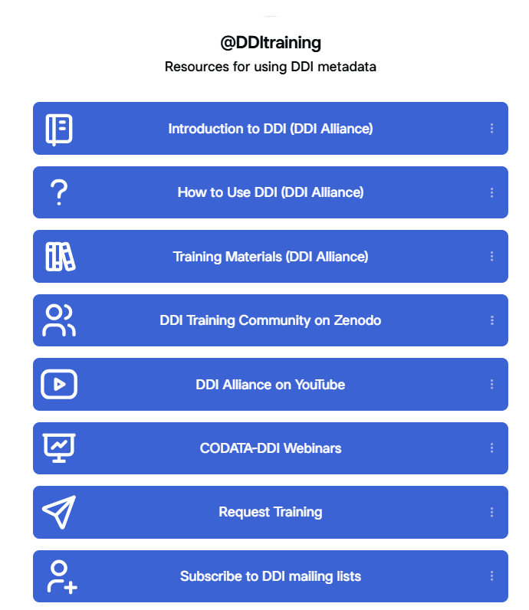
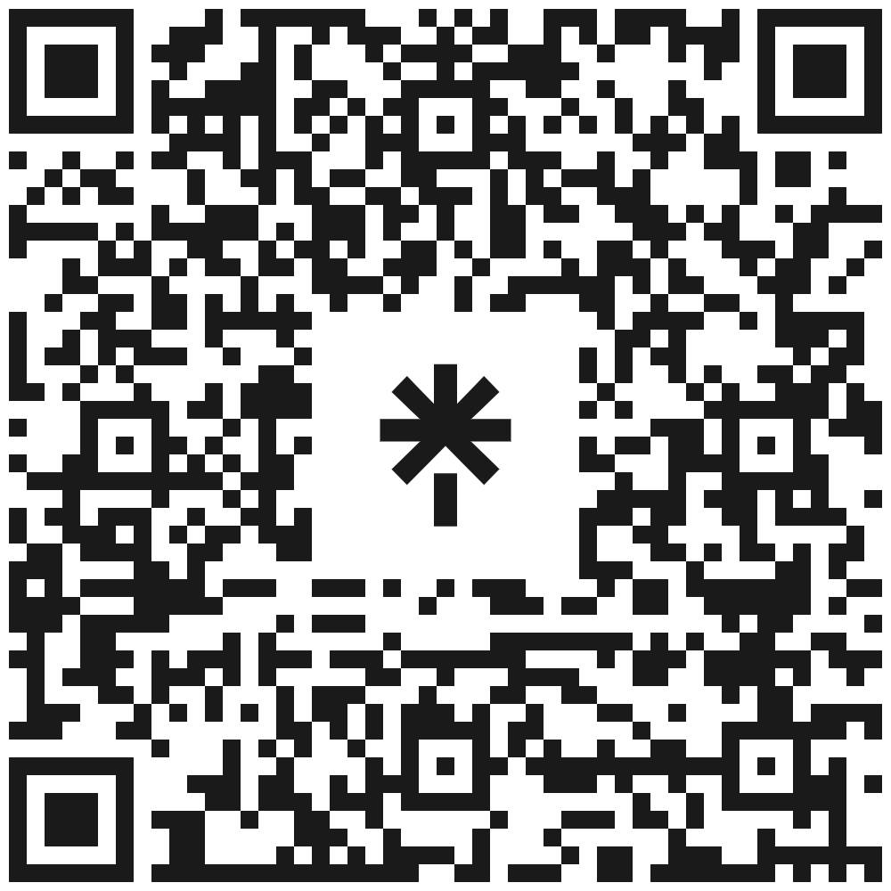
Thank You!
Interested in learning more about the DDI Training Working Group?
Easy access to important DDI Resources https://linktr.ee/DDItraining

