Slide 1
Project group MATCHMAKING
Results
2025

Slide 2




Matchmaking project group
Project scope & objectives
Definition of the issue
X
Inter-institutional infrastructure
inter-institutional
collaboration
service catalogue & matchmaking network

Slide 3


Matchmaking project group
Project scope & objectieven
Target
Synergies
Research data Tools
Persons
Matchmaking
Current
Future
Fostering collaboration & knowledge sharing (Synergies)
Discussing current and future tools

Slide 4

Matchmaking project group
Projectcharter
What difference will this PG make?
See the forest (tools-landscape) through the trees (tools)
Overview forest of tools
tools
experiences
experts
institutions

Slide 5




Matchmaking project group
Projectcharter
What difference will this PG make?
BETTER FASTER SERVICE
SYNERGIES
Easier choosing institutional tools
Better, faster service for researchers
Finding synergies
(to exchange experiences or purchasing a tool together)
EFFICIENCY
EDUCATION
Efficienter working
(no double work)
Possibilities to educate
Image Source: Freepik

Slide 6
Project scope & objectieven
Resources
1
2
CURRENT/ FUTURE INPUT
Knowledge hub
Technical working group
Networkday FRDN
PAST INPUT
Matchmaking sessions
Architecture matrix
Spreadsheet
Catalogue with services
  Description
  Institutions & Experts
  Experiences
  ...
X
Cost, benefits
Platform
Notes:
19/9: Idee om een showcase en demo’s te geven op de Netwerkdag = goed idee
netwerkdag op 1 dag en geen 2 dagen want vraagt te grote belasting/afwezigheid van supportstaf
Plenaire en parallelle sessie waarvan parallelle sessies hands-on, workshops, demo’s zijn -> vertaling van de PG Matchmakin

Slide 7
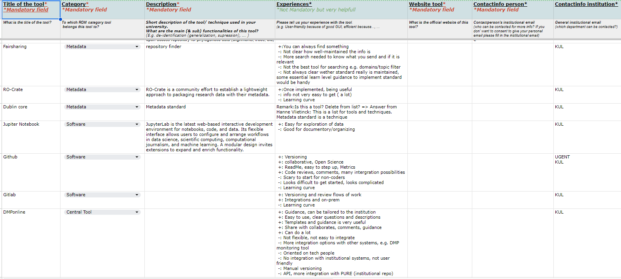
Matchmaking
The Flemish RDM tools experiences list
What difference will this PG make?
+60 Tools
+100 Experiences

Slide 8
Matchmaking
The Flemish RDM tools experiences list
Metadata
Fields | More info
Title of the tool | What is the title of the tool?
Category | To which RDM category tool belongs this tool to?
Description | Short description of the tool/ technique used in your university. What are the main (& sub) functionalities of this tool? (E.g. de-identification (generalization, supression), ... )
Experiences | Please tell us your experience with the tool. (e.g. User-friendly because of good GUI, efficient because..., ...
Website tool | What is the official website of this tool?
Contactinfo person | Contactperson's institutional email (who can be contacted for more info? If you don' want to consent to give your personal email please fill in the institutional email)
Contactinfo institution | General institutional email (which department can be contacted?)
Extra info Recording/ Slides/ Site | If recording, slides or site available, please add the links here.
Source | What is the origin of this info?
LOW TRESHOLD
Minimum metadata fields
RED= Mandatory
GREEN=Very nice to have

Slide 9
Matchmaking
The Flemish RDM tools experiences list
Metadata
ADDED VALUE
towards other lists
Experiences from other research support staff
Contact info
Overview per institutions which tools they use
Fields | More info
Title of the tool | What is the title of the tool?
Category | To which RDM category tool belongs this tool to?
Description | Short description of the tool/ technique used in your university. What are the main (& sub) functionalities of this tool? (E.g. de-identification (generalization, supression), ... )
Experiences | Please tell us your experience with the tool. (e.g. User-friendly because of good GUI, efficient because..., ...
Website tool | What is the official website of this tool?
Contactinfo person | Contactperson's institutional email (who can be contacted for more info? If you don' want to consent to give your personal email please fill in the institutional email)
Contactinfo institution | General institutional email (which department can be contacted?)
Extra info Recording/ Slides/ Site | If recording, slides or site available, please add the links here.
Source | What is the origin of this info?
RED= Mandatory
GREEN=Very nice to have

Slide 10
Analysis
Institutions collaborated:
Tools:
10+ institutions
150 contributions
100+ experiences
60+ tools

Slide 11
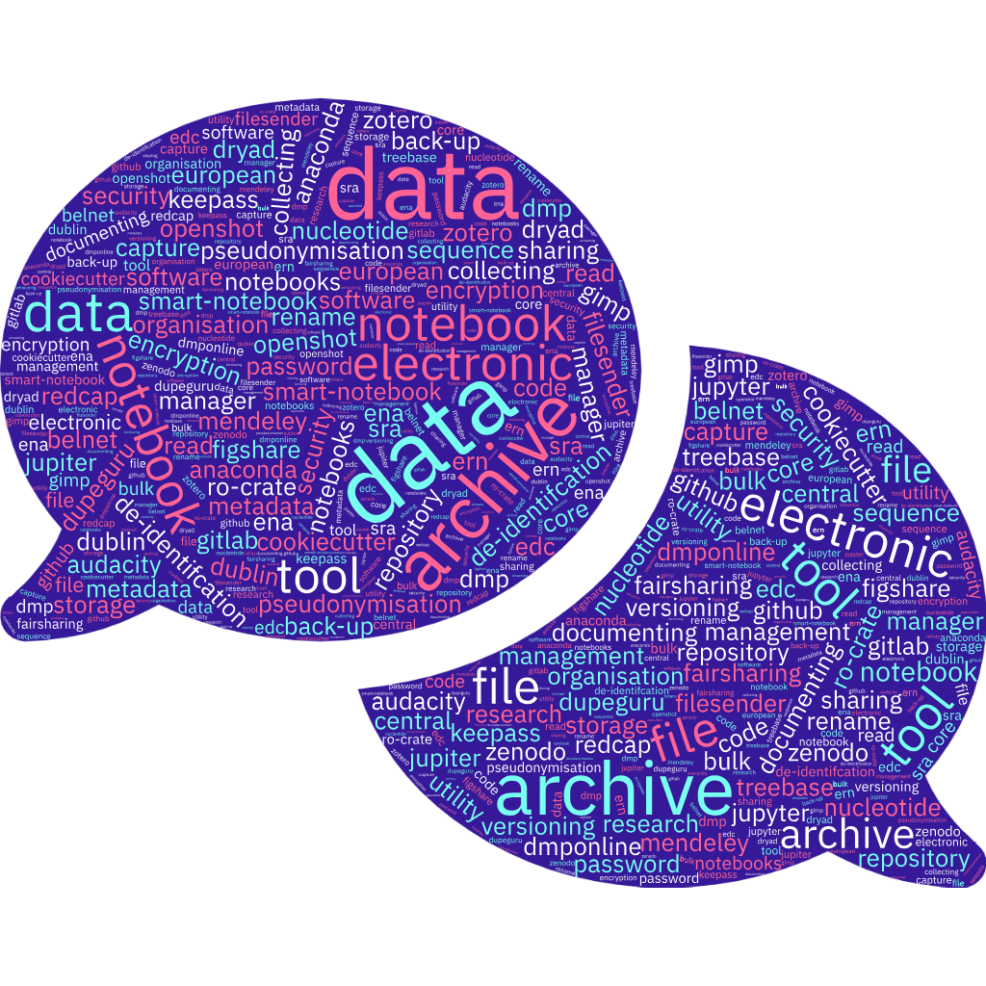
Tools & category

Slide 12

Experiences

Slide 13

Challenges
Keep the fire burning
Actively promoting the list to make sure:
  New experiences, tools are added
  Keep the list up to date
  Keep the list valuable to all users
Image Source: Wikimedia commons

Slide 14
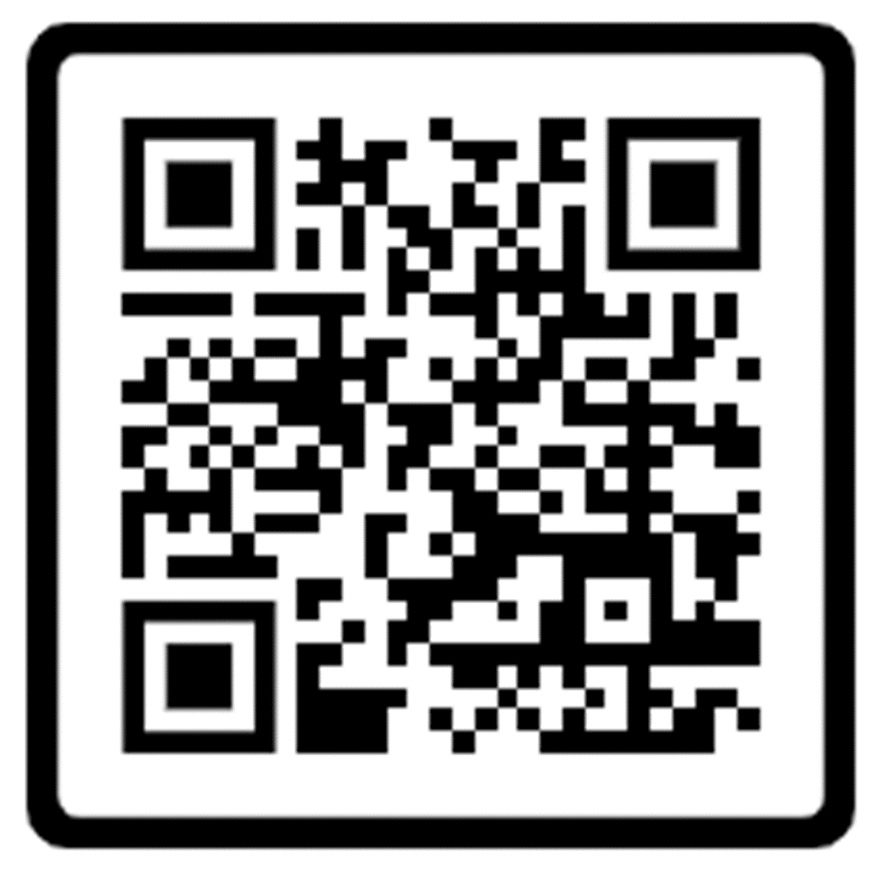
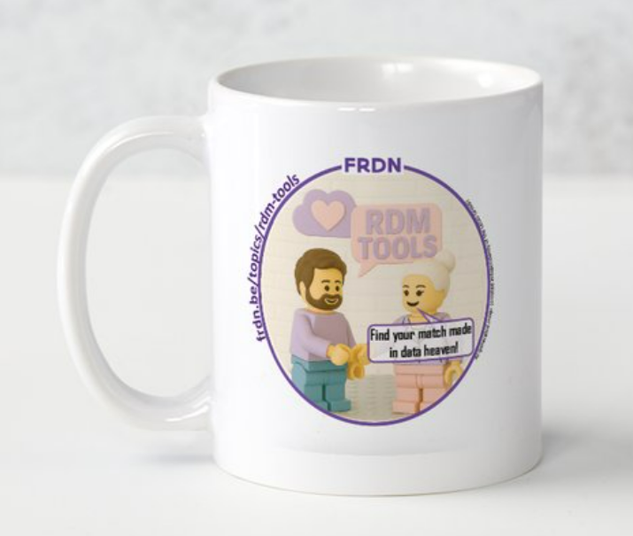
Link to the list
frdn.be/topics/rdm-tools
Ask access
Add tools
Add experiences
Participate & Win !

Slide 15
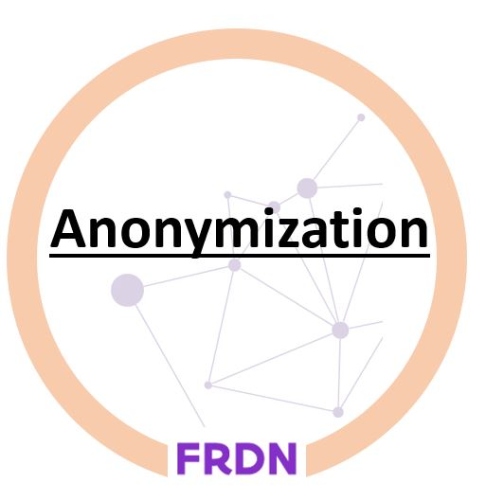
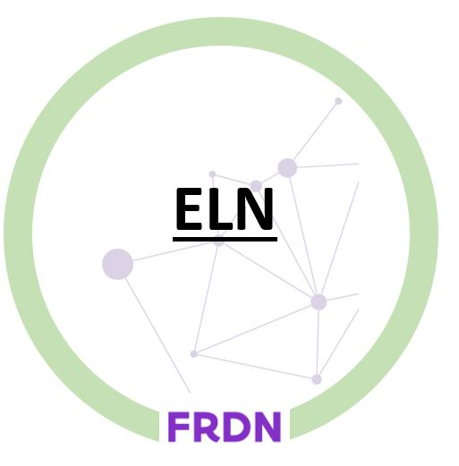

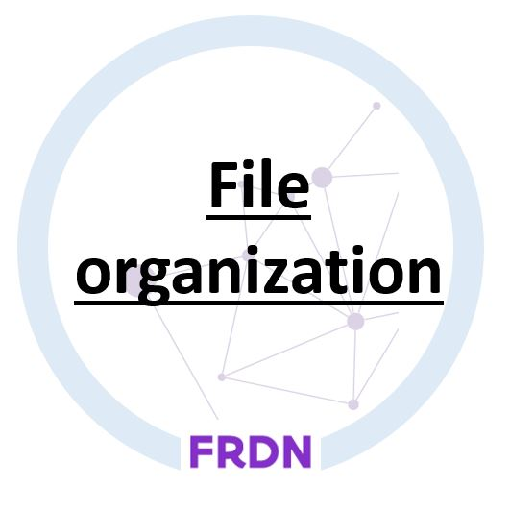



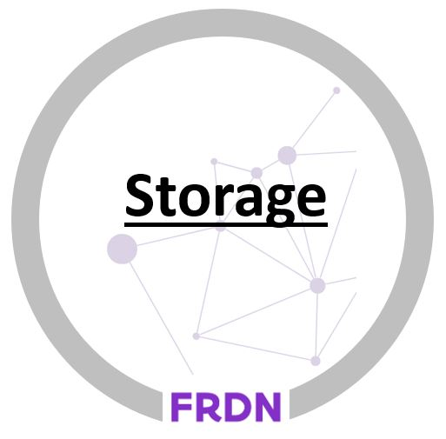


Find your match made in data heaven
?
!

Slide 16
Thank you!
PG MM -
Hanne Vlietinck
Ils De Bal
Jef Scheepers
Patricia Mergen
Philippe Moens

