Slide 1
CAT
Compliance Assessment Toolkit
Wim Hugo, Wilko Steinhoff, Fjodor v Rijsselberg (DANS)
Themis Zamani , Chrysa Thermolia, Irina Skopouli, Fotios Basios, Kostas Kagkelidis (GRNET)
Natascha van Lieshout, Giacomo Cannizzaro (SURF)
Matt Buys (DataCite)
Tommi Suominen, Joonas Kesäniemi (CSC)
Tilman Happek (GWDG)
Paolo Manghi (OpenAire)

Slide 2
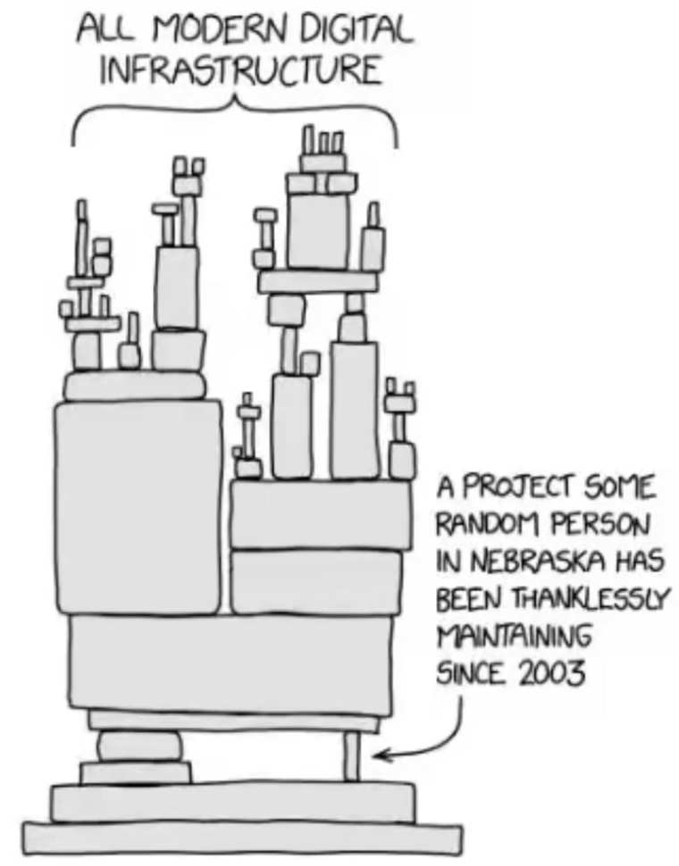
We have PIDs - so what is the problem?
PIDs are expected to be resolvable and persistent - essentially forever - but are they really?
  Some evidence suggests not - with a half-life around 12 years for a published case
Not all Identifier ‘Stacks’ are equal in terms of sustainability, performance, features, and levels of service - nor do they have to be.
As a result, it is important to select the appropriate Identifier for a use case or workflow.
More broadly, one finds claims of compliance with all kinds of norms, frameworks, and community expectation - without any public evidence

Slide 3
Quality Assurance, Expectations, and Reality
Community Expectations
Ecosystem of PID Services
EOSC PID Policy
An unsubstantiated claim of compliance or alignment is possible and will emerge as the expectations are mandated by e.g. EOSC
Prove It or Lose It: No compliance without evidence!

Slide 4
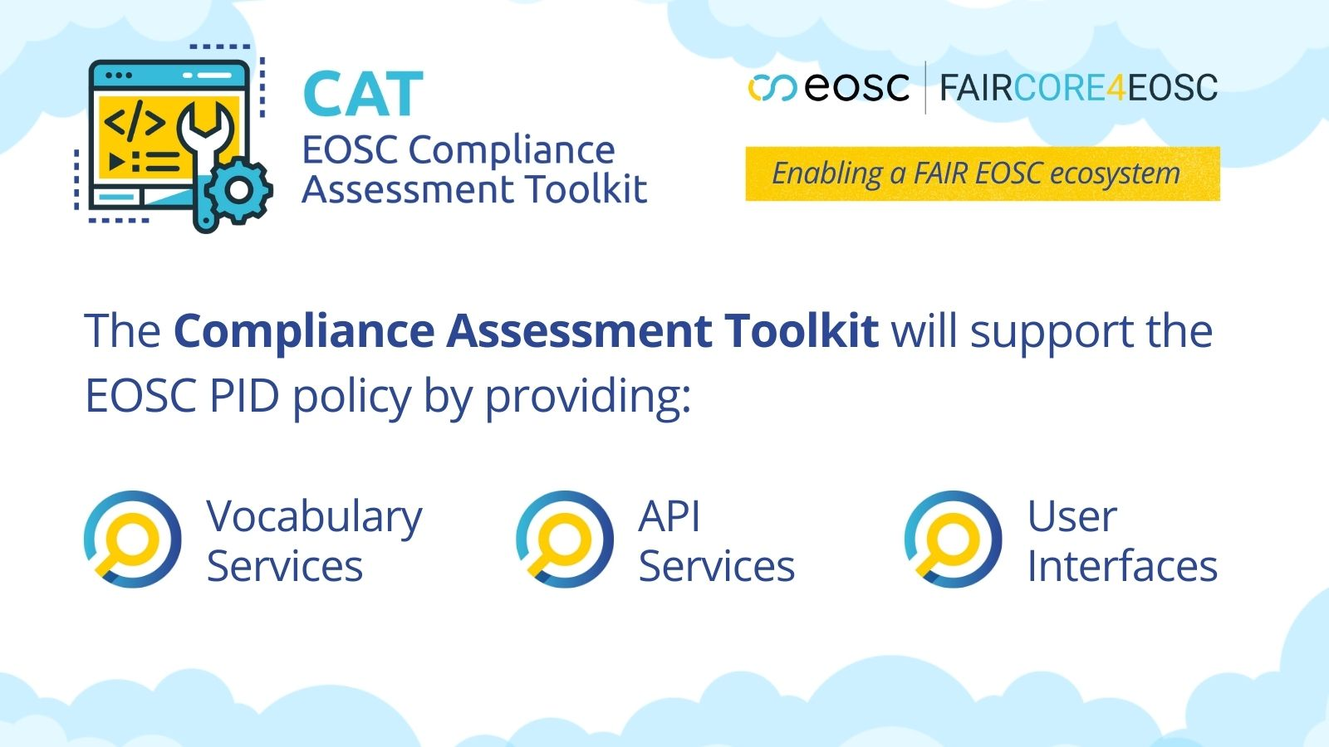
Quality Assurance, Expectations, and Reality
Community Expectations
Ecosystem of PID Services
Formalised
Expectations
(EOSC PID Policy)
Formalised
Evidence
& Guidance
(KB)
Compliance Assessment Toolkit for EOSC: a set of concepts, implemented as a graph database and accessible via APIs, and supported by user interfaces via the APIs.
The Compliance Assessment Toolkit supports the EOSC PID policy with services to encode, record, and query compliance with the policy. To do so, a wide range of compliance requirements ( TRUST, FAIR, PID Policy, Reproducibility, GDPR, Licences) has been evaluated as case studies for definition of a conceptual model.
Formalised Assessment
(CAT)

Slide 5
Some additional links: Examples
Community Expectations
Community can search for compliant services or Identifiers suitable to their use case or workflow
Ecosystem of PID Services
Formalised
Expectations
(EOSC PID Policy)
Formalised
Evidence
& Guidance
(KB)
Actors in the Ecosystem can obtain guidance, best practices, and recommendations about performance levels, assessments, and benchmarks
Community expectations define Benchmarks, which are not part of the criteria (e.g. in the policy) or of the test - they are context-dependent
Formalised Assessment
Tests, Benchmarks
(CAT)

Slide 6
Compliance Assessment Toolkit

Slide 7
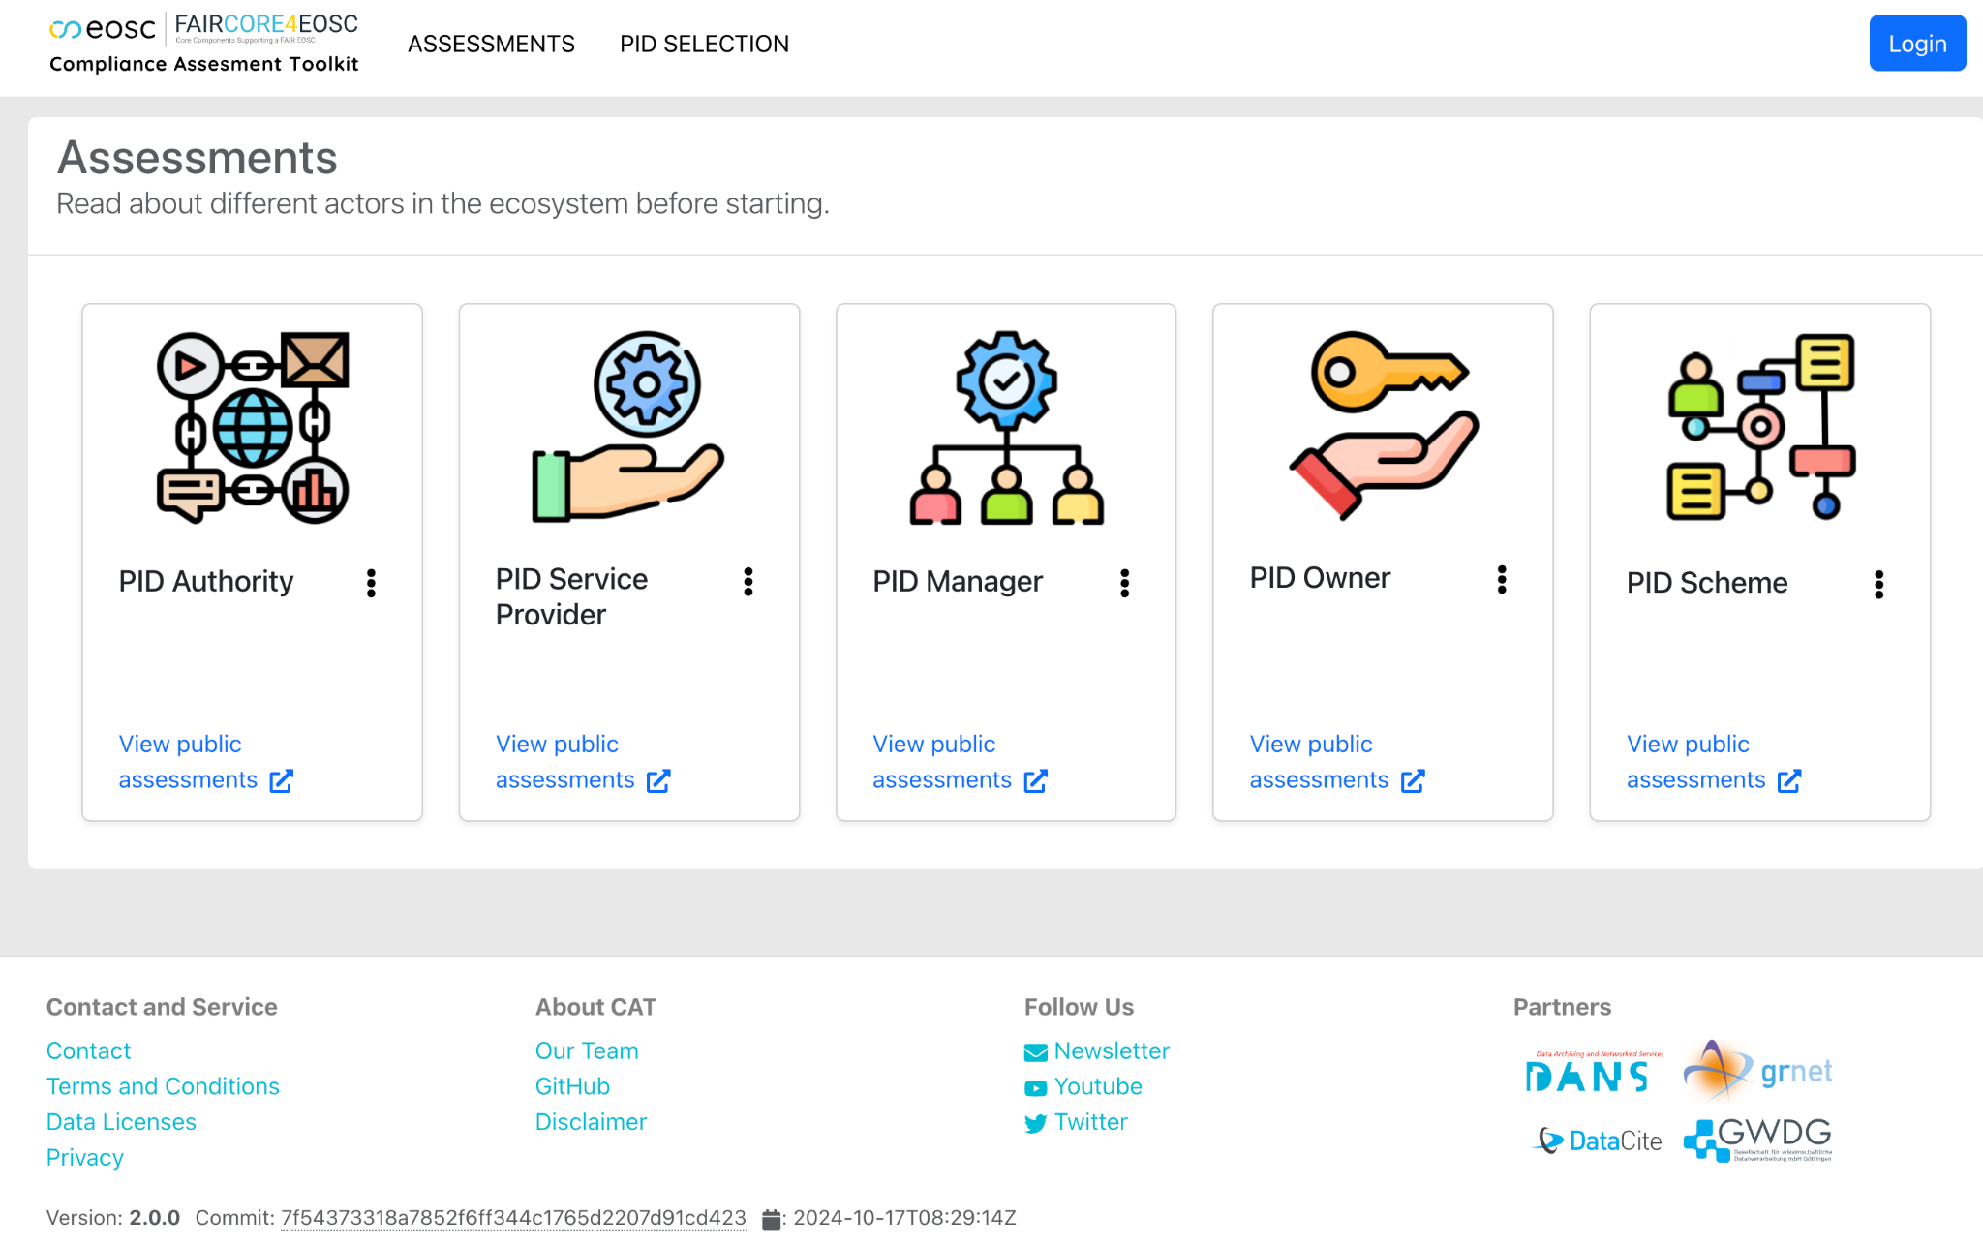
CAT: Beta version has been in operation for some time
Benefits for the whole Ecosystem
For Authorities and Providers: It is important to back up public claims of EOSC Policy Compliance and of performance/ features with publicly available information
For Managers: Optional disclosure of policy compliance for purposes of trust and community acceptance
For Owners and Users: Matching PID services with use cases and expected benefits
For all actors: links to guidance and best practices

Slide 8
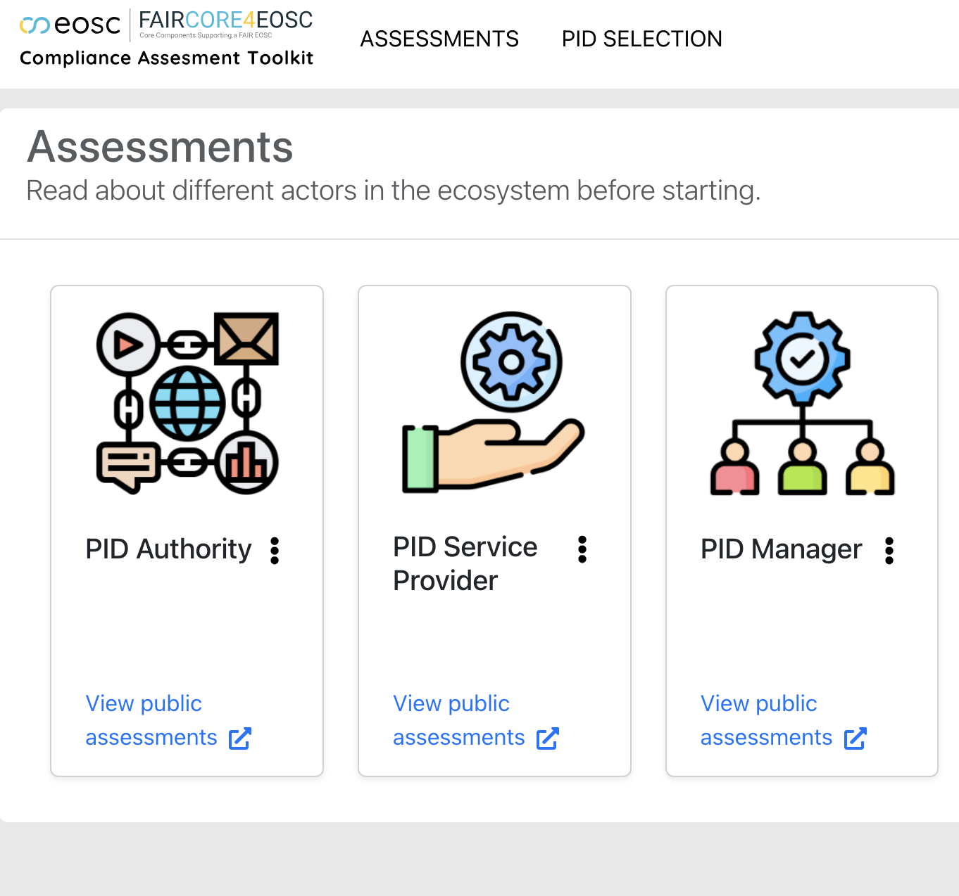
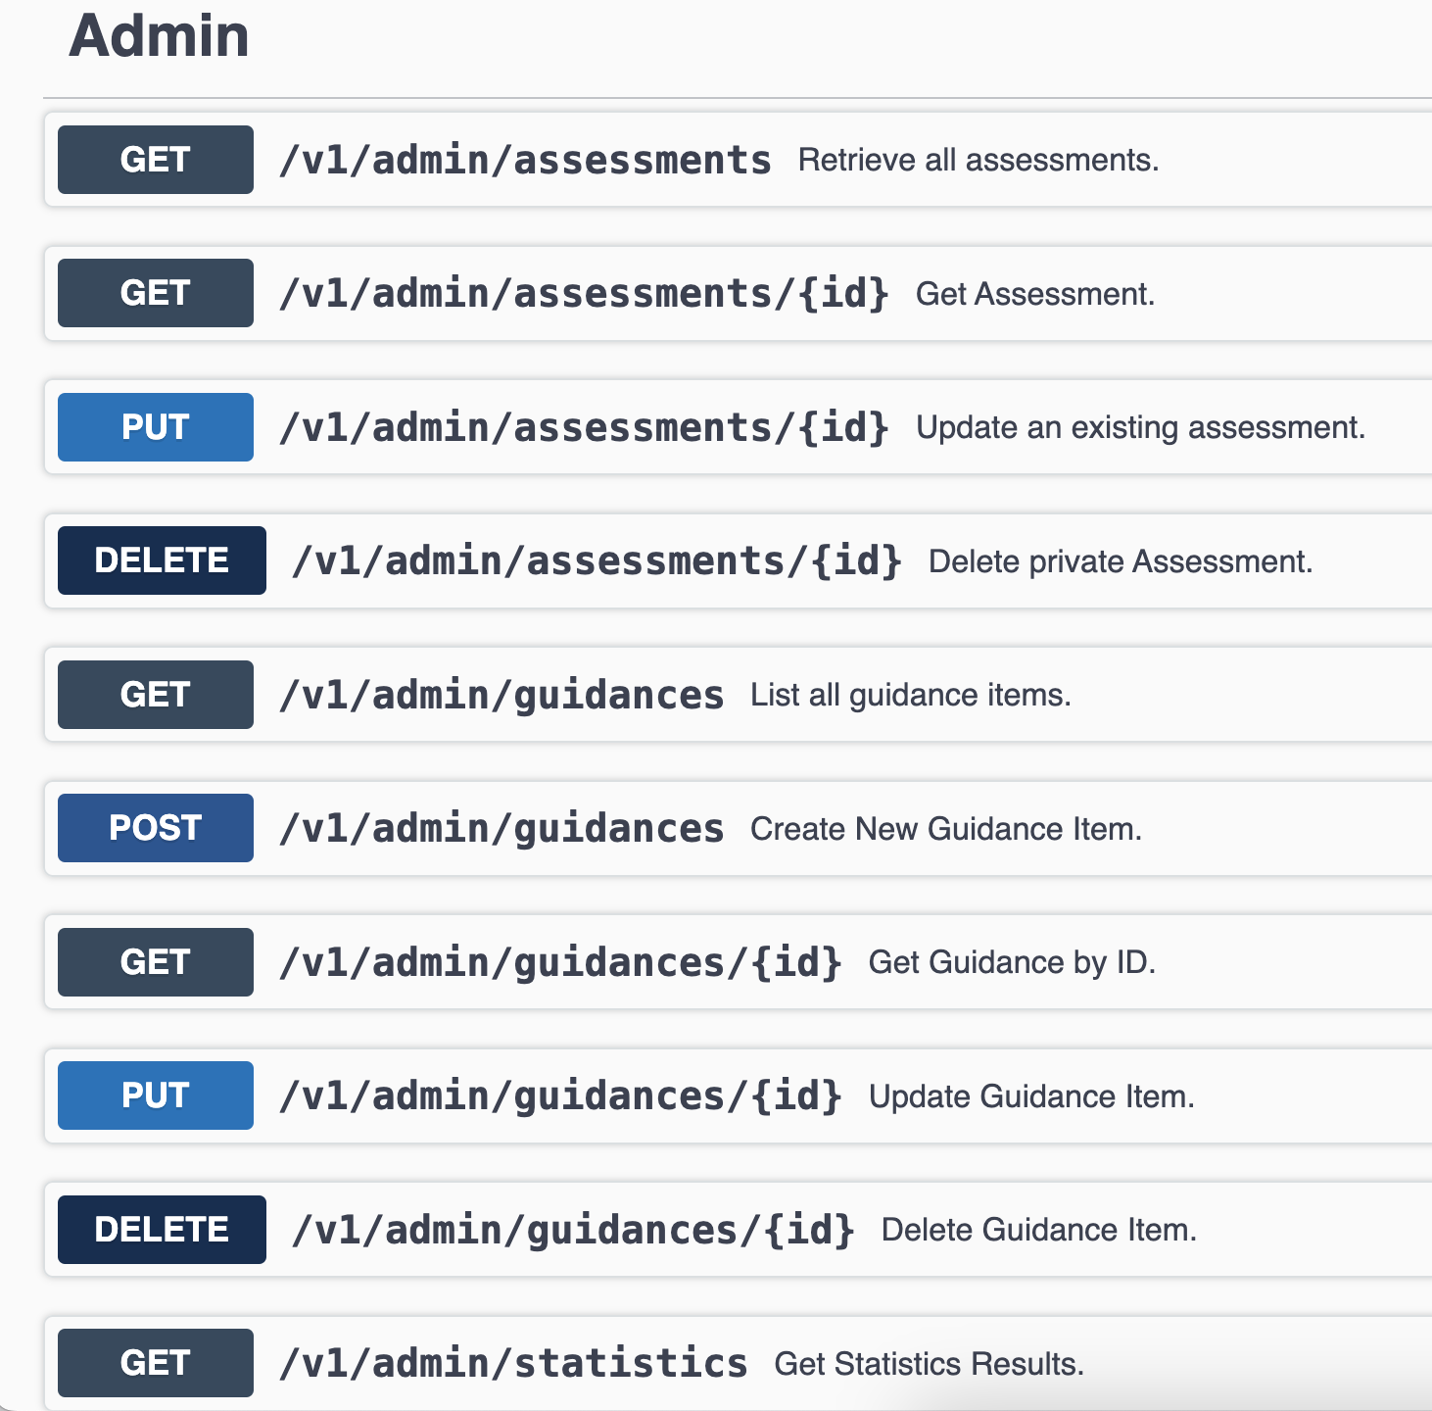
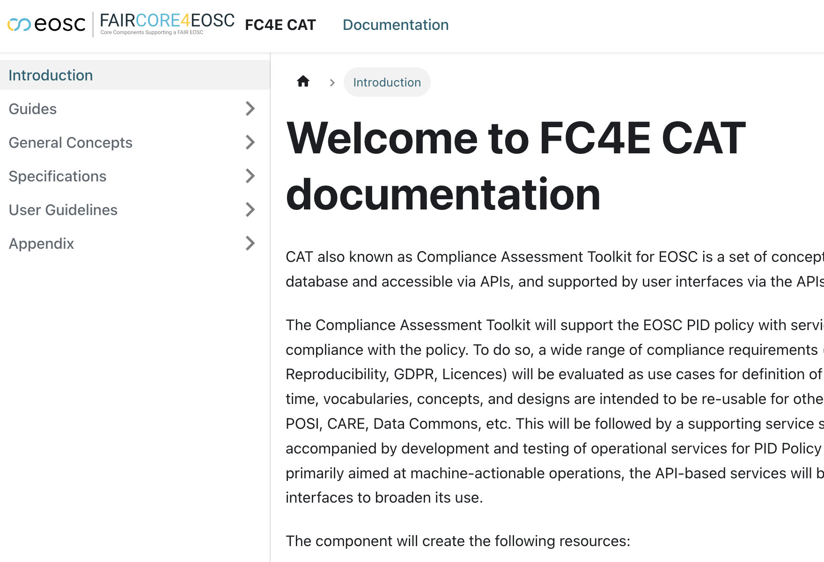
CAT Building Blocks
CAT UI
CAT API
CAT Documentation

Slide 9
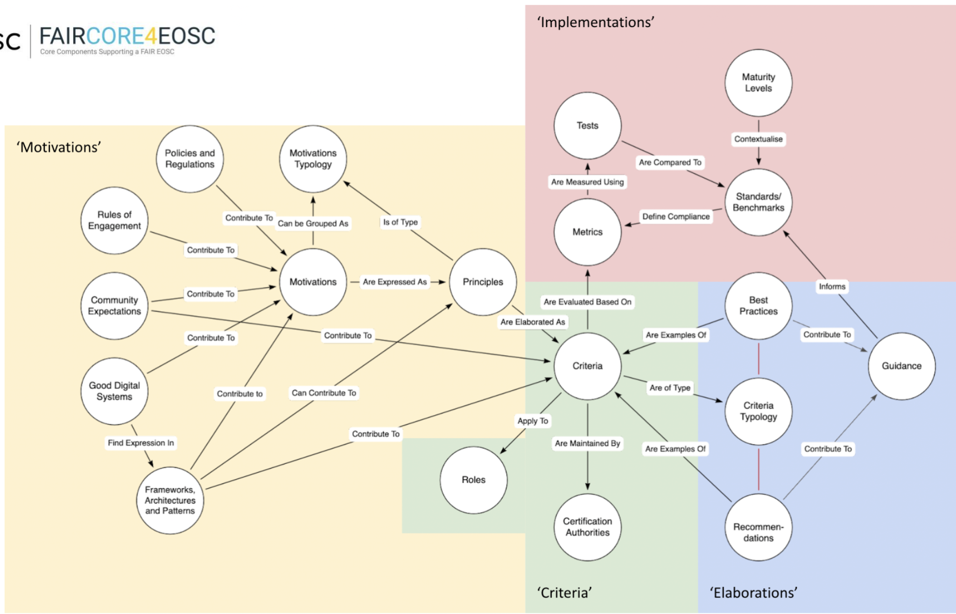
CAT is extensible, and can accommodate many contexts
Case Studies
EOSC PID Policy
RDA PID National Strategies
Several FAIR Assessment Tools
EOSC Interoperability Framework
CoreTrustSeal
TRUST Principles
… and a few more
Flexible Conceptual Model

Slide 10
Validation - in collaboration with FAIR-IMPACT
“Creating EOSC Compliant Persistent Identifier (PID) Policies”
Run time: May to Sept 2024
# of Participants: 12 teams
Goal: Develop a better PID policy/strategy, demonstrated through improved
compliance with EOSC PID Policy using the CAT.
Compensation: 10 000 € for each team to support staff to participate
Support: 3 workshops, 2 CAT assessments, office hours and reading list
Items | Raised | Resolved | In progress | Excluded
UI Issues | 8 | 8 | - | -
Suggestions | 13 | 7 | 3 | 3
Bugs | 10 | 10 | - | -
Assessments | >15

Slide 11
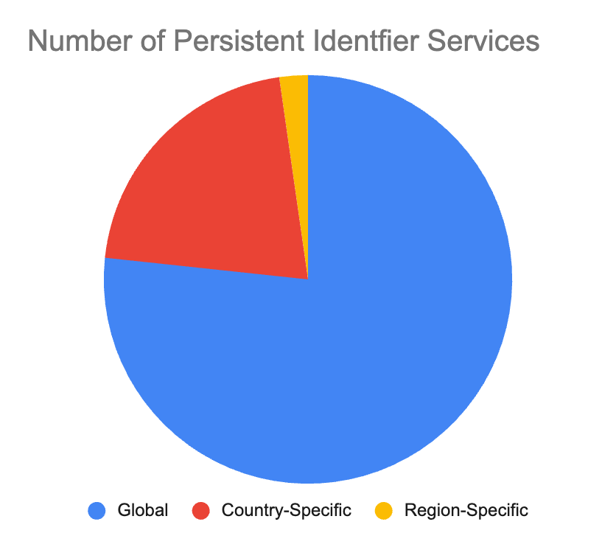
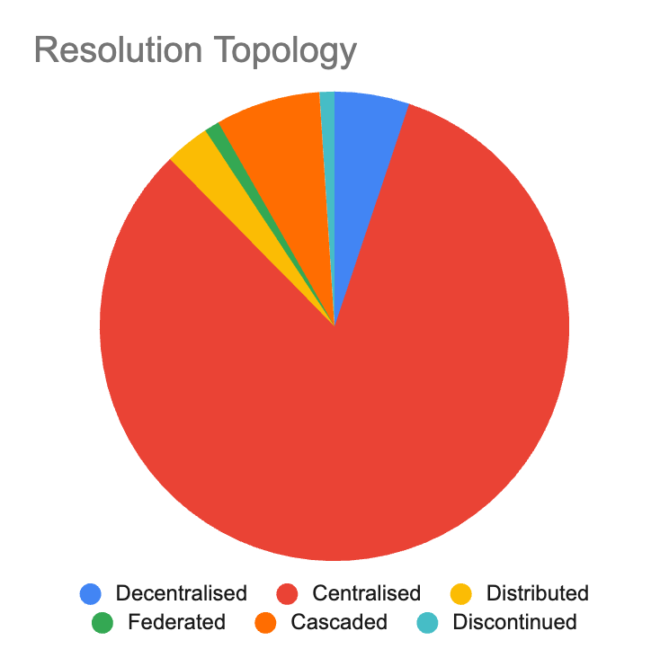


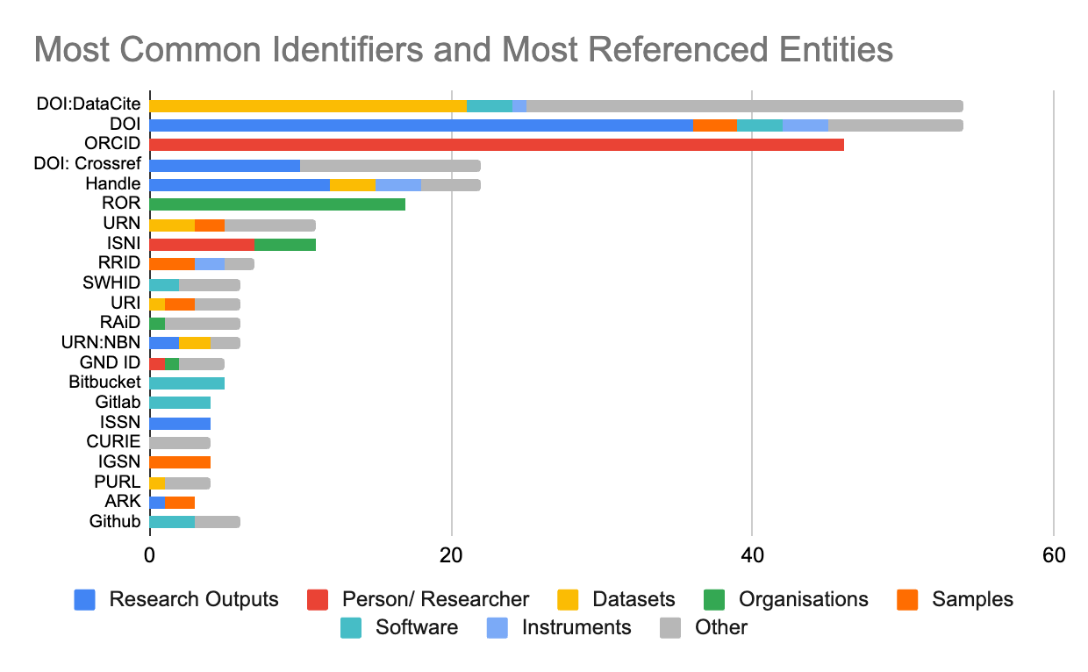
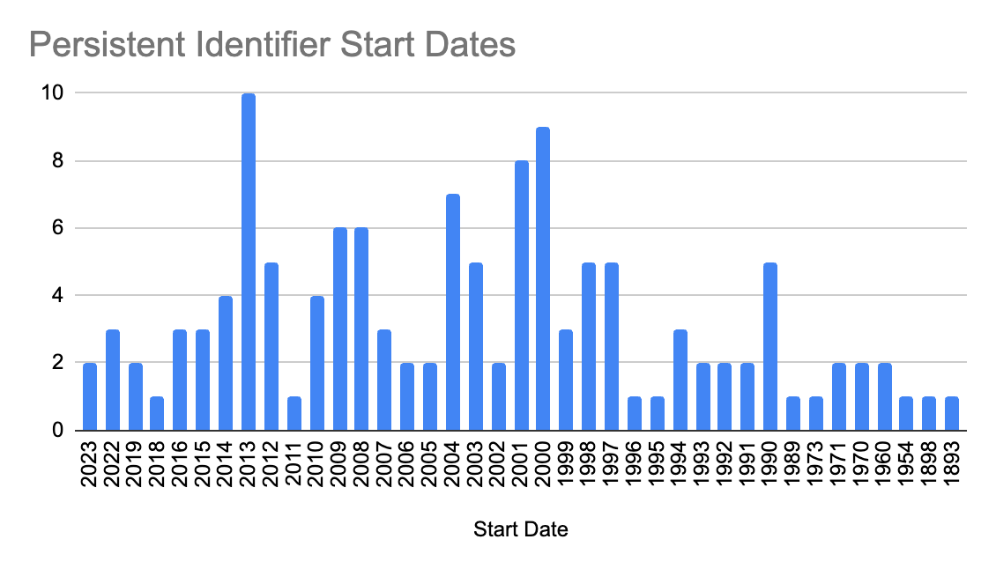
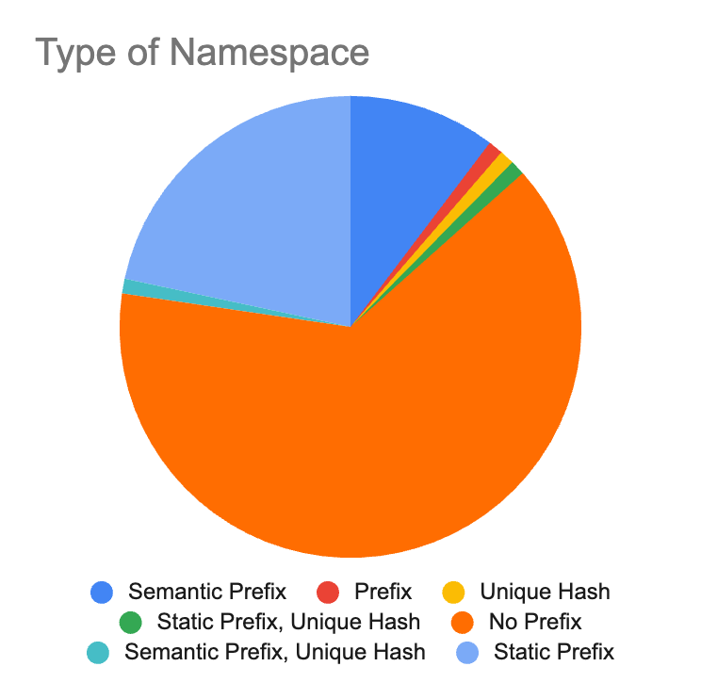
Knowledge Base: End March!
Scheme | Identifiers
URN:NBN | 13
Digital Object Identifier | 11
Uniform Resource Locator | 7
RRID Identifier Scheme | 7
ISNI | 4
Handle System | 4
Universal Product Code | 2
ISSN | 2
Internal Korea NRF Scheme | 2
BibCode Scheme | 2
INSDC Accession Prefix Format | 2
Wikidata Identifier Scheme | 2

Slide 12
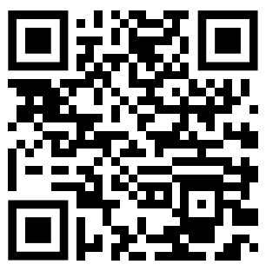
Visit our Booth
Fill in Our Survey

