Slide 1



CENTER FOR SCALABLE DATA ANALYTICS AND
ARTIFICIAL INTELLIGENCE
Tiled & GPU-accelerated
Image Processing
Robert Haase
Funded by
These slides and the related training materials can be reused under the terms of the CC-BY 4.0 license.

Slide 2


Quiz:
How can we estimate the number of cells in an image?
?

Slide 3




Quiz: Recap
How is this feature called?
Feret’s diameter
Minimum Caliper
Minor Axis length
Major Axis length

Slide 4
CENTER FOR SCALABLE DATA ANALYTICS AND
ARTIFICIAL INTELLIGENCE
GPU-accelerated
Image Processing
Robert Haase
Funded by
These slides and the related training materials can be reused under the terms of the CC-BY 4.0 license.

Slide 5
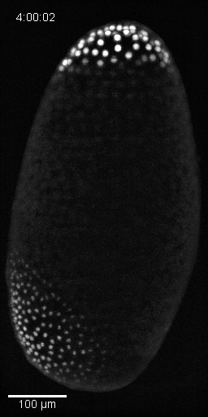


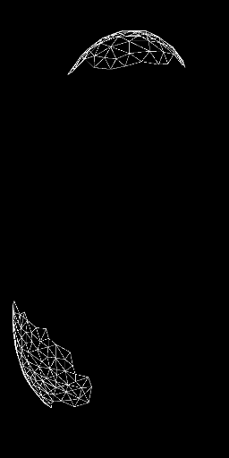


GPU accelerated image processing in life sciences
… to study embryo development
Tribolium castaneum nuclei-GFP,
Background subtracted
Spot detection (3D)
Theoretical membranes
(pseudo Voronoi map)
Neighbor mesh
Average centroid distance of neighbors
0
µm
35
https://clij.github.io/

Slide 6
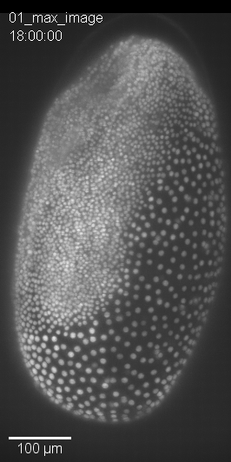
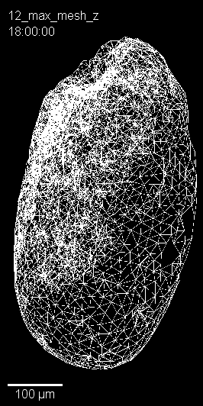
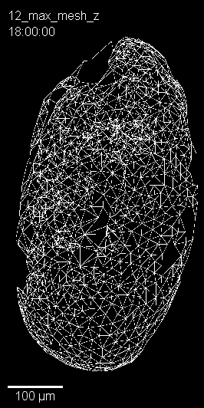
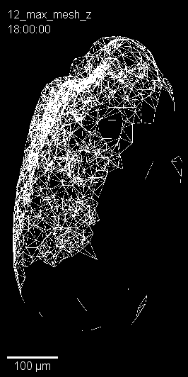
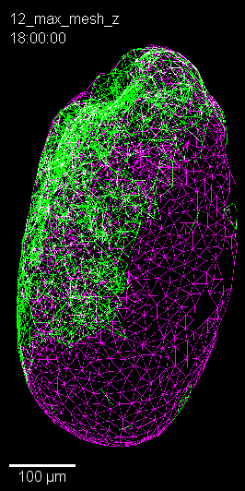
GPU accelerated image processing in life sciences
Raytracing enables differentiating surface and sub-surface mesh nodes
Surface neighbor mesh
Sub-surface
neighbor mesh
3D stack input
Neighbor mesh
Merge
https://clij.github.io/

Slide 7
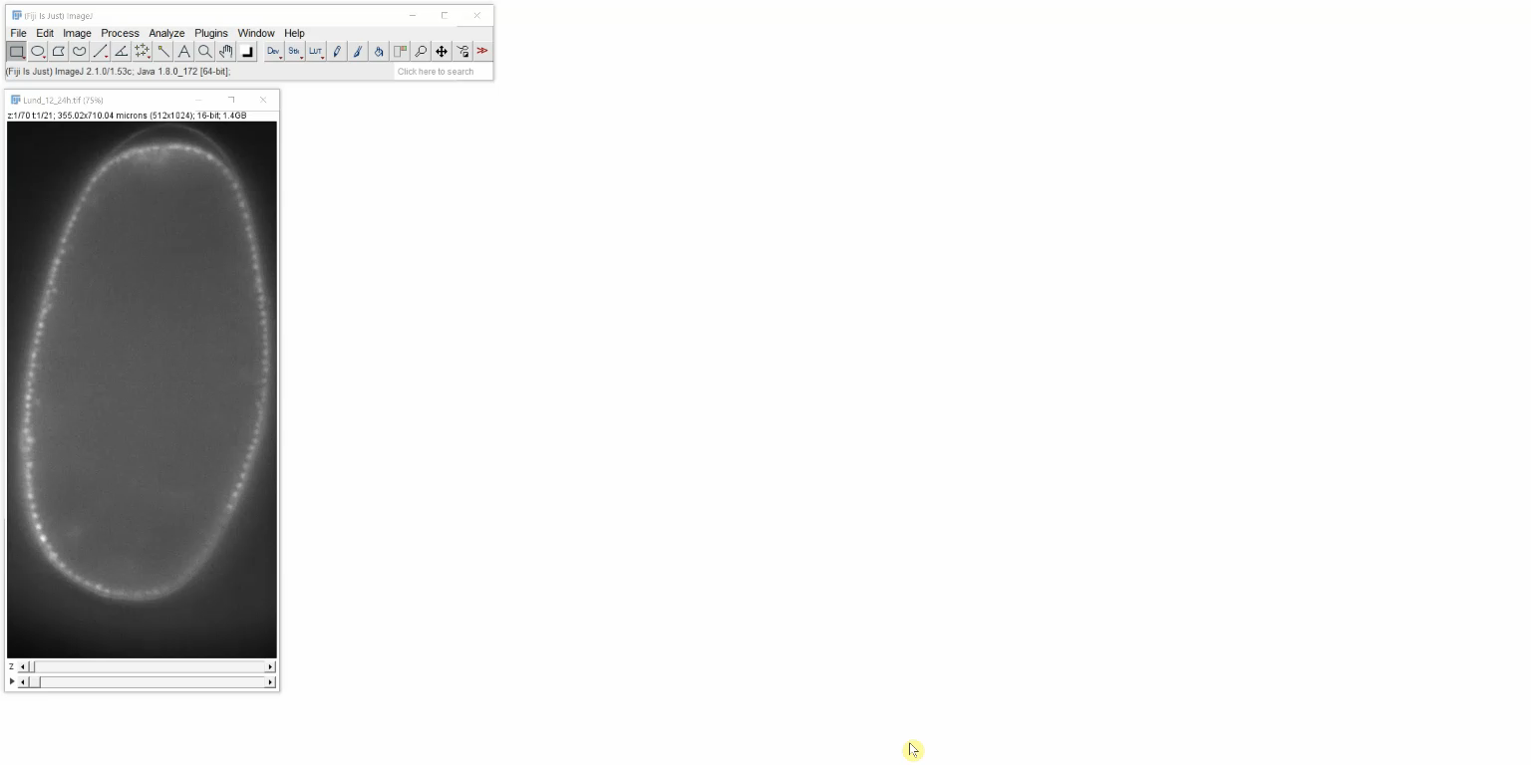
Image processing in life-sciences
State-of-the-art software for more than 20 years: ImageJ / Fiji
2x
Image data source: Daniela Vorkel, Myers lab, MPI-CBG/CSBD
https://imagej.nih.gov/ij/ https://fiji.sc

Slide 8
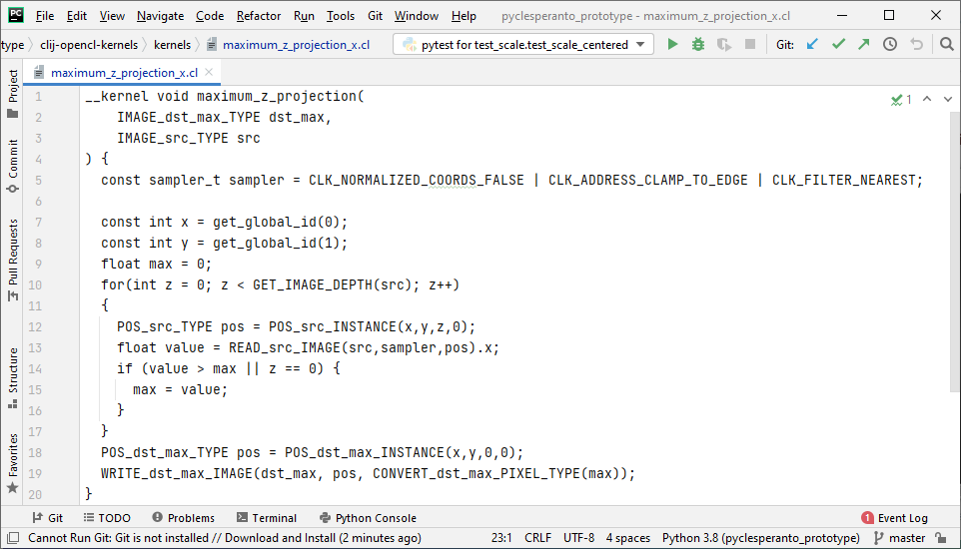
OpenCL-based GPU-acceleration
GPU-acceleration? Learn the Open Computing Language (OpenCL)!
Maximum intensity projection along Z
OpenCL: https://www.khronos.org/opencl/
Kernel collection: https://github.com/clEsperanto/clij-opencl-kernels

Slide 9
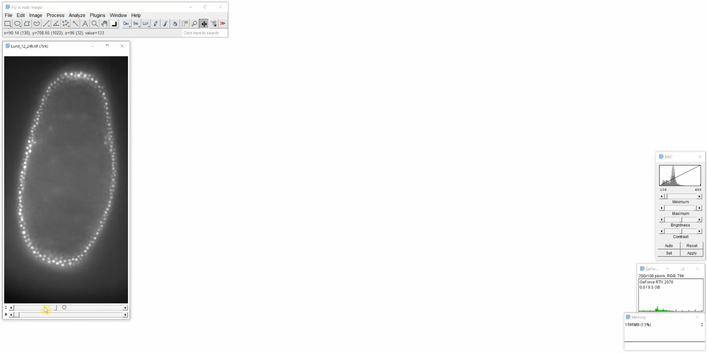
User-friendly GPU-acceleration
2x
Image data source: Daniela Vorkel, Myers lab, MPI-CBG/CSBD
https://clij.github.io/

Slide 10

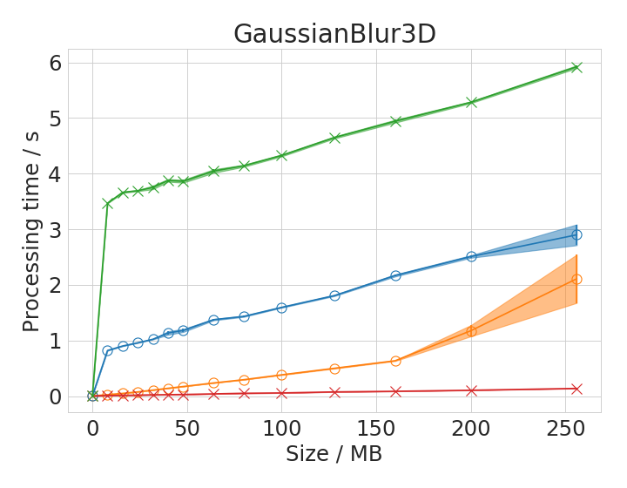
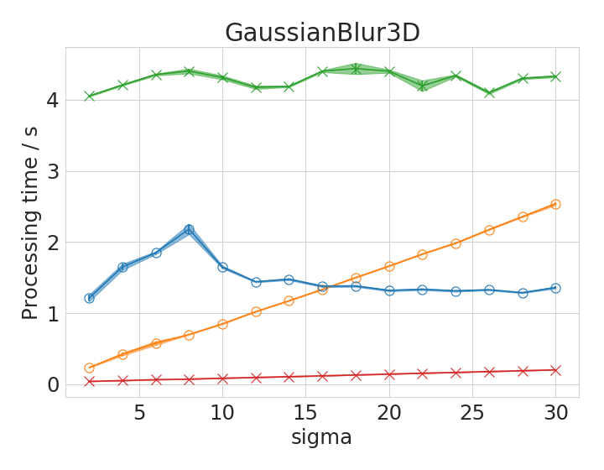

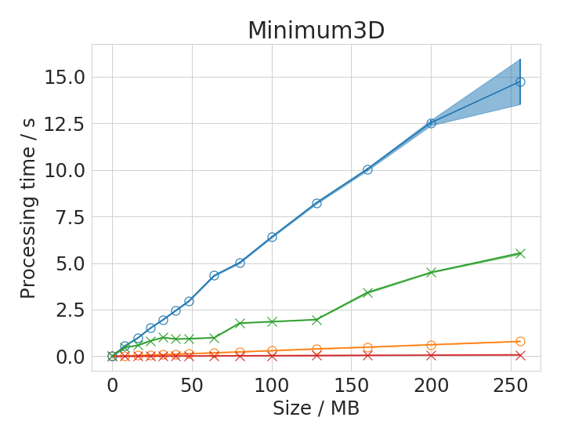
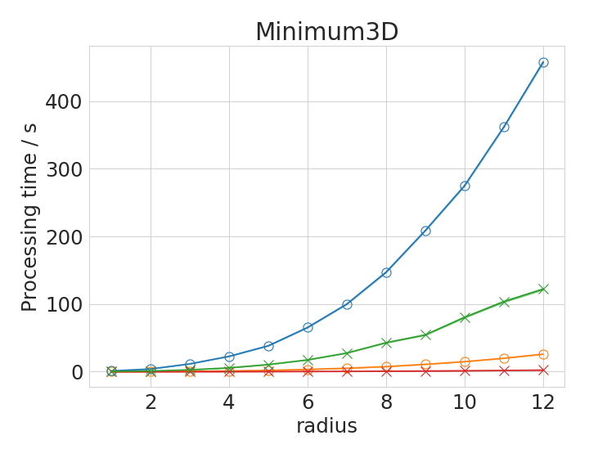
GPU-accelerated image processing
Performance depends on operation, image size, parameters, hardware, ….
vs.
2x Intel Xeon Silver 4110
Nvidia Quadro P6000
Intel Core i7-8650U
Intel UHD 620 GPU
Haase et al. Nat Methods (2020),
https://www.nature.com/articles/s41592-019-0650-1

Slide 11
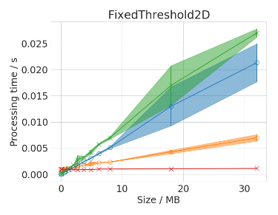
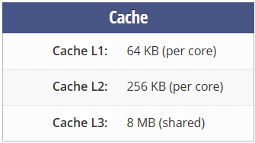
GPU-acceleration only makes sense if images are large
Because the CPU cache is faster than GPU-memory.
CPU cache is also very small though.
Example:
Intel Core i7-8650u*
2x Intel Xeon Silver 4110
Nvidia Quadro P6000
Intel Core i7-8650U
Intel UHD 620 GPU
* https://www.techpowerup.com/cpu-specs/core-i7-8650u.c1975

Slide 12
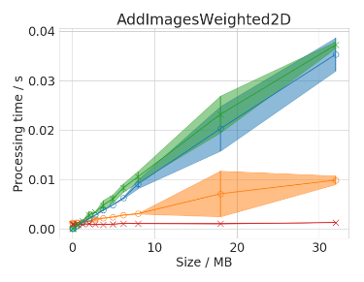
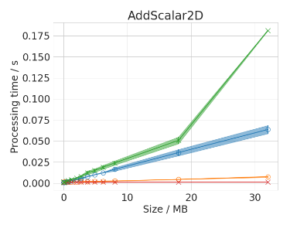
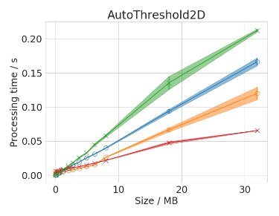
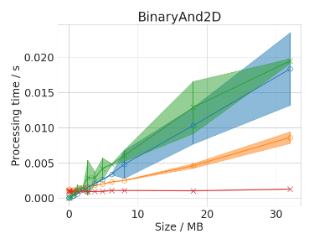
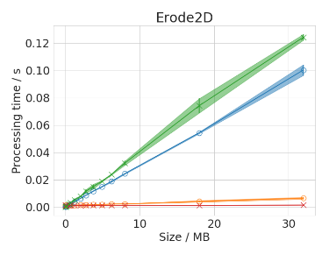
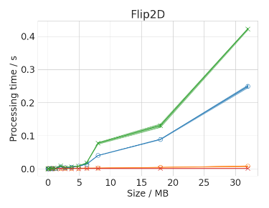
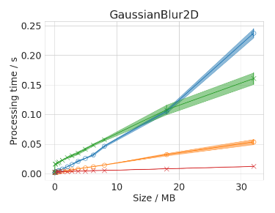
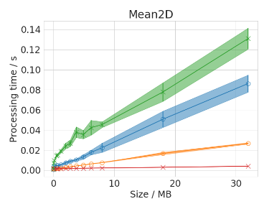
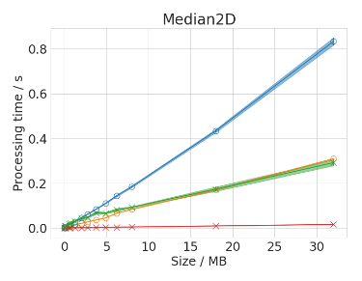
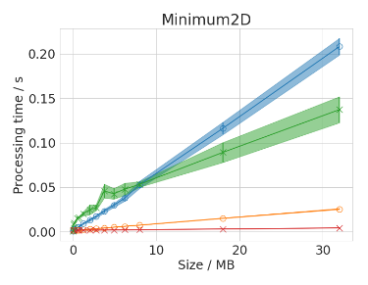
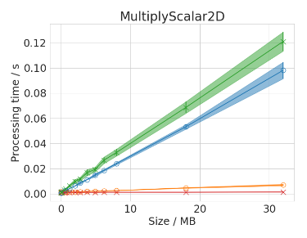
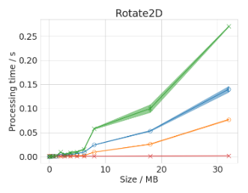
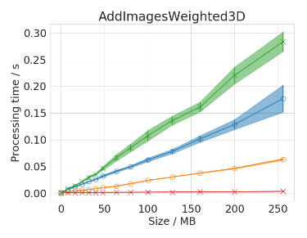
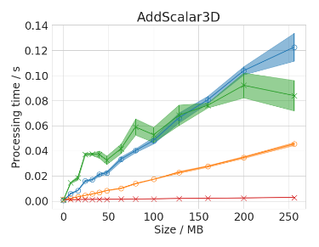
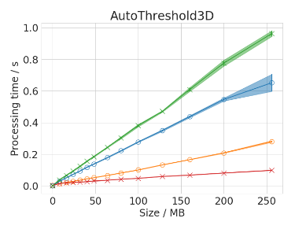
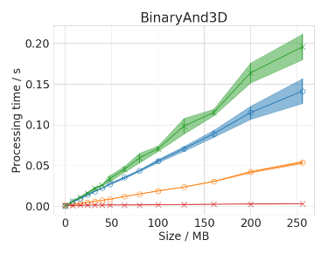
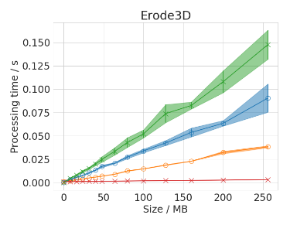
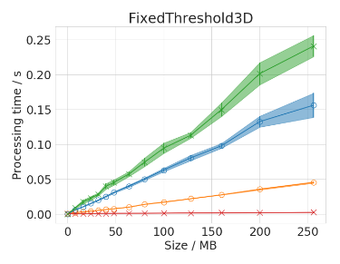
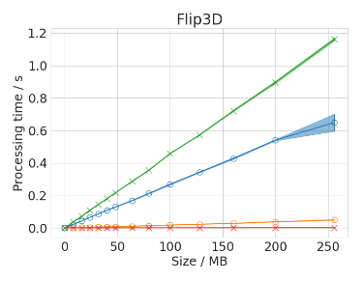

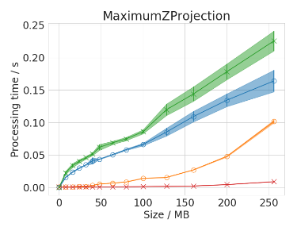
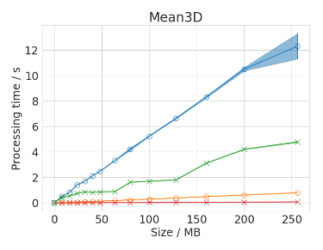
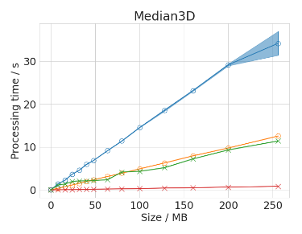

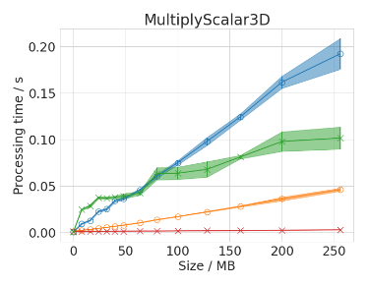
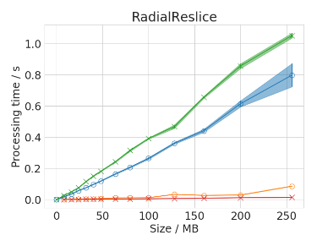
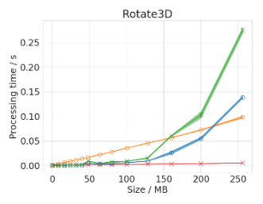
GPU-accelerated image processing
Performance depends on operation, image size, parameters, hardware, ….
Haase et al. Nat Methods (2020),
https://www.nature.com/articles/s41592-019-0650-1

Slide 13
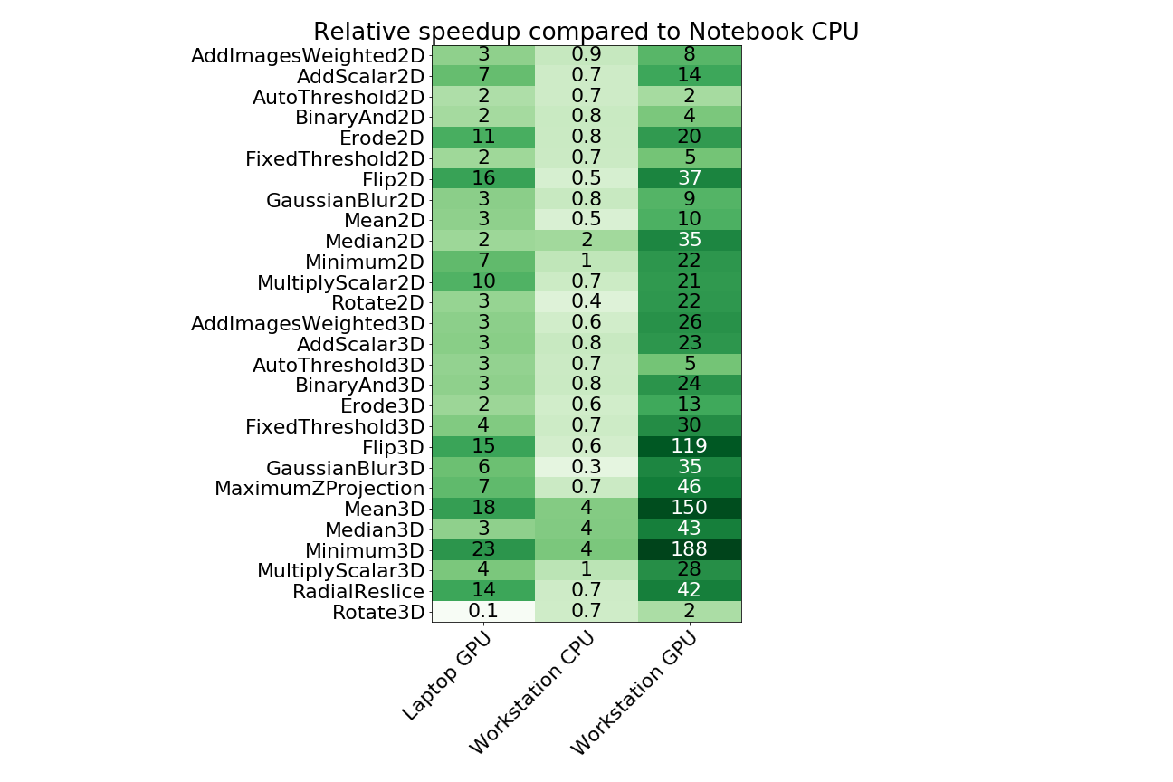
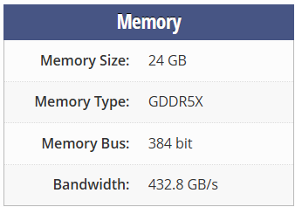
GPU-accelerated image processing
Speedup compared to Laptop CPU
  8 MB (2D)
  64 MB (3D)
Intel UHD 620 GPU (Laptop)
Nvidia Quadro P6000 (workstation)
Haase et al. Nat Methods (2020),
https://www.nature.com/articles/s41592-019-0650-1 https://www.techpowerup.com/gpu-specs/quadro-p6000.c2865

Slide 14
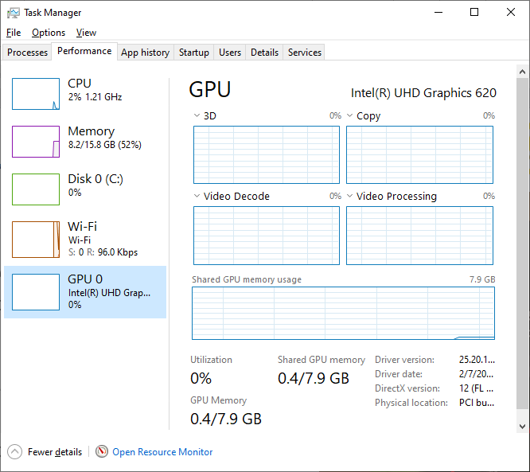
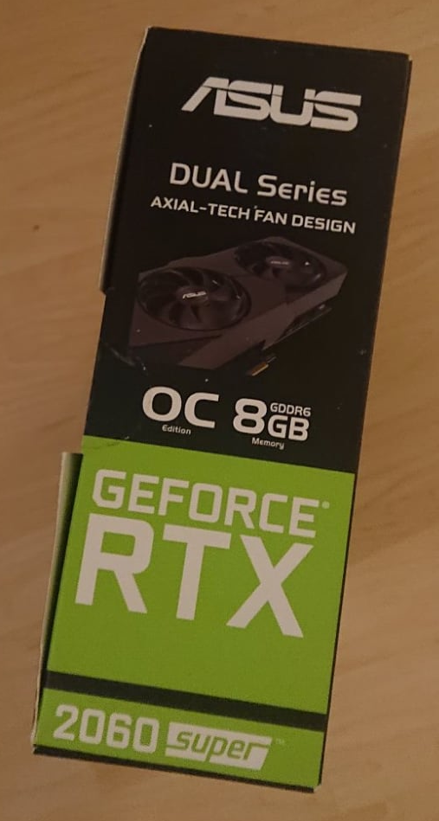
Checklist: When does GPU-accelerated image processing make sense?
In order to accelerate your image analysis workflow
The pre-existing workflow should be slow; ideally:
(processing time / loading time) > 10,
Memory requirements: rule of thumb: image size in GB x number of processing steps + 1))
should fit in your graphics card memory,
If you really want to get the most out of it, you should own a graphics card with GDDR6 memory (memory bandwidth > 400 Gb/s).
Comparison: common DDR4 memory has a bandwidth of about 40 GB/s
Disclosure: I don’t receive any money or anything from any GPU vendor.

Slide 15
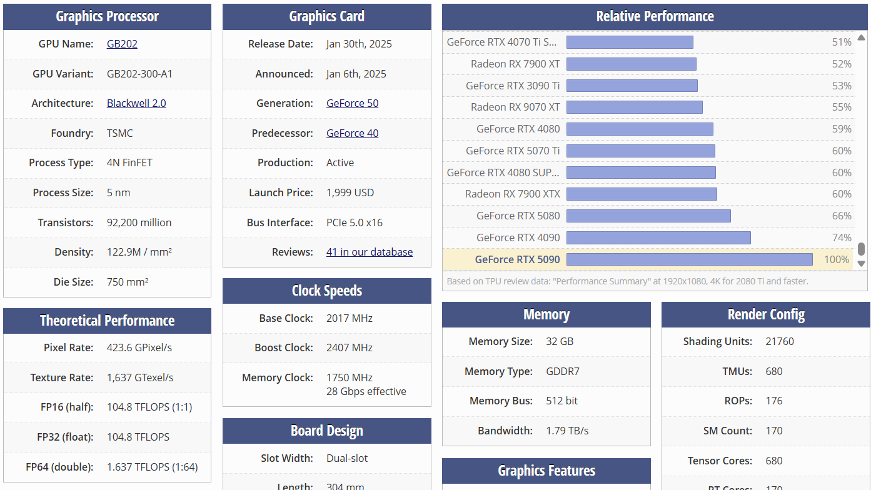
Nvidia RTX 5090 specs
Quiz: What does “memory bound” mean?
Image processing is “memory bound”; important specs:
https://www.techpowerup.com/gpu-specs/geforce-rtx-5090.c4216

Slide 16
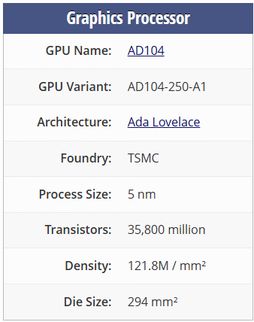
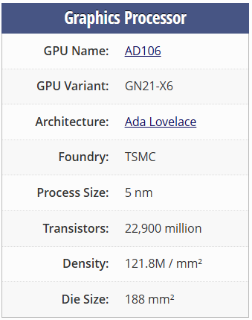
Nvidia RTX 4070 versus 4070 mobile
Vendors name GPUs similarly, despite their configuration is quite different.
RTX 4070
RTX 4070 mobile
https://www.techpowerup.com/gpu-specs/geforce-rtx-4070-mobile.c3944 https://www.techpowerup.com/gpu-specs/geforce-rtx-4070.c3924

Slide 17
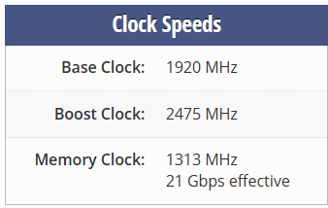
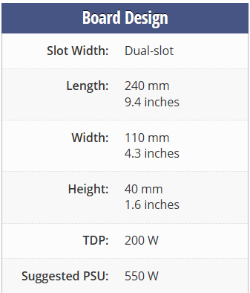




Nvidia RTX 4070 versus 4070 mobile
Quiz: Why are mobile GPUs throttled?
Vendors name GPUs similarly, despite their configuration is quite different.
RTX 4070
RTX 4070 mobile
https://www.techpowerup.com/gpu-specs/geforce-rtx-4070-mobile.c3944 https://www.techpowerup.com/gpu-specs/geforce-rtx-4070.c3924

Slide 18
GPUs allow real-time image processing
GPUs are specialised in processing, very fast thanks to many cores and fast memory access
CPU
CPU
Memory
GPU
Memory
GPU
Core
Core
Core
Core
Core
Core
Core
Core
Core
Core
Core
Core
Core
Core
Core
Core
Core
Core
Core
Core
Core
Core
Core
Core
Core
Core
Core
Core
Core
Hard drive

Slide 19


Data transfer takes time
Data transfer is the bottle neck
Push data to GPU
Pull data from GPU
https://clij.github.io/clij-benchmarking/benchmarking_operations_jmh

Slide 20
Build workflows consisting of many operations
GPU acceleration may suffer from data transfer between CPU and GPU
Central Processing Unit (CPU)
Graphics Processing Unit (GPU)
Gaussian blur
Gaussian blur
push data
Gaussian blur filter
Time
Gaussian blur filter
pull data
https://clij.github.io/clij-benchmarking/benchmarking_workflow_spot_count

Slide 21




Optimal performance through smart memory management
Example workflow processing a Drosophila melanogaster embryo, histone-GFP
Load data
Preprocessing
Transformation
Segmentation
Save data
Haase et al. Nat Methods (2020),
https://www.nature.com/articles/s41592-019-0650-1 https://clij.github.io/

Slide 22
Build workflows consisting of many operations
GPU acceleration may suffer from data transfer between CPU and GPU
Central Processing Unit (CPU)
Graphics Processing Unit (GPU)
Gaussian blur
Gaussian blur
push data
Gaussian blur filter
Time
Gaussian blur filter
Feret’s diameter
Gaussian blur filter
Gaussian blur filter
Subtract
Minimum Caliper
Minor Axis length
Major Axis length
Subtract
Reslice
Maximum projection
pull data
Reslice
Spot detection
Maximum projection
Spot detection
Haase et al. Nat Methods (2020),
https://www.nature.com/articles/s41592-019-0650-1 https://clij.github.io/

Slide 23
Build workflows consisting of many operations
GPU acceleration may suffer from data transfer between CPU and GPU
Central Processing Unit (CPU)
Graphics Processing Unit (GPU)
Gaussian blur
Gaussian blur
push data
Gaussian blur filter
Denoising
Time
Gaussian blur filter
Quiz: What kind of filter is that?
Gaussian blur filter
Gaussian blur filter
Background removal
Subtract
Subtract
Reslice
Maximum projection
Edge enhancement
pull data
Reslice
Spot detection
Maximum projection
Segmentation
Spot detection
Haase et al. Nat Methods (2020),
https://www.nature.com/articles/s41592-019-0650-1 https://clij.github.io/

Slide 24
CENTER FOR SCALABLE DATA ANALYTICS AND
ARTIFICIAL INTELLIGENCE
GPU-accelerated Image Processing in Python: OpenCL / clesperanto
Robert Haase
Funded by
These slides and the related training materials can be reused under the terms of the CC-BY 4.0 license.

Slide 25

GPU-accelerated image processing
Listing available GPUs
Integrated AMD GPU
https://github.com/clEsperanto/pyclesperanto
Picture cropped from https://commons.wikimedia.org/wiki/File:NVIDIA_GeForce_GTX_780_PCB-Front.jpg licensed CC-BY 2.0 by GBPublic_PR

Slide 26

GPU-accelerated image processing
Choosing a GPU
Quiz: Why does it make sense to limit the maximum buffer size to about ¼ of the global memory size?
https://github.com/clEsperanto/pyclesperanto
Picture cropped from https://commons.wikimedia.org/wiki/File:NVIDIA_GeForce_GTX_780_PCB-Front.jpg licensed CC-BY 2.0 by GBPublic_PR

Slide 27

GPU-accelerated image processing
Memory chips
Memory constraints
Transferring from/to the same memory chip would be half as slow, compared to streaming data from one chip through another.
https://github.com/clEsperanto/pyclesperanto
Picture cropped from https://commons.wikimedia.org/wiki/File:NVIDIA_GeForce_GTX_780_PCB-Front.jpg licensed CC-BY 2.0 by GBPublic_PR

Slide 28
GPU-accelerated image processing
Memory chips
Memory constraints
1
2
3
4
Programmers have little to no influence on from/to where data streams.
https://github.com/clEsperanto/pyclesperanto
Picture cropped from https://commons.wikimedia.org/wiki/File:NVIDIA_GeForce_GTX_780_PCB-Front.jpg licensed CC-BY 2.0 by GBPublic_PR

Slide 29



GPU-accelerated image processing
GPU-accelerated image processing also just uses functions.
You used it in the recent weeks already.

Slide 30


GPU-accelerated image processing
Hint: Use SHIFT-Tab to discover functions in clesperanto. You can find them all in the main module. There are no sub-modules like in scikit-image.

Slide 31


Benchmarking
The timeit library makes it straightforward to benchmark compute time in Python / Jupyter.
Quiz: How much faster is cle compared to the sckikit-image filter in this case?
https://docs.python.org/3/library/timeit.html

Slide 32
Benchmarking
The timeit library makes it straightforward to benchmark compute time in Python / Jupyter.
Quiz: Why do we pass the output-image here?
https://docs.python.org/3/library/timeit.html

Slide 33

3D visualization on the cluster
When working on the cluster / Jupyter Hub, consider using stackview instead of napari for inspecting images in 3D.
https://github.com/haesleinhuepf/stackview

Slide 34

CENTER FOR SCALABLE DATA ANALYTICS AND
ARTIFICIAL INTELLIGENCE
GPU-accelerated Image Processing
in Python: CUDA / cupy
Robert Haase
Funded by
These slides and the related training materials can be reused under the terms of the CC-BY 4.0 license.

Slide 35


cupy
CUDA-based GPU-accelerated [image] data processing in Python

Slide 36
drop-in replacement for numpy and scipy
The API of some cupy packages is close to the scipy/numpy API.
This allows easy switching from scipy to cupy.
However, image data still needs to be pushed to GPU memory.
https://github.com/ScaDS/BIDS-lecture-2024/blob/main/07a_gpu_acceleration/10_cupy_basics.ipynb

Slide 37


Common patterns
To make code independent from cupy availablity, while minimizing if-else blocks, some common design patterns emerged:
If this fails because cupy is not installed,
The same pattern works with scipy.ndimage
This will execute and xp will be available.
We can still use np anyway.
https://github.com/ScaDS/BIDS-lecture-2024/blob/main/07a_gpu_acceleration/20_cupy_dropin_replacement.ipynb

Slide 38


Common patterns
You can then call magic code like this, which will do different things depending on cupy-availability.
If cupy is available:
If cupy is not available:
https://github.com/ScaDS/BIDS-lecture-2024/blob/main/07a_gpu_acceleration/20_cupy_dropin_replacement.ipynb

Slide 39



Common patterns
Stackview aims to be cupy/numpy
agnostic
Some if-else blocks are hard to avoid
https://github.com/haesleinhuepf/stackview

Slide 40



Custom kernels
CUDA is also just C. You can write custom cupy kernels using simple syntax.
T represents the image type
Input, output parameters
Function call using cupy-arrays as parameters
Math / CUDA code
Read more: https://docs.cupy.dev/en/stable/user_guide/kernel.html

Slide 41






Image Processing CPU vs. GPU
Requires OpenCL compatible
GPU
Performance versus compatibility
Requires Nvidia GPU
cupy
cle
Required for 3D processing
Simple ITK
Processing performance
Scikit-image
Device compatibility
Logos may be subject to copyright of the respective open source communities

Slide 42
CENTER FOR SCALABLE DATA ANALYTICS AND
ARTIFICIAL INTELLIGENCE
Tiled image processing
Robert Haase
Funded by
These slides and the related training materials can be reused under the terms of the CC-BY 4.0 license.

Slide 43
Quiz: Memory constraints
Assume your computer runs out of memory while processing this image dataset.
What can you do to avoid this?
Tiled image processing
The full data set is about
1024 (width)
2048 (height)
100 (depth)
3700 (frames) large
770 GB

Slide 44
Optimal performance through smart memory management
The classical way of dealing with large image stacks…
Load data
Preprocessing
Load data
Load data
Load data
Load data
Load data

Slide 45
Optimal performance through smart memory management
The classical way of dealing with large image stacks… is suboptimal
Load data
Preprocessing
Load data
Preprocessing
Load data
Preprocessing
Load data
Preprocessing
This strategy does not just take long; it also costs a lot of memory!
Load data
Preprocessing
Load data
Preprocessing

Slide 46
Optimal performance through smart memory management
Processing time-point by time-point is more efficient!
Load data
Preprocessing
Transformation
Segmentation
Save data
Load data
Preprocessing
Transformation
Segmentation
Save data
Load data
Preprocessing
Transformation
Segmentation
Save data
This strategy also works tile-by-tile on large 3D stacks and timelapse data!

Slide 47
Optimal performance through smart memory management
Even better: Distribute tasks between parallelized computation systems
Load data
Preprocessing
Transformation
Segmentation
Save data
Load data
Preprocessing
Transformation
Segmentation
Save data
Load data
Preprocessing
Transformation
Segmentation
Save data
Load data
Preprocessing
Transformation
Segmentation
Save data
Load data
Preprocessing
Transformation
Segmentation
Save data
Load data
Preprocessing
Transformation
Segmentation
Save data

Slide 48




Optimal performance through smart memory management
Even better: Distribute tasks between parallelized computation systems
For this strategy, advanced programming skills are necessary.
Save data
Save data
Save data
Segmentation
Save data
pyopencl / clesperanto
Transformation
Segmentation
Save data
Preprocessing
Transformation
Segmentation
Save data
https://www.python.org/ https://www.dask.org/ https://cupy.dev https://clesperanto.net

Slide 49




Tiling
The last perimeter against big data
If the image is too large for the computer memory, image processing as a whole is not possible.
Processing tile-by-tile poses new challenges

Slide 50


Tiling
Optimal margin size depends on algorithm and its parameters
Example: Gaussian blur (sigma = 20)
Solution: Process with overlapping tiles (size + margin)
Margin: 0 pixels
Margin: 10 pixels
Margin: 20 pixels

Slide 51
Tiling
Example: Gaussian blur (sigma = 20 pixels)
Solution: Process with overlapping tiles (size + margin)
Computation time depends on tile size and margin width
72x72 pixels
Margin: 20 pixels
Size: 5x original
52x52 pixels
Margin: 10 pixels
Size: 2.7x original
Tile
32x32 pixels

Slide 52



Tiling
Checking which labels touch and combine them is feasible.
Some algorithms are hard to solve by processing tiles
Example: Connected component analysis

Slide 53



Tiling
There are algorithms for that, but hardly available tools.
Some algorithms are hard to solve by processing tiles
Example: Connected component analysis

Slide 54


Tiled image processing in Python
Key: tiled file formats, for parallel, distributed, lazy loading
After executing this, no pixel has been read yet.

Slide 55


Tiled image processing in Python
Lazy processing
After executing this, no pixel has been read or processed yet.
After that, results are avaialble

Slide 56





Tiling with/out overlap
Processing of images in tiles: artifacts ad tile borders

Slide 57






Tiling with/out overlap
Processing of images in tiles: artifacts at tile borders

Slide 58
Segmentation quality estimation
Robert Haase
Reusing materials from Lena Maier-Hein, Annika Reinke (DKFZ) et al.
and Martin Schätz (Charles Uni Prague)

Slide 59


Goal
Compare label images quantitatively, to know
  how “good” a segmentation algorithms is and/or
  how “variable” segmentations (from humans or computers are)
How can we know if these results are the same?
Human annotation (“ground truth”)
Algorithm result

Slide 60

Why do results vary?
Potential reasons of same workflows delivering different results:
Image data type (8/16/32-bit float/int)
Workflow implementation
How histograms are determined
How the threshold is determined from the histogram
Compute architecture (CPU, GPU, TPU, …)
Hardware vendor
Software / driver versions
https://forum.image.sc/t/otsus-threshold-method-delivers-different-results-in-scikit-image-and-imagej/24655

Slide 61




Visual comparison
The order in label images may be different. To compare them visually, we need to turn them into binary images first.
https://haesleinhuepf.github.io/BioImageAnalysisNotebooks/29_algorithm_validation/visual_comparison.html

Slide 62









Quantitative comparison
Voxel-wise Youden-Index
Contour distance
Volume standard deviation
Volume error
Classification error
Dice Index
Hausdorff distance
Hamming distance
Jaccard Index
Simplified Hausdorff distance

Slide 63


Choosing the right metric is key
Systematic overview by Maier-Hein, Reinke at al.
Maier-Hein, Reinke et al. Arxiv (2023)
licensed CC-BY 4.0 https://arxiv.org/pdf/2206.01653.pdf
https://www.nature.com/articles/s41592-023-02151-z

Slide 64

Choosing the right metric is key
Source: Cropped from Ext. Data Fig 1 in Maier-Hein, Reinke, et al. licensed CC-BY 4.0 https://arxiv.org/pdf/2206.01653.pdf

Slide 65
Choosing the right metric is key
Source: Cropped from Ext. Data Fig 1 in Maier-Hein, Reinke, et al. licensed CC-BY 4.0 https://arxiv.org/pdf/2206.01653.pdf

Slide 66

Choosing the right metric is key
Define your question
Source: Cropped from Fig 4 in Maier-Hein, Reinke, et al. licensed CC-BY 4.0 https://arxiv.org/pdf/2206.01653.pdf

Slide 67





Overlap metrics
Consider pitfalls and
limitations
(From Figure 56)
Modified (cropped for space reasons)
from Maier-Hein, Reinke et al. Arxiv (2023)
licensed CC-BY 4.0 https://arxiv.org/pdf/2206.01653.pdf

Slide 68
Segmentation quality estimation
In general
  Define what’s positive and what’s negative.
Negative
Positive

Slide 69
Segmentation quality estimation
In general
  Define what’s positive and what’s negative.
Negative
Positive
Reference / “Ground truth”

Slide 70
Segmentation quality estimation
In general
  Define what’s positive and what’s negative.
What an algorithm suggests to be negative
What an algorithm suggests to be positive
Algorithm result

Slide 71
Segmentation quality estimation
In general
  Define what’s positive and what’s negative.
  Compare with a reference to figure out what was true and false
  Welcome to the
  Theory of Sets
A
Prediction A
B
Reference B
(ground truth)
ROI
Region of interest
FP
TP
FN
TP
True-positive
FN
False-negative
TN
FP
False-positive
TN
True-negative

Slide 72


Dice versus Jaccard Index (IoU)
Source: Cropped from Ext. Data Fig SN 3.5 and 3.9 in Maier-Hein, Reinke, et al. licensed CC-BY 4.0 https://arxiv.org/pdf/2206.01653.pdf

Slide 73

Dice versus Jaccard Index (IoU)
Source: Cropped from Ext. Data Fig SN 2.18 in Maier-Hein, Reinke, et al. licensed CC-BY 4.0 https://arxiv.org/pdf/2206.01653.pdf

Slide 74




Sparse Jaccard Index
For every annotated object, we compute the maximum IoU with any segmented object.
We average this value over all annotated objects
Sparse
instance annotation
IoU = 0.35
IoU = 0.66
IoU = 0.69
Instance segmentation candidates
Source: https://github.com/haesleinhuepf/napari-workflow-optimizer

Slide 75


Sparse Jaccard Index
Play with metrics to gain understanding
With Martin Schätz (Charles Uni, Prague)
@schatzcz
https://github.com/haesleinhuepf/the-segmentation-game

Slide 76
Pixel-wise versus Object-wise evaluation
Pixel wise: Segmentation quality
Prediction
Ground truth
FN
FN
FN
FP
TP
TP
FN
FP
TP
FN
FP
TP
TP
FN
True-positive: 4
False-negative: 5
False-positive: 2
IoU = 4 / 11

Slide 77






Accuracy versus Jaccard Index (IoU)
Side-effects of image size and number of nuclei
Nuclei
Reference
Segmentation result
Accuracy: 0.97
Jaccard Index: 0.73
Accuracy decreases because there are less correct black pixels (TN)
Accuracy: 0.95
Jaccard Index: 0.73
https://haesleinhuepf.github.io/BioImageAnalysisNotebooks/29_algorithm_validation/jaccard_index_versus_accuracy.html

Slide 78
Choosing the right metric is key
Define your question
Source: Cropped from Fig 4 in Maier-Hein, Reinke, et al. licensed CC-BY 4.0 https://arxiv.org/pdf/2206.01653.pdf

Slide 79
Pixel-wise versus Object-wise evaluation
Are these objects overlapping?
FN
FN
FN
FN
FN
FN
FN
FN
FN
FN
FN
FN
FN
FN
FN
FN
FN
FN
FP
TP
FN
FN
FP
TP
FN
FP
TP
TP
FN
FP
FP
TP
FN
FP
TP
FN
FP
TP
TP
FN
IoU = 1 / 7
IoU = 1 / 3
IoU = 1 / 2

Slide 80
Pixel-wise versus Object-wise evaluation
Object wise: Detection quality
Prediction
Ground truth
FP
TP
FN
True-positive: 3
False-negative: 1
False-positive: 2
IoU = 1 / 2

Slide 81

Special case in medical imaging
We elaborate segmentation quality of one / large object:
Source: Cropped from Fig 5 in Maier-Hein, Reinke, et al. licensed CC-BY 4.0 https://arxiv.org/pdf/2206.01653.pdf

Slide 82


What metric to use when?
“Metrics reloaded: Pitfalls and recommendations for image analysis validation”
Maier-Hein, Reinke et al. https://arxiv.org/abs/2206.01653

Slide 83



Further reading
Mara Lampert
@marabuuuu.bsky.social
https://focalplane.biologists.com/2023/04/13/quality-assurance-of-segmentation-results/

Slide 84
Exercises
Robert Haase

Slide 85


Exercise: GPU-accelerated image processing
Compare CPU processing speed with a GPU, consider using the cluster for this

Slide 86

Exercise: Tiled image processing
Apply background-removal to an image in tiles. Determine the overlap width that‘s necessary to have artifact-free results.

Slide 87



Segmentation quality
Measure segmentation quality of a given algorithm applied to a folder of images.

Slide 88

Optional exercise
Play Bio-image Analysis Bubbles and test your skills: Can you build a workflow that reproduces the results?
Major parts of this game were written by the AI in cursor. https://www.cursor.com/
https://github.com/haesleinhuepf/bia-bubbles

