Slide 1




An auto-diagnostic SSbD tool to facilitate the integration of Safe and Sustainable by Design approach in the innovative stage
SETAC 2025, May 13th, Vienna (Austria)
Joséphine Steck¹, Loélia Fohet², Catherine Colin², Cécile Philippot¹
¹ Univ. Grenoble Alpes, CEA, Liten, DTNM, 38000 Grenoble, France
² Industrial Technical Center for Plastics and Composites, CT-IPC, Biopôle Clermont-Limagne, 63360 Saint-Beauzire FRANCE
These projects received funding from the European Union’s Horizon Europe research and innovation programme under grant agreements n° 101177608 (PLANETS) and 101091777 (CLEANHYPRO). Views and opinions expressed are however those of the author(s) only and do not necessarily reflect those of the European Union. Neither the European Union nor the granting authority can be held responsible for them.

Slide 2
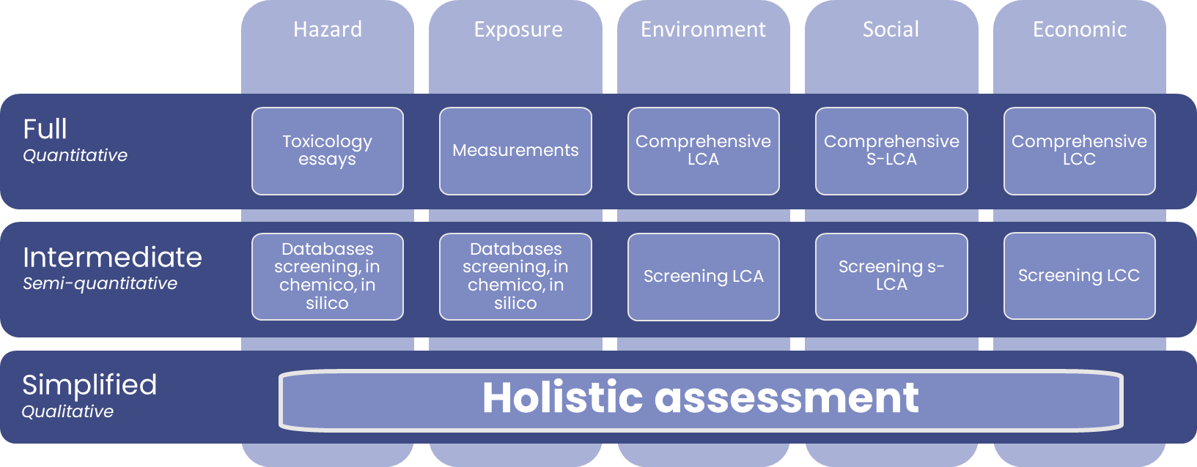
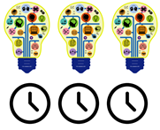
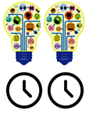

Introduction
The JRC’s methodological guidance published in 2024 emphasised the need to develop a simplified, tiered approach suitable for:
3 categories (molecules, final products and processes;
4 dimensions (safety, environment, economic and social):
Expertise
Tech
SSbD
Abbate, E., Garmendia Aguirre, I., Bracalente, G., Mancini, L., Tosches, D., Rasmussen, K., Bennett, et M.J., Rauscher, H., Sala, S., « Safe and Sustainable by Design chemicals and materials - Methodological Guidance », 2024, JRC.

Slide 3
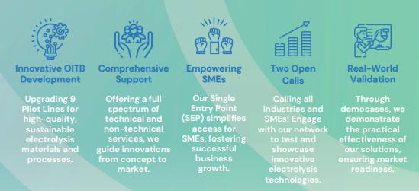
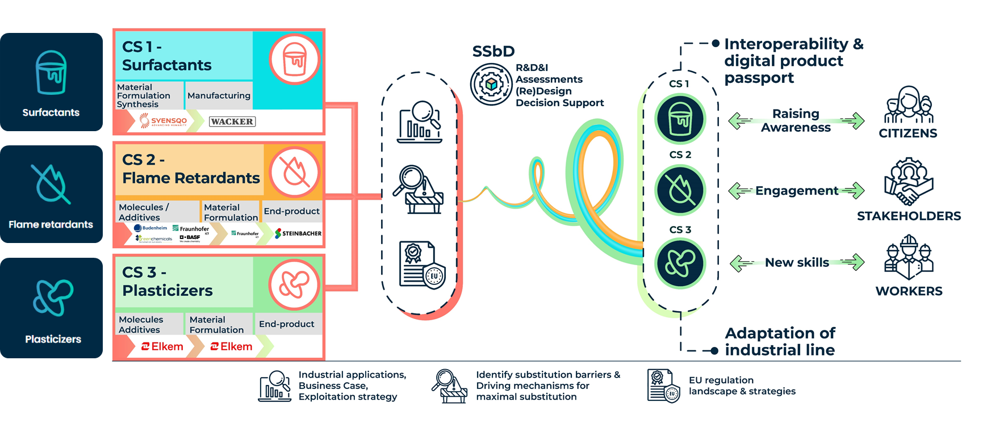
Introduction
Two stories with a common requirement:
A safe and sustainable SIMPLIFIED assessment
Open Innovation Test Bed for Electrolysis Materials for Clean Hydrogen Production
Plasticizers, fLame-retardants and surfactANts: new alternatives validating the the safE and susTainable by deSign approach
Notes:
PLANETS will demonstrate the applicability of the Framework on the technical development of alternatives to 3 of most important classes of molecules in chemical industries (plasticizers, flame-retardants and surfactants). The new molecules and products will be significantly safer to workers and consumers; will have considerably lower environmental impact, while ensuring economic viability and social awareness throughout the 3 value chains.
CLEANHYPRO will develop and organize a sustainable Open Innovation Test Bed for electrolysis materials and components, providing a network of facilities and services through a Single Entry Point to companies. 9 Pilot lines will be upscaled and upgraded fostering a future sustainable manufacturing ecosystem.

Slide 4
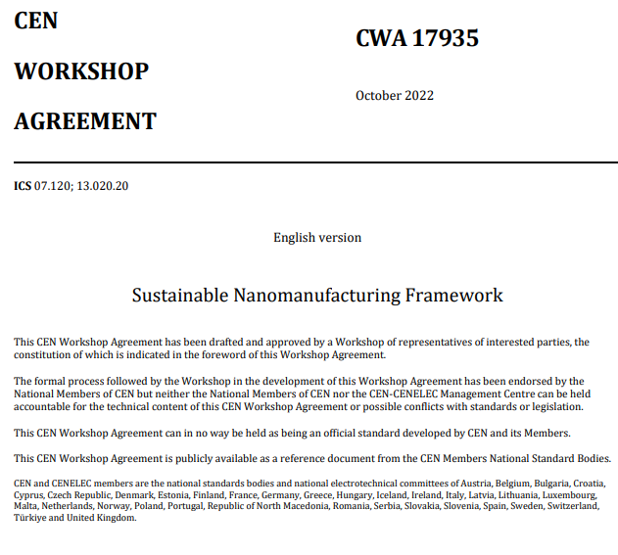
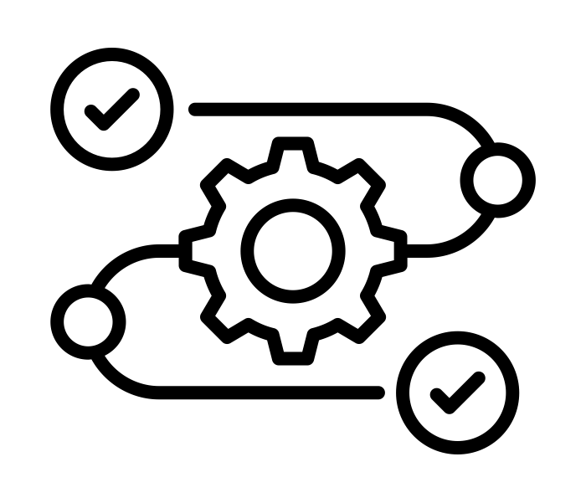
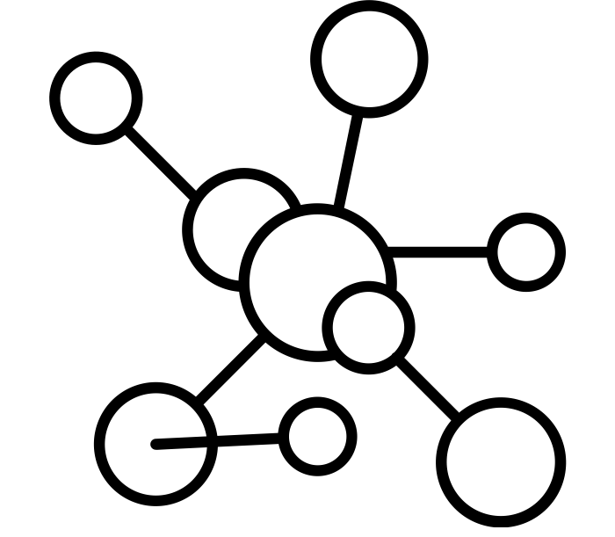
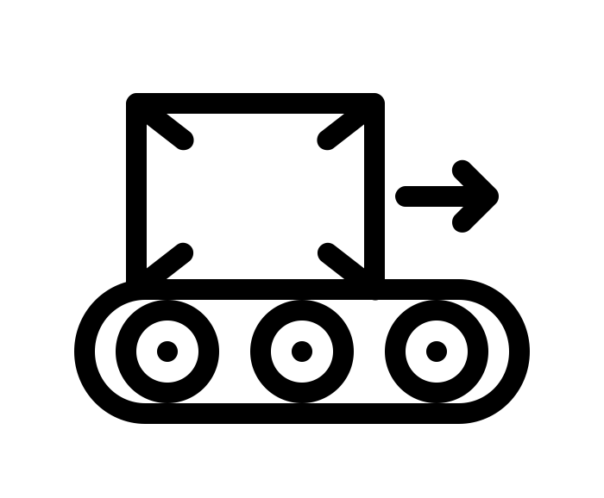
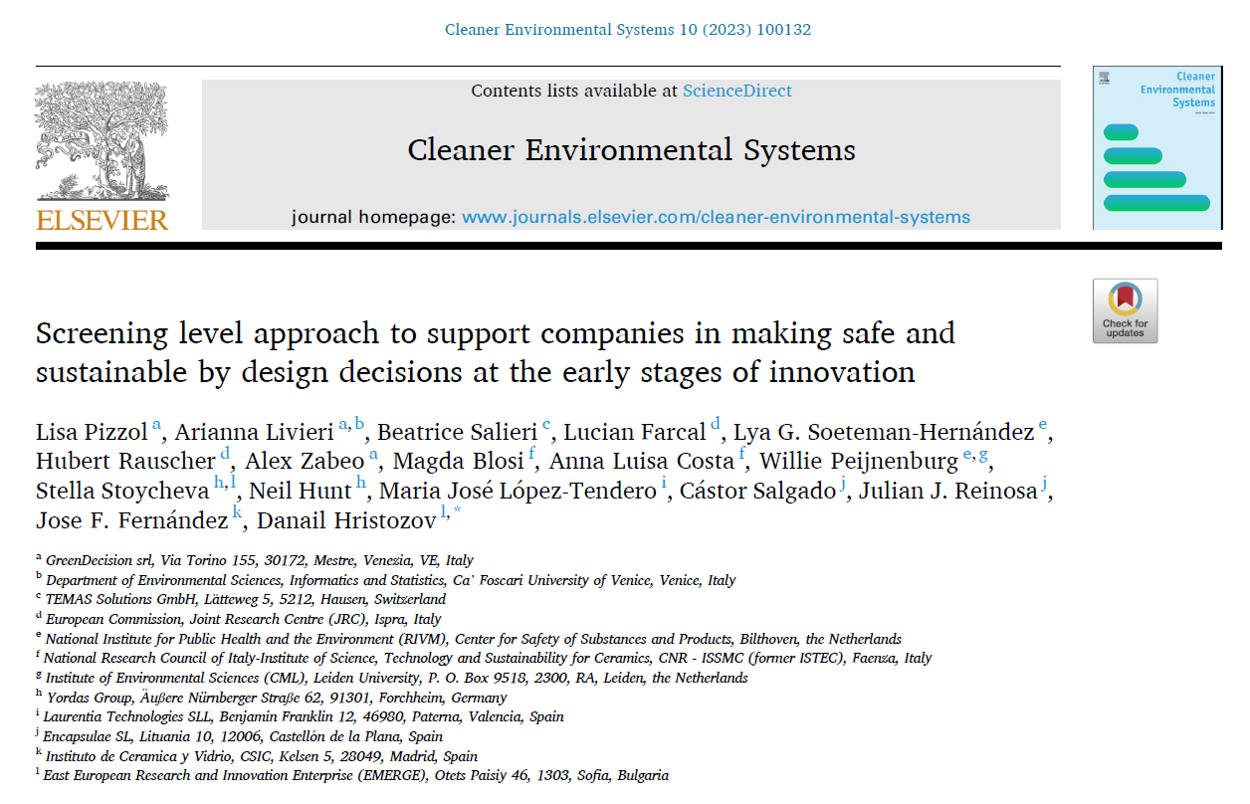
Introduction
Methodology
Results
Perspectives
Project lifetime
Proposal stage
Process design
Molecular
design
Product
design
Project lifetime
Refinement towards simplification
Today
J. S. Jesus López de Ipiña, « Sustainable nanomanufacturing framework CWA 7935 », 2022, CEN, CENELEC.
Lisa Pizzol a, Arianna Livieri a,b, Beatrice Salieri c, Lucian Farcal d, Lya G. Soeteman-Hern´andez e, Hubert Rauscher d, Alex Zabeo a, Magda Blosi f, Anna Luisa Costa f, Willie Peijnenburg e,g, Stella Stoycheva h,l, Neil Hunt h, Maria Jos´e L´opez-Tendero i, C´astor Salgado j, Julian J. Reinosa j, et Jose F. Fern´andez k, Danail Hristozov l,*, « Screening level approach to support companies in making SSbD decisions at early stages of innovation », 2023.
@Copyright: Design circle, joe pictos and tazar tantuar from Noun project

Slide 5
Methodology
1

Slide 6


Scope
Set of Questions
Item
SSbD
Simplified assessment
Safety
Hazard
Release and exposure
Environment
Emissions
Wastes
Consumptions
Economy
Social
Economic performance
Quality
Safety
Hazard
Release and exposure
Environment
Economy
Social
SSbD
Simplified assessment
Dimension
Set of Questions
Item
Dimension
…
…
73
50
questions
questions
Notes:
The tier 1 aforeinmentioned encompasses the SSbD assessment steps in one auto-diagnostic tool based on a previous work promoted in the CWA 7935 [5] and in Pizzol et al [6] and enhanced according to the projects needs. It aims to assess all the dimensions (divided in items) at once and to provide a unique scoring system. The user selects a score: "No" or “I don’t know” (0 points), "partialy" (5 points) and "yes" (10 points) for a series of 10 questions related to each item and details the practices already implemented (Figure 1 - 1). A percentage is obtained for each item which is weighed to obtain a final percentage by step. Once the initial situation (reference) is assessed, the user may define a targeted situation (alternative) with practices to be implemented and the targeted score from 0 to 10 (Figure 1 - 2). Finally, the user may update the score and detail new implemented practices (Figure 1 - 3).
An automatically edited management dashboard presents the initial, targeted and updated assessment results of each step with a radar chart and a unique score which is a percentage obtained from the sum of equally weighted individual item scores. This evaluation highlights the gaps to be filled out and guide the evaluator thought an improvement plan and through the customization of the SSbD assessments to be performed at higher tiers.

Slide 7
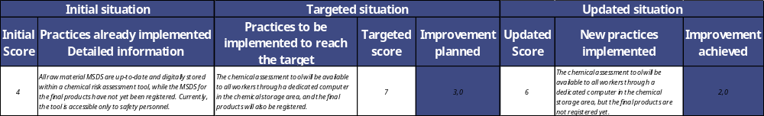
Questionnaire: self-diagnosis
For each question:
answers =
answers =
0
10
« I don’t know » = 0
0
5
10
①
②
③
Unique score to answer a question

Slide 8
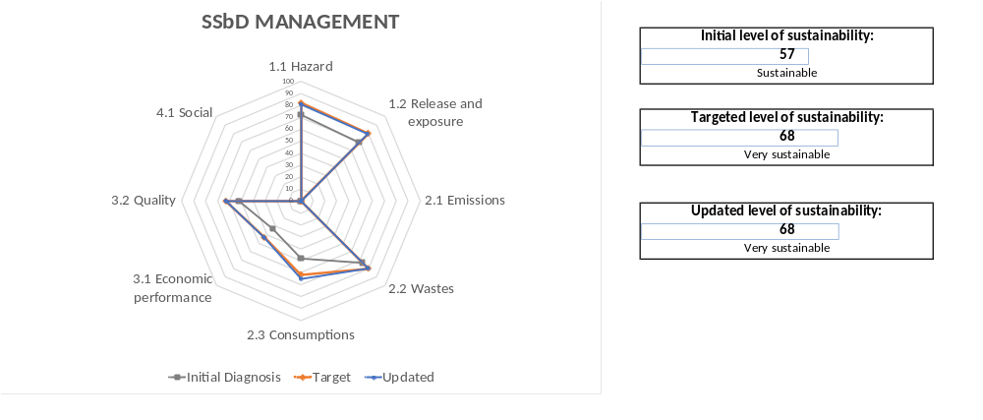
Scoring and visualisation
SSbD
Dimension
Item
…
….
…
…
Question
Question
SSbD level | SSbD score (%)
Not SSbD | 0-15
Low SSbD | 15-30
Fairly SSbD | 30-50
SSBD | 50-65
Very SSBD | 65-85
Highly SSBD | 85-100
Score
from 0 to 100
Score
from 0 to 10
Score
from 0 to 100
Score
from 0 to 100
Average
Average
Sum

Slide 9
Results
2

Slide 10
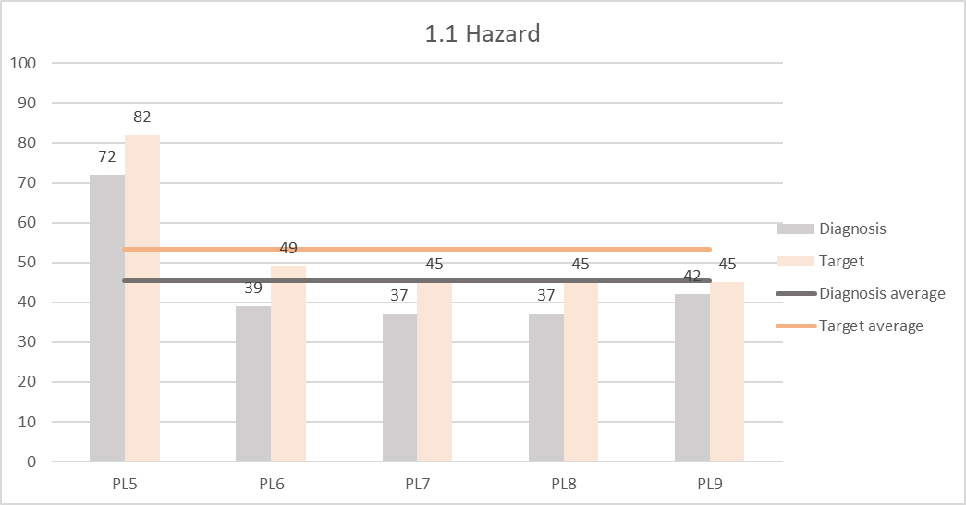
Process design – CLEANHYPRO
CLEANHYPRO ecosystem of 5 pilot lines
Scope – Number of items included max = 5
Level
Number of PL
Scores by item
(1.1 hazard item example for the 5 PL )
Dimension | Item | Number of PL
1. Safety | 1.1 Hazard | 5
 | 1.2 Release and exposure | 5
2. Environment | 2.1 Emissions | 4
 | 2.2 Wastes | 4
 | 2.3 Consumptions | 5
3. Economy | 3.1 Economic performance | 2
 | 3.2 Quality | 5
4. Social | 4.1 Social | 4
current
target
current
target
current
target
current
target
current
target

Slide 11
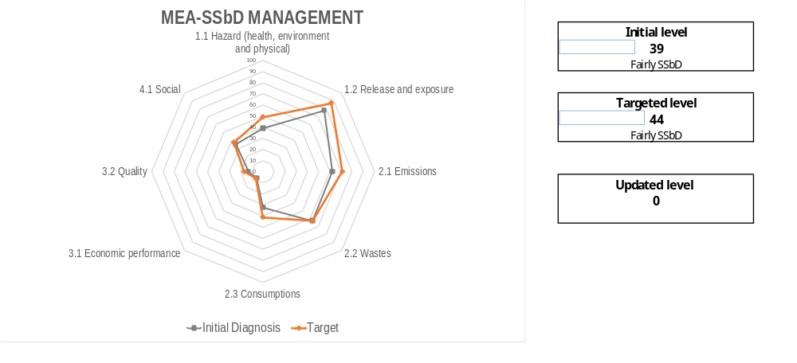
Process design – CLEANHYPRO
Membrane electrode assembly manufacturing - Dashboard
Scores per items
SSbD level
Improvement plan
Item | Actions | KPI
1.1 Hazard | 5 | 1
1.2 Release and exposure | 3 | 2
2.1 Emissions | 1 | 1
2.2 Wastes | 0 | 0
2.3 Consumptions | 1 | 1
3.1 Economic performance | 0 | 0
3.2 Quality | 1 | 1
4.1 Social | 0 | 0
Total | 11 | 6
Improvement plan

Slide 12
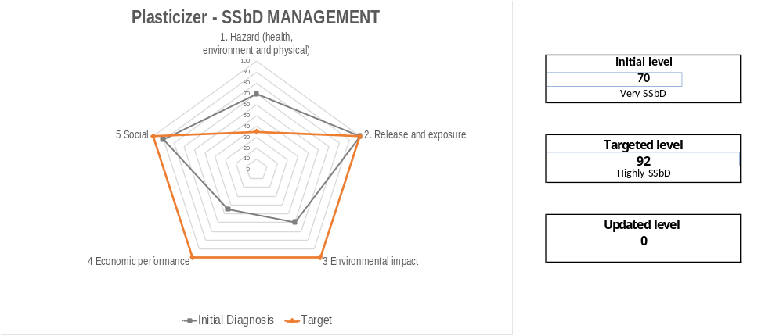
Molecular and product design – PLANETS
Plasticizer - Dashboard
Higher tier assessment strategy:
Hazard
Environment
Economy

Slide 13
Perspectives
3
Refinement and simplification

Slide 14
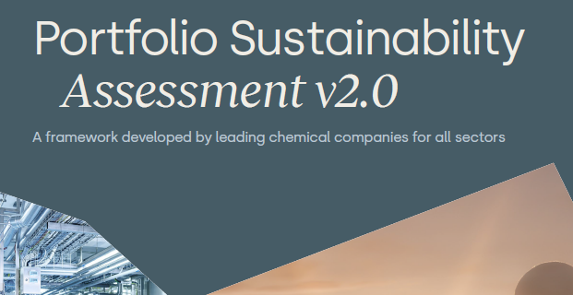
Towards simplification
WBCSD, « Portfolio Sustainability Assessement v2.0 », 2023.
Project lifetime
Proposal stage
Project lifetime
Scope | 5 dimensions 8 items | 4 dimensions 6 items | 5 dimensions
Questions | 73 ranged from 0 to 10 Unknown=0 | 50 0;5;10 Unknown=0 | 36 single option answer (yes/no; Negative / Equal / Positive) Unknown=gap
Dashboard | Spider diagram (per item) Total SSbD score (%) SSbD level | Spider diagram (per item) SSbD score (%) SSbD level | Heat map (per question) SSbD level (C–- to A++)
Improvement plan | Documentated in a table | Not documented | Not documented

Slide 15
Take home messages
Covers all SSbD steps: Hazard, Exposure (workers, consumers, environment), Environment, Economic and Social
Applies to molecules, products, and processes
Enhances SSbD implementation by incorporating industry perspectives and needs
Identifies data gaps, provides improvement plans, and defines higher-tier assessments
Operates on a voluntary basis with a self-diagnosis tool
Requires minimal data and SSbD knowledge
Refines the last version and tests it with case studies within PLANETS

Slide 16
Thank you
Associated work:
Oral Tuesday 13.05: « Value creation and tiering: Incentives of SSbD integration into industrial innovation projects with LCA and measured safety screenings”
Poster 6.11.P-Tu493: «Safe and Sustainable by Design, Scoping, and Simplified Assessment of 60 Alternative Flame Retardants for Use in Insulation Foams »
Abbate, E., Garmendia Aguirre, I., Bracalente, G., Mancini, L., Tosches, D., Rasmussen, K., Bennett, et M.J., Rauscher, H., Sala, S., « Safe and Sustainable by Design chemicals and materials - Methodological Guidance », 2024, JRC.
J. S. Jesus López de Ipiña, « Sustainable nanomanufacturing framework CWA 7935 », 2022, CEN, CENELEC.
Lisa Pizzol a, Arianna Livieri a,b, Beatrice Salieri c, Lucian Farcal d, Lya G. Soeteman-Hern´andez e, Hubert Rauscher d, Alex Zabeo a, Magda Blosi f, Anna Luisa Costa f, Willie Peijnenburg e,g, Stella Stoycheva h,l, Neil Hunt h, Maria Jos´e L´opez-Tendero i, C´astor Salgado j, Julian J. Reinosa j, et Jose F. Fern´andez k, Danail Hristozov l,*, « Screening level approach to support companies in making SSbD decisions at early stages of innovation », 2023.
WBCSD, « Portfolio Sustainability Assessement v2.0 », 2023.
@Copyright: Design circle, joe pictos and tazar tantuar from Noun project
Joséphine Steck
Josephine.steck@cea.fr
These projects received funding from the European Union’s Horizon Europe research and innovation programme under grant agreements n° 101177608 (PLANETS) and 101091777 (CLEANHYPRO). Views and opinions expressed are however those of the author(s) only and do not necessarily reflect those of the European Union. Neither the European Union nor the granting authority can be held responsible for them.

Slide 17
Process design – CLEANHYPRO
Membrane electrode assembly manufacturing – Social answers example
Questions | Initial situation |  | Targeted situation
 | Initial Score | Practices already implemented | Practices to be implemented | Targeted score | Improvement planned
Is the raw material consumption known, quantified and monitored? | 7 | We know where we get our products and in what quantities, but we don't know how they are made. |  | 8 | 1,0
Have you check if the raw materials are considered critical according to the EU list? If they are, are you working on substitution? | 8 | CLEANHYPRO focusses on reducing the use of PFAS and CRM | step up our R&D so that hydrogen technologies have 0 mg/W of CRM | 9 | 1,0
Is the energy consumption known, quantified and monitored? Is the energy consumption optimised ? Are you working on energy reduction/optimisation? | 8 | Energy consumption targets | Improving the performance of electrolysers to enhance their efficiency | 9 | 1,0
Is the water consumption known, quantified and monitored? Is the water consumption optimised ? Are you working on water reduction? | 0 | This is known for the building but not for this specific manufacturing pilot line |  | 0 | 0,0
Do the basic managerial practices with consumptions have been identified and implemented? | 1 |  |  | 1 | 0,0
Do the regulatory requirements on consumptions have been identified and the associated regulatory control has been performed with accredited organizations? | 0 |  |  | 0 | 0,0
Do workers have been appropriately trained on environmental aspects related to consumption and on the proper operation and maintenance of equipment and systems? | 2 | Users are trained to use the equipment properly, and also to turn it off at the end of the day |  | 3 | 1,0
Have you already performed a Life Cycle Assessment? | 0 |  | It will be performed during the project lifetime | 3 | 3,0
TOTAL | 33% |  |  | 41% | 9%

Slide 18
Process design – CLEANHYPRO
Membrane electrode assembly manufacturing – Improvement planed (KPI)
90% of the chemicals MSDS are up to date, read, kept and shared among workers
100% of workers are consulted, informed and appropriately trained about potential hazard, and preventive and protective measures
90% of the stages processes and activities in which a chemical is/will be used, produced or wasted for the whole life cycle are identified
25% of the potential emissions (water, air and soil) are identified, quantified, monitored and mitigated in a life cycle perspective (including consumer use, reprocessing and end of life)
1 life cycle assessment is performed
10% of the incoming materials and final products until the end users are tracked and the process information is registered

Slide 19

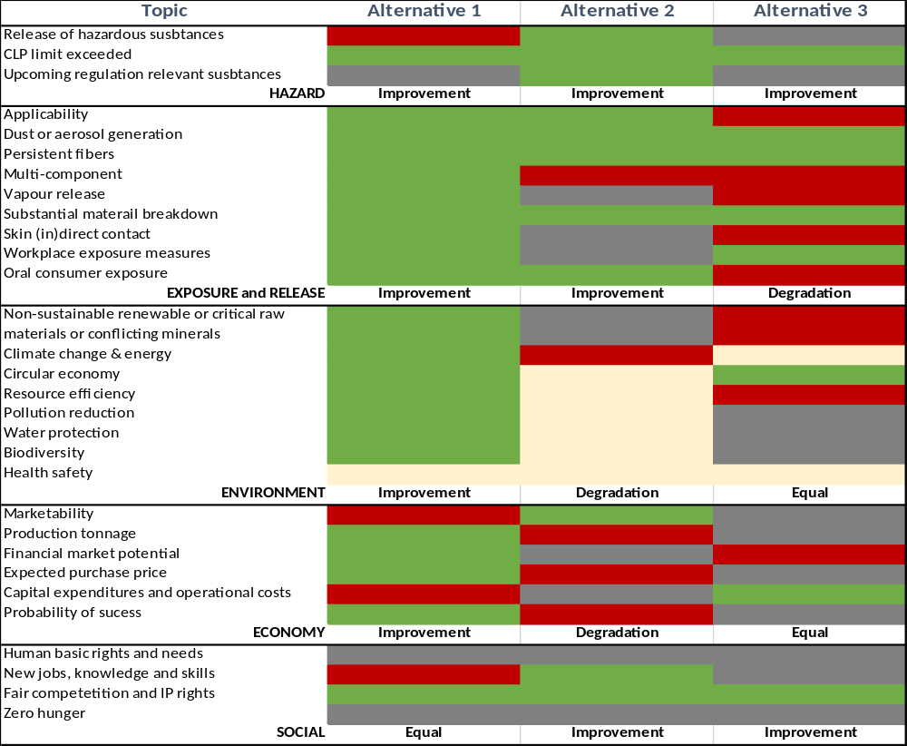
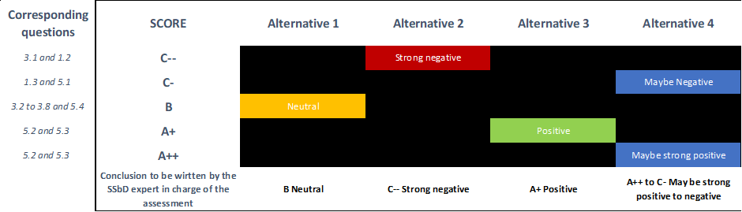
Towards simplification
Molecular and product
PLANETS refined methodology
Scope
Visualisation
36
questions
comparison to a reference
Dimension | Answers
Hazard | Unknown / No / Yes
Release and exposure | Unknown / No / Yes
Environment | Unknown / Negative / Equal / Positive
Economy | Unknown / No / Yes
Social | Unknown / No / Yes
SSbD Level

