Slide 1


EOSC 2.0
The evolution of a federated virtual research environment
Alen Vodopijevec <alen.vodopijevec@cessda.eu>
CESSDA ERIC
Research Data in Bergen
forskningsdatanettverk@UiB lunch seminar
15-05-2025 | Bergen, Norway
CC-BY 4.0

Slide 2
1985.
  87% would share their data on demand
  59% claims that their colleagues were not willing to share the data
  Social sciences: publication concerns - losing the race with time
  Biotechnological fields: financial concerns - losing patents, new projects..
  Ceci, S. J. Scientists’ Attitudes toward Data Sharing. Science, Technology, & Human Values 13, 45–52 (1988).
  https://doi.org/10.1177%2F0162243988013001-206
“Thus this appears to be the right time for those of us responsible for the training of future generations of scientists to introduce into our training some activities designed to inculcate the hallmark norms of science, including data sharing.”

Slide 3
KNOWLEDGE
INFORMATION
DATA

Slide 4
KNOWLEDGE
INFORMATION
DATA

Slide 5
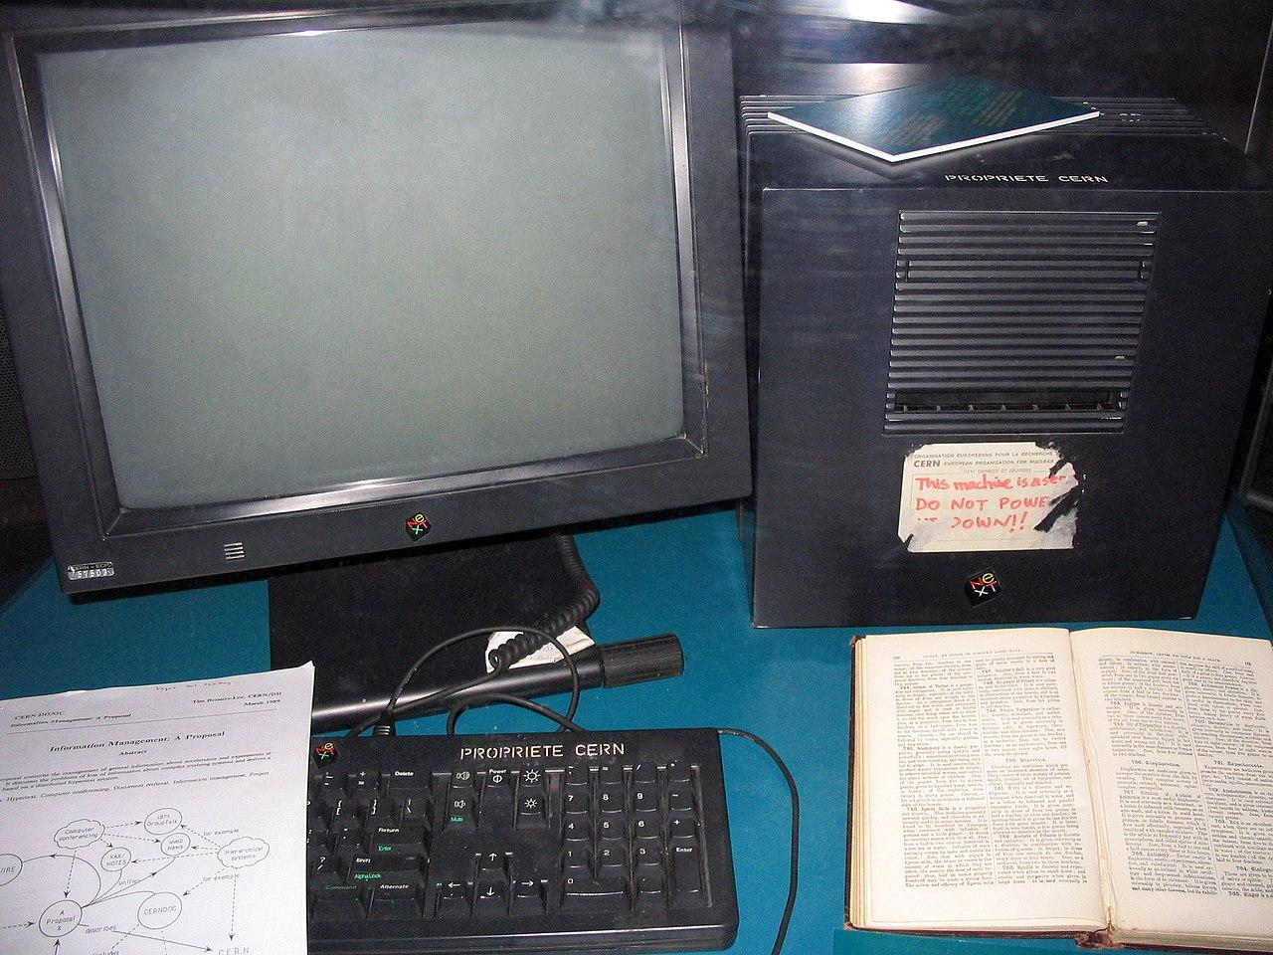
WWW
CERN 1989
World 1991
https://en.wikipedia.org/wiki/Tim_Berners-Lee#/media/File:First_Web_Server.jpg

Slide 6
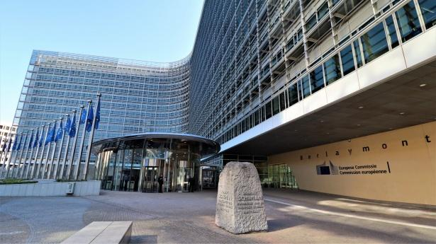
VISION (EC, Info days 2007-08)

Slide 7
Some PMs later …

Slide 8
EOSC stands for European Open Science Cloud
EOSC is an ecosystem for/a web of FAIR data that contributes to data reuse and cross-disciplinary research
Addresses the issues around FAIR data including data quality, management, metadata, publication, tools for processing, sharing, training data for AI
To increase the scientific impact of research data from the various domains and save time and money!

Slide 9
Funding
EOSC project funding started in 2017 with the EOSC-Pilot project
From 2021 ~50 EOSC projects were funded
https://eosc.eu/eosc-macro-roadmap/

Slide 10
Governance (EOSC 1.0)
(2016) EOSC was an initiative by the European Commission to bring together Thematic Research Infrastructures (RIs), Research Performing Organisations (RPOs) and e-Infrastructures to help researchers to implement Open Science
(2021) The EC created the EOSC Partnership and EOSC Association (EOSC-A), governed by three ‘parties’ (EOSC Tripartite):
European Commission, Steering Board (representing the EU member states), Assembly of member organisations (RIs, RPOs, NRENs, etc) represented by the EOSC-A Board
(2024) The EOSC Tripartite decided to create the EOSC Federation which would be made up of EOSC Nodes.

Slide 11
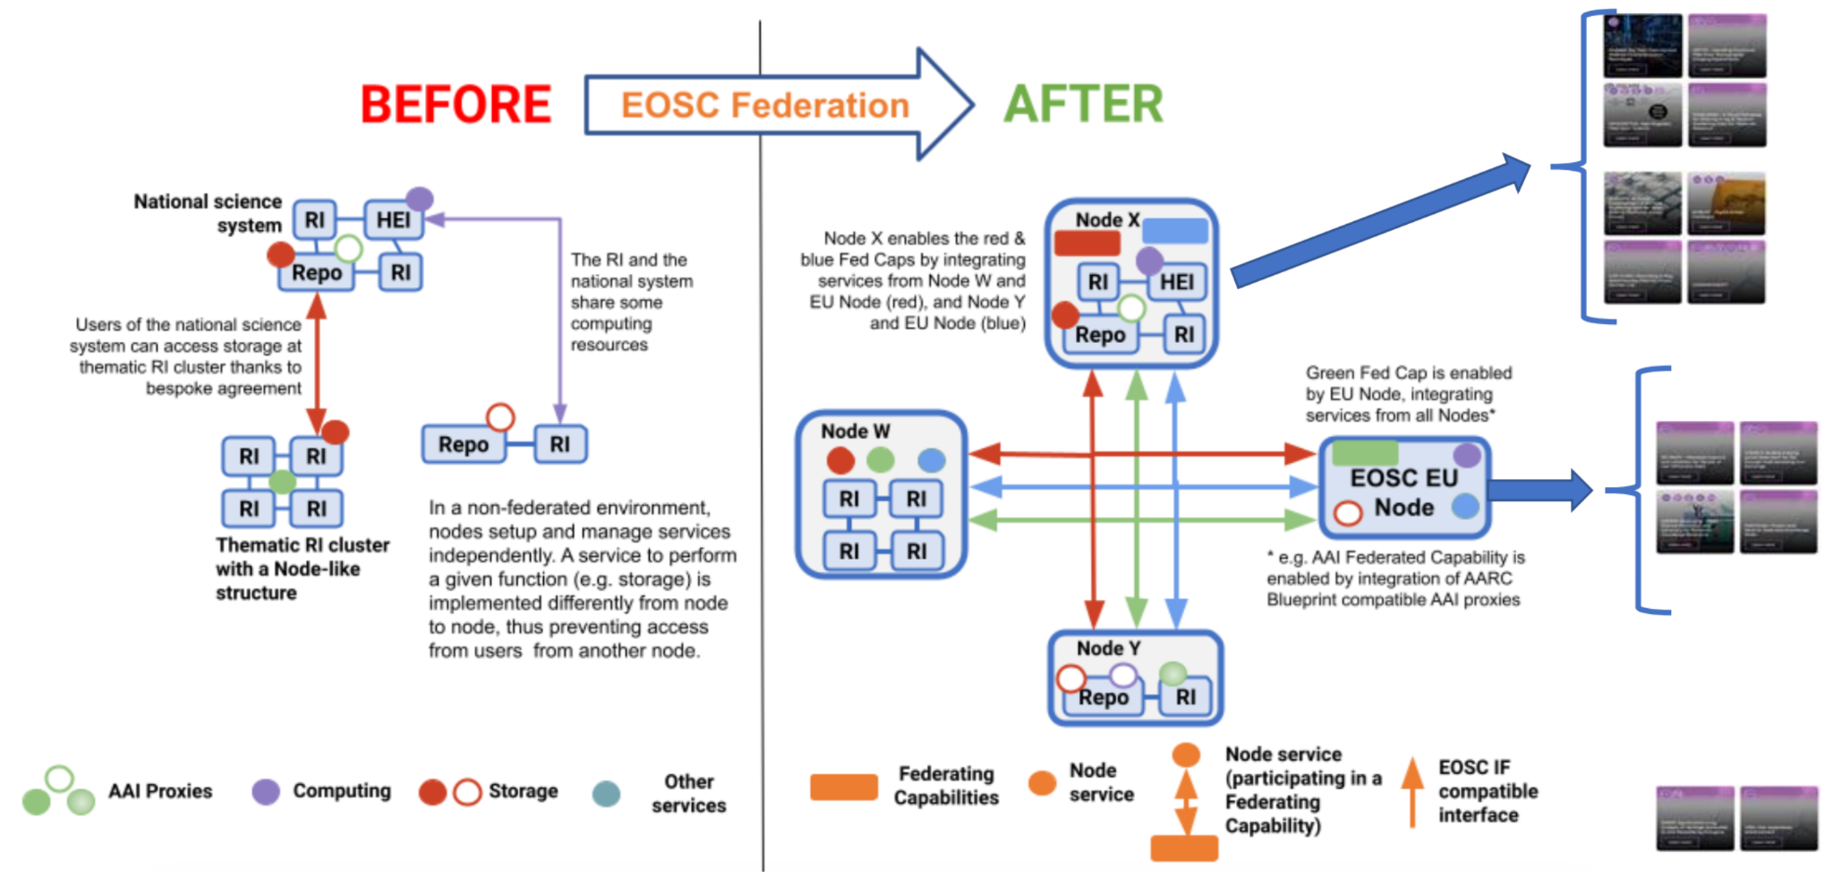
Vision

Slide 12
How it works?
EOSC Federation a virtual infrastructure made up of EOSC Nodes
EOSC Nodes are organisations or groups of organisation that offer data, services and IT infrastructure
EOSC Nodes must federate services by linking to some or all the other Nodes
The EOSC Federation is under construction, lots of details need to be worked out
The Federation will start with 13 Nodes and should be operational by November 2025

Slide 13
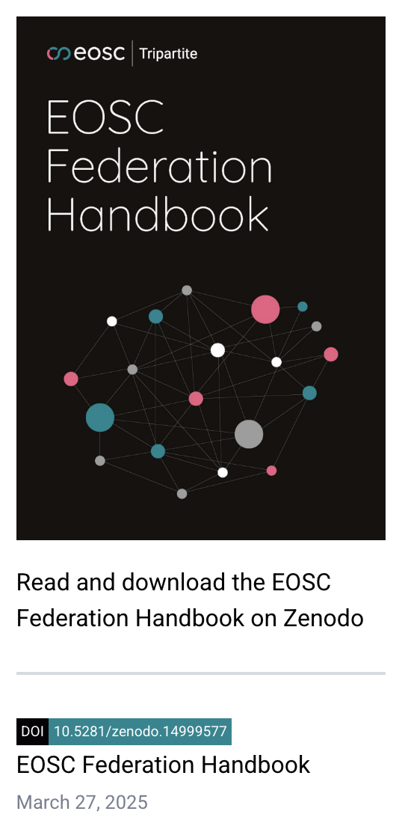

EOSC Federation Handbook is a collaborative effort to document what an EOSC Node is and how to build the EOSC Federation from the EOSC Nodes
https://zenodo.org/records/14999577

Slide 14
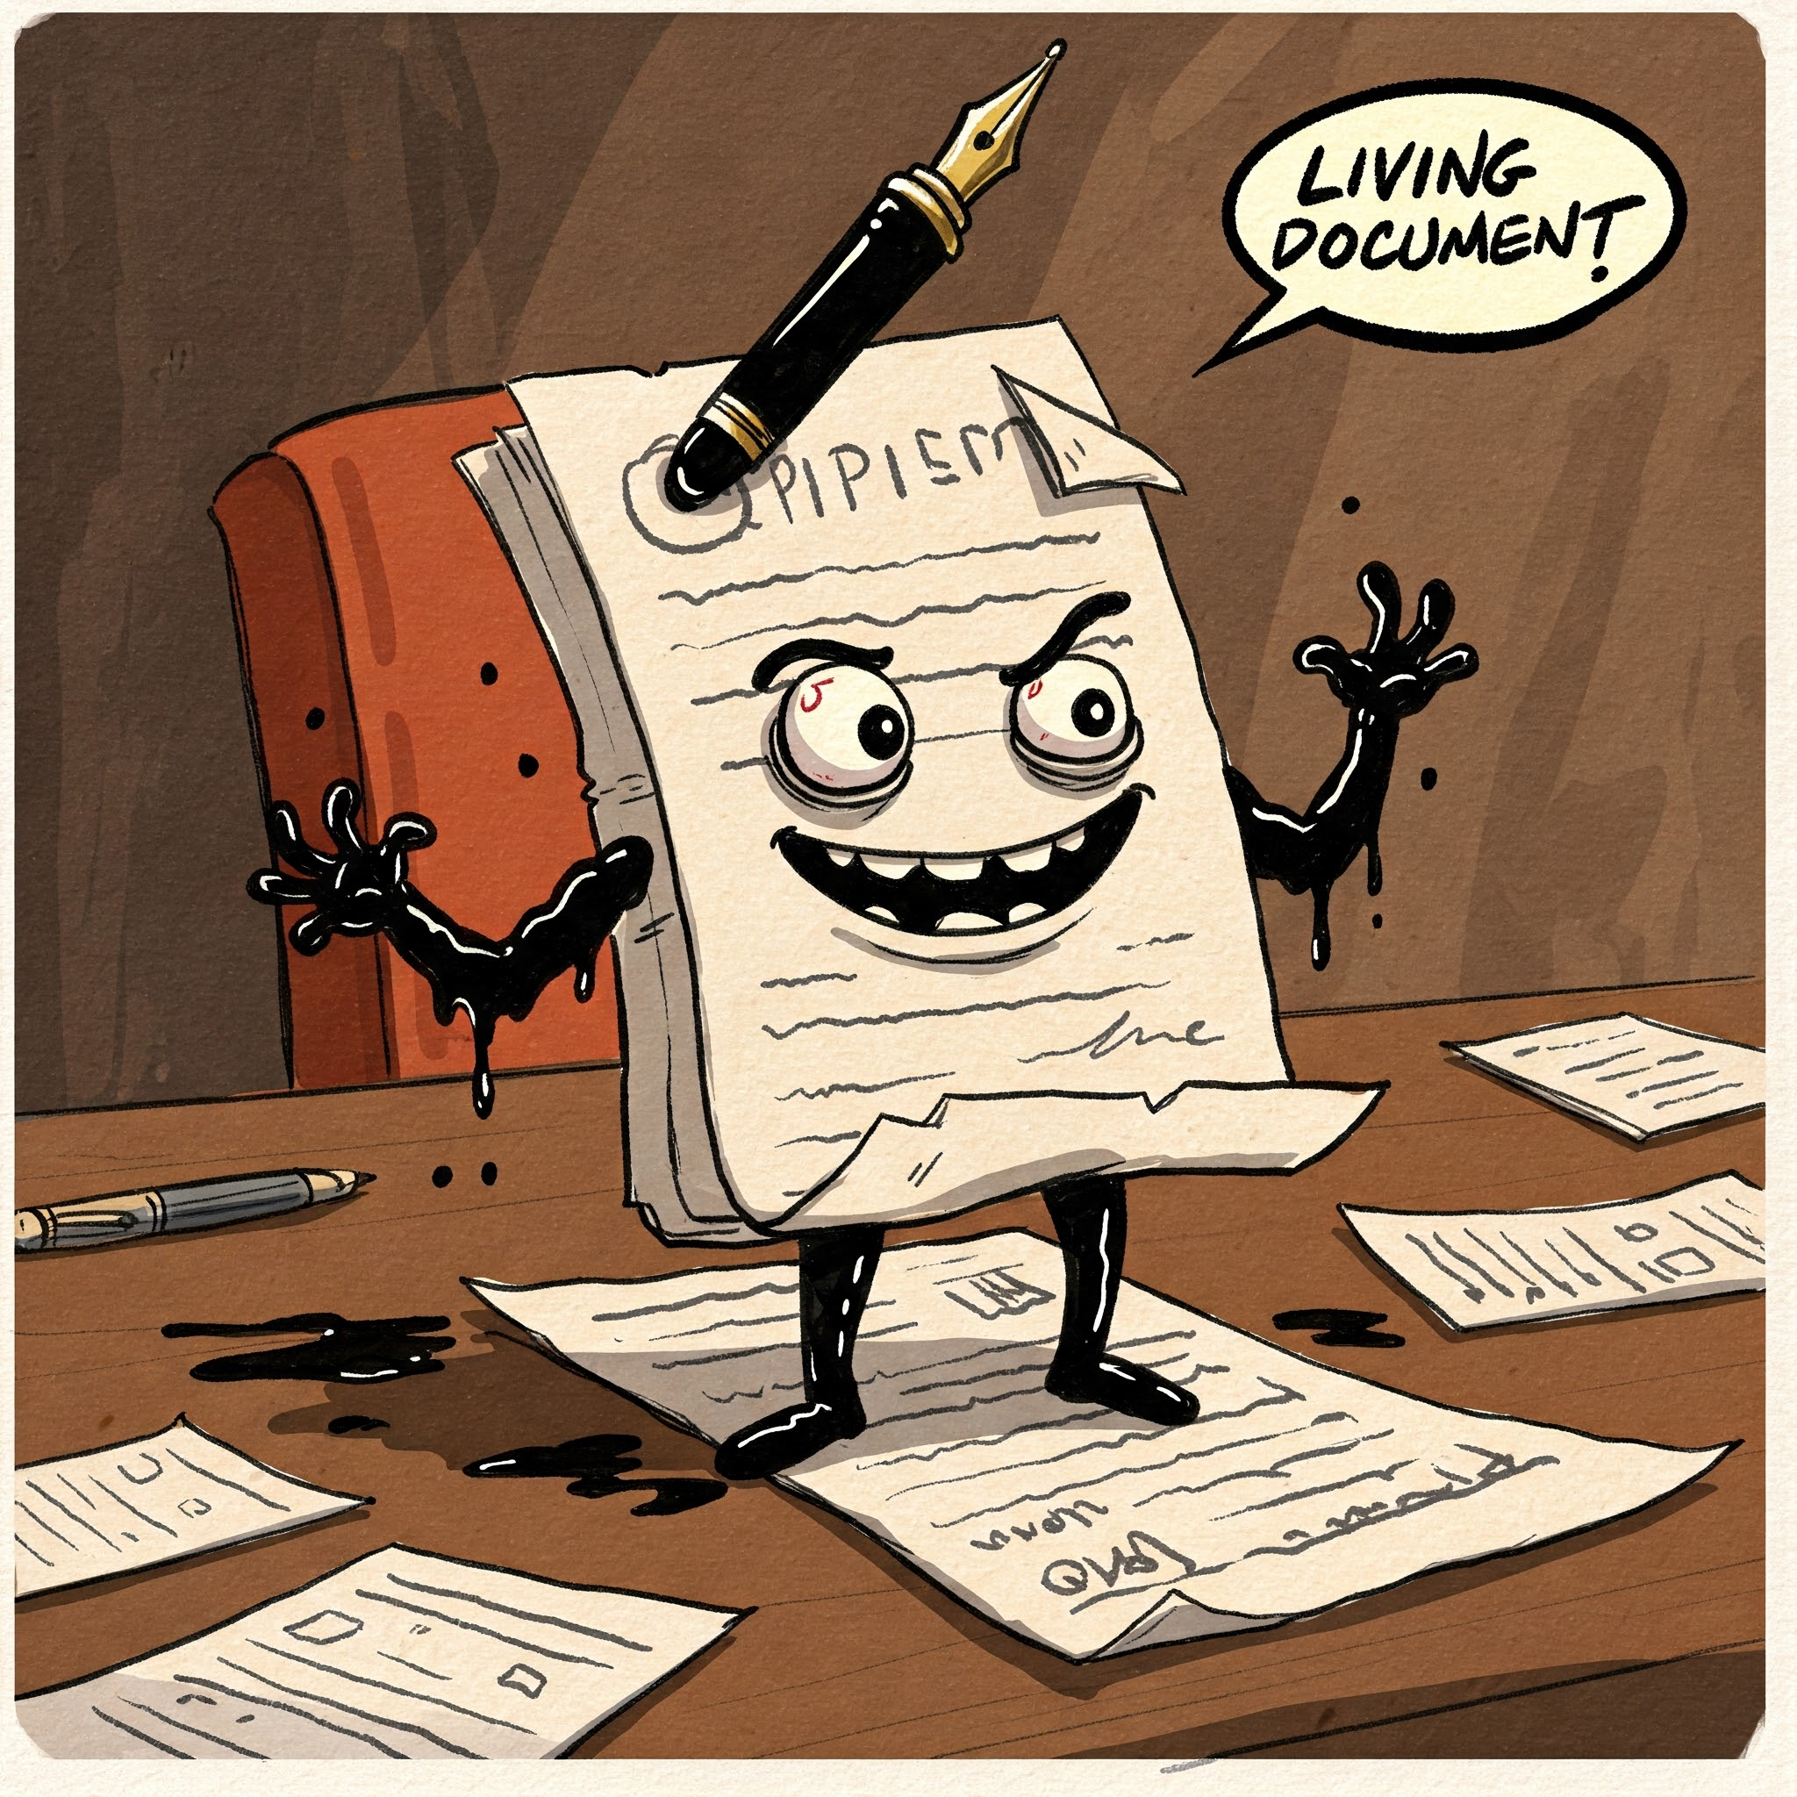
Handbook is a ..
This image is 100% AI generated

Slide 15
Updates based on:
project outputs (eg. EOSC Beyond)
results of the first batch of Nodes participating in a build-up phase

Slide 16

The Vision: EOSC Federation Architecture
CESSDA Pilot Node
EOSC EU Node
Service to connect to a Federating Capability
Showcasing Social Science data and services in the broader EOSC framework
Integration of Core Services:
  Service Catalogue, IdP, PID creation, Monitoring, Order management, Helpdesk
SPs can participate in EOSC Beyond Network:
  advertise offerings via CESSDA Service Catalogue
  offer SSO access to services via CESSDA IdP
European Node (e.g. eInfra)
Core services
Exchange services
Node Exchange
Other resources
Core services
Exchange services
Federating Services
Node Exchange
Other resources
Thematic Node (e.g. RI)
Federating Interfaces defined in the EOSC IF
Thematic Node
(e.g. Scientific Cluster)
Core services
Exchange services
Node Exchange
Other resources
Core services
Exchange services
Node Exchange
Other resources
Regional Node
National Node
Core services
Exchange services
Core services
Exchange services
Node Exchange
Other resources
Node Exchange
Other resources

Slide 17

First wave of EOSC Nodes (13+1)
https://eosc.eu/news/2025/02/eoscs-build-up-phase-to-begin-with-march-kick-off/

Slide 18
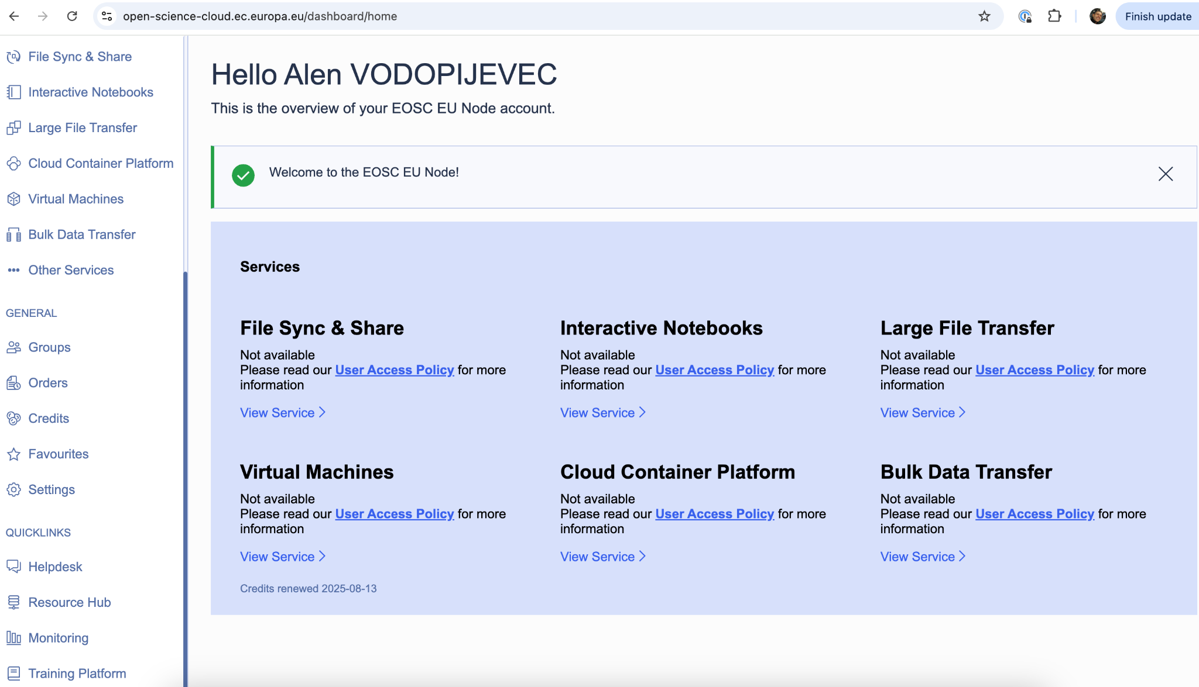
EOSC EU Node
https://open-science-cloud.ec.europa.eu/
A free resource for all EU researchers offering IT services like file sharing, VMs, containers, file transfer, common AAI, resources

Slide 19
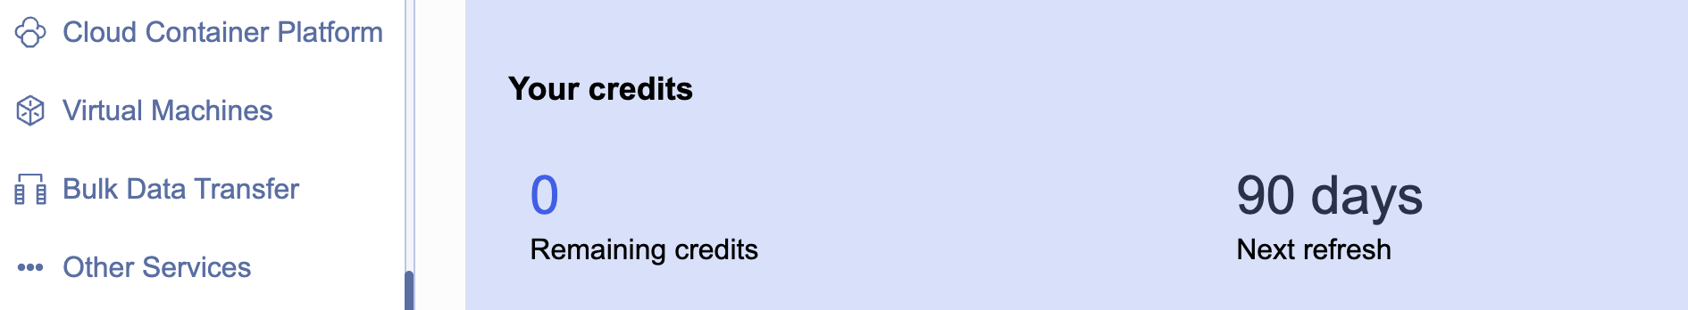
CREDITS 🤑
All researchers have 500 credits/3 months on the EU Node

Slide 20
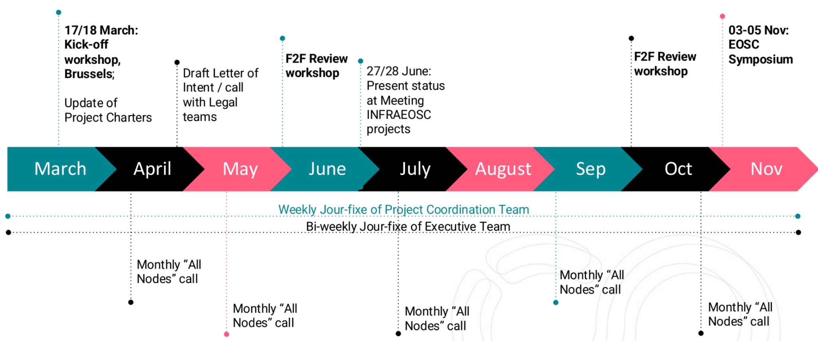
Tentative timeline for the build-up phase

Slide 21
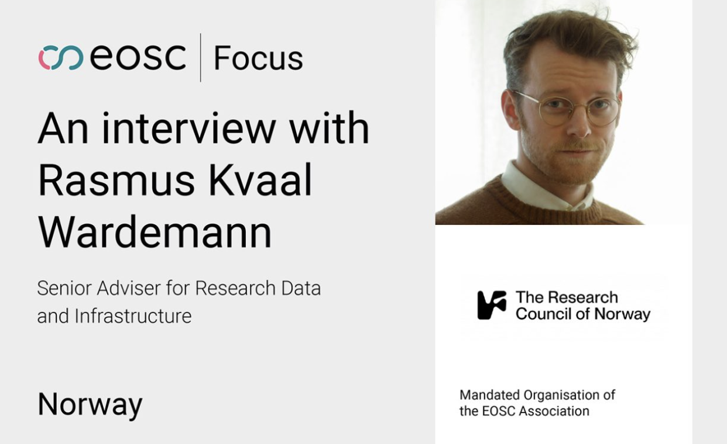
https://eosc.eu/news/2025/05/developing-eosc-in-norway-a-conversation-with-rasmus-kvaal-wardemann/

Slide 22
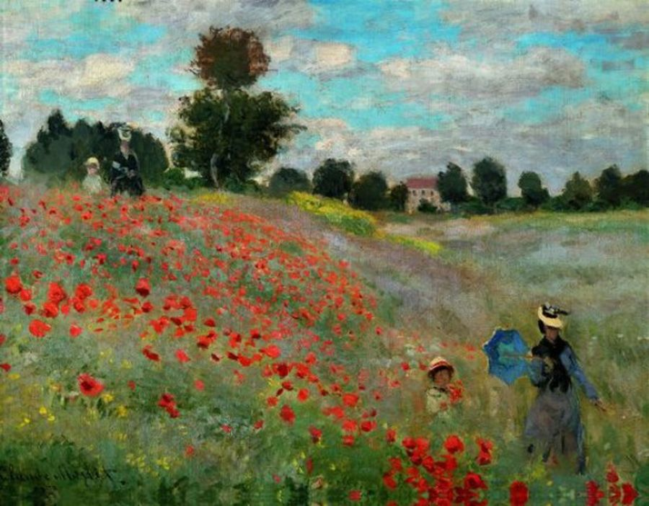
Impressions?
EOSC Credits as a rewarding mechanism for the FAIR RDM practices?
1873. Claude Monet – Poppies

