Slide 1



Liquid Organic Hydrogen Carriers (LOHCs):
A Pathway to Alternative Hydrogen Storage Solutions
DOCTORAL THESIS IN INDUSTRIAL ENGINEERING
Candidate
Federica Guarnaccia
Supervisor
Prof. Michele Manno
XXXVII Cycle
Academic Year 2024 – 2025

Slide 2


Table of Contents
Introduction
Liquid Organic Hydrogen Carriers (LOHCs)
Kinetics
Kinetic modeling
Equivalent reaction
Multi-step approach
The Thermodynamic Model
Thermodynamics
Batch Reactors (BRs)
Batch Reactors (BRs)
Plug Flow Reactors (PFRs): Design overviews
Plug Flow Reactors (PFRs): Definitive design
Dynamic Model Overview
Control Strategies
Control Systems: Parameters overview
Ragone Diagrams
The Map-based Approach
Dynamic Modeling:
Solid Oxide Fuel Cells (SOFCs)
The Maritime Sector: A cargo ship case study
The Dynamic Response
The Maritime Sector: Static response
Conclusions
START

Slide 3
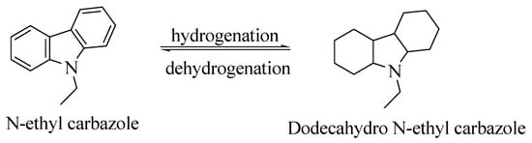
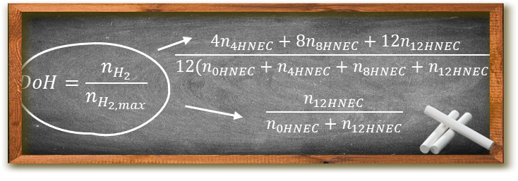
Liquid Organic Hydrogen Carriers (LOHCs)
LOHCs provide an alternative hydrogen storage solution through the reversible saturation of carbon - carbon double bonds.
Hydrogen reactions are exothermic (120-200°C) and favoured by high pressure (30-70 bar). Dehydrogenation reactions are endothermic (180-320°C) and favoured by low pressure (1-7 bar). The gravimetric hydrogen density is about 5-7%.
Interest in LOHC systems has grown due to their potential for easy integration with existing infrastructure and their inherently high transportability.
Most catalysts and carriers are poorly characterized and still affected by low gravimetric density. More importantly, LOHC systems require high temperature heat sources to compensate for the significant reaction heat.
LOHC working principle
LOHC⁺ / LOHC⁻
SOFC stack
User
H₂
H₂
_{Q}
P_{el}
Example of a fully integrated LOHC system scheme

Slide 4




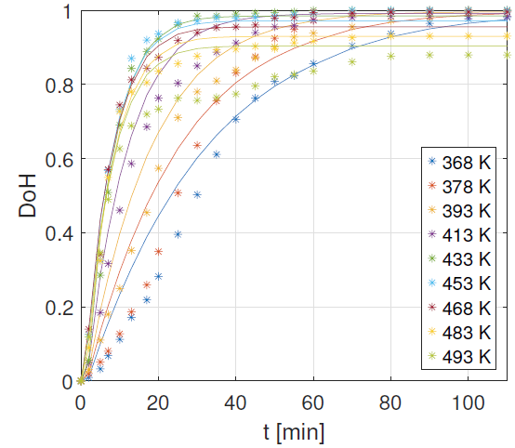
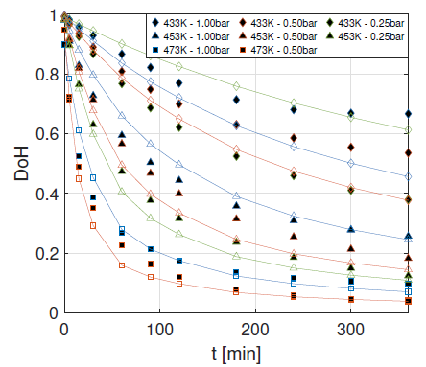





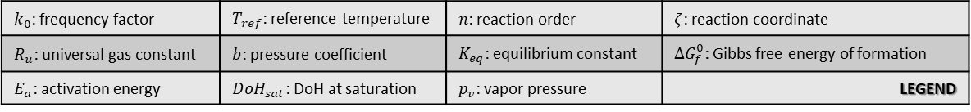



Kinetic modeling
$k_{0}$: frequency factor | $T_{ref}$: reference temperature | $n$: reaction order | $ζ$: reaction coordinate
$R_{u}$: universal gas constant | $b$: pressure coefficient | $K_{eq}$: equilibrium constant | $ΔG_{f}^{0}$: Gibbs free energy of formation
$E_{a}$: activation energy | $DoH_{sat}$: DoH at saturation | $p_{v}$: vapor pressure | LEGEND
$$\frac{dDoH}{dt}=k_{0}\exp\left(−\frac{E_{a}}{R_{u}T_{ref}}\right)\exp\left(bp\right){\left[DoH_{sat}−DoH\right]}^{n}$$
$$K_{eq}={\left(\frac{p_{v_{12HNEC}}}{p_{v_{0HNEC}}}\right)}^{1/6}\frac{ζ^{\frac{1}{6}}\left(\frac{7}{6}−ζ\right)}{{\left(1−ζ\right)}^{\frac{7}{6}}\frac{p}{p_{0}}}$$
$$\frac{dDoH}{dt}=k_{0}\exp\left(−\frac{E_{a}}{R_{u}T}\right)\exp\left(bp\right)DoH^{n}$$
$$ΔG_{f}^{0}=−R_{u}Tlog(K_{eq})$$
LOHC⁺ / LOHC⁻
SOFC stack
User
H₂
H₂
_{Q}
P_{el}
NEC, hydrogenation at 60 bar.
NEC, dehydrogenation at different pressure levels.

Slide 5

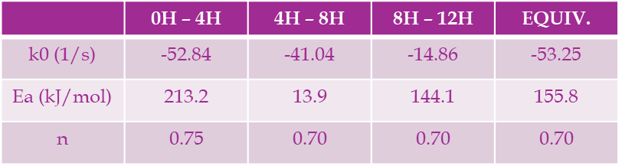
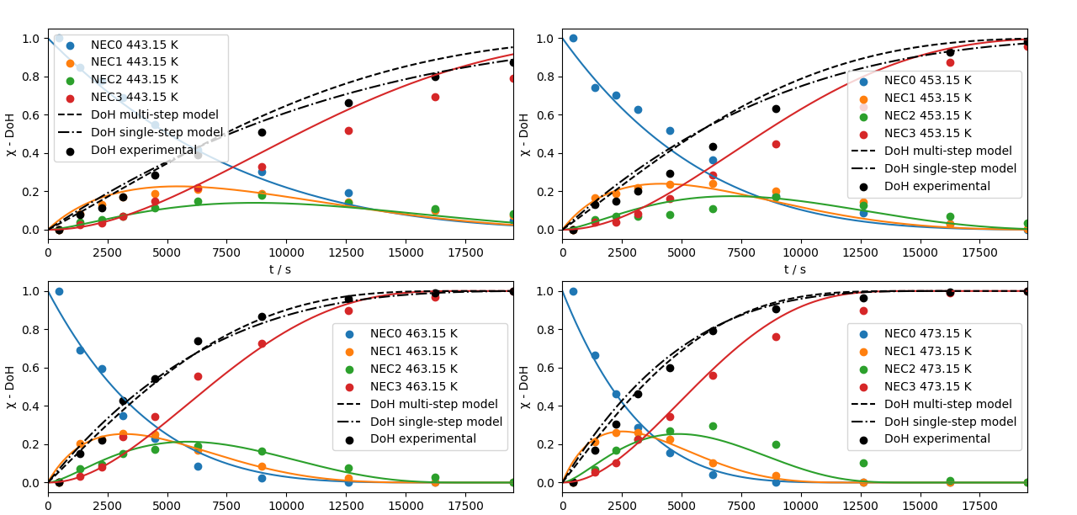
Equivalent reaction
Performance of the multi-step method are better than those obtained by the equivalent reaction at low temperature.
Peak concentration of the intermediates are very well represented by the multi-step reaction. The multi-step approach does not require modelling of the equilibrium concentrations, thus enhancing the reliability of the model.
Comparison between the different models highlights a similar depiction across different models, with most improvements only at low temperature values.
Kinetic parameters of NEC hydrogenation at 70 bar.
LOHC⁺ / LOHC⁻
SOFC stack
User
H₂
H₂
_{Q}
P_{el}
The much easier and faster implementation of the equivalent model justify its introduction in preliminar studies.
Hydrogenation of NEC under 70 bar pressure.

Slide 6
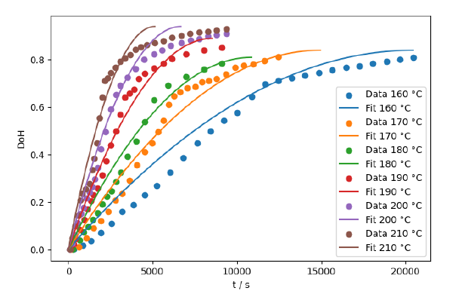
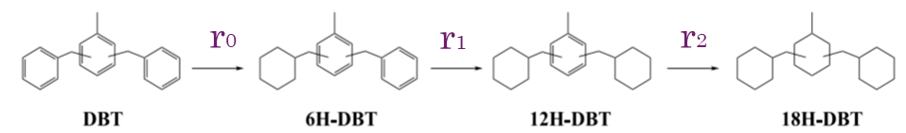





Multi-step approach?
The equivalent reaction approach may provide good fitting performance for some LOHCs such as NEC, however by fitting data for di-benzil toluene (DBT) kinetics, it appears that agreement with experimental results is poor.
Modeling of the saturation at decreasing DoH values for high temperature set-ups is clunky at best, resulting a fitting approach rather than a modeling step.
Even by positing a good enough saturation limit, the error between the effective DoH and the predicted values is high throughout most of the simulation.
As such, the multi-step approach was tested:
LOHC⁺ / LOHC⁻
SOFC stack
User
H₂
H₂
_{Q}
P_{el}
$$r_{i}=k_{i,p}χ_{i}^{n_{i}}\exp\left(−\frac{E_{a,i}}{R_{u}T}\right) i=0,1,2$$
$$\frac{dχ_{0}}{dt}={−r}_{0} (DBT)$$
$$\frac{dχ_{2}}{dt}={r_{1}−r}_{2} (12HDBT)$$
Hydrogenation of DBT under 40 bar pressure under the equivalent reaction hypothesis.
$$\frac{dχ_{1}}{dt}={r_{0}−r}_{1} (6HDBT)$$
$$\frac{dχ_{3}}{dt}=r_{2} (18HDBT)$$

Slide 7
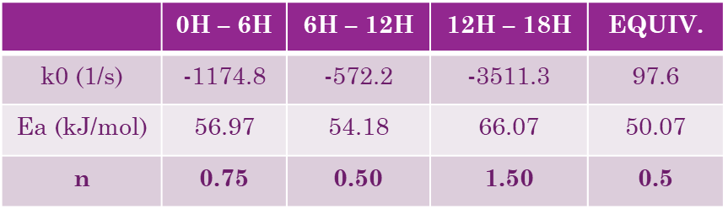
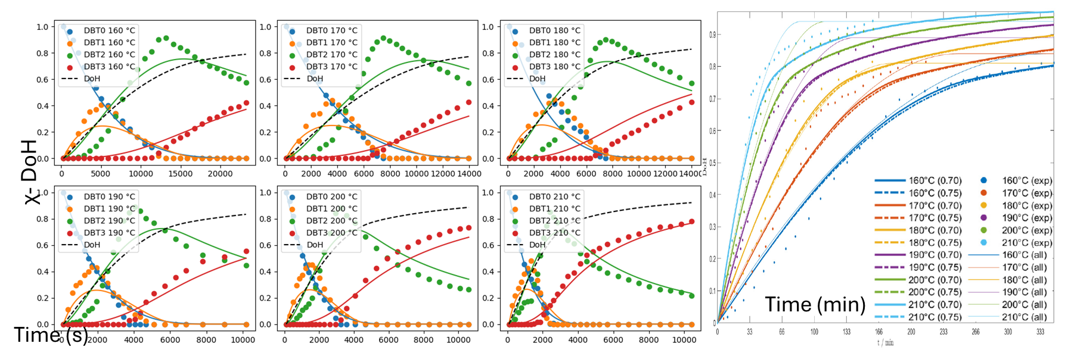
Multi-step approach!
Kinetic parameters of DBT hydrogenation at 40 bar.
Multistep modelling reveals overall good agreement with the final DoH: performances of the multi-step method are much better than those obtained by the equivalent reaction, although the concentration peak of the intermediates are underestimated.
The multi-step approach does not require modelling of the equilibrium concentrations, thus enhancing the reliability of the model.
Comparison between the different models highlights a smoother and more reliable depiction of the more complex modeling, especially at high temperature values.
LOHC⁺ / LOHC⁻
SOFC stack
User
H₂
H₂
_{Q}
P_{el}
Hydrogenation of DBT under 40 bar pressure. Multistep reaction intermediates, and equivalent DoH over time (fine line for equivalent reaction, and bold line for multi-step).

Slide 8
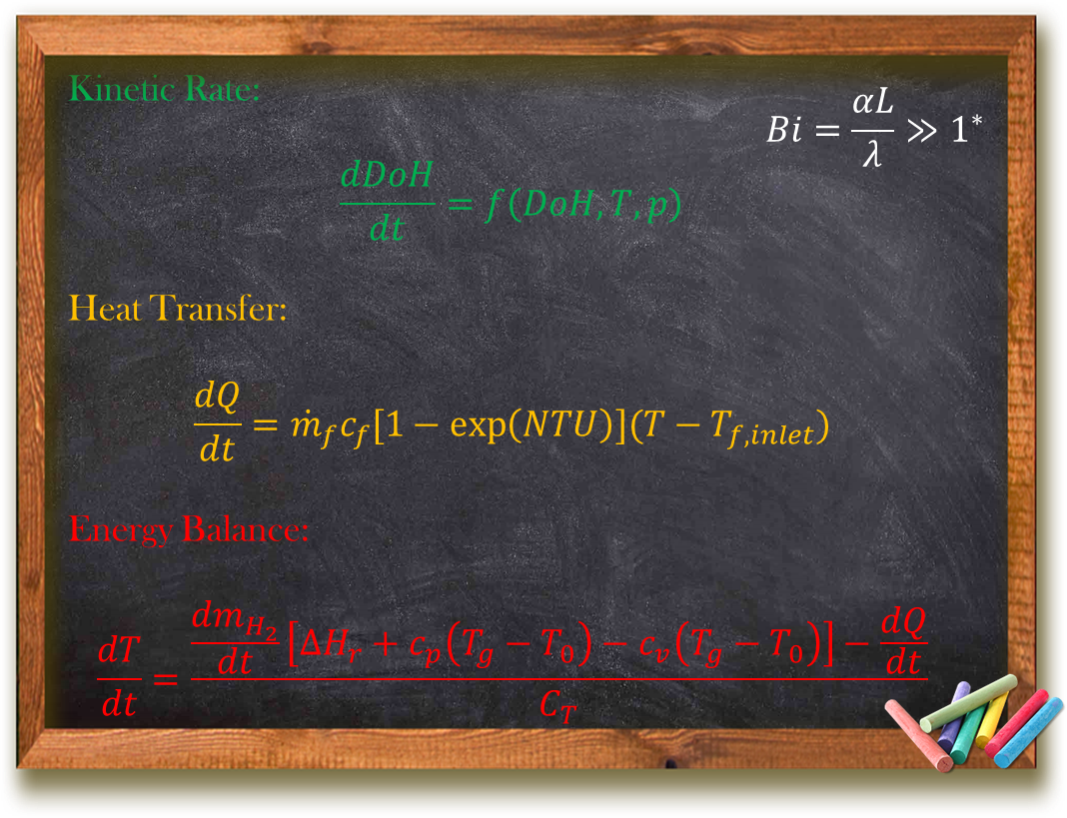

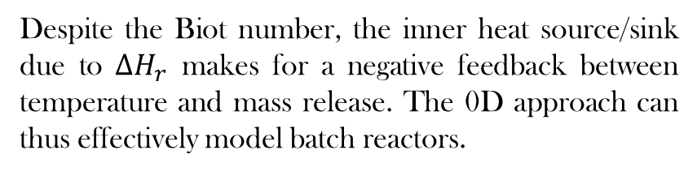
Thermodynamics
Despite the Biot number, the inner heat source/sink due to $ΔH_{r}$ makes for a negative feedback between temperature and mass release. The 0D approach can thus effectively model batch reactors.
Batch Reactor
Plug Flow Reactor
0D
1D
0D
1D
scale
LOHC⁺ / LOHC⁻
SOFC stack
User
H₂
H₂
_{Q}
P_{el}
Note that LOHC density, thermal conductivity, dynamic viscosity, and specific heat capacity have been evaluated through group contribution modelling due to lack of experimental data.
$NTU$: number of transfer units | ${\dot{m}}_{H_{2}}$: released hydrogen mass flow rate | $C_{T}$: LOHC heat capacity | ${ΔH}_{r}$: reaction enthalpy | $L$: characteristic length
$c_{f}$: HTF specific heat capacity | $T_{0}$: reference temperature | $K_{eq}$: equilibrium constant | $λ$: thermal conductivity | $Bi$: Biot number
$\dot{m_{f}}$: HTF mass flow rate | $T_{g}$: hydrogen gas temperature | $Q$: heat exchanged | $α$: convective heat transfer coefficient | LEGEND
*: $α\sim 1\frac{ kW}{m^{2}K}$ and $λ\sim 0.09\frac{ W}{mK}$

Slide 9
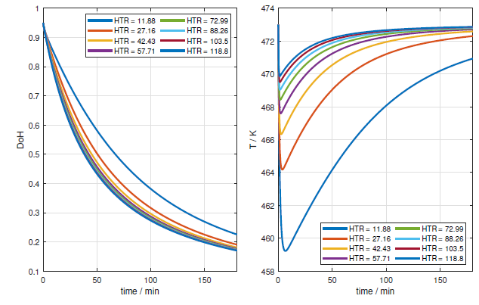
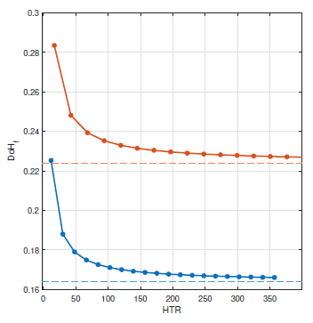
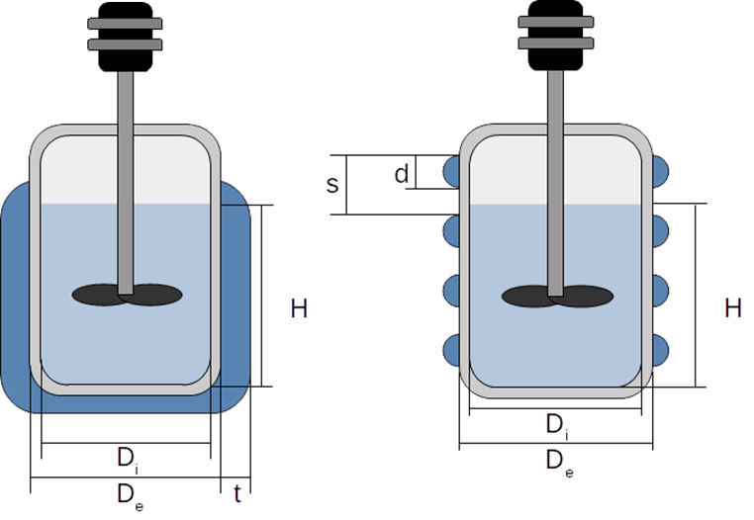


Batch Reactors (BRs)
HTR influence over hydrogen release over time.
HTR influence over the final hydrogen release.
Jacketed and half-pipe coils batch reactor layouts.
DBT
NEC
LOHC⁺ / LOHC⁻
SOFC stack
User
H₂
H₂
_{Q}
P_{el}
Optimal design:
Heat transfer efficacy
Power consumption:
  Stirring power
  Pumping power
Increasing the HTR leads to a lower temperature drop, and the H2 mass flow is thus not kinetically hindered, but to achieve this result a greater amount of heat is required for a given efficiency.
HTR only needs to reach a threshold value!
$$HTR\left[−\right]=\frac{{\dot{Q}}_{f}}{{\dot{Q}}_{r,max}}⋅\frac{T_{des}}{T_{f,i}−T}=\frac{{\dot{m}}_{f}c_{f}ε}{\frac{ΔH_{r}{\dot{m}}_{H_{2},max}}{T_{des}}}$$

Slide 10
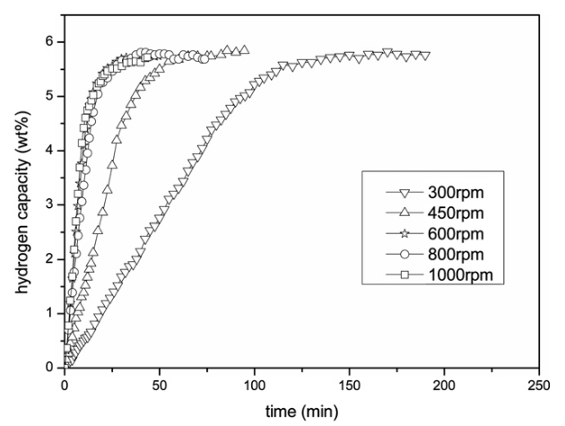










Batch Reactors (BRs)
  Stirring power:
  Note that this term is not only fundamental for power consumption, but it also directly affects the accuracy of 0D modelling.
  Pumping power:
Effect of the impeller rotational speed over the kinetic rate.
Jacketed and half-pipe coils batch reactor layouts.
$N_{p}=\frac{P}{ρ_{L}n_{imp}^{3}d_{imp}^{5}}$
$$d_{imp}=\frac{D_{in}}{3}$$
LOHC⁺ / LOHC⁻
SOFC stack
User
$$f(K,Fr,Re_{imp})$$
H₂
H₂
_{Q}
P_{el}
Optimal design:
Heat transfer efficacy
Power consumption:
  Stirring power
  Pumping power
$$P=\frac{G_{f}\left(Δp_{c}+Δp_{d}\right)}{ρ_{f}}$$
$$Δp_{C}=4×K_{elbow}\frac{ρ_{f}v^{2}}{2}$$
$Δp_{D}=\left(f\frac{π\left(D_{e}+d\right)}{d_{hyd}}\right)$ $\frac{ρ_{f}v^{2}}{2}$
$$f=fun\left(Re,\frac{D_{inner}}{D_{outer}}\right)$$

Slide 11
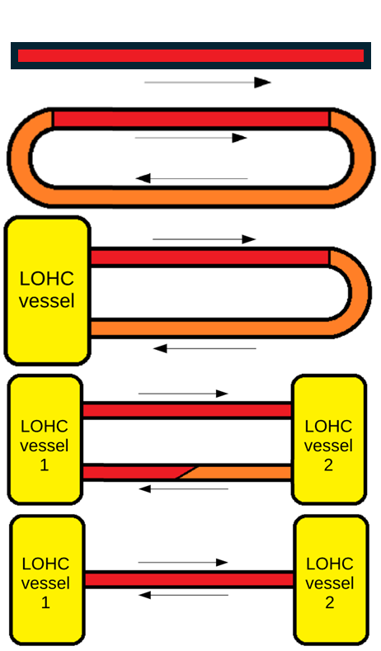
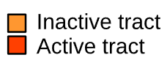


Plug Flow Reactors (PFRs): Design overviews
Tested PFRs layout evolution.
State of the art reactors are single pass open loop PFRs. Due to the slow dehydrogenation kinetics, reactor length is prohibitively high (i.e., 40 m length for about 40 kWh systems).
$$\frac{dDoH}{dz}=−k_{0}^{′e^{−\frac{E_{a}}{R_{u}T}+bp}}DoH^{2}=const⋅DoH^{2}$$
$$L_{isoth}=\frac{1}{const}\frac{DoH_{max}−DoH_{min}}{DoH_{max}⋅DoH_{min}}$$
Closed loops provide a conceptually easier start-up as the reaction starts after the reactor has been filled. For a given volume, the reactor’s length is the isothermal length by the number of turns. With the introduction of inactive tracts, higher controllability is achieved.
LOHC⁺ / LOHC⁻
SOFC stack
User
Continous mixing between flows at higher and lower DoH is enabled by the introduction of a vessel. Controllability and compactness improve.
$$f_{v}=\frac{V_{reactor}}{V_{tot}}$$
$$L_{reactor}=f_{v}n_{turns}L_{isoth}$$
H₂
H₂
_{Q}
P_{el}
A second vessel is introduced, acting as a buffer of partially spent LOHC, further improving on both controllability and compactness, easening intermittent operation. Mixing in the feeding reactor is avoided. Tract from vessel 2 – 1 can either host the catalyst or serve as just a return path to the initial vessel.
The second connection between the two vessels is removed. Vessel 1 and 2 act intermittently as the feed and sink vessel, with flow direction being reversible in the remaining tract, allowing for more compact designs.
All layouts have been modelled and validated. Overall, scheme E provides the most promising route.

Slide 12
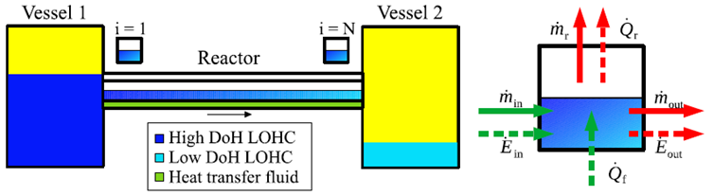
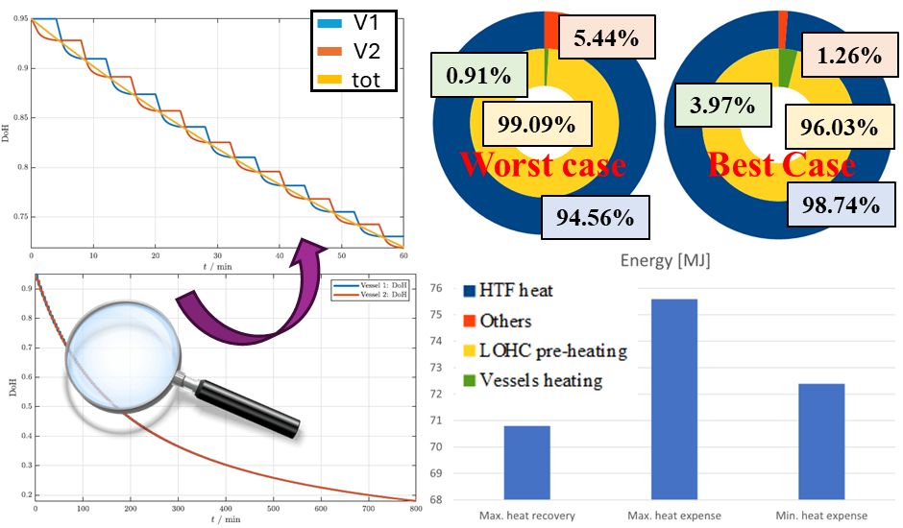

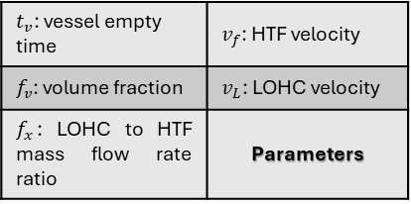
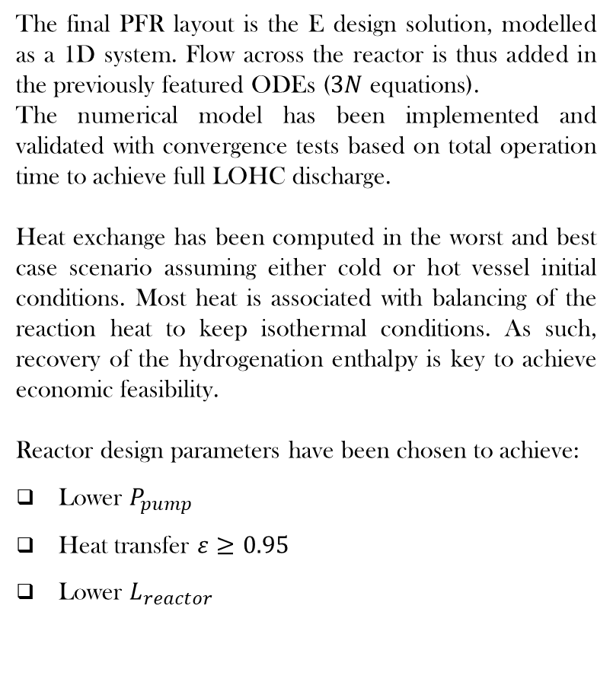
Plug Flow Reactors (PFRs): Definitive design
Final PFR layout.
The final PFR layout is the E design solution, modelled as a 1D system. Flow across the reactor is thus added in the previously featured ODEs ($3N$ equations).
The numerical model has been implemented and validated with convergence tests based on total operation time to achieve full LOHC discharge.
Heat exchange has been computed in the worst and best case scenario assuming either cold or hot vessel initial conditions. Most heat is associated with balancing of the reaction heat to keep isothermal conditions. As such, recovery of the hydrogenation enthalpy is key to achieve economic feasibility.
Reactor design parameters have been chosen to achieve:
Lower $P_{pump}$
Heat transfer $ε≥0.95$
Lower $L_{reactor}$
LOHC⁺ / LOHC⁻
SOFC stack
User
H₂
H₂
_{Q}
P_{el}
$t_{v}$: vessel empty time | $v_{f}$: HTF velocity
$f_{v}$: volume fraction | $v_{L}$: LOHC velocity
$f_{x}$: LOHC to HTF mass flow rate ratio | Parameters
LOHC dehydrogenation: DoH trends (full and zoomed), main heat sources and recovery possibility.

Slide 13

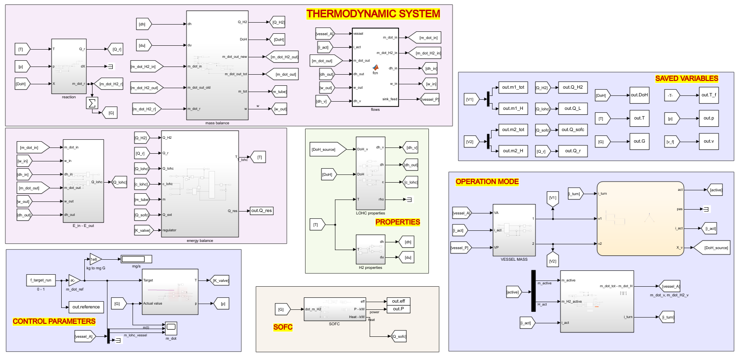


Dynamic Model Overview
LOHC
LOHC⁺ / LOHC⁻
SOFC stack
User
H₂
H₂
_{Q}
P_{el}
SOFC
UTILITIES
CONTROL

Slide 14
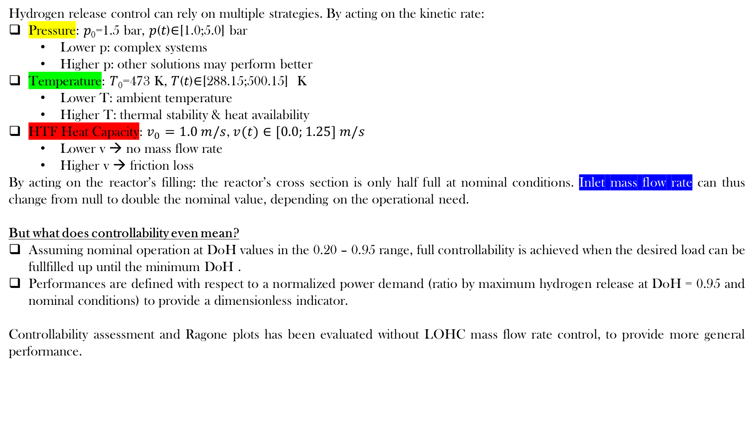

Control Systems: Parameters overview
Hydrogen release control can rely on multiple strategies. By acting on the kinetic rate:
Pressure: 𝑝₀=1.5 bar, 𝑝(𝑡)∈[1.0;5.0] bar
  Lower p: complex systems
  Higher p: other solutions may perform better
Temperature: 𝑇₀=473 K, 𝑇(𝑡)∈[288.15;500.15] K
  Lower T: ambient temperature
  Higher T: thermal stability & heat availability
HTF Heat Capacity: $v_{0}=1.0 m/s$,$v(t)∈[0.0;1.25] m/s$
  Lower v → no mass flow rate
  Higher v → friction loss
By acting on the reactor’s filling: the reactor’s cross section is only half full at nominal conditions. Inlet mass flow rate can thus change from null to double the nominal value, depending on the operational need.
But what does controllability even mean?
Assuming nominal operation at DoH values in the 0.20 – 0.95 range, full controllability is achieved when the desired load can be fullfilled up until the minimum DoH .
Performances are defined with respect to a normalized power demand (ratio by maximum hydrogen release at DoH = 0.95 and nominal conditions) to provide a dimensionless indicator.
Controllability assessment and Ragone plots has been evaluated without LOHC mass flow rate control, to provide more general performance.
$$\frac{dm_{H_{2}}}{dt}=m_{L}w_{\%}k_{0}\exp\left(bp\right)\exp\left(−\frac{E_{a}}{R_{u}T}\right)DoH^{n}$$
$$\frac{dQ}{dt}={\dot{m}}_{f}c_{f}[1−\exp\left(NTU\right)](T−T_{f,inlet})$$
LOHC⁺ / LOHC⁻
SOFC stack
User
H₂
H₂
_{Q}
P_{el}

Slide 15
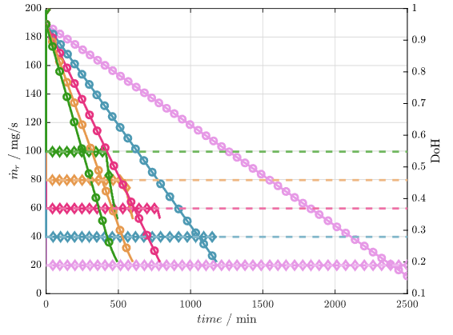
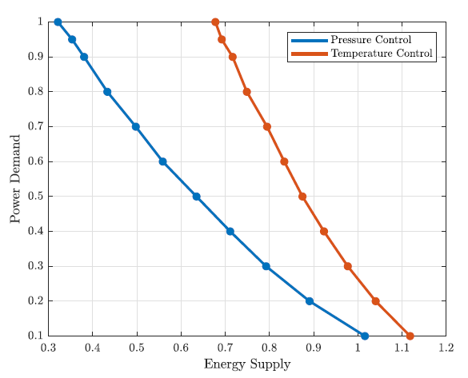
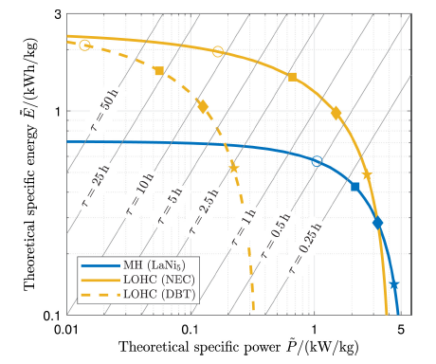
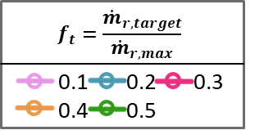

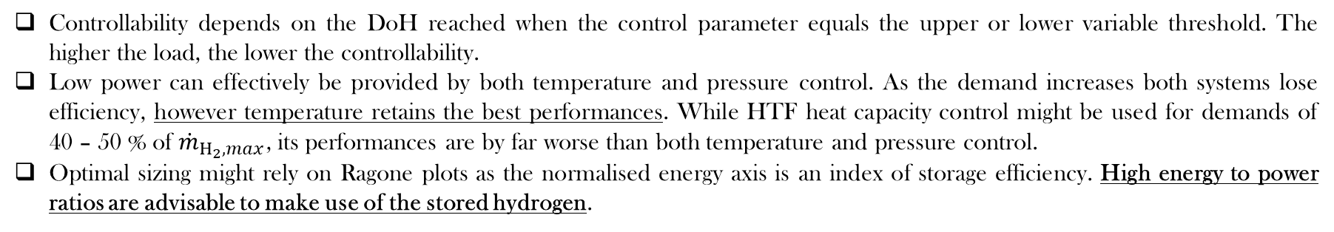
Ragone Diagrams
Controllability depends on the DoH reached when the control parameter equals the upper or lower variable threshold. The higher the load, the lower the controllability.
Low power can effectively be provided by both temperature and pressure control. As the demand increases both systems lose efficiency, however temperature retains the best performances. While HTF heat capacity control might be used for demands of 40 – 50 % of ${\dot{m}}_{H_{2}, max}$, its performances are by far worse than both temperature and pressure control.
Optimal sizing might rely on Ragone plots as the normalised energy axis is an index of storage efficiency. High energy to power ratios are advisable to make use of the stored hydrogen.
LOHC⁺ / LOHC⁻
SOFC stack
User
H₂
H₂
_{Q}
P_{el}
◊: ${\dot{m}}_{r}$
○: DoH
Example of controllability assessment for a temperature – based controller with a constant load.
A dimensional Ragone plots based on the normalized power demand (y-axis) and final DoH achieved (x-axis)
Representative Ragone plot of hydrogen storage: markers indicate the utilisation factors 20, 40, 60, 80% from right to left.

Slide 16
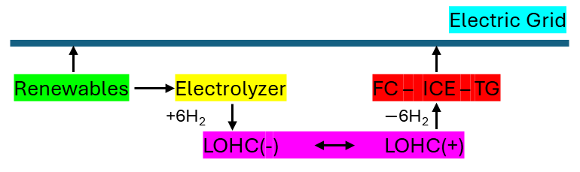



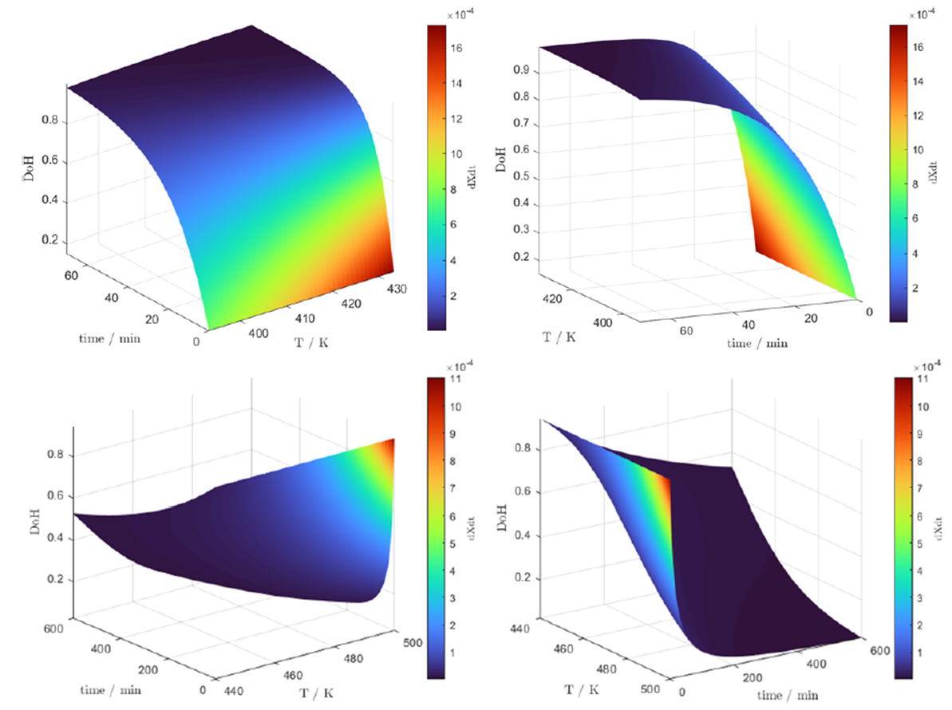









The Map-based Approach
Ragone plots can help guide the sizing of LOHCs and their coupling with the end-user to enhance system performance, but they do not provide insights into the effective operation of the system. LOHCs kinetic and energy balance equations can be rewritten to map the static behaviour of the subsystem, easening integration with more complex energy systems, and enabling optimization procedures.
Example of LOHC integration case study assuming only electric power demand.
function [constraints,temp_lohc_new,heat_lohc] = LOHC(m_lohc,H2_ch,H2_dch,temp_lohc_old,constraints,SOC_lohc_max,SOC_lohc_min)
global dt SOC_lohc_init p_lohc
% LOHC properties loading
carrier = nec();
% checks for sign
constraints = [constraints,H2_ch >= 0 & H2_dch >= 0];
% checks for capacity
SOC_lohc = SOC_lohc_init + dt*(H2_ch - H2_dch)/(m_lohc*carrier.w);
constraints = [constraints, SOC_lohc <= SOC_lohc_max & SOC_lohc >= SOC_lohc_min];
% checks for consistency
dch_on = H2_dch > 0;
ch_on = H2_ch > 0;
constraints = [constraints, dch_on + ch_on < 2];
% checks for thermal stability
dot_SOC = (SOC_lohc - SOC_lohc_init)/dt;
f_T = (carrier.E_act_dch*dch_on + carrier.E_act_ch*ch_on)/8.3145;
f_p = p_lohc*(carrier.b_dch*dch_on + carrier.b_ch*ch_on);
f_SOC = log(dot_SOC/(carrier.fX_dch(SOC_lohc)*dch_on + carrier.fX_ch(SOC_lohc)*ch_on));
temp_lohc_new = f_T/(f_p - f_SOC);
constraints = [constraints, temp_lohc_new >= (carrier.T_min_ch*ch_on + carrier.T_min_dis*dch_on), temp_lohc_new <= (carrier.T_max_ch*ch_on + carrier.T_max_dis*dch_on)];
% evaluates heat cost
c_lohc = carrier.c_lohc(SOC_lohc);
heat_lohc = c_lohc*(temp_lohc_new - temp_lohc_old) + carrier.DH*dt*(H2_ch - H2_dch);
end
LOHC⁺ / LOHC⁻
SOFC stack
User
H₂
H₂
_{Q}
P_{el}
Time DoH Temperature
INPUT:
LOHC(-) size (kg)
H2 charged/discharged (kg/h)
LOHC temperature @t (K)
Other constraints
LOHC SOC bounds
OUTPUT:
Update constraints
LOHC temperature @(t+1) (K)
Heat required (kJ)
Hydrogenation (above) and dehydrogenation (below) maps.

Slide 17
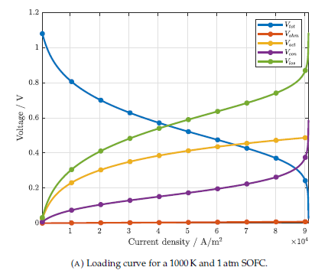
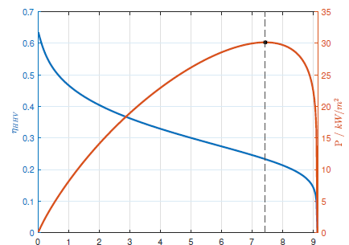
Solid Oxide Fuel Cells (SOFCs)
H2 goes into the SOFC
Electricity is generated
Heat is released
LOHC reaction heat is sunk
H2 is released
LOHC coupling with SOFC systems can overcome the limitations induced by the high reaction heat and dehydrogenation temperature by recovery of the SOFC waste heat.
Different sources contribute to the overall waste heat produced by the SOFC stack, namely:
Ohmic overpotential:
caused by the electric resistance of the SOFC. This requires modeling the electrolyte, cathode, and anode conductivity.
Activation overpotential:
results from activation loss at the electrode – electrolyte interface. This requires evaluating the exchange currents.
Concentration overpotential:
due to mass diffusion limitation. This requires evaluating the concentration of the reactants at the triple phase boundary.
Chemical
reaction:
due to the reaction heat. This requires evaluating the actual cell voltage.
LOHC⁺ / LOHC⁻
SOFC stack
User
H₂
H₂
_{Q}
P_{el}
Example of SOFC losses, power output, and efficiency.
Validation with external references has shown remarkable agreement, although the model seems to understimate concentration losses at high current densities due to loss of linearity.

Slide 18


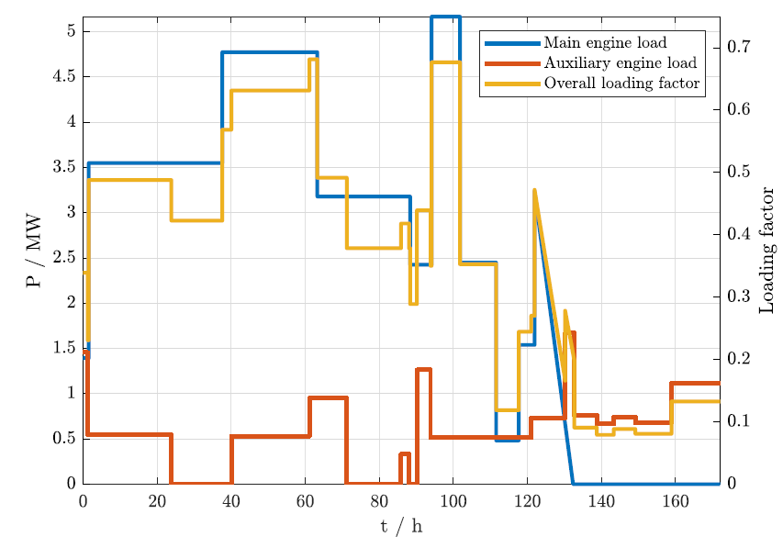



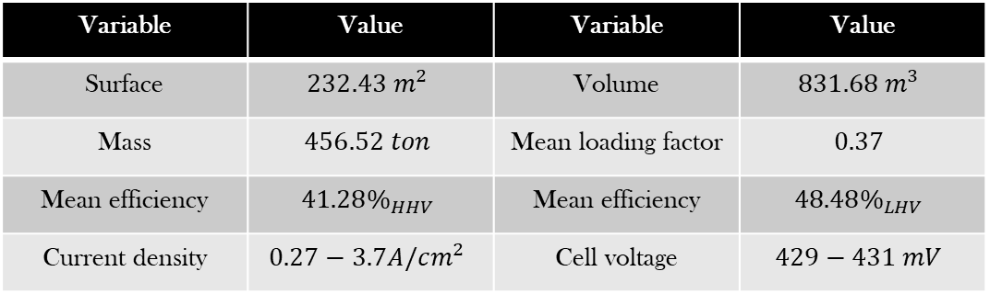
The Maritime Sector: A cargo ship case study
[…] this study is focused on the design, modeling, and feasibility assessment of ammonia-based propulsion systems for shipping applications. […] NH3-based Solid Oxide Fuel Cell (SOFC) system […] designed to replace a conventional diesel powertrain installed on board a container ship.
LOHC⁺ / LOHC⁻
SOFC stack
User
H₂
H₂
_{Q}
P_{el}
SOFC stack sizing: main results.
Variable | Value | Variable | Value
Surface | $$232.43 m^{2}$$ | Volume | $$831.68 m^{3}$$
Mass | $$456.52 ton$$ | Mean loading factor | $$0.37$$
Mean efficiency | $$41.28\%_{HHV}$$ | Mean efficiency | $$48.48\%_{LHV}$$
Current density | $$0.27−3.7A/cm^{2}$$ | Cell voltage | $$429−431 mV$$
Reported: $821.8{ m}^{3}$
SOFC sizing and hydrogen demand
Feasibility constraints: dynamic response
LOHCs comparative systems design
Reported: $451.1 ton$
Reported: $47\%_{LHV}$

Slide 19
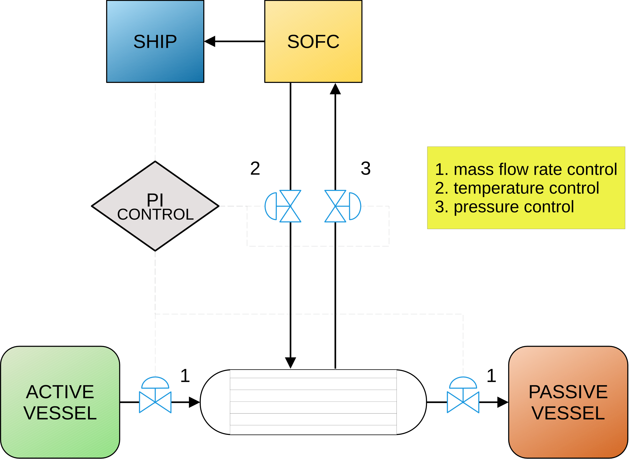
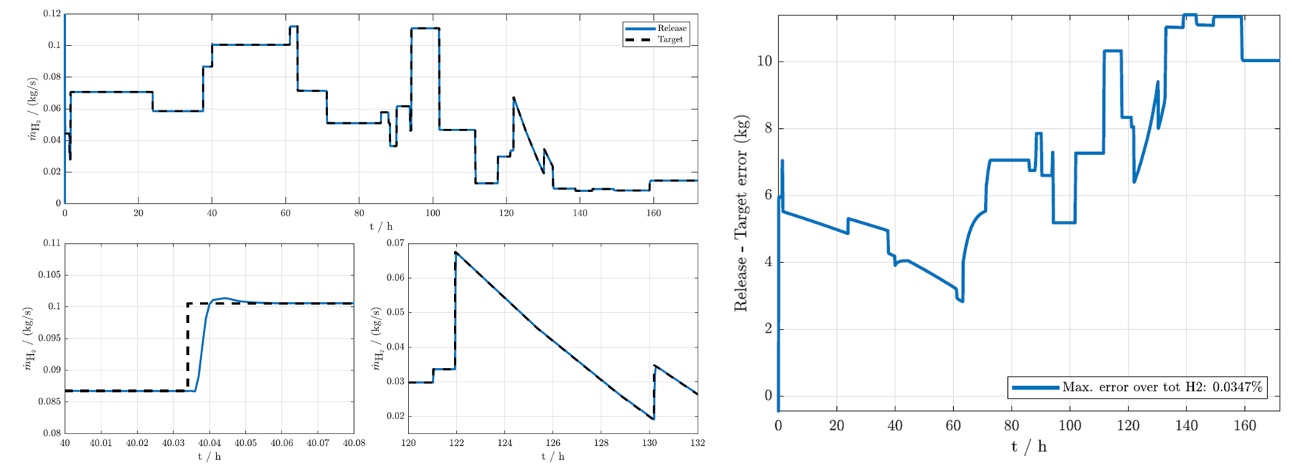
The Dynamic Response
Full system scheme
The dynamic behavior of the LOHC system appears to adequately meet the ship's requirements. Sharp, step-like variations introduce minimal deviations, which are mostly absent when the load changes more gradually.
Control-wise, valve openings manage most of the rapid variability associated with set-point changes. Temperature and pressure generally maintain the set-point as the Degree of Hydrogenation decreases.
LOHC⁺ / LOHC⁻
SOFC stack
User
H₂
H₂
_{Q}
P_{el}
Hydrogen release and cumulative hydrogen release error. Simulations have been assuming NEC as the chosen carrier.

Slide 20

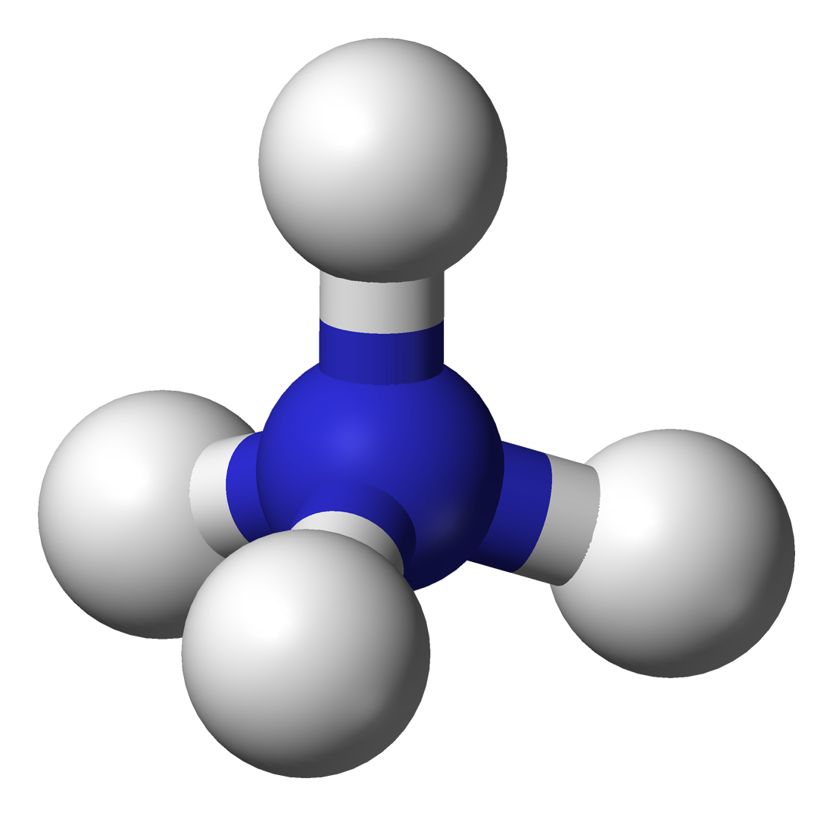

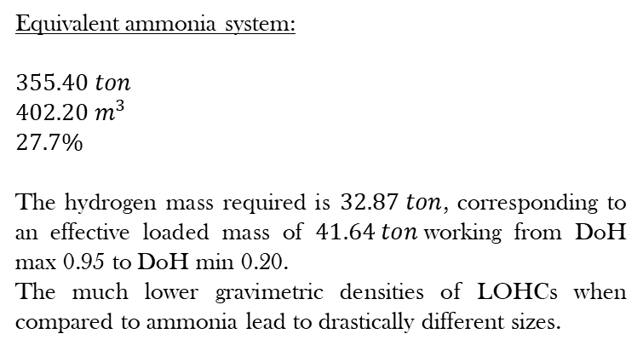
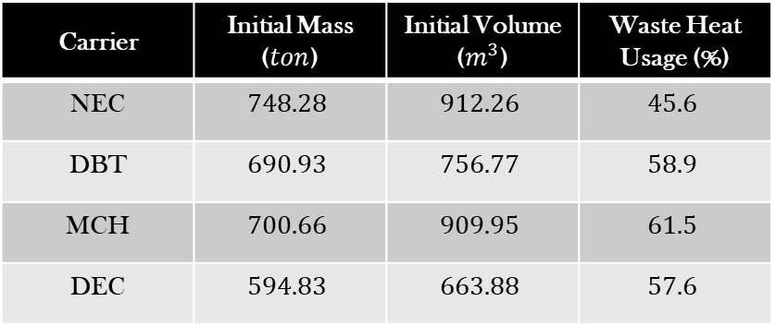
The Maritime Sector: Static response
Carrier | Initial Mass ($ton$) | Initial Volume ($m^{3}$) | Waste Heat Usage (%)
NEC | $$748.28$$ | $$912.26$$ | $$45.6$$
DBT | $$690.93$$ | $$756.77$$ | $$58.9$$
MCH | $$700.66$$ | $$909.95$$ | $$61.5$$
DEC | $$594.83$$ | $$663.88$$ | $$57.6$$
Equivalent ammonia system:
$$355.40 ton$$
$$402.20 m^{3}$$
$$27.7\%$$
The hydrogen mass required is $32.87 ton$, corresponding to an effective loaded mass of $41.64 ton$working from DoH max 0.95 to DoH min 0.20.
The much lower gravimetric densities of LOHCs when compared to ammonia lead to drastically different sizes.
LOHC⁺ / LOHC⁻
SOFC stack
User
H₂
H₂
_{Q}
P_{el}
LOHC sizing main results. Waste heat percentage referred to the total SOFC waste heat computed ($\sim 502.6 MW$).
Dynamic simulations suggest that LOHC systems would likely be capable of meeting changing target requirements,through primary mass flow rate control and secondary control systems for temperature and pressure.
However, the volume and mass requirements for LOHC systems are significantly higher than those for ammonia systems. Literature reviews suggest that the potential variability range of the weight percentage (wt.%) for LOHC compounds is substantially lower than that of ammonia.
Additionally, ammonia systems require less dehydrogenation heat, meaning that LOHC-SOFC systems operating under co-generation schemes are penalized when compared to their the ammonia counterparts.

Slide 21



Conclusions
Liquid Organic Hydrogen Carriers (LOHCs) present a promising alternative for hydrogen storage, particularly in applications requiring sustained low-to-medium loads over time. Their integration into complex energy systems, such as master planning frameworks, leverages the heat generated during the hydrogenation phase.
However, significant volumetric and gravimetric constraints limit their competitiveness in mobility solutions. Furthermore, the dehydrogenation process demands substantial heat, which reduces its feasibility for cogenerative uses. While coupling LOHCs with SOFCs shows potential, it does not necessarily position LOHC systems as the optimal choice for such applications.
      If green hydrogen is available, the complexity and energy demand of using LOHC for storage and release could be better directed toward synthesizing e-fuels via chemical reactors. E-fuels are more suitable for deployment in hard-to-abate sectors, making them a more efficient use of resources.
The limitations of conventional reactor designs described in the literature further increase the LOHC volumetric constraints. Advancing LOHC technology readiness levels (TRL) hinges on developing more sophisticated and compact reactors, surpassing the simplicity of current open-loop PFRs. The introduction of reactor / vessels layouts may improve the overall performance.
Crucially, the availability of robust experimental data for kinetic and thermophysical modeling remains insufficient, with existing kinetic models demonstrating significant inaccuracies even for common carriers. Addressing these gaps is imperative for the broader adoption and optimization of LOHC systems.
LOHC⁺ / LOHC⁻
SOFC stack
User
H₂
H₂
_{Q}
P_{el}

Slide 22
Gambini, Marco and Guarnaccia, Federica and Manno, Michele and Vellini, Michela:
(2022). “Liquid organic hydrogen carriers: Development of a thermodynamic and kinetic model for the assessment of hydrogenation and dehydrogenation processes”. In: International Journal of Hydrogen Energy. DOI: https://doi.org/10.1016/j.ijhydene.2022.06.120.
(2023a). “Ragone plots of material-based hydrogen storage systems”. In: Journal of Energy Storage. DOI: 10.1016/j.est.2023.109815.
(2023b). “Hydrogen flow rate control in a liquid organic hydrogen carrier batch reactor for hydrogen storage”. In: International Journal of Hydrogen Energy. DOI: 10.1016/j.ijhydene.2023.05.153.
(2023c). “Thermal design and heat transfer optimisation of a liquid organic hydrogen carrier batch reactor for hydrogen storage”. In: International Journal of Hydrogen Energy. DOI: https://doi.org/10.1016/j.ijhydene.2023.08.200.
(2024). “Flow rate control in a plug-flow reactor for liquid organic hydrogen carriers dehydrogenation”. In: International Journal of Hydrogen Energy. DOI: 10.1016/j.ijhydene.2024.03.082.
Aakko-Saksa, Paivi T. et al. (2018). “Liquid organic hydrogen carriers for transportation and storing of renewable energy – Review and discussion”. In: Journal of Power Sources. DOI: 10.1016/j.jpowsour.2018.04.011.
Aruna, R. and S.T. Jaya Christa (2020). “Modeling, system identification and design of fuzzy PID controller for discharge dynamics of metal hydride hydrogen storage bed”. In: International Journal of Hydrogen Energy. DOI: 10.1016/j.ijhydene.2019.11.238.
Bioucas, Francisco et al. (2020). “Thermal Conductivity of Hydrocarbon Liquid Organic Hydrogen Carrier Systems: Measurement and Prediction”. In: Journal of Chemical & Engineering Data. DOI: 10.1021/acs.jced.0c00613.
Bourane, Abdennour et al. (2016). “An overview of organic liquid phase hydrogen carriers”. In: International Journal of Hydrogen Energy. DOI: 10.1016/j.ijhydene.2016.07.167.
Choi, In Young et al. (2016). “Thermodynamic efficiencies of hydrogen storage processes using carbazole-based compounds”. In: International Journal of Hydrogen Energy. DOI: 10.1016/j.ijhydene.2016.04.118.
Dennis, Jason et al. (2021). “Model-Based Analysis of a Liquid Organic Hydrogen Carrier (LOHC) System for the Operation of a Hydrogen-Fired Gas Turbine”. In: Journal of Engineering for Gas Turbines and Power. DOI: 10.1115/1.4048596.
Di Micco, S. et al. (2024). “Ammonia-powered ships: Concept design and feasibility assessment of powertrain systems for a sustainable approach in maritime industry”. In: Energy Conversion and Management: X. DOI: 10.1016/j.ecmx.2024.100539.
Dong, Yuan et al. (2016). “Dehydrogenation kinetics study of perhydro-N-ethylcarbazole over a supported Pd catalyst for hydrogen storage application”. In: nternational Journal of Hydrogen Energy. DOI: 10.1016/j.ijhydene.2016.03.157.
Dürr, S. et al. (2021). “Experimental determination of the hydrogenation/dehydrogenation - Equilibrium of the LOHC system H0/H18-dibenzyltoluene”. In: International Journal of Hydrogen Energy. DOI: 10.1016/j.ijhydene.2021.07.119.
Gavin, John (1999). “Understand the Thermal Design of Jacketed Vessels. Energy Transfer/Conversion.” In: Chemical Engineering Process.
Green, Don W. and Robert H. Perry (2008). Perry’s Chemical Engineers’ Handbook, second section. 8th ed. The McGraw-Hill Companies. DOI: 10.1036/0071511253.
Hafsia, Abdenebi et al. (2011). “SOFC fuel cell heat production: Analysis”. In: Energy Procedia. DOI: 10.1016/j.egypro.2011.05.074.
House, J. E. (2007). Principles of chemical kinetics. en. 2nd ed. Amsterdam; Boston: Elsevier/Academic Press. ISBN: 978-0-12-356787-1.
Kakac, Sadik, Hongtan Liu, and Anchasa Pramuanjaroenkij (2002). Heat exchangers: selection rating and thermal design.
Kiermaier, Stephan et al. (2021). “Dehydrogenation of perhydro-N-ethylcarbazole under reduced total pressure”. In: International Journal of Hydrogen Energy. DOI: 10.1016/j.ijhydene.2021.02.128.
Li, J. et al. (2024). “Intrinsic Kinetics of Dibenzyltoluene Hydrogenation over a Supported Ni Catalyst for Green Hydrogen Storage”. In: Industrial and Engineering Chemical Research. DOI: 10.1021/acs.iecr.3c03613.
Lindfors, Lars Peter, Tapio Salmi, and Stefan Smeds (1993). “Kinetics of toluene hydrogenation on Ni/Al2O3 catalyst”. In: Chemical Engineering Science. DOI: 10.1016/0009-2509(93)80224-E.
Niermann, Matthias et al. (2019). “Liquid Organic Hydrogen Carrier (LOHC) – Assessment Based on Chemical and Economic Properties”. In: International Journal of Hydrogen Energy. DOI: 10.1016/j.ijhydene.2019.01.199.
Pashchenko, Dmitry (2022). “Liquid organic hydrogen carriers (LOHCs) in the thermochemical waste heat recuperation systems: The energy and mass balances”. In: International Journal of Hydrogen Energy. DOI: 10.1016/j.ijhydene.2022.06.208.
Peters, Roland et al. (2019). “A solid oxide fuel cell operating on liquid organic hydrogen carrier-based hydrogen – A kinetic model of the hydrogen release unit and system performance”. In: International Journal of Hydrogen Energy. DOI:10.1016/j.ijhydene.2019.03.220.
Peters, W. et al. (2015). “Efficient hydrogen release from perhydro-N-ethylcarbazole using catalyst-coated metallic structures produced by selective electron beam melting”. In: Energy & Environmental Science. DOI: 10.1039/C4EE03461A.
Prinsloo, Francois, J. Dirker, and Josua Meyer (2014). “Heat Transfer and Pressure Drop Characteristics in the Annuli of Tube-in-Tube Heat Exchangers (Horizontal Lay-Out)”. In: DOI: 10.1615/IHTC15.fcv.009225.
Ragone, David V (1968). Review of battery systems for electrically powered vehicles. Tech. rep. SAE Technical Paper.
Rao, Nihal, Ashish K. Lele, and Ashwin W. Patwardhan (2022). “Optimization of Liquid Organic Hydrogen Carrier (LOHC) dehydrogenation system”. In: International Journal of Hydrogen Energy. DOI: 10.1016/j.ijhydene.2022.06.197.
Scargiali, F. et al. (2017). “On the assessment of power consumption and critical impeller speed in vortexing unbaffled stirred tanks.” In: Chemical Engineering Research and Design. DOI: 10.1016/j.cherd.2017.04.035.
Wan, Chao et al. (2012). “Study of catalytic hydrogenation of N-ethylcarbazole over ruthenium catalyst”. In: International Journal of Hydrogen. DOI: 10.1016/j.ijhydene.2012.04.123.

Slide 23
Aakko-Saksa, Paivi T. et al. (2018). “Liquid organic hydrogen carriers for transportation and storing of renewable energy – Review and discussion”. In: Journal of Power Sources. DOI: 10.1016/j.jpowsour.2018.04.011.
Aruna, R. and S.T. Jaya Christa (2020). “Modeling, system identification and design of fuzzy PID controller for discharge dynamics of metal hydride hydrogen storage bed”. In: International Journal of Hydrogen Energy. DOI: 10.1016/j.ijhydene.2019.11.238.
Bioucas, Francisco et al. (2020). “Thermal Conductivity of Hydrocarbon Liquid Organic Hydrogen Carrier Systems: Measurement and Prediction”. In: Journal of Chemical & Engineering Data. DOI: 10.1021/acs.jced.0c00613.
Bourane, Abdennour et al. (2016). “An overview of organic liquid phase hydrogen carriers”. In: International Journal of Hydrogen Energy. DOI: 10.1016/j.ijhydene.2016.07.167.
Choi, In Young et al. (2016). “Thermodynamic efficiencies of hydrogen storage processes using carbazole-based compounds”. In: International Journal of Hydrogen Energy. DOI: 10.1016/j.ijhydene.2016.04.118.
Dennis, Jason et al. (2021). “Model-Based Analysis of a Liquid Organic Hydrogen Carrier (LOHC) System for the Operation of a Hydrogen-Fired Gas Turbine”. In: Journal of Engineering for Gas Turbines and Power. DOI: 10.1115/1.4048596.
Di Micco, S. et al. (2024). “Ammonia-powered ships: Concept design and feasibility assessment of powertrain systems for a sustainable approach in maritime industry”. In: Energy Conversion and Management: X. DOI: 10.1016/j.ecmx.2024.100539.
Dong, Yuan et al. (2016). “Dehydrogenation kinetics study of perhydro-N-ethylcarbazole over a supported Pd catalyst for hydrogen storage application”. In: nternational Journal of Hydrogen Energy. DOI: 10.1016/j.ijhydene.2016.03.157.
Dürr, S. et al. (2021). “Experimental determination of the hydrogenation/dehydrogenation - Equilibrium of the LOHC system H0/H18-dibenzyltoluene”. In: International Journal of Hydrogen Energy. DOI: 10.1016/j.ijhydene.2021.07.119.
Gavin, John (1999). “Understand the Thermal Design of Jacketed Vessels. Energy Transfer/Conversion.” In: Chemical Engineering Process.
Green, Don W. and Robert H. Perry (2008). Perry’s Chemical Engineers’ Handbook, second section. 8th ed. The McGraw-Hill Companies. DOI: 10.1036/0071511253.
Hafsia, Abdenebi et al. (2011). “SOFC fuel cell heat production: Analysis”. In: Energy Procedia. DOI: 10.1016/j.egypro.2011.05.074.
House, J. E. (2007). Principles of chemical kinetics. en. 2nd ed. Amsterdam; Boston: Elsevier/Academic Press. ISBN: 978-0-12-356787-1.
Kakac, Sadik, Hongtan Liu, and Anchasa Pramuanjaroenkij (2002). Heat exchangers: selection rating and thermal design.
Kiermaier, Stephan et al. (2021). “Dehydrogenation of perhydro-N-ethylcarbazole under reduced total pressure”. In: International Journal of Hydrogen Energy. DOI: 10.1016/j.ijhydene.2021.02.128.
Li, J. et al. (2024). “Intrinsic Kinetics of Dibenzyltoluene Hydrogenation over a Supported Ni Catalyst for Green Hydrogen Storage”. In: Industrial and Engineering Chemical Research. DOI: 10.1021/acs.iecr.3c03613.
Lindfors, Lars Peter, Tapio Salmi, and Stefan Smeds (1993). “Kinetics of toluene hydrogenation on Ni/Al2O3 catalyst”. In: Chemical Engineering Science. DOI: 10.1016/0009-2509(93)80224-E.
Niermann, Matthias et al. (2019). “Liquid Organic Hydrogen Carrier (LOHC) – Assessment Based on Chemical and Economic Properties”. In: International Journal of Hydrogen Energy. DOI: 10.1016/j.ijhydene.2019.01.199.
Pashchenko, Dmitry (2022). “Liquid organic hydrogen carriers (LOHCs) in the thermochemical waste heat recuperation systems: The energy and mass balances”. In: International Journal of Hydrogen Energy. DOI: 10.1016/j.ijhydene.2022.06.208.
Peters, Roland et al. (2019). “A solid oxide fuel cell operating on liquid organic hydrogen carrier-based hydrogen – A kinetic model of the hydrogen release unit and system performance”. In: International Journal of Hydrogen Energy. DOI:10.1016/j.ijhydene.2019.03.220.
Peters, W. et al. (2015). “Efficient hydrogen release from perhydro-N-ethylcarbazole using catalyst-coated metallic structures produced by selective electron beam melting”. In: Energy & Environmental Science. DOI: 10.1039/C4EE03461A.
Prinsloo, Francois, J. Dirker, and Josua Meyer (2014). “Heat Transfer and Pressure Drop Characteristics in the Annuli of Tube-in-Tube Heat Exchangers (Horizontal Lay-Out)”. In: DOI: 10.1615/IHTC15.fcv.009225.
Ragone, David V (1968). Review of battery systems for electrically powered vehicles. Tech. rep. SAE Technical Paper.
Rao, Nihal, Ashish K. Lele, and Ashwin W. Patwardhan (2022). “Optimization of Liquid Organic Hydrogen Carrier (LOHC) dehydrogenation system”. In: International Journal of Hydrogen Energy. DOI: 10.1016/j.ijhydene.2022.06.197.
Scargiali, F. et al. (2017). “On the assessment of power consumption and critical impeller speed in vortexing unbaffled stirred tanks.” In: Chemical Engineering Research and Design. DOI: 10.1016/j.cherd.2017.04.035.
Wan, Chao et al. (2012). “Study of catalytic hydrogenation of N-ethylcarbazole over ruthenium catalyst”. In: International Journal of Hydrogen. DOI: 10.1016/j.ijhydene.2012.04.123.
A special thanks to Professor Manno, Gambini and Vellini,
An thank You all for Your attention
Gambini, Marco and Guarnaccia, Federica and Manno, Michele and Vellini, Michela:
(2022). “Liquid organic hydrogen carriers: Development of a thermodynamic and kinetic model for the assessment of hydrogenation and dehydrogenation processes”. In: International Journal of Hydrogen Energy. DOI: https://doi.org/10.1016/j.ijhydene.2022.06.120.
(2023a). “Ragone plots of material-based hydrogen storage systems”. In: Journal of Energy Storage. DOI: 10.1016/j.est.2023.109815.
(2023b). “Hydrogen flow rate control in a liquid organic hydrogen carrier batch reactor for hydrogen storage”. In: International Journal of Hydrogen Energy. DOI: 10.1016/j.ijhydene.2023.05.153.
(2023c). “Thermal design and heat transfer optimisation of a liquid organic hydrogen carrier batch reactor for hydrogen storage”. In: International Journal of Hydrogen Energy. DOI: https://doi.org/10.1016/j.ijhydene.2023.08.200.
(2024). “Flow rate control in a plug-flow reactor for liquid organic hydrogen carriers dehydrogenation”. In: International Journal of Hydrogen Energy. DOI: 10.1016/j.ijhydene.2024.03.082.

