Slide 1
Research Software Quality Kit (RSQKit)
Shoaib Sufi
University of Manchester
ELIXIR-STEERS WP2 meeting
24 April 2025, Online
This project has received funding from the European Union’s Horizon Europe Programme under GA 101129744 — EVERSE — HORIZON-INFRA-2023-EOSC-01-02

Slide 2
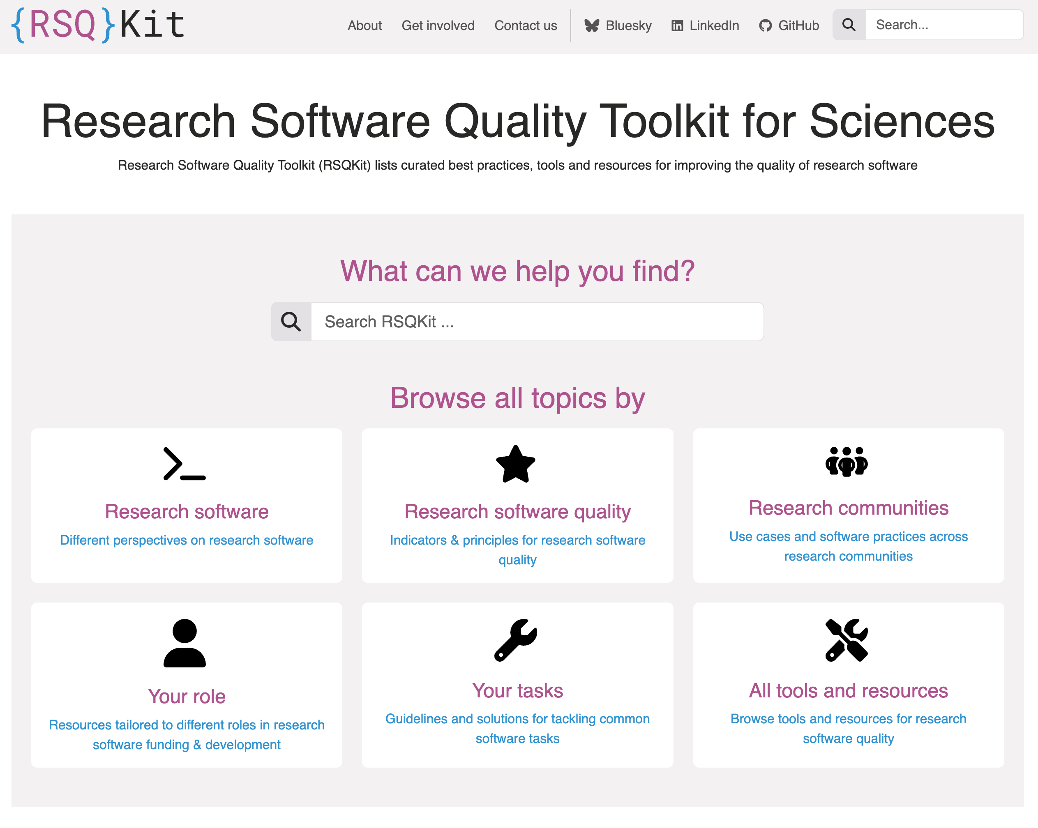



What is RSQKit
https://everse.software/RSQKit/
The Research Software Quality Kit:
Task driven guide – how to improve you research software quality (RSQ)
Tools related to improving RSQ
Training related to improving RSQ
Exemplars of good practice – Research Software Stories (WIP)
Roles involved in research software
Research Infrastructure and cluster with heavy use of Research Software
A model for understanding the research software process for different types of research software
Inspired by
A product of

Slide 3
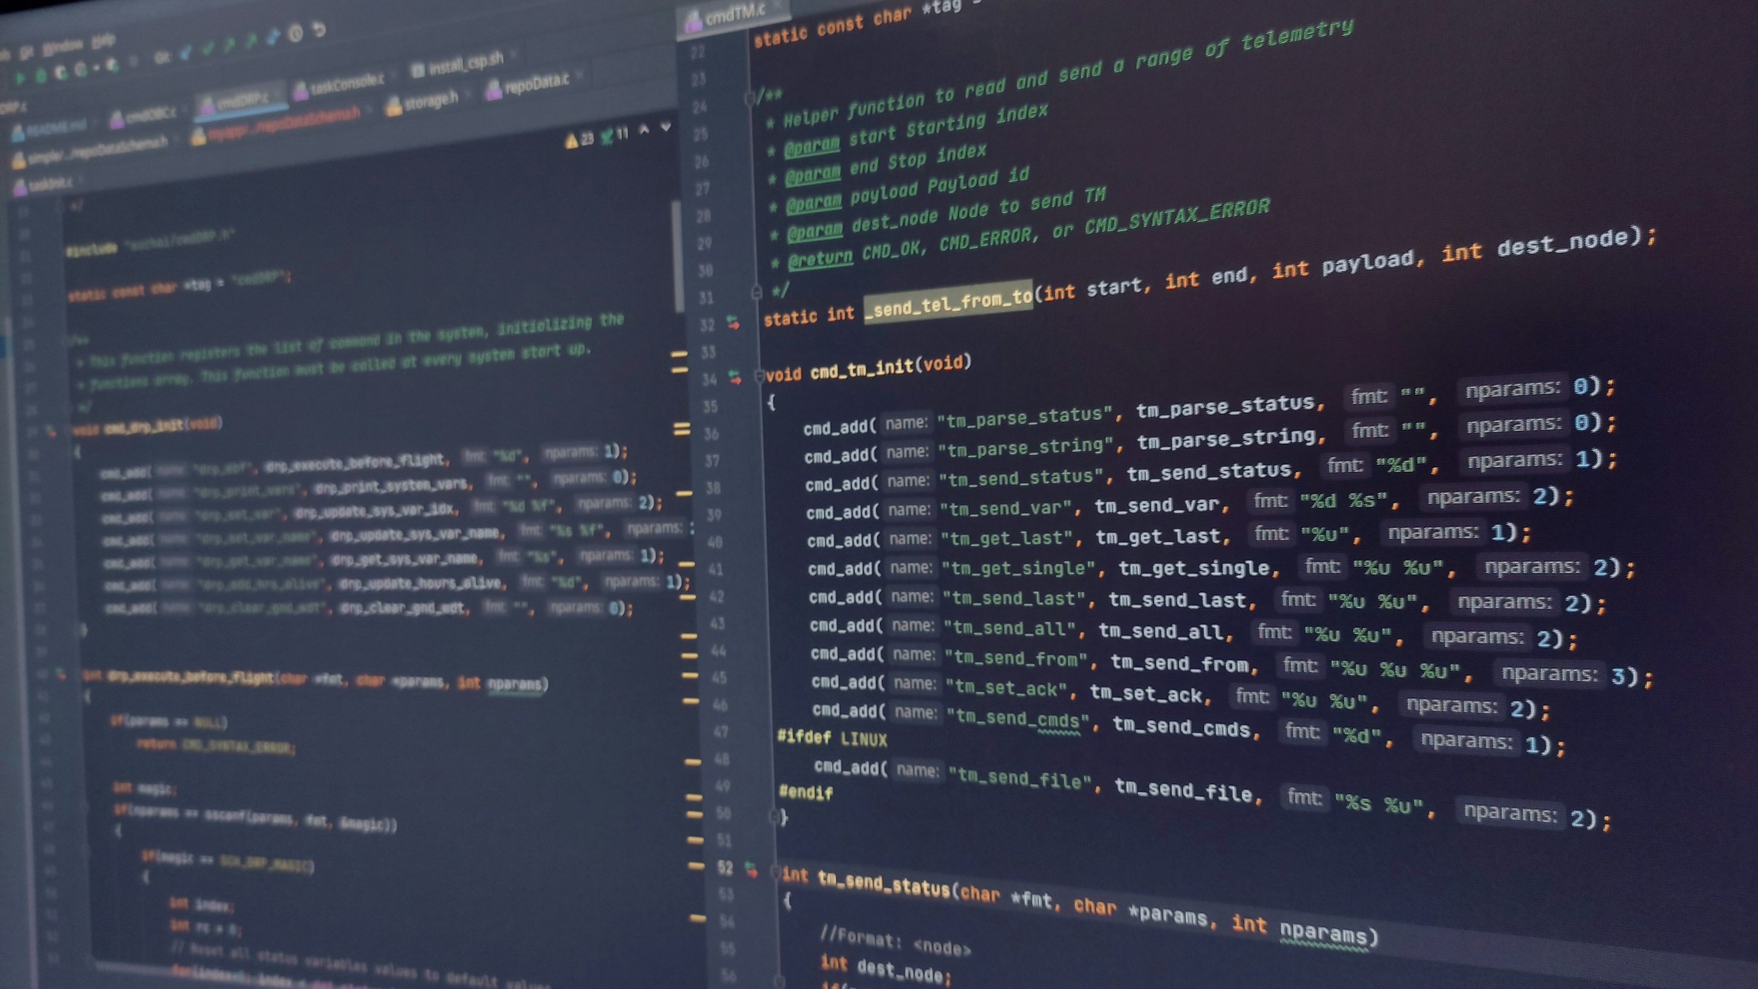
Audience
Researchers who code
Research software engineers
Those managing and/or procuring funding for project with a large software component
Those running research infrastructures using software
Those developing software related policy at organisations and in projects
https://unsplash.com/photos/black-flat-screen-computer-monitor-MmYtZoZ8ET4

Slide 4
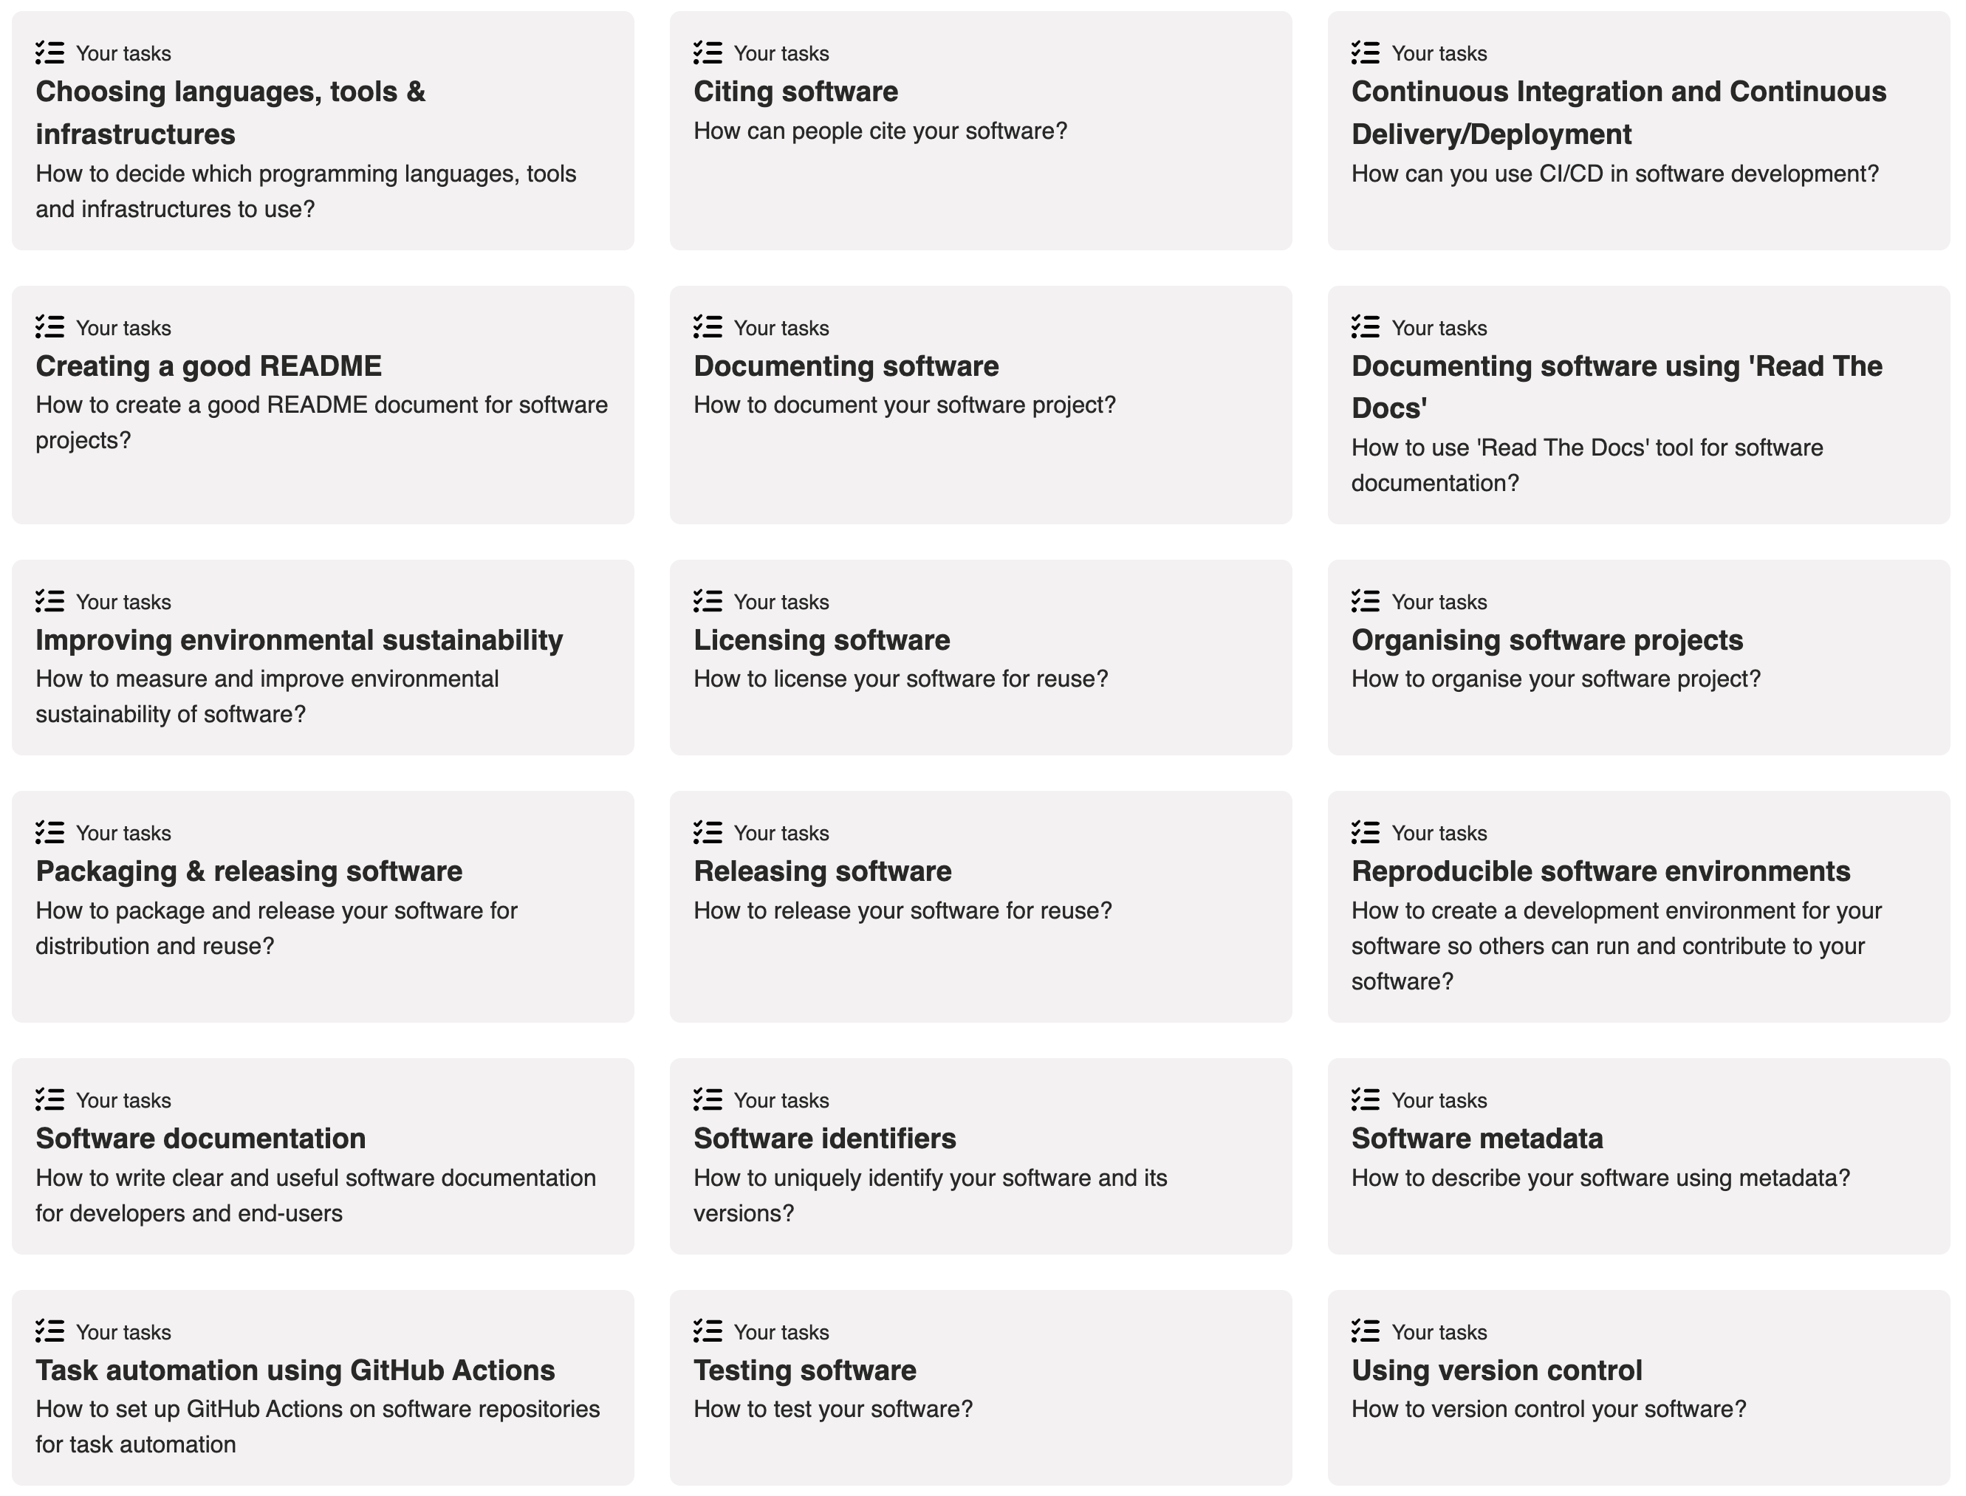
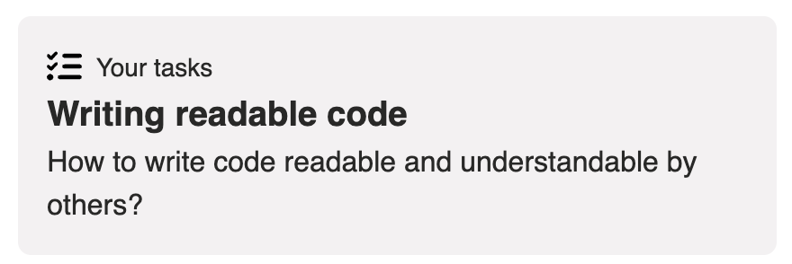
Tasks
Common software tasks that improve quality
Quality of practices vs quality of product

Slide 5
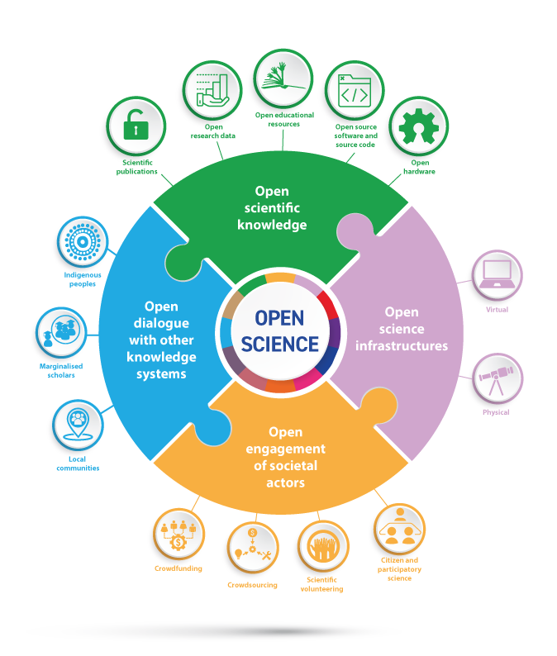
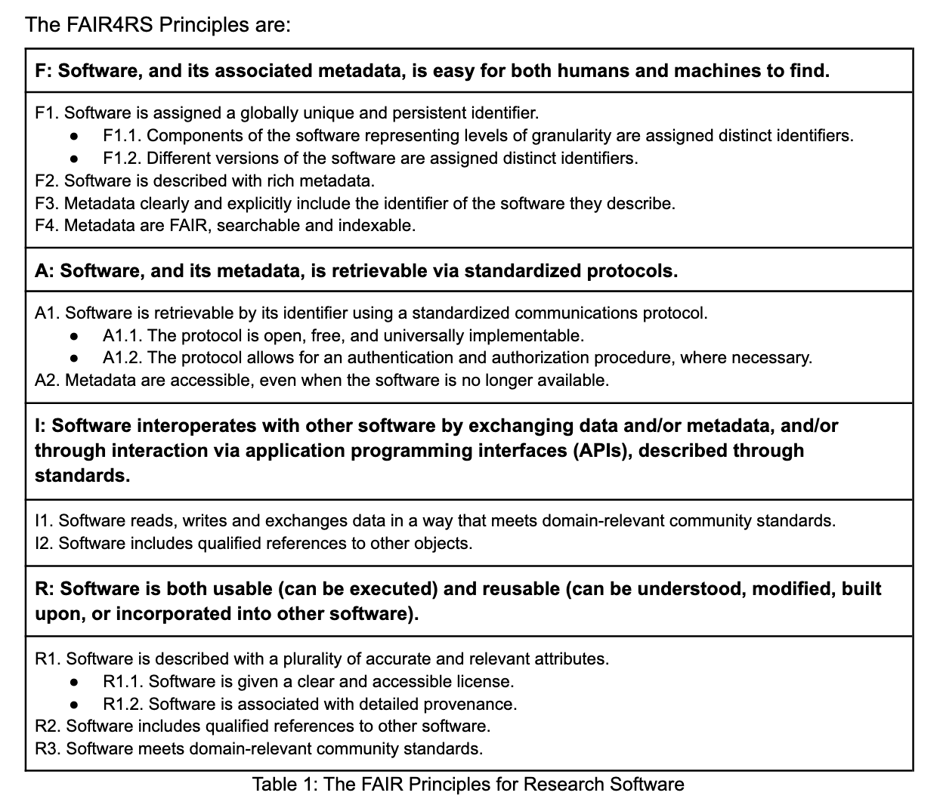
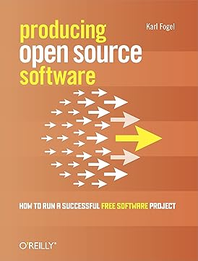


Principles
FAIR Software
Open Research
Community Development
By UNESCO.org - Understanding open science (p:6)

Slide 6
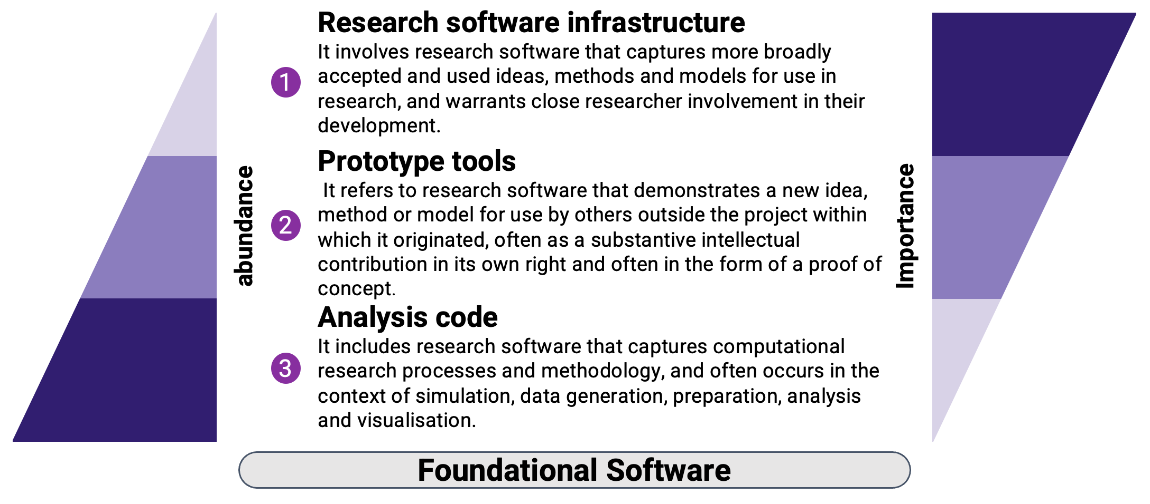
Principles (2)
Tiered Software Engineering
Reach

Slide 7
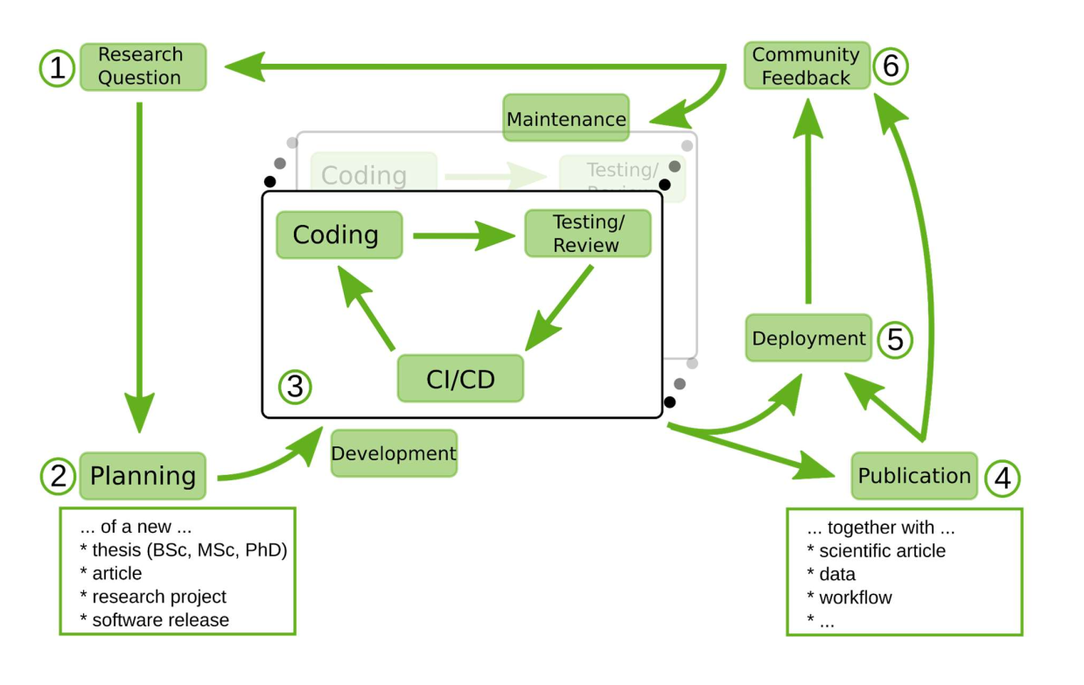
Research Software Lifecycle
10.5281/zenodo.8324827

Slide 8
The ‘Zen’ of RSQKit (ETT++): linkage & automagic
RSQKit
Scope
Research Clusters & Infra
From ETT (Elixir Toolkit Theme) - https://elixir-belgium.github.io/elixir-toolkit-theme/
  Tasks to Tools
  Tools to further information
  Task & Tool linkage to training registry (limited to TeSS)
  Related pages
RSQKit additions (the ++) - Future work
  Extending the training registries that are supported
  Presenting the link between dimensions & indicators with tasks and tools in a meaningful way
    Pathways?
  Connecting roles with tasks
Resources
(tool websites, references, tutorials, existing guidance)
Definitions
Research Software Stories
Roles
Contributors
Tasks
Institutions
Training registries
Tools
Dimensions & indicators
Work in progress / planning
Data
Content
External

Slide 9
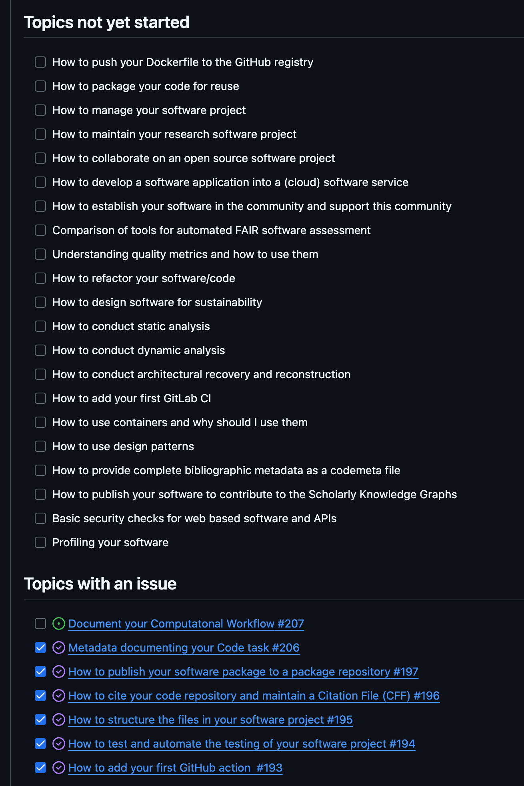
Open for Contributions
Events
Guidelines
List of topics
github.com/EVERSE-ResearchSoftware/RSQKit/issues/224
Reaching beyond the project
deRSE25 (Feb)
CW25 (May)
EVERSE Network event (June)
RSECon25 (in planning) (Sept)
Contributor Agreement
How to Contribute
What to Contribute
What Not to Contribute
Contributor Responsibilities
Acknowledgement of Contributions
Ownership of Content
everse.software/RSQKit/contribution_guidelines

Slide 10


Road Map – next 6 months
Additional prioritised task page content
Improved navigation
  Life cycle stages and tasks
  Marking up task pages with indicators and dimensions
Integration with software quality tool efforts in EVERSE
  At what stage to use which tool
A better description of software roles
Additional external facing workshops & contentathons
A newsletter
  Internal first to reach out across the project
  Moving to the EVERSE network to gain further input / updates
Refreshing the layout
everse.software/network/

Slide 11
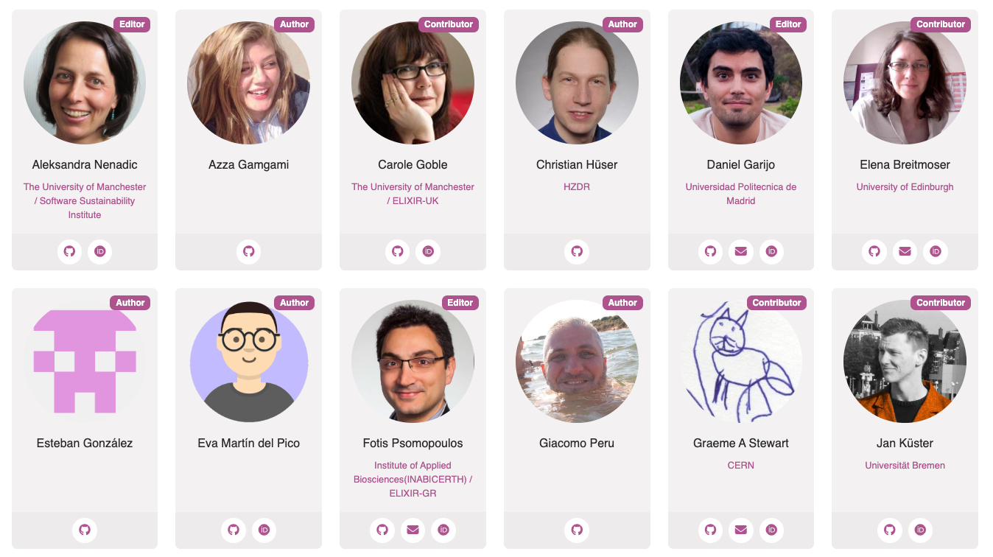
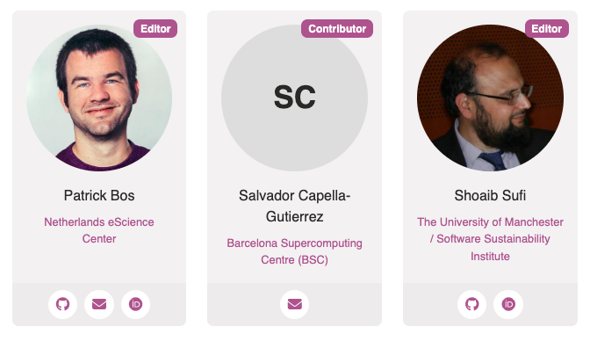

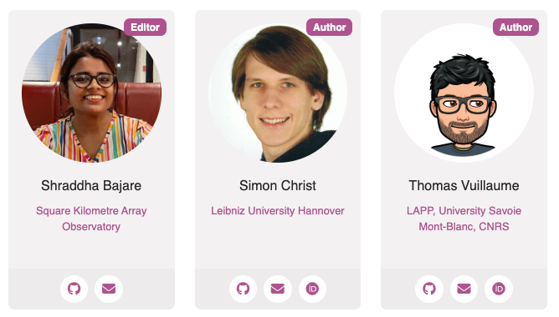

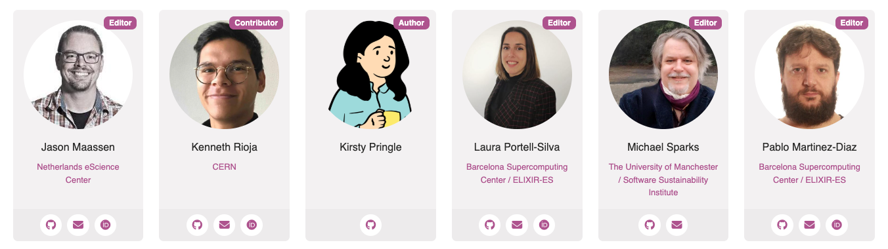
Thanks
Editorial Board –
rsqkit@lists.certh.gr
RSQKit All Contributors

