Slide 1

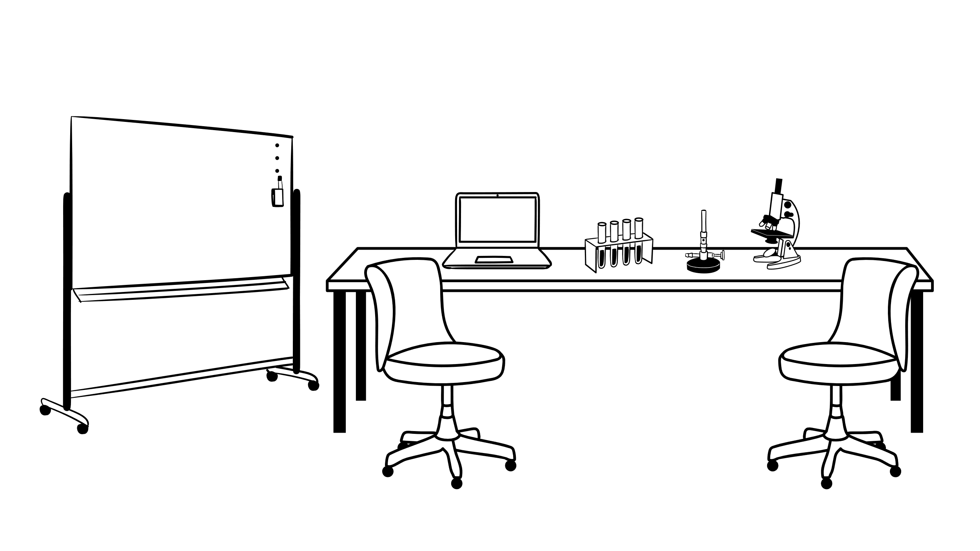




Be an Agent of Change
Make sure you sit next to someone
How to support culture change in research data management

Slide 2

Two minute activity!
Introduce yourselve to your neighbour (first name, main job)!
+ Why are you interested in Change Management?

Slide 3



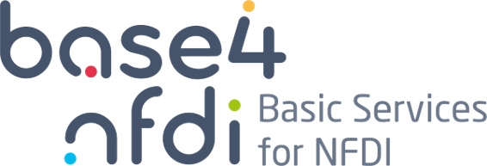






Antje Manske
Training Manager @ Base4NFDI (since 2023) and professional freelancer
Enthusiast for learning and infinitely curious about human behavior
Dipl. Päd. aka professional in behaviour change and learning
Consulting / Industry background
Certified Prosci Change Practitioner & Certified Professional in Talent Development (ATD)
That‘s
me
Main Work
„Extra-Curriculars“
Family
For
Fun
Notes:
Logo credits:
Base4NFDI - https://base4nfdi.de/resources/templates-logos (licensed under CC-BY-4.0)
GESIS - https://www.gesis.org/institut/presse-und-medien/download-bereich/logos (reuse by external parties only with permission)
Antje Manske Consulting – reuse only with permission (hello@antjemanske.info)
NFDI - https://www.nfdi.de/downloads/ (reuse only with permission)
DINInestor AG Forschungsdaten - https://openbiblio.social/@DINInestorAGFD
RDA - https://www.rd-alliance.org/communication-kit/ (reuse only with permission)

Slide 4
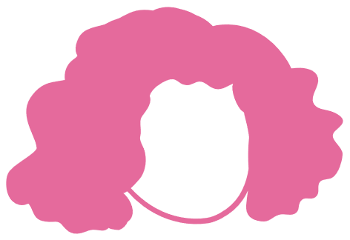


Meet Ellen!*
*data steward persona
Hi!
Notes:
1 min
Ellen is based on discussions me and my colleague Sandra Zänkert had with data stewards in our “Agents of Change” courses.

Slide 5
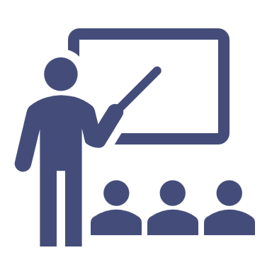

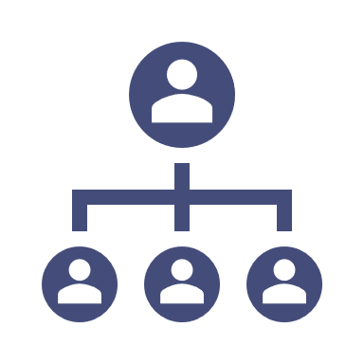
Ellen is a data steward, she…*
Trains researchers on research data management
Consults researchers on individual research data questions
Engages with PIs and institution leads for support & funding
“My goal is to support researchers in RDM, so they can generate new knowledge and solve the problems of the world.”
*among other things

Slide 6
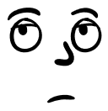

Yes – but am I
a change agent?

Slide 7
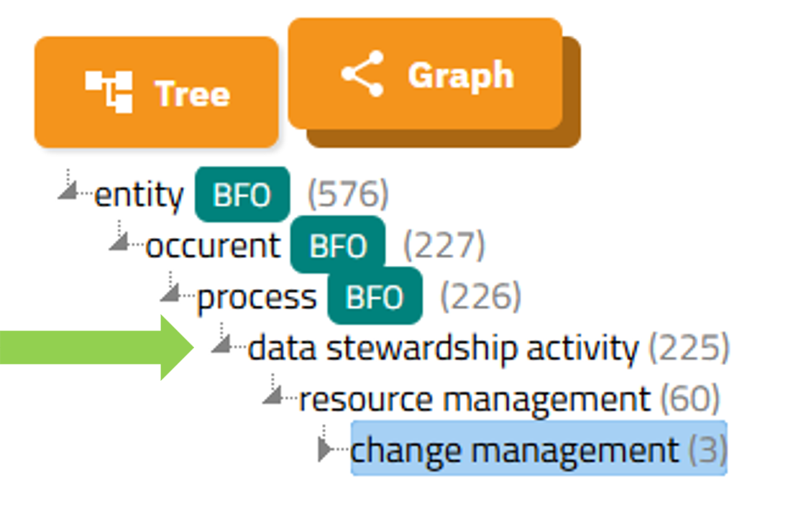
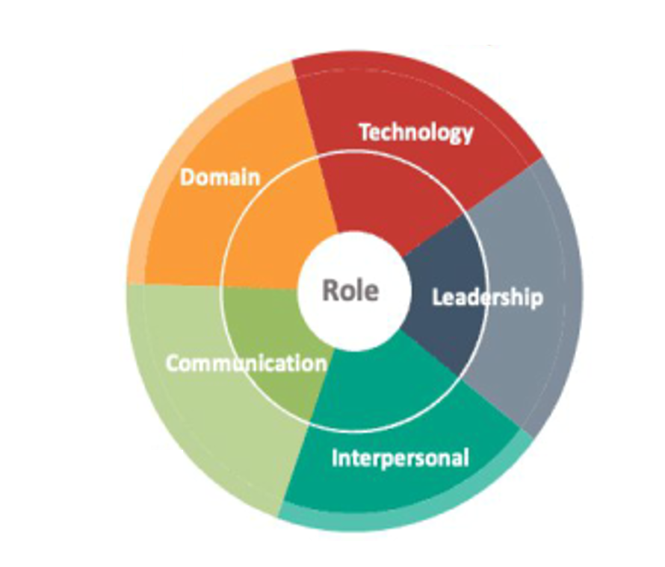

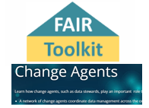
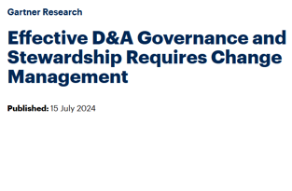
Is Change Management part of Data Stewardship?
Terms4FAIRskills Ontology
Skills4EOSC – Minimum Viable Skillset
Pistoia Alliance (alliance of life science organisations)
Gartner Research (Industry)
But let’s ask the experts – you!
Notes:
The terminology Terms4FAIRskills mentions change management as a data stewardship activity.
https://www.ebi.ac.uk/ols4/ontologies/t4fs/classes/http%253A%252F%252Fpurl.obolibrary.org%252Fobo%252FT4FS_0000411
The skills4eosc minimum viable skillset developed multiple job profiles. The Data Steward MVS mentions advocacy, engagement, cultural competence, governance, consultation and listening and more – all relevant for change management, but also knowledge brokering and for knowledge brokers (another MVS profile) the model explicitly mentions change management as a necessary skill.
https://zenodo.org/records/11469300
There are also data stewards in industry and the Pistoia Alliance for example (a community of FAIR data practitioners from leading life science, pharmaceutical and software companies (organizations both profit and non-profit) has a FAIR toolkit that mentions data stewards as change agents who play an important role to support FAIR data management and that a network of change agents (such as data stewards) can coordinate data management across organisations.
https://fairtoolkit.pistoiaalliance.org/methods/change-agents/
The American research and advisory firm Gartner provides products and services through research reports, conferences and consulting targeted at large corporations, government agencies and more. Unfortunately their reports are not free to share. But one key take-away they had when they evaluated effective data and analytics governance is that data stewardship requires behavioural change management.
https://www.gartner.com/en/documents/5584059

Slide 8
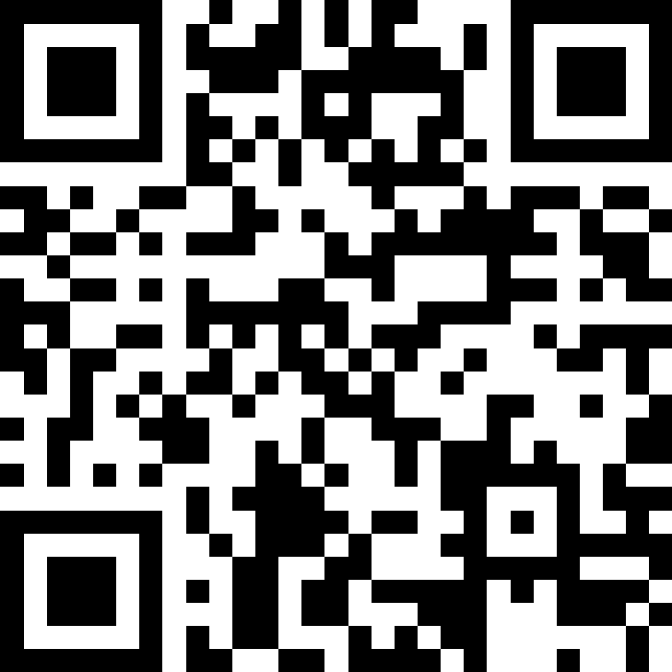
Is managing change and helping people to change their behaviour part of your work?

Slide 9
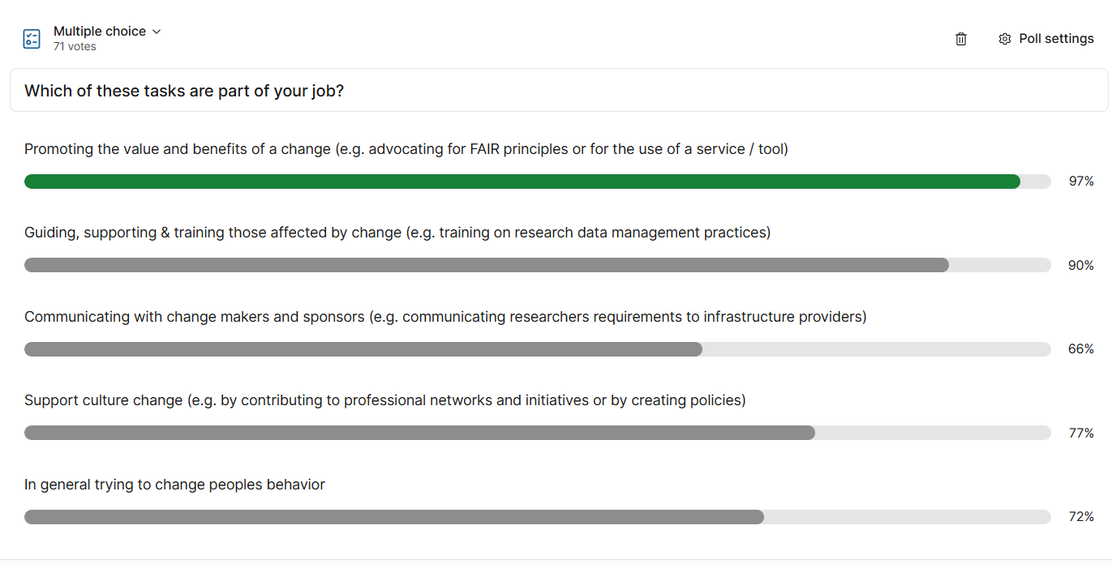
Results:
Notes:
Results from Fellowship of the Data 2025

Slide 10

Congratulations – you are a change agent!

Slide 11



But changing peoples behaviors is not easy
..especially changing behaviours sustainably

Slide 12

Can you relate to some of these quotes from Ellen?
„I cannot convince PIs & insititution leads“
„I train researchers but they don‘t change how they do things“
„They say they don‘t have time for this“
„This new tool is so cool – why does nobody use it?“
„Why don‘t they just DO it?“

Slide 13
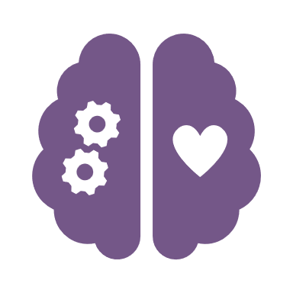
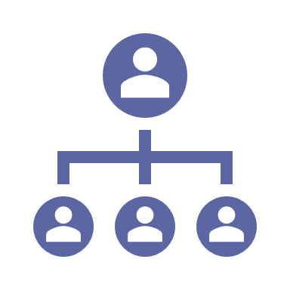
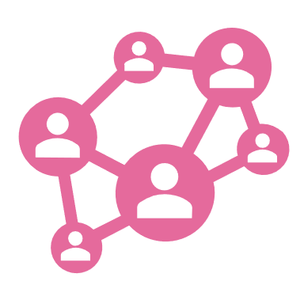
Why is behavior change so hard?
Our brains love the status quo
Goals are often not aligned and there is little management support
Culture reinforces
existing behavior
Notes:
1st we as individuals are not changing easily – our brains simply love the status quo. Even more - change into the unknown is even perceived as a threat, risk or loss. This is called the „status quo bias“. Faced with a decision from different alternatives, the status quo is evaluated as positive. Why is that? Negative emotions are perceived stronger than positive ones – fear of loss outweighs the potential benefits. Something to keep in mind later. Other factors seem to be transaction cost to a new behavior and psychological commitment.
2nd the culture an individual researcher works in will influence which behavior is rewarded, which norms and policies apply, what feels hard vs. what feels intuitive and easy. Social norms – so the actions and opinions of others – also have a strong impact on behavior. Cultural identity and a sense of belonging can create a strong motivation to adhere to established norms and practices.
Last but not least 3rd most change initiatives fail due to missing support from management and leadership and because the different stakeholders involved did not align on the goals properly. They think they are talking about the same thing but when it comes to putting it in action it is hard to impossible to agree on the concrete goals and outputs.
Sources status quo bias & individual factors:
https://pmc.ncbi.nlm.nih.gov/articles/PMC2851882/ / https://www.pnas.org/doi/10.1073/pnas.0910380107
https://pmc.ncbi.nlm.nih.gov/articles/PMC7946166/
https://en.wikipedia.org/wiki/Status_quo_bias
https://www.thebehavioralscientist.com/glossary/status-quo-bias
Sources for culture as a factor maintaining the status quo:
https://www.cos.io/blog/strategy-for-culture-change
https://sweetinstitute.com/cultural-factors-and-behavior-change-and-motivation/
https://sweetinstitute.com/social-factors-and-behavior-change-and-motivation/
https://pmc.ncbi.nlm.nih.gov/articles/PMC10272593/
https://plato.stanford.edu/entries/social-norms/
Sources for management factors that inhibit change success:
https://www.prosci.com/blog/why-change-management-fails
https://www.aimbusinessschool.edu.au/why-abs/blog/why-70-of-change-management-initiatives-fail
https://whatfix.com/blog/barriers-to-organizational-change/

Slide 14

Ellen needs to learn how to manage change

Slide 15

Change Management..
Focuses on supporting people
Aims to achieve specific goals
Is a structured process
Applies a specific sets of methods and tools
Requires time and effort
Change Management is not project management for a change
Following slides adapted from Manske, A., & Zänkert, S. (2024, November 26). Agents of Change - Skills & Strategies for RDM Professionals. Zenodo. https://doi.org/10.5281/zenodo.14221846
Notes:
Essence of the most commonly used definitions
Change Management …
…focuses on supporting people
…aims to achieve specific goals, using a structured process
…applies a specific set of methods and tools
…is not project managemement
…goes beyond training
…is not just communication
…is not a one-time event
…is not a skill only Change Managers need
…requires dedicated time and effort – as a rule of thumb, for any new initiative that requires behavior change, plan 20% of the overall effort for change management activities.
Change management is NOT project management – it focuses on supporting the people impacted by the change and support their behavior change. The goal is to maintain engagement, performance – maybe even fun at work – during a change.

Slide 16
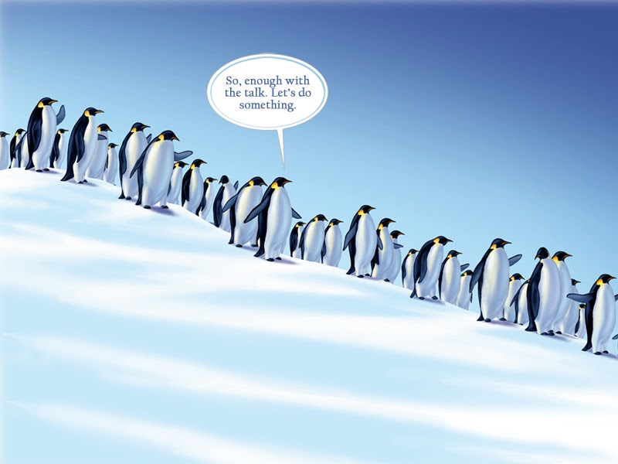
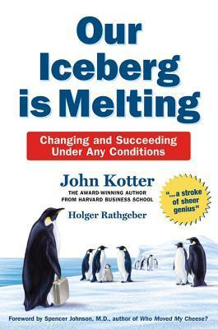
https://x.com/Prosci/status/1232366820155383809
Kotter, J., & Rathgeber, H. (2017). Our iceberg is melting. Macmillan. Included for educational and reference purposes. No copyright infringement intended.
Notes:
Fact is – you cannot reach your goals without people. People changing their behavior, using your new process or tools or adhering to your new policy.
People … or penguins?
What do penguins have to do with change management?
This is the book I have probably bought and given to people the most in my professional life: „Our iceberg is melting“ by John Kotter – where a colony of penguins discovers their iceberg is melting – and you discover important change management principles while the penguines deal with the situation. It is a quick and enjoyable read and it is my recommendation for everyone being involved with managing change.
So in the next section, lets discuss some frameworks and tools you can use to create and execute a change management plan – with your penguins,.. I mean people.. in mind. I will do a quick walkthrough of John Kotters model and others before bringing it all together to the model I suggest for you as RDM professionals and offer some concrete steps you can take.
image: https://orclville.blogspot.com/2007/11/our-iceberg-is-melting.html

Slide 17
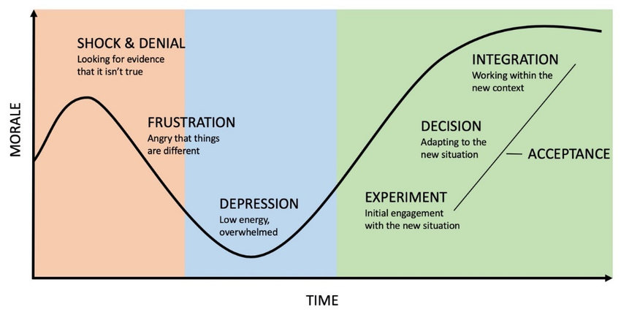
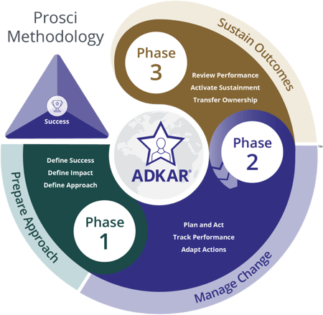
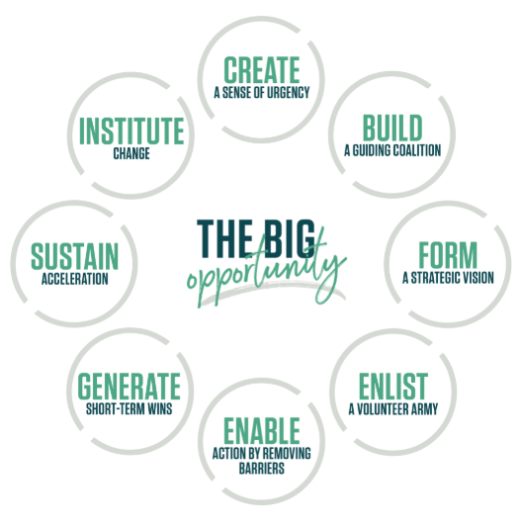
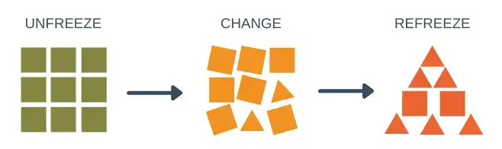
There are numerous methodologies…
3. Kübler-Ross „Change Curve“
4. John Kotter:
8 steps
1. Prosci Methodology*
*Antje is certified as a
Prosci Change Practitioner
2. Kurt Lewin "CATS":
Unfreeze – Change – Refreeze
**too simplistic
Notes:
Introduction to 4 exemplary change management models (Prosci, change-as-three-steps, Change Curve, Kotters 8 steps)
--
If you want to have the benefits from using a systematic change management approach – there is good news. There are numerous methodologies out there and a lot of free material online to get you started.
(1) The Prosci methodology that is designed around a 3 phase approach and involves tools for testing the status quo and track progress. It also includes a very straightforward plan for behavior change called ADKAR (free resources can be found online that I can really recommend). It basically states that if you can change one person, you can change an organization and that every person needs to first get awareness, then desire or motivation to change, than knowledge, than ability (which includes more than training, for example the adjustment of work processes) and last but not least reinforcement to make the new behavior stick.
(2) Kurt Lewins model "changing as three steps" is not widely used due to ist oversimplification BUT it offers some useful advice: Lewin offers a 3 step process for change – unfreeze of the current status or behavior, change and then refreeze. That implies that every change process should have a defined beginning but also endpoint where stability can be regained.
(3) Another model is the Kübler Ross „Change Curve“. Originally Dr Kübler-Ross identified 5 stages of a persons reaction to a significant loss. Now it is a widely accepted model for mapping the different phases of a change process on the emotional level – and like we will see in Kotters 8 steps model in a minute – FEELING is even more important than thinking when it comes to behavior change. So identifying where each stakeholder group is at the moment and how to best adress them is a great tool. I also use it to explain to frustrated sponsors and supervisors why they need to explain the WHY and benefits of the change yet again – for them it is clear. They are already in the Integration stage! But their team members, and people affected by a change might still be in Denial or Depression stage – so it is important to acknowledge these feelings so people can move on.
(4) John Kotter's 8-Step Change Model is a structured approach to implementing organizational change, consisting of creating urgency, building a guiding coalition, forming a strategic vision, communicating the vision, empowering employees, generating short-term wins, consolidating gains, and anchoring changes in the culture. This model, developed based on research of over 100 organizations, provides a clear roadmap for leaders to successfully navigate and embed transformational change within their companies.
Sources:
https://www.prosci.com/methodology/3-phase-process
https://journals.sagepub.com/doi/10.1177/0018726715577707
https://www.researchgate.net/publication/363242905_The_McKinsey%27s_7-S_model_framework_for_assessment_of_challenges_faced_by_teachers_of_children_with_autism_spectrum_disorders_in_the_Limpopo_province_South_Africa/figures?lo=1
https://www.researchgate.net/publication/343844707_Managing_a_Curriculum_Innovation_Process
Image credits (24.3.2025):
1. https://www.prosci.com/blog/prosci-methodology
2. https://expertprogrammanagement.com/2021/09/unfreeze-change-refreeze/
3. https://www.humancapitalbuilders.nl/post/what-is-kubler-ross-change-curve
4. https://www.kotterinc.com/methodology/8-steps/

Slide 18
Some early take-aways
Give room to temporary fear, frustration & anger
THINKING differently can help change behavior but FEELING differently can change behavior more and lead to better results
Communicating the „Why“ of the change and what the individual can gain by changing is key BEFORE you start training and enabling people

Slide 19

How to do it

Slide 20
Pick a project!
You have 3 minutes – talk to your neighbor, do either of you have a change management project right now?
Examples: Increase adoption for a service or tool or compliance with a policy, change a specific RDM behavior (e.g. getting PhDs to use a consistent folder structure for data)
Pick one and write it into the Slido!

Slide 21
Results (sorted by nr. of mentions):
Adoption of RDM services and tools (23)
  Adoption and Usage of ELNs (12)
Creating RDM awareness and providing RDM education (11)
Adoption of RDM practices (e.g. using proper metadata and writing DMPs) (8)
Implement policies and legal requirements (7)
Workflow standardization (6)
Personal and development goals (2)
Establishing data stewardship (3)
Notes:
Results from Fellowship of the Data 2025
1. Creating RDM awareness and providing RDM education
Raising awareness for the need to make RDM accessible for neurodivergent persons
Raise awareness for RDM in researchets and distribute basic knowledge in workshops or talks
Introduce RDM to students
Short workshops
Introduce proper RDM workshops for all members of the institute.
I am creating an RDM bites series for researchers at the institute and I want to convince them to adopt better data management practices
That the researchers come to us for talking about RDM
Increase FAIR training at my institution and engage senior stakeholders to get it embedded in education programmes
Introduce proper RDM workshops for all members of the institute.
Implementing RDM
Convince researchers to go for open access
2. Adoption of RDM services and tools (e.g. also GitLab, establish a data secure IT-environment, comment data base)
Trying to make researchers use a new tool in their data workflow
Convince researchers to use established rdm service.
moving a community to gitlab to work together
Getting people to use the Project GitLab and the "Annotated Research Context" structure. + Properly documenting metadata
Convince people to use our self service and participate in the development community.
Adoption of an ELN for our chemistry department - currently running a trial for 50 users.
Establish a data secure IT-environment including AI use in a medical institution.
Establishing comment Data base for data sharing (access/control)
Increase the adoption of services by introducing approach of service engineering.
Adoption of using central file severs for research data storage
Migration to a new ata Manager platform/application
3. Adoption and Usage of ELNs
Using ELN
Using an ELN
Introduce the use of a ELN
Intruding a ELN
Implement an ELN
Make more researchers use the ELN
Use an ELN instead of an analogue one Make the researcher to publish their data
Getting people to change from paper lab book to an electronic one
Transition from an analog to an electronic lab notebook
Helping people with switching to using electronic lab notebooks
Digital documentation of lab works using ELN tools
Fostering the use of Electronic Lab Notebooks by microbiologists
4. Adoption of RDM practices (e.g. metadata and DMPs, not archiving everything)
Convince scientists to archive their data in a FAIR data repository/ invest time to prepare the metadata well
Write proper metadata
Bringing PhD students to do DMPs
PhD students adopting DMPs
Convince researchers to invest time in RDM practices
Perceive writing a dmp as a simple task
Not a archiving everything.
Adding specific topics to general consultation hours
5. Compliance with law and policies
Raising awareness about legal topics and convincing researchers to think and plan ahead
RDM Guideline to supplement / explain institute's research data policy
Policy adoption by decision makers
Create a data management policy
Implementing a data policy - many changes e.g. requiring DMPs
Securly Store sensitive Data compliant to dsgvo
I have myself taken up a position very different from my all previous jobs, abd I have to support with legal compliance matters which in a still developing projects sometimes struggles with priority. I want to implement legal compliance without making them feel it as a burden but rather a benefit.
6. RDM practice & workflow standardization
Bring people to use simple standards
Standardising the data description
Standardising file naming
Digitalizing the workflows of different science domains within 1 research group
Adapt inst. Rep. to current needs
Adoption and complying with project change control processes
7. Establishing Data Stewardship
Extension of my position
Implement a Data Steward in the institutional process of research
Establishing a data steward network with long term positions
8. Personal and development goals
Keeping space in ny calendar: to breathe, balance, enjoy work more
Convince IT to investigate a script that delete data from a transfer folder too early.

Slide 22


A systematic way to approach change
Build a change Alliance
Create your North Star / Vision
Define the challenge
Enable & remove obstacles
Reinforce & Acknowledge
Plan for 1 or more concrete outcomes
Communicate for awareness & buy-in
 | Remember: Change management focuses on supporting the people who need to change. It often runs in parallel the implementation of a technical / service solution.
Notes:
The models I showed you all have their benefits but I felt to make it applicable to our context some adaptions need to be made to make it suitable for every-day application for people not being full-time change managers. The central idea therefore is to introduce iterations.
We dont move once into one direction, but do small steps in 2-4 week cycles and adjust the operational goals to achieve the vision and the measures to achieve those goals as we go – which makes it easier to adapt to changes and tackle smaller work packages while still moving ahead towards the vision.
Lets go through it on a high level before I want to give you a list of practical suggestions for each step:
The steps you see here represent a logical order and no steps should be skipped. It might be very tempting to jump directly to communication or training people – but that means risiking that your change is not aligned and supported by the relevant stakeholders and ultimately you cannot achieve your goals.
First you need to Define the challenge or change: this includes the why and what of the change as well as a high level analysis of change costs vs potential gains.
(2) Build an alliance to plan, communicate and execute the change. You will need leadership support (e.g. from a PI or insitution lead) who can make decisions on funding, policies and staffing; you will need people with knowledge on the systems and people involved and you will need people with good credibility and a relevant network.
(3) Ok, so you have your team and you have an initial analysis what needs to change and why – these are the ingredients for your vision. A vision presents an attractive image of the future state that is specific yet flexible enough to guide your change activities without a need for micromanagement.
Now that you have the fundamentals and a good foundation – you can start on an iterative process for your actual change measures. Why iterative? Because if you follow an agile approach, you can build quick wins that keep the energy up, you can adjust your plan to changes with lower risk than and improve stakeholder engagement. You can also easily target different groups – for example start with people who already understood the need for the change and can be ambassadors for the change moving forward. And last but not least – you can experiment and try different things.
Without giving away too much – take a look at the order of the steps. While you might work with different target groups in different iterations (e.g. with group leads first), make sure you always follow this order – first make them aware and secure their engagement (they want to be part of the change) – then you can train and support them. Then you should plan in repetition and reinforcement and don‘t forget to celebrate and acknowledge effort and progress.

Slide 23

Step 1 – Define the Challenge
What is the overall goal?
Who needs to change?
What exactly is changing?
Why is the change necessary? What are the benefits?
Notes:
This point is the most important point of all. If you cannot clearly explain the WHY of the changes you want to implement, you will have a hard time bringing people on board. Give them the same answers and arguments you needed to understand the problem and your suggested solution.
SO…
Why does who need to change? (is there a new policy from the DFG? Have you noticed that PhDs keep forgetting where their raw data is? Has someone approached you with a new tool and you want to implement it?)
What can be gained specifically?
What happens if there is no change?
What needs to change specifically? (First iteration and high level view)
Take a moment to consider the costs and benefits of the change – is it really worth it?
What does a specific strategic goal mean for all stakeholders involved? What is exactly is changing?

Slide 24


Change Impact Analysis –
What exactly is going to change for the individual?
Processes & policies
Communication, Social Connections
Tools / Data
Access to resources
Skills & Behaviors
Team & Reporting Structure
Explicit impact
Implicit
impact
Beliefs & expectations
Tasks & Work Areas
How performance is measured
Compensation
Acknowledgement & Opportunities
Notes:
Lets take a closer look at the „WHAT“ of the change – you can do this systematically by performing a so-called change impact analysis.
Explicit changes (Processes, systems, new software, new area of work or additional tasks, ..)
Implicit changes (what is actually acknowledged and rewarded, what attitudes and believes need to change, how will communication be affected?)
Every impact you identify is a potential point for change management measures and messages but also one where to look out for objections
Often when we define a goal it is not completely clear yet what exactly these imply – what exactly will change and for whom. So an impact or change impact analysis needs to be performed. Ideally this is again done with the different stakeholder groups at the table!
For further reading:
https://de.wikipedia.org/wiki/7-S-Modell
https://changemethod.com/change-impact-assessment-techniques/
https://stracl.com/blog/how-to-tackle-change-risks-with-change-impact-analysis
https://www.prosci.com/blog/defining-change-impact

Slide 25
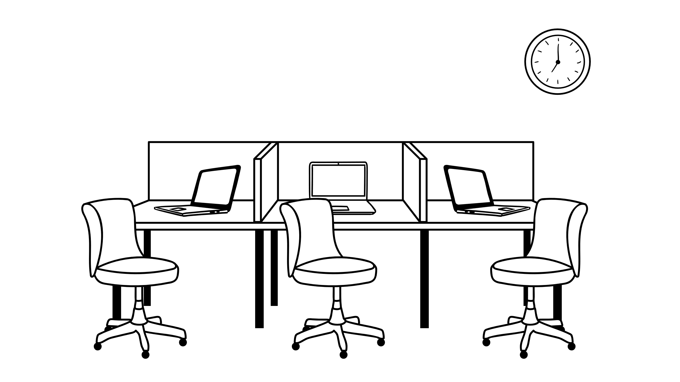
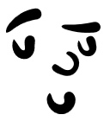

Step 2 - Build an alliance!

Slide 26
Step 2 – Build an Alliance
You need people with time + …
good network with stakeholders
Skills, knowledge
Influence
Notes:
Change management is rarely successful as a one-person-show. You will need leadership support (e.g. from a group PI or insitution lead) who can make decisions on funding, policies and staffing; you will need people with knowledge on the systems and people involved and you will need people with good credibility and a relevant network.
Your alliance is the first group where you have to create buy-in aka engagement and commitment! Make sure they fully understand the change, answer their questions and be honest. Get their input on your change impact analysis.
Think about the people who need to change their rdm behavior, e.g. by using a new tool … -> What does it mean for them to change? How would it make you feel to go through this as an affected person, all things considered?
Again: if you skip this step, you might end up with a change initiative that stagnates after just a few weeks, un-responsive stakeholders and a lot of workload on your shoulders – ultimately without the results you wish for

Slide 27



Step 3 – Create a Vision!

Slide 28
Step 3 – Create your Vision
= attractive and attainable image of the desired future state
  easy to understand
  flexible enough to be interpreted by different teams and under changing conditions
  Agreed on with all relevant stakeholders
Notes:
Ok, so you have your team and you have an initial analysis what needs to change and why – these are the ingredients for your vision. Your vision is an attractive and attainable image of the desired future state.
This is your guiding light and your north star throughout the whole change project. It will help set an attractive goal for everyone involved and guide individual activities without the need for a big strategy paper or micromanagement. Be prepared that formulating the vision could take a few iterations and weeks of time. Be sure that your whole change alliance is involved and on the same page. It is worth it! Effective visions are imaginable, desirable, feasible, focused and flexible enough to allow to be interpreted by different individuals and under changing conditions.
From a vision, strategies and operational goals can be derived.
Criteria for great change visions: Kotter, J.P. (1996). Leading change. Boston: Harvard Business School Press.

Slide 29

A systematic way to approach change
Build a change Alliance
Create your North Star / Vision
Define the challenge
Enable & remove obstacles
Reinforce & Acknowledge
Plan for 1 or more concrete outcomes
Communicate for awareness & buy-in
DONE!
Notes:
Now that you have a great foundation – you can start on your iterative process for the actual change measures
(4) Each iteration starts with a plan for one or more concrete outcomes –define the target group(s) for this iteration and plan concrete measures. You might want to check which members of your alliance you need or if you want to involve additional people just for this iteration – e.g. from a communications or training department.
(5) With every target group, start with communicating the why, what and how of the change – even if you feel you already did it a dozen times, it might need many more iterations before the awareness actually sinks in. Think about how long it took you to really understand why the change needs to happen, to weigh alternatives and build the vision. Allow your target group to go through the same or similar thought processes.
(6) The next step is the heart of your change management plan. Once you are sure everyone understood why the change needs to happen and what their benefits are, you can start enabling people – with training, mentoring or how to documents. A lot of your change activities will be around communication and training but keep a look out for processes, systems, even leadership behavior that is hindering the change. Discuss in your change alliance how to tackle these issues.
(7) Once you executed the planned measures, you are not done yet. Make sure to regularly communicate results and achievement and don‘t let up! Be prepared for some backsteps. Do not lower your goals just because you are facing some difficulties. Change is always messy

Slide 30

Step 4 – Plan next iteration
What is / are the concrete outcomes you want to achieve in the next 2-4 weeks
  Target group
  Measures (communicate – enable – reinforce)
  Check MoSCoW
“Acceptance criteria”
Who to involve?
Notes:
So lets get to work!
Again – why do we iterate? Because we create tangible outcomes in short cycles. We can keep up the momentum and not exhaust collaborators and change sponsors.
Each iteration starts with a plan – chart your course of action by analysing available data, setting goals (SMART or your prefered model), defining the target group for this iteration and re-evaluate the impact analysis for this goal and target group. This might involve including new people in your change alliance (temporarily) To not overload the change alliance, consider if you want to run multiple cycles for different goals and groups in parallel or if you want to close them before starting the next.
Check MoSCoW (Must, Should, Could, Won‘t) – is the outcome essential to achieve the vision? Is a workaround possible or even alternative ways? Can the benefits of the vision be achieved without this?
Last but not least define when exactly the outcomes are reached, for example with „acceptance criteria“ that all involved agree on. In this way you can clearly say if an outcome has been reached.

Slide 31





Step 5 – Communicate for awareness and commitment!

Slide 32




5 – Communicate for awareness & commitment
Communication Ideas
1-1 communication for individual benefits and doubts – also top-down
Team Meetings & Townhalls
Newsletters / Mail
Internal media / website
External media (conferences, ..)
How?
What?
Build awareness (Specific Why & What)
Communicate benefits for the researcher / PI /.. (WIIFM)
Two-way communication, listen actively
Who?
Direct “managers” if it affects daily work
Notes:
Now that you know your target group and goal for this iteration, the first step is to get people on board. Always start with communicating the why, what and how of the change. Communicate often and in different formats – especially important are channels that allow feedback, questions and to raise and discuss concerns.
Studies of the Prosci insitute show that change messages that affect daily work should best be delivered by the direct managers of these employees – so in the research context this might be research group or PI leads or department managers.
What does that mean in practice? It means you should in many cases target them in an earlier iteration than the actual researchers to make sure they are on board and equipped to communicate the change.

Slide 33
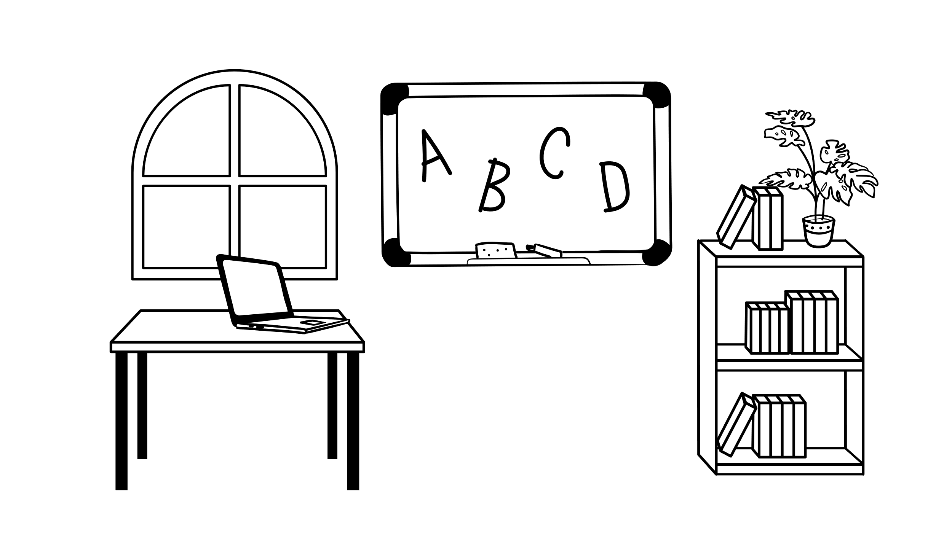

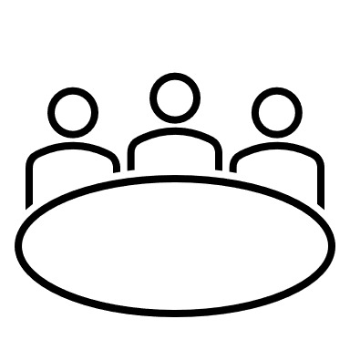

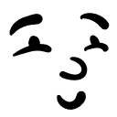

Step 6 –Enable and remove obstacles!

Slide 34

6 – Enable and remove obstacles
First check if target group is aware and motivated
Training
How Tos
Posters
Support
Sustain management support
Office Hours
Ambassador Programs
Train the Trainer
Train Management / Leadership
Coaching / mentoring
Continuous encouragement
Change Experience
Build protoypes
Start small
Create success stories
…
…
Find champions and trailblazers
Reiterate
Get feedback
Listen actively
Address barriers & cultural aspects
Notes:
The next step is the heart of your change management plan but again – do not fall for the temptation to jump directly to this point without completing the former! I will show you some ideas for concrete measures. But let me give you an overview: Once you are sure everyone understood why the change needs to happen and what their benefits are, you can start enabling people – with training, mentoring or how to documents. You might build guidelines and policies, start changing to new systems, processes and tools and execute other change measures.
A lot of your change activities will be around communication and training but keep a look out for processes, systems, even leadership behavior that is hindering the change. Discuss in your change alliance how to tackle these issues.
The sequence in this step is important – make sure internal communication is what you start with. People will be a lot more willing to change if they understand the why and what of the change – on a rational and emotional level. Only motivated people will change their behavior.

Slide 35
What are your best practices for communicating & enabling change?

Slide 36
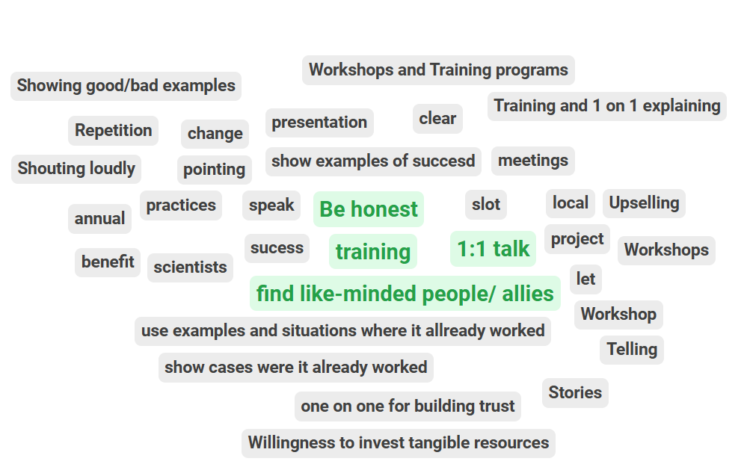
What are your best practices for communicating & enabling change?
Notes:
Results from Fellowship of the Data 2025

Slide 37





7 – Reinforce & Acknowledge
You made people aware, they understood their benefits and you trained them – all good… right?
People seem to adop the new behavior.. But then…
Notes:
Once you executed the planned measures, you are not done. Imagine change as if you want to replace some weeds with very deep rootes with new plants in a garden. You might be able to see some results in just a short amount of time – but if you don‘t constantly water the new plants the old habits aka the deeply rooted weeds will take over again. So make sure to regularly communicate results and achievement and don‘t let up! Be prepared for some backsteps. Do not lower your goals just because you are facing some difficulties. Change is always messy.

Slide 38

Wish vs. Reality

Slide 39

Practical hints for reinforcement
Follow up at least twice
  Repeat messages often and in different ways
Keep listening
  For obstacles, objections
  For success stories
Celebrate (transitions, good-byes, successes)
  Acknowledge effort put in
  Communicate evidence for impact
Don’t let up!

Slide 40
Celebrate and Repeat!
Build a change Alliance
Create your North Star / Vision
Define the challenge
Enable & remove obstacles
Reinforce & Acknowledge
Plan for 1 or more concrete outcomes
Communicate for awareness & buy-in
 | Remember: Change management focuses on supporting the people who need to change. It often runs in parallel the implementation of a technical / service solution.

Slide 41

So that‘s how we change research culture!
..well yes, and…

Slide 42
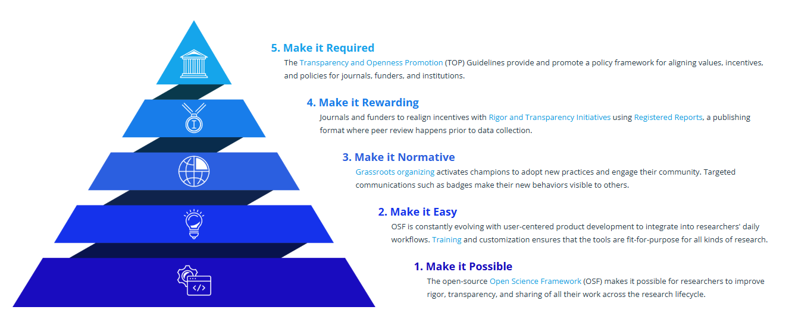
Culture Change
Is there a way to integrate the new behavior into policies and guidelines?
What are possible rewards and incentives for the new behavior?
Who can you activate as a champion to engage their community?
How can you make the new behavior easy / the new default?
How can you make the change possible?
https://www.cos.io/impact
Notes:
Change comes through actions of individual – this is true. Progress has been made by progressive leaders at journals, funders, societies and institutions that are changing incentives and policies directly. Through grassroot actors changing norms despite the dysfunctional reward systems.
The center for open science however, recognizes that academic research is a social system – and therefore change requires a system-based intervention strategy. That means that every actor in this system – every organization and researcher – is either an agent of stasis or of change (driving change or maintaining the status quo)
COS’s strategy focuses on catalyzing innovators and early adopters by providing the tools and training needed for open practices. Their visible success fosters new community norms that, over time, lowers barriers for publishers, funders, and institutions to adjust incentives and policies.
On this slide I added some questions to their hierarchical model that you can ask yourself in your change management activities in order to foster culture change.

Slide 43
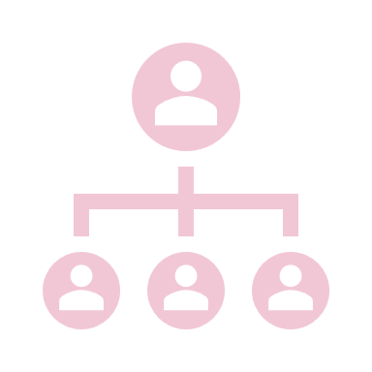


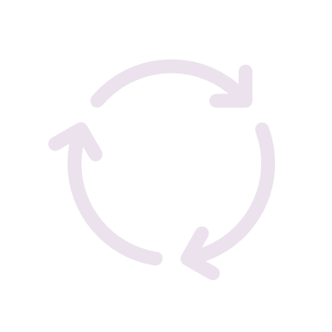

To summarize, change in research needs…
Support from all hierarchy levels
A systematic & iterative change management approach
An alliance with skills, network, influence – and time
Reinforcement and repetition
Gradual change of all aspects of culture

Slide 44
What to do next
Share
Try it out!!
Take a course
Get support
Let’s discuss
Use web resources

Slide 45

My lunch challenge for you
Discuss how you could apply what you learned to your change management task!

Slide 46
Recommended Reads
Kotter, J., & Rathgeber, H. (2017). Our iceberg is melting. Macmillan.
Phillips, J., Klein, J.D. Change Management: From Theory to Practice. TechTrends 67, 189–197 (2023). https://doi.org/10.1007/s11528-022-00775-0
Franklin, M. (2021). Agile Change Management. Kogan Page
www.prosci.com
https://hr.berkeley.edu/sites/default/files/change_management_toolkit.pdf

Slide 47
Credits / Notes for Reuse
Some of the Icons and stock images /videos used in this presentation are sourced from Microsoft Office 365 and are subject to the Microsoft content license. They are used here for illustrative and non-commercial purposes only.
Credits for all other images can be found on each individual slide / in speaker notes.

Slide 48
Thank you!
Any questions?
You can contact me via Linkedin or Mail
antje.manske@gesis.org
hello@antjemanske.info

