Slide 1
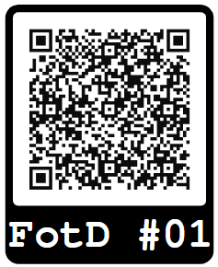
1
What term refers to the practice of providing unrestricted access and reuse of peer-reviewed academic research?
Source: https://scienceeurope.org/our-priorities/open-science/open-access/

Slide 2
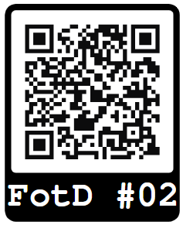
2
What is commonly used to uniquely and sustainably identify datasets, publications and other resources, actors and outputs of the scientific research process - making them easier to find and cite?
Source: https://www.pid-network.de/en/

Slide 3
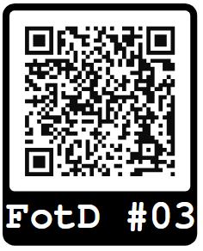
3
What is a digital version of a paper-format used for documenting the conceptualisation, execution and evaluation of scientific experiments, observations, tests and the research data generated in this context?
Source: https://zenodo.org/records/13927614

Slide 4
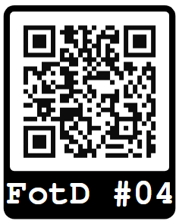
4
What is the acronym for the German initiative aimed at creating a national infra-structure to manage, pre-serve, and make research data accessible across scientific disciplines?
Bonus Question: what consortium is most relevant for you?
Source: https://www.nfdi.de/; https://www.nfdi.de/konsortien/

Slide 5
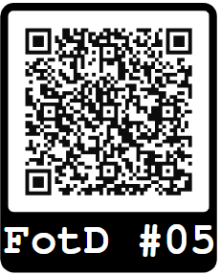
5
What living document
contains general and technical information about tools & applications developed in a research project, information on quality assurance, release and public availability as well as legal and ethical aspects that affect them?
Source: https://datascience.codata.org/articles/10.5334/dsj-2024-043; https://www.rd-alliance.org/groups/fair-research-software-fair4rs-wg/outputs/

Slide 6
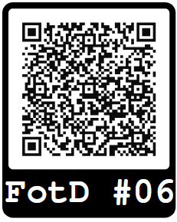
6
Which principles supplement FAIR and mean to sensitize researchers to ensure that rights and interests of indigenous peoples are respected.
Source: https://forschungsdaten.info/praxis-kompakt/english-pages/glossary/#c403985; https://ask.orkg.org/de

Slide 7
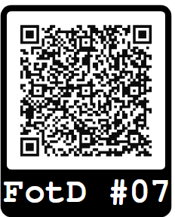
7
What term describes the ability of different systems, devices, or applications to access, exchange, and use data in a coordinated and seamless manner?
Source: https://book.the-turing-way.org/reproducible-research/rdm/rdm-fair.html; https://forschungsdaten-thueringen.de/veranstaltung/coffee-lecture-biodivportal.html

Slide 8
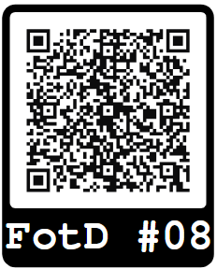
8
What guideline is formulating guiding principles for research that avoids harm to individuals and society?
Source: https://www.konsortswd.de/en/topics/best-practices-research-ethics/; http://research-ethics.org/

Slide 9
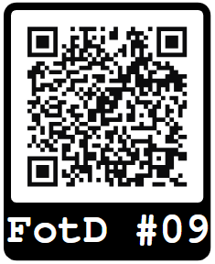
9
What is the term for a standardized system of labeling files and data-sets to ensure consis-tency, clarity, and easy retrieval in research data management?
Source: https://datadryad.org/stash/best_practices;
https://book.the-turing-way.org/project-design/filenaming.html;

Slide 10
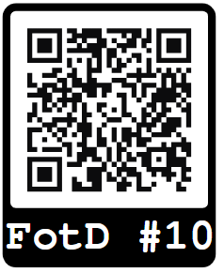
10
What type of licenses allow creators to share their work with others while retaining certain rights, promoting open access and collaboration?
Source: https://creativecommons.org/;
https://forschungsdaten.info/themen/rechte-und-pflichten/forschungsdaten-veroeffentlichen/creative-commons-lizenzen/

Slide 11
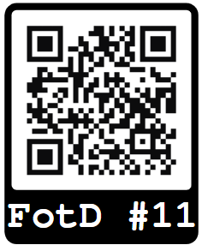
11
What is the acronym for an initiative launched by the European Commission to provide a virtual environment for storing, sharing, and re-using scientific data and results?
Source: https://eosc.eu/; https://open-science-cloud.ec.europa.eu/

