Slide 1

Reproducible image analysis with OMERO
April 3rd, 2025
Trainers: Tom Boissonet, Michele Bortolomeazzi
With the exception of logos and cited third-party content, the content of these slides is shared under the terms of the Creative Commons Attribution License (CC-BY 4.0) unless the content is marked otherwise.

Slide 2



Image analysis workflow with OMERO
Annotation
Import
Export
Images
ROIs
Metadata
Tables
Import
Acquisition
Analysis

Slide 3







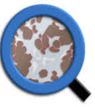

Connections with Image Analysis Software
Non Exhaustive list of tools able to connect to OMERO directly or through plugins:
OMERO python API
ezOMERO
Fiji
napari
CellProfiler
Orbit
rOMERO Gateway
Ilastik
OMERO.matlab toolbox
QuPath
https://www.openmicroscopy.org/omero/features/analyze/
Easing OMERO adoption with ezomero. Ratamero et al. bioRxiv 2023.06.29.546930;
doi: https://doi.org/10.1101/2023.06.29.546930
https://omero-guides.readthedocs.io/en/latest/external_tools.html
https://omero-guides.readthedocs.io/en/latest/api_usage.html

Slide 4
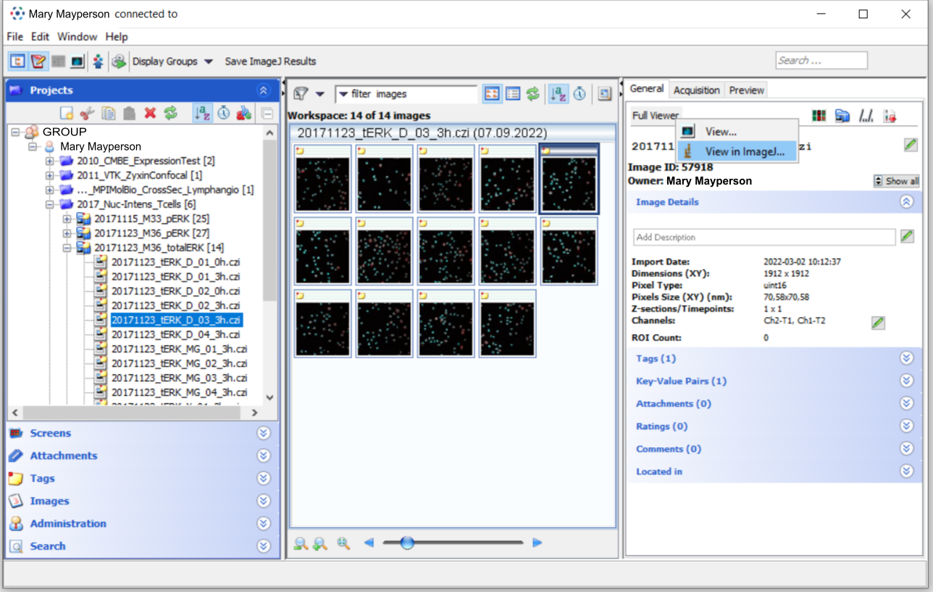
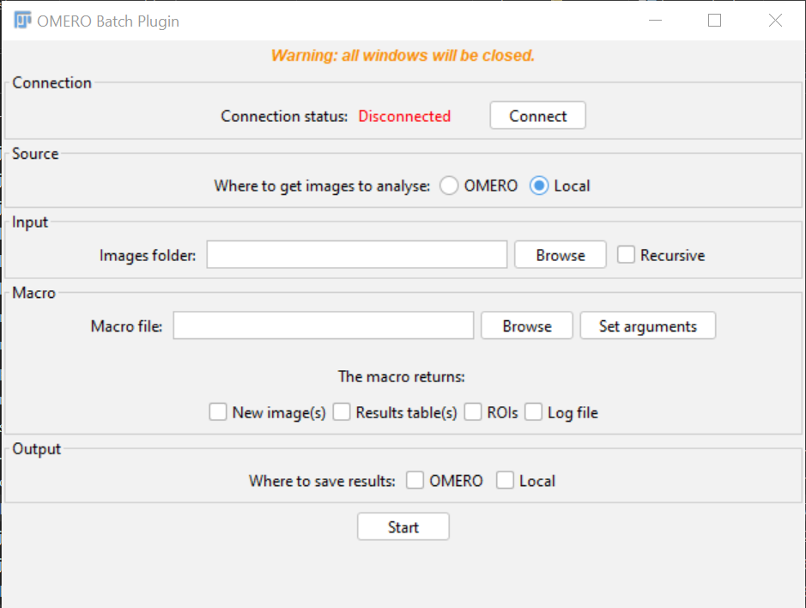
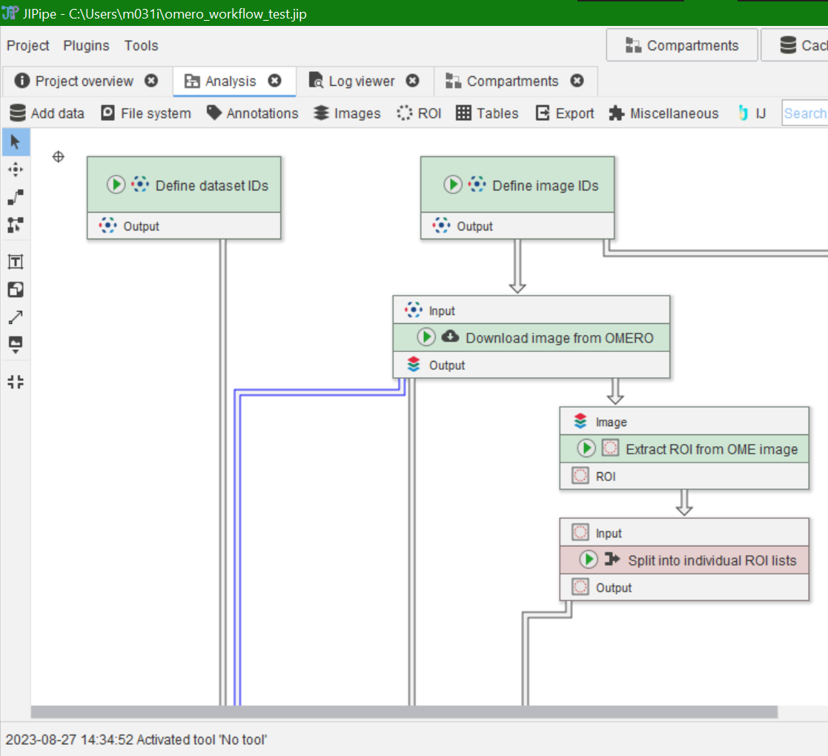
Fiji / ImageJ and OMERO
Three ways of working with Fiji and OMERO:
OMERO plugin for Fiji
Fiji Macros and OMERO.batch plugin
JIPipe
Quick download of Fiji with plugins installed:
https://tinyurl.com/fijiomero
https://github.com/GReD-Clermont/omero_batch-plugin
https://omero-guides.readthedocs.io/en/latest/fiji/docs/index.html
https://jipipe.hki-jena.de/

Slide 5
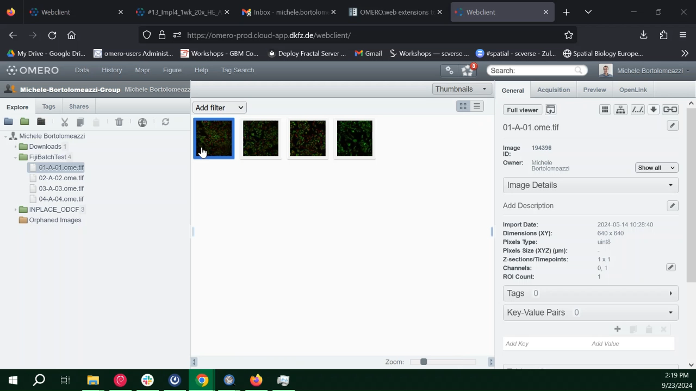
FiJi practical example

Slide 6
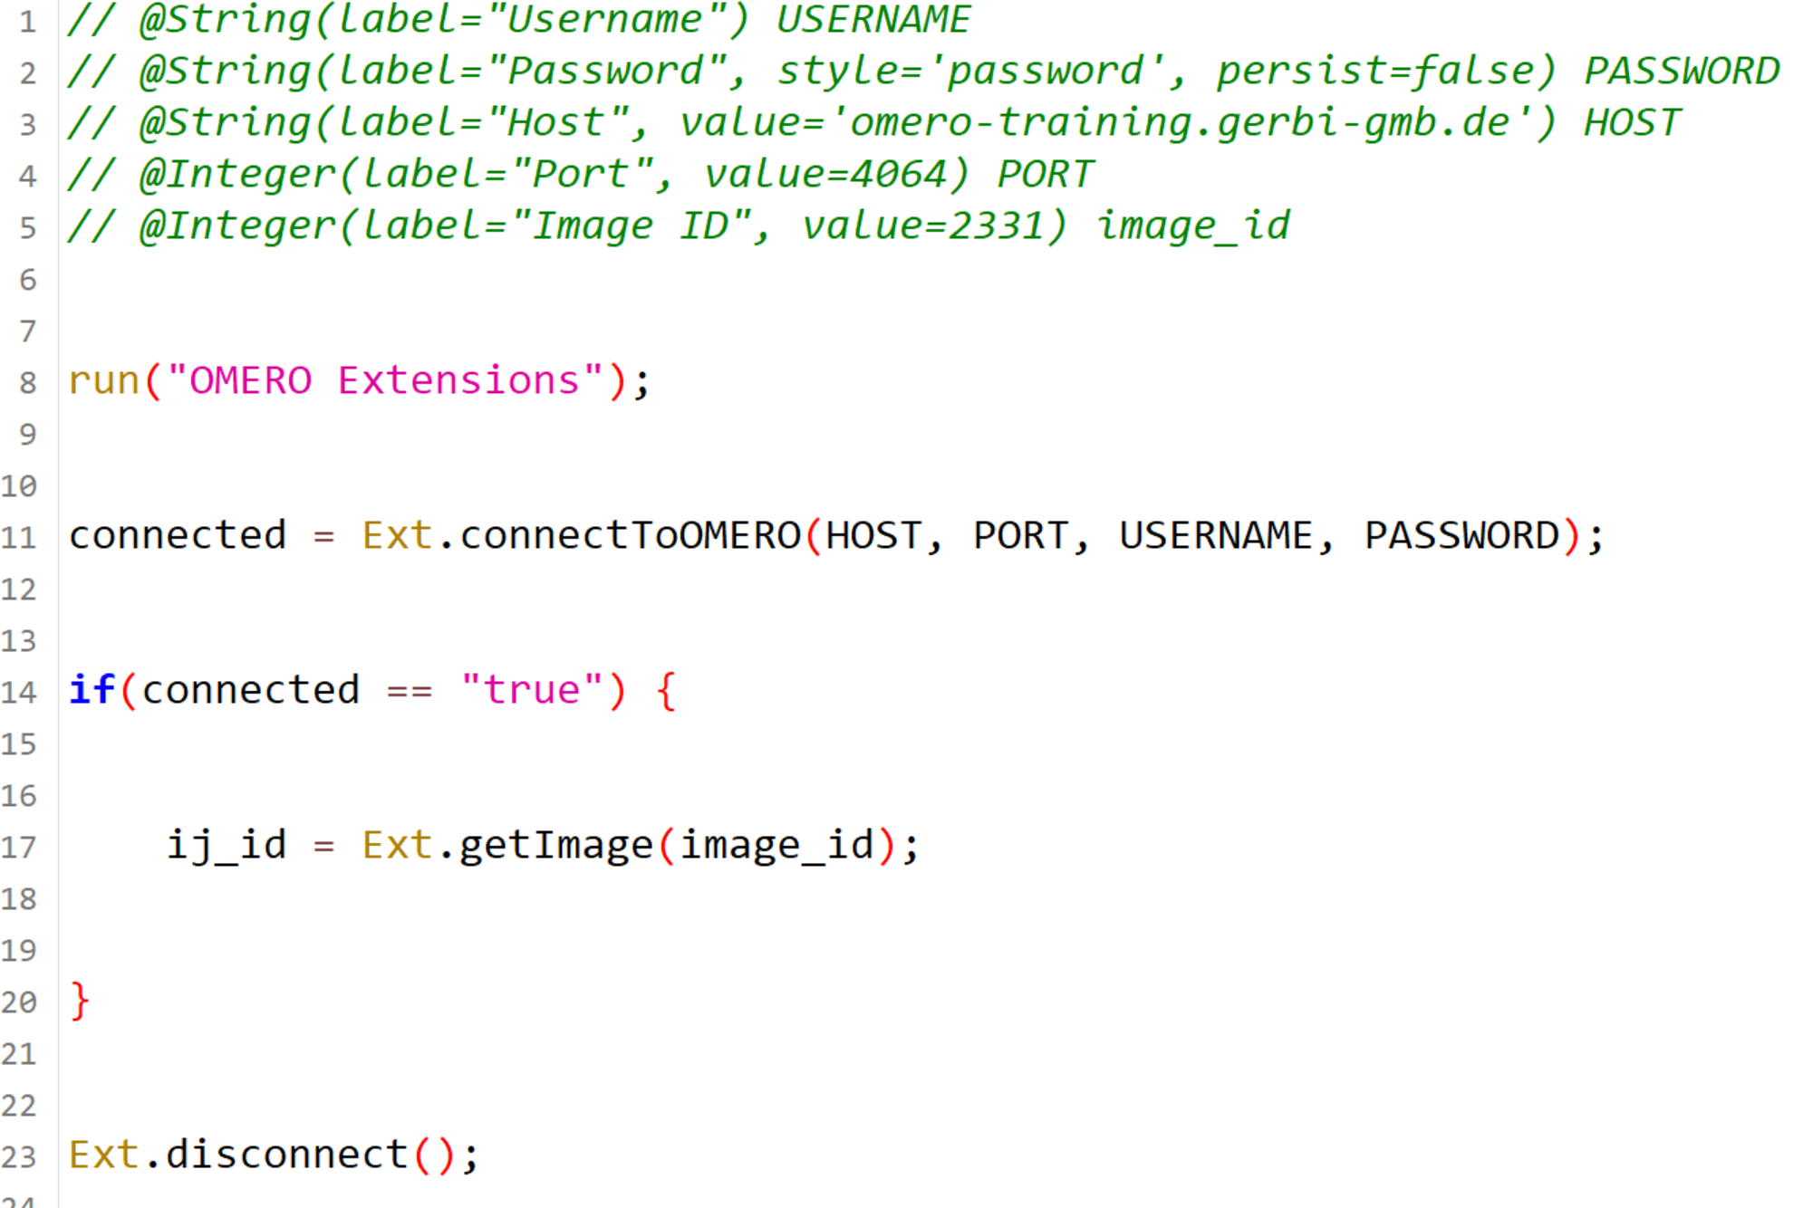
Automating with macros
Make the user input the credentials and address for OMERO
Activate the OMERO plugin
Connect to OMERO
Check if the connection worked
Get the image
Add your image processing
code here
Disconnect from OMERO

Slide 7
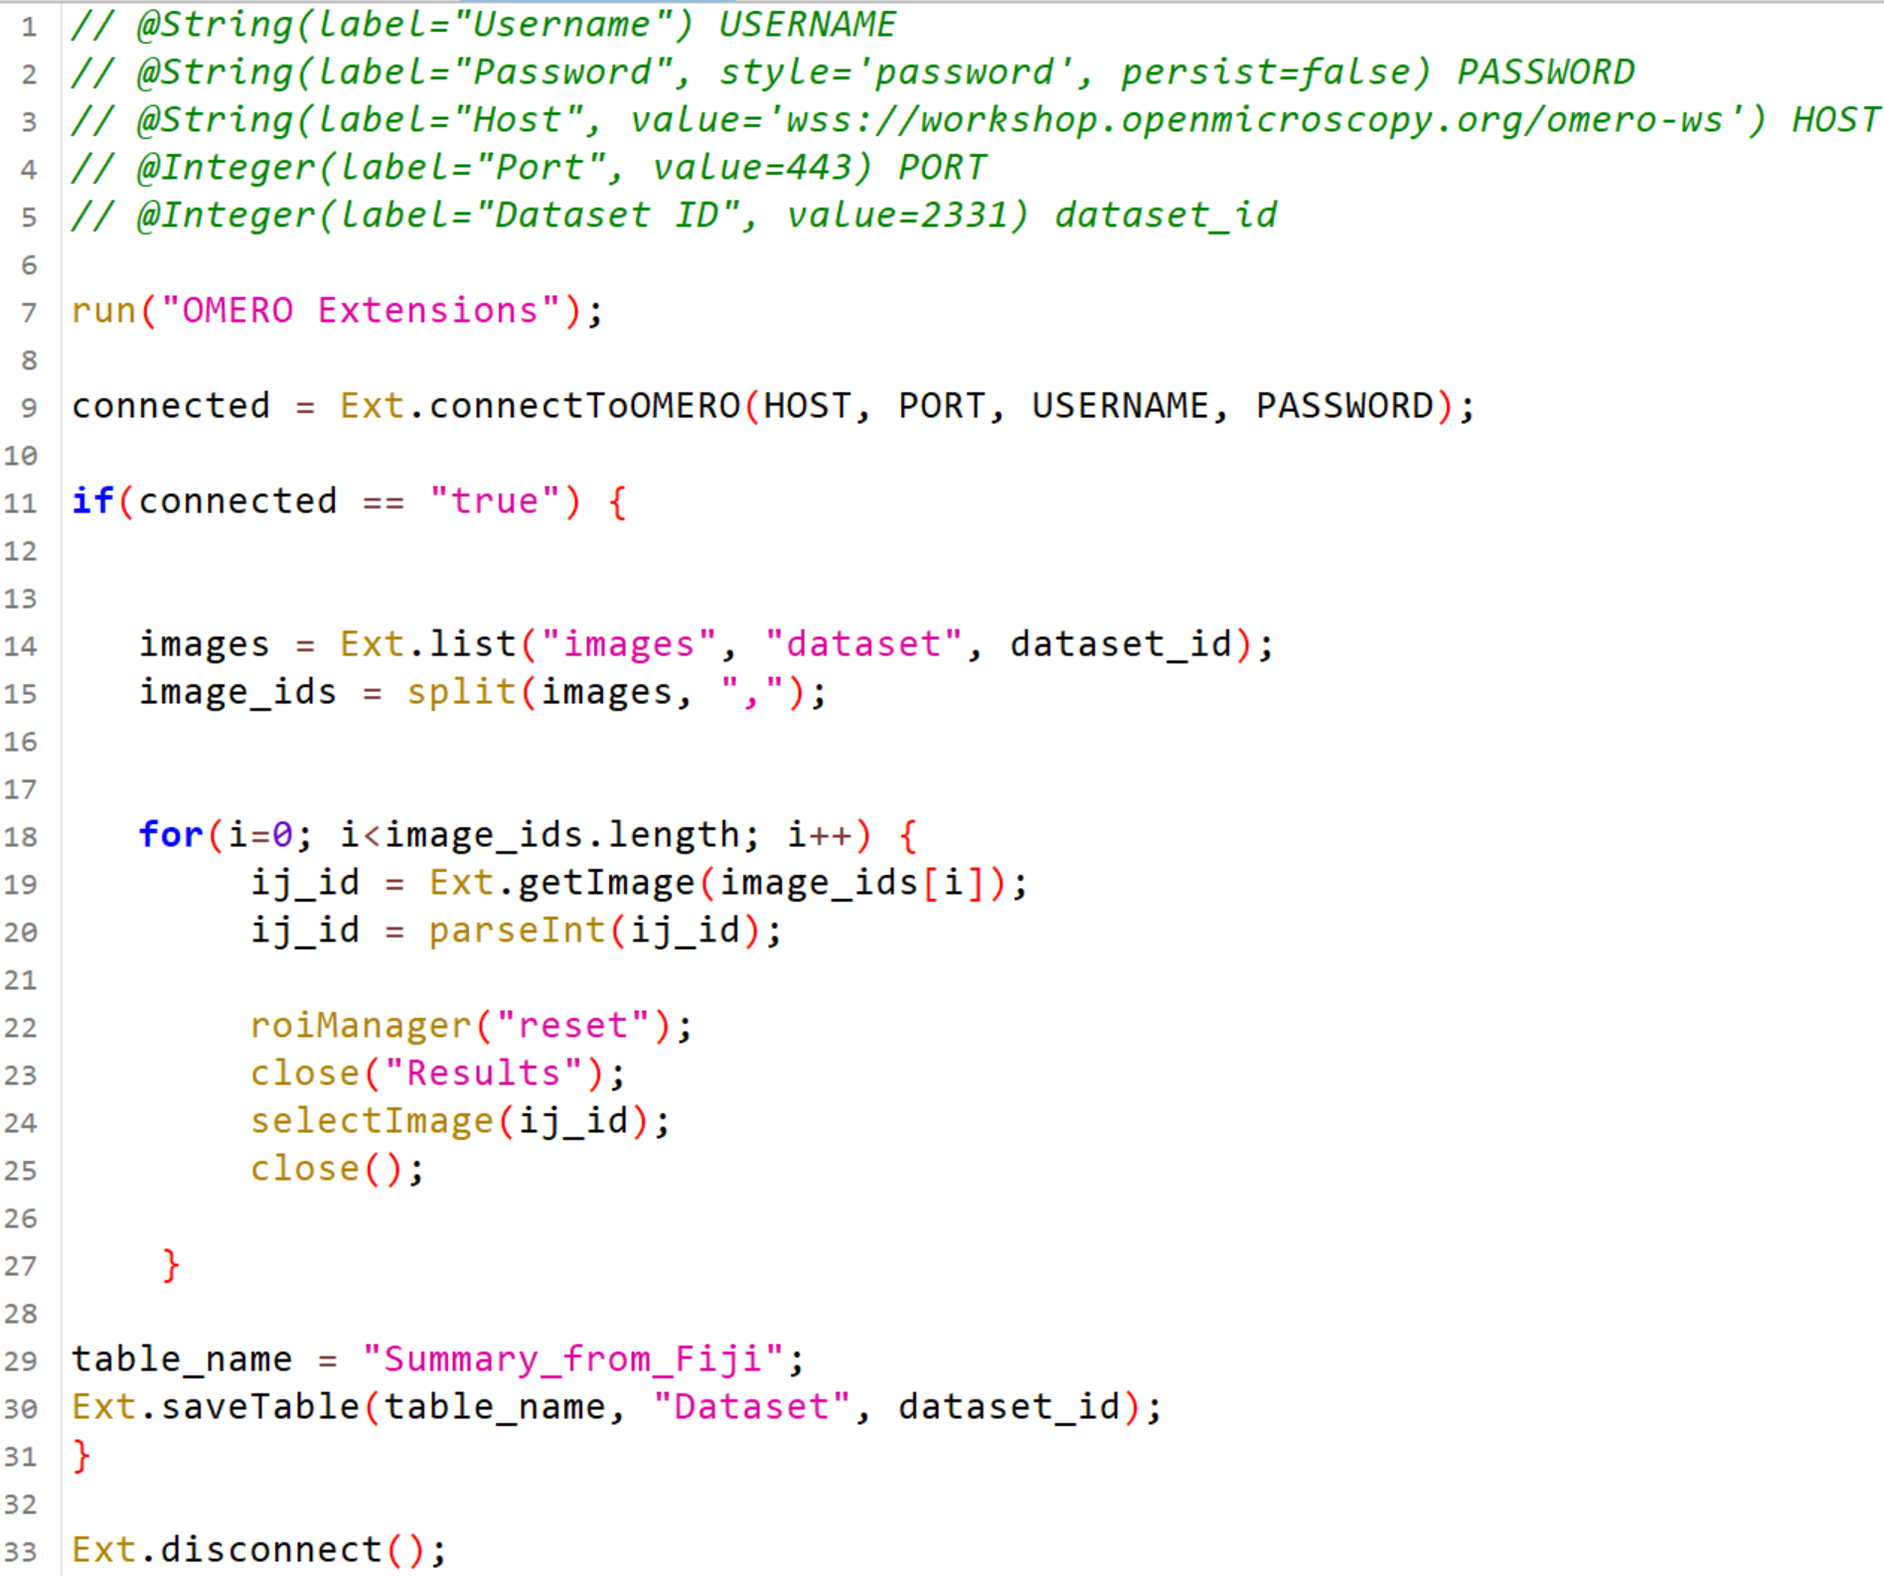
Processing a whole dataset
Make the user input the credentials and address for OMERO
Activate the OMERO plugin
Connect to OMERO
Check if the connection worked
Get Ids of all the images in the dataset
Get the image from OMERO
Add your image processing code here
Repeat for every
image in the dataset
Close image and remove all ROIs for the next cycle
Attach the results to the dataset
Disconnect from OMERO

Slide 8
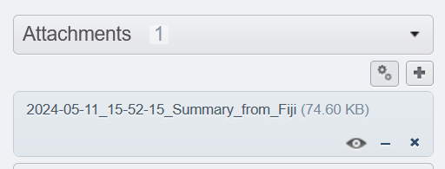
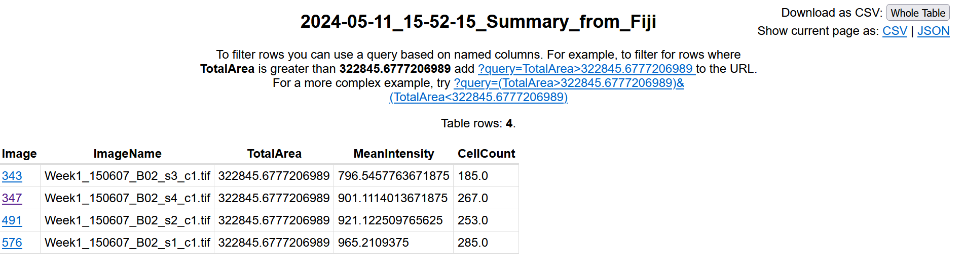
Exploring tables in OMERO
https://wiki-biop.epfl.ch/data-management/omero/omero-tables#tables-on-dataset-level

Slide 9
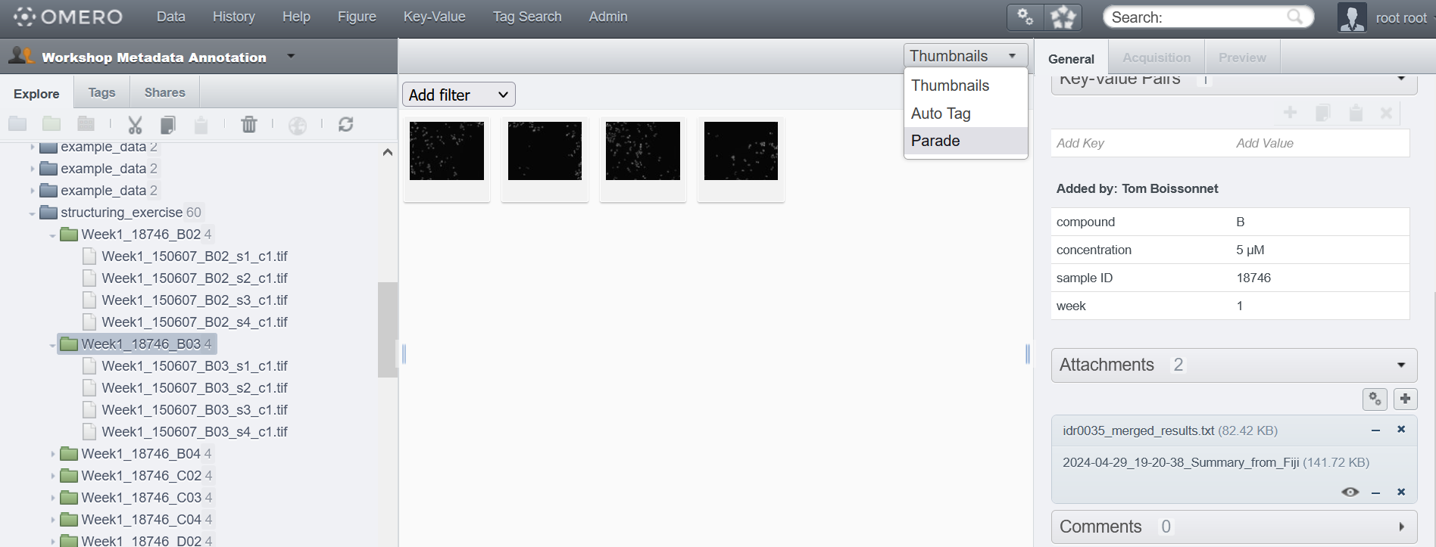
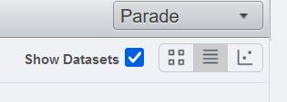
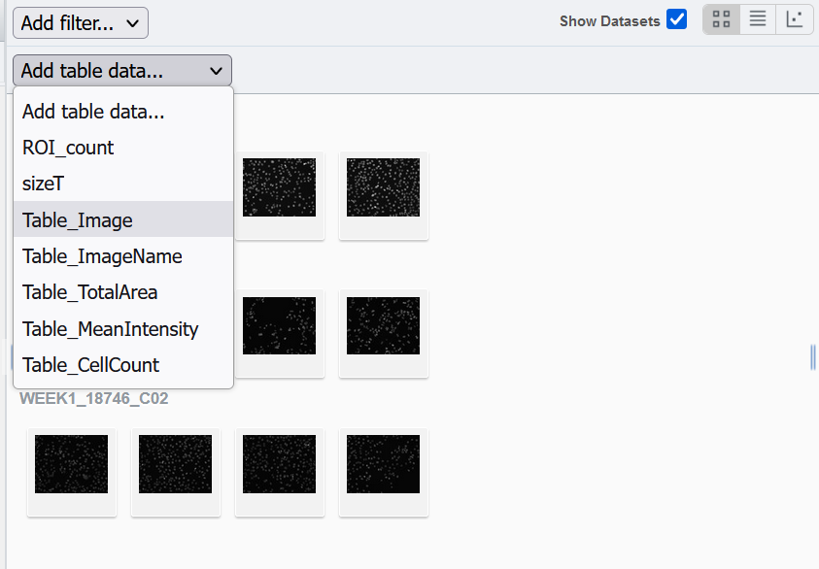
Exploring the results with OMERO

Slide 10
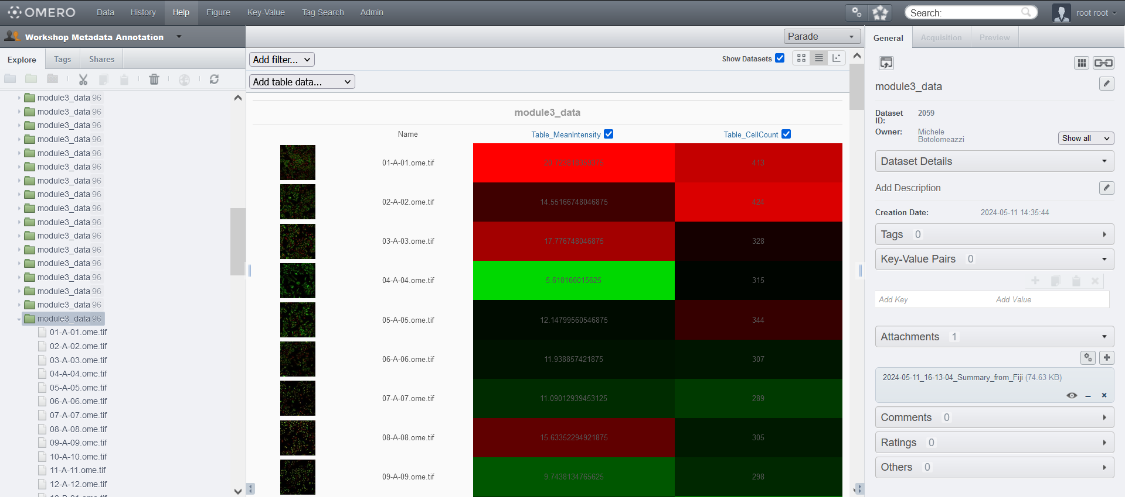
Exploring data with OMERO
https://wiki-biop.epfl.ch/data-management/omero/omero-tables#tables-on-dataset-level

Slide 11
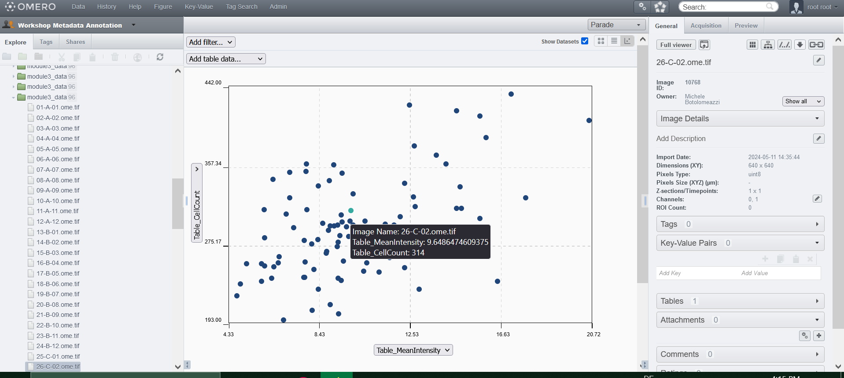
Scatterplots with OMERO.parade
https://wiki-biop.epfl.ch/data-management/omero/omero-tables#tables-on-dataset-level

Slide 12
Can‘t I just use the macros I already have?

Slide 13
OMERO Batch Plugin for FiJi
OMERO Batch Plugin for FiJi
Runs a macro on a dataset of images (local or in OMERO) and saves the results (locally or in OMERO). Very efficient way to build OMERO based workflows from pre-existing macros.
https://github.com/GReD-Clermont/omero_batch-plugin
Pouchin P, Zoghlami R, Valarcher R et al. Easing batch image processing from OMERO: a new toolbox for ImageJ [version 2; peer review: 2 approved]. F1000Research 2022, 11:392 (https://doi.org/10.12688/f1000research.110385.2)

Slide 14
Resources for Fiji and OMERO
Fiji
OMERO
Documentation on all macro Functions
https://wsr.imagej.net/developer/macro/functions.html
OMERO and Fiji macro tutorial
https://omero-guides.readthedocs.io/en/latest/fiji/docs
/threshold_scripting_macro_language.html
Fiji + Python Bioimage analysis tutorials
https://www.youtube.com/watch?v=e-2DbkUwKk4&l
ist=PL5ESQNfM5lc7SAMstEu082ivW4BDMvd0U
BIOP guide for all things OMERO:
https://wiki-biop.epfl.ch/en/data-management/omero
OMERO Traning material:
Image Data Management with OMERO at the DKFZ - Overview
https://zenodo.org/records/8323588
Official OMERO user guides
https://omero-guides.readthedocs.io/en/latest/

Slide 15

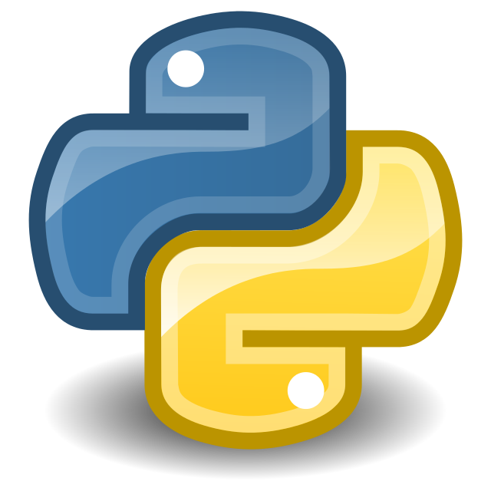






OMERO and Python with Jupyter Notebooks
OMERO python API:
  https://docs.openmicroscopy.org/omero/5.6.0/developers/Python.html
ezomero:
  https://thejacksonlaboratory.github.io/ezomero/index.html
omero-rois:
  https://omero-rois.readthedocs.io/en/latest/
omero2pandas:
  https://pypi.org/project/omero2pandas/
Bioimage analyst

Slide 16
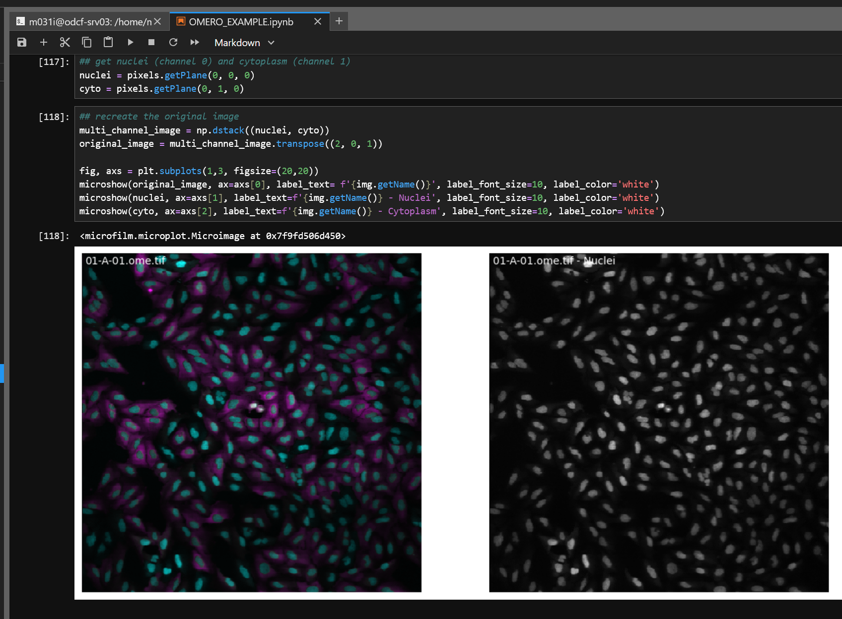
Example workflow
Connect to OMERO
Select images to process
Analyze the images
Send the results back to OMERO
  Tables
  ROIs
  Images
  Annotations

Slide 17
Resources for Python and OMERO
Browsing the Image Data Resource IDR with python:
  https://biapol.github.io/blog/robert_haase/browsing_idr/readme.html
Example jupyter notebooks with OMERO analysis workflows:
  https://zenodo.org/records/8139354
Example jupyter notebook from the OMERO@DKFZ workshop 2024:
  https://github.com/rmassei/2024-jn-omero-pipeline
Collection of bioimage analysis notebooks:
  https://haesleinhuepf.github.io/BioImageAnalysisNotebooks/intro.html
Bioimage analysis notebooks from an image analysis workshop:
  https://github.com/guiwitz/MICPy_Workshop_2022

