Slide 1




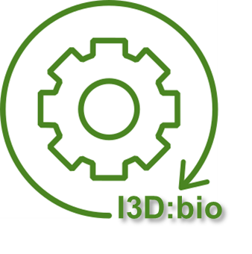

Day-to-day image data management with OMERO
Tom Boissonnet
2025-04-03
With the exception of logos and cited third-party content, the content of these slides is shared under the terms of the Creative Commons Attribution License (CC-BY 4.0) unless the content is marked otherwise.
Funded by the Deutsche Forschungsgemeinschaft (DFG, German Research Foundation) - 462231789

Slide 2
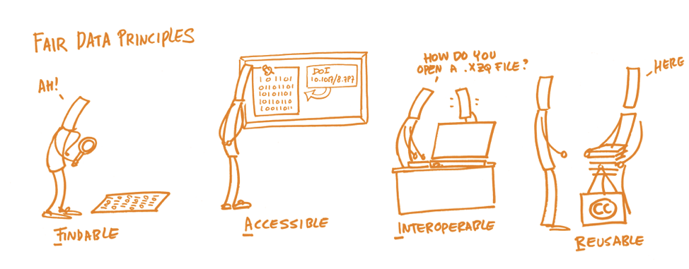
Improving published data: FAIR principles
FAIR is mostly about published data
→ Not the focus for today
https://www.openaire.eu/how-to-make-your-data-fair

Slide 3
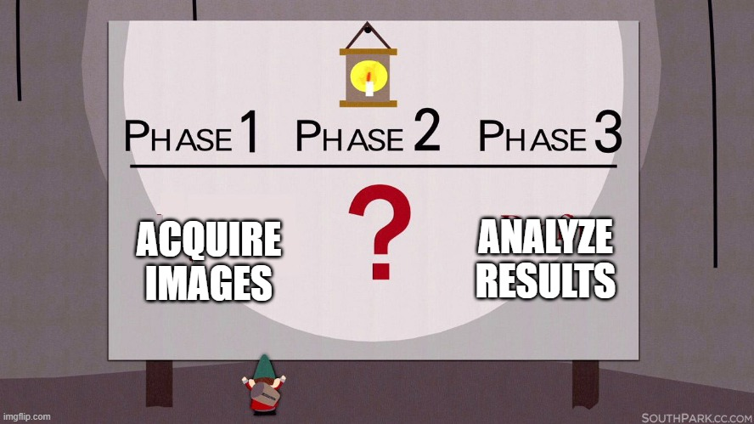
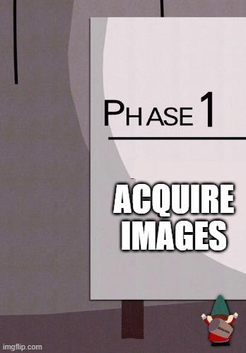
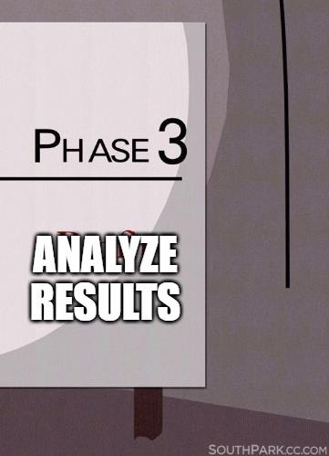
Before publication: from acquisition to analysis

Slide 4




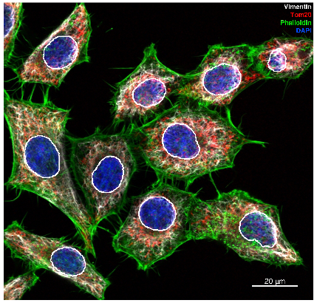
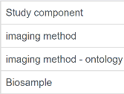
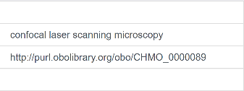
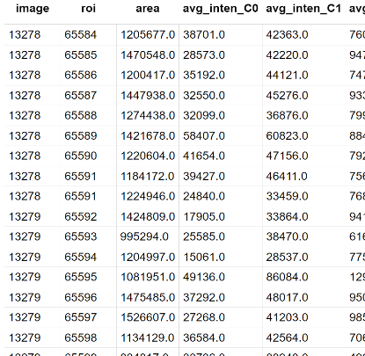
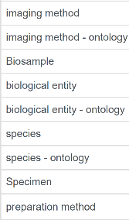
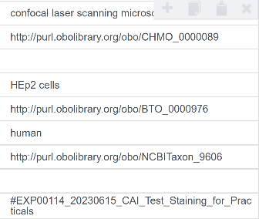








Scientific images are more than pixels
replicates
content detection
experimental details
analysis
dataset
2023-05-10_third_replicate
regions of interest
key-value pairs (REMBI style)
OMERO.table
nucleus_1
nucleus_4
2023-06-15_knockout_assay
nucleus_2
nucleus_3
nucleus_5
nucleus_7
nucleus_6
2023-08-28_EM_lipids_droplets_control
nucleus_9
nucleus_10
nucleus_8
Sarkans et al. REMBI: Recommended Metadata for Biological Images—enabling reuse of microscopy data in biology.
Nat Methods 18, 1418–1422 (2021).
https://doi.org/10.1038/s41592-021-01166-8

Slide 5
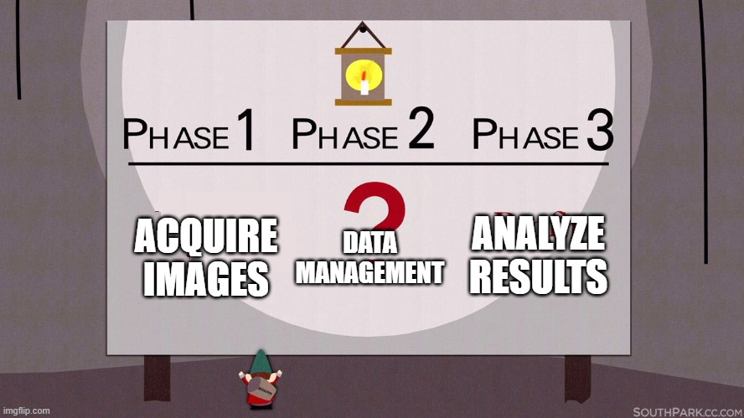
Before publication: from acquisition to analysis

Slide 6



Data management for everyone
in the lab
Group leaders
  Overview of projects
  Monitor progress
  Long term archiving
Experimenters
  Knows all the details of a project, which experiment worked, which had an issue
  Can organize and annotate the data
Bioimage analyst
  Needs metadata for processing
  Share results back
  Traceability of analysis
Image data management → Everyone needs an easy way to see the images

Slide 7
Scientific imaging
Microscopes are primarily measuring devices
Images come with metadata (acquisition parameters)
Images dimensions:
    C: channels (each channel is a "grayscale" image of a given portion of the light spectrum)
    Z: image slices / depth / stack
    T: timeseries

Slide 8
Z and T image dimensions
Z-stack
Timeserie
Distinction between image and file:
  1 file → 1 image (from few MB to a TB)
  1 file → N images
  N files → 1 image (e.g. one file per C/Z/T)
    High-content screening: 10k file per experiment
File management
→ Everyone needs an easy way to see the images
Image data management

Slide 9
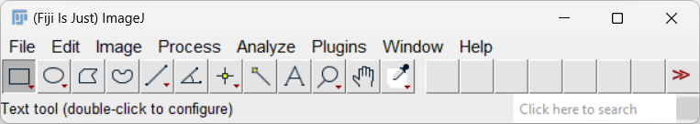
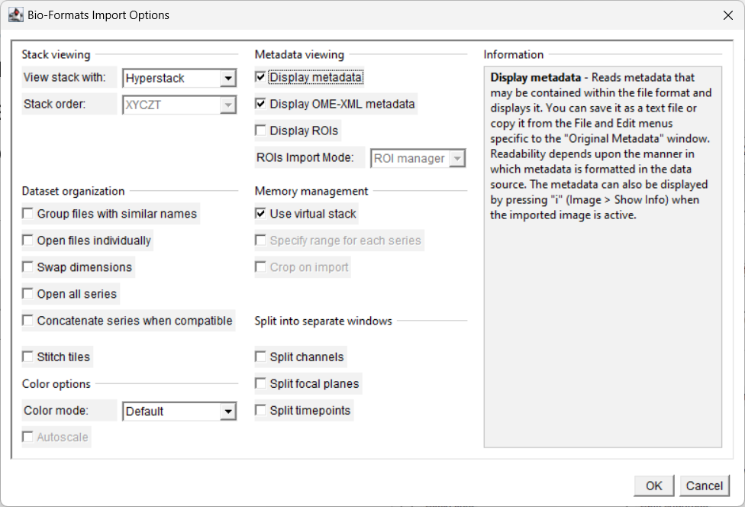




Microscopy file formats
How to read the file to open the image?
  File metadata (headers, file type, encoding, size)
  → Fiji
ZEN
image.czi
Leica LAS X
images.lif
image.nd2
NIS Elements

Slide 10
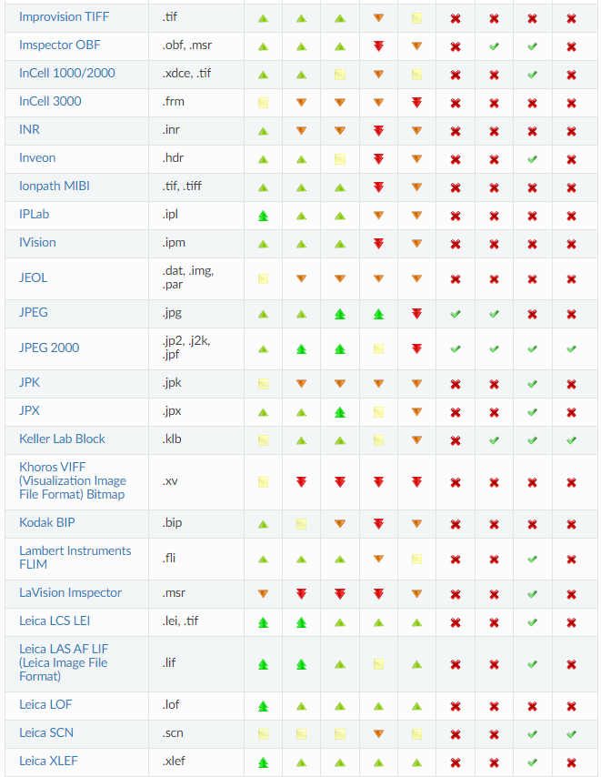
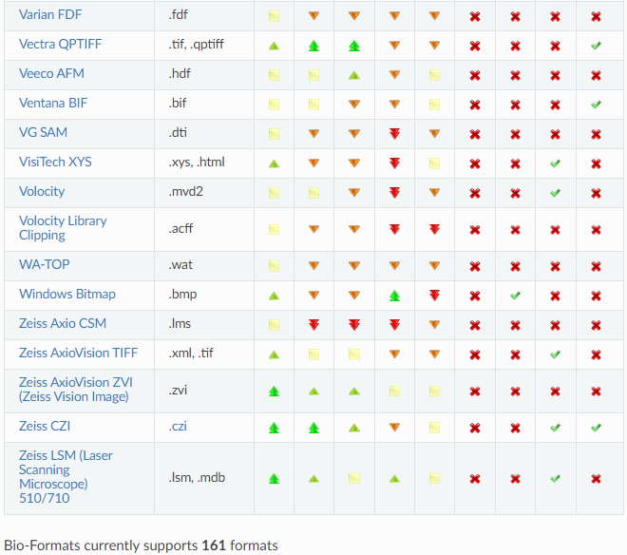
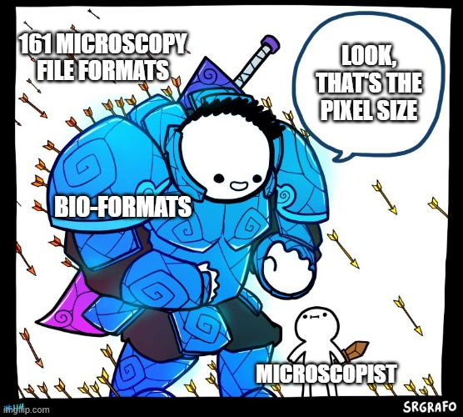
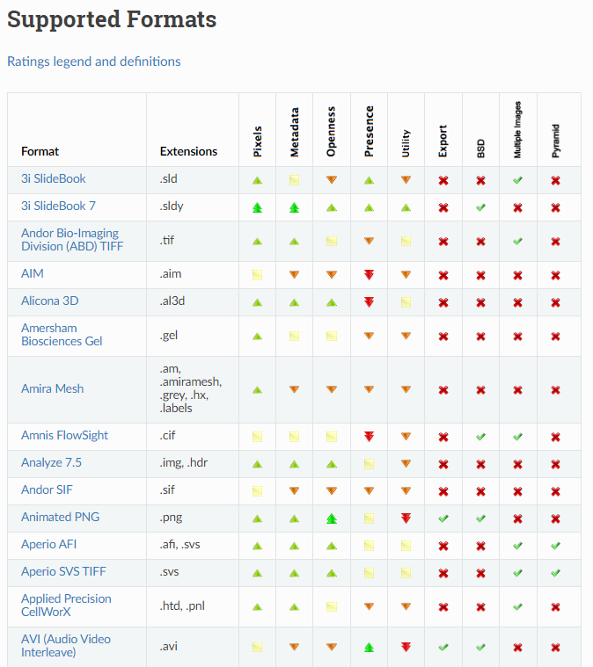
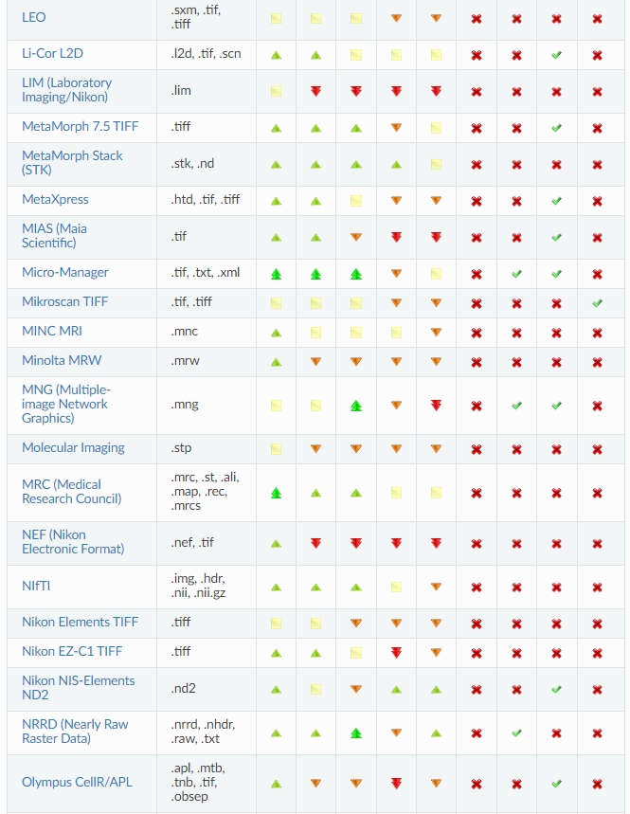
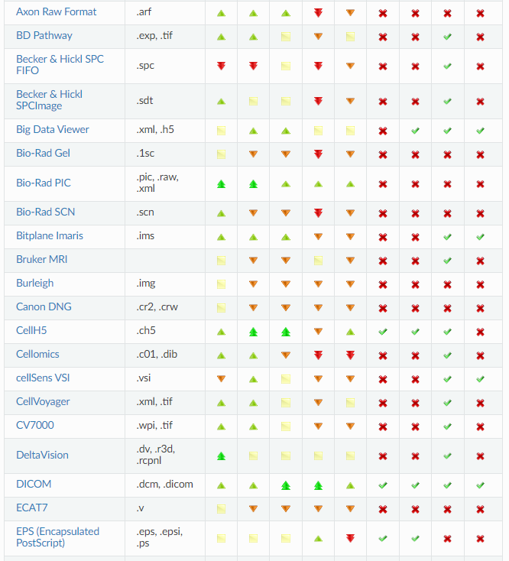
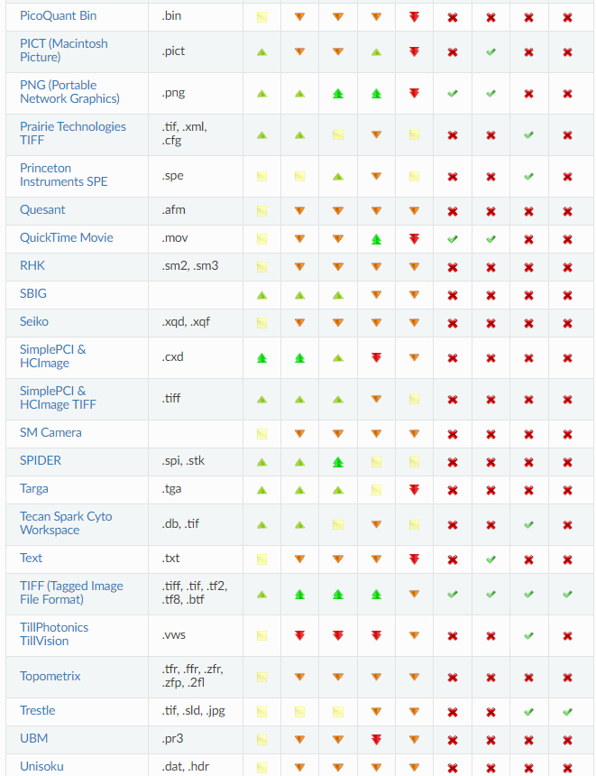
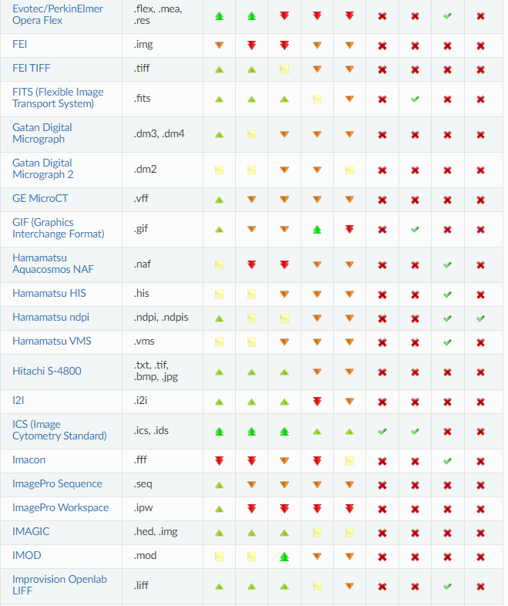
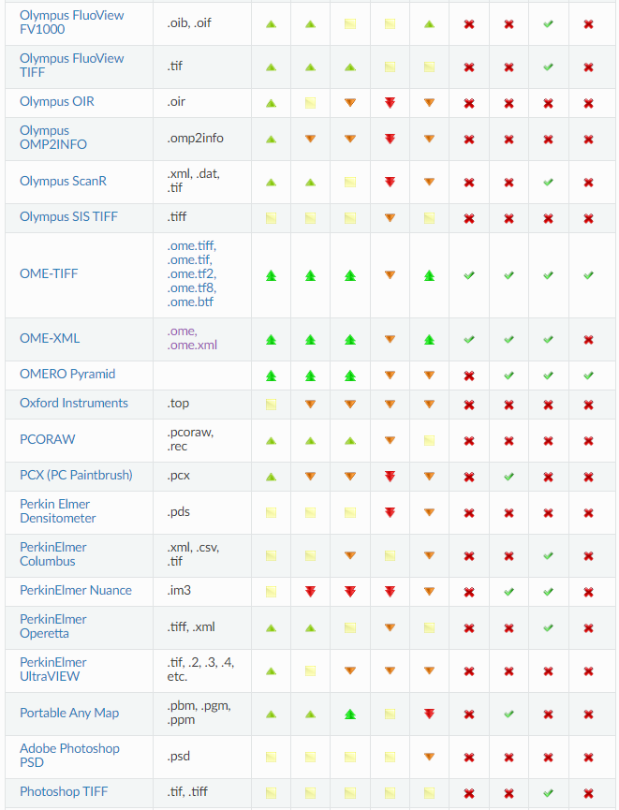
Bio-Formats' supported formats

Slide 11


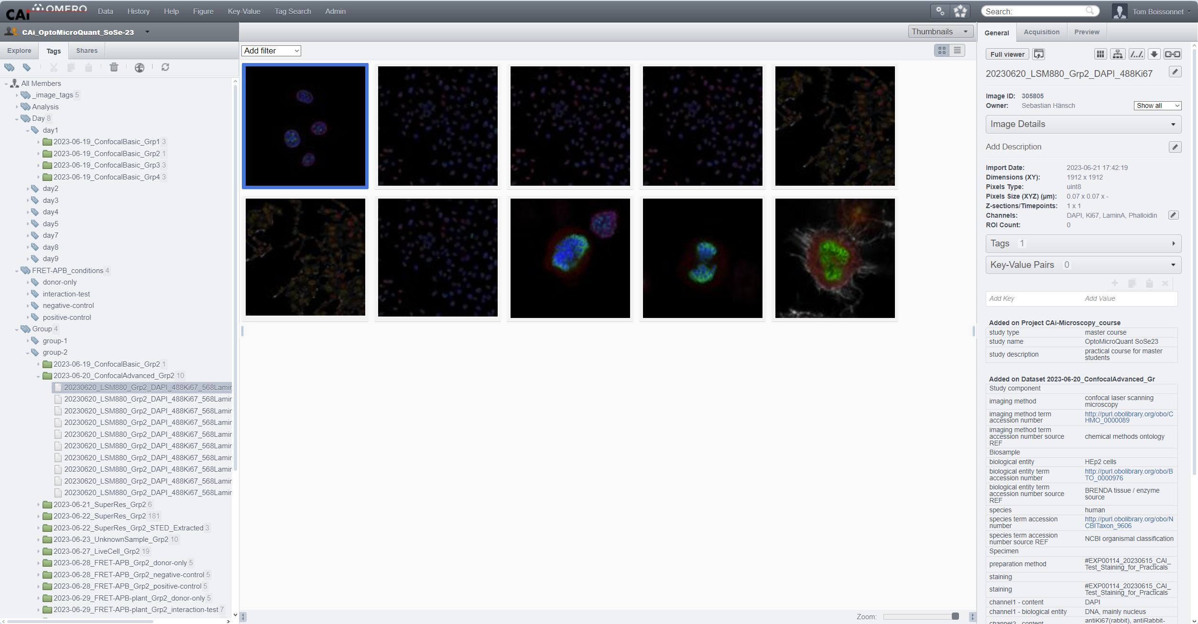




OMERO
User interface
Image management
File management

Slide 12
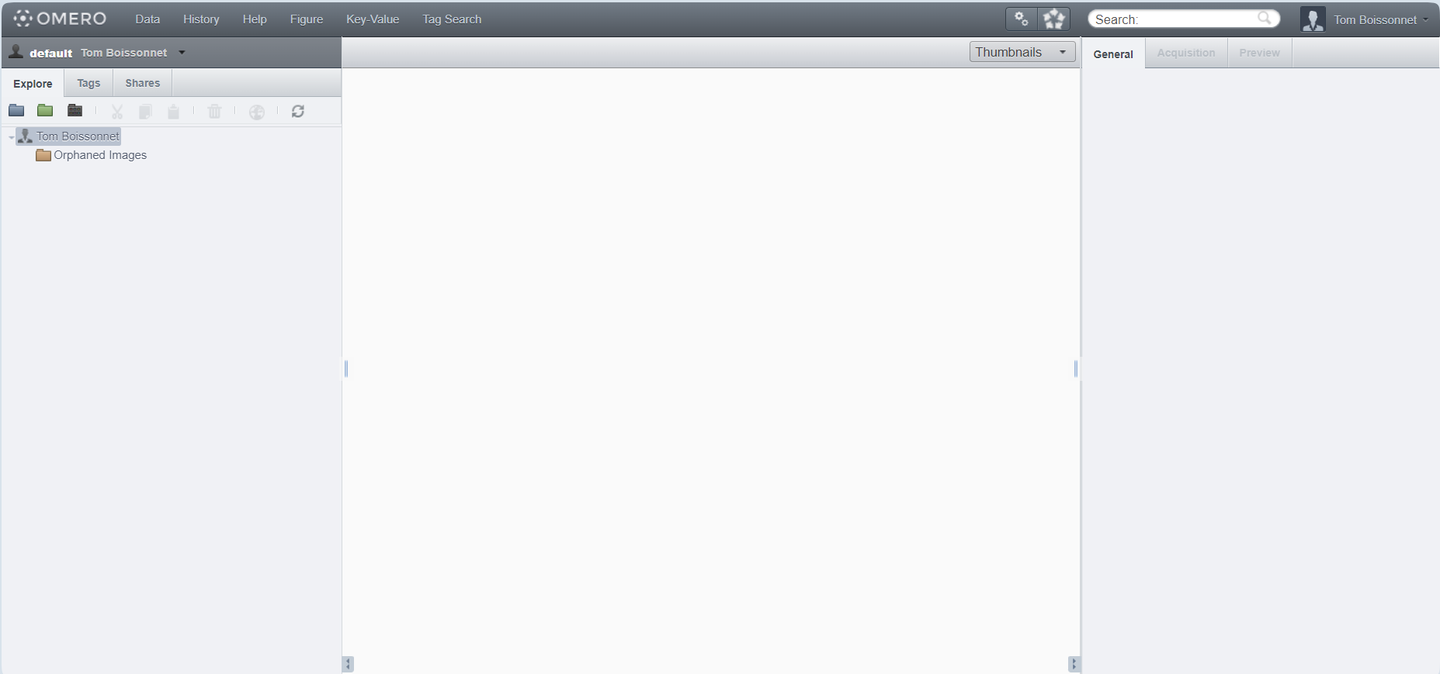
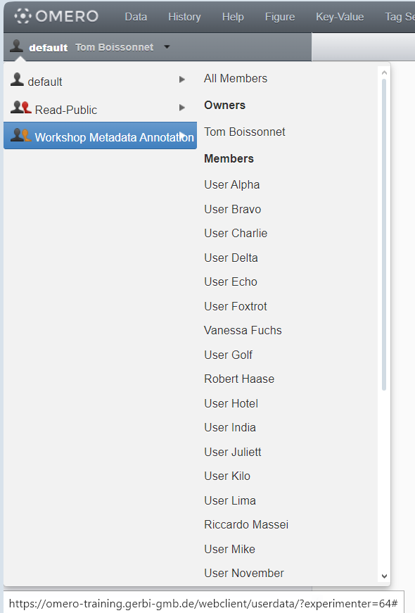
Data overview & exploration
Group leader

Slide 13
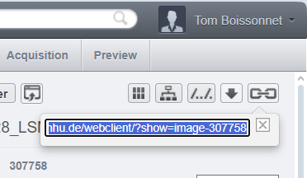

Data overview & exploration — links

Slide 14
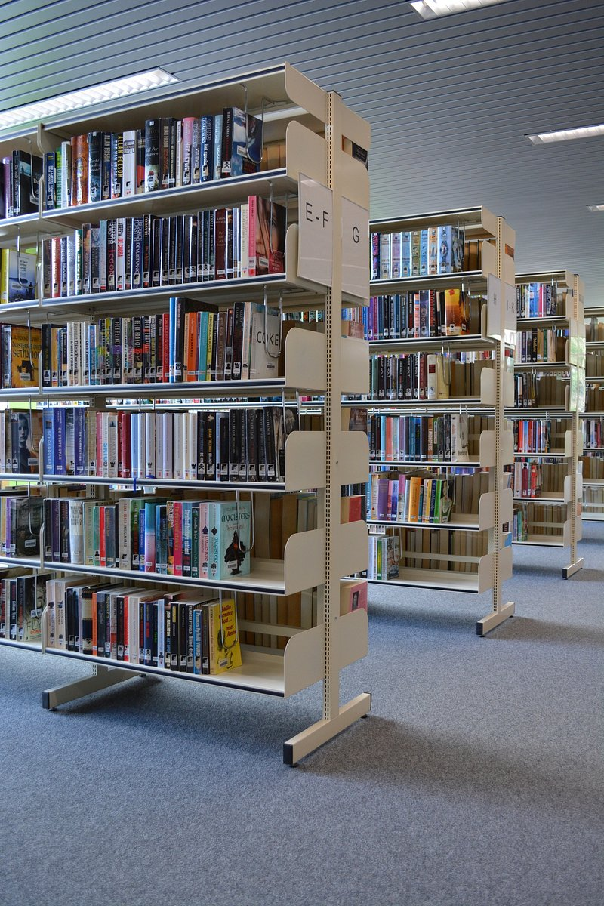
Organizing data
Experimenter
Collection of books on biology
Sorting the books by author, alphabetically

Slide 15
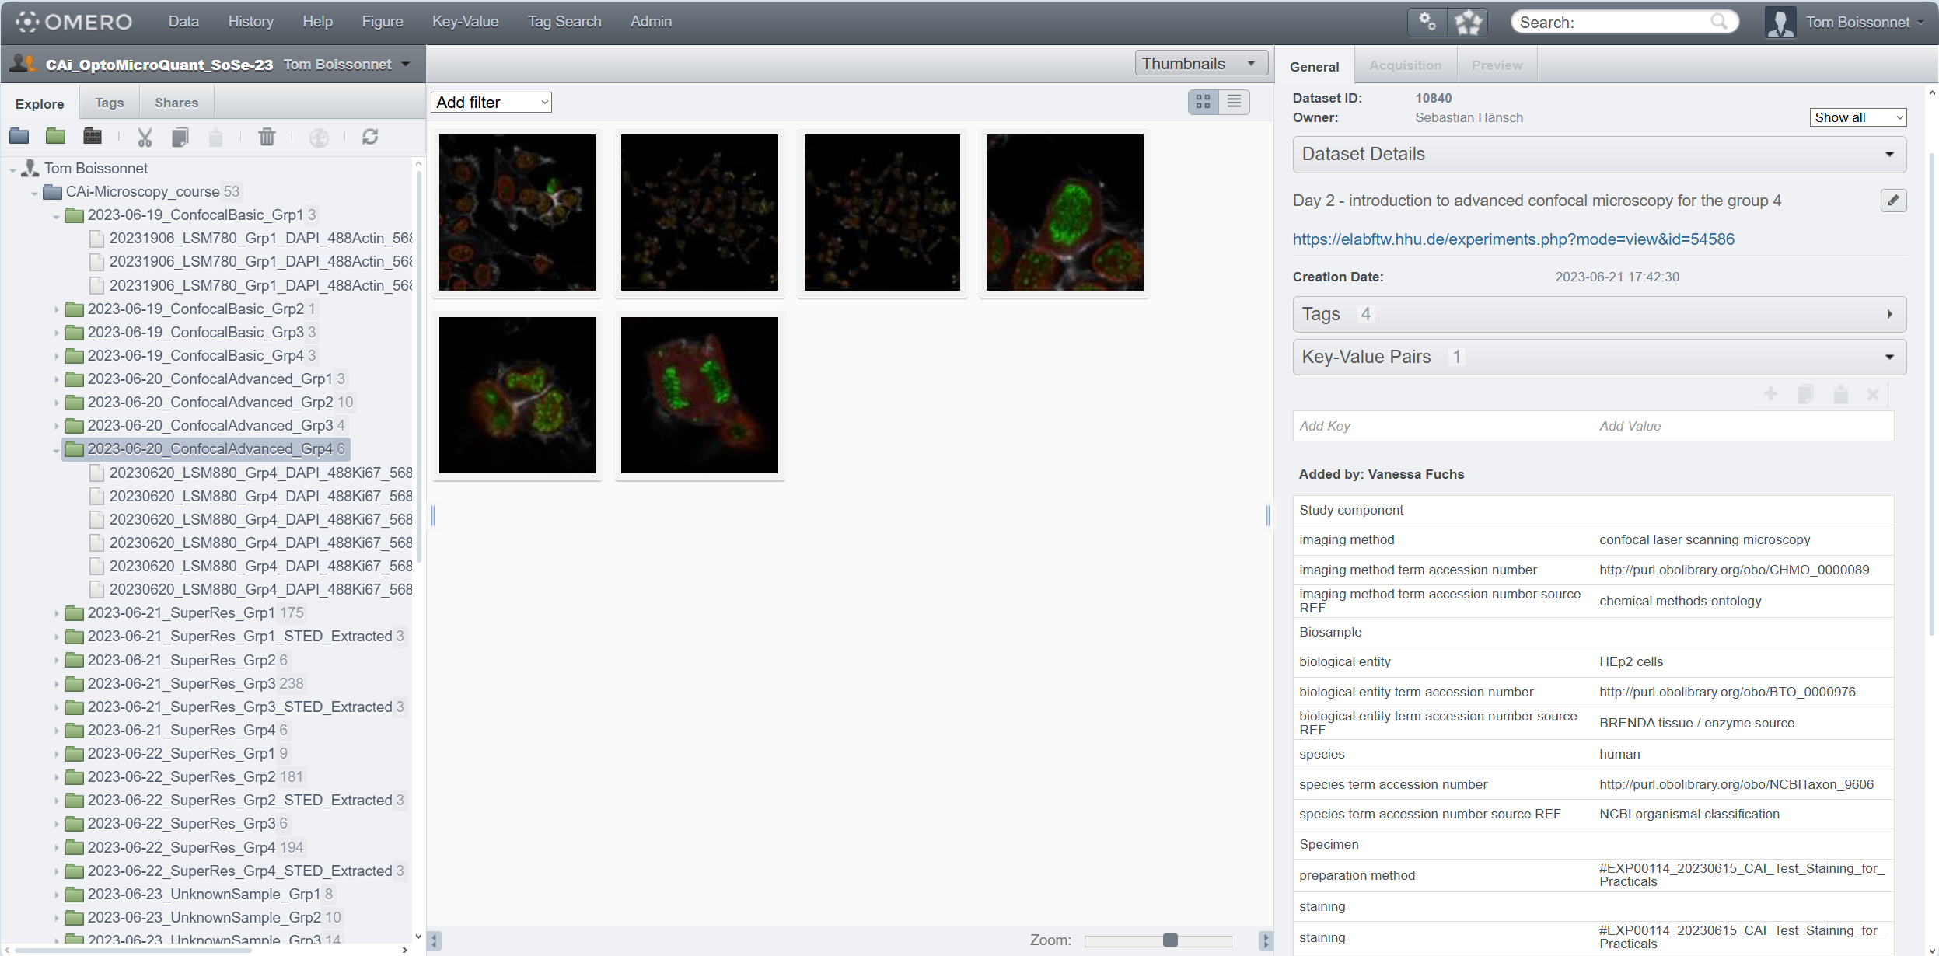
Organizing data — one dataset per sample
link to elabFTW in description
selecting the dataset

Slide 16
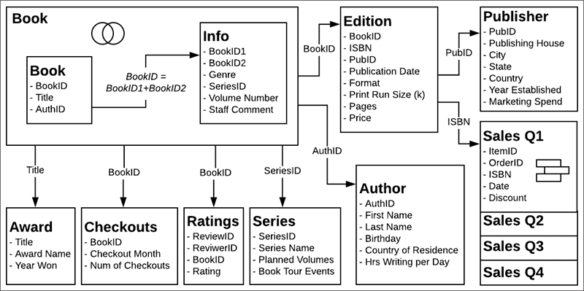
Organizing data
Experimenter
Collection of books on biology
Sorting the books by author, alphabetically
More ways to sort the books?
  organisms: mammals, fish, birds, bacteria
  sub-topics: cell biology, ecology, evolution
  book types: review, textbook, biography, essay

Slide 17
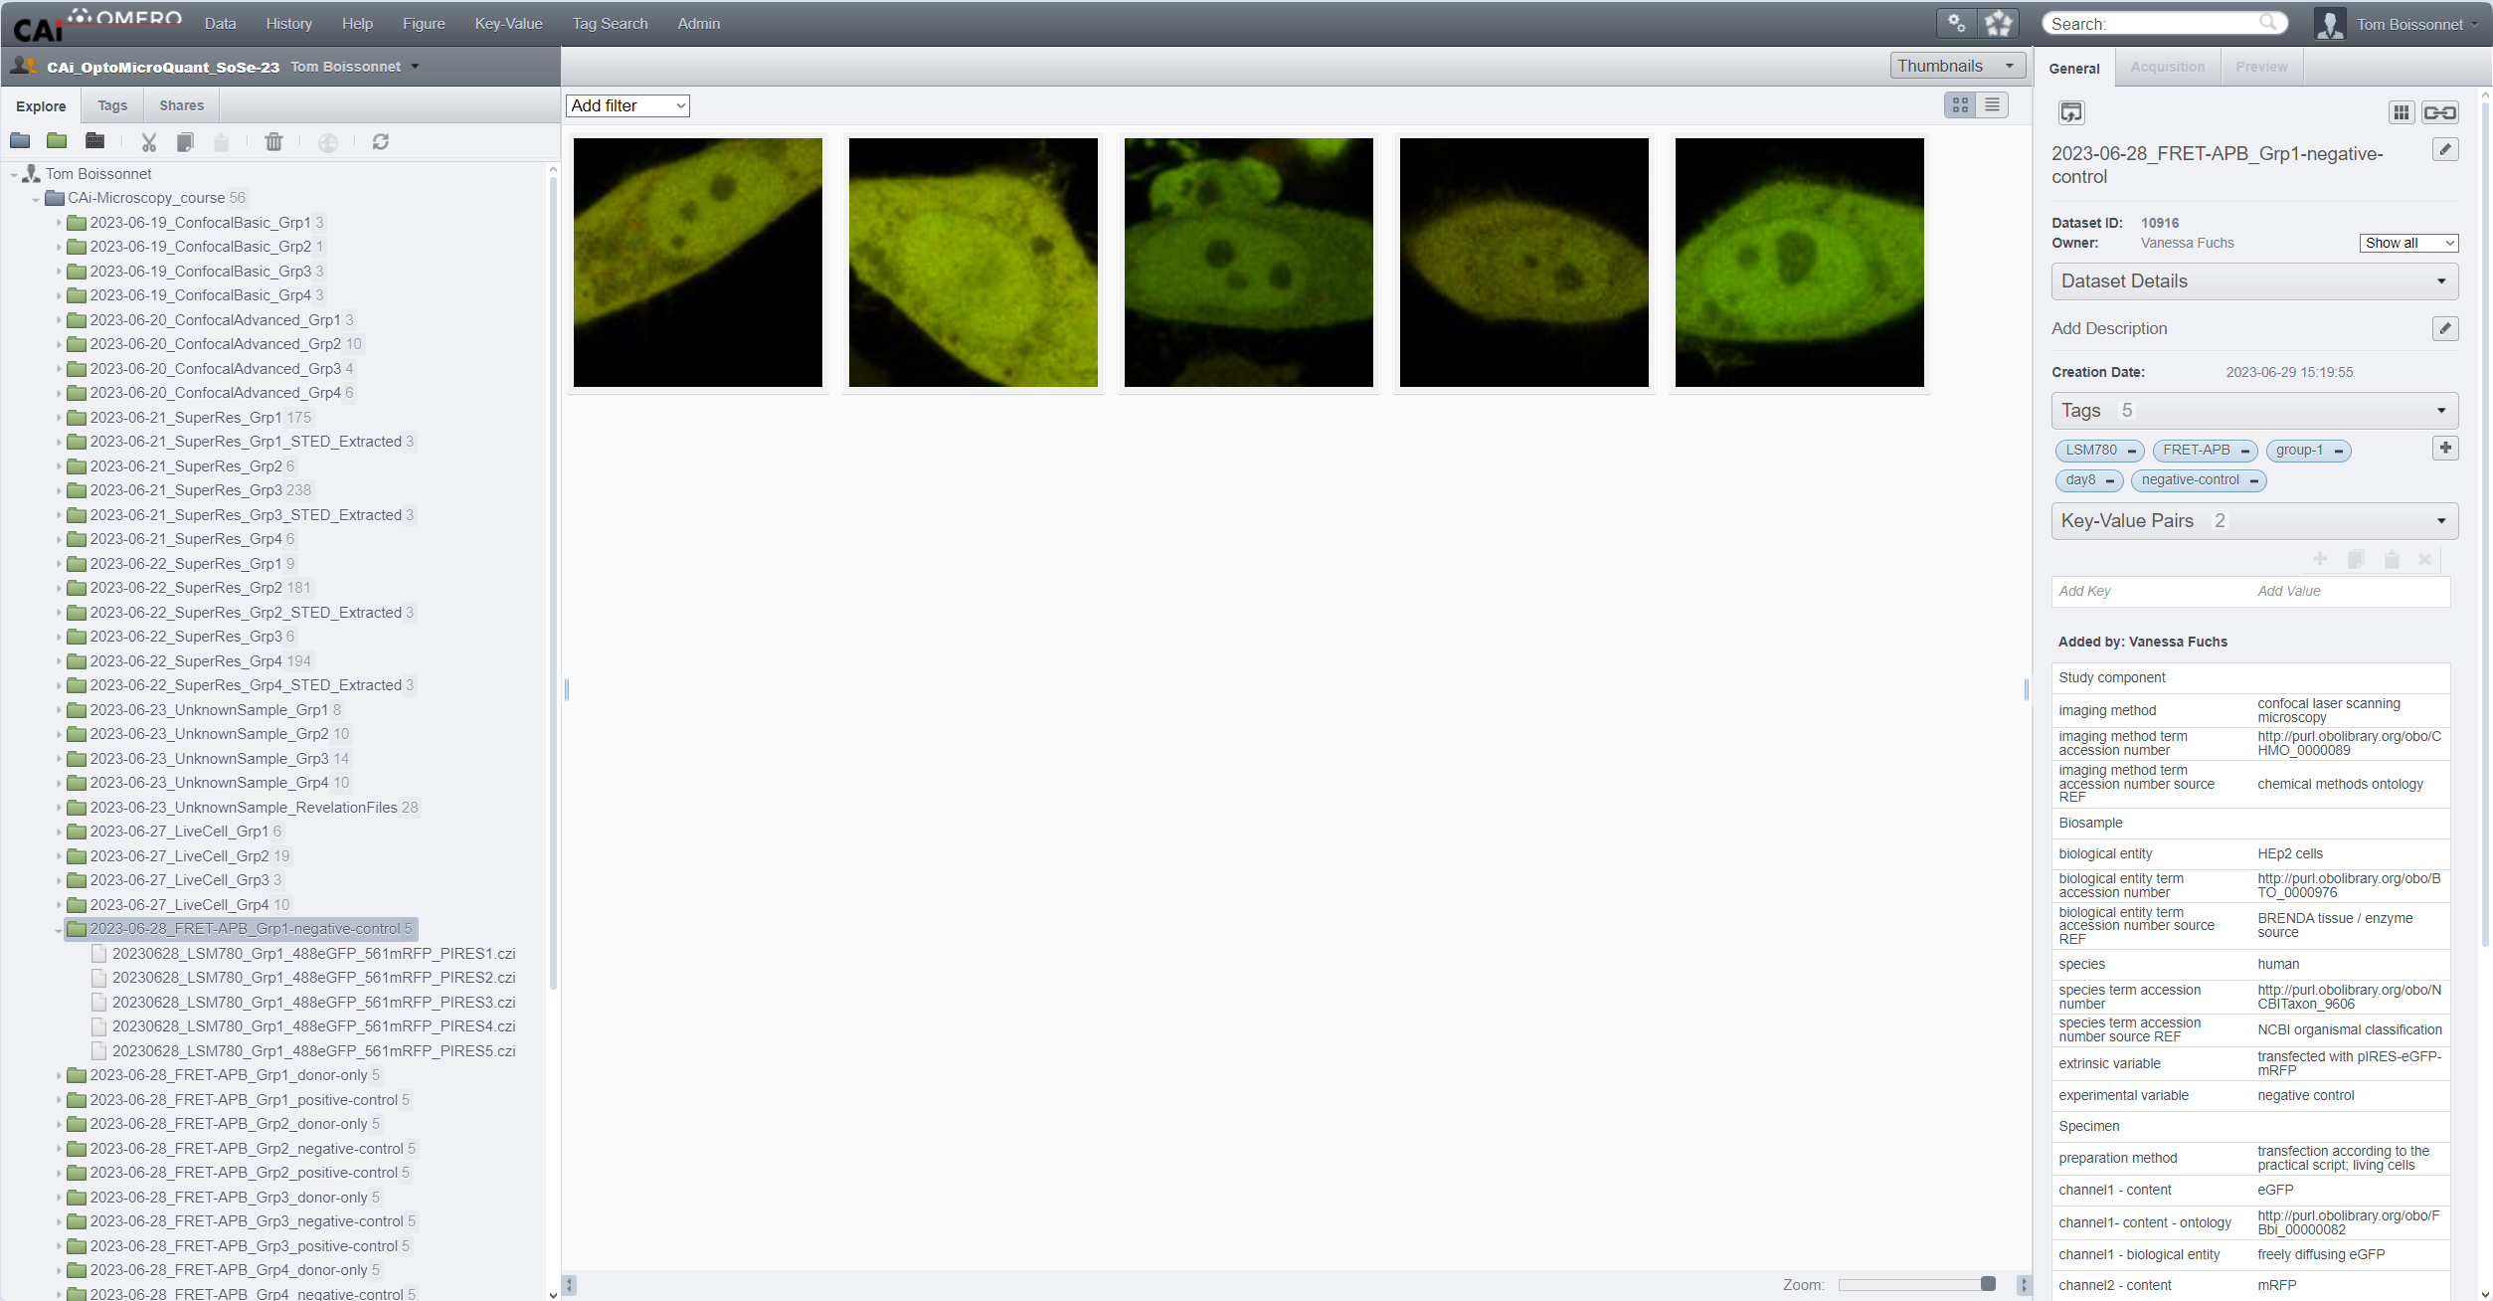
Organizing data — tags

Slide 18
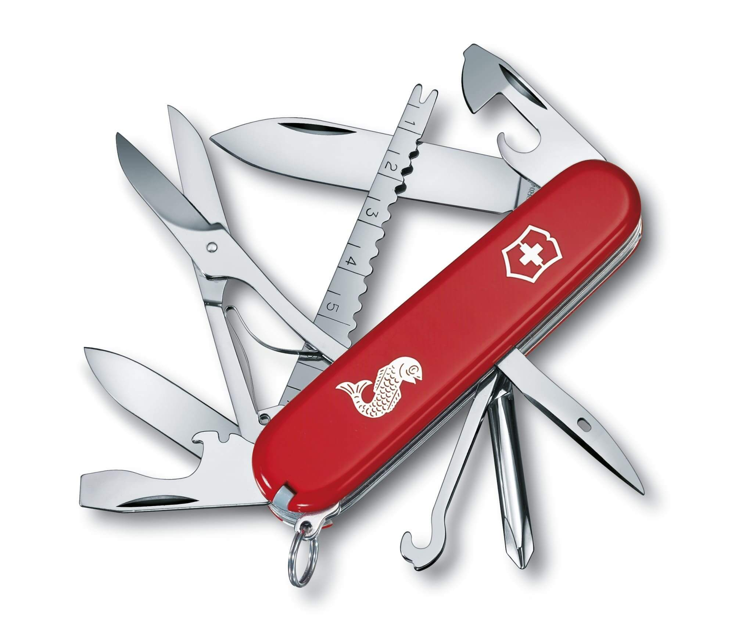
Tags are the Swiss knife or data organization
Create a folder-like structure:
  Make one tag per folder you would like to have (bonus, you can categorize tags with tagsets in OMERO)
  No need to think of a hierarchy, you can browse them in any order
TAGS

Slide 19
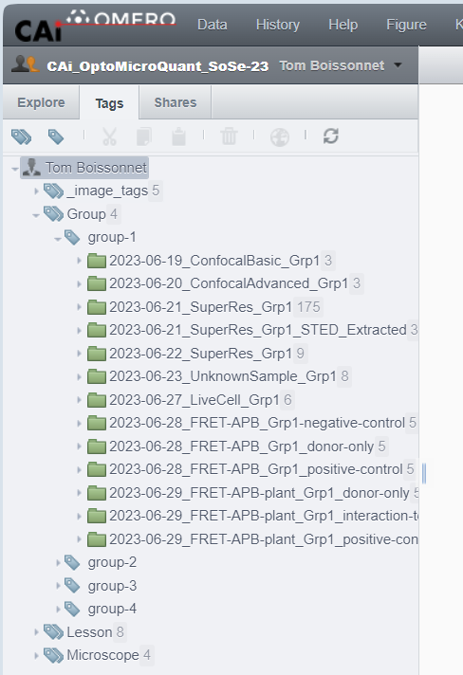
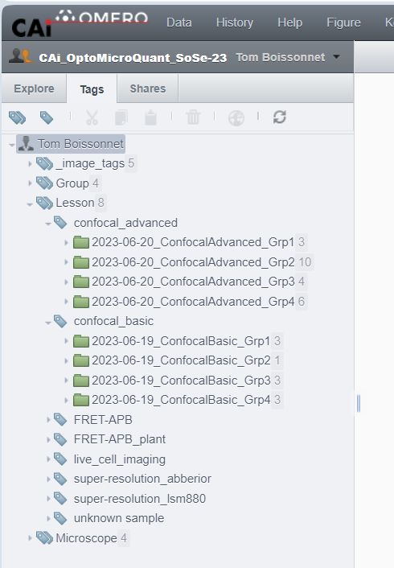
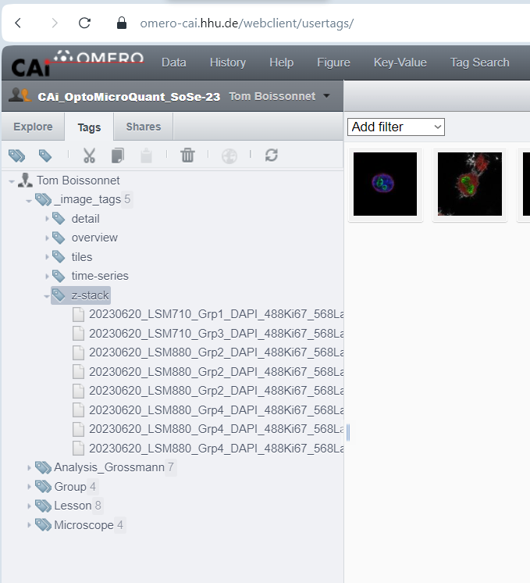
Browsing data from tags
tagset
(tag collection)
tags

Slide 20
Tags are the Swiss knife or data organization
Create a folder-like structure:
  Make one tag per folder you would like to have (bonus, you can categorize tags with tagsets in OMERO)
  No need to think of a hierarchy, you can browse them in any order
Make ground truth dataset for AI training:
  Training, Testing, Validation tags assigned randomly to images
  Images stays in their dataset of origin (keeps metadata)
  Needs larger dataset, new tags: batch_1 and batch_2
Select subset of example images to show:
  Assign a custom tag to images
  Share a link to the tag
  Delete tag if no longer needed → No impact on data organization
TAGS

Slide 21
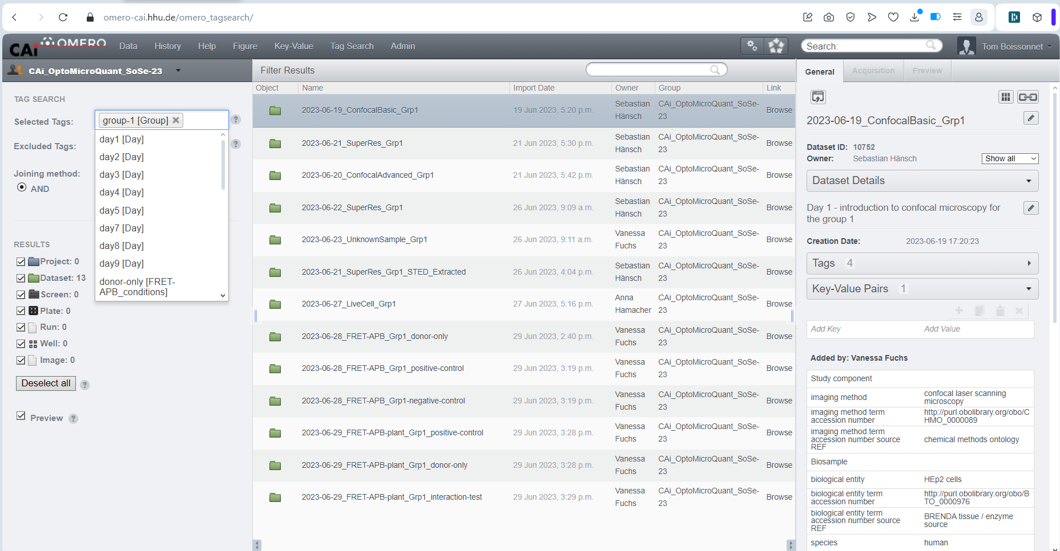
Browsing data from tags — tagsearch

Slide 22
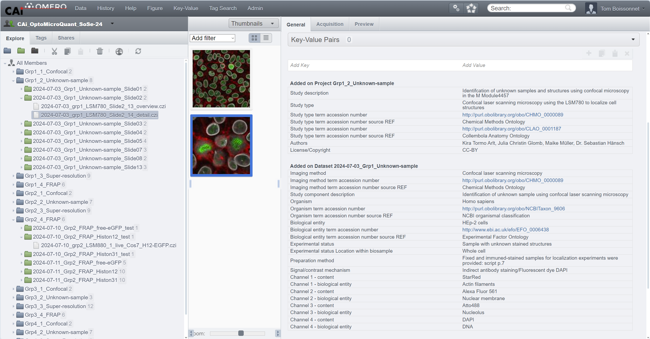
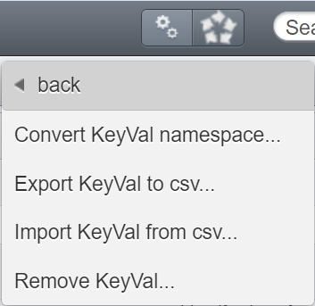
Working with images — key-value pairs
scripts
copy paste

Slide 23
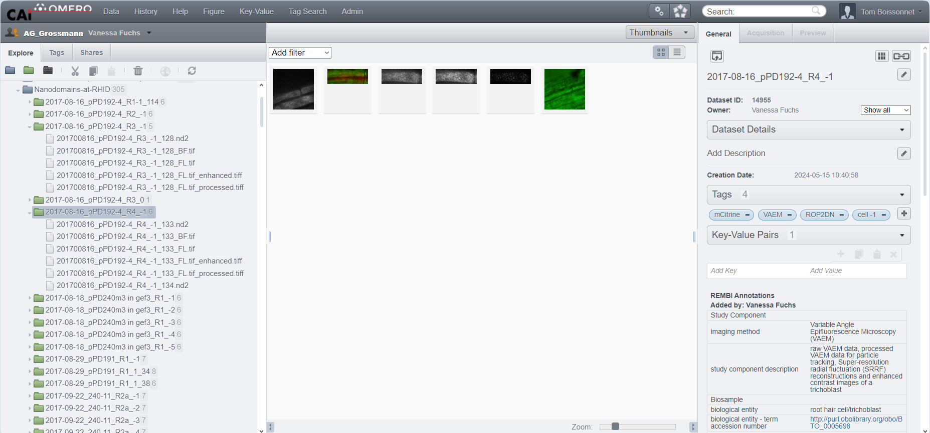
OMERO
.web: a gateway for smart tools
OMERO.figure
OMERO.iviewer
OMERO.tagsearch

Slide 24
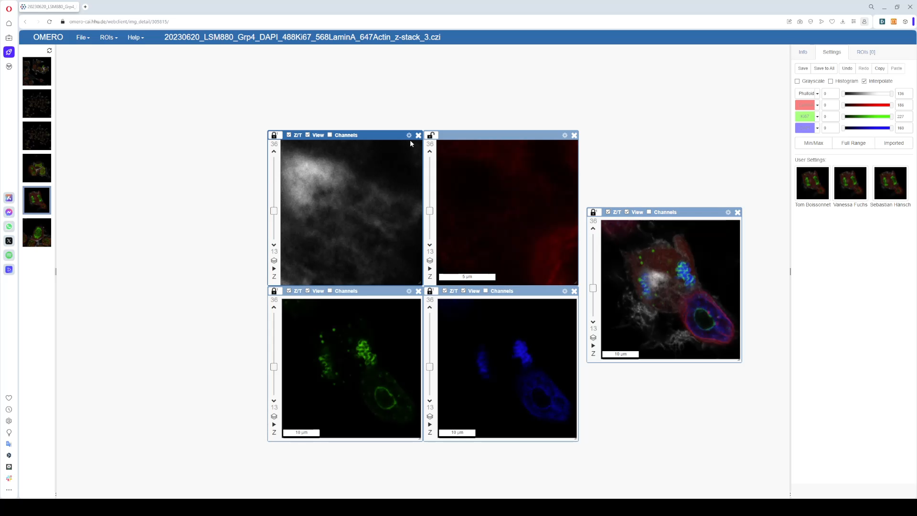
OMERO.iviewer

Slide 25
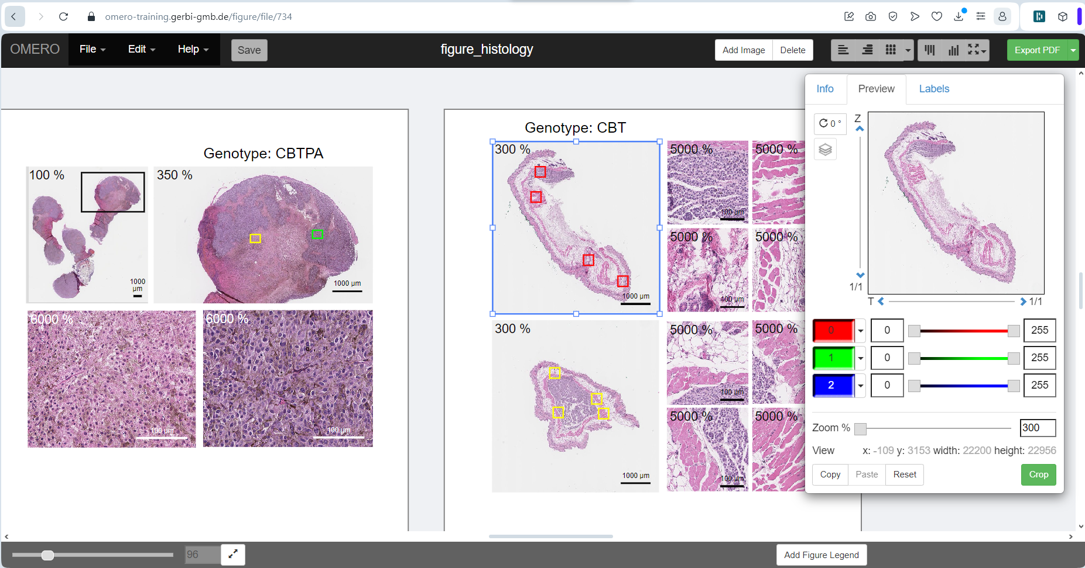
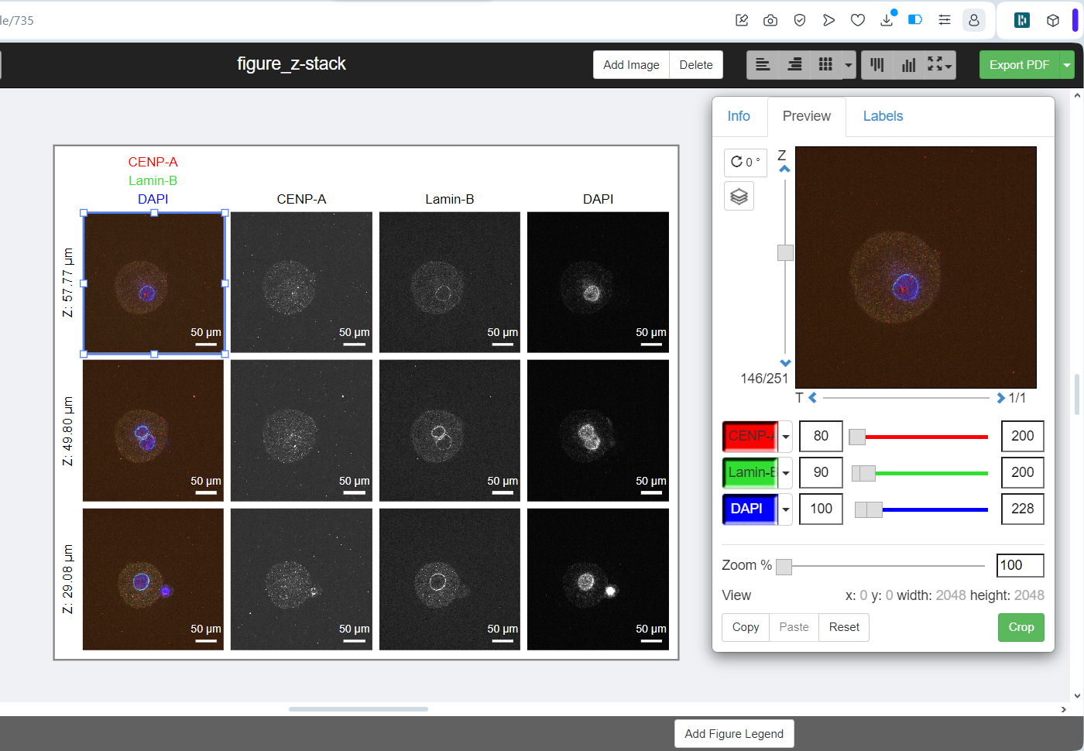
OMERO.figure

Slide 26
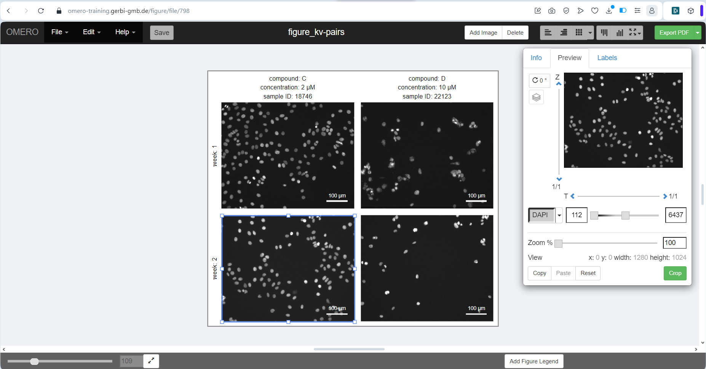
OMERO.figure
added from
key-value pairs

Slide 27
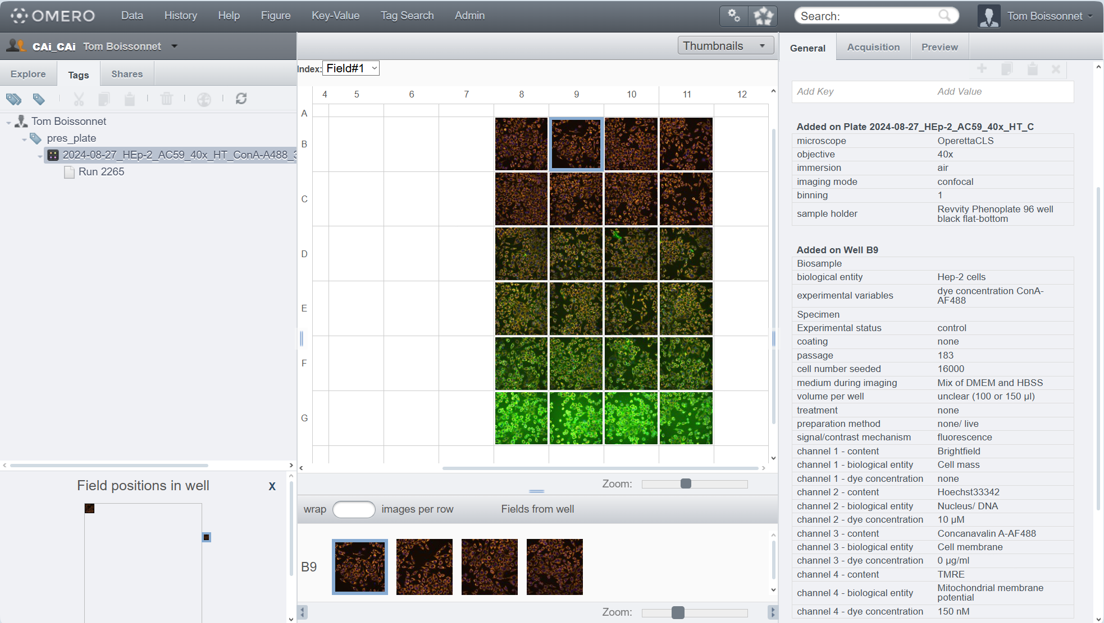
Use case n°1: High content screening figure
Plate
Well
Run / PlateAcquisition
inherited annotation
WellSample (Image)

Slide 28
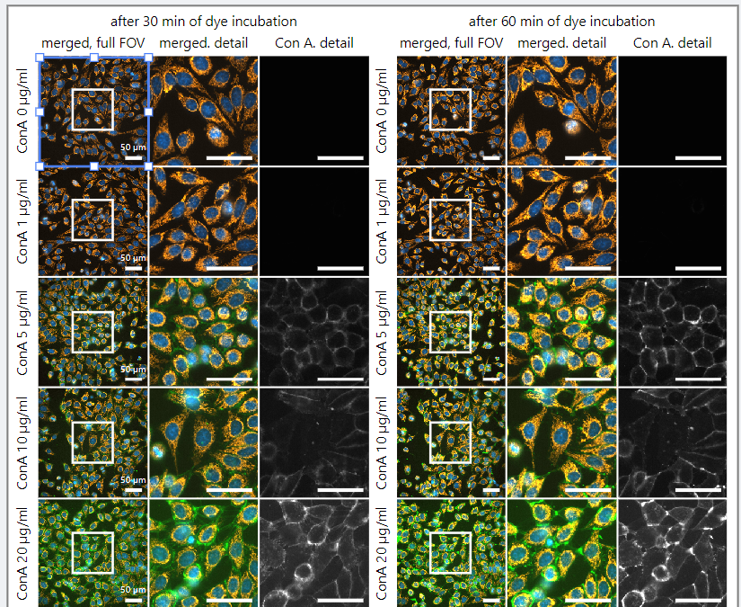
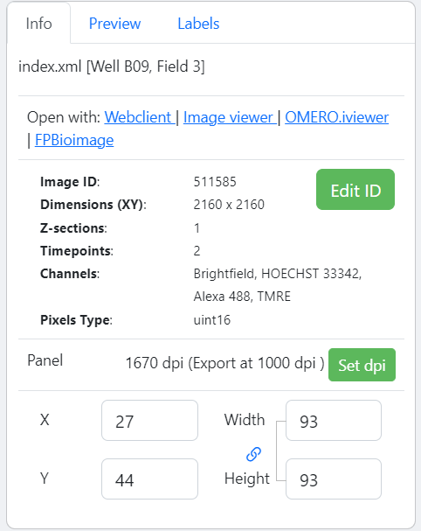
Use case n°1: High content screening figure

Slide 29
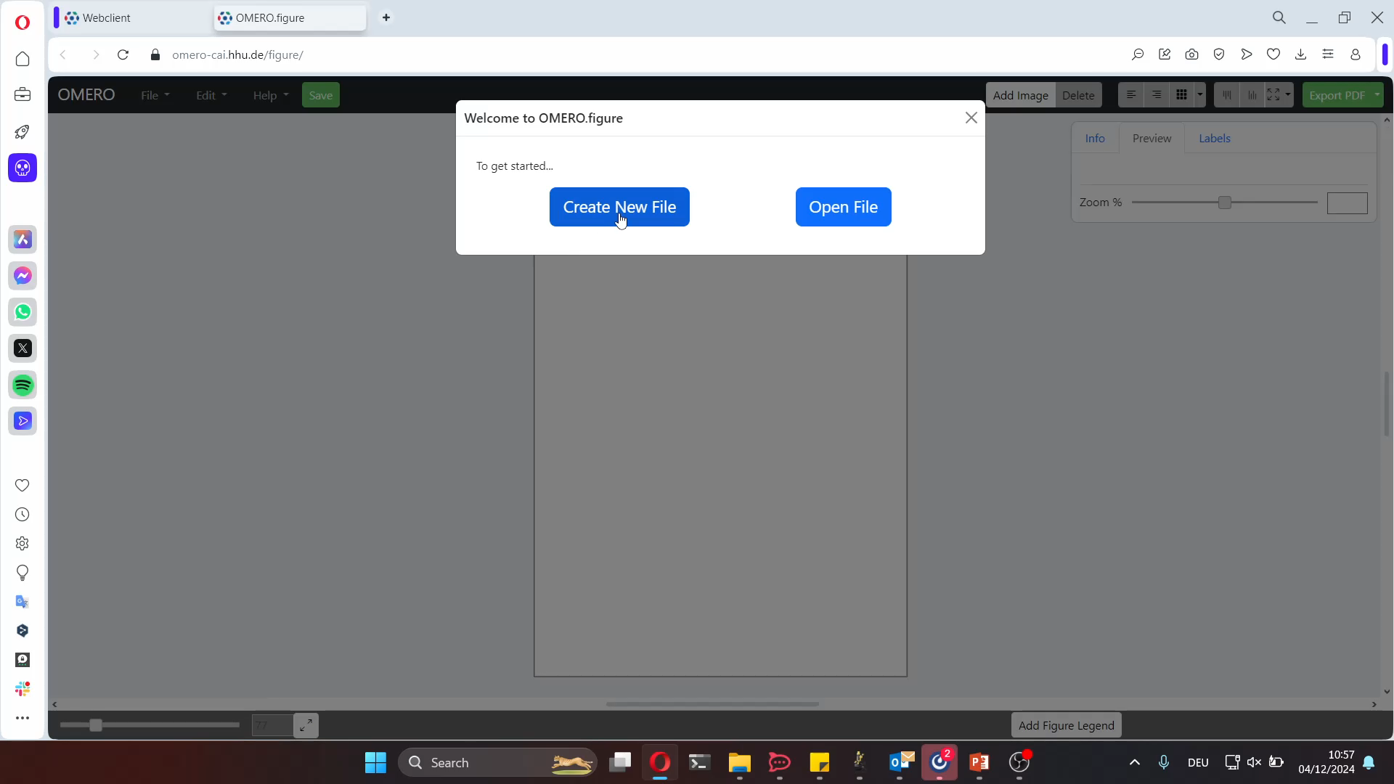
OMERO.iviewer

Slide 30
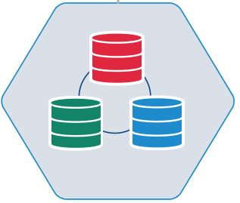



OMERO API
Bioimage analyst
OMERO.figure
OMERO.iviewer
OMERO.tagsearch

Slide 31
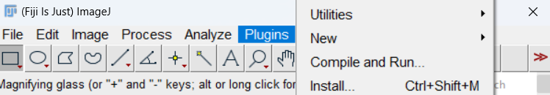

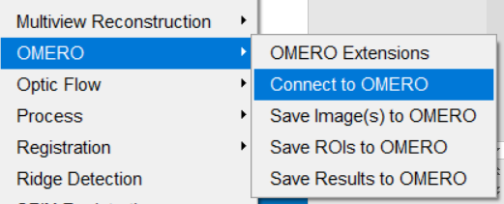



OMERO API
Michele Bortolomeazzi
omero_macro-extension
ezomero

Slide 32


Storing results — ROIs & Tables

Slide 33



Putting everything together
key-value pairs
tags
measurements
ROIs

Slide 34




Data management - Road to data science
One row per
ROI / Image / Dataset / Condition
One column per measurement / property

Slide 35
Conclusion
Data management is for everyone throughout a project
  group leaders
  experimenters
  bioimage analysts
Data management purpose is to increase your ability to explore data
  remote access to data - sharing links over files
  traceability from acquisition to analysis
  extensions to solve specific needs: OMERO.figure

Slide 36
Thank you for your attention
Center for Advanced imaging
  Stefanie Weidtkamp-Peters
  Susanne Klichowski
  Sebastian Hänsch
  Miriam Bäumers
  Anna Hamacher
  Jessica Hausmann
  Steffen Köhler
  Sarah Loeck
  Manuel Anlauf
  Vanessa Fuchs
  Ksenia Krooß
  Katharina Schmitz
  Tehmina Enayat
  Fiona Heimes
I3D:bio
  Christian Schmidt
  Susanne Kunis
  Julia Dohle
  Elisa Ferrando-May
  Roland Nitschke
  Tobias Wernet
Many more
  German BioImaging
  NFDI4BIOIMAGE
  OME team

Slide 37




in-place import in OMERO
OMERO Virtual Machine
Workstation
OMERO
VM Filesystem
Fiji
napari
read plane
internal path
/OMERO/ManagedRepository/
Access image through OMERO.server
OME.TIFF (5D)
2
3
1
OMERO plugins
send plane
request plane
network
database
Fileserver
OMERO
VM Filesystem
import path
Fiji
napari
/Project_A/Experiment_1/
read import path (FS)
internal path
OME.TIFF (5D)
/OMERO/ManagedRepository/
Shortcut access for in-place imported images
OME.TIFF (5D)
2
SYMBOLIC LINK (in-place import)
4
access stack
database
request import path
3
send import path
1

