Slide 1


Child wellbeing survey research data infrastructure
COORDINATE’s Variable Database & Harmonisation Toolbox
Insa Bechert
Leibniz Institute for the Social Sciences
Zagreb, March 5th, 2025

Slide 2
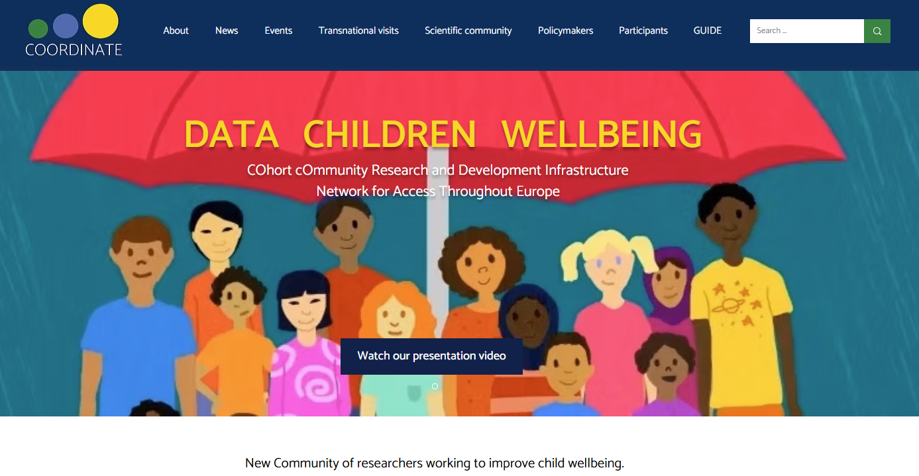
Variable Database
An Excel file listing variable metadata information
Presented as a set of webpages produced with R Markdown
Aim
Listing child and youth wellbeing measures commonly used in key longitudinal and cross-sectional comparative surveys in Europe.
Easy entry point for research on youth and child wellbeing
Focus on listing measures that appear in more than one survey
Survey Programmes
19 European national and international surveys
Documentation accessible in German or English
Quality standards

Slide 3
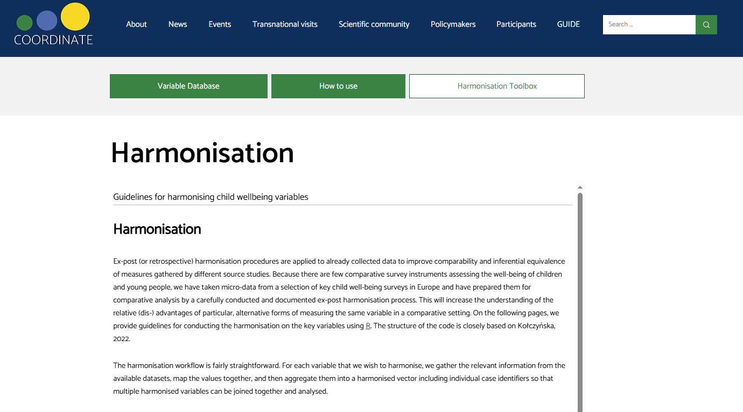
Harmonisation Toolbox
More webpages produced with R Markdown
Aim
NOT to provide readily harmonised datasets, but
Provide researchers with the scripts to harmonise their data
Steps
Set Up
Data Import
Prepare variables for harmonisation
Create a Codebook
Create a Crosswalk Table
Harmonisation
Save customised dataset (R, SPSS or STATA)

Slide 4
Maintainance
All files needed to maintain the Variable Database and Harmonisation Toolbox are stored on the GESIS GitLab to be handed over to GUIDE
Outlook
Keep up the open science idea
Continue work, and enrich the database ith with GUIDE items
Link database with others – e.g. Infra4NextGen?
https://infra4nextgen.com/harmonisationgateway/

Slide 5
Thanks for listening

