Slide 1





Techniques and guidelines for anonymising data
Beate Lichtwardt, Liz Smy, Sharon Bolton, and Cristina Magder
PRUK Workshop ‘Enhancing longitudinal data sharing: Data management strategies and best practices’
Copyright © 2024 University of Essex. Created by UK Data Archive, UK Data Service.
Notes:
This slide deck covers essential techniques, guidelines, and best practices for safeguarding privacy while ensuring the usability of data. By addressing both quantitative and qualitative anonymisation methods, along with considerations for longitudinal data, this training empowers participants to manage data responsibly and in compliance with UK data protection regulations.

Slide 2
Acknowledgment
These materials have been created as part of the UK Data Service Skills Development for Managing Longitudinal Data for Sharing project funded by the Economic and Social Research Council and the Medical Research Council, part of the Population Research UK initiative.
We would like acknowledge the project team members that led on the creation of these materials, Sharon Bolton, Beate Lichtwardt, Cristina Magder, Liz Smy, Hina Zahid as well as the wider project team which includes Natalie Clubb, Gail Howell, Andrea Munson, John Sanderson and Jo Webb, as well as others from the UK Data Service.
Author: UK Data Service; Published: November 2024; Copyright: © 2024 University of Essex. Created by UK Data Archive, UK Data Service.
This work is licensed under the Creative Commons Attribution Share Alike (CC BY SA) licence allowing you to share and adapt the material provided that you give appropriate credit and distribute any adaptations under the same licence conditions.
Notes:
These materials were developed as part of the UK Data Service Skills Development for Managing Longitudinal Data for Sharing project, funded by the Economic and Social Research Council and the Medical Research Council, under the PRUK initiative. Published in November 2024 by the UK Data Service, these materials are © 2024 University of Essex and are licensed under the Creative Commons Attribution Share Alike (CC BY-SA) licence, promoting sharing and adaptation with appropriate credit.

Slide 3

Data anonymisation
Anonymisation is a valuable tool that allows data to be shared, whilst preserving privacy.
Every data source is different! A number of factors to consider:
        different types of data
        different types of identifiers
        different levels of disclosiveness one can aim for.
What to look out for and why? Which techniques and options are available?
(Disclaimer: Content, while applicable more broadly, is primarily influenced by and aligned with current UK legislation as of March 2024.)
Notes:
Anonymisation is a valuable tool that allows data to be shared, whilst preserving its privacy.
Every data source is different. A number of factors need to be considered, such as the different types of data, different types of identifiers, and different levels of disclosivness one can aim for.
This session will give a better understanding of what to look out for and why, and which techniques and options are available for data anonymisation.

Slide 4
Personal data, special category data and personal information
Researchers must adhere to data protection requirements when managing or sharing personal data. In the UK, the Information Commissioner’s Office (ICO) provides in-depth information about personal data, including definitions and considerations for pseudonymisation and anonymisation, within the scope of the UK General Data Protection Regulation and the Data Protection Act 2018.
Personal data is defined by the UK General Data Protection Regulation (UK GDPR) and the Data Protection Act 2018. In essence, personal data is information that relates to an identified or identifiable natural person, be it directly or indirectly, taking into account other information derived from published sources.
Special category data, also sometimes referred to as sensitive personal data, are defined in Article 9 (1) of the UK GDPR. These data require additional attention and protection due to their sensitivity. Special category data consists of data revealing racial or ethnic origin, political opinions, religious or philosophical beliefs, trade union membership, genetic data, biometric data to uniquely identify a natural person, data concerning health, a person's sex life or sexual orientation.
Personal information is defined by the Statistics and Registration Service Act 2007 as information that relates to and identifies an individual (including a body corporate). Personal information, compared to personal data, takes into consideration corporate bodies.
Notes:
Before we start, it is important to be clear and remind everyone of the definitions for ‘personal data’, ‘special category data’, and ‘personal information’ and the differences between those terms.
Disclaimer: Please note that this content, while applicable more broadly, is primarily influenced by and aligned with current UK legislation as of March 2024.
Researchers must adhere to data protection requirements when managing or sharing personal data. In the UK, the Information Commissioner’s Office (ICO) provides in-depth information about personal data, including definitions and considerations for pseudonymisation and anonymisation, within the scope of the UK General Data Protection Regulation and the Data Protection Act 2018.
Personal data is defined by the UK General Data Protection Regulation (UK GDPR) and the Data Protection Act 2018. In essence, personal data is information that relates to an identified or identifiable natural person, be it directly or indirectly, taking into account other information derived from published sources.
Special category data, also sometimes referred to as sensitive personal data, are defined in Article 9 (1) of the UK GDPR. These data require additional attention and protection due to their sensitivity. Special category data consists of data revealing racial or ethnic origin, political opinions, religious or philosophical beliefs, trade union membership, genetic data, biometric data to uniquely identify a natural person, data concerning health, a person's sex life or sexual orientation.
Personal information is defined by the Statistics and Registration Service Act 2007 as information that relates to and identifies an individual (including a body corporate). Personal information, compared to personal data, takes into consideration corporate bodies.
Finally, it is crucial for those working in international contexts or with data from multiple regions to familiarise themselves with and adhere to the relevant legal frameworks and data protection regulations.

Slide 5
Content
Anonymisation steps
Types of identifiers
De-identification and anonymisation
Anonymising quantitative data
Anonymising qualitative data
Intruder testing
Summary

Slide 6
1. Anonymisation steps
3 Steps
1. Find and assess identifiers
2. Implement anonymisation techniques.
3. Review the data and re-assess any remaining disclosure risk
Notes:
A simplified high-level approach can consist of the following three core steps.
Step 1: Find and assess identifiers
Step 2: Implement anonymisation techniques
Step 3: Review the data and re-assess any remaining disclosure risk

Slide 7
2. Types of identifiers
Based on the personal data and personal information definitions an individual or a body corporate can be identified either directly or indirectly, hence identifiers are classified as either direct or indirect.
Direct identifiers
Information that directly identifies data subjects.
Examples: name, address, National Insurance number, NHS number, IP address, email address
Indirect identifiers
Information that in combination, may uniquely identify data subjects. It can potentially be linked to other sources of data (such as the electoral register). Examples: sex, age, region, occupation, income, ethnicity, religious affiliation
Notes:
We distinguish two types of identifiers: direct identifiers and indirect identifiers.
Based on the personal data and personal information definitions an individual or a body corporate can be identified either directly or indirectly; hence identifiers are classified as either direct or indirect.
Direct identifiers - information that directly identifies data subjects; examples include name, address, National Insurance number, NHS number, IP address, email address etc.
Indirect identifiers - information that in combination, may uniquely identify data subjects, this can potentially be linked to other sources of data (such as the electoral register); examples include sex, age, region, occupation, income, ethnicity, religious affiliation etc.

Slide 8
3. De-identification and anonymisation
De-identification of data
… refers to the process of removing or masking direct identifiers. This means that any identifiers that might directly lead to the re-identification of data subjects such as their names and their addresses are either replaced by pseudonyms (fake names), codes or removed. As only direct identifiers are removed the data remains identifiable indirectly, hence data protection legislation applies to any additional processing of the data.
Anonymisation
… refers to the process of ensuring that the risk of identifying a data subject is negligible. This usually involves more than de-identification and often requires that data be further altered or masked, generally by treating indirect identifiers. Anonymisation allows data to be shared ethically and legally while preserving confidentiality.

Slide 9
3.1 Effective anonymisation
The ICO introduced a key concept in ensuring the utility of data, and this is effective anonymisation. They provide guidance on determining whether information qualifies as personal data or anonymous information, affecting the applicability of data protection laws. The assessment involves careful consideration of the risk of identifiability and the factors influencing it.
Data can be classified into several categories based on how identifiable individuals are.
Directly identifiable data: personal data.
Indirectly identifiable data: personal data, if the risk of identifiability is not sufficiently low.
Data unlikely to be identifiable: risk of identifying an individual is considered sufficiently low.
Data that is impossible to identify: genuinely anonymous information.
Notes:
The ICO introduced a key concept in ensuring the utility of data, and this is effective anonymisation. They provide guidance on determining whether information qualifies as personal data or anonymous information, affecting the applicability of data protection laws. The assessment involves careful consideration of the risk of identifiability and the factors influencing it.
Data can be classified into several categories based on how identifiable individuals are.
Directly identifiable data: This is deemed as personal data.
Indirectly identifiable data: This also falls under personal data, if the risk of identifiability is not sufficiently low.
Data unlikely to be identifiable: The risk of identifying an individual is considered sufficiently low.
Data that is impossible to identify: This represents genuinely anonymous information.

Slide 10
3.2 Determining identifiability
In determining identifiability, one must consider:
The nature of the data and its environment.
The context, scope, and purposes of its processing. Processing means taking any action with someone’s personal data. This begins as soon as you have a record about someone and continues until you no longer need the information and it’s been securely destroyed. If you hold information on someone, it counts as processing, even if you don’t do anything else with it (ICO).
The technical and organisational measures in place.
The risk is judged based on objective factors, such as:
The motivation to identify an individual.
The level of skill required for identification.
The cost and time investment needed.
Available technological means.
Legal avenues and the probability of their usage.
By using responsible repositories and making data available under appropriate licences, once anonymisation techniques have been applied, one can ensure the data have been effectively anonymised.

Slide 11
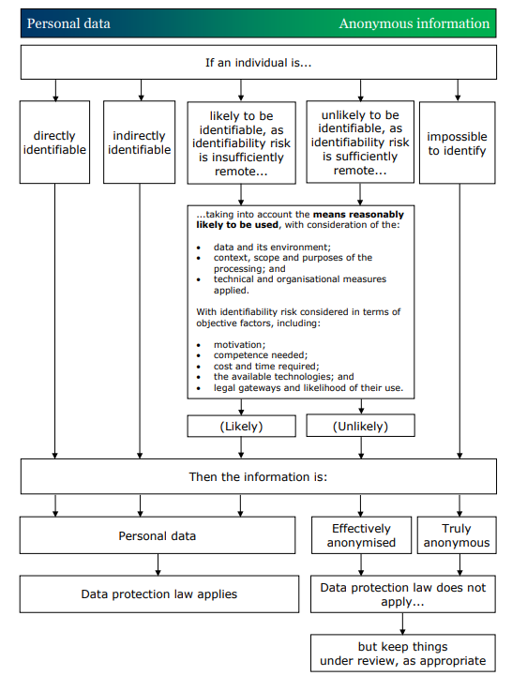
Mapping the concept of the spectrum of identifiability to data protection law
Source: ICO (2021) Chapter 2: How do we ensure anonymization is effective?
Notes:
Once you take all objective factors into account:
• if there are means “reasonably likely” to be used to identify someone, then you must view the information as personal data; and
• if no means are “reasonably likely” to be used, then you can view the information as effectively anonymised.
However, the identifiability risk must be sufficiently remote in the context of the processing.
Information that is effectively anonymised, is not classified as personal data, and data protection law does not apply.
The feasibility and cost-effectiveness of the available means to identify individuals can change over time. In general, the more feasible and cost-effective a method becomes, the more likely it is to be a means reasonably likely to be used.
Additional safeguards could include terms and conditions of use. This will be covered in the final session of the day which looks at data sharing strategies and recommendations.

Slide 12
Quiz 1 (Poll)
1. According to the UK General Data Protection Regulation, which of the following best describes 'personal data'?
Any data that is publicly available.
Data that relates to an identifiable natural person or body corporate.
Information relating to an identifiable natural person.
Notes:
C
(Personal data is information relating specifically to an identifiable natural person. It does not include corporate information).

Slide 13
Quiz 1 (Poll) - Answer
1. According to the UK General Data Protection Regulation, which of the following best describes 'personal data'?
Any data that is publicly available.
Data that relates to an identifiable natural person or body corporate.
Information relating to an identifiable natural person.
Notes:
C
(Personal data is information relating specifically to an identifiable natural person. It does not include corporate information).

Slide 14
Quiz 1 (Poll)
2. Which of the following is an example of ‘Special Category Data’ under the UK GDPR?
An individual's email address.
An individual's genetic data.
Corporate financial information.
Notes:
B
(Genetic data is the only type of Special Category Data listed here. An individual's email address would be classed as personal data but is not sensitive.)

Slide 15
Quiz 1 (Poll) - Answer
2. Which of the following is an example of ‘Special Category Data’ under the UK GDPR?
An individual's email address.
An individual's genetic data.
Corporate financial information.
Notes:
B
(Genetic data is the only type of Special Category Data listed here. An individual's email address would be classed as personal data but is not sensitive.)

Slide 16
Quiz 1 (Poll)
3. Does data protection legislation apply to de-identified data?
Data protection legislation applies to de-identified data because individuals can still be indirectly identified.
Data protection legislation does not apply to de-identified data.
Notes:
A
(Data protection legislation applies because pseudonymised data, while having direct identifiers removed, can still potentially identify individuals indirectly.)

Slide 17
Quiz 1 (Poll) - Answer
3. Does data protection legislation apply to de-identified data?
Data protection legislation applies to de-identified data because individuals can still be indirectly identified.
Data protection legislation does not apply to de-identified data.
Notes:
A
(Data protection legislation applies because pseudonymised data, while having direct identifiers removed, can still potentially identify individuals indirectly.)

Slide 18
Quiz 1 (Poll)
4. What is the main difference between de-identification and anonymisation of data?
De-identification and anonymisation are the same processes.
De-identification involves removing direct identifiers, while anonymisation also involves altering indirect identifiers.
Notes:
B
(Pseudonymisation involves removing or masking direct identifiers, whereas anonymisation also addresses indirect identifiers to ensure negligible re-identification risk.)

Slide 19
Quiz 1 (Poll) - Answer
4. What is the main difference between de-identification and anonymisation of data?
De-identification and anonymisation are the same processes.
De-identification involves removing direct identifiers, while anonymisation also involves altering indirect identifiers.
Notes:
B
(Pseudonymisation involves removing or masking direct identifiers, whereas anonymisation also addresses indirect identifiers to ensure negligible re-identification risk.)

Slide 20
Quiz 1 (Poll)
5. Consider the following data excerpt from summaries created from a focus group discussion:
"Andrew Weaver, a 35-year-old engineer from Bristol, discussed his experiences with urban development projects."
Which of the following options correctly represents the de-identified version of this data?
Participant A, a 35-year-old engineer from Bristol, discussed his experiences with urban development projects.
A male participant discussed his experiences with urban development projects.
Notes:
A
(The first option is the pseudonymised version of the data. It replaces the direct identifier, in this case the specific name of the participant 'Andrew Weaver' with a pseudonym 'Participant A', but retains other potentially identifying information like age, profession, and location.)

Slide 21
Quiz 1 (Poll) - Answer
5. Consider the following data excerpt from summaries created from a focus group discussion:
"Andrew Weaver, a 35-year-old engineer from Bristol, discussed his experiences with urban development projects."
Which of the following options correctly represents the de-identified version of this data?
Participant A, a 35-year-old engineer from Bristol, discussed his experiences with urban development projects.
A male participant discussed his experiences with urban development projects.
Notes:
A
(The first option is the pseudonymised version of the data. It replaces the direct identifier, in this case the specific name of the participant 'Andrew Weaver' with a pseudonym 'Participant A', but retains other potentially identifying information like age, profession, and location.)

Slide 22
4. Anonymising quantitative data
Anonymisation of quantitative data is slightly more straightforward than anonymising qualitative data. However, there are different types of data and different types of identifiers to be aware of, as well as different levels of disclosivity one can aim for.
Direct identifiers
Direct identifiers may be collected as part of the research administration process but are usually not essential research information and can therefore easily be removed from the data. They should never be included in data made available for secondary analysis, unless explicit consent has been given by the respondents to share them. It is best practice to remove direct identifiers from any data which is being used for analysis. This ensures any identifying information is not copied multiple times and reduces the potential risk of disclosure. (Examples: name, address, National Insurance number, NHS number, email address,
driving licence number, social media handle etc.)
Indirect identifiers
Even if direct identifiers have been removed from the data, respondents may still be identifiable through
indirect identifiers. These variables (sometimes referred to as key variables) may include information
unique to the respondent, the household or business, which - when used in combination with other indirect identifiers or linked with other information sources (such as the electoral register) - could potentially identify
data subjects.

Slide 23
Exercise
Please think specifically about the data you manage. Which details of any variables could be classed as an indirect identifier?
Notes:
[Encourage participants to discuss examples from their day-to-day work.]

Slide 24
4.1 Indirect identifiers - context matters
The selection of indirect identifiers should be considered in relation to the subject of your data and the sample characteristics.
(Example: Month of birth might be an important variable for a childhood study, however, this level of detail would not be appropriate for a survey of working adults.)
There might be cultural differences to take into account.
(Example: A variable identifying arranged marriages from a survey conducted in Ethiopia might not be considered problematic because this is still common practice in Ethiopia. However, identifying individuals who had an arranged marriage in England could lead to the identity of a participant being disclosed.)
A survey of a very specific group of people might mean that only limited demographic information can be included to reduce the risk of identification.
(Example: Women working at the UK Data Service.)
One needs to balance data utility against potential information loss and consider,
how access controls can be used.
Notes:
The exercise has highlighted how many different possible indirect identifiers there are and how these can be unique to your data. We are going to look at indirect identifiers in more detail, however, we need to remember that the selection of indirect identifiers should be considered in relation to the subject of your data and the sample characteristics.
…

Slide 25
4.2 Indirect identifiers – common examples
Age / date of birth variables
Education variables
Employment variables
Ethnic group, national identity and religion variables
Geographic variables
Health information
Household size
Income and other financial variables
Life events
Sensitive information
String variables
Notes:
Identifying indirect identifiers in your data is an important step in the anonymisation process. This is a list of some of the common indirect identifiers. The list is not exhaustive, but will give you an idea of the types of variables to look for and how a combination of these variables can be used to uniquely point to someone. Categories are listed alphabetically rather than in order of importance.
We are now going to look at these categories in more detail.
Further: Please have a look at the Handout ‘Techniques and guidelines for anonymising data: Indirect identifiers - common examples’, which we have provided as a separate file.

Slide 26
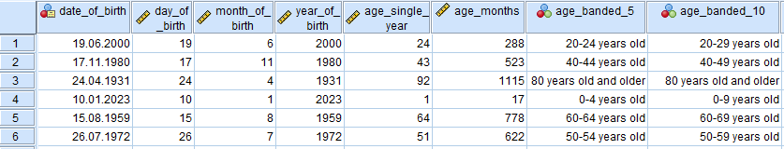
4.2 Indirect identifiers – Age / date of birth variables
Notes:
Age or date of birth is collected for the majority of surveys or individuals. It can be presented in several different formats, as highlighted in the example data file on this slide.
Full date of birth should be only made available under Controlled Access conditions as it can be used to link to other data sources.
Where single year of age is available, you might find that small numbers of very young or old respondents are present in the data. This can be problematic as, when used in conjunction with other indirect identifiers, it can uniquely identify someone or be used to link to external data sources.
Top-coding or bottom-coding might be required to group small numbers of very young or very old respondents, or anonymisation of other variables in the file may make age/date of birth variables less disclosive.
Single year of age is often considered one of the most important demographic variables, therefore one has to keep in mind that banding and top-coding age can render some numeric analyses impossible (including mean age, for example), hence this needs to be considered when deciding for your course of action. Anonymisation of other variables in the file may make age/date of birth variables less disclosive and should be considered in conjunction with any aggregation.

Slide 27
4.2 Indirect identifiers – Education variables(1)
University names |  | Example university course names
Abertay University |  | Wildlife and Conservation Management
Aberystwyth University |  | Wildlife and Countryside Management
Anglia Ruskin University |  | Wildlife Conservation
Arts University Bournemouth |  | Wildlife Conservation and Ecology
Arts University Plymouth |  | Wildlife Conservation and Environmental Management
Aston University |  | Wildlife Conservation and Countryside Management
Bangor University |  | Wildlife Conservation Biology
Bath Spa University |  | Wildlife Ecology and Conservation
Birkbeck, University of London |  | Wildlife Ecology and Conservation Science
Birmingham City University |  | Wildlife Media
Notes:
Education variables can be problematic when they include detailed information, which could be unique or only applicable to a small number of the population. These variables, when used in combination with other variables, could lead to the identity of a participant being disclosed. School, college and university names may be disclosive, if analysed in conjunction with course titles or other information, especially where the data cover more than one course with accompanying institutional information.
Education variables should ideally be categorised using a coding frame. Where educational information is detailed, the usefulness of information for secondary analysis should be considered.

Slide 28
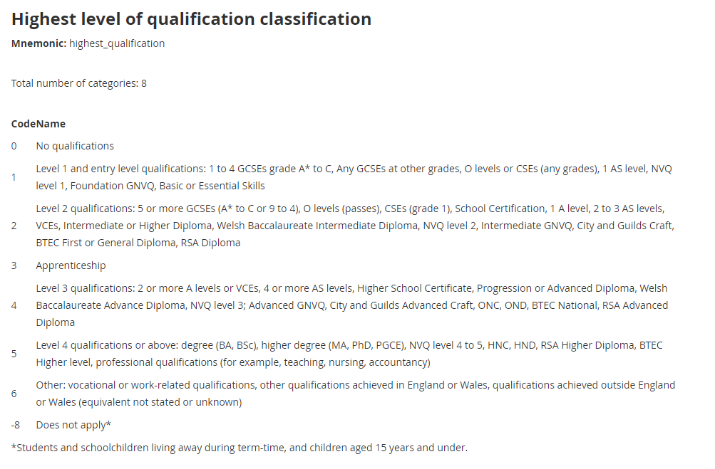
4.2 Indirect identifiers – Education variables(2)
Notes:
Educational attainment or highest qualification level might be more useful than specific institutional information. For example, the ONS Census 2021 ‘Highest level of qualification’ variable codes education level into 8 categories. Removing some level of detail might considerably reduce the risk of identifying an individual.

Slide 29
4.2 Indirect identifiers – Employment variables (1)
Example Job Titles |  | Including Company Names
Fabric Cutter |  | Fabric Cutter, Lewis & Tree
Fabricator Welder |  | Fabricator Welder Brighton Marine Services
Facilities Manager |  | Facilities Manager at Essex University
Factory Cleaner |  | Factory Cleaner, Equanor
Family Contact Supervisor |  | Family Contact Supervisor at Suffolk Police
Farm Worker |  | Farm Worker, Allan & Co
Fencing Installer |  | Fencing Installer Island Landscapes
Field Support Engineer |  | Field Support Engineer, Anglian Water
Finishing Foreman |  | Finishing Foreman, Big Fish Co
Fish Packer |  | Fish Packer, Fish Fry Ltd
Notes:
Employment variables can be problematic when they include unique information or are only applicable to a small number of the population. Unique job titles (often in string variable format) may result in identification, especially, if other key variables in the data are very detailed. They can also include company names which would increase the risk of disclosure. String variable job titles should be removed, especially, if the same information is categorised in other variables.

Slide 30
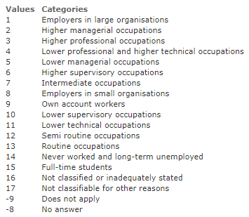

4.2 Indirect identifiers – Employment variables (2)
Example SOC2020 Example NS-SEC
Notes:
Ideally, employment variables should be categorised and coded, for example with SOC(2020) or NS-SEC coding frames, though responses at more detailed levels of these schemas (four-digit SOC codes, for example), may also need aggregation (reduction to three or two digit codes – depending on the access level for the data), if frequency distributions are small.

Slide 31
4.2 Indirect identifiers – Ethnic group, national identity and religion variables
Unique responses
Problematic when used in combination with other variables
‘Other’ open string responses
Measuring equality: A guide for the collection and classification of ethnic group, national identity and religion data in the UK
Notes:
Detailed breakdowns of ethnicity, national identity or religious affiliation can be potentially problematic when used in combination with other variables. ‘Other’ responses which are often recorded in string format can include unique responses. Using a standard coding frame is helpful and the ONS provides some guidance on this complex area (link).

Slide 32
4.2 Indirect identifiers – Geographic variables
England Geographies
Administrative
Census
Electoral
Health
Postal
International
NHS England (Regions) (NHSER)
Integrated Care Boards (ICB)
Sub Integrated Care Board Locations (SICBL)
Westminster Parliamentary Constituencies
Output Areas (OAs)
Lower layer Super Output Areas (LSOAs)
Middle layer Super Output Areas (MSOAs)
Wards
Travel To Work Areas (TTWAs)
Counties
Regions
Non-Metropolitan Districts
Unitary Authorities
Parish
Postcodes (Area, District, Sector, Unit)
International Territorial Levels (ITLs)
Notes:
Geographical or spatial variables present in the data should be considered carefully. Detailed, low level geographic variables will increase the ability to potentially identify data subjects. If the geographic variables are at a detailed level, it should be ensured that frequencies contain sufficient numbers to avoid identification in combination with other variables. For example, one case in a particular small area may mean that the respondent could be identified using a combination of other variables. (Some guidance may recommend cell counts, but the characteristics of the study, sample size and individual dataset should always be considered.)
The research topic of the study must also be borne in mind while checking geographical variables. For example, in a politics-related study, low-level political geographies may be necessary for analysis, such as Ward or Parliamentary Constituency. Also, Scottish/Welsh/Northern Ireland surveys may include LA or similar level areas, as aggregation to Region/GOR level would mean that only country-level analysis would be possible (Wales, Scotland and NI are each one Region/GOR area).
Access level and geo-references are generally assessed together. Data available under Controlled Access conditions may also include other more detailed variables, in addition to lover level geographies.

Slide 33
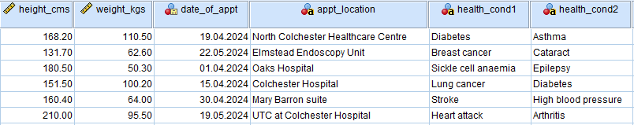
4.2 Indirect identifiers – Health information
Notes:
Health information variables may be disclosive, if they contain unusual combinations of conditions or dates of hospital visits or named individual treatment centres. Aggregation, coding or removal of the variables affected may be the best solution.

Slide 34
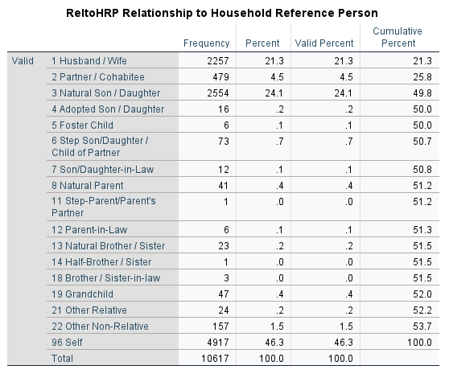
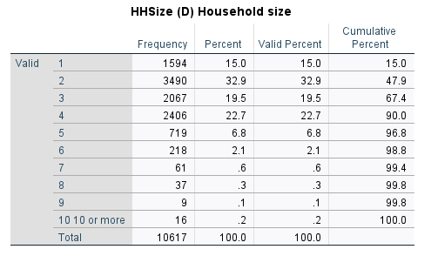

4.2 Indirect identifiers – Household size and composition
Notes:
Large households may mean that they are more unique and identifiable when their size is analysed alongside other variables. Where the survey is household based, the age and sex structure of the household members and relationships of individuals to each other can increase the risk of identification. Top-coding might be required depending on the other variables included, and the individual study details. The ONS recommend top-coding household size at 10.

Slide 35

4.2 Indirect identifiers –
Income and financial information
Individual income
  Wages
  Benefits
  Pensions
Household income
Inheritance details
Savings
Notes:
Income and other financial variables could be disclosive, if they have unique outlying values. Isolated cases of a very high or low income or other financial sums – for example, a large lottery win recorded as unearned income during the time period the data cover - may present a disclosure risk, if analysed alongside other variables and other publicly-available information (some lottery wins are well-publicised). Financial variables need to be checked, and it may be advisable to recommend top-/bottom-coding to aggregate unique cases into a group. Banding and top-coding can hamper some statistical analyses where individual numbers are required, so data usability should always be considered.

Slide 36
4.2 Indirect identifiers – Life events
Examples of life events
Court dates
Deaths
Marriage / divorce
Medical episodes
Moving house
Starting / leaving employment
Notes:
Similar to date of birth variables, exact dates of life events (hospital treatments, court cases, marriages, deaths, etc.) may increase the risk of potential identification. Reducing exact dates to month and year might remove enough detail. However, it depends how crucial the variables are to the data usability so increased access conditions might be more appropriate.
As we mentioned earlier, this list is not exhaustive. These are just some of the common direct identifiers we encounter regularly. Each data source will be unique in terms of subject and sample.

Slide 37

4.2 Indirect identifiers – Sensitive information
The UK GDPR defines special category data as:
  personal data revealing racial or ethnic origin
  personal data revealing political opinions
  personal data revealing religious or philosophical beliefs
  personal data revealing trade union membership
  genetic data
  biometric data (where used for identification purposes)
  data concerning health
  data concerning a person’s sex life and
  data concerning a person’s sexual orientation.
This does not include personal data about criminal allegations, proceedings or convictions, as separate rules apply. For further information, please see our separate guidance on criminal offence data.
Notes:
Data should always be checked for sensitive information. Some variables may include details that could be potentially harmful, if a respondent is identified, such as an unusual or sensitive health condition or status, or details of illegal behaviour. Some sensitive data will be Special Category data under GDPR, and these variables should be considered alongside all other indirect identifiers in the dataset, in case a disclosure risk is identified. They may need to be edited, but, if doing so would harm the usability of the data, access restriction should also be considered.
https://ico.org.uk/for-organisations/uk-gdpr-guidance-and-resources/lawful-basis/a-guide-to-lawful-basis/lawful-basis-for-processing/special-category-data/

Slide 38

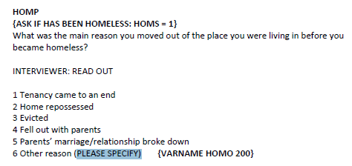
4.2 Indirect identifiers – String (text) variables
Open response questions
Other response/reason (please specify)
Notes:
String (text) variables can include directly and/or indirectly identifying information. These usually include the ‘other’ responses to survey questions. If it is a self-completion survey, the respondents can write whatever they want. The level of detail that can be included in these variables, is amazing. String variables should be checked thoroughly to ensure that they do not contain disclosive text (names, relatives’ names, detailed locations, or anything else) that could result in the identification of respondents/organisations. String variables may need to be edited or removed.

Slide 39
Exercise – Risk considerations in longitudinal data (1)
Do you believe this information has been anonymised?
Does any of the information look problematic?
 | Wave 1 | Wave 2 | Wave 3
Age | 18 | 20 | 22
Sex | Female | Female | Female
Marital status | Single | Married | Widowed
Household type | 1 person | Cohabiting couple | 1 person
Job title | In education | Police officer | Police officer
Region of current address | North East | North East | North East
Notes:
Please have a look at Example Table 1. The table shows data from one respondent collected over 3 waves of data collection. Imagine you have access to the data collection dates too.
- Do you believe this information has been anonymised?
- Does any of the information look problematic?
Notes for discussion
Wave 1 data looks fine, but the build-up of waves and change in circumstances could be problematic.
A change in marital status between waves is not common at such a young age.
The death of the respondent's husband could be reported in the media, especially as he is likely to be young too.
The respondent is a police officer and is likely to wear a uniform, so would be visually identifiable.
There is a chance the husband, who died, could be a police officer too?
The geography is high level, so Wave 1 data is not problematic, but potentially unique changes in circumstances between waves could increase the risk of identification (especially, if the husband's death is reported in the media).

Slide 40
Exercise – Risk considerations in longitudinal data (2a)
Do you believe this information has been anonymised?
Does any of the information look problematic?
 | Wave 1 | Wave 2 | Wave 3
Age | 99 | 101 | 103
Sex | Male | Male | Male
Marital status | Married | Widowed | Widowed
Household type | Cohabiting couple | Living in care | Living in care
Job title | Retired | Retired | Retired
Region of current address | East of England | East of England | East of England
Notes:
Please have a look at Example Table 2. The table shows data from a different respondent collected over 3 waves of data collection. Again, imagine you have access to the data collection dates too.
- Do you believe this information has been anonymised?
- Does any of the information look problematic?
Notes for discussion:
The old age of the respondent could be problematic at all waves.
Change in marital status between waves 1 and 2 – The death of the wife could be reported in the media, especially, if she too is of an old age.
Change in household type between waves 1 and 2 - Local people might know about a 101-year old widowed man moving house.
The geography is high level at region, which does reduce the risk of identification.

Slide 41
Exercise – Risk considerations in longitudinal data (2b)
How does the addition of more detailed geography change the risk?
 | Wave 1 | Wave 2 | Wave 3
Age | 99 | 101 | 103
Sex | Male | Male | Male
Marital status | Married | Widowed | Widowed
Household type | Cohabiting couple | Living in care | Living in care
Job title | Retired | Retired | Retired
Region of current address | East of England | East of England | East of England
Local Authority of current address | Colchester | Tendring | Tendring
Notes:
Now let’s consider how introducing a more detailed geography can change the risk. This table shows the Example 2 we have just looked at, but with the addition of the Local Authority (LA) of the respondent’s residence.
How does the addition of a more detailed geography change the risk?
Notes for discussion
The change in LA between wave 1 and wave 2 corresponds with the respondent’s change in household type when he moved into care.
We now know we are looking for a male around 100 years old, who has moved into a care home in the Local Authority of Tendring. The introduction of a more detailed geography dramatically increases the risk of identification.

Slide 42
4.3 Extra considerations for anonymising longitudinal data
Changes to individuals or household which can be linked to publically available information.
  A change in household size or marital status may increase the risk of identification of a household or individual by linking to births, deaths, marriage, civil partnership and divorce registrations, which are publicly available.
Access to biomarkers overtime can easily create unique information.
  A change in a respondent’s weight tracked over successive years could be identifying when used with other demographic details.
  A change in cortisol between waves might indicate the respondent has a rare condition called Cushing Syndrome. This also has physical symptoms such as a rounded face and pink and purple marks.
Notes:
Any data which contain a longitudinal element pose a further risk, as linking successive waves or years can disclose more information about respondents than cross-sectional data. Each successive wave of data collection leads to an increase in knowledge about each individual or household. This means the risk of identifying a data subject naturally increases with each round of data collection.
A couple of examples include:
Changes to individuals or household which can be linked to publicly available information.
A change in household size or marital status may increase the risk of identification of a household or individual by linking to births, deaths, marriage, civil partnership and divorce registrations, which are publicly available.
Access to biomarkers overtime can easily create unique information.
A change in a respondent’s weight tracked over successive years could be identifying when used with other demographic details.
A change in cortisol between waves might indicate the respondent has a rare condition called Cushing Syndrome. This also has physical symptoms such as a rounded face and pink and purple marks.

Slide 43
4.3 Extra considerations for anonymising longitudinal data - Solutions
Remove the ability to link individuals or households across successive years.
Higher level banding on demographic variables such as ages, marital status, socio-economic and relationship variables.
Reducing the geo-reference variables available.
Access restrictions.
Notes:
One simple solution to reduce the risk of disclosure would be to remove the ability to link individuals or households across successive years. However, this would dramatically reduce the data usability. Other possible methods include higher level banding on demographic variables such as age, marital status, socio-economic and relationship variables, reducing the geo-reference variables available, along with access restrictions.
[Discussion]

Slide 44
4.4 Statistical Disclosure Control (SDC)
Before addressing anonymisation techniques, a wider concept must be introduced: Statistical Disclosure Control.
SDC is a comprehensive approach to data privacy that goes beyond the traditional anonymisation techniques and applies both before (Input SDC) and after data analysis (Output SDC).
Input SDC
Input SDC focuses on the raw individual-level data before any analysis or aggregation is performed. The goal is to modify the data at the individual level to prevent the identification of data subjects in a structured and most often machine-aided manner. Techniques are often categorized based on whether they modify the data through perturbation or use non-perturbative methods to ensure the privacy of individuals in the dataset.
Perturbative methods involve altering the actual data values in some way to prevent the identification of individuals, while striving to preserve the overall statistical properties of the data. These include noise addition, data swapping, the Post Randomization Method, and synthetic data generation.
The non-perturbative methods do not completely change the actual data values but reduce the detail to prevent the identification of individuals. These include the techniques we will discuss shortly in more details such as recoding, banding, top/bottom coding.
Several freeware can be used for input SDC such as sdcMicro, and the Amnesia Anonymization Tool.

Slide 45
4.4 Statistical Disclosure Control (SDC)
Output SDC
Output SDC focuses on modifying the data after it has been analysed or aggregated. Output SDC is particularly relevant when publishing findings or releasing aggregated statistics. It ensures that the published information does not reveal sensitive details about individuals/ data subjects. Techniques in Output SDC include:
  Table cell suppression: removing or modifying numbers in tabulated data that do not meet the SDC threshold.
  Controlled rounding: adjusting figures in tabular data to prevent back-calculation to exact numbers.
  Data swapping: similar to input SDC, but applied to aggregated data.

Slide 46
4.5 Anonymisation techniques
Once familiarised with the different types of identifiers present in quantitative data, one needs to decide on the best techniques to use to mitigate disclosure risk present in the data.
Before going ahead and making changes to data, remember that any changes should be made alongside data-sharing plans.
Why?
Because future access will dictate the level of anonymisation needed and avoid under- or over-anonymisation is to be avoided. Consider how the data are going to be shared and the legal and ethical controls in place. This will influence the appropriate level of detail required to mitigate disclosure risk present in the data.
The most common quantitative anonymisation methods used are:
a) recoding, b) banding, c) top/bottom coding, d) generalisation.
Notes:
…
The most common quantitative anonymisation methods used are recoding, banding, top/bottom coding and generalisation. We will look at each in turn.

Slide 47
4.5.1 Recoding or categorisation
We use this method to reduce the number of distinct categories or values of a variable, thus reducing disclosure risk.
Example:
Ethnicity |  | Ethnicity
Black (Caribbean) |  | Black
White (Irish) |  | White
Black (African) |  | Black
Asian (Pakistani) |  | Asian
White (Scottish) |  | White
Black |  | Black
White |  | White
Notes:
We use this method to reduce the number of distinct categories or values of a variable, thus reducing disclosure risk.
Recode into fewer categories (less precision).

Slide 48
4.5.2 Banding or binning
Banding, also known as binning or grouping, is an effective anonymisation technique commonly applied to continuous variables like age or income. It involves categorising these variables into broader ranges or bands.
Example:
Income (£) |  | Income (£)
88,599 |  | 75,000 – 99,000
21,478 |  | 10,000 – 24,999
9,996 |  | Less than 9,999
51,299 |  | 50,000 – 74,999
120,987 |  | 100,000 or more
197,000 |  | 100,000 or more
27,998 |  | 25,000 – 49,000

Slide 49
4.5.3 Top/bottom coding
By top/bottom coding, the goal is to reduce disclosure risk added by small counts in the tails of a distribution.
Example:
Age |  | Age
27 |  | 27
118 |  | 80+
89 |  | 80+
56 |  | 56
48 |  | 48
31 |  | 31
57 |  | 57
Notes:
By top/bottom coding, the goal is to reduce disclosure risk added by small counts in the tails of a distribution, if there are concerns that there might be small counts. A good example here is age, where we might have some very small counts at either end of the spectrum (youngest and oldest research participants). By top and/or bottom coding we would recode, for instance, all under 10 or all over 80 and hide potential outliers.

Slide 50
4.5.4 Generalisation
Survey data might contain free-text responses that increase the disclosure risk. To reduce the risk of disclosure you can generalise the meaning of a detailed text variable by replacing the potential disclosive information.
Example:
In a dataset containing employee feedback, respondents provided detailed descriptions of their roles and responsibilities. These free-text responses could potentially be disclosive, especially in cases where the role is unique or highly specialised within the organisation.
→The detailed descriptions of roles and responsibilities can be replaced with more general text or coded into broader categories. For instance, specific tasks and job responsibilities can be categorised under generic job functions.
Original Detailed Response: "I am responsible for leading the cybersecurity initiatives, specifically focusing on blockchain technology security and data encryption techniques.“
Generalised Text or Coded Response: "Involved in IT security and data protection."

Slide 51

5. Anonymising qualitative data
Qualitative data pose particular challenges regarding anonymisation.
Considerations need to be given to the level of anonymity required to meet the needs agreed upon during the informed consent process.
Removing/redacting too much information reduces the value and integrity of the data.
Removing/redacting too little information might lead to potential identification of respondents.
Notes:
Qualitative data poses particular challenges regarding anonymisation. Considerations need to be given to the level of anonymity required to meet the needs agreed upon during the informed consent process. Removing/redacting too much information reduces the value and integrity of the data, however, removing/redacting too little information might lead to potential identification of respondents.

Slide 52
5.1 Anonymising qualitative data – techniques
De-identification and anonymisation techniques in relation to direct and indirect identifiers found in qualitative data.
Direct identifiers → use pseudonyms
Direct identifiers (information which can be linked directly to the individual) should be disguised by allocating pseudonyms, or fake names/details, which should be consistent throughout the project, including in publications and follow-up research. Pseudonyms ensure the integrity of relationships inherent in the data and allow for a richer understanding of the data as a whole. Care should be taken to ensure that pseudonyms do not still signpost to participants in any way (e.g. using a nickname), and that names are changed in all files (e.g. document metadata, interview transcripts, interview summaries, and data listings).
Indirect identifiers → categorise and generalise
When anonymising transcript data, it is crucial to handle indirect identifiers (pieces of information that, while not directly revealing an individual's identity, can potentially lead to the identification of a person when combined with other data) with care. Categorisation and generalisation are useful tools.
Notes:
We are going to look at de-identification and anonymisation techniques in relation to direct and indirect identifiers found in qualitative data.
Use pseudonyms for direct identifiers
As already covered for quantitative data, direct identifiers refer to information which can be linked directly to the individual, such as a name or contact details. These should be disguised by allocating pseudonyms, or fake names/details, which should be consistent throughout the project, including in publications and follow-up research. Pseudonyms ensure the integrity of relationships inherent in the data and allow for a richer understanding of the data as a whole. Care should be taken to ensure that pseudonyms do not still signpost to participants in any way (e.g. using a nickname) and that names are changed in all files (including, for example, document metadata, interview transcripts, interview summaries, and data listings).
Categorising and generalising indirect identifiers
When anonymising transcript data, it is crucial to handle indirect identifiers with care. In relation to qualitative data, indirect identifiers are pieces of information that, while not directly revealing an individual's identity, can potentially lead to the identification of a person, when combined with other data. These often include socio-demographic characteristics such as age, sex, occupation, education, location data or significant dates such as date of birth or date of employment. Categorisation and generalisation are useful tools.

Slide 53
5.1 Anonymising qualitative data – techniques (continued)
Indirect identifiers – categorise and generalise (continued)
Categorisation serves as an effective strategy to preserve the utility of data while better-preserving privacy. By grouping similar data into categories, researchers can maintain essential analytical value without exposing specific details. For instance, ages within the text can be classified into ranges such as [20-25] years, [26-30] years, etc., rather than making available exact ages. Similarly, occupations can be categorised based on an international standard classification, allowing for a broader but still meaningful analysis.
Generalisation is another technique where specific details are replaced with broader concepts. This approach can apply to various data types, including geographical locations, where specific places might be generalised to regions or countries. For example, generalising from "living in a small village near the town of Blackburn in Lancashire" to "living in a rural area in the North West of England".

Slide 54
5.2 Anonymising qualitative data – best practice
Anonymisation plans
Anonymisation plans outline the strategy in place for protecting participants’ identities. They should outline what characteristics are automatically de-identified and what other potentially disclosive information to look out for.
Use find-and-replace
Ensure all text is changed using tools like find-and-replace, to rule out the possibility of human error. Where relevant, be sure to explore style variations (capitalisation, punctuation, and pluralisation) of the text so that all possible permutations of the word are found. Text editor tools often have an advanced option to search for wildcards, or variations, of the text. Where there is no option for wildcards, one can annotate this in your search using ? (for single characters) and * (for multiple characters).
Identify changes with brackets
Identify replacements in text clearly. A common way to highlight this is with [square brackets] or XML tags (e.g. <anonsec>anonymised text<anonsec>). Transcription guidelines should document which annotations denote changes in the text.

Slide 55
5.3 Anonymising qualitative data – open source tools
The UK Data Service text anonymisation tool
… uses MS Word macros to help find disclosive information to remove or de-identify. It does not anonymise or make changes to data but uses MS Word macros to find and highlight numbers and words starting with capital letters in text. (Numbers and capitalised words are often disclosive, e.g. as names, companies, birth dates, addresses, educational institutions and countries.)
Textwash
The open-source text anonymisation tool Textwash uses Python to identify and replace direct identifiers but can only run on text files (.txt), not in Word or RTF.
FAMTAFOS (Free automated multi-language text anonymisation for open science)
FAMTAFOS is currently in development and is an open-source desktop app that utilises AI technology to anonymise text at scale. It is based on Textwash.
Most AI tools that can be used to anonymise text work on the principle of Named Entity Recognition (NER), and can be set to search for names, locations, occupations, etc. They will then tag them for subsequent human editing.
Beyond the programs listed above, many new tools now offer free online facilities, but it is worth noting that uploading text into an online interface may risk the inadvertent sharing of unanonymised data.
If using one of these online tools to anonymise qualitative data, you should first check with the website/tool owner that no text is retained within the system after use!
Notes:
There are a number of open source tools available which can be helpful when anonymising qualitative data.
The UK Data Service text anonymisation tool uses MS Word macros to help find disclosive information to remove or pseudonymise.
The open-source text anonymisation tool Textwash uses Python to identify and replace direct identifiers, but can only run on text files (.txt), not in Word or RTF.
FAMTAFOS is currently in development and is an open-source desktop app that utilises AI technology to anonymise text at scale. It is based on Textwash.
Most AI tools that can be used to anonymise text work on the principle of Named Entity Recogition (NER), and can be set to search for names, locations, occupations, etc. They will then tag them for subsequent human editing. Beyond the programs listed above, many new tools now offer free online facilities, but it is worth noting that uploading text into an online interface may risk the inadvertent sharing of unanonymised data.
If using one of these online tools to anonymise qualitative data, you should first check with the website/tool owner that no text is retained within the system after use.

Slide 56
6. Intruder testing
Intruder testing involves using individuals described as ‘friendly intruders’ to try and see if they are able to re-identify anyone in the dataset.
These intruders should have some background knowledge of the data similar to that of a typical user. However, they do not need to be specialist hackers with the capability of employing advanced data exploration techniques. (ONS, 2024)
Not intended as a replacement for theoretical disclosure risk metrics, but as a tool to be used alongside more traditional methods.
(Office for National Statistics ‘Guidance on intruder testing’: www.ons.gov.uk/methodology/methodologytopicsandstatisticalconcepts/disclosurecontrol/guidanceonintrudertesting#why-and-when-is-it-necessary)
Notes:
Intruder testing is not intended as a replacement for theoretical disclosure risk metrics, but as a tool to be used alongside more traditional methods.
Office for National Statistics ‘Guidance on intruder testing’: https://www.ons.gov.uk/methodology/methodologytopicsandstatisticalconcepts/disclosurecontrol/guidanceonintrudertesting#why-and-when-is-it-necessary

Slide 57
Quiz 2 (Poll)
1. Please select all direct identifiers!
Passport number
Educational attainment
Marital status
NHS number
Full name
Postcode sector
Mobile telephone number
Notes:
Passport number (correct answer)
Educational attainment
Marital status
NHS number (correct answer)
Full name (correct answer)
Postcode sector
Mobile telephone number (correct answer)

Slide 58
Quiz 2 (Poll) - Answer
1. Please select all direct identifiers!
Passport number
Educational attainment
Marital status
NHS number
Full name
Postcode sector
Mobile telephone number
Notes:
Passport number (correct answer)
Educational attainment
Marital status
NHS number (correct answer)
Full name (correct answer)
Postcode sector
Mobile telephone number (correct answer)

Slide 59
Quiz 2 (Poll)
2. Please select all indirect identifiers, either sensitive or not sensitive!
Age
Educational attainment
Job title
Ethnicity
Religious affiliation
Household size
Life events e.g. exact date of marriage
Income
Life satisfaction rating
Health conditions
Internet usage (hours per day)
Air quality index
Sexual orientation
Notes:
Age (correct answer)
Educational attainment (correct answer)
Job title (correct answer)
Ethnicity (correct answer)
Religious affiliation (correct answer)
Household size (correct answer)
Life events e.g. exact date of marriage (correct answer)
Income (correct answer)
Life satisfaction rating
Health conditions (correct answer)
Internet usage (hours per day)
Air quality index
Sexual orientation (correct answer)
Life satisfaction rating, internet usage and air quality index are unique to the respondent, the household or business.

Slide 60
Quiz 2 (Poll) - Answer
2. Please select all indirect identifiers, either sensitive or not sensitive!
Age
Educational attainment
Job title
Ethnicity
Religious affiliation
Household size
Life events e.g. exact date of marriage
Income
Life satisfaction rating
Health conditions
Internet usage (hours per day)
Air quality index
Sexual orientation
Notes:
Age (correct answer)
Educational attainment (correct answer)
Job title (correct answer)
Ethnicity (correct answer)
Religious affiliation (correct answer)
Household size (correct answer)
Life events e.g. exact date of marriage (correct answer)
Income (correct answer)
Life satisfaction rating
Health conditions (correct answer)
Internet usage (hours per day)
Air quality index
Sexual orientation (correct answer)
Life satisfaction rating, internet usage and air quality index are unique to the respondent, the household or business.

Slide 61
Quiz 2 (Poll)
3. A data file contains 2 respondents with an ethnic group of White: Gypsy or Irish Traveller. Which anonymisation technique is most appropriate for reducing the risk of identification, if the data are to be released under Open Access?
Remove the ethnic group variable
Recode data into wider category
Banding/binning
Top/bottom coding
Notes:
Remove the ethnic group variable
Recode data into wider category (correct answer)
Banding/binning
Top/bottom coding
Removing the whole ethnic group variable would unnecessarily remove too much data and reduce the utility of data. Banding/binning and top/bottom coding are techniques appropriate for continuous data such as age or income.

Slide 62
Quiz 2 (Poll) - Answer
3. A data file contains 2 respondents with an ethnic group of White: Gypsy or Irish Traveller. Which anonymisation technique is most appropriate for reducing the risk of identification, if the data are to be released under Open Access?
Remove the ethnic group variable
Recode data into wider category
Banding/binning
Top/bottom coding
Notes:
Remove the ethnic group variable
Recode data into wider category (correct answer)
Banding/binning
Top/bottom coding
Removing the whole ethnic group variable would unnecessarily remove too much data and reduce the utility of data. Banding/binning and top/bottom coding are techniques appropriate for continuous data such as age or income.

Slide 63
Quiz 2 (Poll)
4. Which of the following techniques are appropriate for anonymising qualitative data?
Replace direct identifiers with pseudonyms
Categorisation of indirect identifier
Generalisation of indirect identifiers
All of the above
Notes:
Replace direct identifiers with pseudonyms
Categorisation of indirect identifier
Generalisation of indirect identifiers
All of the above (correct answer)
Direct identifiers should be replaced with pseudonyms and indirect identifiers should be masked using categorisation and generalisation to preserve the utility of data.

Slide 64
Quiz 2 (Poll) - Answer
4. Which of the following techniques are appropriate for anonymising qualitative data?
Replace direct identifiers with pseudonyms
Categorisation of indirect identifier
Generalisation of indirect identifiers
All of the above
Notes:
Replace direct identifiers with pseudonyms
Categorisation of indirect identifier
Generalisation of indirect identifiers
All of the above (correct answer)
Direct identifiers should be replaced with pseudonyms and indirect identifiers should be masked using categorisation and generalisation to preserve the utility of data.

Slide 65
7. Summary anonymisation steps
Step 1: Find and assess identifiers
Identify potential identifiers (direct and indirect).
Evaluate the likelihood of re-identification by considering both the data itself and the potential availability of external information that could be linked to it.
Key questions to consider:
  Can the identity of a participant be deduced from information in the data file?
  Is there a possibility of inadvertently disclosing or causing harm to a third party based on the information in the data file?
Notes:
Coming back to the initial high-level anonymisation approach (slide 5) consisting of three core steps:
Step 1: Find and assess identifiers
Step 2: Implement anonymisation techniques
Step 3: Review the data and re-assess any remaining disclosure risk
Step 1: Find and assess identifiers
Start by identifying potential identifiers. This should include both direct identifiers (information identifying data subject directly e.g. names, addresses) and indirect identifiers (information which when combined might identify data subjects e.g. age, sex, educational attainment, occupation).
Evaluate the likelihood of re-identification by considering both the data itself and the potential availability of external information that could be linked to it.
Key questions to consider:
Can the identity of a participant be deduced from information in the data file?
Is there a possibility of inadvertently disclosing or causing harm to a third party based on the information in the data file?

Slide 66
7. Summary anonymisation steps (continued)
Step 2: Implement anonymisation techniques
Ensure that all direct identifiers have been removed (deleted) or de-identified (replaced with fake names or codes).
Address the indirect identifiers you have identified as potentially leading to identification. Techniques may include:
  Aggregation: Group data points to decrease identifiability.
  Generalisation: Modify detailed information to more general terms to prevent identification. Highly applicable for qualitative data such as transcripts, but also for survey data containing string variables.
  Data specific techniques: Incorporate specialised techniques such as recoding,
  top/bottom coding or statistical disclosure control in quantitative data, and methods like blurring
  or altering features in visual data, or voice distortion in audio data. Careful consideration should
  be given to methods such as blurring or voice distortion; depending on the context and
  envisioned usage of the data, usability might be compromised.
Key questions to consider:
  How can the data be altered to prevent identification while retaining its utility for
  secondary analysis?
  Are the anonymisation techniques employed sufficient to protect against re-identification?
  Make sure to consider the nature of the data including the data type and format, sensitivity,
  and uniqueness, as well as intended usage.
Notes:
Step 2: Implement anonymisation techniques
Ensure that all direct identifiers have been removed (deleted) or pseudonymised (replaced with fake names or codes).
Next, address the indirect identifiers you have identified as potentially leading to identification. Techniques may include:
Aggregation: Group data points to decrease identifiability. For example, rather than using specific ages, categorise them into broader age ranges such as 20-24, 25-29, 30-34, 35-39 etc.
Generalisation: Modify detailed information to more general terms to prevent identification. Highly applicable for qualitative data such as transcripts, but also for survey data containing string variables. For example, generalise “living in the city of Preston in Lancashire” to “living in an urban location in the North West of England”.
Data specific techniques: Incorporate specialised techniques such as recoding, top/bottom coding or statistical disclosure control in quantitative data, and methods like blurring or altering features in visual data, or voice distortion in audio data. Careful consideration should be given to methods such as blurring or voice distortion; depending on the context and envisioned usage of the data, usability might be compromised.
Key questions to consider:
How can the data be altered to prevent identification while retaining its utility for secondary analysis?
Are the anonymisation techniques employed sufficient to protect against re-identification? Make sure to consider the nature of the data including the data type and format, sensitivity, and uniqueness, as well as intended usage.

Slide 67
7. Summary anonymisation steps (continued)
Step 3: Review the data and re-assess any remaining disclosure risk
Ensure that the anonymisation process has been consistently applied across the data.
Conduct a thorough review to confirm that no real residual risk of disclosing personal or sensitive information remains. If there is a low residual risk of disclosure, consider an effective anonymisation approach, a concept introduced by the ICO.
Key questions to consider:
  Have all identifiers, both direct and indirect, been adequately anonymised or removed?
  Is there any remaining information that, when combined with other available data, could lead
  to the identification of individuals?
Notes:
Step 3: Review the data and re-assess any remaining disclosure risk
Ensure that the anonymisation process has been consistently applied across the data.
Conduct a thorough review to confirm that no real residual risk of disclosing personal or sensitive information remains. If there is a low residual risk of disclosure, consider an effective anonymisation approach, a concept introduced by the ICO.
Key questions to consider:
Have all identifiers, both direct and indirect, been adequately anonymised or removed?
Is there any remaining information that, when combined with other available data, could lead to the identification of individuals?

Slide 68
Resources
ICO - Chapter 2: How do we ensure anonymisation is effective? ico.org.uk/media/about-the-ico/documents/4018606/chapter-2-anonymisation-draft.pdf
ICO - Anonymisation: managing data protection risk code of practice ico.org.uk/media/1061/anonymisation-code.pdf
ICO - Key data protection terms you need to know: Processing ico.org.uk/for-organisations/advice-for-small-organisations/key-data-protection-terms-you-need-to-know/#processing
ONS Policy for social survey microdata www.ons.gov.uk/methodology/methodologytopicsandstatisticalconcepts/disclosurecontrol/policyforsocialsurveymicrodata
CESSDA Data Management Expert Guide dmeg.cessda.eu/Data-Management-Expert-Guide/5.-Protect/Anonymisation
De-identification and Disclosure Review Procedures (UKDA, CD249).

Slide 69
Task (to be completed outside of the workshop)
Exercise: Practical anonymisation of survey data
A dummy dataset (fictional data) has been created to facilitate this exercise.
Imagine a scenario where you must prepare the data for dissemination to secondary researchers from an extensive research initiative aiming to explore the intricate relationships between lifestyle choices, personal characteristics, and health outcomes across a diverse population. The study gathered comprehensive data from individuals from various regions to assess patterns in health behaviours, media consumption, travel habits, and socio-economic status.
Use your knowledge gained during the training sessions to assess the data for release under Safeguarded Access and Open Access.
Complete the provided table with details of the variables of concern, the potential disclosure risk, and suggested edits required for release under Safeguarded Access and Open Access.
Notes:
Finally, there is the offer to complete an ‘Anonymisation of Survey Data Task’ outside the workshop/training using the provided fictional dummy dataset.
Imagine…

Slide 70
Task (to be completed outside of the workshop)
Exercise: Practical anonymisation of survey data
When you click on the link https://ukdataservice.ac.uk/app/uploads/pruk_training_anon_exercise.zip,
an automatic download of a zip bundle (pruk_training_anon_exercise.zip) starts. It contains the following files:
You can choose, which data format you wish to work in.
File name | Description
pruk_training_anon_exercise.docx | Exercise worksheet in Word format
pruk_training_anon_exercise.pdf | Exercise worksheet in PDF format
pruk_training_anon_exercise.csv | Data in CSV format
pruk_training_anon_exercise.dta | Data in Stata format
pruk_training_anon_exercise.sav | Data in SPSS format
pruk_training_anon_exercise.tab | Data in Tab-Delimited format
pruk_training_anon_exercise_ukda_data_dictionary.rtf | Data dictionary in RTF format
pruk_training_anon_exercise_answers.pdf | Exercise answers
Notes:
To obtain the dataset for the Task, please click on the link and decide which data format you are going to use.
Finally, the zip bundle also contains a file containing all answers.

Slide 71
Thank you.

Slide 72
Any questions?
?

