Slide 1
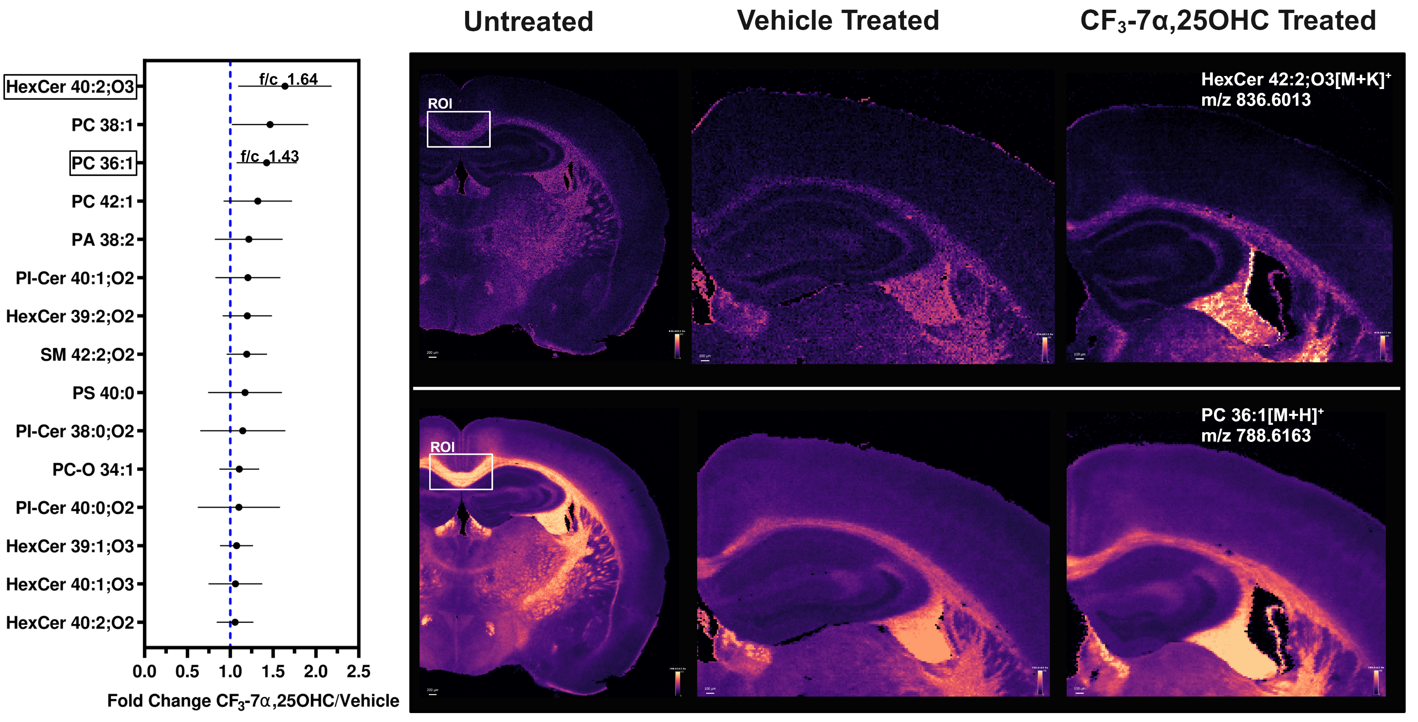
Supplemental data 2
a
b
A
C
E

