Slide 1
In-service Simulation of Second Phase Particle Evolution in Zircaloys
Kieran Lynch, Philipp Frankel, Mia Maric, Christopher Race, Matt Topping, Christopher Daniel, Aidan Cole-Baker, and Joseph Robson
April 2025
Notes:
Note: 30 min presentation – 25 mins with 5 min Qs?

Slide 2
Overview
Zr(Fe,Cr)₂ evolution in Zircaloy-4 during quenching and annealing
- SPPs in Zircaloy
- The Kampmann-Wagner Numerical (KWN) model
- Simulating SPP evolution from a recrystallised state
- Characterisation and simulation of SPP evolution during quenching and annealing
Simulating Zr(Fe,Cr)₂ evolution in Zircaloys during irradiation
- SPP amorphization
- SPP dissolution
1
2

Slide 3
Zr(Fe,Cr)₂ evolution in Zircaloy-4 during quenching and annealing
- SPPs in Zircaloy
- The Kampmann-Wagner Numerical (KWN) model
- Simulating SPP evolution from a recrystallised state
- Characterisation and simulation of SPP evolution during quenching and annealing
1

Slide 4
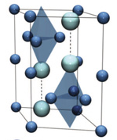
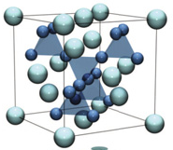
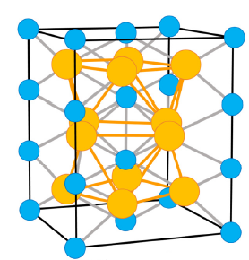
SPPs in Zircaloy
 | Zr | Sn | Fe | Cr | Ni
Zircaloy-2 (wt. %) | Balance | 1.5 | 0.15 | 0.1 | 0.05
Zircaloy-4 (wt. %) | Balance | 1.5 | 0.21 | 0.1 | /
BCT Zr₂(Fe,Ni) is only present in Zircaloy-2 ^{[2]}.
C14 Laves phase
Zr(Fe,Cr)₂
C15 Laves phase
Zr(Fe,Cr)₂^{[1]}
Hexagonal C14 phase is more commonly observed in Zircaloy-2 and -4, although both can be present.
Burr PA, Murphy ST, Lumley SC, Wenman MR, Grimes RW. Corros Sci. 2013 Apr 1;69:1–4.
Shah Z. Characterizing and Modelling Precipitation in Zirconium Alloys. The University of Manchester; 2019.

Slide 5
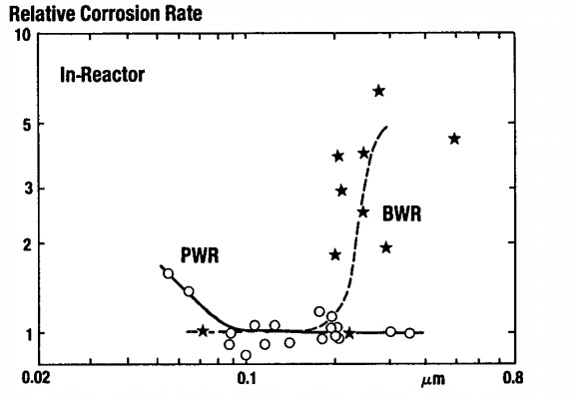
SPPs and corrosion
Zircaloy-2
Zircaloy-4
Garzarolli F, Steele H. Behaviour of structural materials for fuel and control elements in light water cooled power reactors. In: Improvements in Water Reactor Fuel Technology and Utilization. Stockholm; 1986. p. 387–407.

Slide 6
Zr(Fe,Cr)₂ evolution in Zircaloy-4 during quenching and annealing
- SPPs in Zircaloy
- The Kampmann-Wagner Numerical (KWN) model
- Simulating SPP evolution from a recrystallised state
- Characterisation and simulation of SPP evolution during quenching and annealing
1

Slide 7



The KWN model
Classical precipitation theory
Start
Increment time by Δt. Calculate number of new particles nucleated in interval.
Nucleation:
Calculate solute concentration remaining in matrix.
Calculate growth rates for new and existing particles. Update size distribution.
Calculate volume fraction of precipitate.
Has end time been reached?
Growth and coarsening:
N
End
Y
Assumptions:
Mean-field approximation
Diffusion controlled growth in the matrix
Pseudo-binary Fe-Cr solute
Key parameters:
Effective solute diffusivity
Nucleation site density
Effective SPP interfacial energy
J. D. Robson, “Modeling precipitate evolution in zirconium alloys during irradiation,” Journal of Nuclear Materials 476, (August 2016): 123–131.

Slide 8
Zr(Fe,Cr)₂ evolution in Zircaloy-4 during quenching and annealing
- SPPs in Zircaloy
- The Kampmann-Wagner Numerical (KWN) model
- Simulating SPP evolution from a recrystallised state
- Characterisation and simulation of SPP evolution during quenching and annealing
1

Slide 9
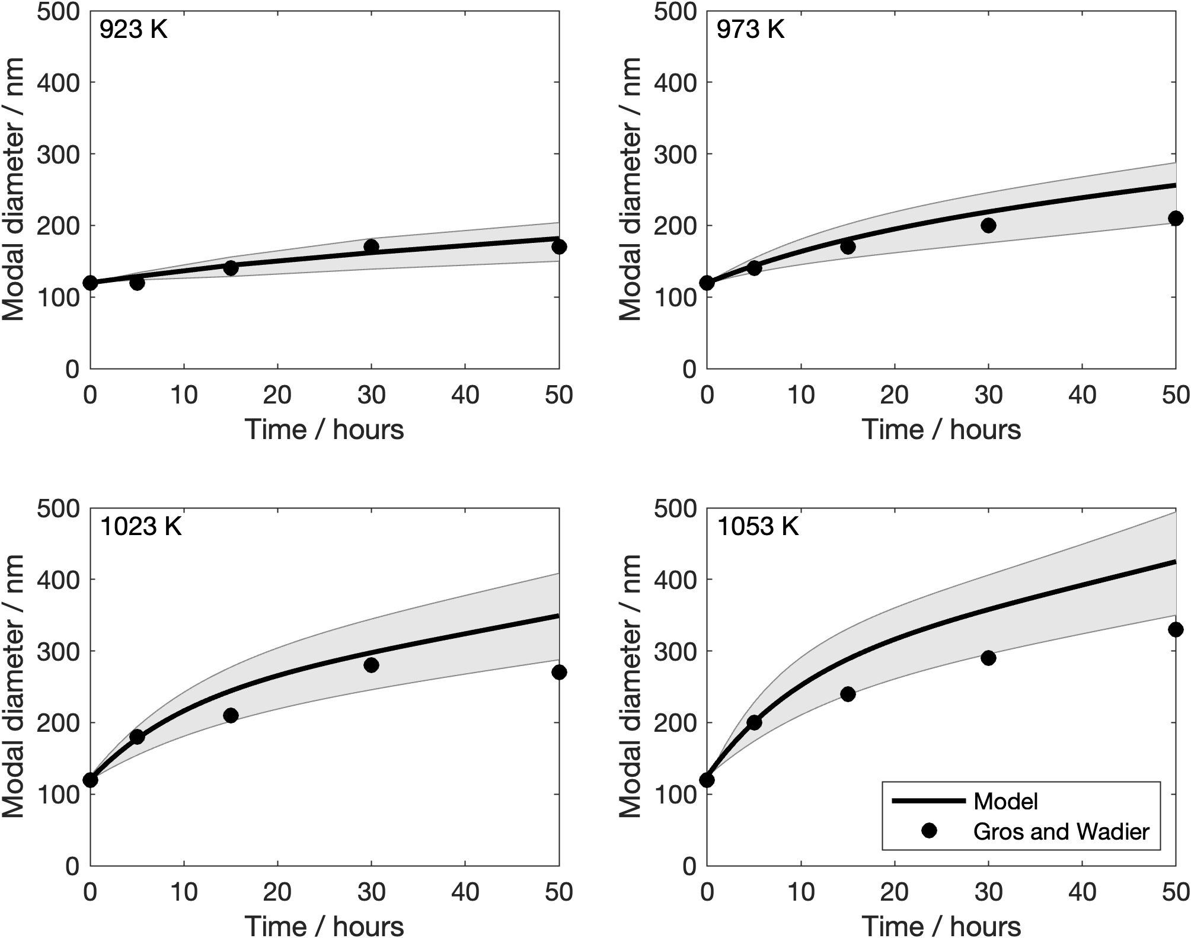
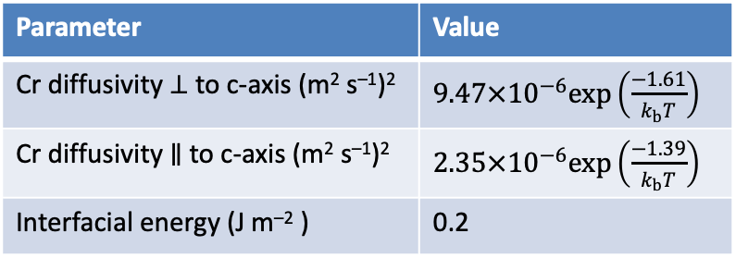
SPP evolution from recrystallised state
Fe-Cr binary solute, with Cr being slower diffuser
Parameter | Value
Cr diffusivity ⊥ to c-axis (m² s^{–1})² | $9.47×10^{−6}exp\left(\frac{−1.61}{k_{b}T}\right)$
Cr diffusivity ∥ to c-axis (m² s^{–1})² | $2.35×10^{−6}exp\left(\frac{−1.39}{k_{b}T}\right)$
Interfacial energy (J m^{–2} ) | 0.2
J. P. Gros and J. F. Wadier, Precipitate growth kinetics in zircaloy-4, J. Nuc. Mater. 172, no. 1 (1990): 85–96.
G. Hood and R. Schultz, Diffusion of 3D Transition Elements in α-Zr and Zirconium Alloys, in ZITNI: Eighth Int. Symp., (ASTM International, December 4, 1989), 435–450.
Notes:
Average between the two diffusion rates offers good predictions for lower temperatures and earlier annealing times. This suggests that as the system is further into the SPP coarsening regime, the interparticle spacing increases, and the slower diffusion of Cr along the a-axis direction becomes rate controlling.
This is good and shows its effectiveness; however, the model in this form was trialled for quenching and couldn’t successfully replicate experimental trends, leading to further model development to capture the mechanisms controlling SPP evolution during quenching and annealing.

Slide 10
Zr(Fe,Cr)₂ evolution in Zircaloy-4 during quenching and annealing
- SPPs in Zircaloy
- The Kampmann-Wagner Numerical (KWN) model
- Simulating SPP evolution from a recrystallised state
- Characterisation and simulation of SPP evolution during quenching and annealing
1

Slide 11
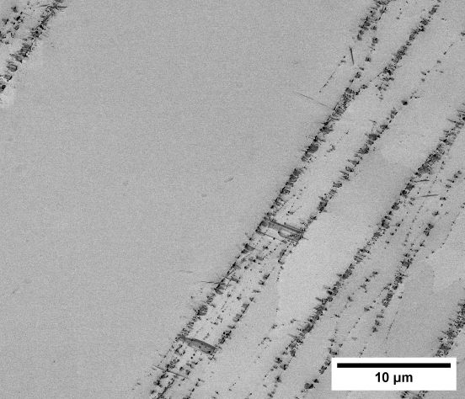
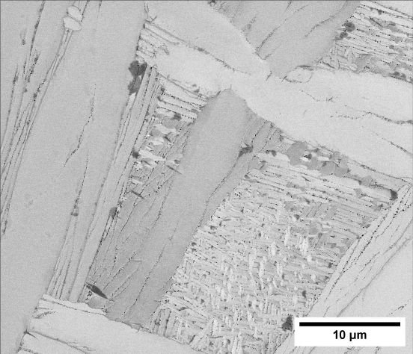
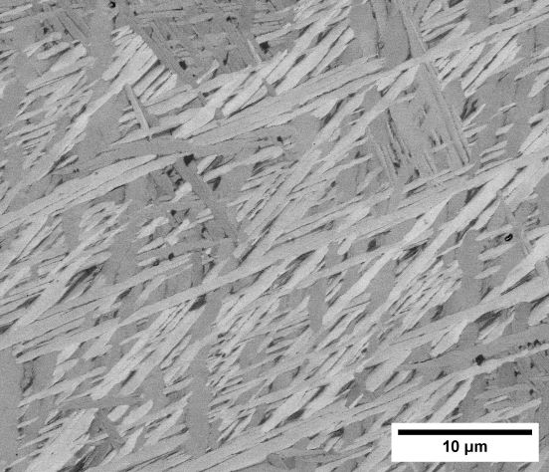
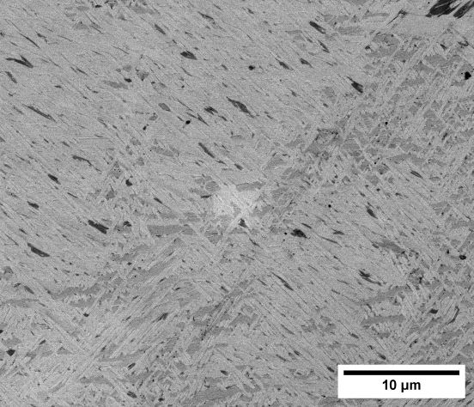
Zircaloy-4 as-quenched microstructure
Lack of SPPs in the grain interior
ABQ
OBQ_{SC}
OBQ_{FC}
WBQ
Increasing quench rate
Decreasing α-lamella width
Decreasing SPP size
Increasing SPP number density

Slide 12
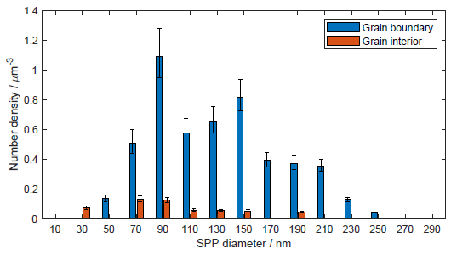
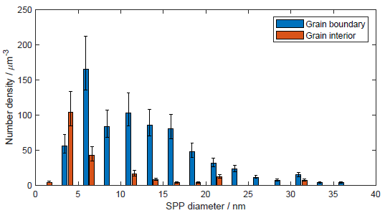
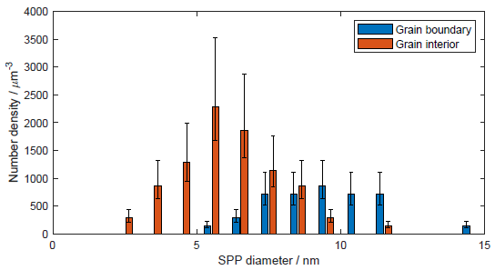
SPP size distribution
Air quenched
Oil quenched
Water quenched
Distinction between distribution of grain boundary and grain interior SPPs
Decreased quench rate → increased volume fraction of grain boundary SPPs

Slide 13
Solute segregation
β-Zr
α-Zr
SPPs
Fe/Cr conc. in α-Zr
Fe/Cr conc. in α-Zr
Fe/Cr conc. in α-Zr

Slide 14
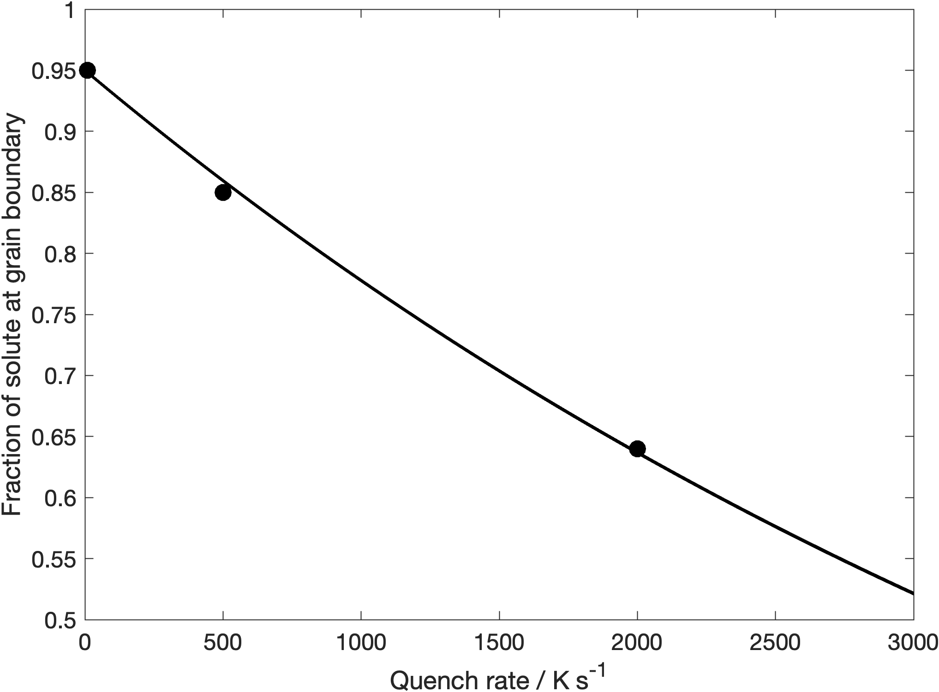
Solute segregation
Fraction of solute at grain boundary $=0.95\exp\left(−0.0002QR\right)$

Slide 15


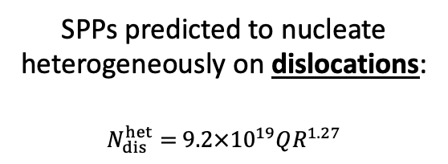
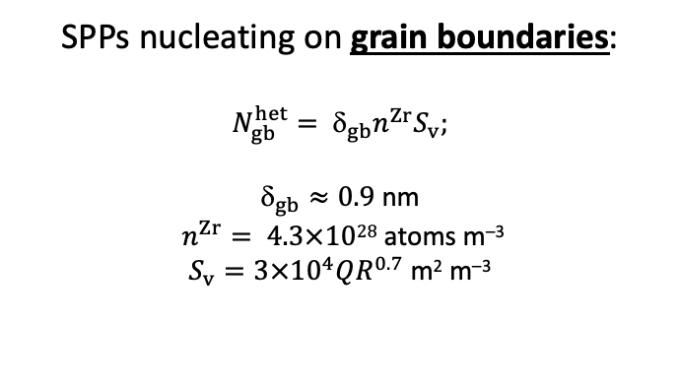
Grain interior
Grain boundary
SPPs nucleating on grain boundaries:
$$N_{gb}^{het}= _{gb}n^{Zr}S_{v};$$
$_{gb}≈0.9$ nm
$n^{Zr}= 4.3×1028$atoms m^{–3}
$S_{v}=3×10^{4}QR^{0.7}$ m² m^{–3}
SPPs predicted to nucleate heterogeneously on dislocations:
$N_{dis}^{het}=$ $9.2×10^{19}QR^{1.27}$
Nucleation
Growth
1. J. Ardell, On the coarsening of grain boundary precipitates, Acta Metall. 20, no. 4 (April 1972): 601–609.
2. X. Sun and O. Northwood Derek, Effect of substructure on the thermoelectric power of a β-quenched ZrCrFe alloy, Rare Metals 12, no. 2 (April 1993): 110–116.
3. Corvalán Moya, M. J. Iribarren, N. Di Lalla, and F. Dyment, Grain boundary diffusion and segregation of Cr in α-Zr, J. Nuc. Mater. 382, no. 1 (November 2008): 35–38.

Slide 16
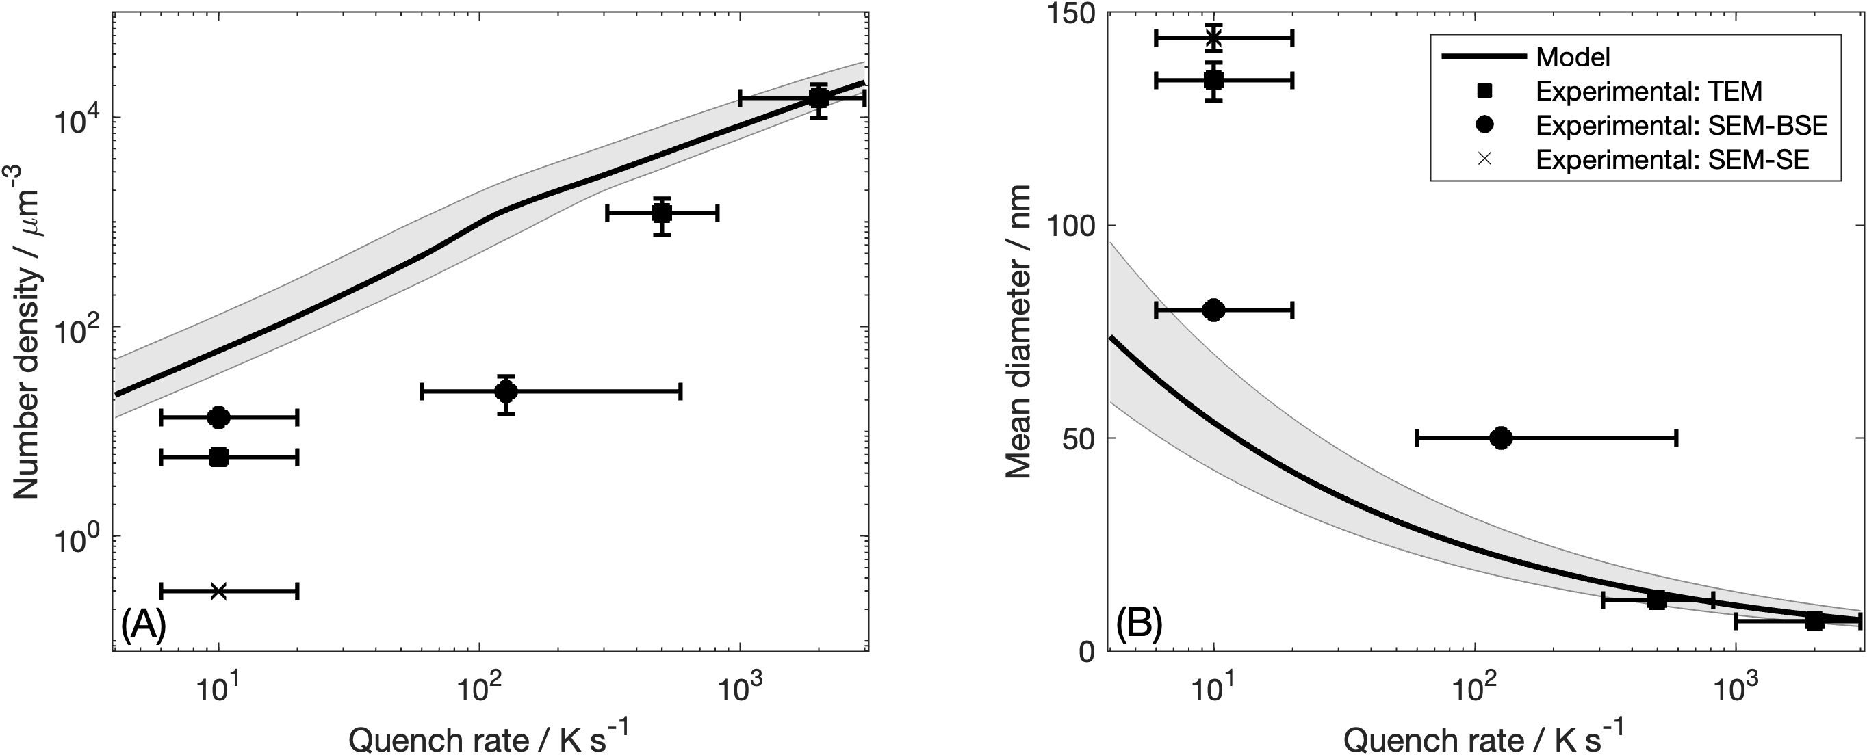
Experimental comparison: as-quenched
3
4
2
1
1. Loss of smaller SPPs during mechanical grinding and polishing (SEM-SE)
2. Resolution and minimum detection limits of SEM-BSE analysis
3. Loss of smaller SPPs during mechanical grinding and polishing (SEM-SE)
4. Limited sample size (a single grain) in STEM analysis

Slide 17
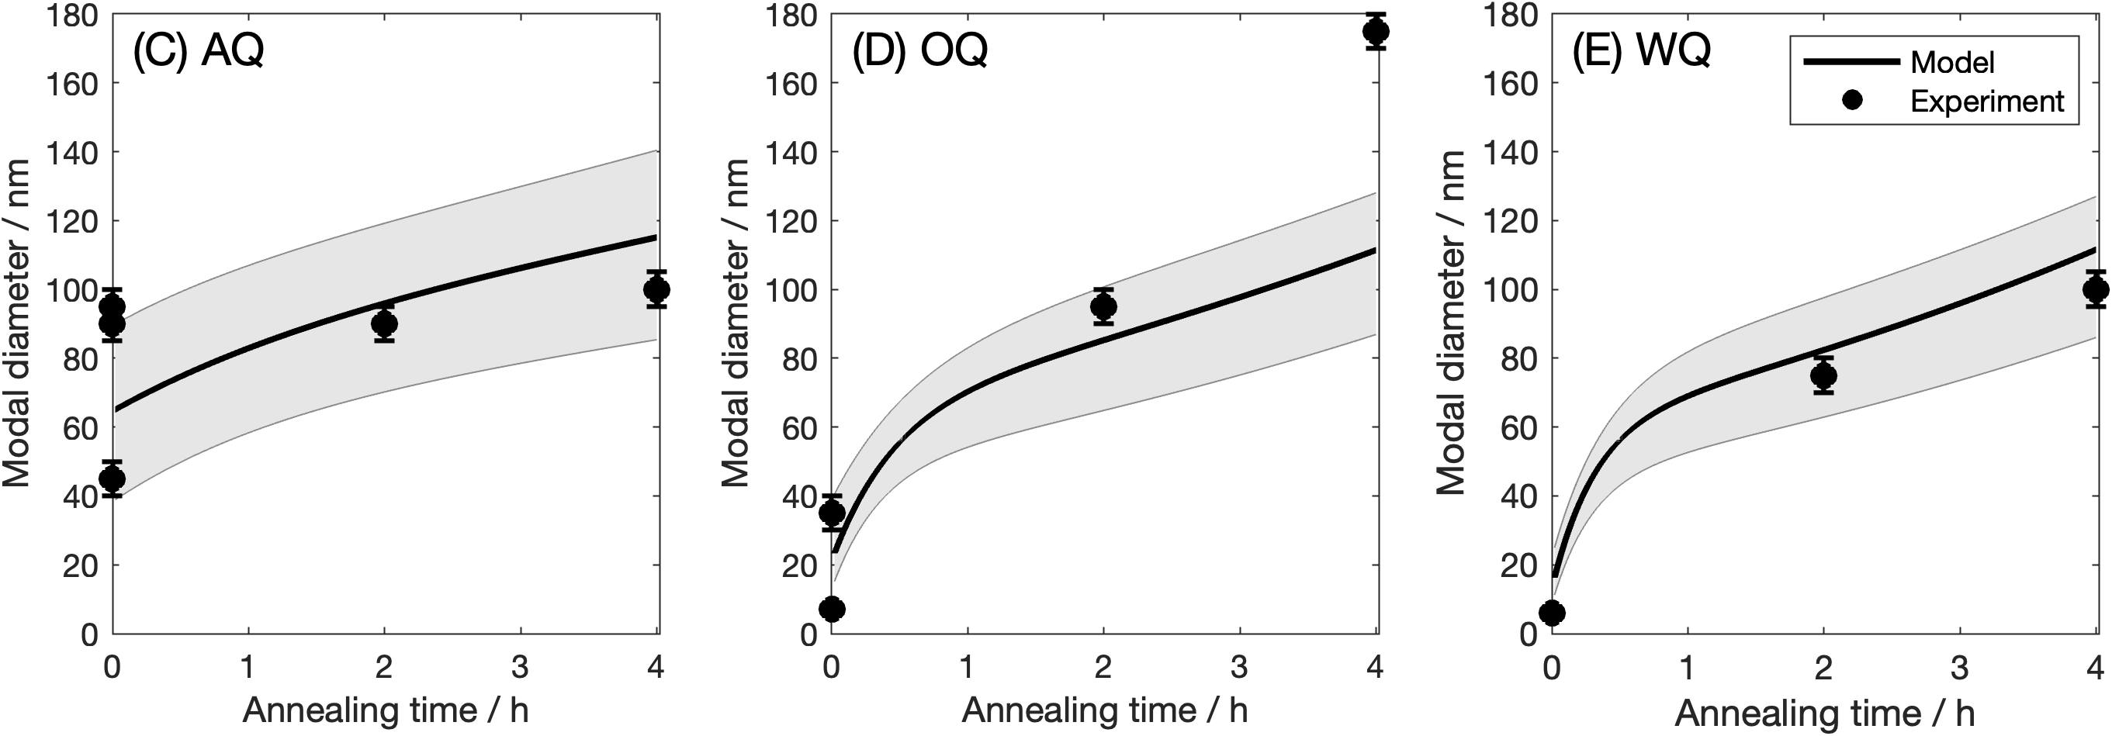
Experimental comparison: post-quench annealing at 700 ºC

Slide 18
Simulating Zr(Fe,Cr)₂ evolution in Zircaloys during irradiation
- SPP amorphization
- SPP dissolution
2

Slide 19
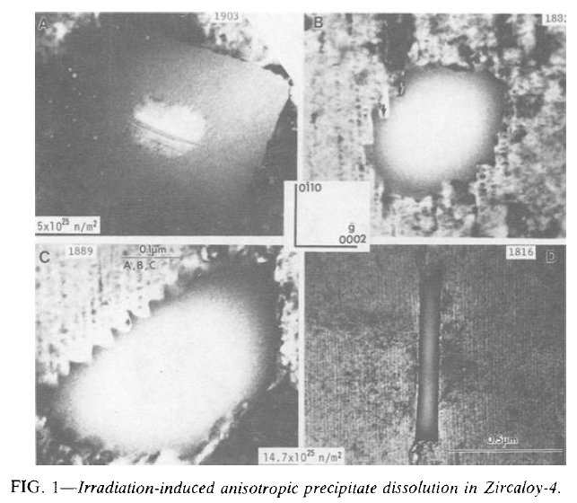
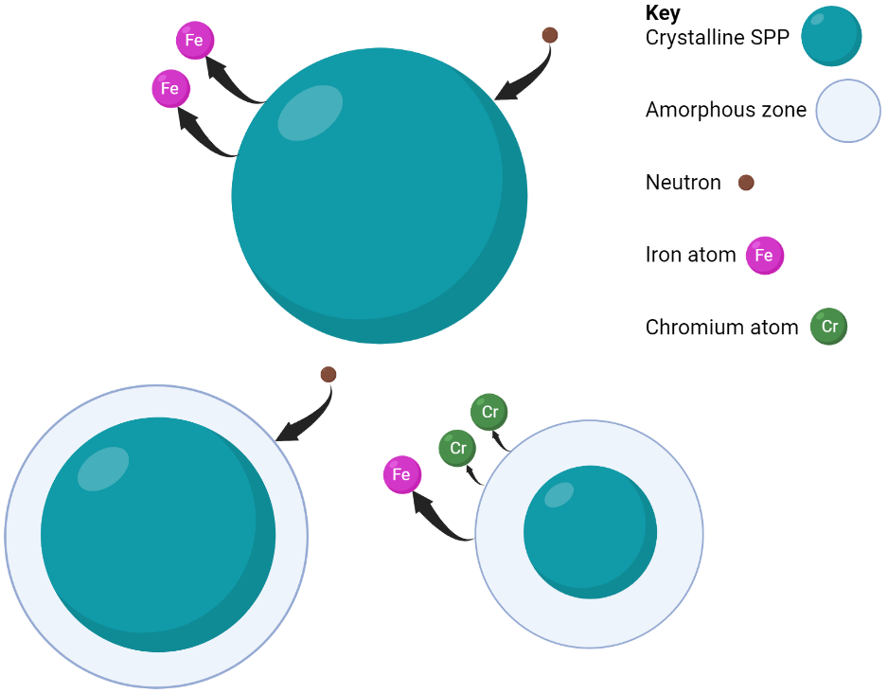
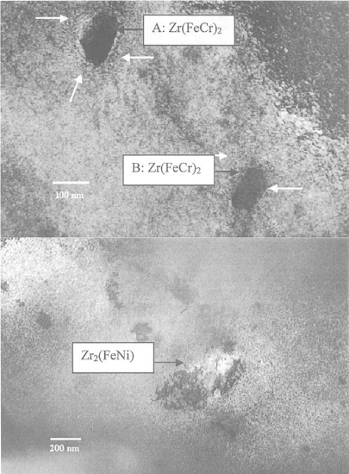
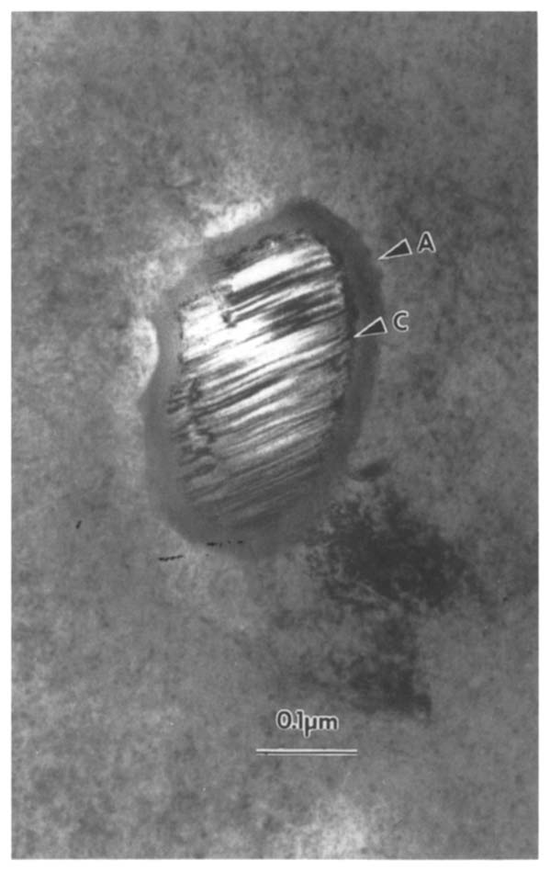
Yang W, Adamson R. Beta-Quenched Zircaloy-4: Effects of Thermal Aging and Neutron Irradiation. ZITNI: 8th. ASTM International; 1989. p. 451–77.
Amorphization
Type of damage
Point defects
Chemical disorder
Antisite defects
Frenkel pairs
Vacancies and interstitials
Goll W, Ray I. The behavior of intermetallic precipitates in highly irradiated BWR LTP cladding. In: Moan G, Rudling P, editors. ZITNI: 13th. ASTM International; 2002. p. 80–95.
Motta AT, Lemaignan C. A ballistic mixing model for the amorphization of precipitates in Zircaloy under neutron irradiation. J Nucl Mater. 1992 Nov 1;195(3):277–85.
Dissolution

Slide 20
The model
Alloy fabrication - KWN
Start
Increment time by Δt. Calculate number of new particles nucleated in interval.
Calculate solute concentration remaining in matrix.
Calculate growth rates for new and existing particles. Update size distribution.
Irradiation exposure
Calculate volume fraction of precipitate.
Has end time been reached?
Increment time by Δt.
Activate irradiation.
N
End
Y
Calculate amorphous zone width and precipitate dissolution rate. Update size distribution.
N
Has end time been reached?
End
Calculate volume fraction of precipitate remaining and matrix solute concentration.
Y
Robson JD. J Nucl Mater. 2016 Aug 1;476:123–31.

Slide 21
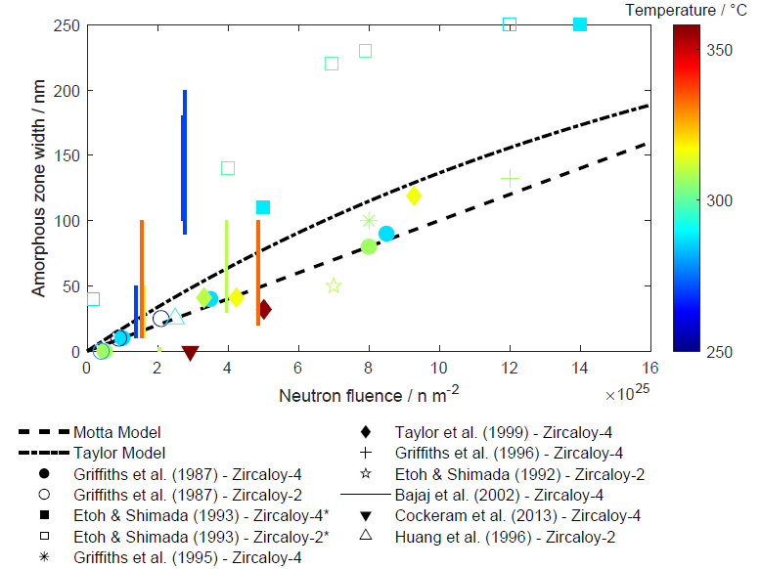
SPP amorphization
Amorphization
Lower T
Higher T
Taylor model: Amorphization occurs from irradiation damage which leads to Fe loss. When the Fe loss reaches a critical point the amorphous phase becomes stable.
Considers temperature and flux.
Motta AT, Lemaignan C. A ballistic mixing model for the amorphization of precipitates in Zircaloy under neutron irradiation. J Nucl Mater. 1992 Nov 1;195(3):277–85.
D. F. Taylor, H. R. Peters, and W. J. S. Yang, A Simple Kinetic Model of Zircaloy Zr(Fe,Cr)2 Precipitate Amorphization During Neutron Irradiation, in Ninth Int. Sym. Env. Deg. Mat. in Nuc. Power Systems-Water Reactors, 1999, 1161–1168.

Slide 22
Simulating Zr(Fe,Cr)₂ evolution in Zircaloys during irradiation
- SPP amorphization
- SPP dissolution
2

Slide 23
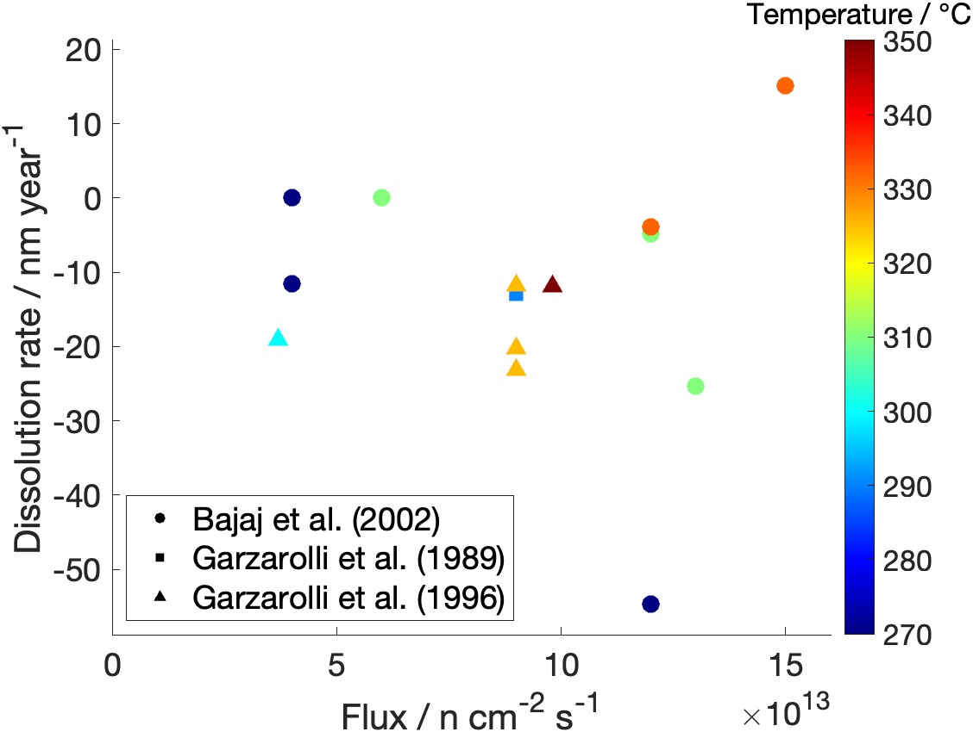
Irradiation-induced Zr(Fe,Cr)₂ dissolution
At typical reactor temperatures:
Dissolution

Slide 24
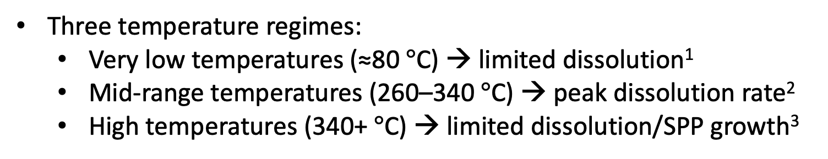
Irradiation-induced Zr(Fe,Cr)₂ dissolution
General trends:
Higher flux → increased dissolution rate
Increased fluence → increased dissolution
Three temperature regimes:
  Very low temperatures (≈80 $°$C) → limited dissolution¹
  Mid-range temperatures (260–340 $°$C) → peak dissolution rate²
  High temperatures (340+ $°$C) → limited dissolution/SPP growth³
1. M. Griffiths, R. W. Gilbert, and G. J. C. Carpenter, Phase instability, decomposition and redistribution of intermetallic precipitates in Zircaloy-2 and -4 during neutron irradiation, J. Nuc. Mat. 150, no. 1, 1987, 53–66.
2. R. Bajaj, B. F. Kammenzind, and D. M. Farkas, Effects of neutron irradiation on the microstructure of alpha-annealed Zircaloy-4, in ZITNI: Thirteenth Int. Sym., 2002, 400–425.
3. F. Garzarolli, P. Dewes, G. Maussner, and H. H. Basso, Effects of High Neutron Fluences on Microstructure and Growth of Zircaloy-4, in ZITNI: Eighth Int. Sym., 1989, 641–657,

Slide 25

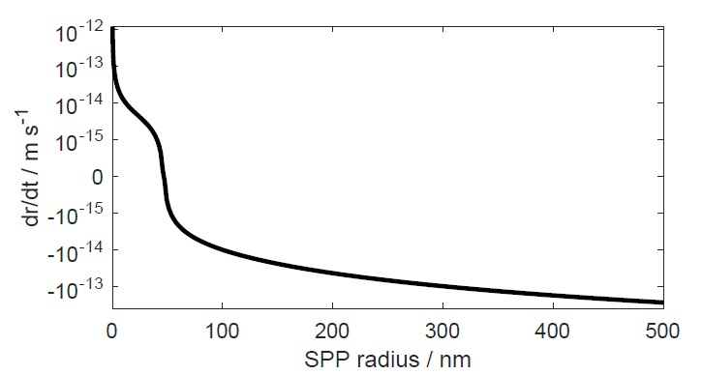
Nelson-Hudson-Mazey (NHM) model
Unable to correctly predict trends:
Negligible variation in dissolution rate with temperature
Low temperatures: diffusion is limited → growth term is negligible → unrealistic rapid dissolution
High fluxes: ballistic dissolution term dominates → unrealistic rapid dissolution
Dissolution caused by ballistic sputtering
Diffusion-controlled growth
Predictions:
Inverse Ostwald Ripening
Precipitates converge to an equilibrium size
Reducing temperature → reduced diffusivity → adjusts equilibrium size
R. S. Nelson, J. A. Hudson, and D. J. Mazey, “The stability of precipitates in an irradiation environment,” Journal of Nuclear Materials 44, no. 3 (September 1972): 318–330.

Slide 26
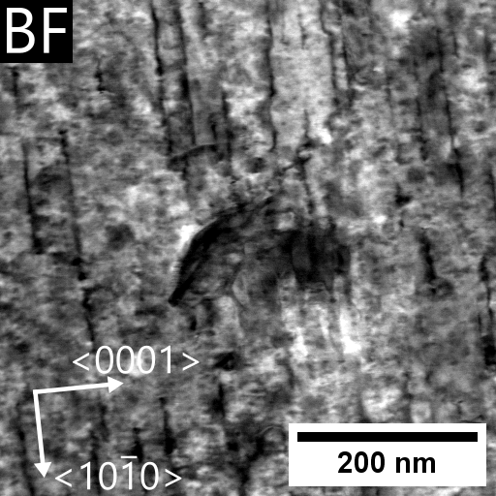
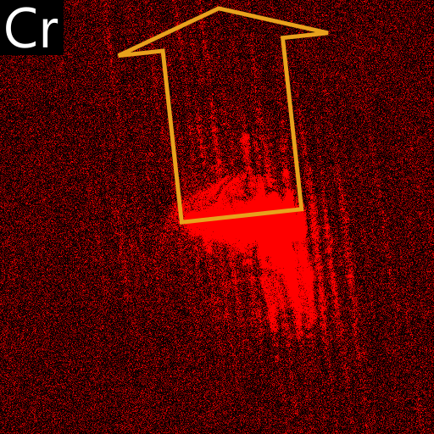
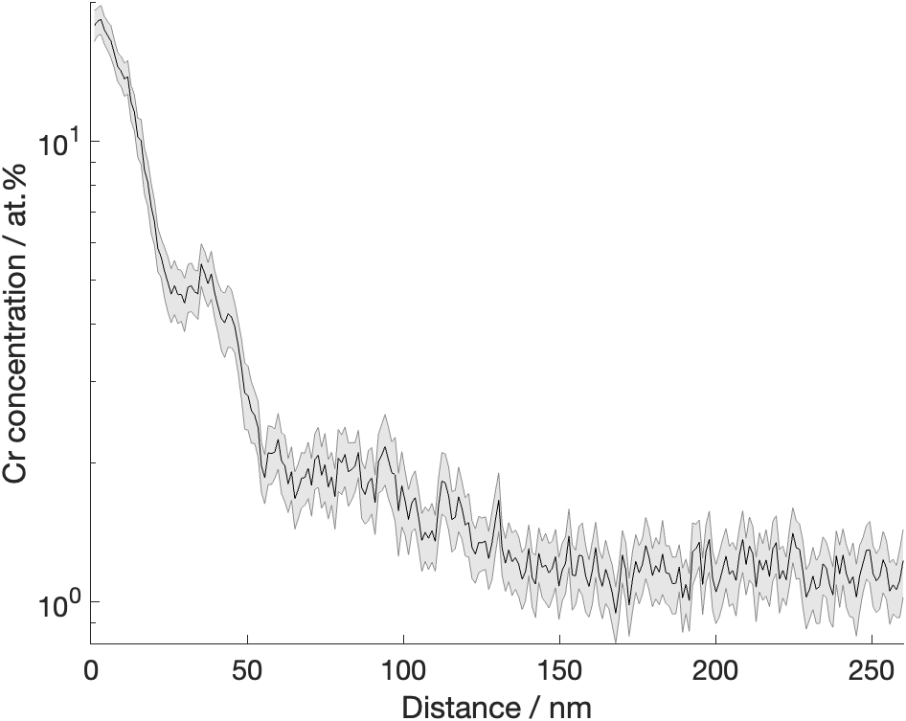
Modified NHM Cellular (MNC) model
Key NHM assumptions:
1) Ballistically sputtered solute atoms are instantaneously relocated in the matrix to infinite distances
2) Recoil events do not transport solute atoms back to the SPP
C
320 ± 10 °
6×10¹⁸ n m⁻² s⁻¹
16×10²⁵ n m⁻² (32 dpa)

Slide 27
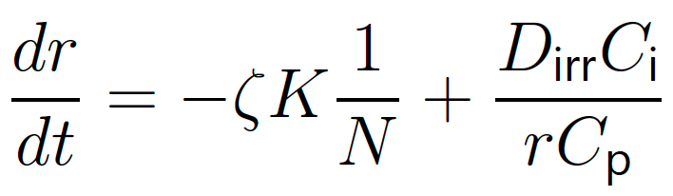
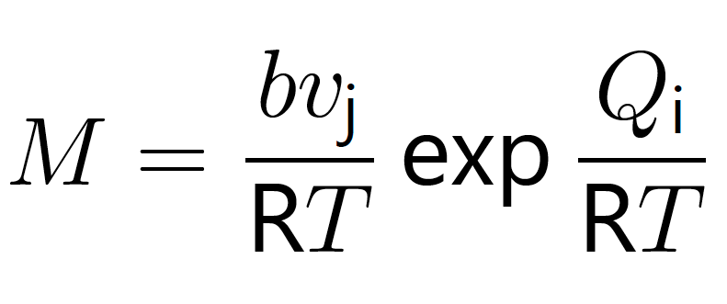
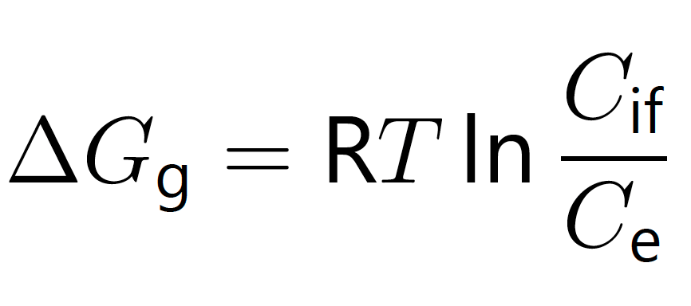
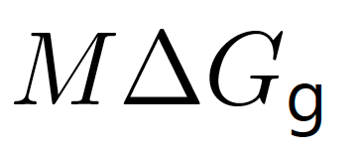

MNC model
X
Interface mobility
Change diffusion-controlled growth to an interface-controlled mechanism
Thermodynamic driving force for growth/dissolution
Solute distribution in matrix is solved using Fick’s second law
X
Dissolution caused by ballistic sputtering
J. W. Christian, The Classical Theory of Nucleation, in The Theory of Transformations in Metals and Alloys, 2002:422–479.

Slide 28
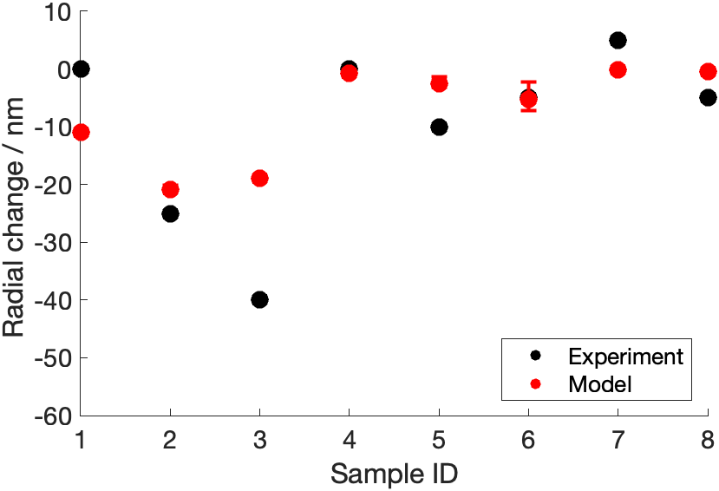
MNC model calibration
Temperature (°C) | Flux (×10¹⁴ n cm⁻² s⁻¹) | Fluence (×10²¹ n cm⁻²)
270 | 0.4 | 1.39
270 | 0.4 | 2.77
270 | 1.2 | 2.77
310 | 0.6 | 2.05
310 | 1.3 | 1.62
310 | 1.2 | 3.96
332 | 1.5 | 1.56
332 | 1.2 | 4.86
R. Bajaj, B. F. Kammenzind, and D. M. Farkas, Effects of neutron irradiation on the microstructure of alpha-annealed Zircaloy-4, in Zirconium in the Nuclear Industry: Thirteenth Int. Sym., 2002, 400–425.

Slide 29
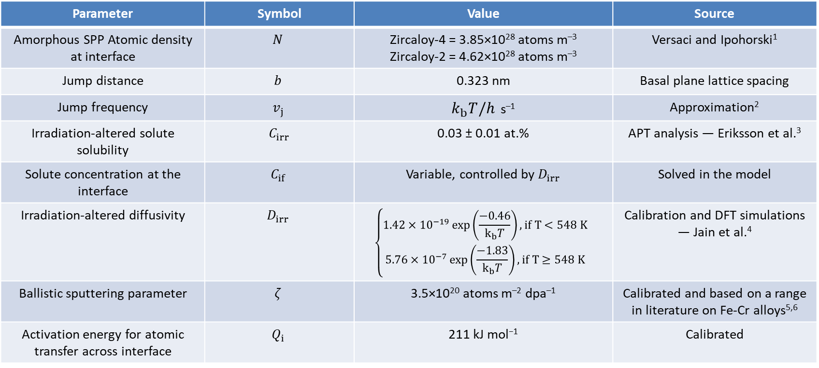
MNC model parameters
Parameter | Symbol | Value | Source
Amorphous SPP Atomic density at interface | $$N$$ | Zircaloy-4 = 3.85×10²⁸ atoms m^{–3} Zircaloy-2 = 4.62×10²⁸ atoms m^{–3} | Versaci and Ipohorski¹
Jump distance | $$b$$ | 0.323 nm | Basal plane lattice spacing
Jump frequency | $$v_{j}$$ | $k_{b}T/h$ s^{–1} | Approximation²
Irradiation-altered solute solubility | $C_{irr}$ | 0.03 ± 0.01 at.% | APT analysis — Eriksson et al.³
Solute concentration at the interface | $$C_{if}$$ | Variable, controlled by $D_{irr}$ | Solved in the model
Irradiation-altered diffusivity | $$D_{irr}$$ | $$\left\{\begin{aligned}1.42×10^{−19}\exp\left(\frac{−0.46}{k_{b}T}\right), if T<548 K \\ 5.76×10^{−7}\exp\left(\frac{−1.83}{k_{b}T}\right), if T≥548 K \end{aligned}\right.$$ | Calibration and DFT simulations — Jain et al.⁴
Ballistic sputtering parameter | $$ζ$$ | 3.5×10²⁰ atoms m^{–2} dpa^{–1} | Calibrated and based on a range in literature on Fe-Cr alloys^{5,6}
Activation energy for atomic transfer across interface | $$Q_{i}$$ | 211 kJ mol⁻¹ | Calibrated
1. R. A. Versaci and M. Ipohorski, Composition of Zr(Cr, Fe)2-type precipitates in Zircaloy-2 and Zircaloy-4, Journal of Nuclear Materials 116, no. 2–3 (June 1983): 321–323.
2. J. Robson, A. Panteli, and P. B. Prangnell, Modelling intermetallic phase formation in dissimilar metal ultrasonic welding of aluminium and magnesium alloys, Sci. Tech. Weld. Join. 17, no. 6, 2012:447–453.
3. J. Eriksson, G. Sundell, P. Tejland, H. O. Andrén, and M. Thuvander, Nanoscale chemistry of Zircaloy-2 exposed to three and nine annual cycles of boiling water reactor operation — an atom probe tomography study, J. Nuc. Mat. 561, 2022:153537.
4. A. C. P. Jain, P. A. Burr, and D. R. Trinkle, First-principles calculations of solute transport in zirconium: Vacancy-mediated diffusion with metastable states and interstitial diffusion, Pyhs. Rev. Mat. 3, no. 3, 2019: 033402.
5. Y. Zhao et al., Effect of heavy ion irradiation dose rate and temperature on α′ precipitation in high purity Fe-18%Cr alloy, Acta Materialia 231, 2022: 117888.
6. K. N. Thomas and G. S. Was, Effect of cascade size and damage rate on α’ precipitate stability in Fe-15Cr, Journal of Nuclear Materials 585, 2023: 154615.

Slide 30
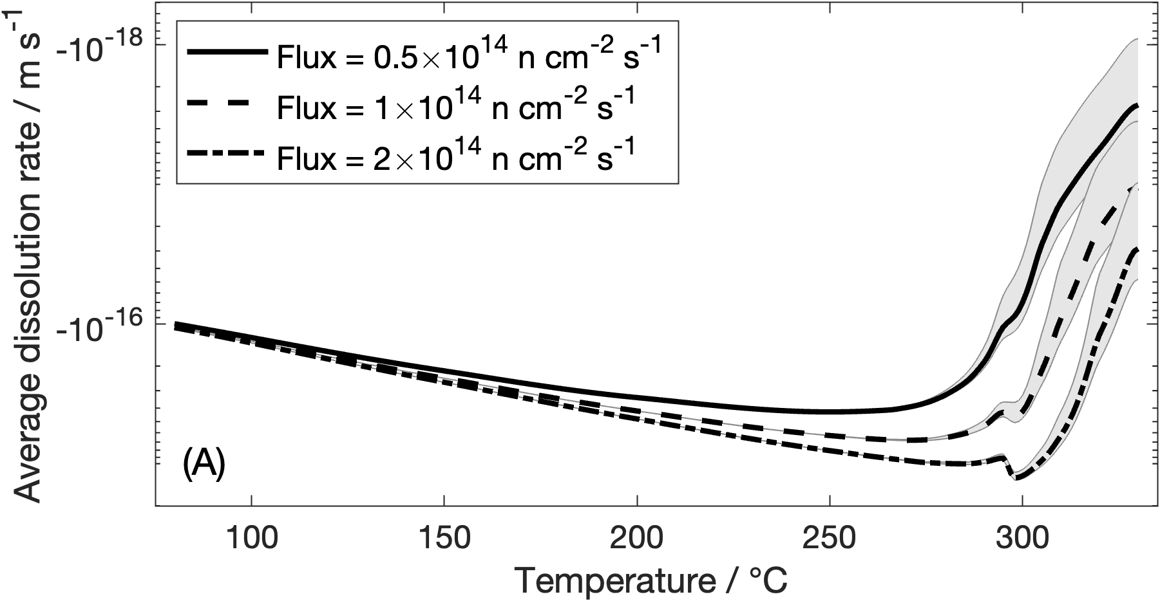
MNC model predictions: neutron irradiation
Simulation time of 1 year
Notes:
That figure is produced by simulating 1 year reactor exposure

Slide 31
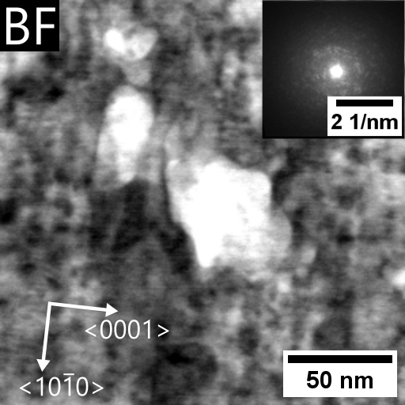
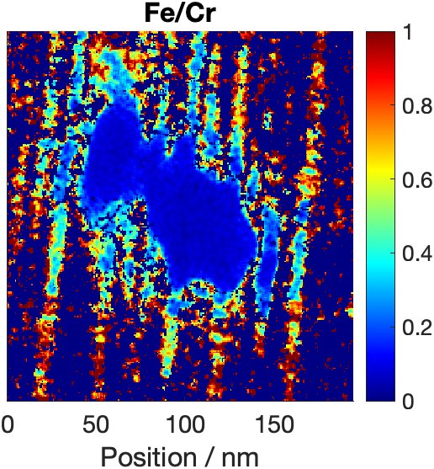
MNC model predictions: neutron irradiation – experimental comparison
Case 1 – typical neutron irradiation
Flux | Temperature | Fluence
0.92×10¹⁴ n cm^{–2} s^{–1} | 290 °C | 1.1×10²² n cm^{–2}
 | Starting mean diameter | Final mean diameter
Experiment | 340 nm | 240 nm
Model | 346 nm | 235–252 nm
F. Garzarolli, P. Dewes, G. Maussner, and H. H. Basso, Effects of High Neutron Fluences on Microstructure and Growth of Zircaloy-4, in ZITNI: Eighth Int, Sym., 1989, 641–657.
Case 2 – high-flux neutron irradiation
Flux | Temperature | Fluence
6×10¹⁴ n cm^{–2} s^{–1} | 320 °C | 1.62×10²² n cm^{–2}
 | Starting mean diameter | Final mean diameter
Experiment | 49 nm | Unknown, but amorphous shells remain
Model | 49 nm | 12–16 nm
Cr

Slide 32
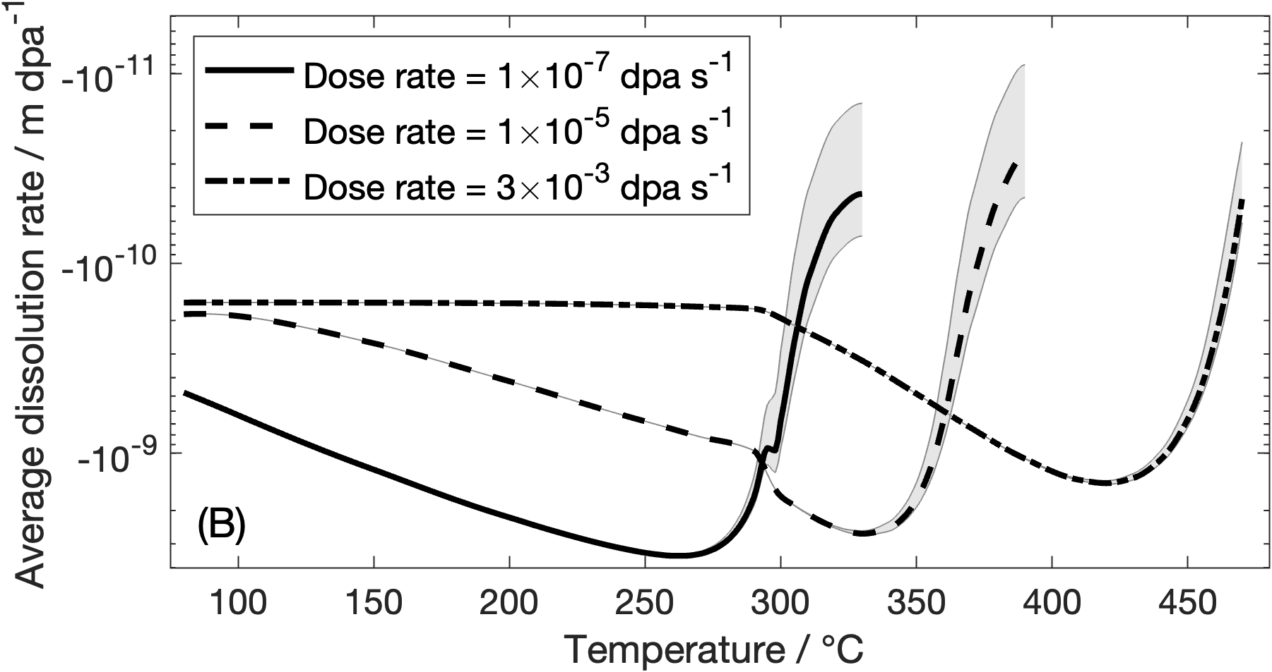
MNC model predictions: heavy ion irradiation
Total dose of 10 dpa
Notes:
This was to a total dose of 10 dpa.

Slide 33
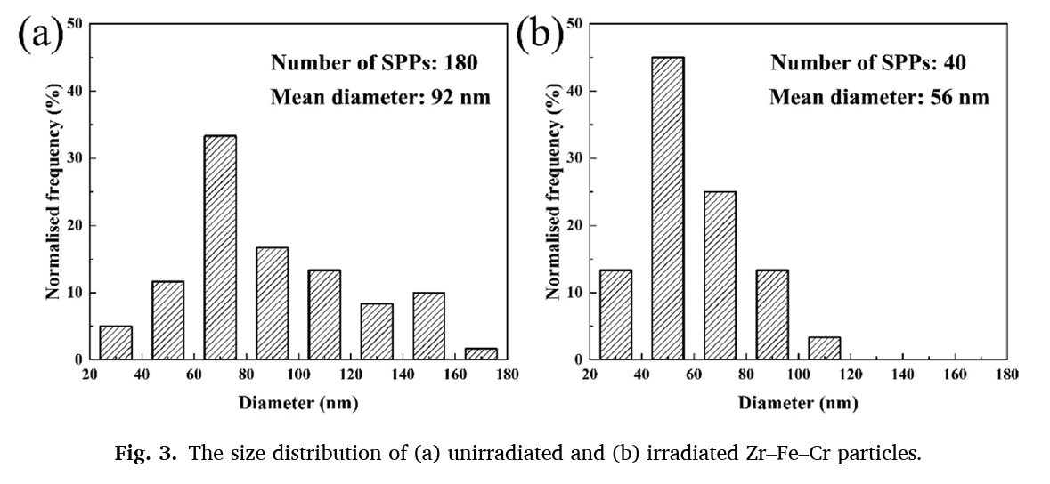
MNC model predictions: heavy ion irradiation – experimental comparison
Case 1 – heavy ion irradiation
 | Dissolution rate
Experiment | –1.4 nm dpa^{–1}
Model | –1.55 nm dpa^{–1}
Dose rate | Temperature | Dose (Kr¹⁷⁺)
3×10^{–4} dpa s^{–1} | 400 °C | 13 dpa
F. Li, S. Li, and Y. Wang, TEM-studies of the element segregation in irradiation induced defect structure in Zircaloy-4, Vacuum 200 2022:111053.
Notes:
This was to a total dose of 10 dpa.

Slide 34
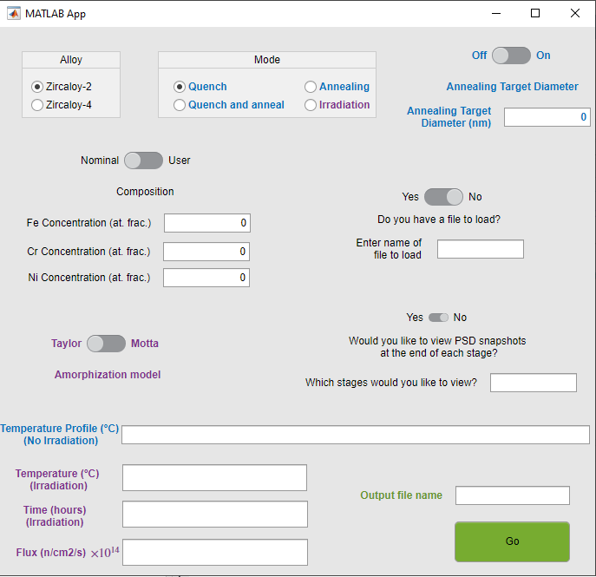
The model

Slide 35
Thank you for listening
Kieran.lynch@global.amentum.com

