Slide 1
Copyright notice
All images in this slide deck are subject to copyright and are used here with express permission from the creators. Copying and using any of the images in separate materials, without obtaining independent permission, would be a violation of copyright.

Slide 2

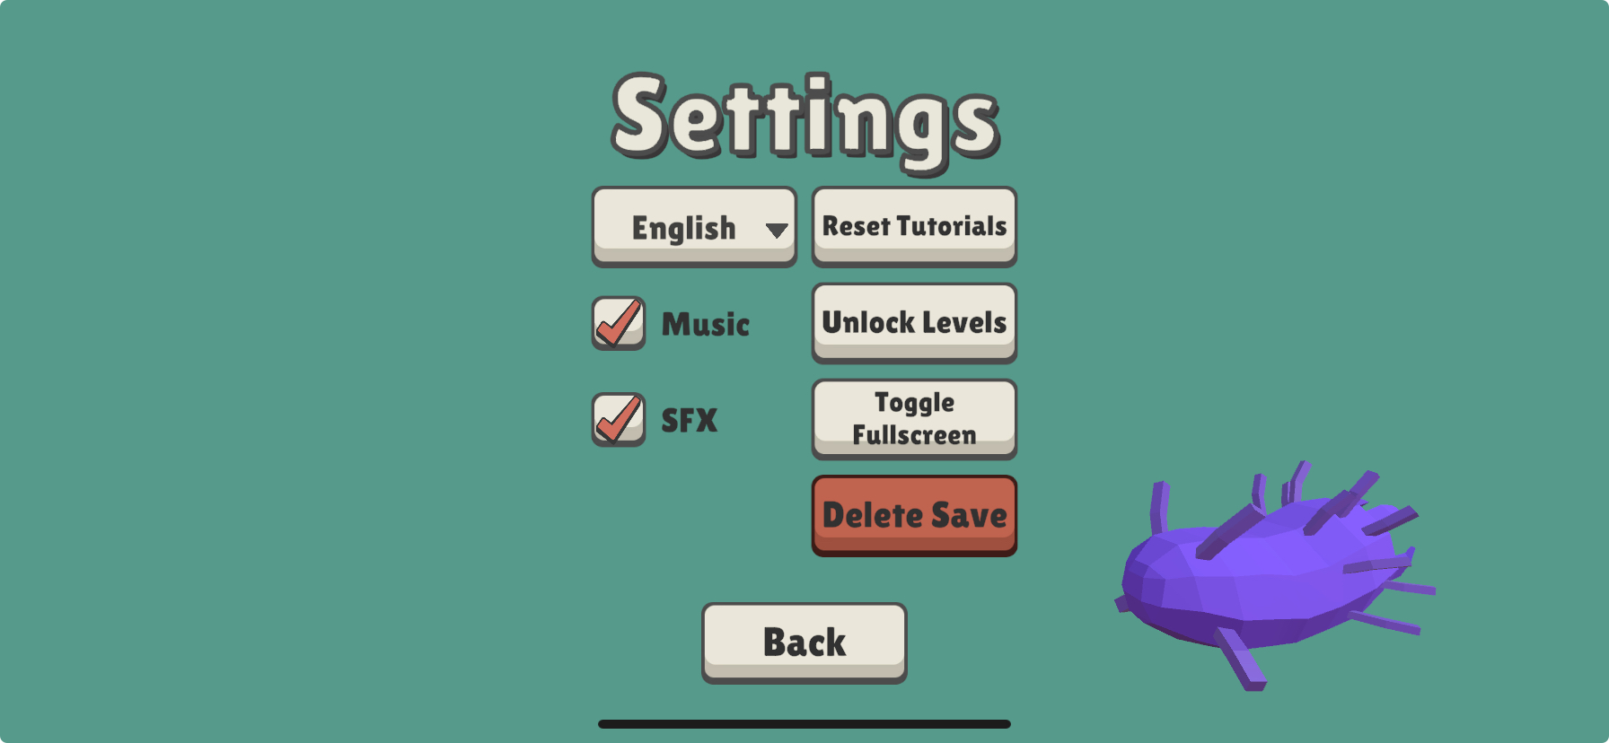
For the teacher
This lesson references these levels: 22–25, 30, 35
To unlock all levels, so that students can access levels without having solved the preceding ones, go to the main menu, settings, Unlock Levels, than click on "Back."

Slide 3



Oxygen and energy

Slide 4

Hi there, it’s me, Splitter.
Today, we’ll see how cells obtain energy.
Energy is essential for living things.

Slide 5
Remember that a living thing:
Is born and dies
Is composed of cells
Maintains itself and develops by drawing on matter and energy from its environment
Can make new living things

Slide 6

This is the topic we’ll focus on today:
Living things maintain themselves and develop by drawing on energy from their environment

Slide 7

When you think about why you need energy, you probably think about moving around and exercising.
And that’s right!

Slide 8
But your cells, like the cells of all living things, use energy all the time to maintain themselves and develop.
The process is called cellular respiration.
I’ll tell you how it works in my cell.

Slide 9
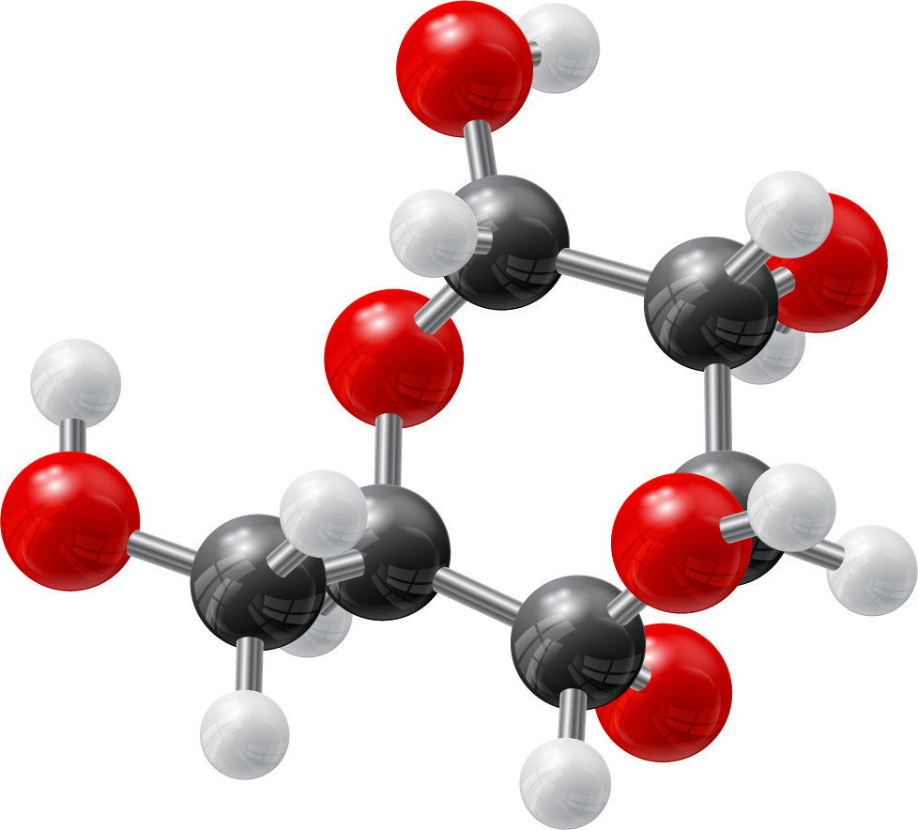
Glucose molecule
The bonds that hold molecules together are made of electrons.
In this picture, the bonds look like steel rods, but in reality electrons are invisible balls of energy.
molecular bond

Slide 10
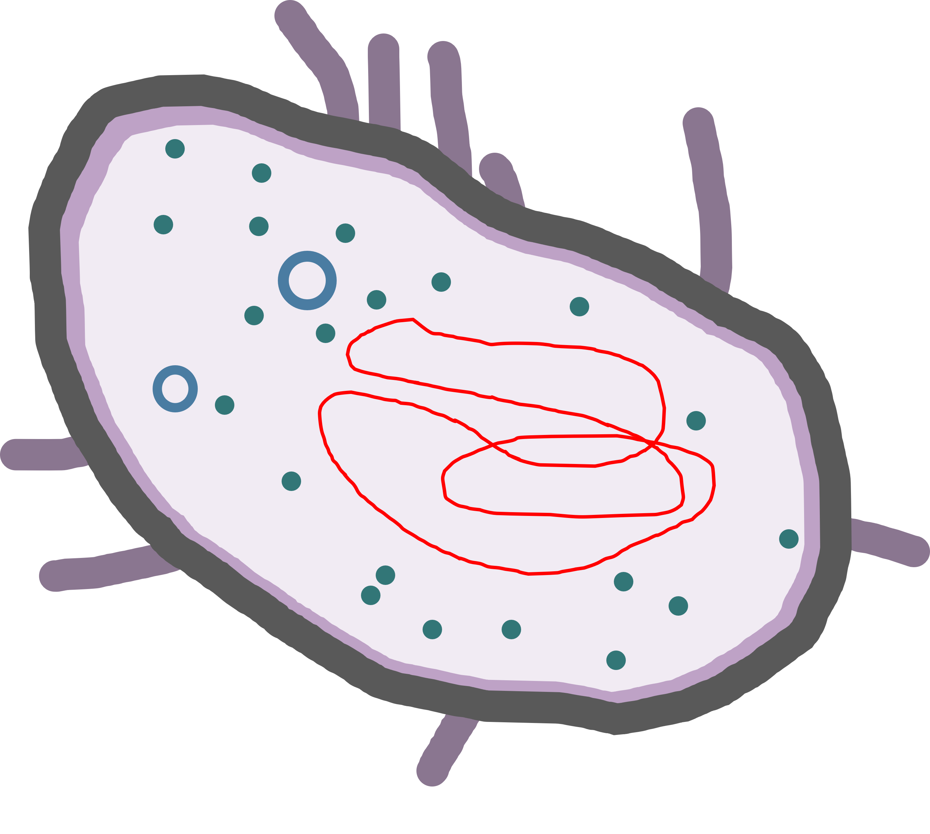
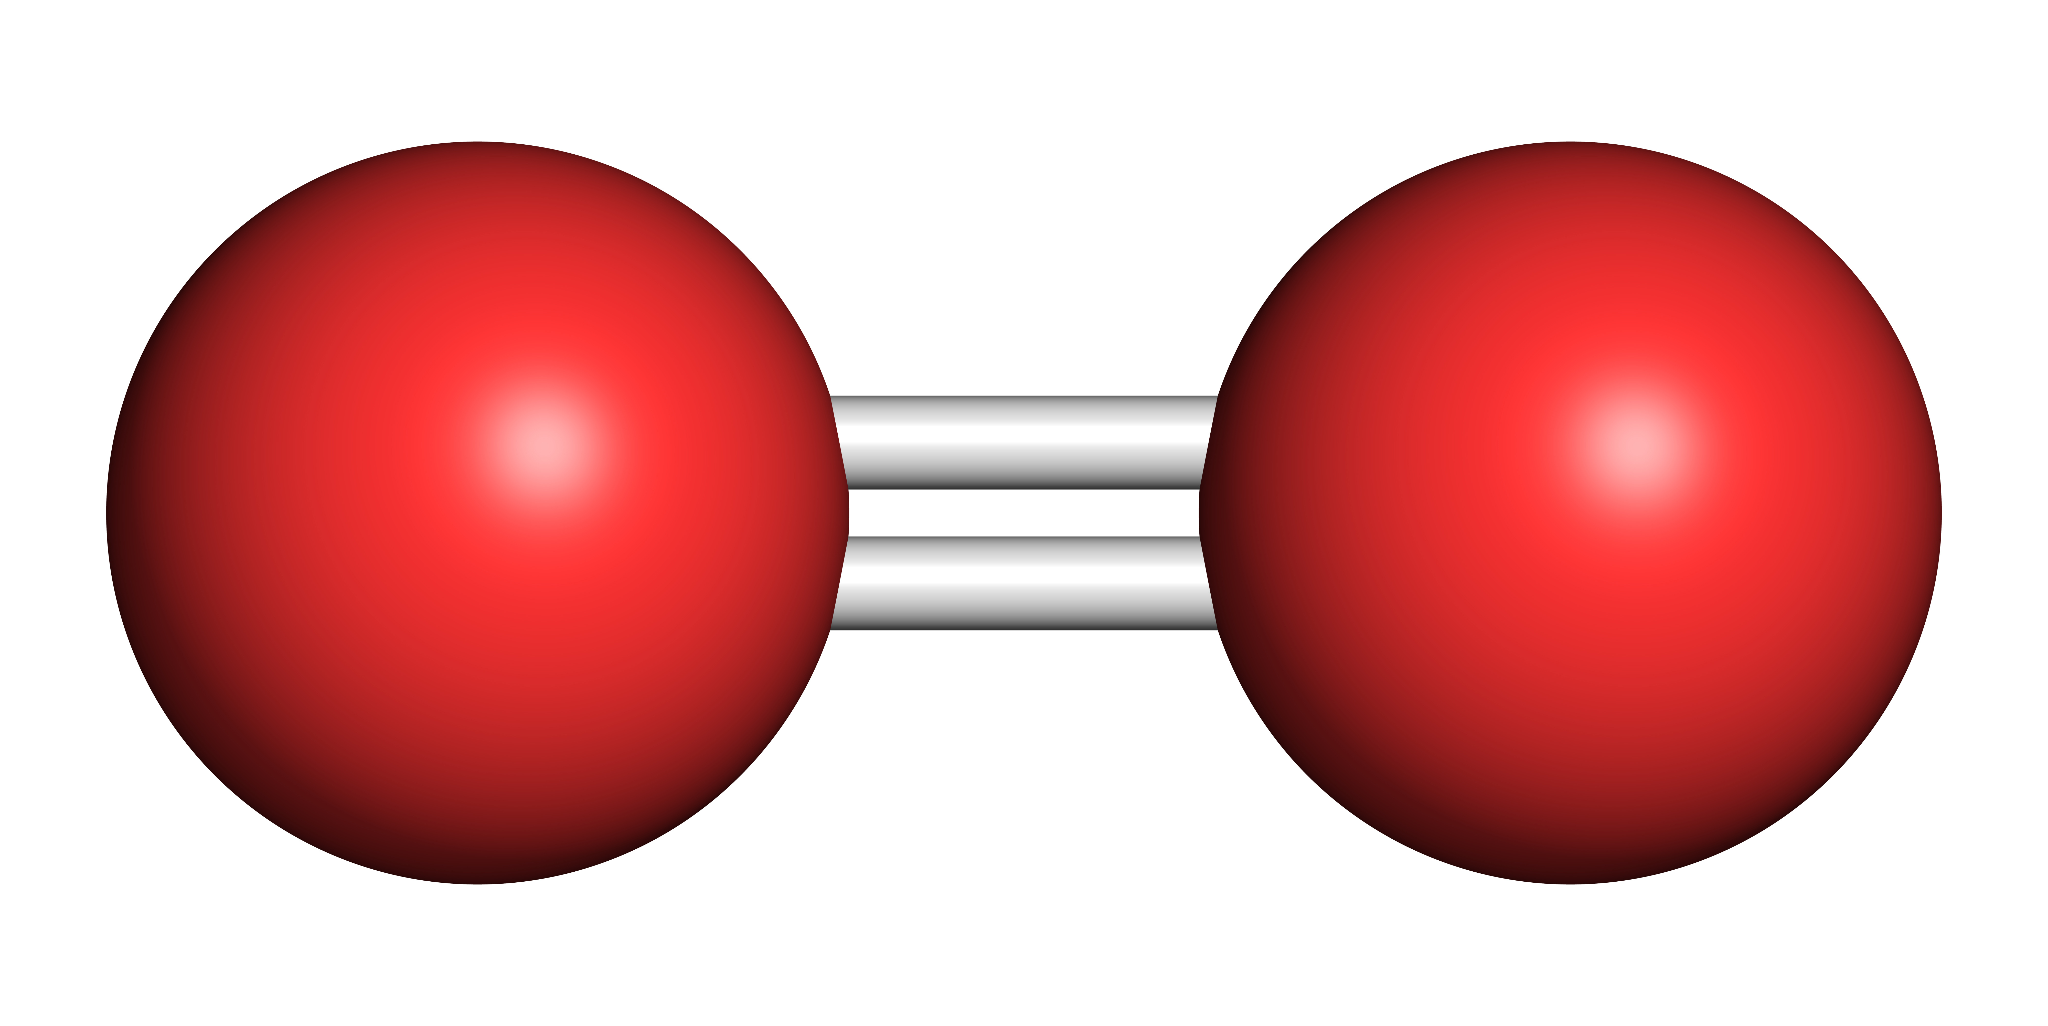
Certain microbes, myself included, use oxygen to produce energy.
We break the bonds of organic carbon molecules to set the electrons free.
Then we roll the electrons along our cell membrane and drop them onto an oxygen molecule.
The flow of electrons produces energy in our cell.
glucose
A molecule of atmospheric oxygen, O₂

Slide 11
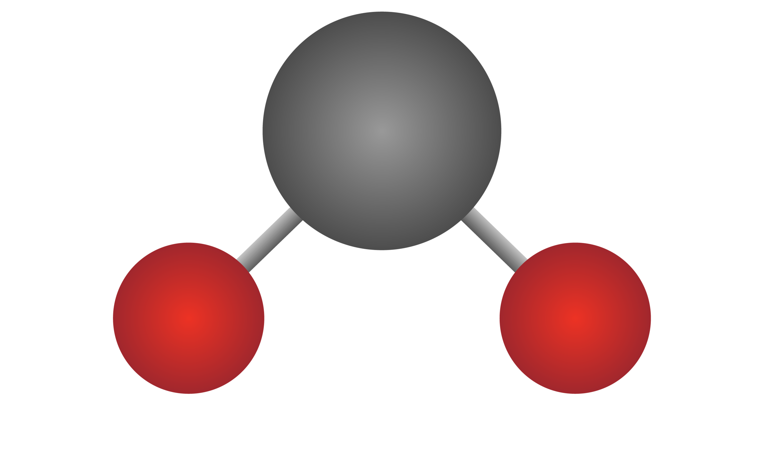
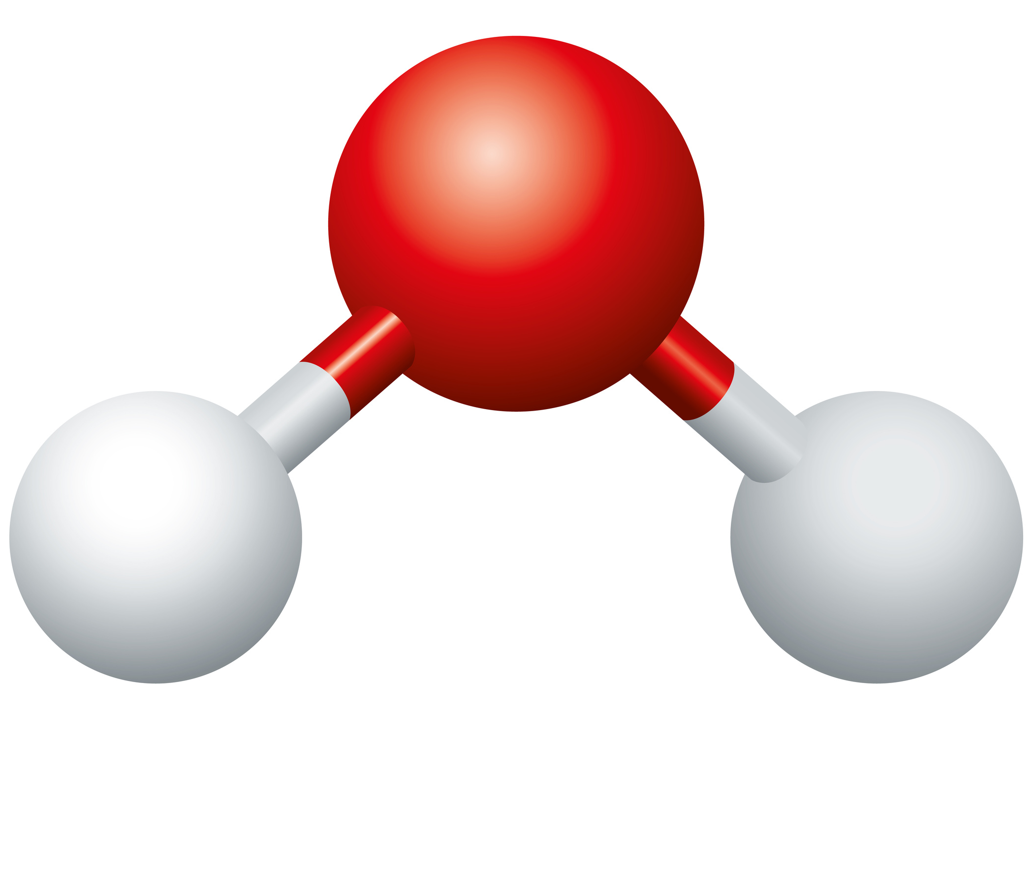
Here is the chemical equation for the breakdown of glucose with oxygen.
$$C_{6}H_{12}O_{6}+{6O}_{2}→{6CO}_{2}+{6H}_{2}O+energy$$

Slide 12


Microbiomes game
Several microbes in the game need oxygen to produce energy.
Play each of these levels.
What happens to each microbe if no oxygen is present?
Microbe | Level | Without oxygen…
Splitter | 22
Foodie | 23
Lighty | 25

Slide 13
Microbiomes game
Several microbes in the game need oxygen to produce energy.
Play each of these levels.
What happens to each microbe if no oxygen is present?
Microbe | Level | Without oxygen…
Splitter | 22 | Splitter does not eat or reproduce.
Foodie | 23 | Foodie does not eat or reproduce.
Lighty | 25 | Lighty does not produce food.

Slide 14
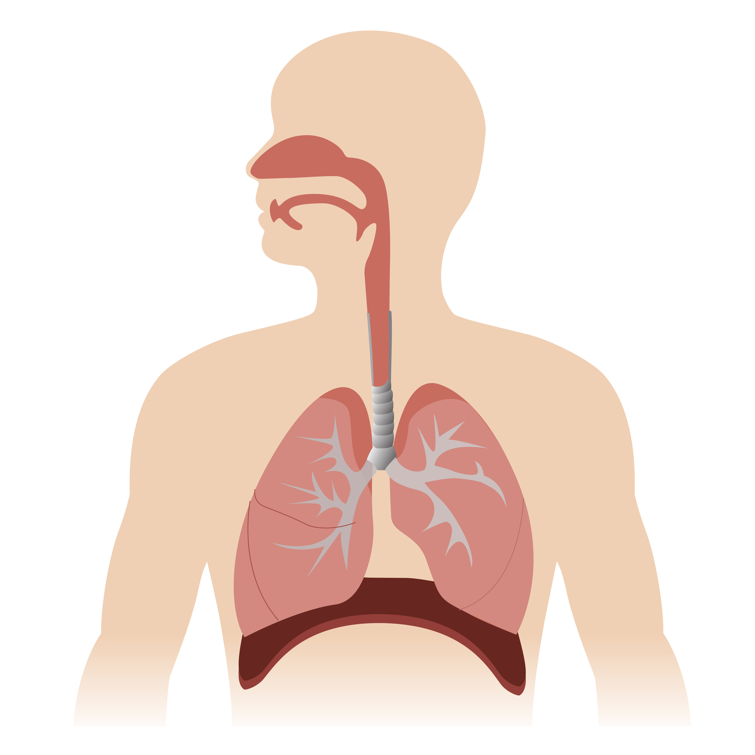
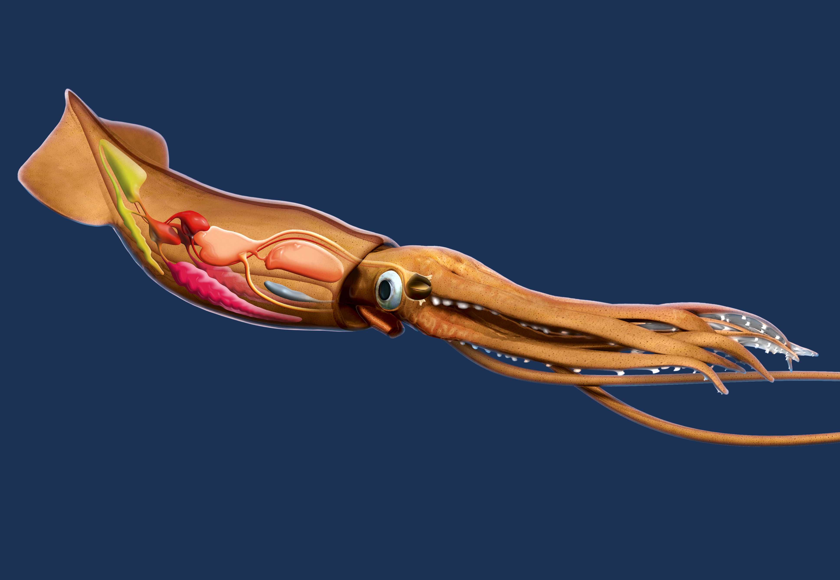
By the way, all animals, including you and your squid friends, use oxygen to produce energy.
lungs
gills
Claus Lunau / Science Photo Library
Paveu / Adobe Stock

Slide 15
Certain living things use molecules other than oxygen to produce oxygen.
In fact, oxygen can even be toxic to them.

Slide 16

Microbiomes game
Play level 35.
How does Extremo respond to oxygen?
Microbe | Reaction
Extremo

Slide 17
Microbiomes game
Play level 35.
How does Extremo respond to oxygen?
Microbe | Reaction
Extremo | Extremo does not reproduce in the presence of oxygen.

Slide 18
What does Extremo use to produce energy, if not oxygen?
Extremo uses carbon dioxide and hydrogen.
Other microbes use compounds like nitrate or sulfate.
$${CO}_{2}+{4H}_{2}→{CH}_{4}+{2H}_{2}O$$

Slide 19
Let’s think of some examples of environments with and without oxygen.
With oxygen | Without oxygen

Slide 20

We can start with your body.

Slide 21
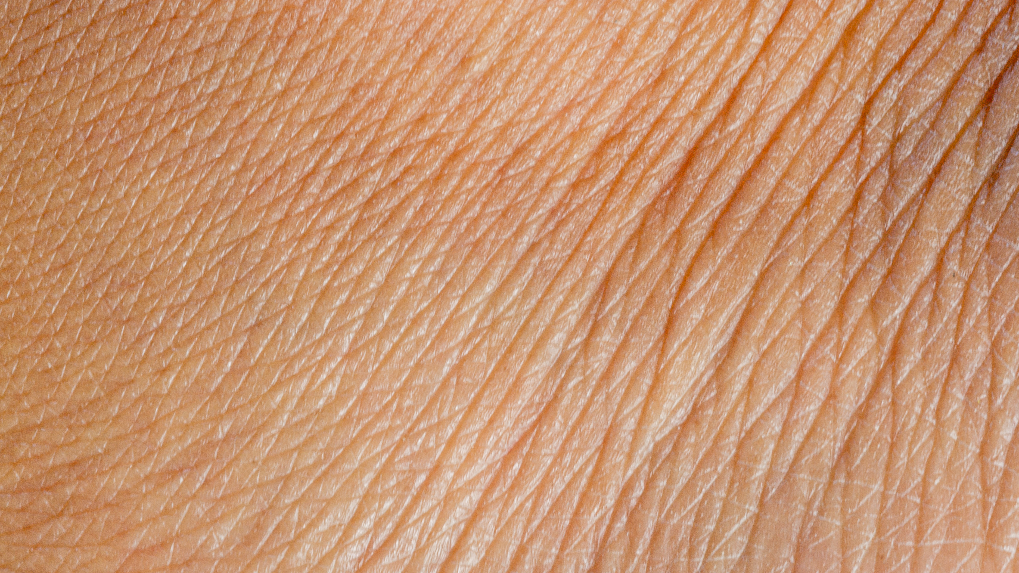
The surface of your skin is in contact with the atmosphere, so it’s an oxygen-rich environment.
banjongseal168 / Adobe Stock

Slide 22
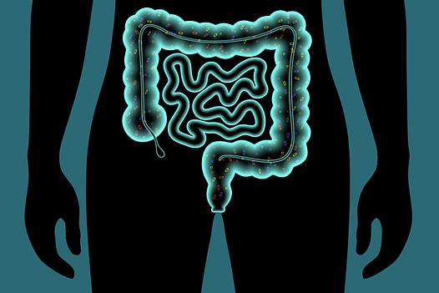
Your gut is out of reach of the atmosphere, so it’s poor in oxygen.
Pikovit/Science Photo Library

Slide 23

The atmosphere is rich in oxygen thanks to photosynthetic organisms, such as plants, algae and cyanobacteria, which produce oxygen.
Planty, who is a type of unicellular algae, produces oxygen.
Planty

Slide 24
Microbiomes game
Play level 30.
What does Planty need to produce oxygen ?

Slide 25
Microbiomes game
Play level 30.
What does Planty need to produce oxygen ?
Planty needs sunlight.

Slide 26

Irene / Adobe Stock
Oxygen from the atmosphere can penetrate into shallow water.

Slide 27
Irene / Adobe Stock
But not into thick mud.

Slide 28
What are some environments with and without oxygen?
Can you think of others?
With oxygen | Without oxygen
Human skin Shallow water | The human gut Thick mud

Slide 29
There are also environments where the oxygen concentration changes over short distances, like from the outside to the inside of a chunk of soil.
Images: Adobe Stock / Brock Biology of Microorganisms

Slide 30

Microbiomes game
Level 35 is an example of one of these environments, with a zone with oxygen next to a zone without oxygen.
How does Breather affect other microbes in the microbiome?

Slide 31
Microbiomes game
Breather consumes oxygen, creating conditions that are unfavorable to Splitter et Lighty, but that are just right for Extremo.

Slide 32
Let’s imagine that microbes like Breather consume oxygen in the water at the bottom of a lake, or in the lake sediments.
What would happen to the animals that live there?

Slide 33
Here are some animals that live at the bottom of a lake:
Mussels that attach themselves to rocks…
Linda Pitkin/2020VISION/Nature Picture Library/SCIENCE PHOTO LIBRARY

Slide 34
…crayfish, who walk forwards and swim backwards…
Jan Hamrsky / Nature Picture Library / SCIENCE PHOTO LIBRARY

Slide 35
…clams that burrow themselves in the sand.
Laurie O’Keefe / SCIENCE PHOTO LIBRARY

Slide 36
Let’s imagine that microbes like Breather consume oxygen in the water at the bottom of a lake, or in the lake sediments.
What would happen to the animals that live there?
The animals that can move, like crayfish, would swim away. The animals who can’t move easily, like mussels or clams, would die.

Slide 37
I don’t know about you, but I could use a breath of fresh air.
See you next time!

Slide 38
For the teacher
Additonal levels related to oxygen and energy:
26
36

Slide 39

A game developed by:
In collaboration with:
With the support of:

