Slide 1
Copyright notice
All images in this slide deck are subject to copyright and are used here with express permission from the creators. Copying and using any of the images in separate materials, without obtaining independent permission, would be a violation of copyright.

Slide 2
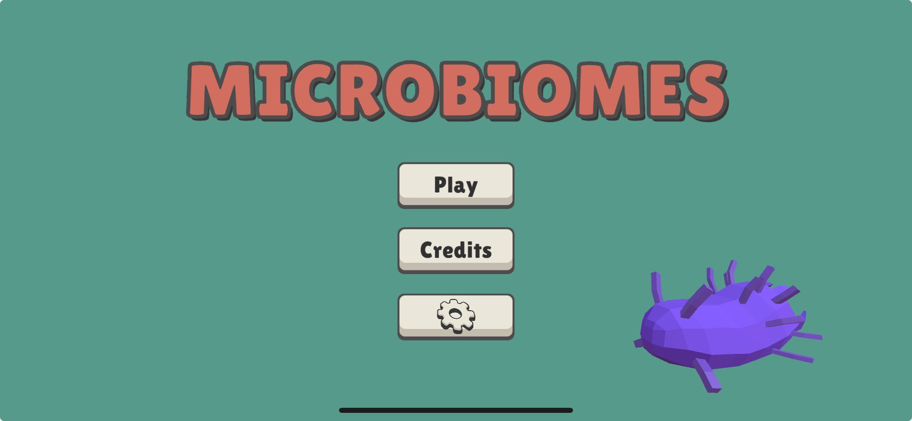
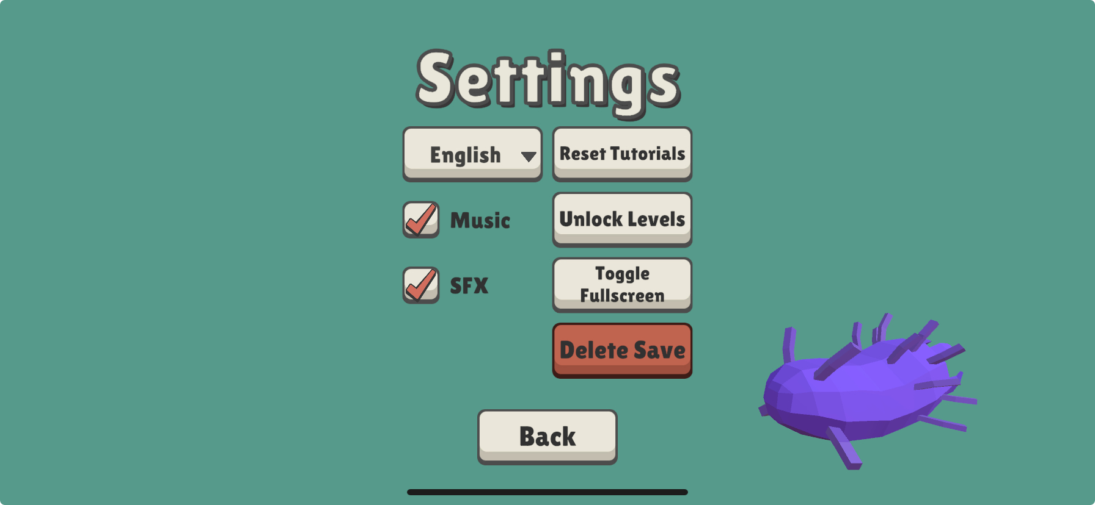
For the teacher
This lesson references these levels: 3, 15, 34
To unlock all levels, so that students can access levels without having solved the preceding ones, go to the main menu, settings, Unlock Levels, than click on "Back."

Slide 3

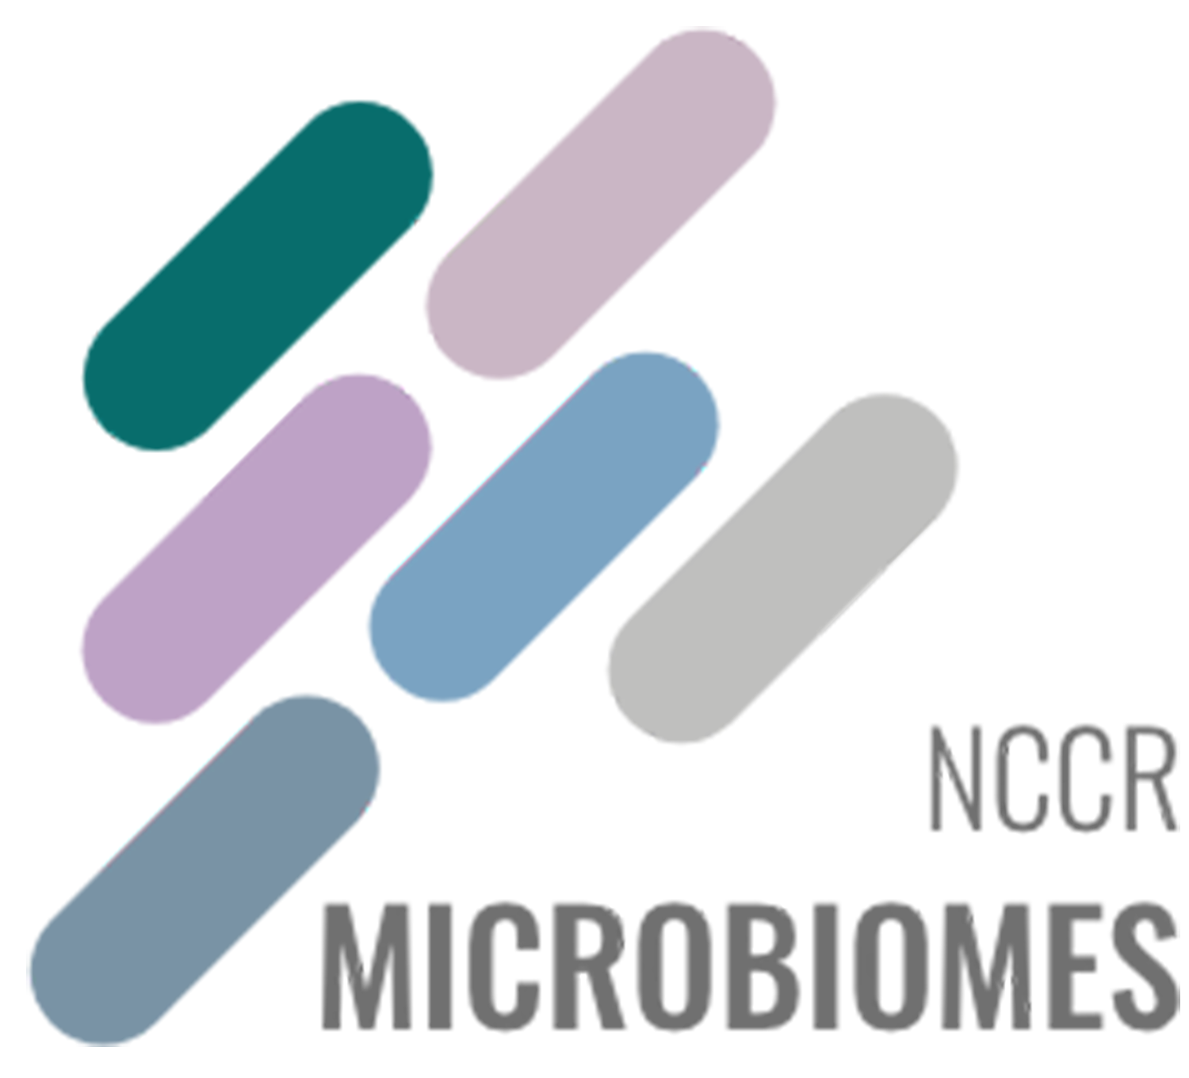

Nutrients

Slide 4

Hey there, Splitter here.
Good to see you again!

Slide 5
We’ve talked a lot about ecosystems and the diversity of life.
But I realize we haven’t even talked about what life is yet.
Let’s do that now.

Slide 6
A living thing:
Is born and dies
Is composed of cells
Maintains itself and develops by taking matter and energy from its environment
Can make new living things

Slide 7
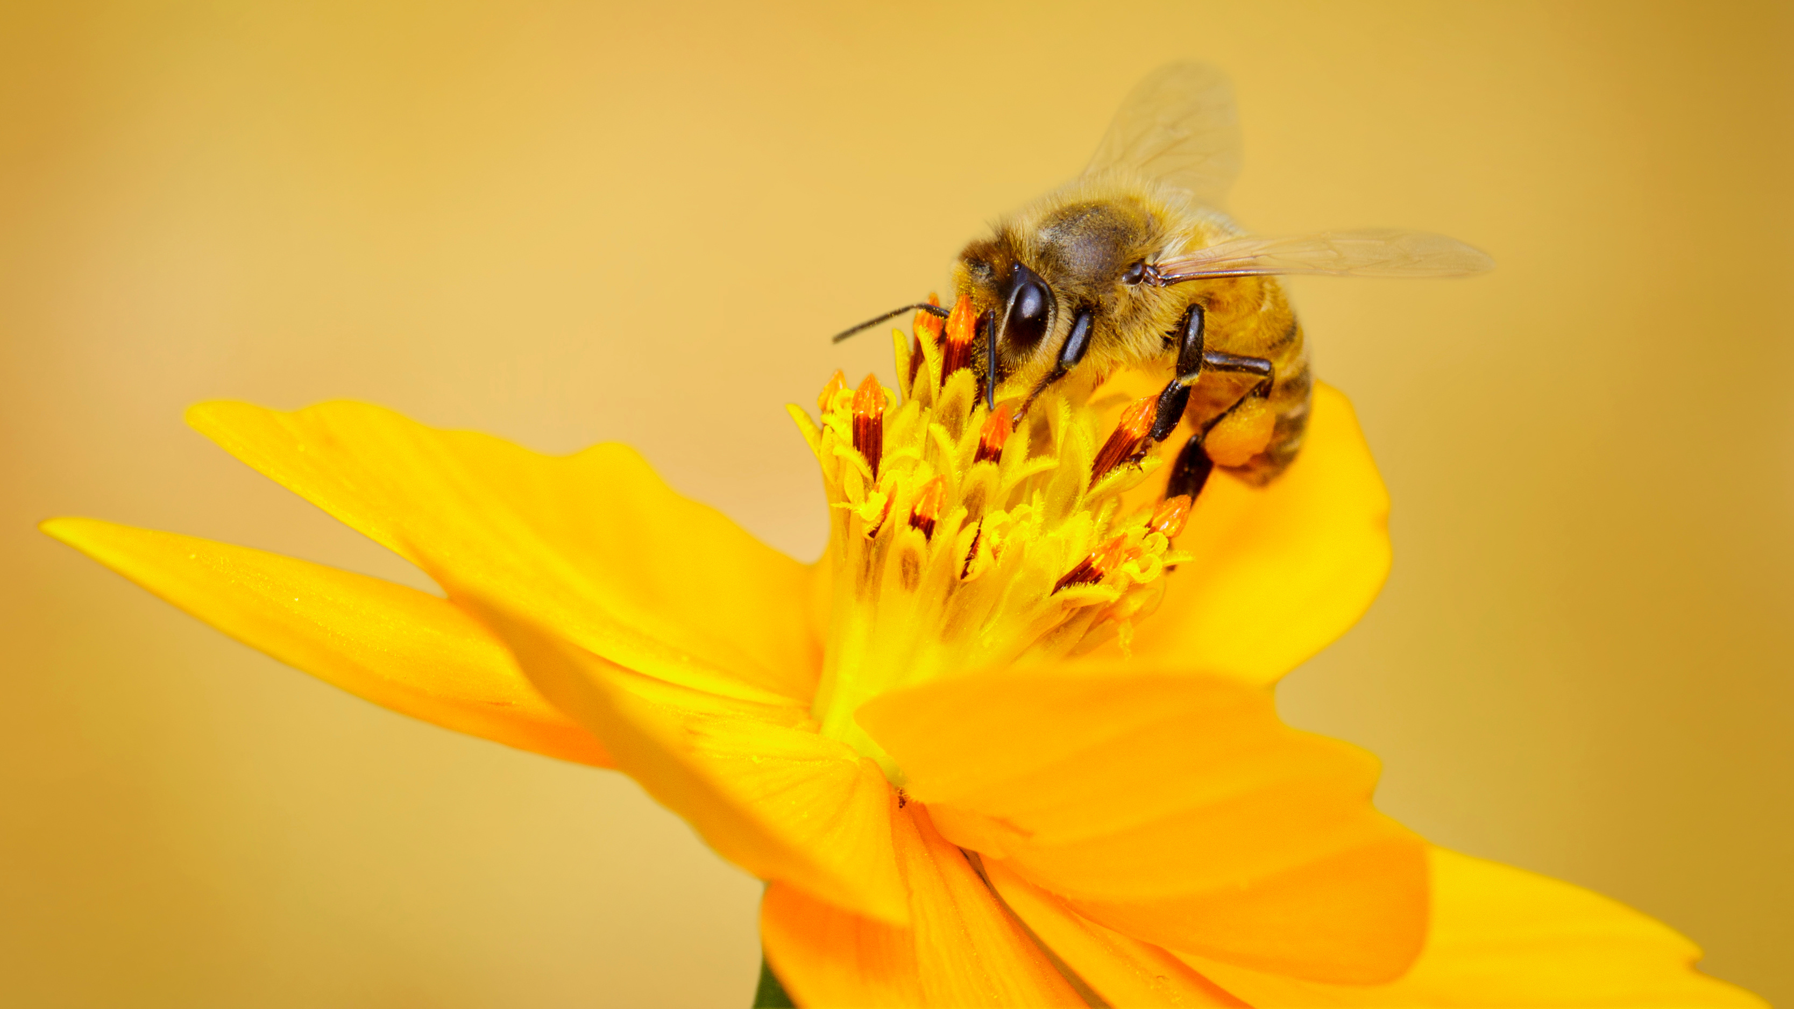
Today we’ll focus on these two elements:
Is composed of cells
Maintains itself and develops by taking matter and energy from its environment

Slide 8
The bacterial cell

Slide 9
As a living thing, I have to build and maintain the parts of my cell.
That’s right, I have just one cell.
That means my whole body is held in a single compartment!

Slide 10
Let’s look more closely at the parts of my cell.
Starting with the outside.
Cytoplasm
Plasmids
DNA
Ribosomes
Pili
Cell membrane
Cell wall

Slide 11
The membrane and the wall of my cell are thin layers that separate what’s inside me from the outside.
My cell membrane lets useful substances into my cell and keeps harmful ones out. It also expels waste.
My cell wall helps me keep my shape.
Pili
Cell membrane
Cell wall

Slide 12
My pili help me stick to surfaces.
Pili

Slide 13
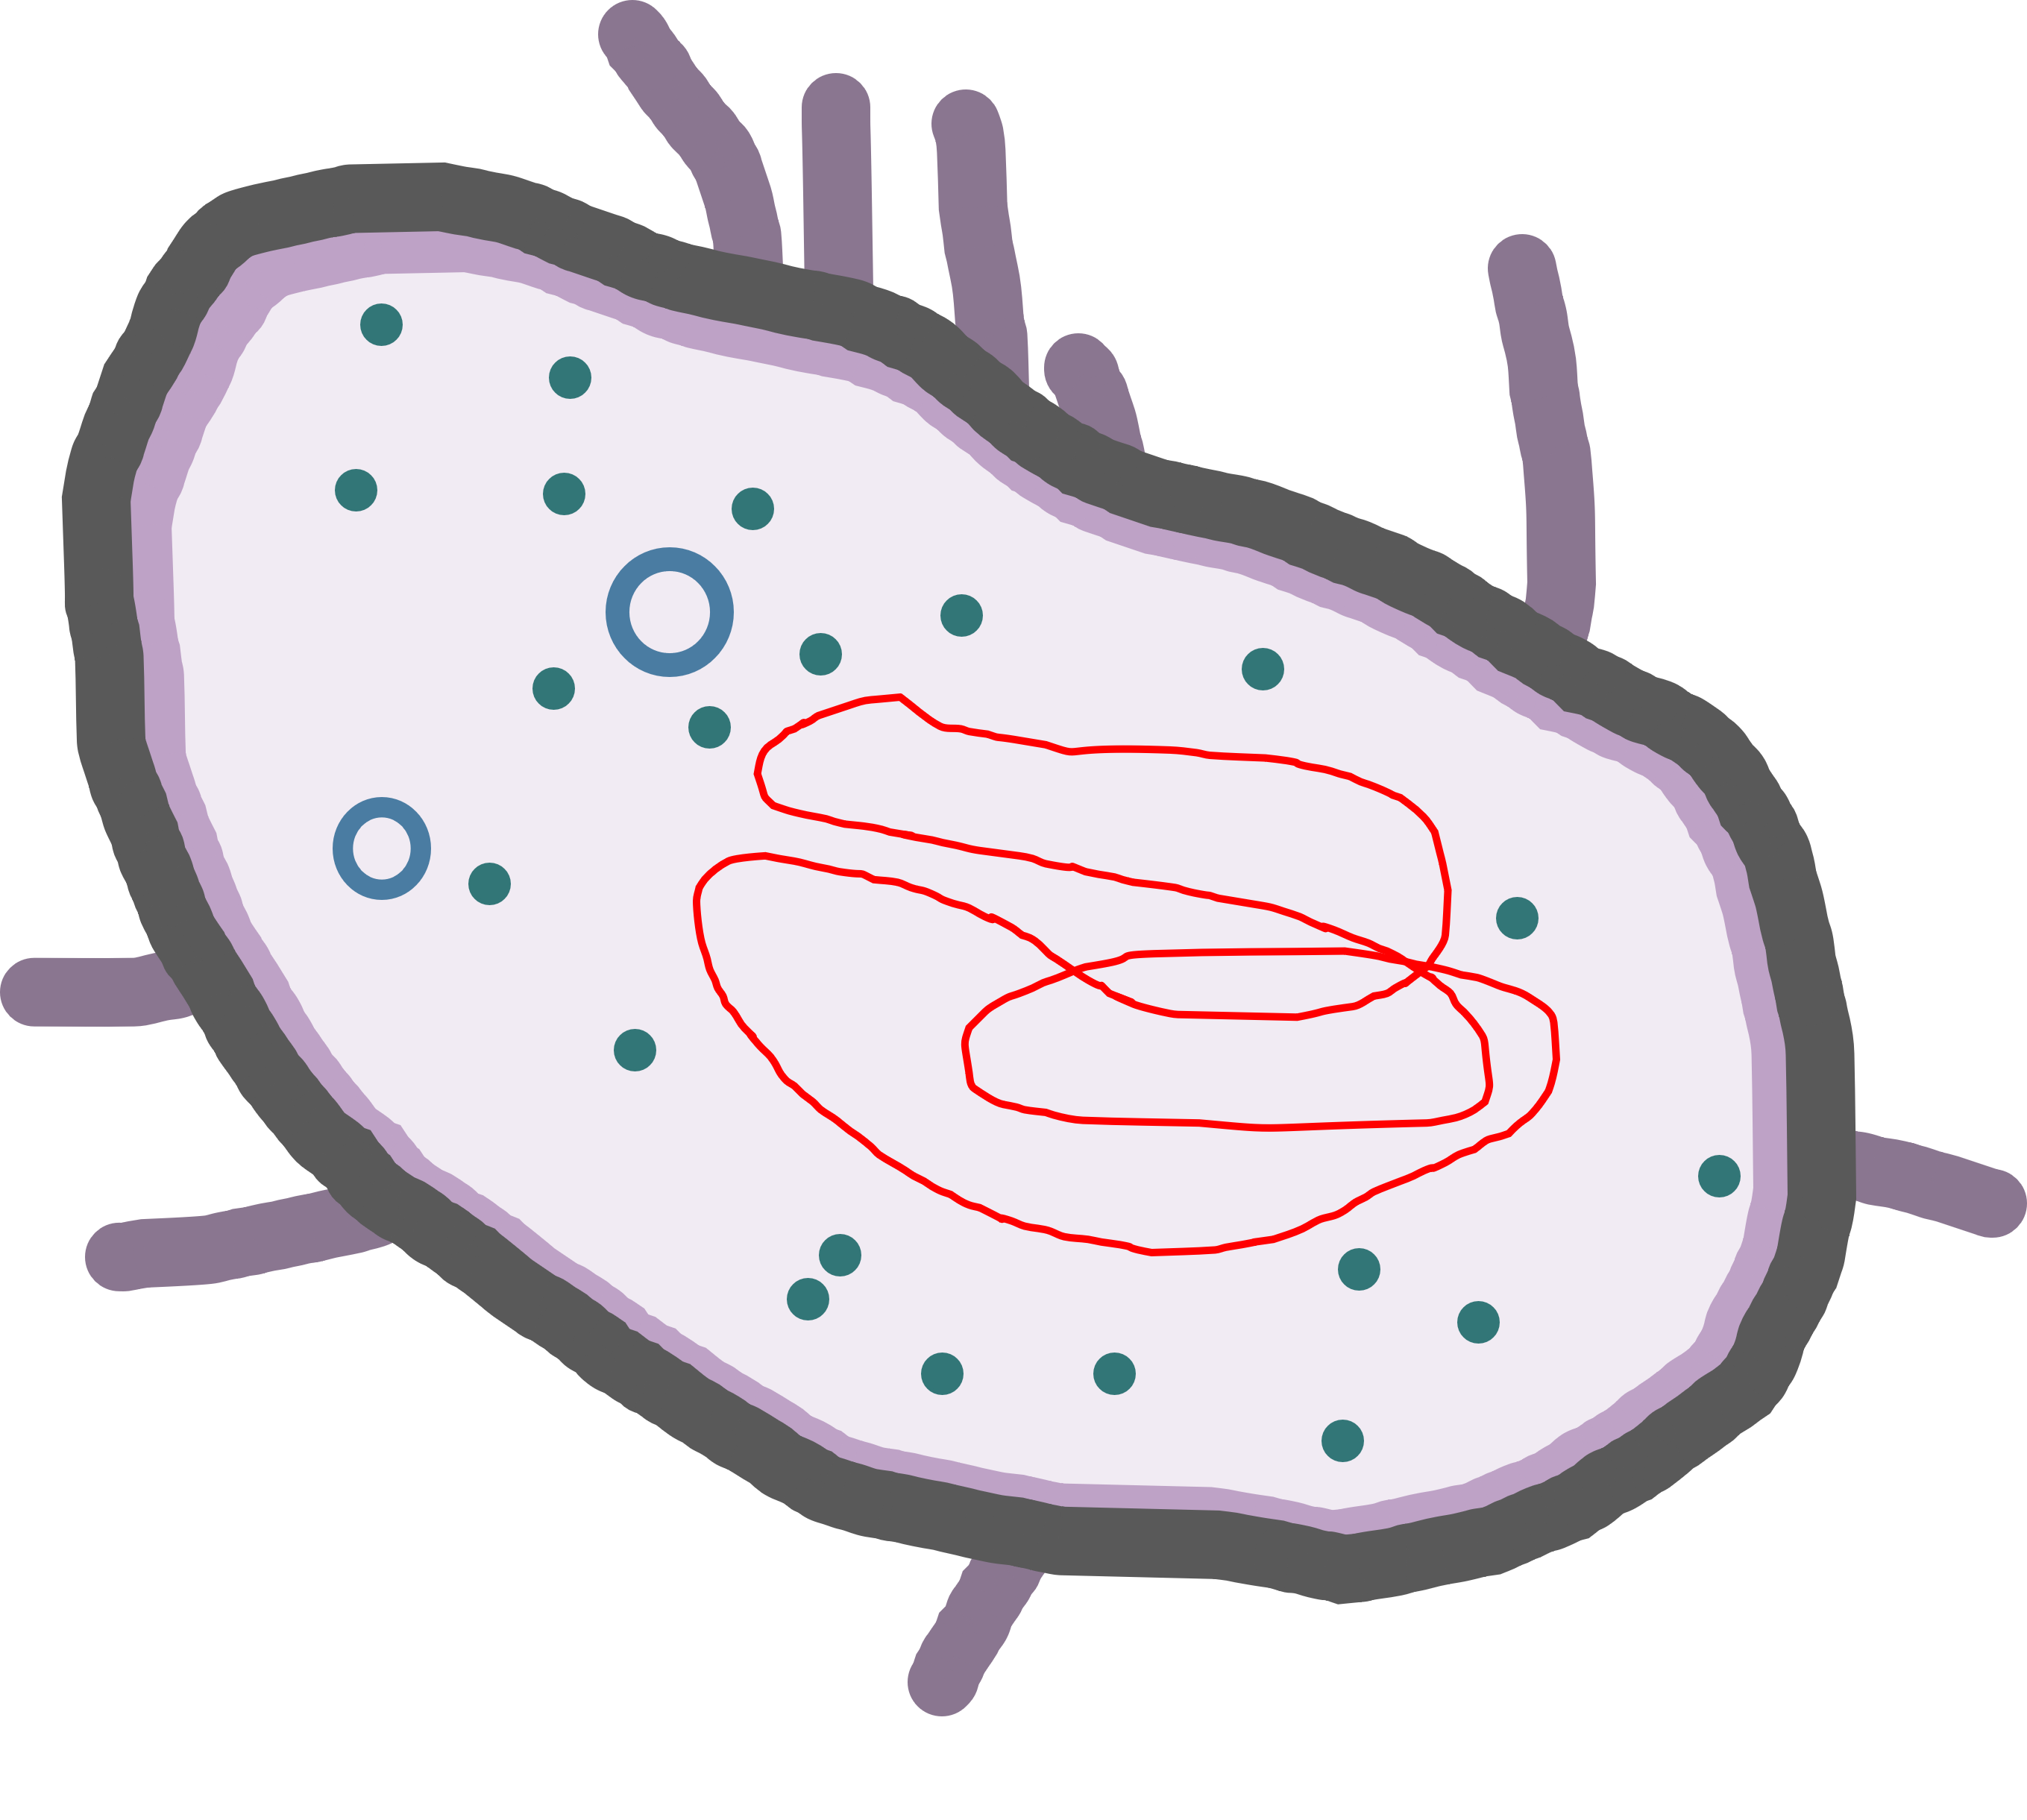
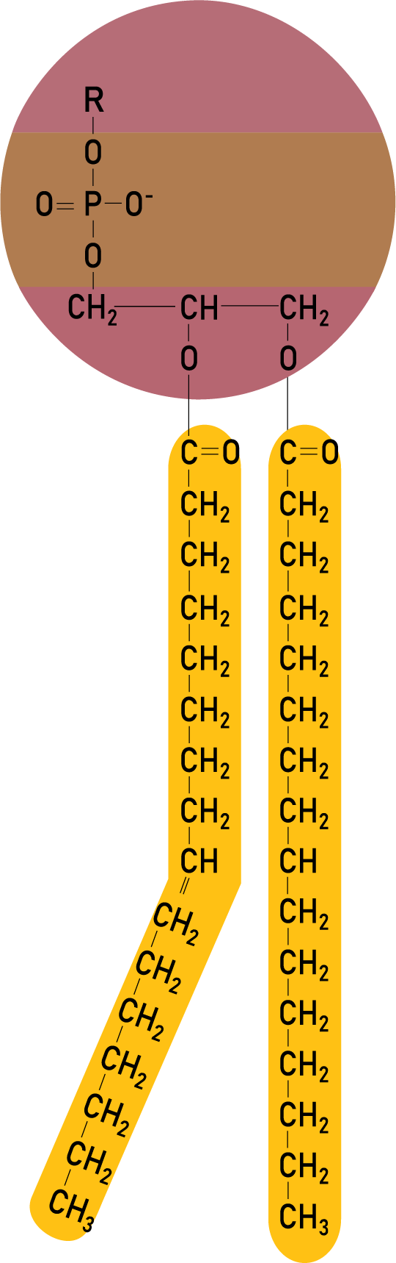
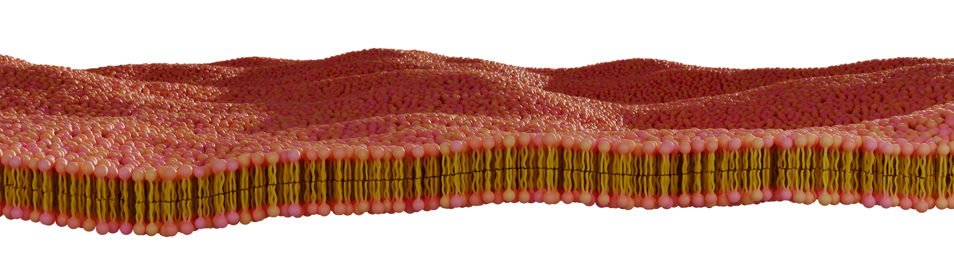
This is what my cell membrane looks like if you zoom in really, really close. It is made of molecules, which are themselves made of elements.
Do you know which elements the letters C, H, O and P stand for?
Notes:
Elle est constituée de molecules, qui à leur tour sont constituées d’éléments.

Slide 14
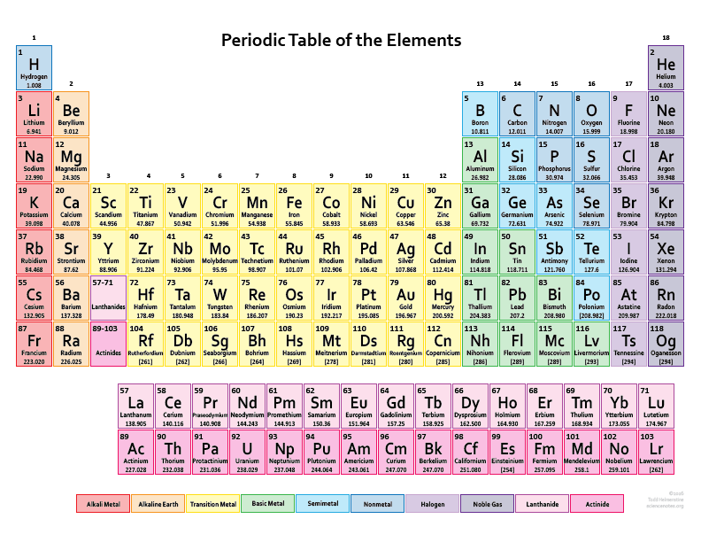
Image: Science Notes
Notes:
https://sciencenotes.org/list-elements-atomic-number/

Slide 15
Let’s make a list of the elements my cell is made of (and that your cells are made of, too, by the way).
Chemical symbol | Element
C | Carbon
H | Hydrogen
O | Oxygen
P | Phosphorus

Slide 16
Now let’s go inside.
The cytoplasm is a gel-like substance that holds my DNA.
Cytoplasm

Slide 17
The DNA is the genetic information that helps make me who I am.
It’s the set of instructions to make me, like the code of a video game or the blueprints for a house.
DNA

Slide 18
Plasmids are small loops of DNA that are separate from my main strand of chromosomal DNA.
I can pass plasmids to other cells, and receive them, too, through my pili.
Plasmids

Slide 19
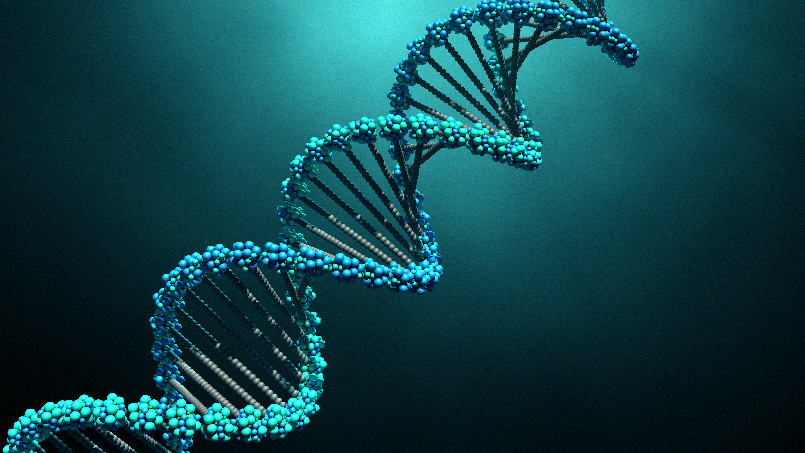
My DNA is also made of molecules.

Slide 20
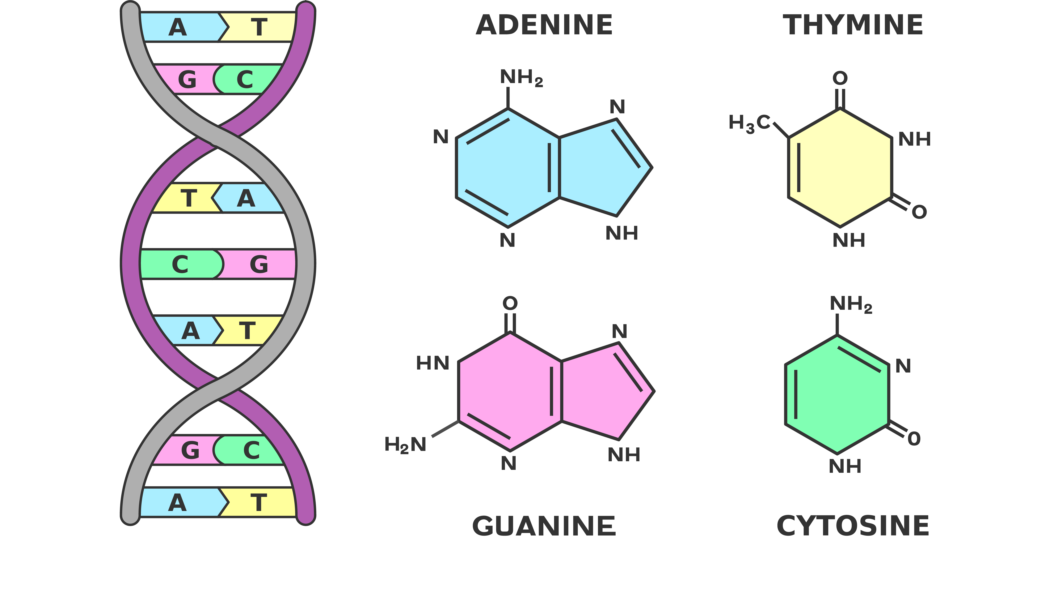
Here are the molecules of my DNA: they are made of carbon, hydrogen, oxygen and nitrogen.

Slide 21
Let’s add nitrogen to our list.
Chemical symbol | Element
C | Carbon
H | Hydrogen
O | Oxygen
P | Phosphorus
N | Nitrogen

Slide 22
Ribosomes are like tiny factories, where the instructions from my DNA are carried out and transformed into proteins.
Proteins carry out all kinds of important functions, like giving my cell its shape, controlling what flows into and out of my cell, and sensing what’s going on outside my cell.
Ribosomes

Slide 23
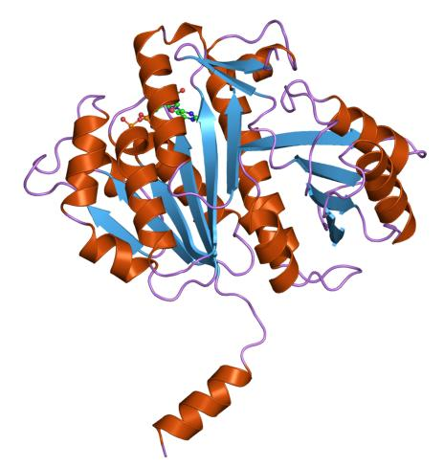
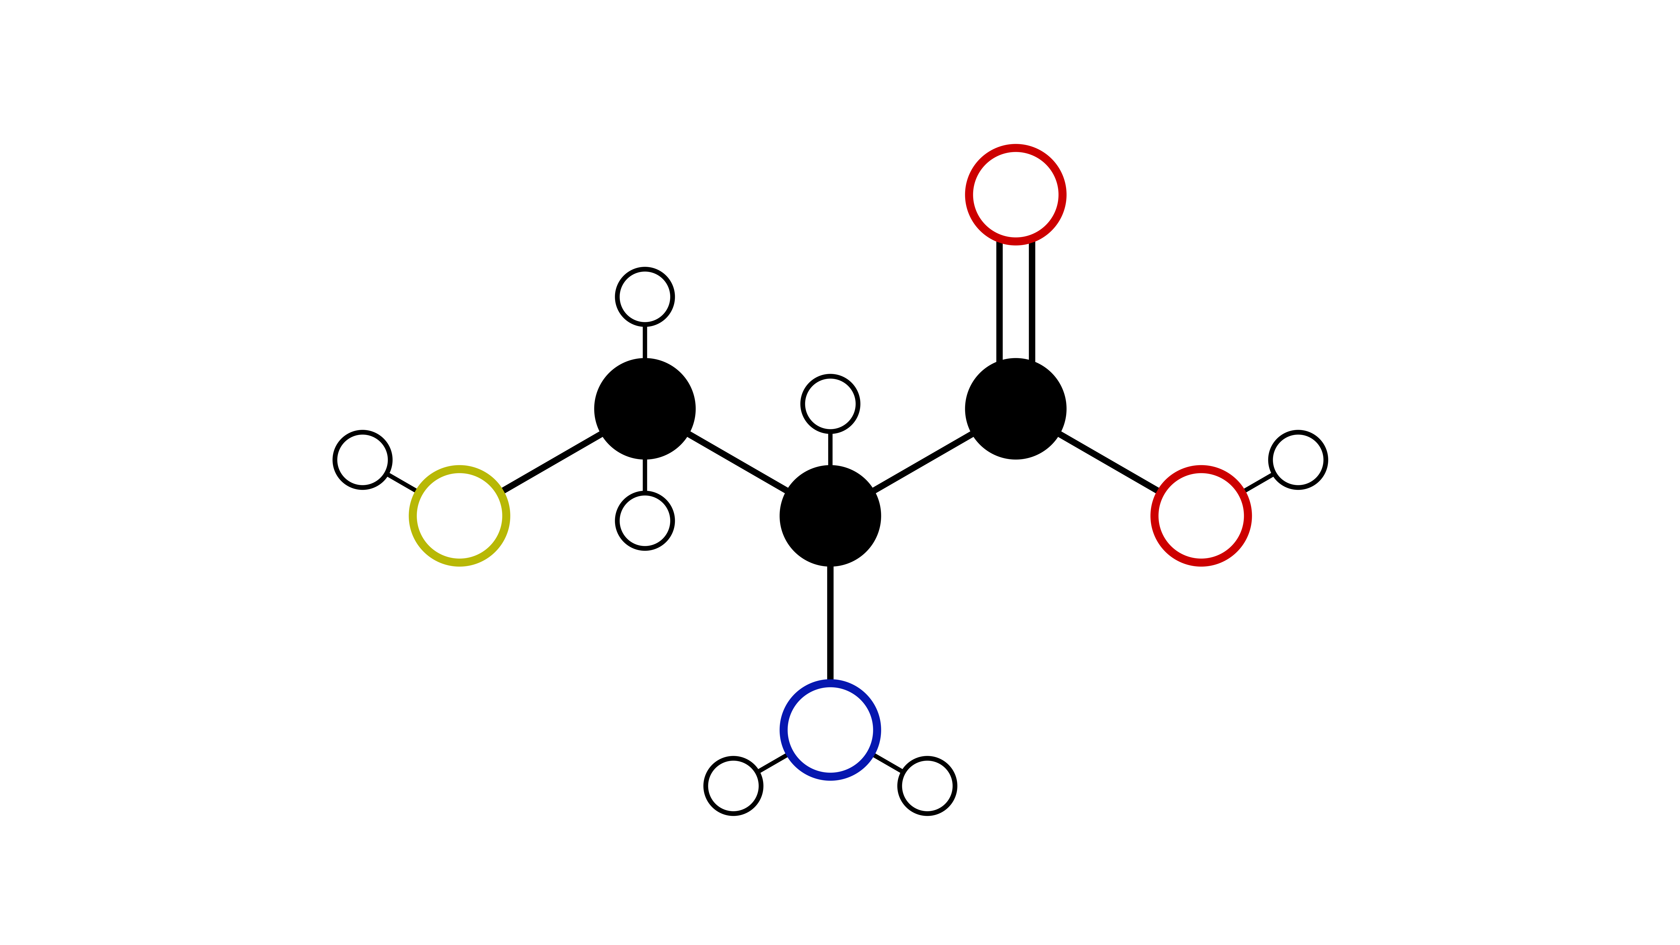
O
C
C
S
C
O
N
Protein
Amino acid
Proteins are made of molecules called amino acids.
Jawahar Swaminathan, European Bioinformatics Institute
Notes:
FtsZ, une protéine procaryote qui joue un rôle fondamental dans la scissiparité (ou division binaire) chez les bactéries
Cette acide aminé est cysteine.

Slide 24
So let’s add sulfur (S) to our list, because it’s part of certain amino acids.
These elements are the most important nutrients for living things.
Chemical symbol | Element
C | Carbon
H | Hydrogen
O | Oxygen
P | Phosphorus
N | Nitrogen
S | Sulfur

Slide 25
So where do I get the nutrients I need to build and take care of my cell?
(Where do you get the nutrients you need?)

Slide 26
Heterotrophs and autotrophs

Slide 27
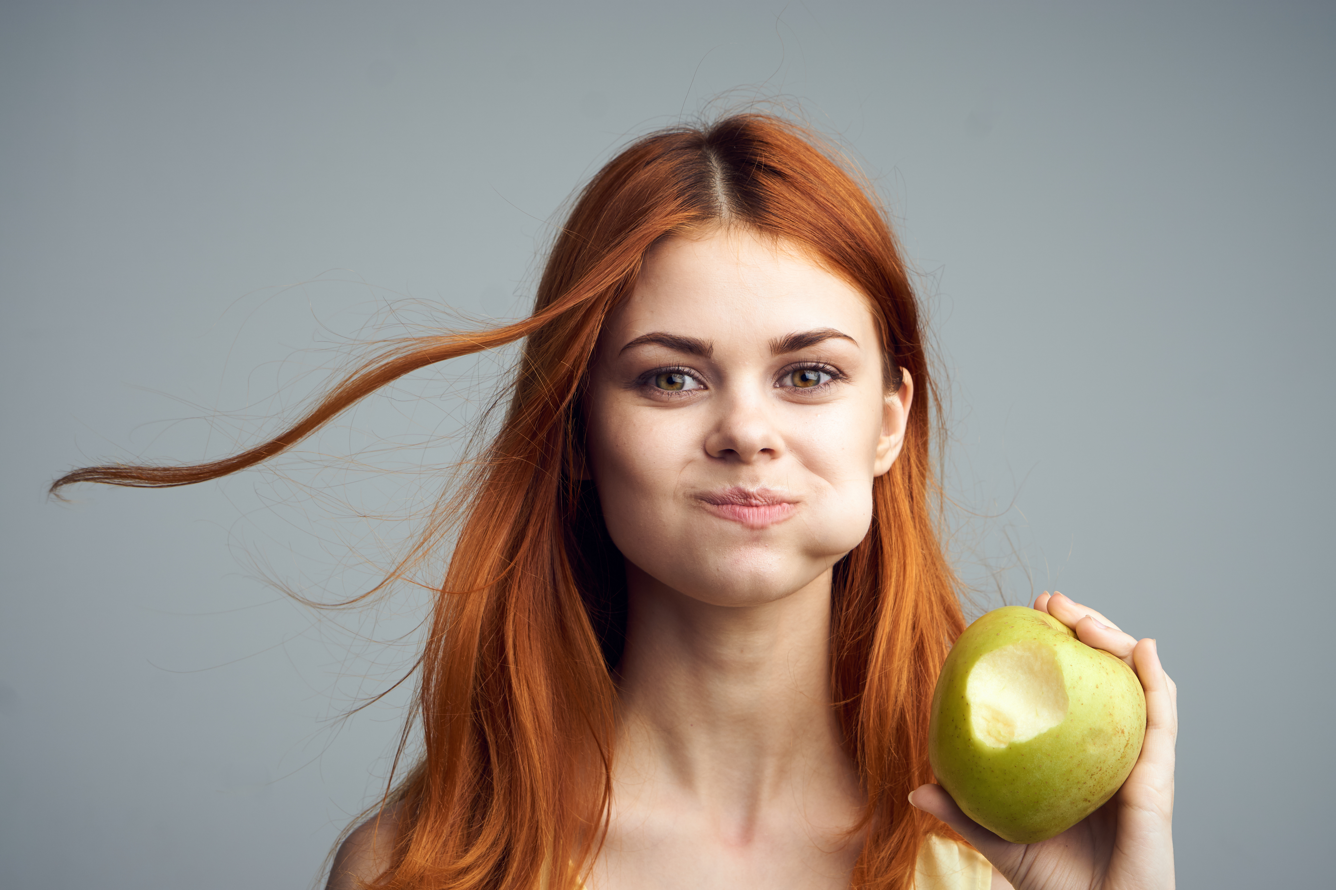
You and I are both heterotrophs.
We consume what’s called organic carbon.
Organic carbon comes from other organisms. You eat plants and animals.
I don’t have a mouth, and I can’t chew.
I absorb the organic carbon that surrounds me.

Slide 28
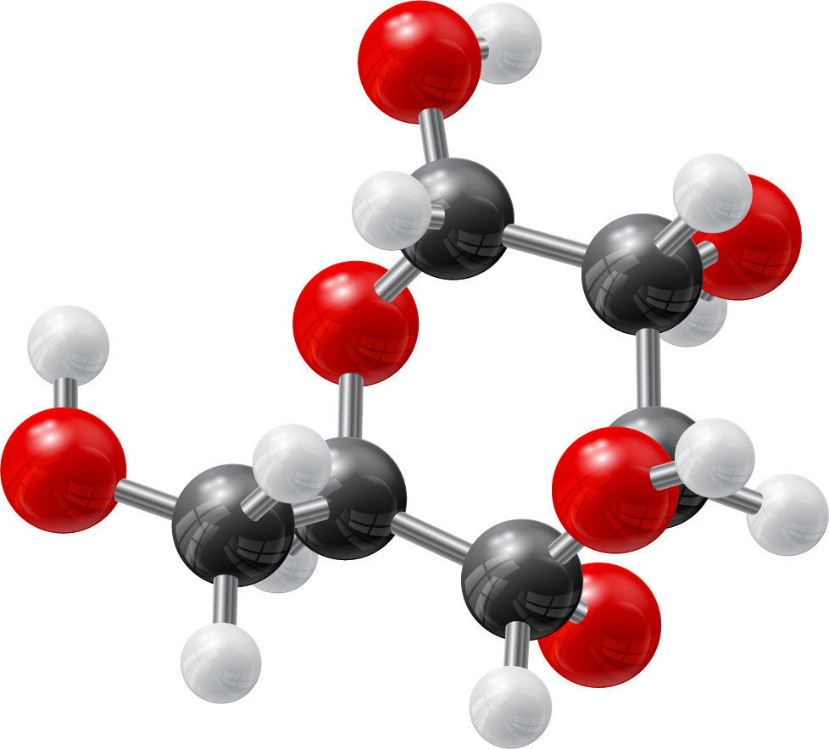
Glucose
That apple contains glucose, also called sugar.
We can zoom in on glucose to see the atoms it’s composed of.
We break up the sugar and rearrange the atoms to make it into the different parts of our cells.
Carbon
Hydrogen
Oxygen

Slide 29
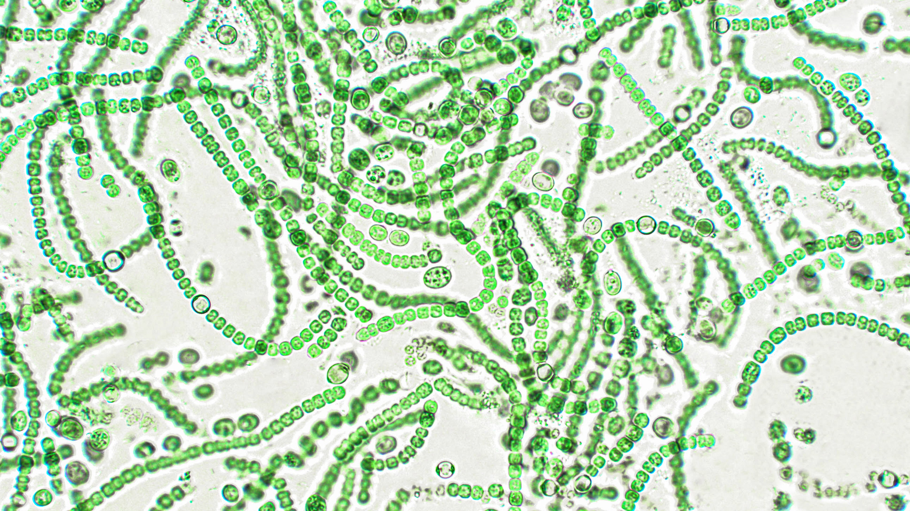
There are other organisms that can build themselves from inorganic carbon.
They’re called autotrophs, and they simply pull carbon dioxide (CO₂ ) out of the air.
elif / Adobe Stock
Notes:
Diagram of lighty converting CO2 to organic carbon. Photosynthesis

Slide 30
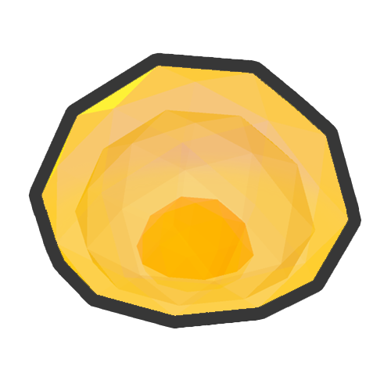
Microbiomes game
Play level 3.
Lighty is an autotroph.
Lighty uses CO₂ (inorganic carbon) from the atmosphere.
What else does Lighty need to feed himself and produce food for me?

Slide 31
Microbiomes game
Play level 3.
Lighty is an autotroph.
Lighty uses CO₂ (inorganic carbon) from the atmosphere.
What else does Lighty need to feed himself and produce food for me?
He needs sunlight.

Slide 32
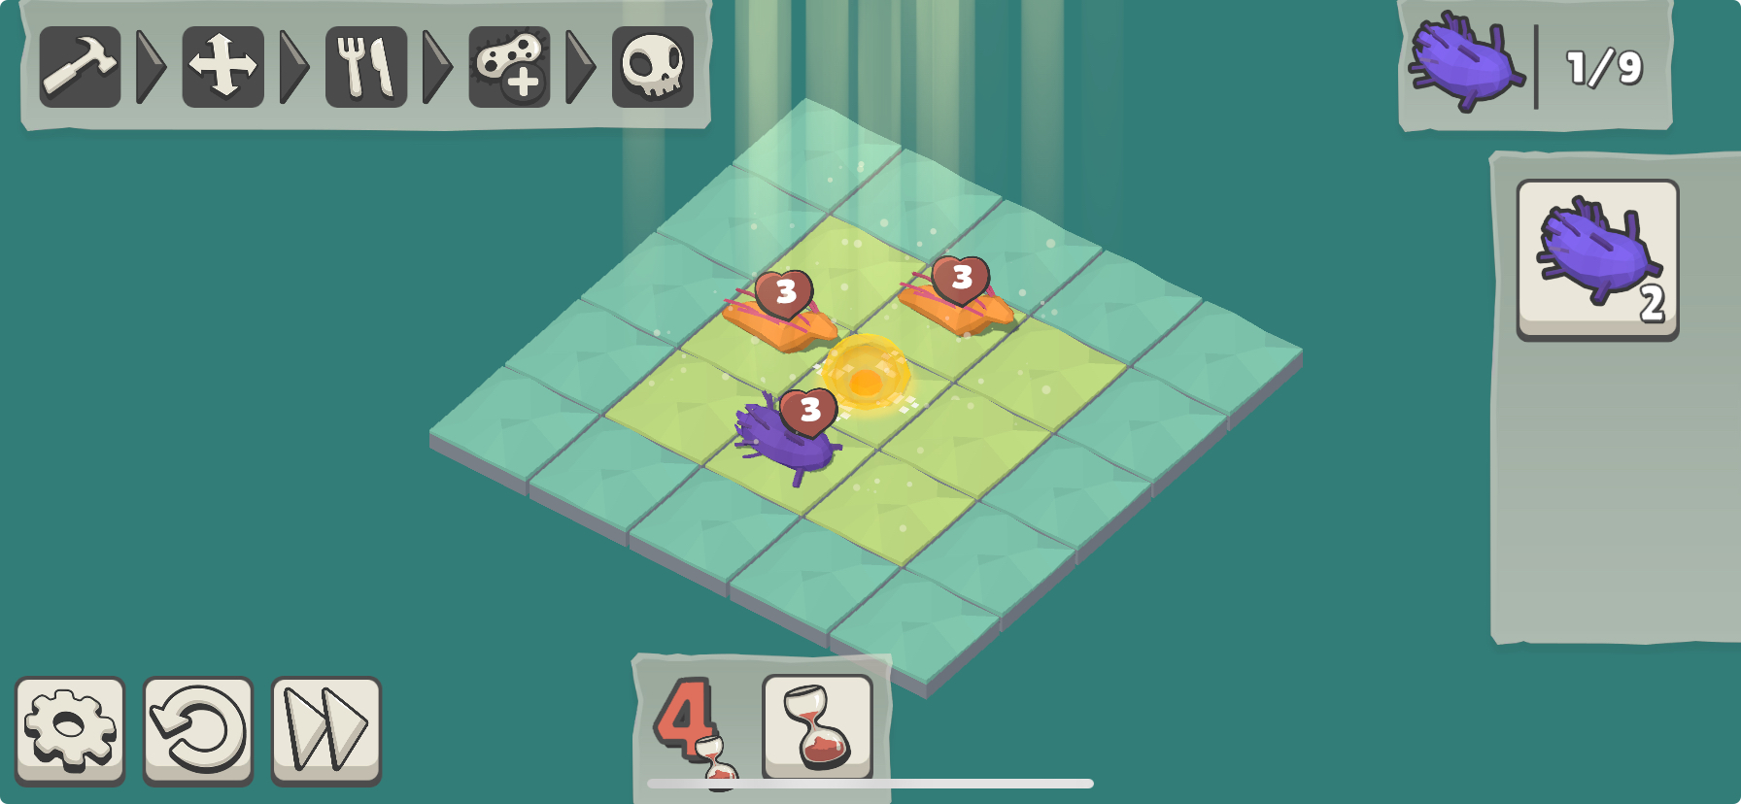
Microbiomes game
Now play level 15.
What would happen to Foodie and me without Lighty?

Slide 33
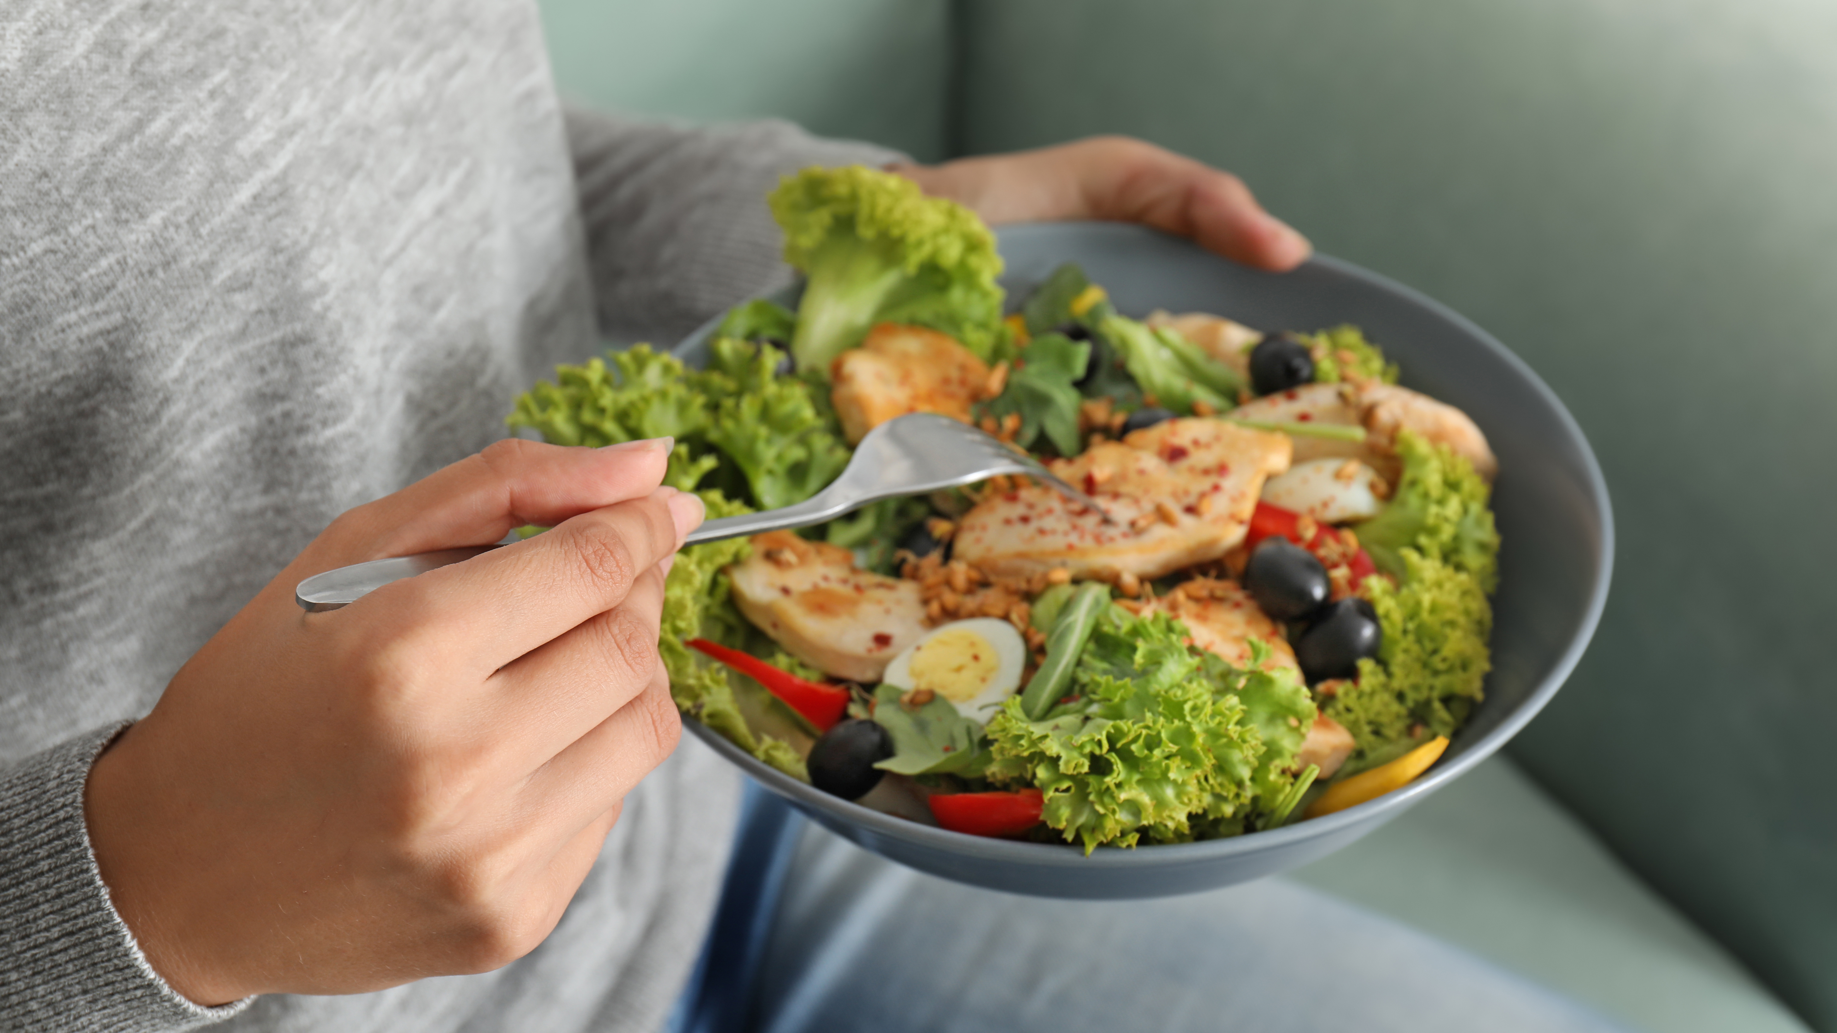
Which autotrophs do you rely on for food?

Slide 34
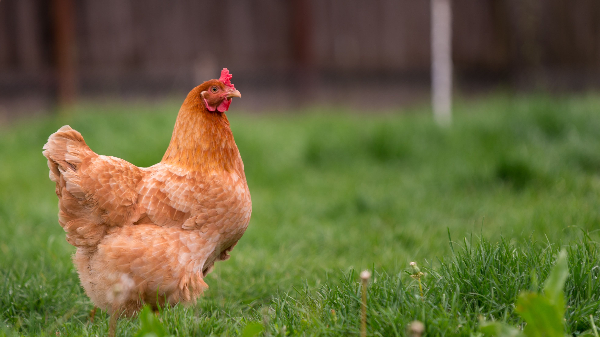
If you eat animals, what autotrophs do they rely on?

Slide 35
There are also autotrophs that don’t need sunlight to feed themselves.
They also build their cells out of CO₂, but by using energy from chemical reactions rather than from sunlight.

Slide 36


Microbiomes game
I’m curious to know if Extremo is an autotroph.
Let’s play 34 and write a short explanation about each microbe’s relationship to carbon.
Microbe | Autotroph or heterotroph? | Explanation about carbon
Foodie
Extremo

Slide 37
Microbiomes game
I’m curious to know if Extremo is an autotroph.
Let’s play 34 and write a short explanation about each microbe’s relationship to carbon.
Microbe | Autotroph or heterotroph? | Explanation about carbon
Foodie | Heterotroph | Foodie needs organic carbon to survive and to reproduce.
Extremo | ? | Extremo doesn’t reproduce in the presence of organic carbon.
Do you think Extremo is an autotroph?

Slide 38
Microbiomes game
Does Extremo consume food?
Does Extremo seem to build new cells?
What are two differences between Extremo and Lighty?

Slide 39
Microbiomes game
Does Extremo consume food?
No.
Does Extremo seem to build new cells?
Yes, because Extremo divides.
What are two differences between Extremo and Lighty?
Extremo doesn’t use sunlight.
Extremo doesn’t make food for others.

Slide 40
Microbiomes game
So yes indeed, Extremo is an autotroph.
Extremo must be obtaining nutrients; otherwise Extremo wouldn’t build new cells.
So Extremo must be making food.
Microbe | Autotroph or heterotroph? | Explanation about carbon
Foodie | Heterotroph | Foodie needs organic carbon to survive and to reproduce.
Extremo | Autotroph | Extremo doesn’t reproduce in the presence of organic carbon.

Slide 41
Extremo seems to use inorganic carbon, but using energy from chemical reactions rather than from sunlight.

Slide 42
That’s all for today.
I think it’s time for me to have a snack! All this talk of carbon has worked up my appetite.
Bye!

Slide 43
For the teacher
Additional levels related to nutrition:
12
17

Slide 44




A game developed by:
In collaboration with:
With the support of:

