Slide 1

Welcome to
BioImage Town!
Josh Moore, Senior RDM Officer
German BioImaging, e.V. / Open Microscopy Environment
With the exception of logos and cited third-party content, the content of these slides is shared under the terms of the Creative Commons Attribution License (CC-BY 4.0) unless the content is marked otherwise.

Slide 2
Special welcome
Honored
Guests
New
Colleagues

Slide 3
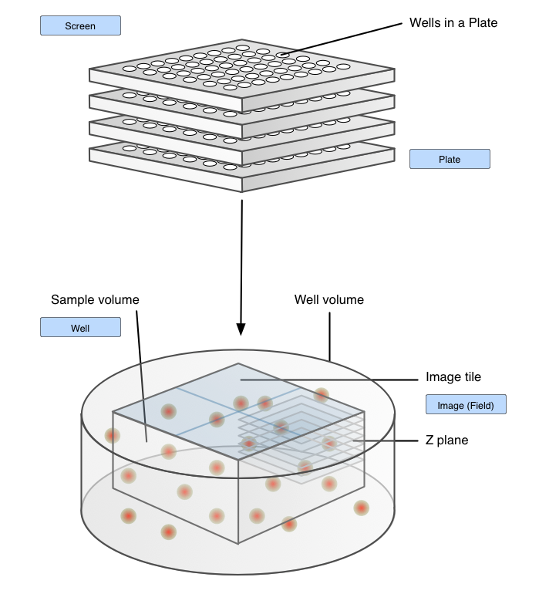
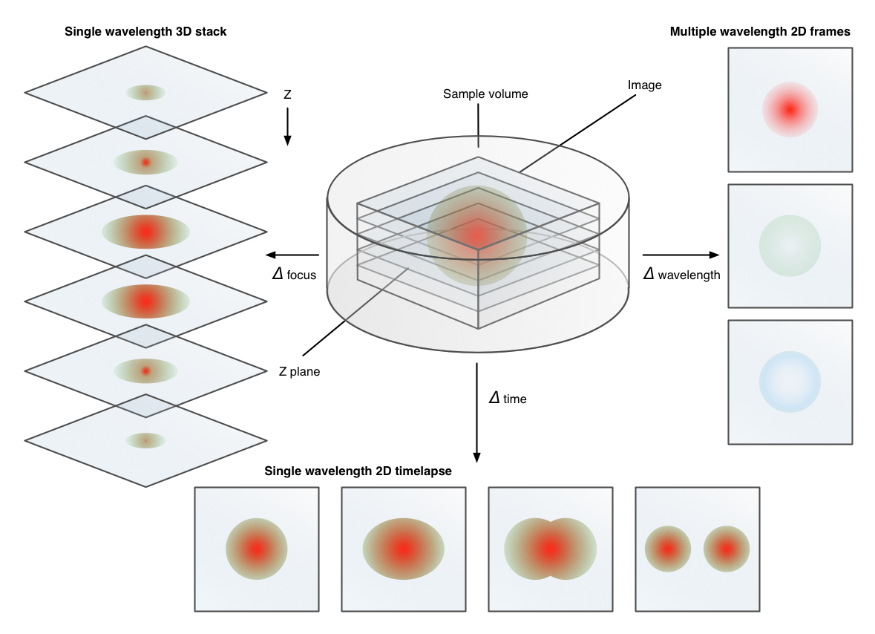
Value of bioimages
https://ome-model.readthedocs.io/

Slide 4
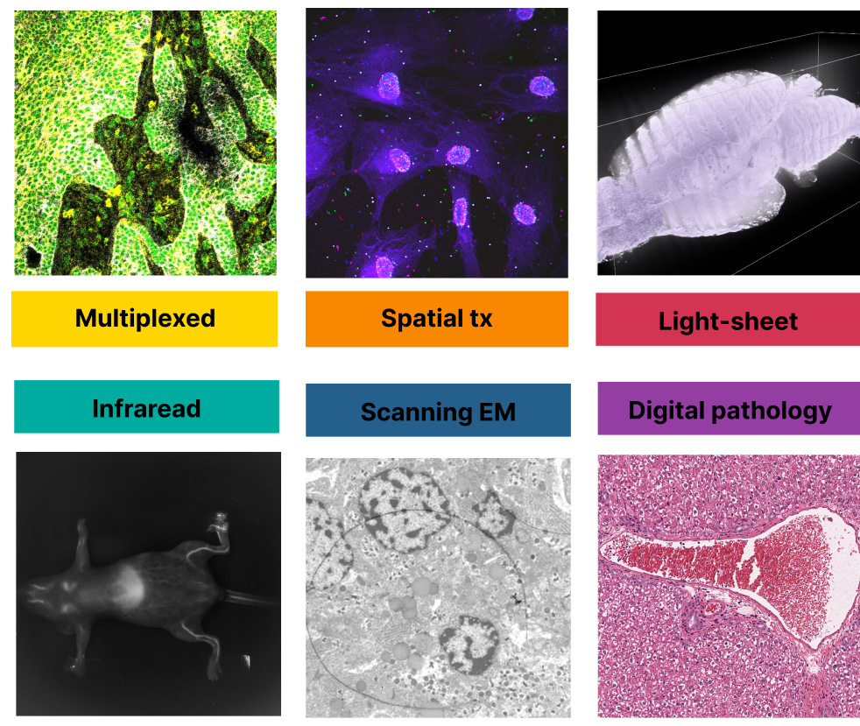
Value of bioimages

Slide 5
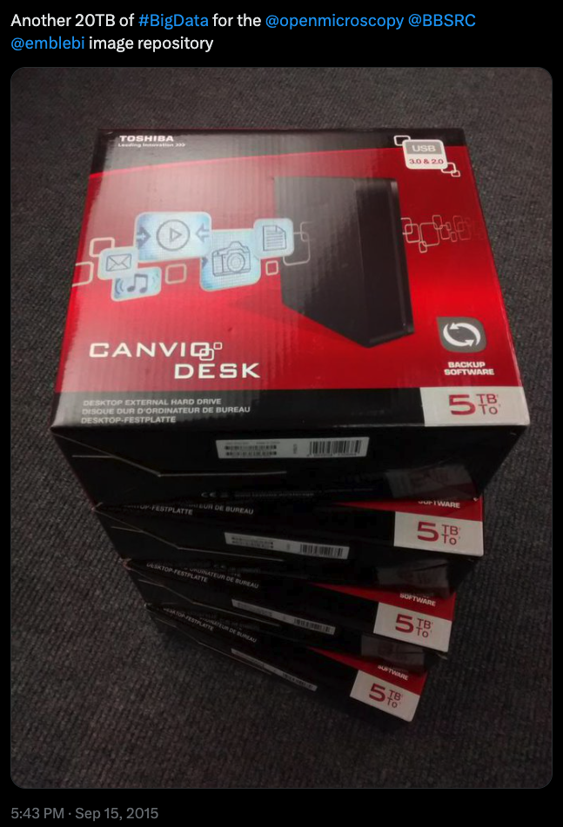
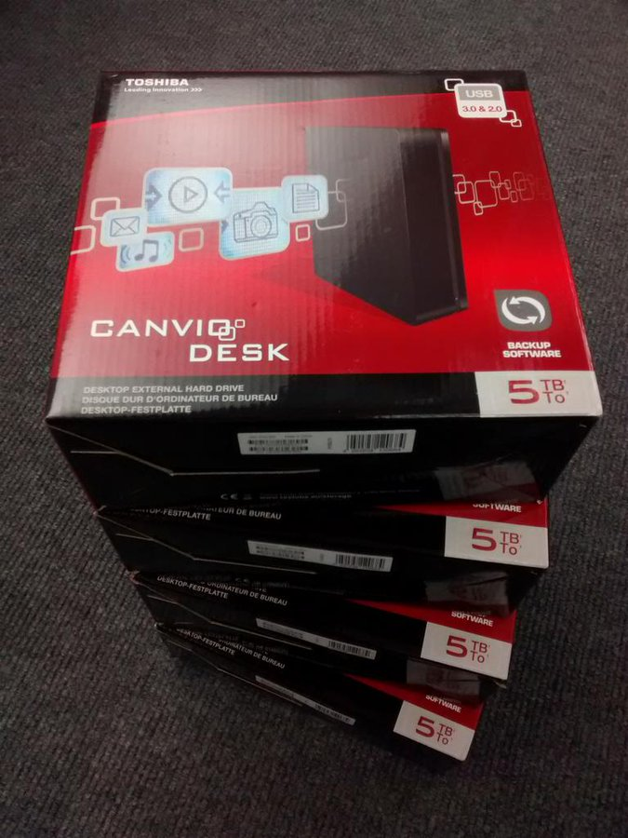
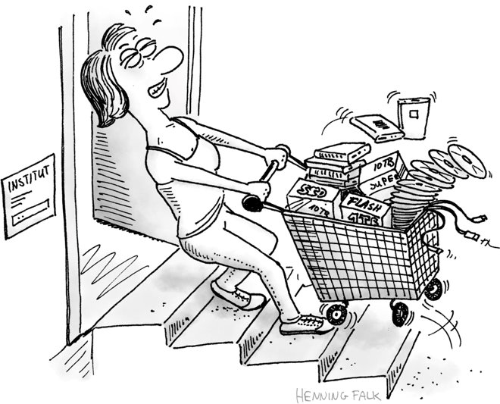
Image Data Management isn’t always FAIR
"Clara shares" by Henning Falk, ©2022 NumFOCUS, is used under a CC BY 4.0 license.
https://github.com/zarr-developers/zarr-illustrations-falk-2022#clara-shares
Image: Simon Li
https://twitter.com/penguinoops/status/643812318699225088

Slide 6
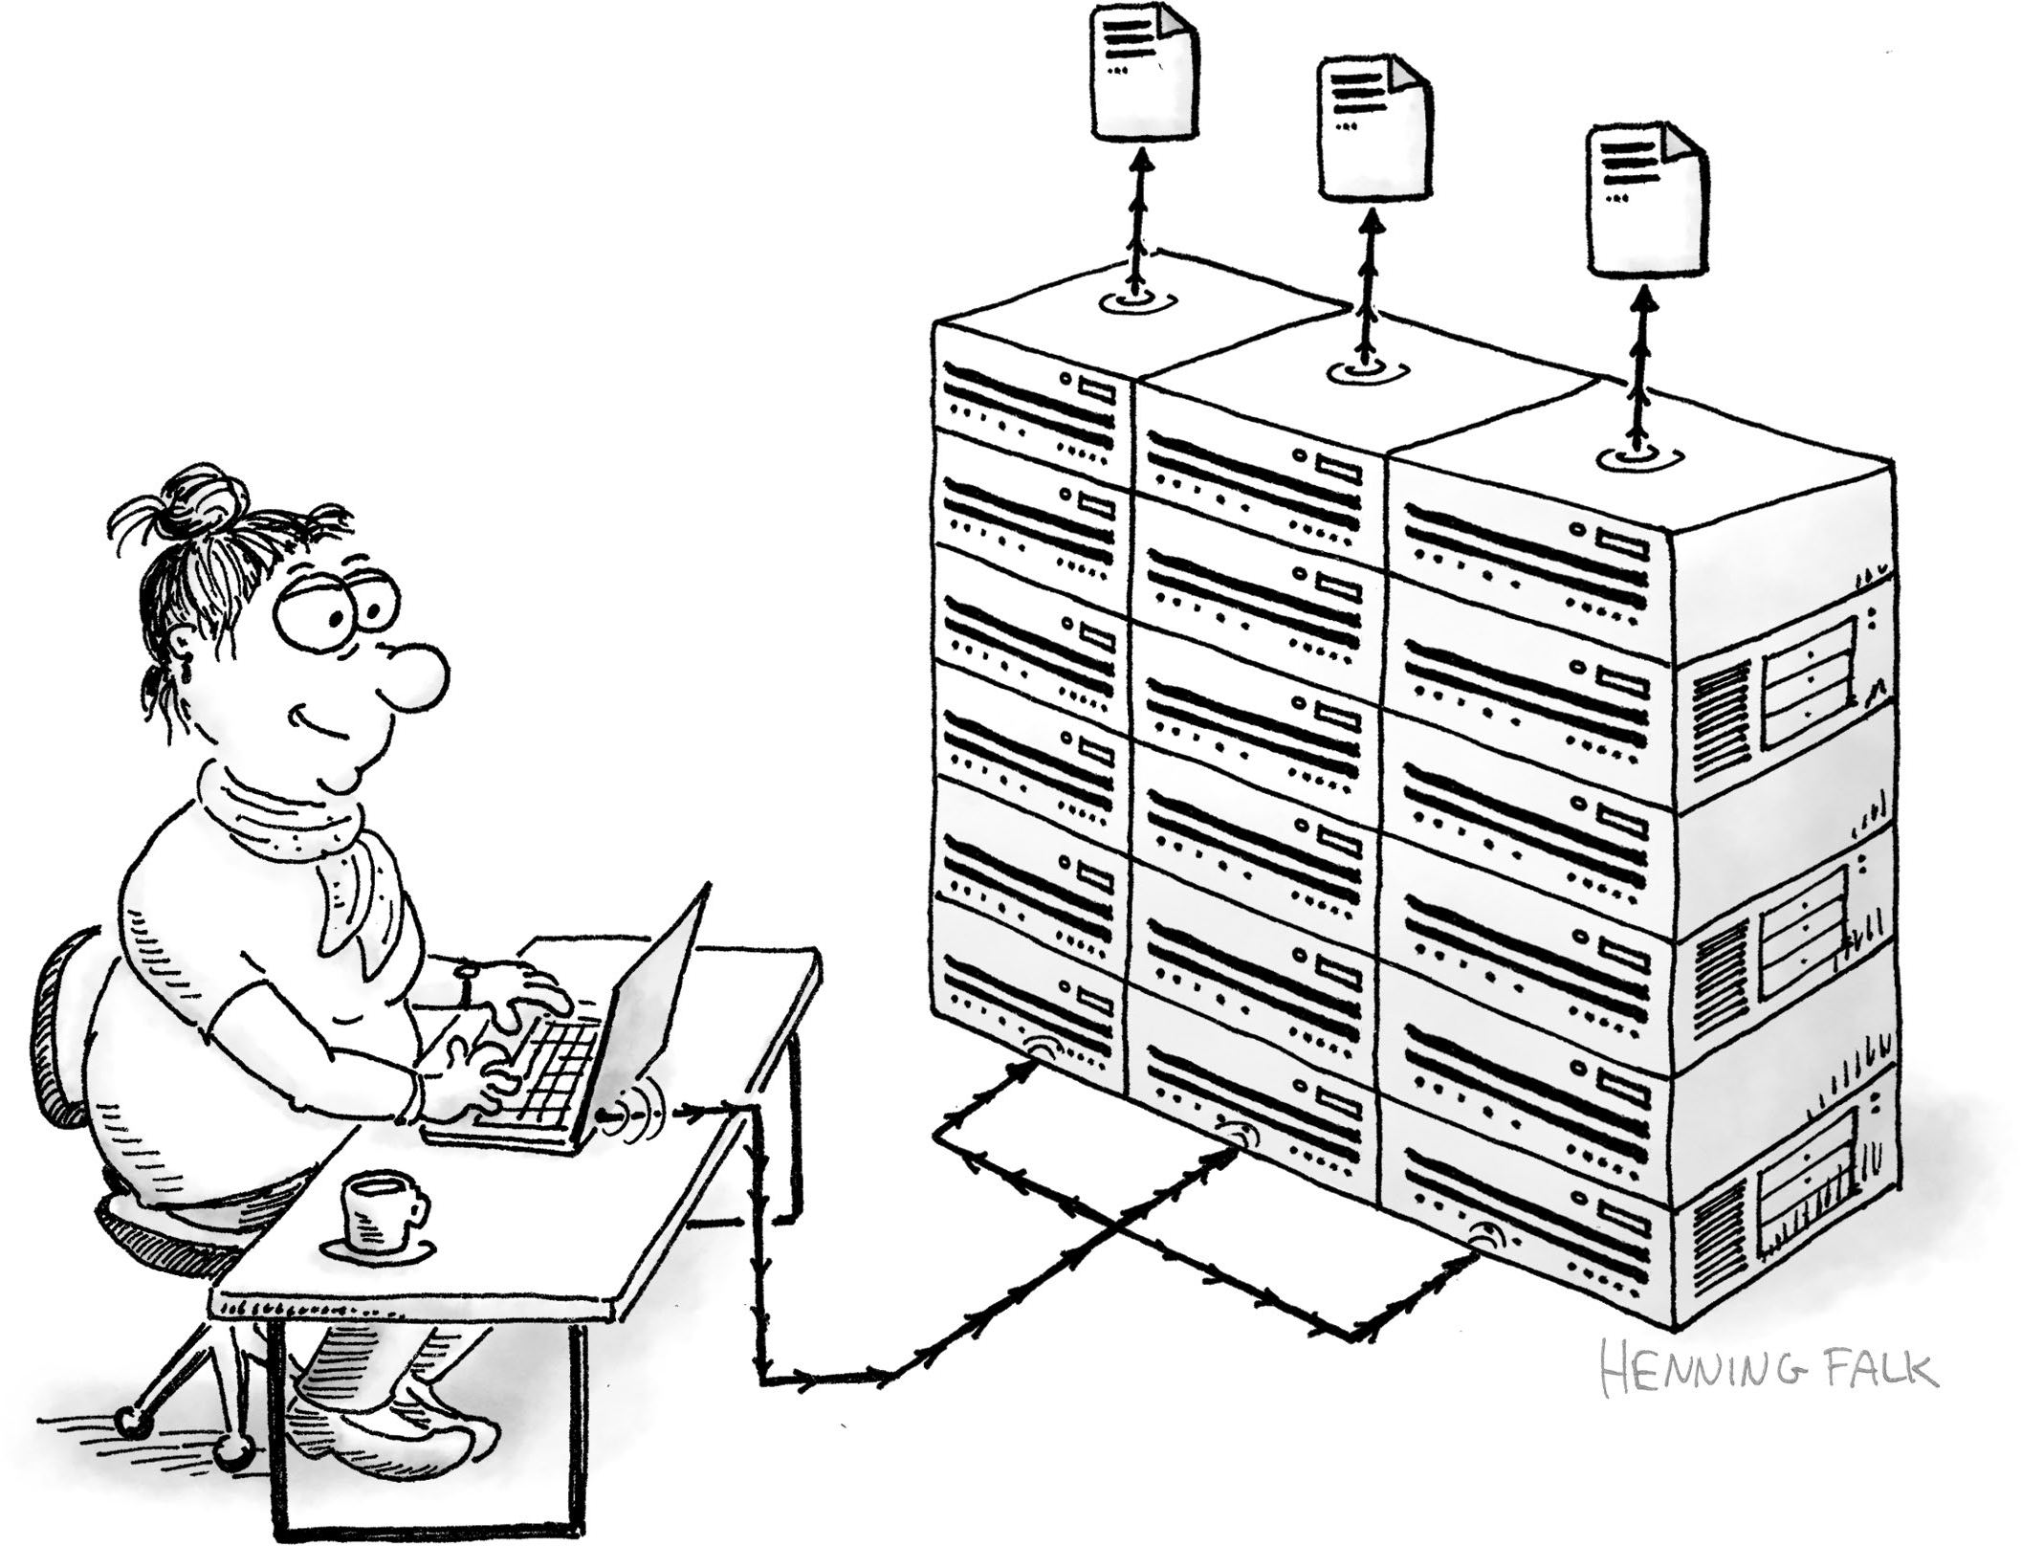




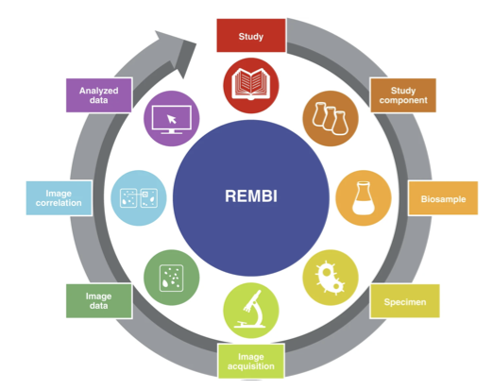




A brief history of making images go
"Bea computes" by Henning Falk, ©2022 NumFOCUS, is used under a CC BY 4.0 license.
https://github.com/zarr-developers/zarr-illustrations-falk-2022#bea-computes
2000
2005
2016
2018
2024
JSON RFC (2006)
“FAIR” Wilkinson (2016)

Slide 7
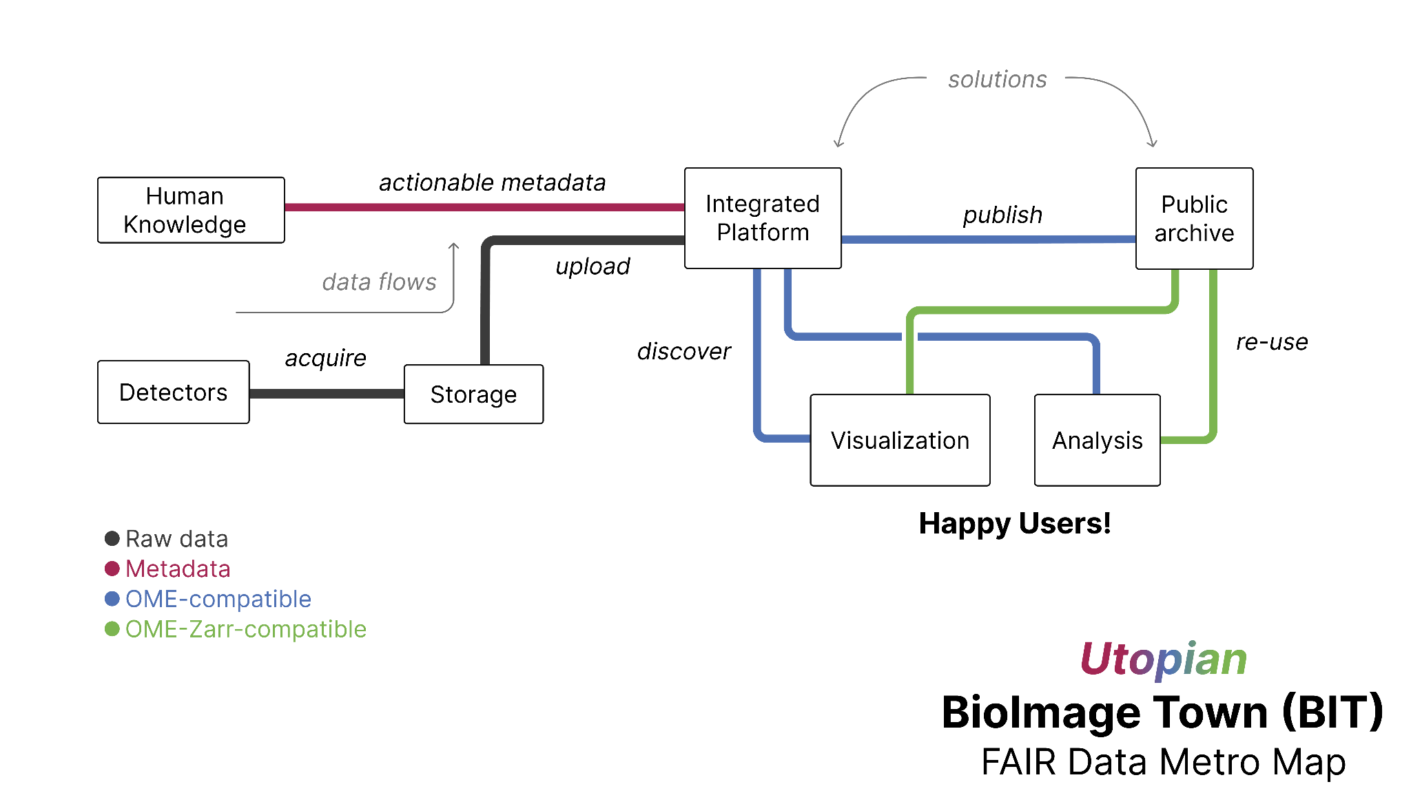

Slide 8
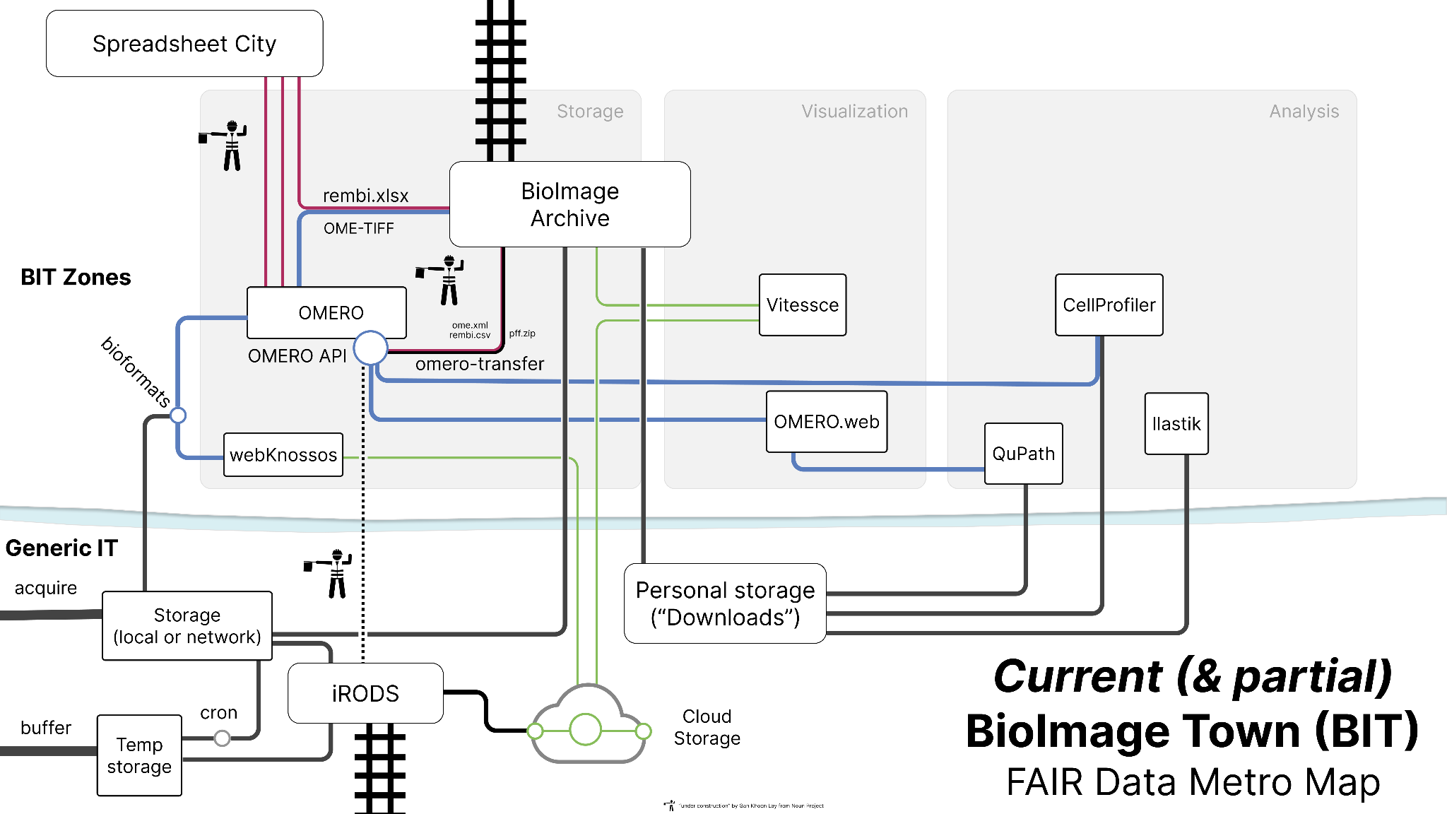





https://doi.org/10.5281/zenodo.8019760
Moore et al., CC-BY 4.0

Slide 9
2000
XML
“
https://en.wikipedia.org/wiki/Rapid_transit_track_gauge
The OME Model is a specification for storing data on biological imaging. The model includes image parameters, such as XYZ dimensions and pixels type, as well as extensive metadata on, for example, image acquisition, annotation, and regions of interest (ROIs). This common specification is essential for the exchange of image data between different software packages.
Swedlow et al. (2003) Informatics and quantitative analysis in biological imaging. Science 300(5616), 100-2. Published 4 April 2003
DOI: 10.1126/science.1082602
https://bit.ly/citing-ome

Slide 10
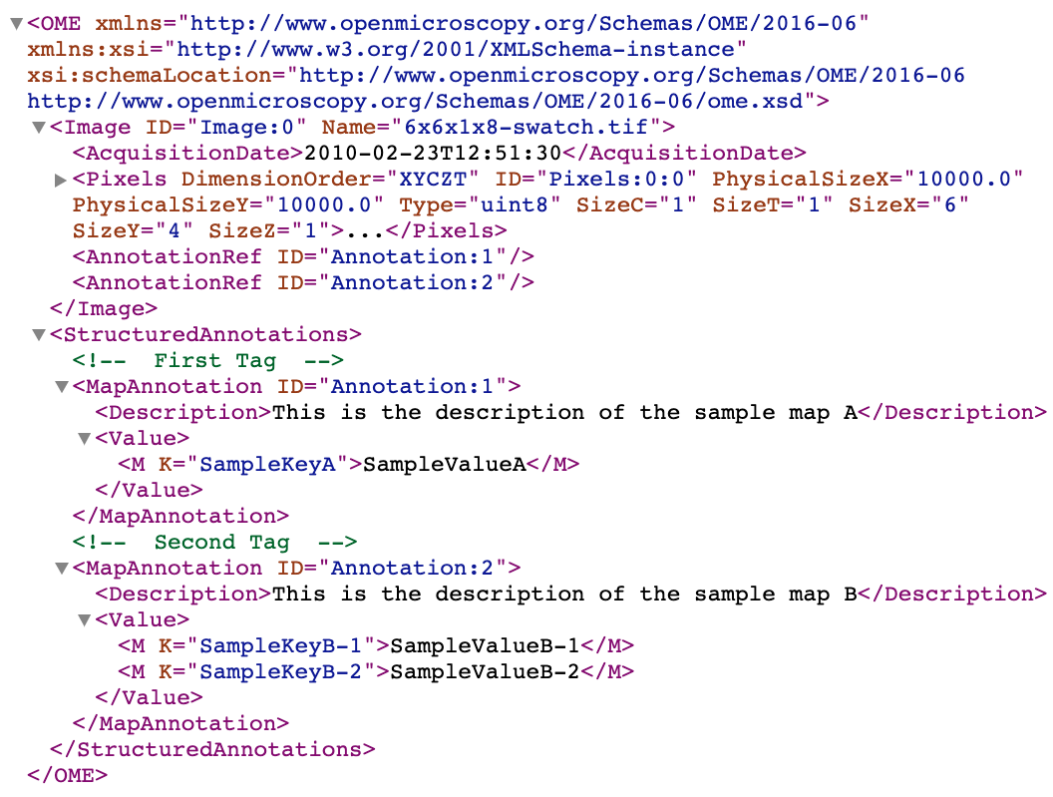
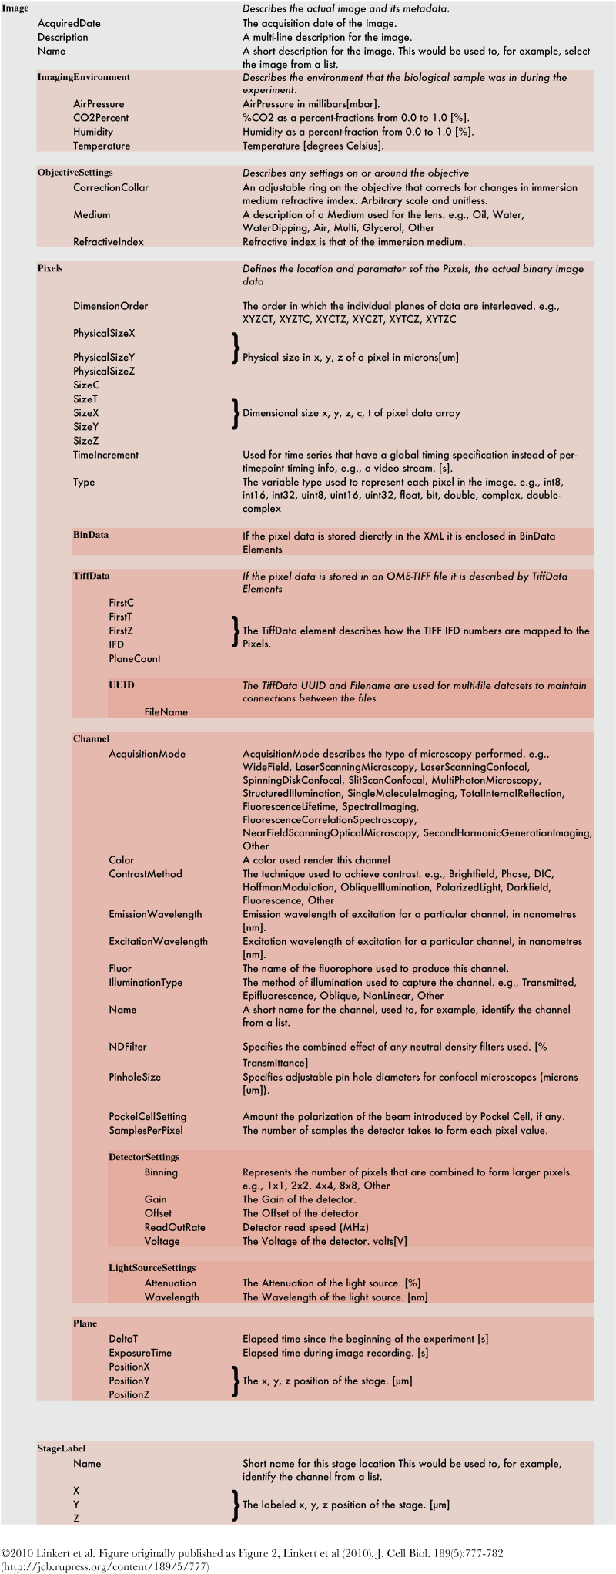
2000
XML
Goldberg, et al. (2005) The Open Microscopy Environment (OME) Data Model and XML File: Open Tools for Informatics and Quantitative Analysis in Biological Imaging. Genome Biol. 6:R47.
DOI: 10.1186/gb-2005-6-5-r47
https://bit.ly/citing-ome

Slide 11
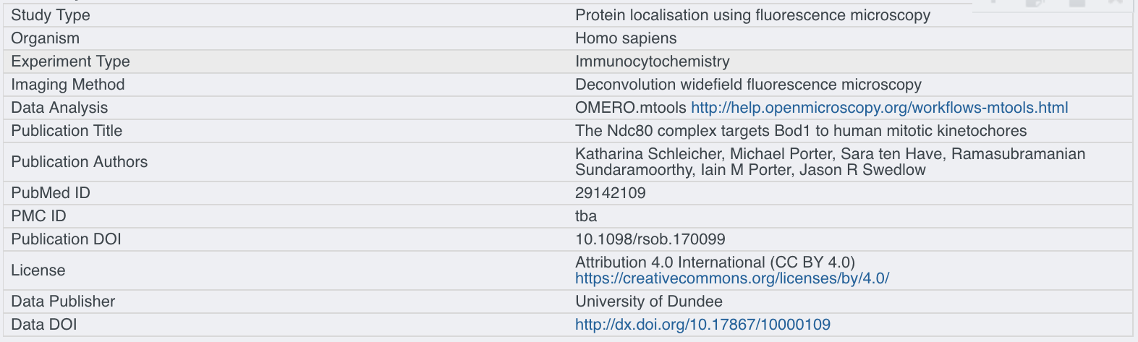
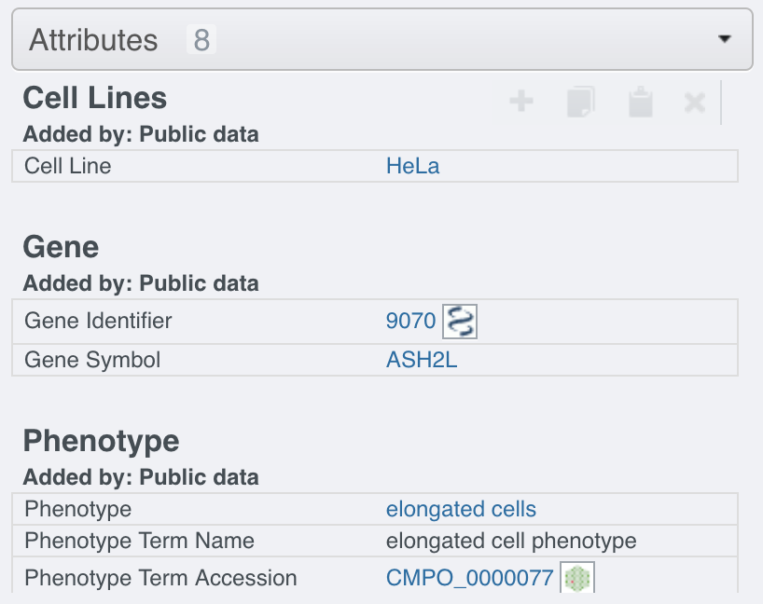
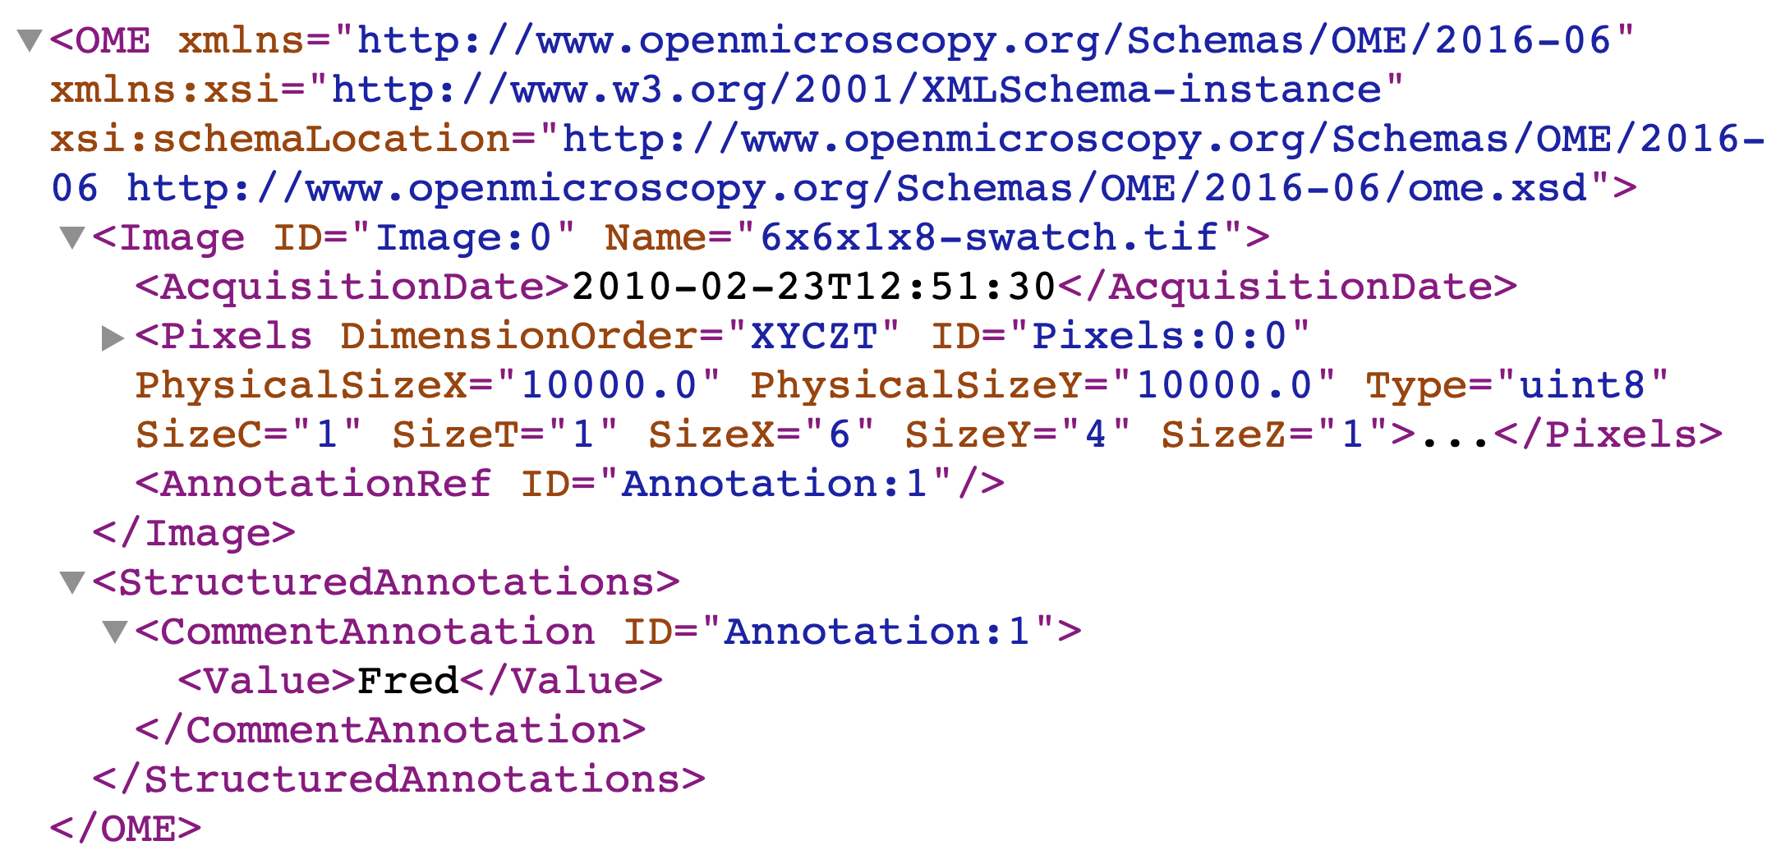
2000
XML
Last major modeling effort for high-content screening
2013
2008
Add key-value (K/V) pair annotation
2016
2010
Added flexible structured annotations for user-extensions
Use k/v for ontology links

Slide 12
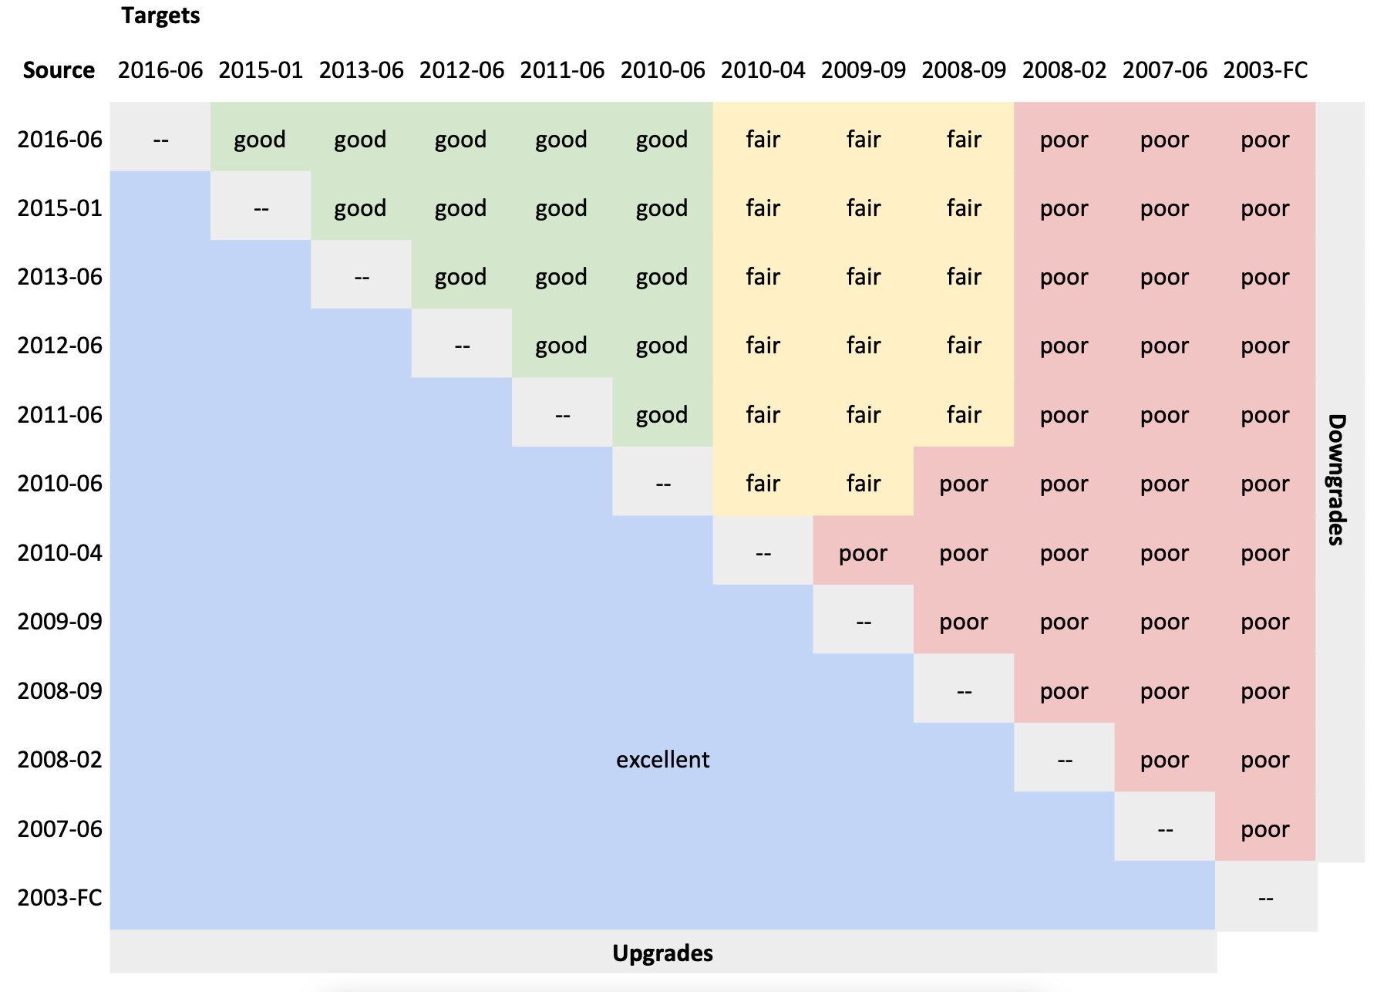
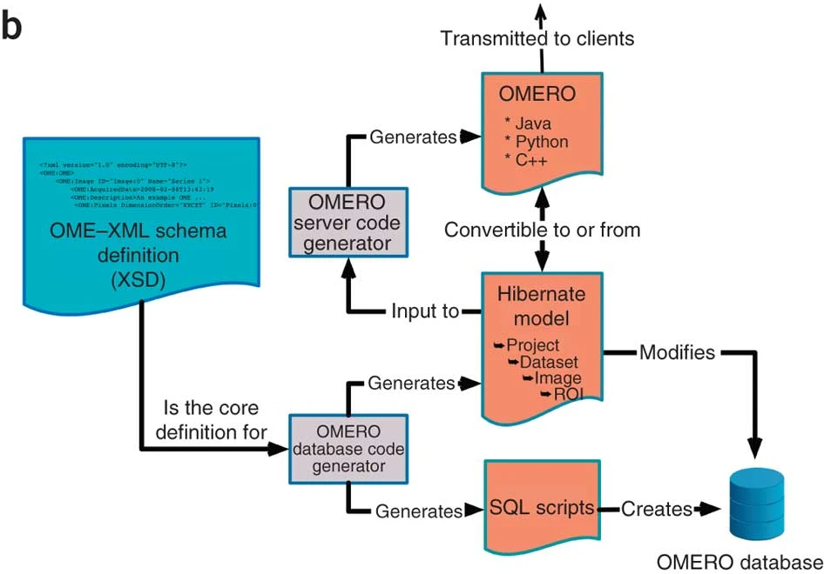
2000
XML

Slide 13
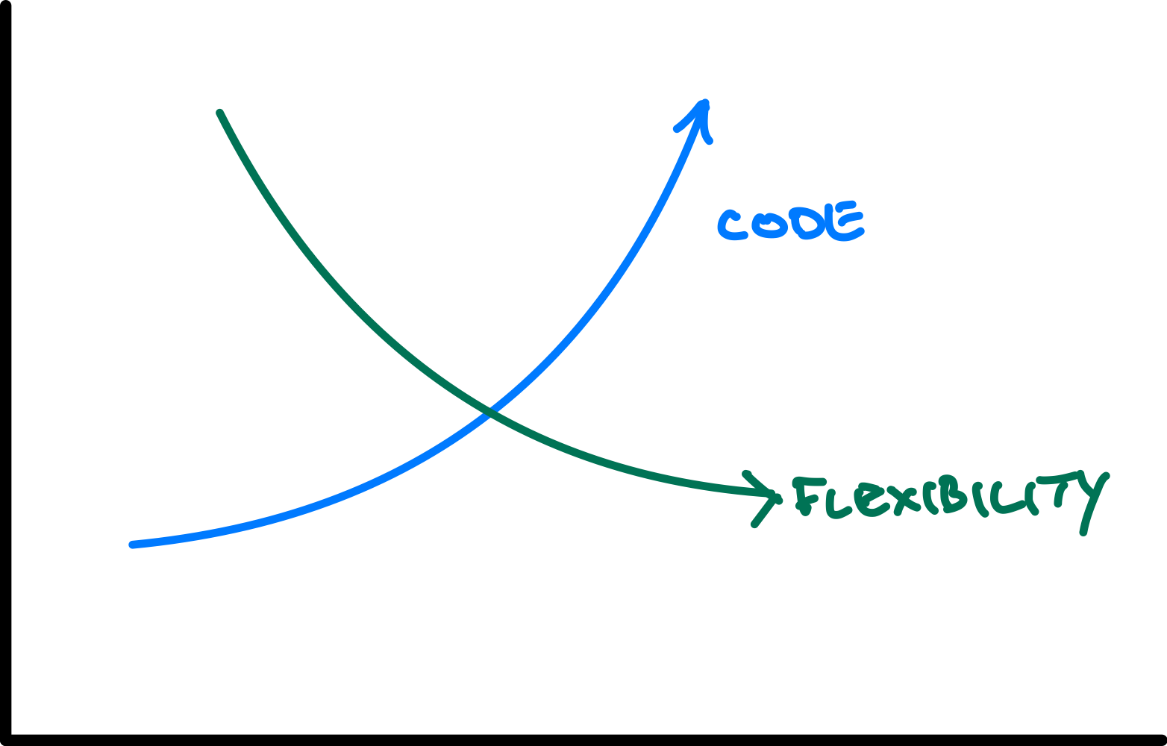
Intermezzo
2000

Slide 14
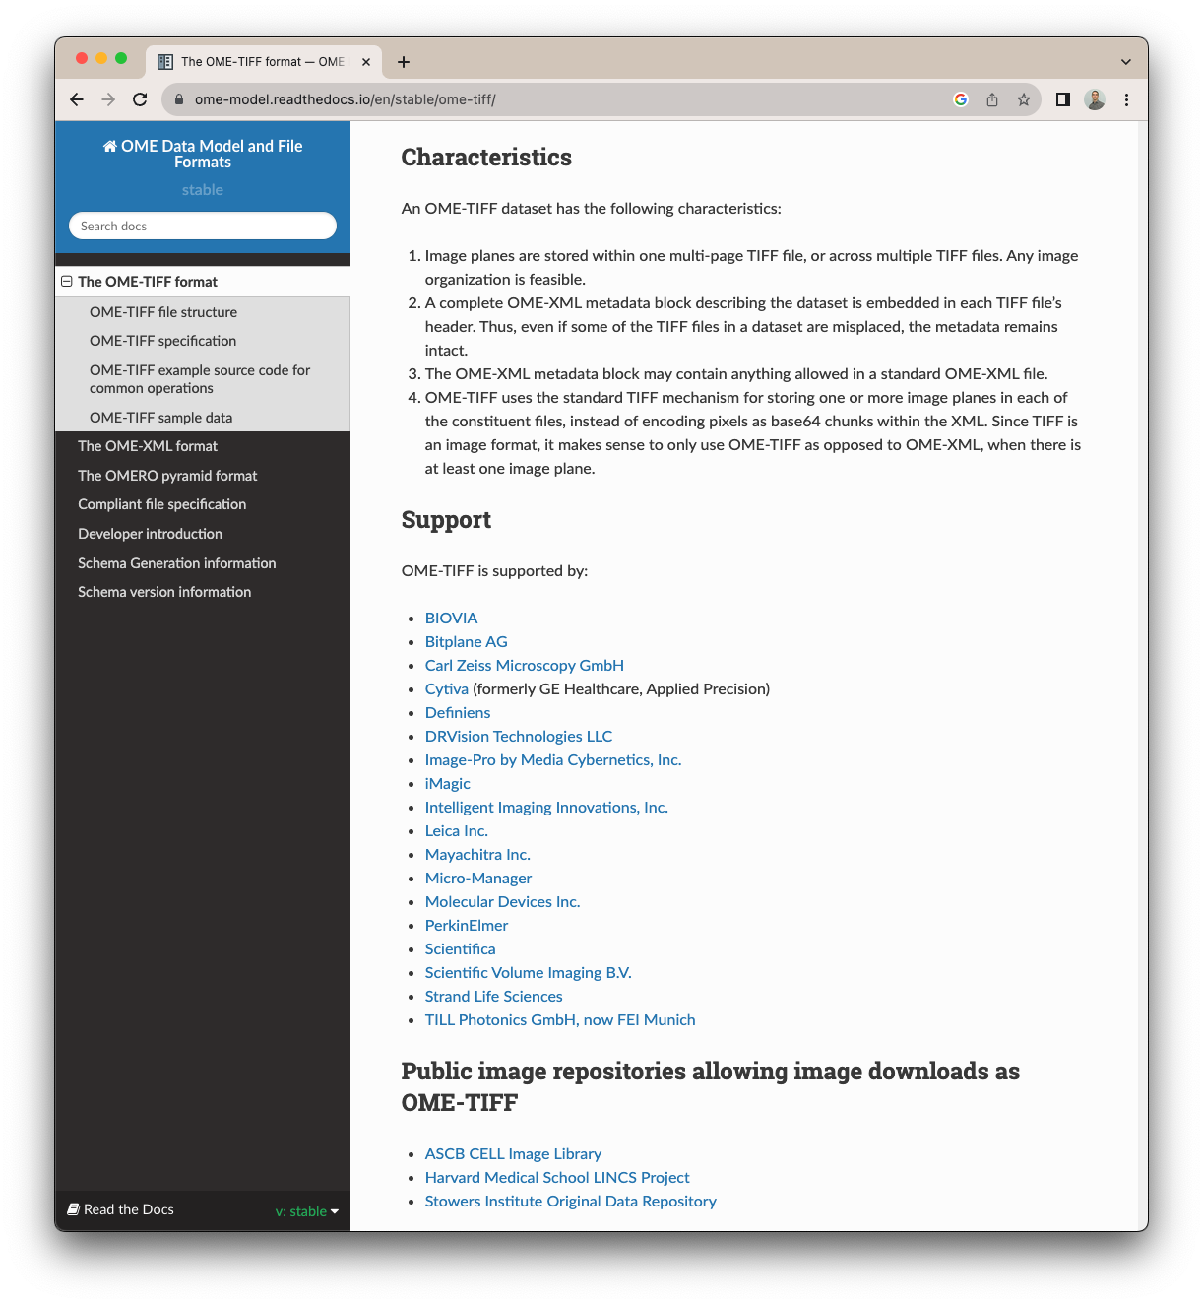
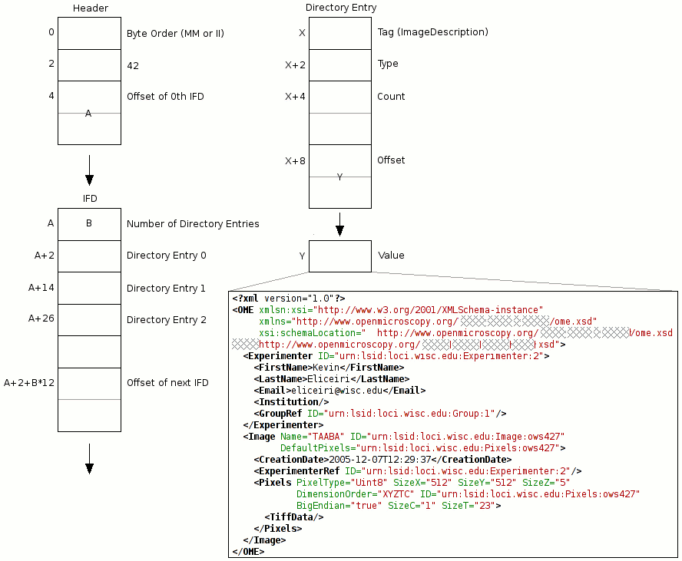
2005
TIFF
https://ome-model.readthedocs.io/en/stable/ome-tiff/specification.html

Slide 15
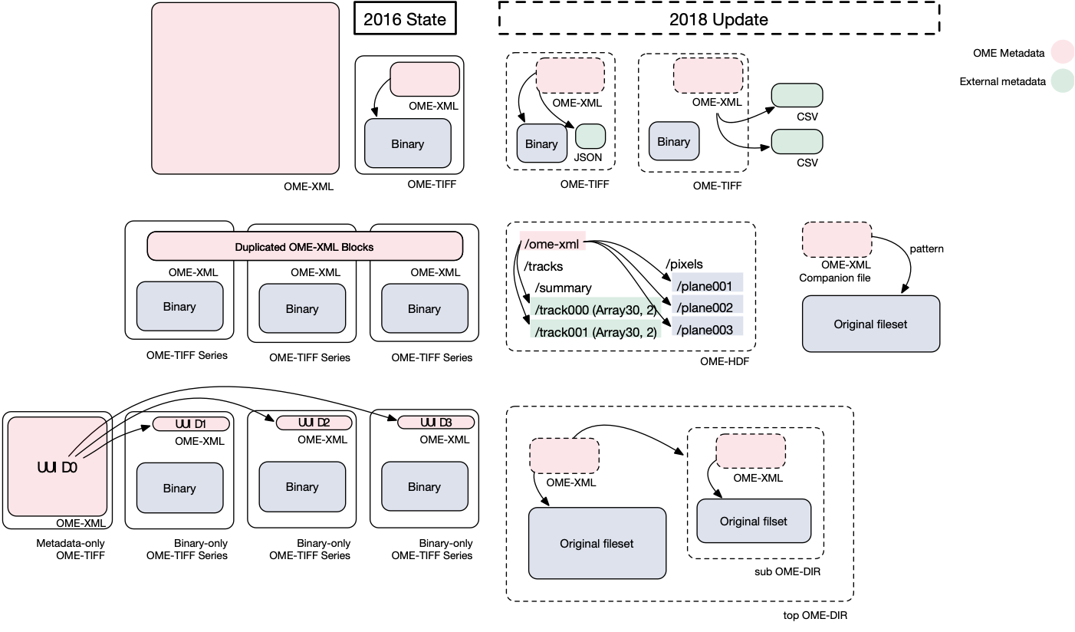
2005
Besson et al. (2019) Bringing Open Data to Whole Slide Imaging. Digital Pathology ECDP 2019. Lecture Notes in Computer Science, vol 11435.
DOI: 10.1007/978-3-030-23937-4_1 PMID: 31579322 PMCID: PMC6774793

Slide 16












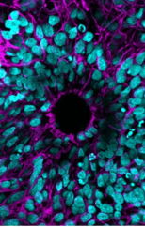

















2005
META-DATA
Linkert et al. (2010) Metadata matters: access to image data in the real world. The Journal of Cell Biology 189(5), 777-782. doi: 10.1083/jcb.201004104
DOI: 10.1083/jcb.201004104
https://bit.ly/citing-ome

Slide 17
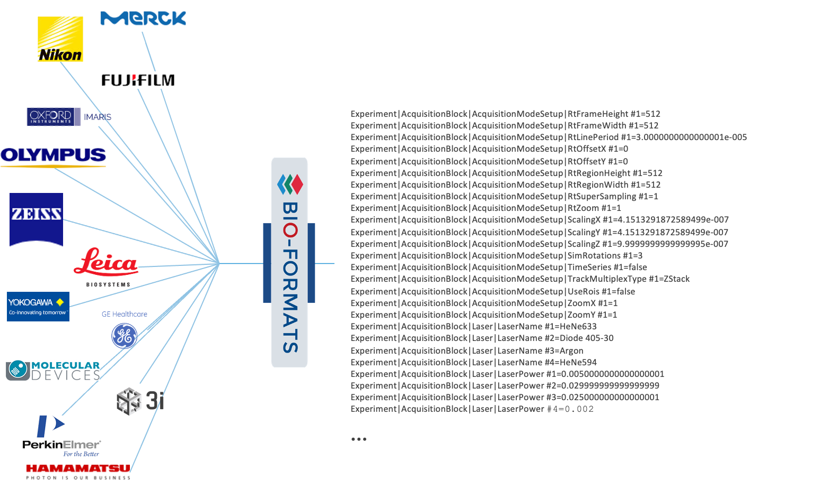
2005

Slide 18
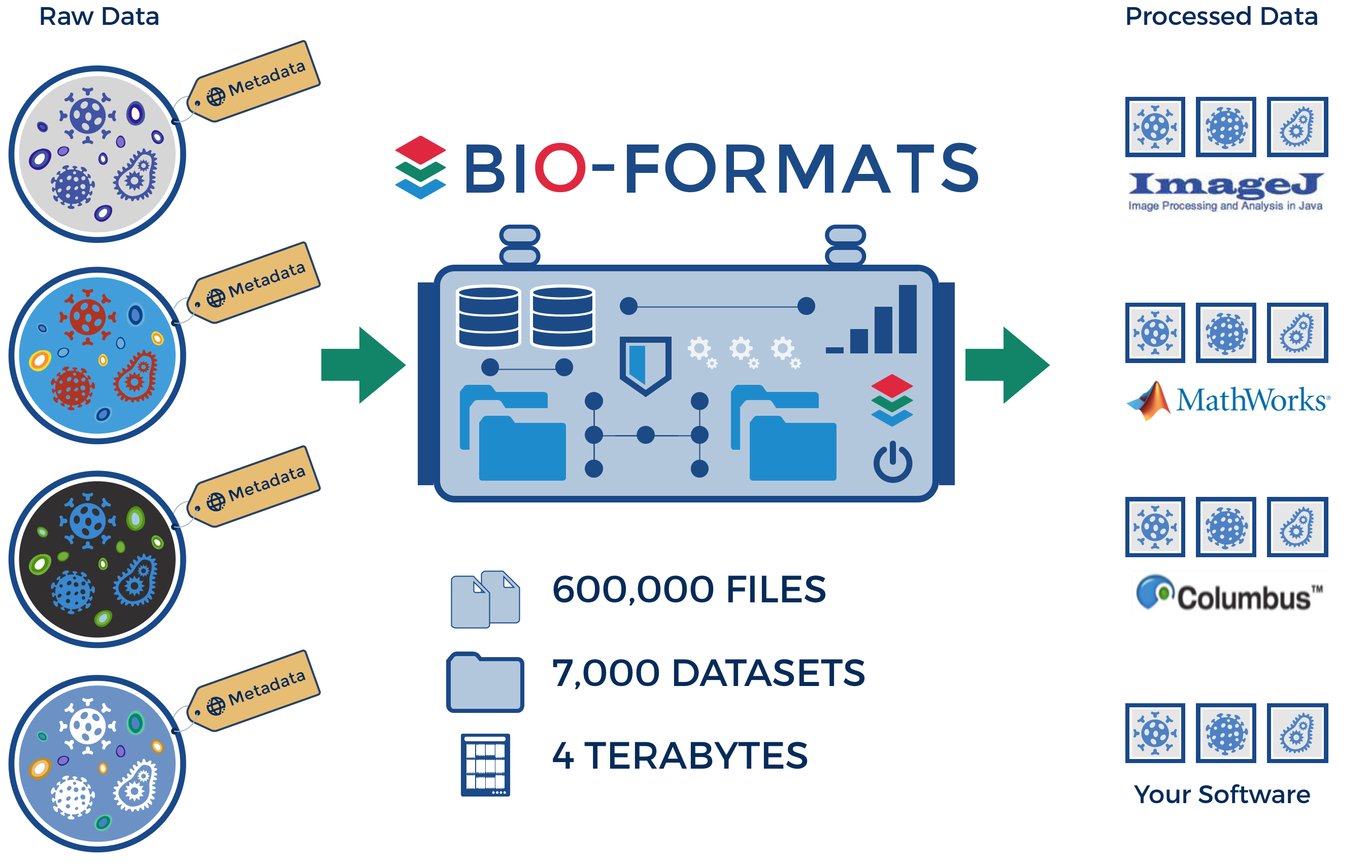
2005
→ Apps using Bio-Formats were started >100,000 times per day in 2015 - 2022. ←

Slide 19
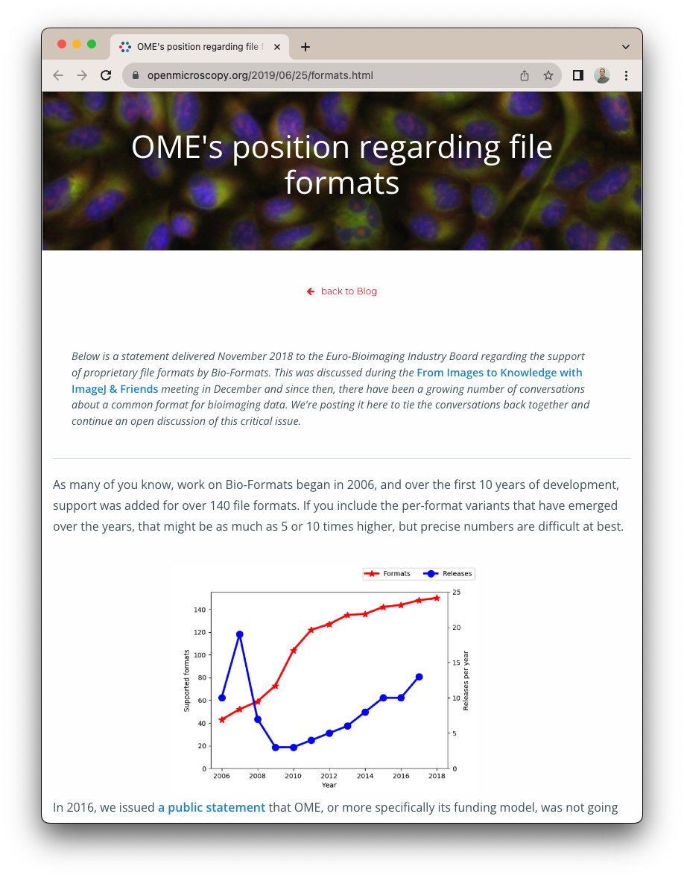
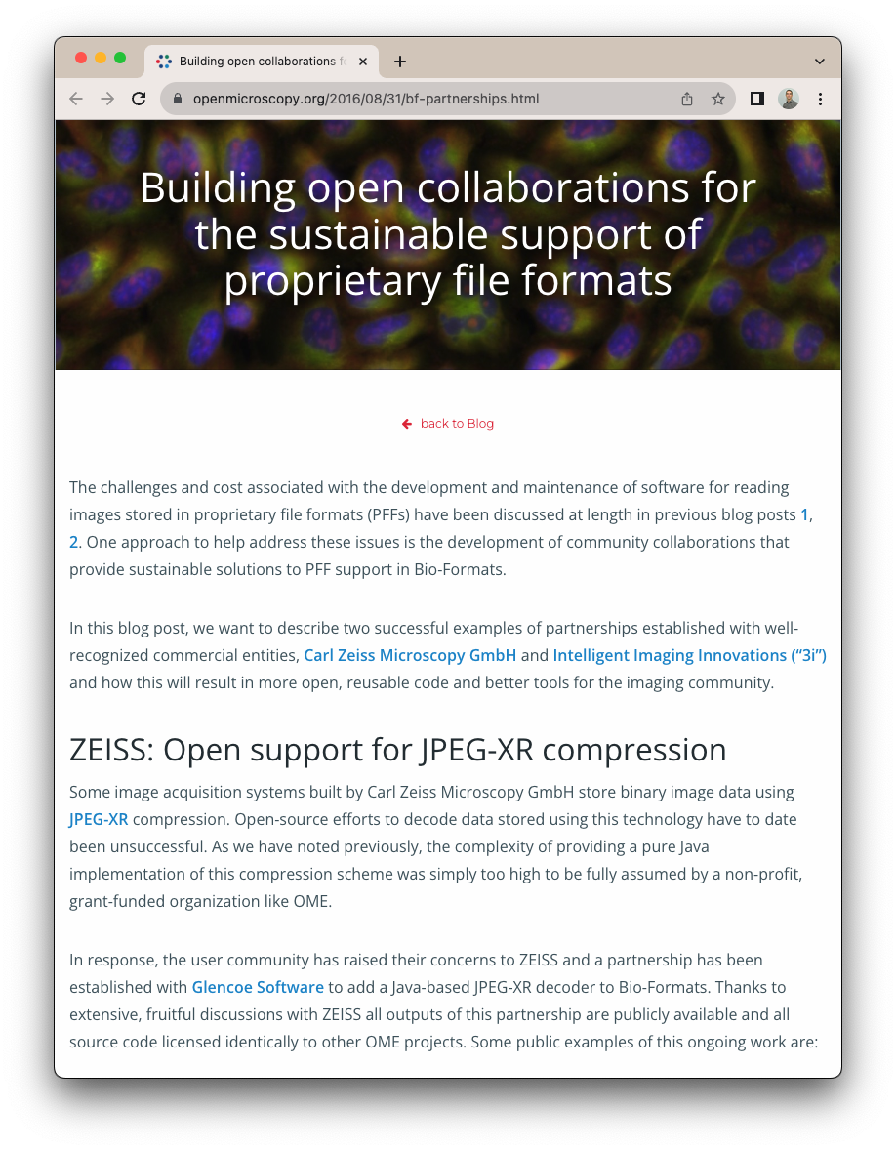
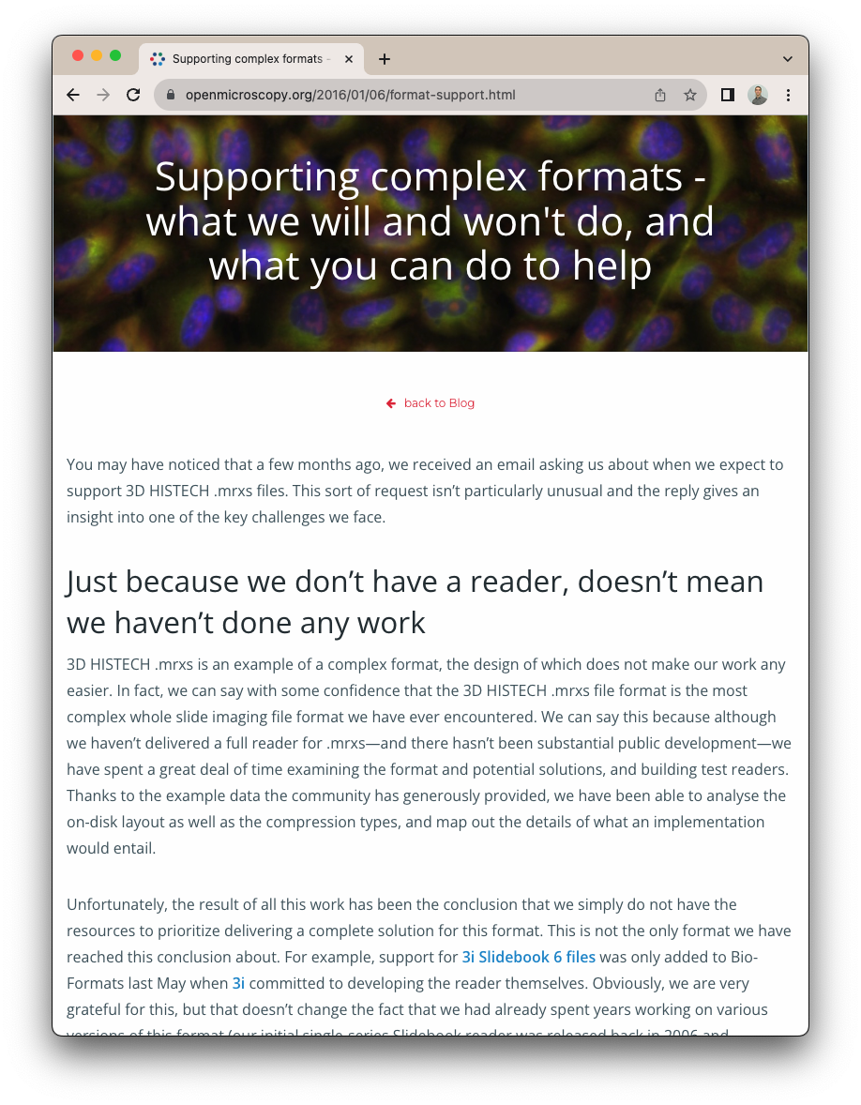
2005
openmicroscopy.org/2019/06/25/formats.html
openmicroscopy.org/2016/08/31/bf-partnerships.html
openmicroscopy.org/2016/01/06/format-support.html

Slide 20

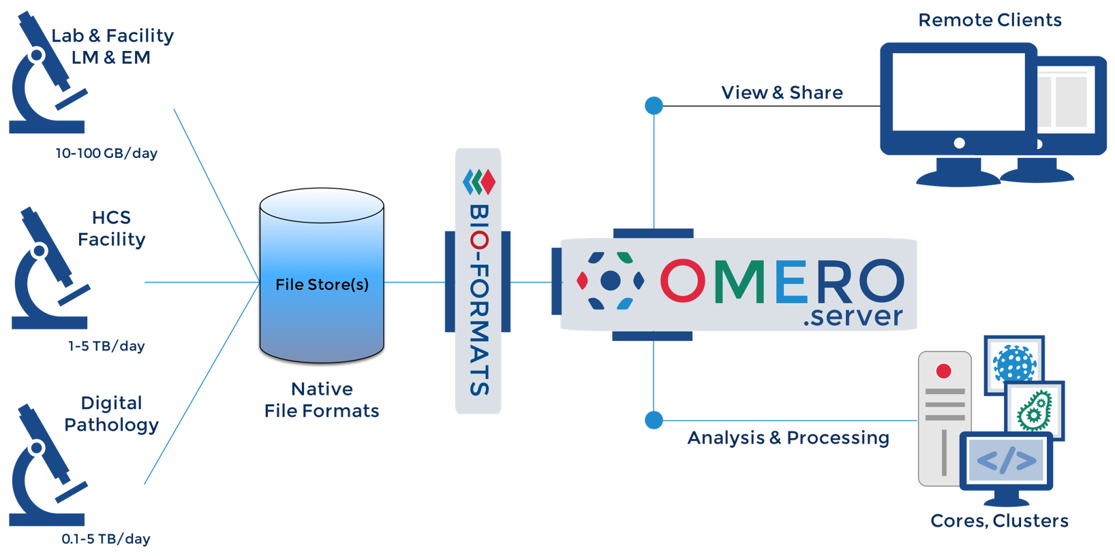
2005

Slide 21
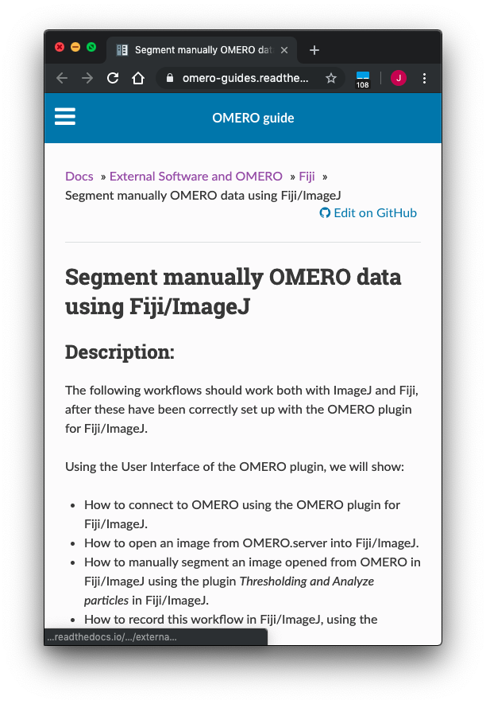
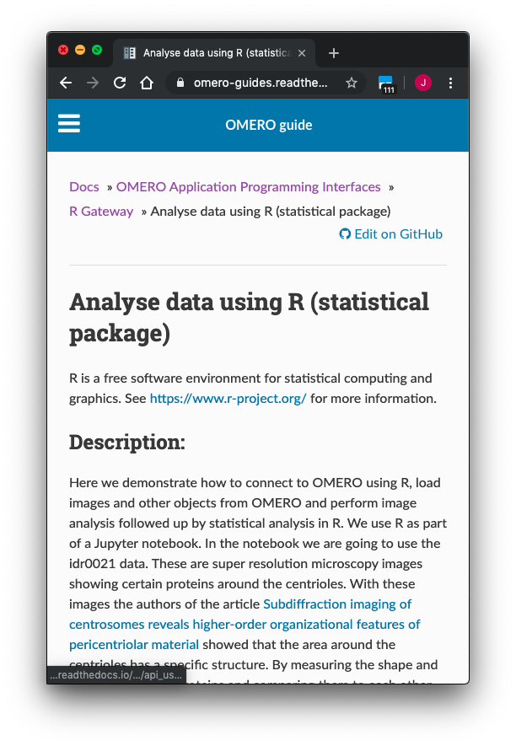
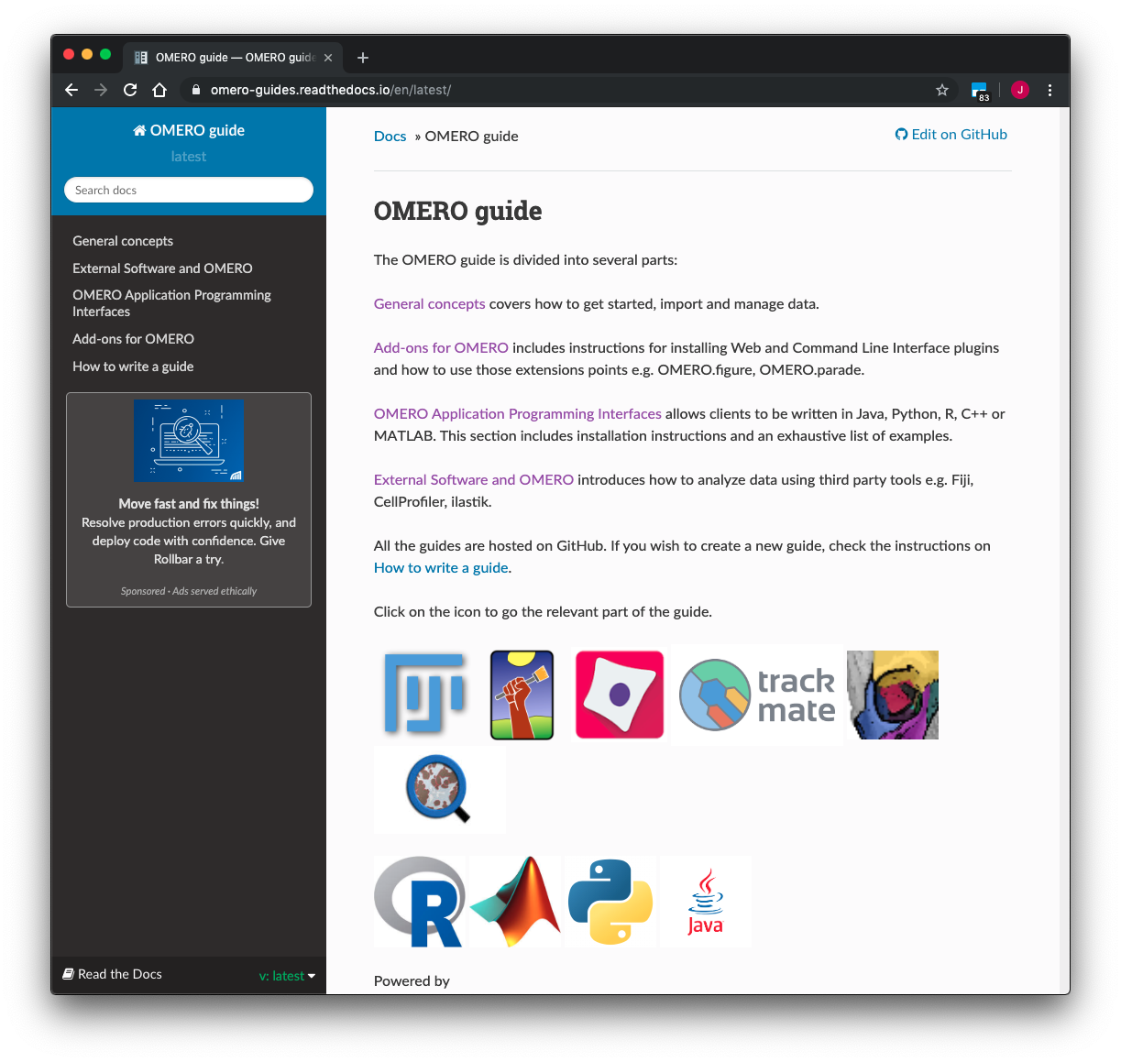
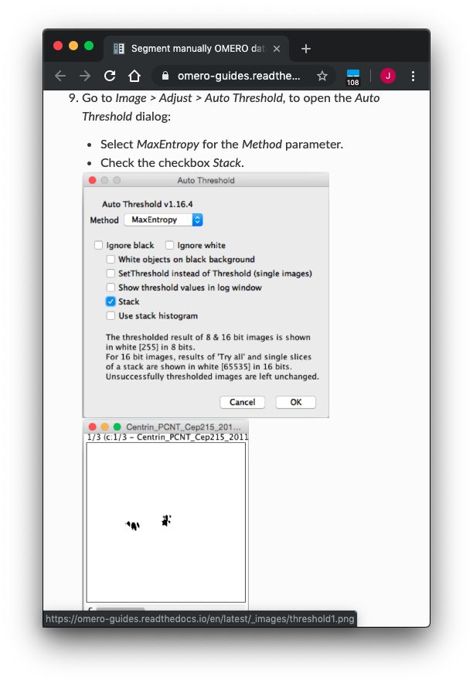
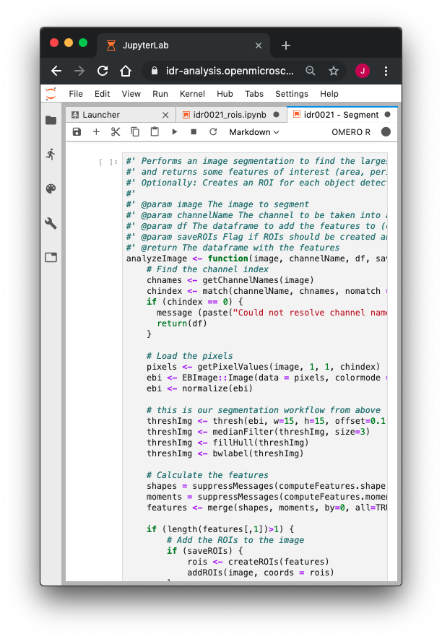

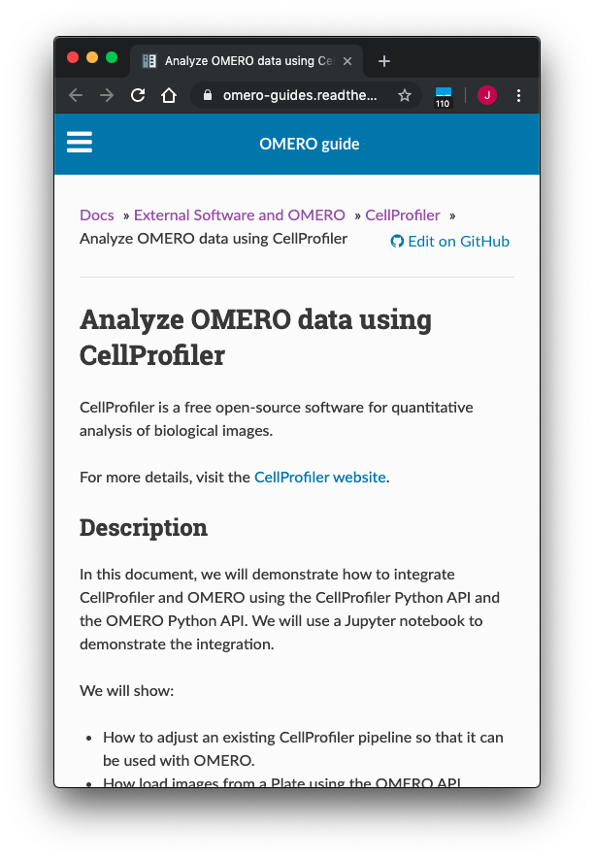
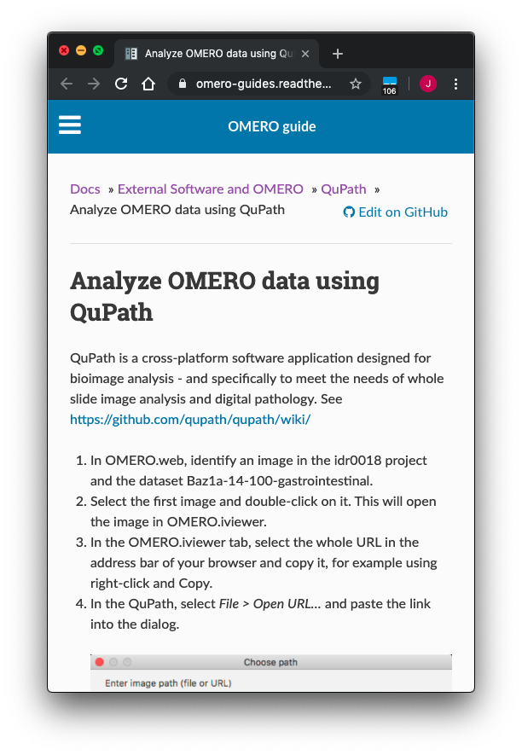
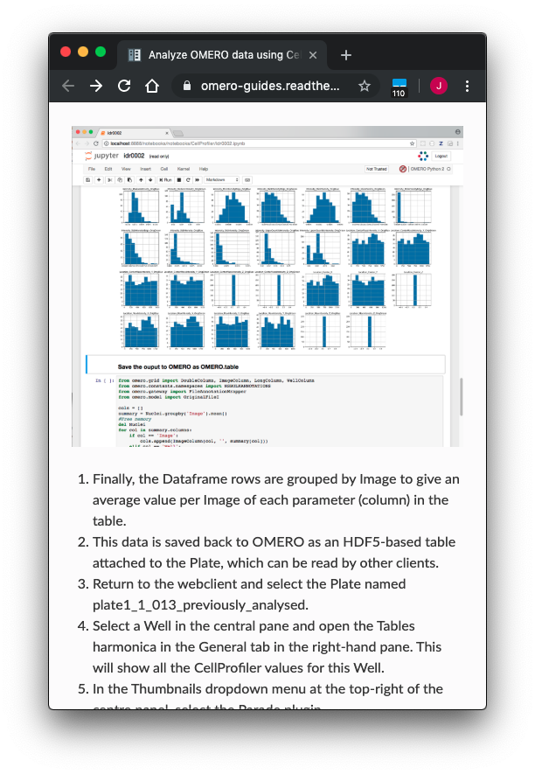
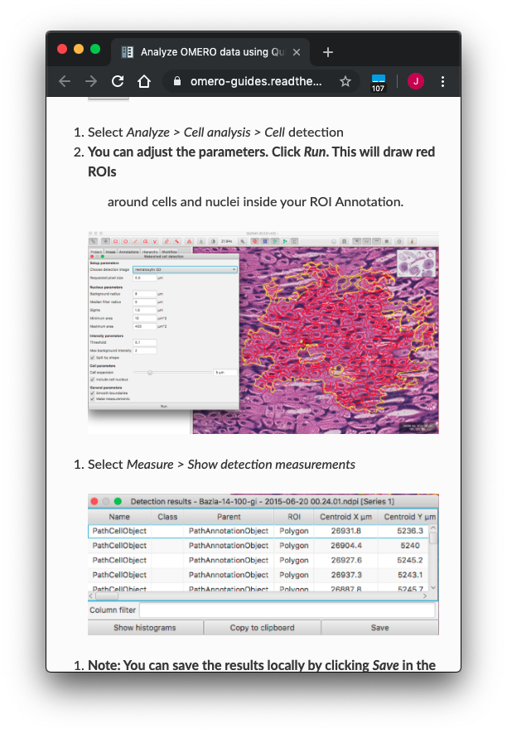
2005
https://omero-guides.readthedocs.io

Slide 22
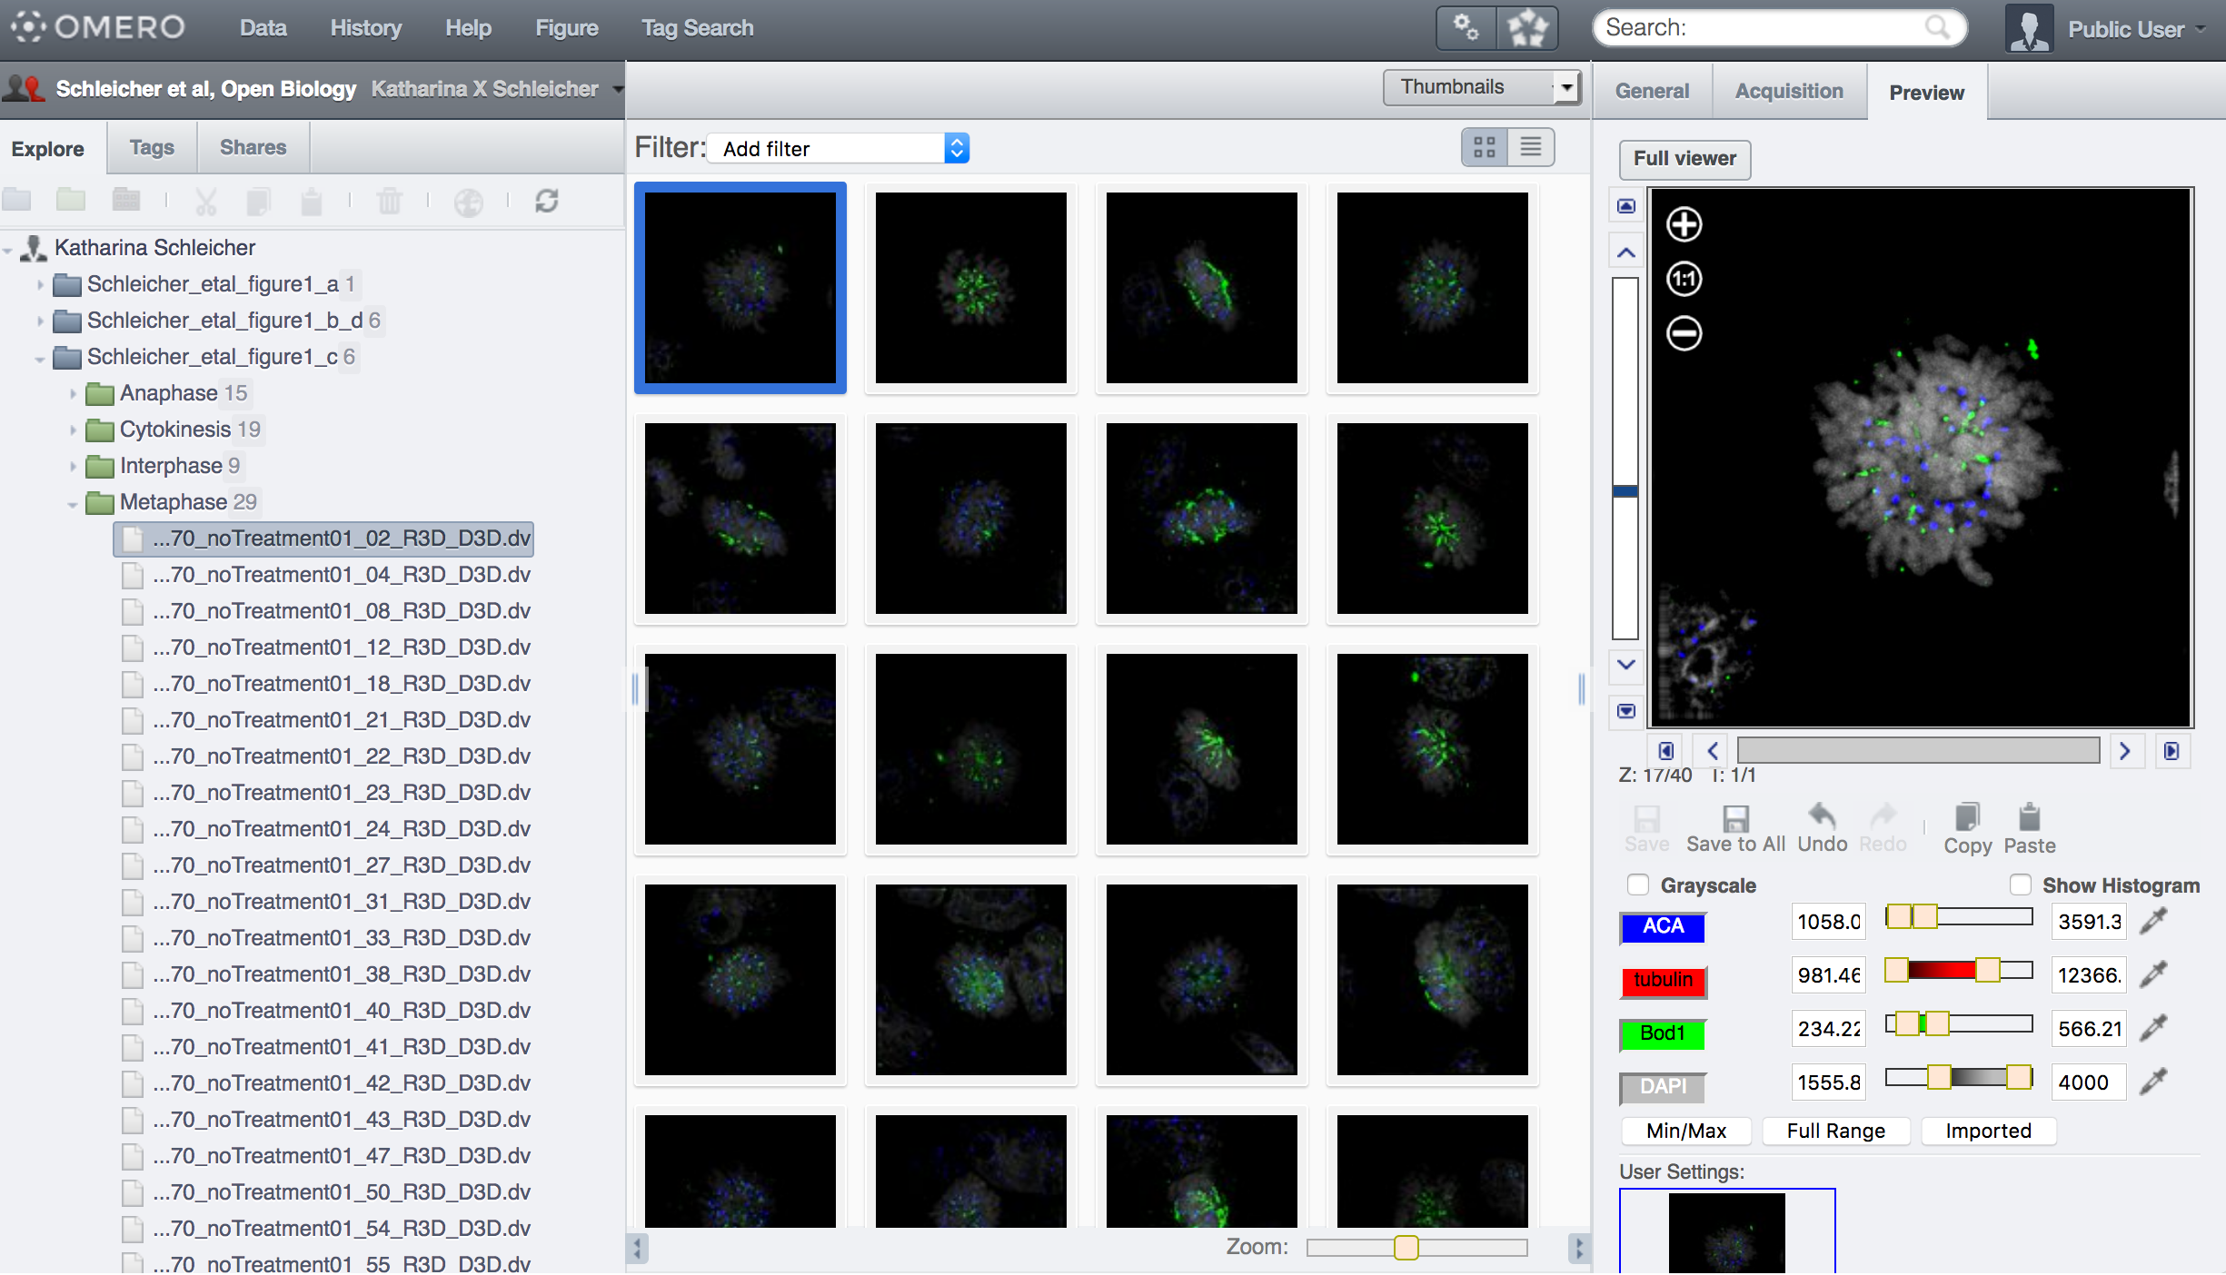
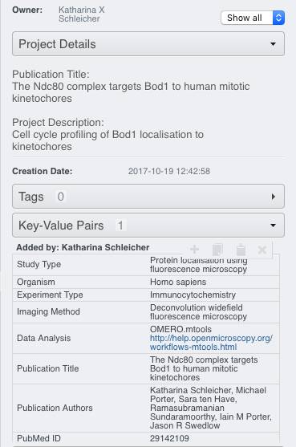
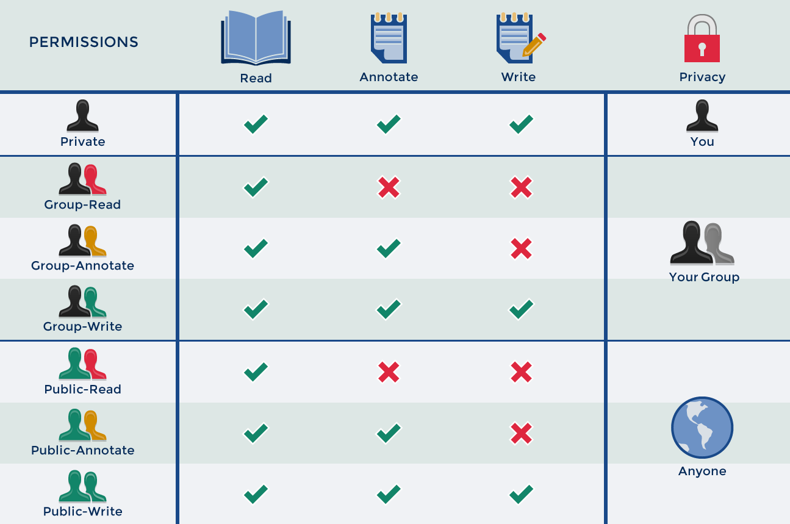



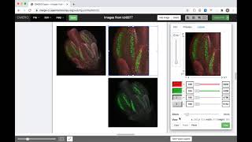
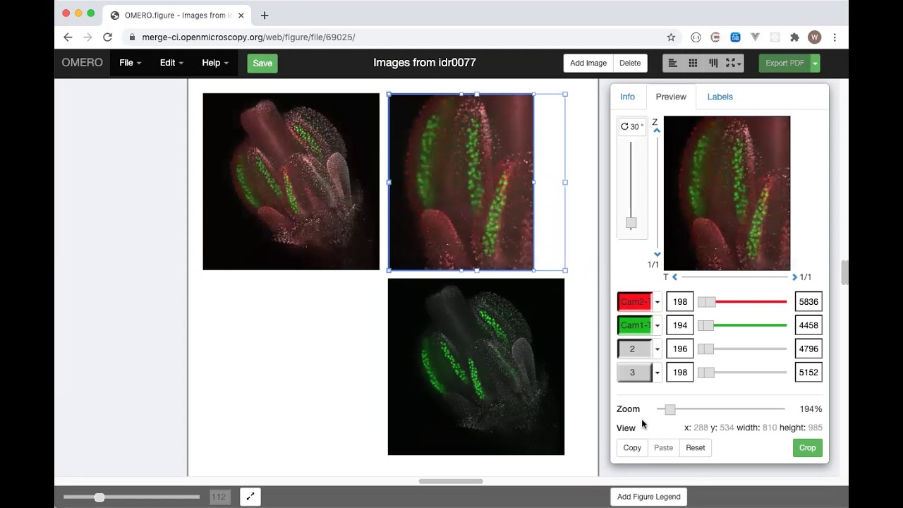
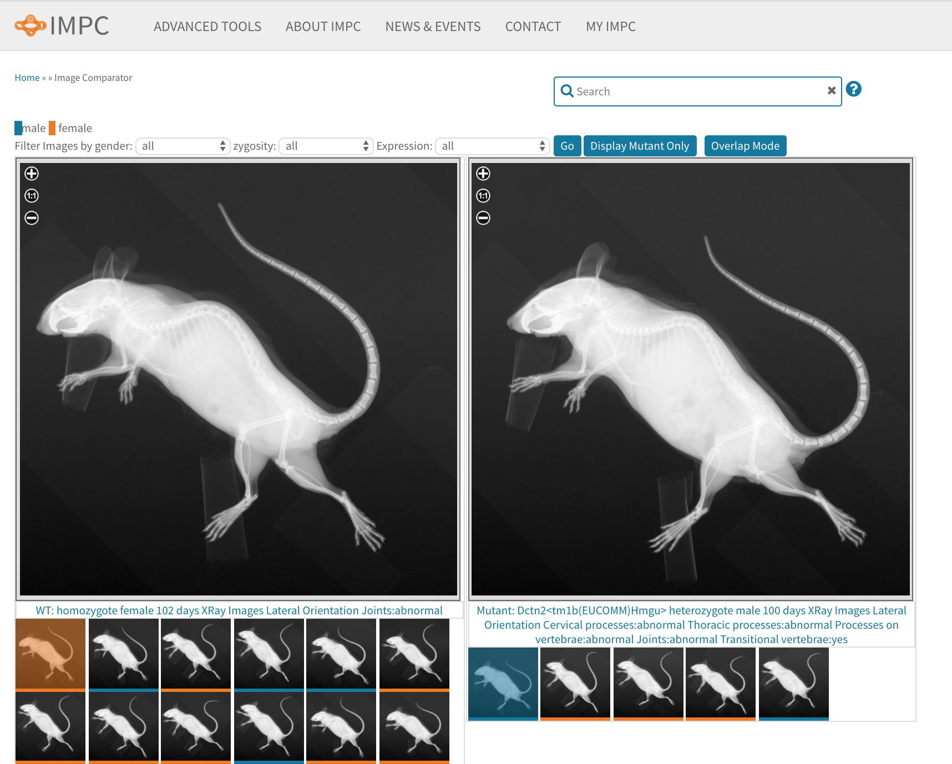
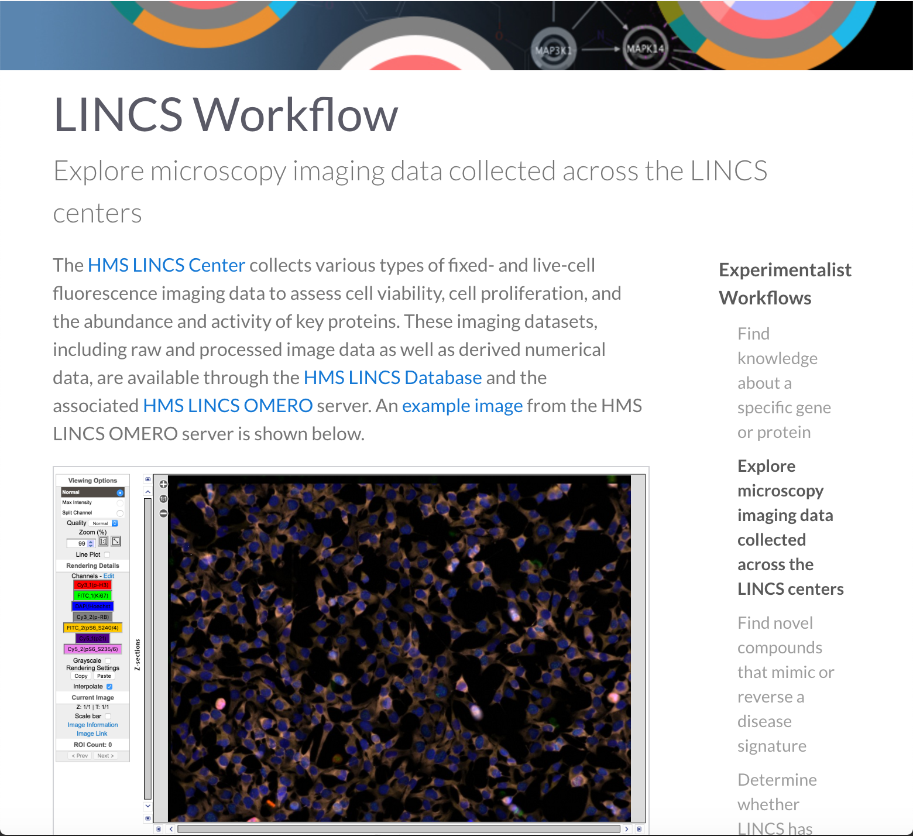
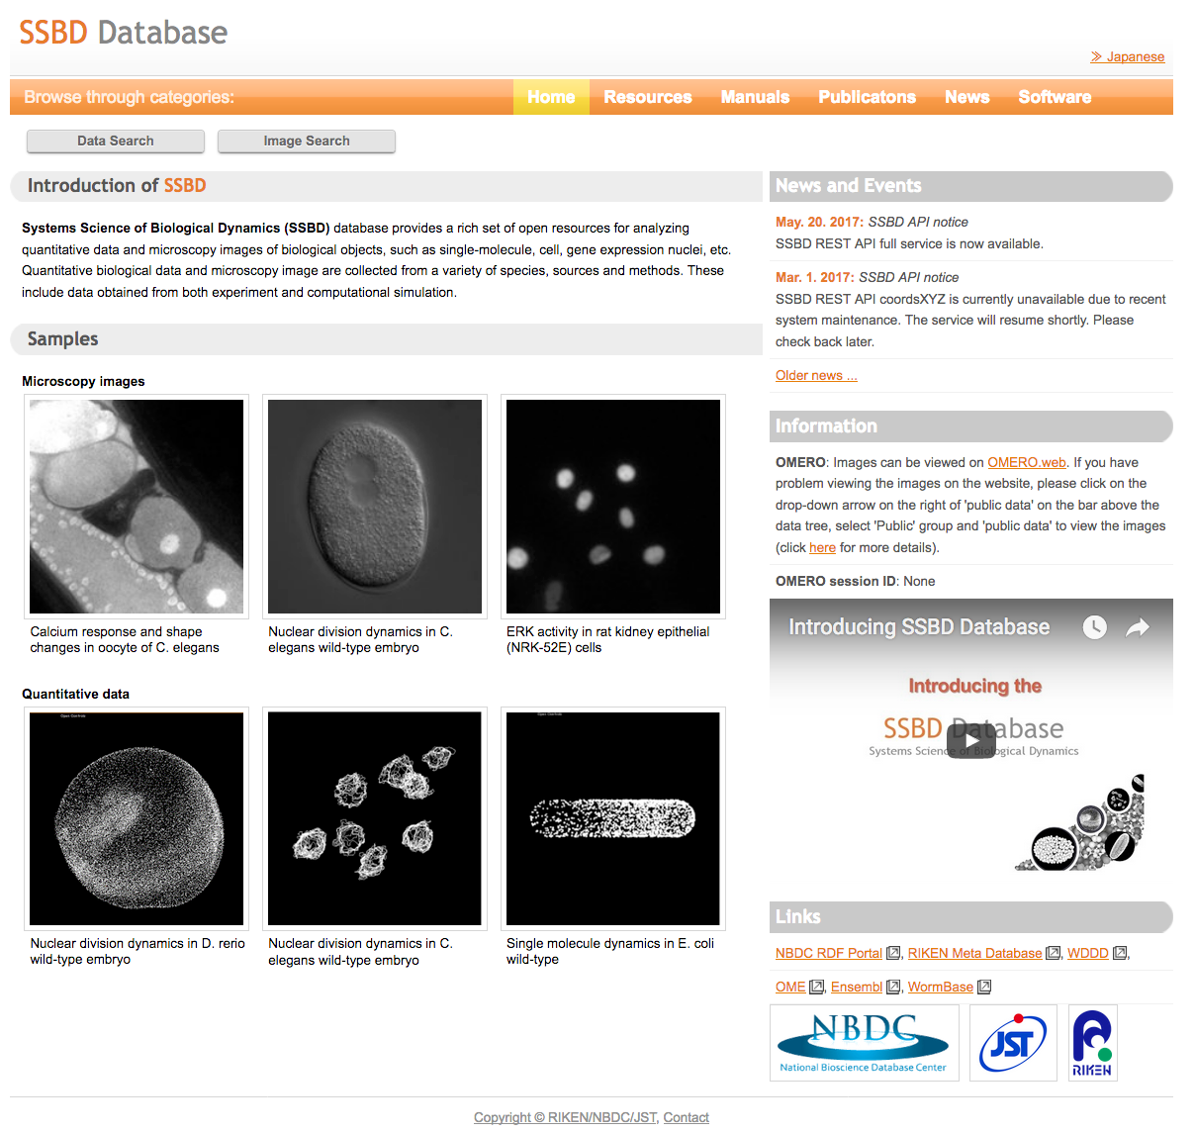
2005
Collaborate on data publication
Annotate
Rapidly edit figures
https://www.mousephenotype.org
https://lincs-omero.hms.harvard.edu
http://ssbd.qbic.riken.jp/

Slide 23

2005
EMPIAR/EMDataBank / PDBe
Ardan Patwardhan, Ingvar Lagerstadt & Gerard Kleywegt, EBI

Slide 24
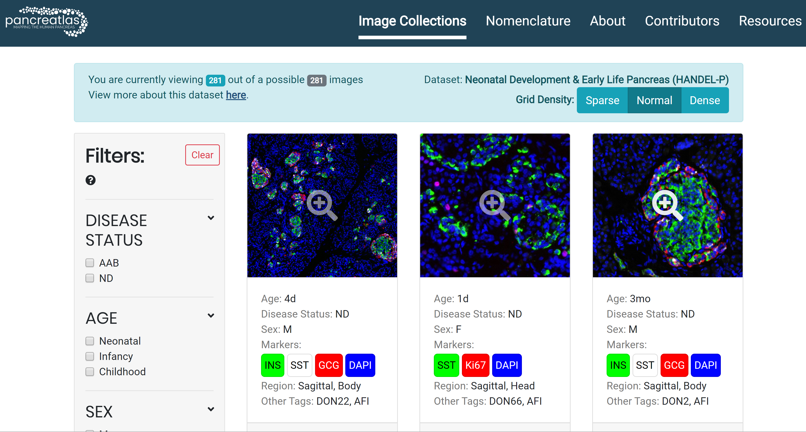
2005
HIRN Tissue Atlas: Pancreatlas.org
Diane Saunders, Marcela Brissova, Alvin Powers, Vanderbilt University Medical Center

Slide 25
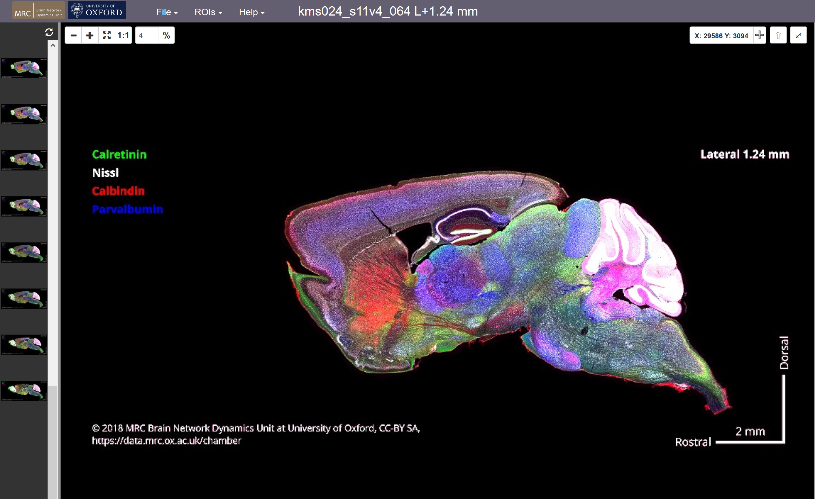
2005
CHemoarchitectonic Atlas of the Mammalian Brain
Kouichi Nakamura & Peter Magill, Univ of Oxford

Slide 26
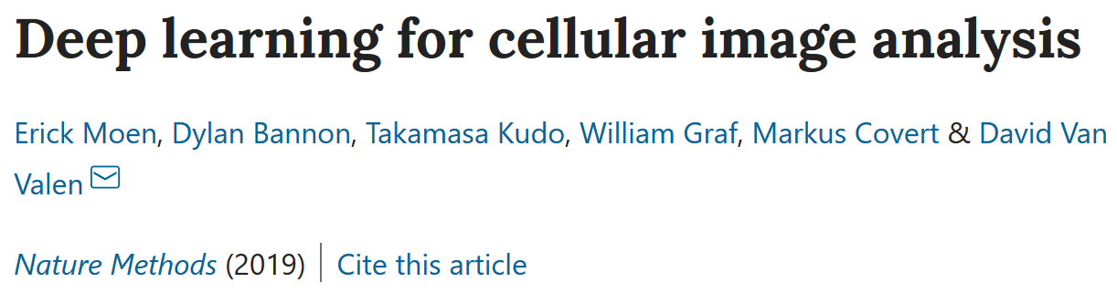
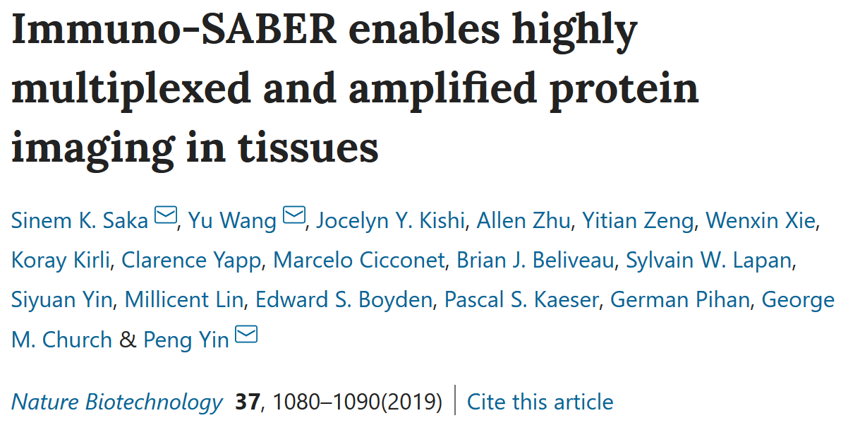
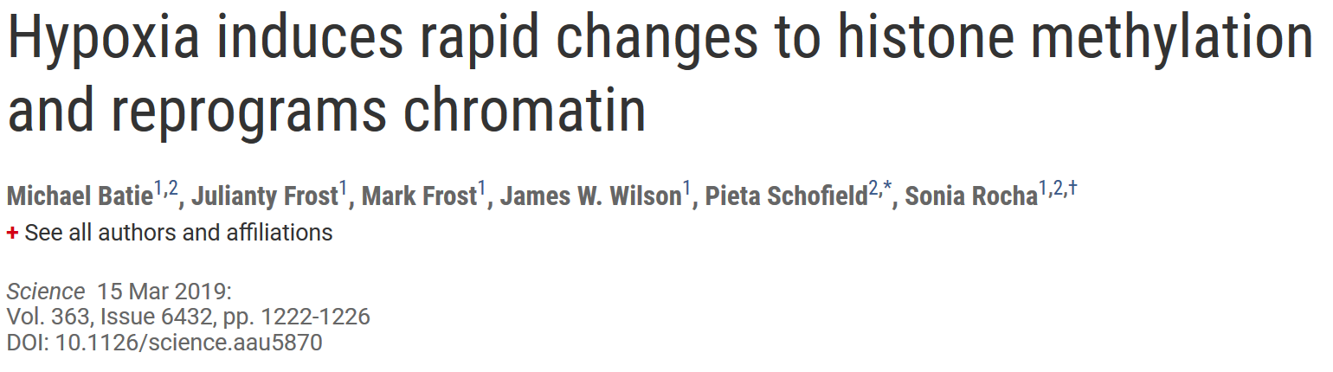




2005

Slide 27







Intermezzo
2005
Use
≠funding
PRs
Project

Slide 28


2016
Euro-BioImaging– ELIXIR Image Data Strategy
https://elixir-europe.org/sites/default/files/documents/euro-bioimaging_elixir_image_data_strategy.pdf

Slide 29











2016
https://idr.openmicroscopy.org
Gene Product
Targeting HCS
Genetic HCS
Experimental
metadata
Cross-data
browsing
Geographic HCS
Integrated
studies
Chemical HCS
Biomolecular
annotations
Cloud
analysis
Histopathology
Analysis
results
Thumbnails (of 5D Images)
Download
(local analysis)
3D-Sim
Williams et al. (2017) The Image Data Resource: A Bioimage Data Integration and Publication Platform. Nature Methods 14(8), 775-781. Published 19 June 2017 DOI: 10.1038/nmeth.4326
https://bit.ly/citing-ome
Super-resolution

Slide 30
2016
October 2023 Metrics
Raw data size | 385 TB
Image files | 38 M
5D Images | 14 M
2D Planes | 118 M
Organisms | 71
Genes | 89 K
Antibodies | 12 K
Compounds | 40 K
Organism | NCBITaxon https://www.ncbi.nlm.nih.gov/taxonomy
Study Type | Experimental Factor Ontology (EFO) https://www.ebi.ac.uk/efo/
Screen Type (HCS) | Experimental Factor Ontology (EFO) https://www.ebi.ac.uk/efo/
Screen Technology Type (HCS) | Experimental Factor Ontology (EFO) https://www.ebi.ac.uk/efo/
Library Type (HCS) | Experimental Factor Ontology (EFO) https://www.ebi.ac.uk/efo/
Protocol | Experimental Factor Ontology (EFO) https://www.ebi.ac.uk/efo/
Imaging Method | Biological Imaging Methods Ontology (FBbi) https://www.ebi.ac.uk/ols/ontologies/fbbi
Phenotype | Cellular Microscopy Phenotype Ontology (CMPO) https://www.ebi.ac.uk/cmpo/
Clinical/Pathology | SNOMED CT https://bioportal.bioontology.org/ontologies/
Compounds | PubChem https://pubchem.ncbi.nlm.nih.gov/

Slide 31

2016
~ 78,000 Unique IPs
~34 M hits

Slide 32











2016
  >100 cross-published studies
  cross-referenced via accessions and DOIs
https://idr.openmicroscopy.org/about/studies.html

Slide 33


Tissue Data: Human Protein Atlas
2016
https://www.proteinatlas.org

Slide 34
In Situ Sequencing - Linking Multimodal Metadata
2016
idr0101, Payne et al Science DOI:10.17867/10000169

Slide 35
2016
idr0101, Payne et al Science DOI:10.17867/10000169

Slide 36
2016
Jhu et al, 2022, Nature Methods https://vis.nucleome.org/static/apps/IDR_demo/

Slide 37

Intermezzo
2016

Slide 38

2018
Cost
Extract metadata
Extract pixels
Collaborative annotation
Remote viewing
Curated metadata
Scalable infrastructure
Extensible metadata
Chunked, cloud access
10e3
unique
users
per
month
10e2
servers
p.m.
10e1
subs p.a.
Complexity
Local Storage
Remote Storage
Centralized Storage
Object Storage

Slide 39
2018
Imaging repositories
Remote
Upload
Download
Proprietary File Formats (PFF)
Analysis clients & libraries
On-the-fly
translation
Local

Slide 40
2018
Imaging repositories
Remote
Upload
Download
???
Proprietary File Formats (PFF)
Analysis clients & libraries
On-the-fly
translation
Local

Slide 41
2018
Monolithic file format
NETWORK
CONCATENATE
SPLIT
Local computer
Access via network
External data storage
NETWORK
Chunkable file format
Moore et al. (2021). OME-NGFF: a next-generation file format for expanding bioimaging data-access strategies. Nature methods (2021). Published: 29 November 2021 DOI: 10.1038/s41592-021-01326-w
https://bit.ly/citing-ome

Slide 42
2018

Slide 43
2018

Slide 44
2018
Today
https://www.nature.com/articles/d41586-023-03064-9
https://news.ycombinator.com/item?id=37737318

Slide 45
2018
Today
Volume EM
N5
WKW
Precomputed
https://xkcd.com/927/
https://openorganelle.janelia.org/datasets
https://webknossos.org/
https://github.com/google/neuroglancer

Slide 46
Today
Spatial Transcriptomics
expression data (matrices)
scaling factors (json)
image (png)
positions (matrices)
large images (png, 40k x 40k pixels)
◼︎
◼︎
“raw” data processed data
Slide courtesy: Luca Marconato (EMBL)

Slide 47
2018
Today
Single cell and
spatial omics data analysis
AnnData
SpatialData
Very large images, standard cloud-native formats
Interactive visualization and annotation
Slide courtesy: Luca Marconato (EMBL)

Slide 48
Today
Issues
  Java
  Mixed formats
Slide courtesy: Luca Marconato (EMBL)

Slide 49
Today
Consumers
…
Napari
CZI Core Funding
WebAtlas
HCA WSSS Extension through 2023
BIA
EBI Core Funding
IDR
Wellcome into 2024
Formats Stack
Development
SpatialData
CZI Single Cell - Data Insights 2023-2025
Languages: Javascript, Python, R
NGFF
NFDI4BIOIMAGE 2023-2028
CZI EOSS5 2022-2024
Languages: Java, Javascript, Python
Zarr
CZI EOSS4 2021-2024
Languages: C/C++, Java, Javascript, Julia, Python, R, Rust

Slide 50
Intermezzo
Today

Slide 51
A brief history
"Bea computes" by Henning Falk, ©2022 NumFOCUS, is used under a CC BY 4.0 license.
https://github.com/zarr-developers/zarr-illustrations-falk-2022#bea-computes
2000
2005
2016
2018
2024

Slide 52
OME.Perl
OMERO3
OMERO4
OMERO5
XML
TIFF
Zarr
ImageJ Macros
Library

Slide 53
Collaboration
Convention
Conversion

Slide 54

Acknowledgments
openmicroscopy.org/about/#consortium
Funded by the Deutsche Forschungsgemeinschaft (DFG, German Research Foundation) under the National Research Data Infrasstructure – NFDI 46/1 – 501864659
The NFDI4BIOIMAGE consortium comprises legally independent partners and does not act autonomously towards third parties. The authors represent the contributions from their respective affiliated institutions and work together for the project.

