Slide 1
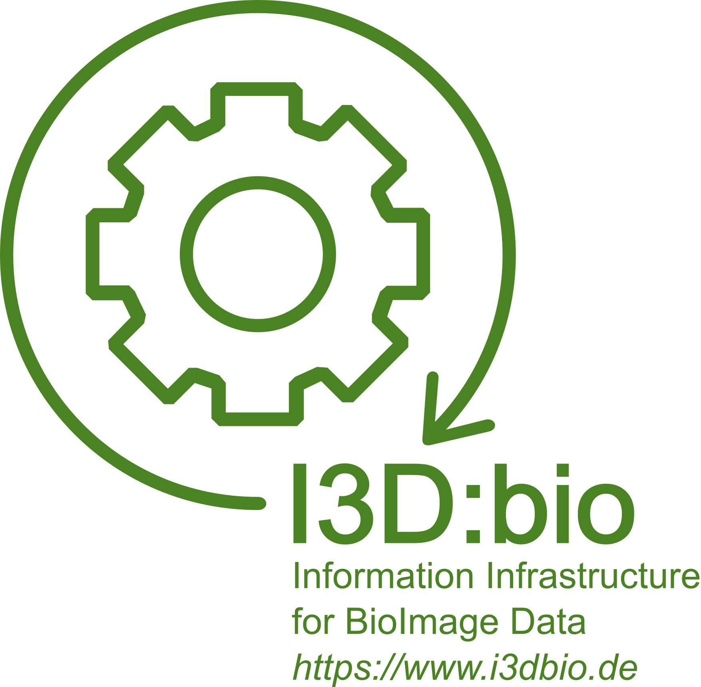
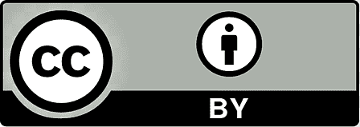
Managing FAIR microscopy data at scale for universities and research institutions: an introduction for non-imaging stakeholders
Christian Schmidt¹, Michele Bortolomeazzi², Ksenia Krooß³, Jan-Philipp Mallm², Elisa Ferrando-May¹, Stefanie Weidtkamp-Peters³
1 Enabling Technology Department, German Cancer Research Center (DKFZ), Heidelberg
2 Single-cell open Lab, German Cancer Research Center (DKFZ), Heidelberg
3 Center for Advanced Imaging (CAi), Heinrich Heine University Düsseldorf
With the exception of the used logos, and unless marked otherwise, the content of these slides is published under the terms of the Creative Commons Attribution 4.0 License (CC-BY) (http://creativecommons.org/licenses/by/4.0)
Zenodo DOI: 10.5281/zenodo.15026373

Slide 2

Introduction
Ksenia Krooß:
  Center for Advanced Imaging at the Heinrich Heine University Düsseldorf
  Biologist (plant science)
  Data Steward in NFDI4BIOIMAGE
Michele Bortolomeazzi:
  DKFZ German Cancer Research Center, Heidelberg
  Biologist/bioinformatician (cancer research)
  Staff member of NFDI4BIOIMAGE, OMERO administrator at the DKFZ
Christian Schmidt:
  DKFZ German Cancer Research Center, Heidelberg
  Biologist (immunology, cell biology, biochemistry), science manager
  Project coordinator of NFDI4BIOIMAGE and I3D:bio

Slide 3
Slido
Let‘s get to know each other:
What is your background?
What is your current job/profession?

Slide 4
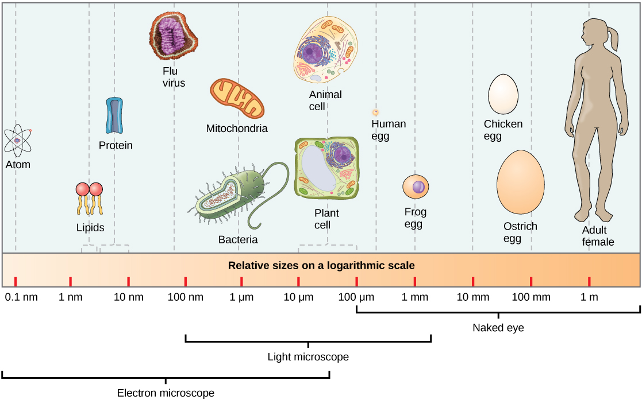
Bioimaging and its role in research
Super-resolution microscopy
Mesoscopy, Light sheet microscopy, etc
Modified after: Samantha Fowler, Rebecca Roush, James Wise, OpenStax, Concepts of Biology, Apr 25, 2013, Houston, Texas
Access for free at https://openstax.org/books/concepts-biology/pages/1-introduction
Reused under the terms of the CC-BY 4.0 license: https://creativecommons.org/licenses/by/4.0/

Slide 5
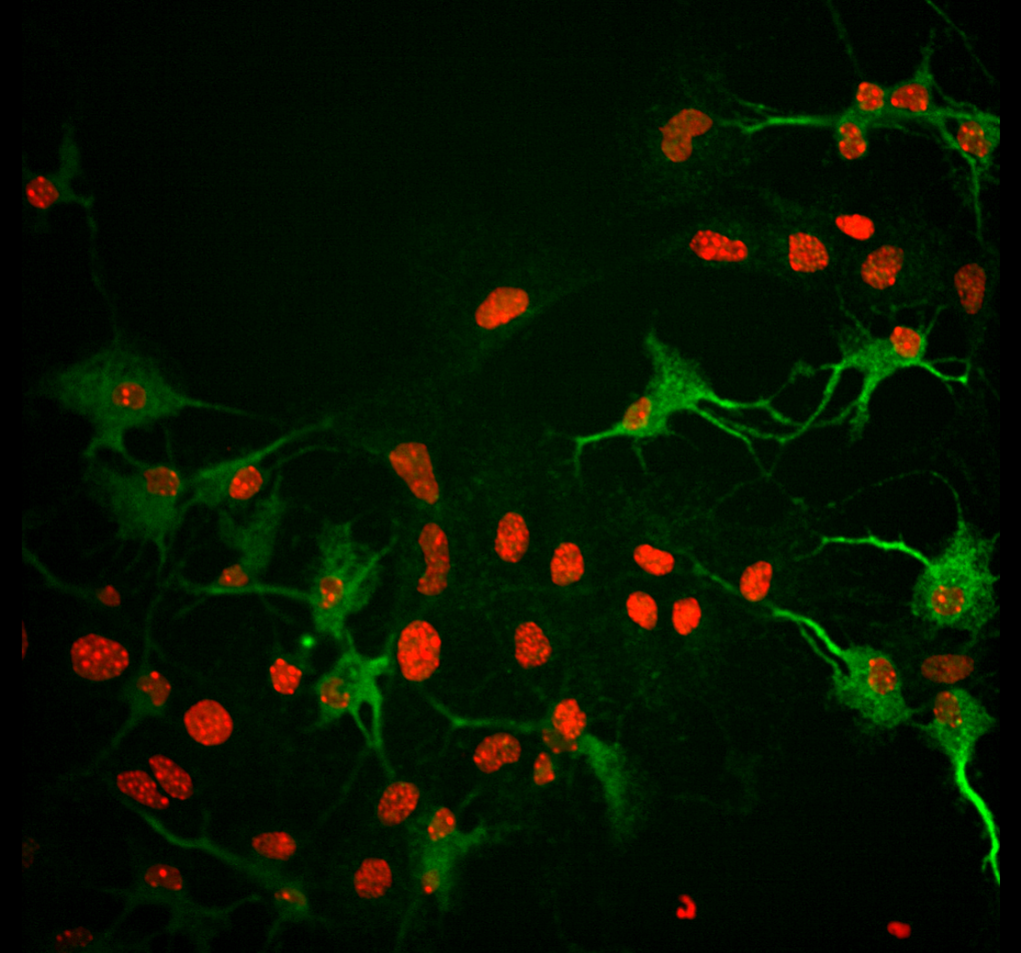
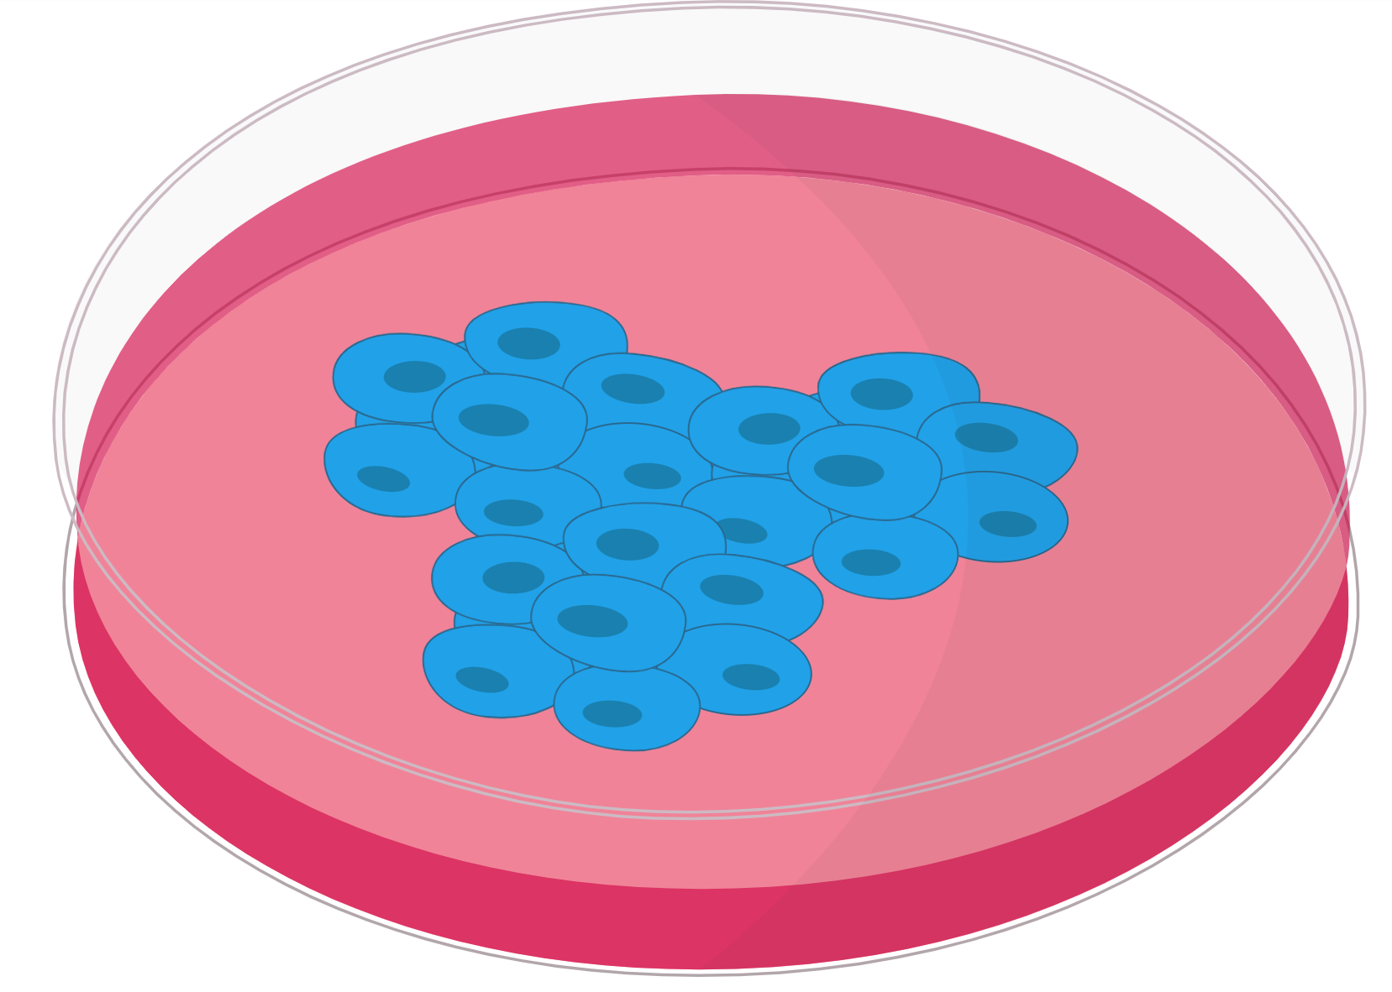
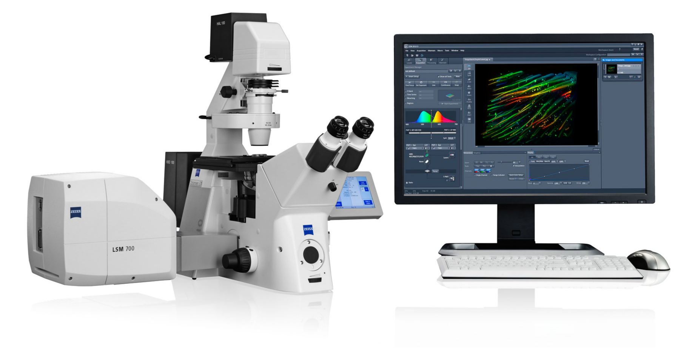
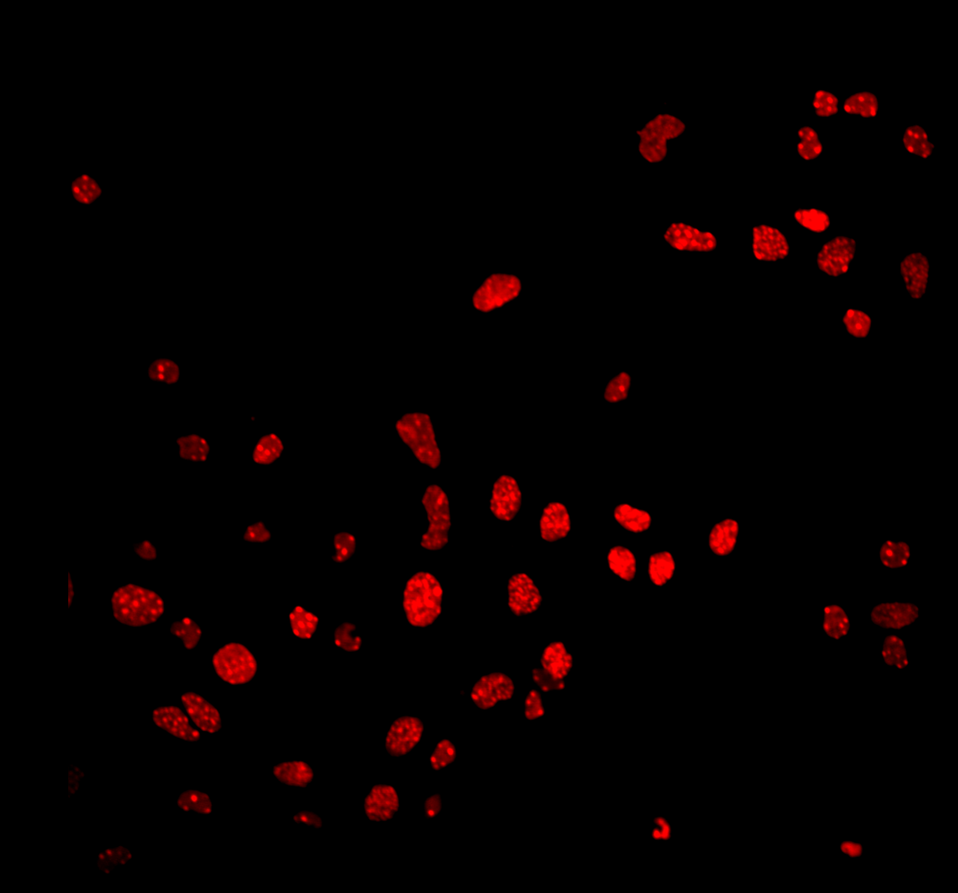
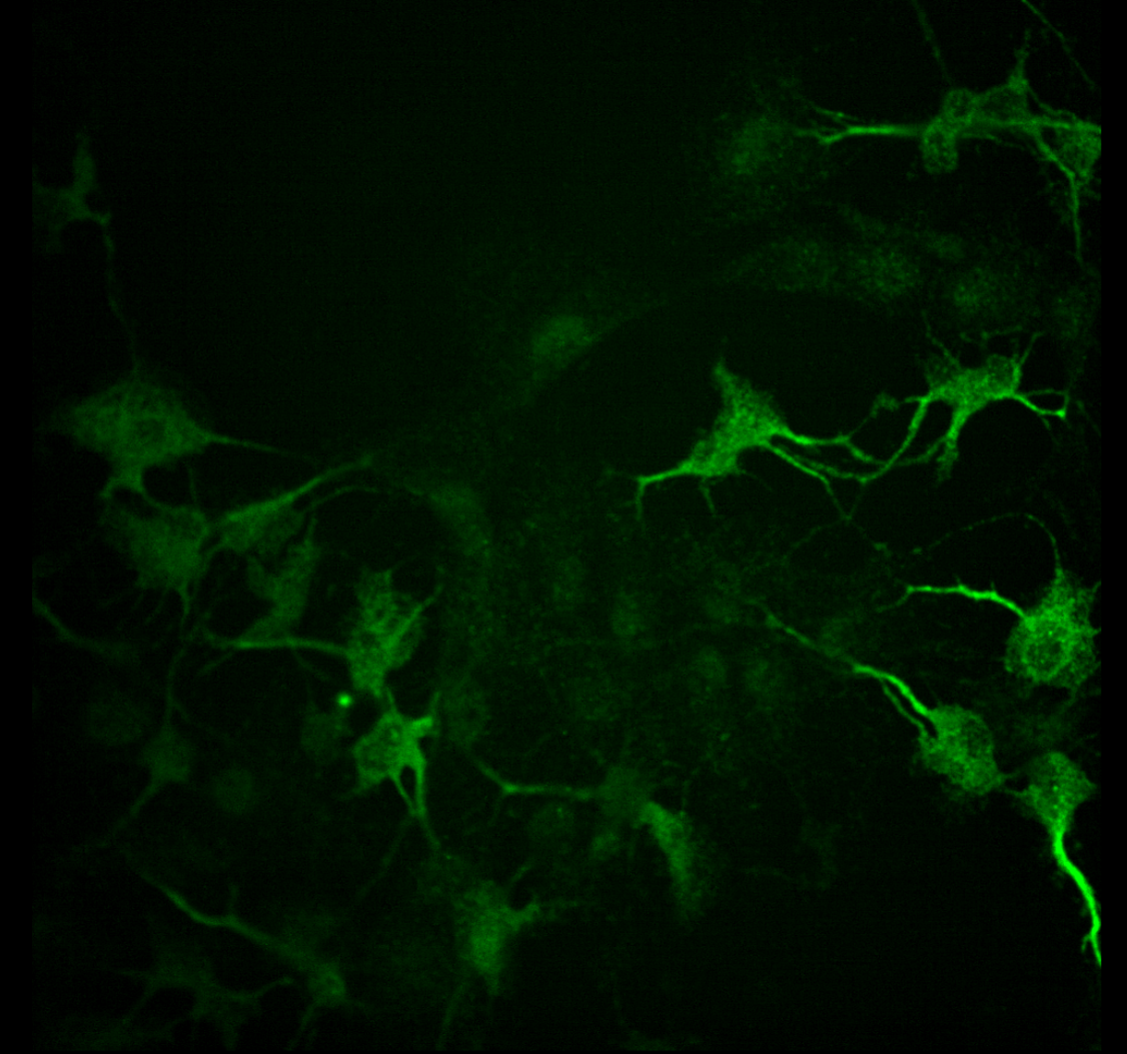
Bioimaging and its role in research
Preparation, staining, etc
~ µm to mm scale
A laser scanning confocal microscope
Image by Zeiss Microscopy on Flickr, https://www.flickr.com/photos/zeissmicro/6908567127
reused under the CC-BY-SA license, https://creativecommons.org/licenses/by-sa/2.0/
De Vos, 2019, BioImage Archive, https://www.ebi.ac.uk/biostudies/BioImages/studies/S-BIAD7
glassslideflat icon by Servier https://smart.servier.com/ is licensed under CC-BY 3.0 Unported https://creativecommons.org/licenses/by/3.0/
stem_cell_colony icon by Marcel Tisch https://twitter.com/MarcelTisch is licensed under CC0 https://creativecommons.org/publicdomain/zero/1.0/

Slide 6
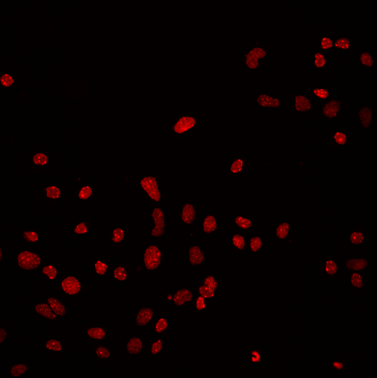
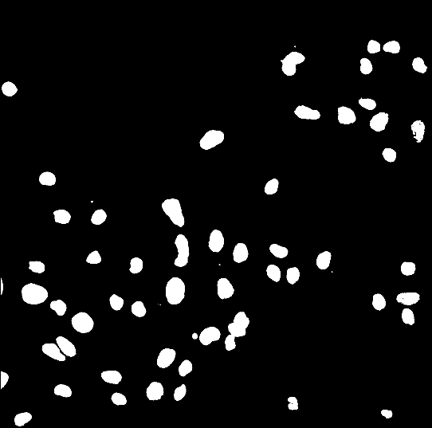

Bioimaging and its role in research
Image Acquisition
X
Image processing and analysis
Y
A laser scanning confocal microscope
Ch 1
Ch 2
Count the number of objects
Quantify the area
Measure cell shapes
Measure the fluorescence intensity of other channels
Etc…
*
→ Statistical evaluation and presentation of the results
X: 816; Y: 1037; Ch1: Intensity = 1991; 16-bit

Slide 7
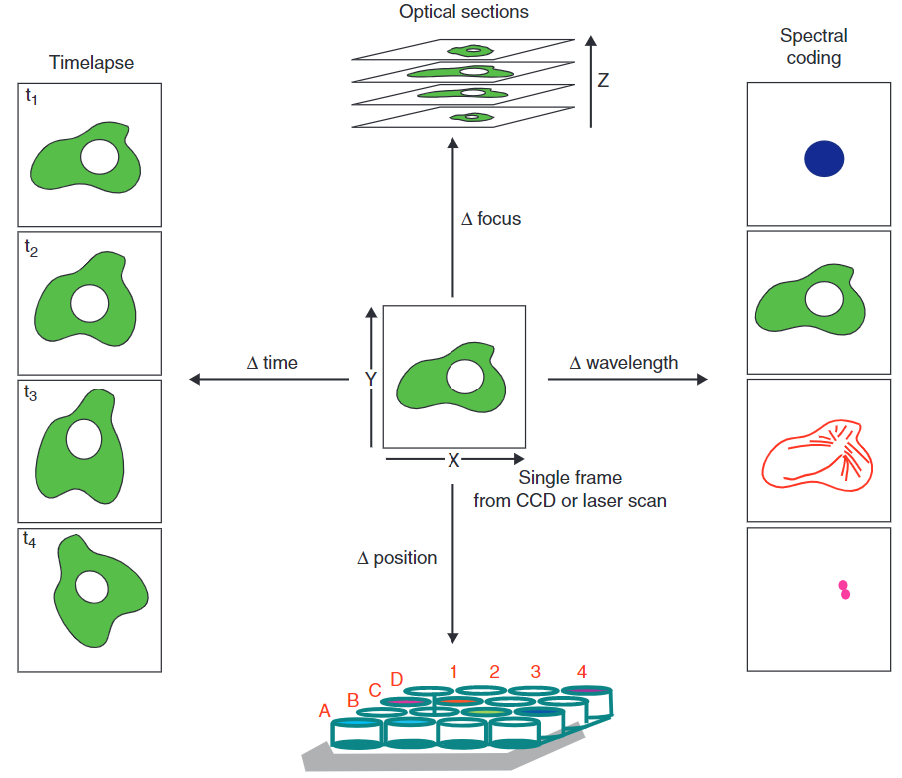
Schematic of bioimage data
X and Y dimension
+ channel dimension
→ 3D image
X and Y dimension
+ channel dimension
+ time dimension
+ Z stack dimension
→ 5D image
→ Very complex in its structure (N-dimensional arrays)
Often very large file sizes (GB to TB range)
Often in proprietary, vendor-owned file formats
No standard metadata attached
Goldberg et al., 2005, Genome Biol, doi: 10.1186/gb-2005-6-5-r47

Slide 8
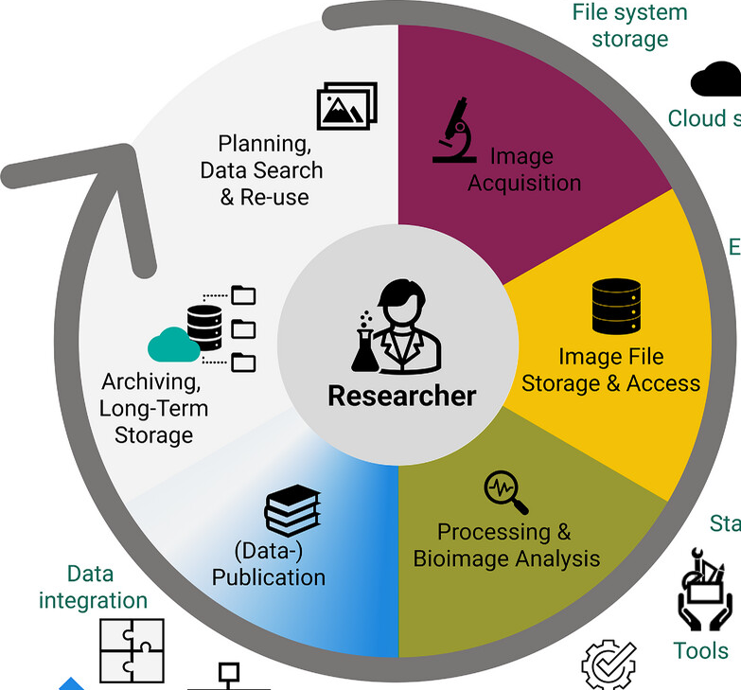
The bioimage data life cycle
Findability, access regulations, reusable workflows and microscopy-based assays
Sample preparation, instrument setup and QC,
Image acquisition campaign
Storage space and file organization,
Tracing metadata provenance
Internal archives vs. Public repositories
Integration of image data into figures, best practices for representation,
Sharing original underlying data
Point-and-click Software vs. automated workflows, reproducibility of steps and pipelines
Schmidt, C., Boissonnet, T., Dohle, J., Bernhardt, K., Ferrando-May, E., Wernet, T., Nitschke, R., Kunis, S., & Weidtkamp-Peters, S. (2024). A practical guide to bioimaging research data management in core facilities. Journal of Microscopy,. https://doi.org/10.1111/jmi.13317

Slide 9
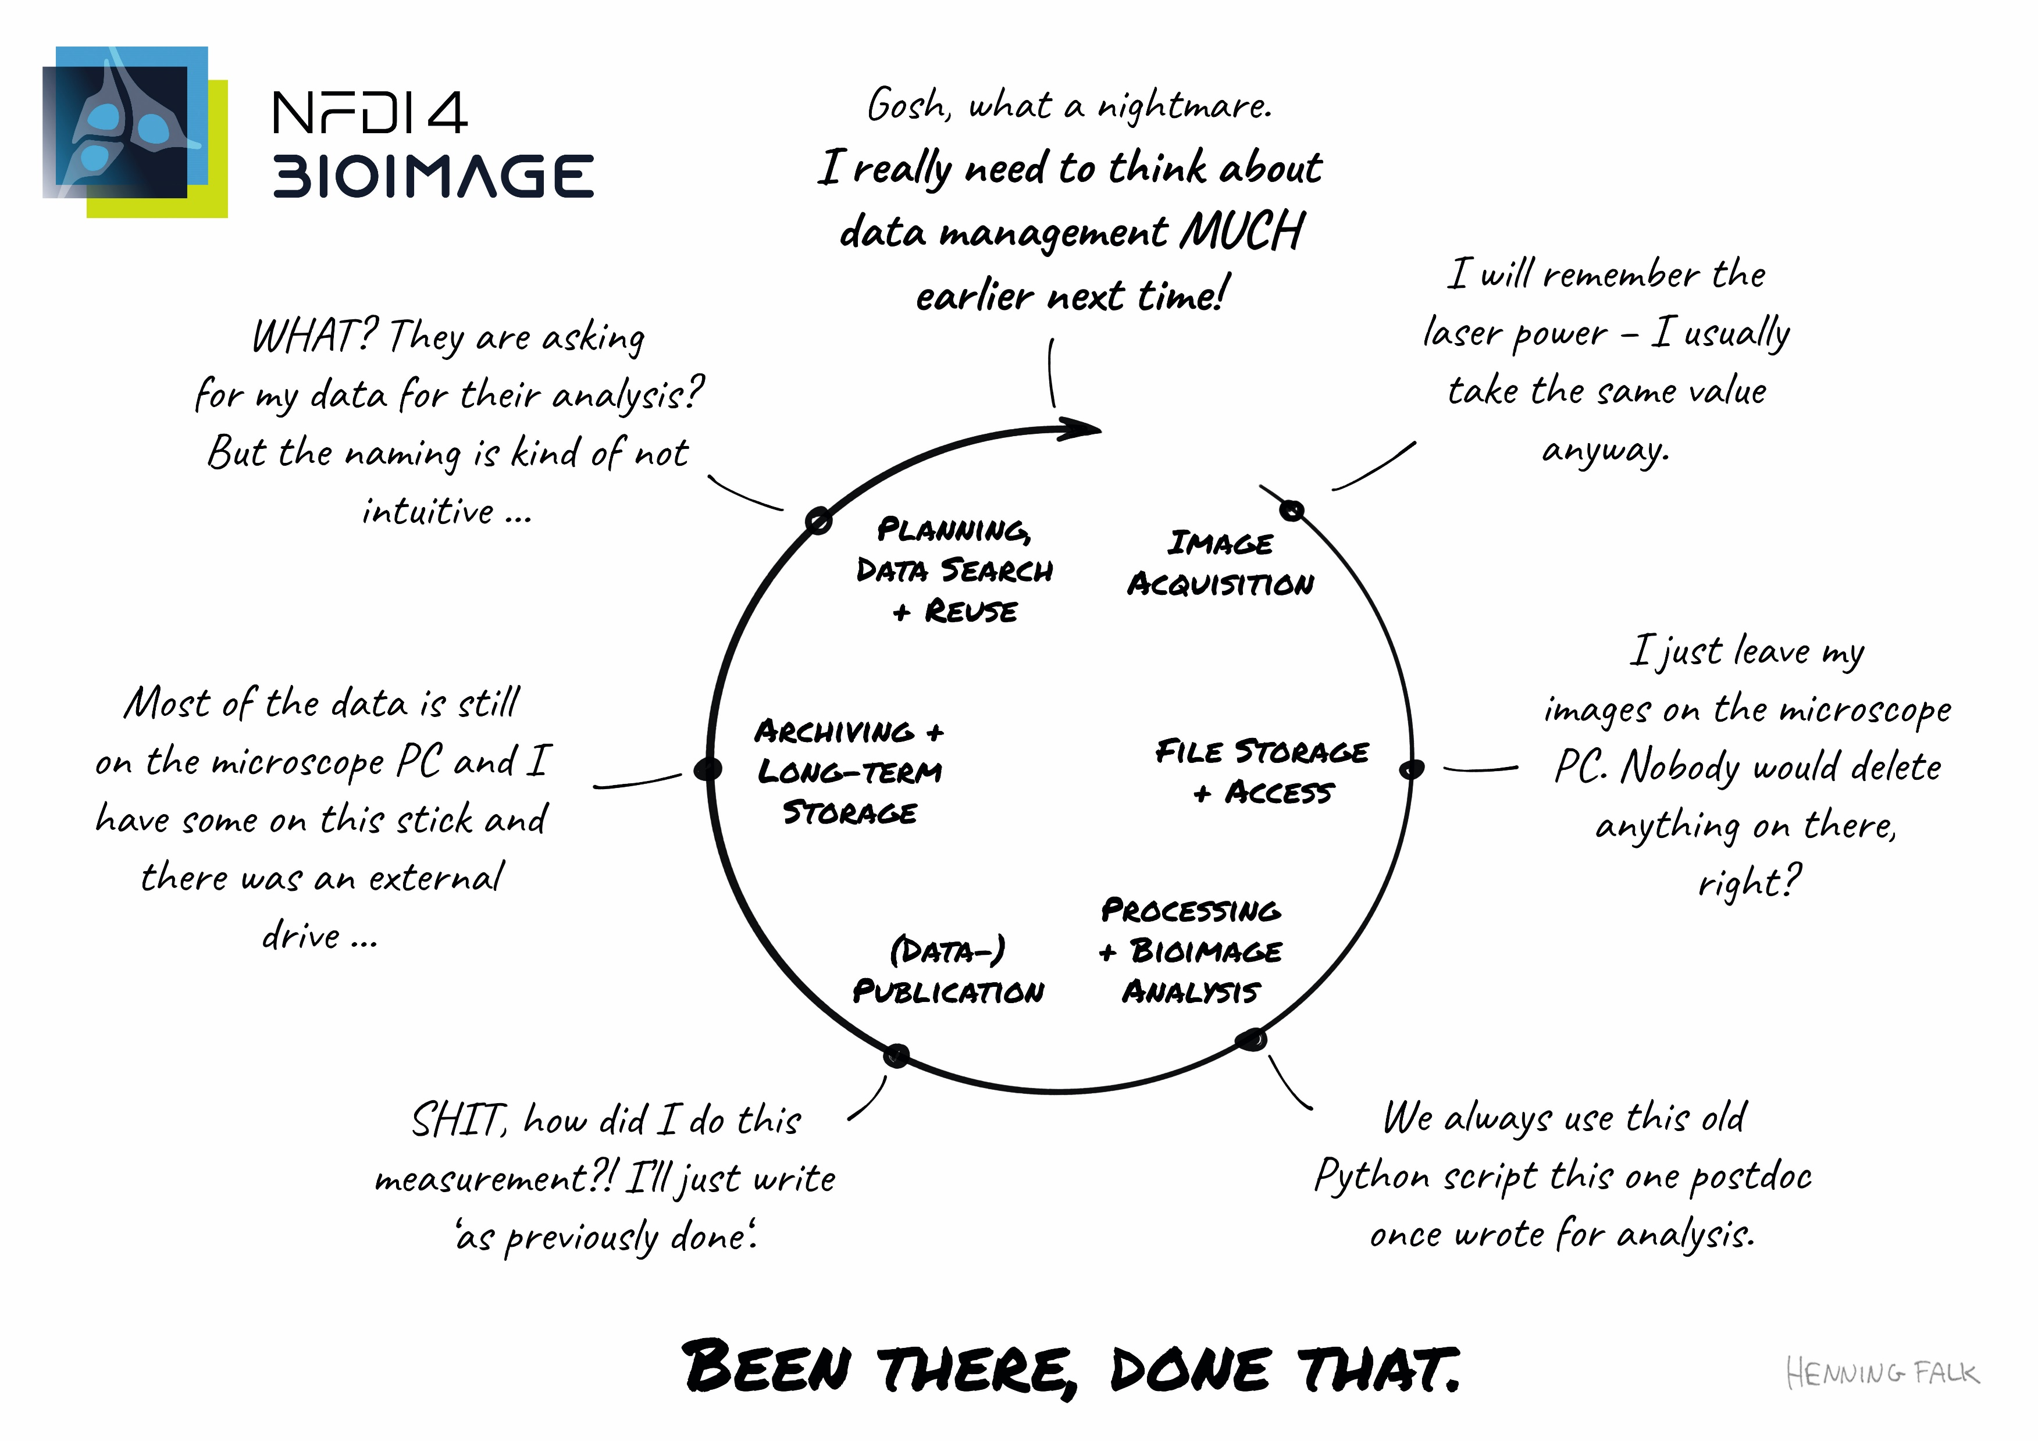
The bioimage data life cycle???
“Image Data life cycle", NFDI4BIOIMAGE Consortium (2024): NFDI4BIOIMAGE data management illustrations by Henning Falk, Zenodo, https://doi.org/10.5281/zenodo.14186100, is used under a CC BY 4.0 license.

Slide 10



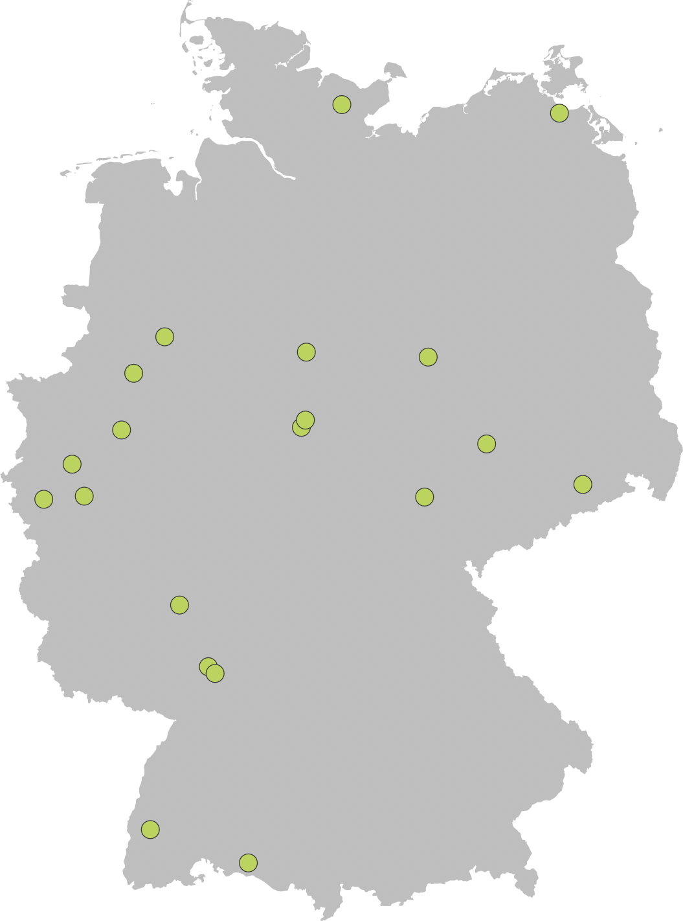






(Inter)national collaboration is key to RDM

Slide 11
Collaboration of different stakeholders
Microscopists / Core Facilities
Group leaders
Bioimage analysts and wet-lab scientists
Information Technology / Scientific IT
Libraries
RDM teams
Open science teams
(Data protection offices)
Legal offices (IP-rights?)
…

Slide 12
Goal for this workshop
Bring us closer together, learn from each other

Slide 13
Learning goals for you
Become familiar with the bioimaging data type and the specific challenges for microscopy data management
Know about OMERO as a data management tool and its major assets
Learn about Next-generation file formats for large N-dimensional array data, in particular, OME-Zarr for bioimaging
Learn about REMBI, the minimum metadata for microscopy data.
Findability for bioimaging: Where to deposit microscopy data?
Discuss potential for synergies and communication gaps between different stakeholders
Know who to contact with use cases in bioimaging RDM (NFDI4BIOIMAGE and I3D:bio)

Slide 14
Learning goals for us
Learn about your perspectives, insights, and advice

Slide 15


Acknowledgments
Contact
NFDI4BIOIMAGE Help Desk
Data Stewardship Team
https://nfdi4bioimage.de/help-desk
NFDI4BIOIMAGE
Coordination Office
Inga Mohr & Christian Schmidt
office@nfdi4bioimage.de
I3D:bio Help Desk
https://gerbi-gmb.de/i3dbio/i3dbio-help-contact/
NFDI4BIOIMAGE partners
I3D:bio
Collaboration partners
GerBI-GMB community
https://bsky.app/profile/nfdi4bioimage.bsky.social
https://nfdi.social/@nfdi4bioimage
https://www.linkedin.com/company/nfdi4bioimage/
Funded by the Deutsche Forschungsgemeinschaft (DFG, German Research Foundation) under the National Research Data Infrasstructure – NFDI 46/1 – 501864659
The NFDI4BIOIMAGE consortium comprises legally independent partners and does not act autonomously towards third parties. The authors represent the contributions from their respective affiliated institutions and work together for the project.

